Slide 1
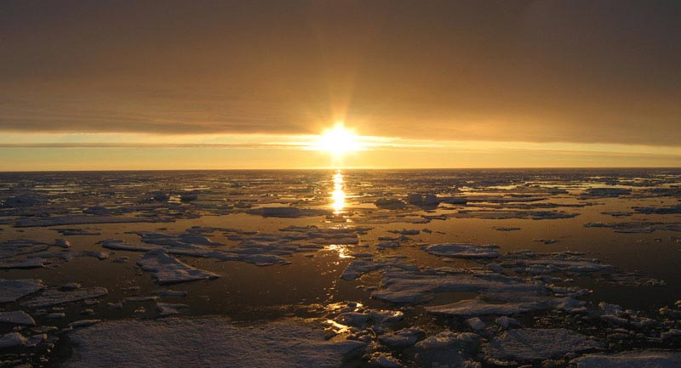
A New Metric for Cloud Properties
in a Nearly Ice-Free Arctic
Jennifer Francis
Dept. of Marine and Coastal Sciences
Rutgers University

Slide 2
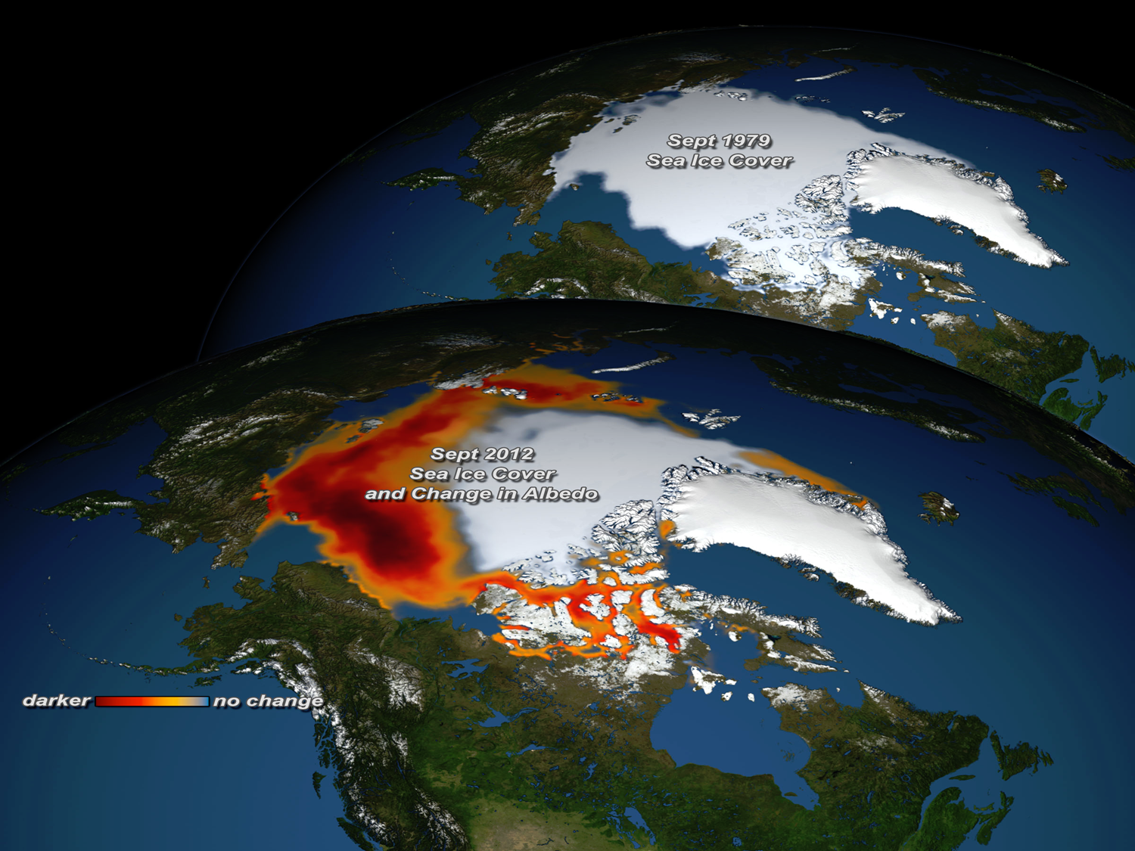

Summer
sea ice
1979
Arctic
sea ice is
vanishing
2012
Notes:
Energy absorbed. Global warming 25% larger. Arctic 2x warmer => more sea level rise

Slide 3
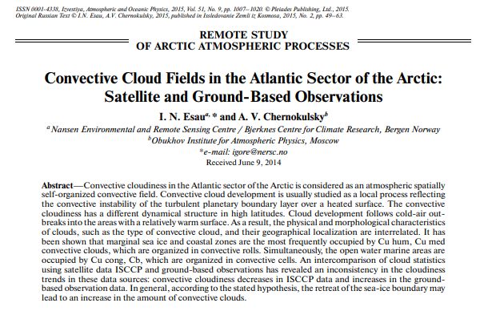

Slide 4
Simulated Arctic cloud fraction in October using MIROC5 model
Blue: 1976 – 1985 (high ice conditions)
Red: 1996 – 2005 (low ice conditions)
Right: change in cloud fraction
Height (sigma)
More mid-
level cloud
Less low
cloud
Abe et al, 2016

Slide 5
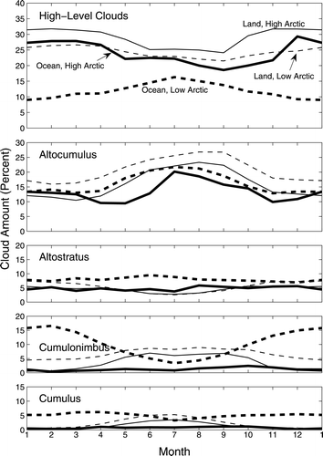
Observed Arctic cloud types:
Convective clouds over Arctic Ocean are uncommon, most prevalent in autumn.
Eastman and Warren 2010

Slide 6
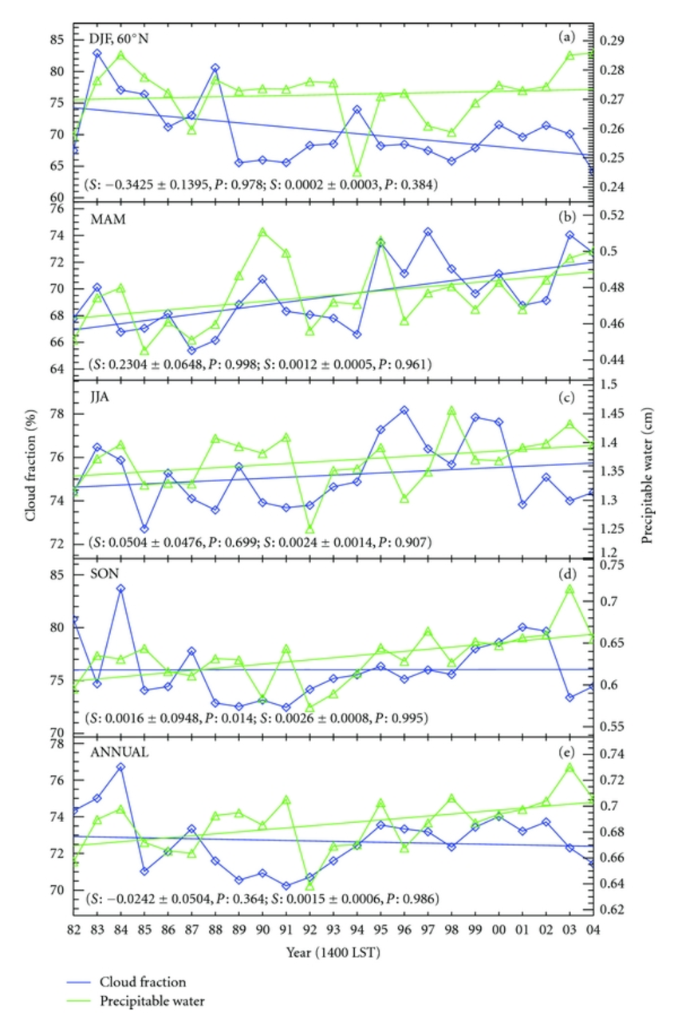
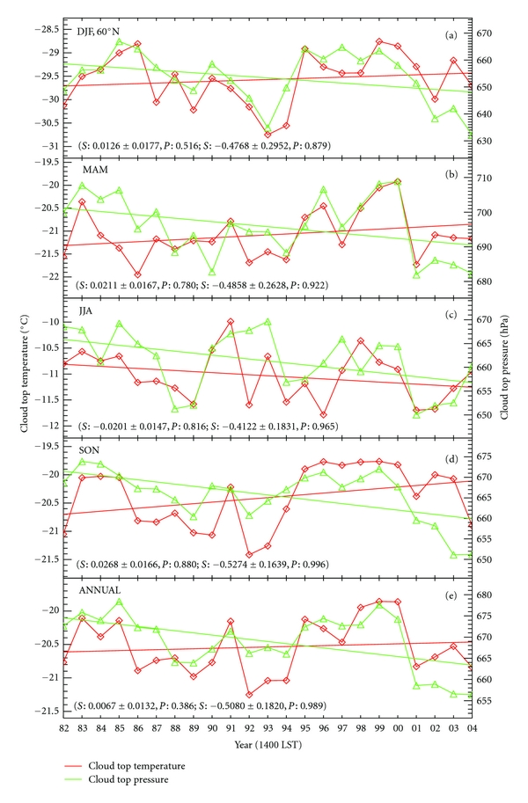
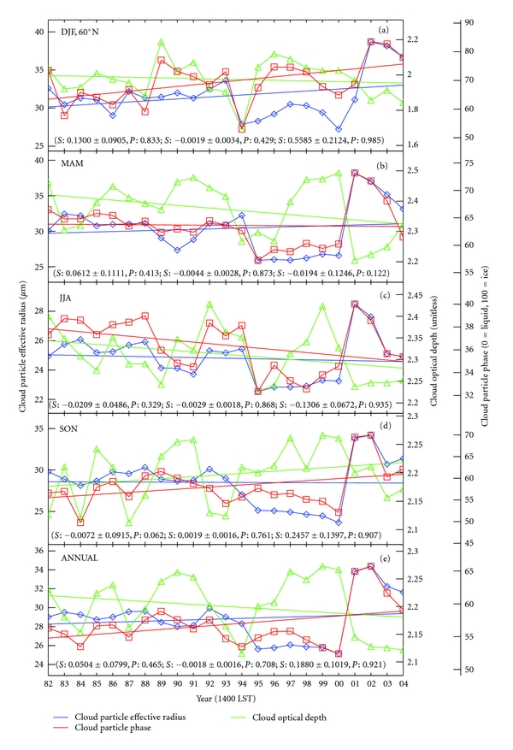
Cloud fraction, precipitable water
Cloud-top temperature, pressure
Effective radius, phase, τ
DJF
MAM
What a mess!
JJA
SON
ANN
We need a new metric…
Wang et al, 2012

Slide 7

Introducing…
the Ackermeter™ !

Slide 8
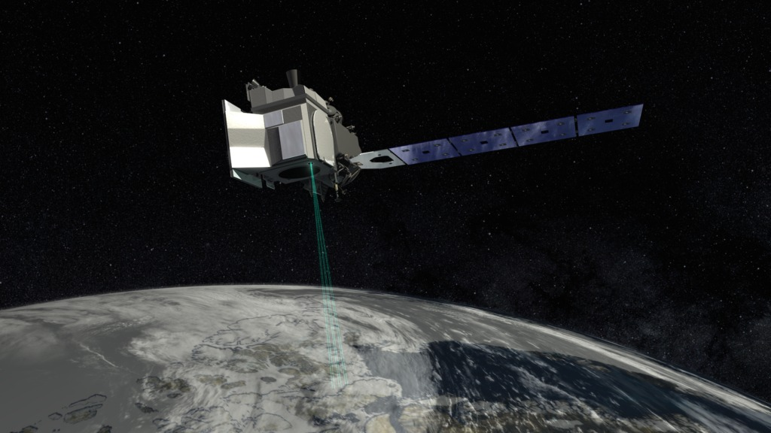
ICESat
A-mode

Slide 9
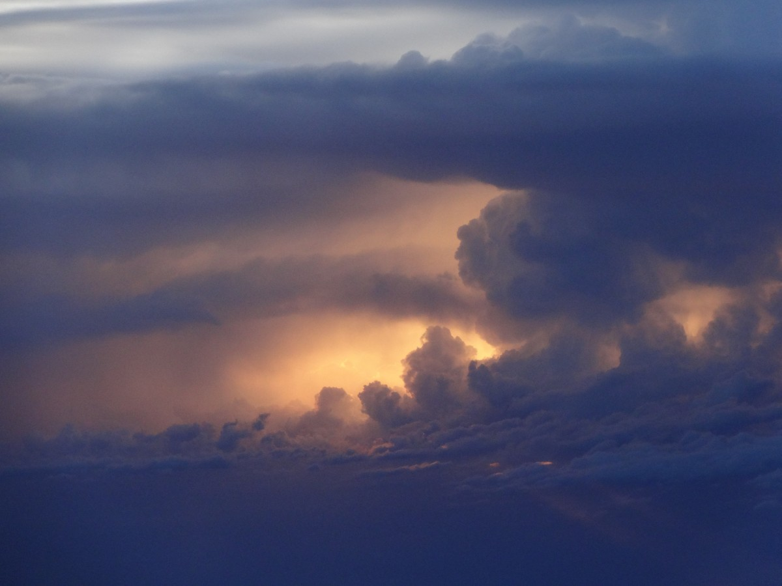
“The Ackermeter™ represents a long-overdue game-changer in observing Arctic cloud characteristics, destined to revolutionize our knowledge of the Arctic climate system.”
-- Dr. I. C. Myiguana

Slide 10
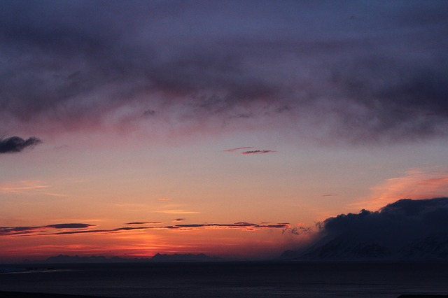
Ackermeter™ Attributes:
  14 pan-Arctic observations per day
  Unambiguous feature diagnosis
  Intuitive diagnostics
  Extendable to globe
  Straightforward validation
  Unique, synergistic results
  Units: Ack (# day⁻¹ 100 km⁻²)

Slide 11

But # of what???
Hint:
What makes cumulus clouds so cool?

Slide 12
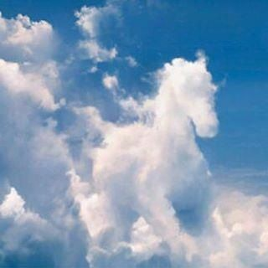
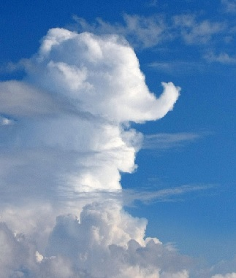
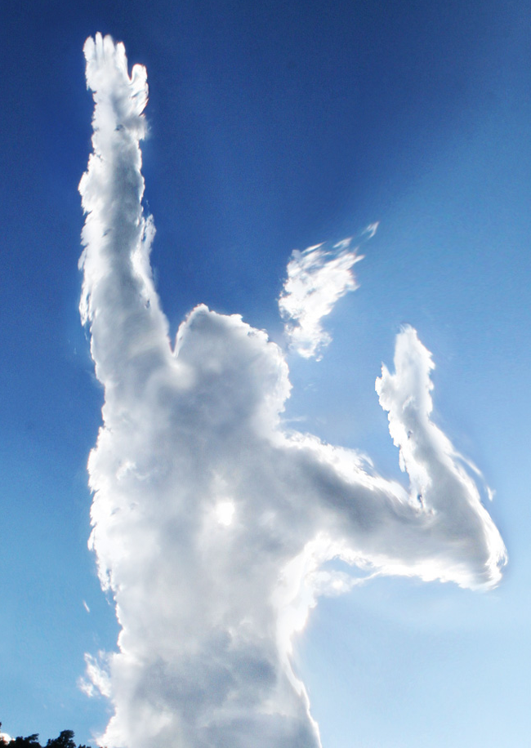
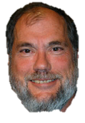

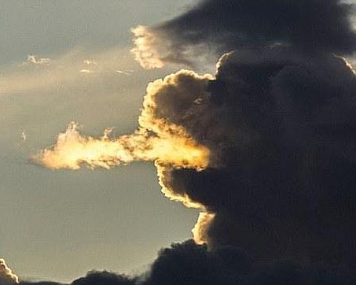

Slide 13
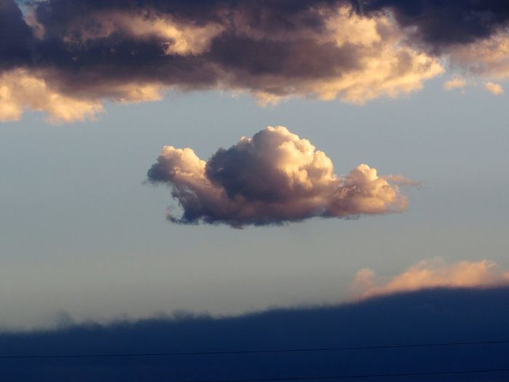
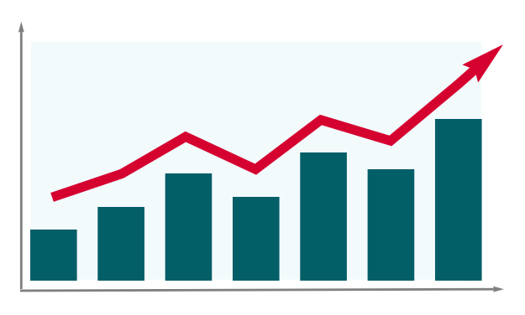
Preliminary findings:
1000
750
500
250
0
OCT
Arctic-Mean ACKs
2011 2012 2013 2014 2015 2016 2017

Slide 14
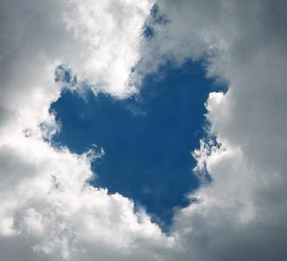
Thank-you
TOM
for your inspiration, guidance, encouragement, and friendship.
Now, get out there and enjoy retirement and your family!
francis@imcs.rutgers.edu

