Slide 1
Some Peculiar Ethics of Geoengineering
Stephen M. Gardiner
Professor of Philosophy &
Ben Rabinowitz Endowed Professor of the Human Dimensions of the Environment
Director of the Program on Values in Society
Department of Philosophy & Program on Values in Society
University of Washington, Seattle

Slide 3

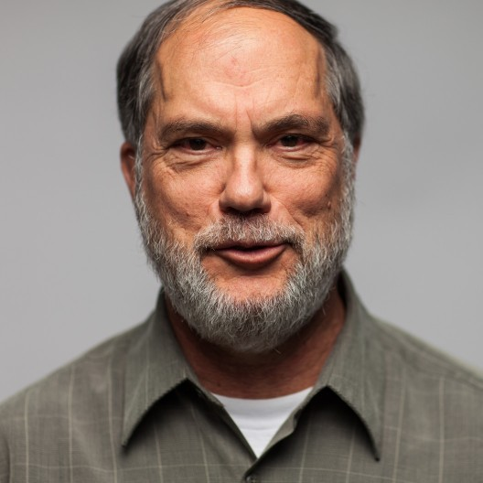

Slide 4
Part 1
Relevance of Ethics

Slide 5

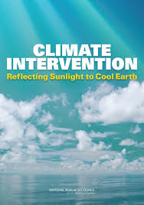
Background
‘Ethics’: include moral philosophy, political philosophy, legal theory, normative foundations/aspirations of economics
Strong emphasis in Royal Society (2009) and NAS (2015): importance for decision-making, and research priority
Early days for ethics as well as science
My focus is on SSI, as a paradigm case

Slide 6
“Steve, it should be MCB …”

Slide 7
Salient Values (An Incomplete List …)
Welfare (e.g., benefits/harms of geoengineering)
Justice (e.g., procedural, distributive; international, intergenerational, across species)
Rights (e.g., national self-defense; sovereignty; individual protections)
Relationship with nature (e.g., less intrusive interventions)
Intention (e.g., doing vs. allowing)
Responsibility (e.g., compensation; rectifying injustice)
Precaution (e.g., catastrophe avoidance)
Virtue and vice (e.g., hubris, recklessness, inflicting tragic choices)
Political legitimacy (e.g., unilateral, multilateral, the desperate)
Control & Domination
(Examples: Gardiner 2010 [6, 8, 9], 2011 [2, 4], 2013 [3, 10]; Elliott 2011 [7]; Hartzell-Nichols 2012 [7]; Morrow et al. 2013 [9]; Morrow 2013 [5]; Smith 2012 [10]; Svoboda et al. 2012 [2]; Whyte 2012 [3])

Slide 8
Part 2
Some Misleading Early Framings

Slide 9
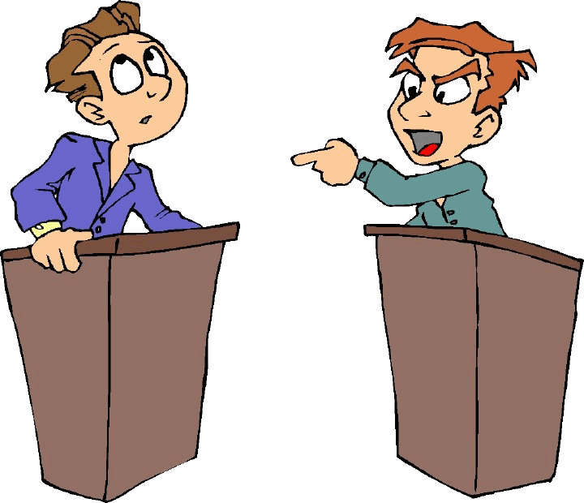
(1) “Two Camps” Framing: ‘Geoengineering: For or Against?’
Scepticism (about the question):
No one favors geoengineering under just any circumstances, for just any reason. Examples:
Sun always shines on Her Majesty
consensus against deployment now
(2) Most can imagine accepting geoengineering under at least some (perhaps highly unusual and demanding) circumstances

Slide 10
“But Steve’s against it, right?”

Slide 11
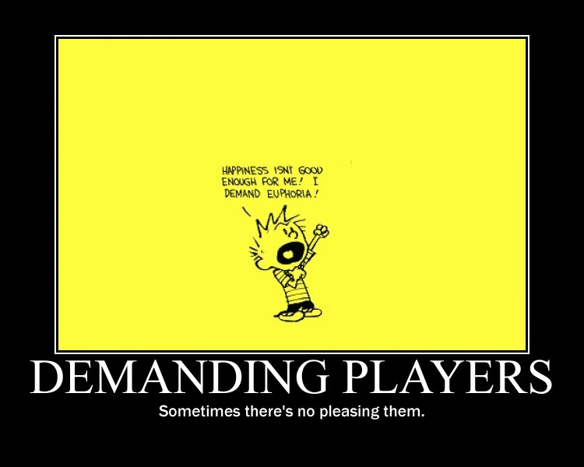
(2) Portfolio Framing?
“Every tool in the toolkit”
Misleading:
not everything is in the portfolio that could be (e.g., “one child”, retrenchment)
Begs the question:
many things are out for ethical reasons
some think forms of SSI should be too

Slide 12
“Whatever. … MCB’s in the toolkit, right?”

Slide 13
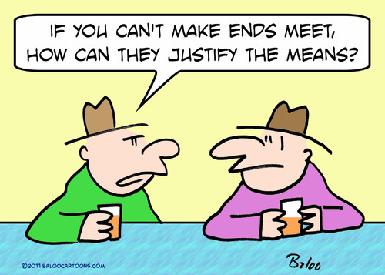
Two Better Questions
Justificatory Q: ‘Under what conditions do you think geoengineering might become justified?’
… including (for example):
threat to be confronted
background circumstances (e.g., poverty, global structures)
governance mechanisms needed (e.g., consultation, collective decision-making)
compensation provisions
protections for individuals, etc.
(2) Contextual Q: ‘How relevant are those conditions to the world we live in, or one that may plausibly emerge in the foreseeable future?’

Slide 14
Part 3
Justificatory Question

Slide 15

(1) Welfare: Universal Benefit?
Empirical challenges:
SSI as risky
Descriptively implausible for SSI as such
Extremely demanding for any form of SSI on global, intergenerational scale

Slide 16
Theoretical challenges:
Simplistic proxies? (e.g., precipitation, temperature)
Ethically implausible requirement:
too strong
too weak (e.g., other values, such as rights and justice)

Slide 17
(2) Welfare: “Better than Catastrophe”?
Too easy?
Disguise much that is at stake (e.g., radical procreative policies, genocidal SSI)
How low can you go? (e.g., carbon dictatorship; slave-state SSI)

Slide 18
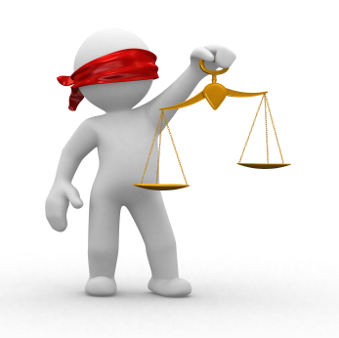
Interim Conclusion
Need a more specific and sophisticated standard than the generic “universal benefit” or “better than catastrophe” framings
& one that pays attention to concerns other than welfare
work for ethics, broadly conceived (philosophy, political theory, legal theory, etc.)

Slide 19
(3) Justice
Distributive (e.g., “winners and losers”)
Procedural (e.g., “whose hand on the thermostat?”)
Recognition
Foundational questions:
how to register appropriate concern for future people, nonhuman animals,
especially given that they are not around to represent themselves

Slide 20
(4) Some Other Values …
Non-domination
Responsibility:
what would would-be climate manipulators owe those under their yoke?
Human relationship with the rest of nature
responsibilities to the nonhuman
profound politicization of nature
thought-control analogy

Slide 21
Part 4
Contextual Question

Slide 22
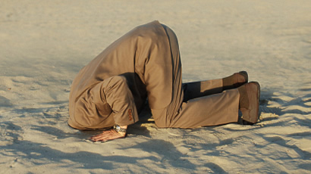
Avoiding the Contextual Question?
CQ:
‘How relevant are the justificatory conditions identified to the world we live in, or one that may plausibly emerge in the foreseeable future?’

Slide 23
‘How relevant are the justificatory conditions identified to the MCB funding that I can get now, or that might plausibly emerge in the foreseeable future?’

Slide 24
Avoiding the Contextual Question?
CQ:
‘How relevant are the justificatory conditions identified to the world we live in, or one that may plausibly emerge in the foreseeable future?’

Slide 25
Step 1: Context of Failure
40% increase since 1990

Slide 26
Some Basic Contextual Concerns
“technological imaginaries”
ethical imaginaries
e.g., legitimate and just, global, intergenerational institutions
competing standards:
ethically attractive, minimally decent, “tolerably” indecent, beyond the pale
lingering political inertia

Slide 27
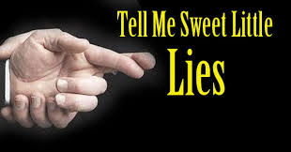
In Short …
Internal Pressure
Political inertia
How that restricts the realm of social feasibility
A paradoxical question …

Slide 28

A Paradoxical Question …
“What are we ethically obliged to do given that we have not done, and will continue not to do, what we are ethically obliged to do?”
Context of ethical failure
Unease
reflected in concerns about moral hazards, slippery slopes, techno-fixes that do not address the core problem, moral schizophrenia, etc.
Ethical responsibilities of scientists

Slide 29

1st Case: Agent 1
Engaged in activities that he morally ought not to be engaged in.
Has a large number of options available to him to address the situation.
When these are ranked according to strong moral values he acknowledges, he faces a set of possible responses, from A-Z, where A is the best and Z the worst.
Despite recognizing A as the best option, Agent 1 nevertheless refuses to take it, but offers no very serious - let alone adequate - reason for doing so (moral or otherwise).
Indeed, Agent 1 will not consider any of the good or decent options put in front of him, and neither will he consider the best of the more flawed alternatives. Instead, he rejects every option suggested from A-X, and (again) without serious grounds for doing so.

Slide 30
Agent 1 (cont.)
Nevertheless, Agent 1 is not quite comfortable doing nothing; instead, he is willing to consider options Y and Z (and only these). Y and Z are pretty bad options (though not necessarily inherently morally bad, or absolutely prohibited). In particular, though it is possible that Y and Z may help a lot, they also bring with them very serious risks, including a realistic threat that they may make matters much worse.
However, Agent 1 claims that, since Y and Z are (arguably) better than nothing, his pursuit of them is entitled to some moral respect, and that (therefore) he deserves some praise for being open to, and then ultimately choosing, one of these options.
In particular, he cannot understand why some are so keen to criticize him for focusing on Y and Z. Indeed, he protests: “Can’t people see that not doing Y and Z might result in a catastrophe that we should desperately try to avoid?”, and “Why (then) can’t they stop being fussy about the “ethics” of the situation, and support a solution that might actually help?”

Slide 31
‘Will Agent 1 give me any money for MCB?’

Slide 32
Part 5
A Key Intergenerational Threat

Slide 33
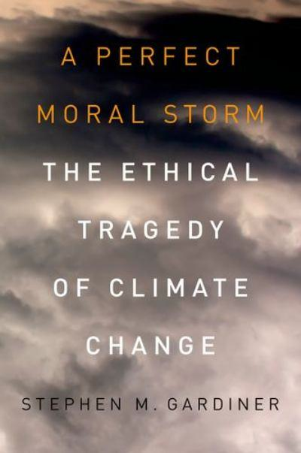
Context: A Perfect Moral Storm
Strong temptations for the current generation of the most affluent to behave badly, passing the buck to the future, poorer people, nonhuman nature
Lack adequate institutions and theories to defend against those temptations
Situation is ripe for abuse, including in how we think and talk about the issue (problem of moral corruption)
Manifest in other areas of climate policy.

Slide 34
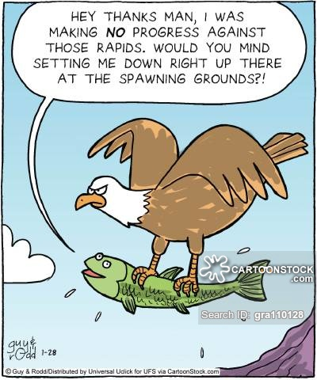
Key Threats: Selection Bias
Predatory geoengineering:
e.g., interventions aimed at illegitimately setting back the interests of geopolitical rivals
Parochial geoengineering:
e.g., short-term geoengineering “fixes” on behalf of the current generation, without regard to the long-term consequences for future people (of one’s own nation as well as others)
Instance?
Previous emphasis on SSI at the expense of CDR?

Slide 35
Ethics (moral, political, legal, economic philosophy) is highly relevant to SSI
There are a large number of highly salient concerns (including welfare, justice, political legitimacy)
Early framings (e.g., “every tool”, universal benefit) often marginalize these
SSI raises important questions of justification (e.g., compensation, rights), and calls out for meaningful ethical standards to apply to geoengineering interventions
Since it is widely held that SSI has become a serious option mainly because of political inertia, there are also important contextual issues, especially around the paradoxical question
Taking the contextual issues seriously (e.g., perfect moral storm analysis) helps to highlight some central threats (e.g., parochial geoengineering), and to explain why some regard SSI as so ethically troubling

Slide 36
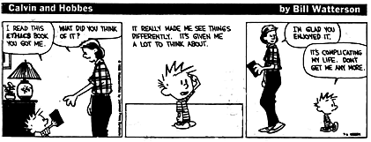

Slide 37
‘Will Agent 1 give me any money for MCB?’

