Slide 1


Earth Observations from 1 mln Miles or
Earth Observations from the Sun-Earth Lagrangian Eye
Alexander Marshak (NASA GSFC)

Slide 2

Tom and Lobsters
Got there
June 10, 2015
Gordon Meeting, New London, NH, 2013

Slide 3
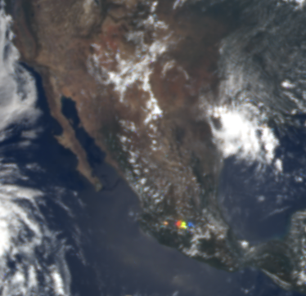
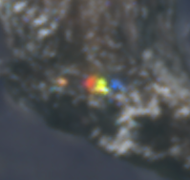
Beautiful Lights: July 4th, 2018
Got there
June 10, 2015
zoom
https://epic.gsfc.nasa.gov/archive/natural/2018/07/04/png/epic_1b_20180704190006.png

Slide 4
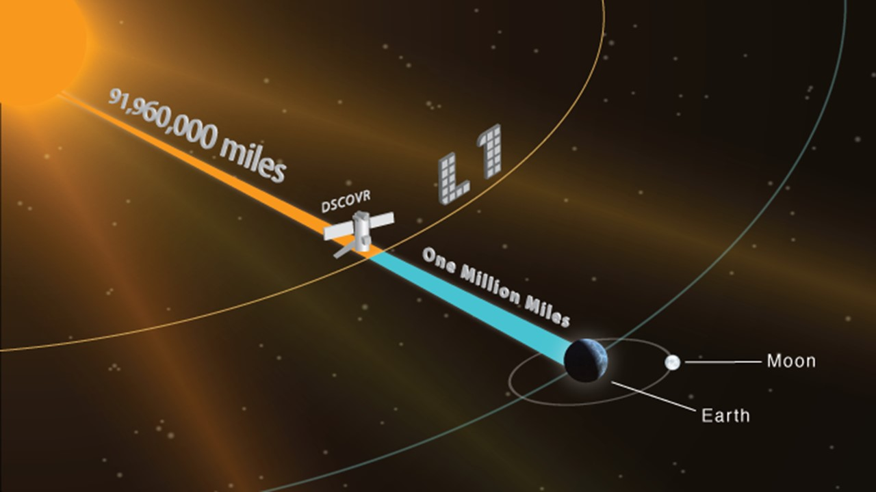
DSCOVR at Lagrange-1
Got there
June 10, 2015
DSCOVR resides at the L1 point a million miles from Earth. The Lagrange points mark positions where the combined gravitational pull of the two large masses provides the centripetal force required to orbit them. The spacecraft may be “parked” there to make observations.
Notes:
The Sun-Earth first Lagrange point 1 million miles upstream of Earth is a unique and new vantage point for Earth science studies. (L1 is four times further than the orbital radius of the Moon. DSCOVR will not sit precisely at L1. Solar radio emissions would prevent communication with the spacecraft. We will orbit around L1 that will take us to Sun-Earth-S/C angles of 4-15 degrees.)

Slide 5
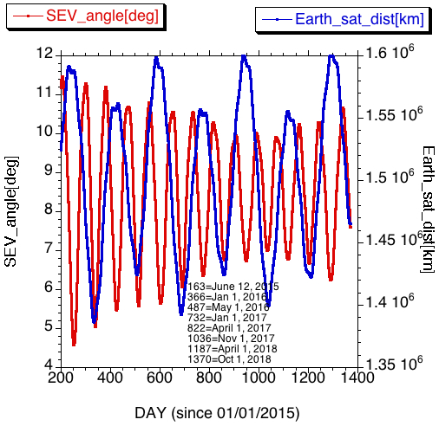
Lissajous Orbit
Sun Earth Vehicle (SEV)
July 14; 18:00 GMT:
1292 day since 01/01/2015
dist. from Earth = 1.6007 10⁶ km
SEV = 6.2º; Scat. angle = 180º-SEV = 173.8º
Velocity = 0.220 km/sec

Slide 6
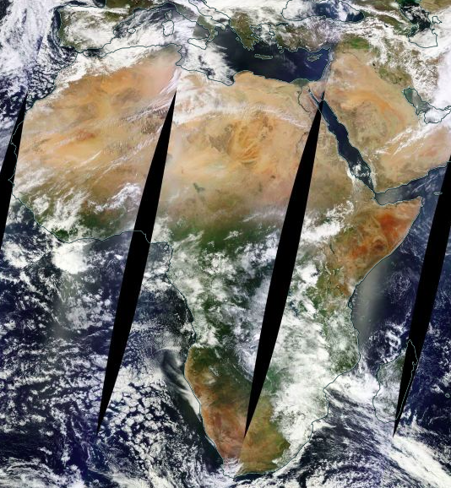

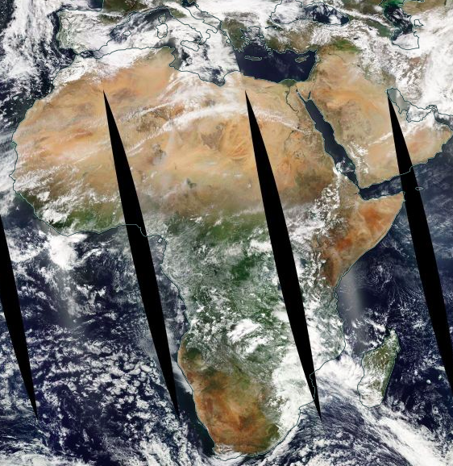

MODIS/Terra&Aqua and EPIC/DSCOVR
MODIS Terra
10:30 equatorial crossing time
EPIC
10:56 UTC
MODIS Aqua
13:30 equatorial crossing time

Slide 7
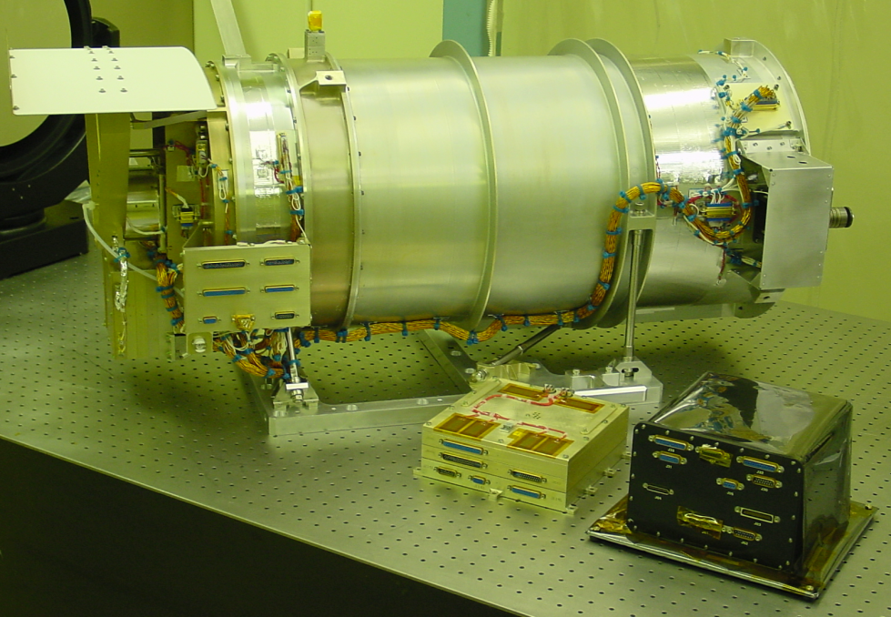
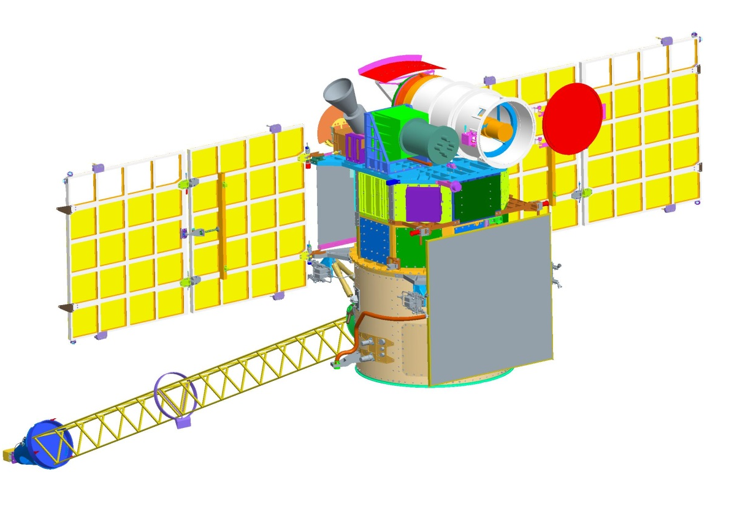
Earth Polychromatic Imaging Camera (EPIC)
2048 x 2048 pixel CCD;
8 km pixel size;
10 spectral bands: from 317 to 780 nm
One full set of images
13/day in winter
22/day in summer

Slide 8
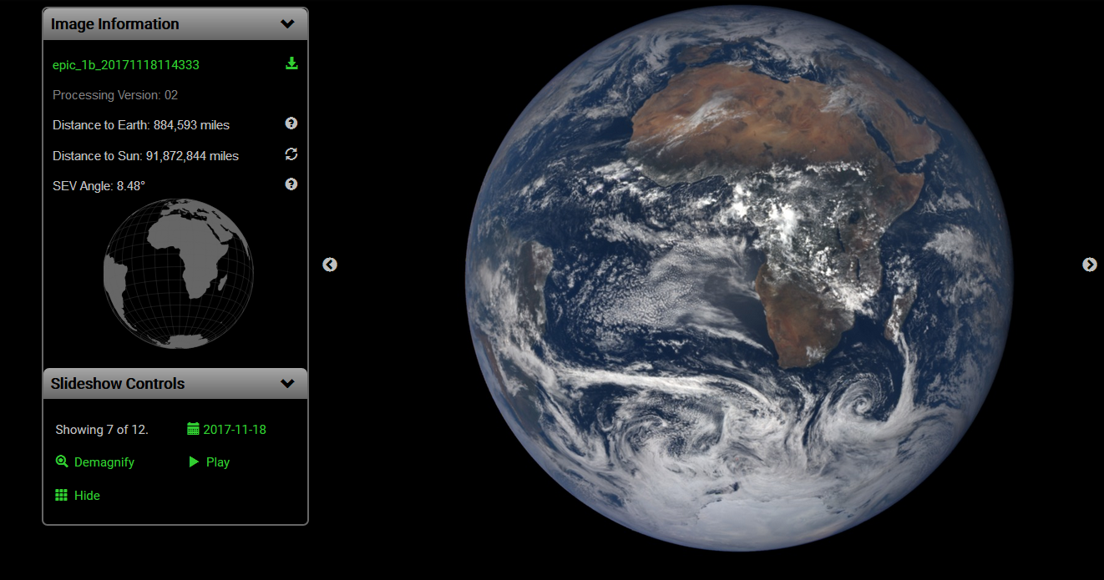
DSCOVR: EPIC (Earth Polychromatic Imaging Camera)
https://epic.gsfc.nasa.gov/
EPIC delivers hourly observations of the entire sunlit face of the Earth. Many images contain unexpected bright flashes of light over both ocean and land.

Slide 9
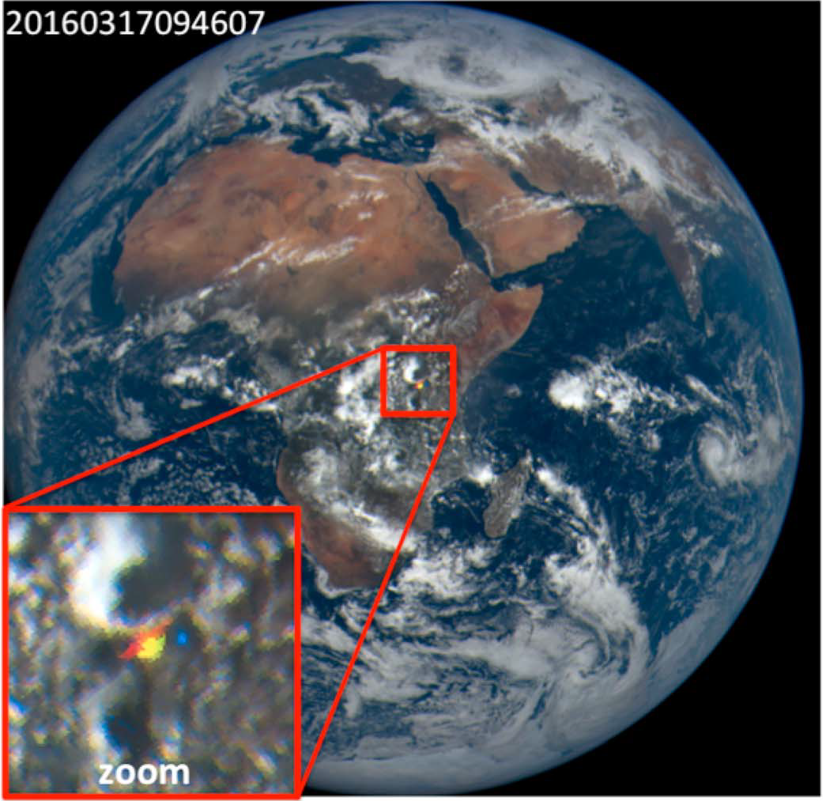
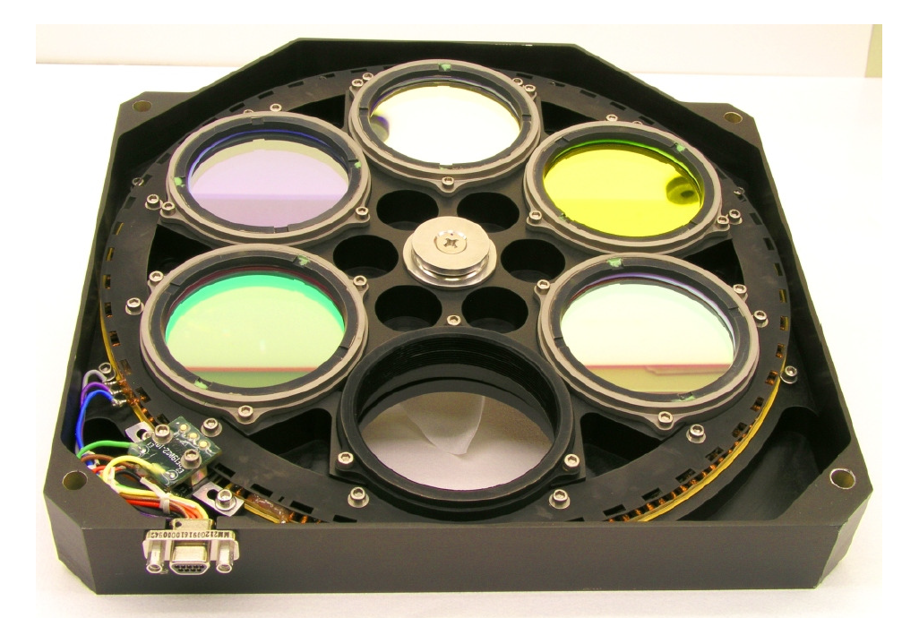
The date and time of image capture
An example of a bright spot:
The inset focuses on the glint
Pixel size near center - 10 km
Angular spread ≈3 × 10⁻⁴ degree
Because EPIC uses a rotating filter wheel, there is a time lag between the images at different wavelengths: ≈3 min difference between blue (443 nm) and green (551 nm), ≈4 min (≈ 100 km) between blue and red (680 nm).
What is the physical origin of the bright spot? (e.g. lightning, cosmic rays)

Slide 10
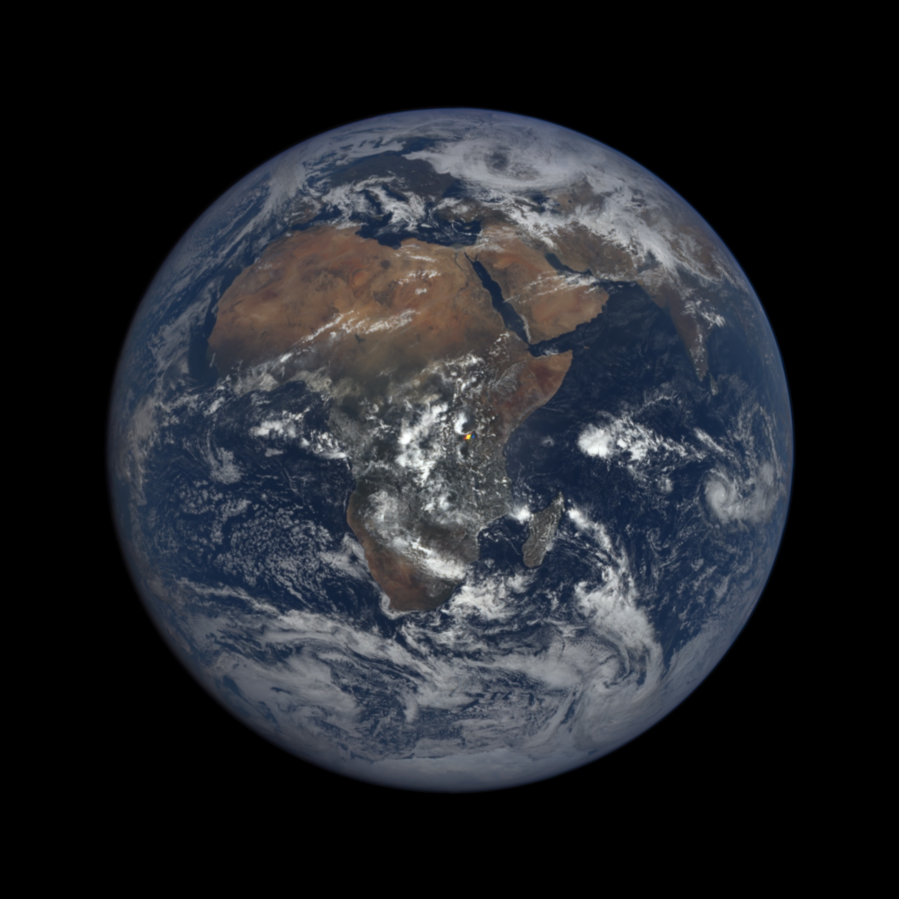
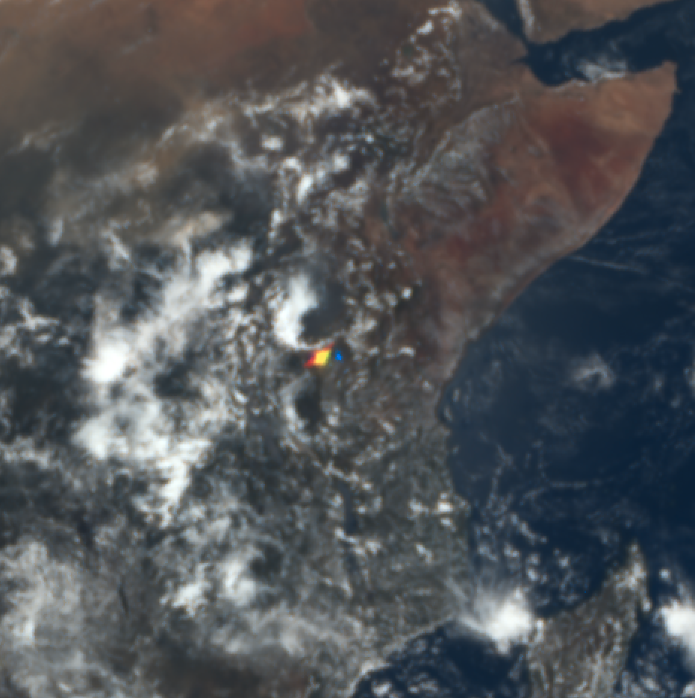
Colorful bright flash over Africa
2016 03 17, 09:46 UTC

Slide 11
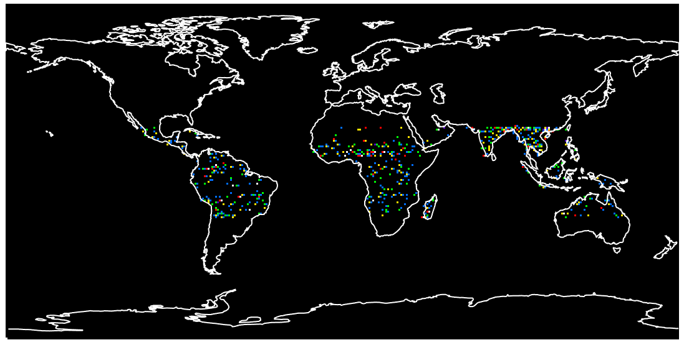
Locations of flashes during one year of data collection
25ºN
25ºN
25ºS
25ºS
As the Earth axial tilt (23.4°) causes local zenith directions to vary,
the location of flashes reaches its southernmost latitude of ≈25°S around 22 Dec and its northernmost latitude of ≈25°N around 22 June.

Slide 12
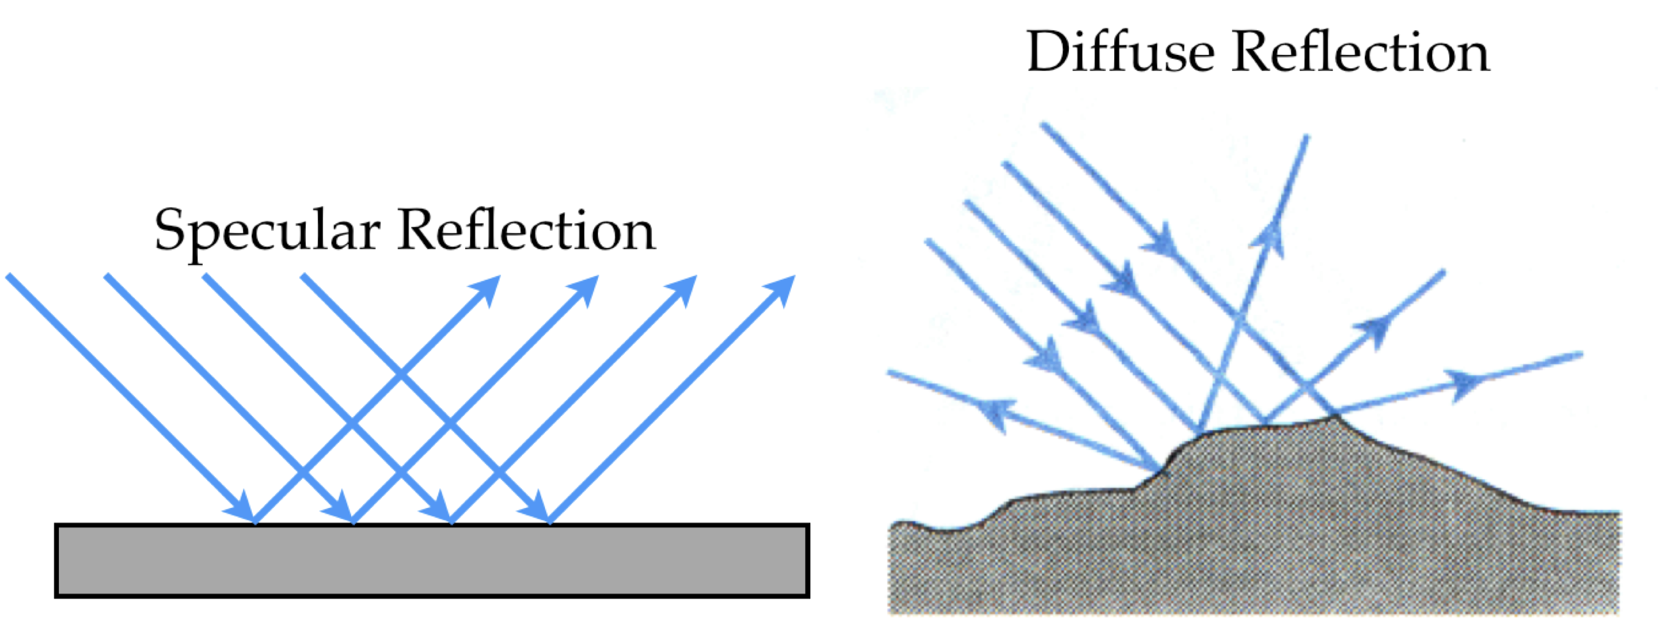
Conjecture: the physical origin of the bright spots over land is specular reflection (glint) off horizontally oriented ice crystals in clouds
Specular Reflection: (i) single scattering; (ii) angle of incidence equals angle of reflection. Requires a smooth service.

Slide 13
Particle Size
Tiny hexagonal platelets of ice, floating in air in nearly perfect horizontal alignment are likely responsible for the glints observed by EPIC over land.
What could be a crystal size?
The specular signal within an angle of only ~3x10⁻⁴ degree (0.62º/2048) must either contain smooth large oriented ice plates or smaller oriented platelets sending back diffracted light.
Size distribution of such crystals depends greatly on cloud temperature and humidity but the range is from tens of μm to mm.

Slide 14
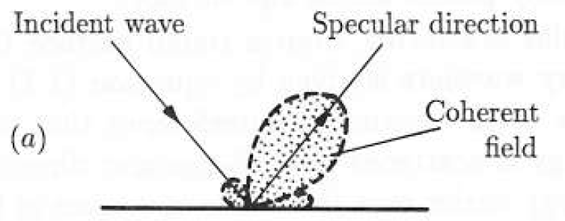
Effect of diffraction
Θ = λ/D => D = λ/Θ
Θ is the angular res., λ is the wavelength and D is the diameter of ice platelet;
If λ=0.5 μm and D=50 μm, then Θ=10⁻² (or on the order of 1º)
Θ is angular half-width of the diffraction lobe around the specular dir.
from Crawford, 1968 p. 486
The angular spread of about 1º can also be explained by the simple diffraction estimate.

Slide 15
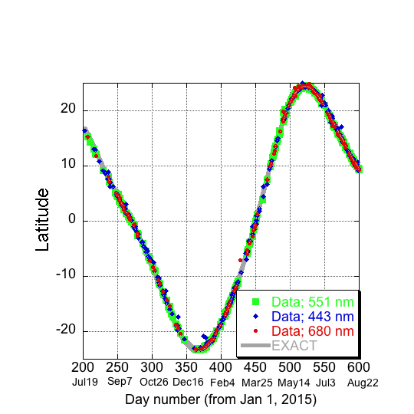
Observed Latitudes of Glints vs. Theoretical
Locations of Specular Reflection (gray curve)

Slide 16
Coplanarity at one pixel
Solar zenith angle (SZA) and vehicle zenith angle (VZA) add up to the Sun-Earth-Vehicle (SEV) vertex angle at the specular pixel.
Zenith direction is along normal to a given Earth pixel but the three vectors do not necessarily lie in the same plane. SEV triangle does not necessarily contain the normal.
Coplanarity requires SZA + VZA = SEV and it was confirmed by the data.
VZA
SZA
SEV

Slide 17
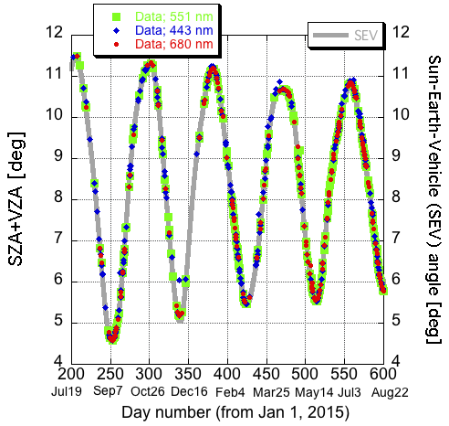
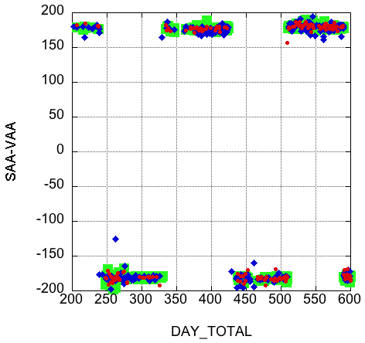
Angles
SZA + VZA = SEV
SAA = VAA ± 180
VZA
SZA
SZA = solar zenith angle
VZA = viewing (or vehicle) zenith angle
SEV
SAA = solar azimuth angle
VAA = viewing azimuth angle

Slide 18
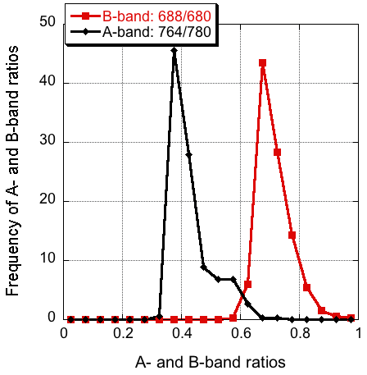
Cloud altitude from oxygen absorption measurements
Observations
DSCOVR
Surface: Low reflectance ratio
High cloud:
High reflectance ratio
← Low altitude High altitude →

Slide 19
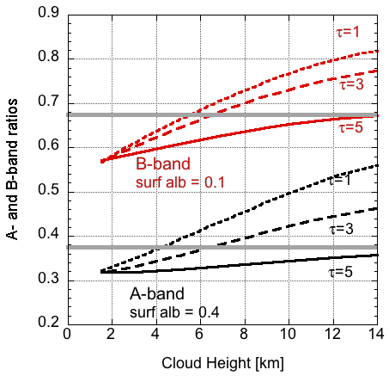
Height of the detected sunglints
Observations
RT calculations
A and B band ratios peak at 0.37 and 0.68, respectively.
Right panel: RTsimulations of A and B band ratios for cloud optical depths (τ) = 1, 3, and 5 over vegetated areas. Thin clouds with τ between 1 and 3 yield intersections with the solid gray lines at cloud heights of 5–8 km. Cloud heights greater than 5 km contain ice. Hence, cloud ice platelets cause glints.

Slide 20
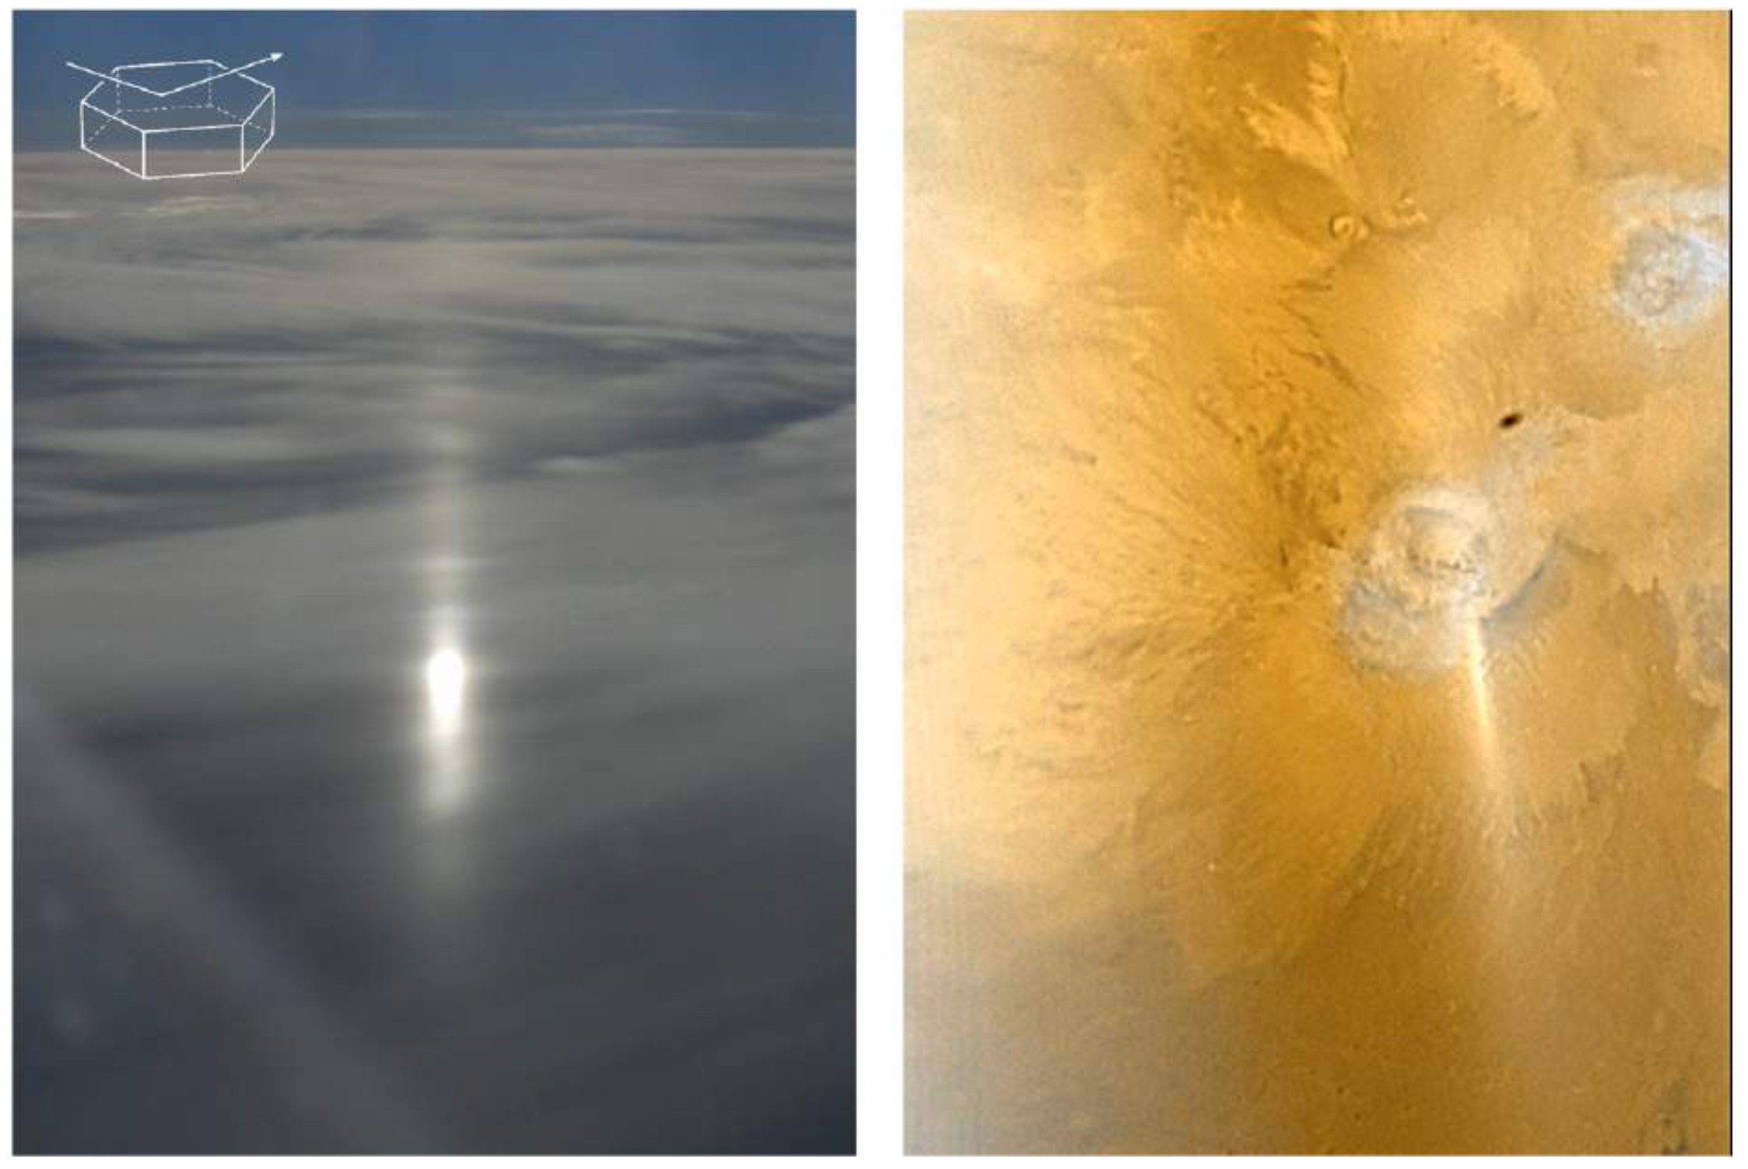
Halo wings (left), CCD blooming? (right)
300 km
Mars Halo (Orbiter Camera)
Aircraft
photo
Können (2017, BAMS)
Water-ice clouds’ halo on Mars (2006)

Slide 21
Concluding Remarks
The Lagrangian eye readily registers a glint signal.
An efficient detector of ice clouds. Statistics on ice-containing clouds.
Contribution of glints to albedo.

Slide 22
Thank you !

Slide 23
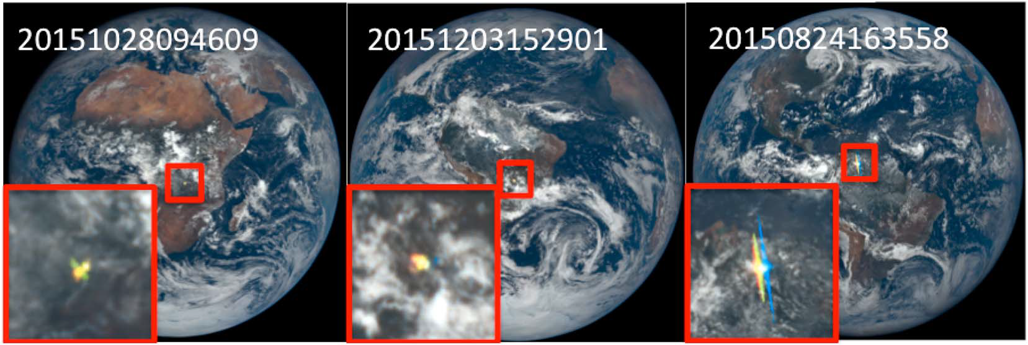
What is the physical origin of the bright spots?
About 8% of images collected over the 400 days contain the conspicuous bright spots over land as well as over water.
Scanning all images from June 2015 to August 2016 yielded 213 red, 336 blue, and 317 green flashes. What is the origin of these flashes, e.g., could these be lightning strikes?
Notes:
Why the Wings? Sensor saturation, not halo. EPIC CCD array: quantum well depth = 10⁵ electrons per pixel. Electron flux above saturation “spills” over along CCD columns.

Slide 24
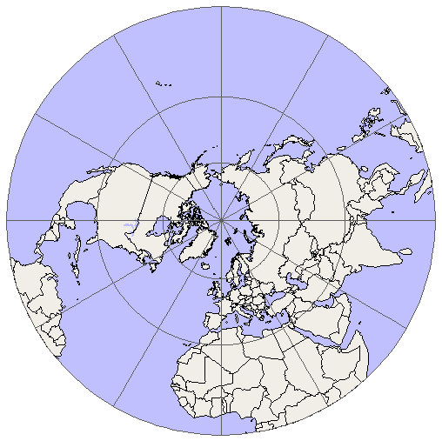
Flashes are colored
The EPIC filter wheel
Time of blue image
Time of red image
(≈4 minutes later)
Glint shifts by ≈ 100 km
DSCOVR
DSCOVR

