Slide 1
Road Trip

Slide 2


Slide 3

What makes a good road trip ?

Slide 4
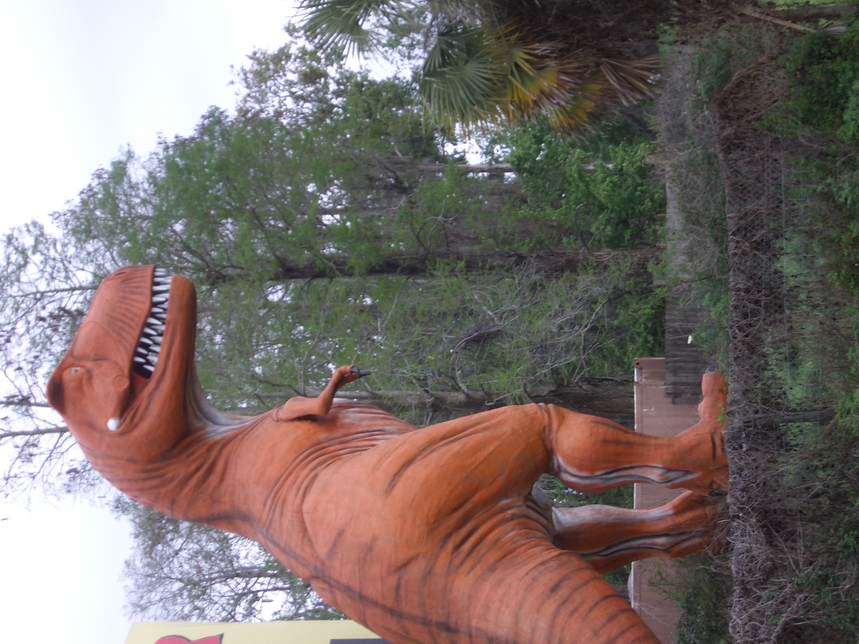

Snacks
Fun Destination
Companions
Long enough to create real conversations
The unexpected
Notes:
You may not get were you were trying to go …
For me ... part of what differentiates a road trip from an adventure is not just that there is a car involved or long distances, but it has to be a shared adventure ...
… go beyond pleasantries and run out preformulated thoughts …. learn to get along people … Its a time to really listen and think new thoughts.

Slide 5
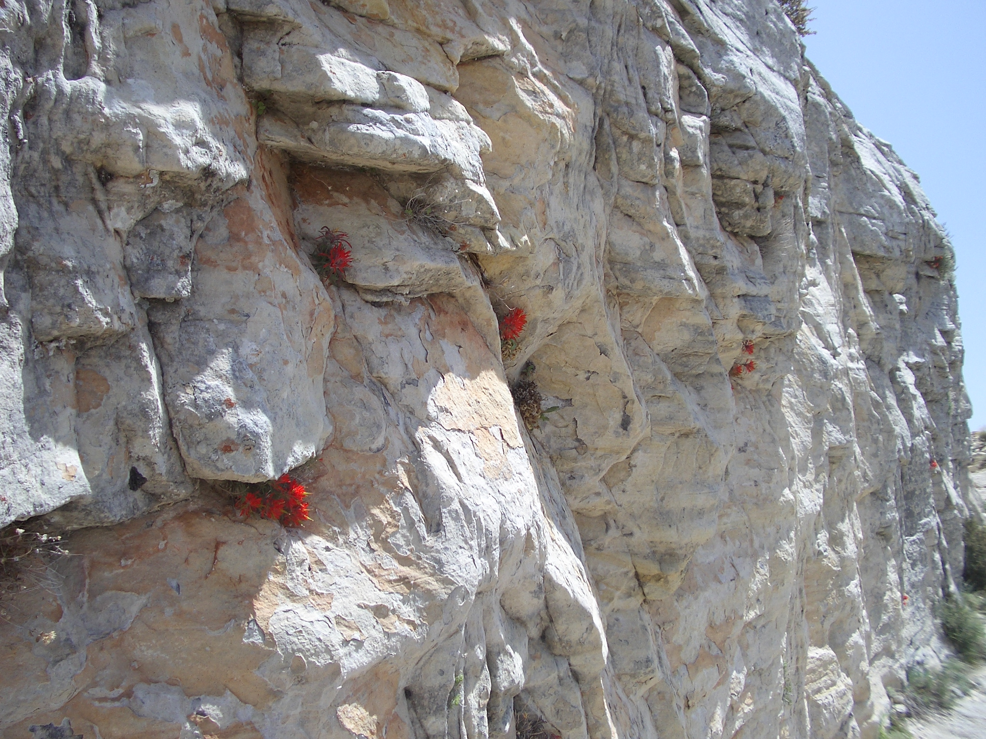
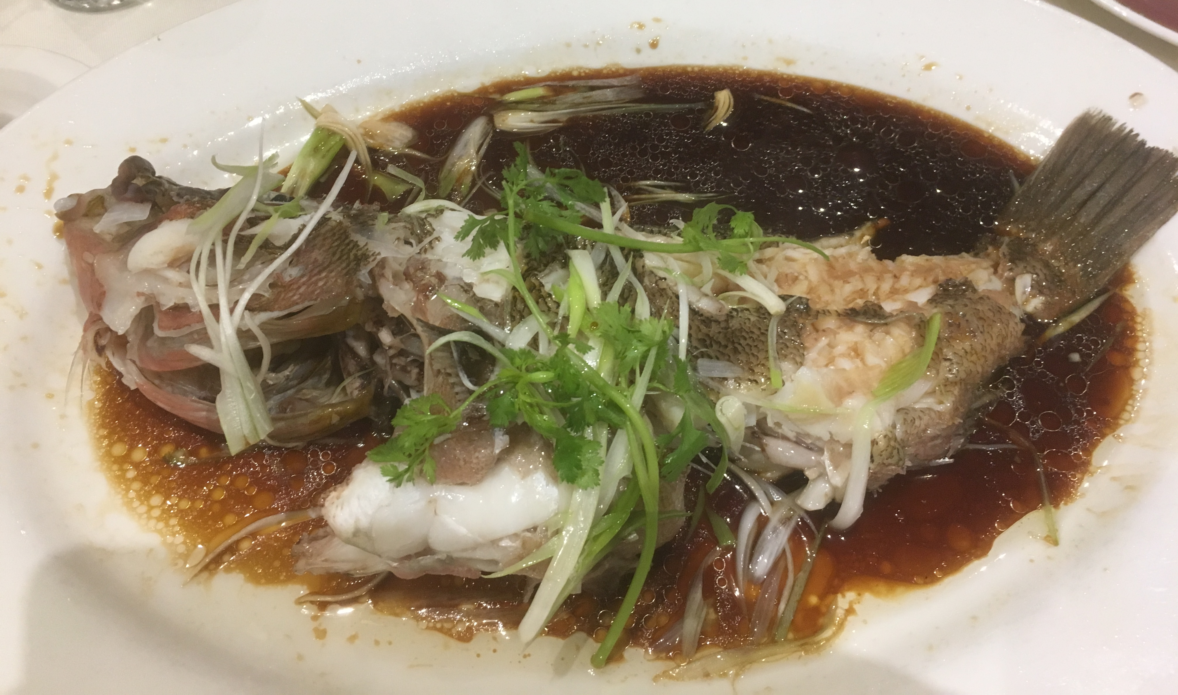
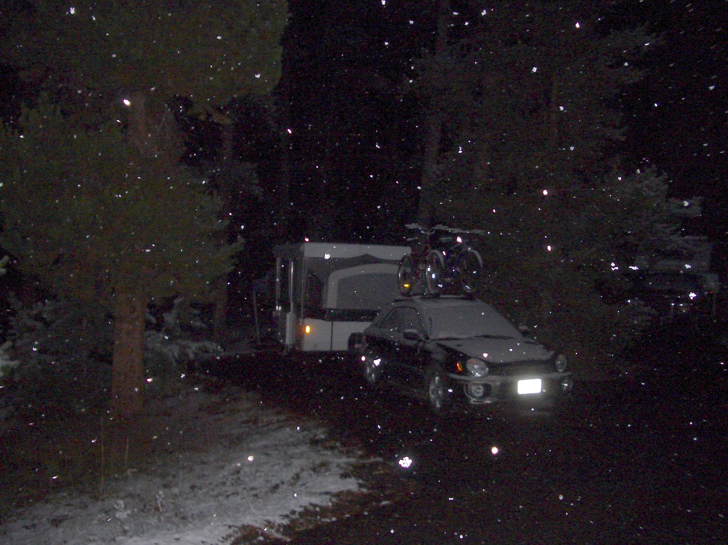
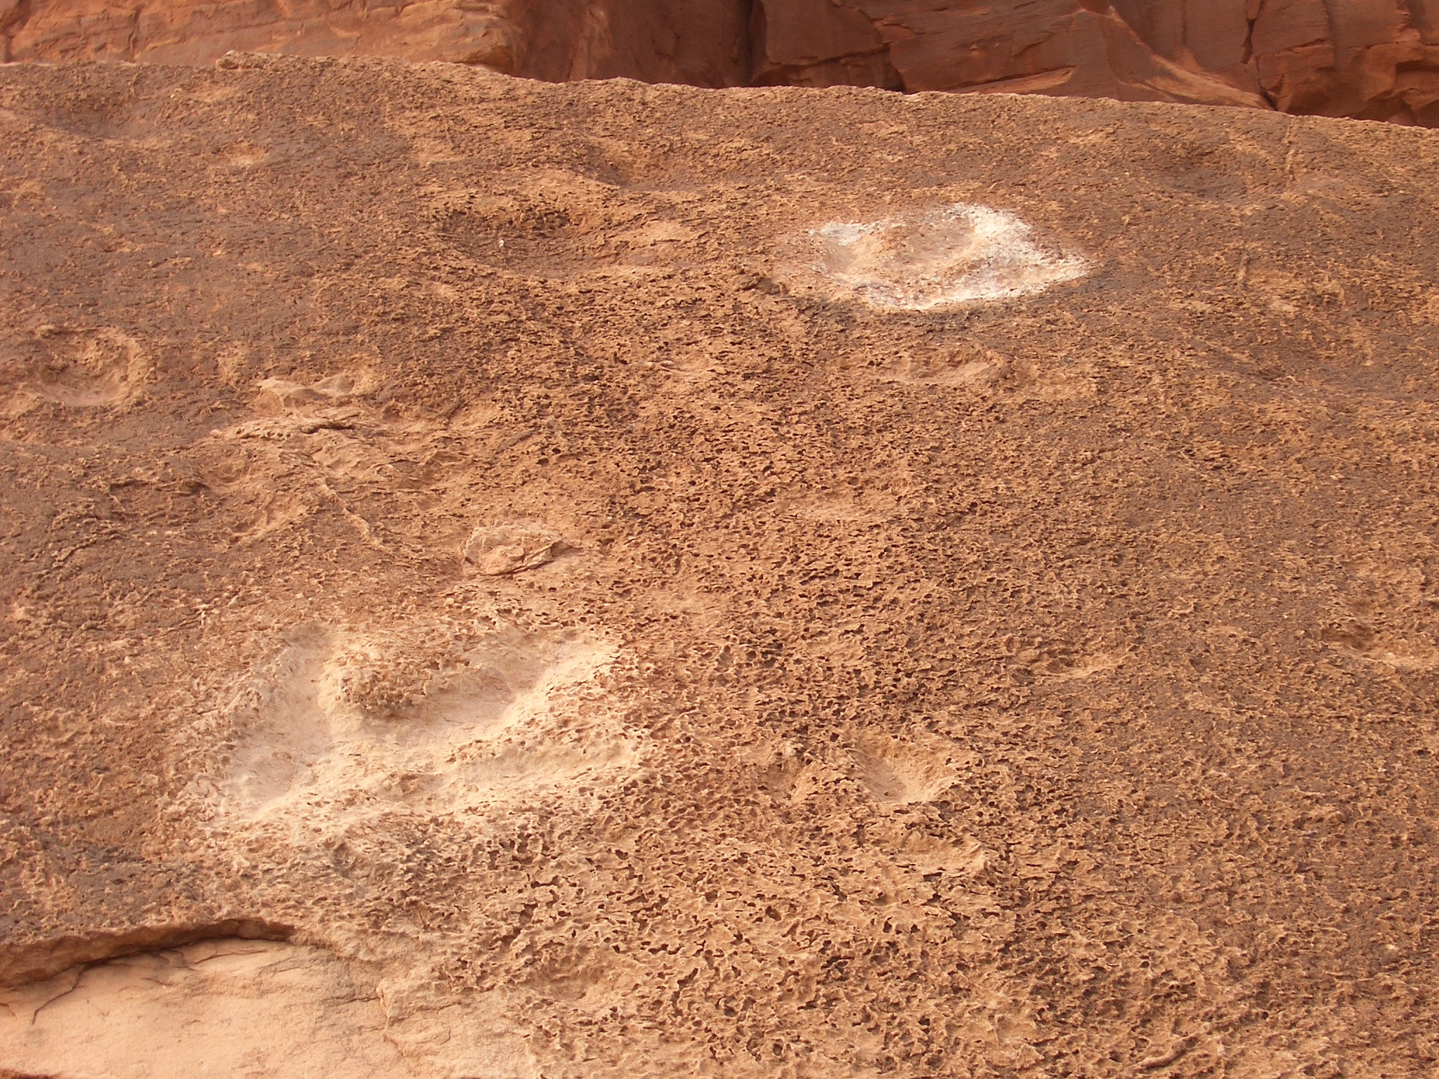

Slide 6
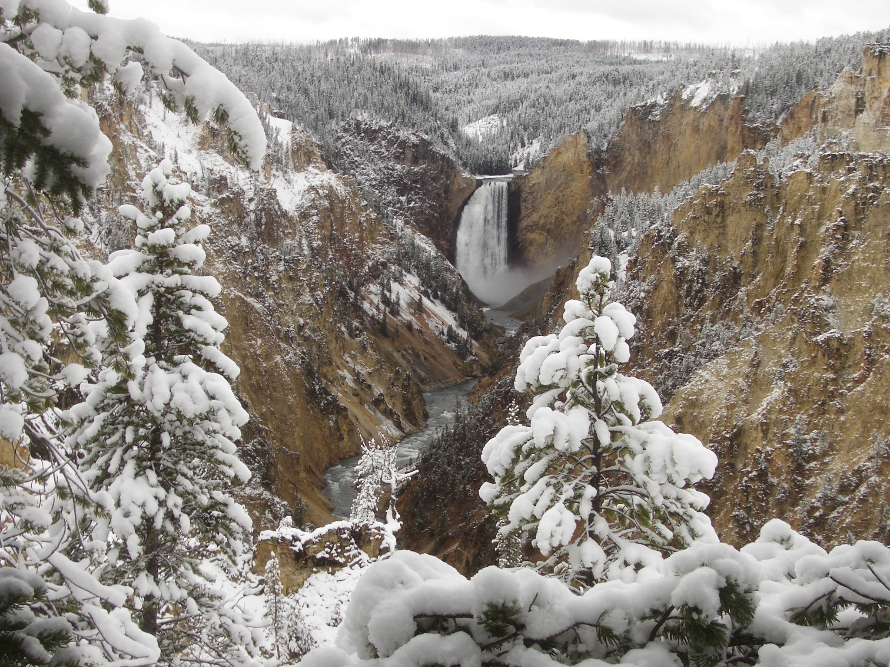

Slide 7
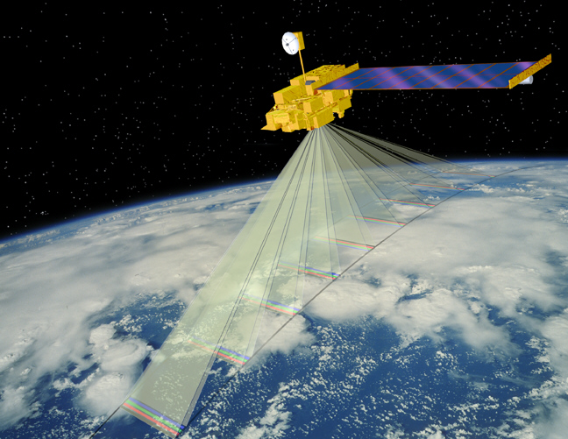
MISR
400-km swath,
4 wavelengths (446, 558, 672, 866 nm)
Contiguous zonal coverage:
9 days at equator / 2 days at poles
275 m - 1.1 km sampling
7 minutes to observe each scene at all 9 angles

Slide 8
Stereo-imaging
Satellite
First view angle
Apparent
position
A significant advantage of the MISR CTH retrieval is that the technique is purely geometric and has little sensitivity to the sensor calibration.
The retrieval has been the focus of several studies including Marchand et al. (2007), Naud et al. (2002, 2004, and 2005a,b), Seiz et al. (2005), Marchand et al. (2001).
height above
the surface
Surface
Second view angle
(no cloud motion)
position in first image
Surface
Parallax : Apparent change in position
Second view angle
(with cloud motion)
Apparent
position in first image
Surface
Cloud Motion + Parallax

Slide 9
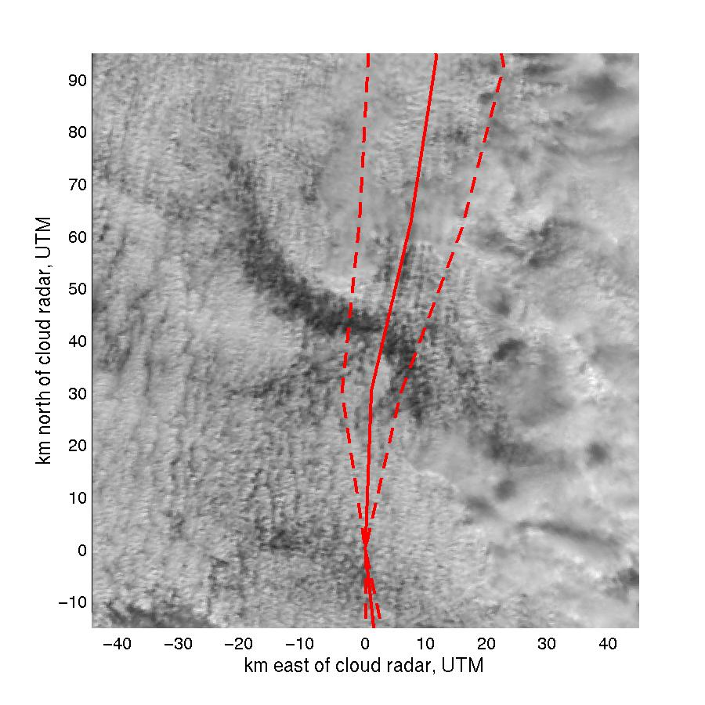
March 3, 2000 – Case Study
Marchand and Ackerman (2004)
Notes:
Mention Scales, location of ARM site, what am I doing ? , Why ?

Slide 10
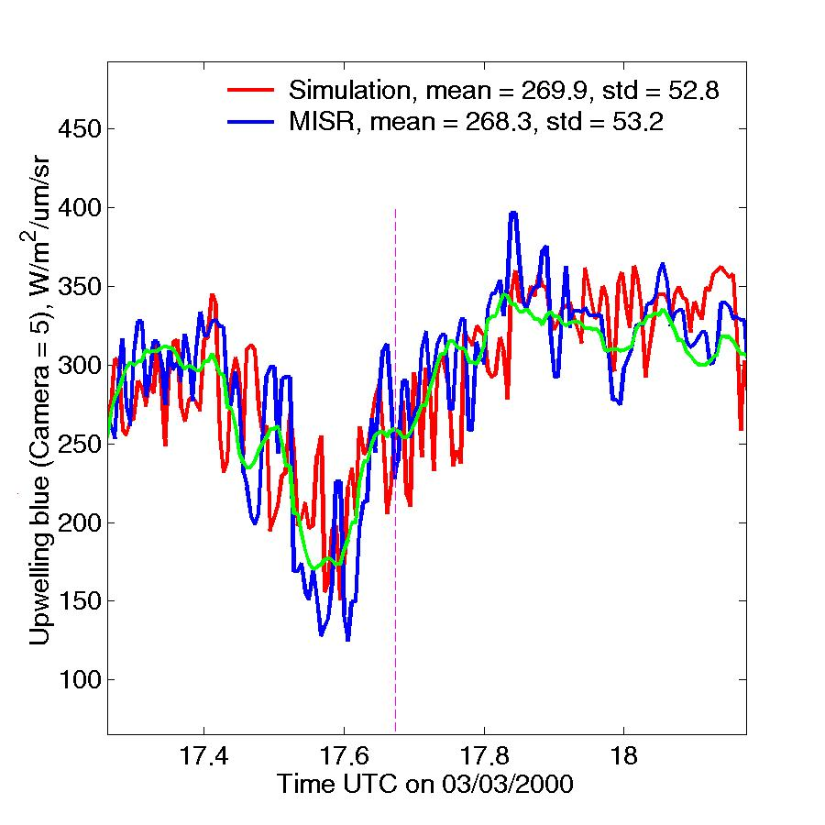
Simulations & MISR Nadir Measurement
+0.6 K Tb31

Slide 11
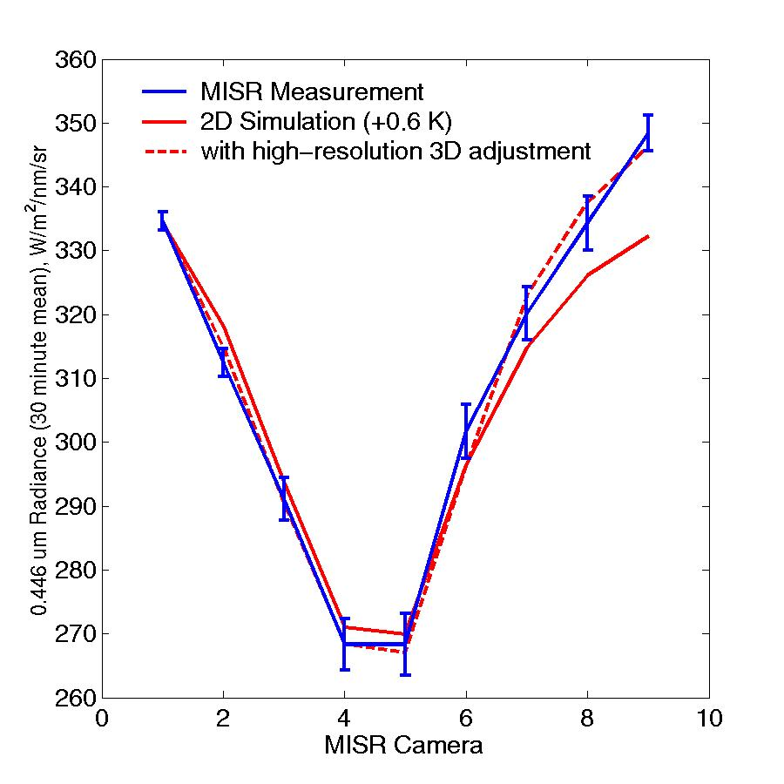
Relative Difference (Blue Band)

Slide 12
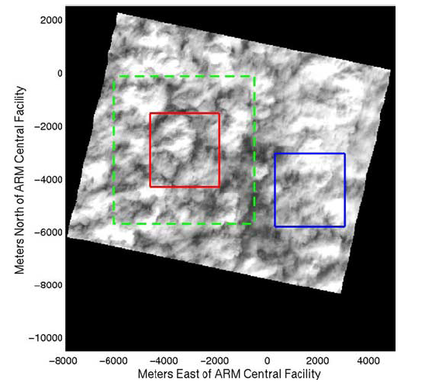
Coincident AirMISR Image

Slide 13
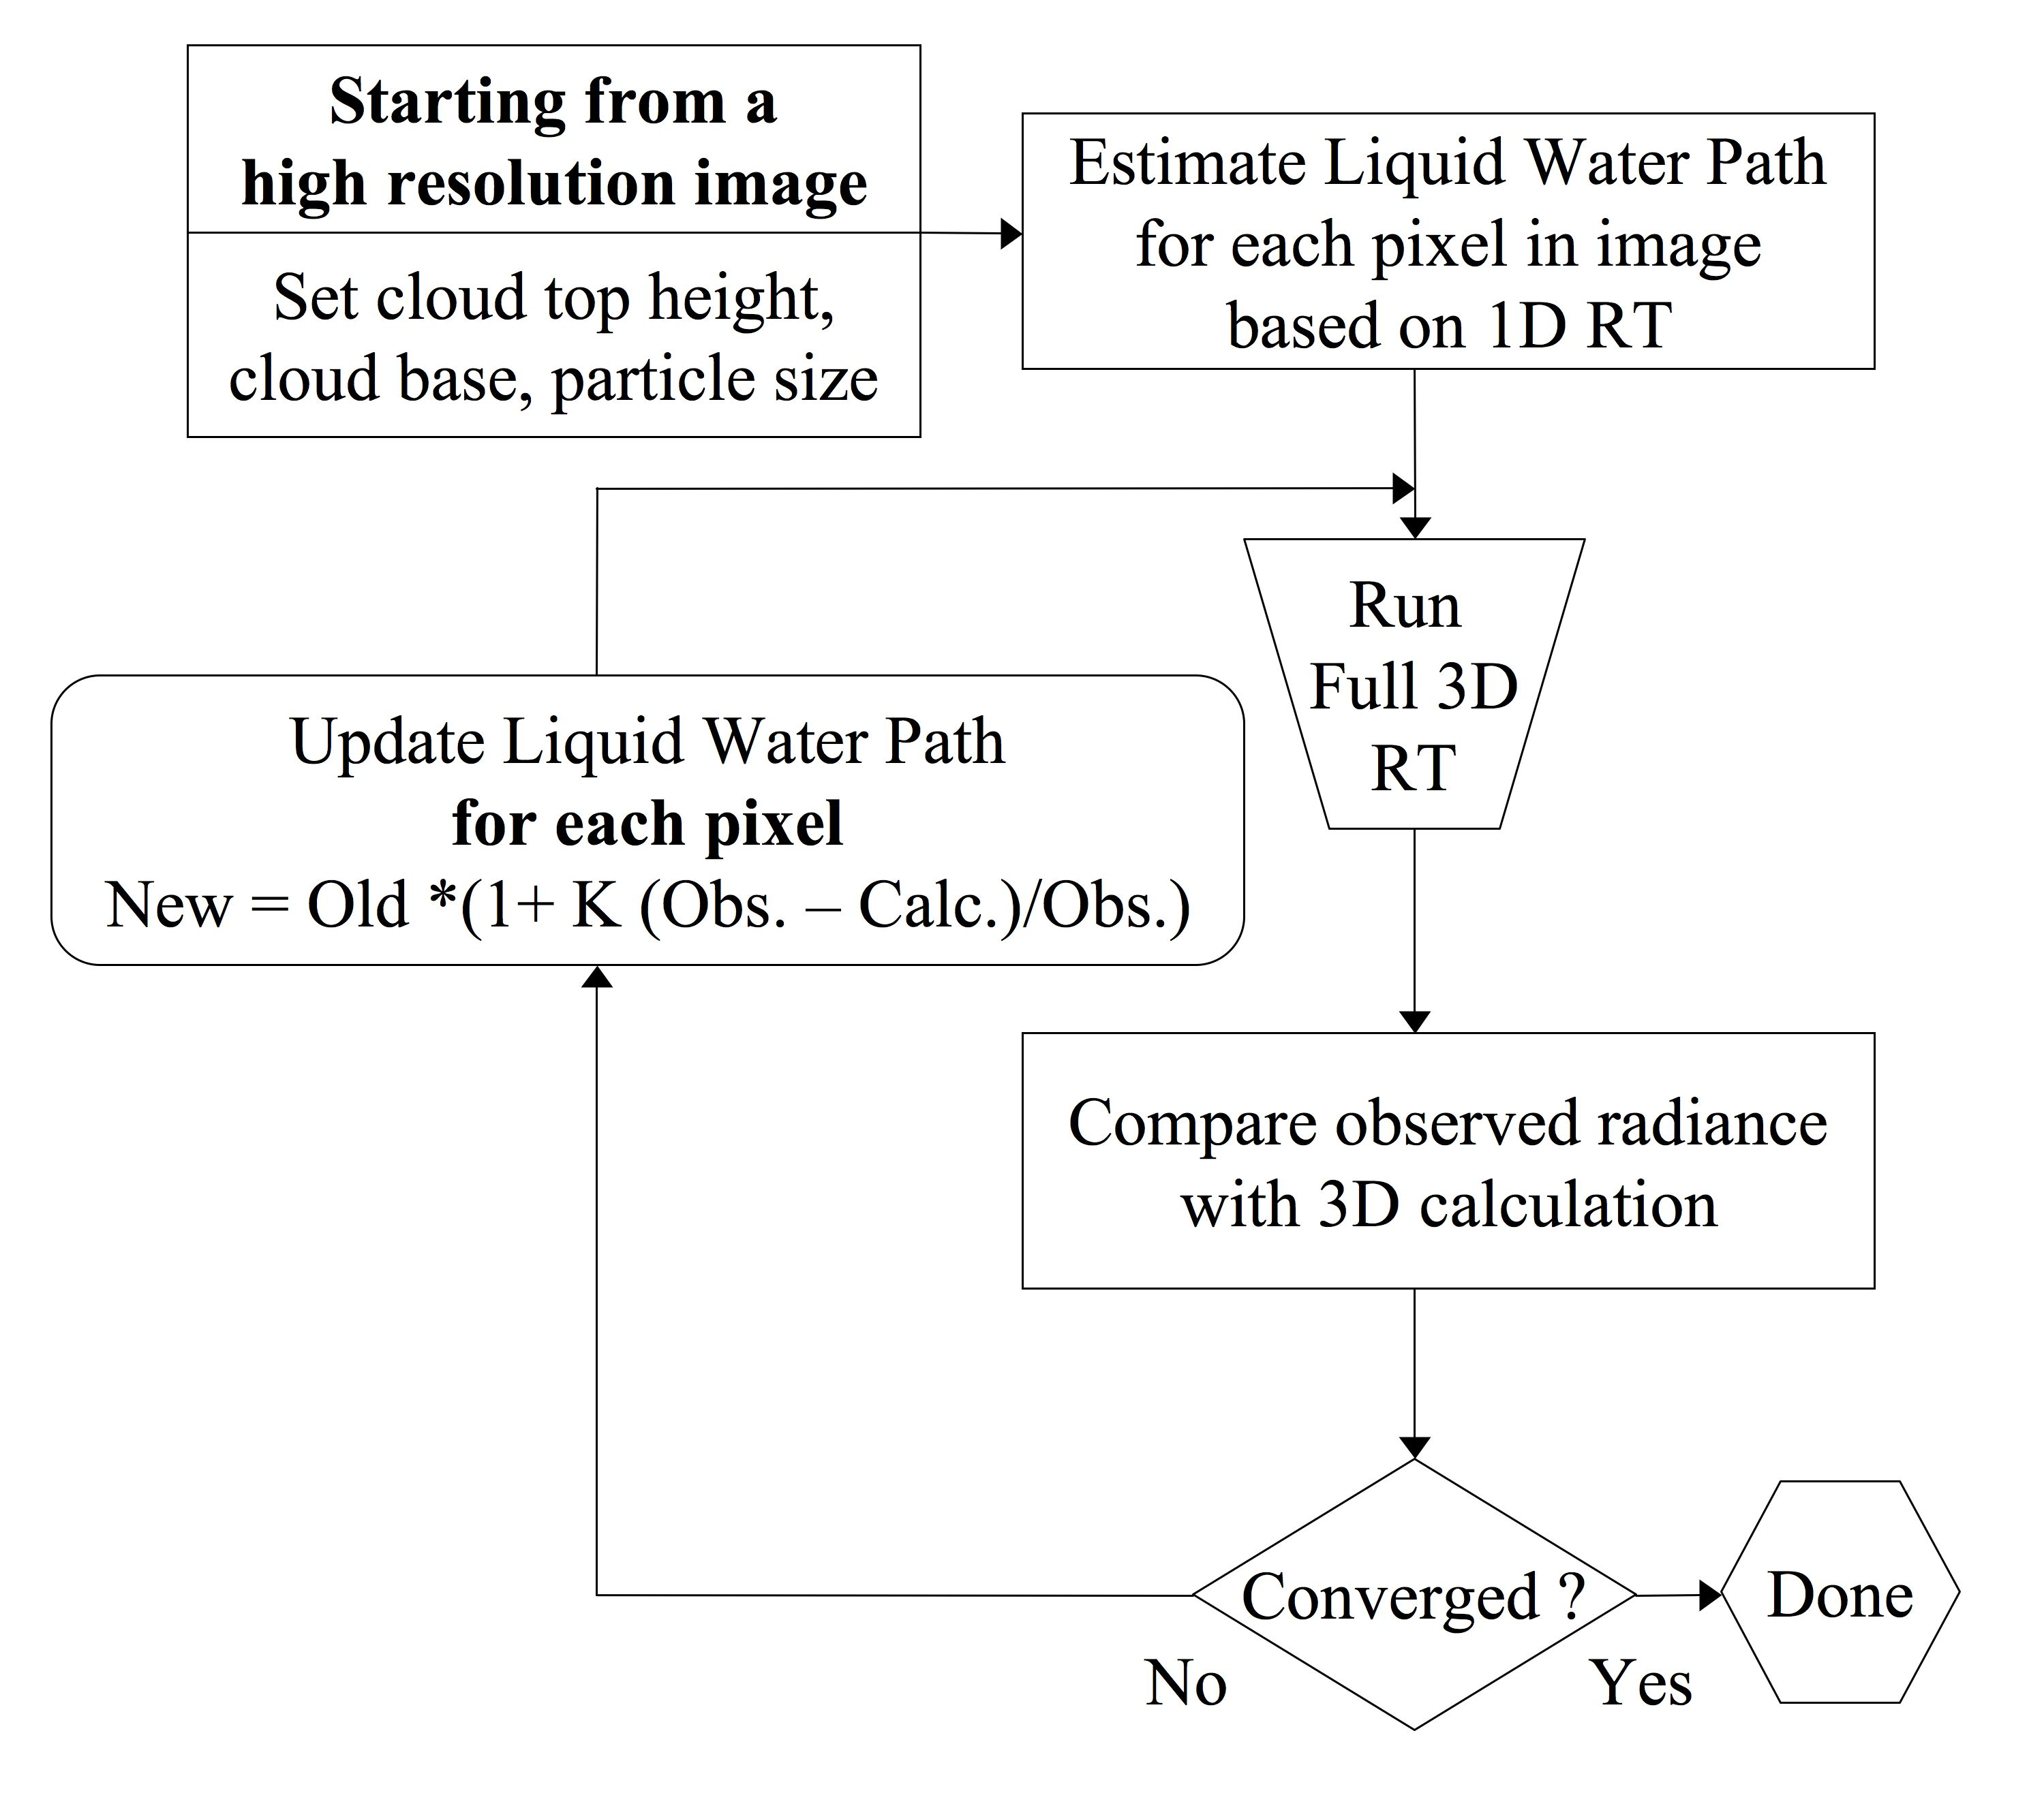

Slide 14
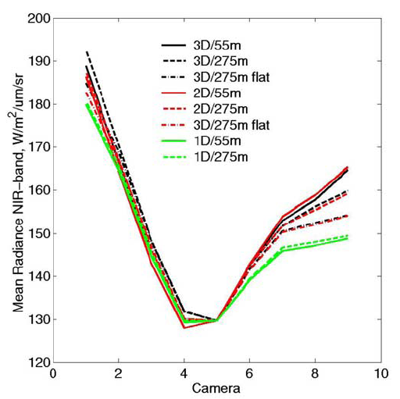

Slide 15
Consider a simple rectangular cloud
with constant liquid water path (LWP) & Effective radius (Re)
Note: 1D retrieval of LWP and Re does not match the True LWP/Re. This large error is entirely due to neglecting 3D structure.
1D
retrieval
3D Calc.
Update LWP and Re based on difference between True and 3D Calculated radiances
3D calculation of visible/SWIR reflectance from the “True” cloud field is used as input to the retrieval.
Repeat 3D Calculation and LWP/RE update ….
After a few iterations,
The retrieval is much
Improved.
How well does this work for “real” clouds ?
Notes:
This simple case demonstrates that a 3D retrieval can produce significant improvement in LWP & Re retrievals. Here the clouds is 2x2x1 km in size with a LWP of 80 g/m2 and Re of 5 microns. There is no vertical variation in the cloud properties. Sun is to the North with an angle to zenith of 45 degrees.
The questions we are trying to address now is whether this works for much more complicated 3D structures and “real” observations from PODEX (and possibly SEAC4RS).
Based on simple test cases, we know the answer will depend to some degree on resolution of the input imagery AND that polarization may be helpful. Experience also suggest that retrievals of cloud-top-height structure (which we hope to obtain from stereo-imagery) will be important.
We are currently setting up the retrieval to work with the MYSTIC 3D Monte Carlo RT code which is capable of polarization calculations, and also testing on much more complex clouds from LES simulations … while we await actual observations.

Slide 16
LES Example - Shallow Cumulus

Slide 17
LES
1D Retrieval (Nakajima-King)

Slide 18
3D Retrieval (2 wavelength) …

Slide 19
3D Retrieval (2 wavelength) … Perfect Vertical

Slide 20
3D Retrieval (2 wavelength)

Slide 21
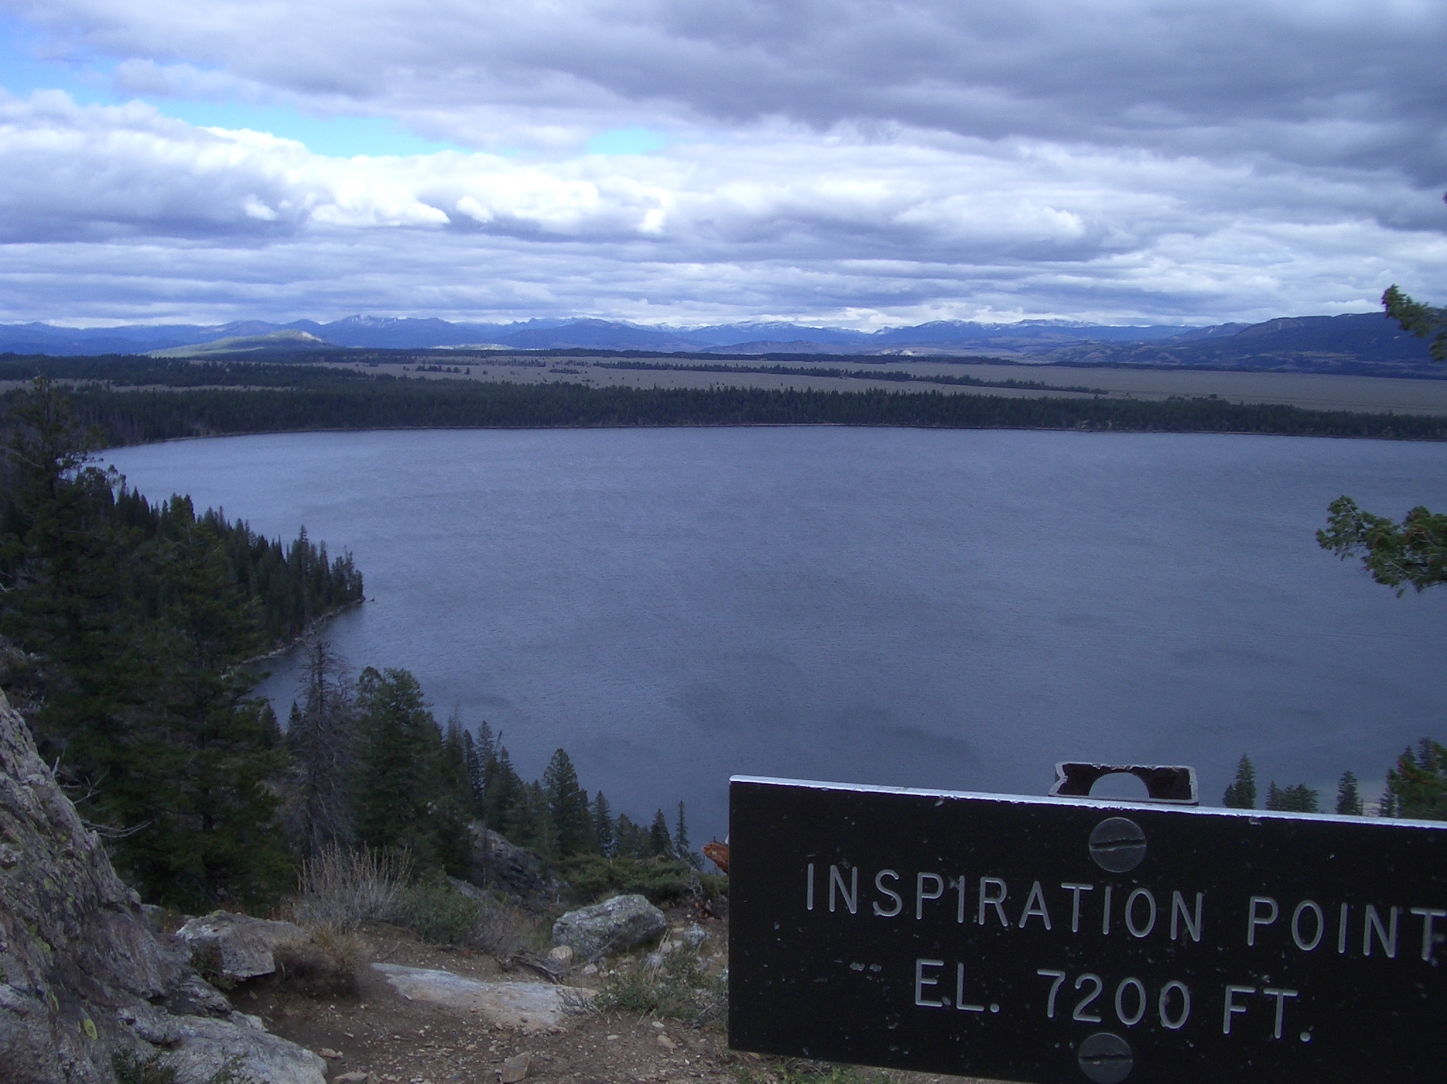
Road Trip = a journey of self discovery
Tom, it has been a pleasure to
be on this journey with you.

Slide 22
LES
3D Retrieval (fixed Re)

Slide 23
LES
1D Retrieval (fixed Re)

Slide 28
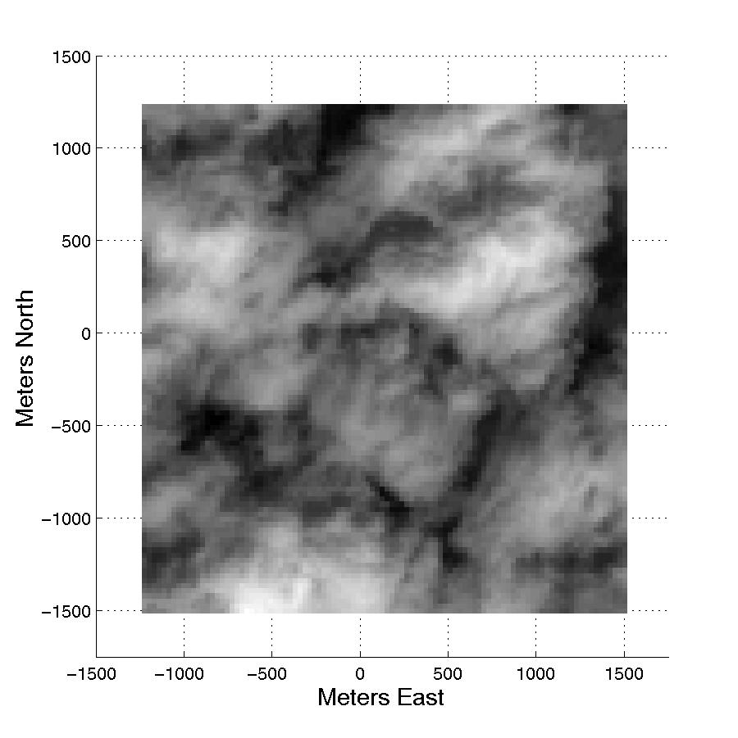
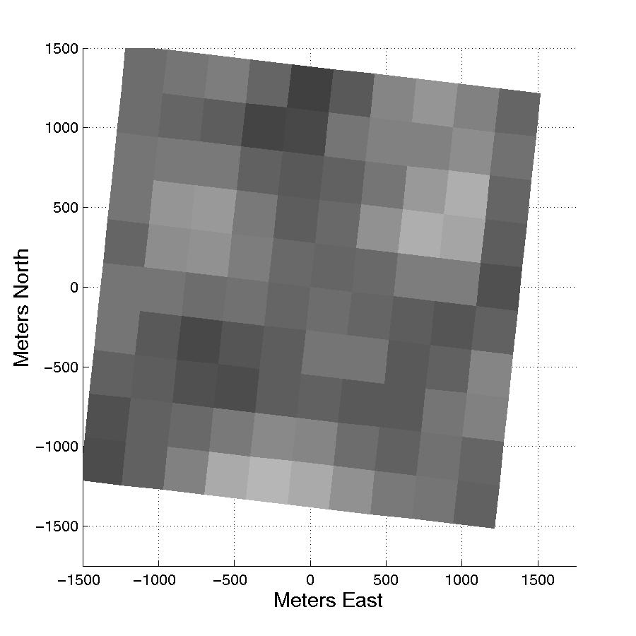
AirMISR
MISR (Same region)

Slide 29
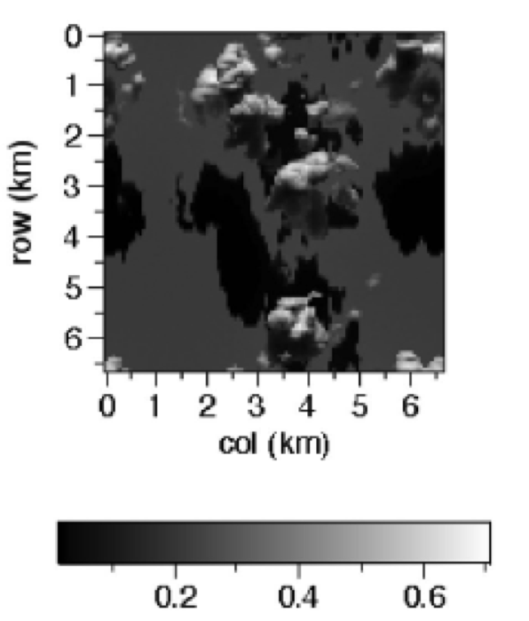
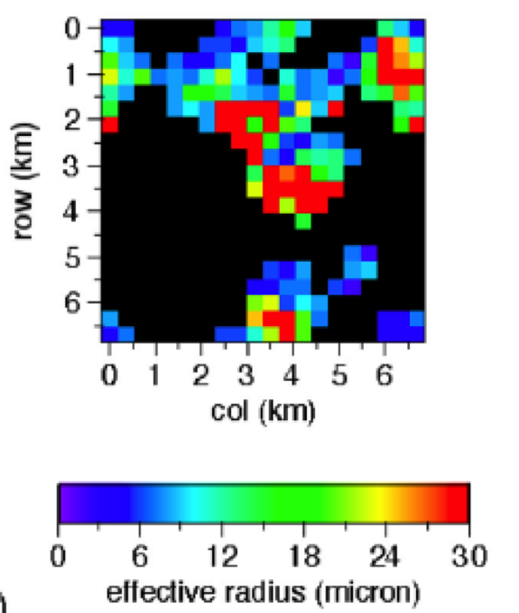
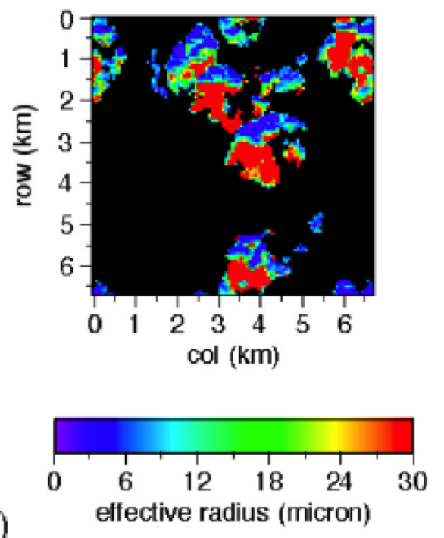
From Marshak et al . (2006) :
With respect to the plane-parallel approximation, shadowing tends to increase re more than illumination decreases it; this results in an overall bias toward larger re.
Ignoring shadowing in 1-D retrievals results in substantial overestimation of re that often goes in pair with underestimation of tau.
Subpixel clear sky contamination and low surface albedo at 2.13 mm contribute to small nadir reflectance and thus large re.
Notes:
Re = 10 in forward calcuations …. 18 % of retrieved pixels > 30 at 355 m

Slide 30
1D/2D Radiative Transfer Code Inputs
FSSP/1 DC – size of cloud particles (Re, sigma)
Microwave Radiometer
Total column liquid water and water vapor
Reprocessed using forward model iterative approach at 20 second resolution
Radar Wind Profiler – cloud velocity
Radiosonde - profiles of temp., pressure, and RH
Radar / Lidar – cloud boundaries
ASD spectrometer – surface albedo
Ozone – Climatological value
Simulation Resolution ~ VΔt ∼ (13 m/s)(20 s) = 260 m
Notes:
Velocity ~ 13 m/s ➔ 260 meter resolution

