Slide 1

aerosol radiative effects with MACv2
Lazaros Oreopoulos
Stefan Kinne
MPI-Meteorology

Slide 2
outline
what are MACv2 aerosol direct rad. effects ?
direct radiative effects by component
anthropogenic contributions
how does anthrop. aerosol influence climate ?
indirect (via clouds) impacts
direct vs indirect (via clds) impacts (over time)
dimming and brightening by anthrop. aerosol

Slide 3
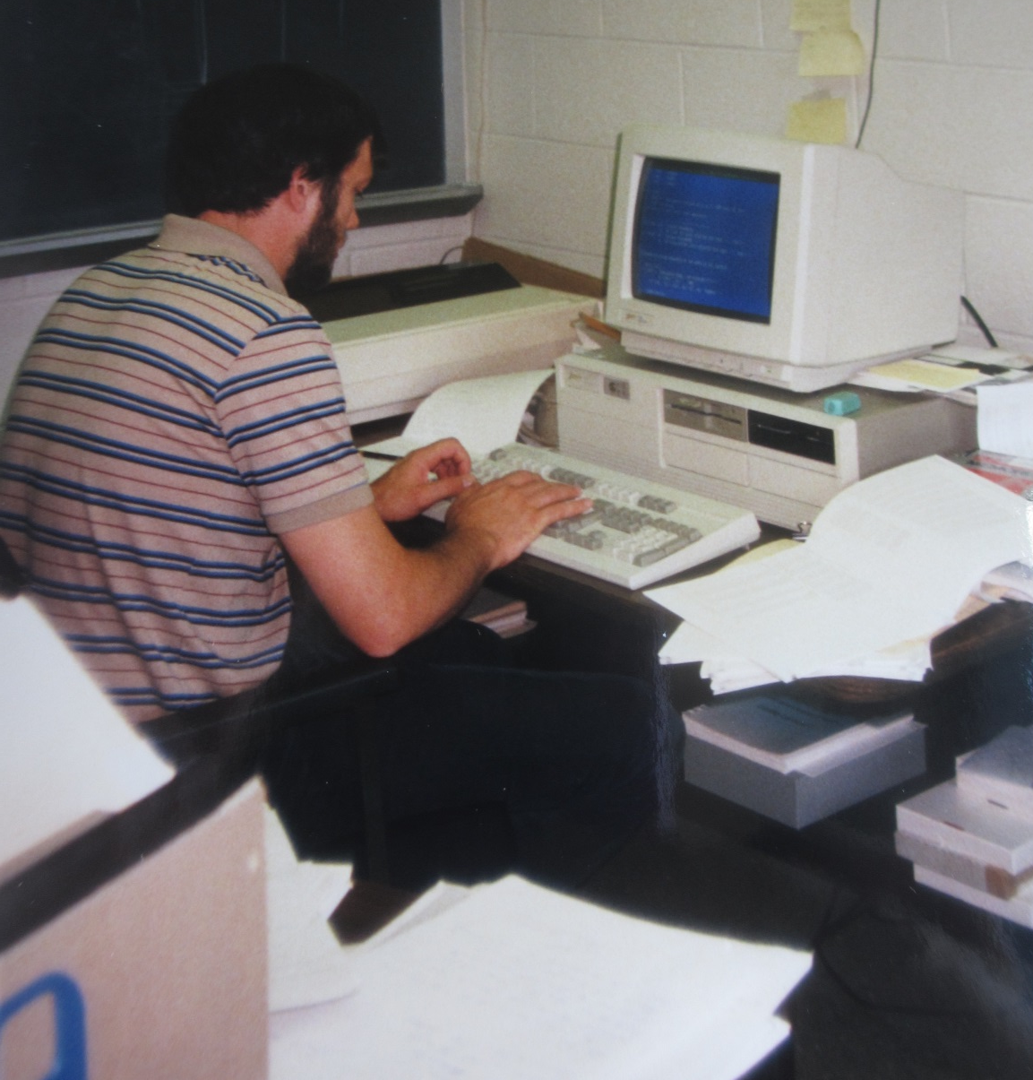
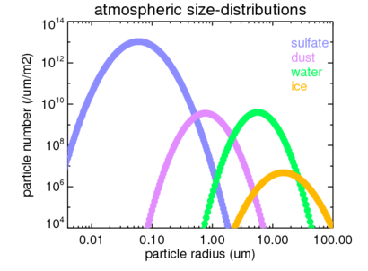
my aerosol research began with TOM
hhh
…introduced me to aerosol and log-normal size distributions
background aerosol: sulfate, mode rad: 0.08um, std.dev 1.8
30 years ago

Slide 4
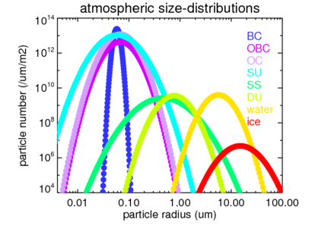
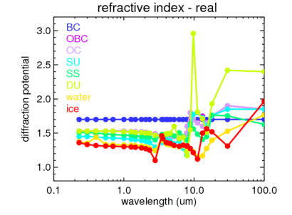
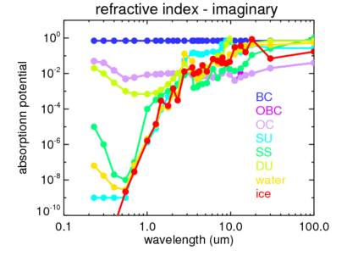
so I assumed component properties

Slide 5
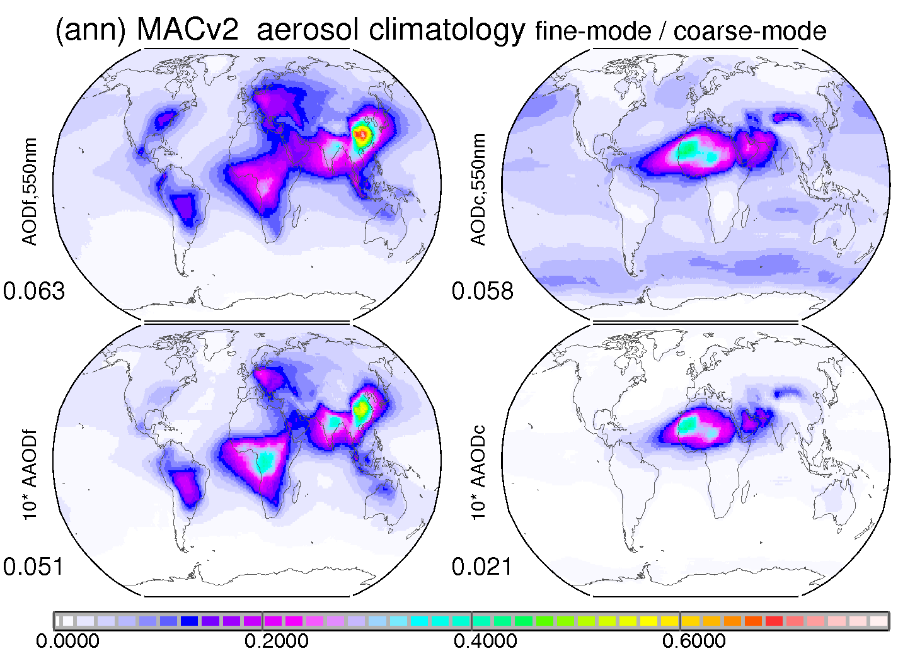
apply to MACv2 optical properties
Aerosol <1um
Aerosol > 1um
AODf AODc
50% 50%
AAODf AAODc
70% 30%
(10 times) (10times)

Slide 6
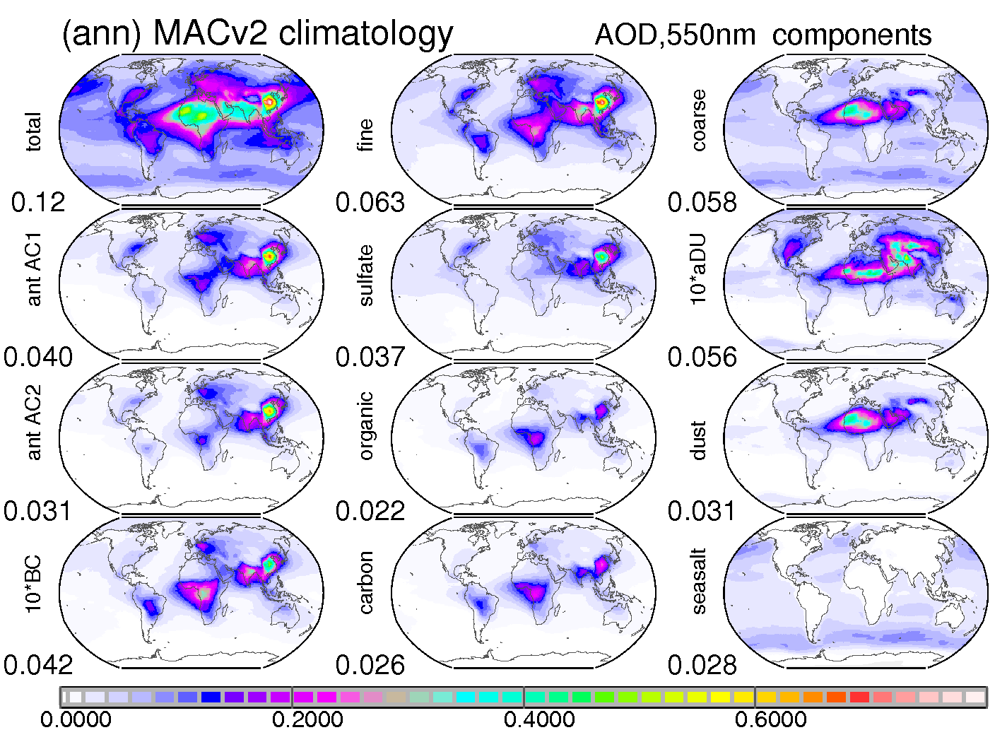
component AOD
AOD
550nm
.037 SU
.031 DU
< 1um
OC
BC
CA
SU
> 1um
DU
SS
organic
soot
OC+BC
sulfate
.022 OC
.028 SS
10*times
.026 CA
.004 BC
dust
seasalt

Slide 7
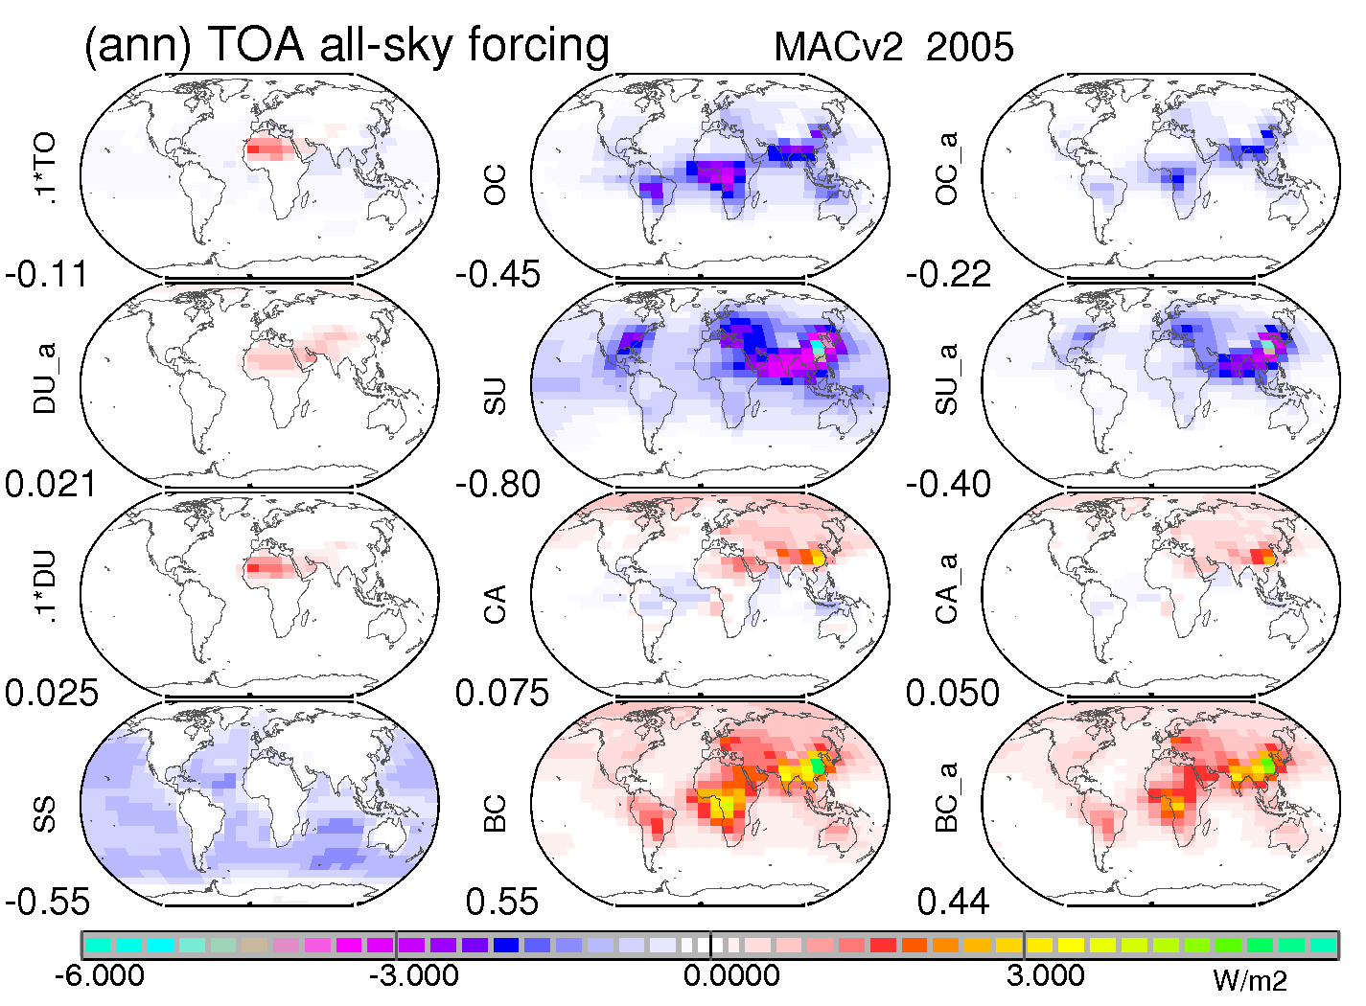
component TOA forcing
AOD
0.1*times
+.25 DU
- .45 OC
< 1um
OC
BC
CA
SU
> 1um
DU
SS
organic
soot
OC+BC
sulfate
- .55 SS
- .80 SU
+.55 BC
+ .08 CA
dust
seasalt
← cooling (net-flux loss) (net-flux gain) warming →

Slide 8
anthr component TOA forcing
anthrop
AOD 550nm
- 50% of AODf
- 25% of AOD
- uncertain
- .22 OC
- .40 SU
< 1um
OC
BC
CA
SU
organic
soot
OC+BC
sulfate
+.44 BC
.+. 05 CA
← cooling (net-flux loss) (net-flux gain) warming →

Slide 9
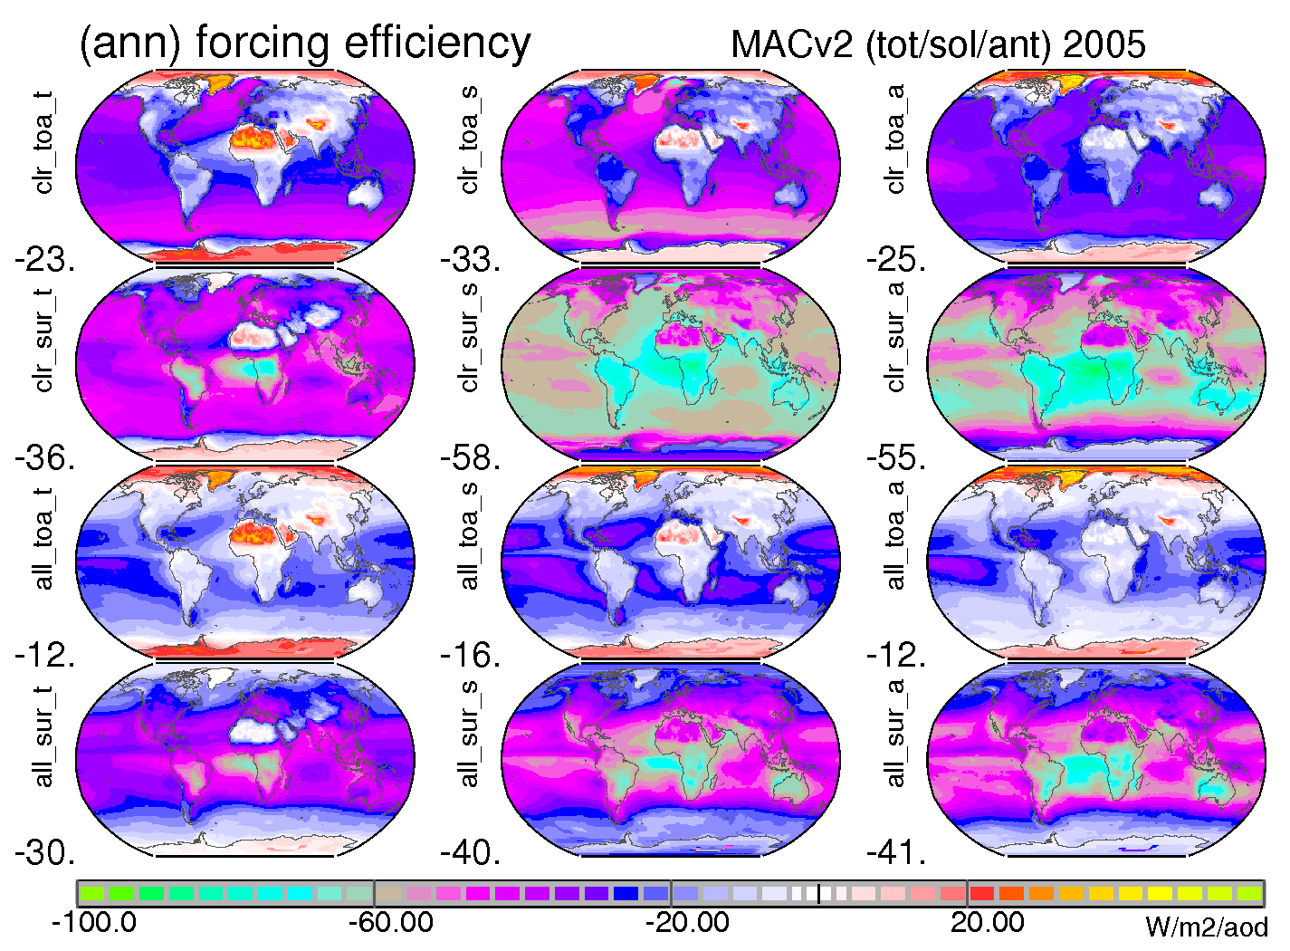
TOA forcing efficiencies (/ AOD)
total (sol+IR) anthropog.
clear
-sky
all
-sky
- 24
- 12
← cooling (net-flux loss) (net-flux gain) warming →

Slide 10
indirect too ?
yes … there is also an aerosol indirect effect
via modified clouds
extra anthropogenic aerosol tends to increase cloud droplet concentrations
as more nuclei compete for the same water (at condensation) cloud droplets are smaller
how
extract potential from satellite observations of
AOD of <1um sizes: aerosol number
CDNC at cloud top: droplet number
(this is the for cloud droplets … so via competition for the same

Slide 11
the indirect ‘relationsship’
AODf vs CDNC
AODf
satellite fit
model param
CDNC

Slide 12
extract CDNC / radius - change
d (CDNC)
v
PD
v
PI
d(drop-radius) = 1/ {d(CDNC)**(1/3)} if LWC unchanged

Slide 13
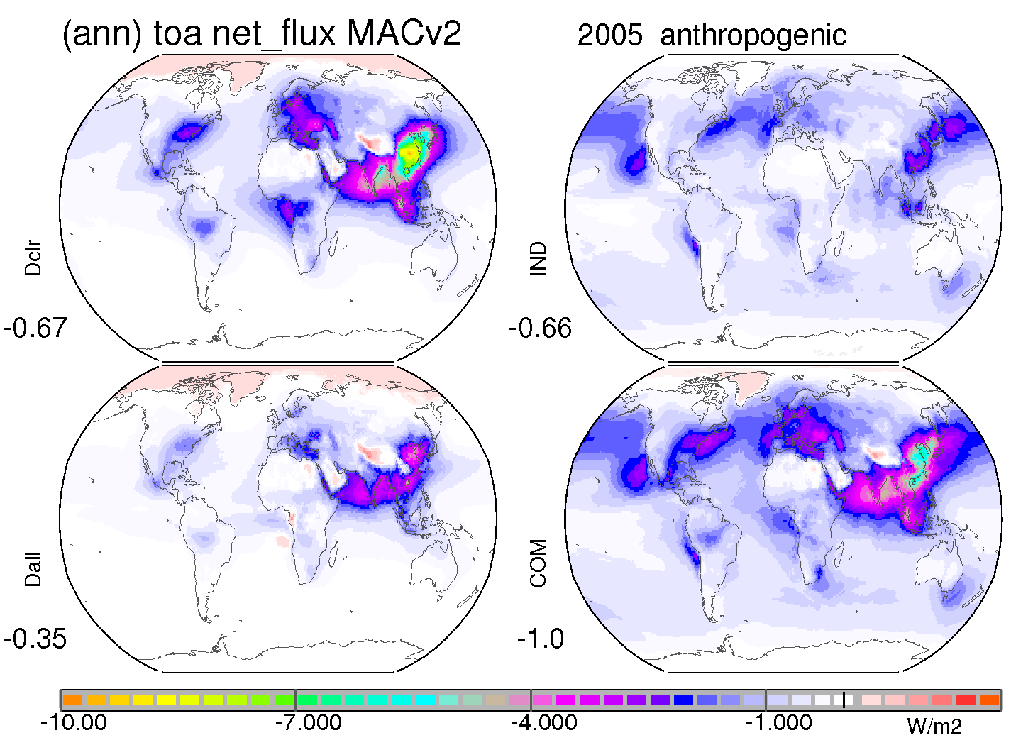
direct vs indirect (TOA) today anthropogenic
at TOA: indirect is larger (on average)
indirect
direct clear-sky
- .66
direct all-sky
direct +
indirect
- .35
← cooling (net-flux loss) warming →

Slide 14
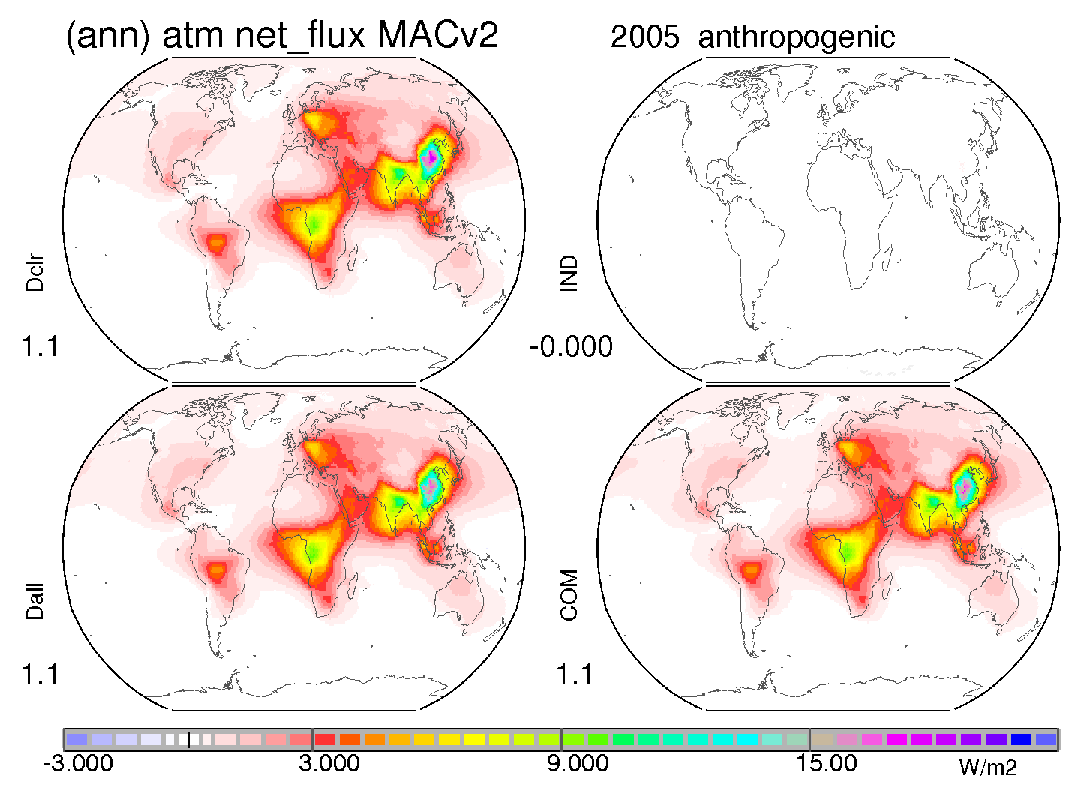
direct vs indirect (atmos) today anthropogenic
for atmos: only direct matters
indirect
direct clear-sky
+ 0.0
direct all-sky
direct +
indirect
+ 1.1
← cooling (net-flux gain) warming →

Slide 15
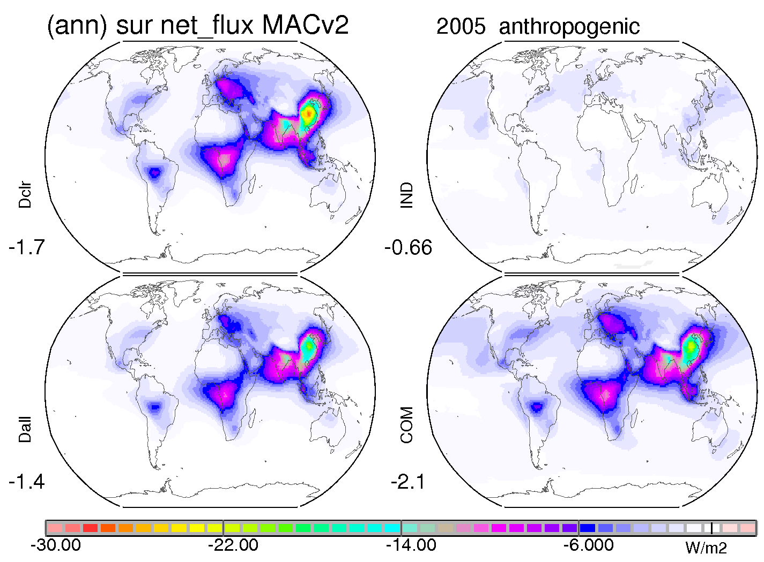
direct vs indirect (surface) today anthropogenic
at surface: direct dominates
indirect
direct clear-sky
- .66
direct all-sky
direct +
indirect
- 1.4
← cooling (net-flux loss) warming →

Slide 16
to remember
there is a lot of spatial variability to aerosol rad. effects, which global averages do not capture
still when using global averages…
the TOA forcing efficiency is at -12 W/m2 /AOD
cooling co-emitters reduce BC mitigation pot.
direct and indirect effects cool - but differently
anthropogenic effects (today) … in W/m2 dominant
TOA: - .67 DIR clr ) - .35 (DIR all ) - .66 (IND) - 1.0 (tot)
atm: +1.1 (DIR clr ) +1.1 (DIR all ) +.00 (IND) + 1.1(tot)
surf: - 1.7(DIR clr ) - 1.4 (DIR all ) - .66 (IND) - 2.1 (tot)

Slide 17
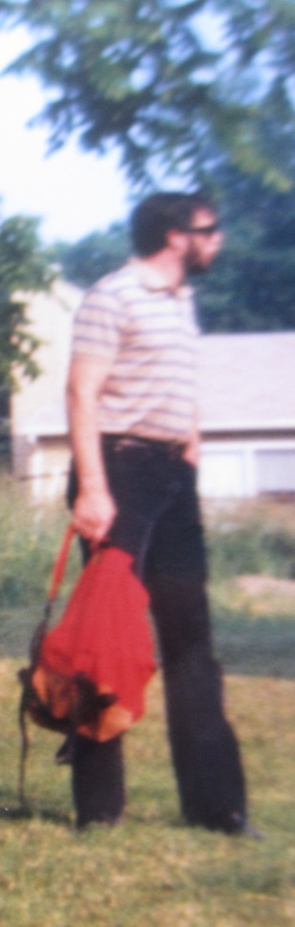
… back to TOM
Tom
always impressed/s with clear presentations
was/is always outspoken … with strong (‘Lutheran’) opinions
has a soft / caring core
among all his accomplishments … (that counts most) … is his family
so if we celebrate TOM, we also celebrate Linda and his family !
… and I was lucky enough as I became part of it … 30 years ago!

Slide 18


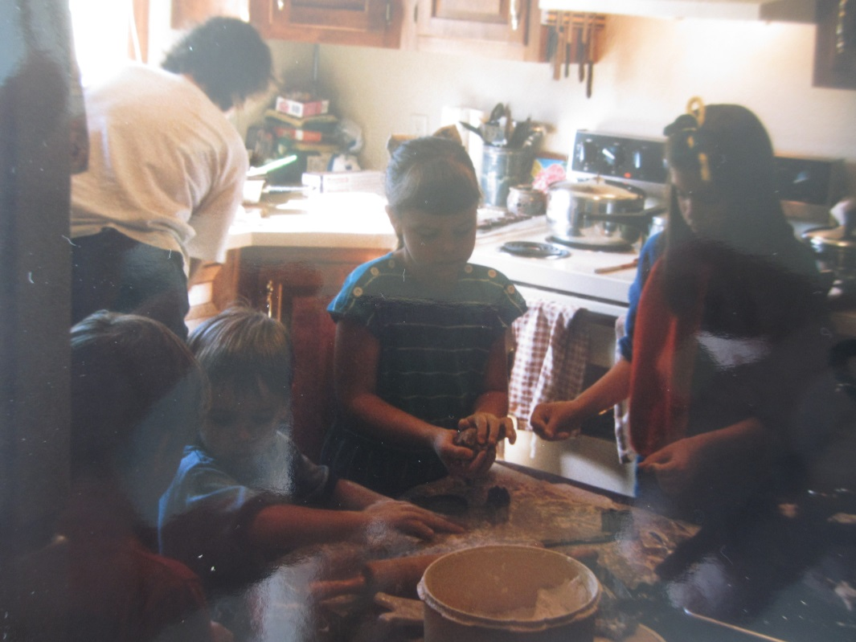
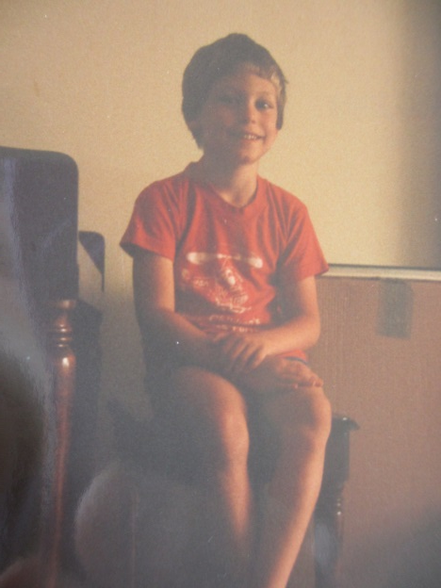
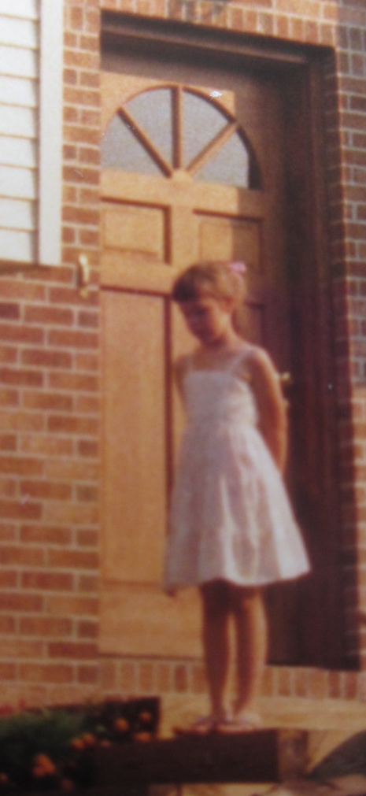
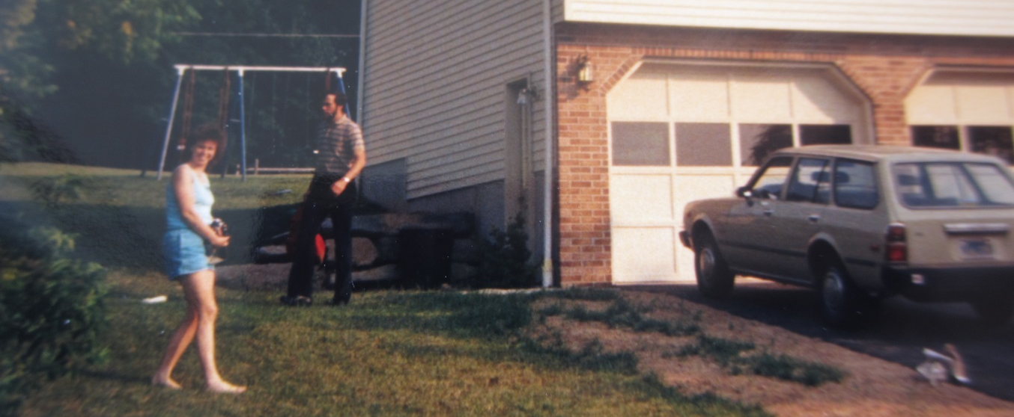
TOM & family

Slide 19
extras

Slide 20
MACv2
Max-Planck Aerosol Climatology version 2
merging of observations and modeling (.55um)
monthly (1x1 lon/lat) gridded global maps for
aod, ssa, asy (at any wavelength)
CCN (IN) estimates
component mixture (BC, OC, SU, SS, DU)
altitude distribution
anthropogenic attribution
temporal (anthropogenic) change
ftp://ftp-projects.zmaw.de/aerocom/climatology/MACv2_2018/

Slide 21
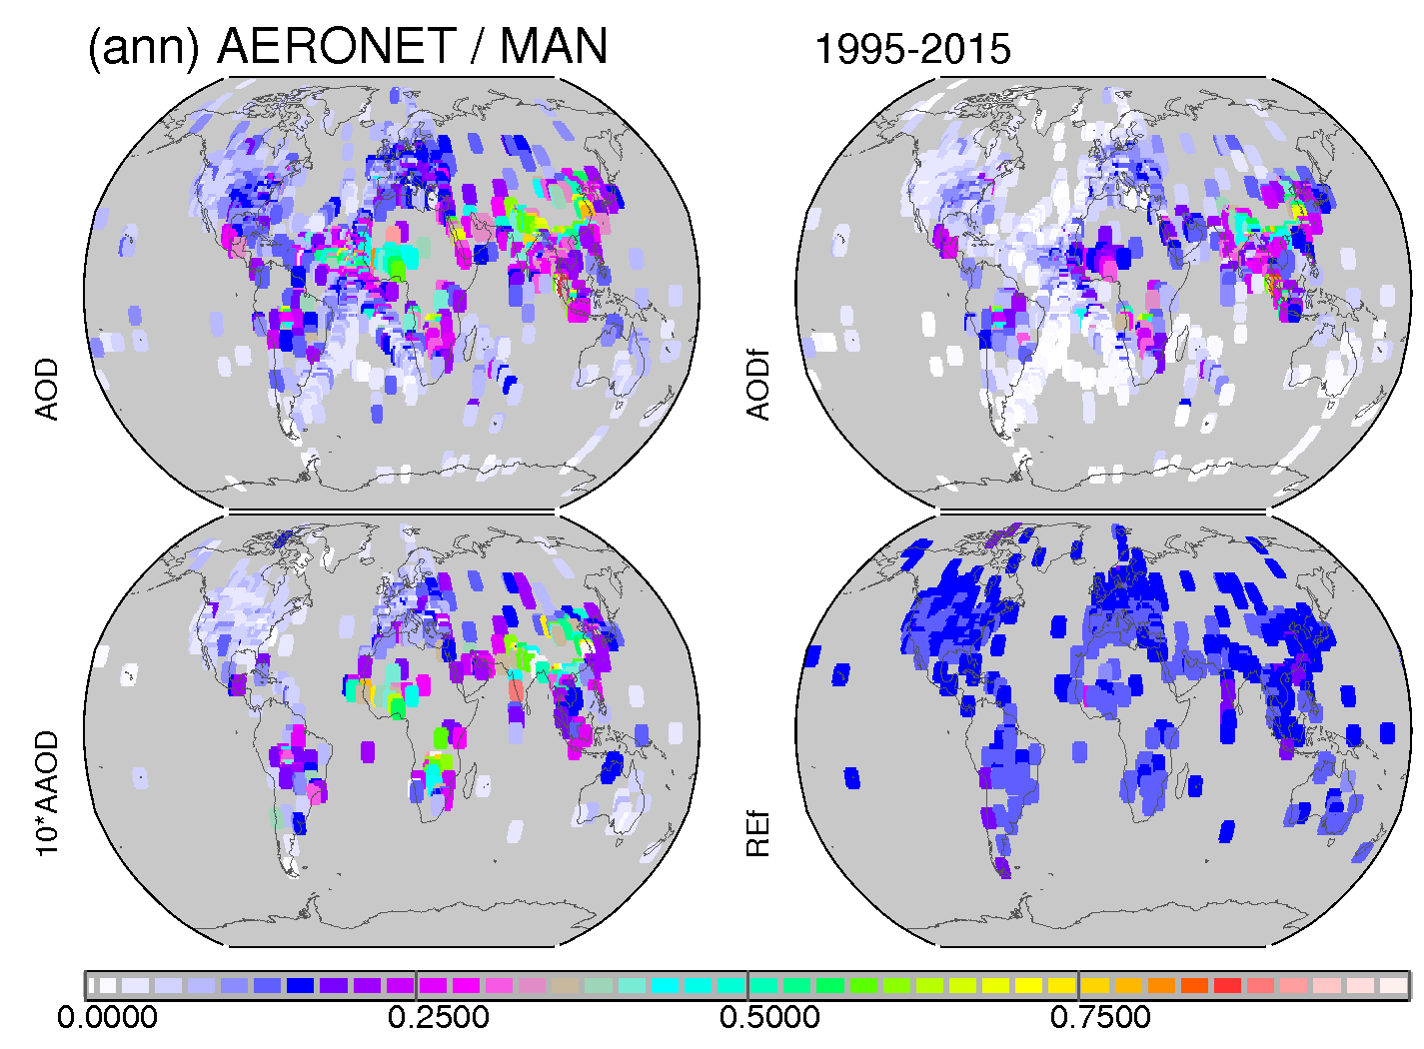
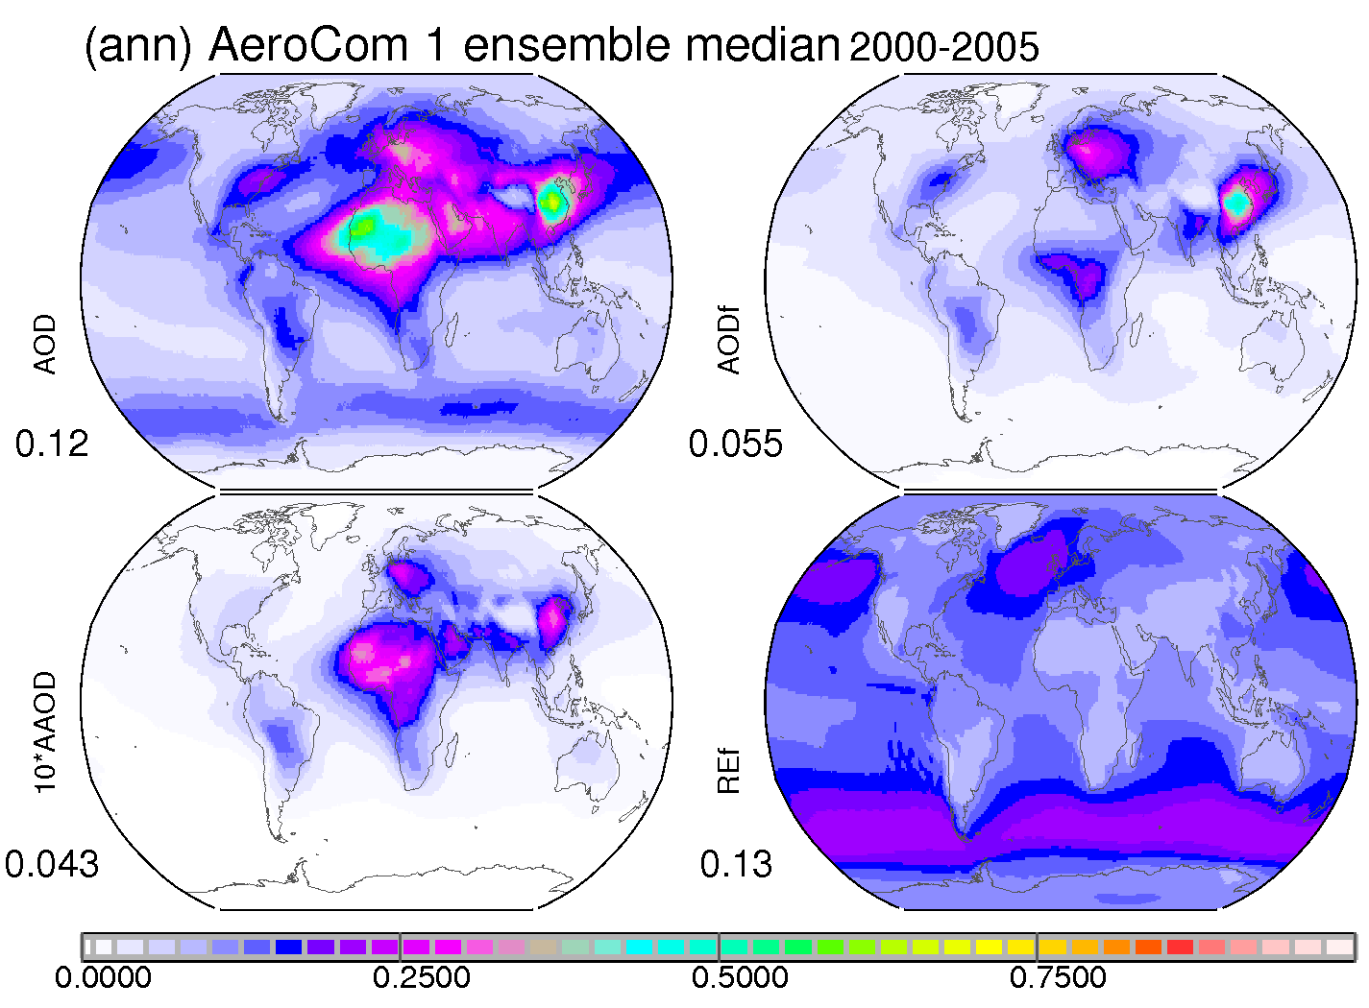
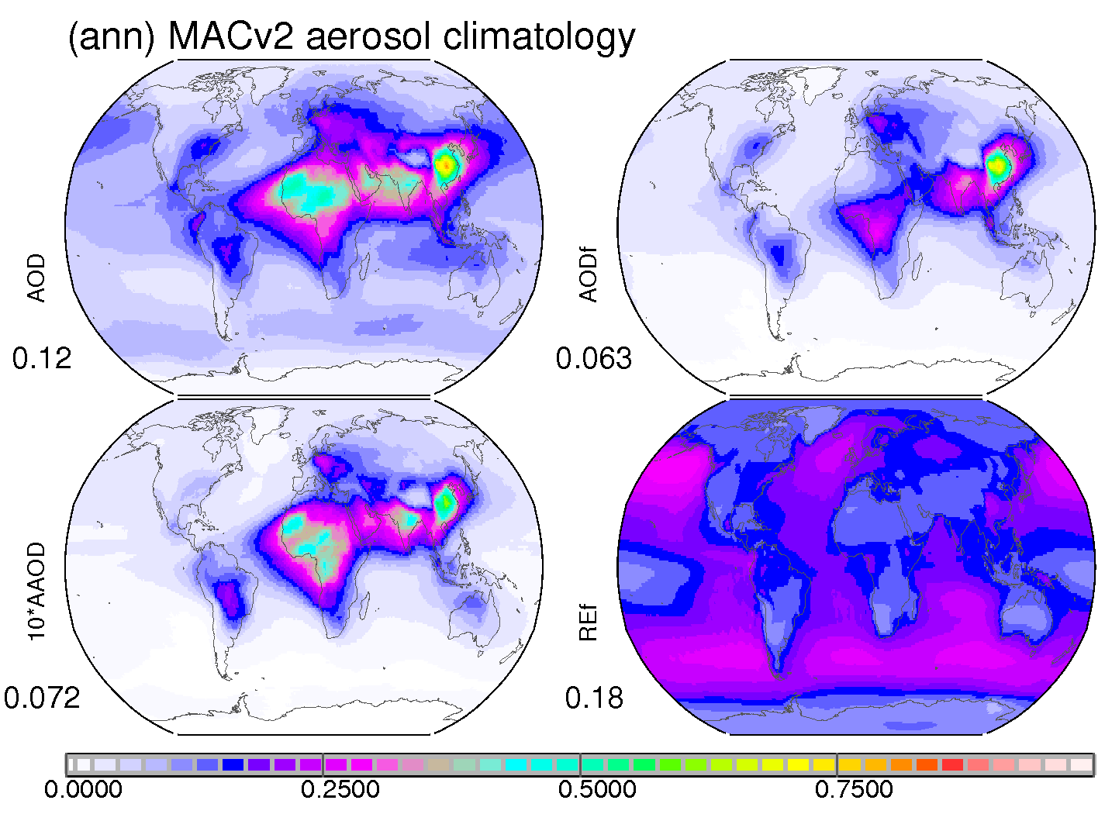
the merging
Ouality
Context
AOD, 550nm
amount
AODf, 550nm
size
AAOD, 550nm
absorption
(10 times)
reff, fine
size

Slide 22
updates in Version 2
more recent AERONET data are included
(multi-year) reference year 2005 (not 2000)
MAN data over oceans are now included
better coverage for AOD and AODf
a new data merging (regional) procedure
stronger AERONET/MAN data weight
only absolute properties are merged
e.g. AAODf, AAODc instead of SSA
pre-defined aerosol types for are applied
spectral dependencies via component AODs
new anthropogenic assignment
now lower - based on IPCC5 emissions

Slide 23
optical properties amount & absorption … by size
AODf AODc
AAODf AAODc
(10 times) (10times)
fine-mode
coarse-mode

Slide 24
anthropogenic
only contributions to sub-micrometer (fine-mode) sizes
based on fine-mode fraction scaling factors by bottom-up AeroCom modeling
AC1 with AeroCom 1 emissions (→ MACv1)
AC2 with AeroCom 2 emissions (→ MACv2)
uncertainties directly affect climate impact estimates
annual AOD 550nm maps
total 2005
33%
anthropogenic 2005
as in MACv1
26%
anthropogenic, 2005
as in MACv2

Slide 25
component mixture MACv2 distributed on pre-defined ‘components’
fine-mode
OC
BC (coated)
SU (non-abs)
coarse-mode
DU
SS
anthropogenic dust (via Ginoux) shown for comparison
AOD
550nm
10*times
10*times
BC and ant-DU multiplied by 10

Slide 26
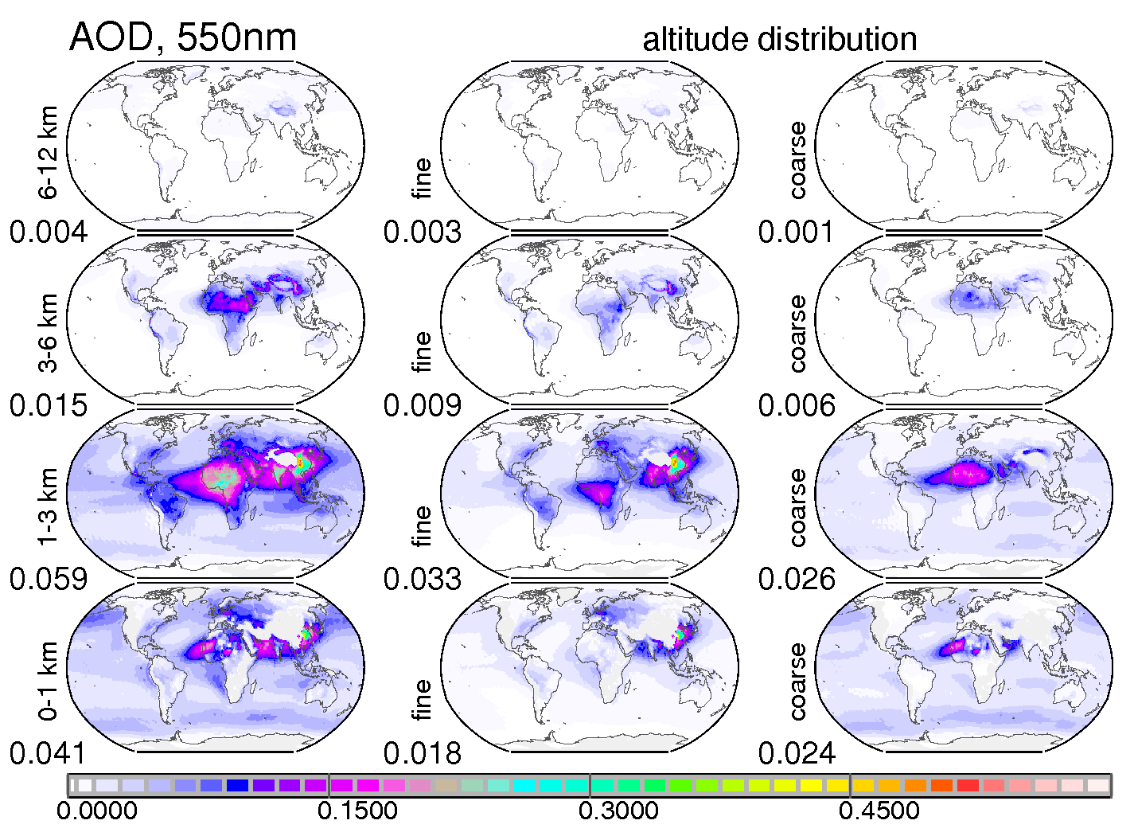
altitude distribution
based on scaling factors (multiplied to MACv2 column AOD) by bottom-up modeling for
fine-mode AOD
coarse-mode AOD
alternate scaling with CALIPSO
fine AOD
coarse AOD
>6
km
asl
3-6
km
asl
1-3
km
asl
0-1
km
asl

Slide 27
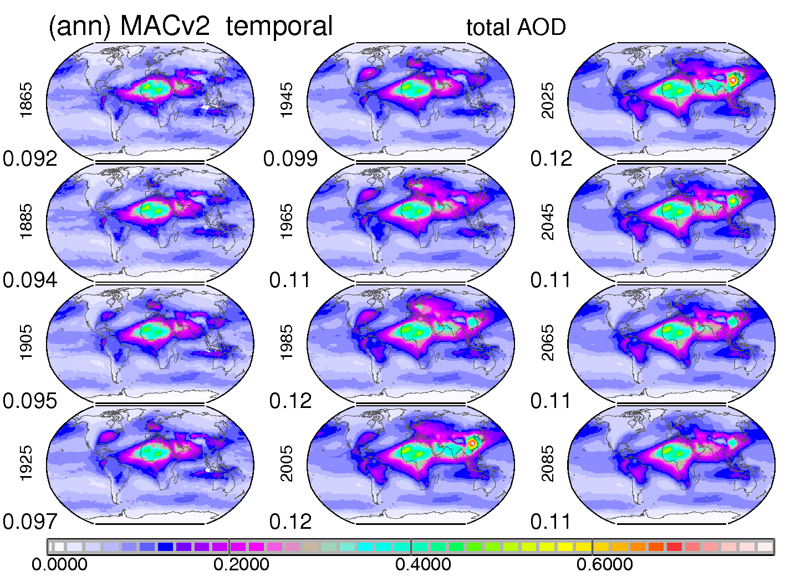
temporal change
natural (coarse-mode + PI fine-mode) unchanged
anthr change
based on scaling via bottom-up
1850-2100
1865
1885
…
2065
2085

Slide 28
MACv2 summary
today’s global column properties here at 550nm
AOD (aerosol optical depth: column amount)
0.122 (total) 0.058 (coarse) 0.063 (fine)
.030(DU) .028(SS) .022(OC) .04(BC) .037(SU)
.031 (anthropogenic)
SSA (single scattering albedo: column absorption)
0.941 (total) 0.964 (coarse) 0.919 (fine)
ASY (asymmetry-factor: angular scattering behavior)
0.70 (total) 0.77 (coarse) 0.64 (fine)
strong spatial and temporal variability
captured by 1x1 lat/lon monthly maps

Slide 29
direct radiative effects
impacts of the aerosol (or added) presence on the radiative energy distribution in atmosphere
apply dual calls in offline radiative transfer with and without (or with less) aerosol and then look at netflux-changes
at TOA (overall climate impact)
at surface (impact on surface processes)
for atmosphere (impact on dynamics)
in the focus
today’s total aerosol
today’s component aerosol components
today’s anthropogenic contributions

Slide 30
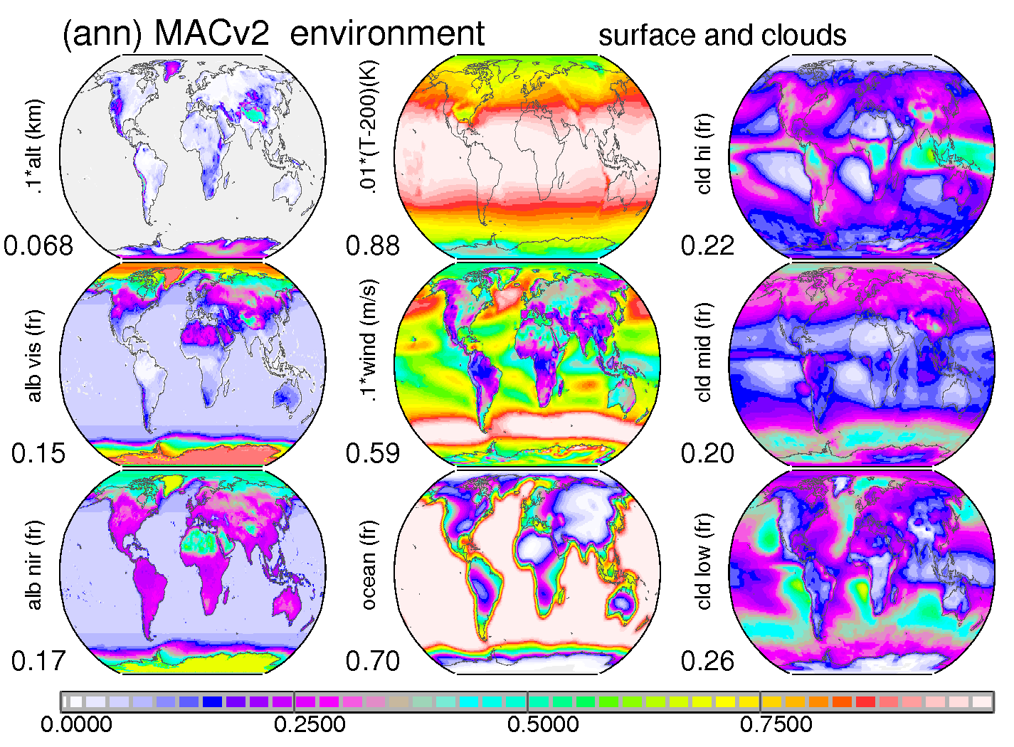
the setup
the radiative transfer model
8 solar / 12 IR bands
two-stream model
9 diff sun-elevations
8 cloud permutations
the monthly input
MACv2 aerosol
ISCCP clouds
MODIS sp. albedo
standard profiles
the output
rad. netflux changes
ISCCP (H/M/L) cloud cover
alt(km)/10
high
MODIS vis
mid
MODIS nIR
low

Slide 31
scenarios
no clouds (clear-sky)
better comparable to observations
with clouds (all-sky)
climate relevancy
focus on TOA and surface impacts
atmospheric impacts by diff (TOA minus surface)
focus on total and solar (SW only) impacts
infrared (LW) impacts by diff (total minus solar )
anthropogenic contribution
solar (SW) impacts only matter

Slide 32
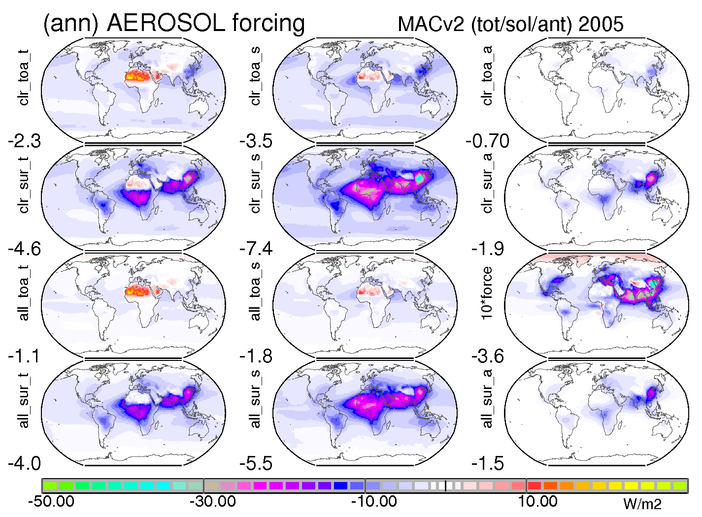
direct effects (today, annual)
total (sol+IR) total (solar only) anthropog.
TOA
clear
surf
clear
TOA
all
surf
all
10*times
← cooling (net-flux loss) (net-flux gain) warming →

Slide 33
forcing efficiencies (/ AOD)
total (sol+IR) total (solar only) anthropog.
TOA
clear
surf
clear
TOA
all
surf
all
← cooling (net-flux loss) (net-flux gain) warming →

Slide 34
comp. TOA effects (today, annual)
(in W/m2) total comp ant-com
DU
+0.25
- 0.25 sol
+0.50 IR
+0.02 ant
SS
-0.55
SU
-0.80
-0.40 ant
OC
-0.45
-0.22 ant
BB
+0.55
+0.25 to +0 .44 ant
0.1*times
0.1*times
← climate cooling climate warming →

Slide 35
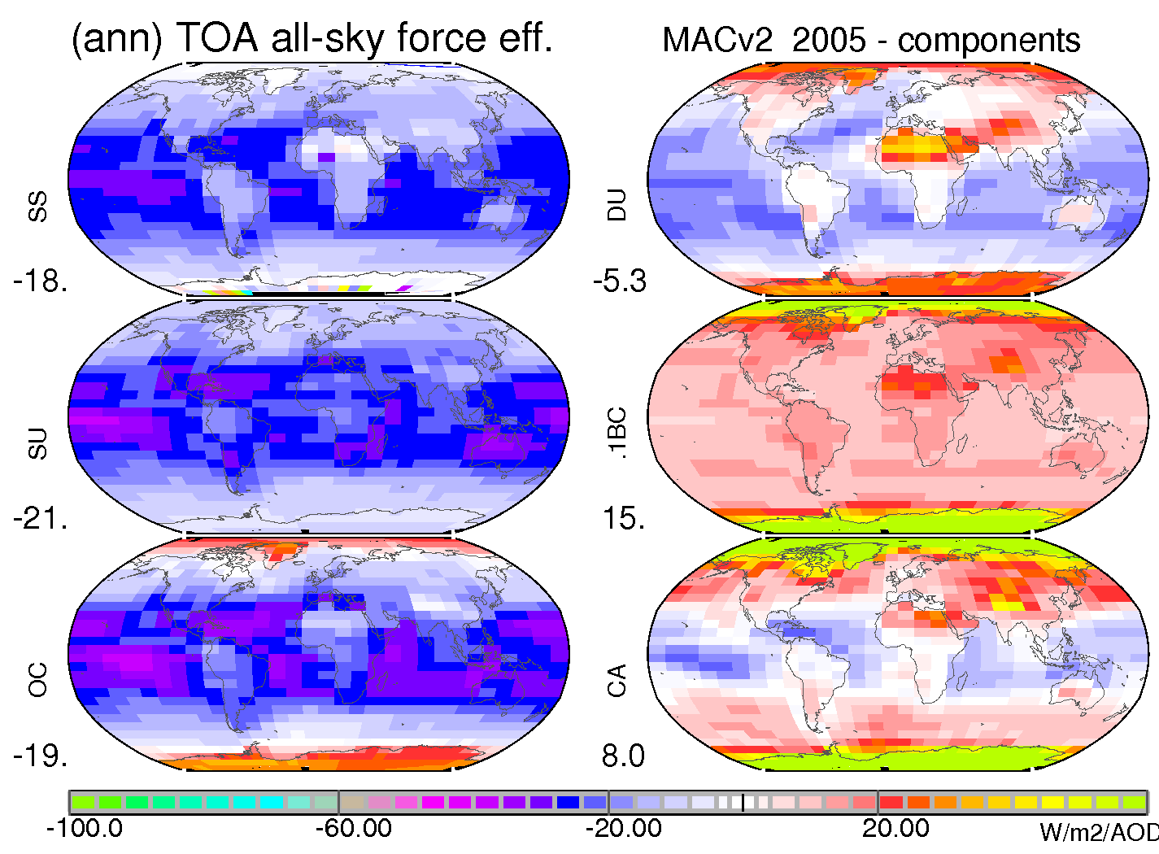
comp. TOA efficiencies (/AOD)
all-sky FE /AOD E
in W/m2 /AOD
SS -20 (-18)
SU -22 (-21)
OC -20 (-19)
DU +8 (-5)
BC +130 (+150)
CA +3 (+8)
using global avg for forcing and AOD
FE spatial avg
0.1*times

Slide 36
direct summary
direct effect (today) … in W/m2
TOA: -1.1 (total) -1.8 sol /+0.7 IR -0.35 (anthrop)
surf: -4.0 (total) -5.5 sol /+1.5 IR -1.5 (anthrop)
component TOA effects … in W/m2
BC: +.55 (total) +.25 .. +.45 (ant) what is ant-BC ?
DU: +.25 (total) + .02 (anthrop) ant-DU small
SU: - .80 (total) - .40 (anthrop) main ‘cooler’
OC: - .45 (total) - .22 (anthrop)
CA: +.08 (total) +.05 (anthrop) OC+BC ~ neutral
SS: - .55 (total) not anthrop

Slide 37
aerosol and climate
part of today’s aerosol is anthropogenic
20-33% of today’s global average AOD
> 50% of today’s global mean aerosol number
two main impacts on to consider
added presence in the atmosphere (DIRECT)
aerosol modified water clouds (INDIRECT)
indirect effects ?
aerosol provide nuclei on which droplets grow
→ smaller droplets at water condensation
+ higher planetary albedo, delayed precipitation - faster evaporation at dry air entrainment.

Slide 38
indirect assumptions
only water drop size reductions matter
cloud-lifetime effects are secondary
MODIS retrievals identify reduced drop sizes but no significant changes to water content with Iceland volcano sulfate over the Atlantic
apply satellite regional microphys associations
use ‘observations’ … rather than model parameteriz.
use large scale stats … exaggeration at small scales
use fine mode AOD for aerosol concentration
use ‘good’ CDNC … overcast, ocean, no-side views
regionally associate (diff sensors: MODIS, ATSR)

Slide 39
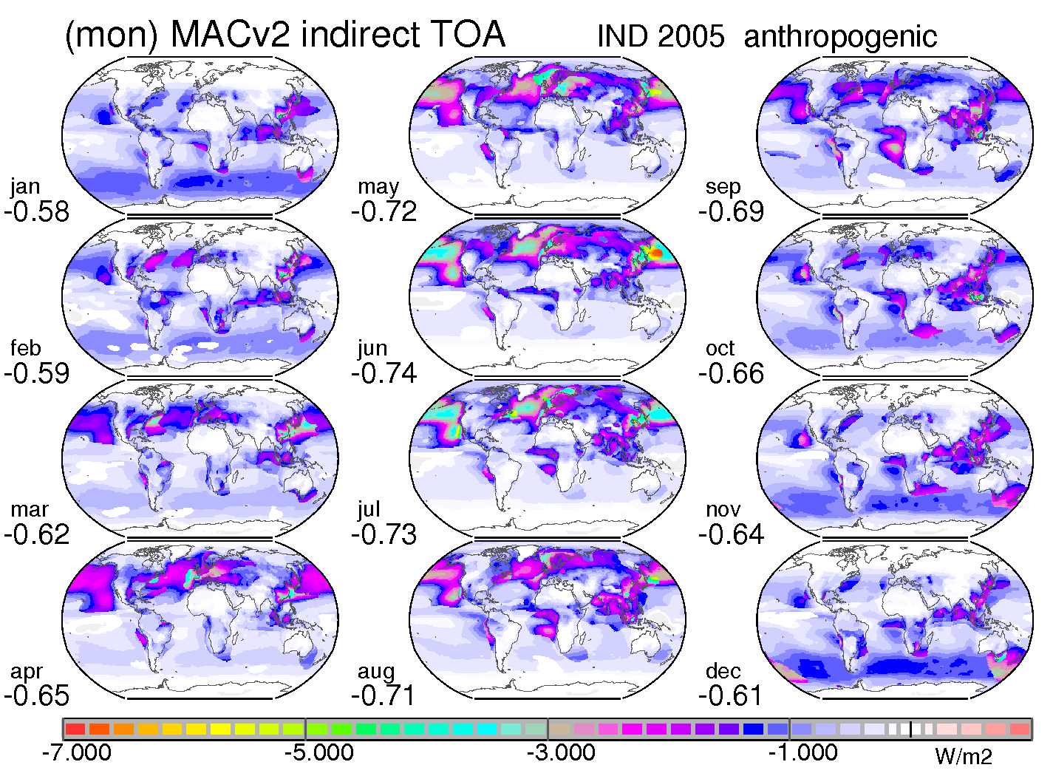
indirect – on planetary albedo
impact is strongly influenced by environment !
sun
clouds
altitude
surface
seasonality !
over oceans !
← cooling (net-flux loss)

Slide 40
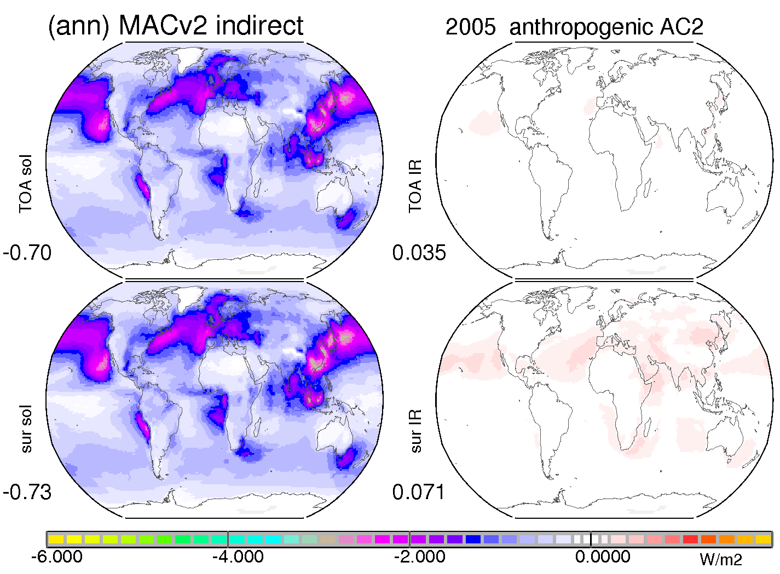
today’s aerosol indirect effect
solar impact dominates -.70 W/m2 cooling
IR impacts are small - especially at TOA
solar
IR
TOA
surface
← cooling (net-flux loss) (net-flux gain) warming →

Slide 41
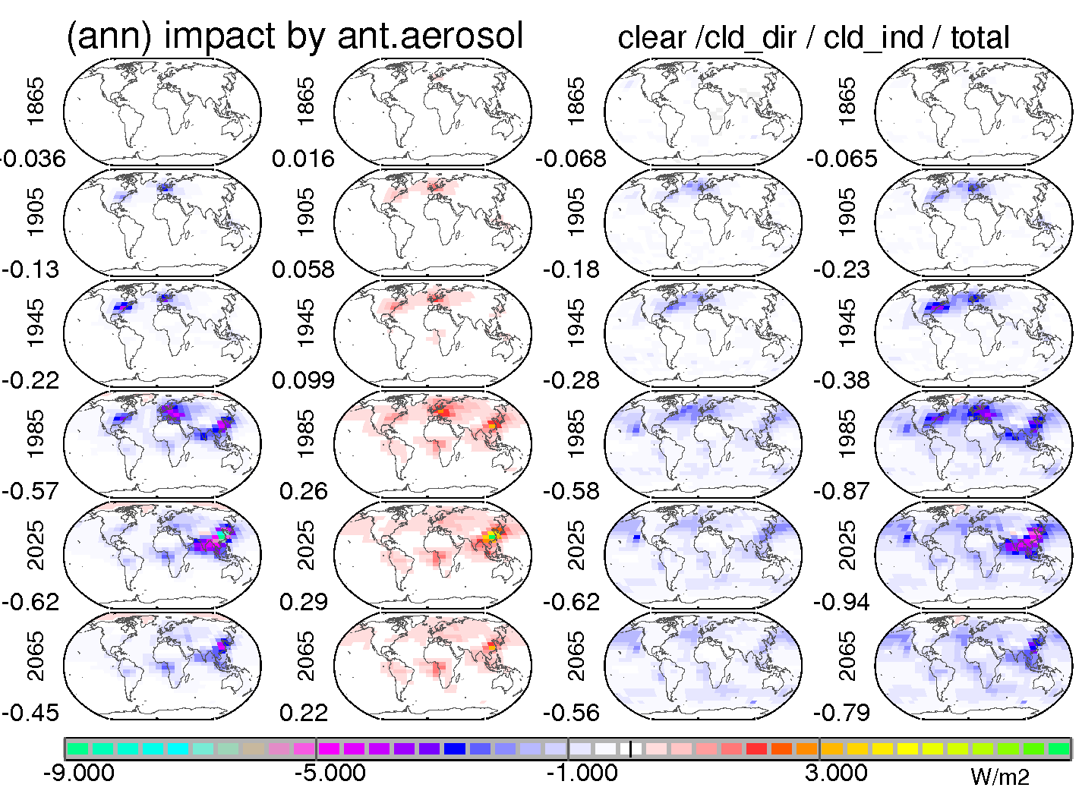
direct vs indirect

Slide 42
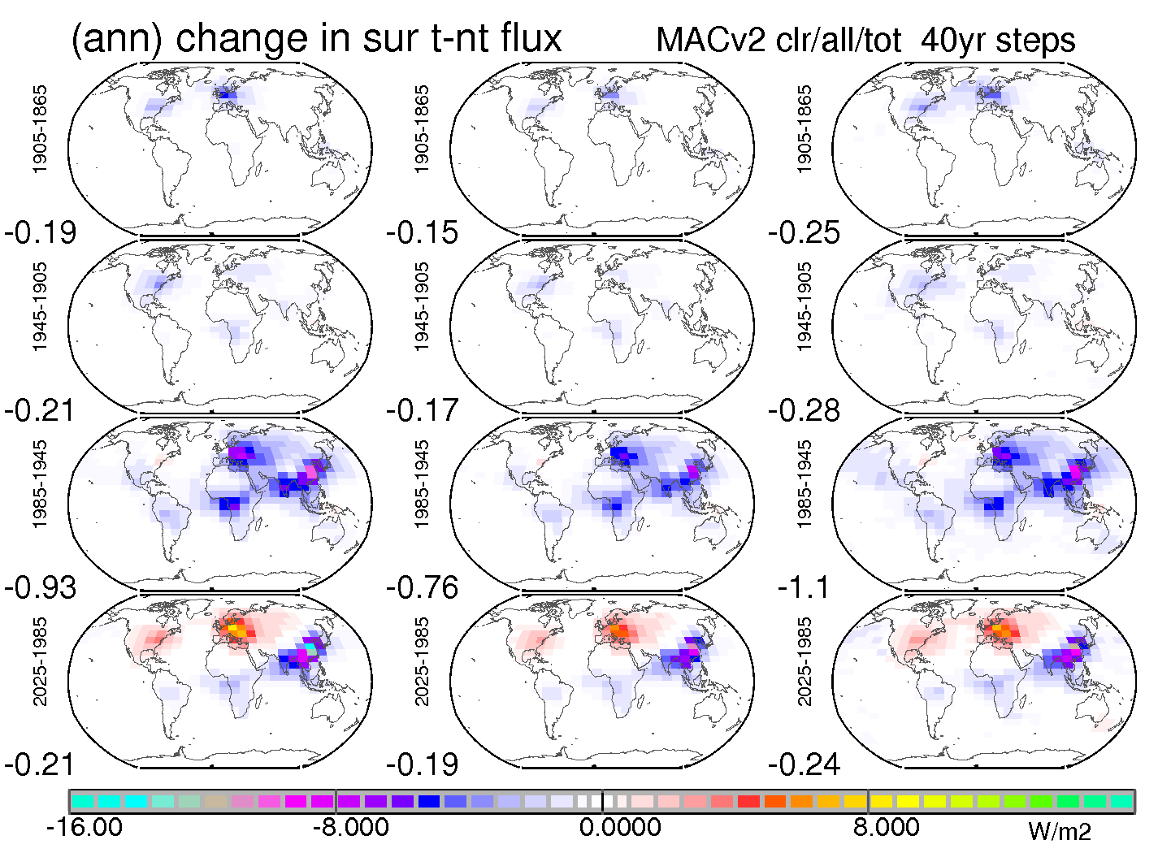
dimming / brightening
at surface direct/clear direct/all direct + ind
1905
- 1865
1945
-1905
1985
-1945
now
-1985

Slide 43
retrieval model by MACv2
assume a simple 4 component model
fine-mode strong absorbing type
fine-mode scattering type
coarse-mode strong absorbing type
coarse-mode scattering type
MACv2 (AODf, AODc, AAODf, AAODc) defines
fractional contributions for fine-types
fractional contributions for coarse types
fractional contributions of fine-mode and coarse-mode by AOD
for any loc / month → COMPOSITION defined

Slide 44
ingredients
MACv2
defines →
AODc
AODf
AAODc,
AAODf
ICAP
defines
FMF as function of AOD

Slide 45
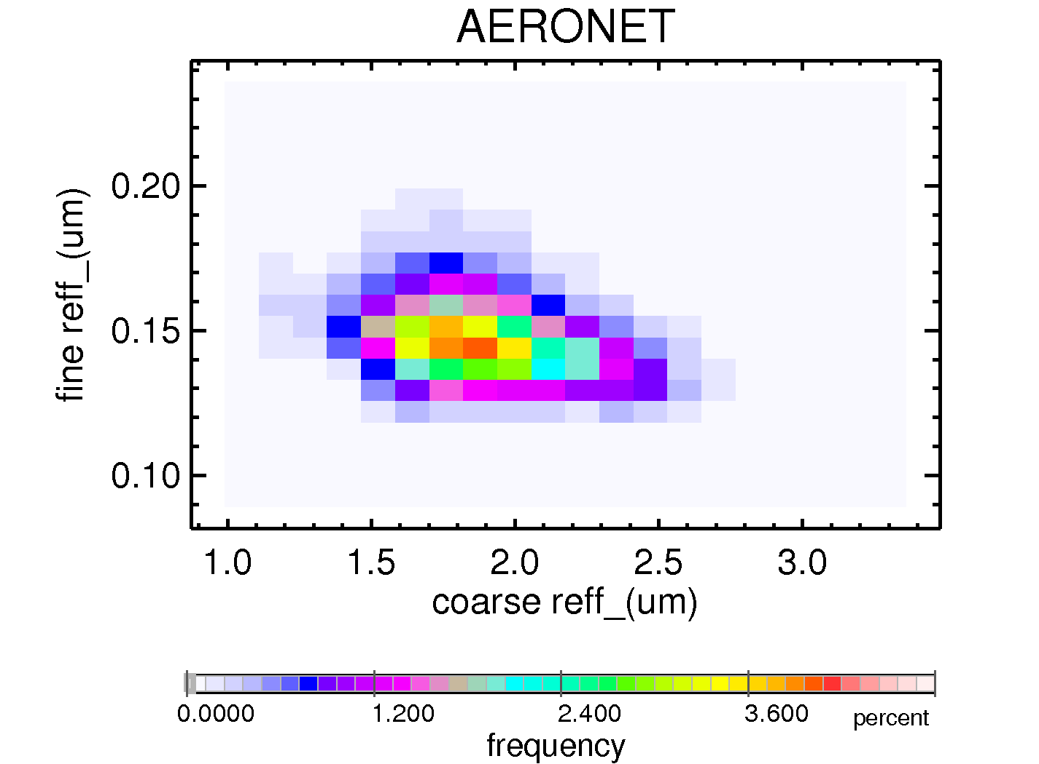
bi-modal distribution
fine-mode
Reff = .145um
coarse-mode
Reff = 1.9um
based on
AERONET
statistics

Slide 46
scatt & abs ‘extreme’ types
prepare LUT for 4 log-normal distributions
fine
r,m =.096, sdev. 1.5; RI,im = 0.0 (→SSA=1)
r,m =.096, sdev. 1.5; RI,im = 0.05 (→SSA=.77)
coarse
r,m =.97, sdev. 1.7; RI,im = 0.0 (→SSA=1)
r,m =.97, sdev. 1.7; RI,im = 0.01 (→SSA=.74)

Slide 47
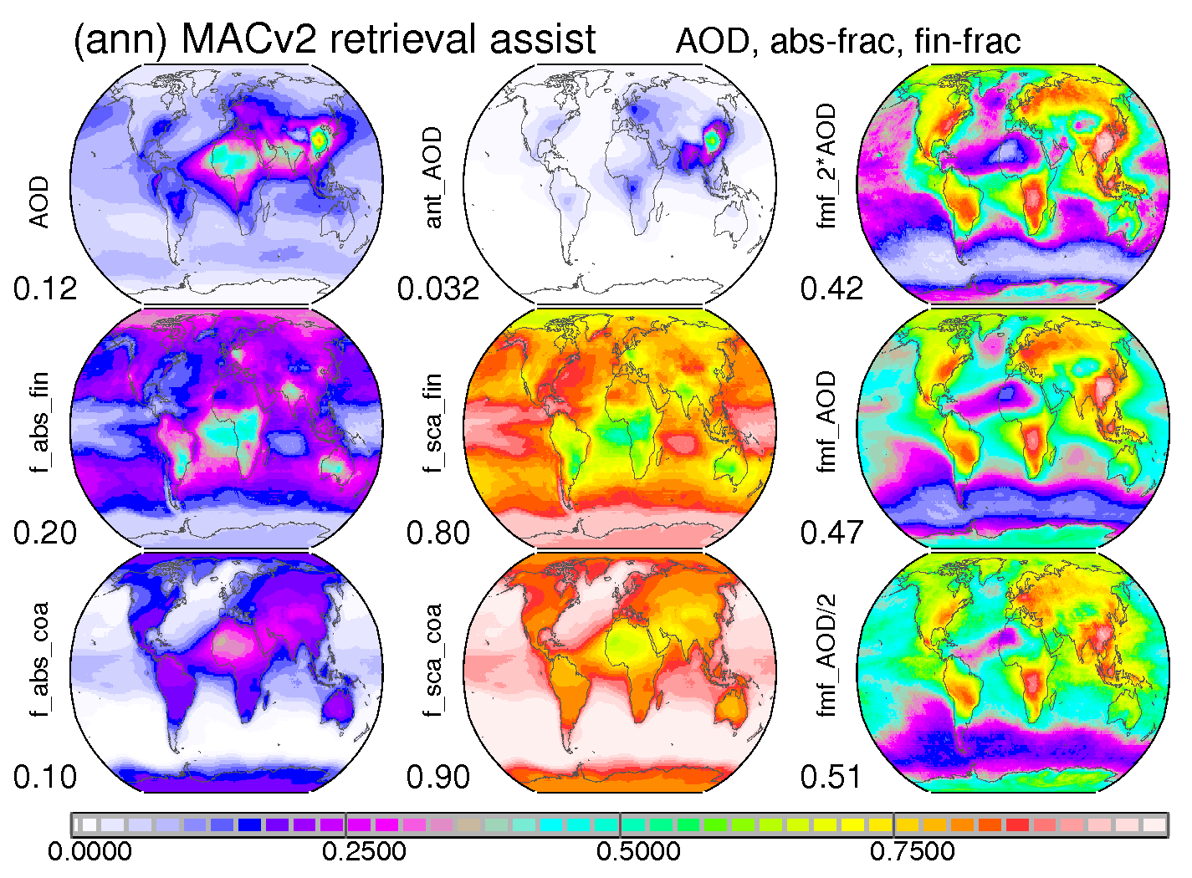
local fraction per size mode
MACv2
prescribes the absorbing type fractions for
fine-mode
coarse-mode
the remaining fraction goes to ‘scattering’ type

Slide 48
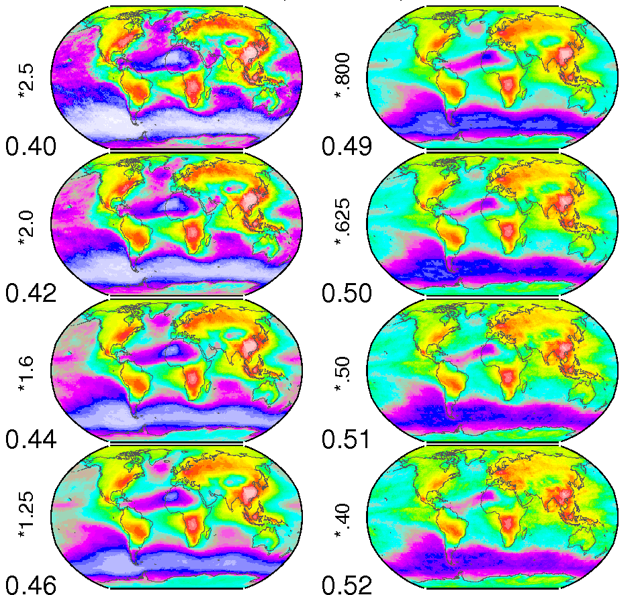
FMF (as function of AOD)
FMF
for different
AOD ret / AOD MACv2
factors
2.5
2.0
1.6
1.25
.8
.625
.5
.4

Slide 49
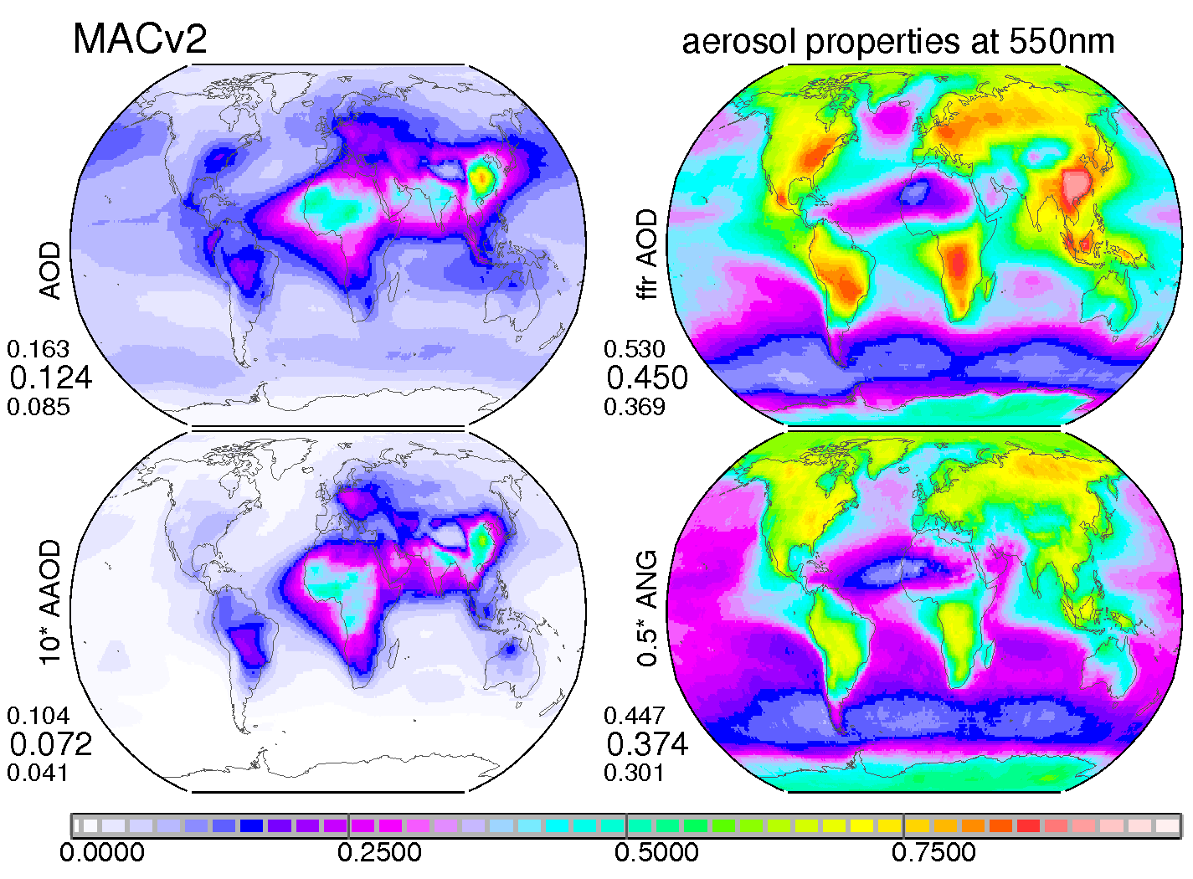
concept for an retrieval
assume the local MACv2 fine-mode fraction
define fine- and coarse-mode fraction according to mode absorption by MACv2
retrieve an AOD and
compare to MACv2 value →
based on AOD diff pick an improved fine fraction
retrieve the eventual AOD
all needed monthly 1x1 global maps are on ftp
ftp://ftp-projects.zmaw.de/aerocom/climatology/ MACv2_2018/retrieval/ read the README file

Slide 50
outlook
quantify variablity
(monthly) PDFs in place of averages
accounting for associations (e.g. AOD - AAOD)
use more / better observations
consider spatial context from assimilations of satellite data
use active remote sensing to for AOD alt-distr.
apply updated / more photometer data
address uncertainty
via sensitivity studies

