Slide 1
Sunlight is Free: How Atmospheric Scientists help Harness it
Manajit Sengupta
University of Washington, Seattle, WA
July 14th, 2018

Slide 2
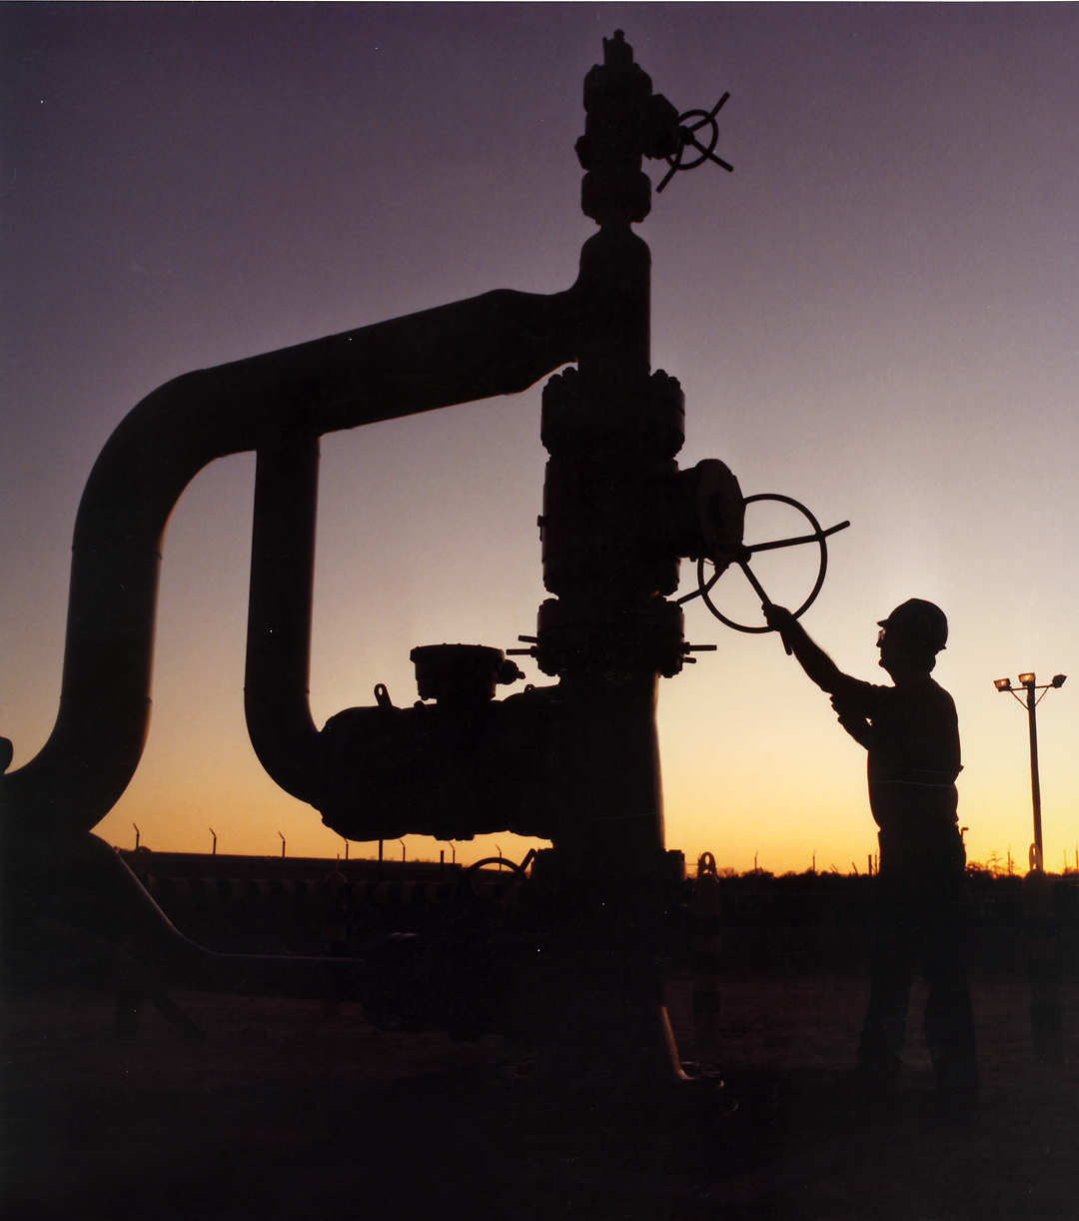
The Fuel is Free…but Variable
Understand the Weather-Driven
Renewable Energy FUEL Supply:
Characterize renewable energy density which varies with TIME and LOCATION
In one average day at NREL,
an area of 236 m² receives 1.7MWh of solar radiation
~13 parking spaces = 1 BOE/day
Credit: DOE
*1 Barrel of Oil = 1.7MWh

Slide 3
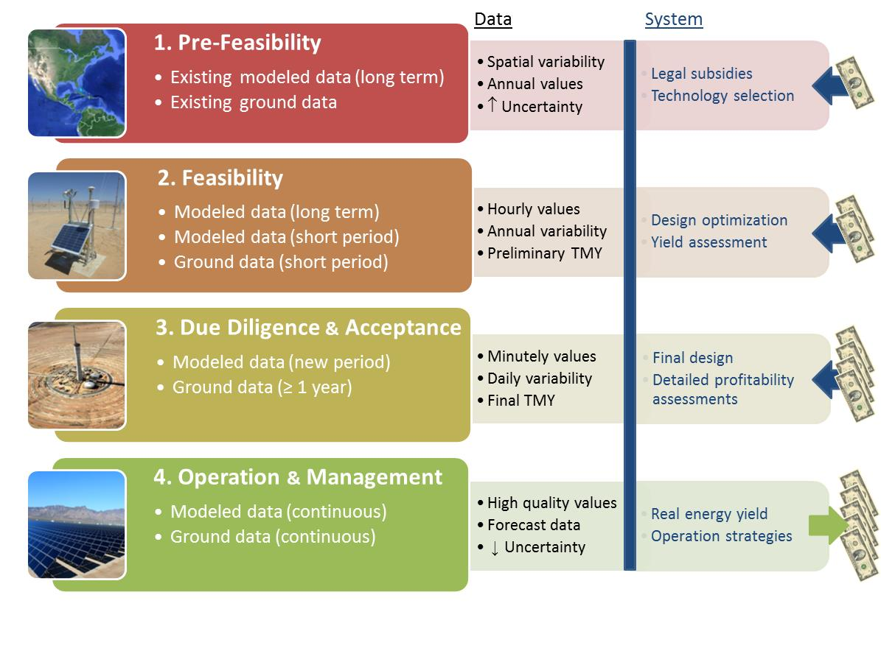
How is Solar Resource Information Applied
Reduce solar deployment, financing and operational costs.
Source: https://www.nrel.gov/docs/fy18osti/68886.pdf

Slide 4
What are our Research Objectives?
1. Improve accuracy and reduce costs of solar measurements.
4. Disseminate accurate solar resources information
2. Develop accurate solar resource data products and models
3. Develop & publish standards and best practices for solar measurement and modeling
Impact: Easily accessible, high-quality solar resource information reduces the cost of solar prospecting, financing, deployment and operations.

Slide 5
Measurement and Standards

Slide 6
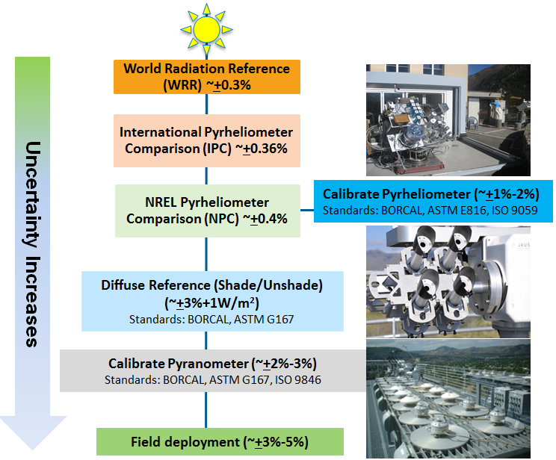
How uncertain is our best measurement?
Sources of Measurement Uncertainty
Calibration
Spectral response
Zenith angle response
Maintenance-Soiling
Data logger uncertainty
Temperature dependence
Nonlinear response
Thermal offset
Instrument aging

Slide 7
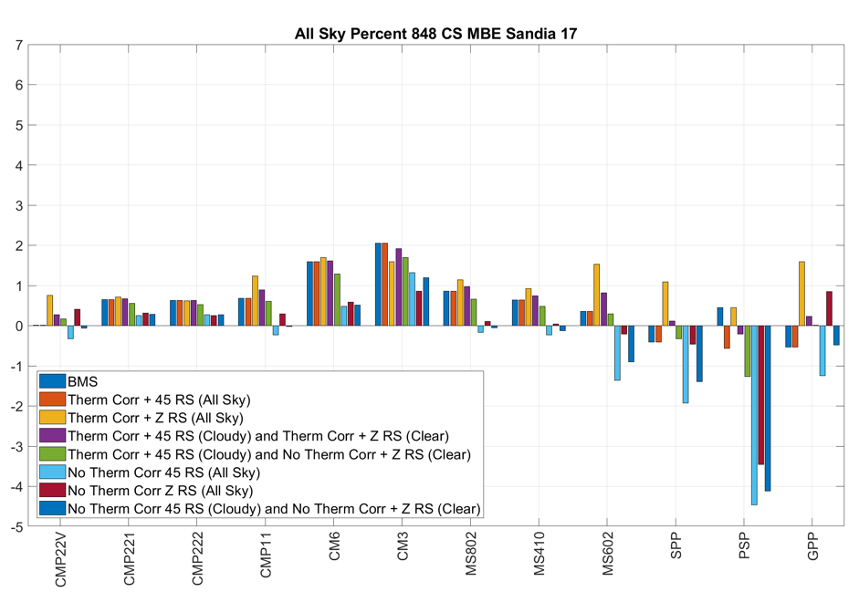
Comparing Radiometers under All-sky Conditions

Slide 8
Can we evaluate long-term variability?
GHI measurements using PSP from 1981.
Factory calibration used initially.
NREL calibration process changed over the years.
Thermal offset correction needed for this instrument but was only used in later years.

Slide 9
Standardization Helps
Standards reduce the cost of doing business – essentially reducing the cost of generating electricity from renewable technologies.
E824-10 Standard Test Method for Transfer of Calibration From Reference to Field Radiometers (Calibration Standard)
G173-03(2012) Standard Tables for Reference Solar Spectral Irradiances: Direct Normal and Hemispherical on 37° Tilted Surface (Modeling standard)
G183-15 Standard Practice for Field Use of Pyranometers, Pyrheliometers and UV Radiometers (Deployment standard)
ISO – 9060 – Specification and classification of instruments for measuring hemispherical solar and direct solar radiation, (Classification Standard)
E927-10(2015) Standard Specification for Solar Simulation for Photovoltaic Testing (Technology Evaluation standard)

Slide 10
Modeling Solar Radiation

Slide 11
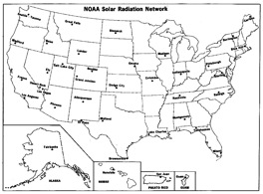
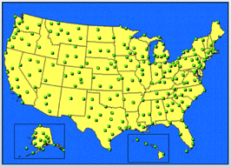
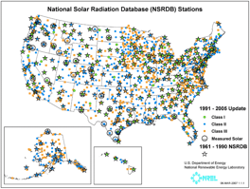
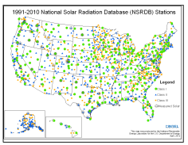
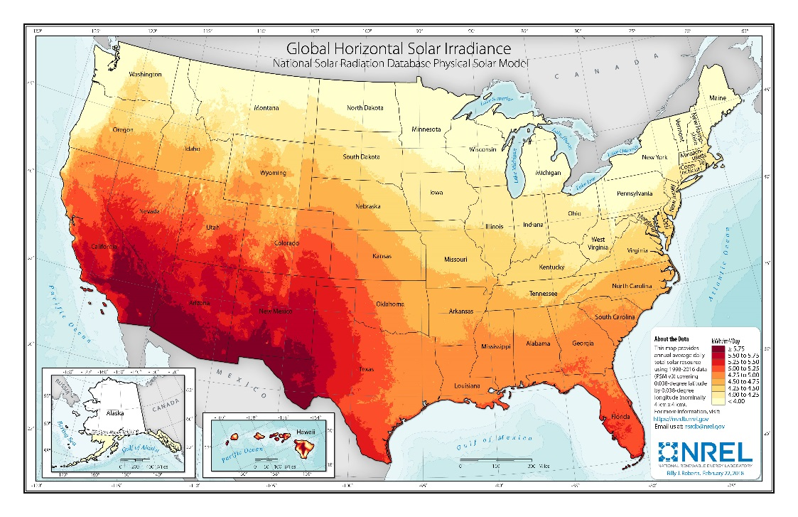
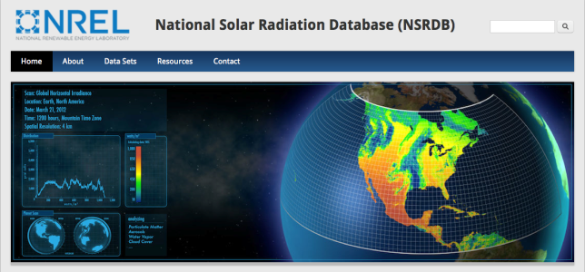
The National Solar Radiation Data Base
SOLMET 1977–80
NSRDB 1961–1990
NSRDB 1991–2005
NSRDB 1991–2010
248 weather stations with 26 Solar measurement stations [ERDA, NOAA, 1979]
239 modeled stations with 56 partial measurement stations
[DOE, NOAA, 1994]
1,454 modeled locations
[DOE, SUNY-A, NOAA, 2007]
1,454 modeled locations
[DOE, CPR, 2012]
http://nsrdb.nrel.gov
Satellite-based, gridded, 4 km x 4 km, half-hourly [DOE, NOAA, UW, SCS 2016]

Slide 12
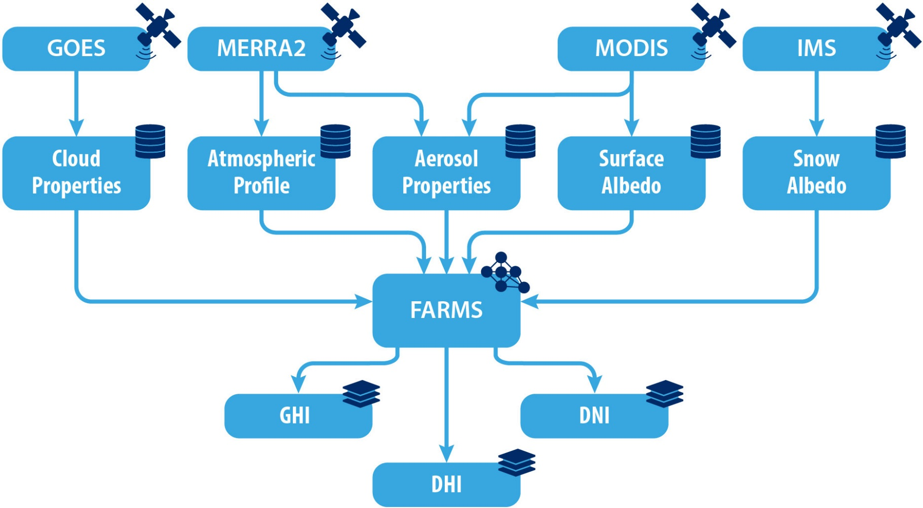
The Physical Solar Model (PSM) Framework

Slide 13
Solar Energy Models are Empirical and Time-Efficient
Solar Energy
Meteorology
Solving the radiative transfer equation for clear and cloudy conditions
Time-consuming.
Regression and parameterization
Mostly for clear sky
Time-efficient.
The Simple Model of the Atmospheric Radiative Transfer of Sunshine (SMARTS) computes clear-sky solar irradiances in 2002 wavelengths using <0.1 second.

Slide 14
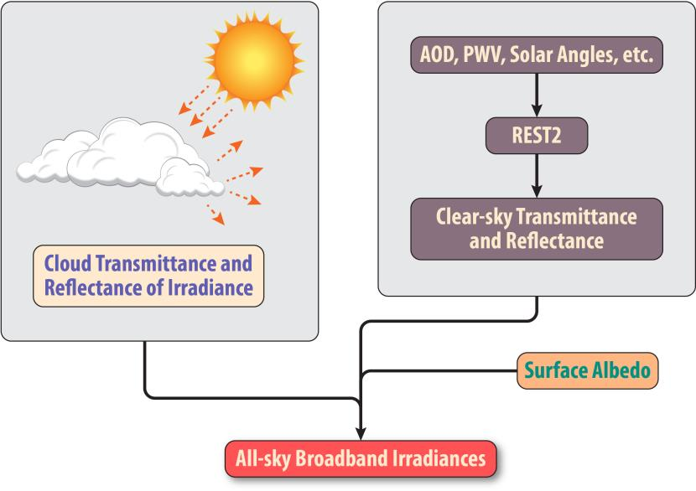
Fast All-sky Radiation Model for Solar applications (FARMS)
Xie et al., Solar Energy (2016)

Slide 15
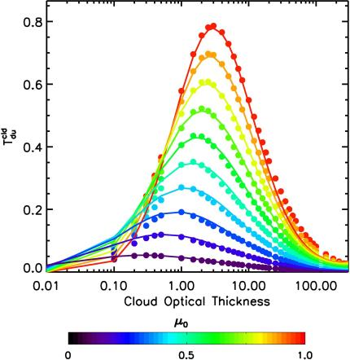
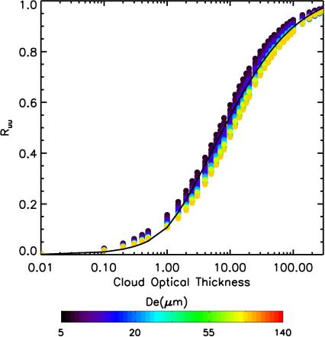
Parameterization of Cloud Transmittance and Reflectance
Cloud transmittances are parameterized as exponential functions of cloud optical thickness and solar zenith angles.
Cloud reflectances are parameterized using simple equations of cloud optical thickness.

Slide 16
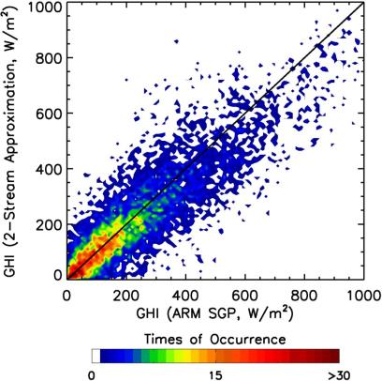
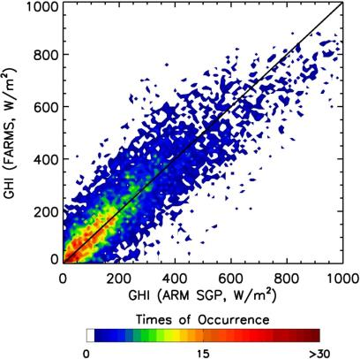
FARMS Is as Accurate as RRTMG
RRTMG
FARMS
GOES satellite data are collocated to a U.S. Department of Energy Atmospheric Radiation Measurement (ARM) Southern Great Plains (SGP) site. The satellite-based retrievals of cloud properties are used as inputs to two-stream and FARMS. A total number of 9,669 scenarios associated with cloudy-sky conditions are selected during 2009–2012.

Slide 17
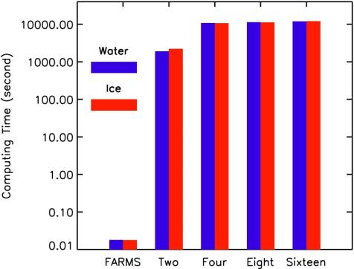
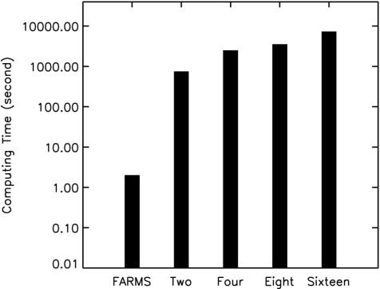
FARMS Is Much More Time-Efficient
32 min.
3 h, 30 min.
13 min.
2 h
2 s
0.018 s
Computation of cloud T for 39 cloud optical thicknesses, 28 particle sizes, and 50 solar zenith angles
Computation of solar radiation for 9,669 scenarios of cloudy-sky conditions over ARM SGP

Slide 18
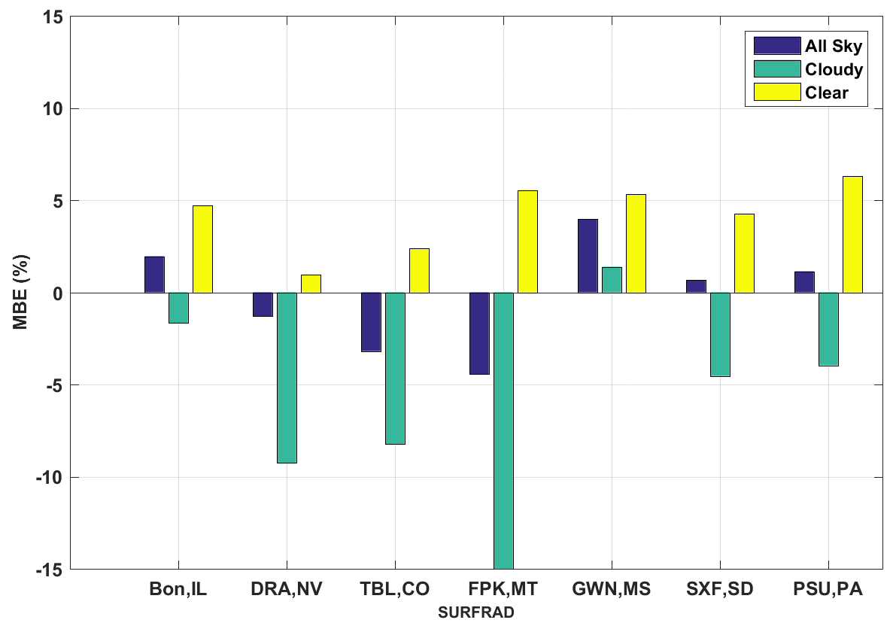
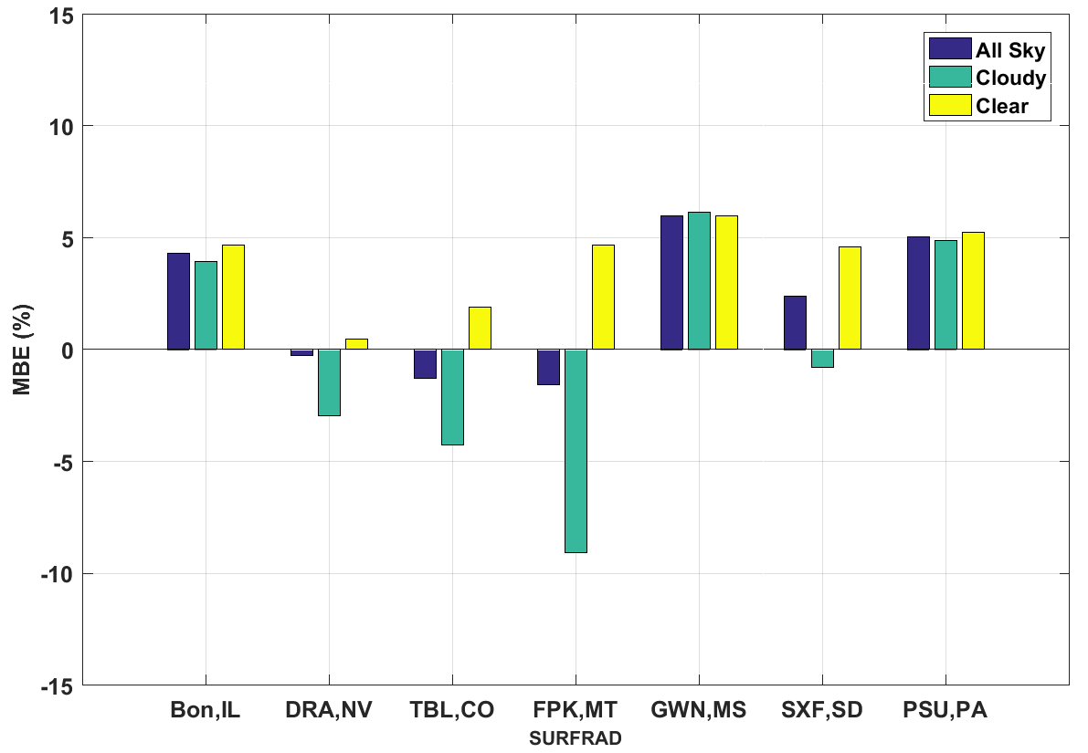
Validating the NSRDB
GHI: NSRDB Version 2
GHI: NSRDB Version 3
Difference between the two versions:
MERRA-2 hourly AOD vs monthly AOD
Precipitable water vapor from MERRA2
Surface Albedo from MODIS and Snow Cover from IMS
Time shifting method on GOES East.

Slide 19
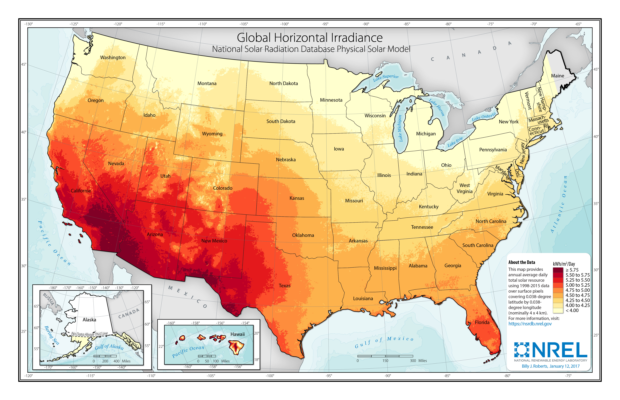
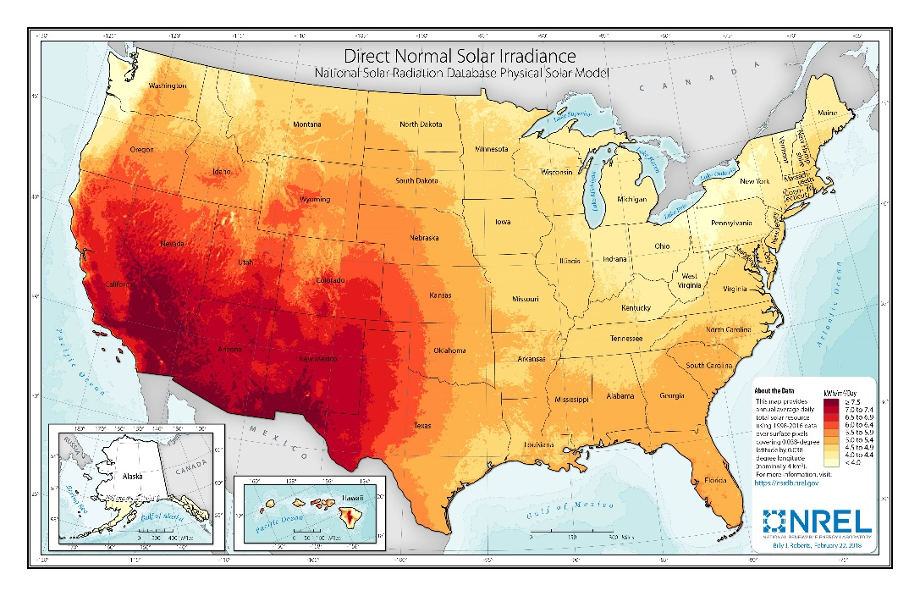
Making Technology Viable
DNI Version 2
GHI Version 2
DNI Version 3
GHI Version 3

Slide 20
New Challenges
Developing cheaper instruments with low maintenance but similar accuracy – used of photodiodes and LED’s
Improving cloud property and aerosol retrievals using next-generation satellites (GOES-16)
Forecasting solar radiation at various time-scales – sub-hourly to days ahead
The biggest challenge: Keep Tom’s legacy of excellence going!

Slide 21
Handing over to the next-generation:
Tom’s retiring!
Pourna’s off to college!
Can assure you that the future is in good hands.

