Slide 1
Evaluation of Surface Irradiance in Models using ARM Data: A 20-year Retrospective
Laura Hinkelman

Slide 2
In the beginning:

Slide 3
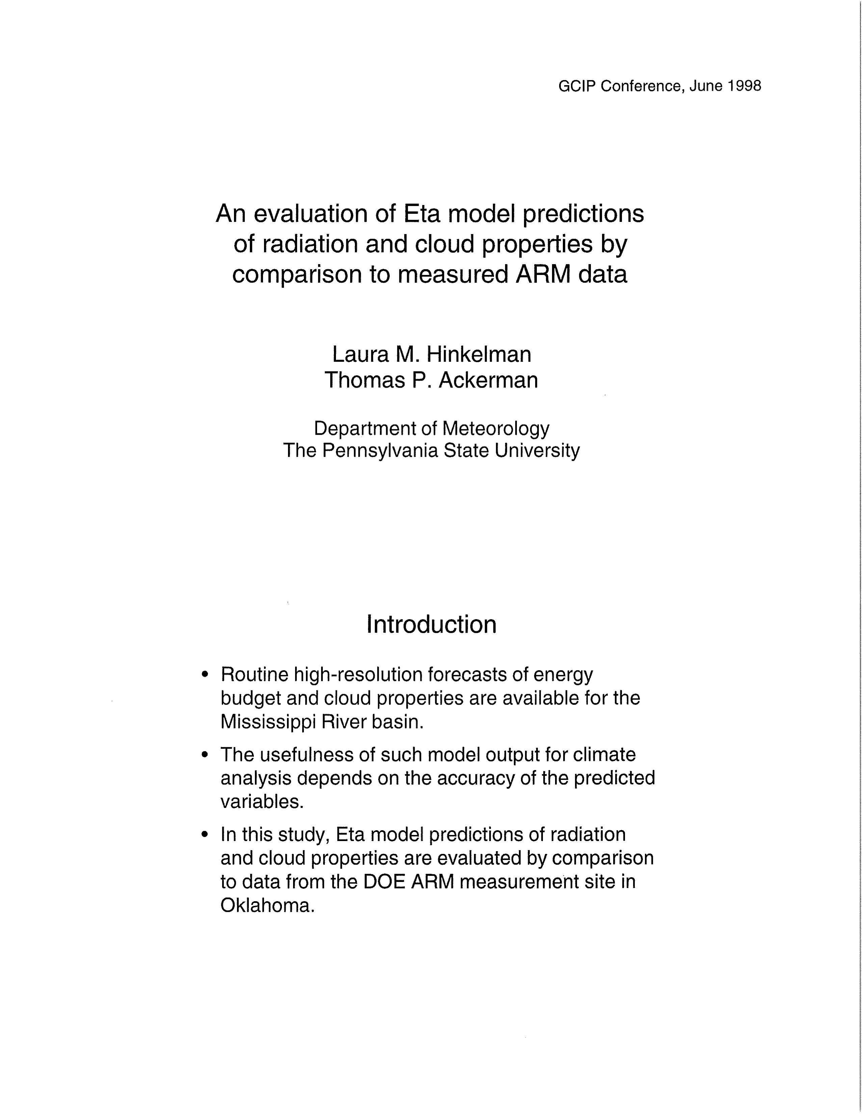
In the beginning:

Slide 4
Background:

Slide 5
!!
Background:

Slide 6
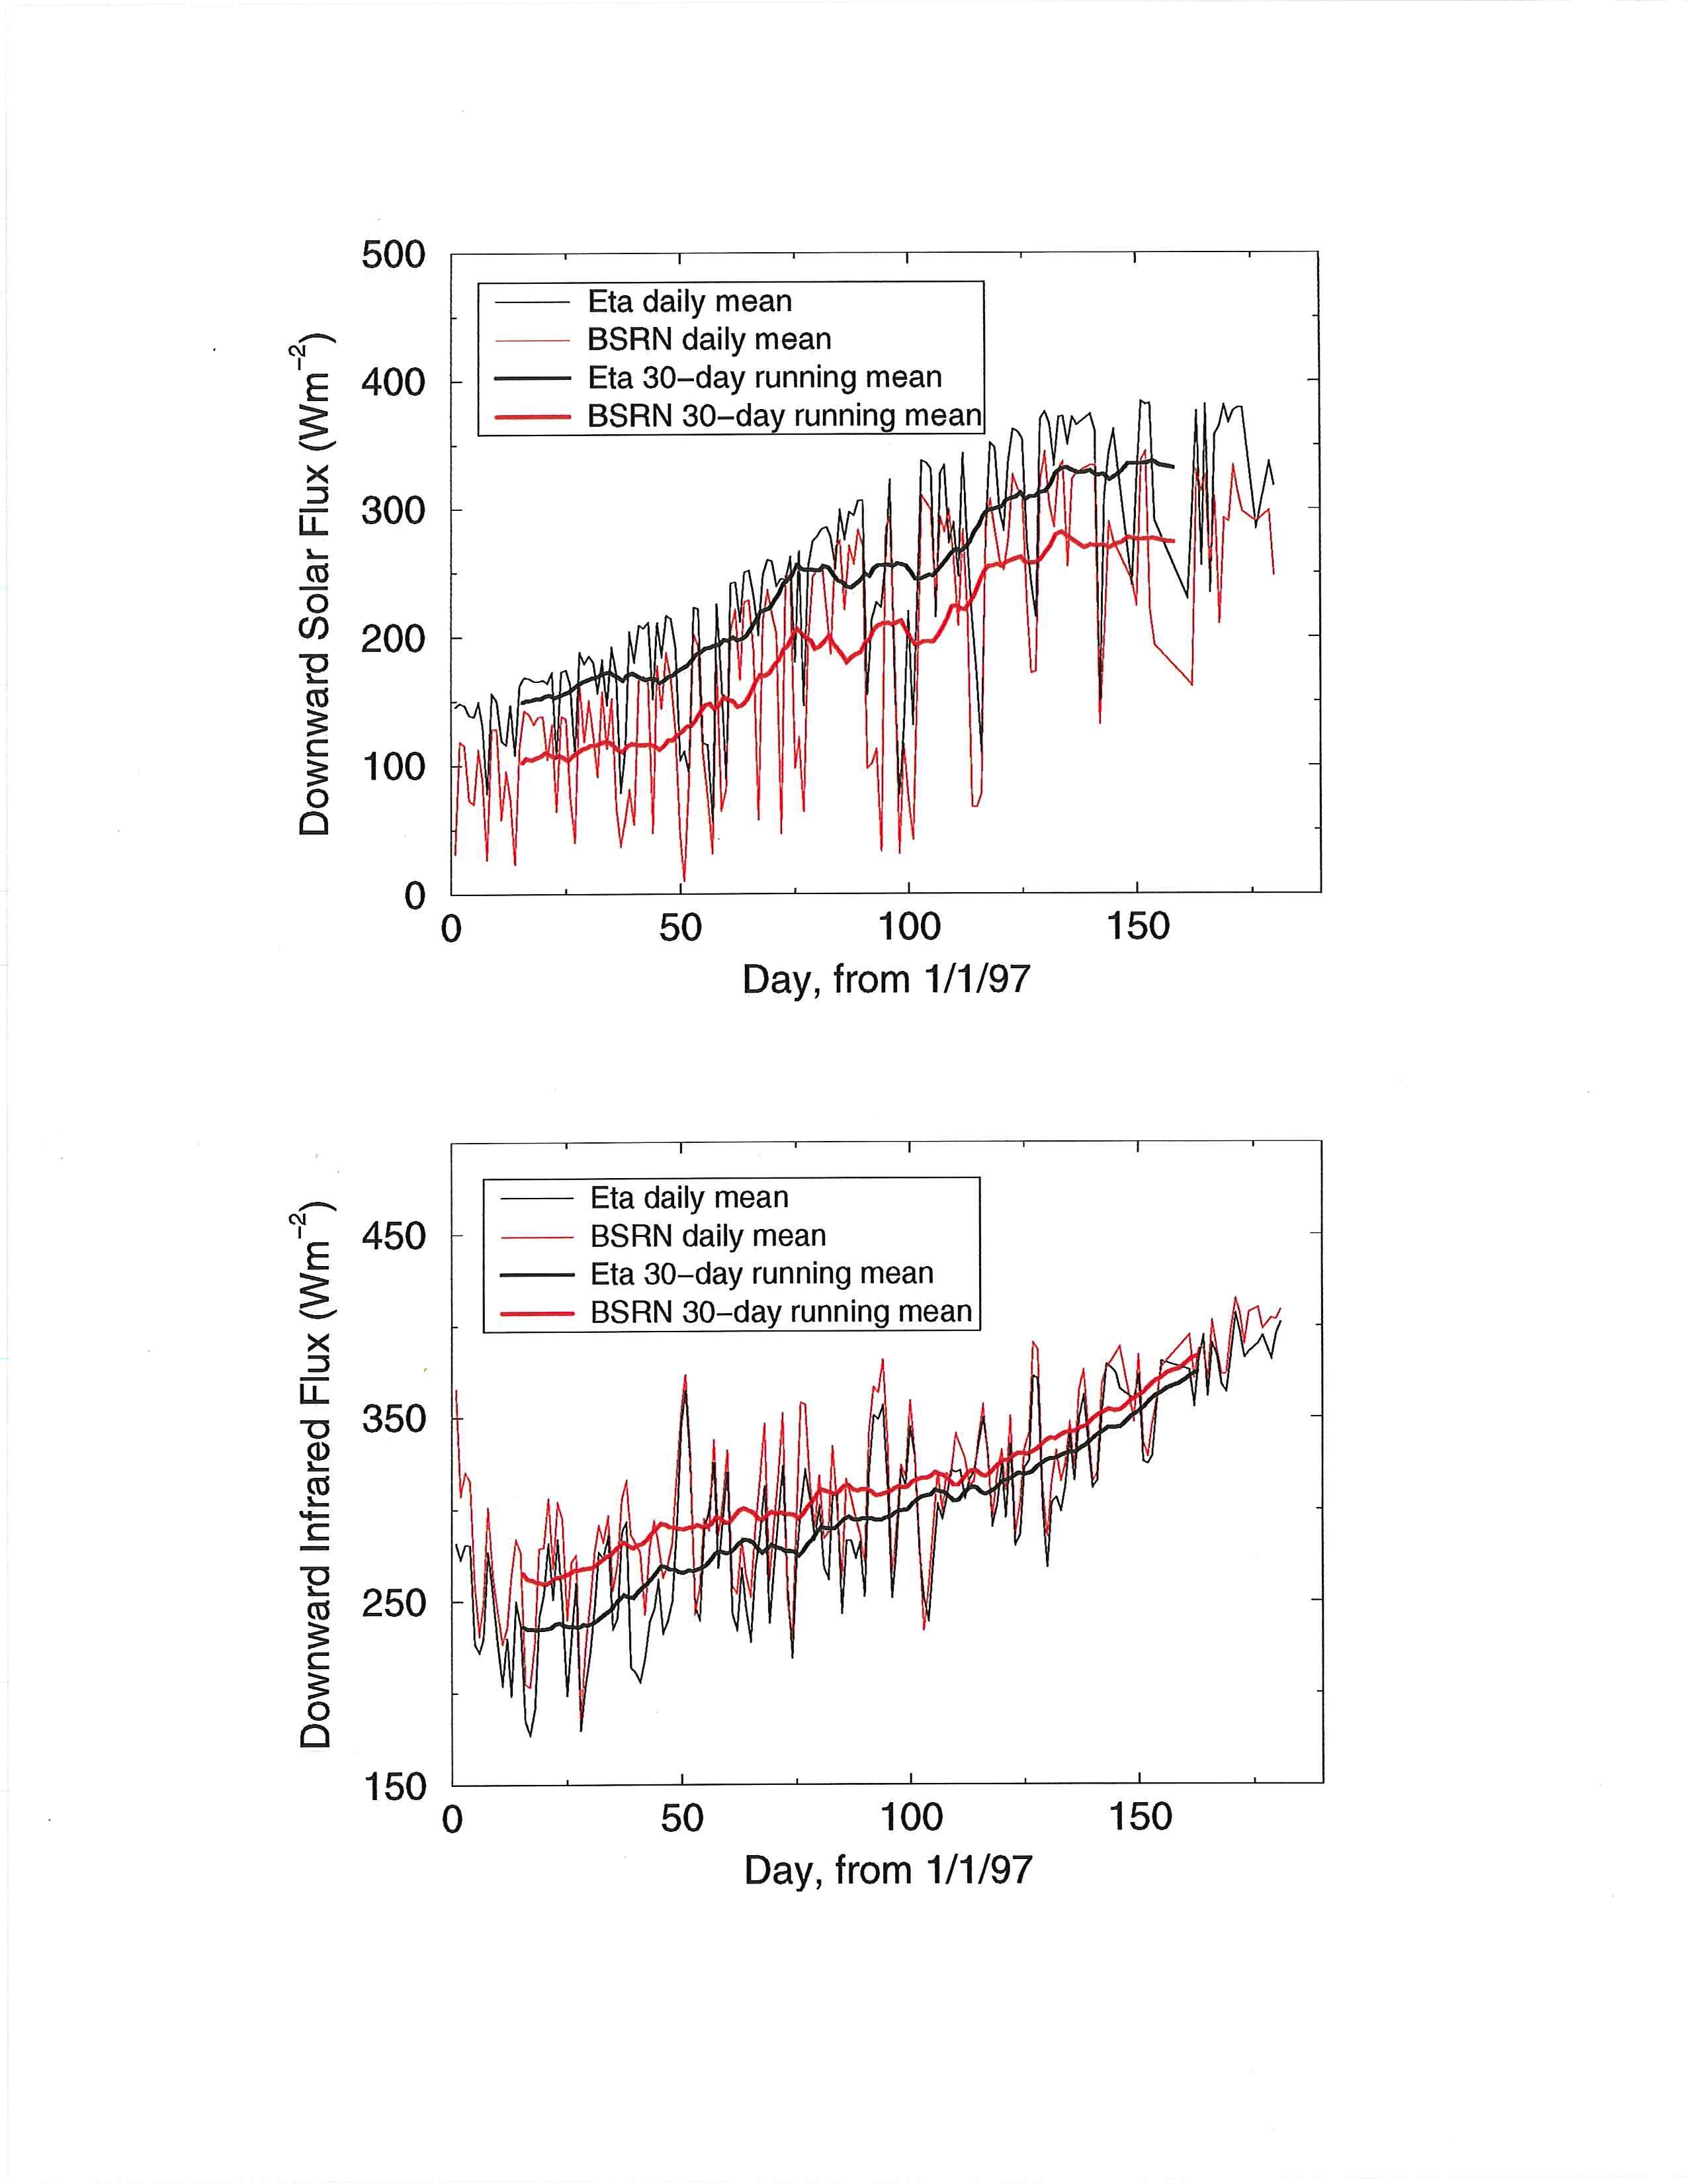
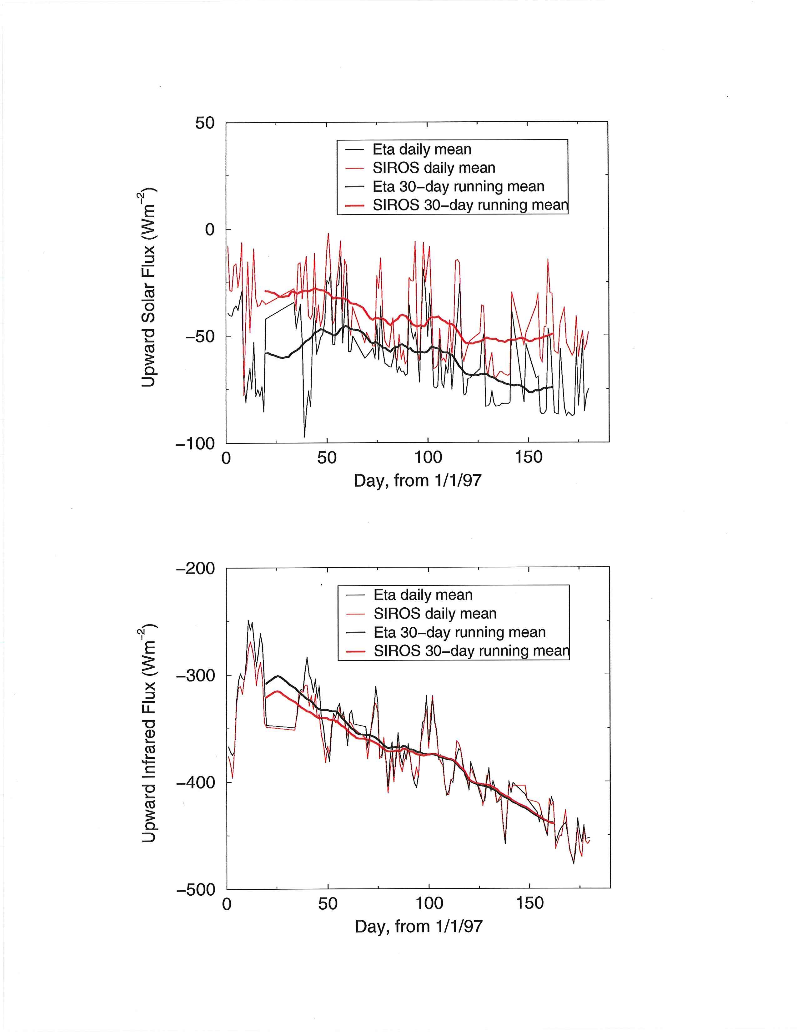
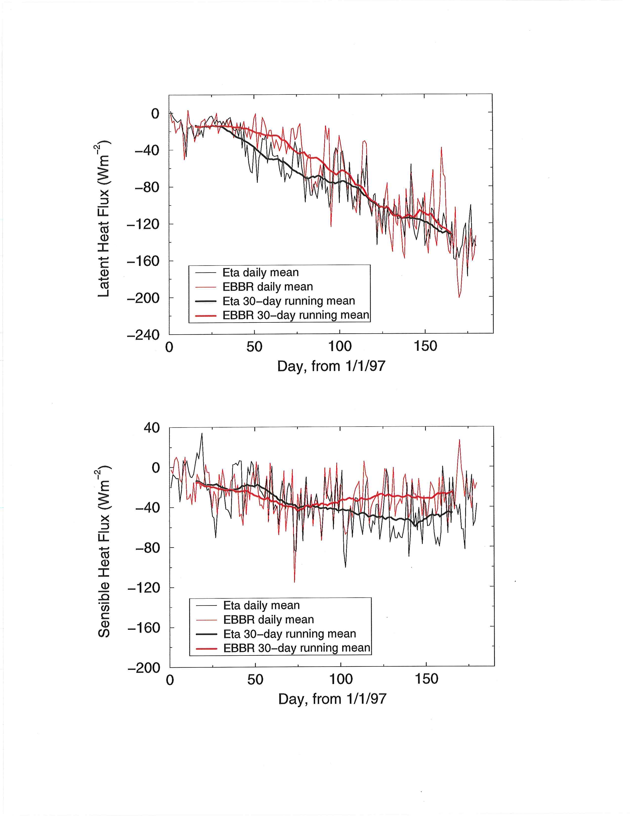
Results:

Slide 7
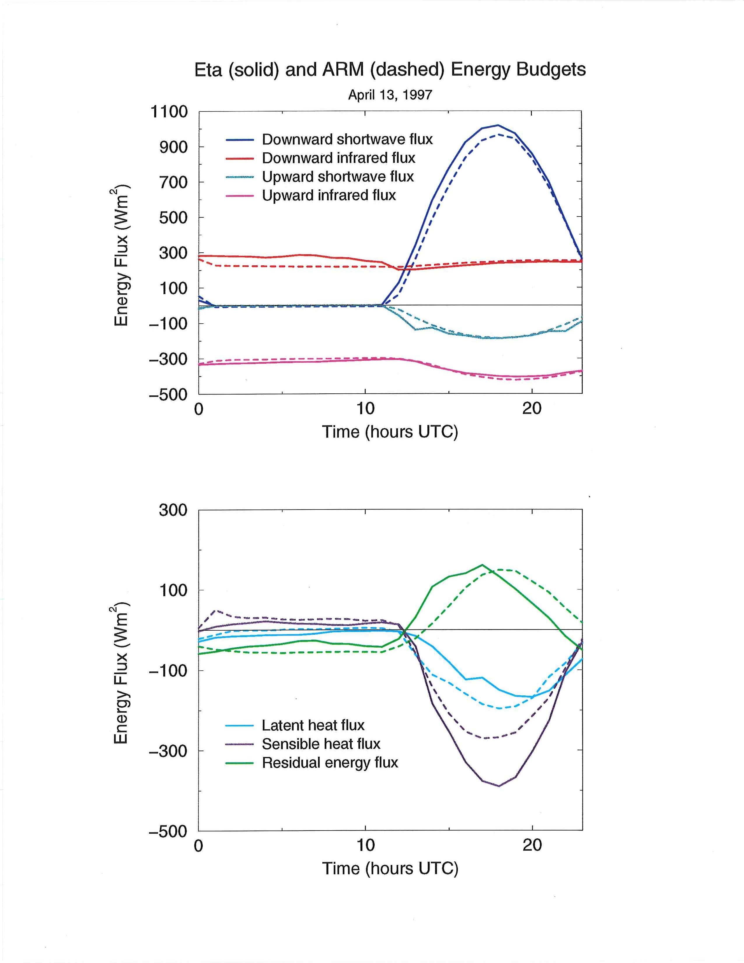
Results:

Slide 8
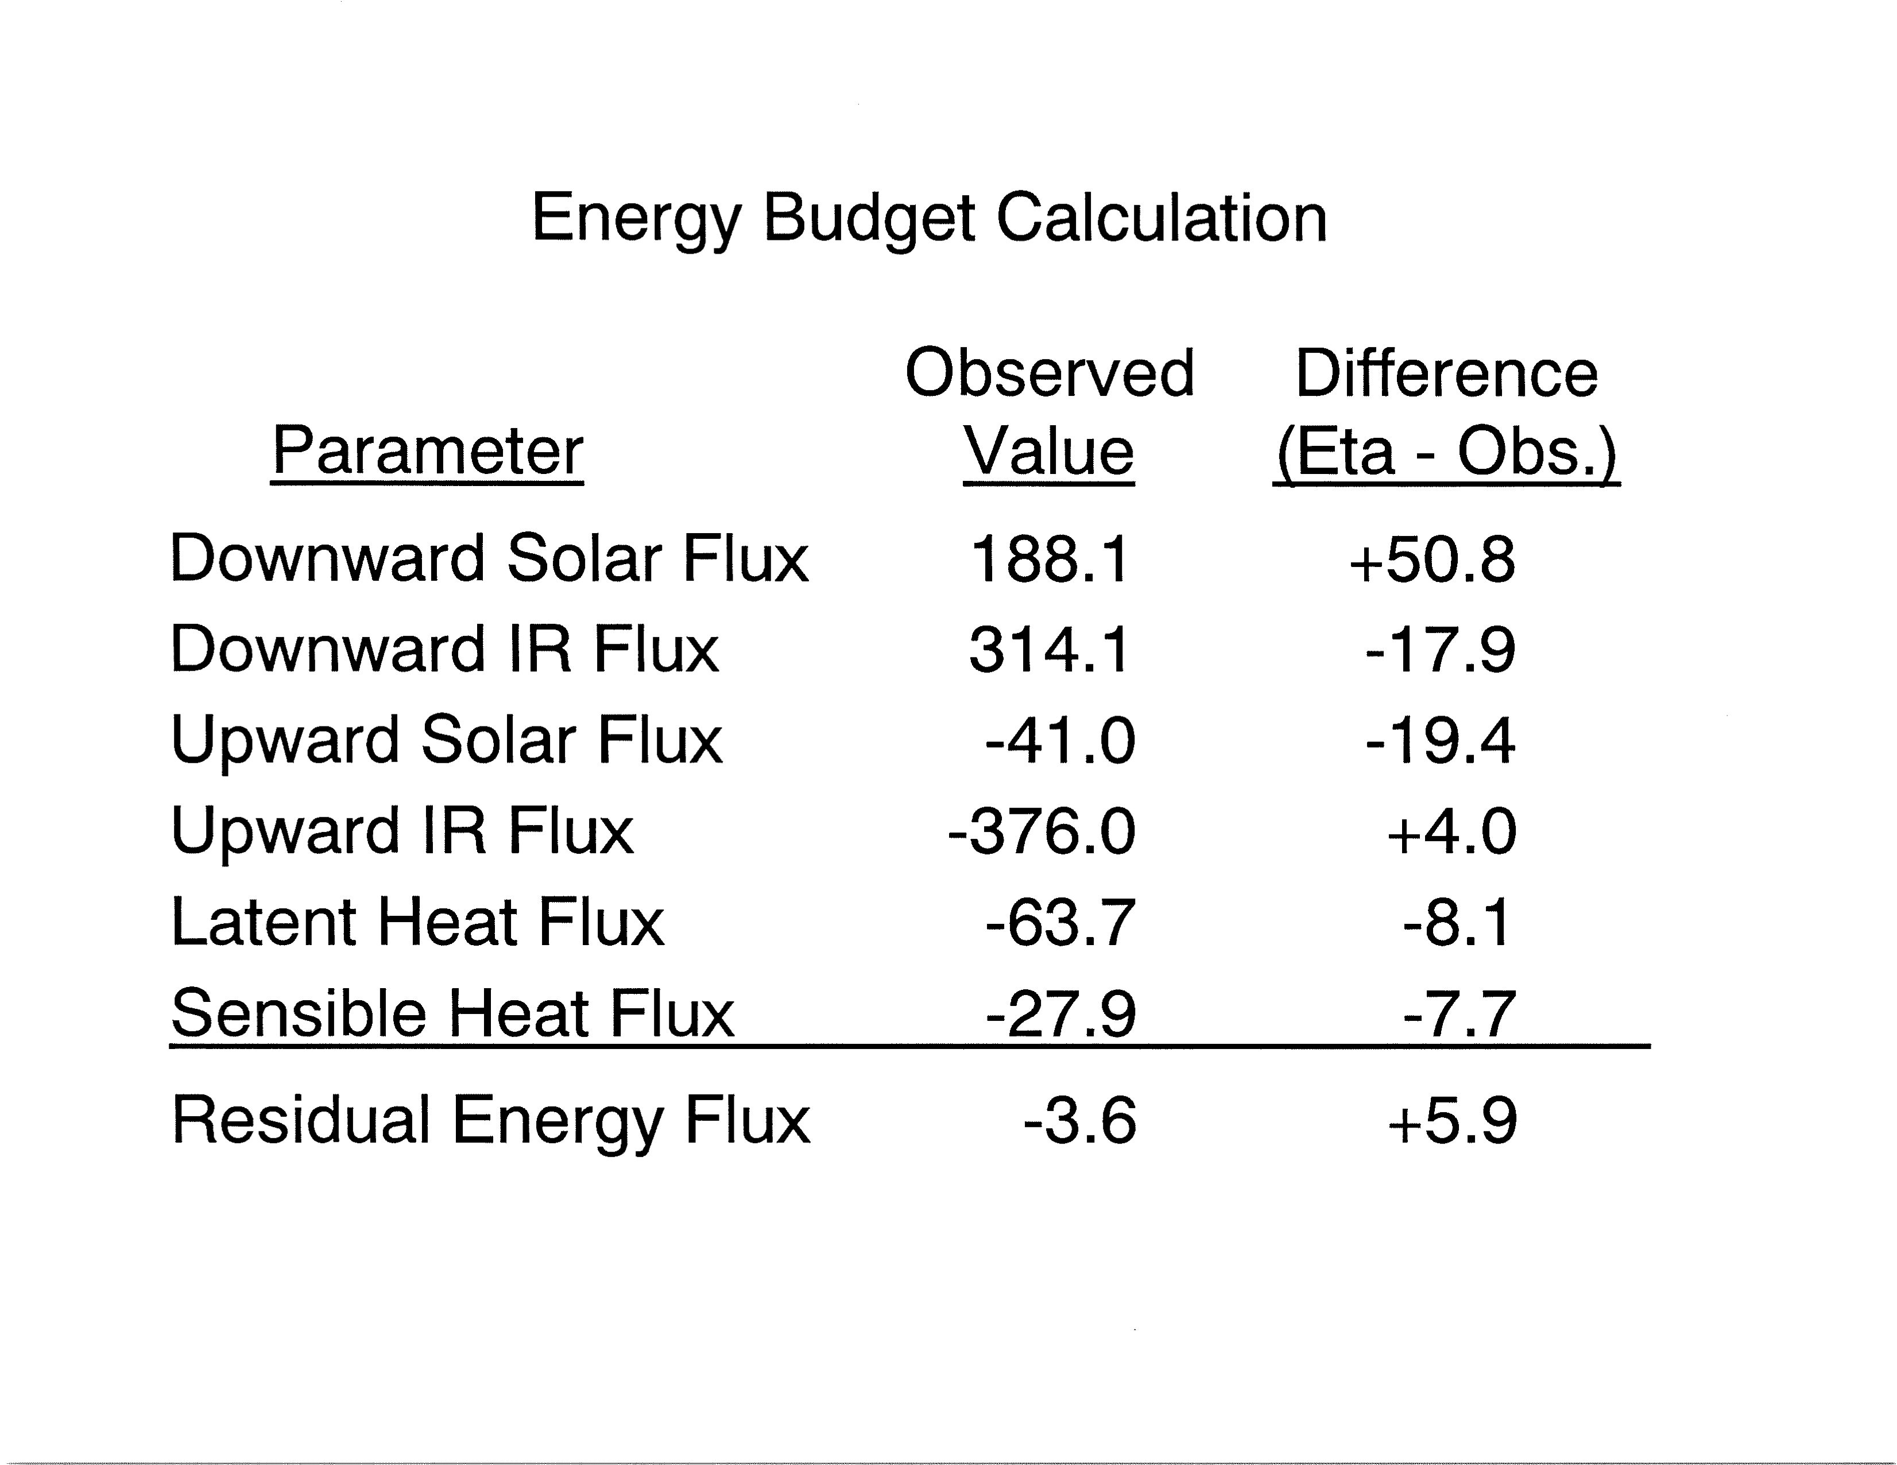
Summary:

Slide 9
Summary:

Slide 10
At the same time....
1999

Slide 11
2003

Slide 12
The Biggest User

Slide 13
The Biggest User

Slide 14
The Biggest User

Slide 15
The Biggest User

Slide 16
The Biggest User

Slide 17
The Biggest User

Slide 18
The Biggest User

Slide 19
The Biggest User

Slide 20
Clear sky
All sky
2011
SWDN
SWDN
LWDN
LWDN
SWUP
SWUP
LWUP
LWUP

Slide 21
And now....
Breaks down contributions of multiple processes to irradiance errors.
Integrates observations over entire SGP area.
2018

Slide 22
Attribution
Net SW
Net LW

Slide 24
Conclusions
Long-term irradiance measurements from ARM have been extremely useful for evaluating model performance.
Analysis techniques have become increasingly complex.
Still large positive biases in surface downwelling SW irradiance.

