Slide 1
Some Well-Wishes from Colleagues Unable to Attend

Slide 2
Congratulations on your retirement! Best wishes for your new endeavors…Bob Ellingson

Slide 3
Dear Tom, I have always liked the discussions we had - about the weather, politics, and American or Dutch culture. We have met on several occasions, but for me the first and the last time stand out. The first time was in Germany at an EarthCare meeting (I don't think it was called EarthCare back then), and the last time was at the 40 years anniversary of Cabauw (and now I have forgotten to mention your visit to Delft with overflowing canals and sand bags to keep the houses dry). You appeared as a man of strong opinions, with a strong sense of purpose, but open to other views and options- I liked that. I have always appreciated your scientific achievements - and your humour: science is serious fun after all. I wish you all the best for your future, Herman Russchenberg

Slide 4
Dear Tom, You are and have been a highly regarded scientist in the area of clouds and atmospheric radiation [to name just a few]. We have crossed paths in the USA, Australia and the Netherlands and we shared many interests and research topics. I think that you may look back on a splendid carrier and your research papers and results will be used and referred to in many years to come. I have used them myself many times in the past! I wish you all the best for the future and hope that when you reflect on your own work and carrier that you may loop upon it with the satisfaction and the gratitude that it deserves. Reinout Boers

Slide 5
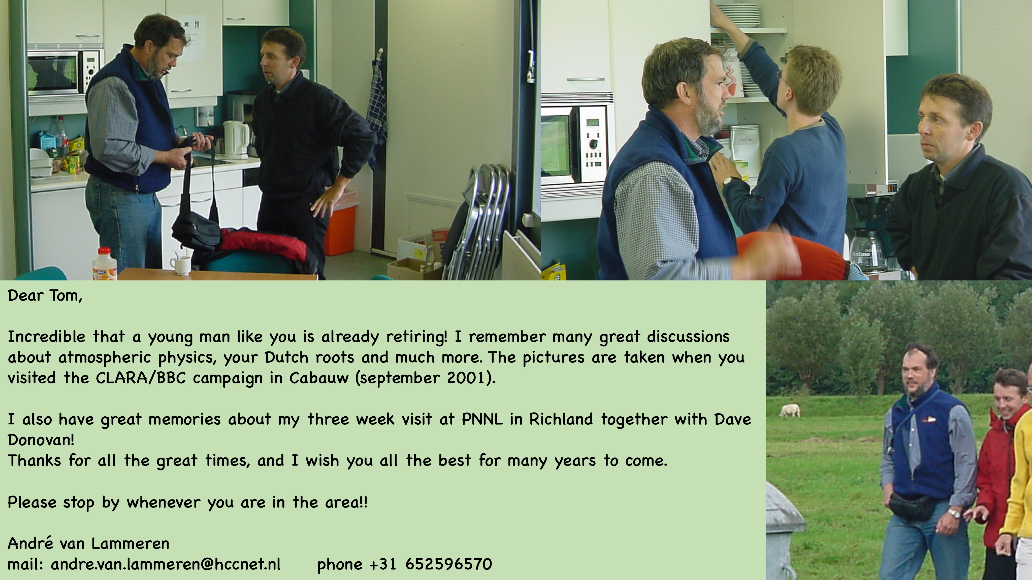

Slide 6
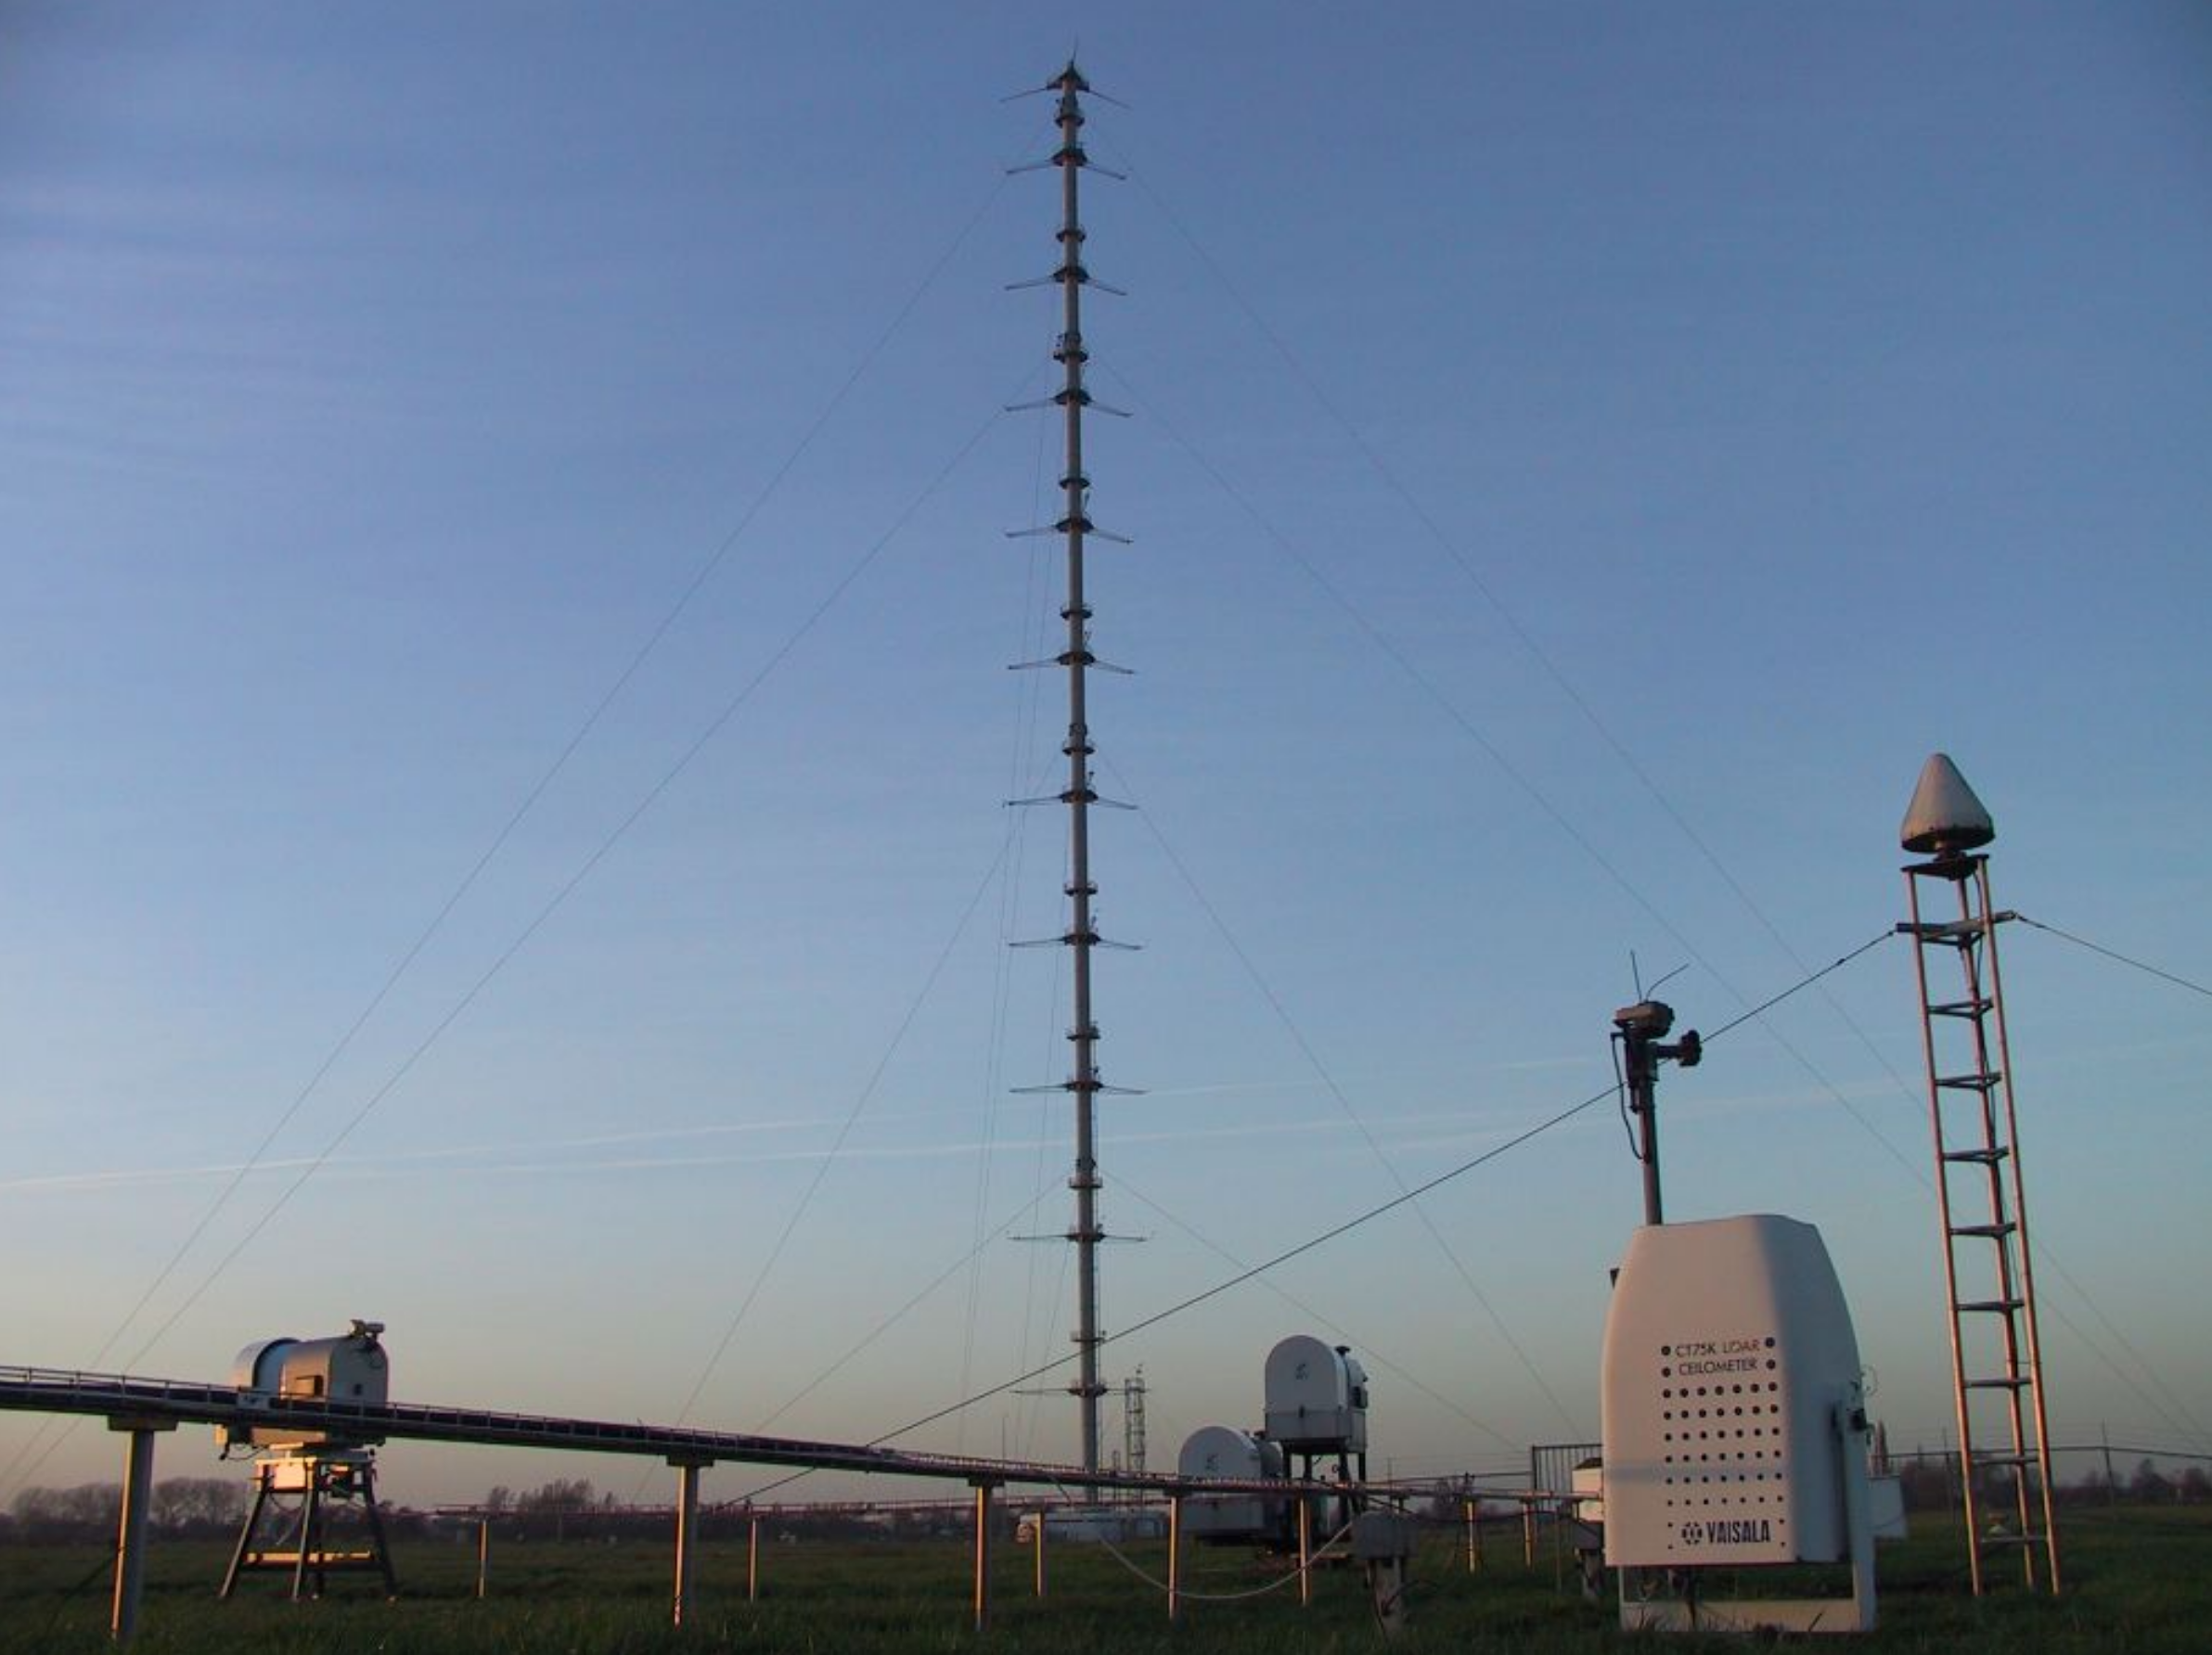

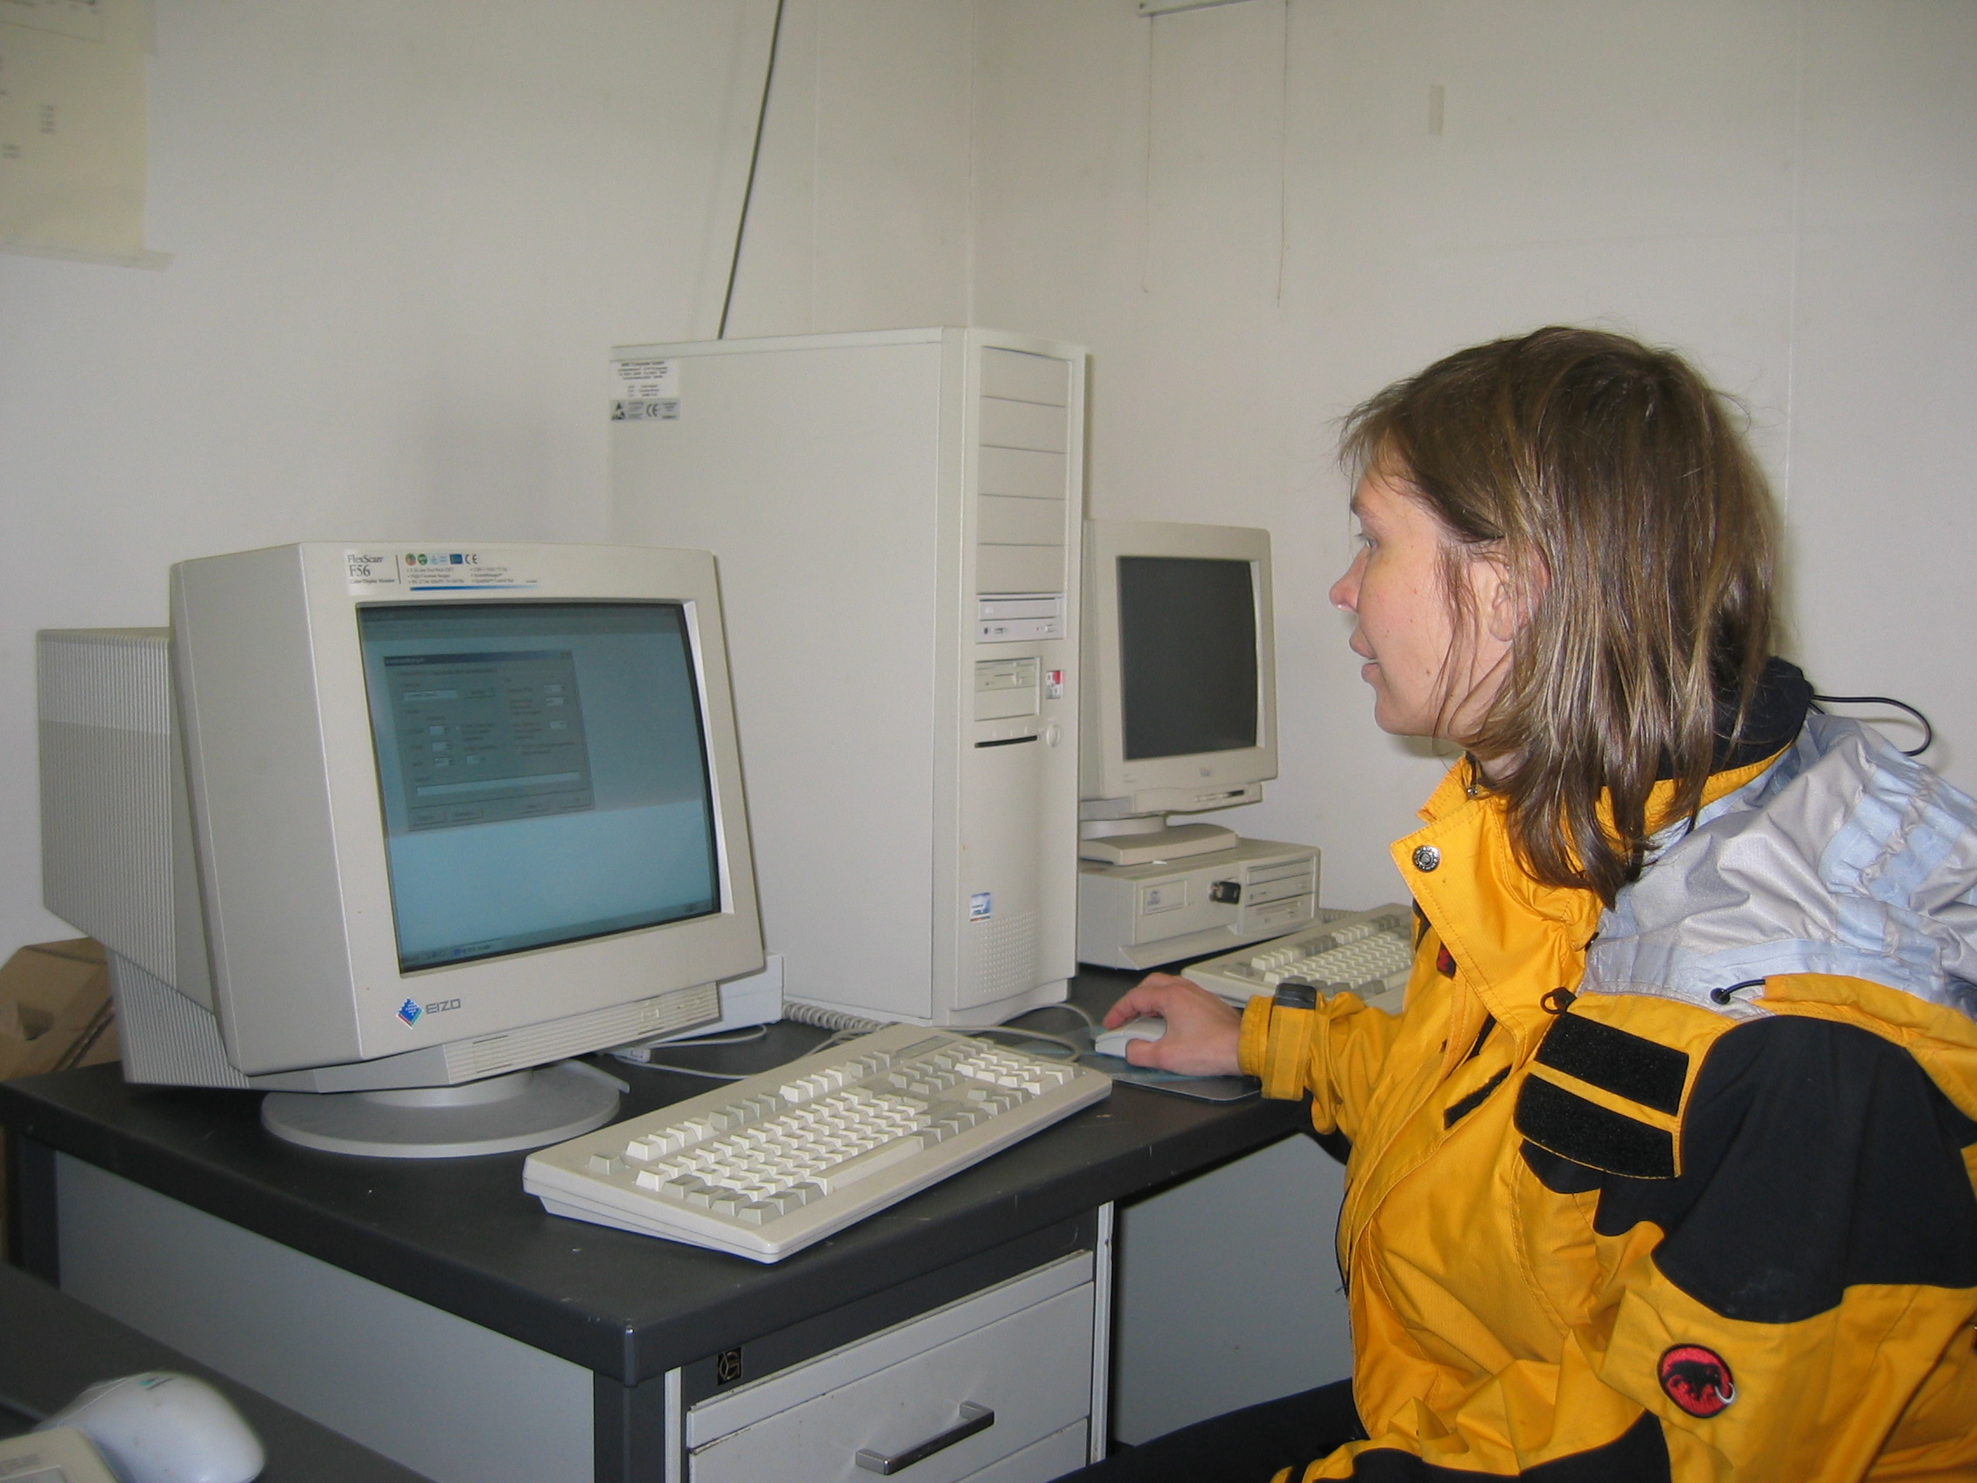
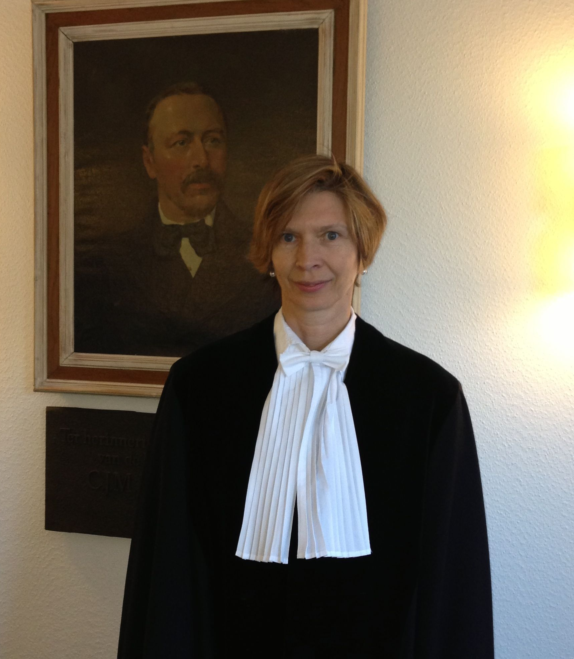
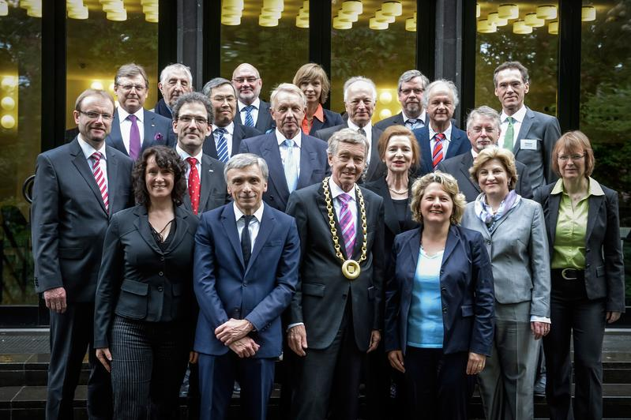
Times Change
IV. Retirement
Go for gold!
I. Ground-based remote sensing sites:
Who got the idea? Dealing with all these flaky instruments .. Why synergy? Just means more things can go wrong!
Dear Tom,
all the best wishes for your next career steps – enjoy the time and reach high!
Sorry to not be in Seattle
Susanne
II. Advising students:
Too many questions? Too smart? When?
III. Science politics:
No words

Slide 7
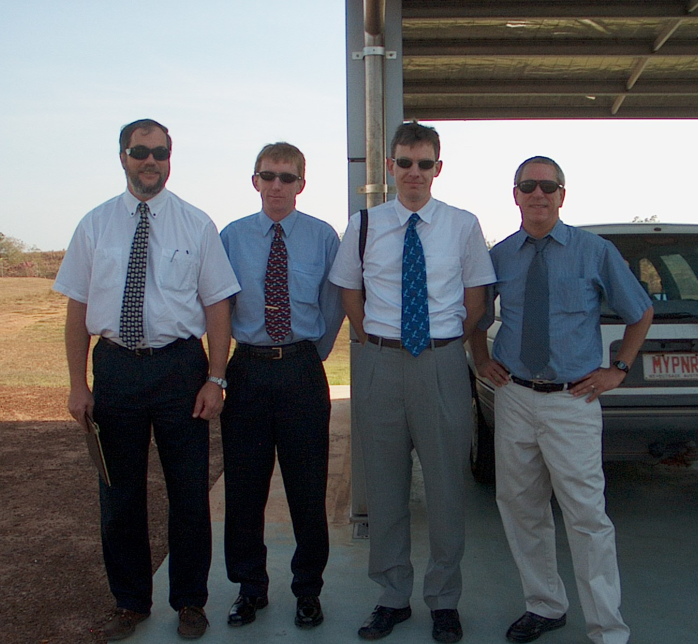
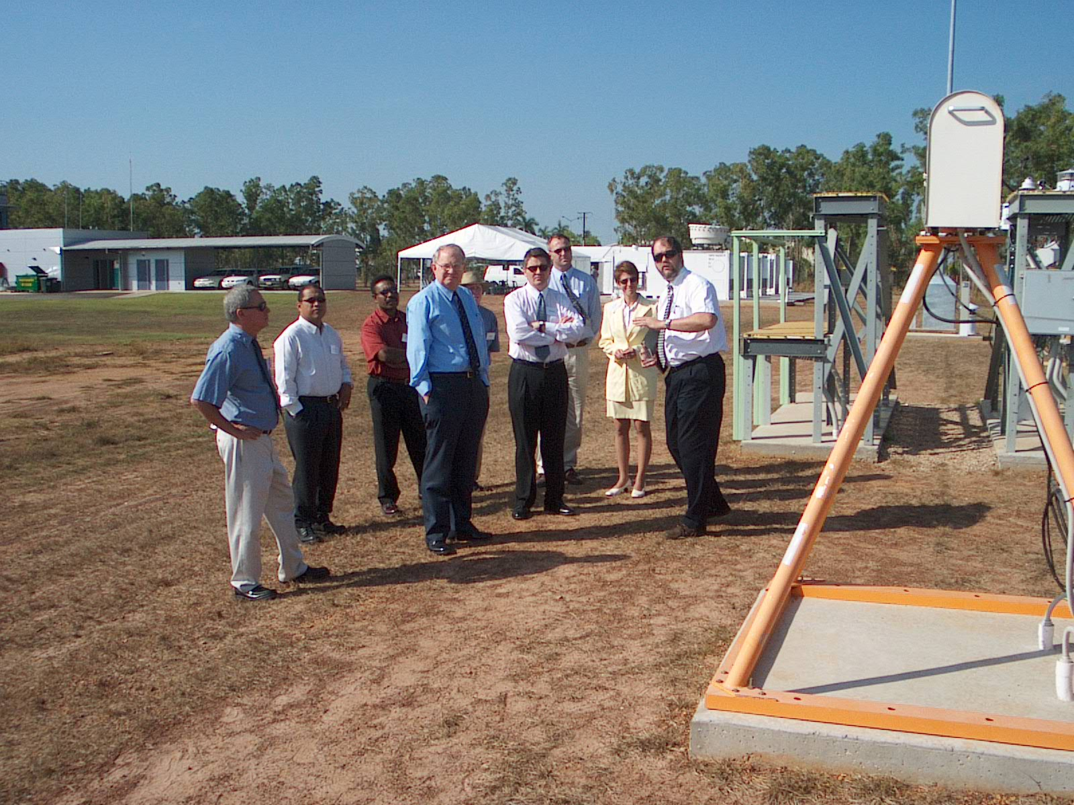
Christian Jakob and Peter May wish you a happy retirement!

Slide 8
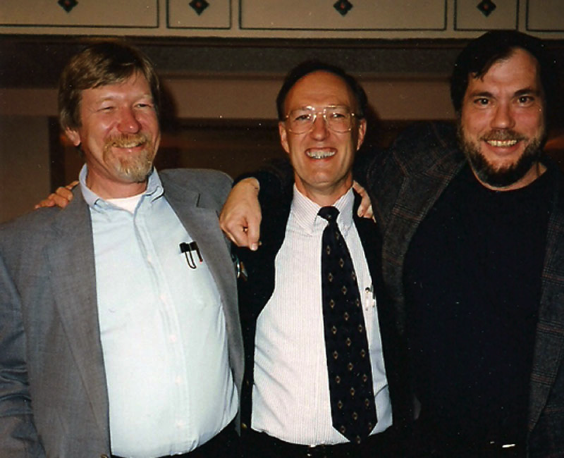
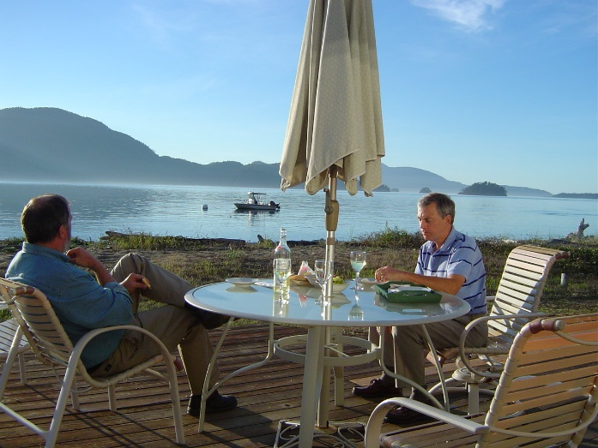
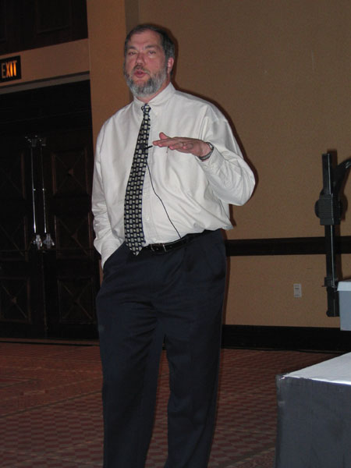
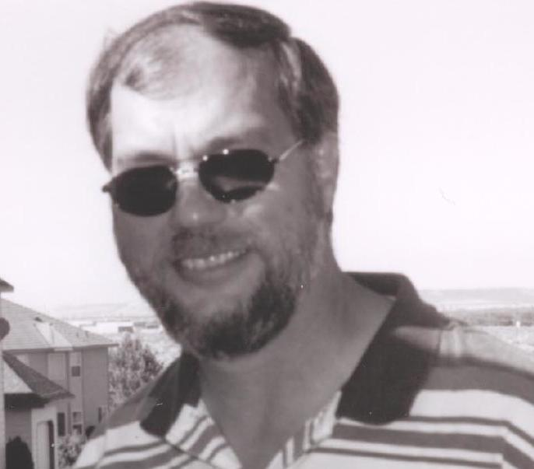
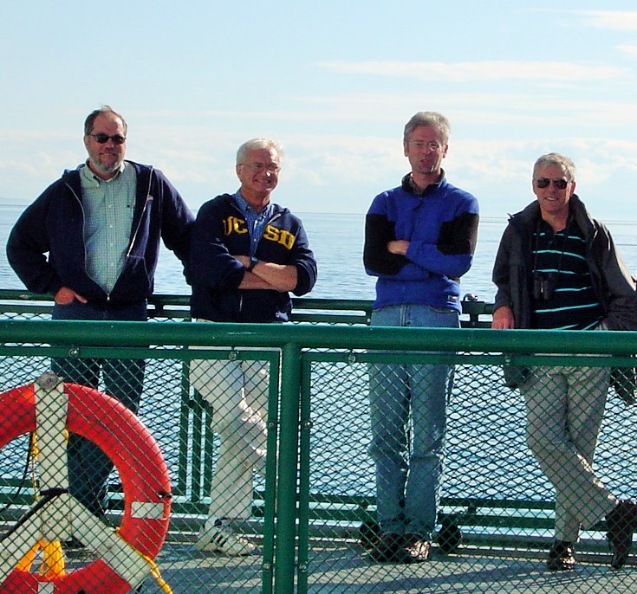
Some Random Pictures
With Tony Slingo, Sep 2006
2004
1997

Slide 9
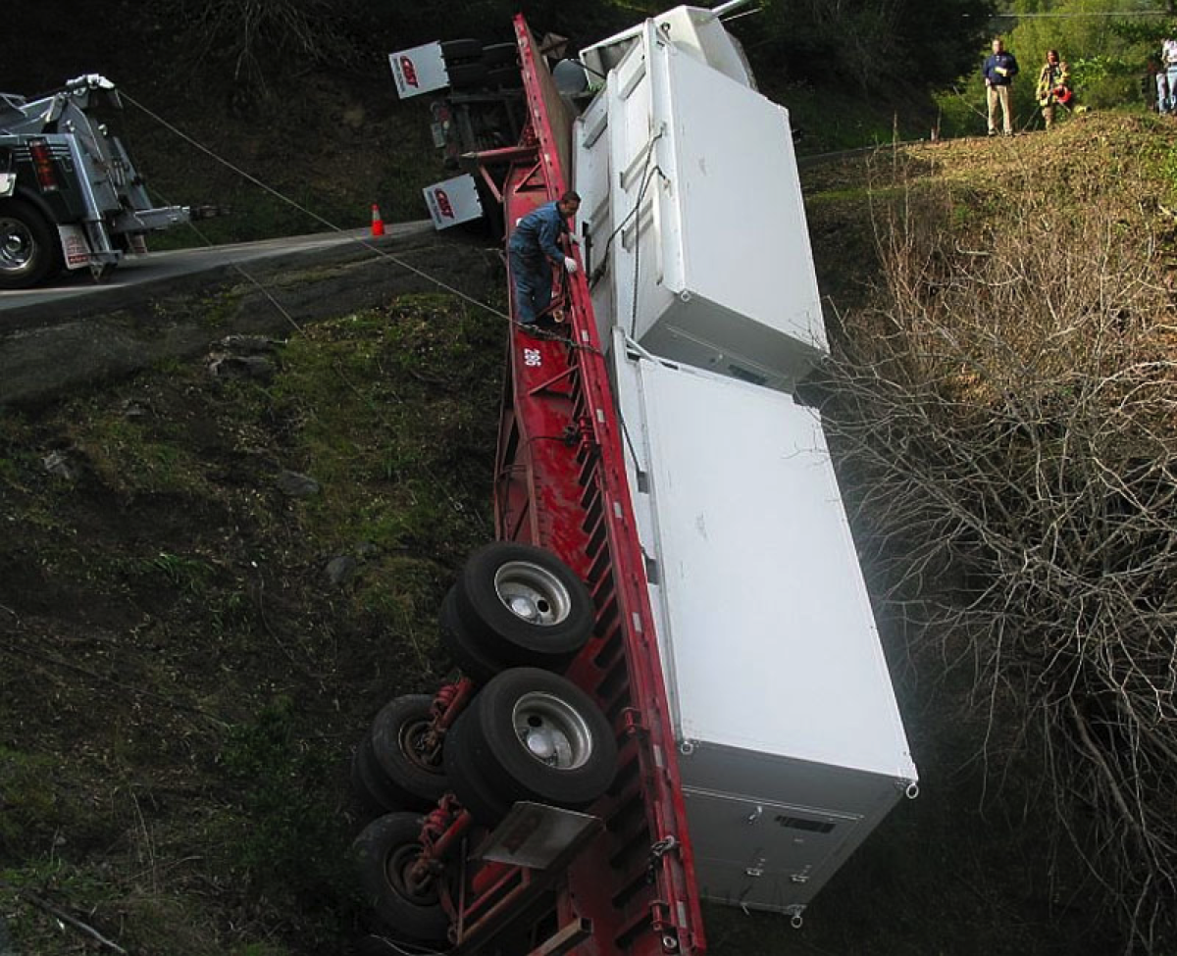
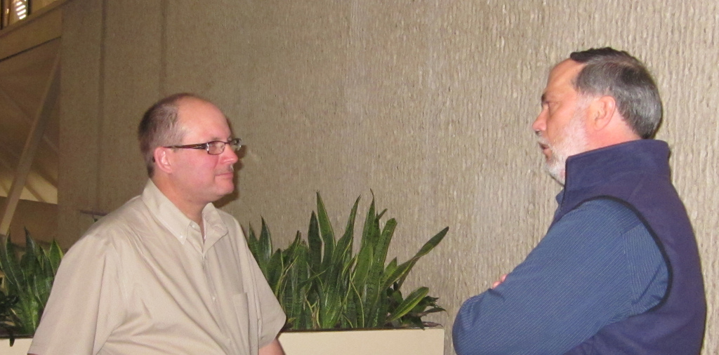
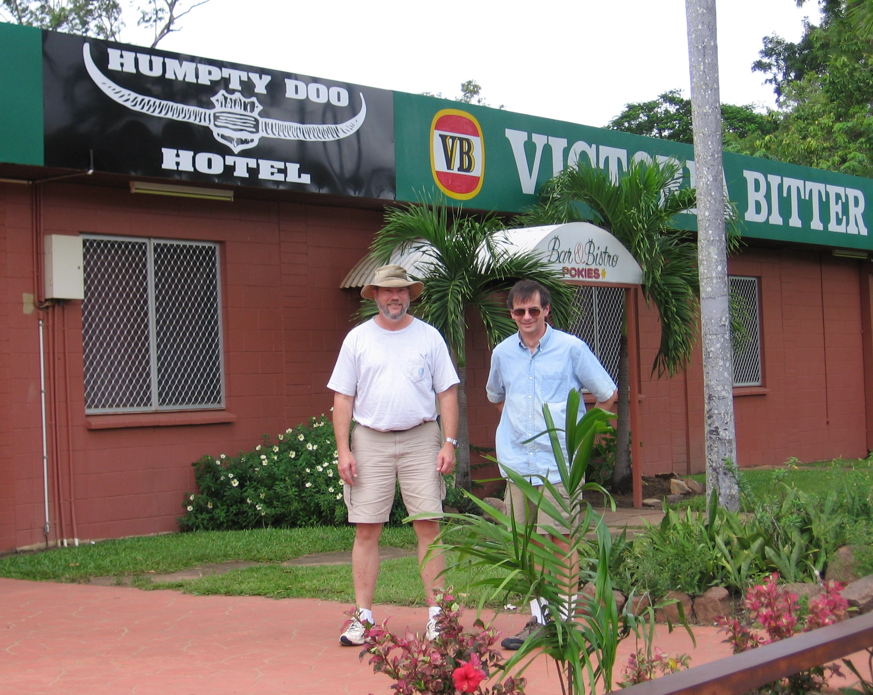
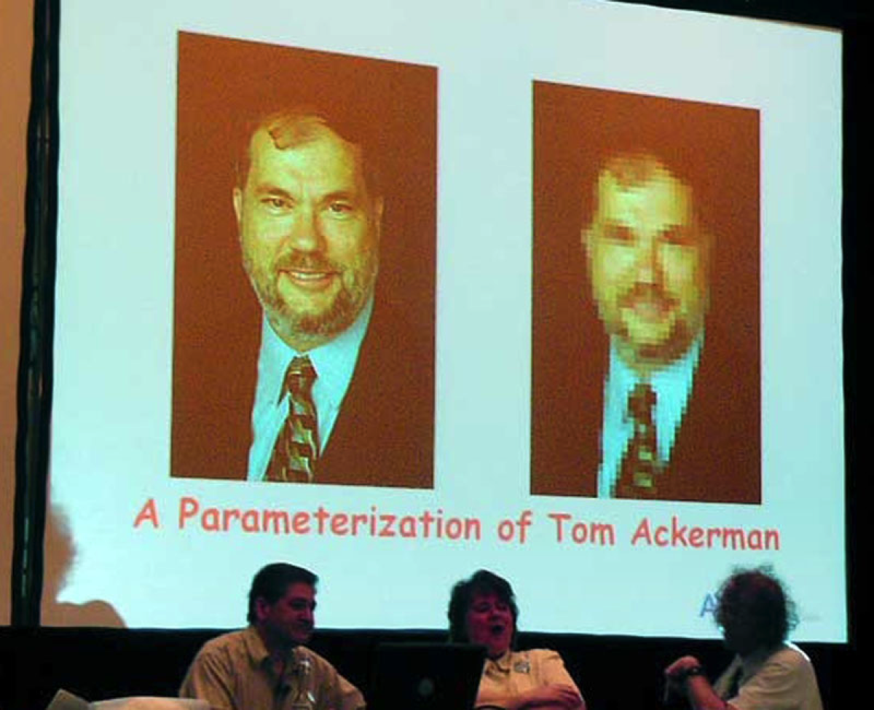
2011
“The AMF fell off a cliff!”
2005
Tony Del Genio’s roast of Tom at ARM STM 2004
2007

Slide 10
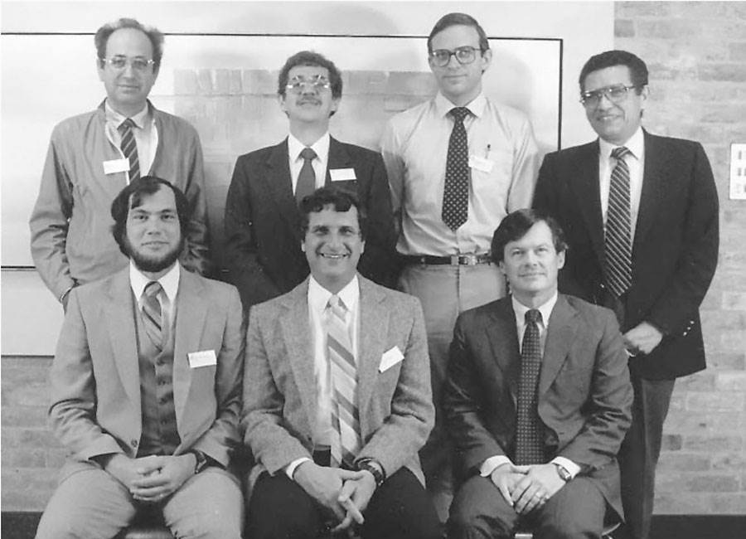
Arctic Haze Conference 1986

Slide 11
Cool Science from the ARM Raman Lidars
Dave Turner
NOAA Earth System Research Lab
One of Tom’s “Adopted Students”

Slide 12
Water Vapor: A Critical Variable to Measure
Even from ARM’s early days, water vapor was a key variable
Program elders desired to have remote sensing methods to measure both water vapor and temperature
Did not want to depend on radiosondes
Hoped that Radar wind profilers / radio acoustic sounding systems would provide the temperature profiles
Either Differential Absorption Lidar (DIAL) or Raman lidar for water vapor profiling
DIAL laser transmitter too complicated; decision was to try Raman lidar
Several RLID approaches possible; ARM Instrument Development Program funded work to determine that narrowband, narrow FOV best with solid-state laser
RLID goal: to measure WV as well as possible (other fields are secondary importance)
ARM Raman lidar, built by John Goldsmith at Sandia Nat Lab, deployed in summer 1995, but really didn’t start collecting data until summer 1996
That was just prior to the first water vapor IOP !

Slide 13
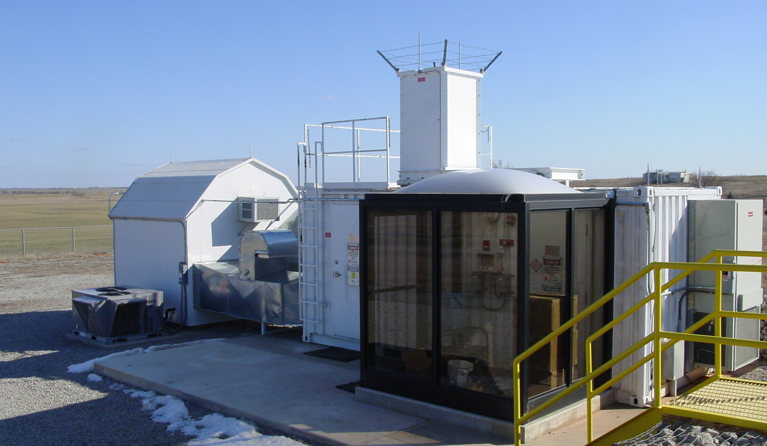
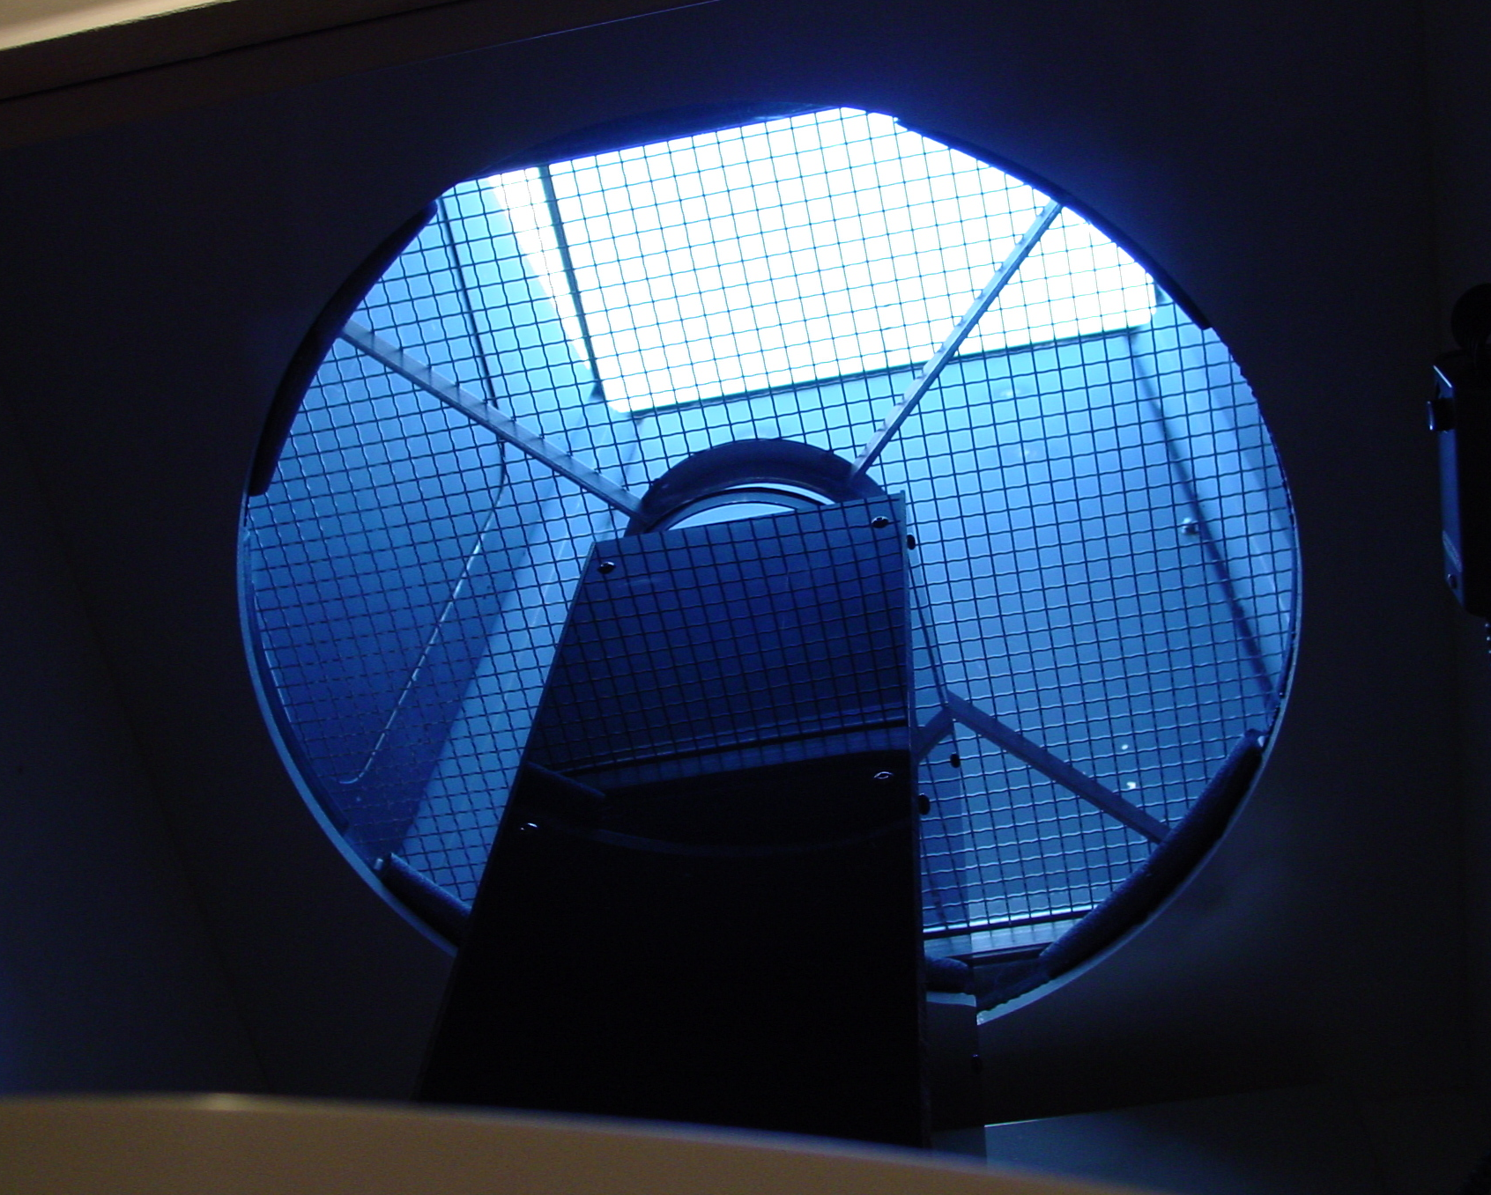
But the Early Days Were Rough
System uptime was less than 20% in 1996 and 1997
Optics were burning, laser was failing (expensive!)
Poor electrical service in rural OK; voltage dips would trip interlock which required manual restart (and would often happen after close of business or on weekends)
Possibility of severe weather often resulted in lidar being manually shutdown and secured for long stretches (a hail stone could trash a $60K telescope)
Tom took me aside in 1997: “I don’t think that instrument can ever be made to be operational; I wouldn’t bother <working on it>” (paraphrased)
Vestibule (cut down contamination)
Hail Shield
Massive UPS

Slide 14
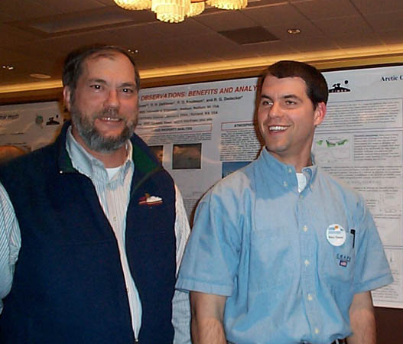
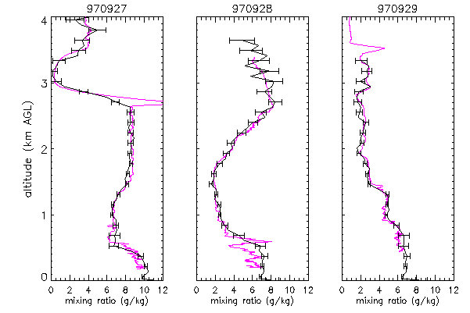
Early RLID Science
WVIOPs were initial focus
Demonstrate how well RLID profiled WV, especially in the daytime (JTECH 1999)
2004
Daytime comparisons to aircraft!
But the aerosol measurements were totally unique
Studied aerosol extinction-to-backscatter ratio over the SGP (JGR 2001)
Lidar Ratio vs. RH

Slide 15
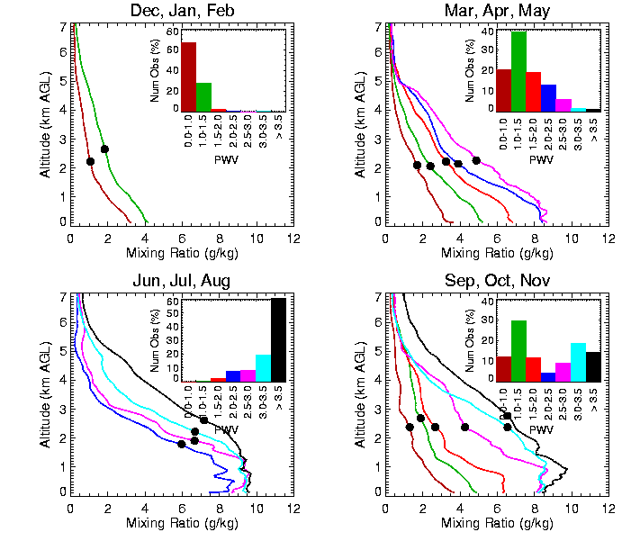
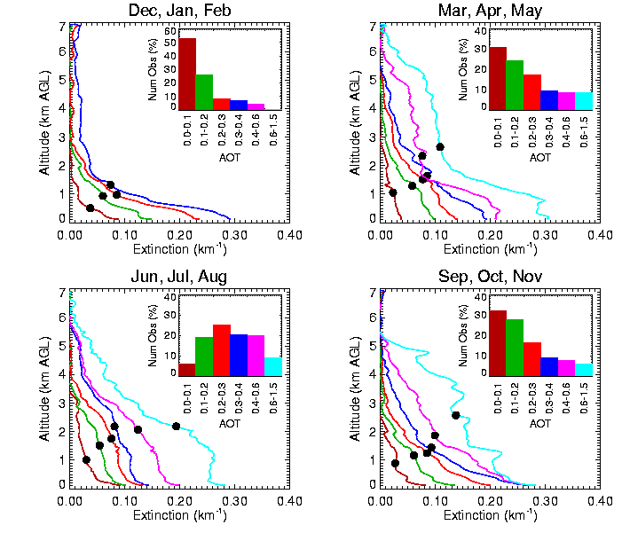
Early RLID Science
WVIOPs were initial focus
Demonstrate how well RLID profiled WV, especially in the daytime (JTECH 1999)
But the aerosol measurements were totally unique
Studied aerosol extinction-to-backscatter ratio over the SGP (JGR 2001)
Developed a 2-year “climatology” of water vapor and aerosol profiles (GRL 2001)
Lidar Ratio vs. RH
WV Mixing Ratio and Scale Height
Aerosol Extinction and Scale Height

Slide 16
Raman Lidar A Versatile Remote Sensing Instrument for Water Vapor and Cirrus Cloud Studies
Tom Ackerman
Jennifer Comstock
David Turner
Disclaimer
Presentation at the AMS Annual Meeting in 2003

Slide 17
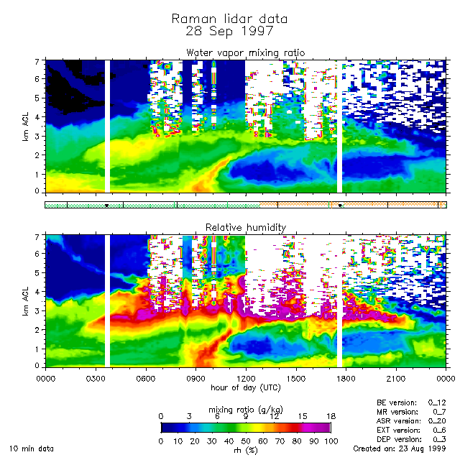
From Tom’s AMS Presentation
Notes:
Unique depiction of atmospheric water vapor measured by the SGP Raman lidar. This sequence captures the passage of a cold front across the central facility. Early in the day, there is warm, moist air present. About noon a layer of undercutting cold air shows up that displaces the moist air and pushes it up. The lifting produces some small clouds aloft which block the lidar beam. By the end of the day, the cold dry air has completely replaced the moist air. This is the only continuously operating Raman lidar in the world.

Slide 18
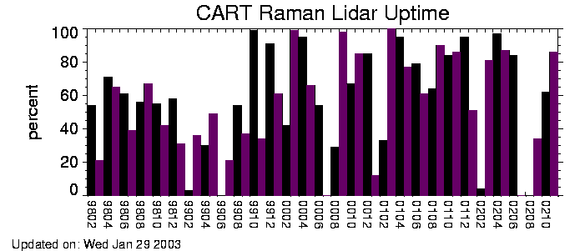
Raman Operations 1998 - 2002
2000
From Tom’s AMS Presentation

Slide 19
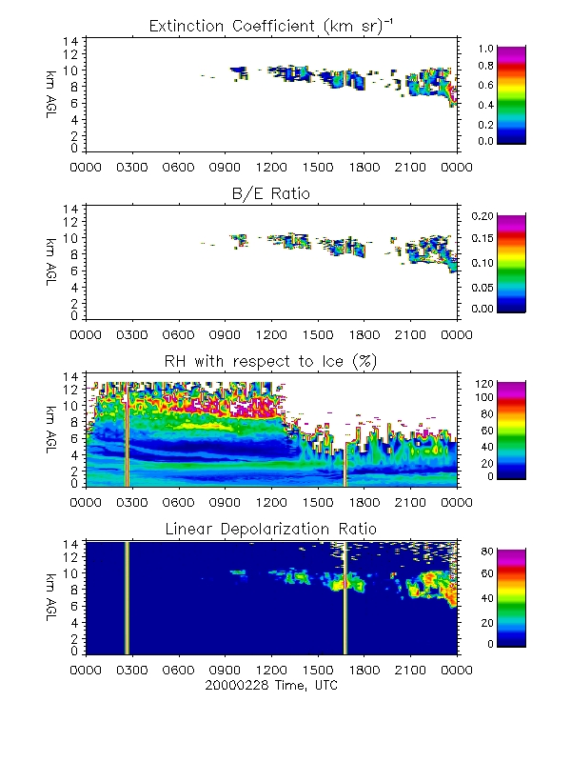
From Tom’s AMS Presentation

Slide 20
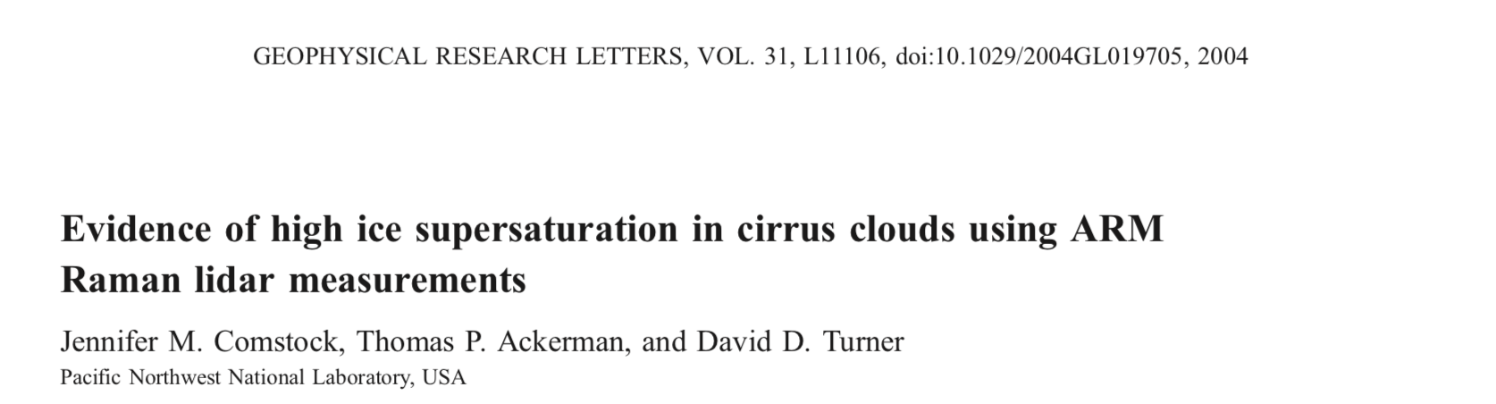
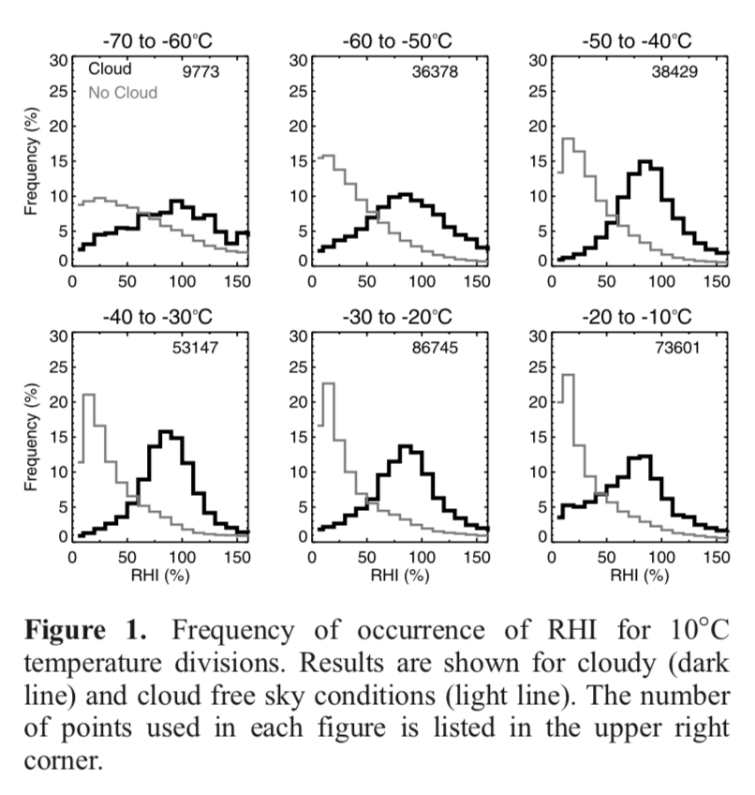

Slide 21
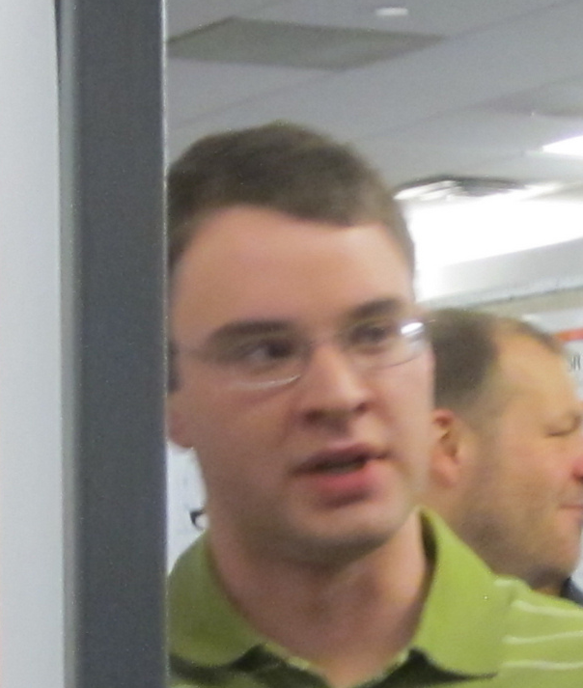
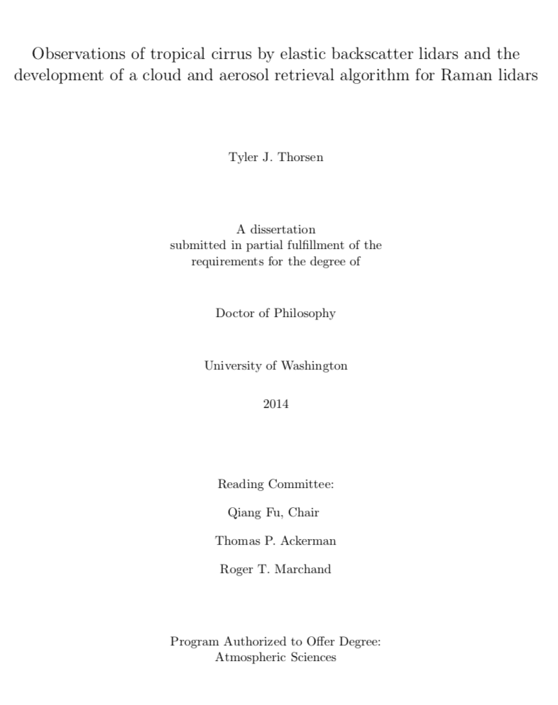
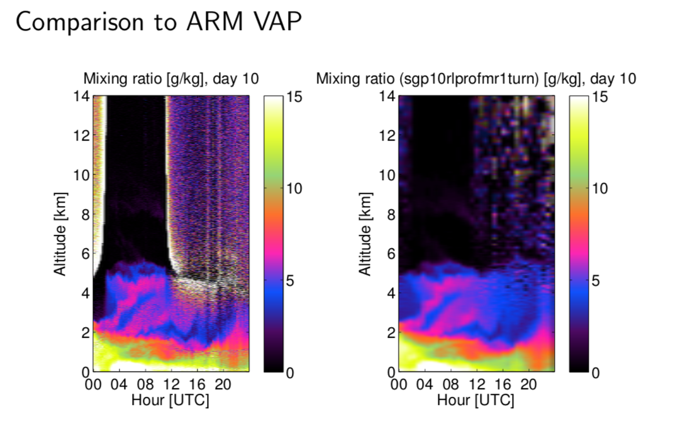
From Tyler’s class presentation
Around 2010, Tom excitedly introduced me to a new student he had in one of his classes, Tyler Thorsen.
Tom had Tyler develop code to derive water vapor from the raw Raman lidar signals as a class assignment and compare it to the operational datastream
Tyler completed his PhD in 2014 using the Raman lidar heavily to look at tropical cirrus, and is now a lidar scientist at NASA LaRC.
Tyler’s codes are slowly replacing all of my original operational RLID processing codes…

Slide 22
Tom is now one of the

Slide 23
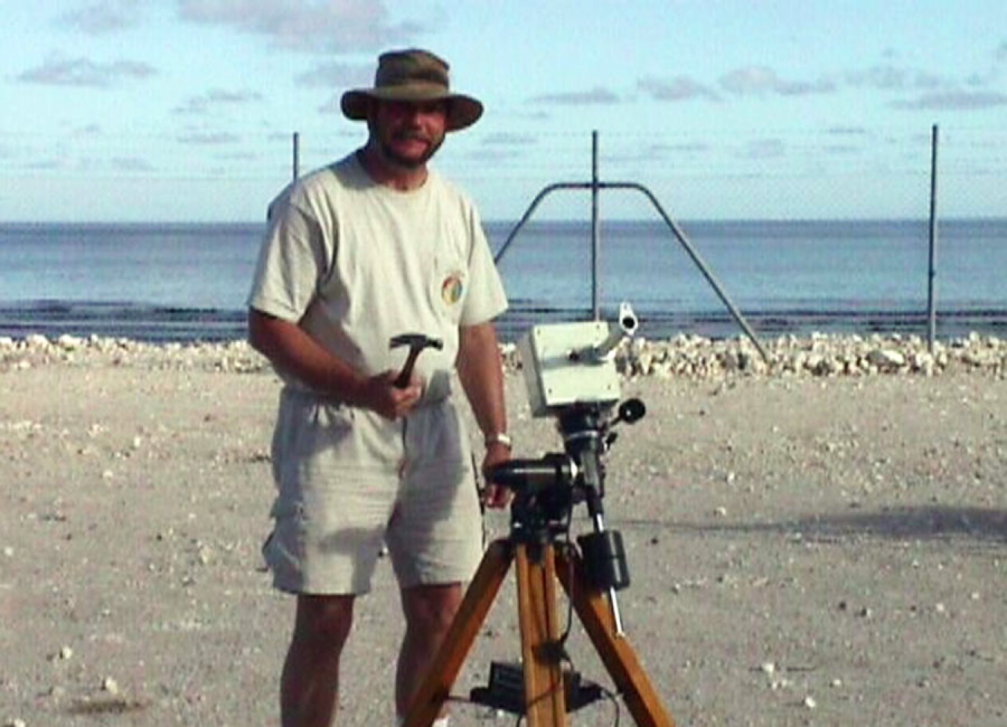
Almost, anyway. We are still worried about his fine motor skills

Slide 24
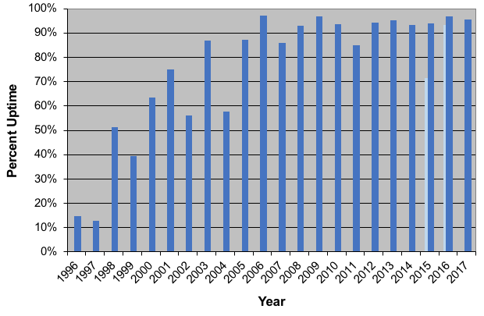
Uptime for the SGP Raman Lidar
And the ENA Raman Lidar has been up 89% of the time since Jan 2017!
By far the longest record of Raman lidar data in the world!

Slide 25
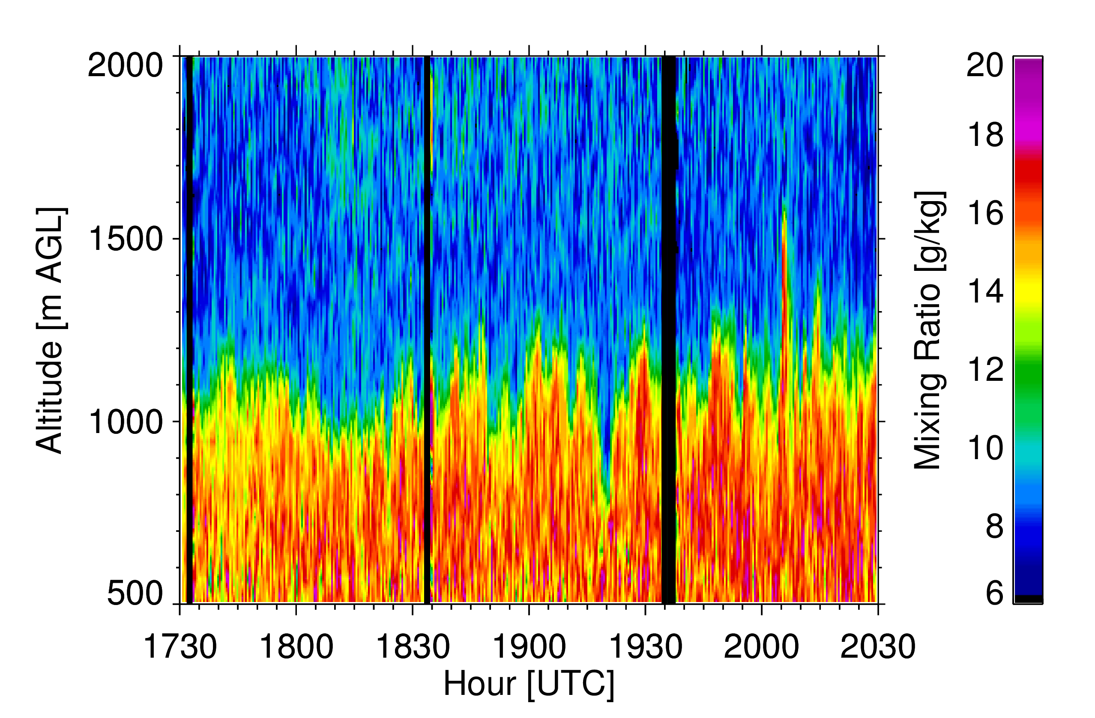
A New Application: Turbulent Mixing
Measurements require high temporal and spatial resolution
Relative to the integral time scale of the eddies
“Low” noise
ARM Raman lidars, HSRLs, and Doppler lidars have these characteristics
Requires that the BL be quasi-stationary (i.e., eddy characteristics are not changing with time)
Extract out time-series at different height ranges; processed independently
Autocovariance technique used to separate atmospheric variability from lidar noise
Evaluated with aircraft obs

Slide 26
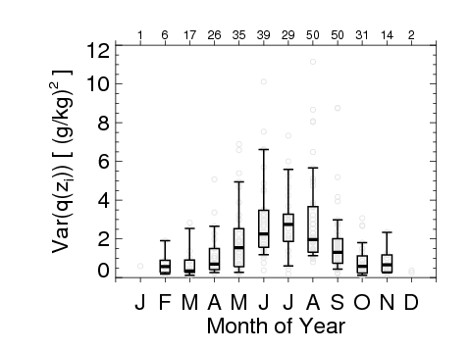
Turbulence: Long-term Datasets are Key
CRMs / GCMs typically parameterize turbulence as functions of larger-scale variables that are predicted
Important to sample across wide range of atmospheric conditions and different seasons
300 cases in well-developed, quasi-stationary CBLs were identified from 6 years of SGP RLID data
Large number of statistics computed
E.g. variability of WV variance at top of CBL
UWisc HSRL was deployed in Norman for summer 2012, and 17 cases in quasi-stationary CBLs were identified
Aerosol data require more care to avoid hygroscopic growth
Statistics (especially median skewness profile) matched RLID well

Slide 27
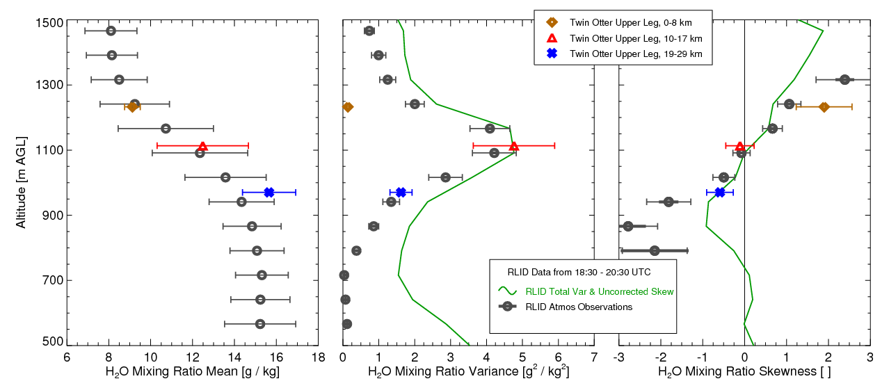
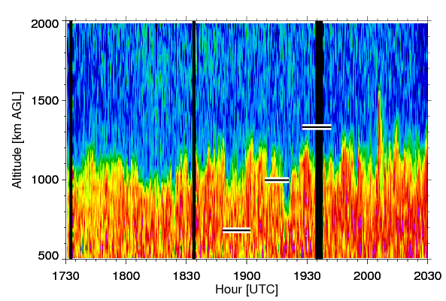
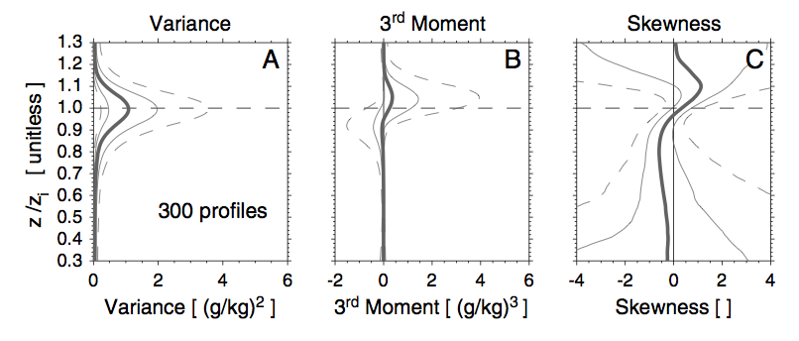
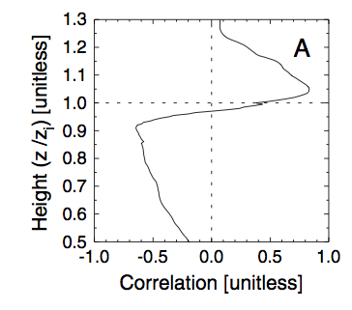
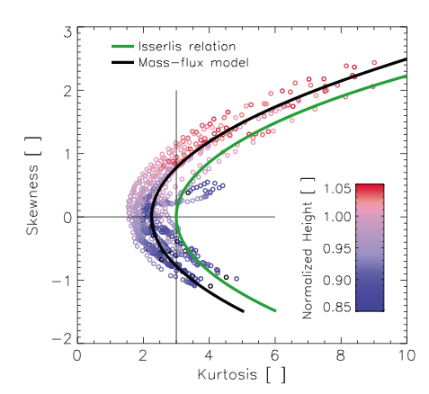
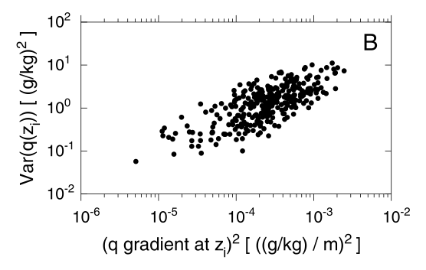
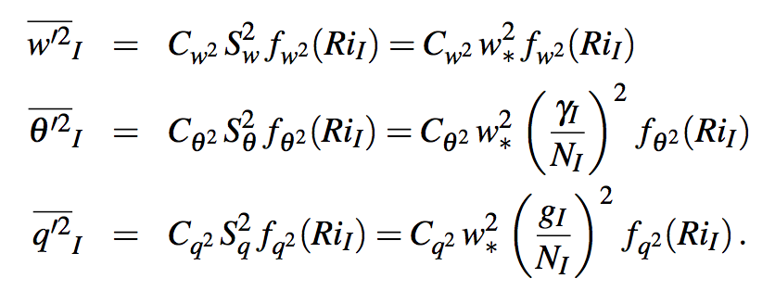
Some Raw Ingredients to Improve BL Turb Parameteriz’s
(1) Water Vapor Mixing Ratio from Raman lidar (75-m, 10-s)
(2) Compute variance(z) and skewness(z) for each case
(3) Statistics in CBL for 300 cases collected over 6 years
(6) Strong relationship between skewness and kurtosis at CBL top (HSRL)
(5) Correlation of WV variance at CBL top with 3rd moment of WV throughout BL
(4) Relating WV variance and WV gradient at CBL top

Slide 28
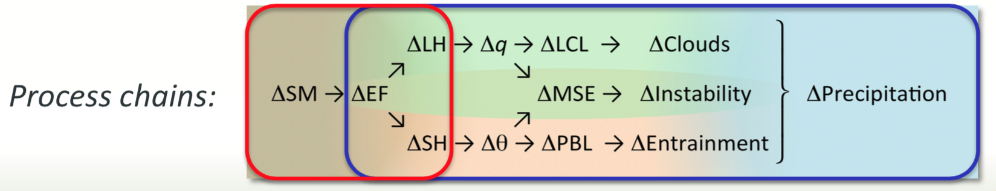
Work that is already underway…
A range of “similarity relationships” have been developed from LES model output (e.g., Sorbian 2005)
Relationships are being tested with co-located RLID (q, T) and Dopper lidar (w, u, v) obs
Paper by Wulfmeyer et al. (JAS, 2016) outlines how
Working on deriving latent heat profiles from the RLID and DLID datasets now
Higher order statistics being used to build subgridscale cloud parameterizations (Van Weverberg et al. 2016)
Have analyzed WV turbulence data from Darwin RLID also (Osman et al. JGR 2018)
These lidars allow us to study land-atmosphere interactions to really get at this chain of processes…
Conducted LAFE at SGP in Aug 2017
Eclipse event was superb case study for land-atmosphere interactions (GRL 2018)
Overview of LAFE in BAMS (accepted)
Land-atmospheric feedback
Red: Terrestrial leg
Blue: Atmospheric leg

Slide 29
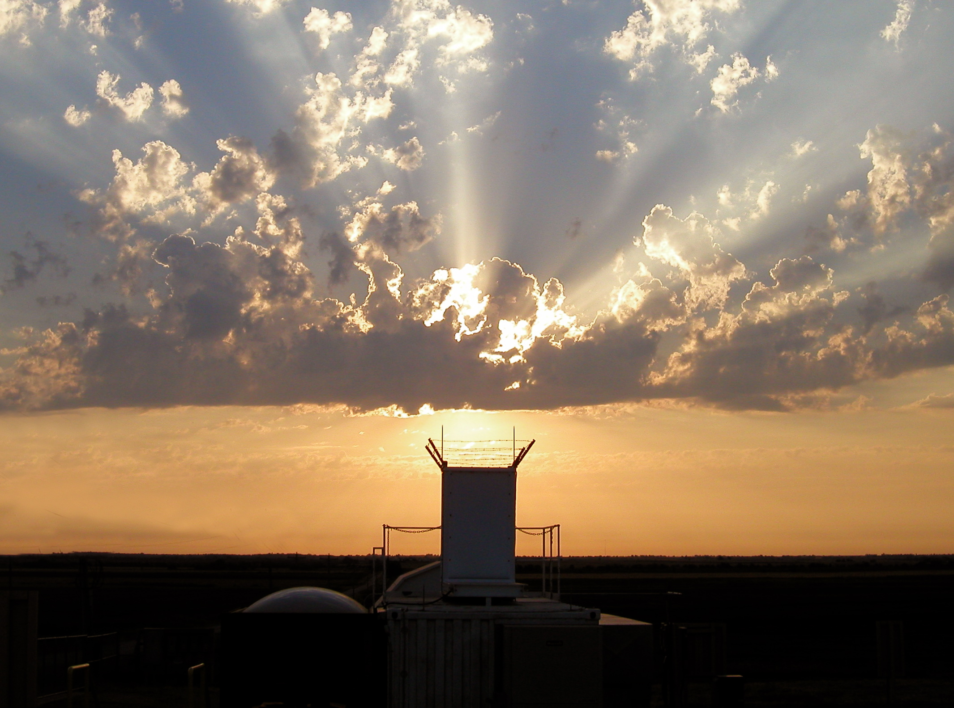
Even during a sunset, there is still so much promise and beauty! I hope the next 30+ years are wonderful! Thanks for everything, Tom!

