Slide 1
25 years of Cloud and Radiative Transfer Studies with ARM and ARM-like Observations
Tom Ackerman’s Retirement Seminar
University of Washington
July 14, 2018
Jim Mather

Slide 2
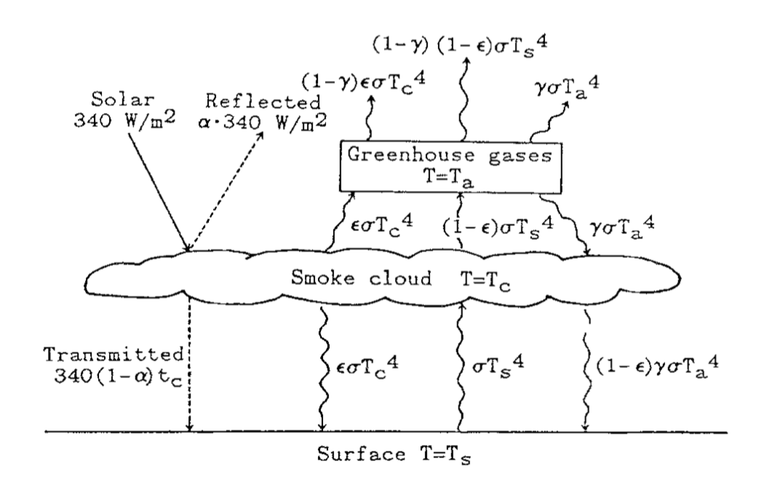
An Influential Class
First encounter with Tom in a radiative transfer class at Penn State (1989).
First real atmospheric science project: an analysis of Singer’s critique of the Turco et al. nuclear winter work
From Singer, 1988

Slide 3
The Tropical Western Pacific (TWP) Site Science Team
5 years, 1 OH instrument, and 2 tropospheric chemistry field campaigns later…
Early ARM responsibilities and opportunities (my next homework assignment):
Providing data quality assessments and scientific input to the TWP operations team
Refining and applying a correlated-k 2/4-stream model
Engaging with the TWP measurements
  TOGA-COARE
  ARM-TWP
… and many trips to Albuquerque

Slide 4
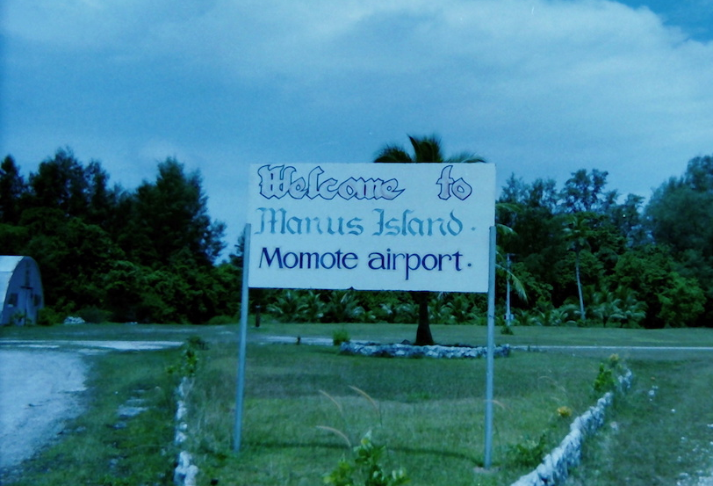
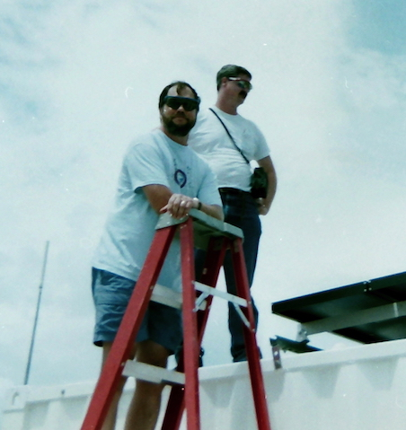
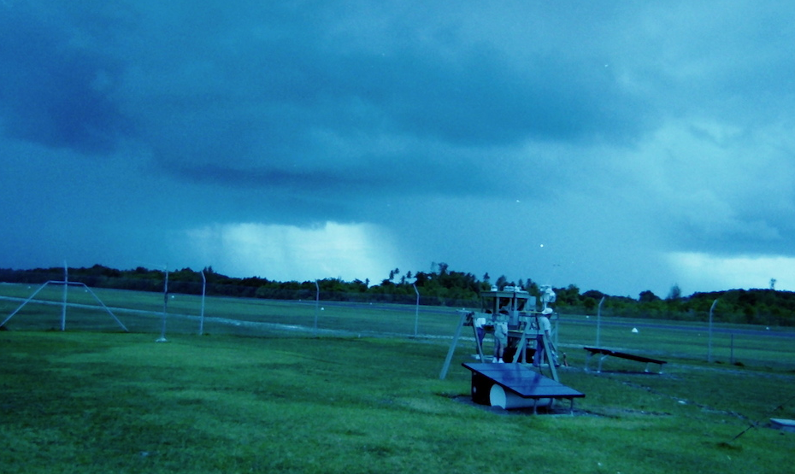
Manus Island, Papua New Guinea
Installation of the first TWP ARM site in 1996

Slide 5
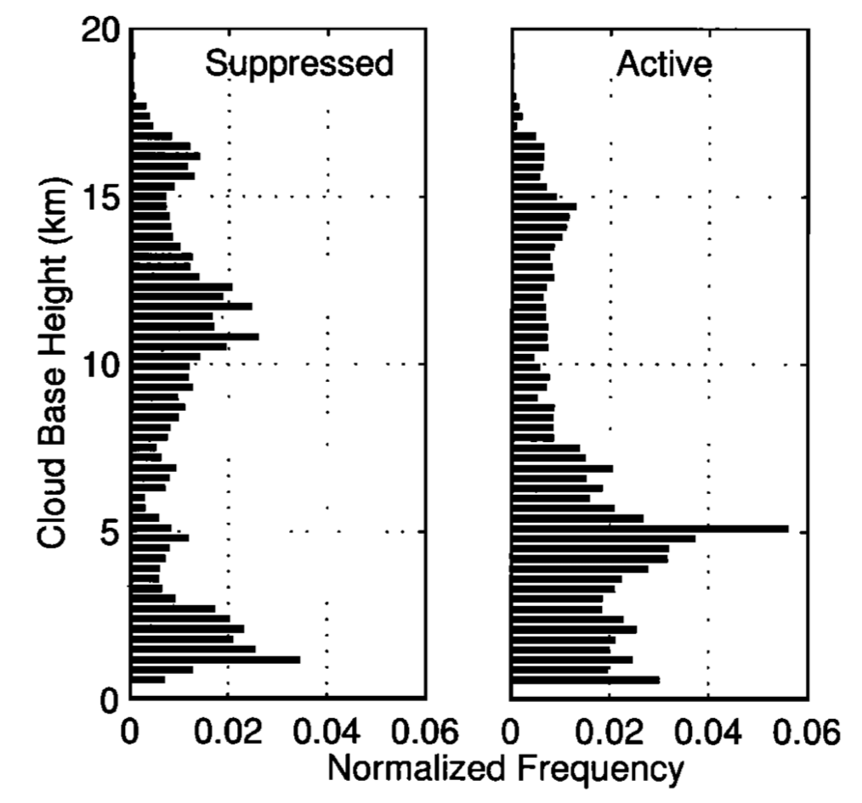
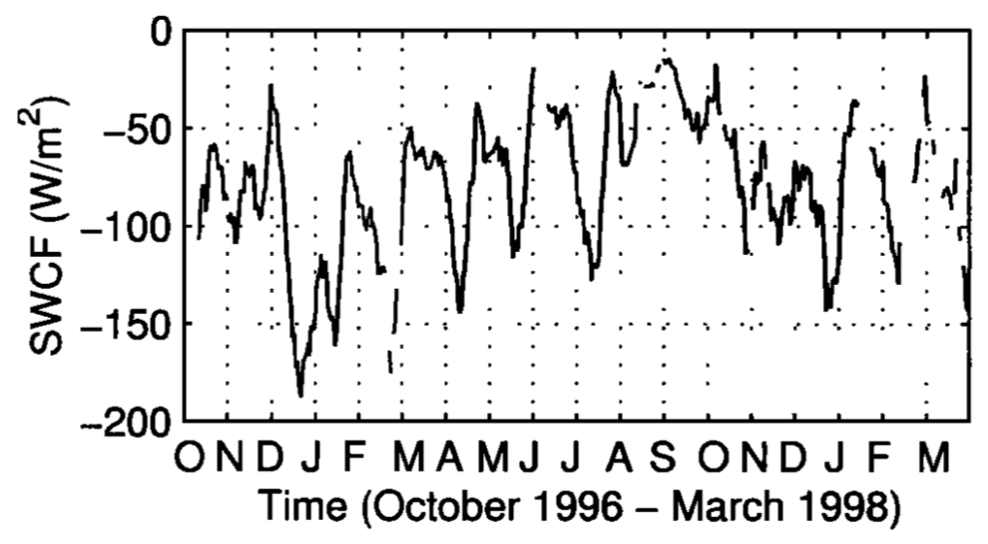
A First Look at Manus
The first 18 months of measurements:
Distinctive vertical cloud structure
Clear MJO cycle
Strong ENSO event
Mather, Ackerman, Jensen and Clements 1998
Notes:
Observed strong westerly wind burst preceding the ENSO event

Slide 6
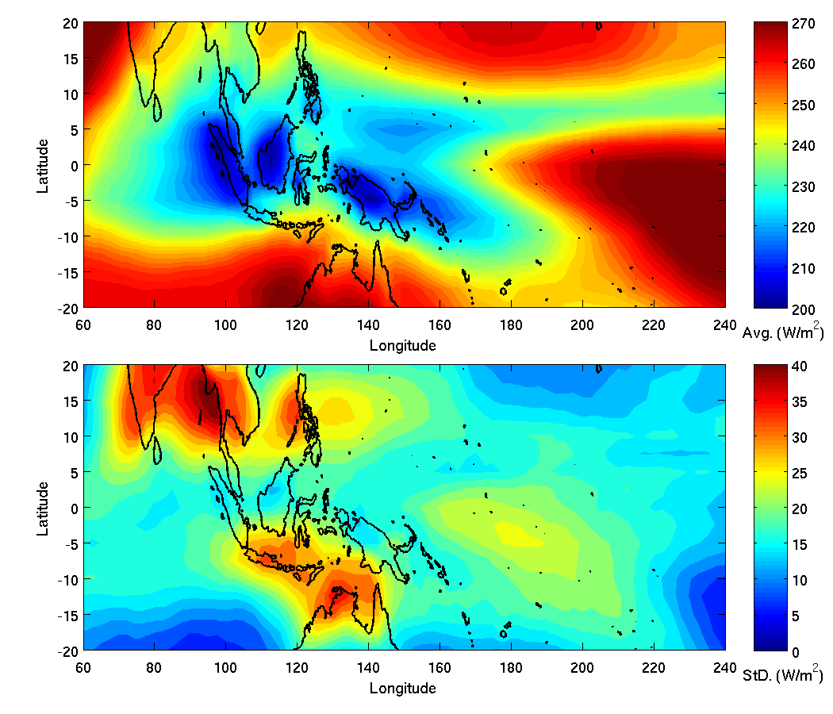
The TWP Environment
Annual average and standard deviation of out-going longwave
Radiation.
Mather, 2005

Slide 7
The TWP Environment
Outgoing Longwave Radiation at 4 Locations
Examining the relationship between convection and cloudiness at Manus relative to the maritime continent region.
5-year Composite of Precipitation at Manus
Mather, 2005

Slide 8
The ARM Mission (1996)
Relate observed radiative fluxes to the temperature and composition of the atmosphere, specifically including water vapor and clouds, and to surface properties
Develop and test parameterizations (for general circulation models) that can be used to accurately predict the radiative properties and model the radiative interactions involving water vapor and clouds

Slide 9
State of ARM After One Decade
From Tom’s 2001 Presentation to the ARM Science Team
ARM is alive and healthy after a decade
We need a tighter focus on our primary goal of improving cloud and radiation parameterization
Important science goals include:
  Assessing modeled heating rate profiles (and importance of doing so)
  Relating aerosol optical properties to composition
  Deriving cloud properties from remote sensors
  Assessing cloud resolving model (CRM) simulations with observations and using CRM simulations to extend observations

Slide 10
Calculating Radiative Heating Rate Profiles from ARM Measurements
Radiosonde profiles of temperature and humidity +
Microwave radiometer precipitable water +
High temporal resolution surface air temperature
→ Constrained profiles of temperature and humidity at high temporal resolution
Radar profiles of reflected power +
Radiosonde temperature profiles +
Field observations of cloud particle distributions
→ Profiles of liquid and ice water content and effective particle size
Derived profiles of temperature and humidity +
Derived profiles of cloud water content and particle size
→ 4-stream radiative transfer model (Fu and Liou, 1992)
→ Radiative Fluxes and heating rates

Slide 11
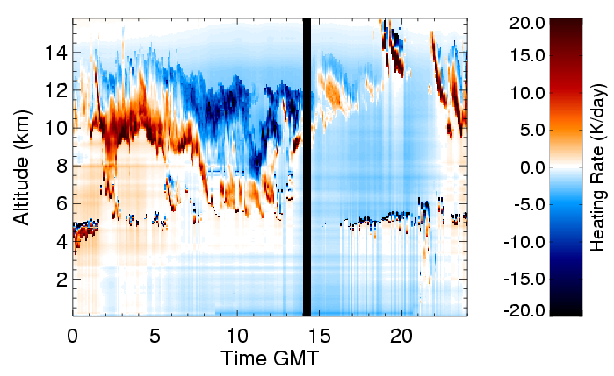
Tropical Radiative Heating Rates
Strong heating at cloud base and cooling at cloud top.
Mather, McFarlane, Miller and Johnson 2007

Slide 12
Tropical Radiative Heating Rates
Strong heating at cloud base and cooling at cloud top.
Optically thin clouds can experience heating throughout the layer.
Mather, McFarlane, Miller and Johnson 2007

Slide 13
Tropical Radiative Heating Rates
Strong heating at cloud base and cooling at cloud top.
Optically thin clouds can experience heating throughout the layer.
Also see heating below cloud base.
Mather, McFarlane, Miller and Johnson 2007

Slide 14
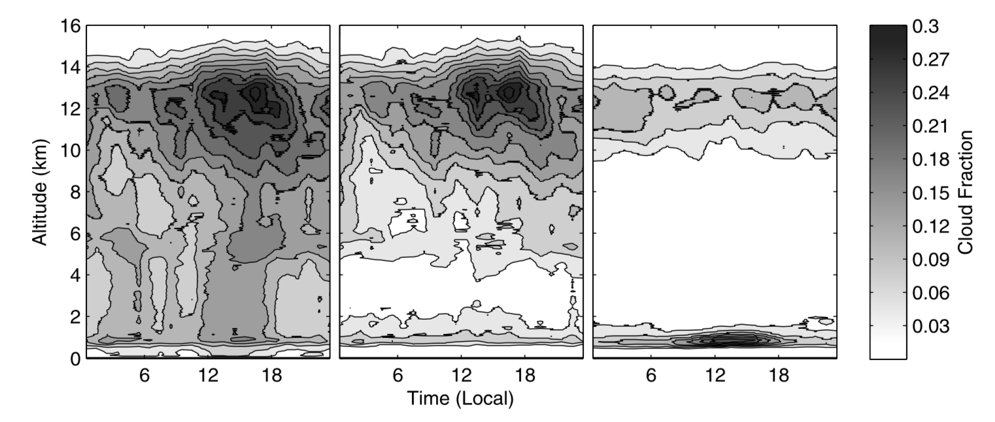
TWP Heating Rate Structure
Manus
Nauru
Mather, McFarlane, Miller and Johnson 2007

Slide 15
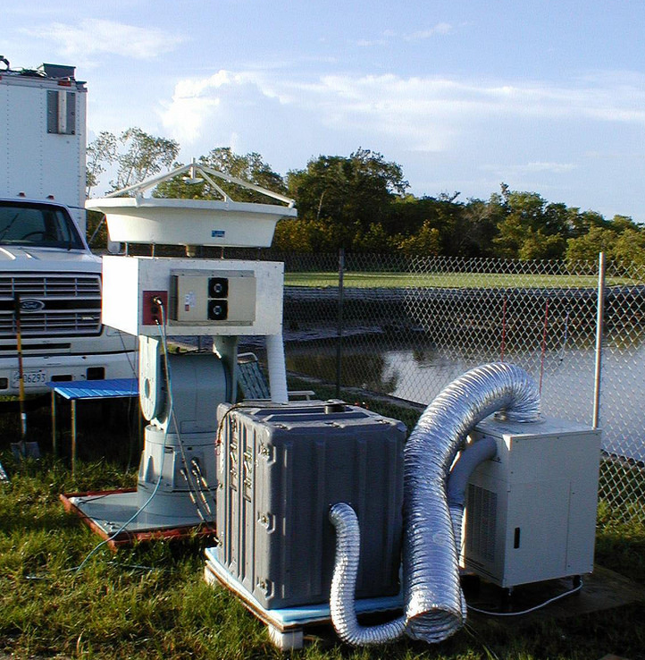
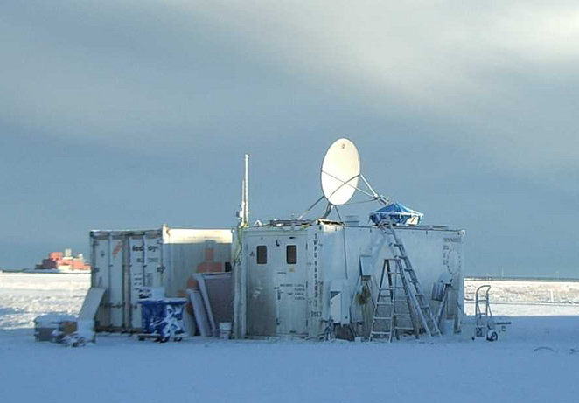
PNNL Atmospheric Remote Sensing Laboratory (PARSL)
PARSL included many instruments found in an ARM observatory:
Radiometers (Broadband, MFRSR, MWR)
Radiosonde system
94 GHz radar
PARSL was deployed 5 times between 2000-2006.
Pilot deployment to Long Beach, WA
IMPROVE2: Sisters, OR (2001)
CRYSTAL-FACE: Everglades City, FL (2002)
M-PACE: Oliktok, AK (2004)
TWP-ICE: Darwin, Australia (2006)
Notes:
The PARSL radar was built by Kevin Widener. Other members of the PARSL team included:
Connor Flynn, Chuck Long, Roger Marchand, Dave Turner, and others from PNNL

Slide 16
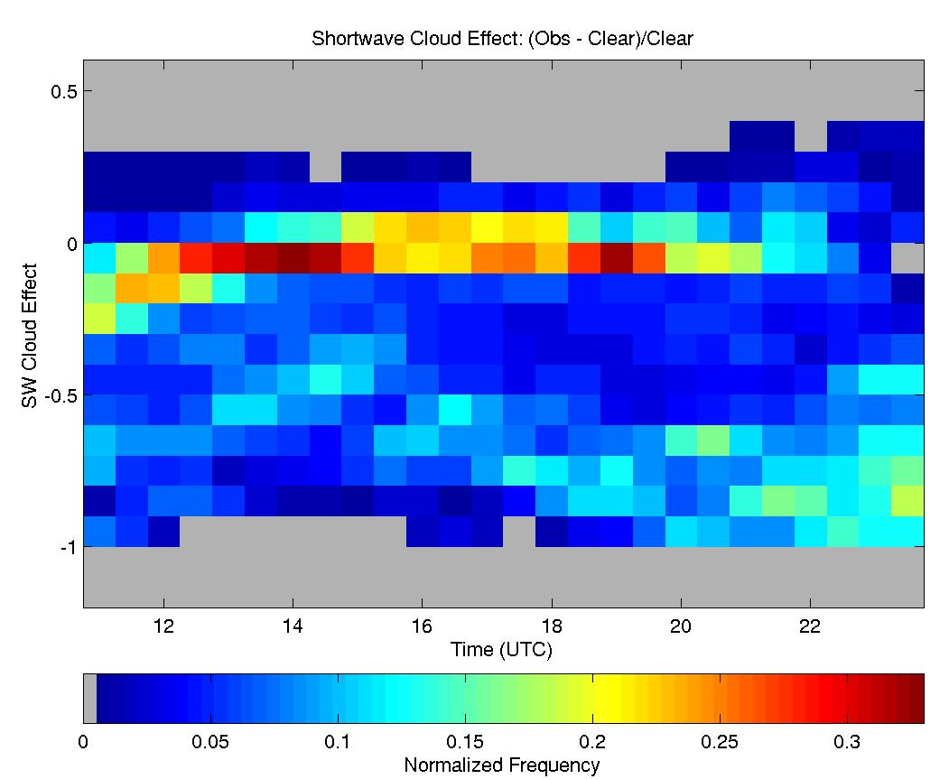
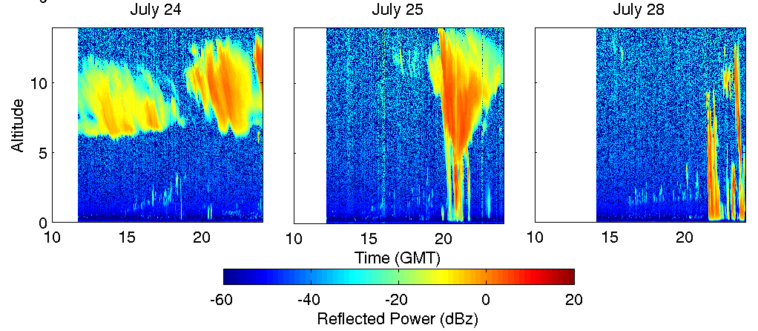
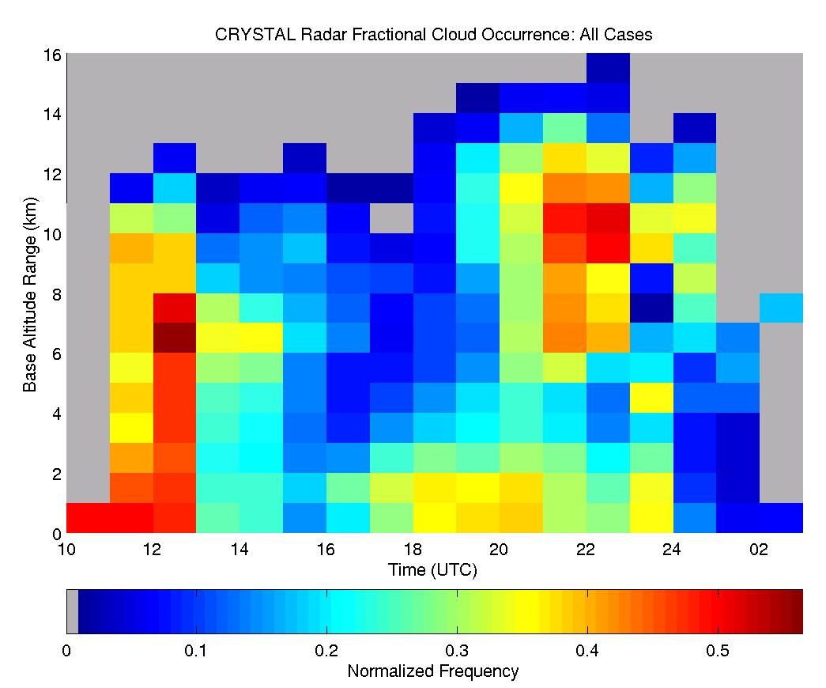
PARSL Observations: CRYSTAL-FACE
The strong sea-breeze-driven diurnal cycle is evident in the PARSL observations from south Florida.

Slide 17
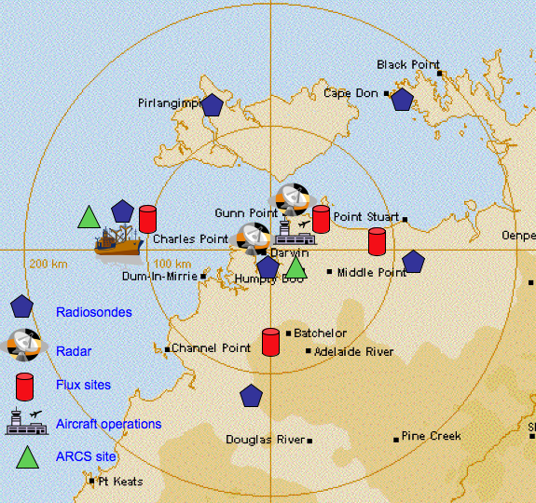
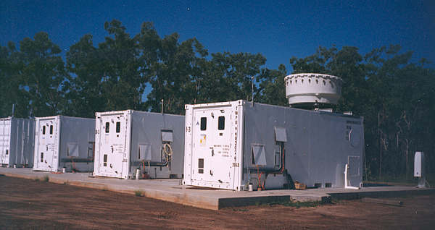
The Tropical Warm Pool International Cloud Experiment (TWP-ICE)
Close collaboration between ARM and the Australia Bureau of Meteorology
Coordinated with the UK-based ACTIVE aerosol and chemistry campaign
Has resulted in > 80 publications
May et al., 2008

Slide 18
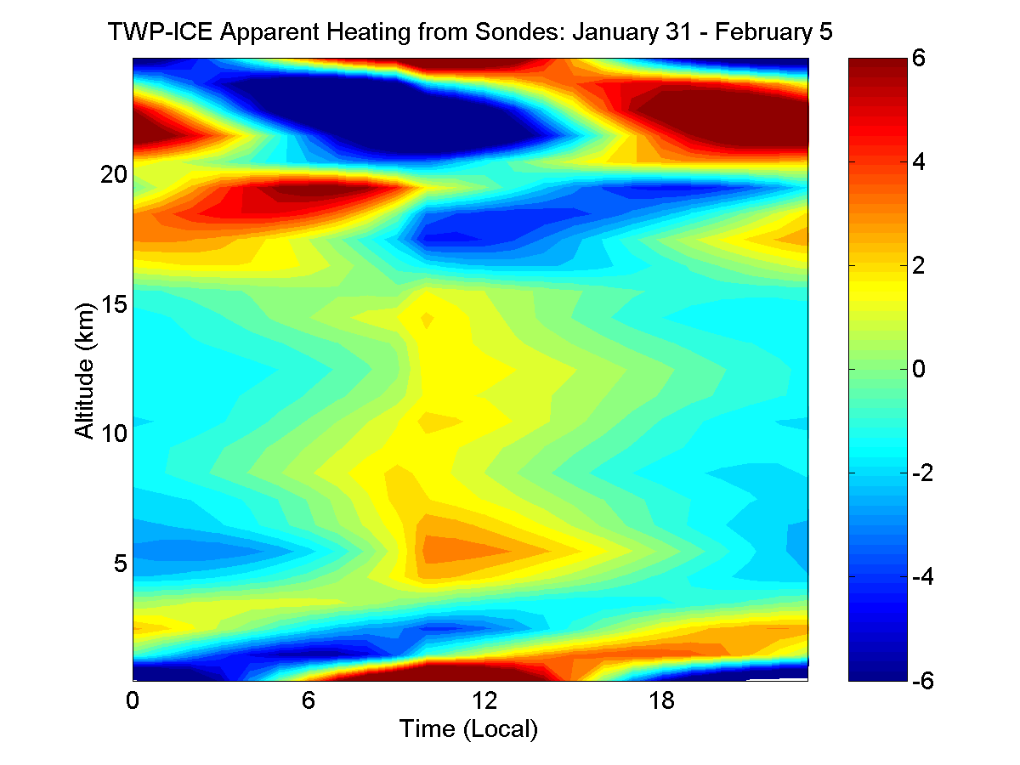
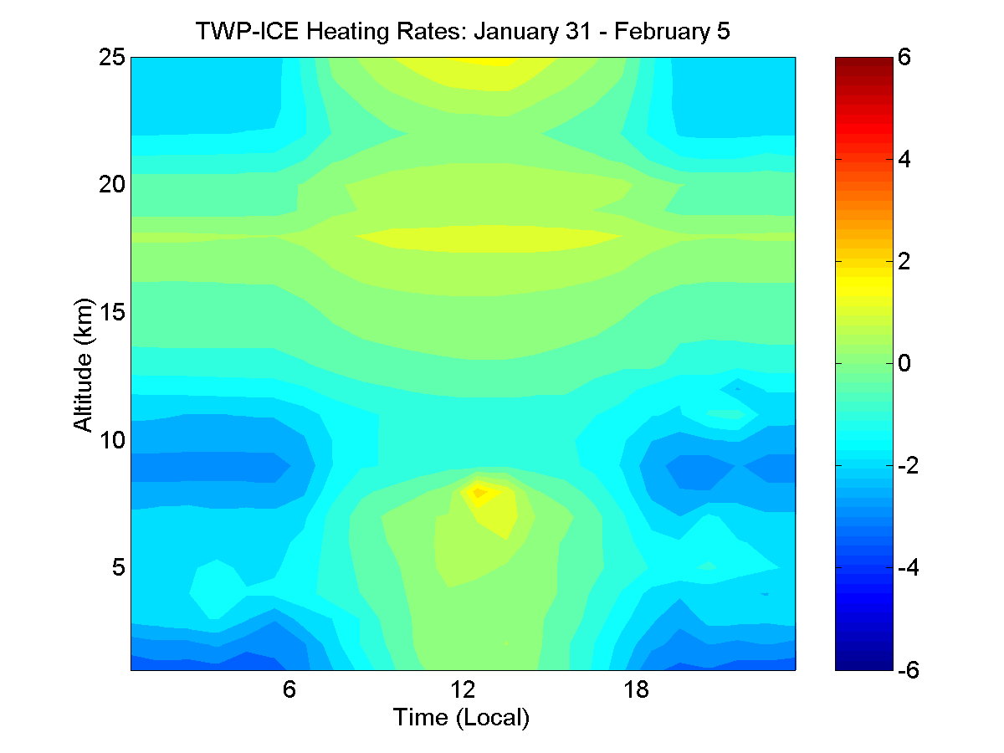
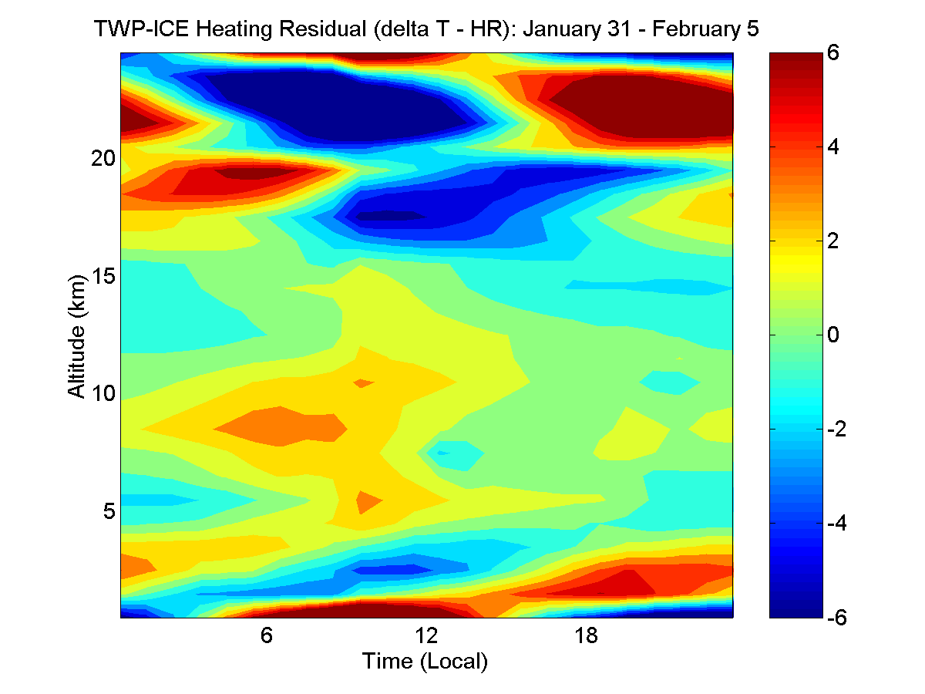
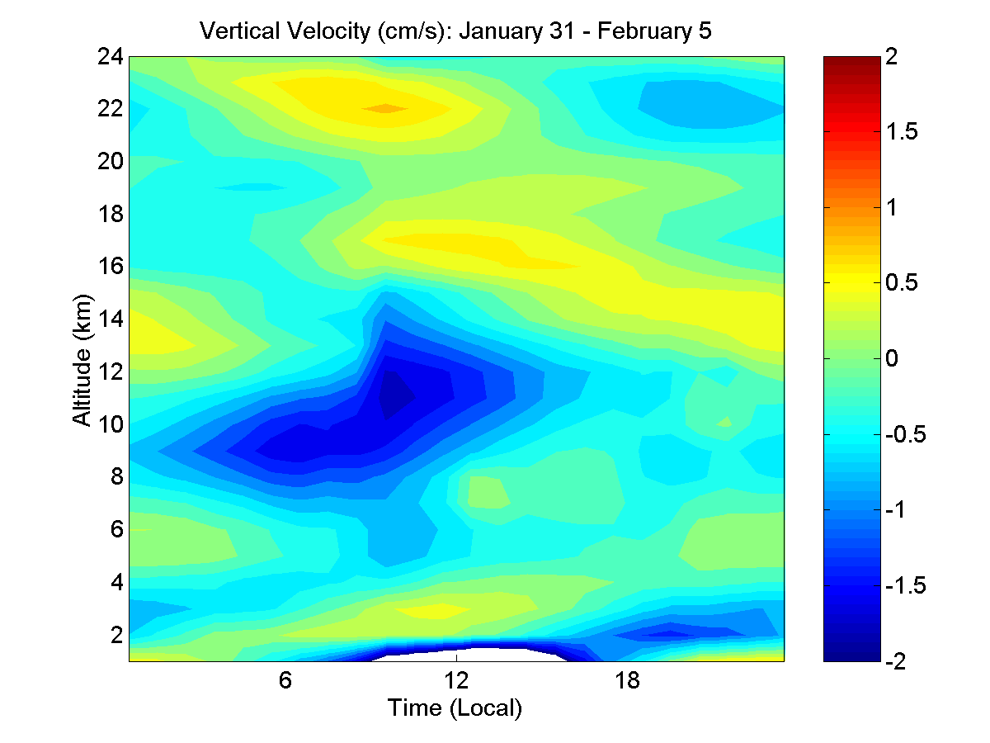
Radiative Heating and Dynamics (Convectively Suppressed Period)
__
=
Notes:
Following the Ackerman “Heating rates from tropical anvils” paper – unpublished. Suppressed period.

Slide 19
ARM Technical Coordination
Expanding measurement capabilities through the 2009 Recovery Act
Establishment of new sites at Oliktok and Graciosa Island – and the subsequent end of the TWP sites
Incorporation of an aerial facility within ARM
Implementation of Unmanned Aerial Systems and Tethered Balloon Systems
Development of an integrated observation and modeling framework

Slide 20
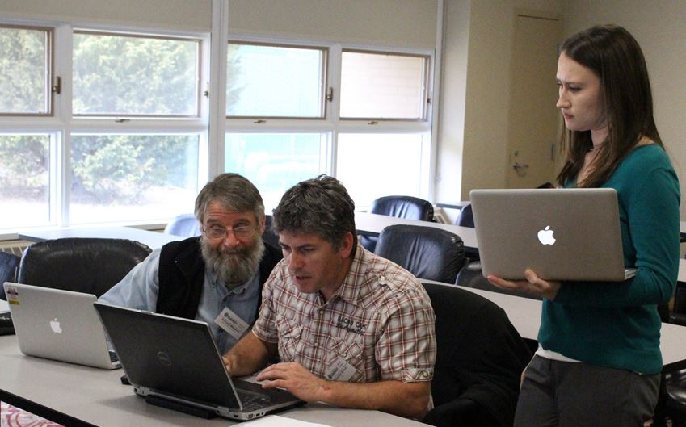
LES ARM Symbiotic Simulation and Observation (LASSO)
        LASSO integrates high-resolution (100 m) atmospheric simulations with ARM observations and diagnostics – currently over the Southern Great Plains during shallow convection events.
Image with several scientists collaborating on a problem (e.g. at a meeting)
Cases released for 2015/16; 2017 underway
Soliciting ideas for next phase
Measurement-based diagnostics
  Cloud Fraction
  Cloud Base Height
  Liquid Water Path
Led by Bill Gustafson and
Andy Vogelmann

Slide 21
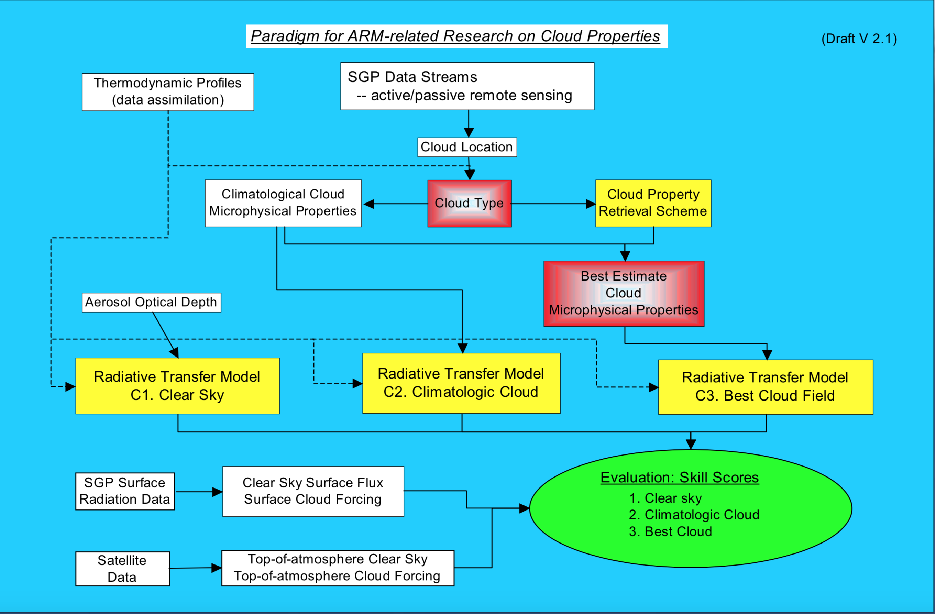
Framework for Deriving Cloud Properties
Ackerman, 2001

Slide 22
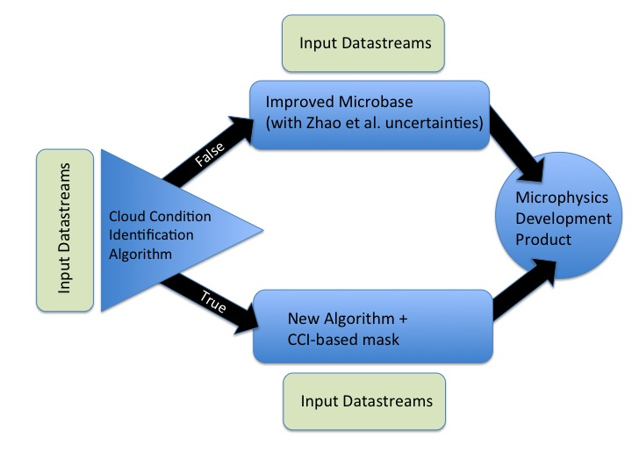
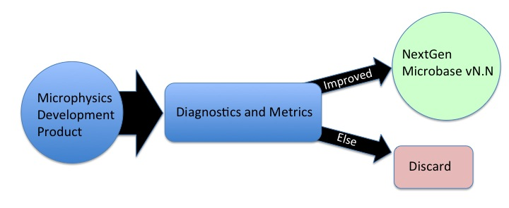
Operational Ground-Based Retrieval for Clouds (OGRE-Clouds)
Framework for development, testing, and improvement of continuous cloud microphysics products
Led by Mike Jensen and
colleagues at BNL

Slide 23
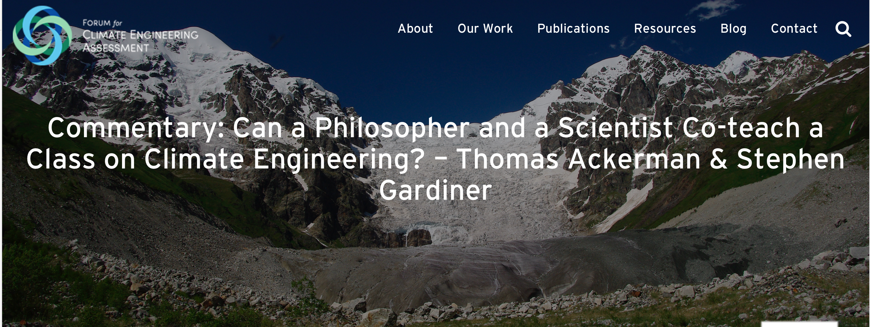
Speaking out about Climate Science

