Slide 1
Tom Ackerman
A tribute to a swell guy…
Chuck & Sue Long

Slide 2
Historical perspective
Tom and I first met at Penn State (1989)
We hit it off because we both come from large families
where repartee was taken to the extreme
verbal Darwinism of survival of the "wittiest"
Has provided many years of verbal jousting
Out of respect for elder cronies, I made sure to let Tom “win” half of them

Slide 3
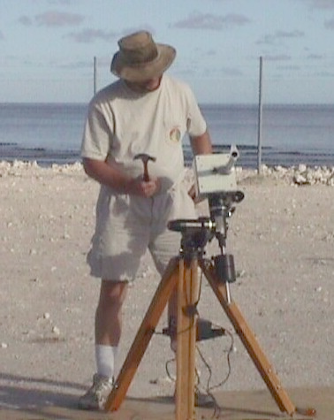
What I learned from Tom…
%@$#*&%!!
Instrument setup and operation
Essential tools needed for field work
Language skills for field work

Slide 4
Why has Tom been so successful?
Tom Ackerman has “IT”
In fact Tom Ackerman is full of “IT”
Tom spreads “IT” around and leaves trails of “IT” in his wake.
Others then clean “IT” up
Take “IT” and run with “IT”
Produce something useful from “IT”
Tom ends up smelling like a rose!
In recognition of this process, we at Penn State formed the “AckPak”

Slide 5
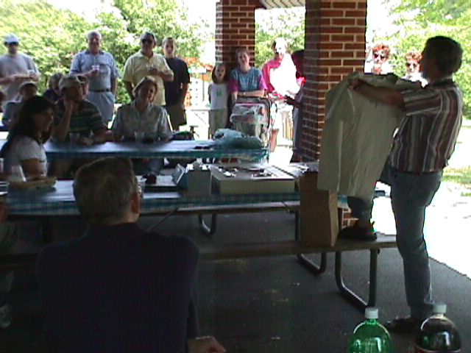
PSU Celebrates Tom Leaving
Devilishly Handsome Presenter
Saint Linda
Tom

Slide 6
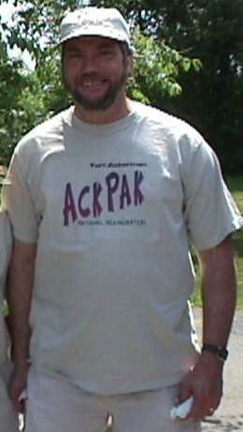
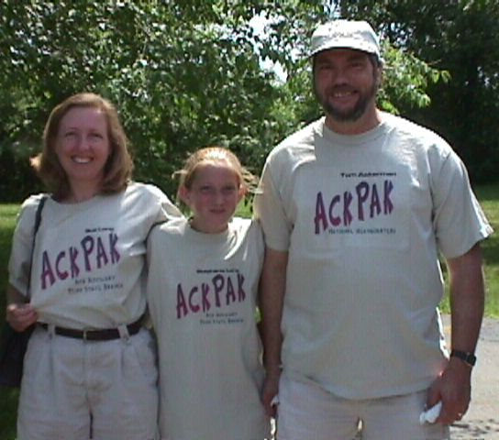
AckPak T-Shirts
Head Ack
Honorary Acks

Slide 7
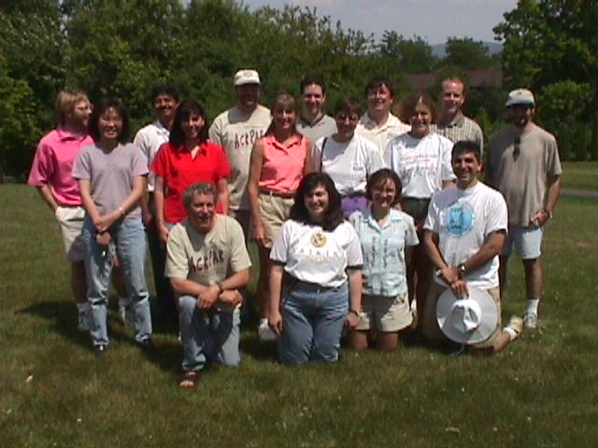
The AckPak 1998
We made Tom look so good he got the job at PNNL!

Slide 8
He did it again!
We made Tom look so good at PNNL that he got another cushy job at UW!
Once again a party was held to celebrate Tom’s leaving.
Tom moved from the right-hand side of the US map to the left at PNNL, and now even lefter to the coast…
So we again commemorated the event with a new, updated AckPak Tshirt

Slide 9

New T-shirt

Slide 10
Yippee!!!
Tom is finally moving on with no efforts needed by any of his colleagues or students!
He did everything needed all by himself!
So what is it that Tom has done?
He has lived long enough to get really, really old!
Finally, something Tom did not need help to do!
(Well except for great effort by Linda)
To commemorate, a final new T-shirt:

Slide 11

Final T-shirt:

Slide 12
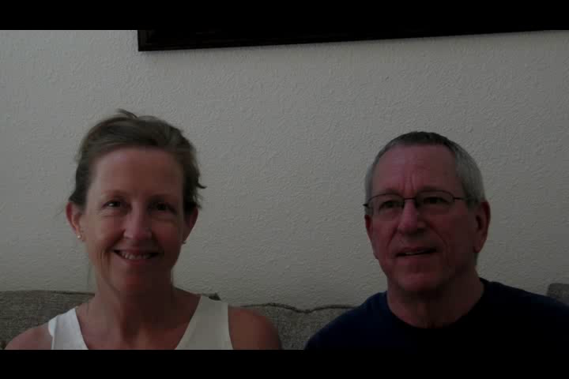
In conclusion:

Slide 13
Happy Retirement!
Start enjoying those Denny’s senior specials!

