Slide 1

ATMS 101 Wind Autumn 2024

Slide 2

Why is there wind?
Wind is the movement of air
Created by differences in pressure.
Air often accelerates from high to low pressure

Slide 3
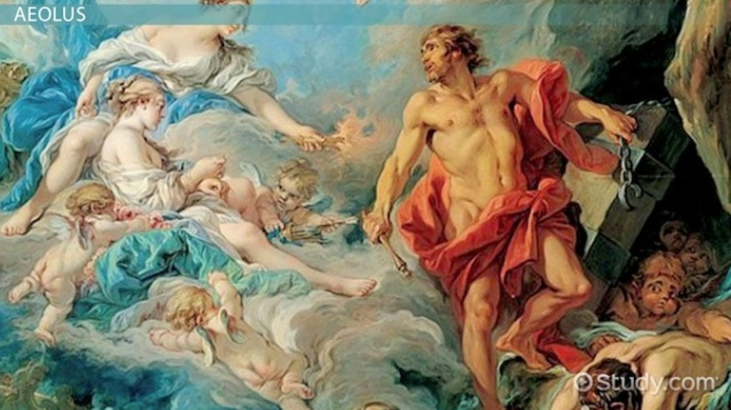
Ancients had other ideas…
Aeolus, god of the winds.

Slide 4
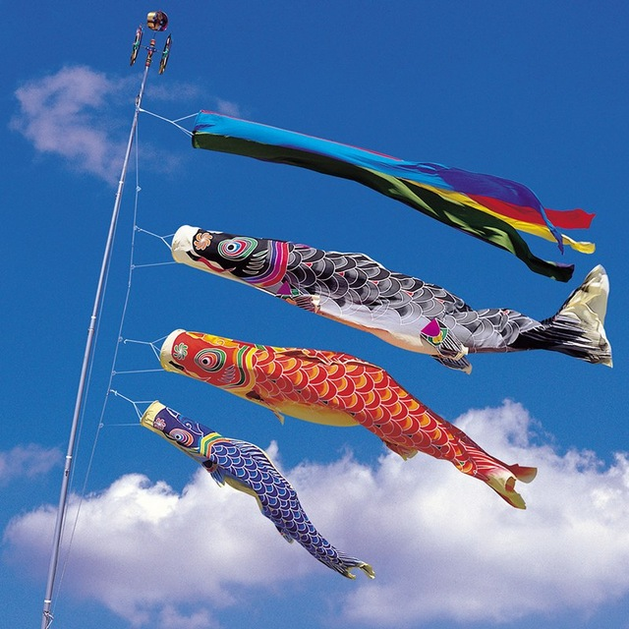
Ancient Wind Measurement
Wind vanes were perhaps the most ancient meteorological instruments.
Mesopotamian and Sumerian documents, dating back nearly 4,000 years, describe primitive wind vanes.
Streamers used for wind direction observation in China during the second century B.C.E.

Slide 5
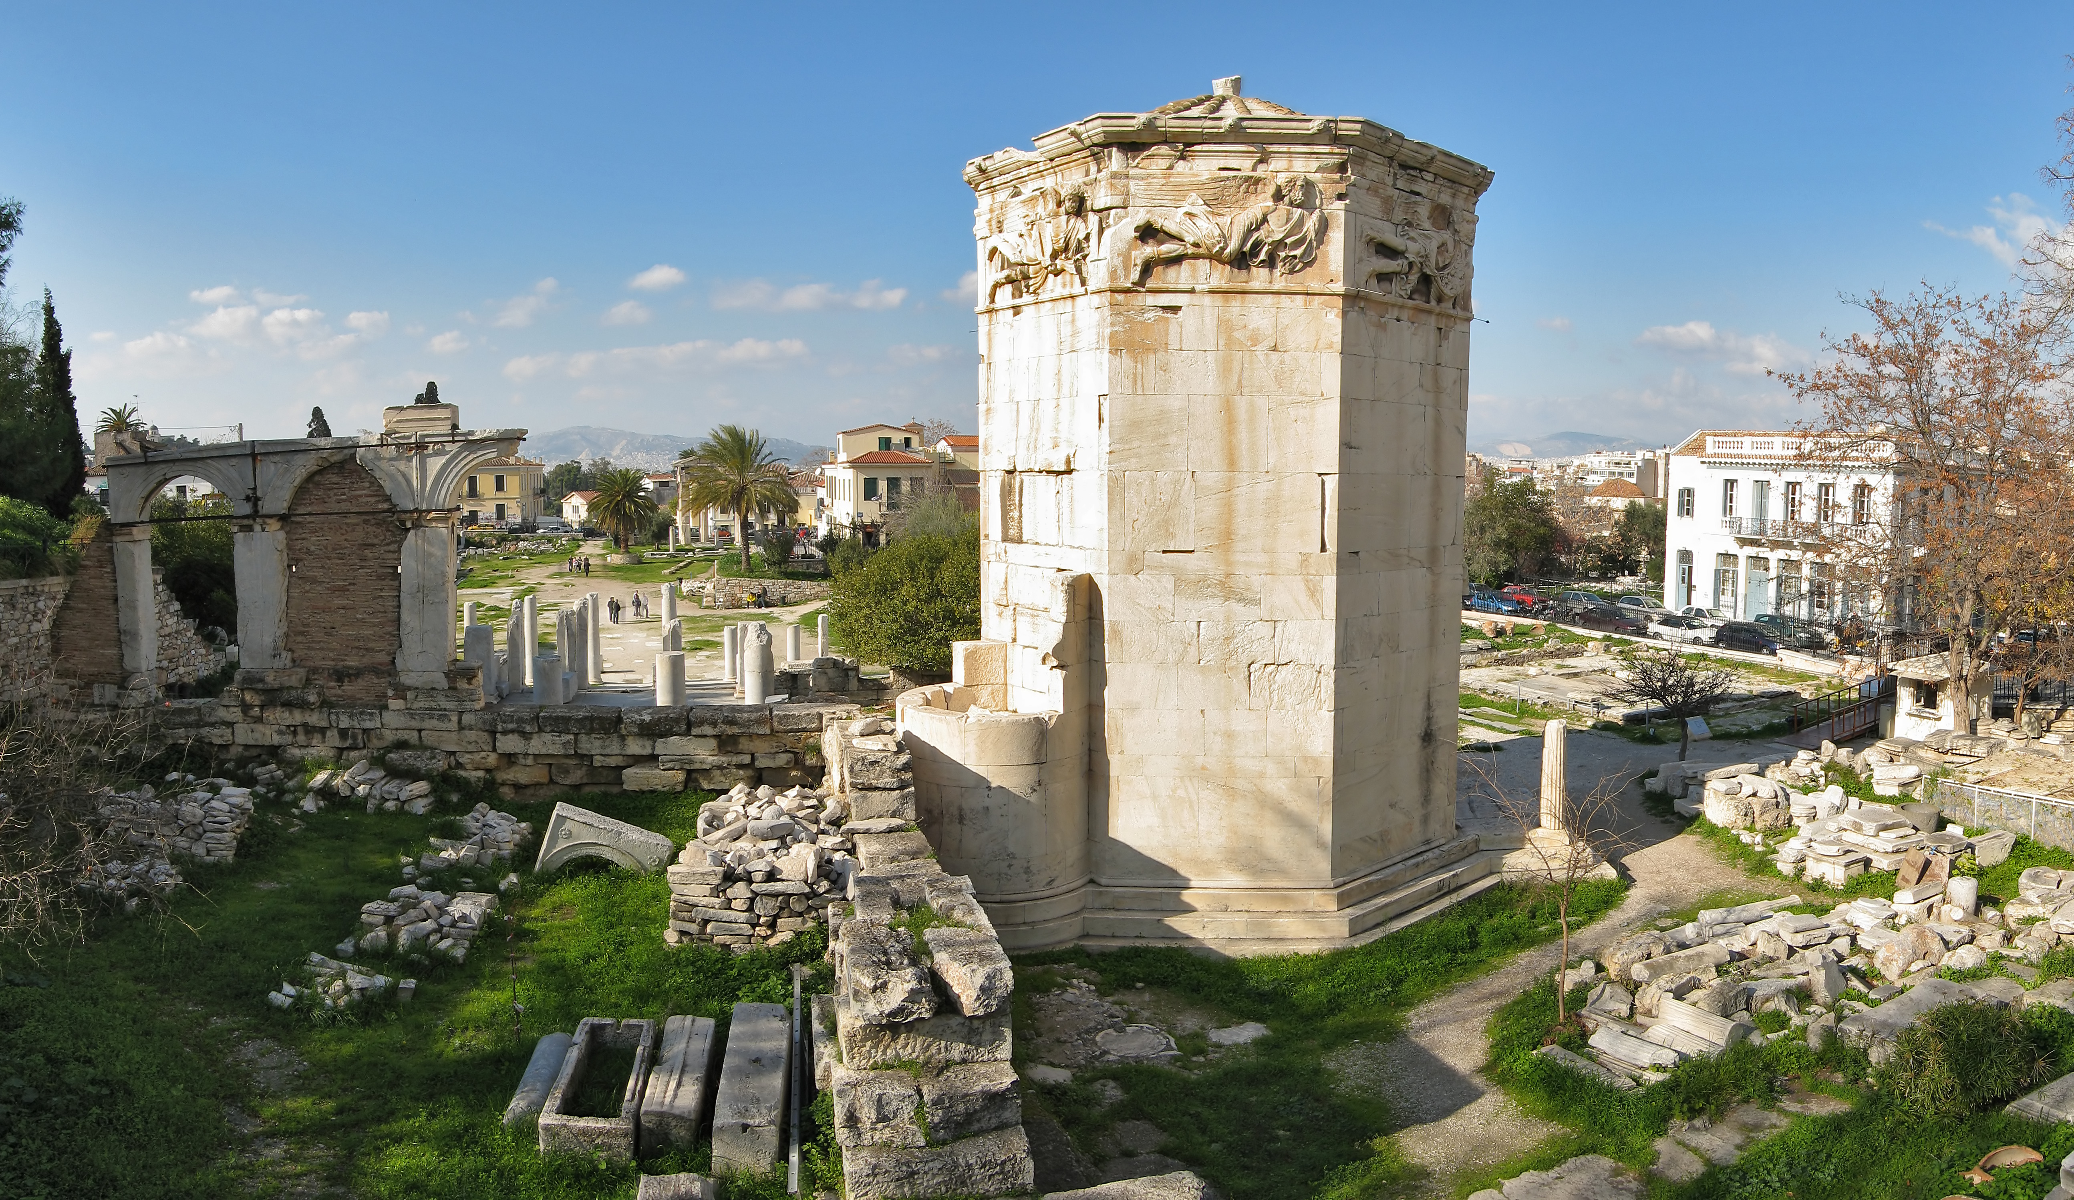
Wind Measurement
The famous Tower of the Winds in Athens, dating back at least to 50 B.C.E., was topped by a wind vane in the form of a Triton
Wind vanes and wind banners were common during the Middle Ages, and were found on many churches, ships, and towers.

Slide 6


Slide 7
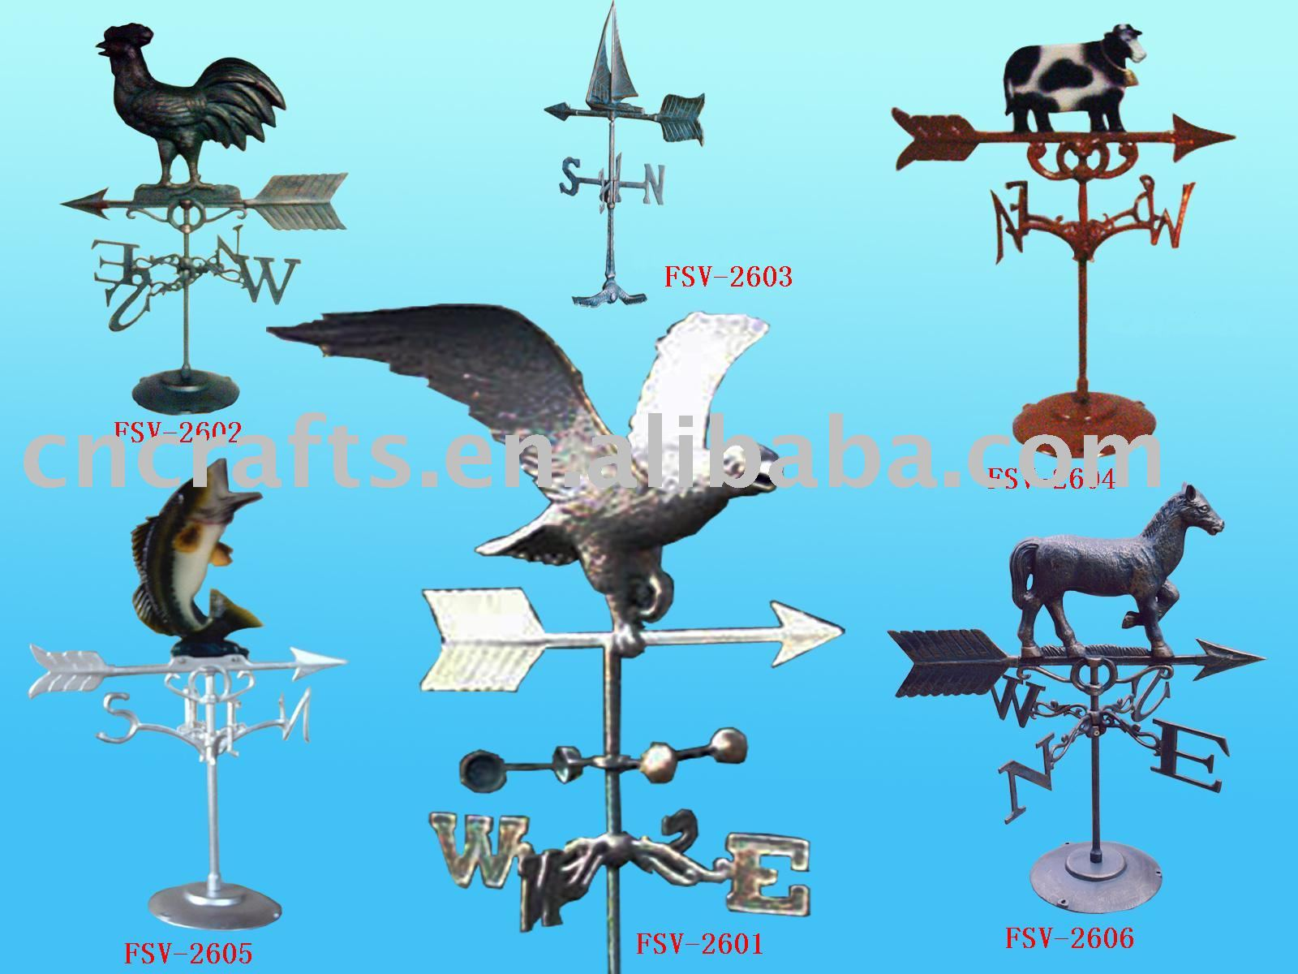
Wind direction can be measured with wind vanes

Slide 8
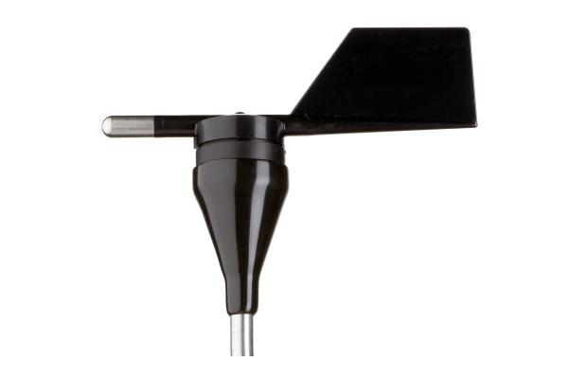
More modern version

Slide 9
Wind speed is measured with anemometers

Slide 10
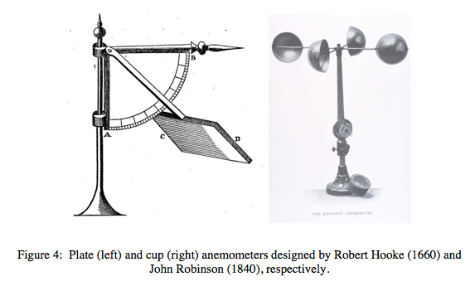
Early anemometers
Plate anemometer Early 4-cup anemometer

Slide 11
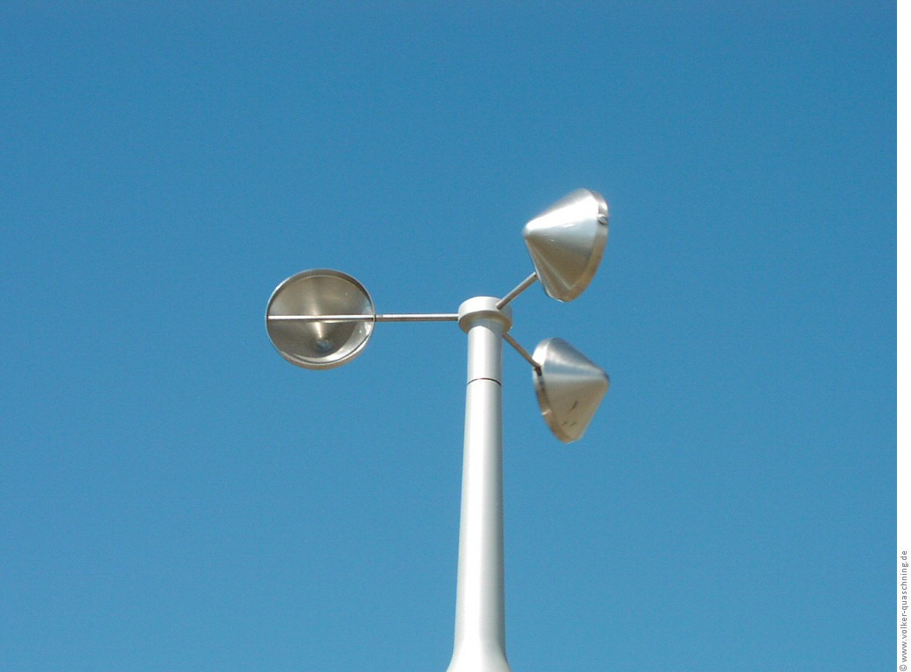
Modern Three-Cup Anemometer

Slide 12
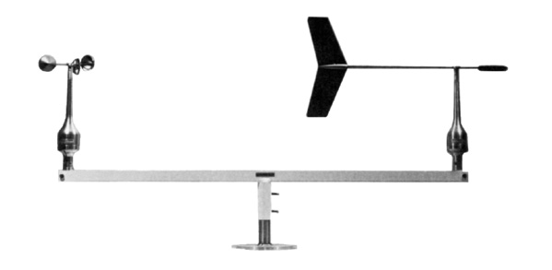
Combo

Slide 13
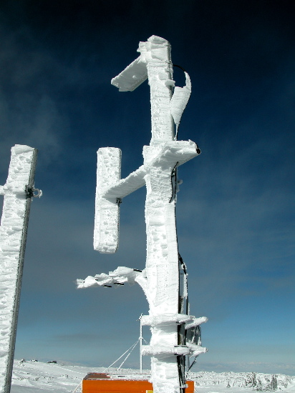
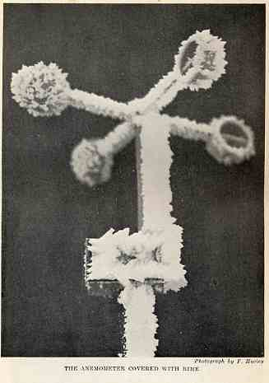
Sometimes anemometers and wind vanes have icing issues

Slide 14
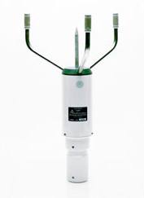
Sonic Anemometers Measure wind speed and direction with sound waves Speed of sound waves influenced by wind
The solution….

Slide 15
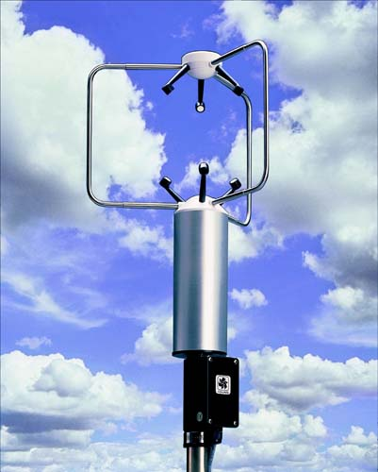
Sonic Anemometer

Slide 16
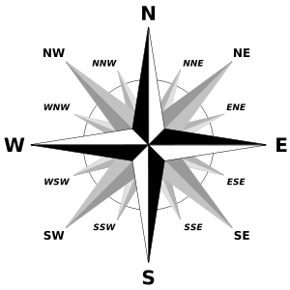
Wind Terminology
Wind direction is the direction from which the wind is coming
Easterly wind is from the east
Westerly wind is from the west
Given in cardinal directions (N, S, etc) or in degrees.

Slide 17
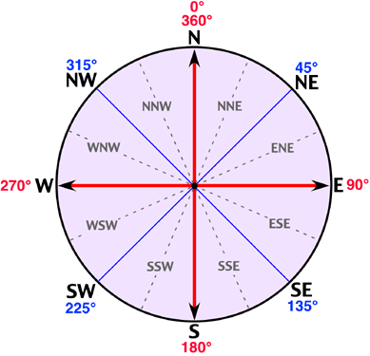
Wind Direction (degrees) Meteorologists generally use degrees

Slide 18

Wind Speed
Miles per hour in the U.S. in media
More often given in knots
1 knot = 1 nautical mile per hour= 1.15 mph
1 knot is ~ .5 meter per second

Slide 19
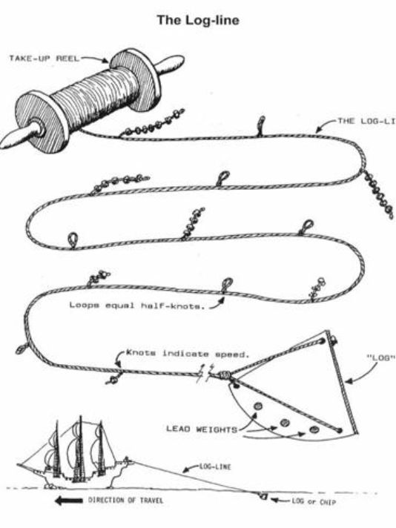
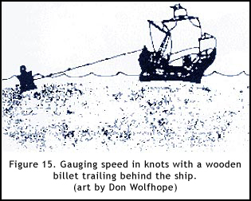
Historical Origin of Knots

Slide 20
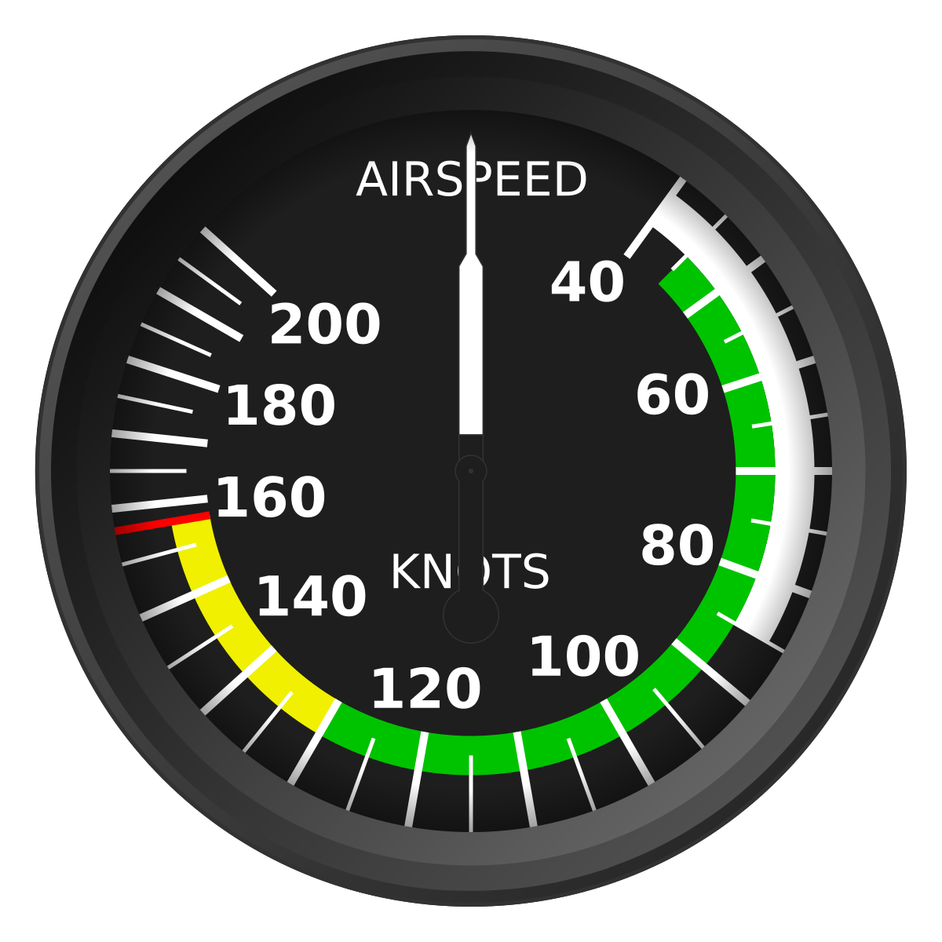
Aviation Took on the Nautical Terminology

Slide 21
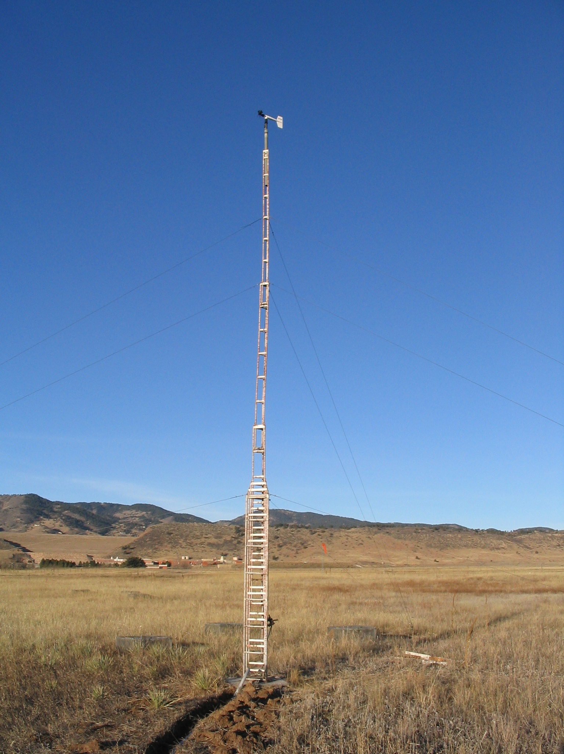
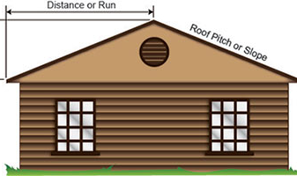
Proper Exposure of Surface Wind Instruments
Open area
Sensors at 10 m (roughly 30 ft) above the ground.
Not above pitched roof.

Slide 22
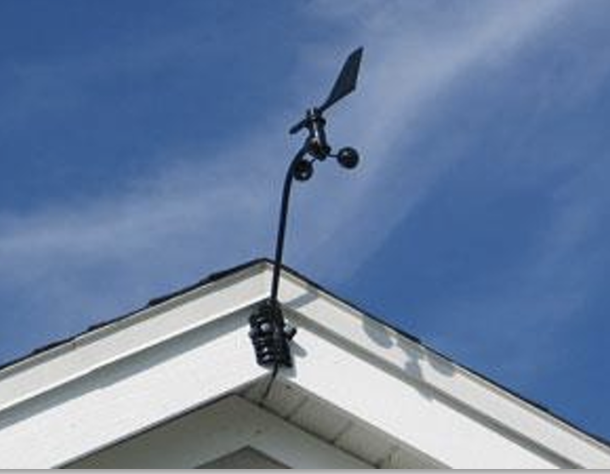
Bad Location!

Slide 23
Sustained Winds and Wind Gusts
Sustained wind: usually average over 1-2 minutes
Gusts: typically, strongest 3-5 second average wind reported during a recent period (often 10 minutes).
Gusts usually 1.3-1.4 times the sustained wind speed--but can be much more on some occasions.

Slide 24
Atmospheric Sciences Bldg. Sustained Winds and Gusts
Sustained winds black, gusts-–red dot

Slide 25
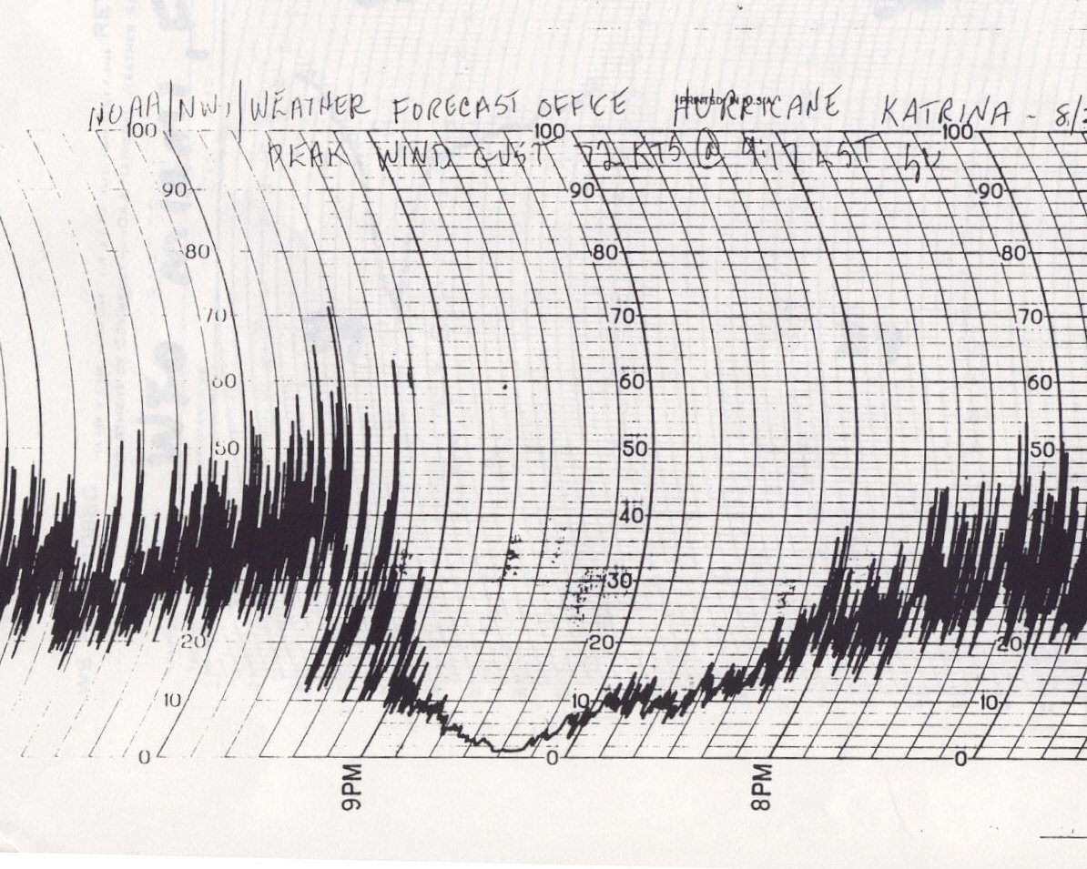

Slide 26
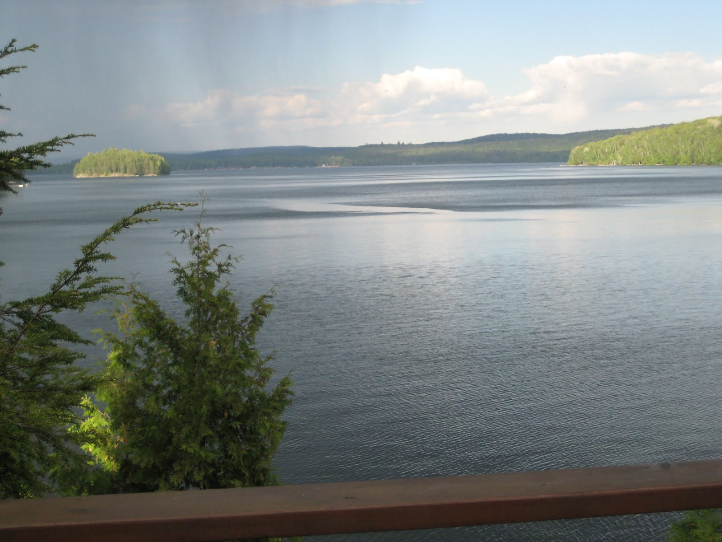
You Can Often See Gusts Over Water—called “cat’s paws”

Slide 27
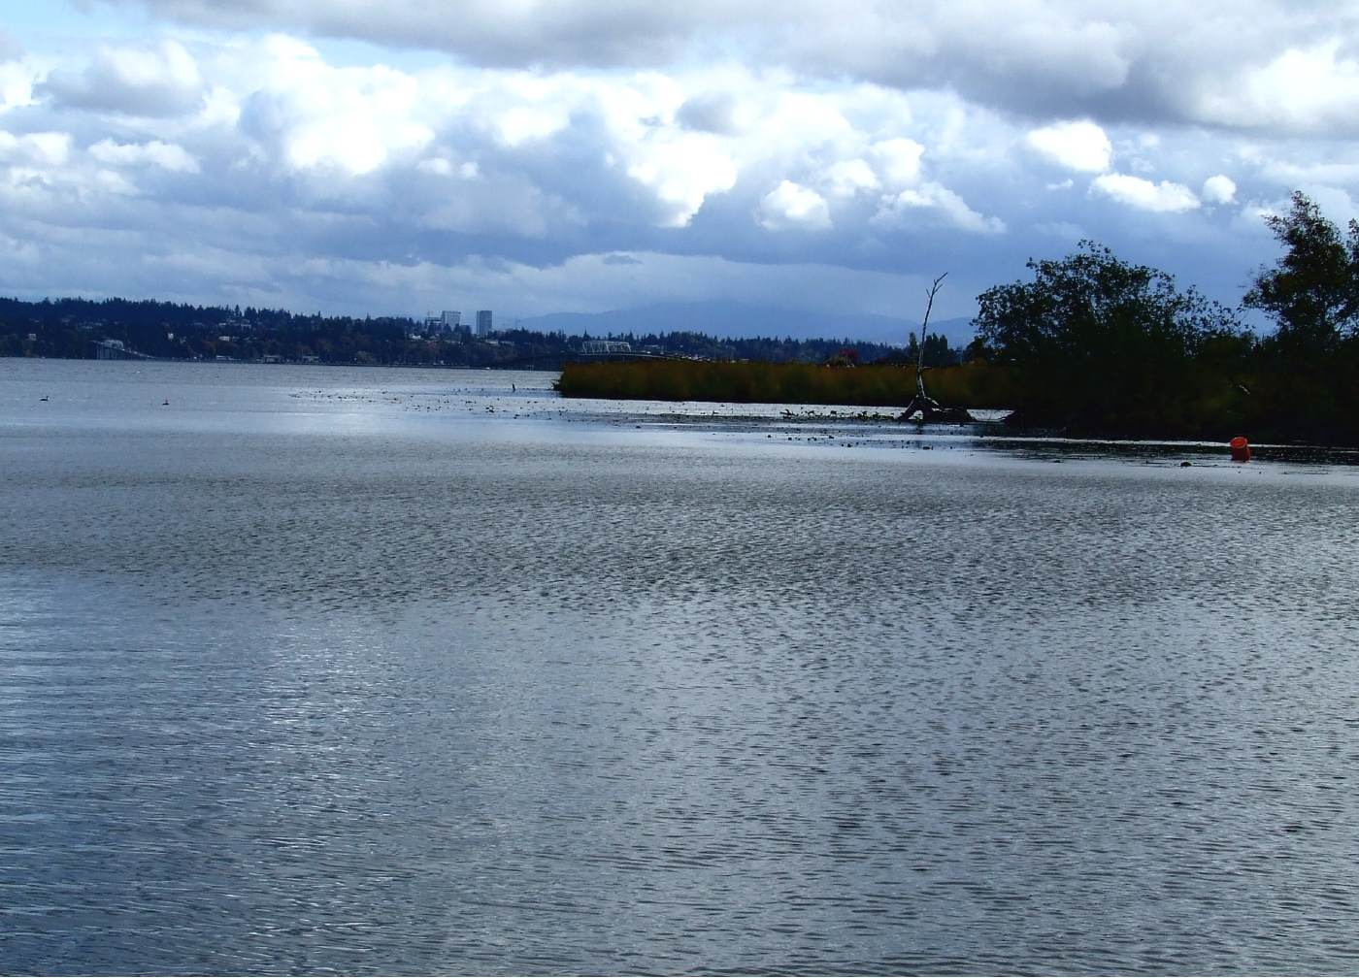
Darkened areas caused by small waves forced by wind

Slide 28
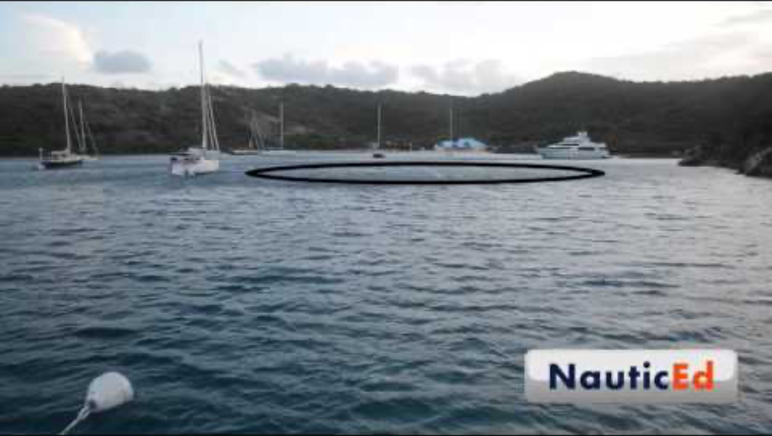

Slide 29

Why are there wind gusts?

Slide 30
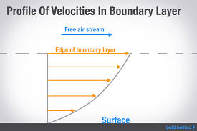
Winds generally increase with height above the surface (since the rough surface slows near-surface winds)

Slide 31
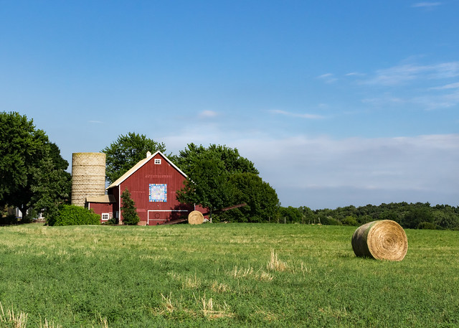
FASTER
SLOWER

Slide 32
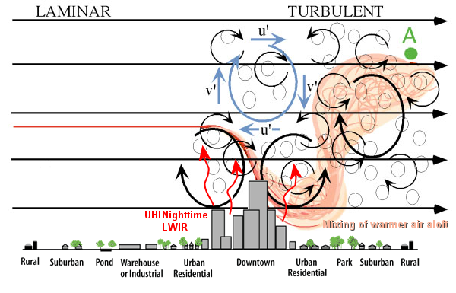
Turbulence in lower atmosphere can mix down stronger winds aloft

Slide 33
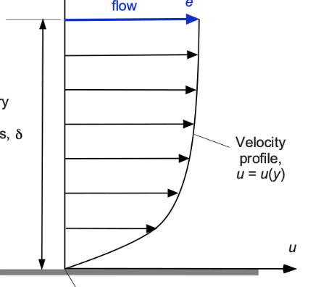
Then turbulence in atmosphere mixes down stronger winds from aloft, a gust occurs

Slide 34
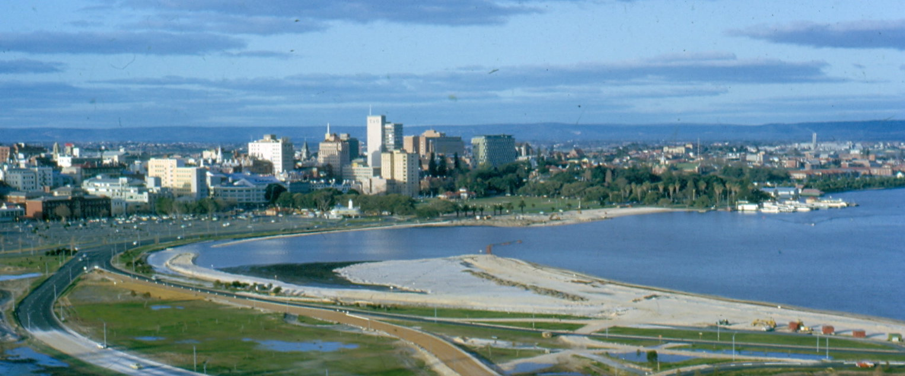
Winds are often far stronger over water than land
Water is much smoother aerodynamically (less rough) than land
Trees, building, hills, etc. slow down winds near the surface over land.
Wind over water can be 50-200% stronger (or more) than over land.

Slide 35
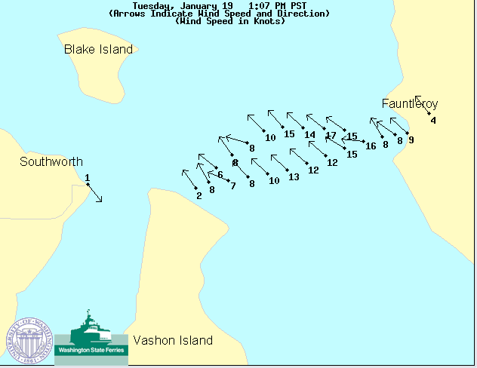
Wind Observations on WA State Ferries

Slide 36
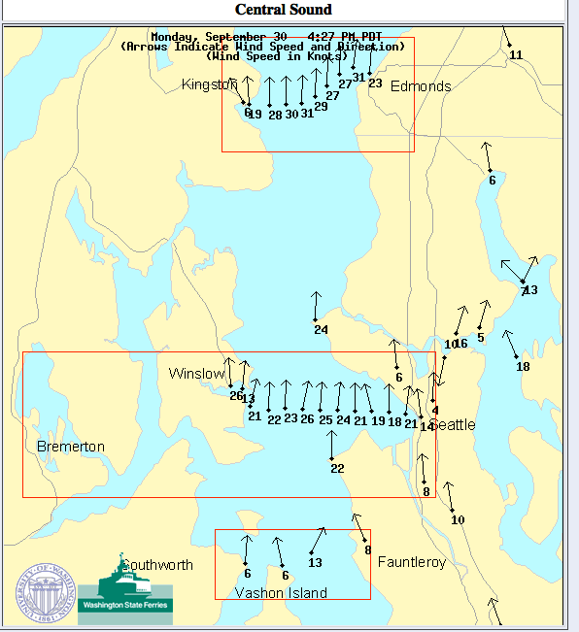

Slide 37
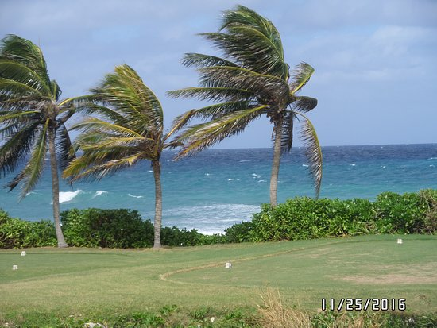
Estimating Wind Subjectively
Wind direction: flags, low clouds, trees and branches, throw grass in air
Wind speed: Beaufort Scale

Slide 38
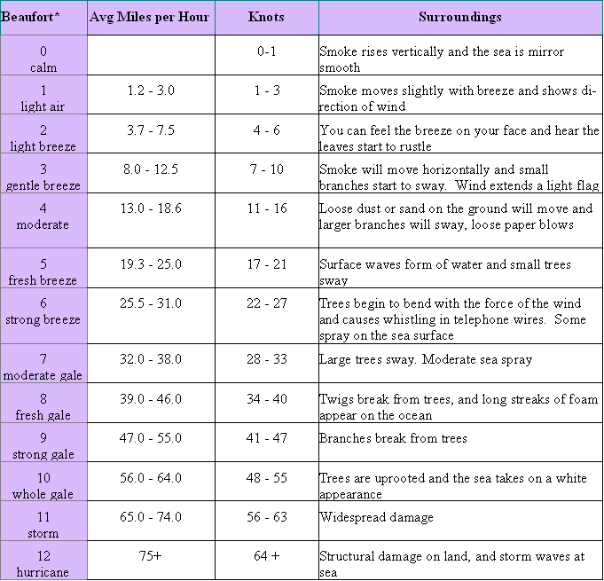
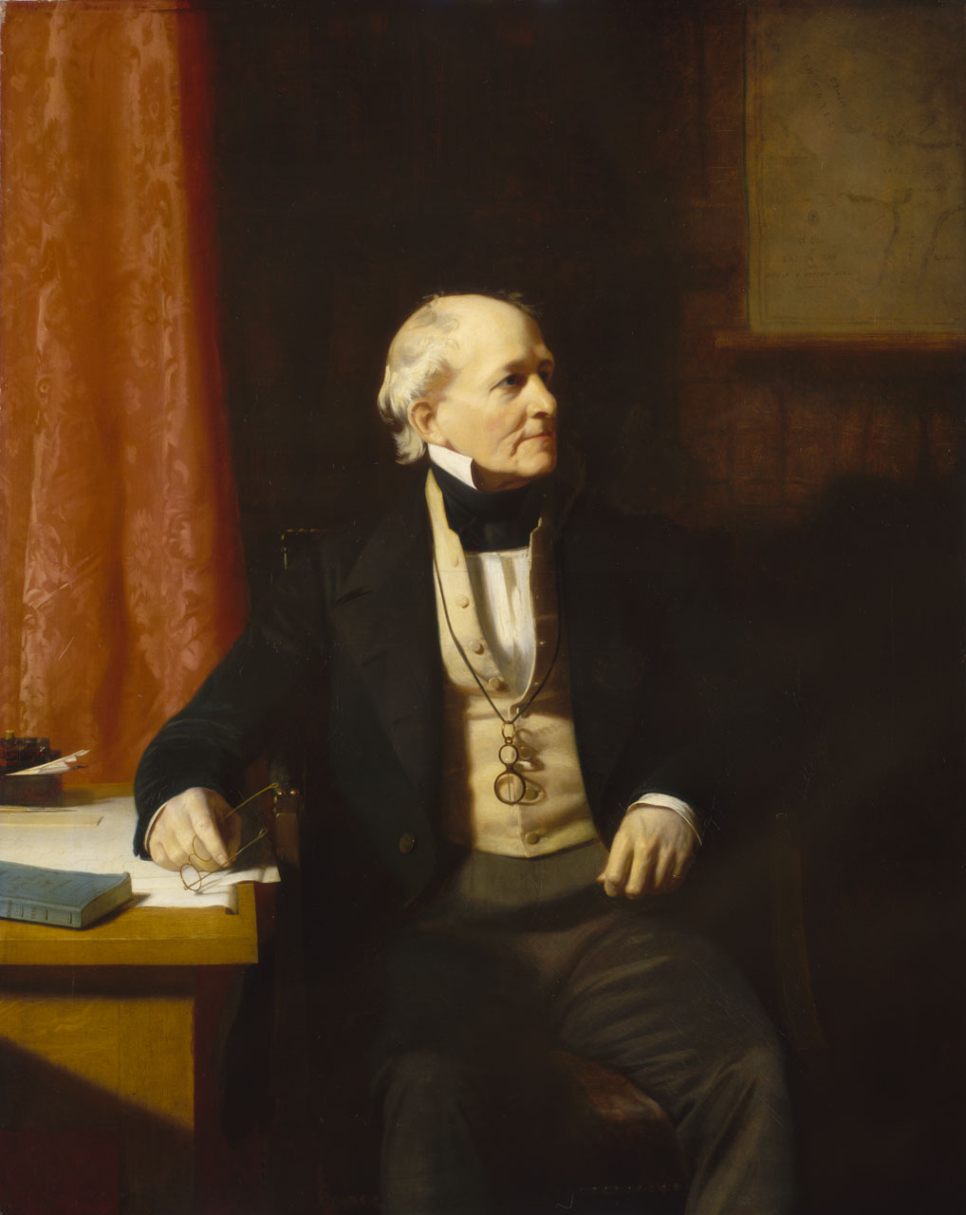
Beaufort Scale
Sir Francis
Beaufort, 1805

Slide 40
mph knots

Slide 41
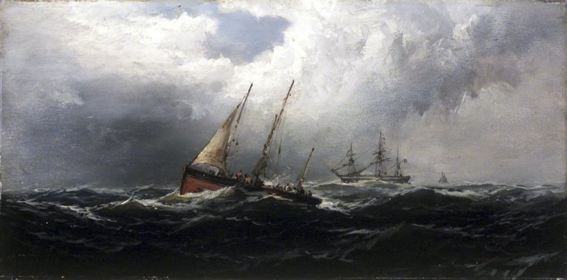
Wind Terminology
Gale-force winds: 34-47 knots
Storm-force winds: 48-64 knots
Hurricane winds: 64+ knots
(these are sustained winds)

Slide 42

Wind

Slide 43
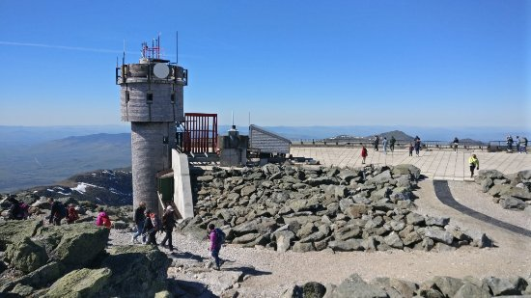
Strongest Near-Surface Winds
Anemometer: 231 mph, Mt. Washington, NH 1934
Doppler Radar: 318 mph, OK City Tornado, 3 May 1999

Slide 44
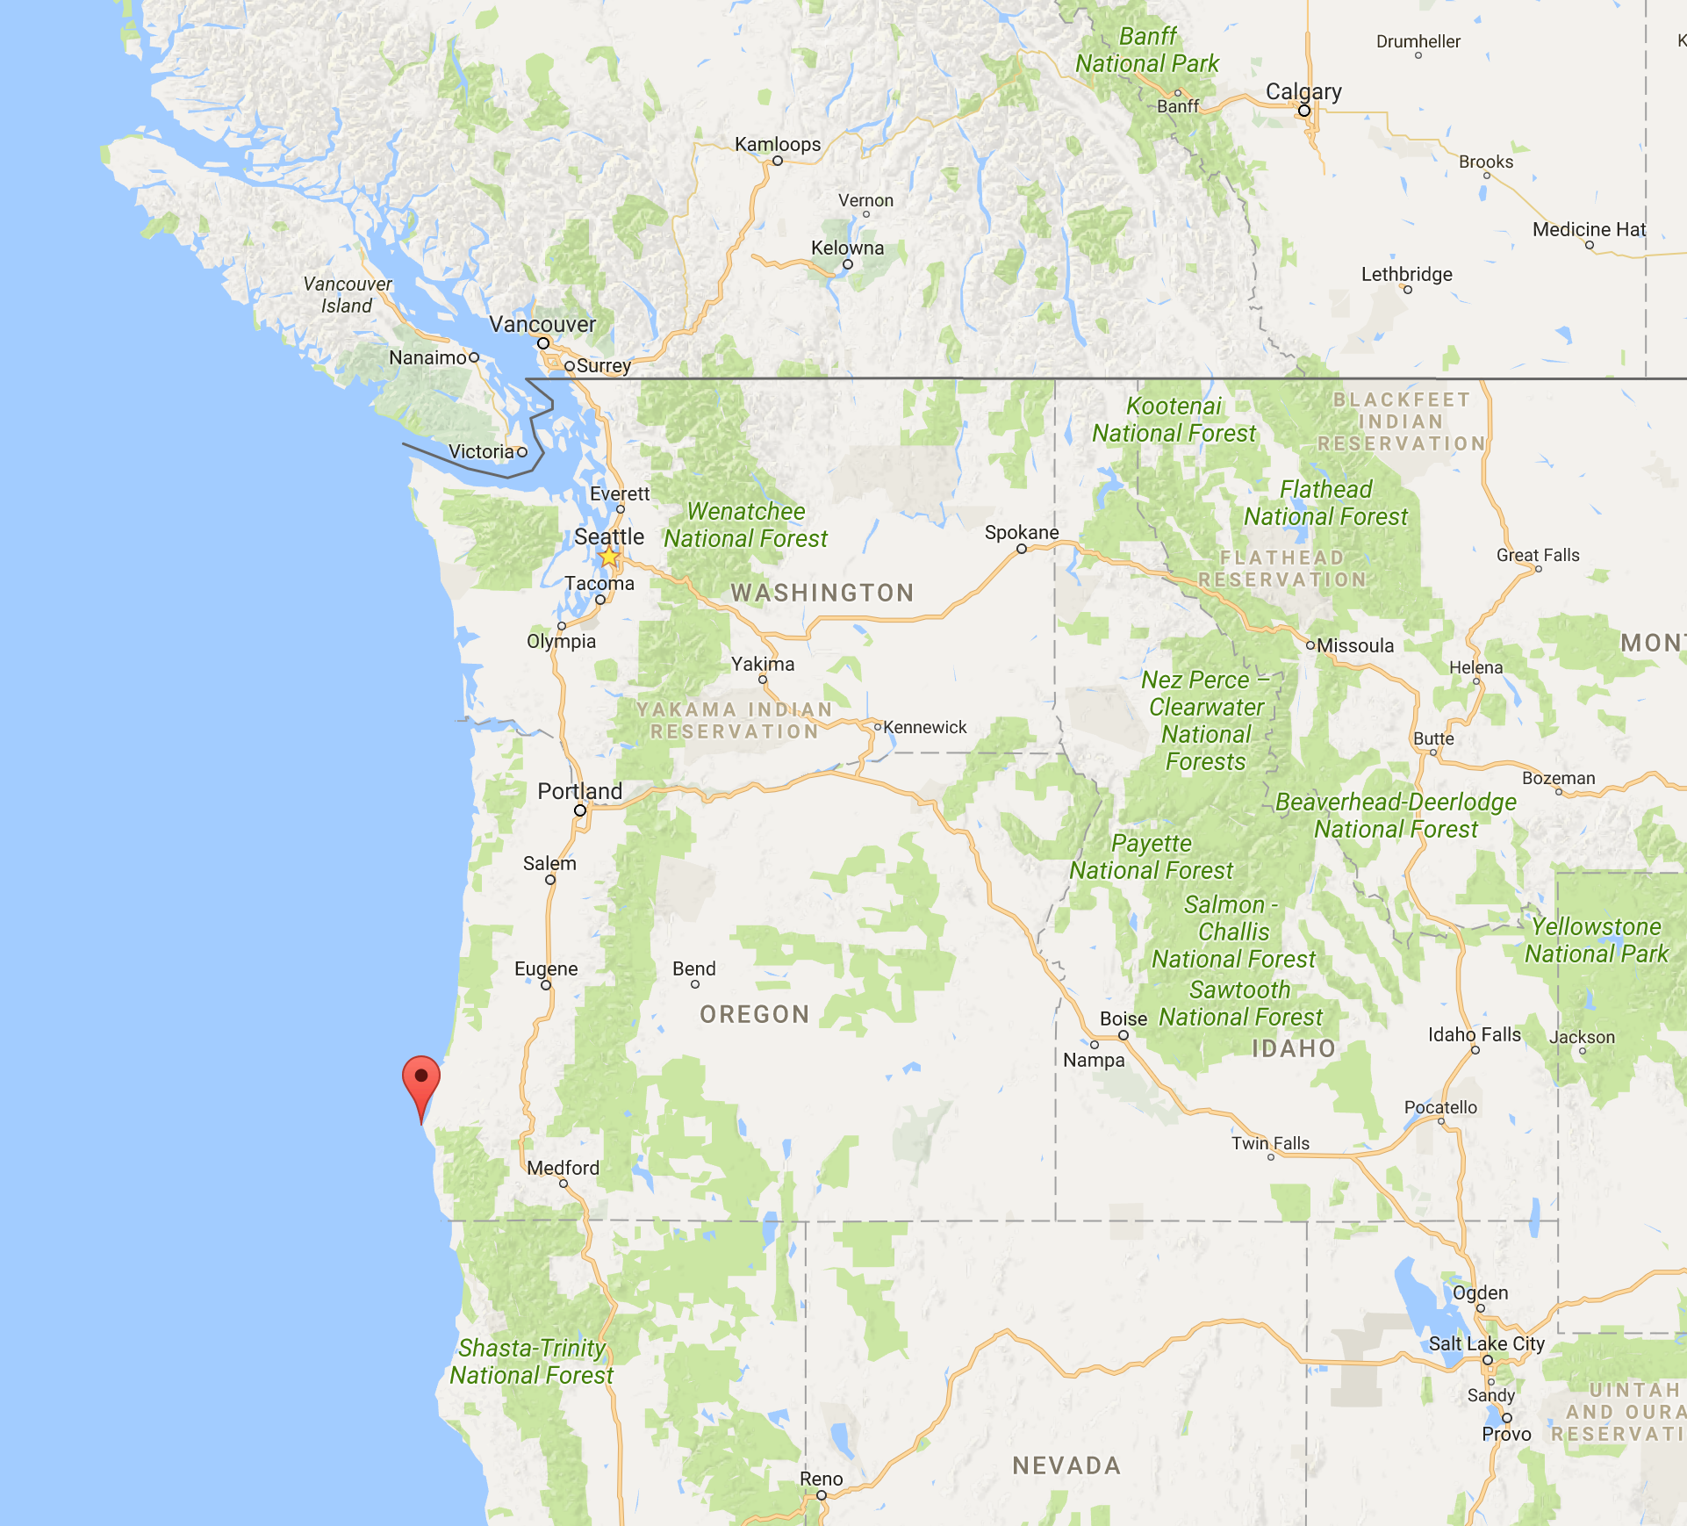
The NW Wind Record
Point
Blanco

Slide 45
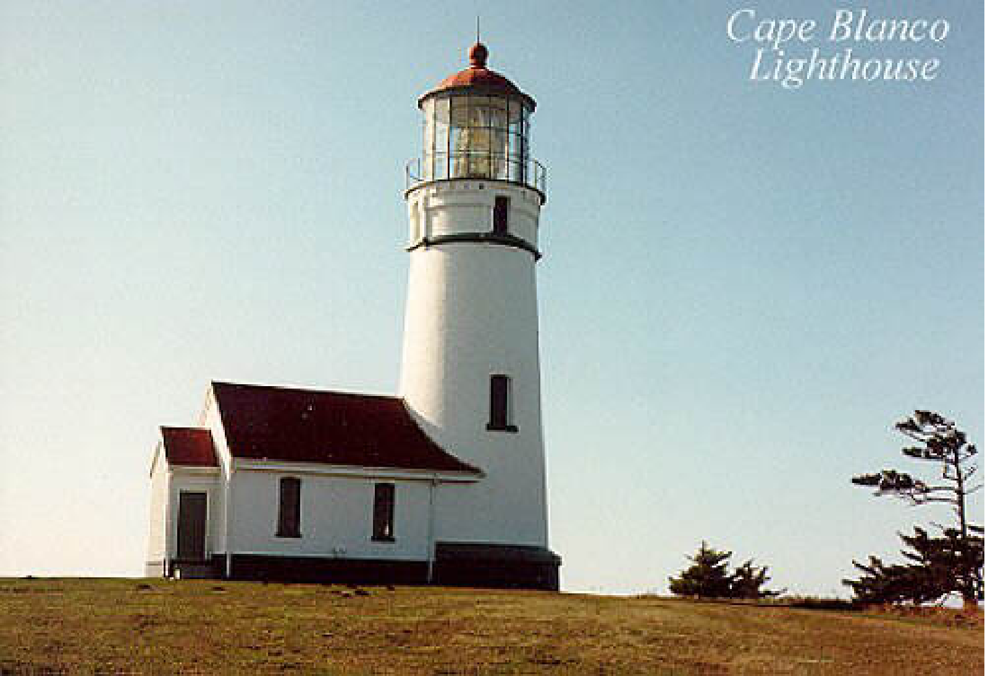
Columbus Day 1962: At Cape Blanco there were 150 mph sustained winds with gusts to 179!

Slide 46
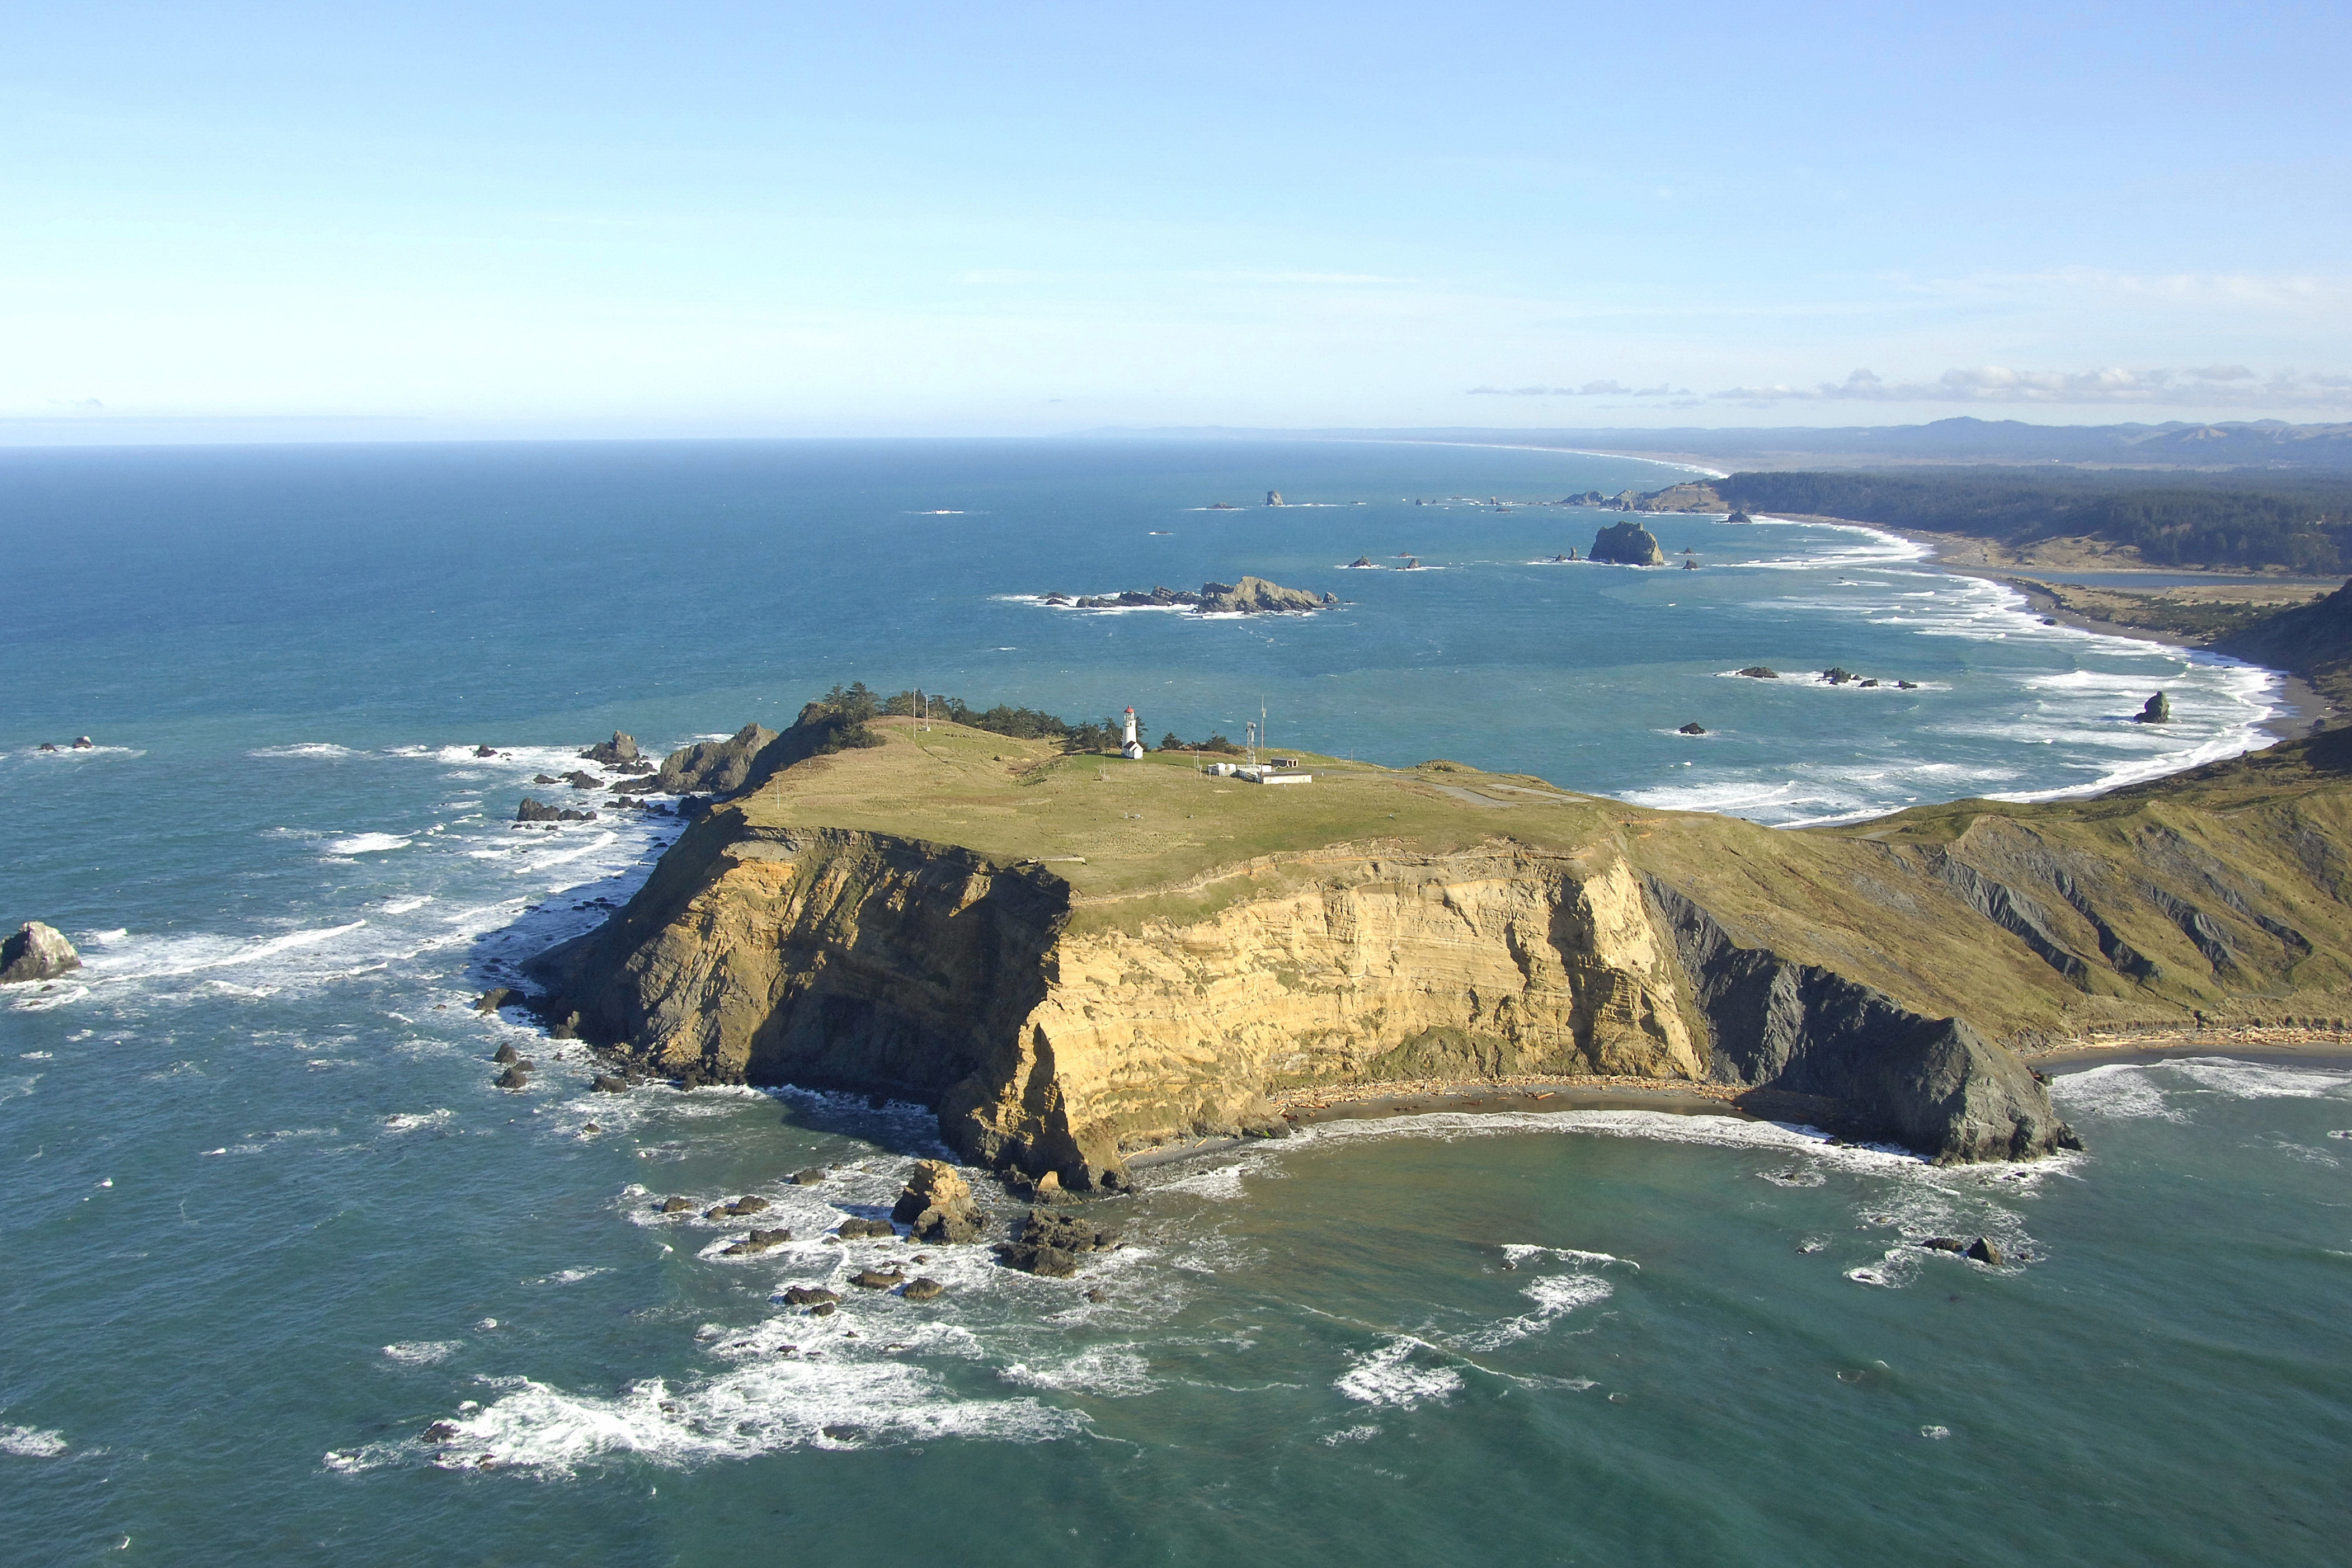
Winds Were Probably Enhanced by Bluffs

Slide 47
The End

