Slide 1
Forecasting Visibility
ATMS 452
Spring 2024

Slide 2
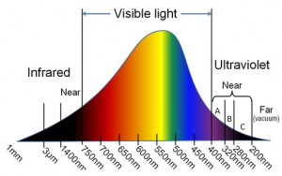
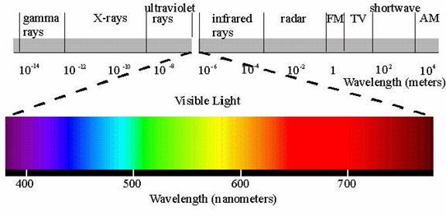
Visibility deals with visible light

Slide 3
Reductions to visibility are caused by the scattering and absorption of visible light. Major causes:
Hydrometeors: fog, drizzle, snow, rain…particularly heavy rain and snow
Dust and smoke: wildfires, dust raised by strong winds, volcanic eruptions
Other particles such as sand
Air pollution

Slide 4
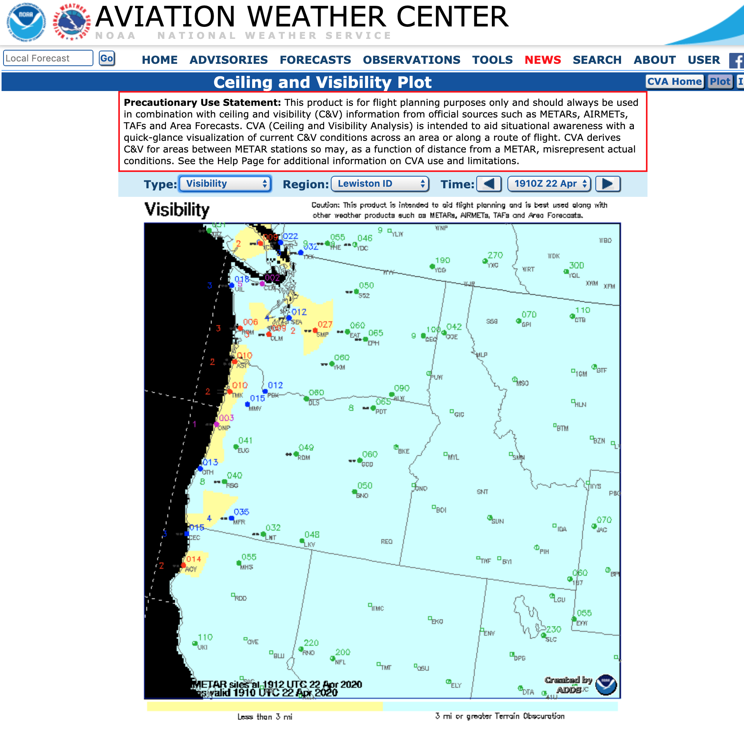
Why forecasting visibility is important
Essential for aviation. Flight rules (VFR, IFR) dependent on visibility.
Transportation safety: many accidents on roadways are related to visibility issues (dust, smoke, fog)

Slide 5
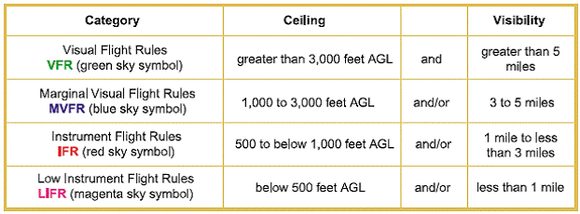
Aviation Flight Rules: Visibility is a Key Component

Slide 6
Some Examples of Major Reductions to Visibility

Slide 7
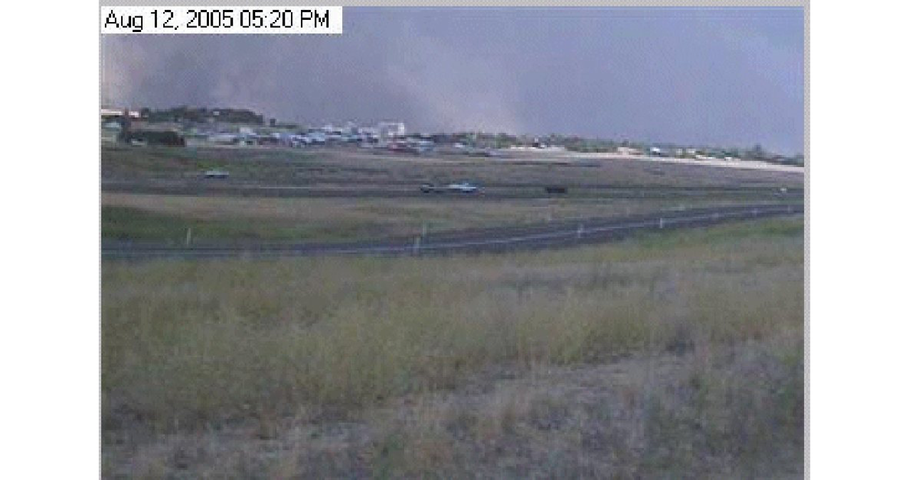
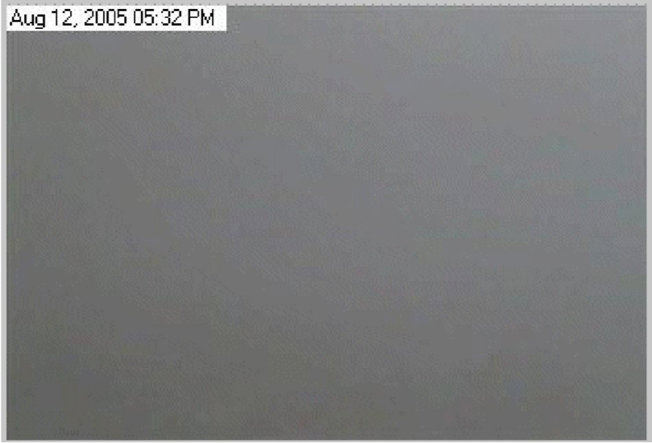
Dust Storms in Eastern Washington
Winds, increasing rapidly from a thunderstorm outflow or a cold front, interacting with plowed fields, can cause rapid decline of visibility resulting in multiple accidents, sometimes involving 10-30 cars/trucks.
Can close major roads, such as I-90.

Slide 9
Heavy wildfire smoke can do the same….

Slide 10
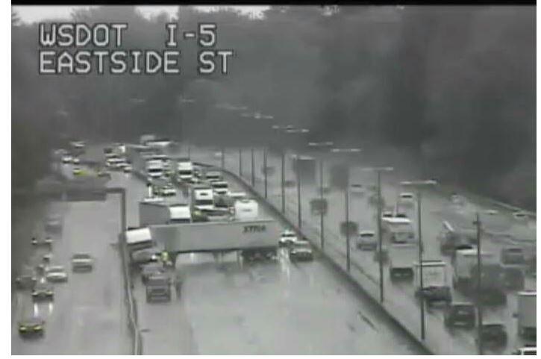
Heavy Rain Over Roadways
Visibility loss from heavy rain can cause chain reaction accidents involving many vehicles.
First, one car slows as loses visibility entering rain, or being blinded leaving rain by the sun
Following cars are too close and hit the first car, followed by more cars behind.

Slide 11
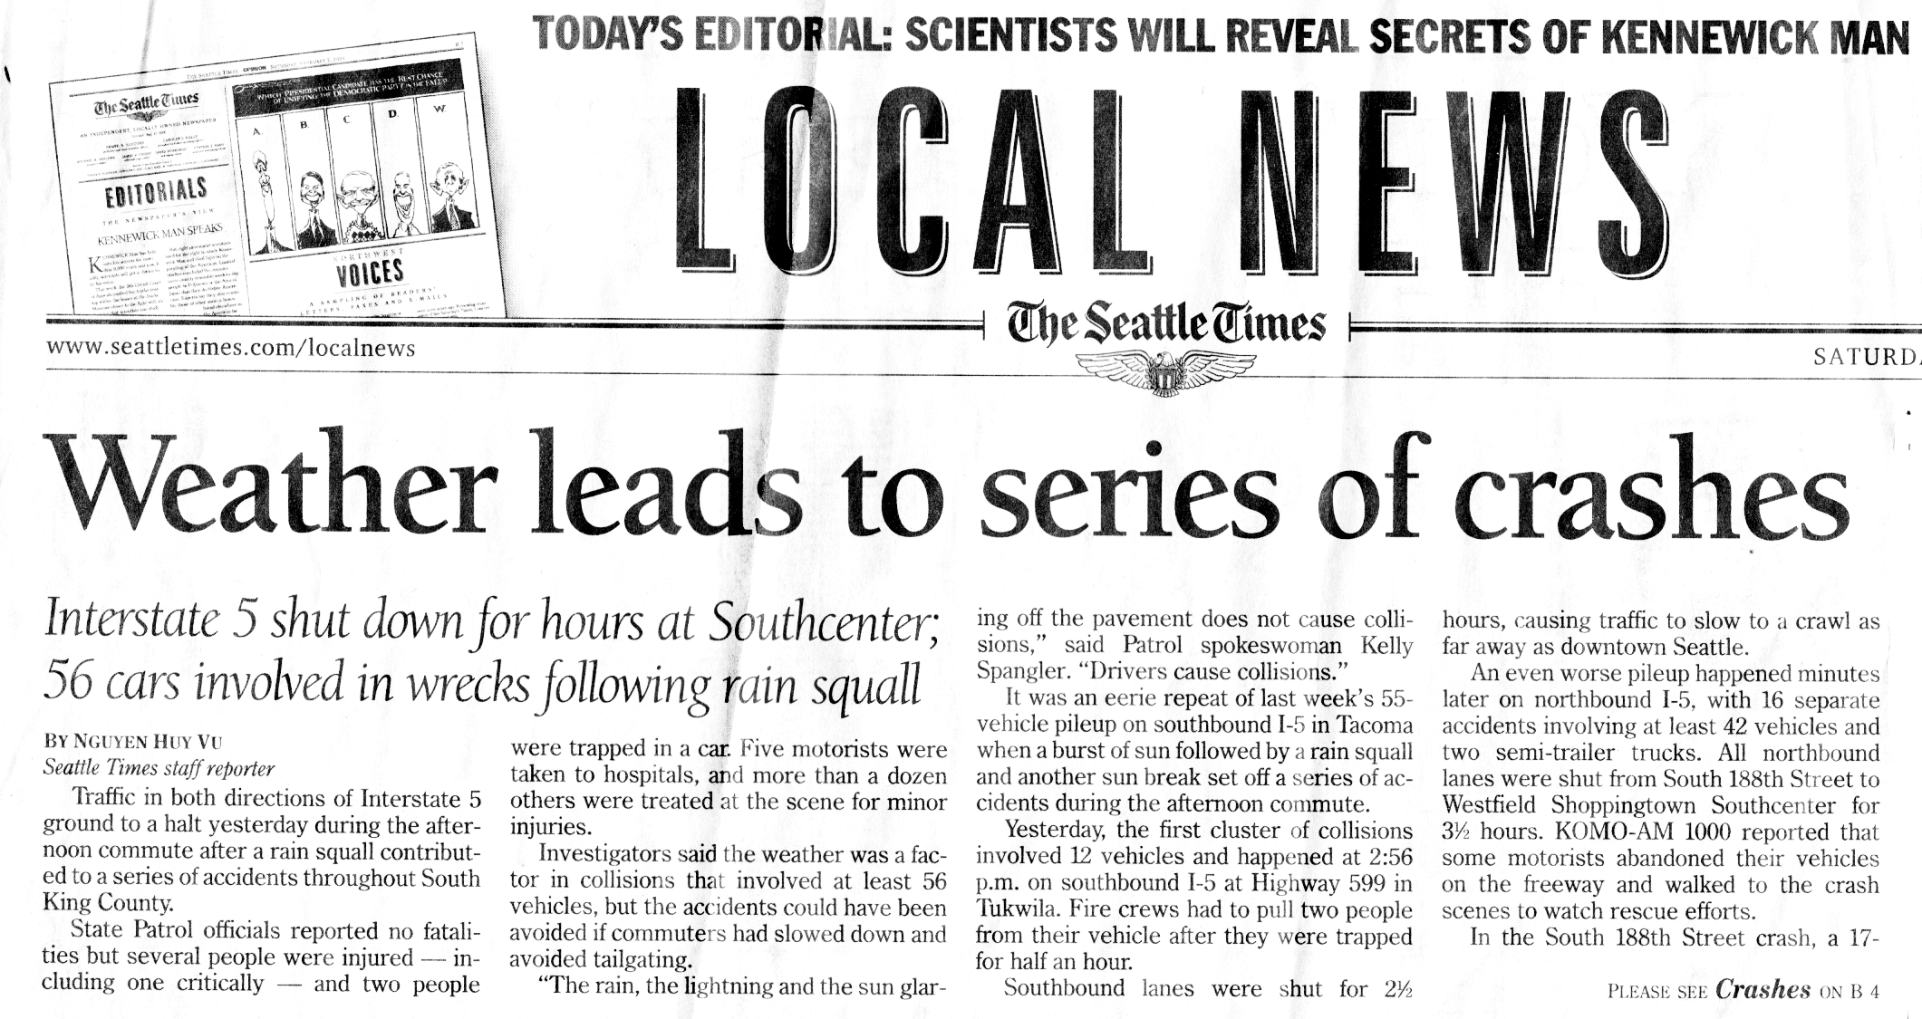
Within two weeks there were TWO multi-car accident incidents: one with 56 cars and another with 55 cars involving reduced visibility

Slide 12
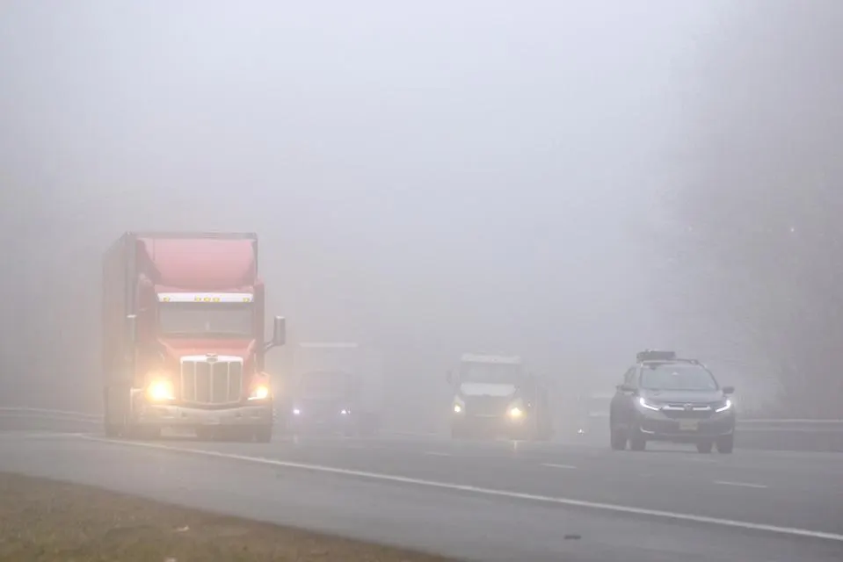
And of course…fog..

Slide 13
Visibility is a great weakness for models
Plays into failure modes, like poor boundary layer schemes. Poorly simulated fog.
Highly localized problems (e.g., in valleys and near sources) that models often don’t have the resolution to deal with or lack information about relevant particle sources.

Slide 14
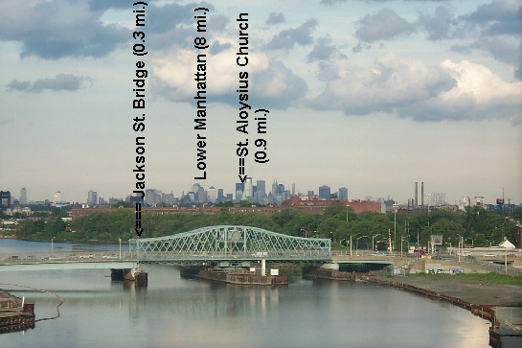
Observing Visibility
Old days: human observers would use local landmarks of known distances

Slide 15
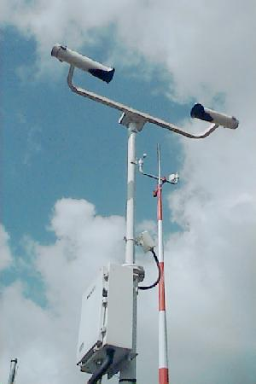
Today: automated sensors such as the ASOS Visibility Sensor
Uses Xenon light source and then measures how much light is scattered into the sensor
Scattered light can be related to visibility
Point value, not integrated over distance. A Problem.

Slide 16
Particle size and visibility
Large particles (compared to the wavelength of light): Mie Scattering. Not wavelength dependent (whitish haze)
  E.g., Large hygroscopic salt particles
Small particles (compared to light). Bluish haze. Rayleigh Scattering. Scattering proportional to 1/λ⁴
  E.g., Combustion particles

Slide 17

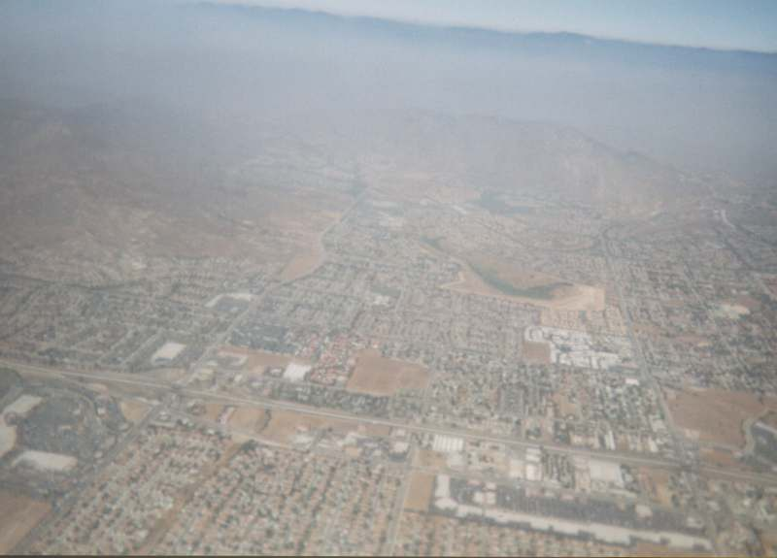
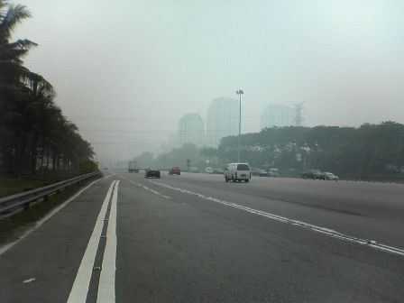
Rayleigh Scattering
Mie Scattering

Slide 18
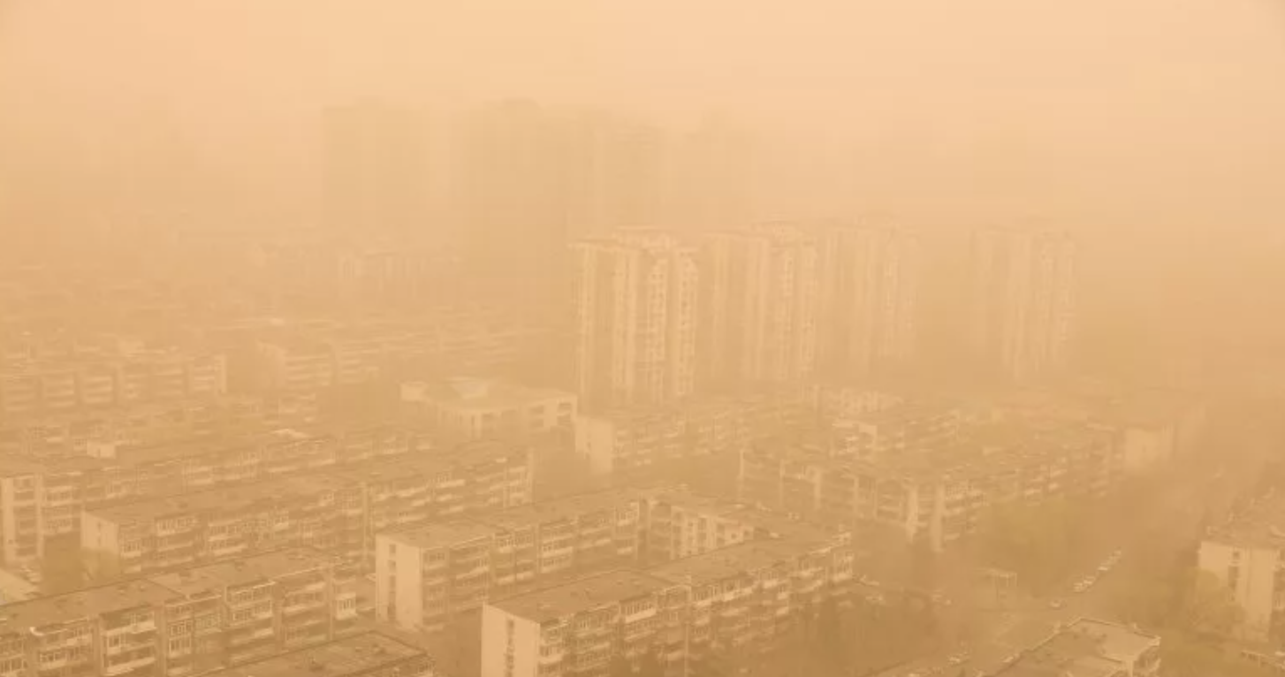
More particles and larger particles result in lower visibility

Slide 19
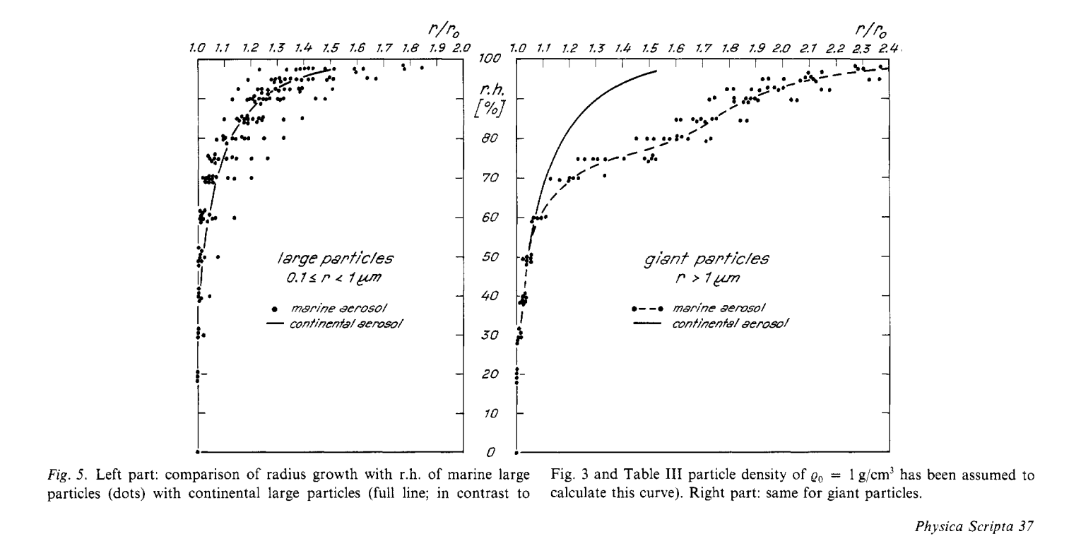
Relative humidity variations affect the size of particles, particularly hygroscopic (water attracting) substances (e.g., salt)

Slide 20

Hygroscopic nuclei can start to grow when RH is below saturation (100% RH)
There is growth starting around 60-70% RH
“Sticky” salt shaker example.
Other condensation nuclei are not effective until near 100% RH

Slide 21
Visibility Can Depend on Relative Humidity and the Presence of Hygroscopic Nuclei
Worsens at RH increases from 70 to 100%
Lots of implications!

Slide 22
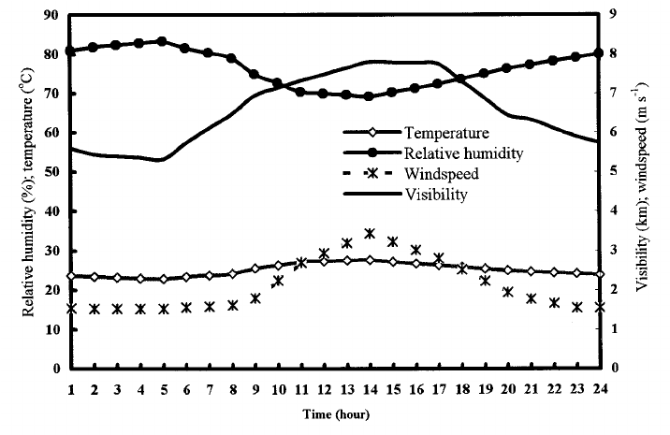
Visibility Generally Improves During the Day
Temperatures increase, causing RH to decline. Particles shrink.
Less stable during day, mixing near-surface water vapor into BL, drier mixed air down
Also, cleaner mixed air
down (with exceptions)

Slide 23
Visibility Generally Improves During the Day

Slide 24
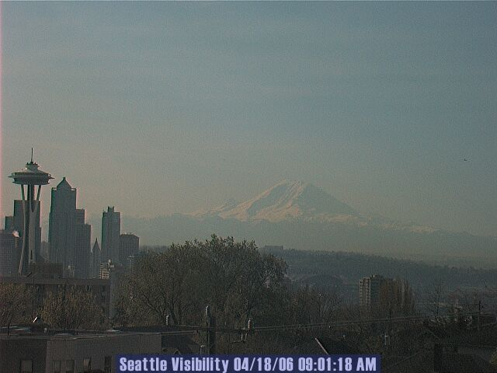

Slide 25
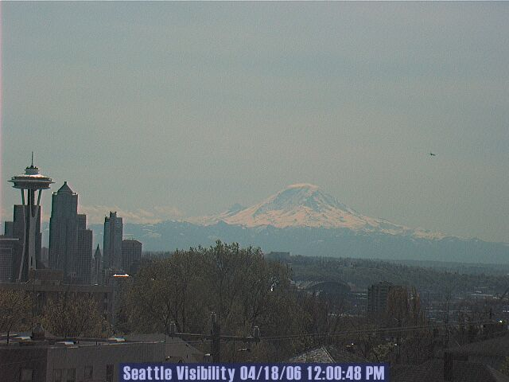

Slide 26
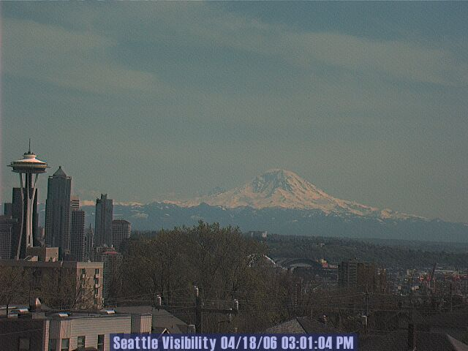

Slide 27
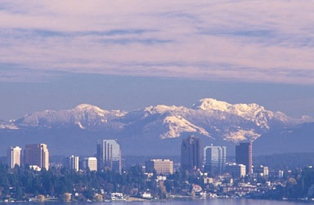
Offshore-directed Flow/Downslope Flow Enhances Visibility. Why?

Slide 28
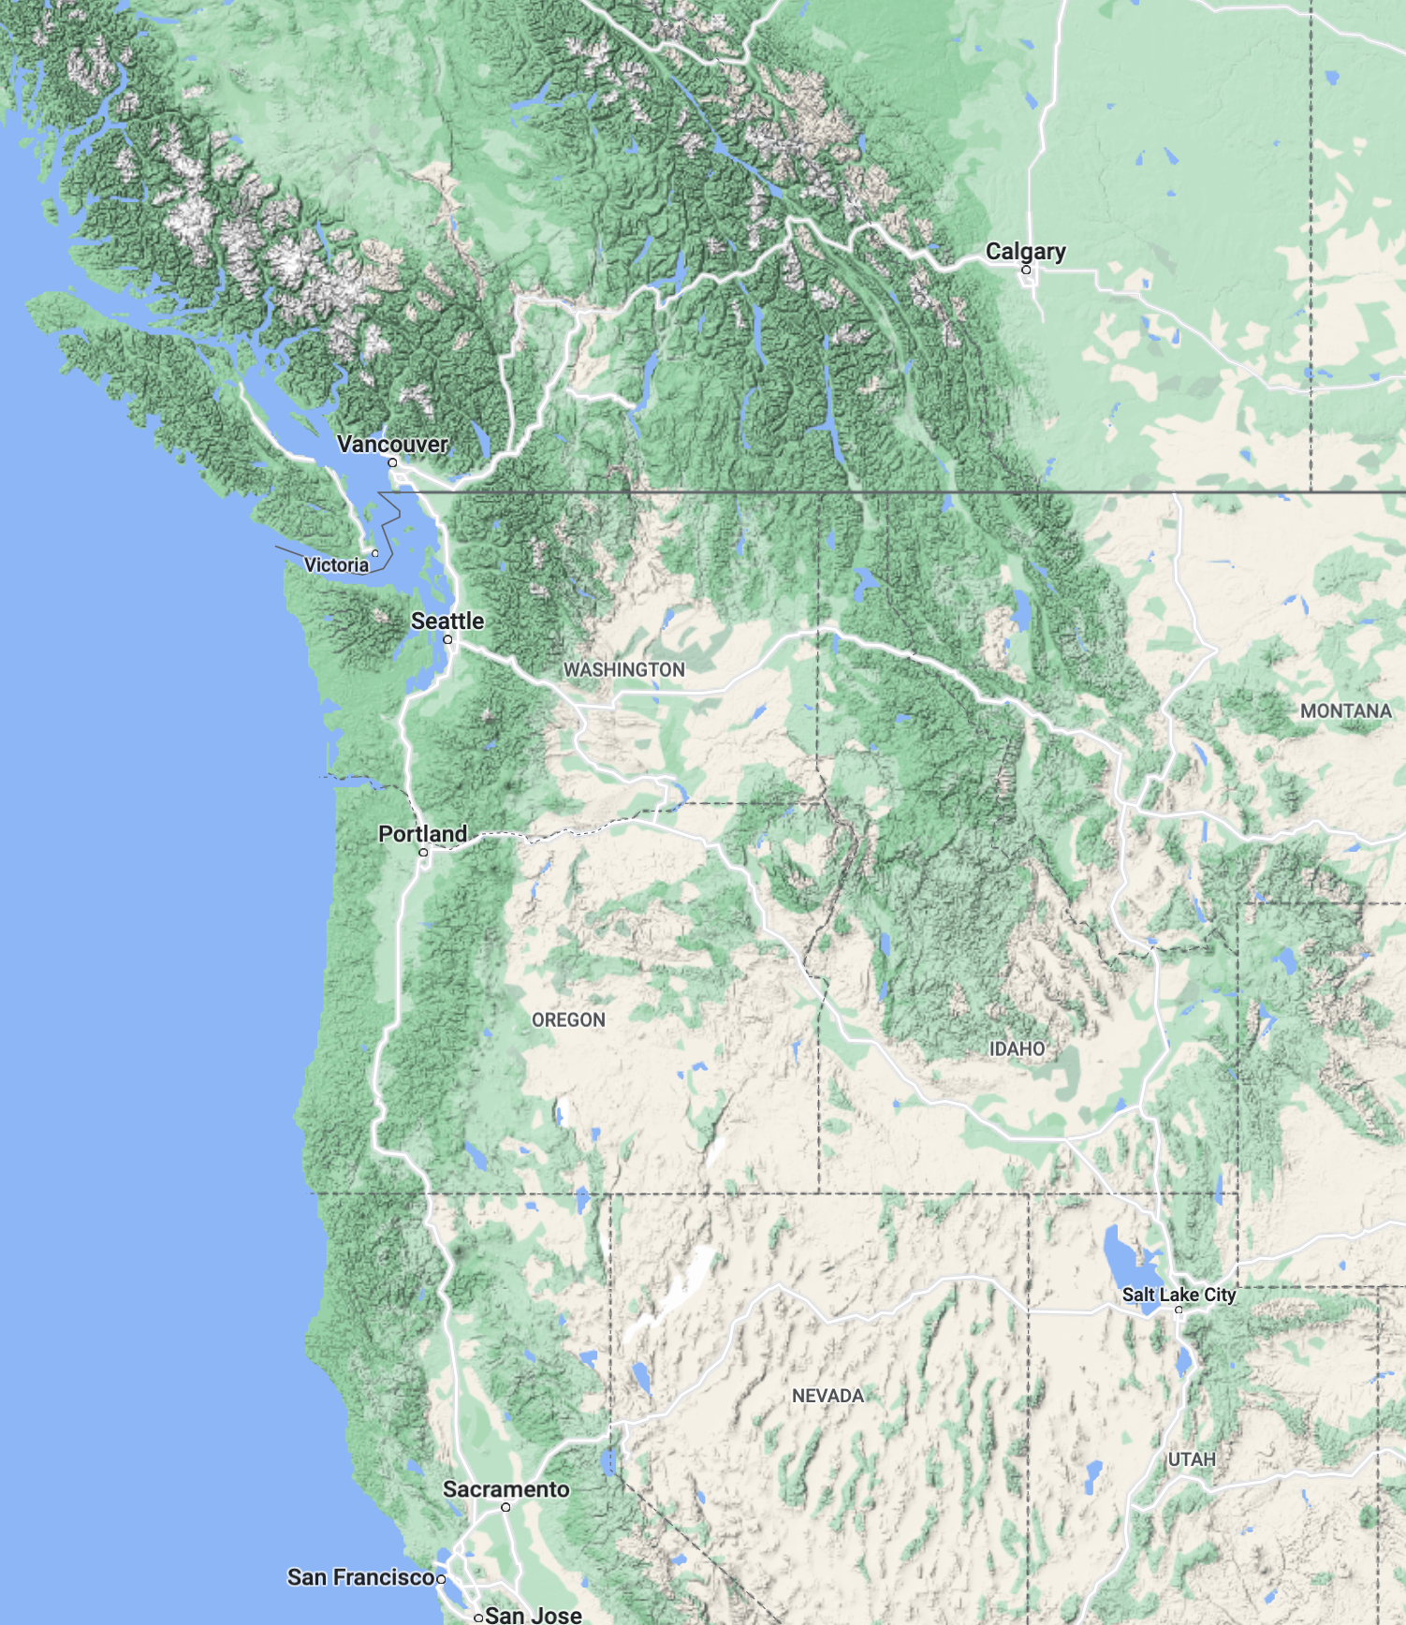
Good for Visibility!

Slide 29
Why offshore-directed (generally easterly) flow has better visibility?
Offshore flow on the West Coast originates from a drier, continental area.
Descent over western slopes of Cascades increases temperature and reduces RH, shrinking particles
Interior CCN are less hygroscopic, not many salt particles.

Slide 30
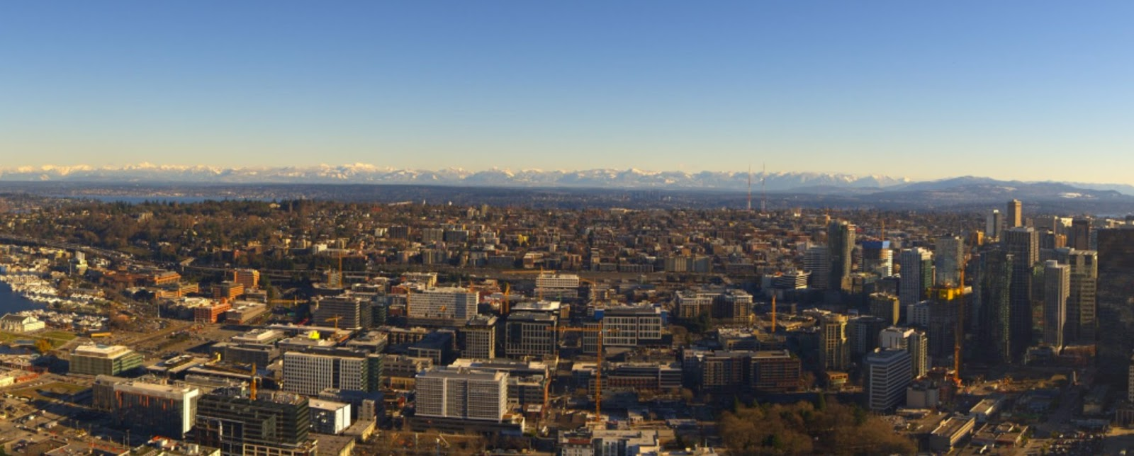
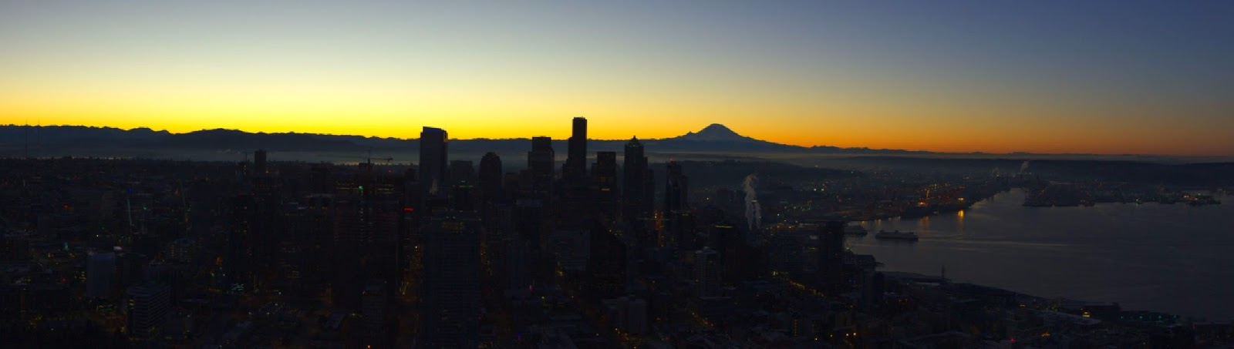
Offshore flow situation

Slide 31

Visibility Often Degrades Rapidly with Onshore Flow (even without clouds)

Slide 32
Reasons: high relative humidity over marine areas, more hygroscopic nuclei (salt particles)

Slide 33
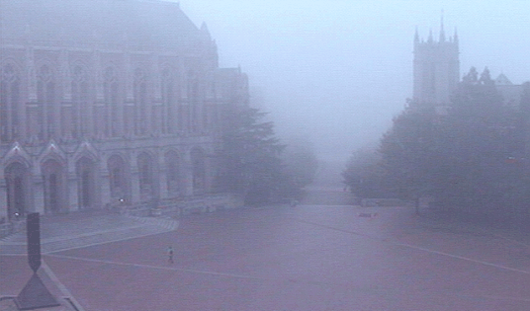
Fog: The most important (and difficult) visibility issue

Slide 34
Fog plays to all forecast deficiencies
Requires models to have ultra high resolution in both the horizontal and vertical
Typically, shallow and thus hard to simulate
Depends critically on PBL schemes…and current ones have major problems, as does other relevant physics (e.g., microphysics, radiation)
Requires accurate simulation of surface properties (e.g., soil moisture)
Often highly localized, and thus difficult to predict.

Slide 35
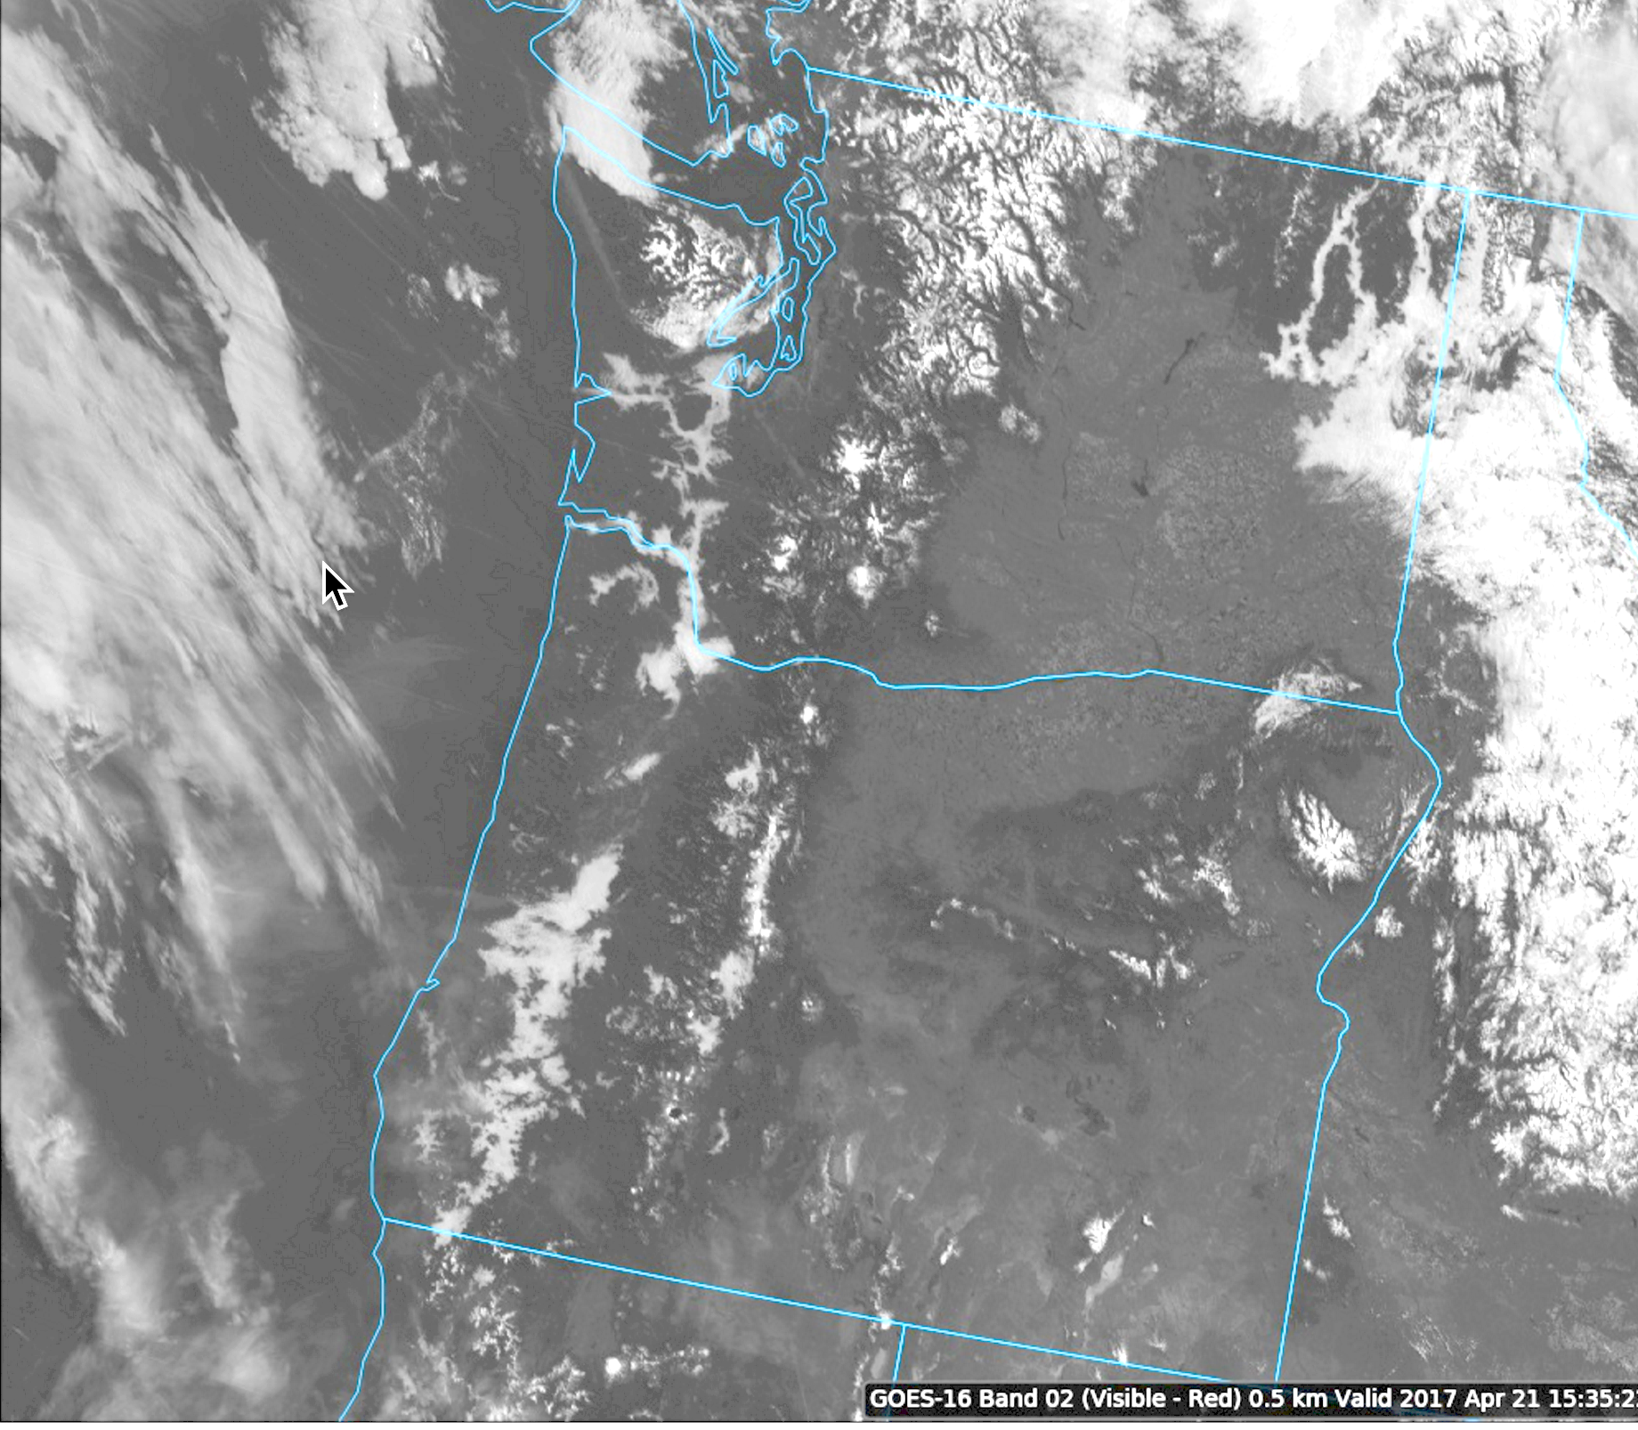

Slide 36
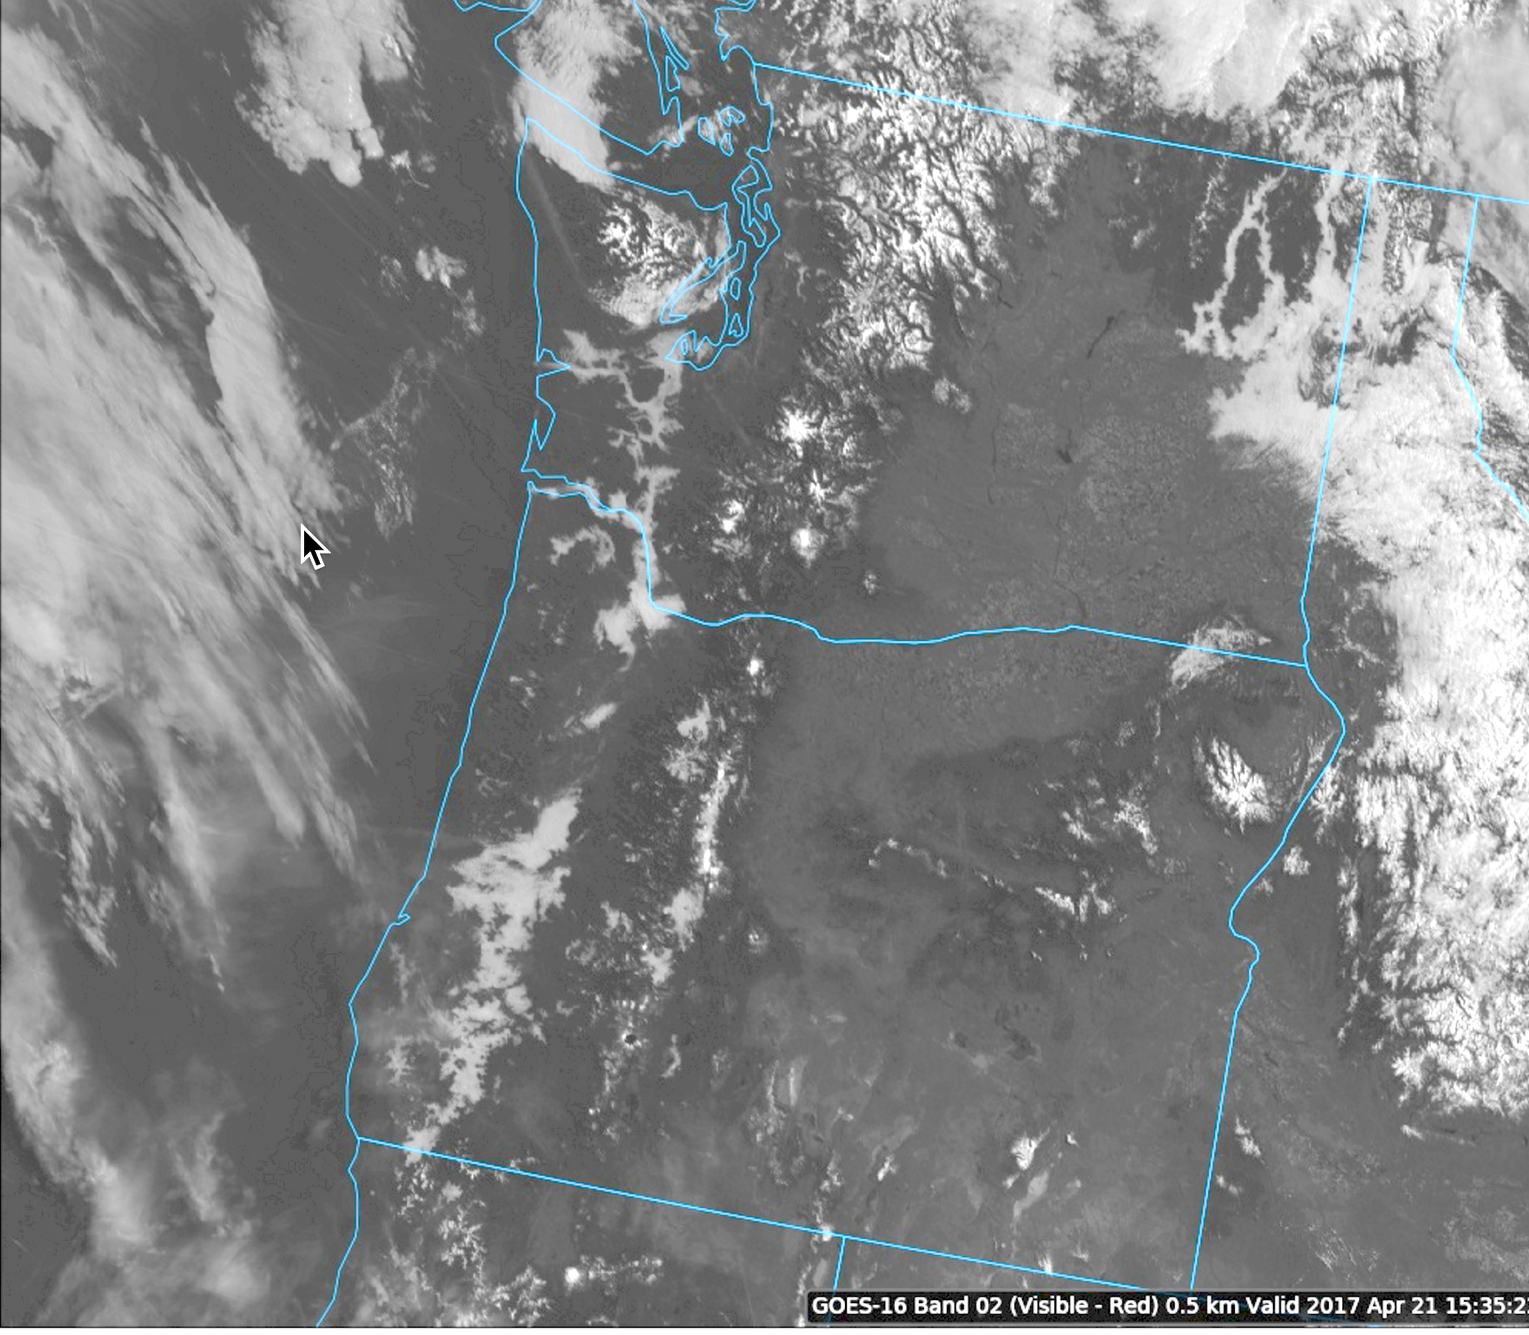

Slide 37
FOG Prediction
101

Slide 38

Fog is made of either liquid water droplets or ice crystals
Produced by:
  Cooling air to saturation (by radiation or adiabatic processes) or….
  Adding moisture to the air to saturate (e.g., evaporation of precipitation, evap. from surface)
Or a combination of the two.

Slide 39
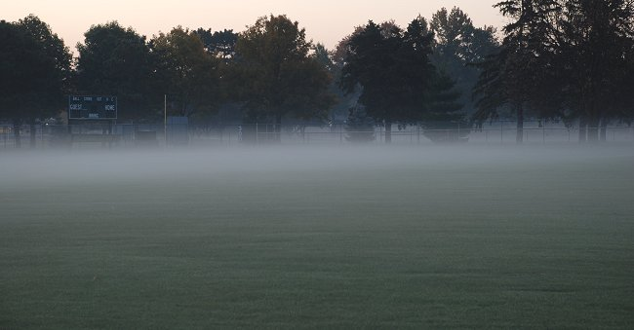
Fog Depth
Can be very shallow (ground fog, GF)
Or can extend to several hundred meters above the surface.

Slide 40
Fog Forecasting
Forecasters often compare T and T_{d} at the surface to predict fog
Fog seldom forms when T-Td > 4F
But does when T –Td is 1-2 F or less
Need some wind (and thus turbulence) to produce fog through any depth (more on this later)

Slide 41
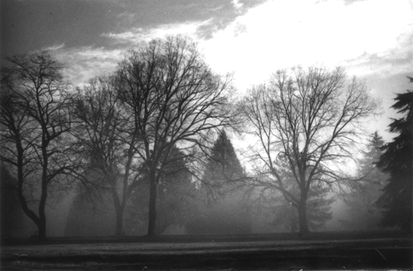
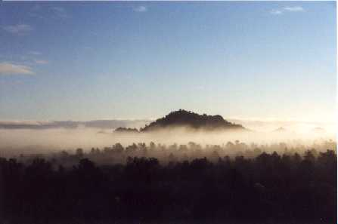
Radiation Fog

Slide 42
Radiation Fog
Associated with good radiational (LW) cooling to space
Needs clear or nearly clear skies aloft (particularly no low to mid-level clouds)
Usually associated with high pressure
Moist surface/PBL helps. e.g. swamps, wetlands, after rainy period). Brings T_{d} up.
Often associated with surface-based inversions

Slide 43
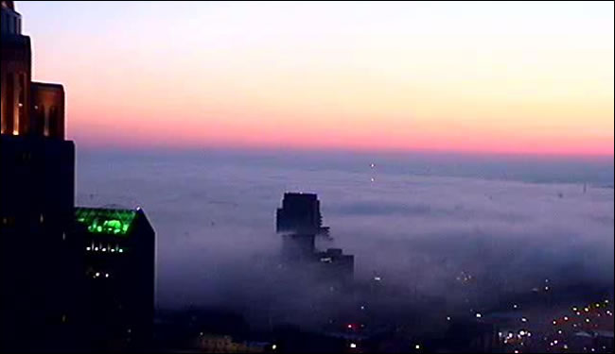
Radiation Fog
Dry in middle to upper troposphere helps. Why?
Light winds help (~2-7 knots).
  Calm winds lead to ground fog
  If winds are strong, there is too much mixing of dry, warm air from above—no fog.

Slide 44
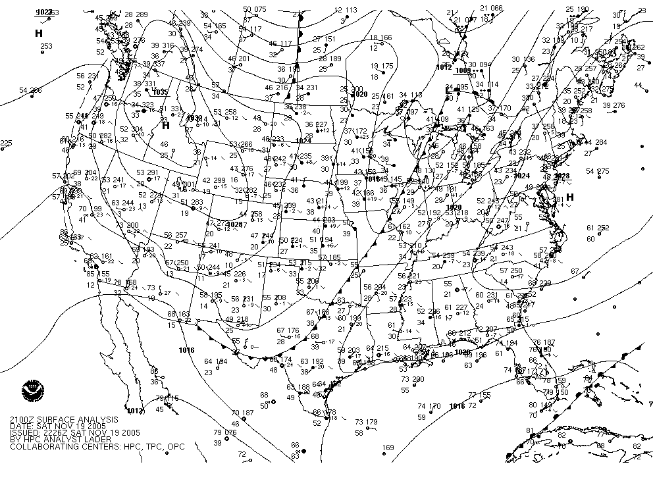
Fog Synoptics for Our Region

Slide 45
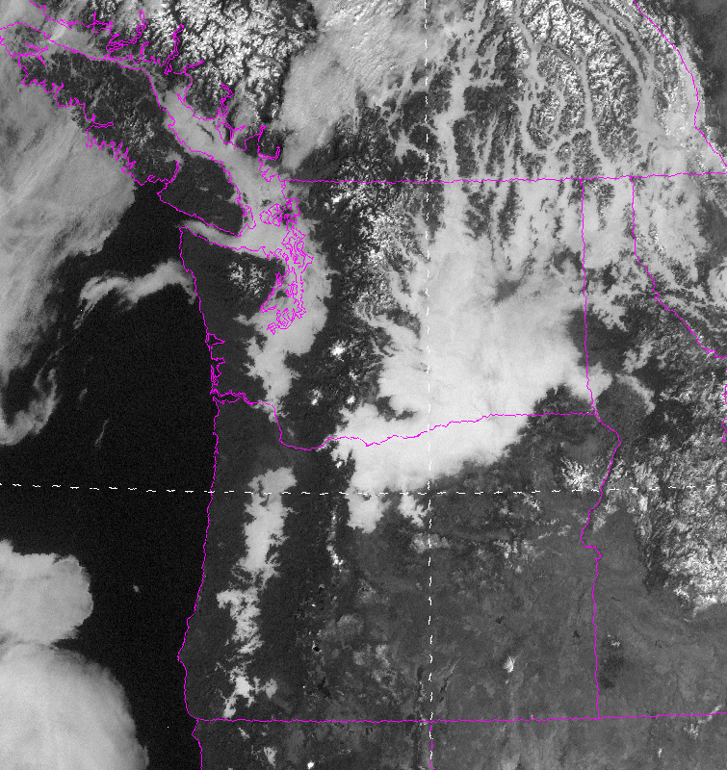

Slide 46
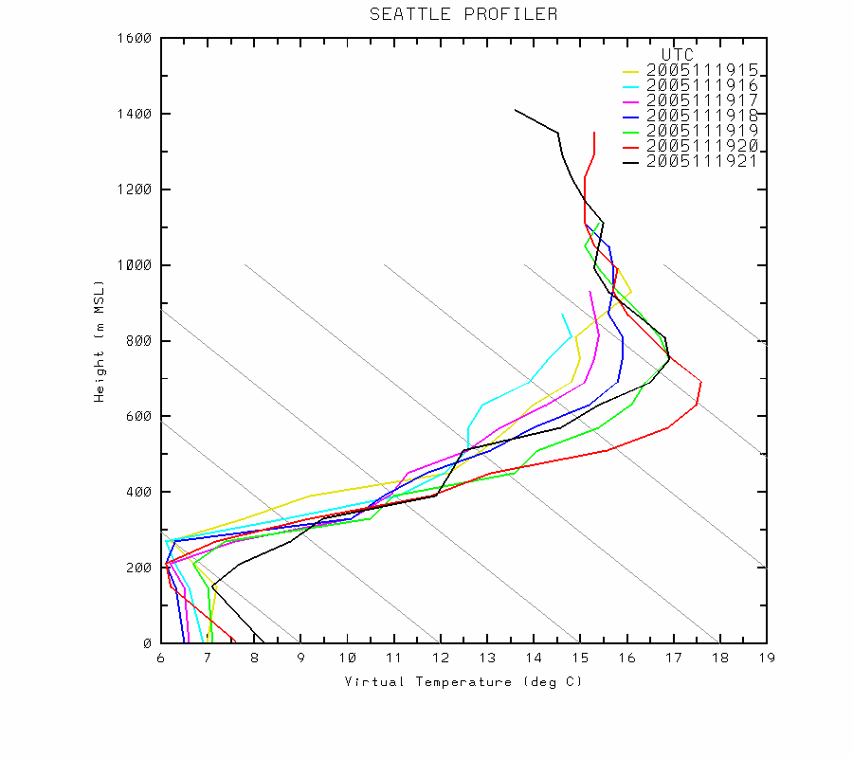

Slide 47
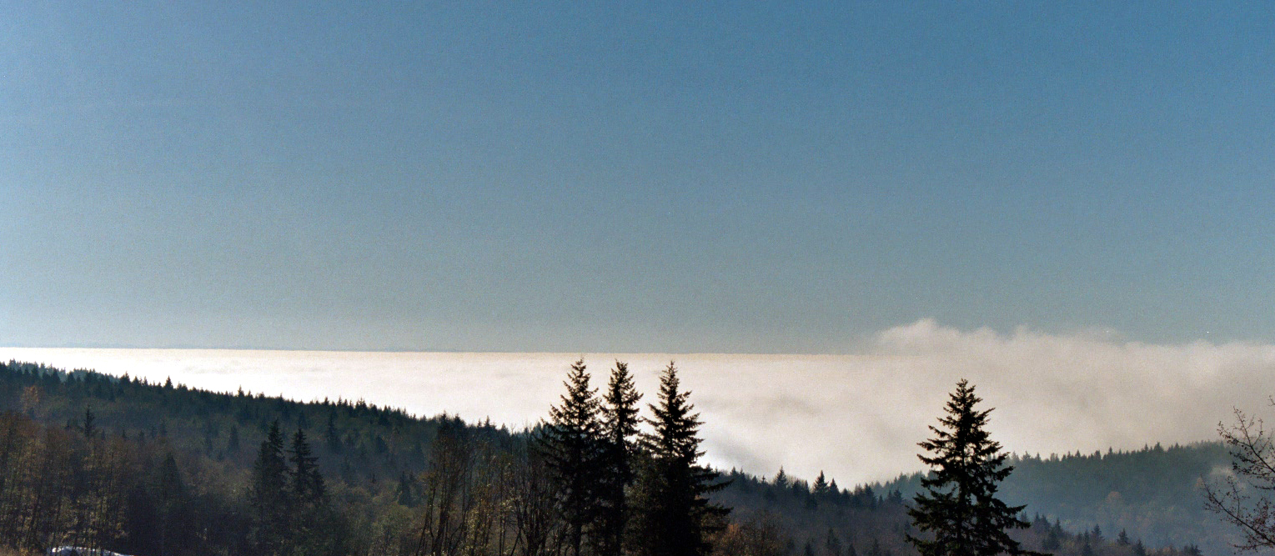
Radiation Fog From Above

Slide 48
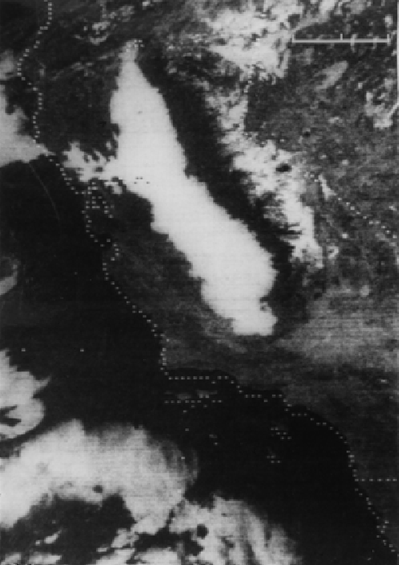
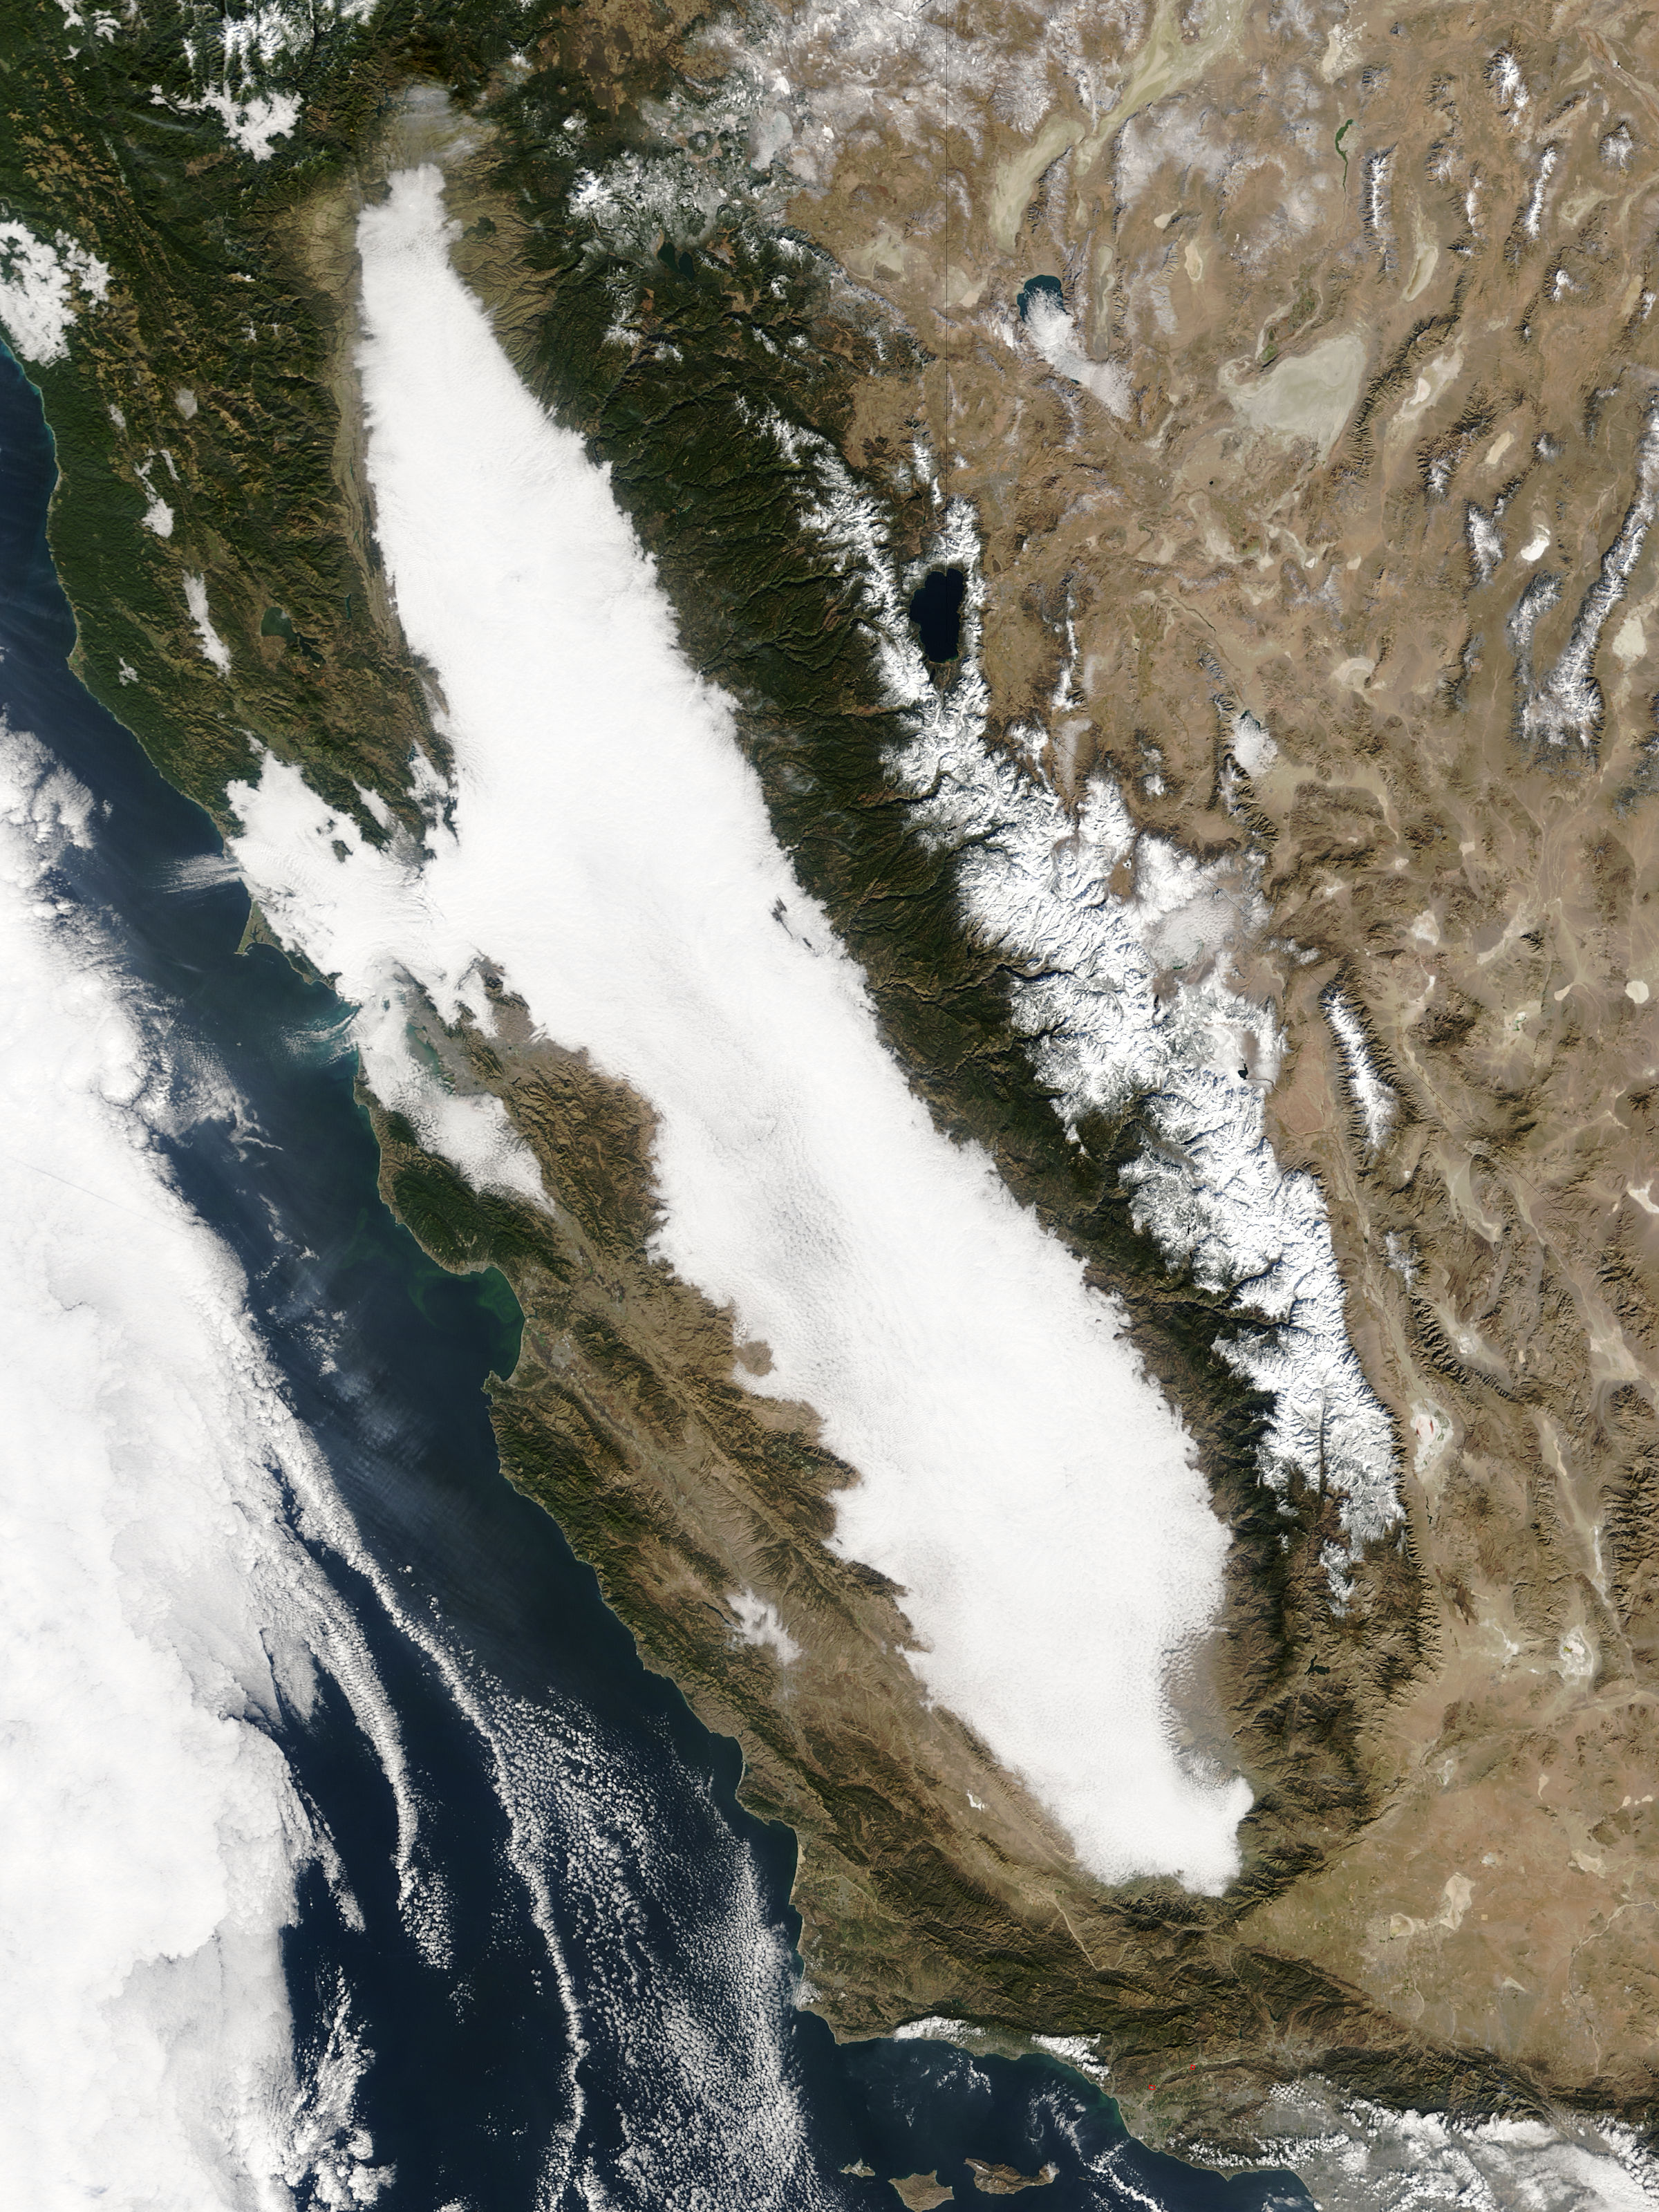
Tule Fog:Radiation Fog in the Central Valley

Slide 49
An important element of fog forecasting is the hydrolapse
The hydrolapse is the vertical gradient of water vapor
If moisture is too limited in the vertical, may not get significant fog…just dew, frost, or ground fog.
Or nothing…
But how does a forecaster know the hydrolapse?

Slide 50
Determining the Hydrolapse
Radiosondes (RAOBS) and aircraft observations can help (but not many aircraft observe water vapor)
Many operational forecasters look at the T_{d} at the surface during the previous afternoon near the time of max temp.
Often called the crossover temp.

Slide 51
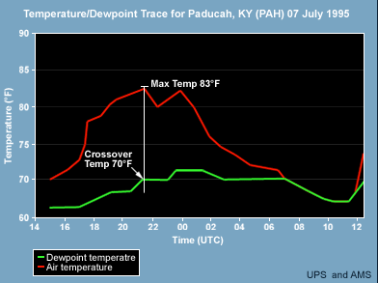
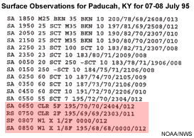
Crossover temperature of 70F

Slide 52
Why does crossover temp give information on moisture aloft?
During max temp time, PBL mixing reaches its max height
Mixing brings down air from aloft, so sampling T_{d} at the top of the PBL.
If T_{d} drops substantially in the afternoon, that means moisture is shallow.

Slide 53
Using the crossover temp
Expect substantial fog if the temperature at night is predicted to fall to or below the crossover temperature.

Slide 54
NWS Discussion
000 FXUS62 KGSP 131857 AFDGSP AREA FORECAST DISCUSSION NATIONAL WEATHER SERVICE GREENVILLE-SPARTANBURG SC 253 PM EDT THU APR 13 2006 .SHORT TERM /TONIGHT THROUGH SATURDAY/... NORTHWESTERLY FLOW ALOFT WILL REMAIN OVER THE AREA THRU FRIDAY. …. THERE IS THE POSSIBILITY THAT KAND/KCLT COULD HAVE A BRIEF PERIOD OF MVFR FOG AROUND SUNRISE FRI GIVEN THE FORECAST HYDROLAPSE. HOWEVER CROSSOVER TEMPS ARE WELL BELOW FORECAST LOW TEMPS...THEREFORE WILL LEAVE OUT FOR NOW. CANNOT RULE OUT SOME VFR CEILINGS FROM TIME TO TIME...BUT CHANCE NOT HIGH ENOUGH TO INCLUDE AT THIS TIME. && .GSP WATCHES/WARNINGS/ADVISORIES... GA...NONE. NC...NONE. SC...NONE. && $$ SHORT TERM...RWH/CSH LONG TERM...CSH AVIATION...RWH

Slide 55
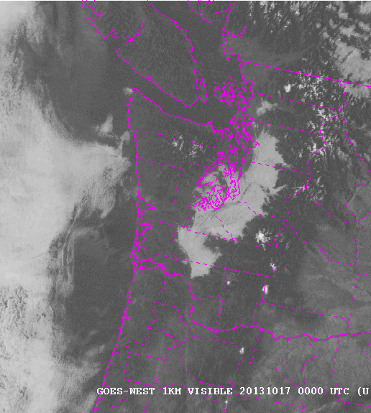
Radiation fog evolution
Radiation fog often lifts during the day (burns up from the ground)
Burns off from the edges.

Slide 56
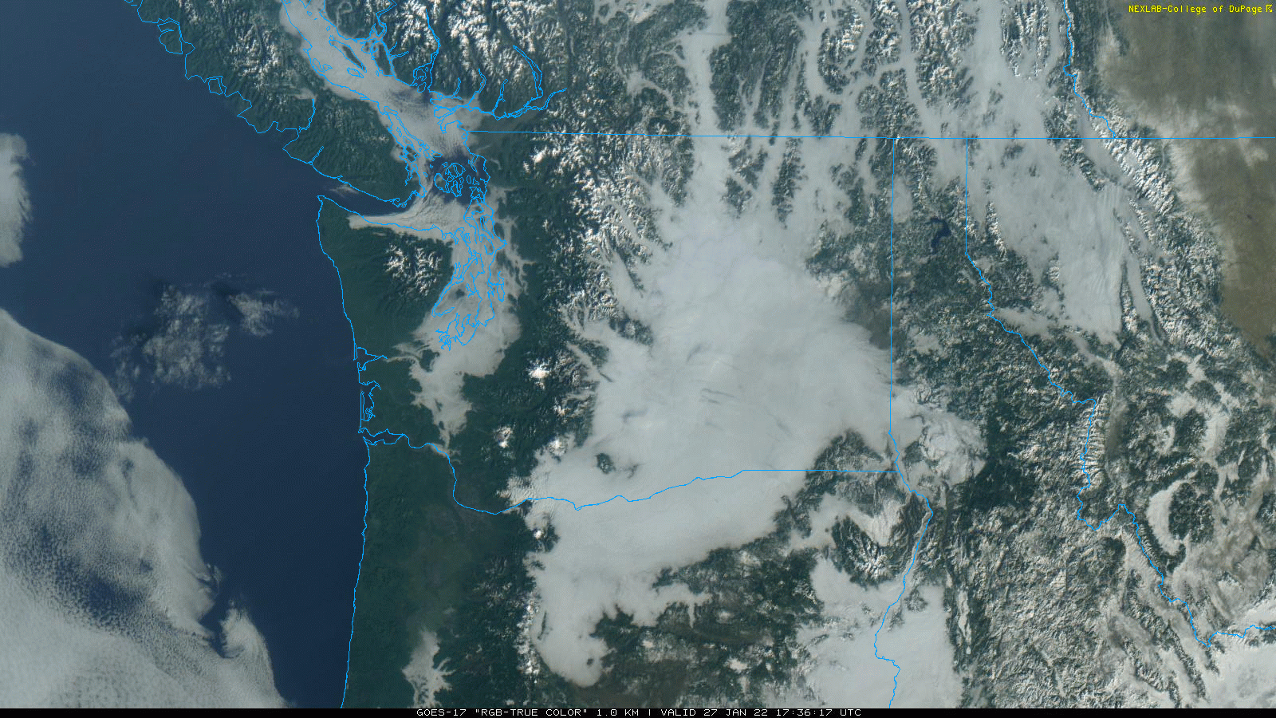

Slide 57
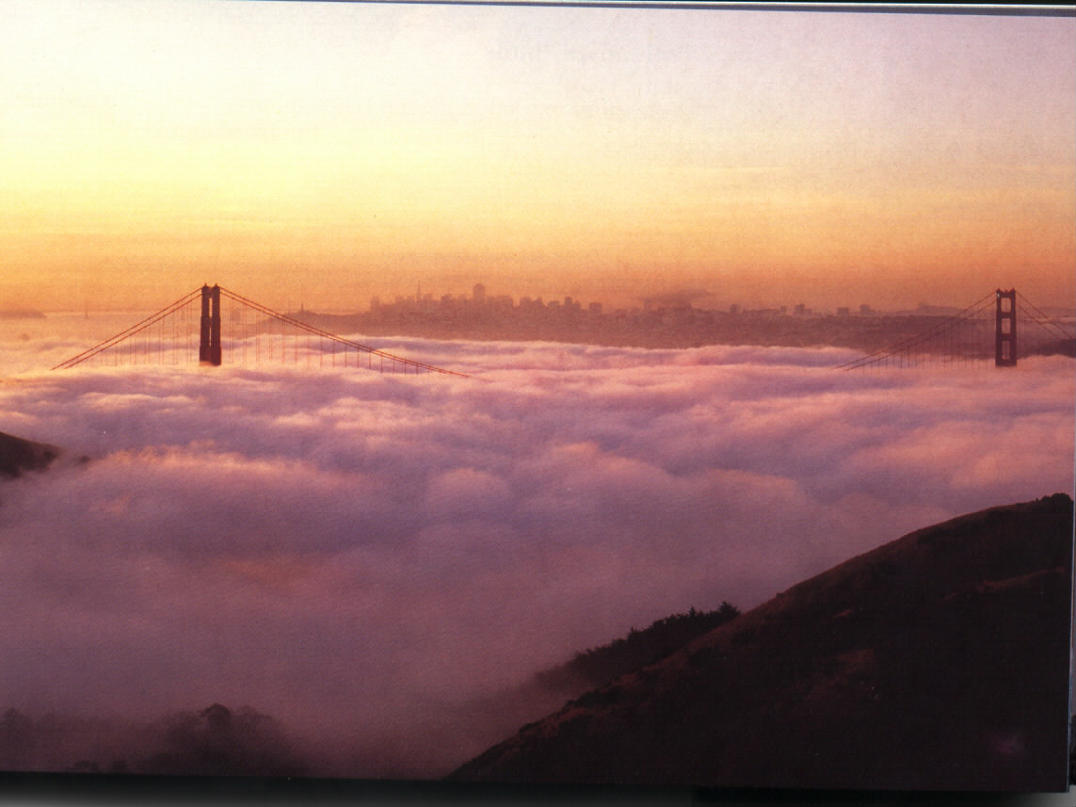

Advection Fog

Slide 58
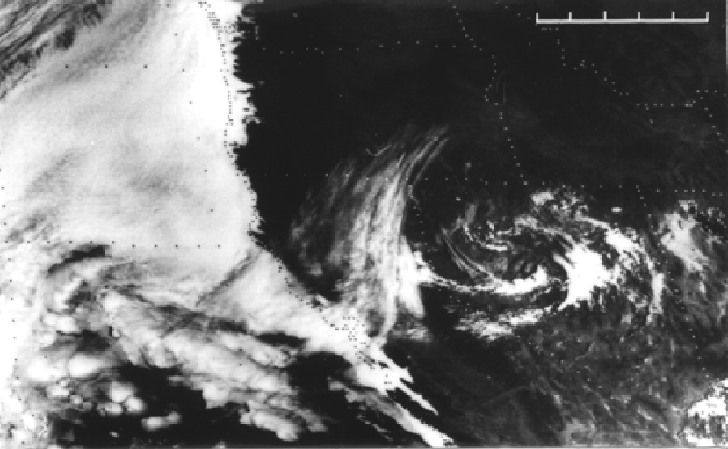

Slide 59
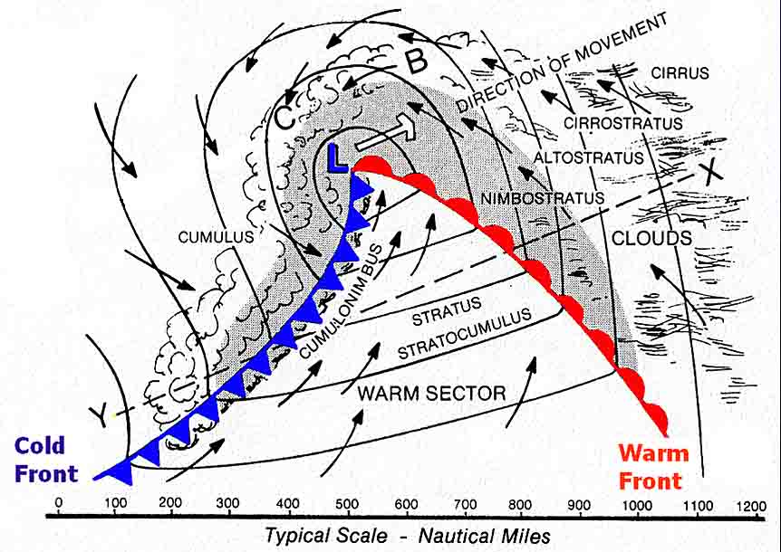
Advection Fog
Associated with relatively warm, moist air moving over a cooler surface.
Examples: warm/moist air passing over cool, upwelling coastal waters, snow.
Northern warm sectors over oceans

Slide 60
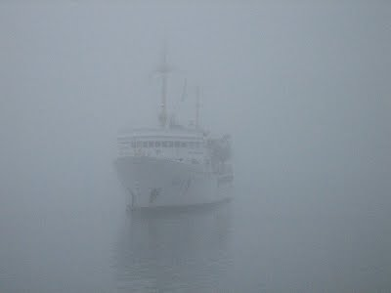
Off of maritime Canada

Slide 61
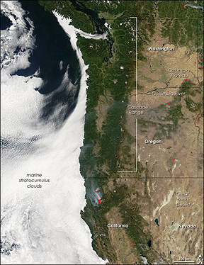
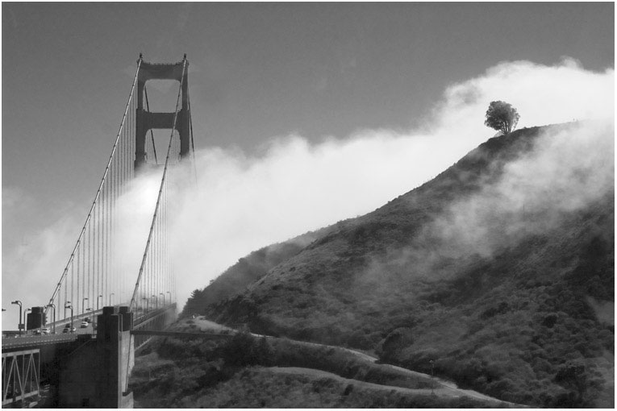
West Coast Advection Fog

Slide 62
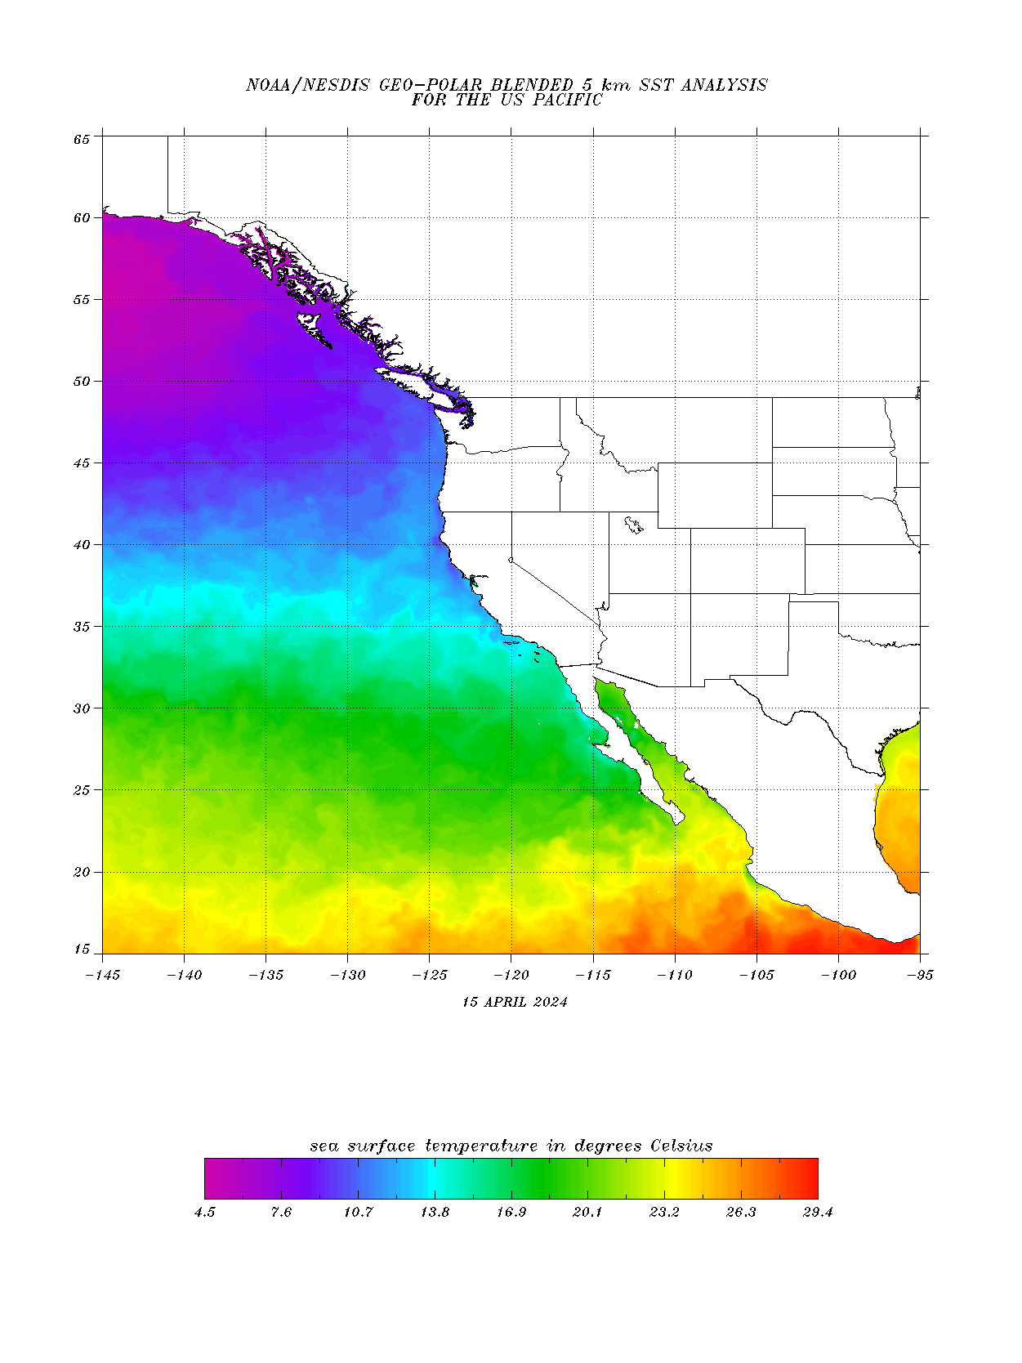
Associated with cool coastal waters

Slide 63
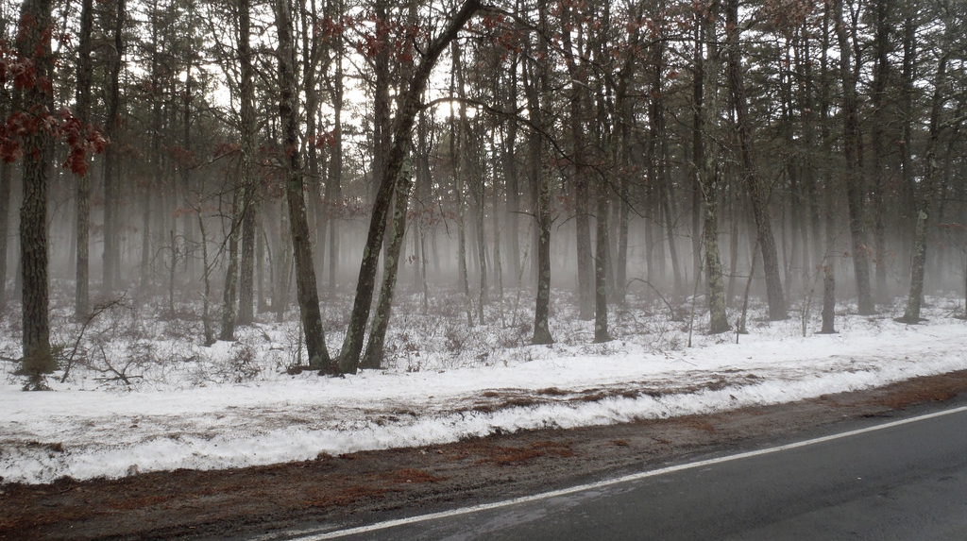
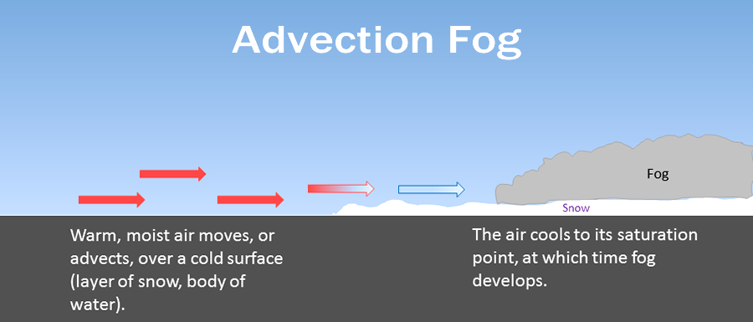
Advection fog over snow

Slide 64
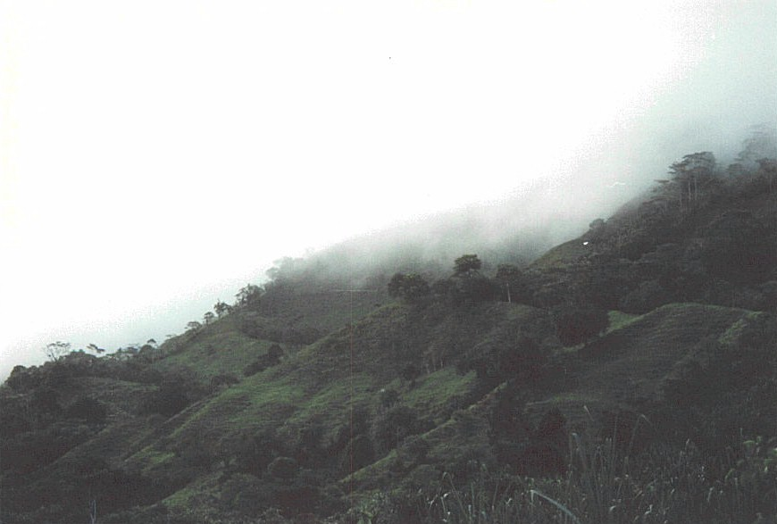
Upslope Fog

Slide 65


Results from adiabatic cooling on slopes
Often in Cascade passes, from flow from either direction

Slide 66

Upslope Fog: Snoqualmie Pass

Slide 67


Slide 68


Frontal Fog

Slide 69

Frontal fog
Adding moisture to cool air below until it saturates
Big player in warm frontal zone.

Slide 70

More Generally: Precipitation Fog
Precipitation often associated with fog.

Slide 71

Steam Fog

Slide 72


Slide 73

Resulting from mixing of cold, dry air and moist, warm air

Slide 74

Steam Fog
Unsaturated cold air passing over warm water mixes with warmer and moister air adjacent to water
The two air masses may not be saturated, but the mixture is.

Slide 75

Steam Fog
Usually need a big difference in temperature in the vertical between the two air masses, generally 20F or more
Often happens during arctic outbreaks here in the Northwest as cold air goes over our warm water (~50F).

Slide 76


Slide 77
Geographical Distribution of Fog

Slide 78

Cold water offshore
Upslope
Fog on Appalachians

Slide 79

Number One Fog Location in US
Cape Disappointment (106 days year of heavy fog)

Slide 80
Fog often collects in bowls and valleys

Slide 81

Fog can become very persistent, particularly in winter due to its radiative properties.
IR emission at top of fog helps maintain it

Slide 82
Annual Fog Variation
Most locations over land have a maximum radiation fog frequency in autumn because of:
  Long nights
  Not many big storms/clouds (good IR cooling)
  Greater vertical stability (less mixing)
  Moister ground in autumn than summer
Advection fog locations are different…often have higher frequency in late spring and summer (e.g., US West Coast)

Slide 83

Annual Variation
Washington State

Slide 84


Advection Fog Along West Coast Maximum in Spring and Summer When Coastal Northerlies are Strongest

Slide 85


Coastal waters are coldest then compared to water offshore due to upwelling

Slide 86


Slide 87

Why is VERY Dense Fog often a good sign for later in the day?

Slide 88
Fog can impact other critical forecasting issues like ice on roadways
The worst roadway icing is usually due to fog passing over a subfreezing roadway.
More information is here:
https://atmos.washington.edu/~cliff/Roadway.htm

Slide 89
Forecasting Fog: Some Tips
Short-term, T vs T_{d}
  Assume constant T_{d}, extrapolate/forecast temp to within 1F of T_{d}
  To forecast deep or persistent fog, remember the crossover temp. If T predicted to drop to crossover temperature, better chance of fog.
Very dense fog is usually shallow, will burn off early.
Low–level moisture helps fog (recent rain, moist area)
Rain can moisten air and cause fog.

Slide 90
Fog Forecasting
Climo is very useful. Fog often develops in the same locations (e.g., bottoms of valleys)
Radiation fog. Clear or nearly clear skies, 2-7 knots, very light winds produce ground fog, strong winds no fog
Mid-level and lower clouds reduce radiative cooling and lessen fog chances
Light fog often occurs after rain starts as T_{d} rises and T falls.

Slide 91

Rain Causing Fog Often Occurs

Slide 92

Forecasting Fog
Fog burns off from edges and lifts into stratus
Many NWS offices have local fog rules. In Seattle they talk about fog lifting 500 ft every two hours during the morning.
Models have trouble with fog, but are improving as vertical and horizontal resolution increases.

Slide 93


Slide 94



Slide 95


Slide 96


Slide 97

MOS and NBM powerful tools for fog prediction when models are not good

Slide 98

Dust storms: An increasing visibility forecasting problem

Slide 99



Slide 100

April 21, 1931: The Biggest Duststorm in NW History

Slide 101


Slide 102

Phoenix Dust Storm

Slide 103


Slide 104


Slide 105


Slide 106
Dust/sand storms
Can reduce visibility to near zero.
Strong winds are key.
Often associated with strong cold fronts or the outflow from strong convection.
Minimum wind speed threshold to lift sand/dust depends on the characteristics of the surface
Fine dust easier to loft (lower wind speeds) than large sand particles.

Slide 107

My rule of thumb: when the sustained winds get to 20 kts and fine materials, consider forecasting dust. When 30 kt…for sure

Slide 108
Examples
https://www.youtube.com/watch?v=dTjxptZxD3g
https://www.youtube.com/watch?v=Esz6ne9x9yM

Slide 109
What increases dust storms?
Greater disturbance of soils—more agriculture, grazing, more off-road vehicles, more mountain biking, more exploration for oil and another resources.
Drier/warmer periods over western U.S

Slide 110

Big New Challenge: Wildfire Smoke Reduces Visibility
Depends critically on 3-D distribution of smoke
Smoke stays high, less effect on surface visibility
Smoke aloft can mix down to the surface during day, degrading visibility

Slide 111

Bolt Fire: Sept. 2022

Slide 112



Slide 113

Ceilometers at Airports and Other Locations can Follow Smoke

Slide 114



Slide 115

Smog: Reduction of visibility from photochemical smog
LA

Slide 116
Smog and Visibility
Requires the combination of No_{x}, organic volatiles (natural—e.g. terpenes-- or man-made—dry cleaners), and ultraviolet radiation (UV)
Less of problem due to cleaner cars and air quality regulations.

Slide 117

Precipitation and Visibility
Heavy rain or snow can reduce horizontal visibility to < ¼ mile
On the other hand, after precipitation, visibility can improve as pollutants and CCN are removed.

Slide 118

Aviation Weather Center Has Visibility Observations

Slide 119

Major Tool: HRRR Smoke https://rapidrefresh.noaa.gov/hrrr/HRRRsmoke/

Slide 120

HRRR Model Predicts Visibility

Slide 121
The END

