Slide 1
Upper-Level Fronts and Frontogenesis
ATMS 370
Winter 2026

Slide 2
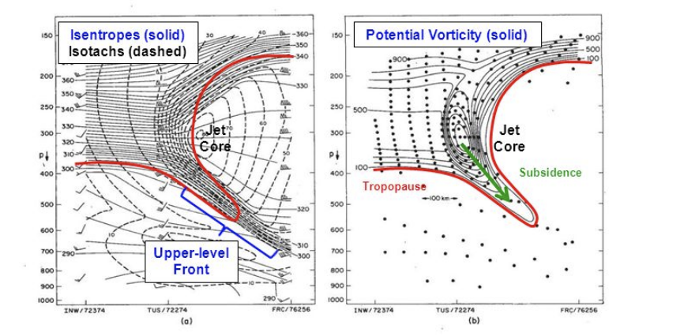
Definition
Upper-level fronts: regions of large horizontal thermal contrast in the middle to upper troposphere.
Associated with the tropopause and jet stream.

Slide 3
History
In the first half of the 20th century there was no concept of upper-level fronts.
Most studies described a polar or midlatitude front that extends from the surface to the tropopause.
The tropopause was considered an extensive and impenetrable barrier between the troposphere and stratosphere.

Slide 4
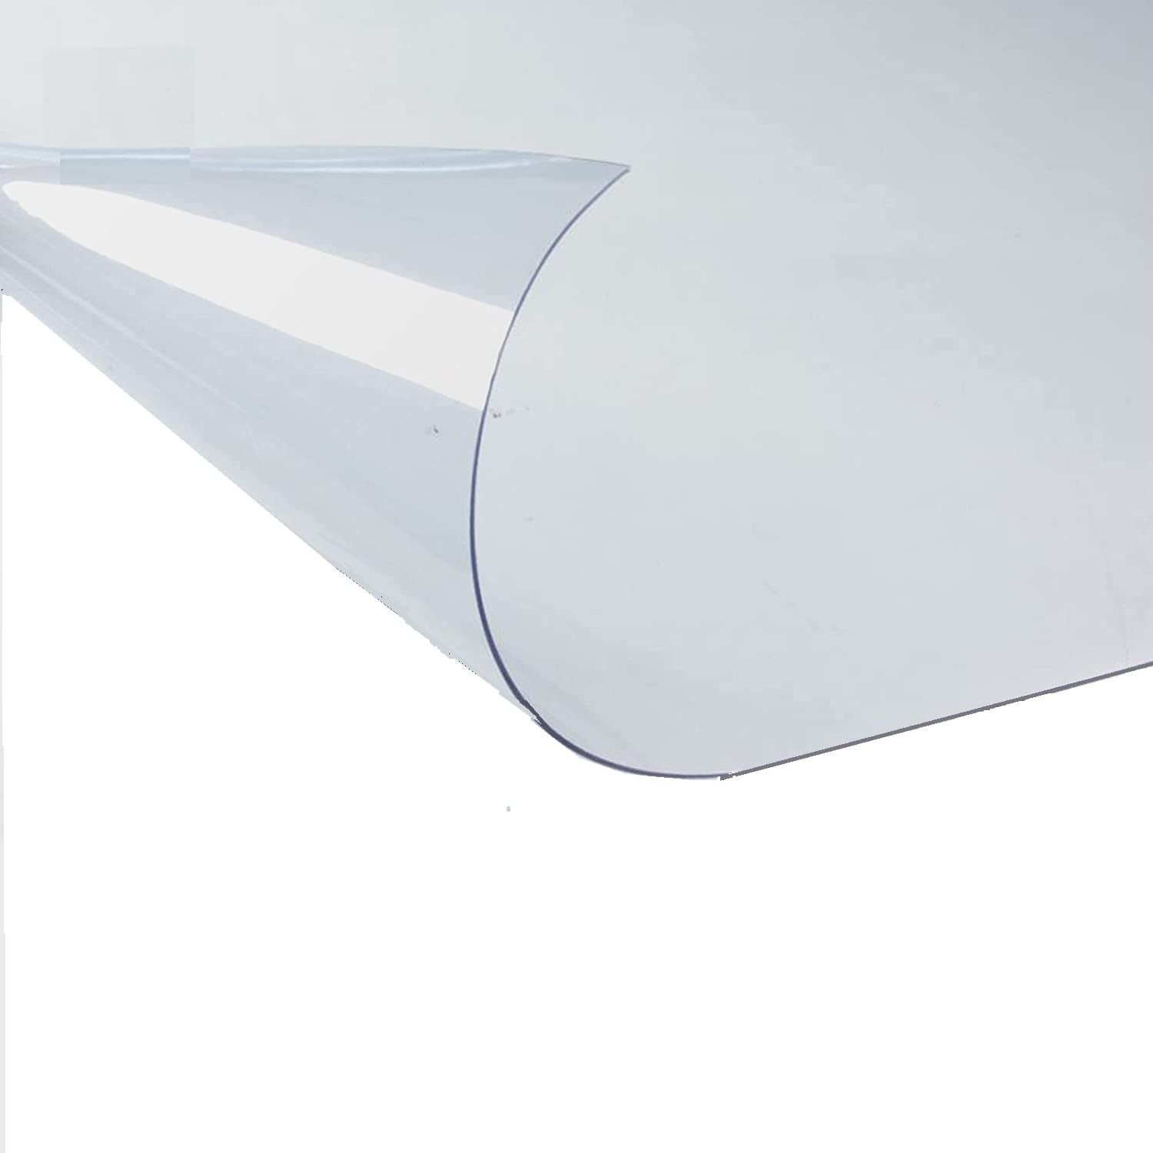
The concept of the tropopause
No air movement through it!

Slide 5
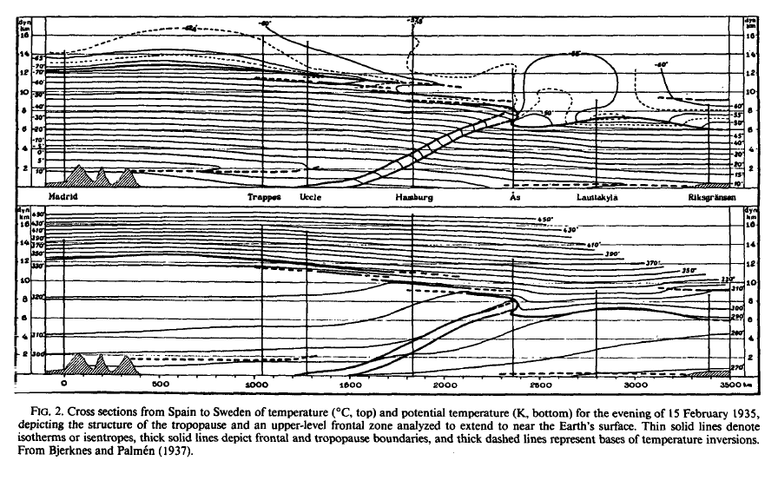
1920s-1950: Polar Front and Impenetrable Tropopause
Bjerknes and Palmen 1937

Slide 6
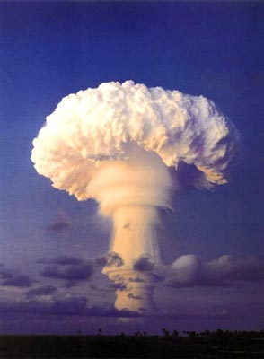
During the 50’s and 60’s Some Nations Conducted Above-Ground Testing of Nuclear Weapons

Slide 7
Radioactivity
It was thought the above-ground tests were not a problem:
  Radioactivity injected into the stratosphere would stay there.
  Radioactivity injected into troposphere (in remote areas) would fall out rapidly or would be removed by precipitation.
But that did not prove to be the case. High concentrations of radioactivity showed up in the U.S. and other locations. High levels of strontium-90 were found in milk.

Slide 8
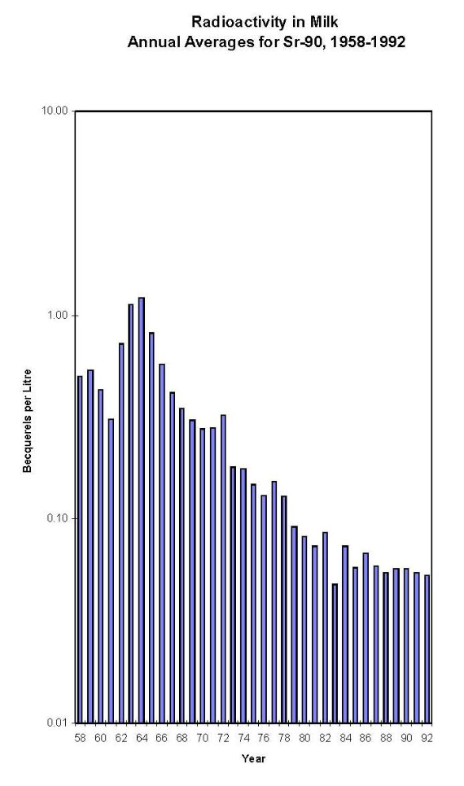


Slide 9
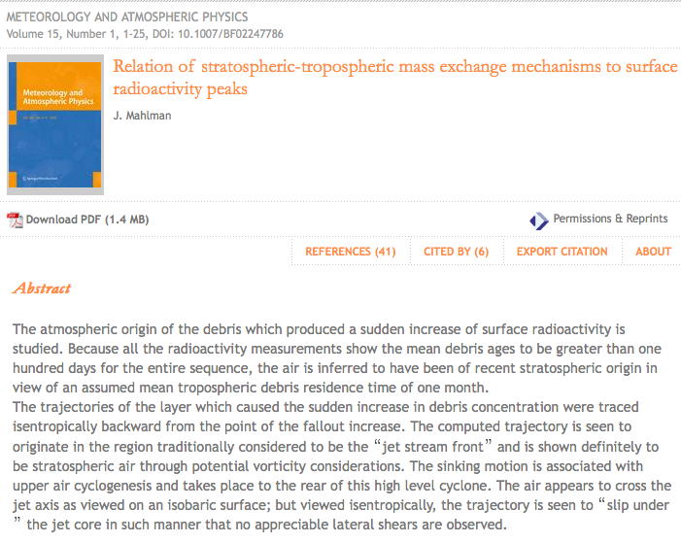
Research Showed There Was A Conduit from the Stratosphere to Troposphere

Slide 10
How did the radioactive material in the stratosphere get into the midlatitude troposphere??

Slide 11
Upper- level fronts and stratosphere-troposphere transport
To answer this question, several synoptic studies and field experiments took place in the 1950s and 1960s.
They found new meteorological animals:
  the upper-level front
  Tropopause folding and gaps
  Stratosphere-troposphere exchange

Slide 12
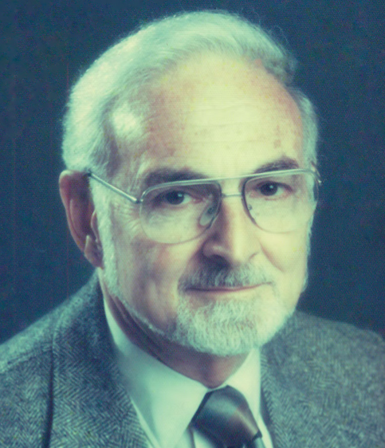
The First Study of Upper-Level Fronts: Reed 1957 (our dept!)

Slide 13
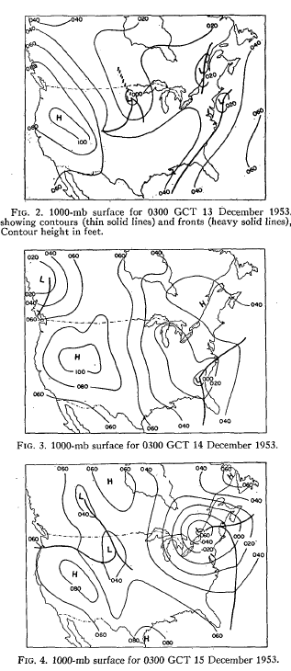

Slide 14
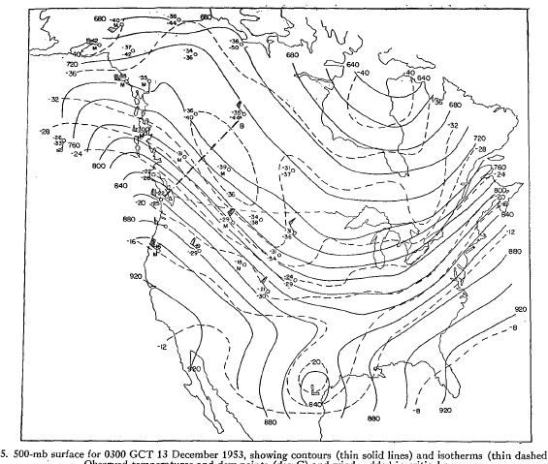

Slide 15
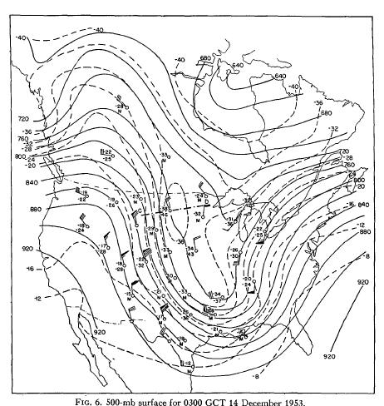

Slide 16
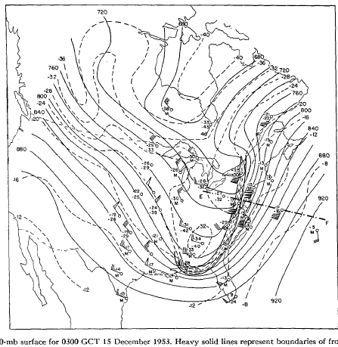

Slide 17
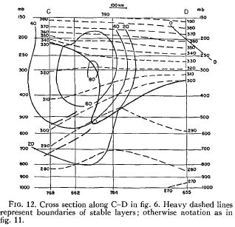
Vertical Cross Section

Slide 18
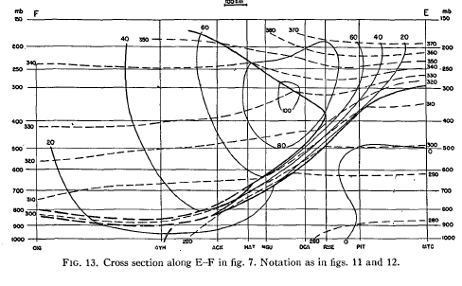

Slide 19
A Series of Aircraft-Based Field Experiments Described the Detailed Structure of Upper-Level Fronts in the 1960s and 1970s

Slide 20
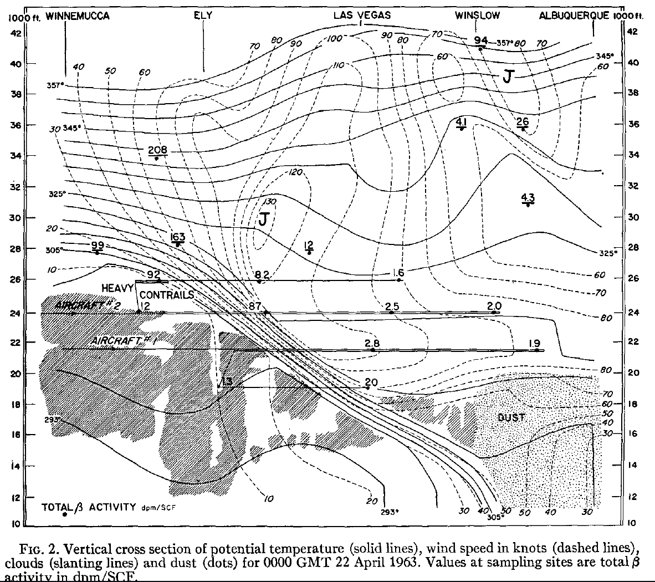

Slide 21
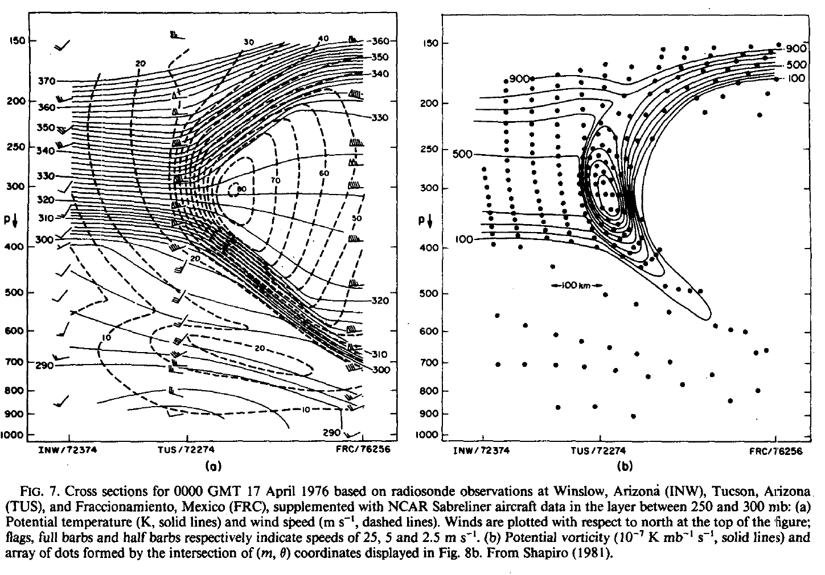
More Detailed Aircraft Data Showed the Details of Upper-Level Fronts

Slide 22
Review: Why does potential temperature increase rapidly in the stratosphere?

Slide 23
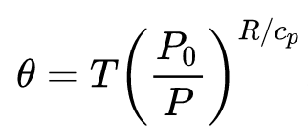
Hint
P_{o} is 1000 hPa

Slide 24
Hint
Temperature increases in the stratosphere while p decreases rapidly

Slide 25
Potential temperature increasing rapidly with height indicates stability
stratosphere

Slide 26
Why is the stratosphere very stable?

Slide 27



Slide 28
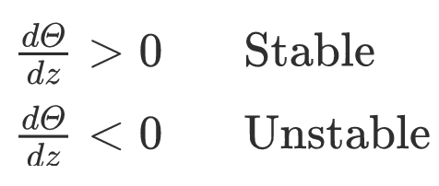
In an unsaturated atmosphere, the vertical gradient of potential temperature determines stability

Slide 29
Stable

Slide 30
Let’s talk about upper-level fronts

Slide 31
Upper-Level Front Characteristics
Usually associated with the midlatitude jet.
Can extend down to 900-800 hPa
Close association with upper-level troughs.
Often associated with substantial clear air turbulence.
Associated with a folding or “extrusion” of the tropopause.
Can also be associated with high ozone values.

Slide 32
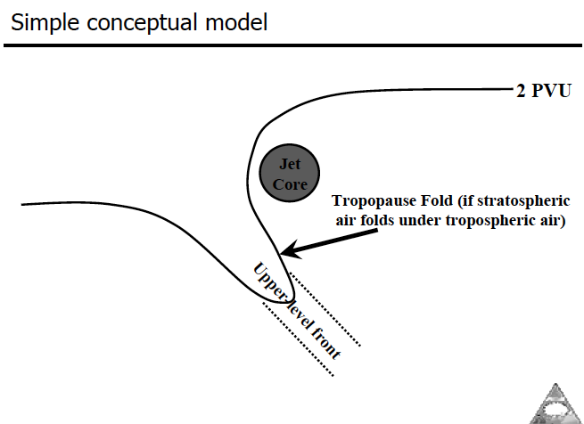
Upper-Level Fronts Associated with Tropopause Folding Near Jet
tropopause

Slide 33
stratosphere

Slide 34
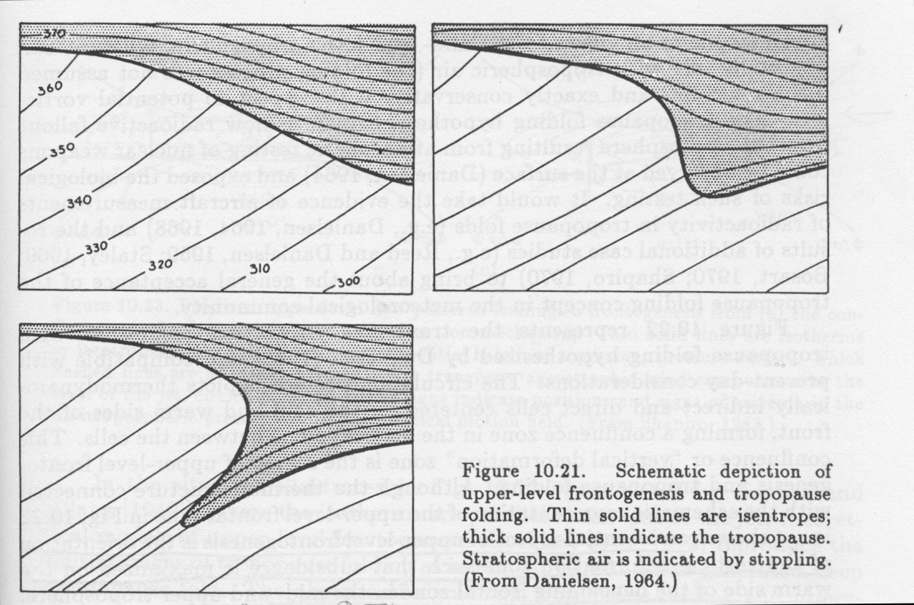
“Folding” of the Tropopause

Slide 35
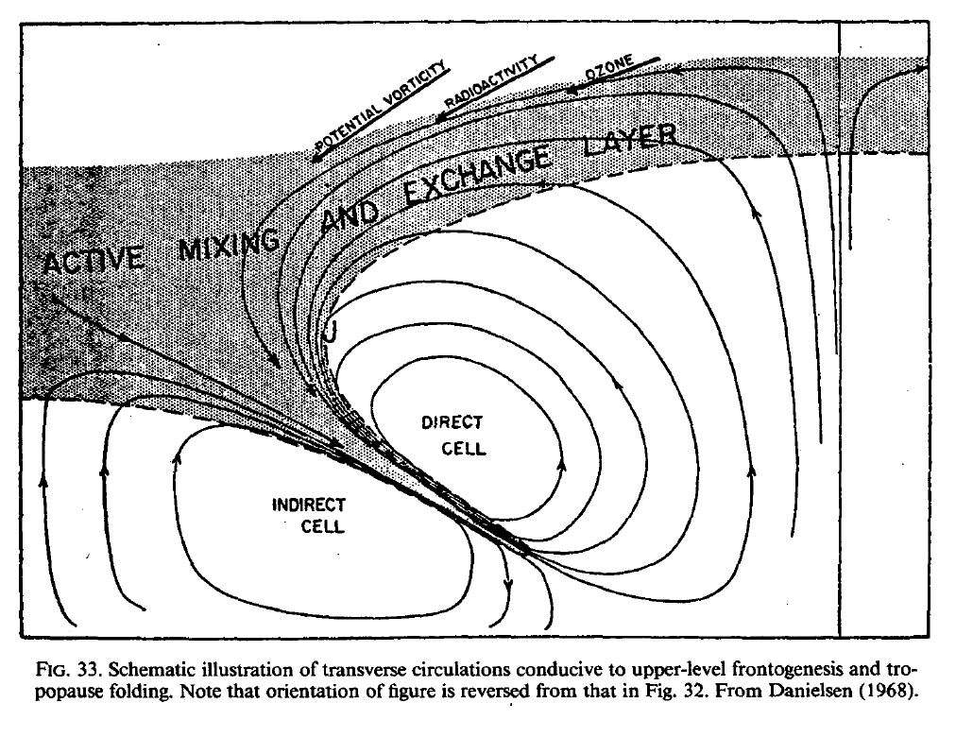
Stratospheric Air Injected into the Troposphere Through Upper-Level Fronts with Folding

Slide 36
Upper-Level Fronts Can Inject Air From the Stratosphere into The Troposphere

Slide 37
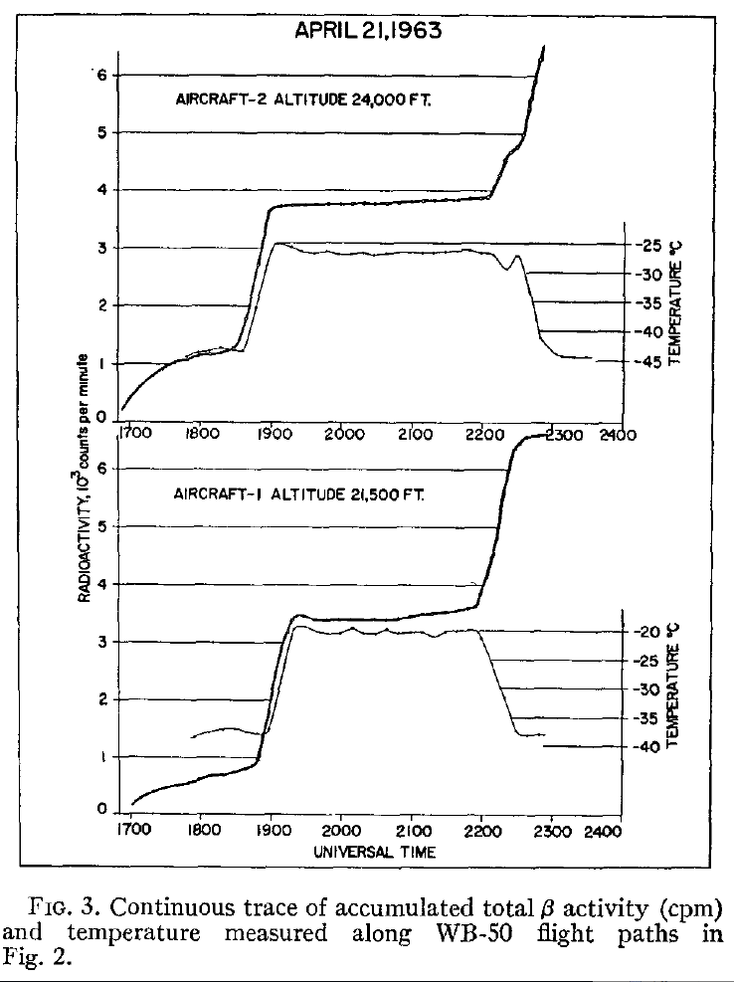
Radioactivity
Measurements of radioactivity showed that high levels of radioactivity (from A-Bomb tests) in the stratosphere were entering the troposphere through upper-level fronts.

Slide 38

Potential Vorticity As a Tracer of Air Parcel Origin
Potential vorticity is high in the stratosphere because of the large stability there. Ertel Potential Vorticity (PV):
Aircraft studies found stratospheric values of potential vorticity transported into the troposphere through upper-level fronts.
Total Vorticity
stability

Slide 39
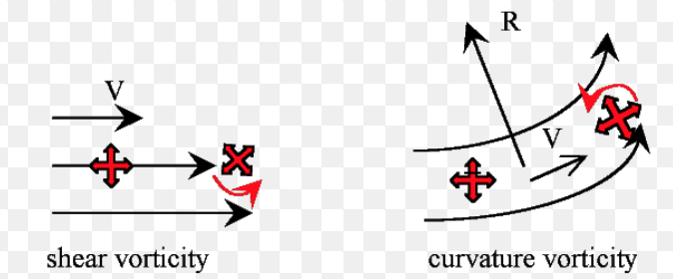
Relative Vorticity: Tendency for Rotation

Slide 40
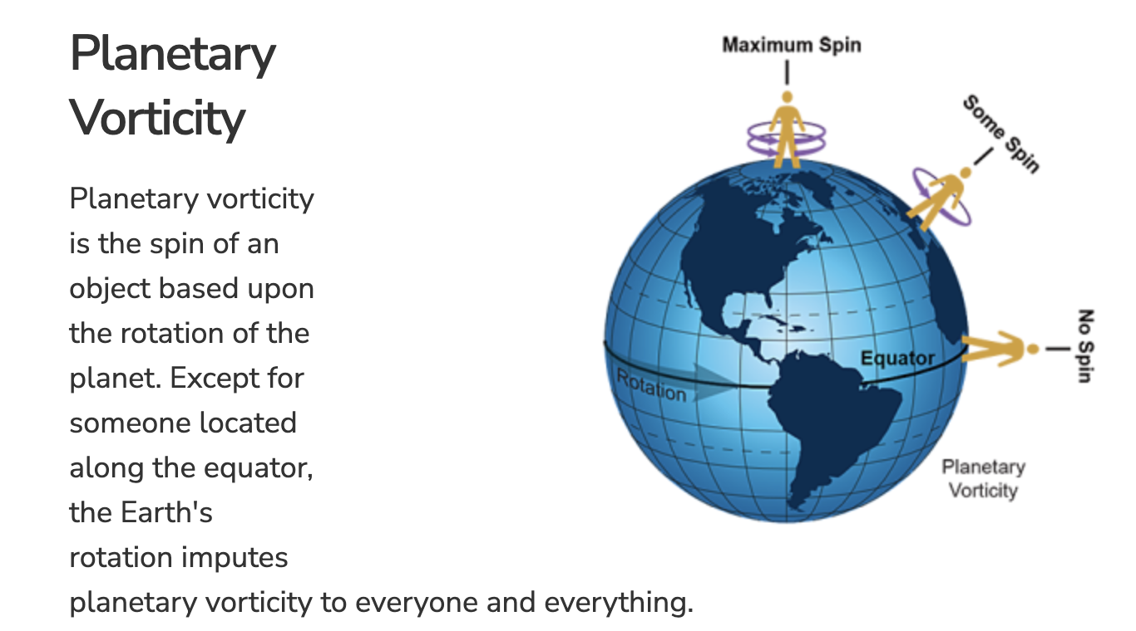
Planetary Vorticity (f): Because We are on a Rotating Planet

Slide 41
Absolute or total vorticity is the sum of relative and planetary vorticity
Potential vorticity is high in the stratosphere because of the large stability there. Ertel Potential Vorticity (PV):
Total vorticity
stability

Slide 42
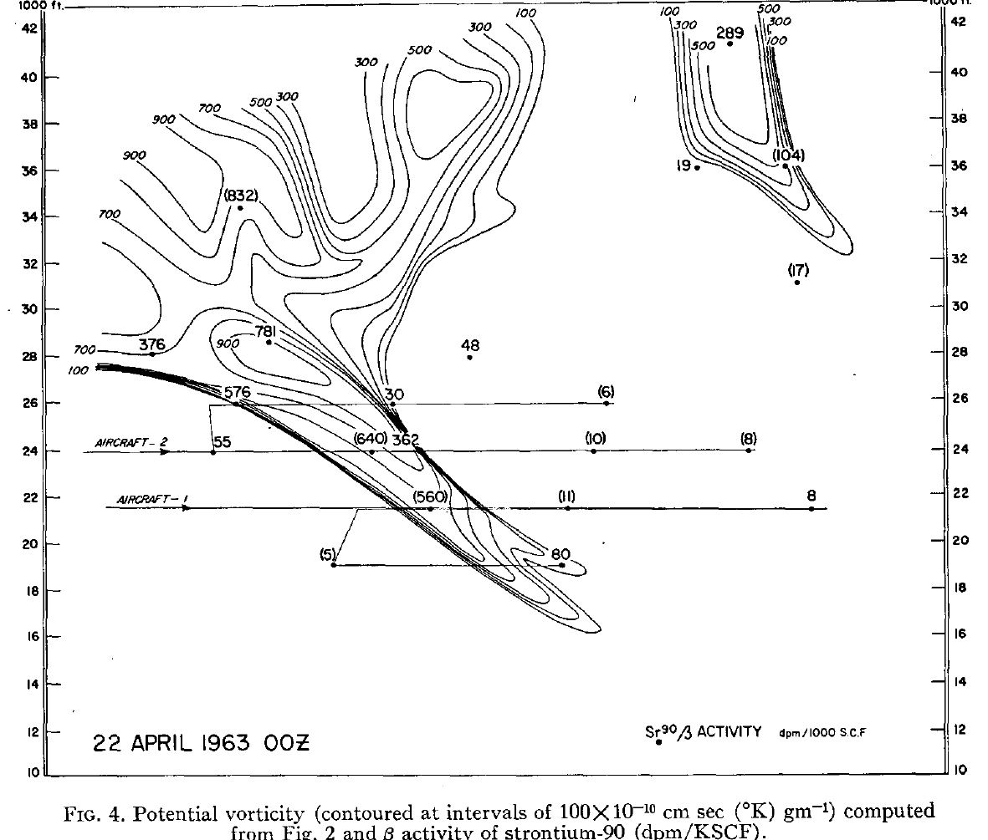

Slide 43
Ozone and Upper-Level Fronts
Ozone levels are generally higher in the stratosphere than the troposphere.
Ozone can be injected into the troposphere through upper-level fronts
The ozone associated with enhanced upper-level fronts can frequently be observed at the surface, particularly at mountain and higher-elevation observation sites.

Slide 44
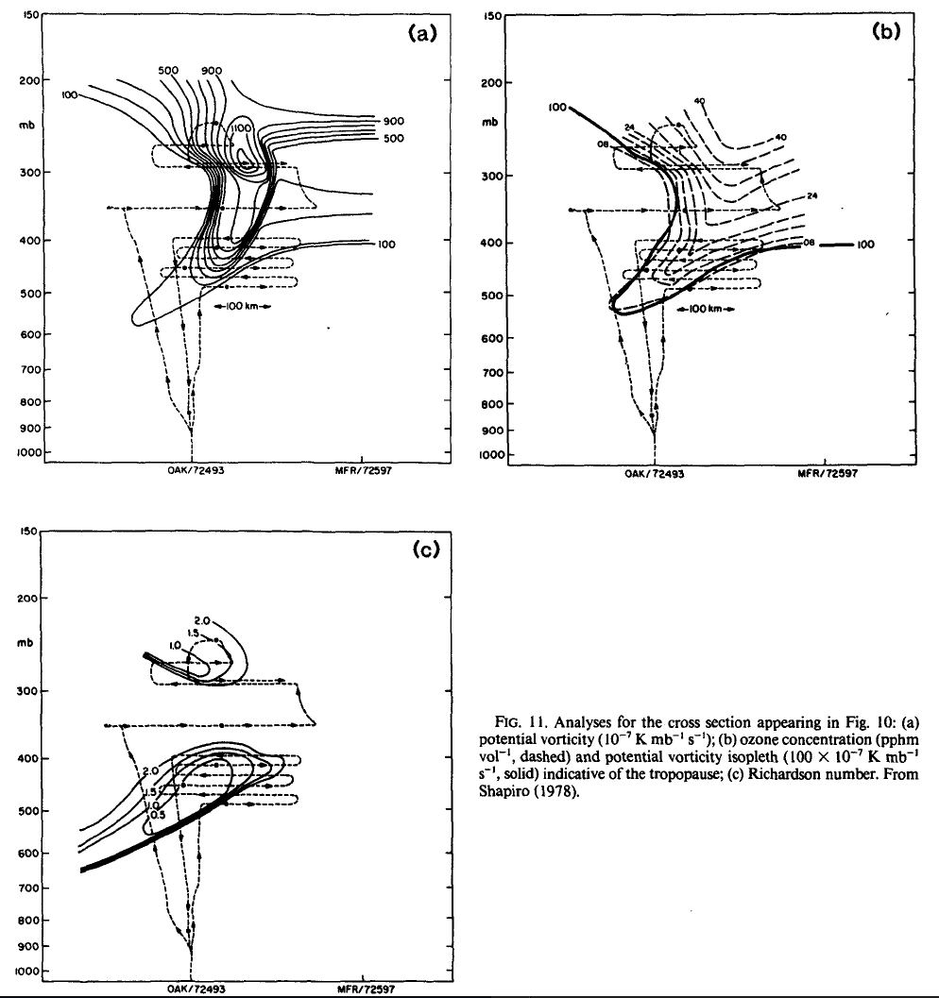
Ozone Measured By Aircraft

Slide 45
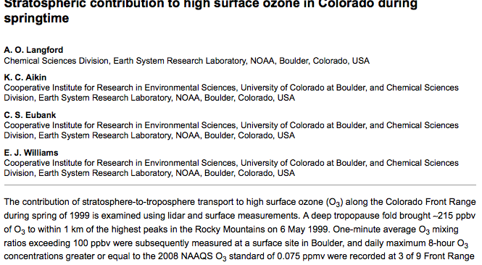
Many studies have documented such stratospheric ozone in the troposphere

Slide 46
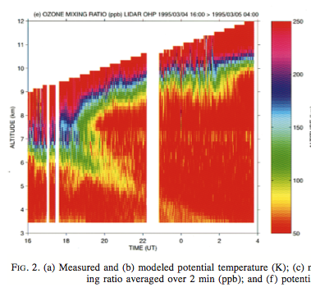
Remotely Sensed Ozone During an Upper Level Front

Slide 47
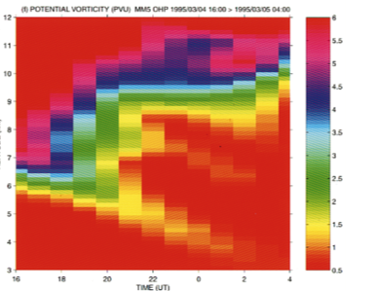
Simulated Potential Vorticity Structure at Same Time

Slide 48
Tropopause is often indicated by the 2 PVU surface

Slide 49
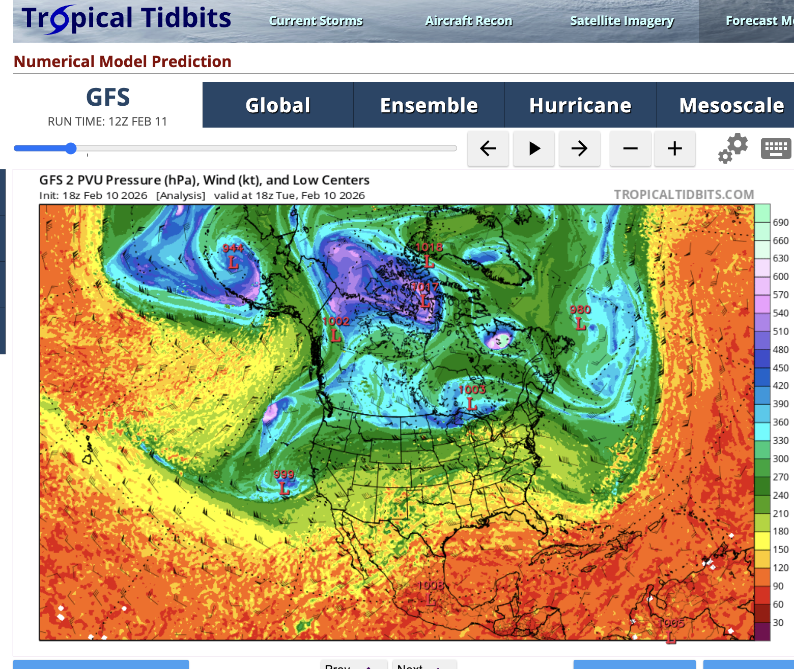

Slide 50
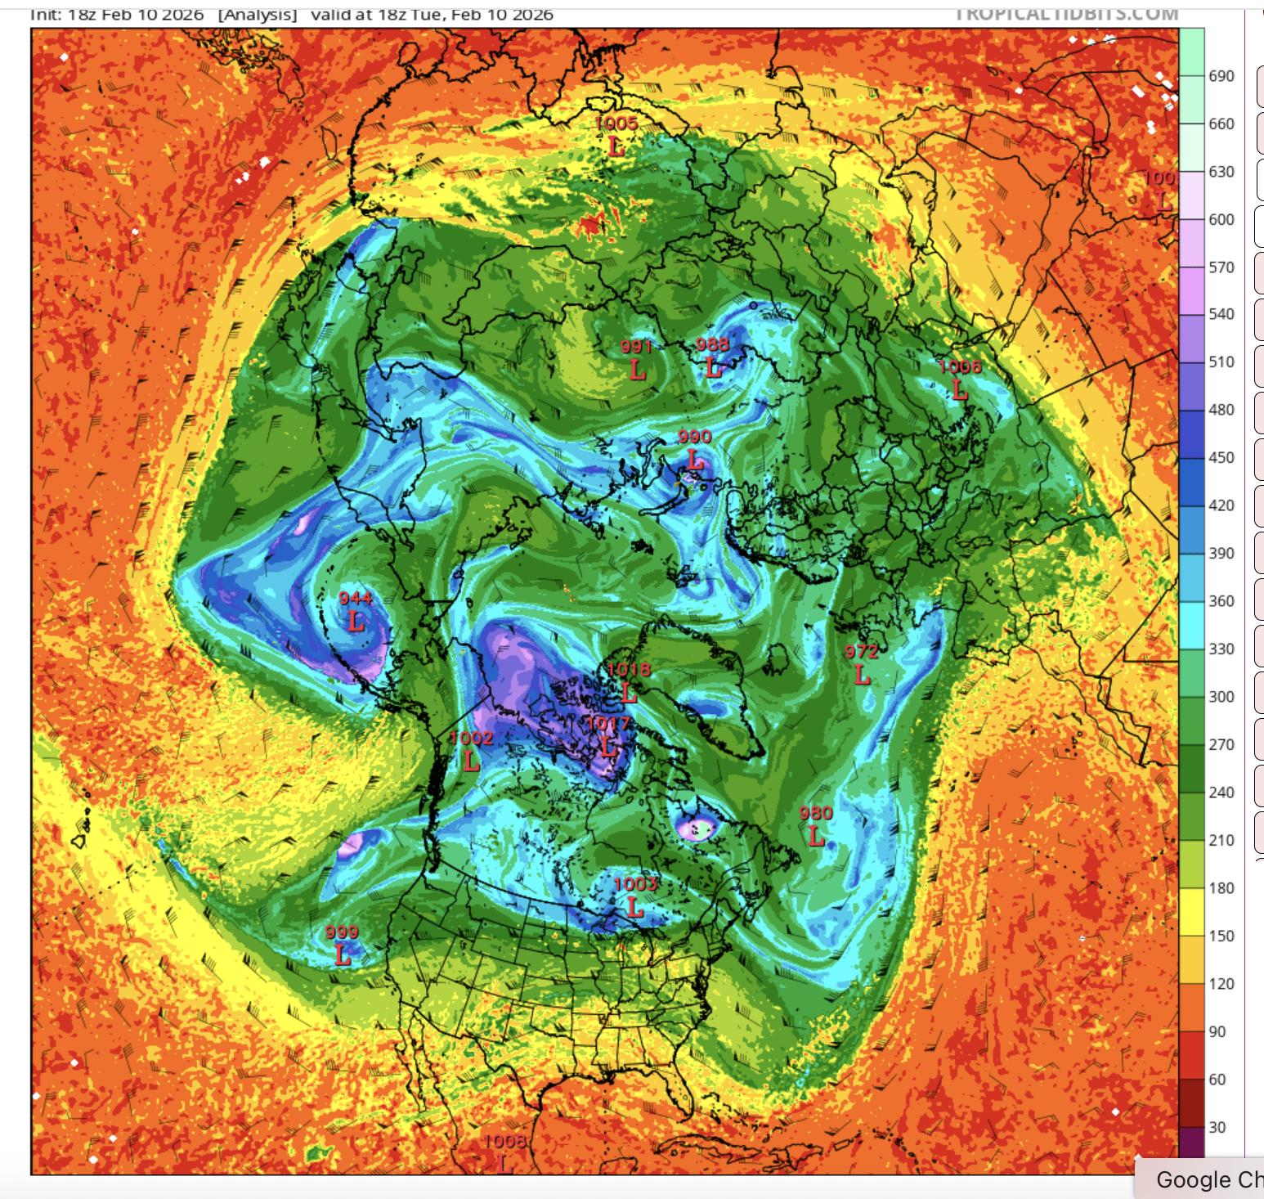

Slide 51
Intense Clear-Air Turbulence (CAT) Can Be Associated with Upper-Level Fronts.
Why?

Slide 52
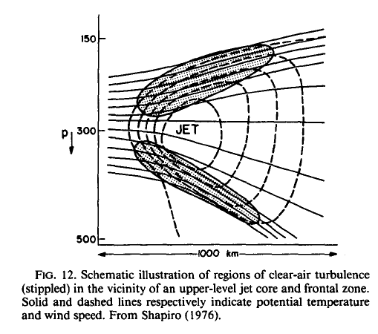
CAT Associated With Upper-Level Front and the Lower Stratosphere

Slide 53
Clear Air Turbulence is Associated with a High Richardson Number

Slide 54
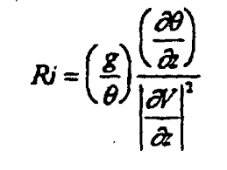
Richardson Number (Ri):
Small Values (less than roughly .25) produces instability/mixing
Vertical stability
Vertical wind shear
Large wind shear can result in small
Ri and thus instability.

Slide 55
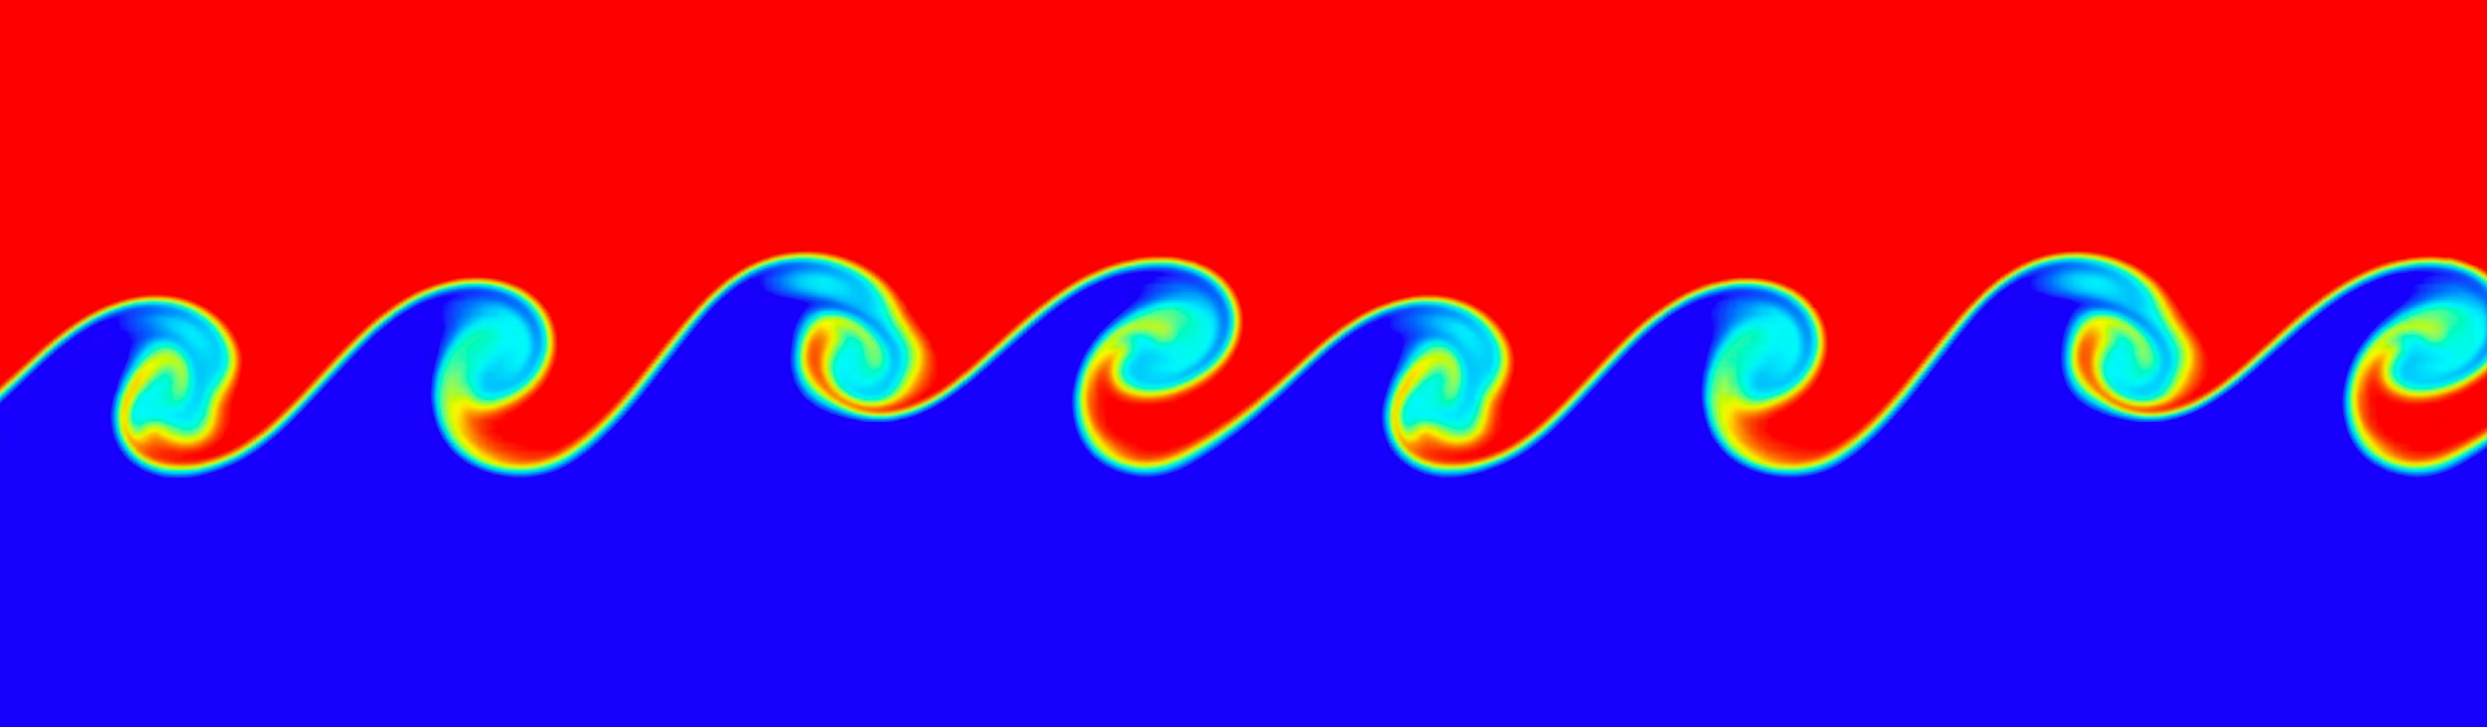
https://www.youtube.com/watch?v=qEGbzZM0Baw

Slide 56
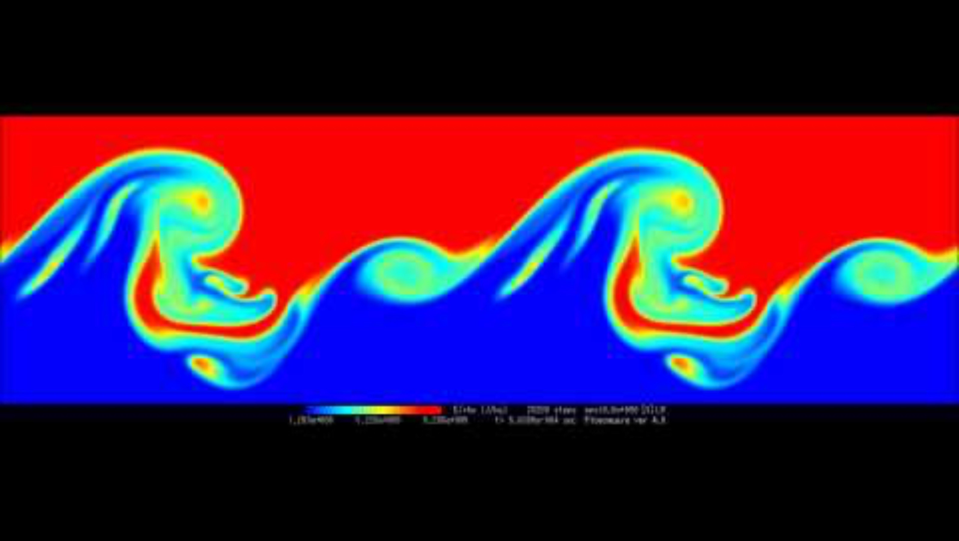

Slide 58
Richardson Number (small less stable)
J

Slide 59
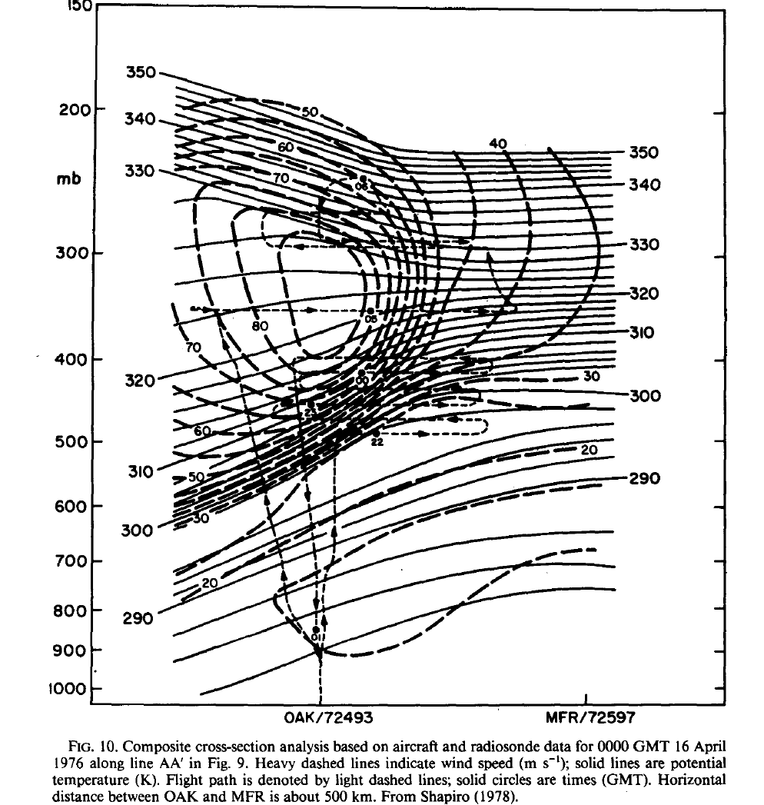
Turbulence

Slide 60
Example: Upper-Level Frontogenesis for Cyclone Developing over the U.S. in 1987

Slide 61
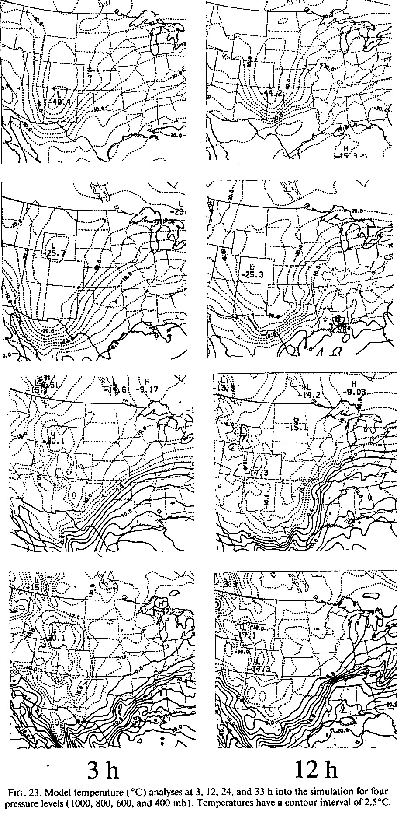
Temperature
400 hPa
1000 hPa

Slide 62
How are Upper-Level Fronts Created?

Slide 63
Upper-Level Frontal Frontogenesis
Tilting frontogenesis associated with differential vertical motion is often dominant.
Horizontal confluent frontogenesis is also important, but usually secondary.

Slide 64
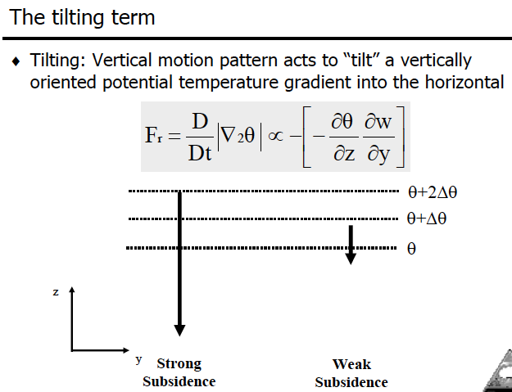
Tilting Frontogenesis
Large warming
Weaker warming

Slide 65
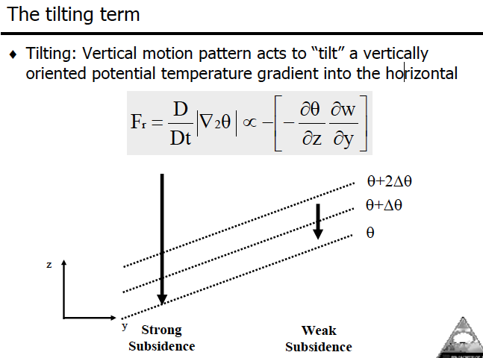
Tilting Frontogenesis

Slide 66
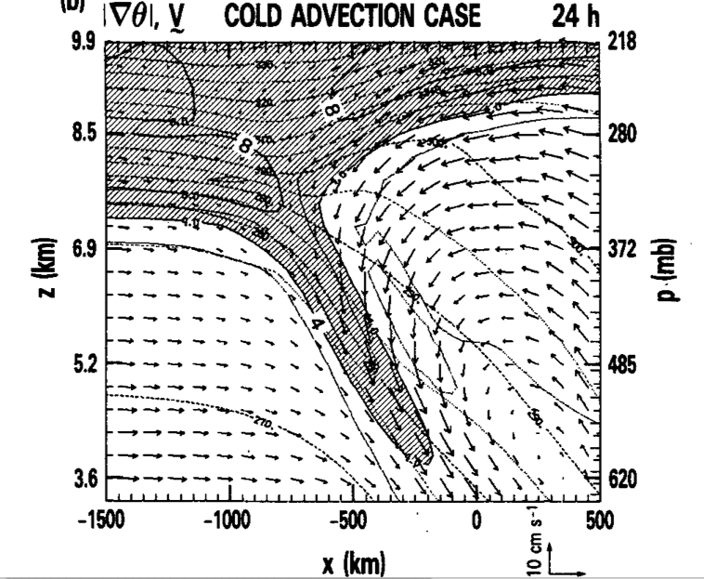
Keyser et al (1986) 2-D Primitive Equation Simulation

Slide 67
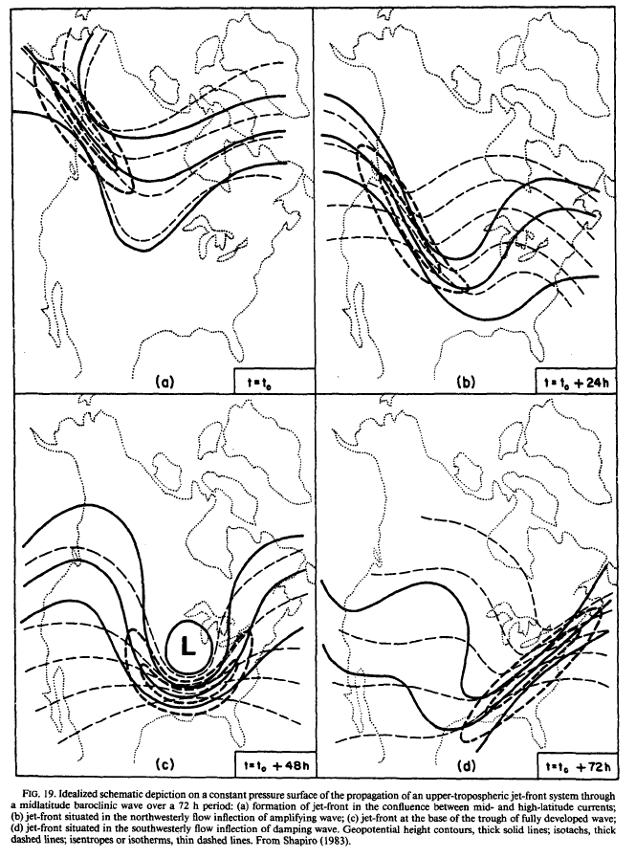
Horizontal Confluence can also contribute on the eastern side of upper-level trough.

Slide 68
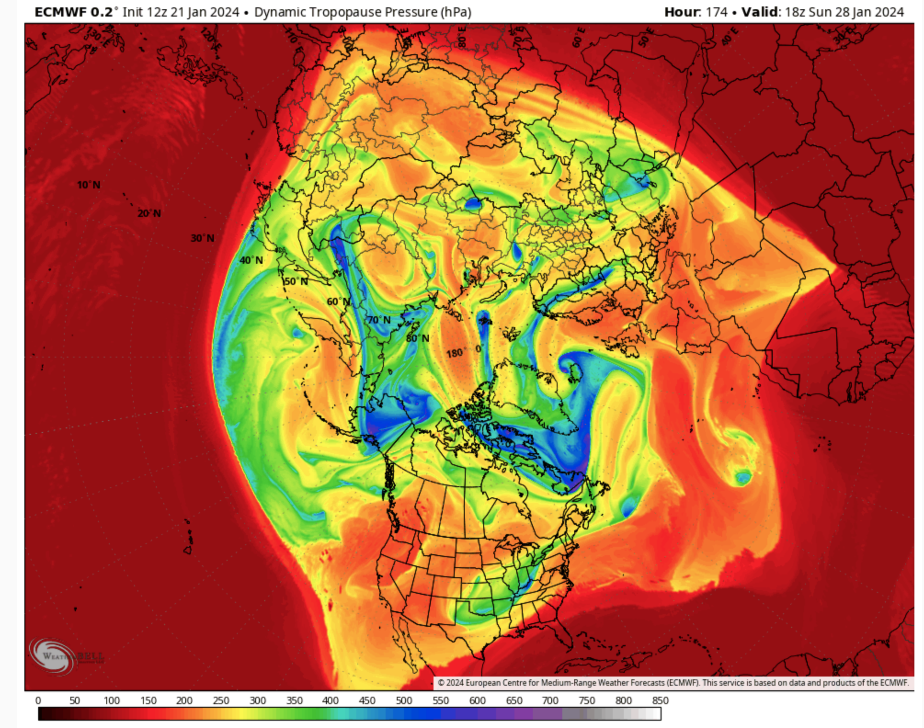
You can see upper level fronts on tropopause maps (large slope of tropopause)_

Slide 69
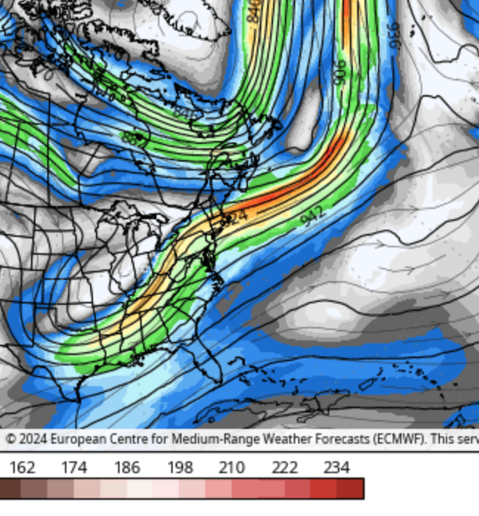
Trop
Tropopause Pressure
300 hPa wind

Slide 70
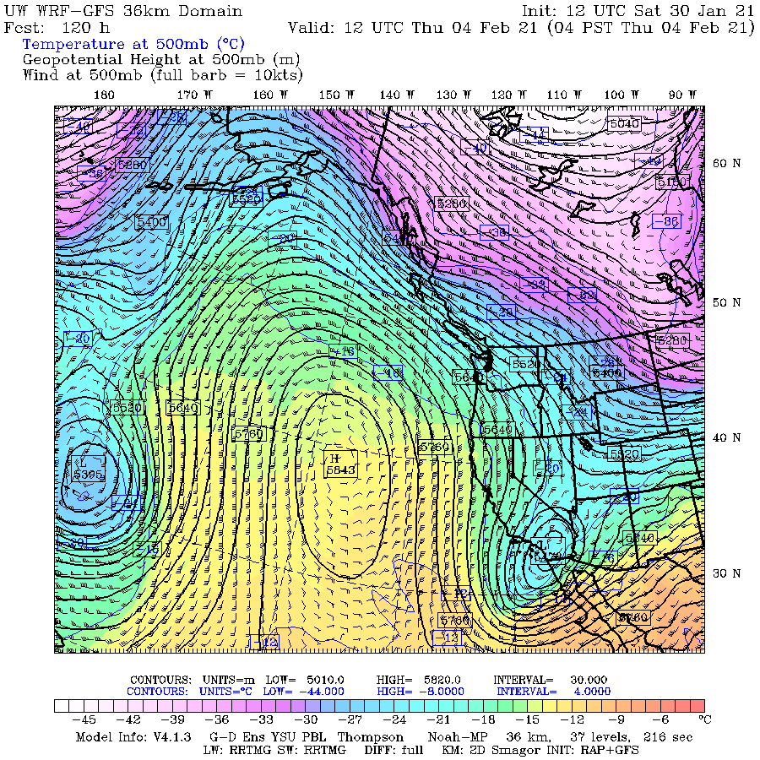
Example

Slide 71
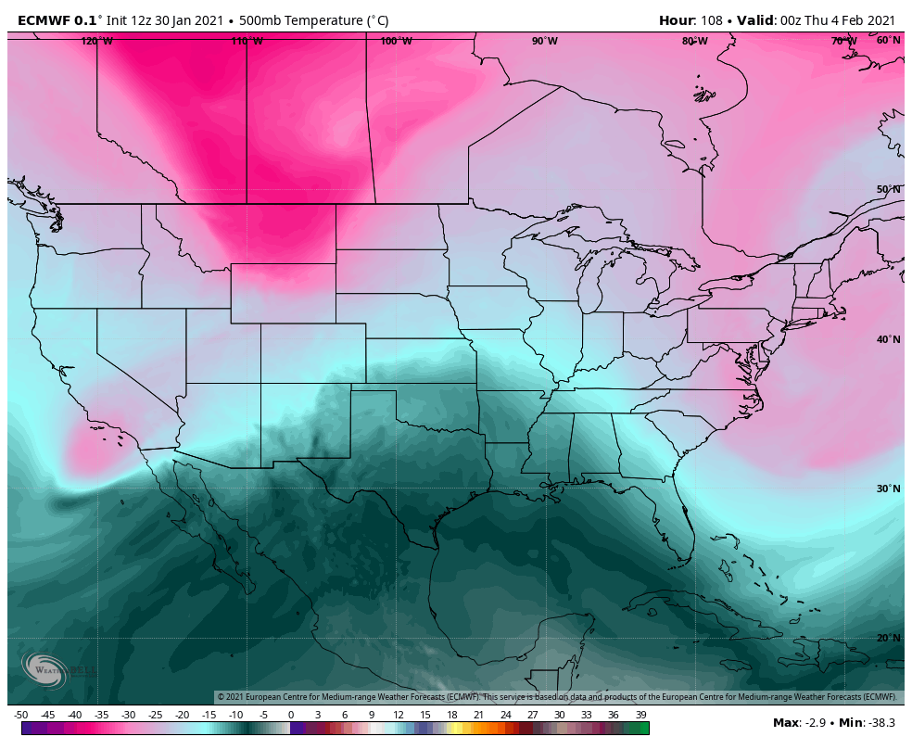

Slide 72
The End

