Slide 1
370 Tropical
Winter 2025

Slide 2

Tropical Meteorology is Important for Many Reasons
About 40% of the land surface is in tropics. Large population.
Tropical storms, some of which influence the midlatitudes.
Interactions with the midlatitudes (e.g., El Nino, La Nina, atmospheric rivers)

Slide 3
Major Differences Between Tropical and Midlatitude Meteorology
Weaker temperature gradients and pressure gradients, in general.
Small Coriolis parameter (f). Less geostrophic near equator
Weather is far more steady day to day
More diurnal (sea breezes/precipitation)
Poorer data availability than in midlatitudes

Slide 4
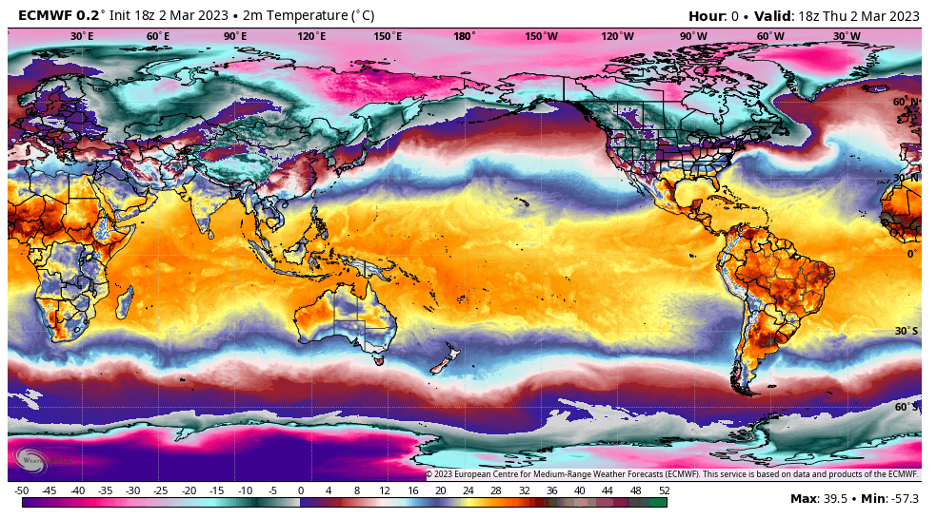
Relatively Uniform Temperatures

Slide 5
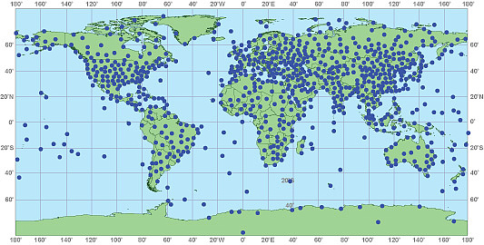
Upper Air Observations
Relatively sparse in tropics

Slide 6
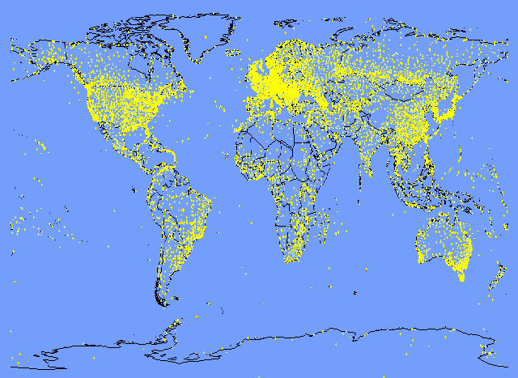
Surface Observations
Sparse in tropics

Slide 7
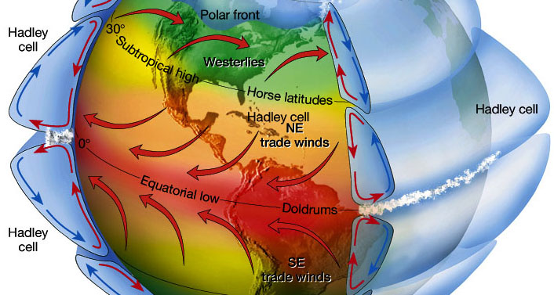
Large-Scale Tropical Features
Hadley Circulation (a.k.a Hadley Cell)
Trade winds
ITCZ (Intertropical Convergence Zone)
ITCZ

Slide 8
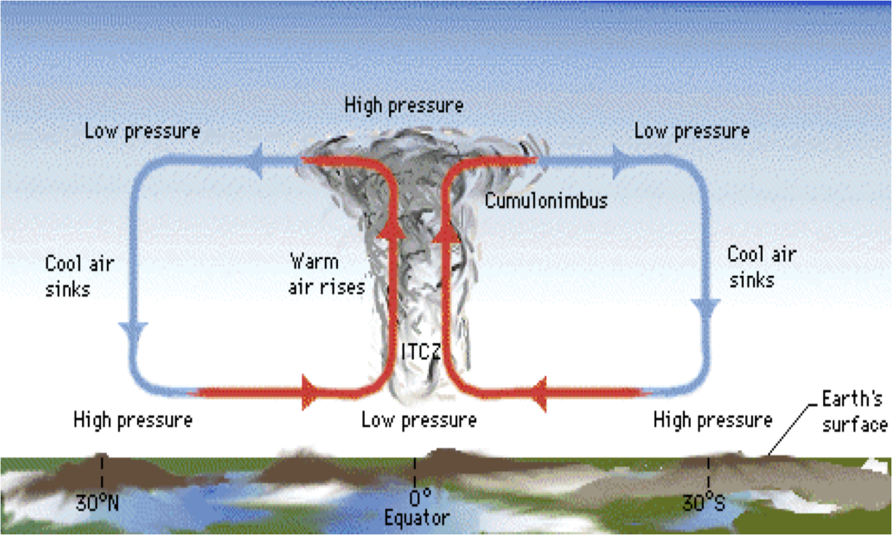
Hadley Cell (s)

Slide 9
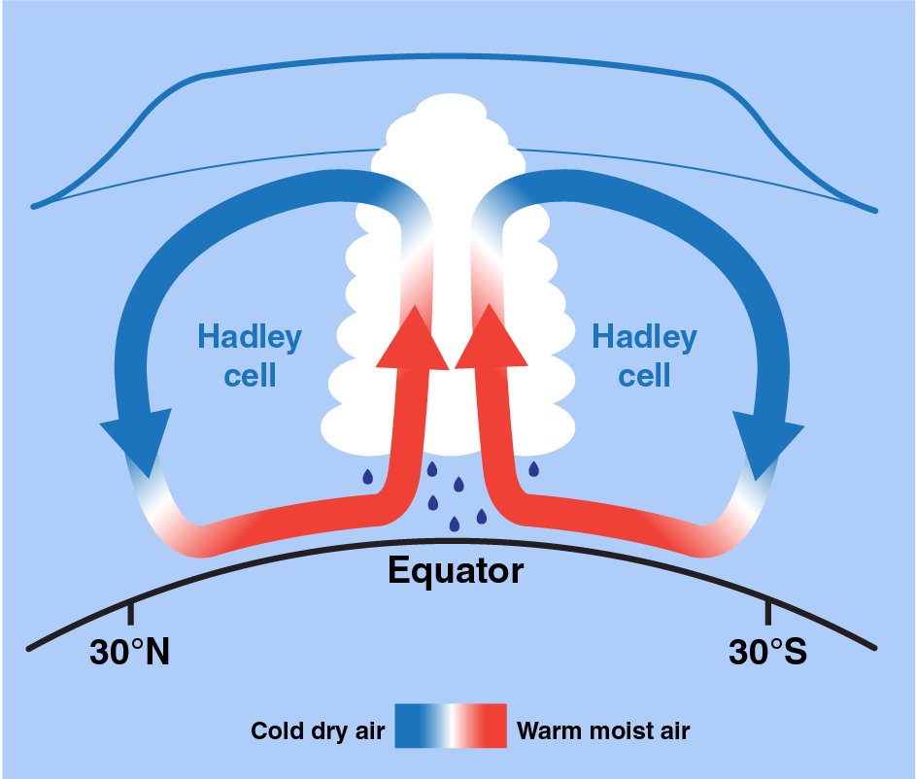
Correction to most ITCZ Schematics
The upward motion is concentrated near the ITCZ
The downward motion is spread out in latitude (roughly 15N/S and poleward) and weaker.
The ITCZ in not
necessarily on equator

Slide 10
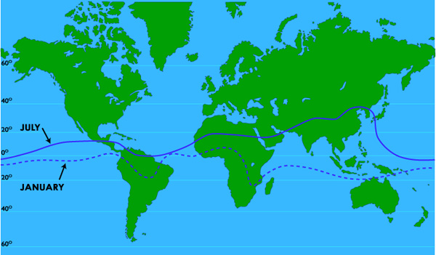
ITCZ is generally not on the equator
Moves northward during northern summer

Slide 11
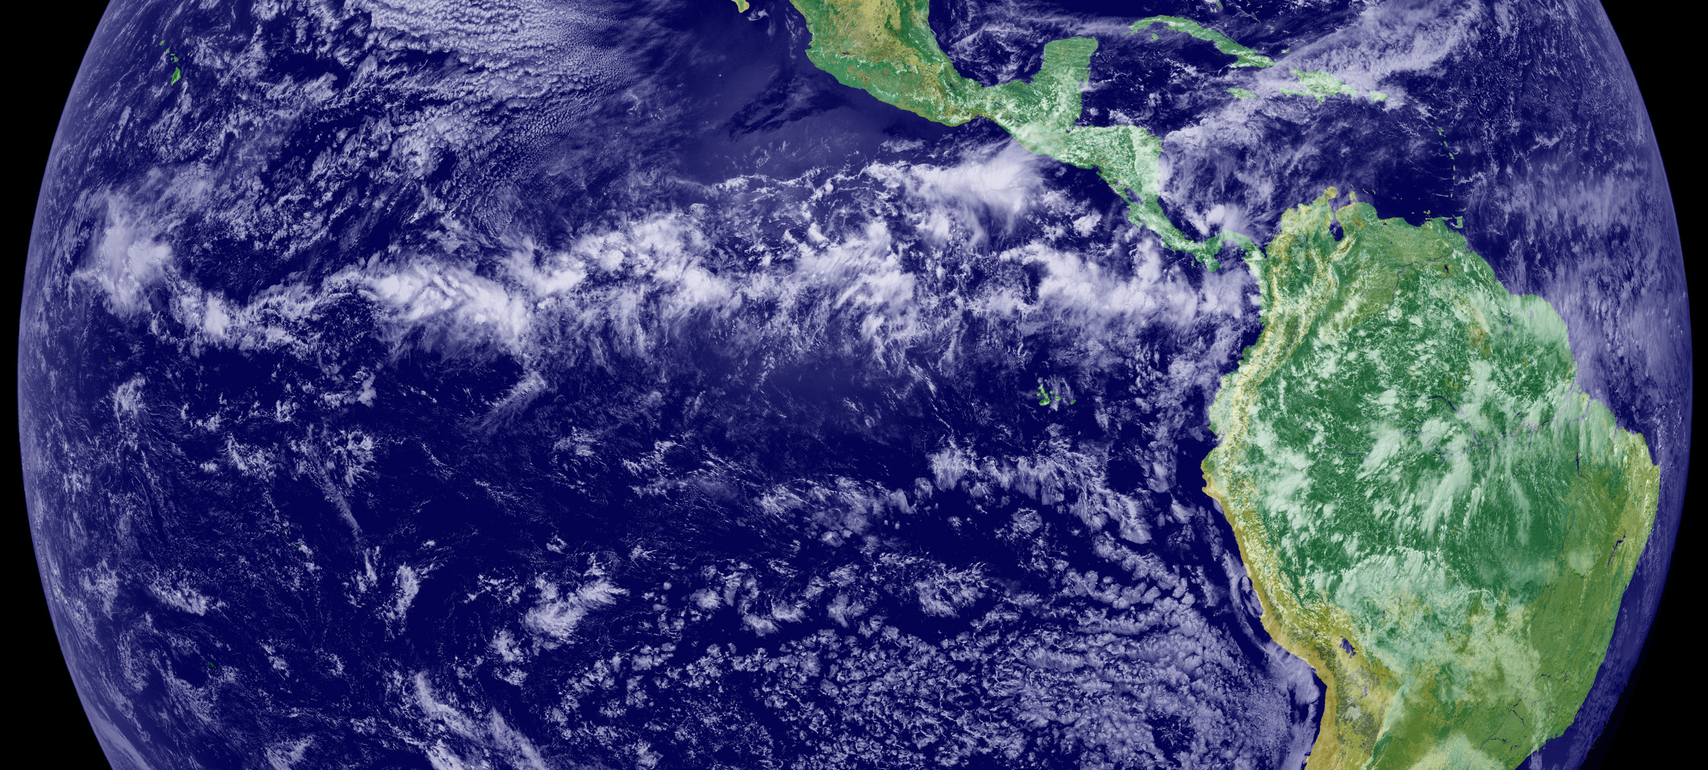

Slide 12
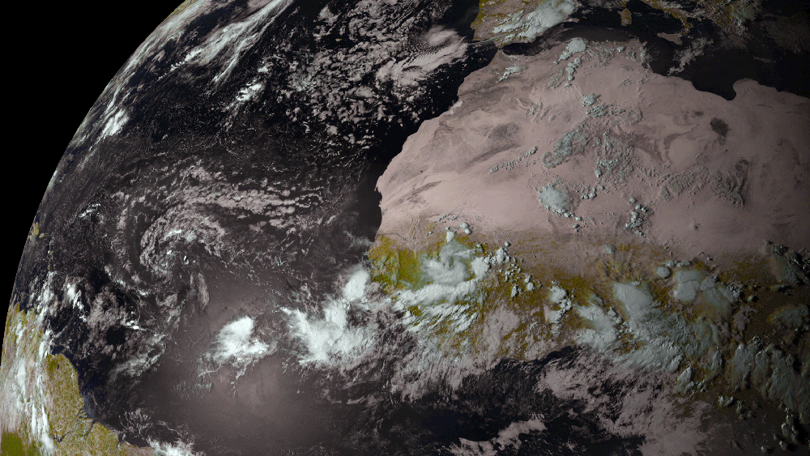

Slide 13
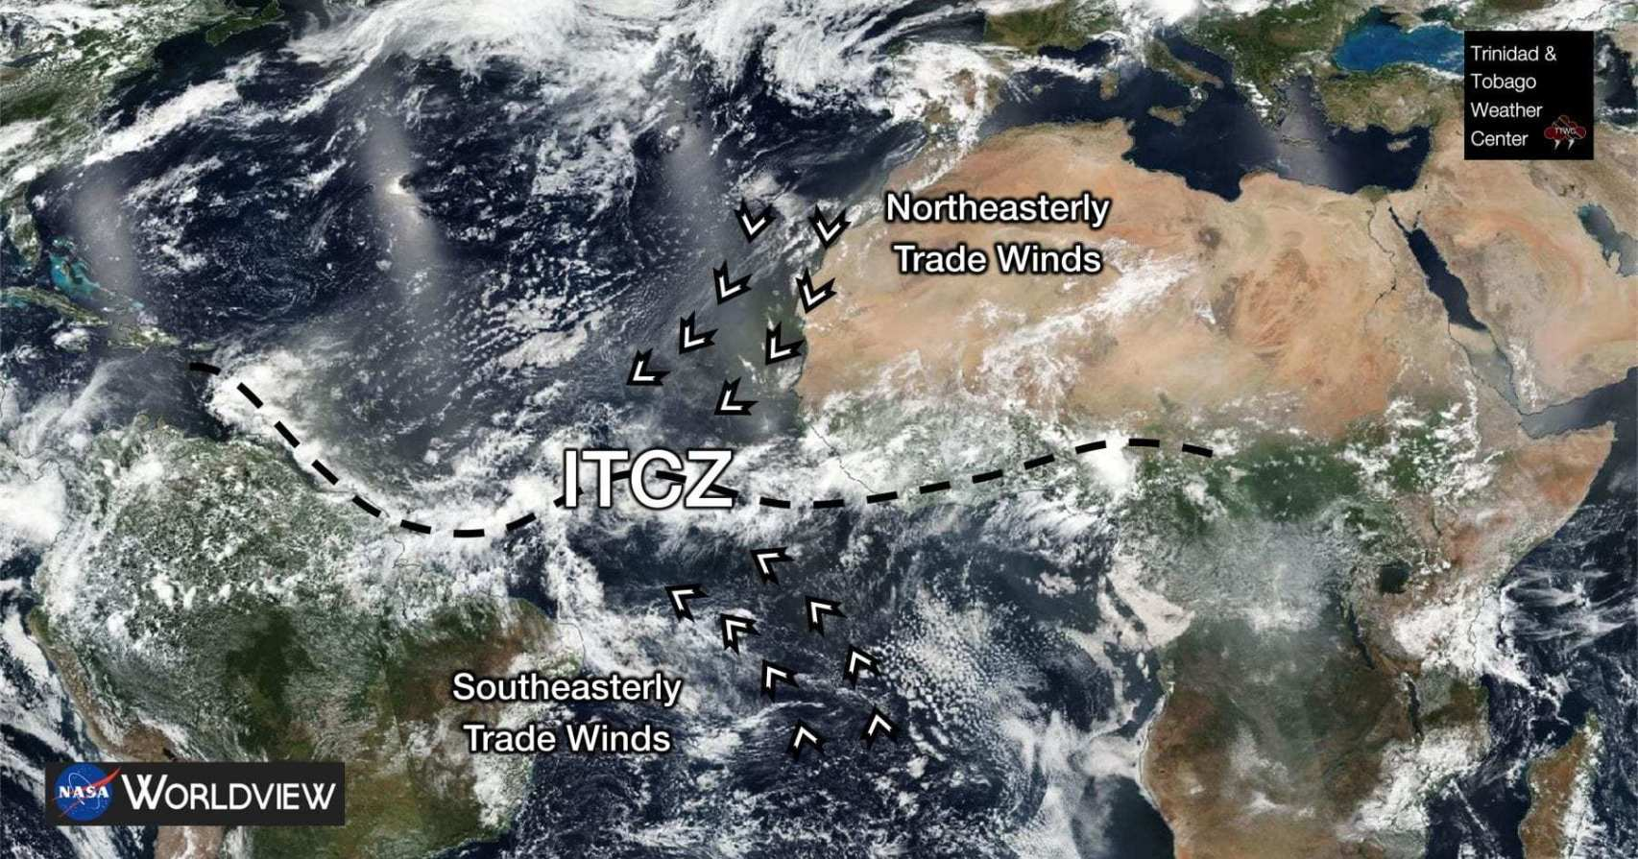

Slide 14
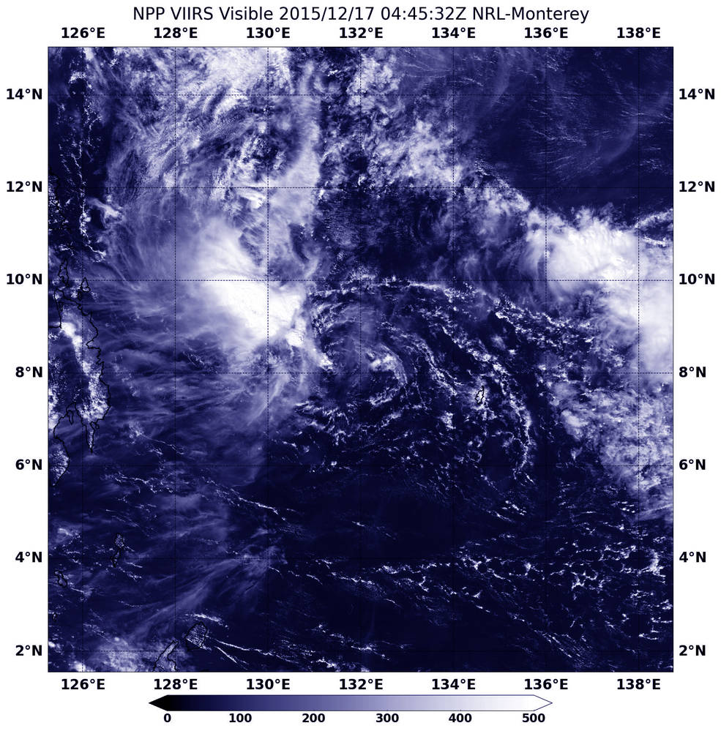
ITCZ made up of cloud clusters

Slide 15
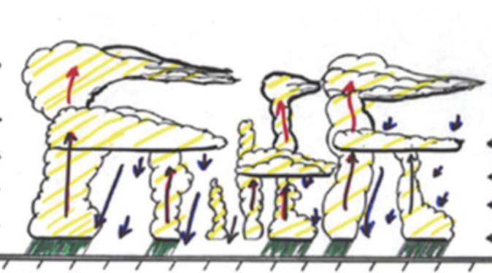
Cloud Cluster: Convective Cores with Anvils Between Them

Slide 16
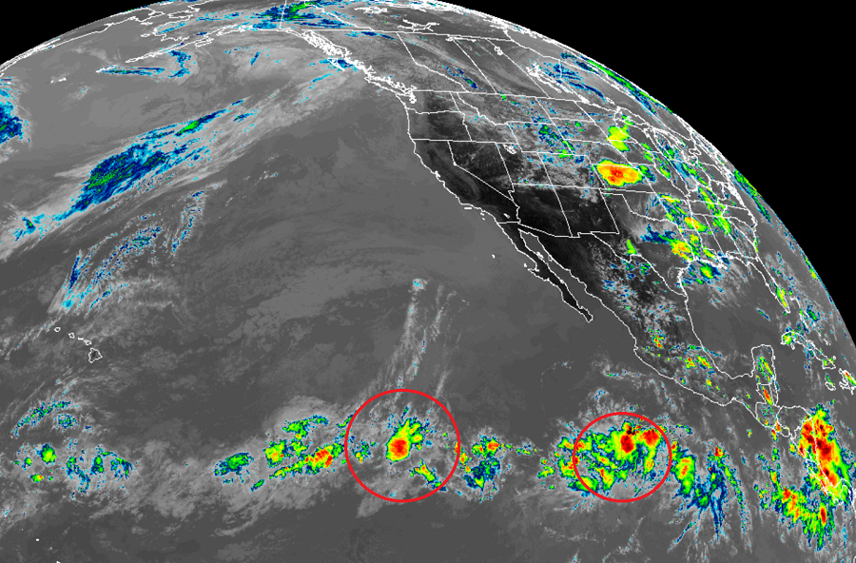

Slide 17
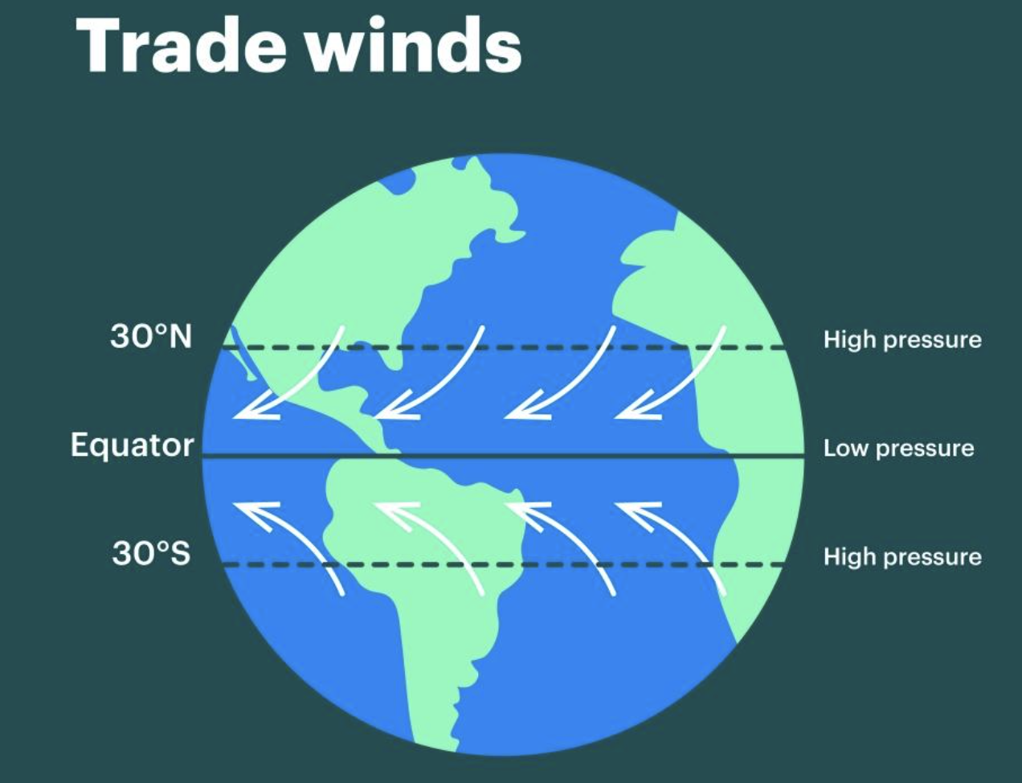
Lower branch of the Hadley Circulations
NE and SE trades with 30 degrees of the equator
NE Trades
SE Trades

Slide 18
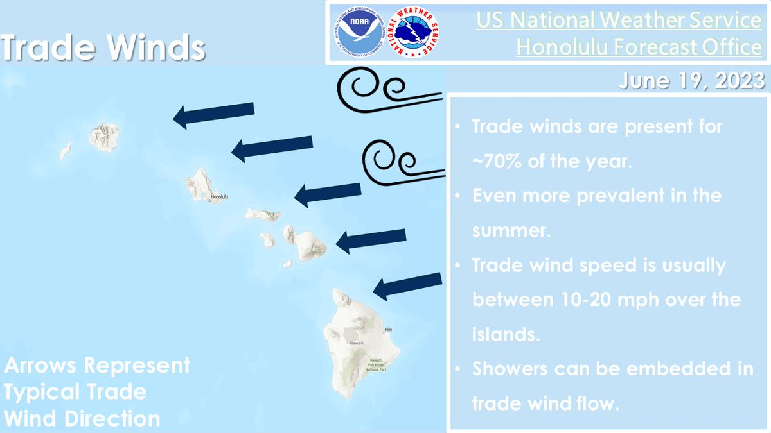
Trades are highly reliable and steady with infrequent interruptions
Very important for locations such as Hawaii

Slide 19
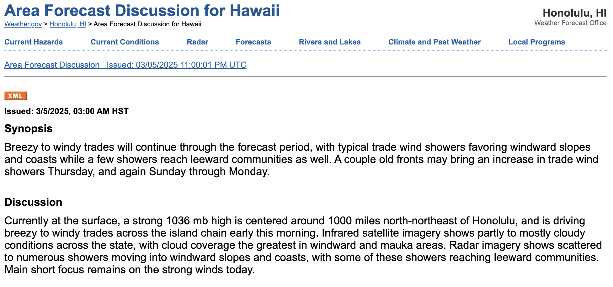

Slide 20
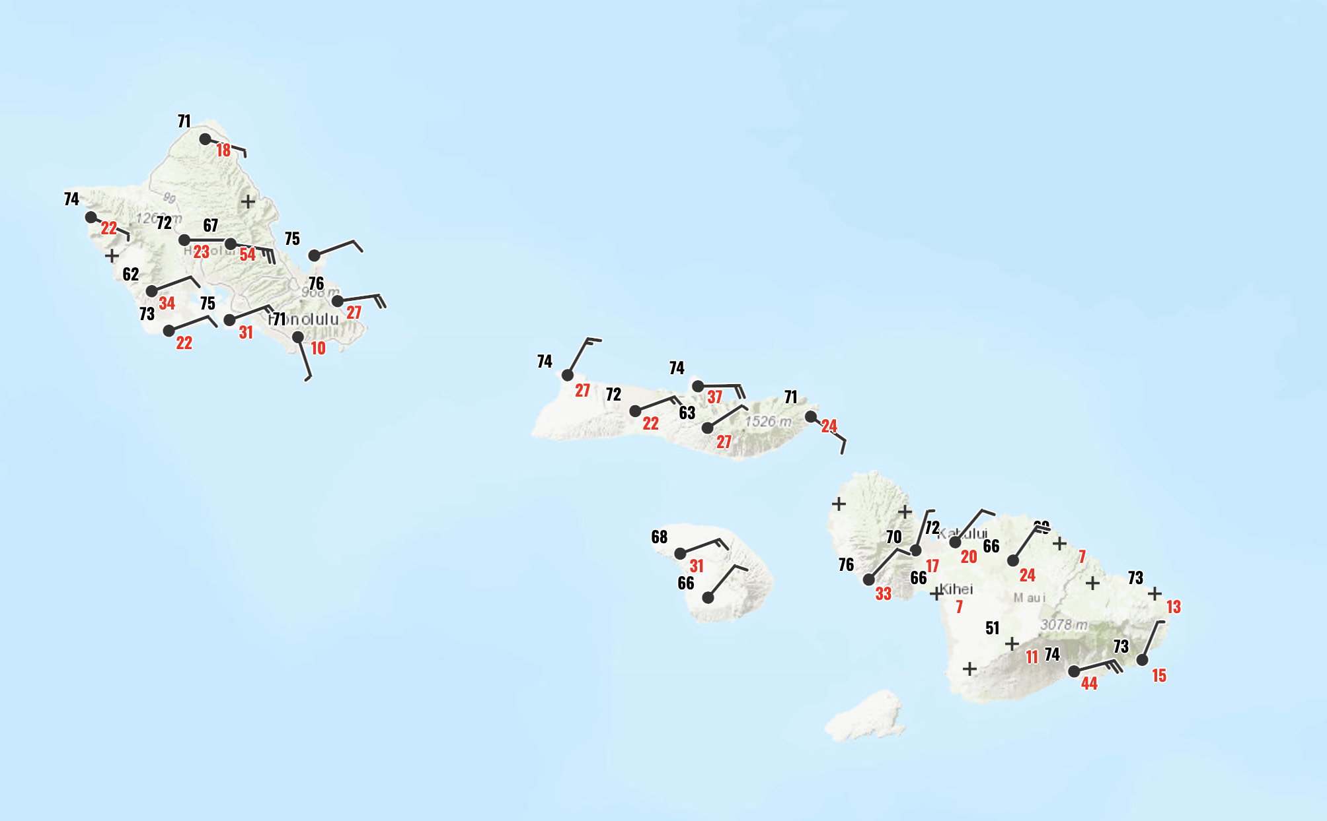
March 5, 2025 9 AM

Slide 21
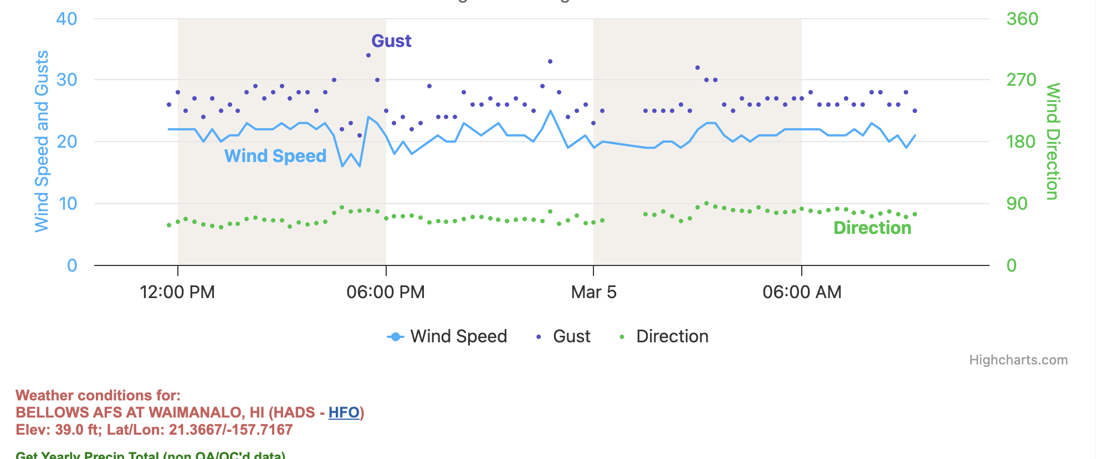
Trades are very steady

Slide 22
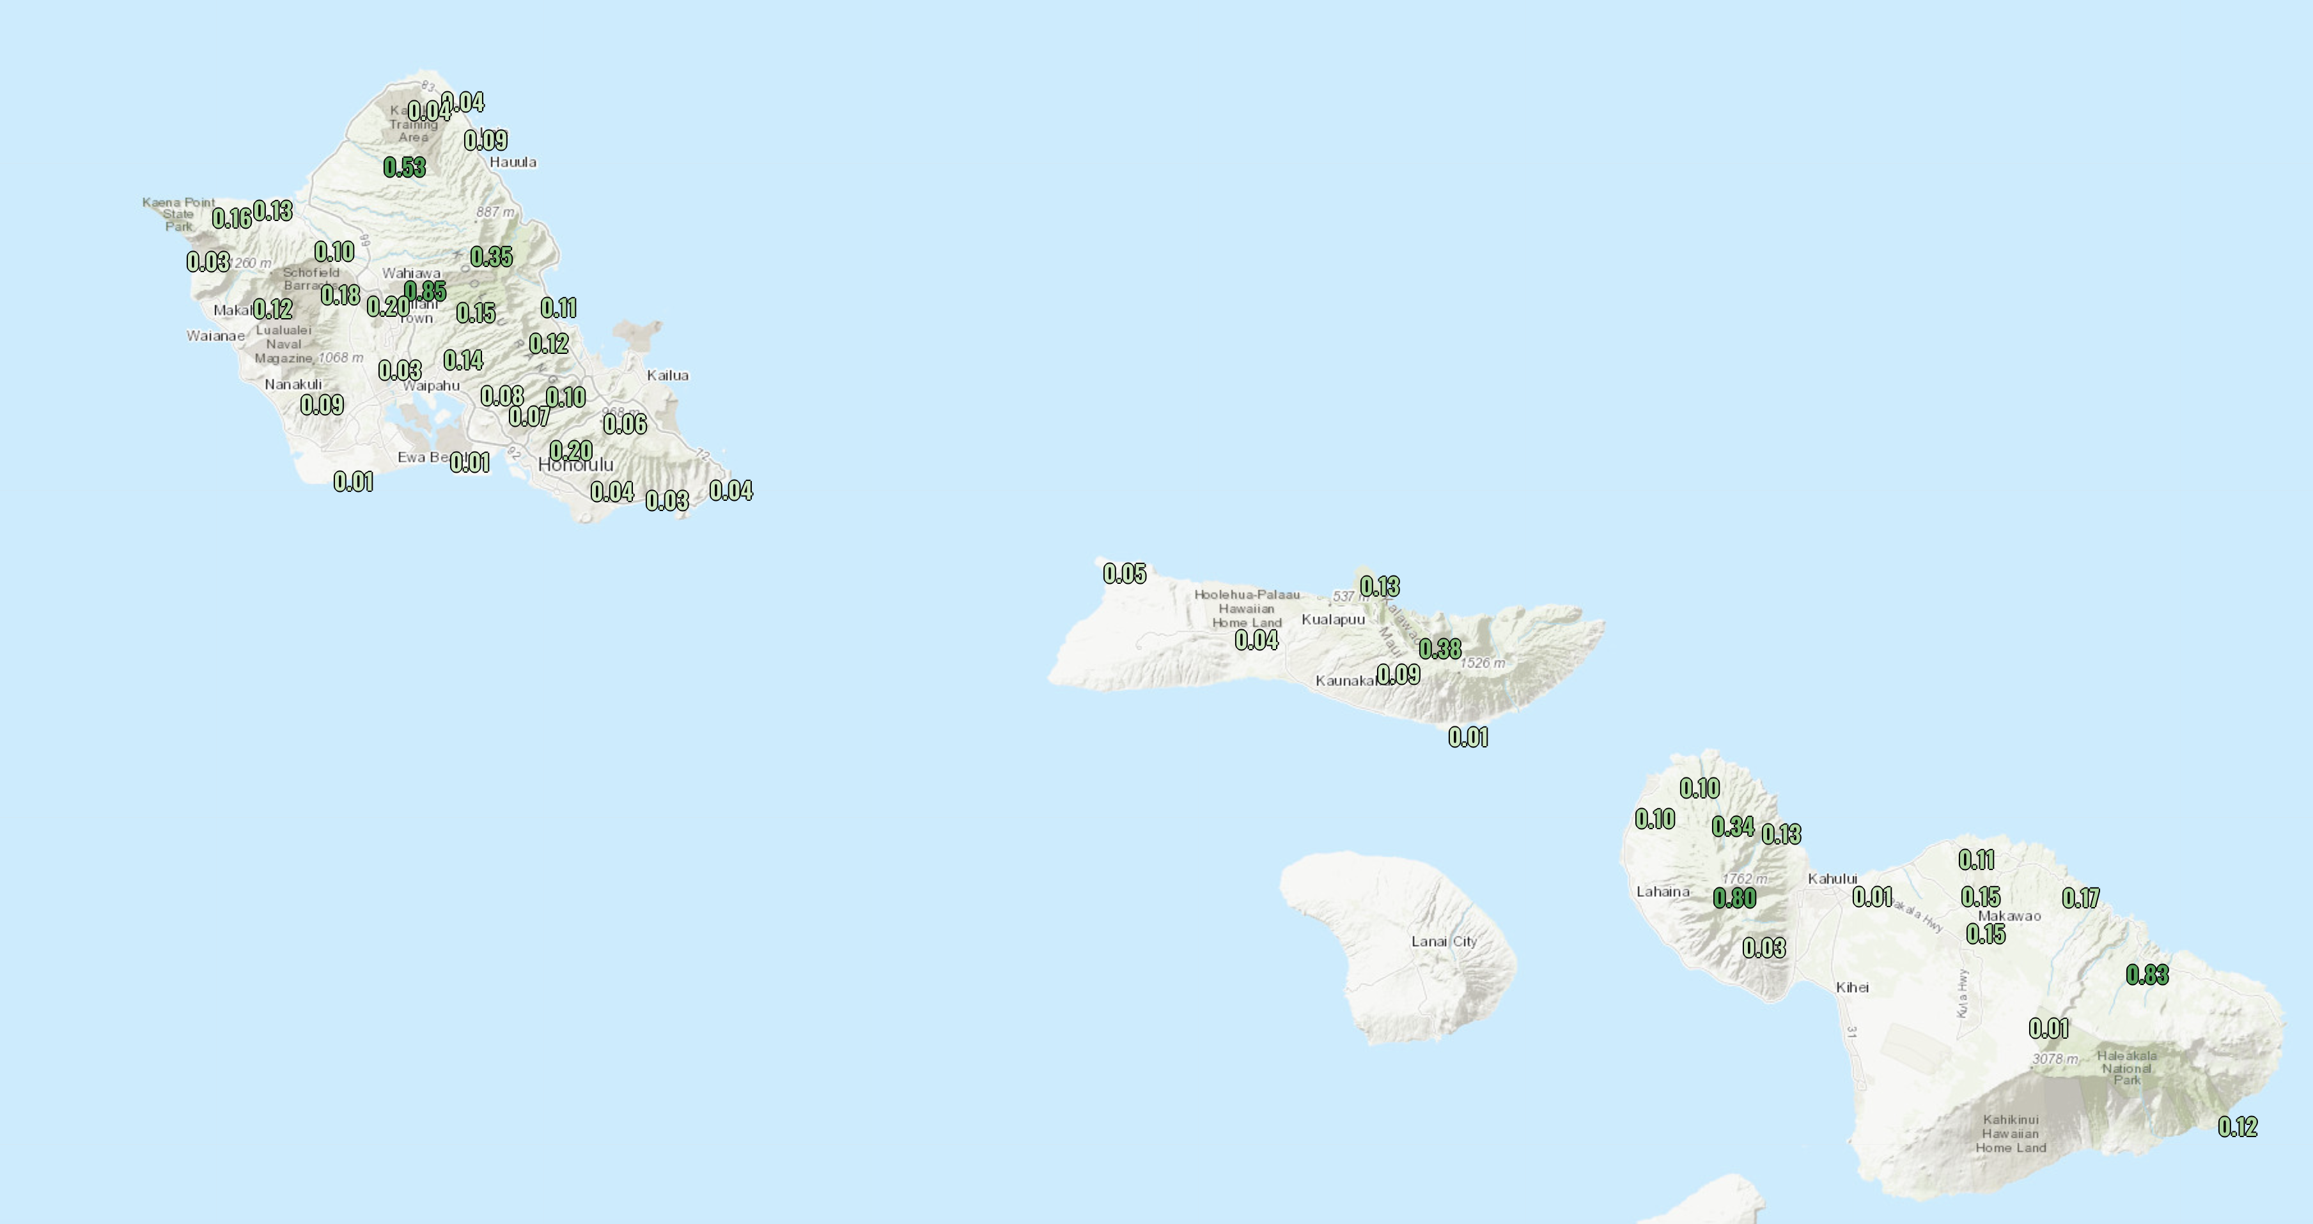
Trades result in precipitation on windward side

Slide 23
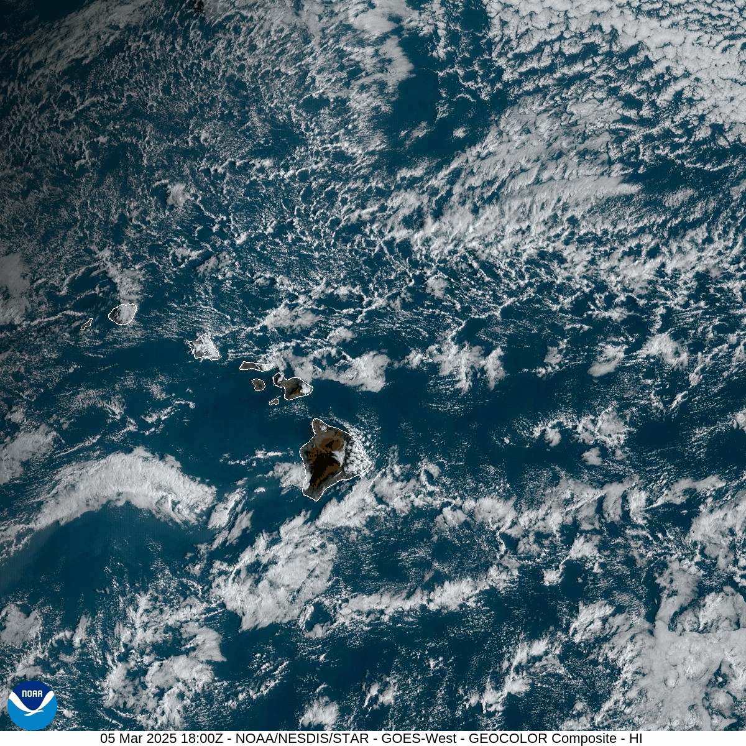

Slide 24
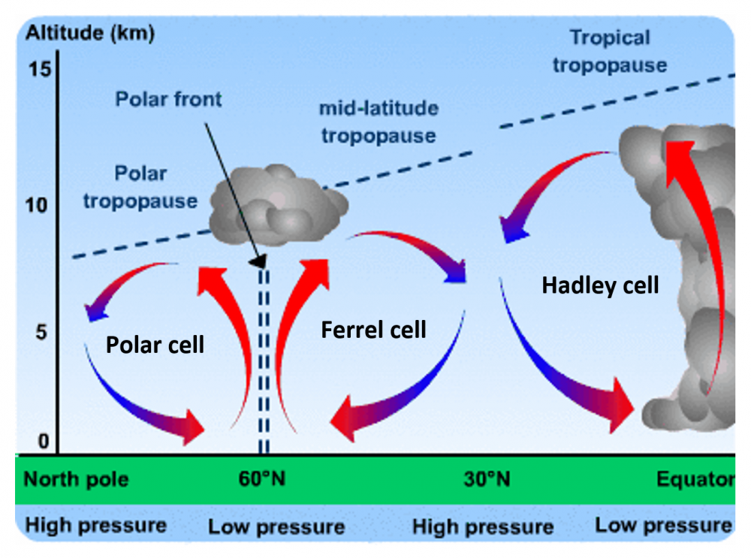
Sinking motion in the subtropics creates deserts in those latitudes (25-35 degrees from equator)

Slide 25
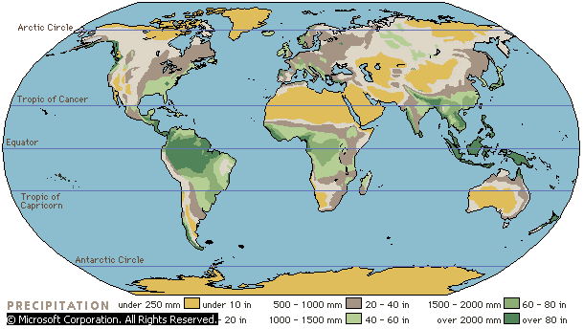
Major Deserts in the Subtropics

Slide 26
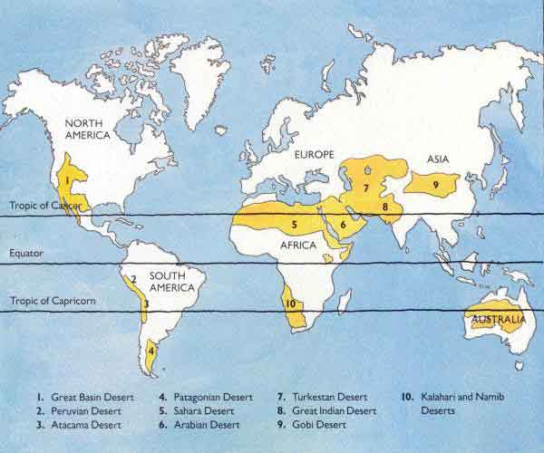
World’s Major Deserts

Slide 27
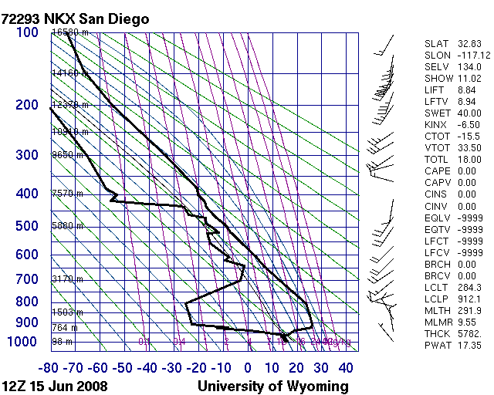
Trade Wind Inversions a.k.a. subtropical inversions
Produced by the sinking sinking air in the subtropics
Cool water near surface also helps
A persistent feature of subtropical soundings

Slide 28
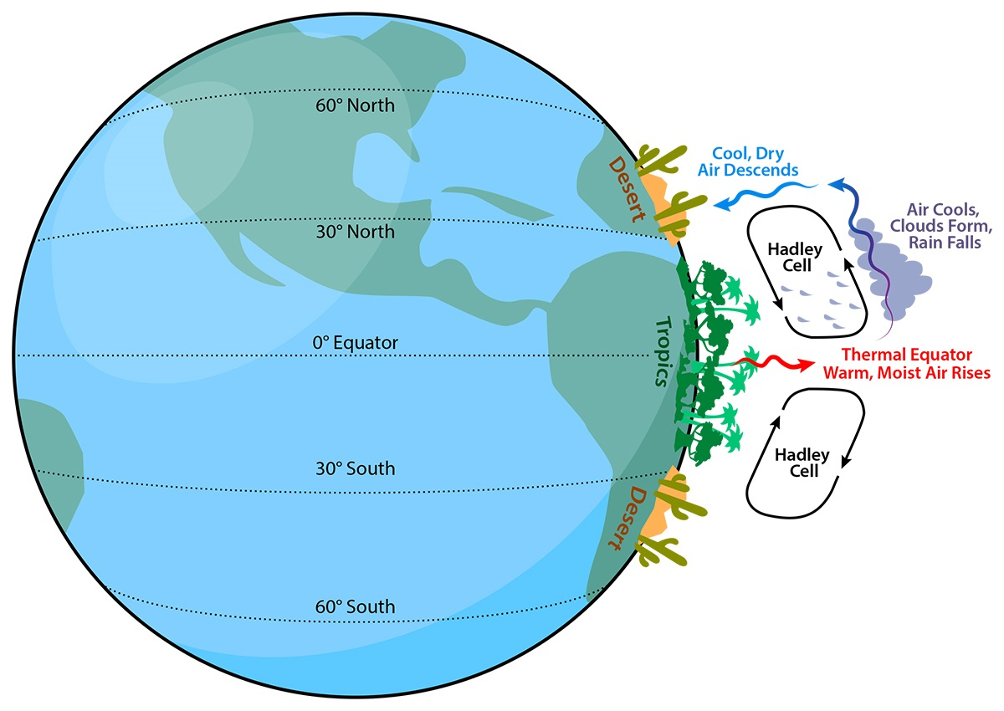
Why trade wind inversions? Subsidence from Hadley circulation and subtropical highs

Slide 29
SUBTROPICAL HIGH
Strong subsidence and adiabatic warming
Weaker subsidence, less warming
Cool water can hel

Slide 30
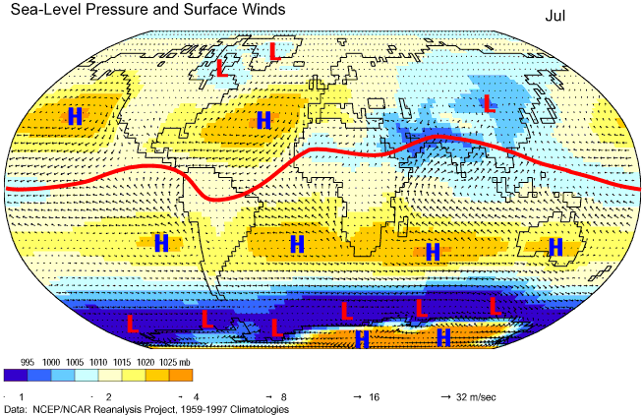
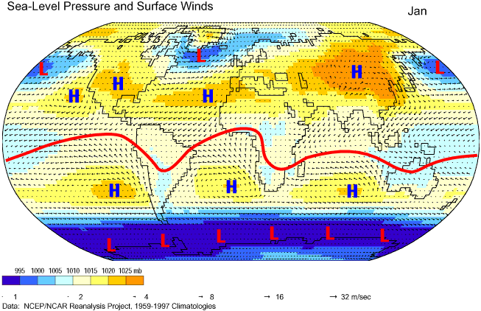
Strongest sinking on the eastern side of subtropical highs

Slide 31
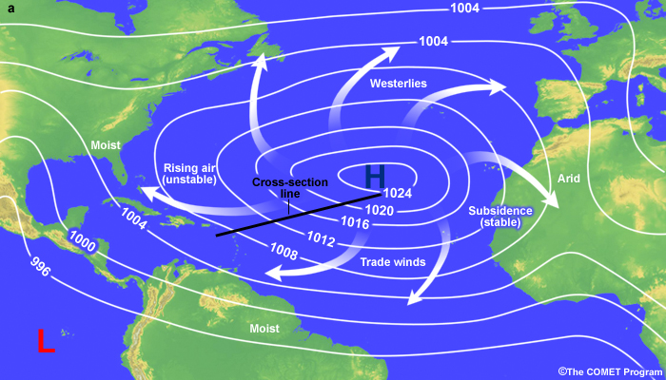
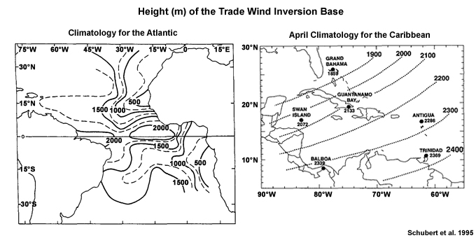
Subsidence is not zonally uniform: greater on the eastern side of the oceanic subtropical highs
Weaker
Stronger

Slide 32
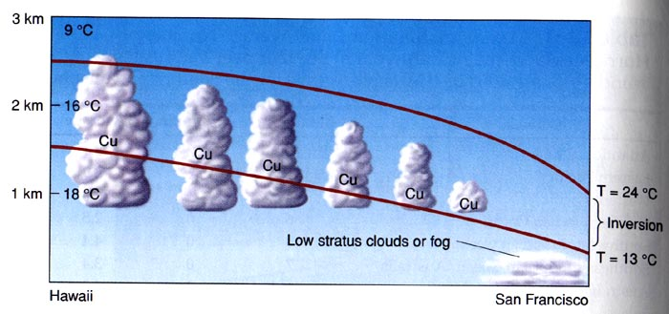
Strongest sinking and inversion (and lowest) over eastern subtropical oceans

Slide 33
Low and strong at SanDiego

Slide 34
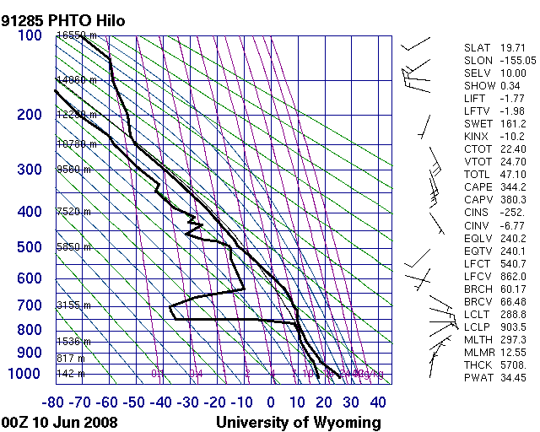
Higher and weaker over Hawaii
Hilo
Hawaii

Slide 35
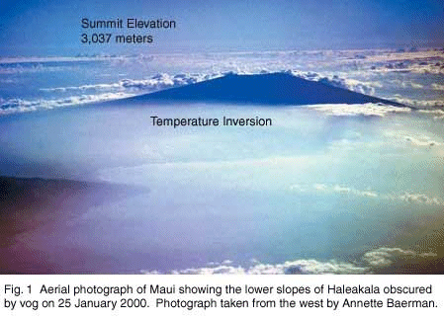

Hawaiian
View of Inversion from Above
Maui

Slide 36
Trade Wind or Subtropical Inversion
The height of the base of the inversion varies from about 500 m on the eastern side of the subtropical highs to about 2000 m to the west.
The inversion is generally strongest where the height of its base is lowest, and vice versa. The thickness of the inversion layer varies from tens of m to more than 1000 m.

Slide 37
Height of Top of Trade Wind Inversion Base

Slide 38
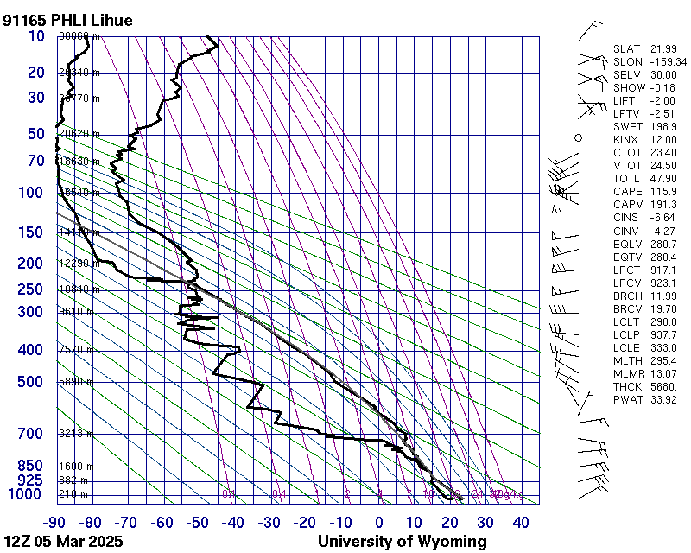
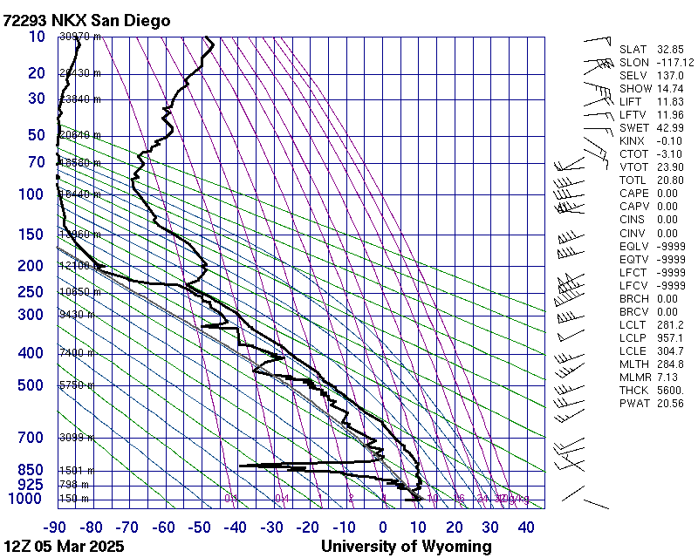

Slide 41
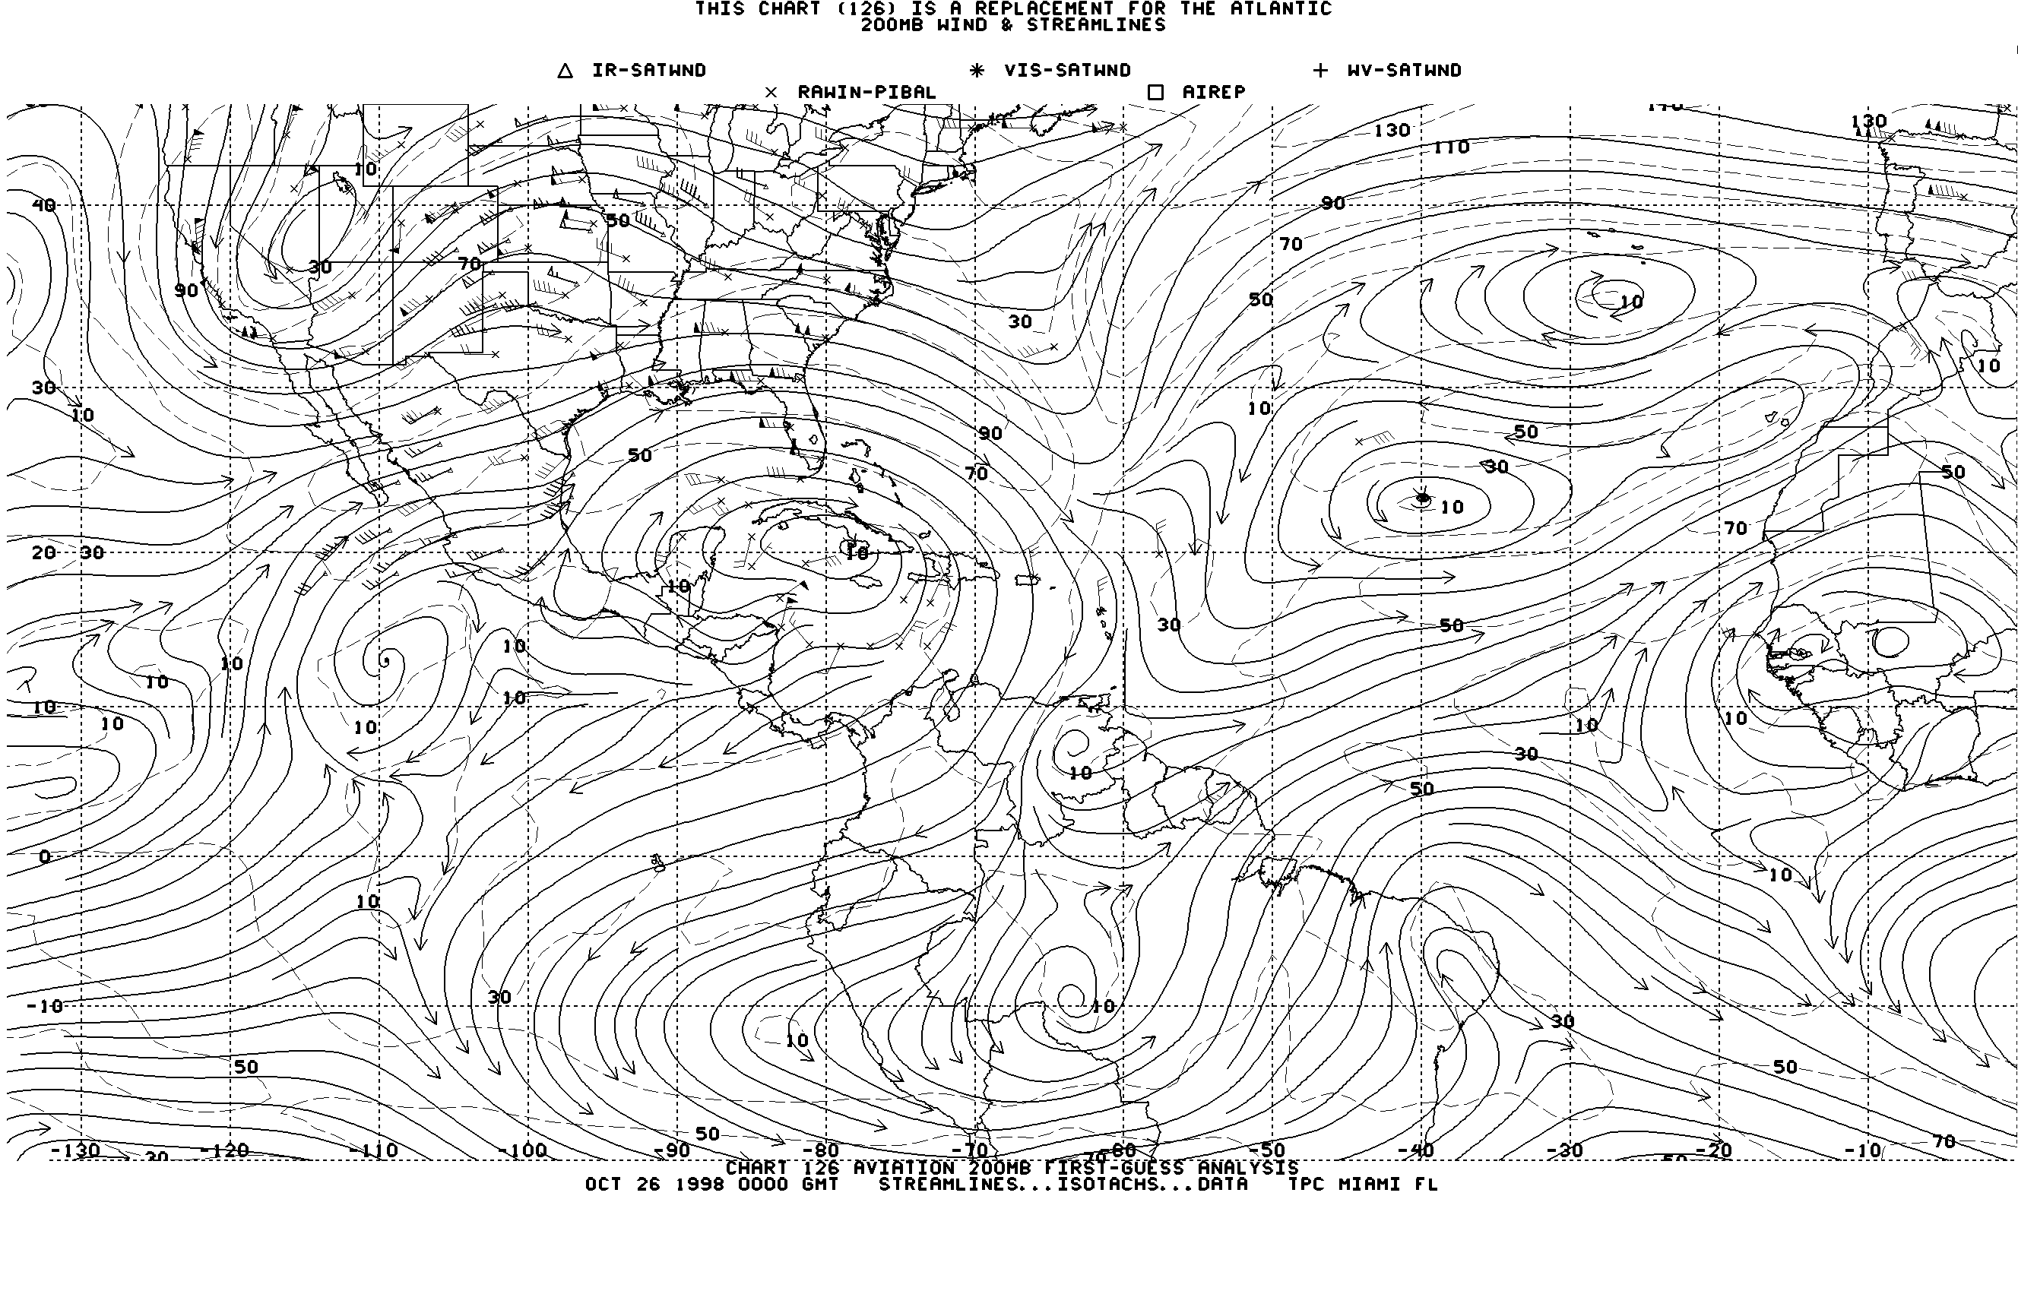
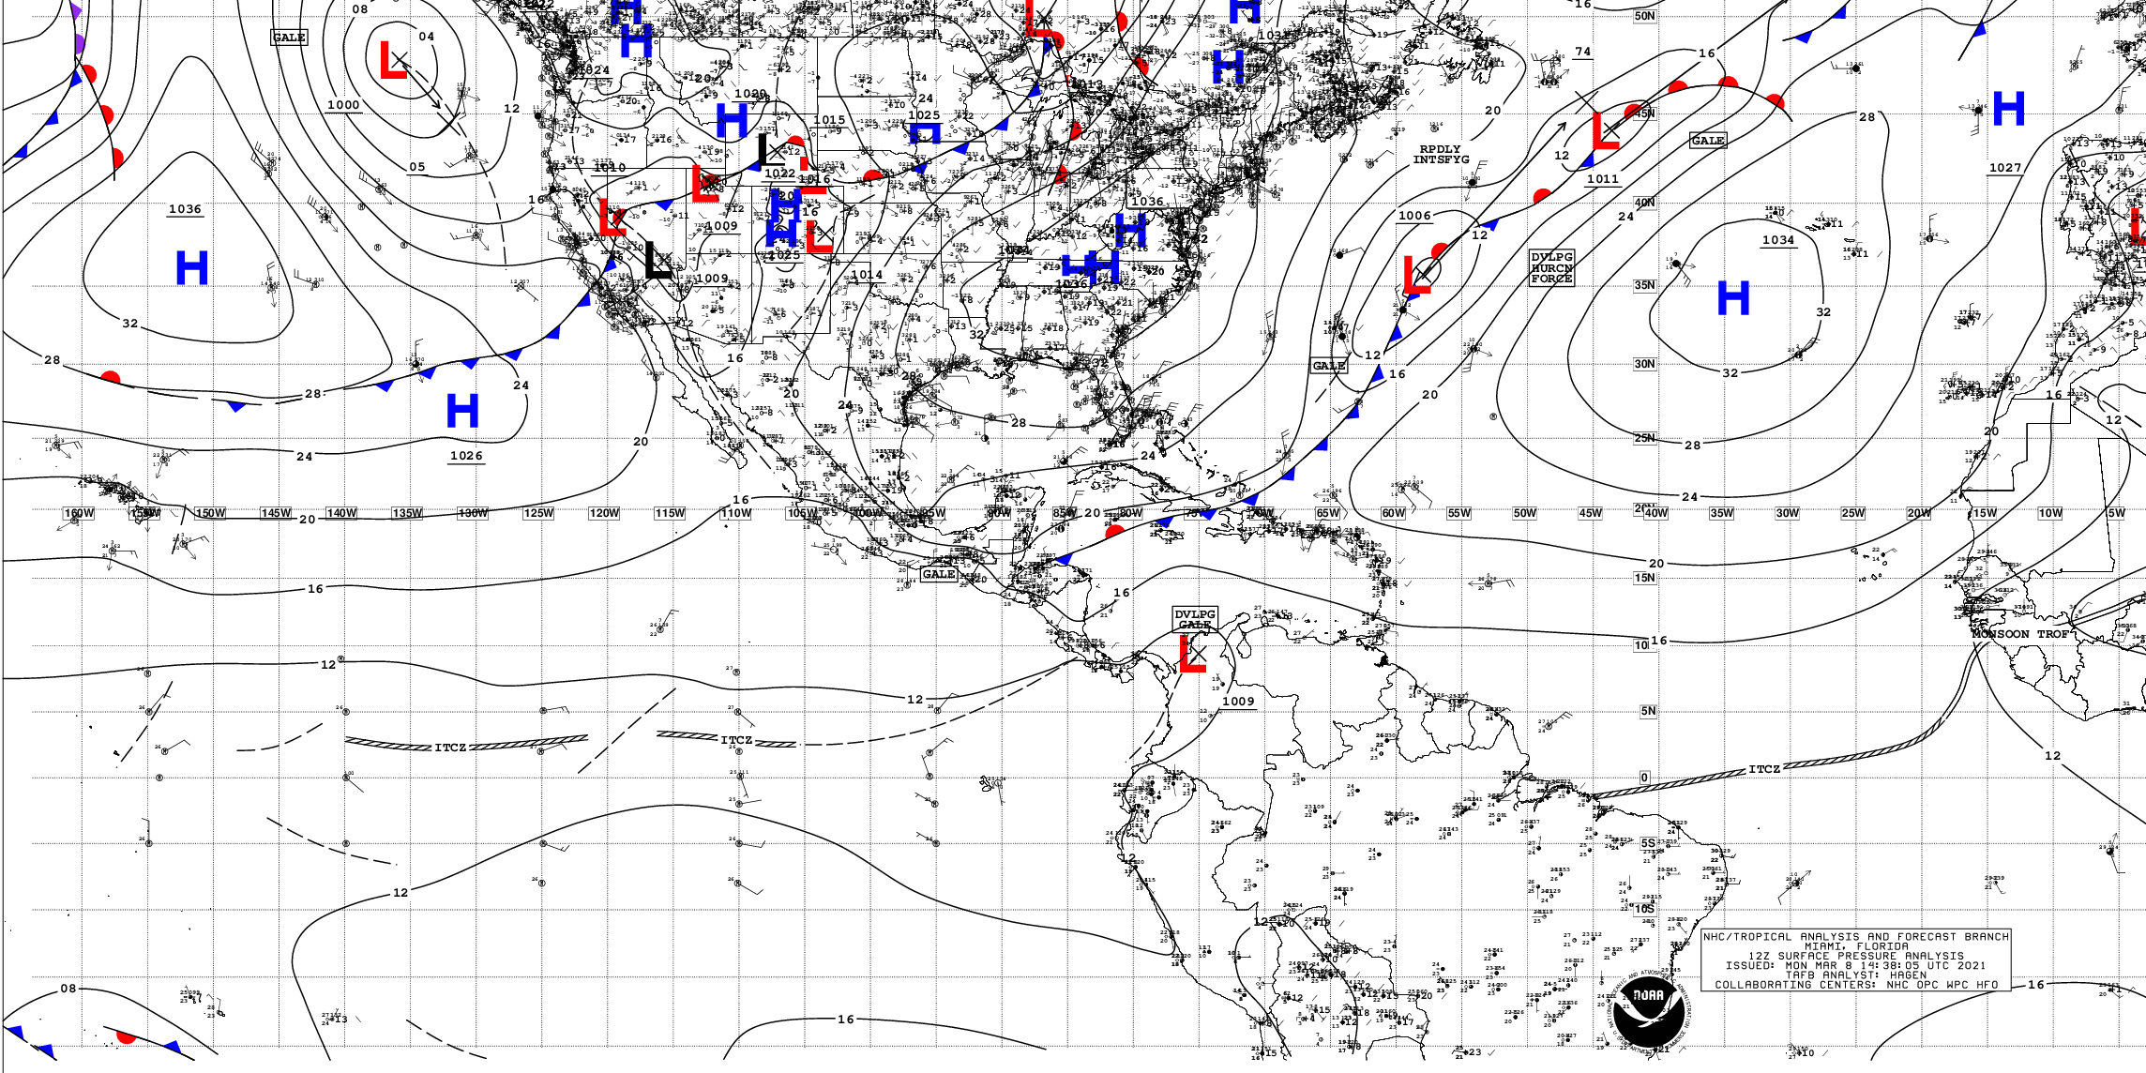
Tropical Analyses
Both midlatitude-style, isobaric analysis, and streamline/isotach analyses.
Why the latter very popular in the tropics?

Slide 42
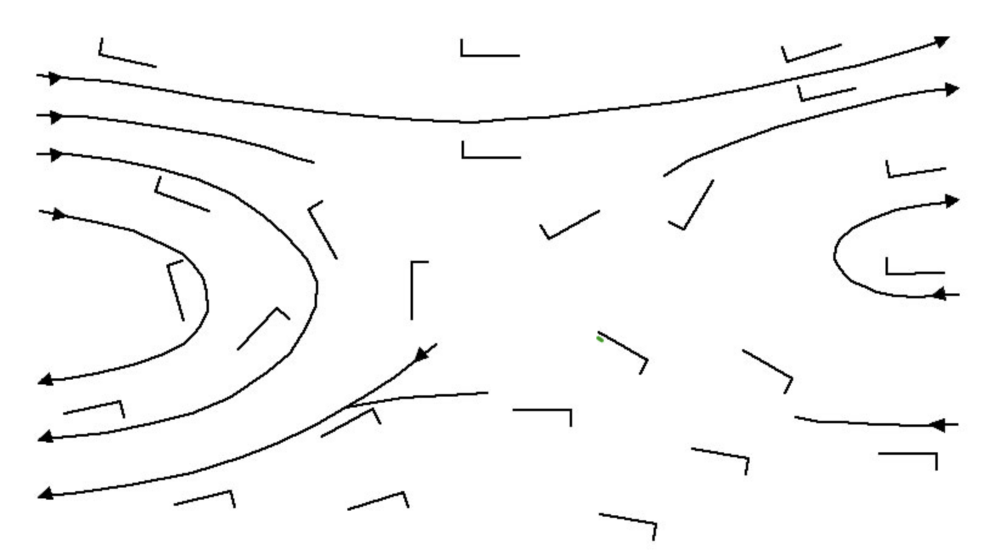
Review
A streamline is a line everywhere parallel to the instantaneous flow.
An isotach is a line of constant wind speed.

Slide 43
Streamline-Isotach Analysis

Slide 44
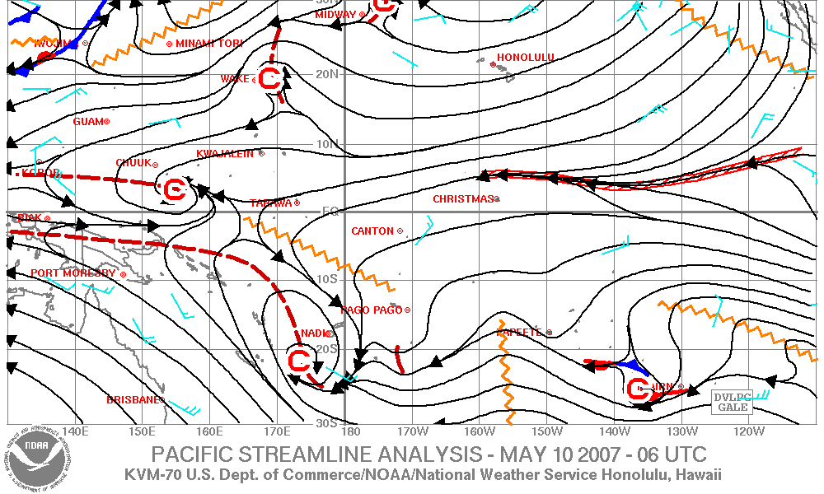
Streamline Isotach Analysis

Slide 45
Why are streamline/isotach analysis popular in the tropics?

Slide 46
Why are streamline/isotachs better than isobars/heights in the tropics?
The flow is not geostrophic within roughly 5 degrees of the equator (so connection between pressure and winds is not straightforward)
Lot of pibals (just winds) in the tropics compared to radiosondes (wind but no heights).
Pressure variations normally weak in the equator (large noise to signal)

Slide 47
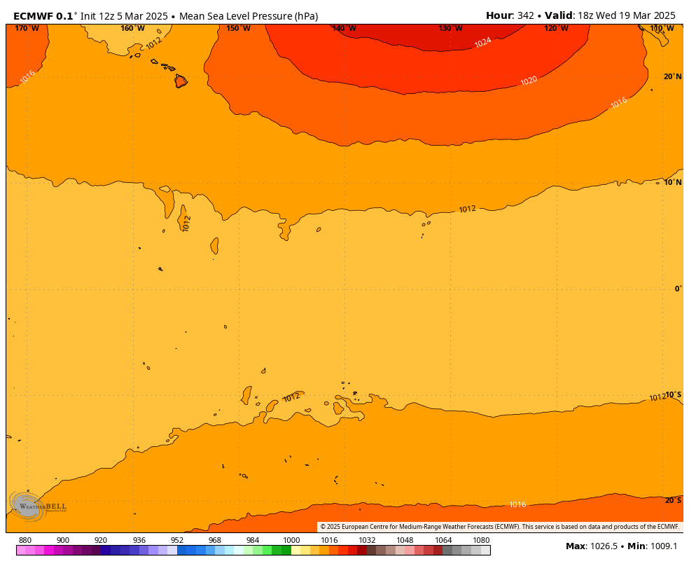

Slide 48
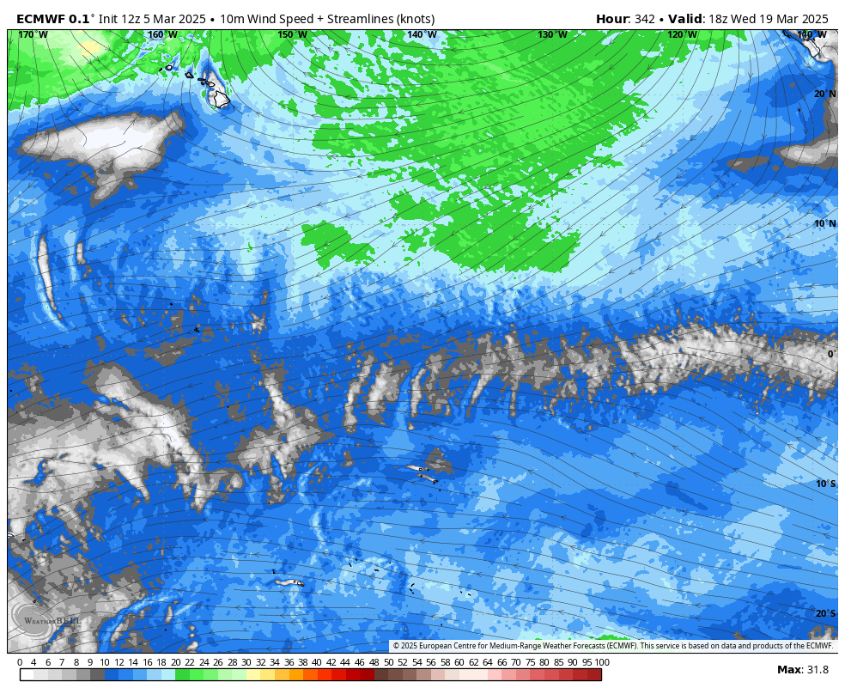

Slide 49
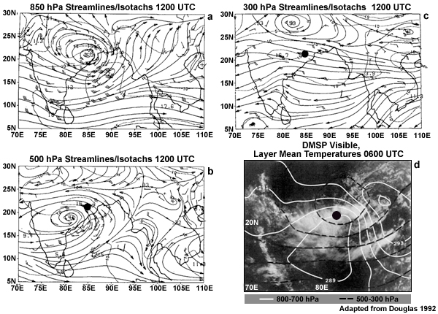
Thus, why not analyze winds instead of pressure?

Slide 50
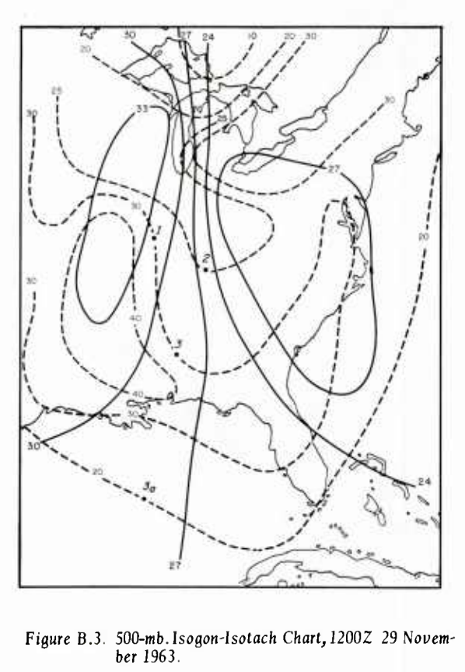
Streamline/isotach analysis is generally used but there are alternatives (isogon, isotach)
Not intuitive

Slide 51
Streamline/Isotach Analysis 101
Remember the component wind circulations we studied earlier and how they combine:
  Translation
  Divergence/convergence
  Rotation
  Deformation

Slide 52
Translation: movement in one direction

Slide 53
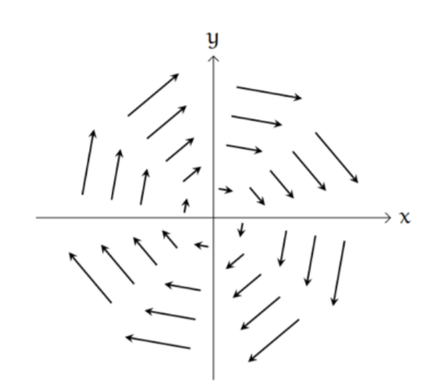
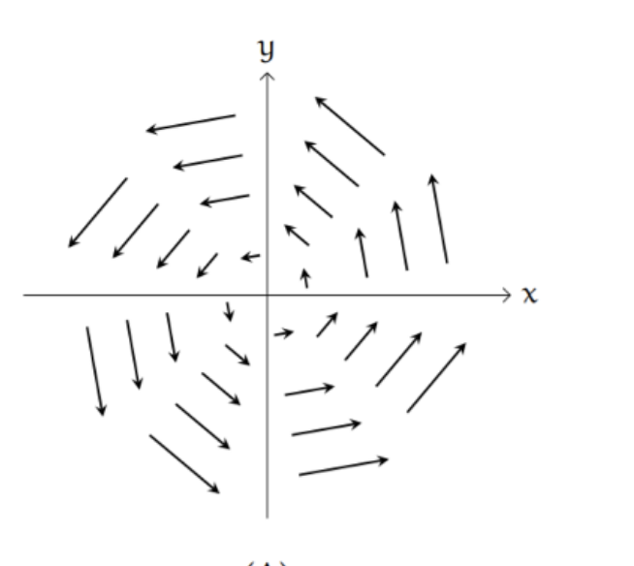
Rotation (cyclonic or anticyclonic)
clockwise
counterclockwise
Anticyclonic (NH)
Cyclonic (NH)
Northern Hemisphere

Slide 54

Divergence (or convergence)
Divergence
Convergence

Slide 55
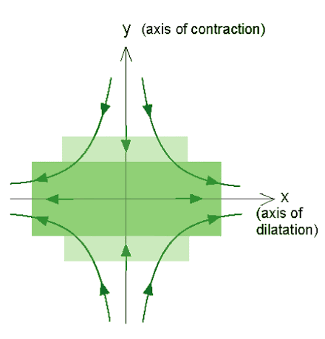
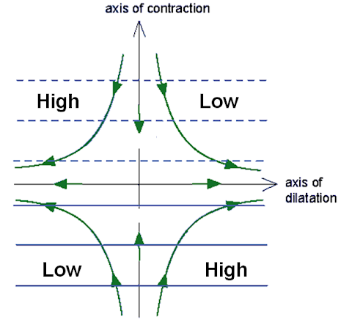
Deformation

Slide 56
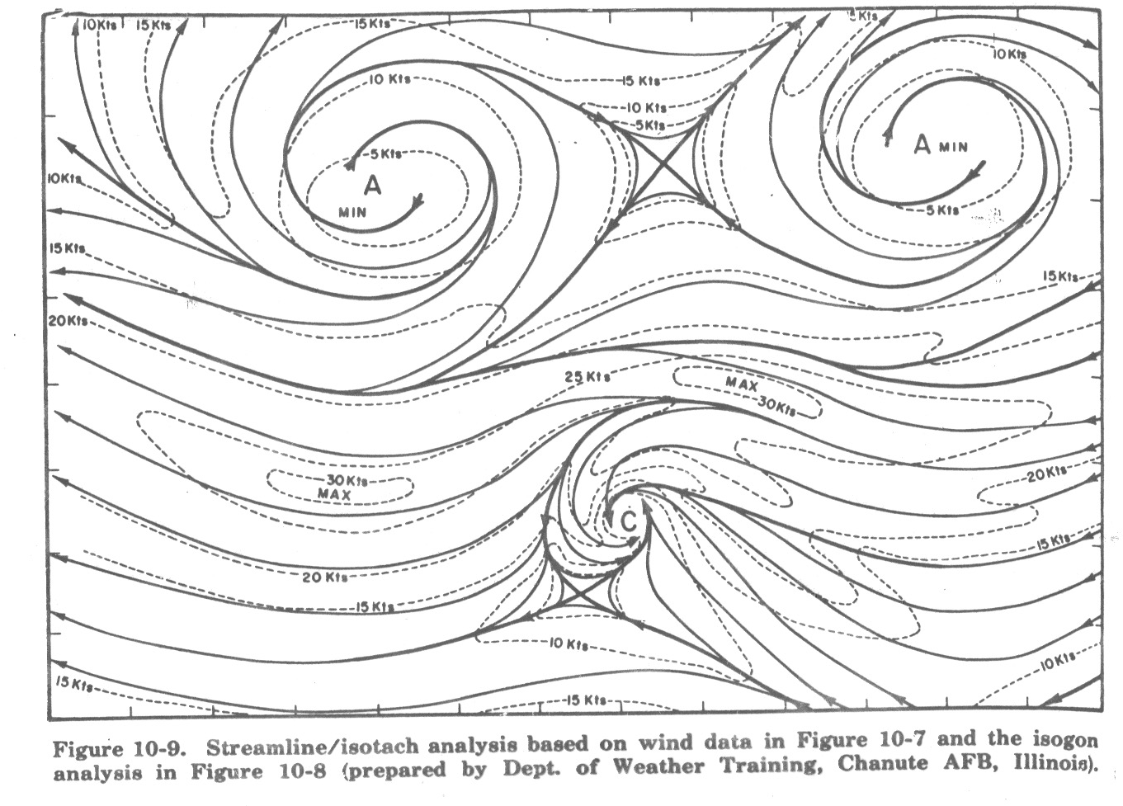
Can you find deformation, convergence, rotation, translation?

Slide 57
Streamline/isotach analysis
Winds should go to zero at singular points:
  Centers of rotation
  Centers of convergence/divergence
  Centers of deformation

Slide 58
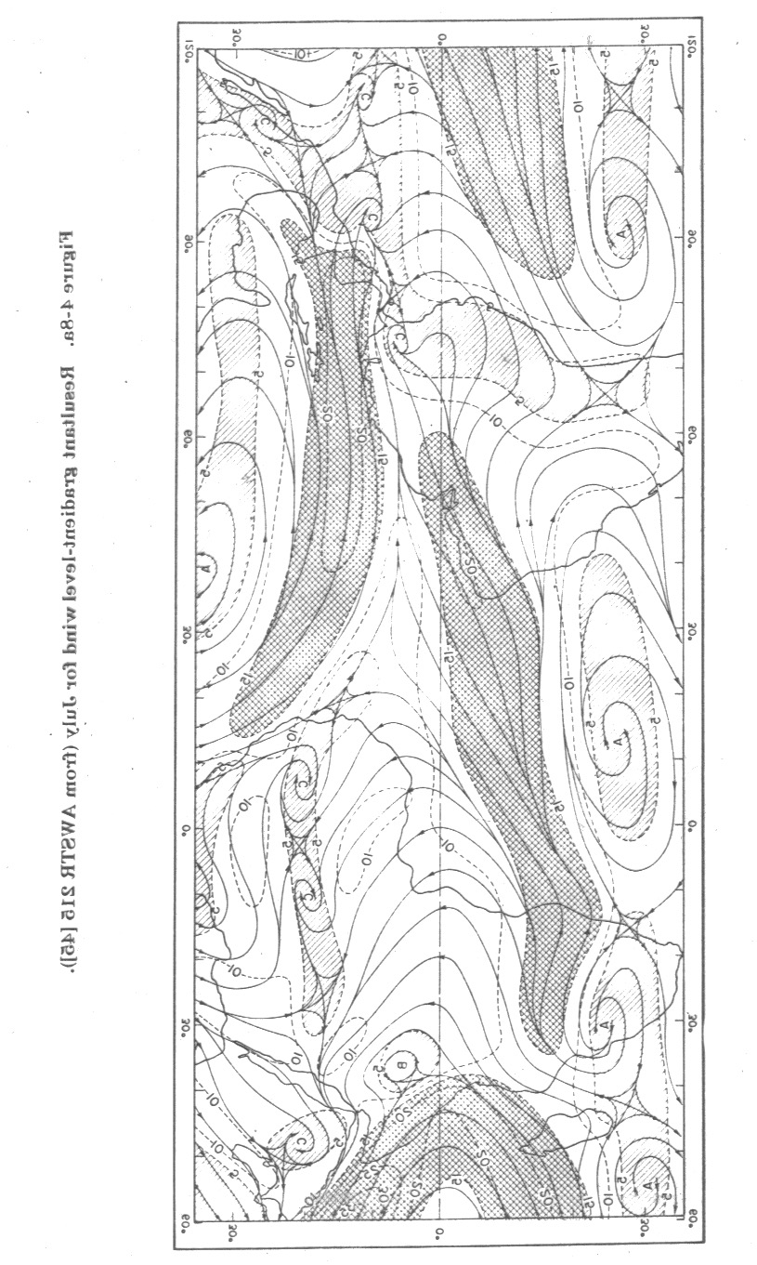

Slide 59
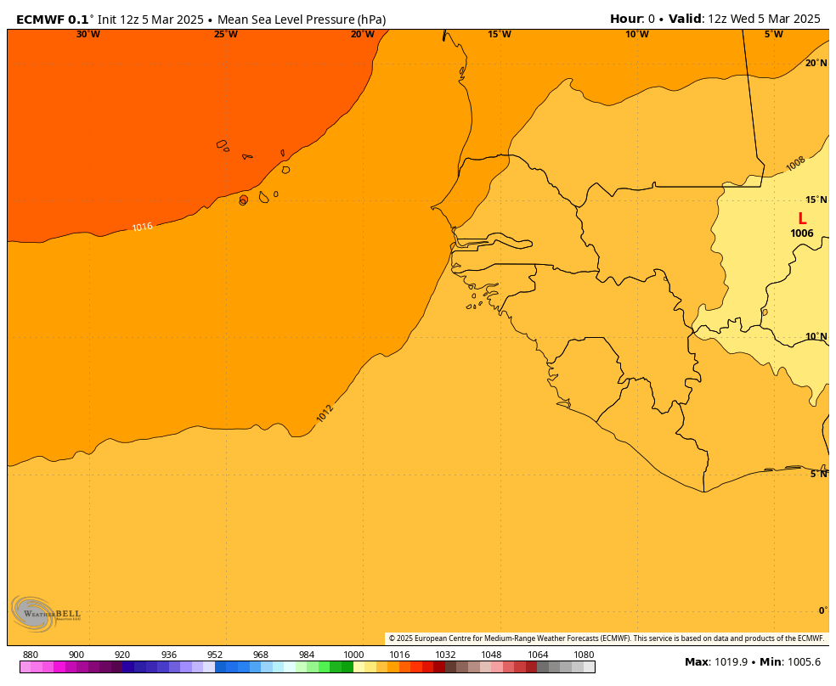

Slide 60
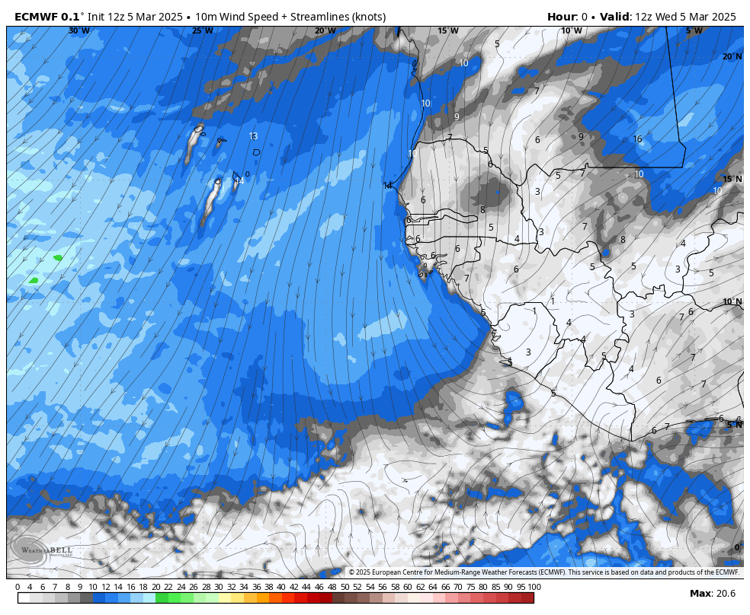

Slide 61


Slide 62


Slide 63
Easterly Waves:
The Major Synoptic Disturbances in the Tropics
Westward-moving synoptic waves in the tropics
Lower-tropospheric waves that modulate clouds/rainfall and move westward at ~5-10 m/s and have wavelengths of 2000-4000 km.

Slide 64

Troughs or ridges?

Slide 65

Trough or Ridge?
Red lines are streamlines

Slide 66
A trough!! Cyclone rotation in the northern hemisphere

Slide 68

These waves modulate clouds and precipitation

Slide 69


Slide 70

Clouds and Precip on Eastern Side

Slide 71

West
East
Vertical Structure of an Easterly Wave

Slide 72
Many easterly waves originate over Africa and are known as African Easterly Waves

Slide 73

African Wave Structures (Reed et al., 1977)

Slide 74
African Easterly Waves Are Closely Associated with and Propagate within a Midtropospheric Easterly Jet Originating Over Africa
Maximum jet and wave amplitude centered around 650-700 hPa near 15N
Associated with large temperature difference between the hot Sahara and cool Gulf of Guinea

Slide 75
The Mean State over West Africa: The African Easterly Jet (AEJ)
Burpee, R.W. 1972 The origin and structure of easterly waves in the lower troposphere of North Africa, J. Atmos. Sci. 29, 77-90
Why is the AEJ there?

Slide 76

Remember??
HOT
Cool

Slide 77

Surface temps and thermal wind equation!
HOT
COOLER
Large temperature gradient between 10º-20ºN

Slide 78


Slide 79

Zonal (easterly) wind accelerates over Africa!
Mean 700hPa U wind, 16th July – 15th August 2000

Slide 80
Origin of African Easterly Waves
An instability on the African easterly jet deriving energy from large vertical and horizontal wind shears.
Barotropic instability from large horizontal wind shear
Baroclinic instability from large vertical wind shear
Release of latent heat in convection helps initiate and support these waves.

Slide 81


Slide 82
Monsoons
Monsoon is a term from the Arabic "Mausin," or "the season of winds."
Referred to the seasonally shifting winds in the Indian Ocean and surrounding regions, including the Arabian Sea.

Slide 83

Essentially a large-scale sea breeze

Slide 84

Monsoon Circulations Exist Around the World
Occur in tropics and subtropics
Some well-known monsoons:
  India/China/SE Asia
  West Africa
  Southwest U.S.

Slide 85


Asian/Indian Monsoon
Summer
Winter

Slide 86


Indian Monsoon

Slide 87

West African Monsoon
Summer
Winter

Slide 88


Slide 89

Southwest or North American Monsoon

Slide 90

NA Monsoon: Synoptic Evolution

Slide 91


Slide 92

Synoptics of the North American Monsoon

Slide 93


Slide 94

Because of the Monsoon, U.S. Southwest is Wettest During July and August

Slide 95


Slide 96

Monsoon Video https://www.youtube.com/watch?v=TC75USRhdho

Slide 97
https://www.youtube.com/watch?v=TC75USRhdho

Slide 98

Upper-Level Features over the Tropics

Slide 99

200 hPa Easterly Jet
Most prominent in July
Extends from SE Asia to eastern Africa
Results from the temperature gradient between the Himalayas and the Indian Ocean at higher levels
Asia
Africa

Slide 100


Slide 101

Strongest in Summer

Slide 102

Explanation: Thermal Wind
Elevated Himalayas warm aloft (particularly during summer (sensible and latent heat)
Cooler over Indian Ocean
With warming to north, easterly flow gets stronger with height

Slide 103
Explanation: Thermal Wind

Slide 104
Don’t Forget!

Slide 105

Tropical Upper-Tropospheric Troughs (TUTTs)

Slide 106

A TUTT Over the Pacific

Slide 107

TUTT
Produced by subsidence near and just above tropopause
Can assist tropical cyclone genesis and intensification
About 20% of hurricanes/tropical storms can be traced to TUTTs

Slide 108

Hawaii’s Kona Lows

Slide 109

Kona Low
Strong, persistent subtropical low/cyclone that brings strong winds and moisture to the Hawaiian Islands

Slide 110

Often associated with a cut-off low breaking off from the midlatitude jet stream

Slide 111


Slide 112



Slide 113


Slide 114


Slide 115


Slide 116

Hurricanes and Tropical Storms

Slide 117
Some Tropical Terminology
Easterly Wave:
  A wavelike disturbance in the tropical easterly winds that moves from east to west.
Tropical Disturbance: Often the earliest stage of a tropical cyclone and usually develops from an easterly wave.
  An organized area of thunderstorms that persists for more than 24 hours.
  Low pressure might form at the surface, but winds remain below 30 mph. No closed wind circulation.

Slide 118
Tropical depression (TD): A tropical cyclone with a closed circulation and maximum sustained winds near the surface of less than 34 knots (39 mph.) Tropical depressions are listed only with a number, not a name.
Tropical storm: Tropical cyclone with winds of 35-64 knots (39 to 74 mph). In most of the world, a storm is given a name when it reaches tropical storm intensity.

Slide 119
Hurricane: A tropical cyclone with winds greater than 64 knots (74 mph). Normally this name is applied to such storms in the Atlantic Basin and the Pacific Ocean east of the International Date Line. Called typhoons over the western Pacific.

Slide 120
How do tropical storms differ from mid-latitude storms?

Slide 121
Midlatitude Versus Tropical Storms
Midlatitude Tropical
Large temperature gradients | Weak temperature gradients
Large Vertical Wind Shear Environment | Weak Vertical Wind Shear Environment
Energy source: baroclinic instability from temperature gradients | Latent heat release, air-sea interactions
1000-2000 km in size | 500-1000 km in size
Form over land and water and can maintain itself over land | Form over warm tropical waters, die over land
Mainly stratiform clouds | Highly convective

Slide 122

Structures

Slide 123

Key Structures

Slide 124


Slide 125


Slide 126


Slide 127



Slide 128


Slide 129

Inside the Eye: It slopes outward

Slide 130


Slide 131

Anticylonic
cyclonic

Slide 132

Saffir-Simpson Scale
(remember: these are sustained winds)

Slide 133

The Biggest Threat from Tropical Storms is NOT the Winds or Precipitation, but Storm Surge

Slide 134



Slide 135

Storm Surge Origin: winds pushing water up on coast, increased waves, low pressure also raises sea level

Slide 136

Reverse or Inverted Barometer Effect
Roughly 1 cm per hPa

Slide 137


Slide 138

Hurricane Climatology (Avoids the Equator) Low Coriolis!

Slide 139
Why Avoids South America?

Slide 140

Hurricanes Need Warm Water (27C or more)

Slide 141

Seasonal Variation: July to October peak

Slide 142

Origins
Most hurricanes and typhoons begin as easterly waves
Easterly waves to tropical disturbance to tropical depression to tropical storm to hurricane

Slide 143


Slide 144
Energy Source of Tropical Storms/Hurricanes
Latent heat release is critical, which requires warm water that results in substantial evaporation.
Associated warming causes pressure to fall, which results in more moisture coming into storm, more latent heating: positive feedback!

Slide 145
Two Types of Latent Heating Feedback
CISK: Conditional Instability of the Second Kind
WISHE: Wind Induced Surface Heat Exchange

Slide 146

CISK
CISK: More latent heating, caused pressure drops, which sucks in more water vapor, leading to more latent heating…

Slide 147
WISHE
WISHE: More latent heading, produces more pressure drops, which increases winds, which increases waves, which pulls more moisture off the ocean, leading to more latent heating in storm…

Slide 148

More wind produces more sea spray which injects more moisture into atmosphere

Slide 149
Tropical Cyclogenesis Requirements
Warm ocean waters of at least 26.5C/ 80F throughout a sufficient depth (at least 50 m/ 150 ft).
  Warm waters are necessary to fuel the heat engine of the tropical cyclone.
An atmosphere which cools fast enough with height such that it is unstable to moist convection.
  Thunderstorm activity allows the heat/moisture stored in the ocean waters to move into tropical cyclones

Slide 150
Requirements
Relatively moist layer in the mid-troposphere (5 km [3 mi]).
  Dry mid levels are not conducive for development of widespread thunderstorm activity.
A minimum distance of at least 500 km [300 mi] from the equator.
  For tropical cyclogenesis to occur, there is a requirement for sufficient Coriolis force to support the circulation.

Slide 151
Requirements
A pre-existing near-surface disturbance with sufficient vorticity and convergence.
  Requires a weakly organized system with spin and low-level inflow.
Low values (less than about 10 m/s) of vertical wind shear between the surface and the upper troposphere.
  Large values of vertical wind shear disrupt the developing tropical cyclone by interfering with the organization of deep convection around the cyclone center.

Slide 152
Hurricane Prediction: A Mixed Report
During the past thirty years there has been substantial improvement in hurricane track forecasts as computer models improved and more data became available to describe their environment.
Over the same period only minimal improvement in hurricane intensity forecasts.

Slide 153


Slide 154


Slide 155


Slide 156


Slide 157

Hurricane Katrina (2005)
48-h Before: Virtually a Perfect Forecast of Track

Slide 158

Better NWP models and more information on the hurricane environment have aided prediction of hurricane tracks
NOAA P3

Slide 159

Aircrart can deploy dropsondes in and around storms

Slide 160


Slide 161

NOAA G-4

Slide 162


Slide 163

Unmanned Drones That Can Release Dropsondes

Slide 164

Latest Drone Technology: Saildrones

Slide 165


Slide 166


Substantial Promise
The use of higher resolution prediction and more detailed data in and around hurricanes should result in better intensity predictions.
15-km grid spacing
1.67 km grid spacing

Slide 167

New Research Shows the Importance of Warm, Dry, Dust-laden air off the Sahara: The Saharan Air Layer (SAL)

Slide 168


Slide 169
SAL
The SAL can cover an area the size of the continental U.S. and has been tracked as far west as the Caribbean Sea and Central America.
SAL weakens tropical storm activity by warming aloft (reduces lapse rate)

Slide 170

Extratropical Transition (ET)
A significant number of tropical cyclones move into the midlatitudes and transform into extratropical cyclones.
As they do so, they take on the structural characteristics of midlatitude cyclones and switch energy sources (latent heating to baroclinic instability)

Slide 171

ET
During ET a cyclone acquires increased forward motion and can intensify.
Often poorly forecast by current numerical models, associated with periods of lower synoptic predictability over a wide area downstream.

Slide 172

Satellite
Sequence

Slide 173

Superstorm Sandy Experienced ET

Slide 174

Superstorm Sandy Experienced ET

Slide 175


Slide 176

Climo Tracks of ET Systems

Slide 177
Some Big Impacts of ET
Severe flooding associated with the ET of Tropical Storm Agnes in 1972
Hurricane Hazel (1954) resulted in 83 deaths in the Toronto area of southern Ontario, Canada. In the northwest Pacific, severe flooding and landslides have occurred in association with ET.
Tropical Storm Janis (1995) over Korea, in which at least 45 people died and 22, 000 people were left homeless.
The Columbus Day Storm (1962) was an ET

Slide 178




http://oregonstate.edu/~readw/October1962.html

Slide 179

Columbus Day Storm Started as Hurricane Freda

Slide 180
ET and Predictability
ET events are often not predicted well by today’s synoptic models (e.g., GFS)
The interaction of ET’s with the midlatitude jet stream/baroclinic zone can result in the production of amplified midlatitude waviness that can have a large impact on downstream flow.
ET events are often associated with periods of poor predictability over large areas downstream of the transition.

Slide 181



MOTIVATION: IMPROVED WEATHER FORECASTS
Impacts on Numerical Model Performance
The poleward movement of a tropical cyclone often results in a period of reduced forecast accuracy in operational numerical global weather prediction models
Hurricane
Maria
TY Nabi
TY Saola

Slide 182
Madden Julian Oscillation
(MJO)
The MJO is an eastward moving tropical disturbance of clouds, rainfall, winds, and pressure that moves eastward and returns to its initial starting point in 30 to 60 days on average.

Slide 183


Slide 184


Slide 185

Cloud Height Anomalies
Blue is higher

Slide 186
The MJO not only influences the tropics but has an impact on midlatitudes…including our region!

Slide 187


Slide 188


Slide 189

Diurnal Circulations and Diurnal Variability is Large in the Tropics
Not surprising with large diurnal heating over land
Strong sea breeze circulations
Large diurnal precipitation variations

Slide 190

Large diurnal variations in precipitation on coasts of big tropic islands in tropics due to strong sea breezes and mountain slope circulations

Slide 191

Sea Breeze Circulations
Start at the coastline and build both offshore and inland
Typically have a scale of 50-100 km but can be more.
Lends some predictability to tropical weather.

Slide 192
Sea Breeze Circulation

Slide 193
El Nino Southern Oscillation (ENSO)
A 3-7 year, quasi-periodic variation between:
  El Nino
  Neutral
  La Nina
Has large influence both in the tropics and midlatitudes.
Main source of forecast skill beyond a few weeks in the midlatitudes.

Slide 194

Walker Circulation
Walker Circulation

Slide 195


Slide 197

La Nina Conditions

Slide 198

The Pacific Ocean is Like A Big Sloshing Bathtub

Slide 199


An Important Measure of ENSO is the Surface Temperature in the Tropical Pacific
Nino 3.4 area is frequently
used

Slide 200
Why do we care in the midlatitudes?
The circulations in the midlatitudes are substantially different in El Nino, Neutral, and La Nina years.
Since the temperature of the tropical Pacific changes relatively slowly, this gives meteorologists insights into the weather over the next several months.

Slide 201


Slide 202

El Nino – weak Aleutian High

Slide 203
La Nina – strong Aleutian High

Slide 204
Great Web Site on ENSO: Climate Prediction Center http://www.cpc.ncep.noaa.gov/products/precip/CWlink/MJO/enso.shtml

Slide 205
Who is responsibility for tropical storm prediction in the U.S?
National Hurricane Center (Miami):
  Atlantic, Caribbean, Gulf of Mexico, E. Pacific
Joint Typhoon Warning Center (Hawaii):
  Joint between NOAA/Air Force/Navy
  Pacific and Indian Ocean

Slide 206


Slide 207
The End

