Slide 1
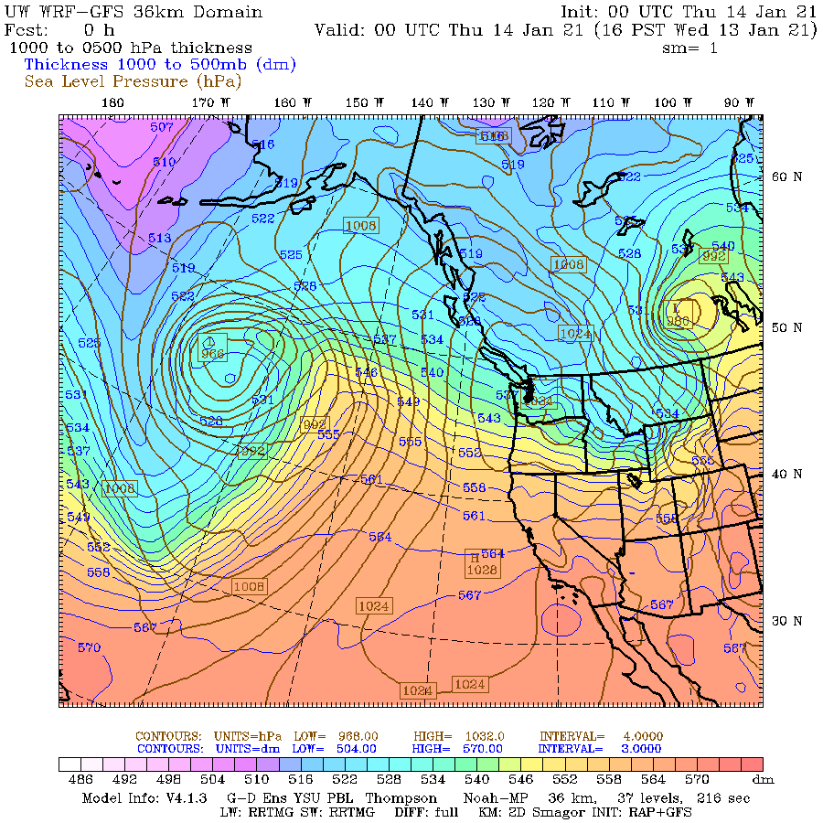
Thickness
One of the most important and used concepts in synoptic meteorology
Appears on many maps you will use.

Slide 2
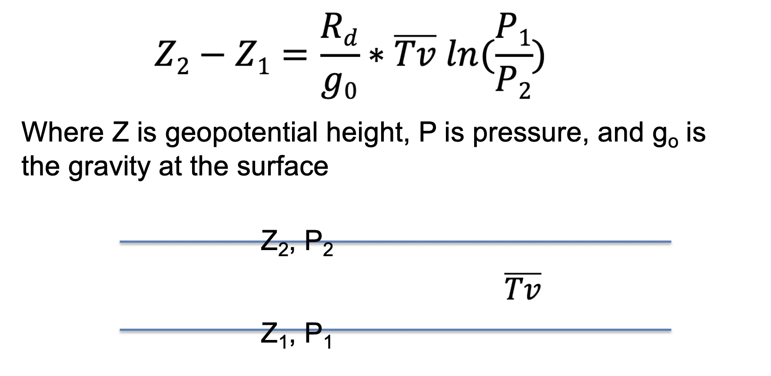
Thickness is the difference in geopotential height between two pressure surfaces.
To derive a relationship, start with the hypsometric equation (Z₂ – Z₁ is thickness).

Slide 3
Thickness is proportional to the mean virtual temperature of the layer.
Thus, the geopotential height at two levels is related to the intervening temperature distribution between them

Slide 4
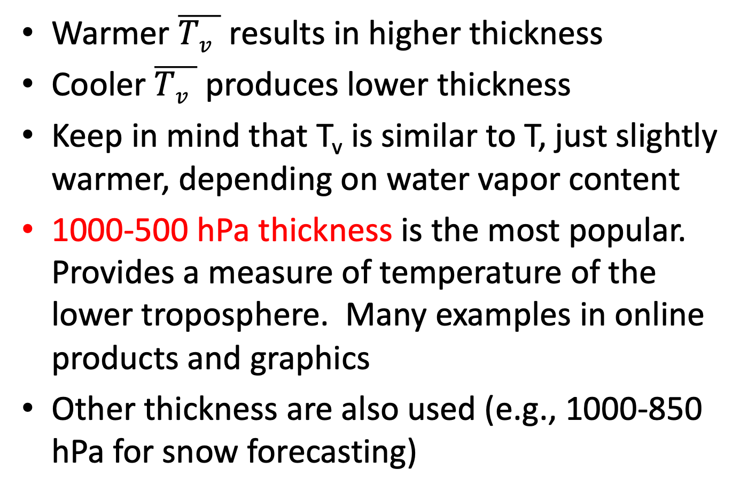
Thickness
Warmer $\overline{Tv }$ results in higher thickness
Cooler $\overline{Tv }$ produces lower thickness
Keep in mind that T_{v} is similar to T, just slightly warmer, depending on water vapor content
1000-500 hPa thickness is the most popular. Provides a measure of temperature of the lower troposphere. Many examples in online products and graphics
Other thickness are also used (e.g., 1000-850 hPa for snow forecasting)

Slide 5
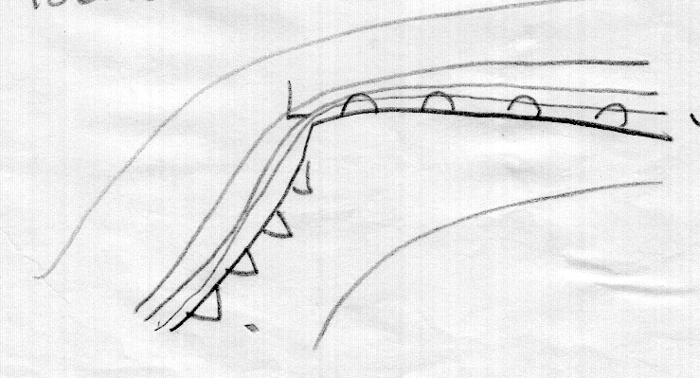
Thickness
For every 60 m change in 1000-500 hPa thickness, temperature in the layer changes by 3C
1000-500 hPa thickness is good measure of lower tropospheric temperature and temperature change (baroclinicity).
Can use to find frontal regions and more.
Tight packing on
cold side of front
Lesser
thickness
Larger thickness

Slide 6
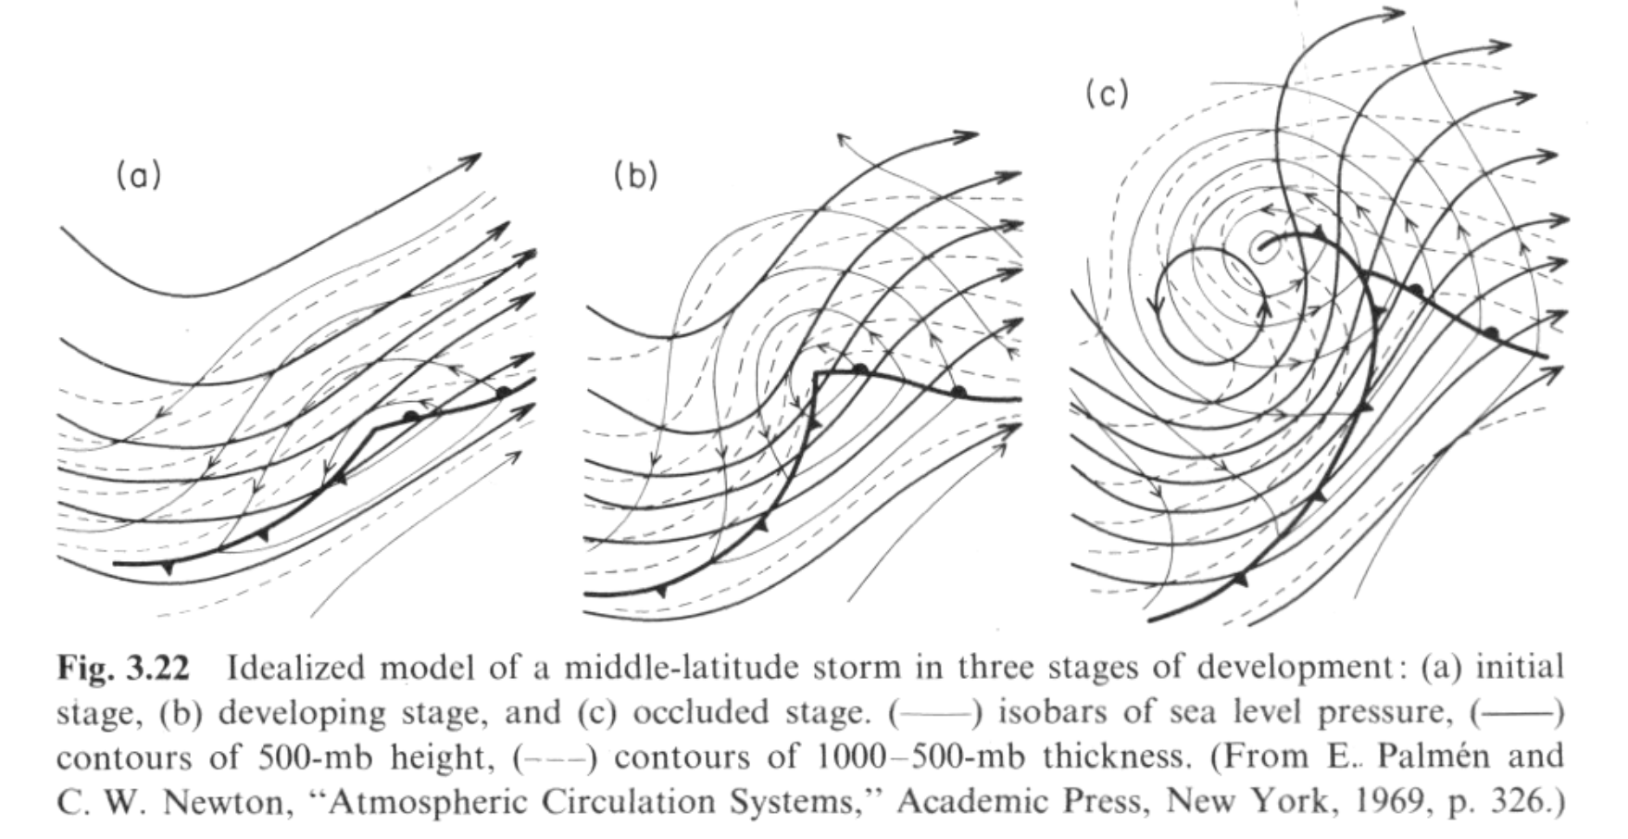
Classic Figure: Palmen and Newton

Slide 7
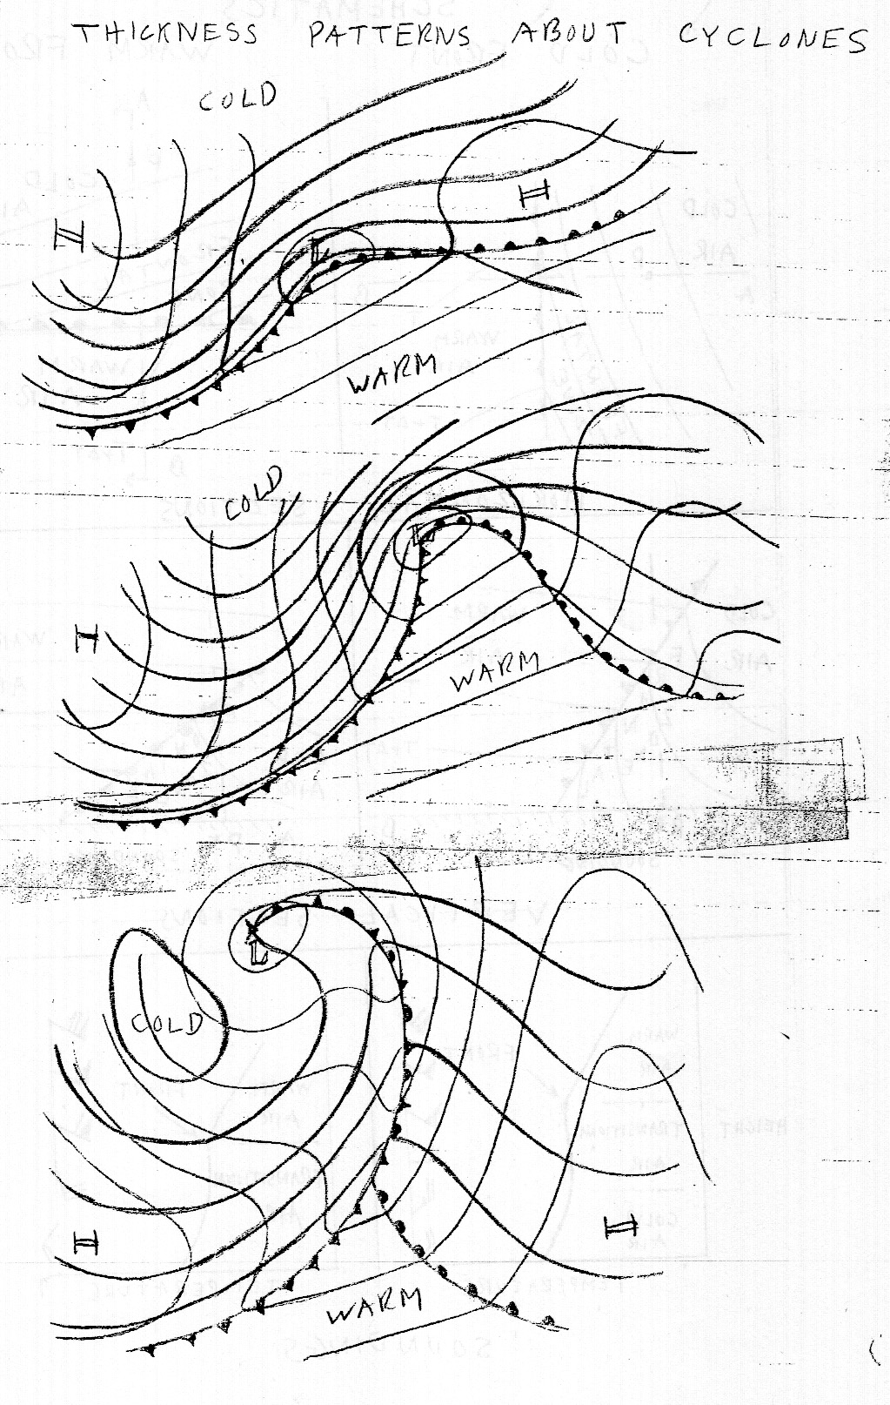
Another
Version

Slide 8
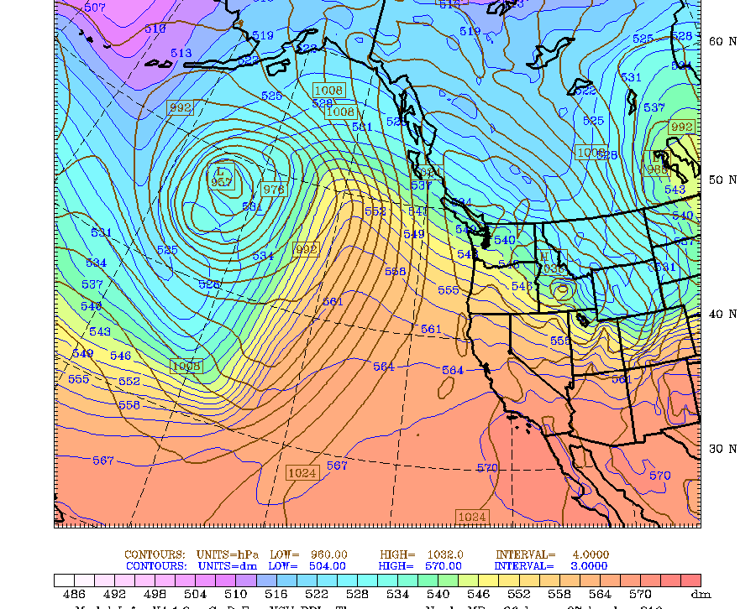
You need to be able to relate thickness to fronts since numerical model DON’T Indicate fronts

Slide 9
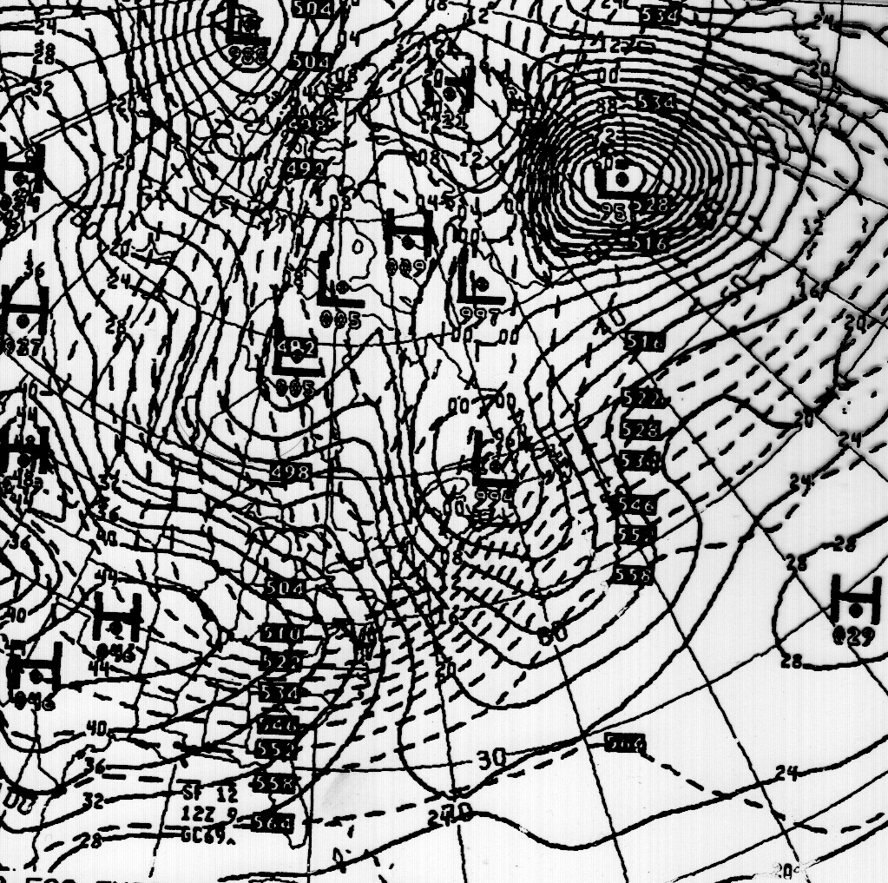
Generally given in decameters (dm)
“540” indicates 5400 m thickness

Slide 10
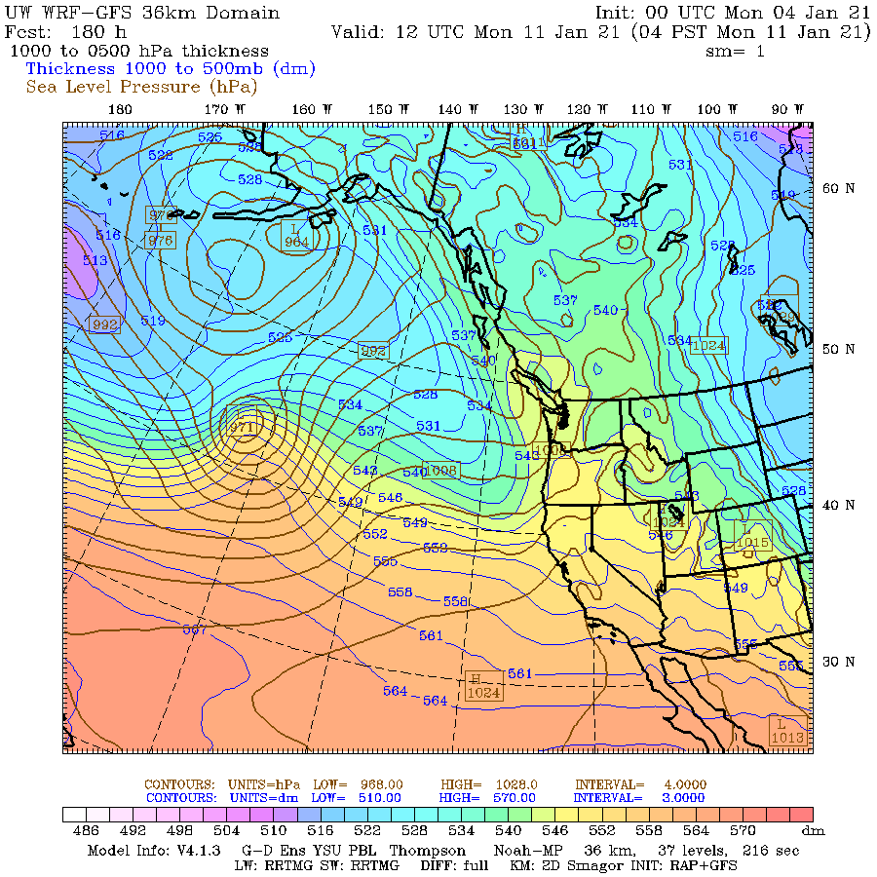

Slide 11
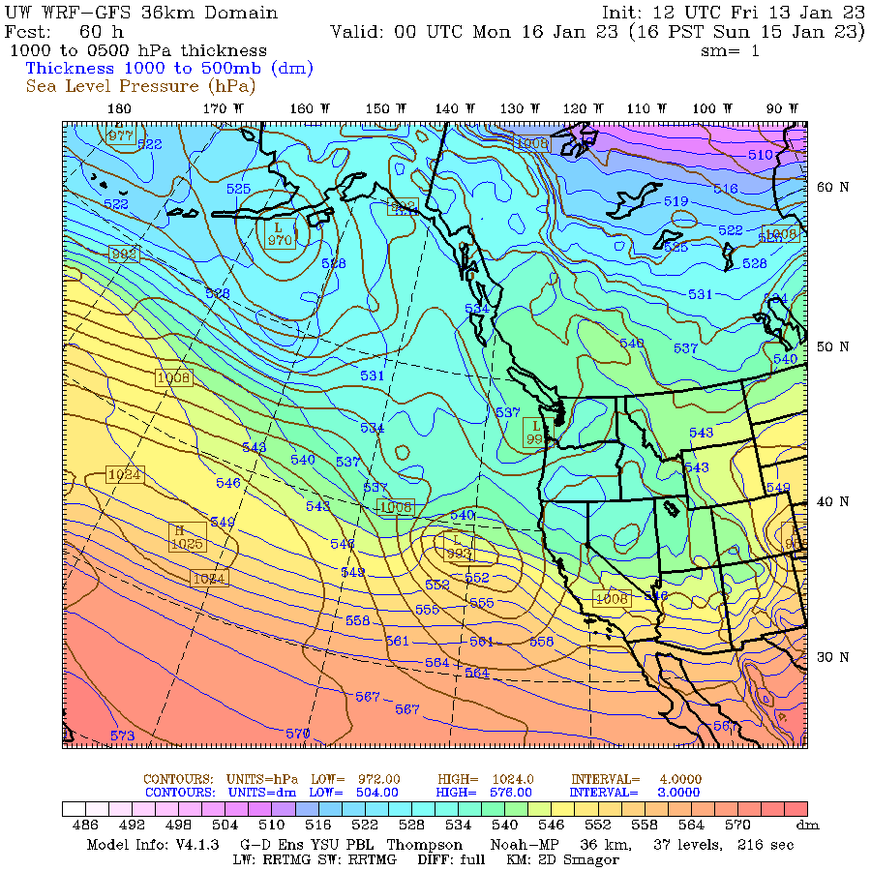
Thickness (1000-500 hPa)

Slide 12
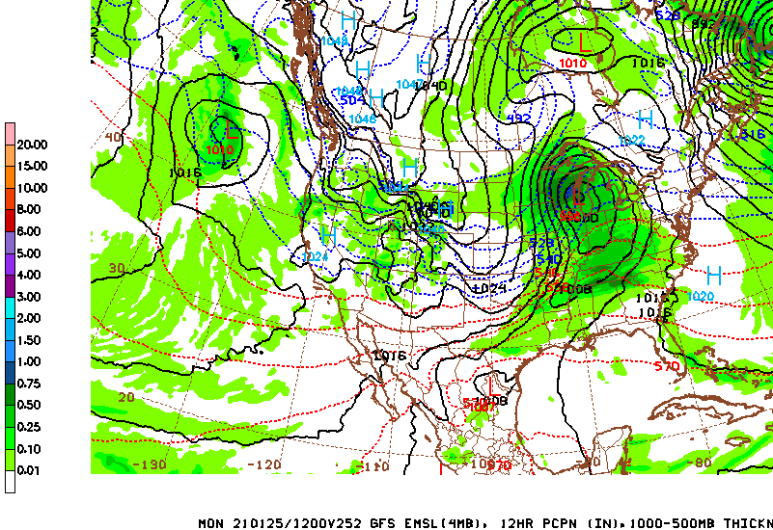

Slide 13

Thickness Useful For Forecasting, Particularly For Deciding on Rain versus Snow
Rain/snow 50-50% line for continental areas often ~5400 m thickness (1000-500 hPa)
Colder/lower thickness is better for snow
For Seattle and West coastal areas, the 50% percentile for snow using 1000-500 hPa thickness is 5220 m. Why?

Slide 14
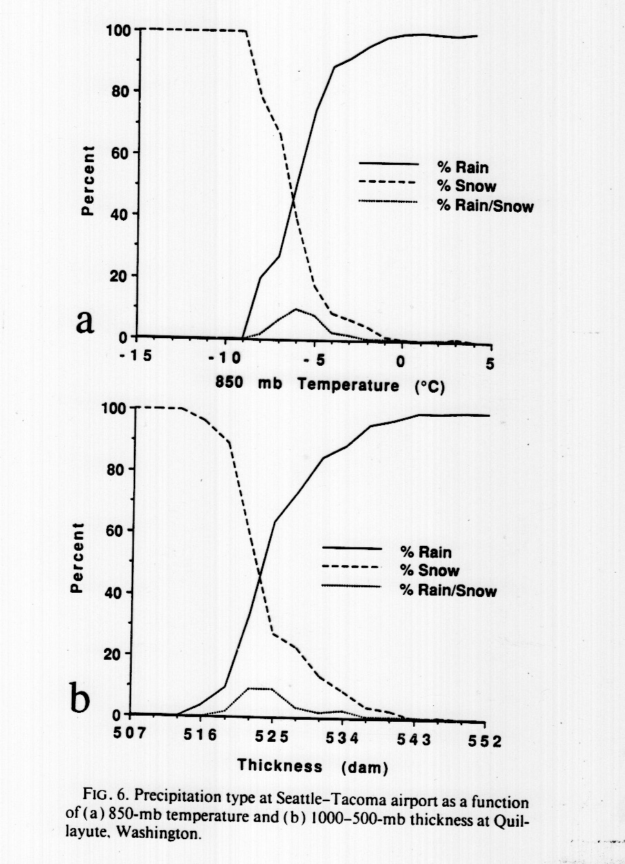
Why?
Warm water and resulting warmer air near the surface results in needing much cooler air aloft to get snow to the surface.

Slide 15
Thickness
In Cascades 5400 m 1000-500 hPa thickness works reasonably well. More continental.
Seattle NWS forecast office likes to use 1000-850 hPa thickness of 1300 m for 50% line for lowland snow
As we shall see, thickness is related to another important concept: thermal wind.

Slide 16
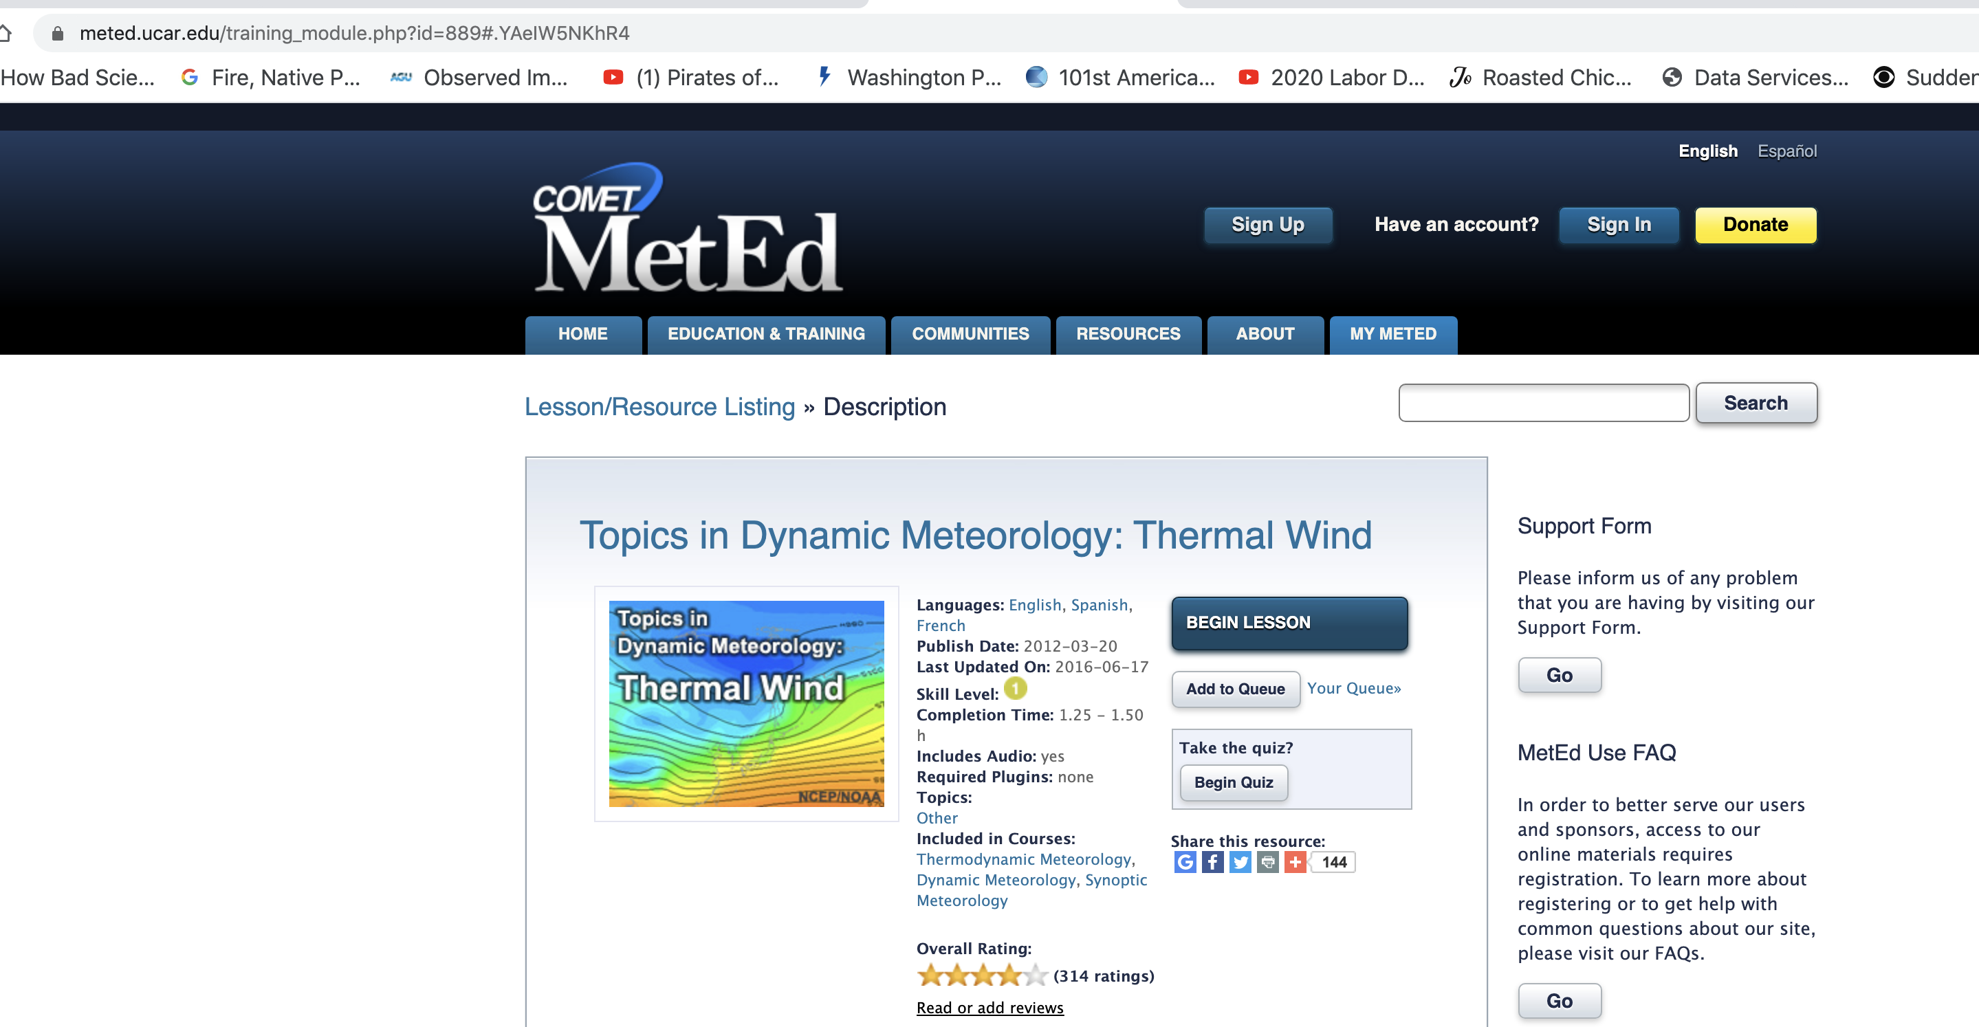
Homework Assignment
Go through COMET METED Thermal Wind Online Lesson

Slide 17
COMET Thermal Wind Module
You need to set up a login…free.
You don’t have to hand anything in. Do the exercises you wish to if you want to deepen your understanding.

Slide 18
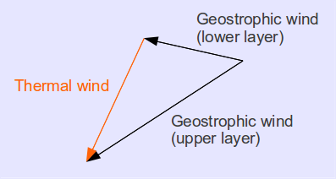
The Thermal Wind
The thermal wind, V_{T}, is a vector defined as the difference between the geostrophic wind at two levels of the atmosphere.
The name is really a misnomer, since it is not a wind, but a difference of the geostrophic winds between two levels.

Slide 19
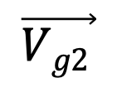
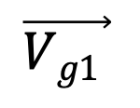
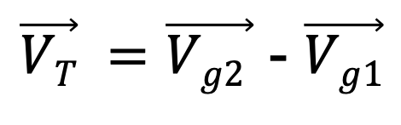
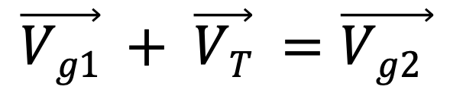
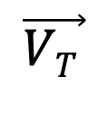
The Thermal Wind is the Vector Difference of Geostrophic Winds at Two Levels
2
$$\vec{Vg1 }$$
$$\vec{VT }$$
1
$$\vec{Vg2 }$$
$$\vec{Vg1} + \vec{VT} =\vec{Vg2 }$$
$\vec{VT} =\vec{Vg2 }$ - $\vec{Vg1}$

Slide 20
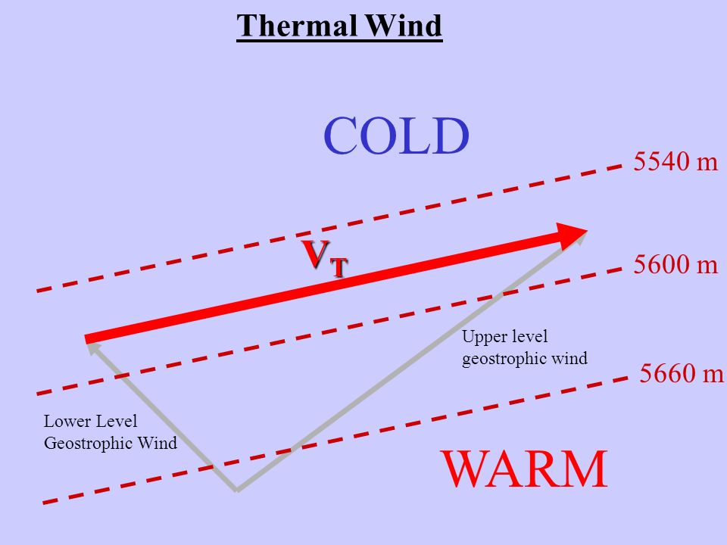
Thermal Wind and Thickness
The thermal wind vector is parallel to thickness lines
Higher thickness to the right of thermal wind.
The magnitude of the thermal wind vector for a layer is proportional to the horizontal gradient of thickness (or the mean temperature gradient of the layer).

Slide 21
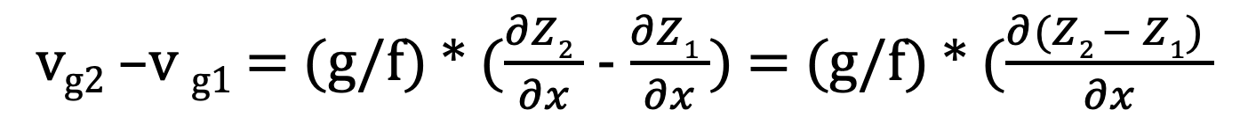
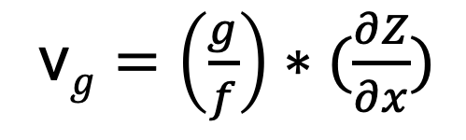
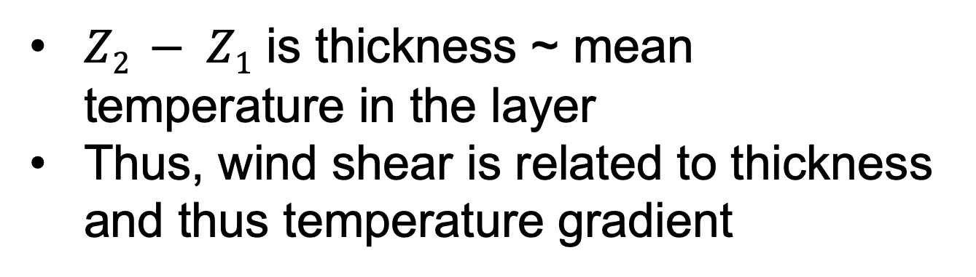
Thermal Wind And Thickness
Mathematical Connection
One (N-S) component of geostrophic wind
Geostrophic
Wind, constant
P, V component
v$g=\left(\frac{g}{f}\right)∗(\frac{∂Z}{∂x})$
v_{g2} –v _{g1} = (g/f) * $(\frac{∂Z2 }{∂x}$ - $\frac{∂Z1 }{∂x}$) = (g/f) * $(\frac{∂(Z2 − Z1) }{∂x}$
$Z2 − Z1$ is thickness ~ mean temperature in the layer
Thus, wind shear is related to thickness and thus temperature gradient

Slide 22
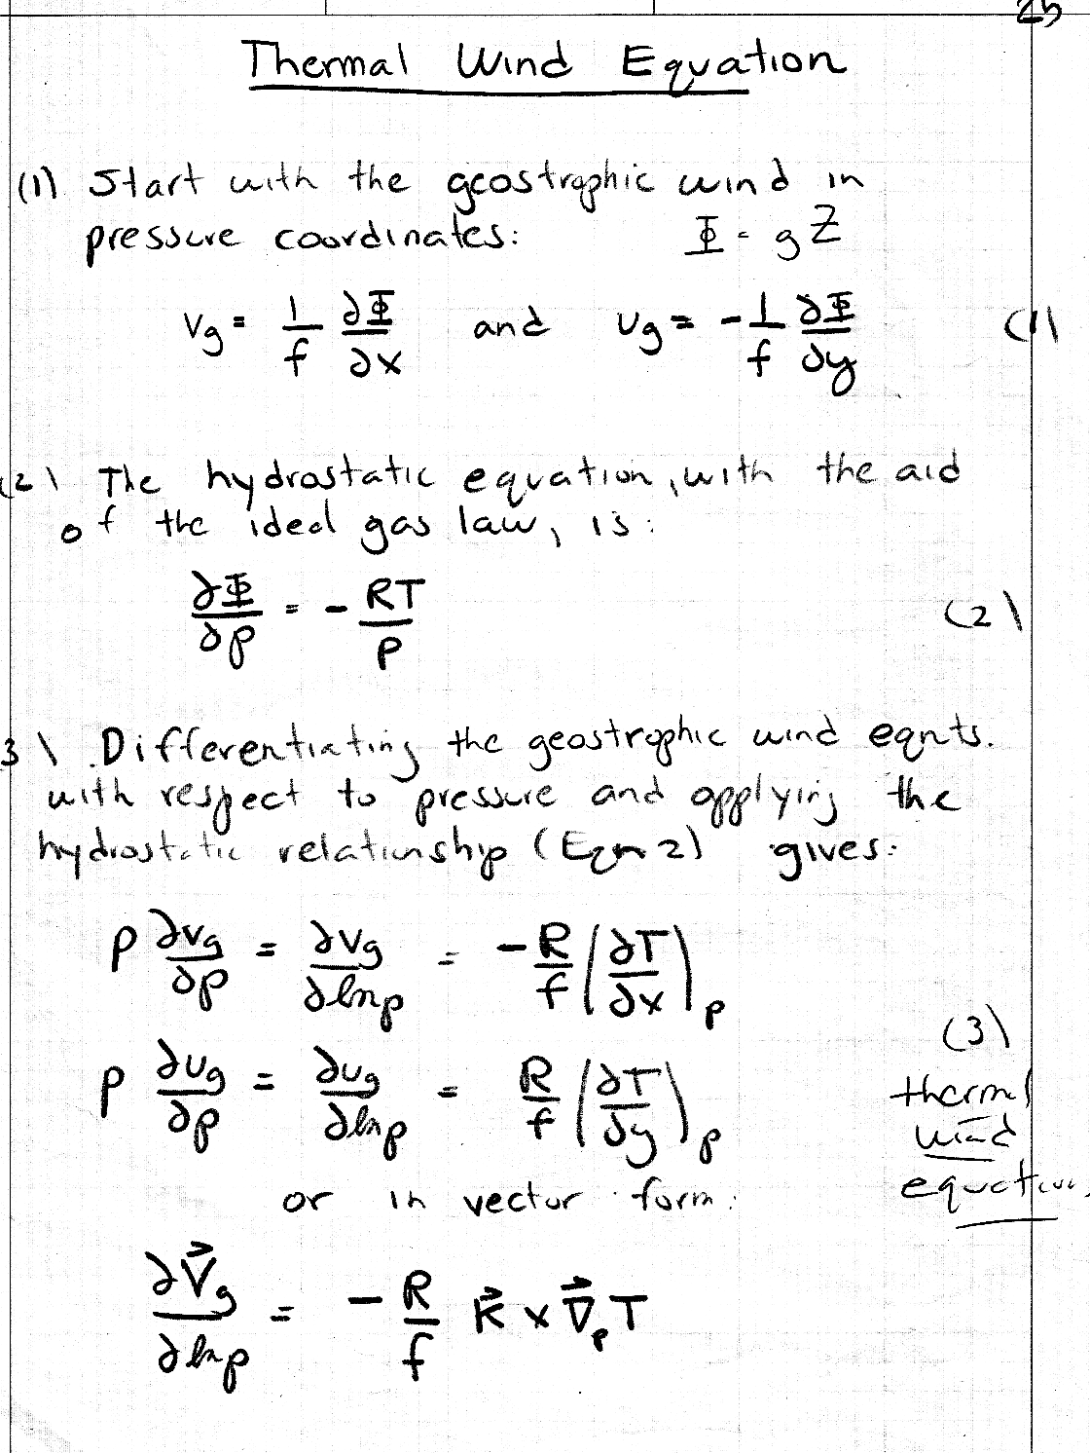
Derivation of Thermal Wind Equation

Slide 23
Believe it or Not!
Much of the atmosphere is in approximate thermal wind balance (follows the thermal wind equation).
Why? Because most of the atmosphere is ~geostrophic and in hydrostatic balance.
Thus, in most of the atmosphere, vertical wind shear is related to horizontal temperature gradients.

Slide 24
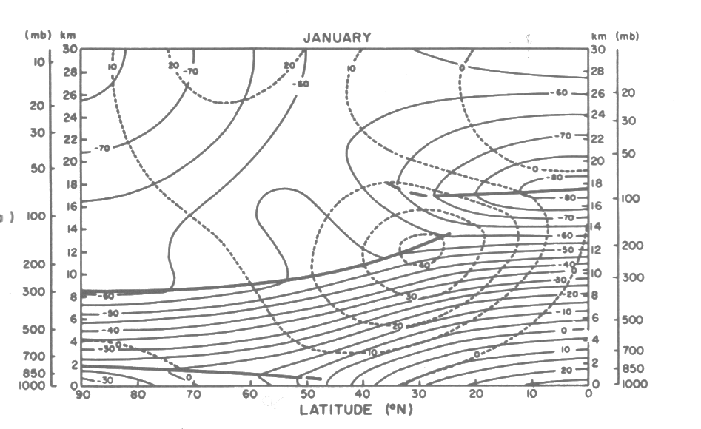
N-S Vertical Cross Section
Winds in ms⁻¹, temps in C

Slide 25
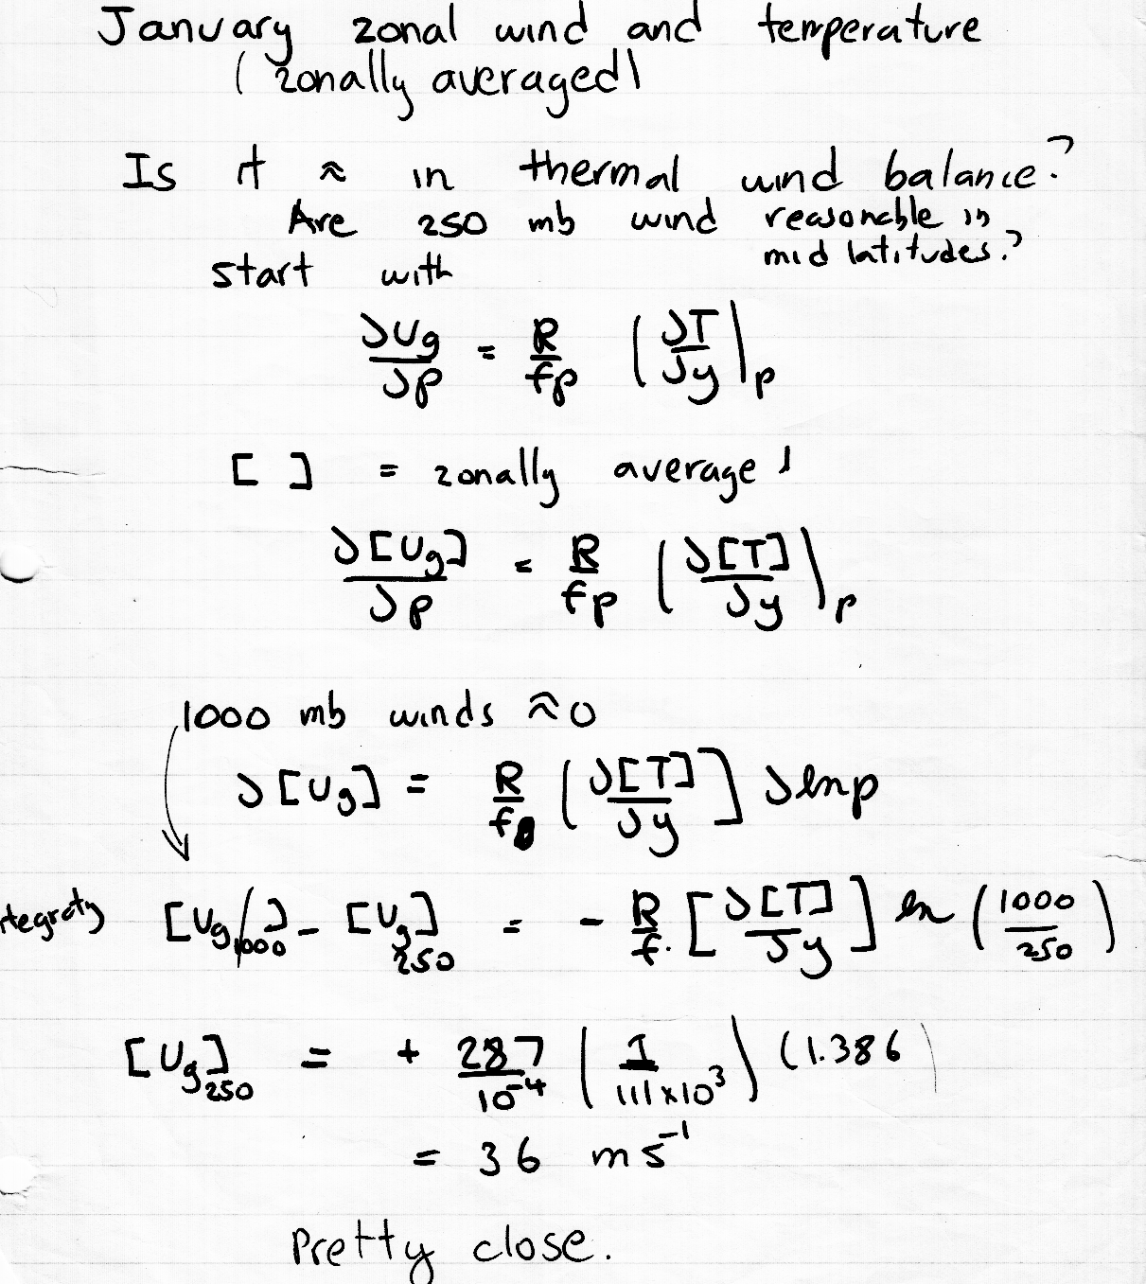
Back of the envelope calculation using thermal wind is quite reasonable

Slide 26
No only are horizontal temperature gradients associated with vertical wind shear, but directional changes in wind are related to temperature advection
All based on the atmosphere being geostrophic and in hydrostatic balance

Slide 27
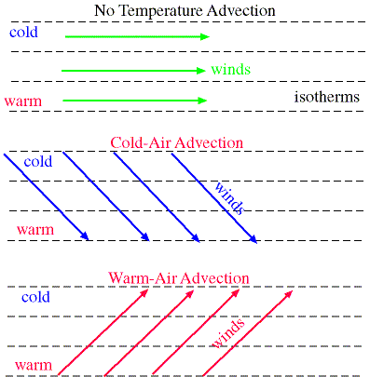
Temperature Advection
Geostrophic wind shear in the vertical is associated with horizontal temperature gradients.
The turning of the geostrophic wind with height is related to temperature advection.

Slide 28
Temperature Advection
Backing (counterclockwise turning with height) of the the geostrophic wind: cold advection
Veering (clockwise turning with height) of the the geostrophic wind: warm advection
Thus, if the actual winds are ~geostrophic (not bad assumption above boundary layer) one can determine temperature advection from a single sounding

Slide 29

Thus, if you are on an isolated island with a radiosonde unit that provides wind with height, you can tell whether warm or cold air is approaching
Have to be at least 5 degrees off the equator! Why?

Slide 30
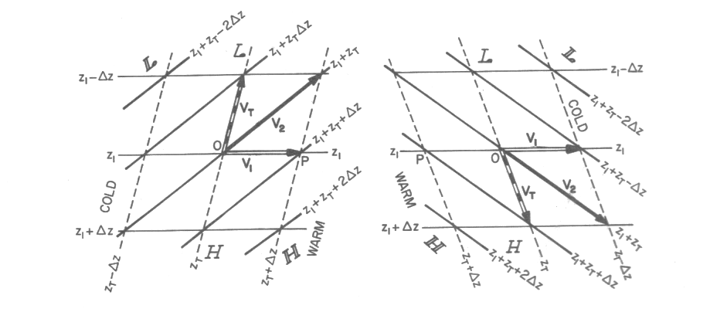
Does this make sense?
Lower
Thick
Lower
Thickness
Backing (counter) Veering (clock)
Cold advection
Warm advection

Slide 31
Does this make sense?
Lower
Thickness
Backing (counterclockwise rotation)
Cold advection

Slide 32
Does this make sense?
Lower
Thick
Lower
Thickness
Backing (counter) Veering (clock)
Cold advection
Warm advection

Slide 33
Where in the atmosphere is there a lot of temperature advection?
?

Slide 34
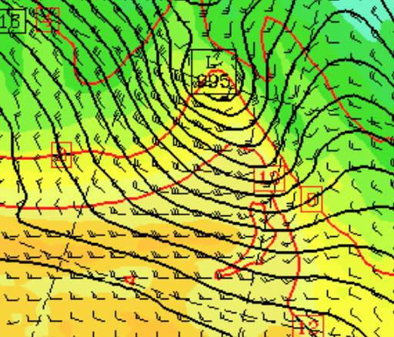
With Fronts!
Where there are strong temperature gradients
925 hPa Temperatures and SLP

Slide 35
Frontal Zones
In cold frontal zones, winds back with height
  Cold advection
In warm frontal zones, wind veer with height
  Warm advection
In areas of little temperature advection, there is little turning with height

Slide 36
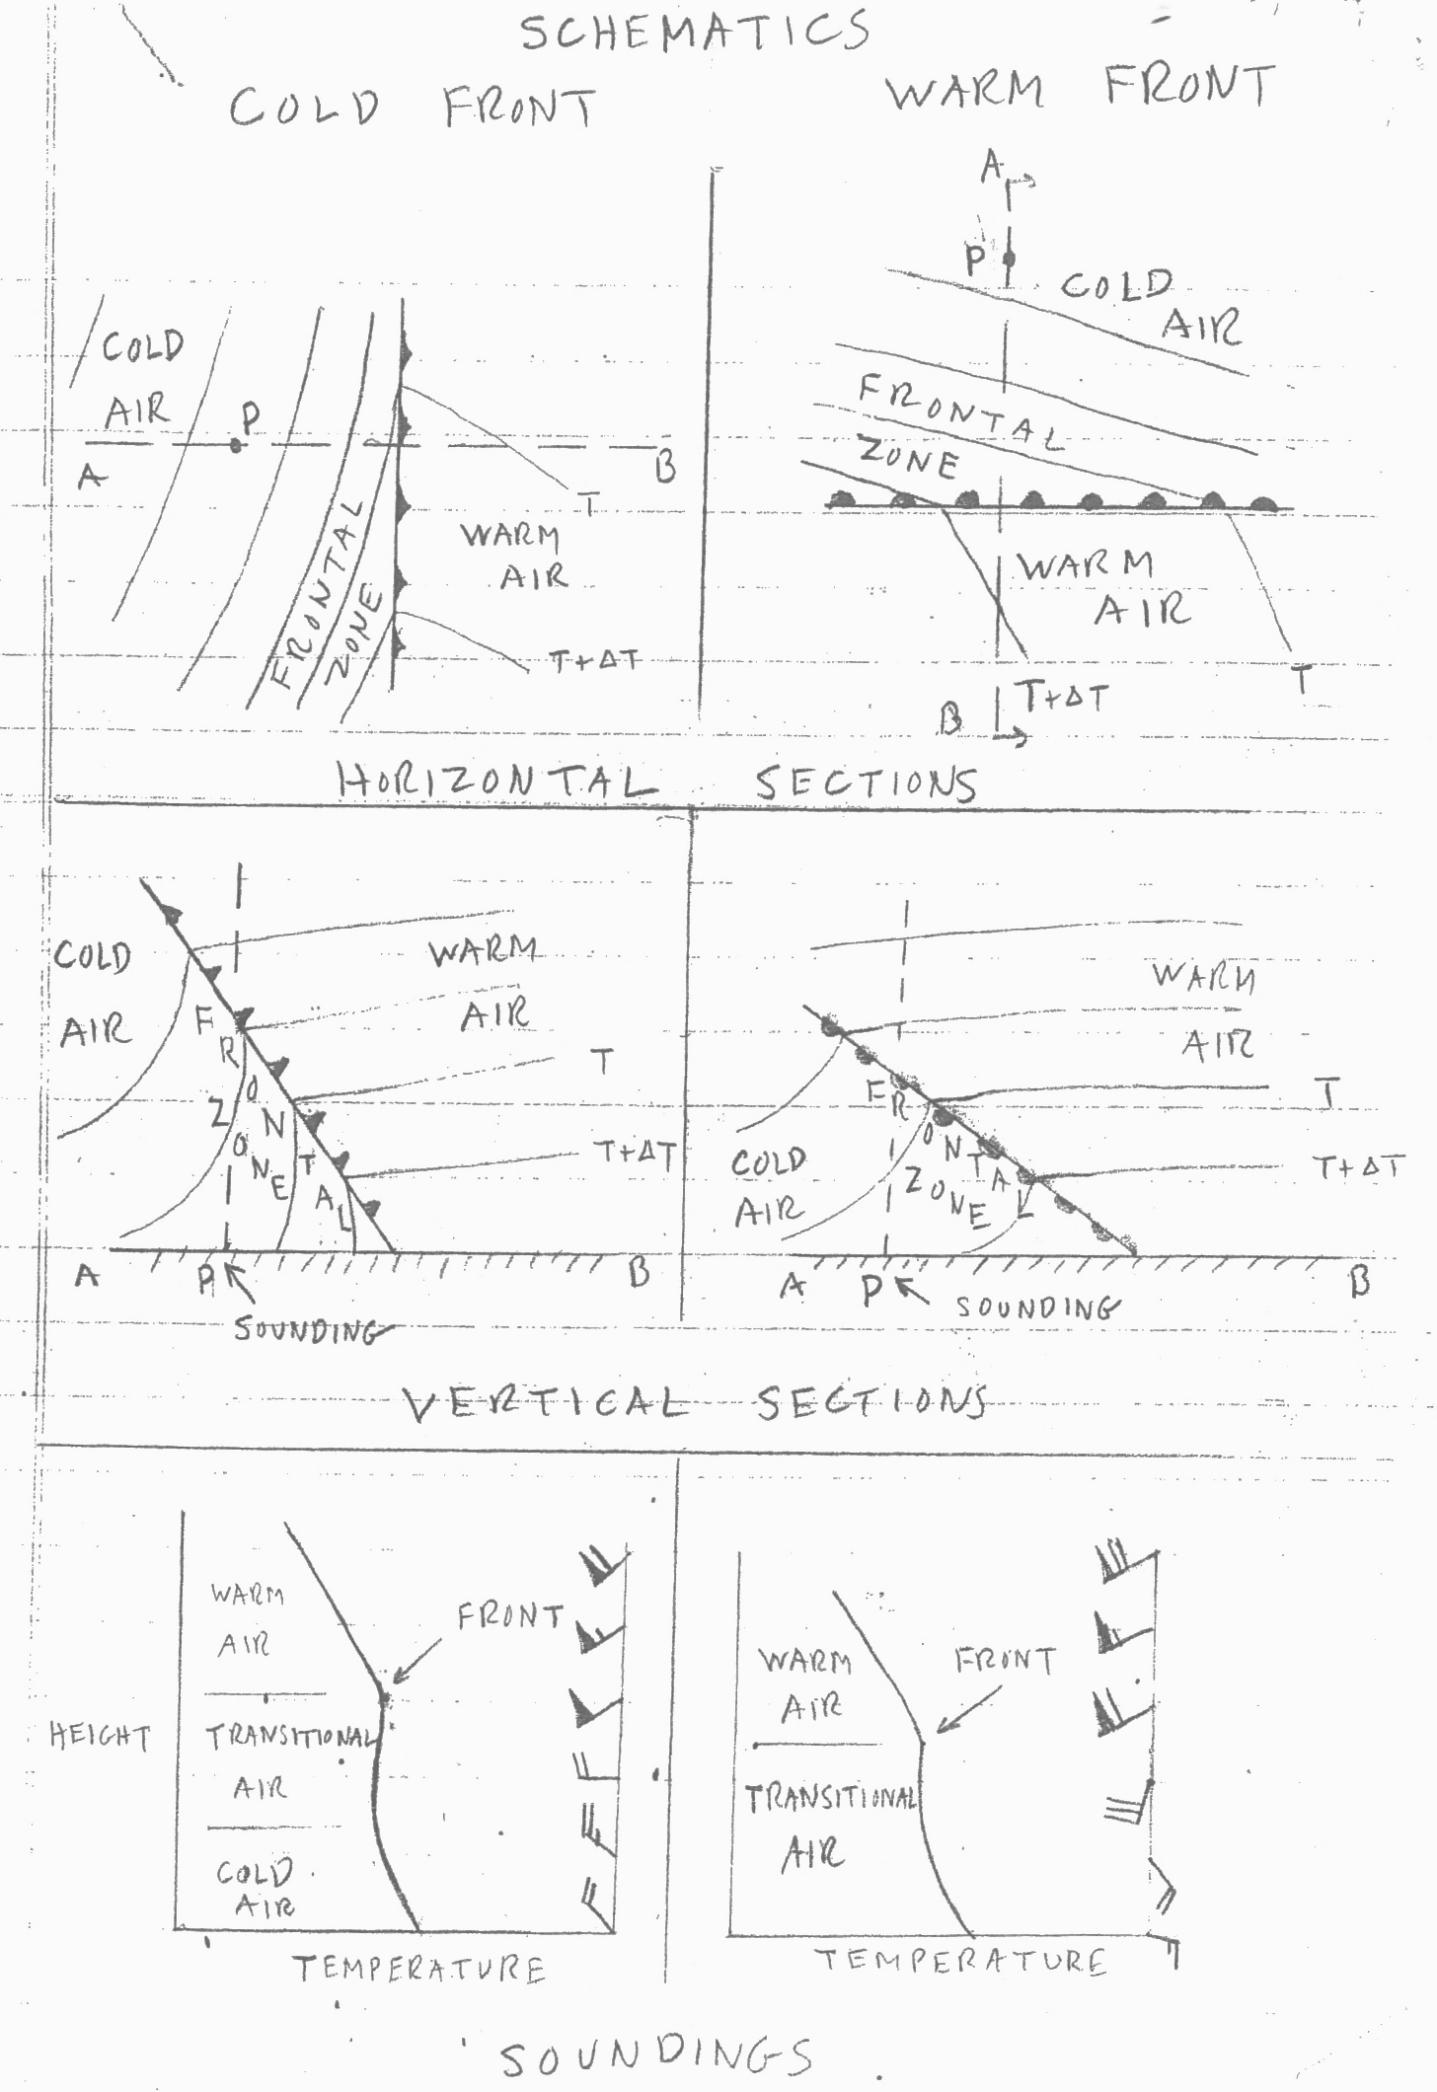
Frontal Zone
Always on Cold
Side of Front
Frontal Zones
Are Stable
Layers

Slide 37
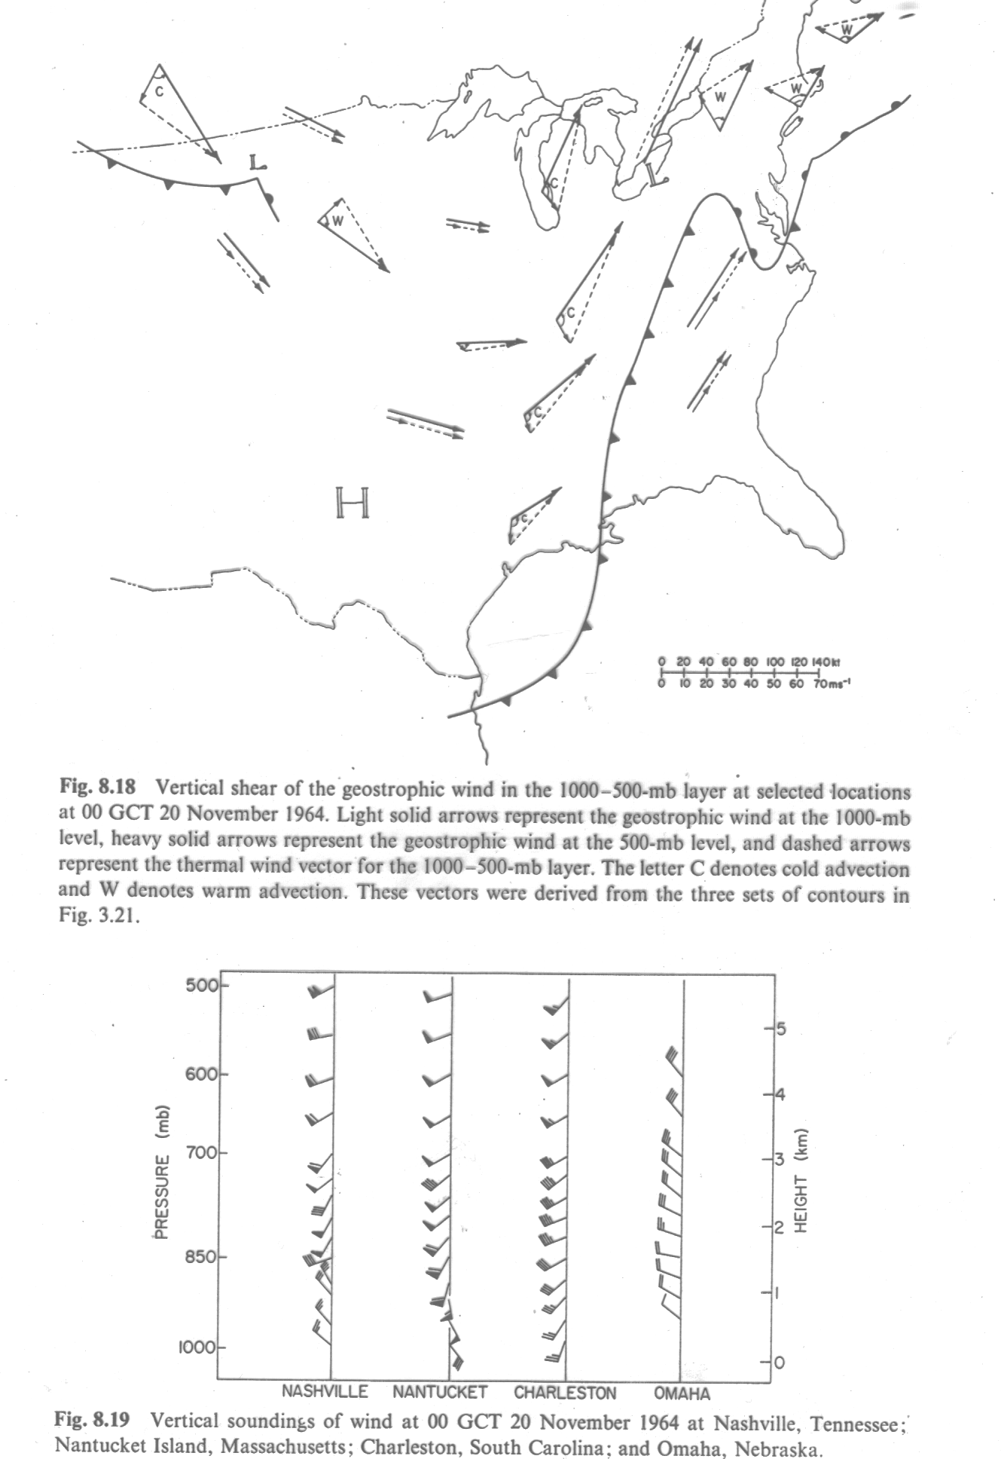

Slide 38
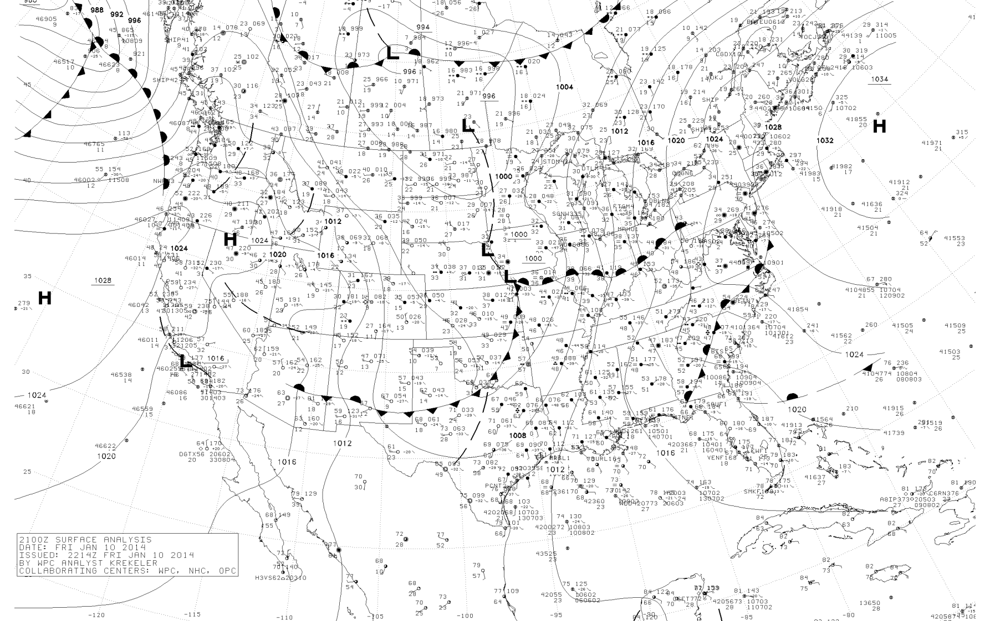
Warm Front Approaching UIL (Quillayute)

Slide 39
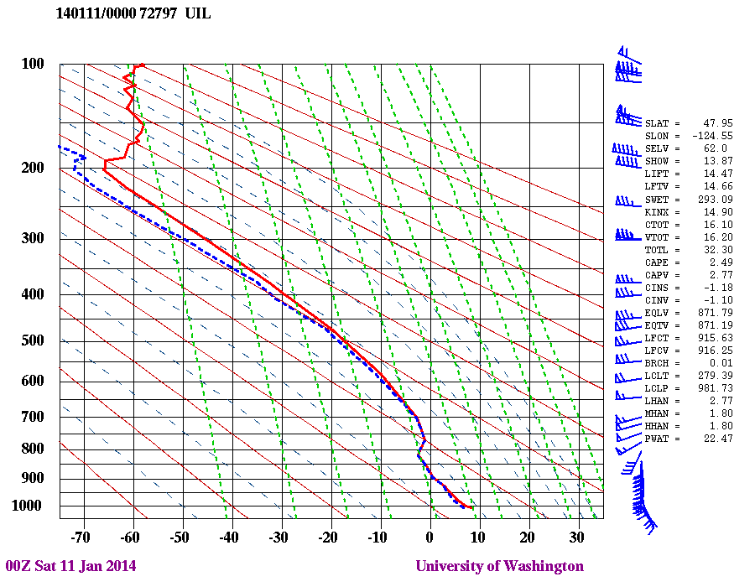
Clockwise rotation

Slide 40
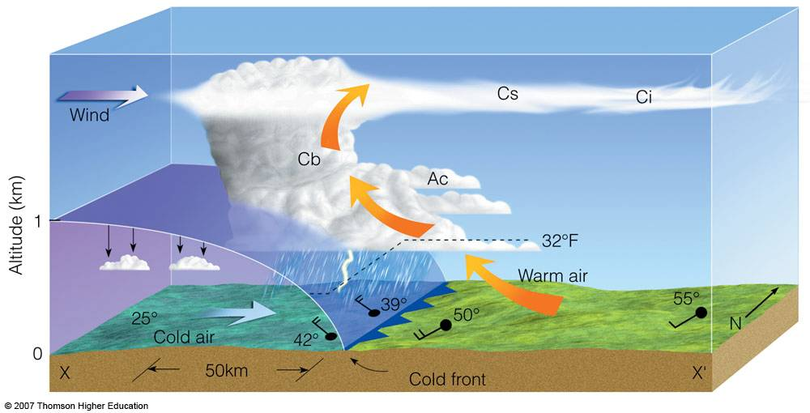
Approaching Cold Front: backing

Slide 41
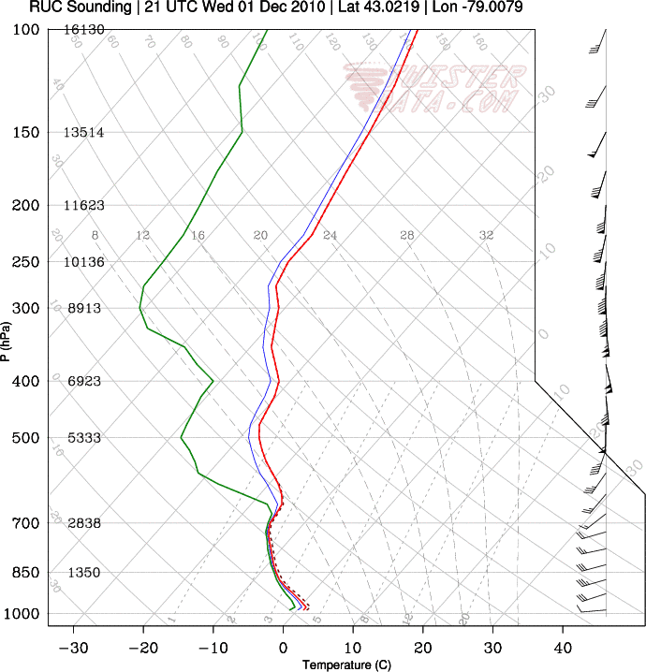
Cold advection sounding

Slide 42
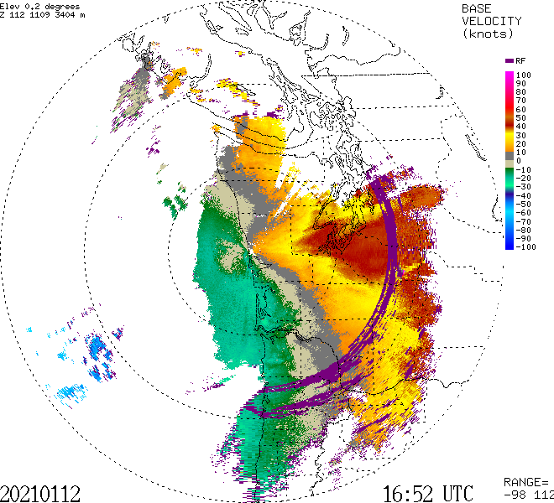
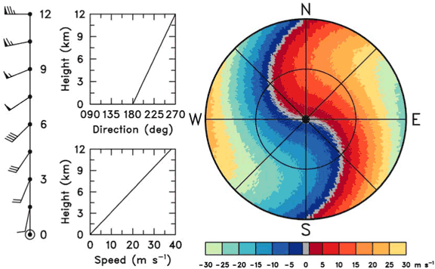
Weather Radar and Temperature Advection
You can tell whether warm or cold advection is occurring by looking at the radar Doppler velocities
Specifically, the zero radial velocity line (usually gray) is important.

Slide 43
The Doppler Velocity (Radial Velocity towards or away from the radar)

Slide 44
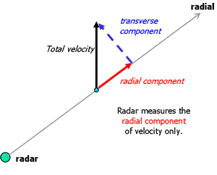
Radar Doppler Velocities Give Radial Wind Component toward or away from radar

Slide 45
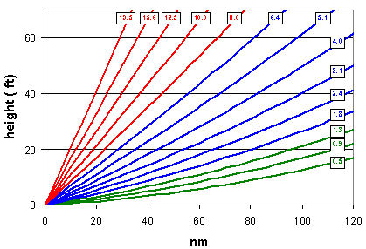
Radar imagery is generally depicted on a tilted surface
Scans in azimuth ( 0 to 360°) at a series of increasing scan angles from the horizontal.

Slide 46
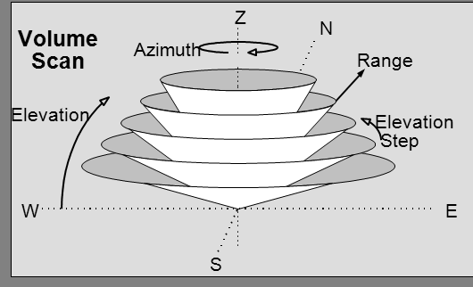

Slide 47

Each radar elevation angle shown on a polar-type chart with range circles, with the beam ascending with distance
Lower
Higher

Slide 48
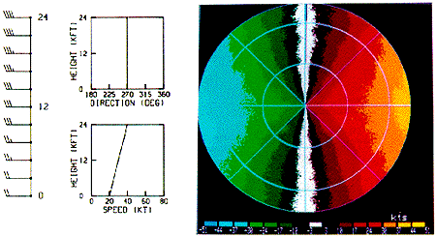
No turning with height, no advection

Slide 49
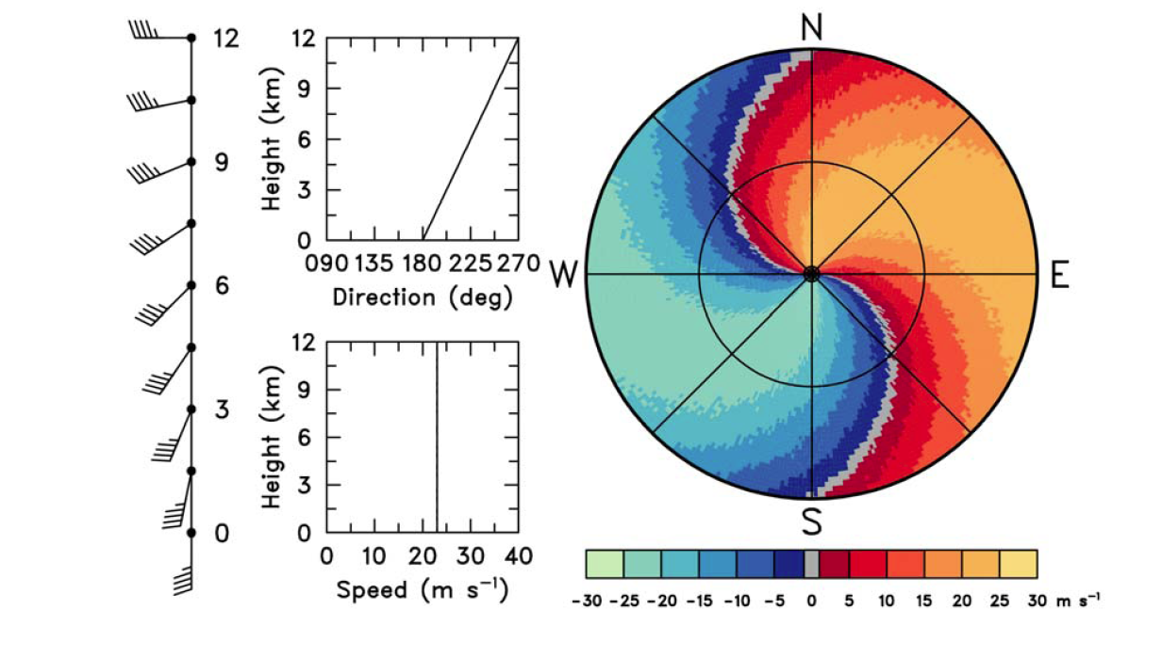
“ S “ shape: veering

Slide 50
“ S “ shape: veering

Slide 51
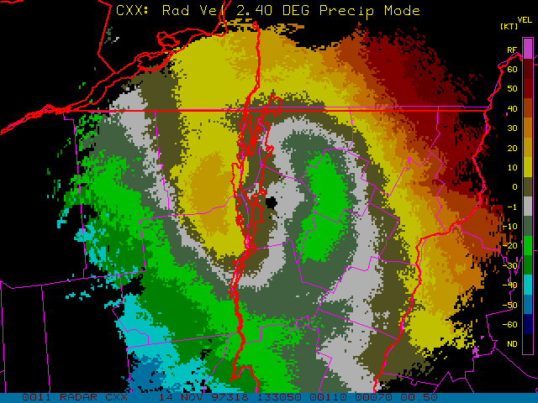

Slide 52
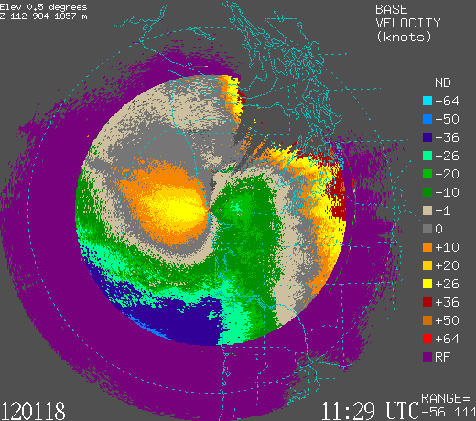

Slide 53
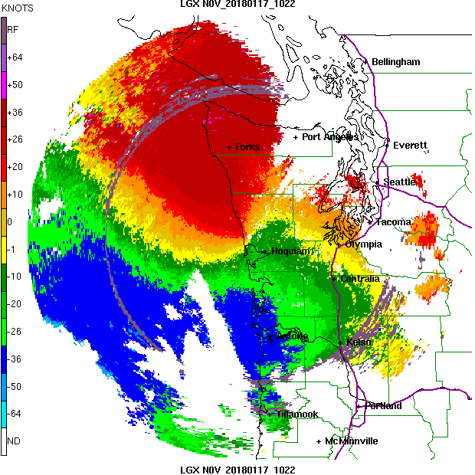

Slide 54
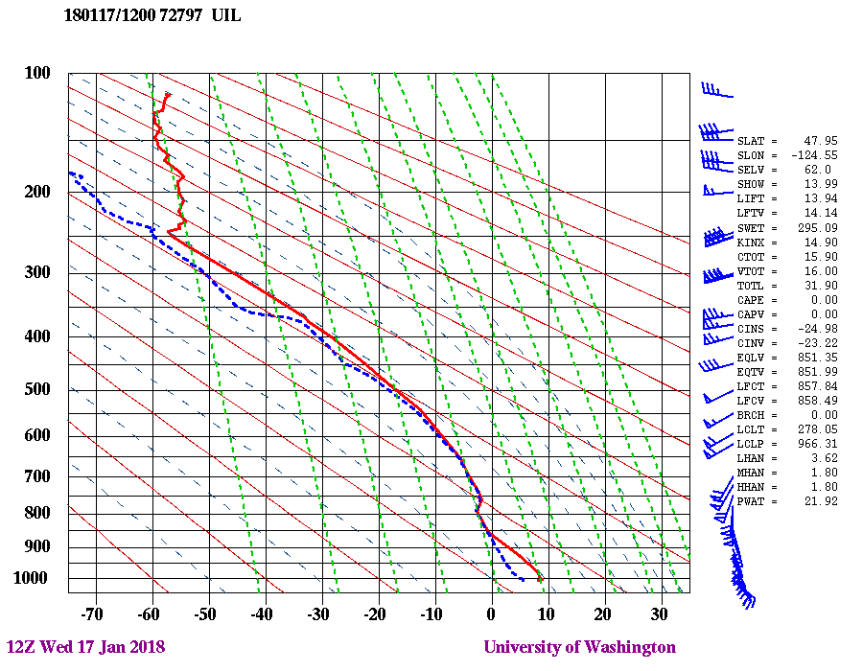

Slide 55
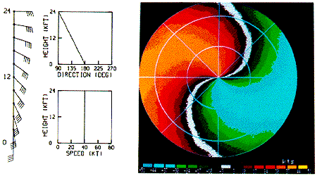
Backing: Backwards S
Cold Advection

Slide 56
Fronts and Wind Shear Example:
January 11, 2014
Washington Coast

Slide 57
Warm Front Approaching UIL

Slide 59
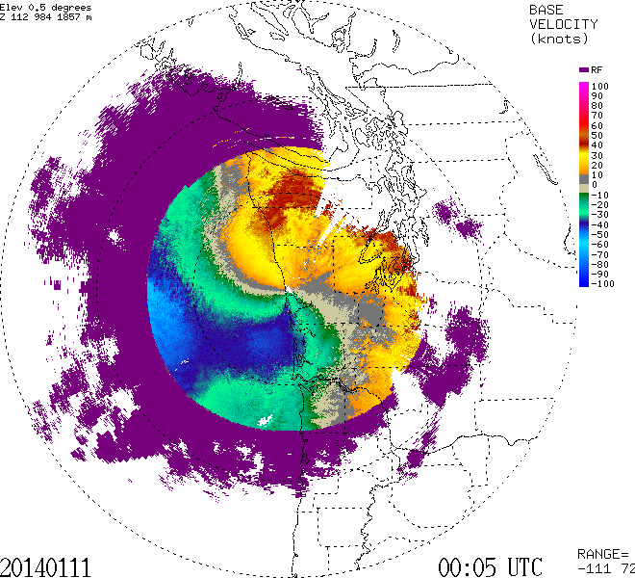

Slide 60
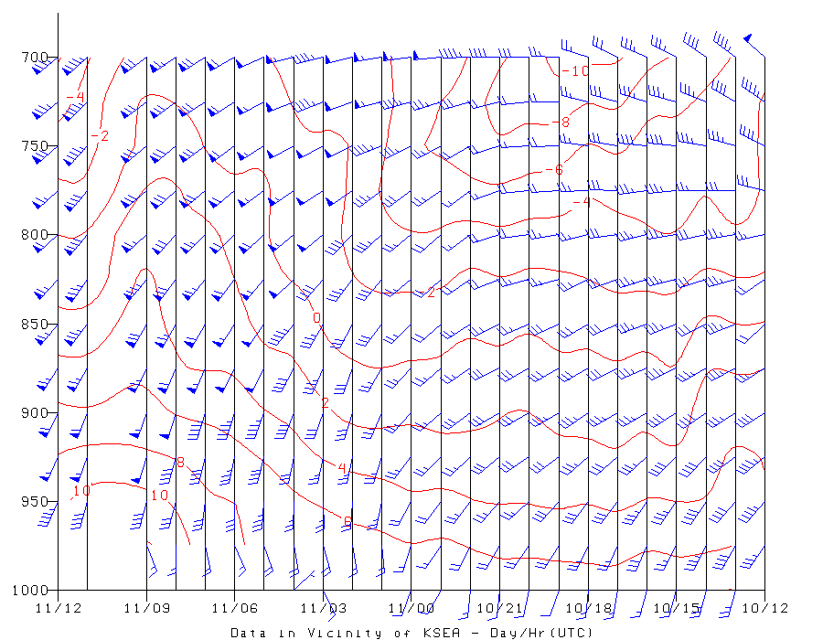
SeaTac Airport ACARS Winds/Temp

Slide 61
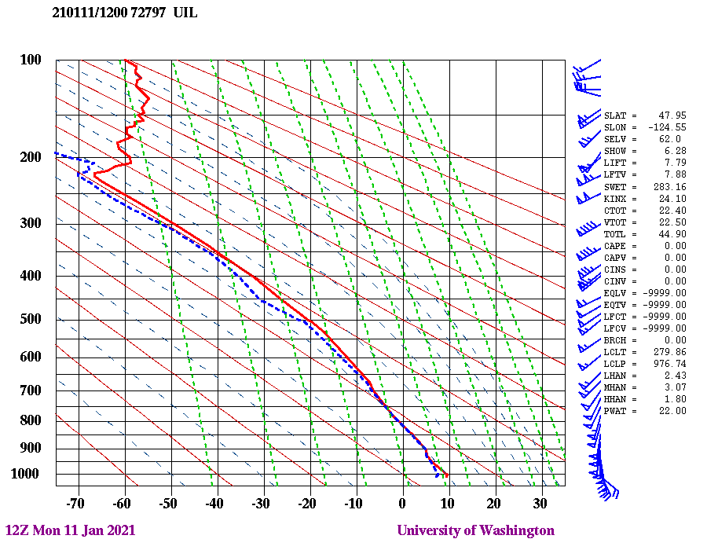
12-h later

Slide 62


Slide 63

Example From 2021

Slide 64


Two Days Ago

Slide 65


Slide 66
The end

Slide 67
You can see for yourself!
Red is thickness
Lower
Thickness
Higher
Thickness

