Slide 1
Scalar Analysis in Synoptic Meteorology
ATMS 370
Winter 2023

Slide 2
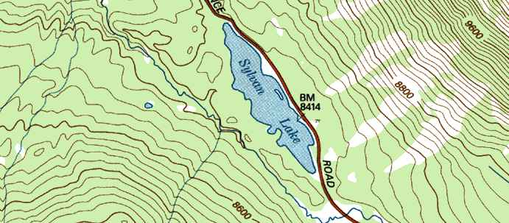
Definition
Scalar Analysis is the analysis of a quantity that has magnitude only
Examples: temperature and pressure.
Consists of drawing isopleths: line of constant values. Topographic maps are good examples.

Slide 3
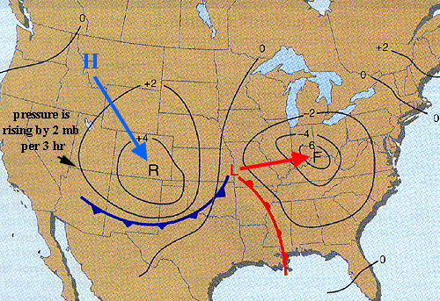
Examples of Meteorological Isopleths
isobar: pressure
isohyet: precipitation
isopycnic: density
isotach: wind speed
isogon: wind direction
isotherm: temperature
isentrope: potential temperature
isallobar: pressure change
isallobars
You will use many of these in a career in atmospheric sciences

Slide 4
Begin with map with some parameter plotted at selected observation points.
Generally standardized contours and values.
Then interpolate between points as one draws continuous lines.
1200
1000
800
1400
800
900
1200

Slide 5
Linear interpolation is acceptable as first approximation, but non-linear variations should be taken into account if possible
linear
Non-linear
400
500
700
1300

Slide 6

Both human and machine-based interpolation/analyses are done: humans often do a very good job at it, even capturing non-linear effects
Human’s can gain understanding through manual analysis
That is one reason you will do so in class.
There is an intimate connection between our hands and brains

Slide 7
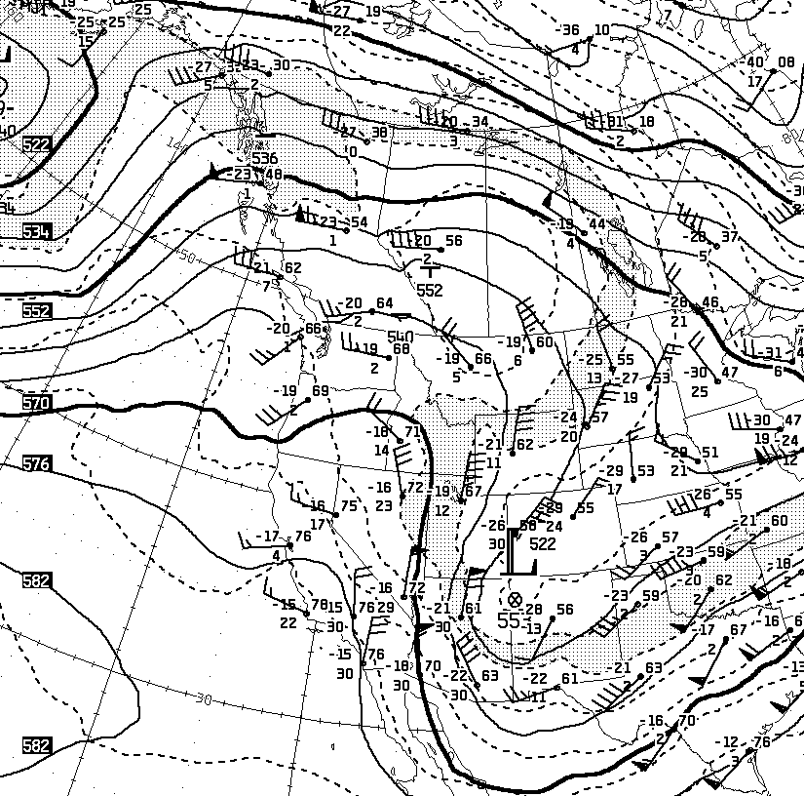
500 hPa: The first level you will analyze
Will analyze 500 hPa geopotential heights. Noting ridges, troughs, closed lows, closed highs.
Important level: about half the mass of atmosphere is above and below. ~5500 meters, 18,000 ft.
60-m contour interval is standard
Centered around 5400 m. e.g., 5280, 5340, 5400, 5460, 5520 meters
Labeled in decameter (dm)—hundreds of meters (e.g., 540, 546)

Slide 8
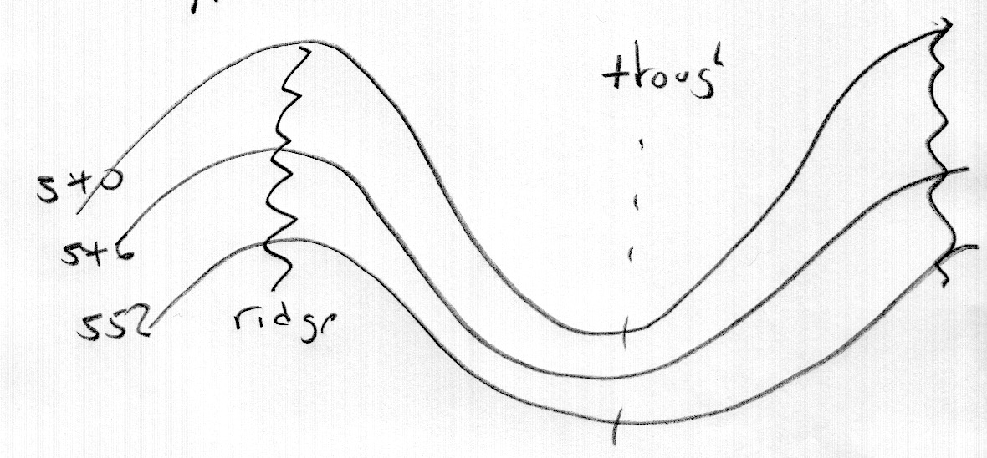
Typical 500 hPa wave pattern
Weaker
gradient
Tighter gradient

Slide 9
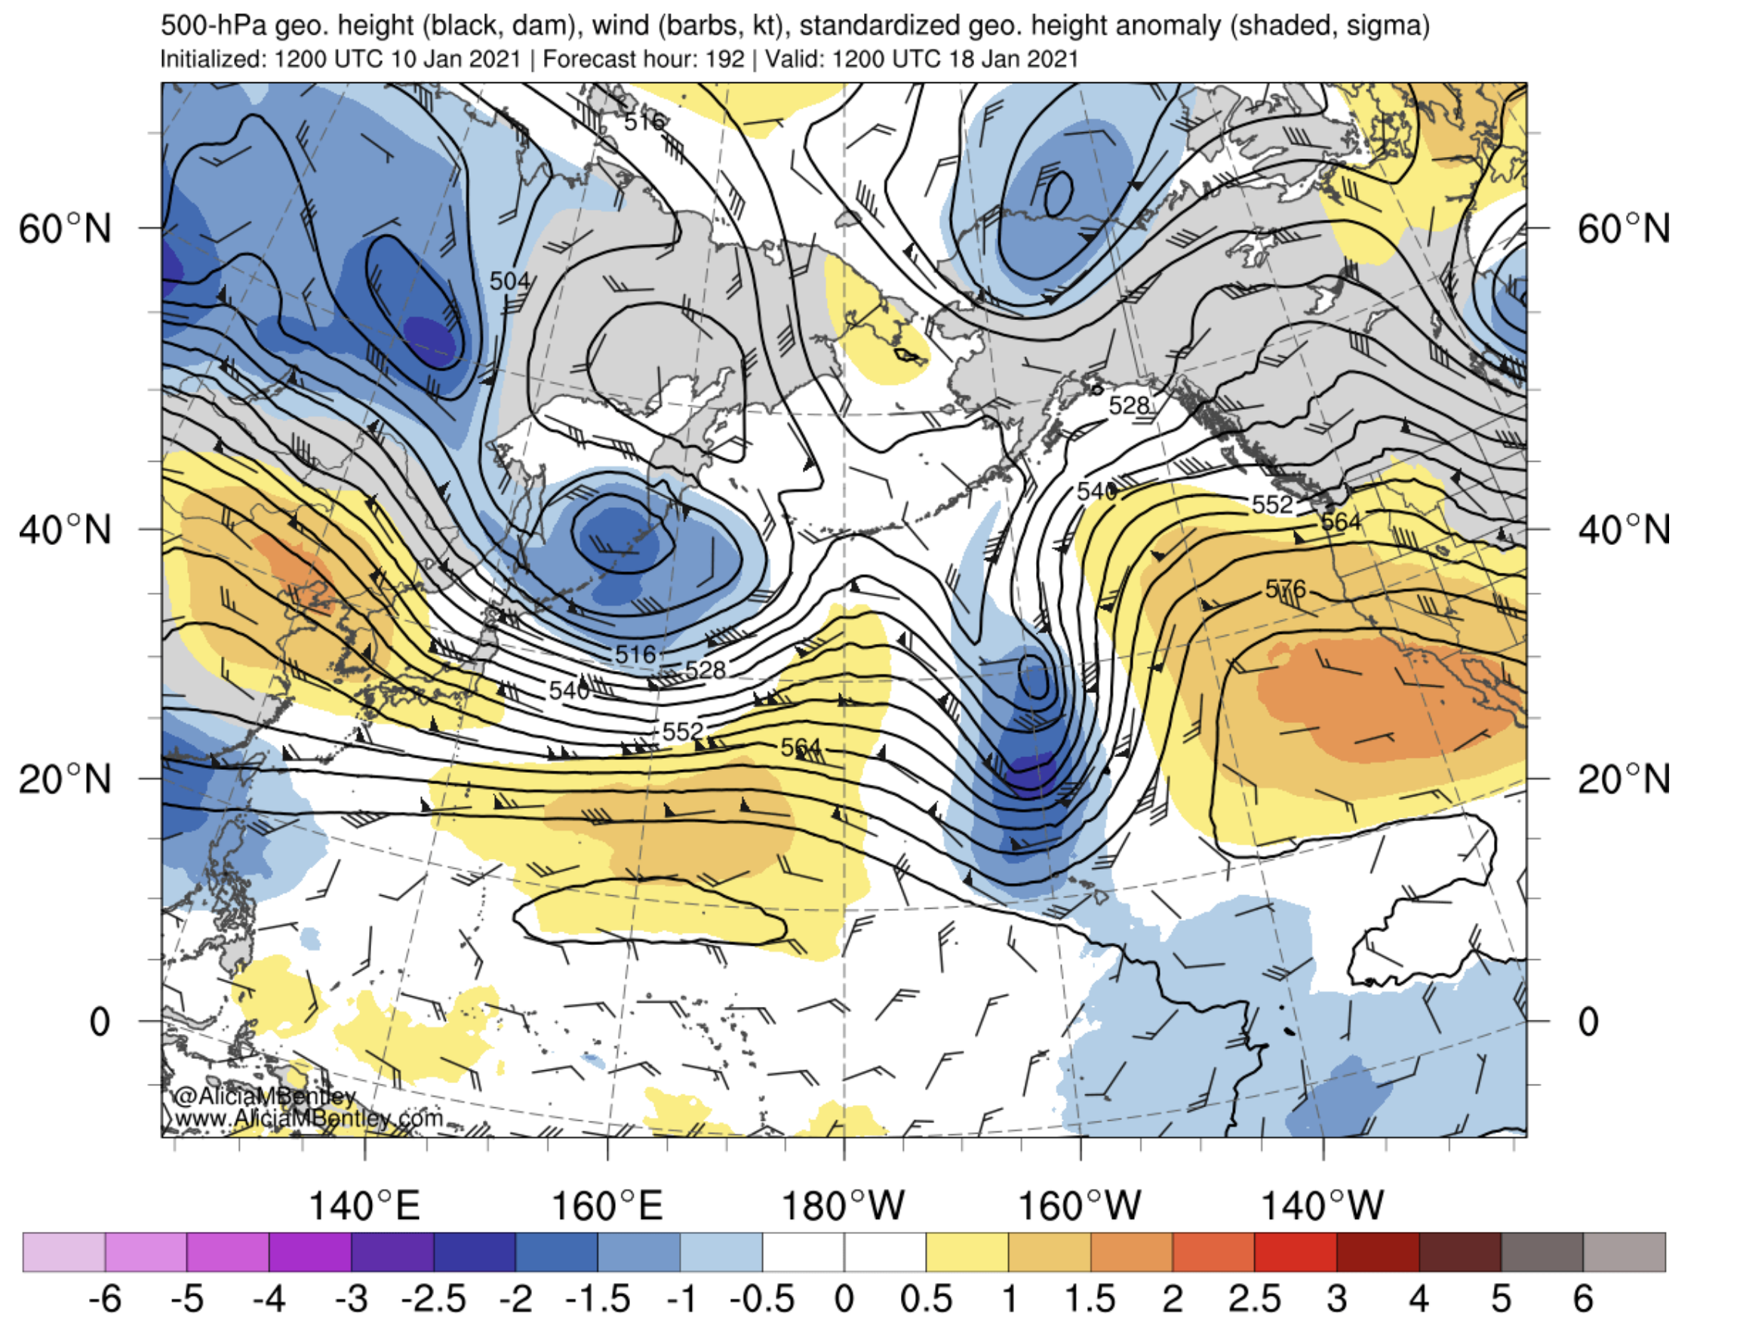

Slide 10
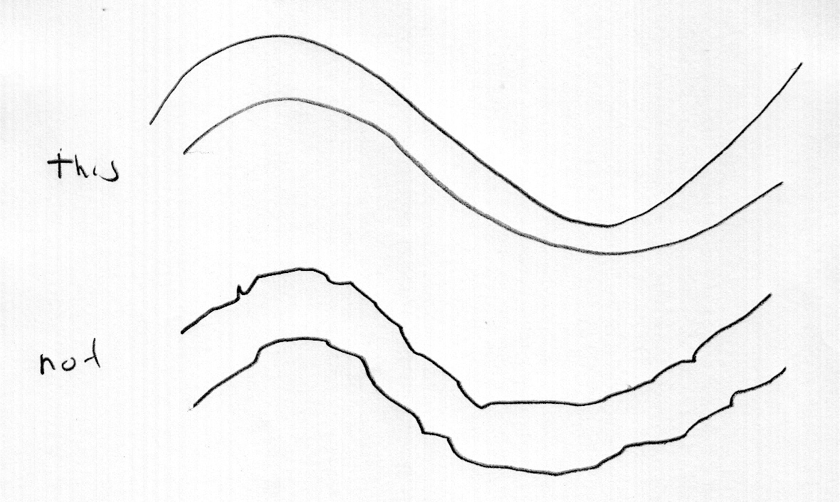
Important tip: You are doing a synoptic (larger scale) analysis. Keep lines smooth!
Keep in mind that all observations have errors: thus, you have some leeway with the lines

Slide 11
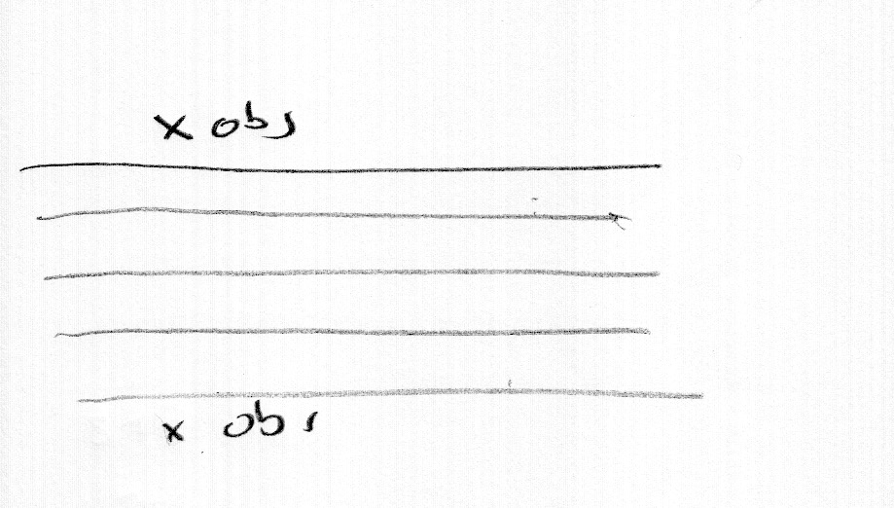
Where data is sparse, choose simple, regular spacing
This

Slide 12
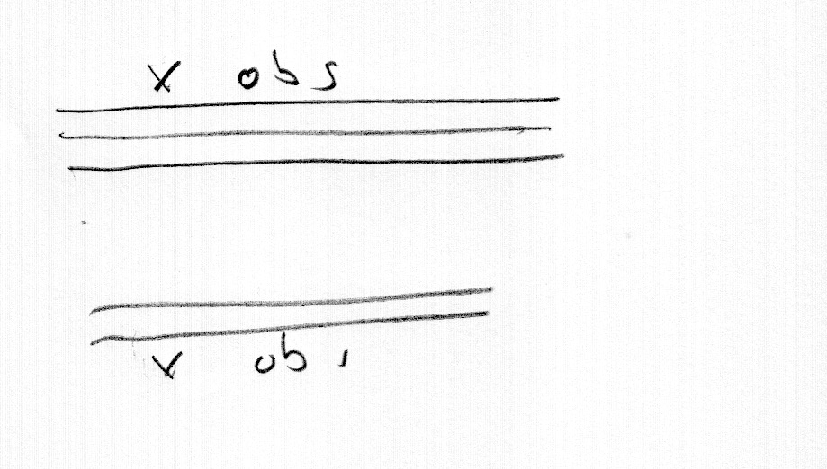
NOT THIS

Slide 13
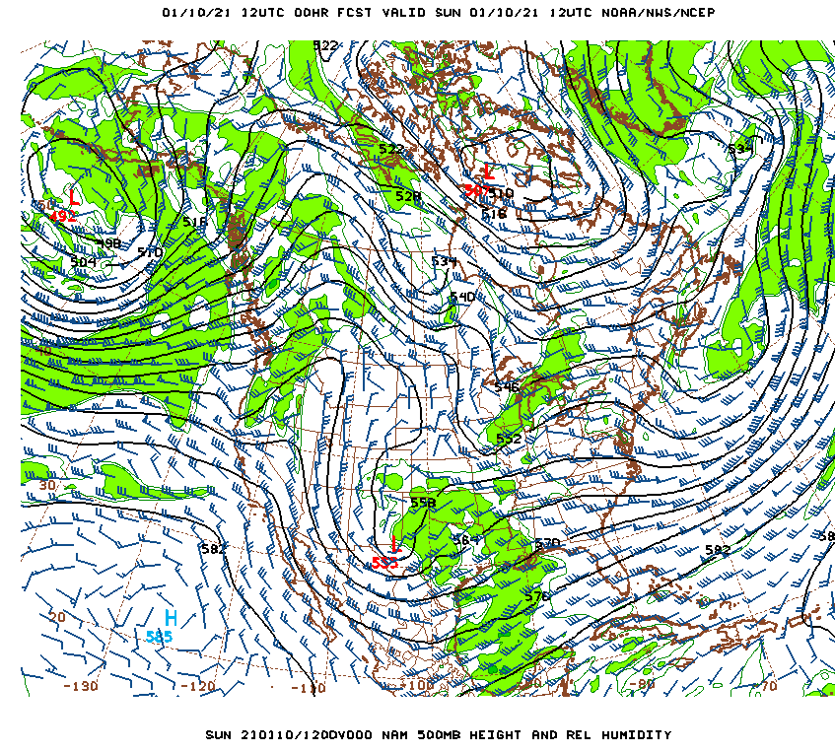
500 hPa analysis tips
Observations are not perfectly accurate, typically 500 hPa heights have errors of ~10-15 meters. Thus, you have some flexibility in your analysis.
Flow is very close to geostrophic at 500 hPa so:
  Winds should be ~parallel to height lines
  Wind speeds should be scaling with height gradient (winds stronger with greater gradients)
  Thus, winds give you a lot of information about height lines

Slide 14
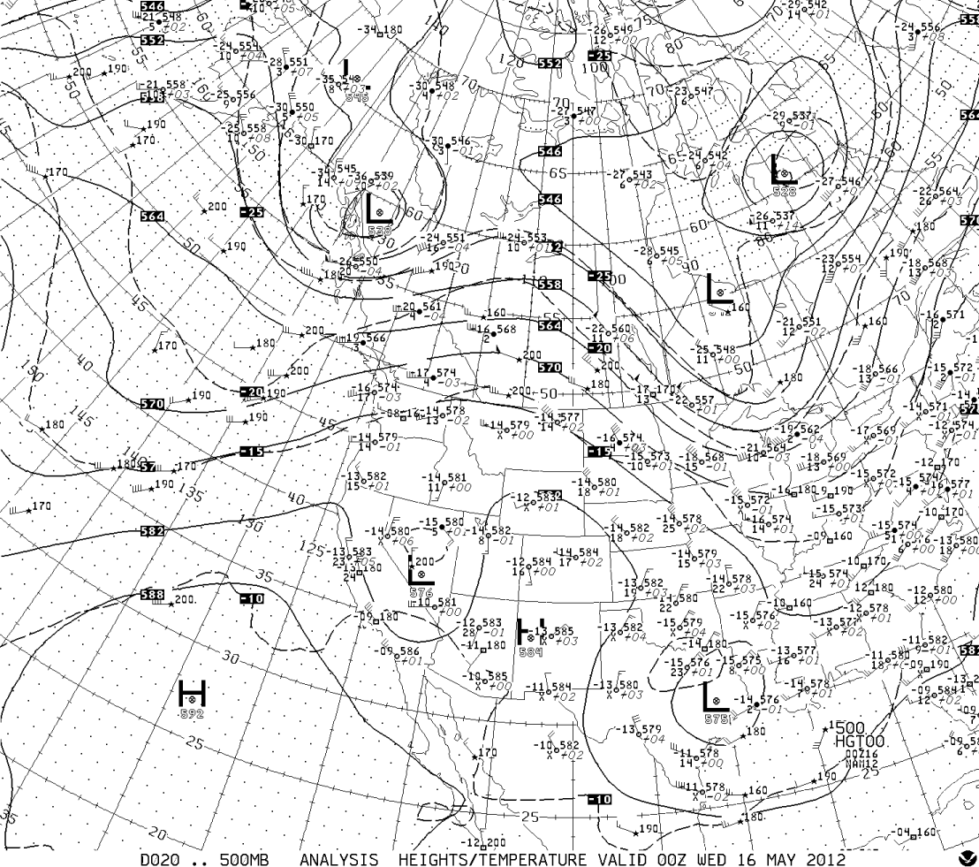

Slide 15
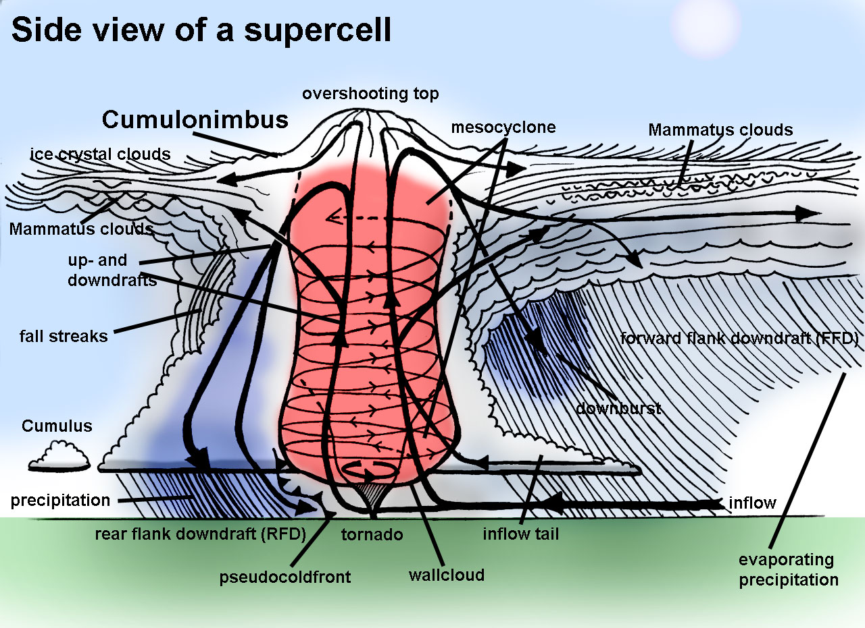
Sometimes there are discrepancies with geostrophy at 500 hPa
In tight troughs or ridges where the gradient wind balance is better than geostrophic
  supergeostrophic winds in ridges
  subgeostrphic winds in troughs.
  More later in class!
Where there are observation errors
Due to subsynoptic features we are not analyzing (e.g., thunderstorms)

Slide 16
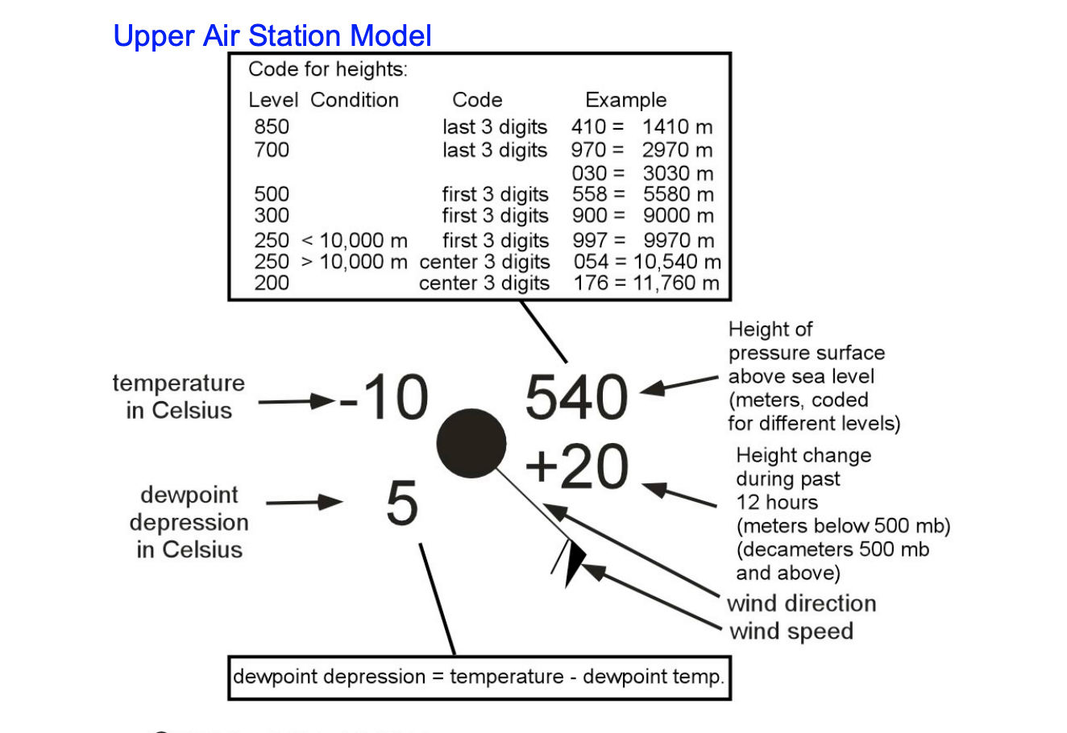
Upper-Level Station Model (radiosonde)
At 500 hPa, height (hhh) is
in decameters. (553 is 5530 meter)
Circle is shaded if dew point depression is five or less

Slide 17
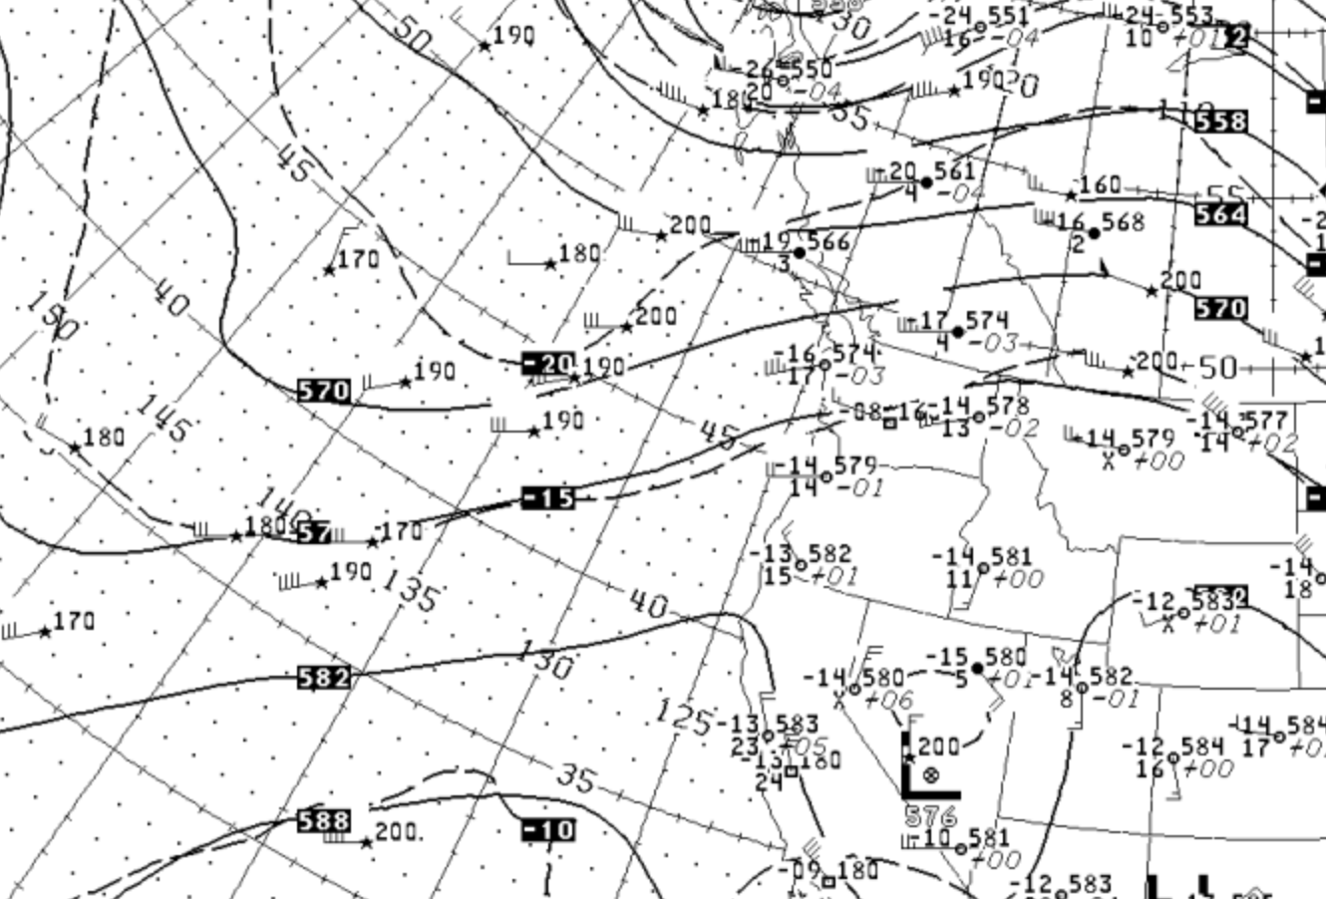
* Indicates satellite based observations

Slide 18
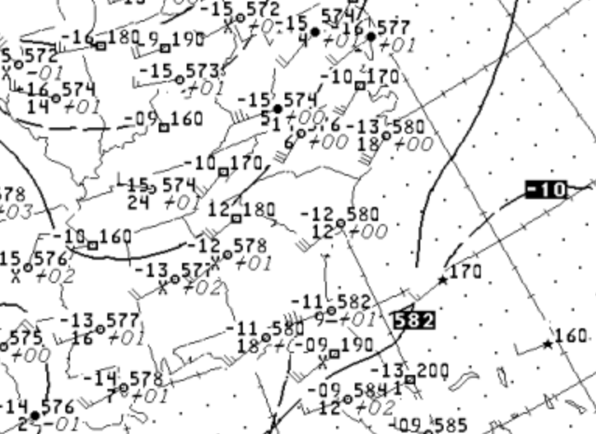
Rectangle indicates aircraft-based observations

