Slide 1
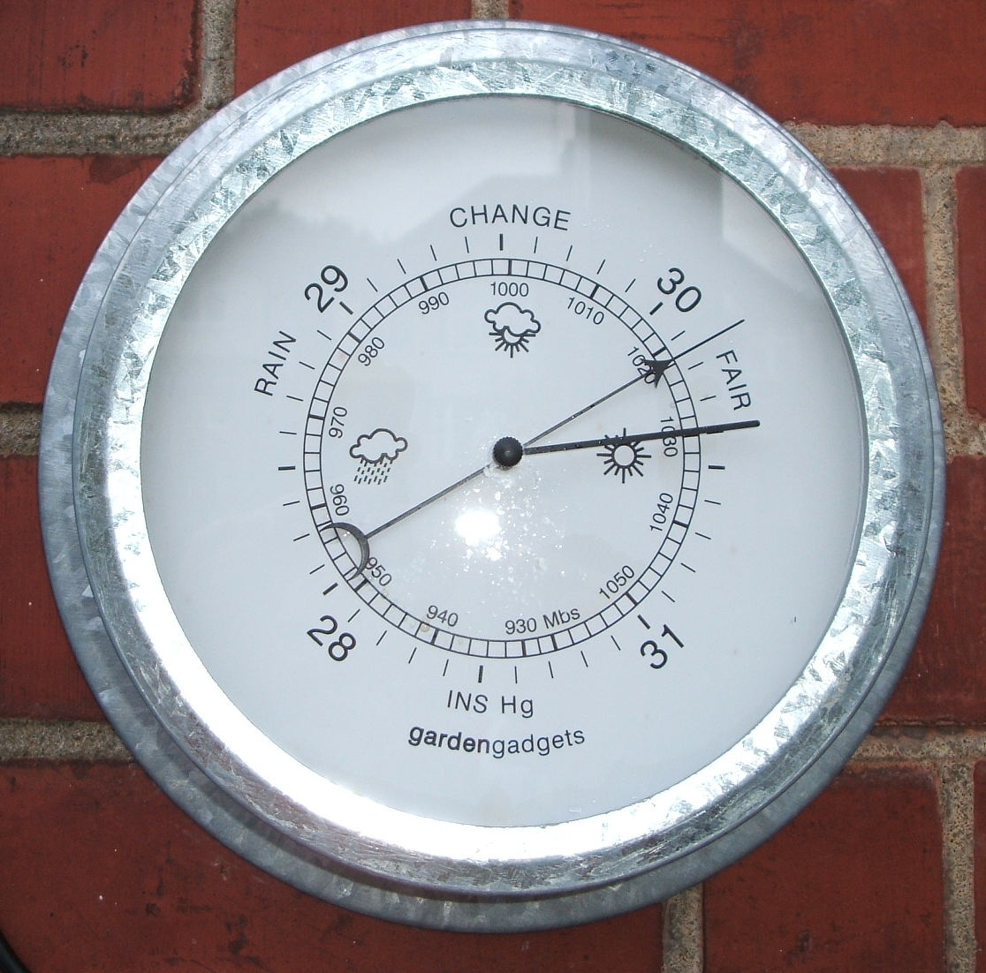
Forecasting Sea Level Pressure
ATMS 452
Spring 2023

Slide 2
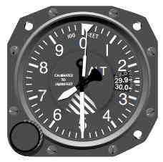
Remember: There Are Two Versions in General Use
Sea level pressure: takes station pressure to sea level using hypsometric equation. Uses temporally averaged surface temperature for reduction to SL.
Altimeter setting: also uses hypsometric equation but applies U.S. standard atmosphere for temperature structure.

Slide 3
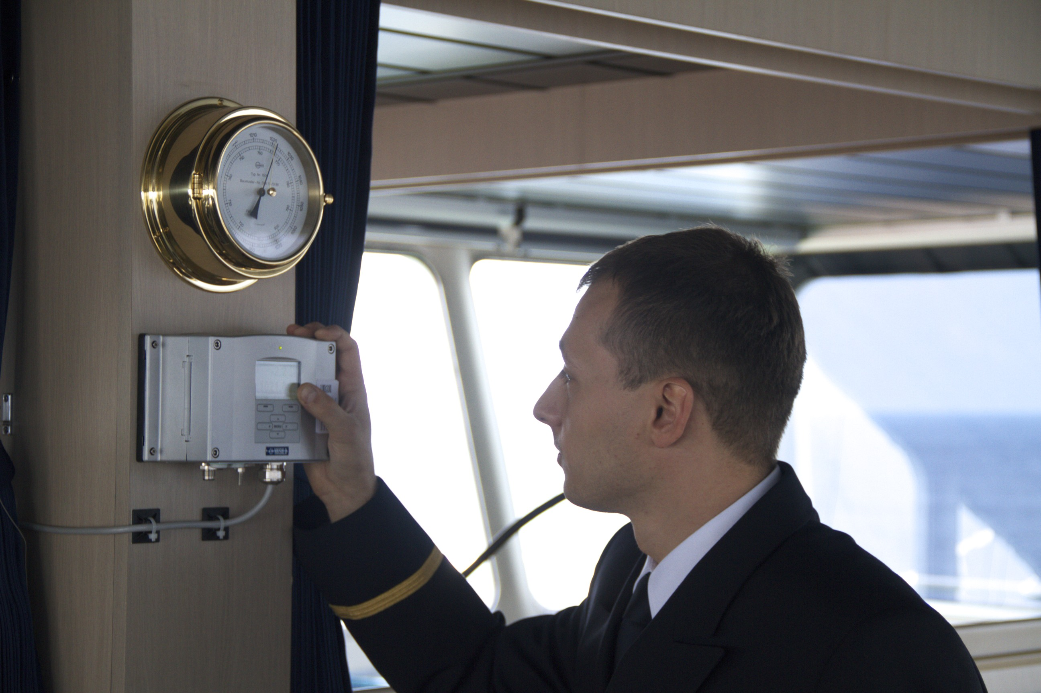
Surface Pressure Observations
ASOS is the best…the gold standard
Ships generally the worst
Huge number of pressures from smartphones are now becoming available

Slide 4
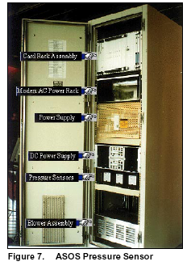
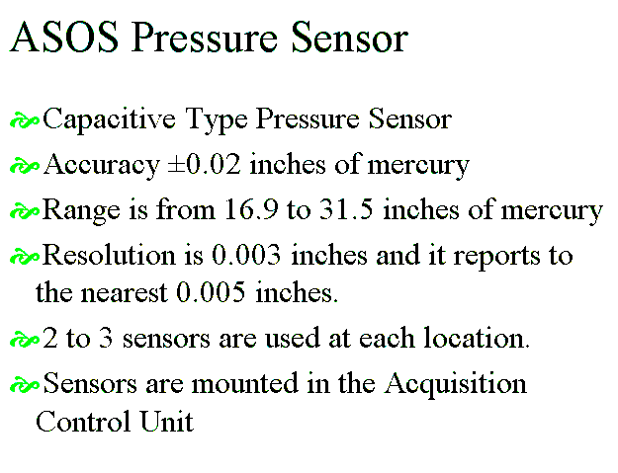

Slide 5
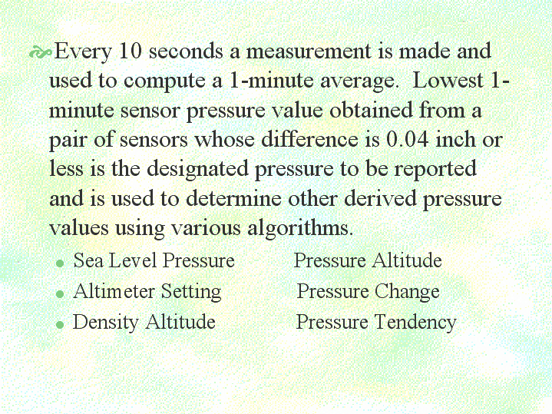

Slide 6
High-Resolution Models Can Greatly Improve Pressure Forecasts Near Terrain Compared to Coarse-Resolution Models

Slide 7
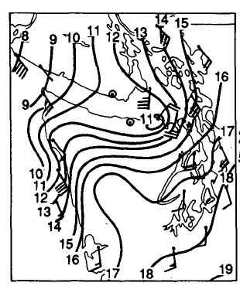
Effects of Terrain: Often a pressure ridge on windward side, pressure trough on lee side

Slide 8
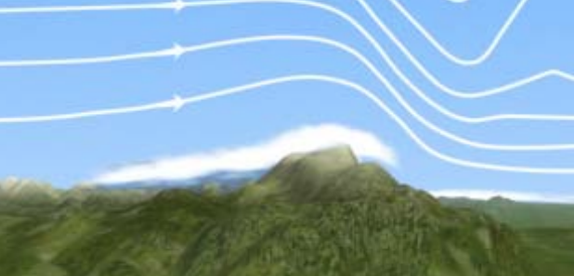
High
Low

Slide 9
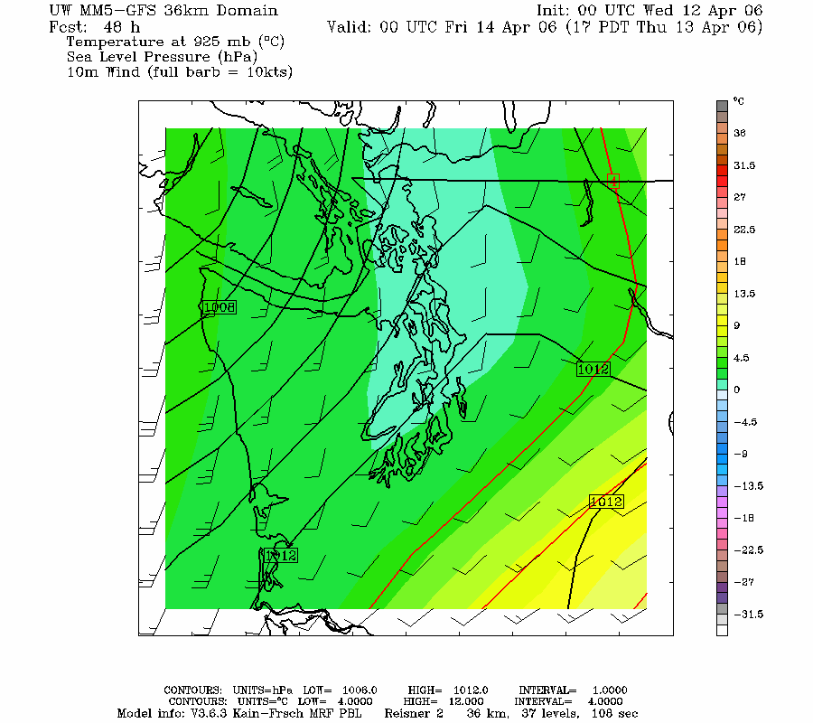
36 km

Slide 10
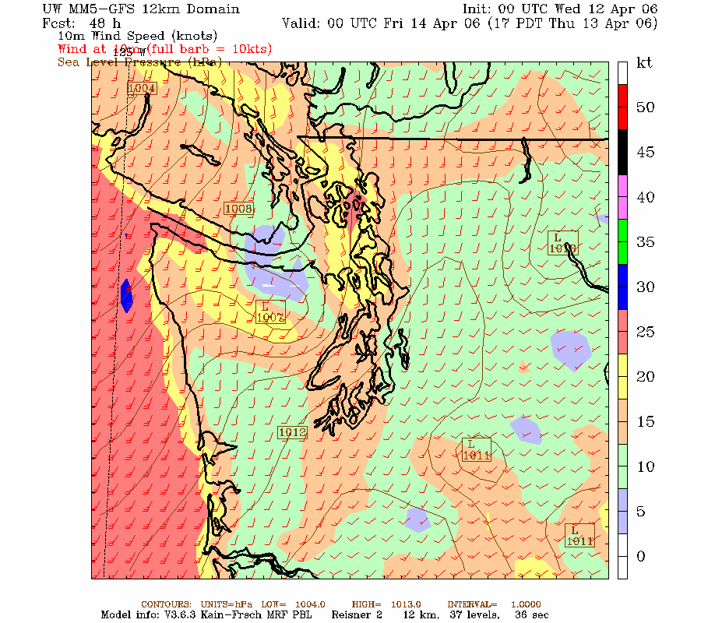
12 km

Slide 11
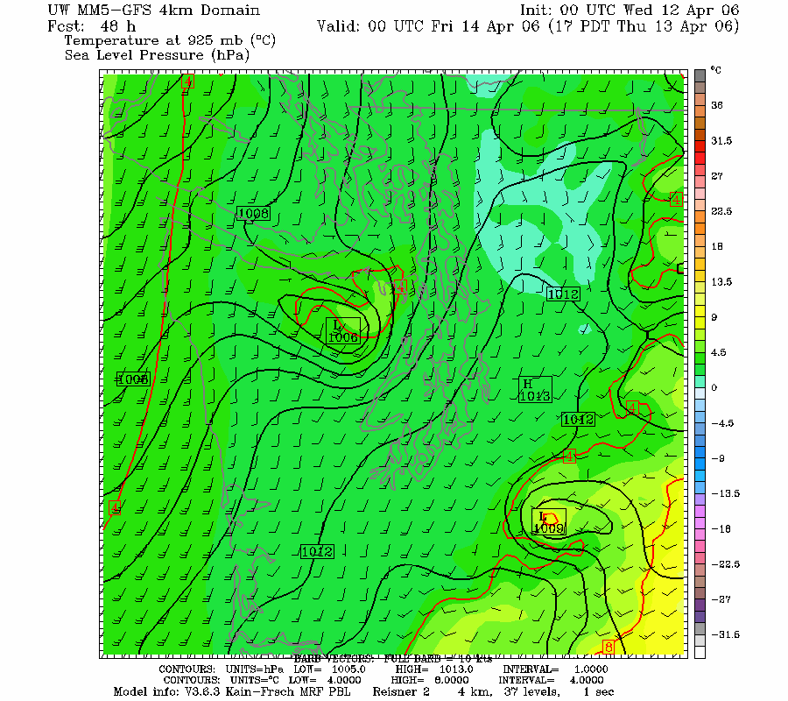
4km

Slide 12
Pressure “Reduction” to Sea Level
A Major Problem

Slide 13
Major Problem in Pressure Reduction for BOTH Analyses and Forecasts
Model pressure fields at sea level and geopotential heights at lower levels below terrain (e.g., 925 hPa) are based on assuming a 6.5 K per km lapse rate through the ground
Can give deceiving or WACKY results when actual lapse rate differs

Slide 14
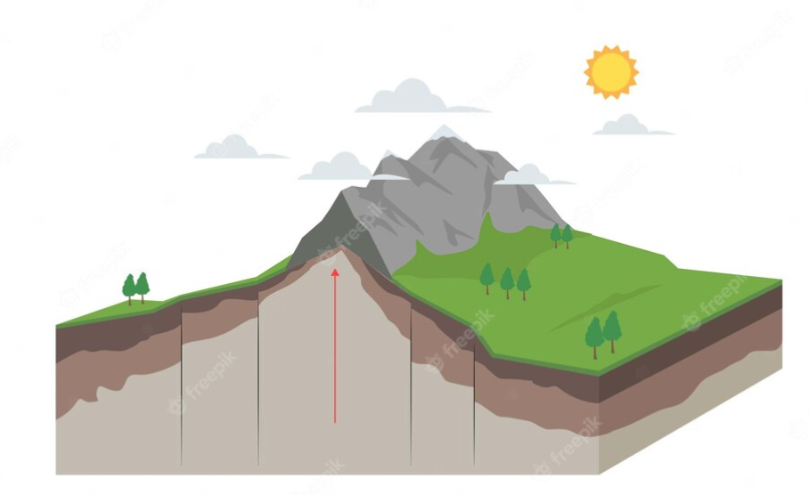
SL

Slide 15
Often the free atmosphere has a different lapse rate than assumed in terrain and that can lead to problems
Can result in fictious pressure features in model output
The fictious pressure features change during the day.

Slide 16
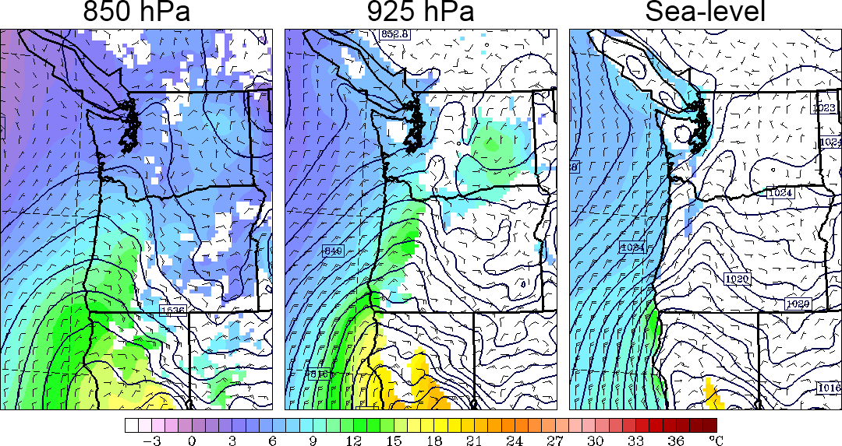
At Night During Warm Season: phony troughs under terrain during night

Slide 17
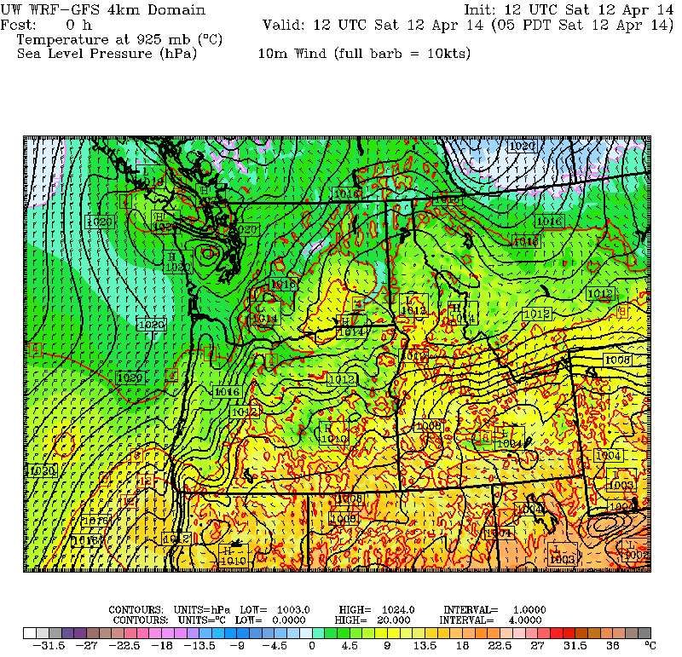

Slide 18
Why?
Models usually use the U.S. Standard Atmosphere for pressure reduction
During the night, as the lower atmosphere stabilizes (cools), the free (real) atmosphere can develop a smaller decrease of temperature with height than the U.S. Standard Atmosphere at low levels (smaller lapse rate than 6.5 C per km).
Too warm under model terrain.
This produces an artificial pressure gradient, with unreasonable low pressure under terrain

Slide 19
Nighttime Situation
Same pressure at 1 km
0C
0 C
1km
Free
Atmosphere
cooler
US Standard
Atmosphere
warmer
4 C
6.5 C
Higher SLP
Warmer…Lower SLP
Thus, the model atmosphere under terrain is warmer than in the real world producing unrealistic low pressure.
Away from terrain there are no reduction issues.

Slide 20
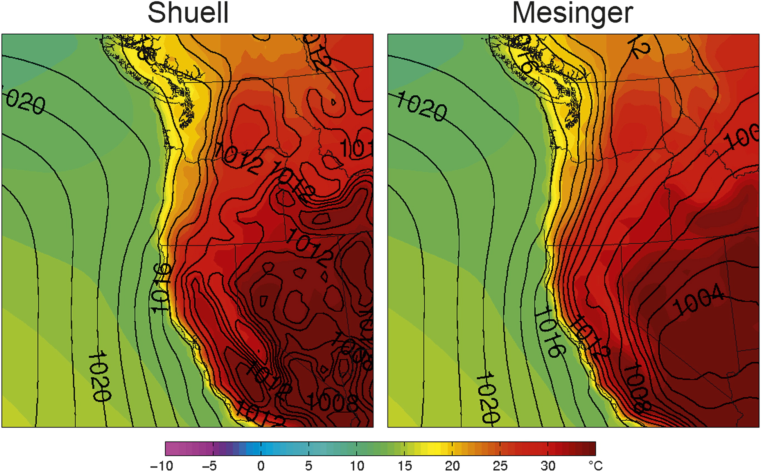
During the day just the opposite, phony troughs inland at low elevations
Fig. 5. Composites of sea level pressure (solid lines, hPa) and 1000-hPa temperature (color shading, C) for JJA at 0000 UTC.

Slide 21
Why?
During the day, the real atmosphere over the Central Valley is ~dry adiabatic (9.8 C per km), while over the mountains we assume U.S. Standard atmosphere (6.5C per km).
Becomes cooler at low levels inside the mountains…thus higher pressure.

Slide 22
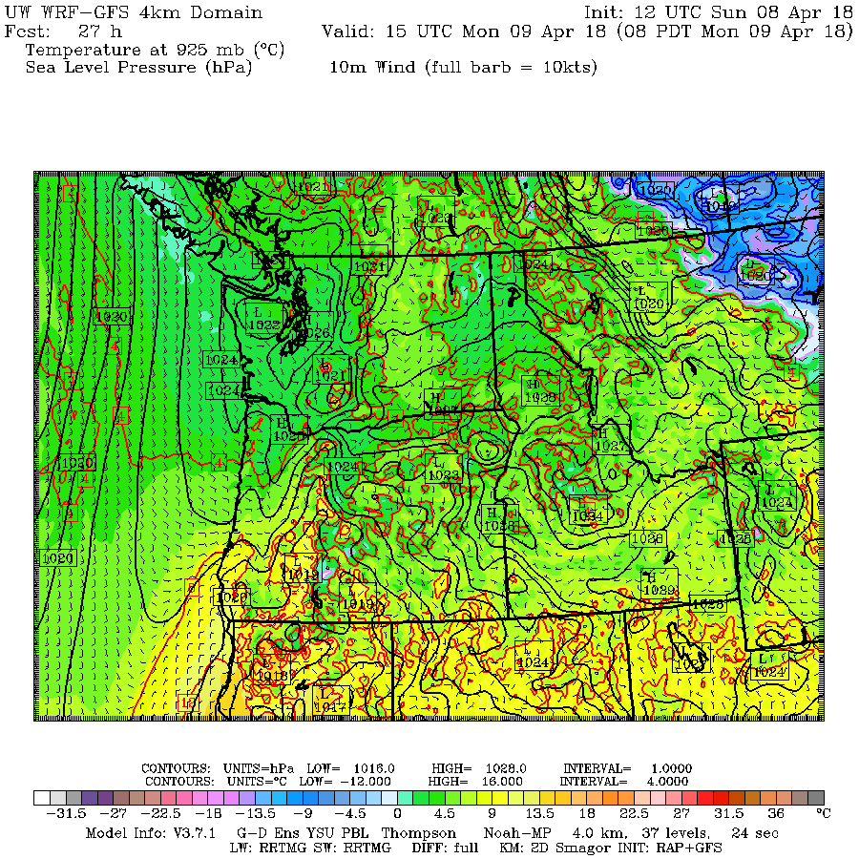
These problems are often evident

Slide 23
Although model improvements have occurred, significant pressure errors sometimes occur

Slide 24
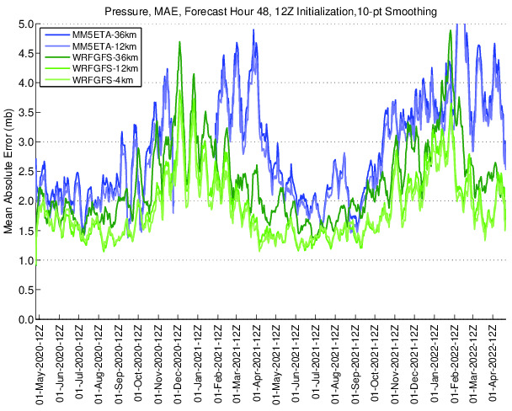
Errors
Large in
Winter

Slide 25
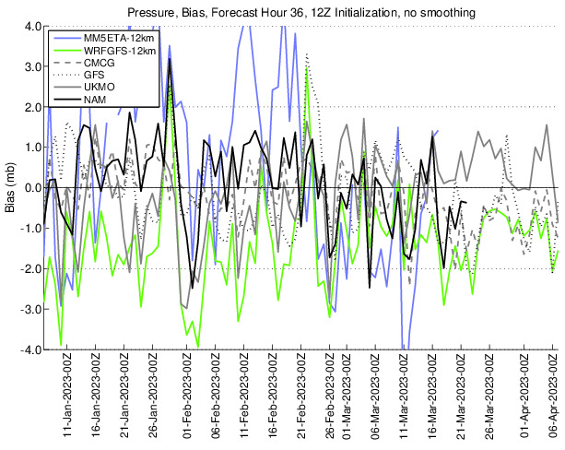
Different modeling systems have different pressure biases

Slide 26
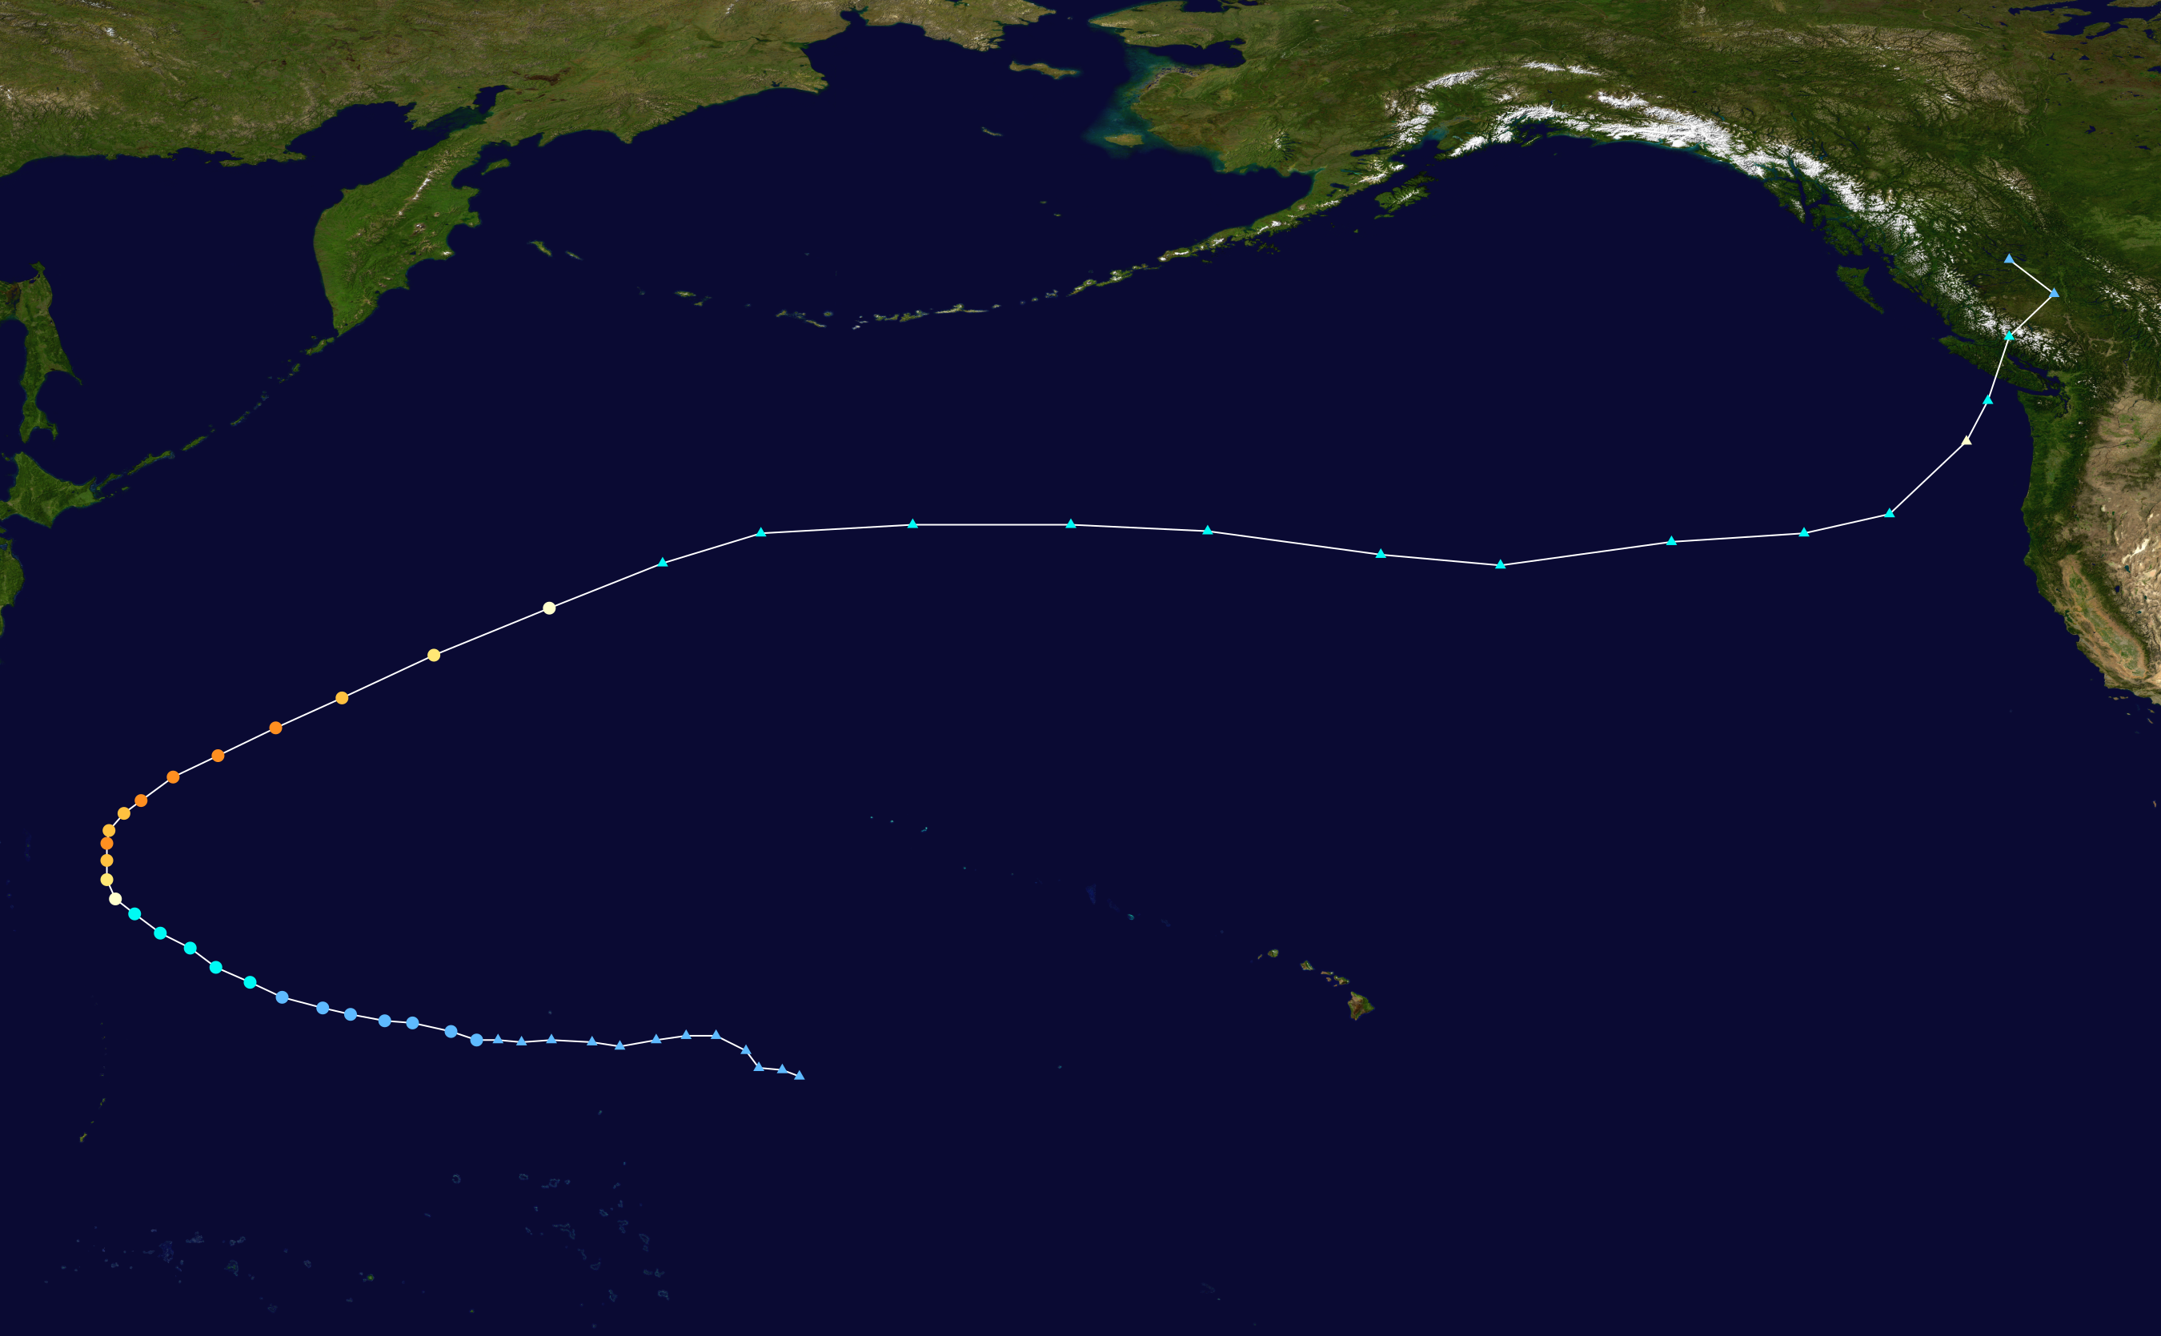
Major Pressure Errors Often Occur with Extratropic Transition Events
Typhoon Songda: October 2016

Slide 27
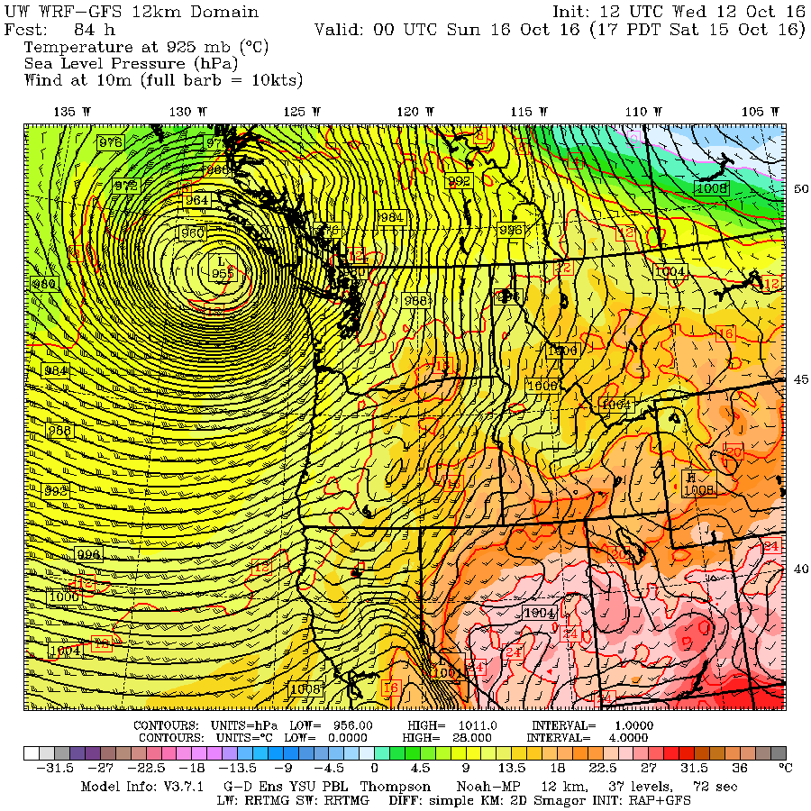
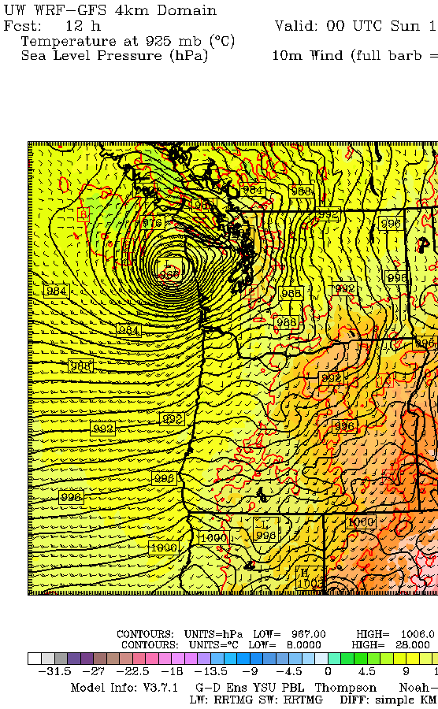

Slide 28
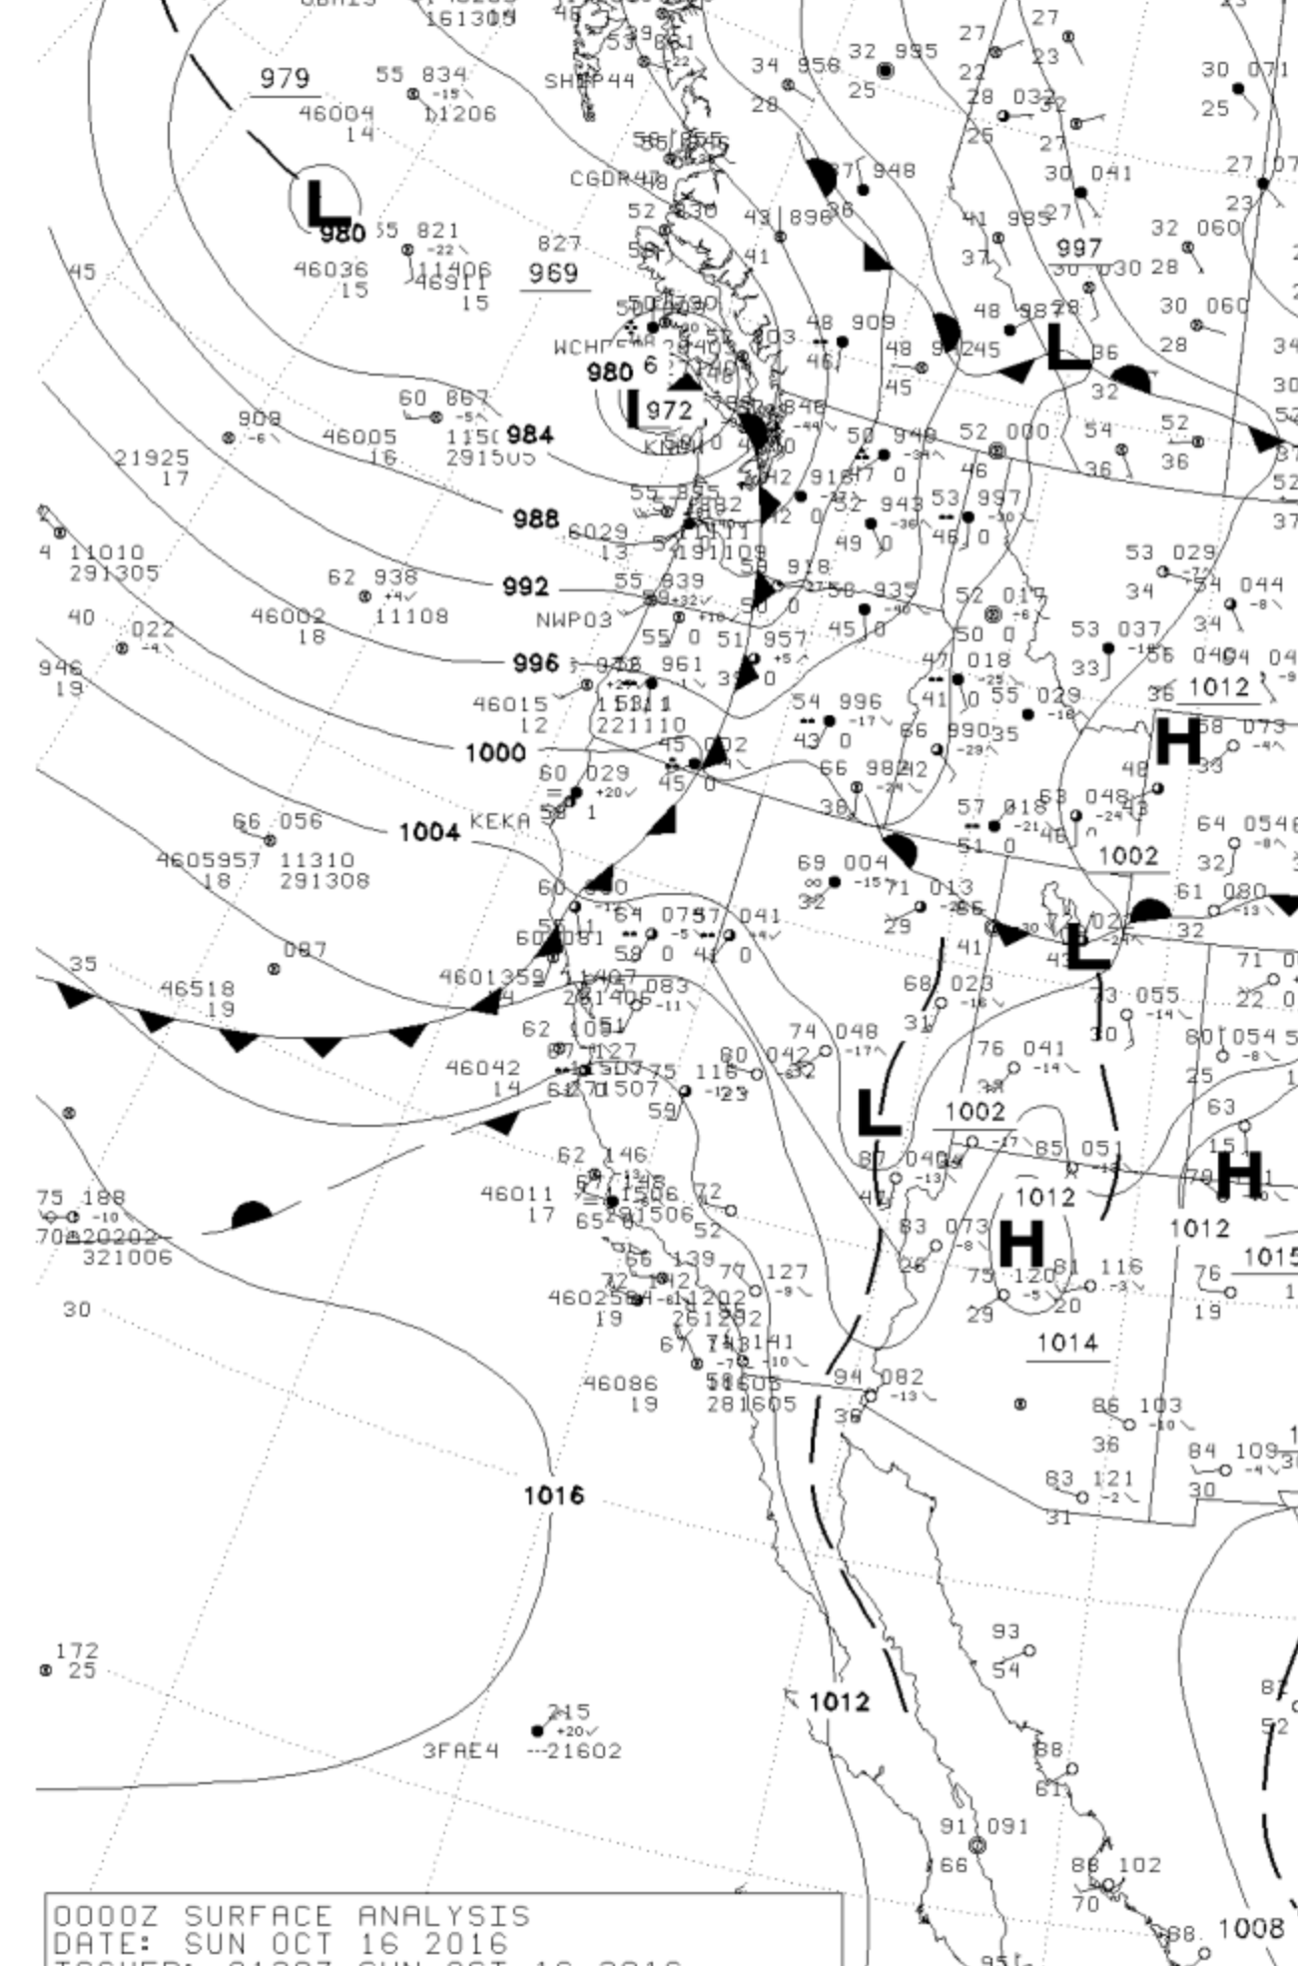

Slide 29
GFS Generally Has Far Better Pressure Forecasts Than NAM

Slide 30
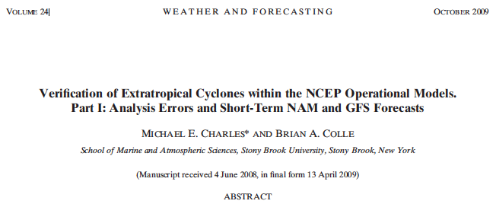
The NCEP GFS has more skillful cyclone intensity and position forecasts than the NAM over the continental United States and adjacent oceans
Over the eastern Pacific the NAM has a large positive (underdeepening) bias in cyclone central pressure.
For the short-term (0–60 h) forecasts, the GFS and NAM cyclone pressure errors over western North America are larger than the other regions to the east.

Slide 31
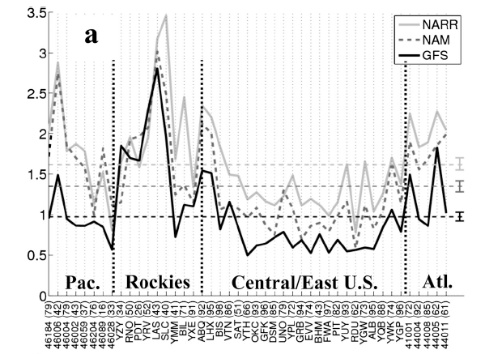
SLP analysis MAE for the GFS (solid black), NAM
(dashed), and NARR (gray). The numbers of cyclones verified between 2002 and 2007 are shown in the parentheses. The dashed horizontal lines represent the average error during the period and the 90% confidence intervals are shown using the vertical bar on the right.
Pressure Errors Vary Spatially

Slide 32
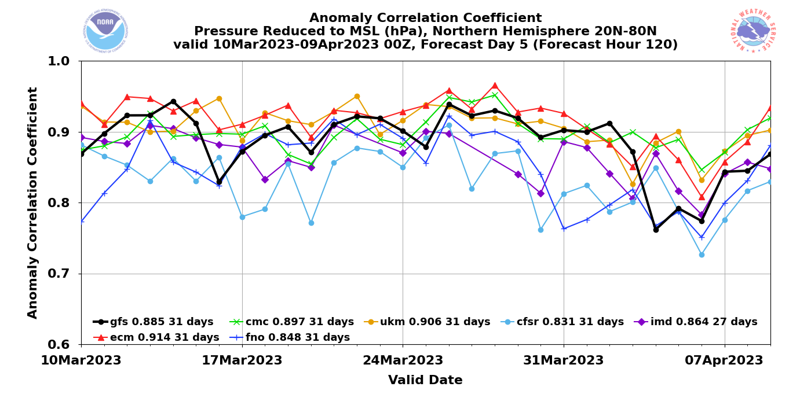
Global Models: ECMWF is best. UKMET is second
GFS is more likely to have pressure “drop outs”

Slide 33
Smartphone Pressures
Some smartphones measure pressure information
Encouraging data assimilation experiments using this data source.

Slide 34
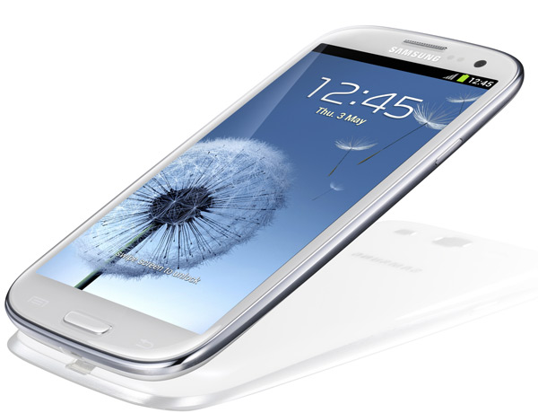

Some of the smartphones/pads with pressure sensors
iPhone
Samsung Galaxy III, IV, V, VI
Nexus 4 and 10
Some Sony, Nokia, and Chinese phones

Slide 35
Smartphone Pressures
Currently getting 60 million a day from IBM/weather.com
Excellent calibration using machine learning.
There may be a new source with much more data.

Slide 36
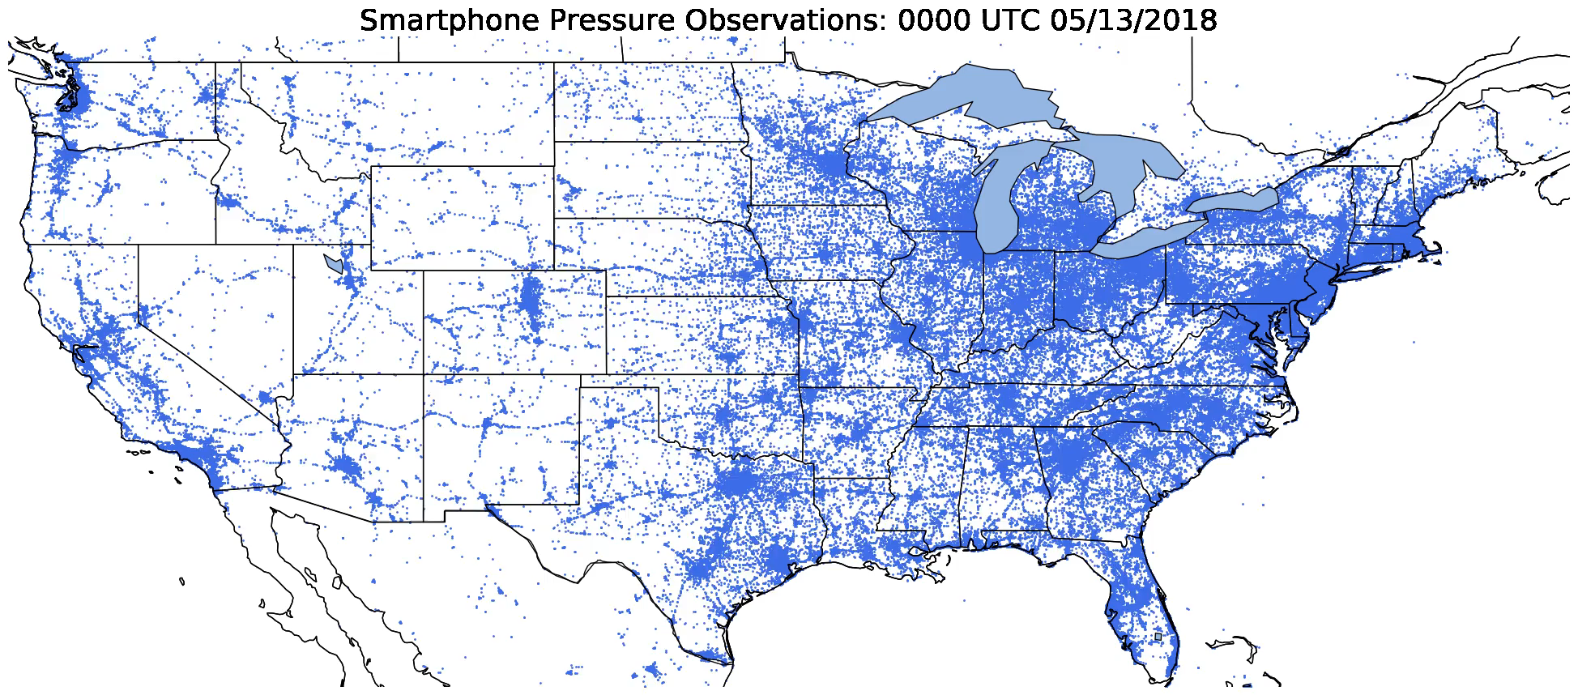
Notes:
Hook: Show time-lapse of madis pressure observation locations in the United States. Then show time-lapse of smartphone pressure observations (ask what if it looked like this).
Reasons why more surface data is necessary:
- Extending predictability requires better initial conditions (Zhang et al., 2019)
- Increased surface observation density in space and time has been shown to be beneficial for convective forecasting (Sobash and Stensrud, 2015; Gasperoni et al. 2018)
- Verification for high resolution numerical models.

Slide 37
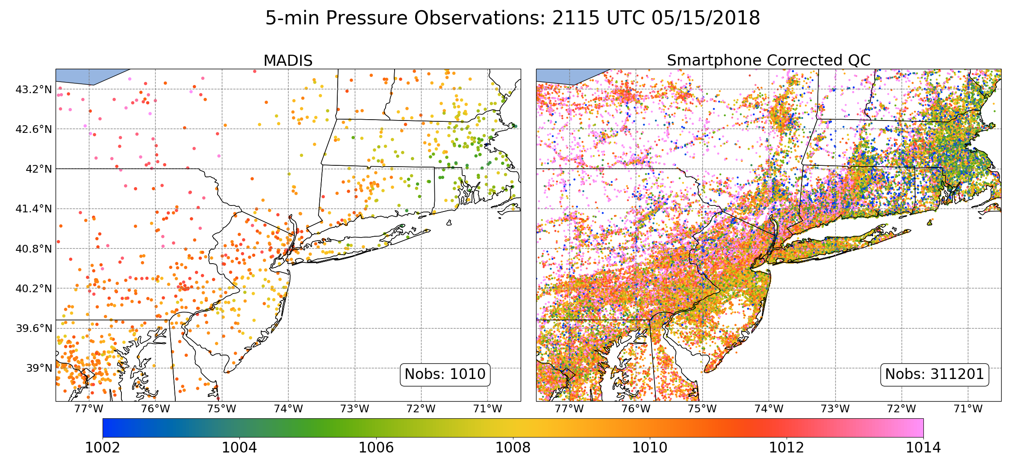
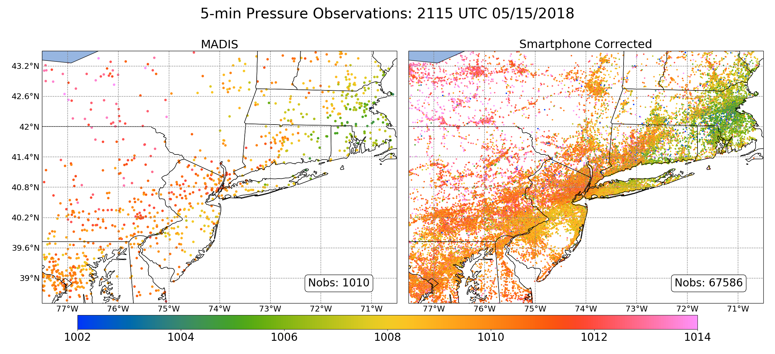
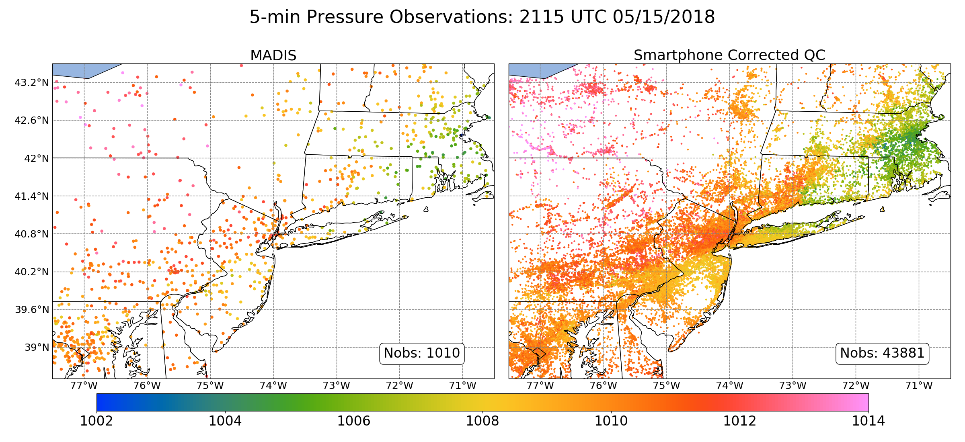
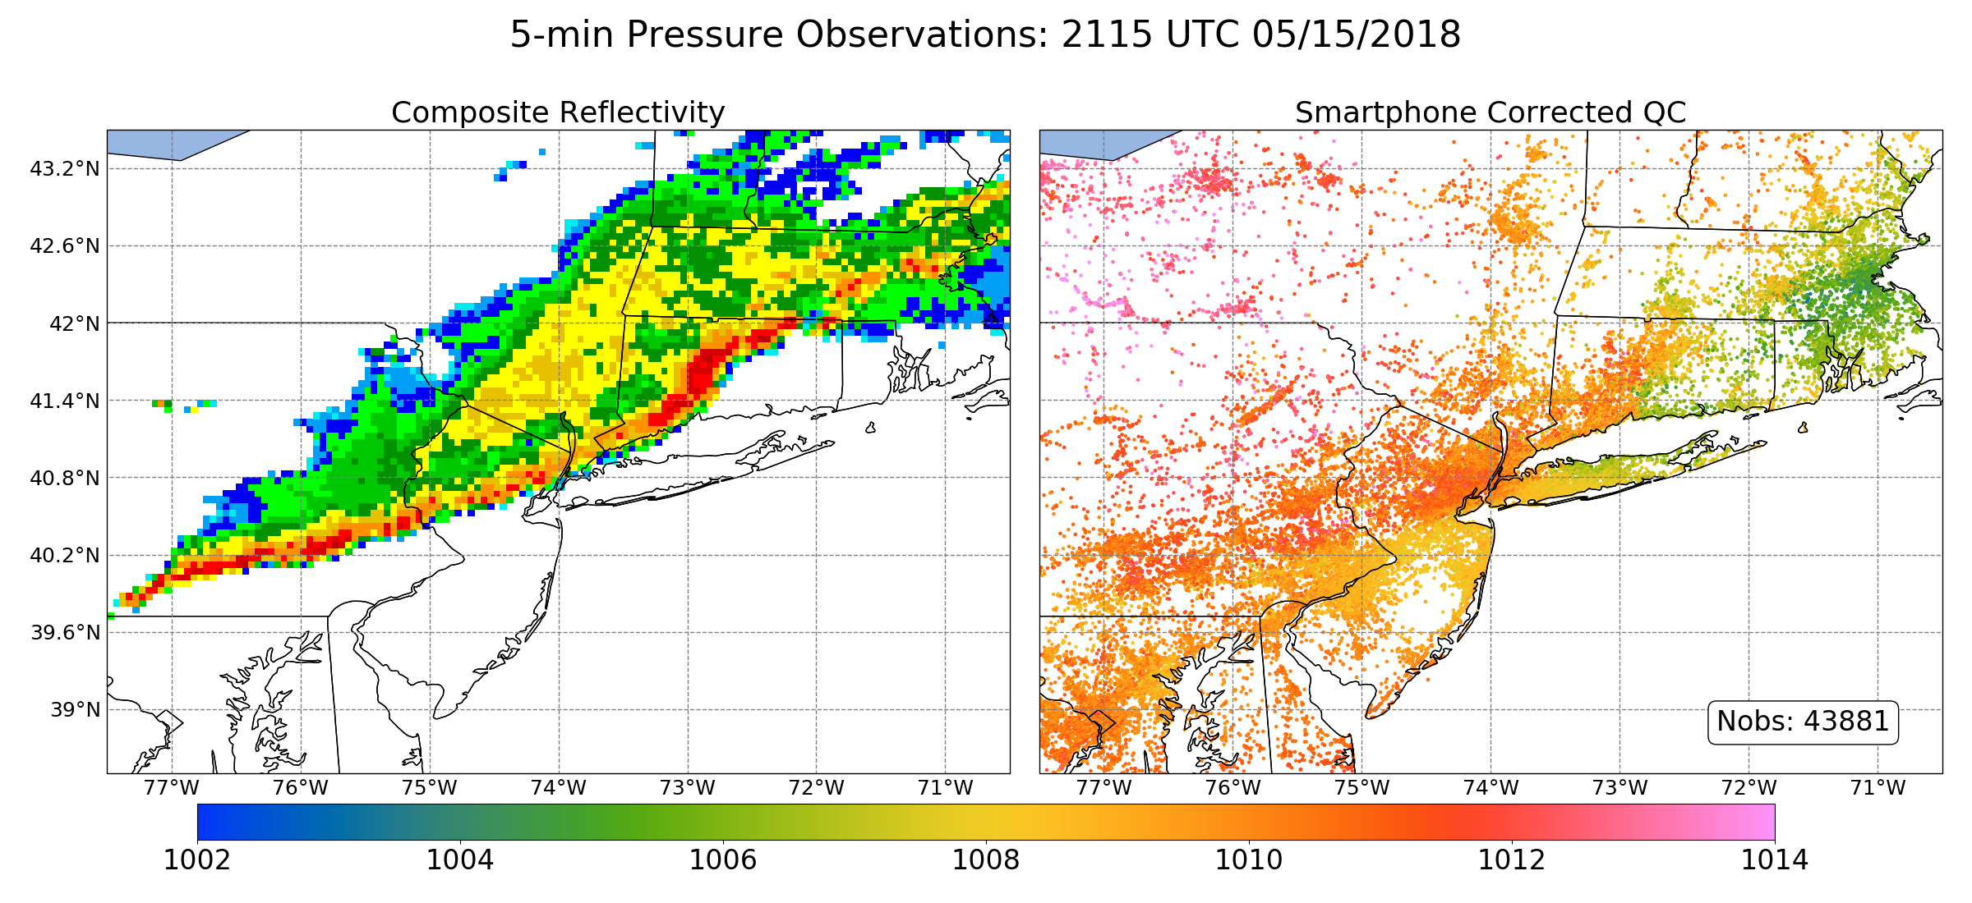
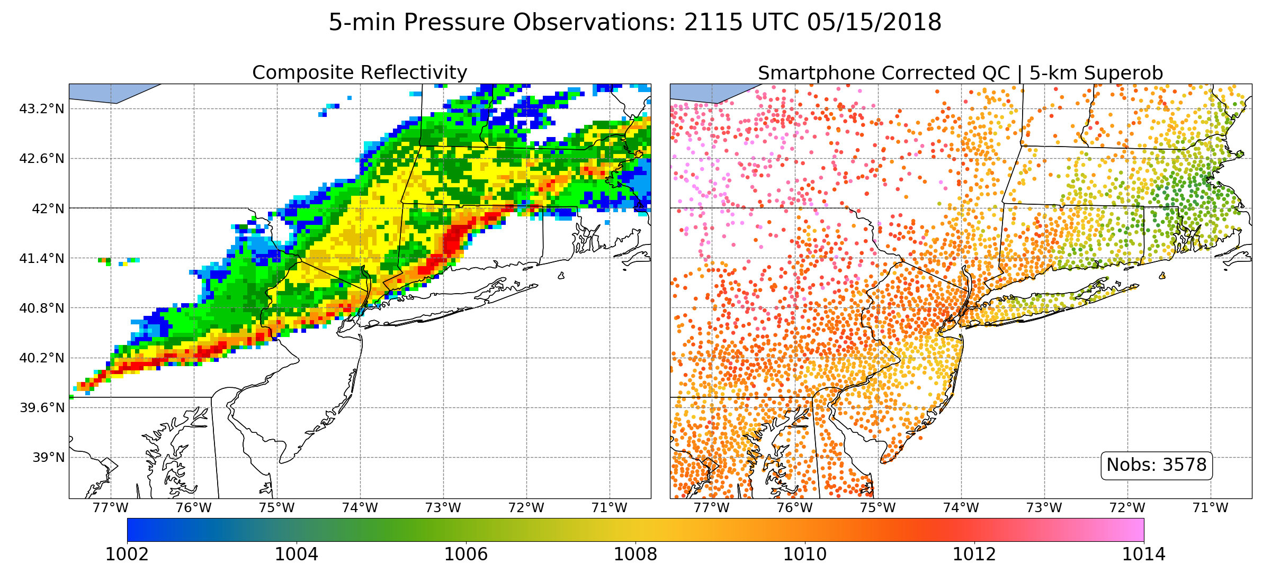
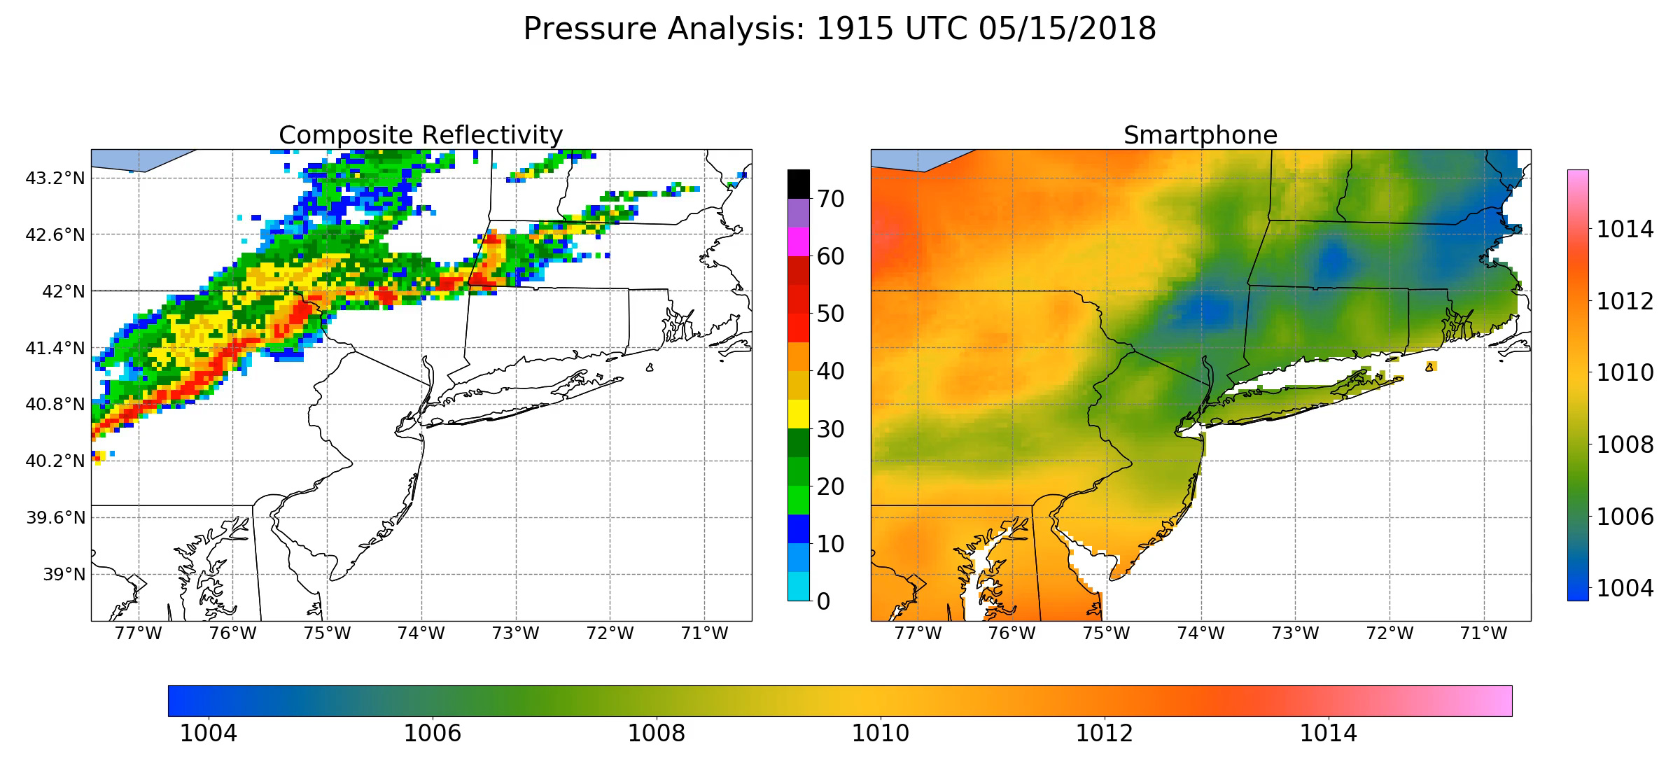
Notes:
Hook: Show time-lapse of madis pressure observation locations in the United States. Then show time-lapse of smartphone pressure observations (ask what if it looked like this).

Slide 38
Forecasting Strategy for Pressure
You are dependent on the models
Your task is to pick the best one for your area.
ECMWF/UKMET generally the best synoptic pressures across the globe.
High-resolution models needed to get pressures right in areas of complex terrain.
Learn about model pressure biases for locations of interest.

Slide 39
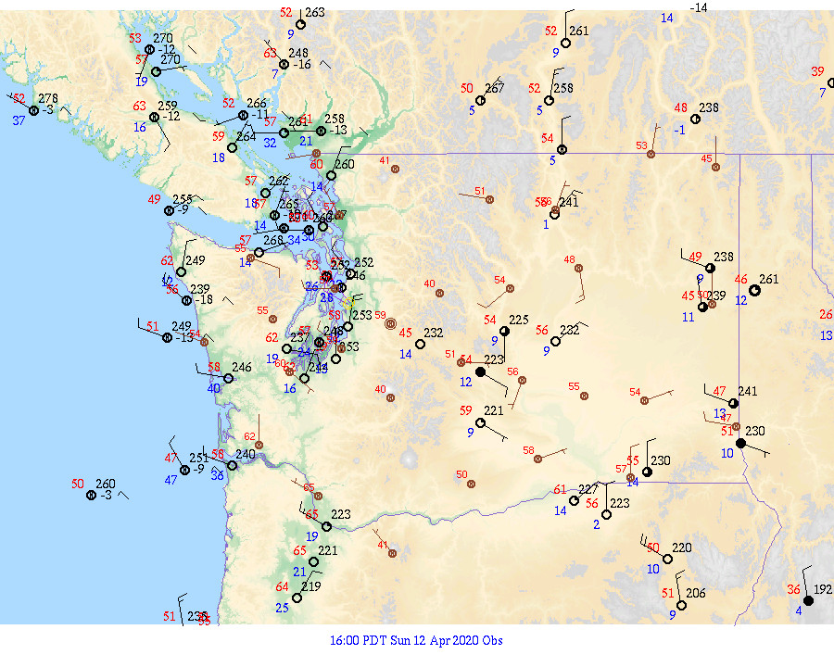
The value of isallobaric analyses and pressure tendency
Isallobar: lines of constant pressure change.

Slide 40
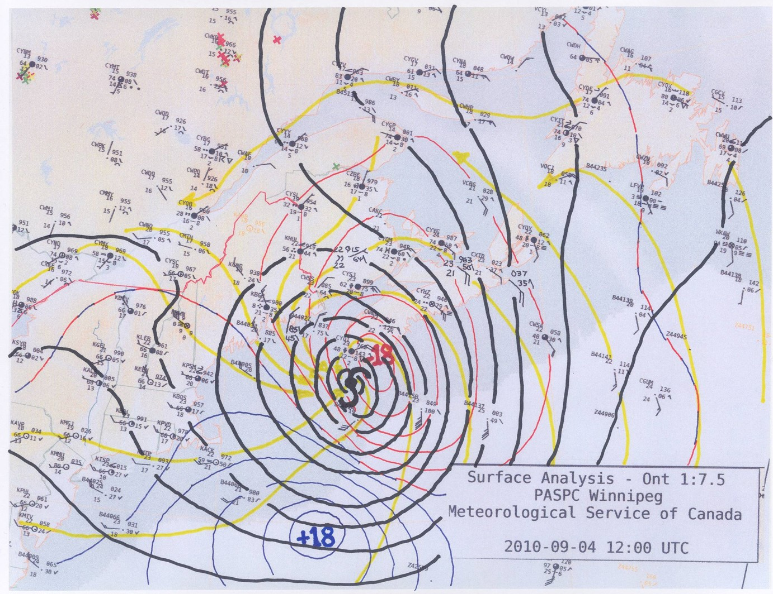
Isallobaric analysis

Slide 41
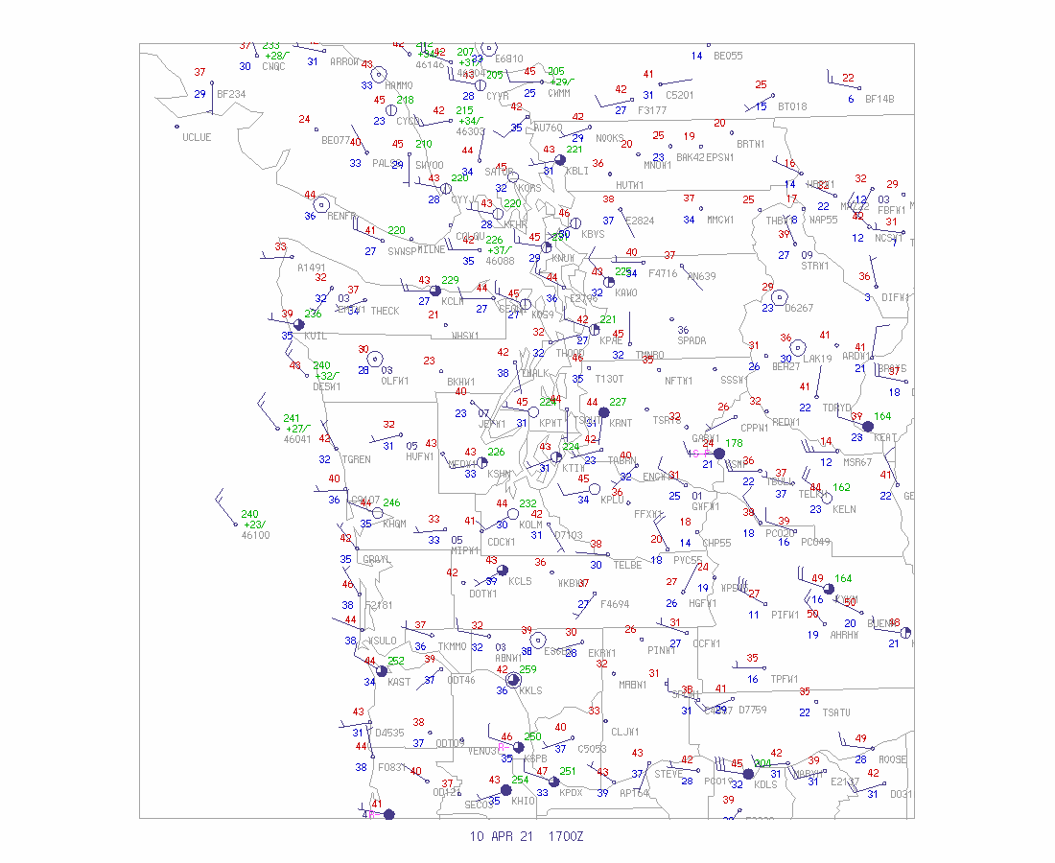
When models are going bad
The use of pressure change can help identify where low centers are heading if NWP has problems.

