Slide 1
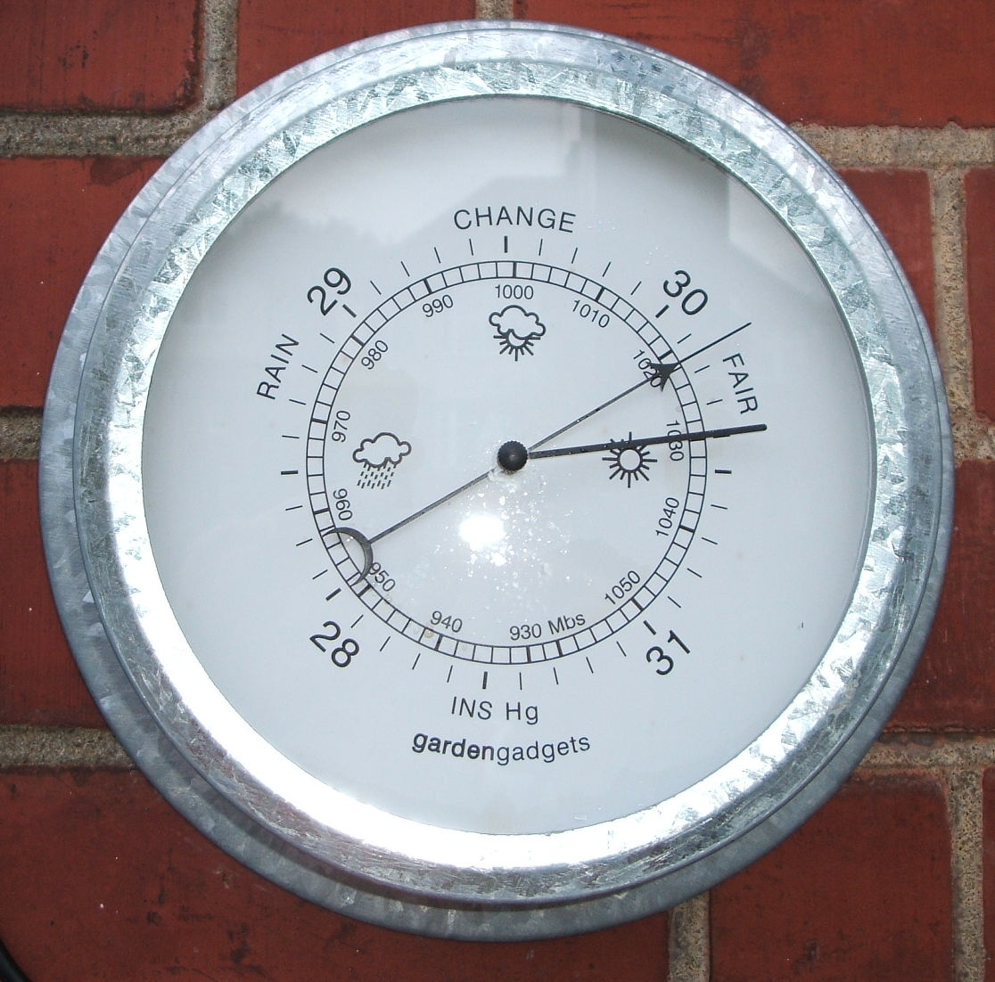
Forecasting Sea Level Pressure
ATMS 452
Spring 2022

Slide 2
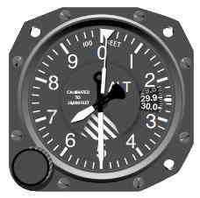
Remember: There Are Two Versions in General Use
Sea level pressure: takes station pressure to sea level using hypsometric equation. Uses temporally averaged surface temperature.
Altimeter setting: also uses hypsometric equation, but applies U.S. standard atmosphere for temperature structure.

Slide 3
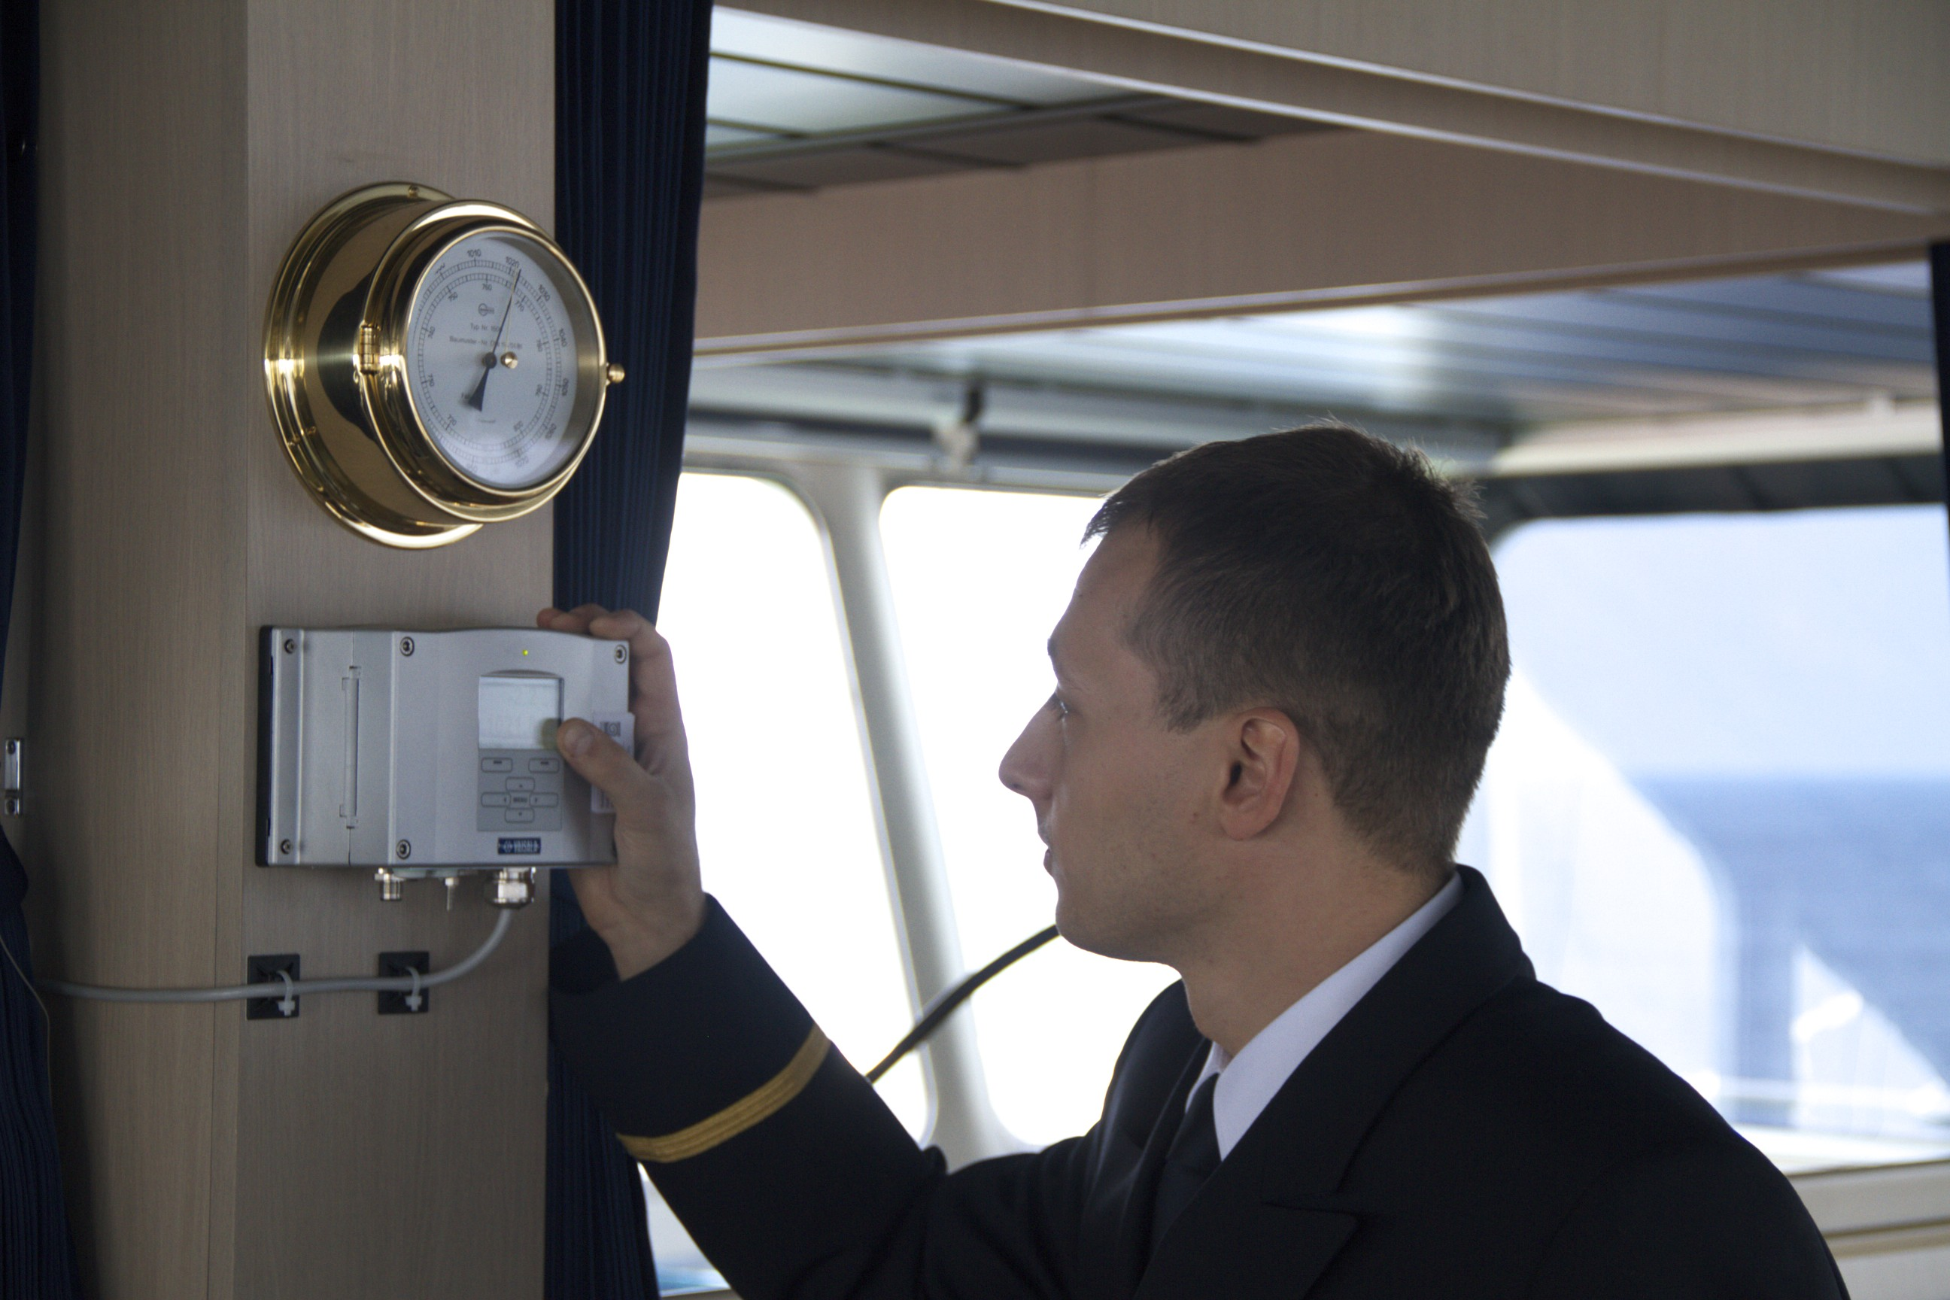
Surface Pressure Observations
ASOS is the best…the gold standard
Ships generally the worst
Huge number of pressures from smartphones are now becoming available

Slide 4
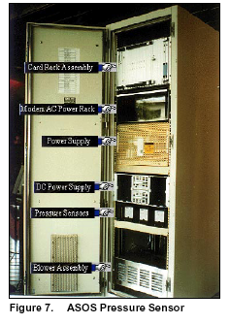
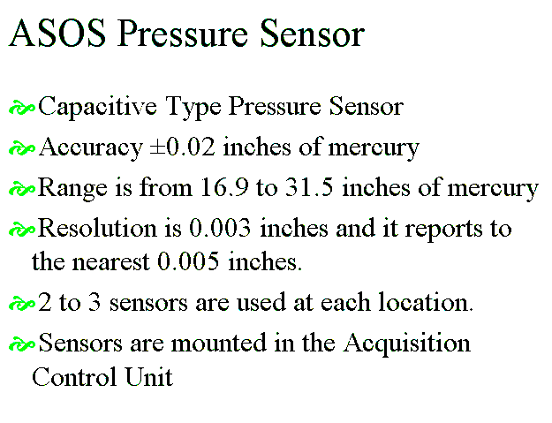

Slide 5
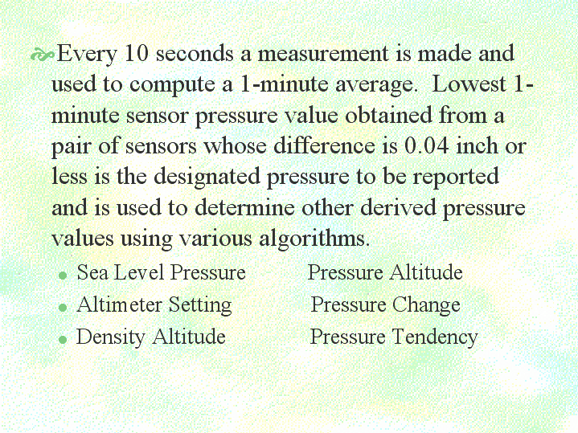

Slide 6
High-Resolution Models Can Greatly Improve Pressure Forecasts Near Terrain Compared to Coarse-Resolution Models

Slide 7
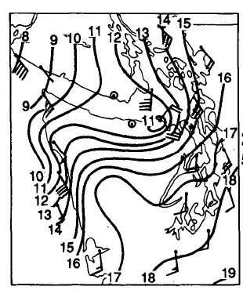
Effects of Terrain: Often a pressure ridge on windward side, pressure trough on lee side

Slide 8
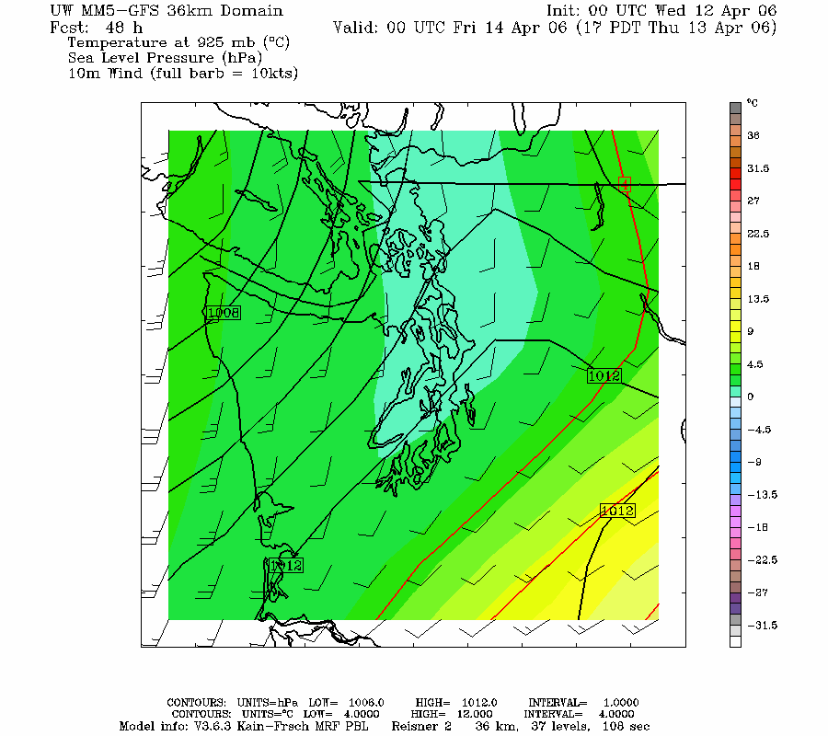
36 km

Slide 9
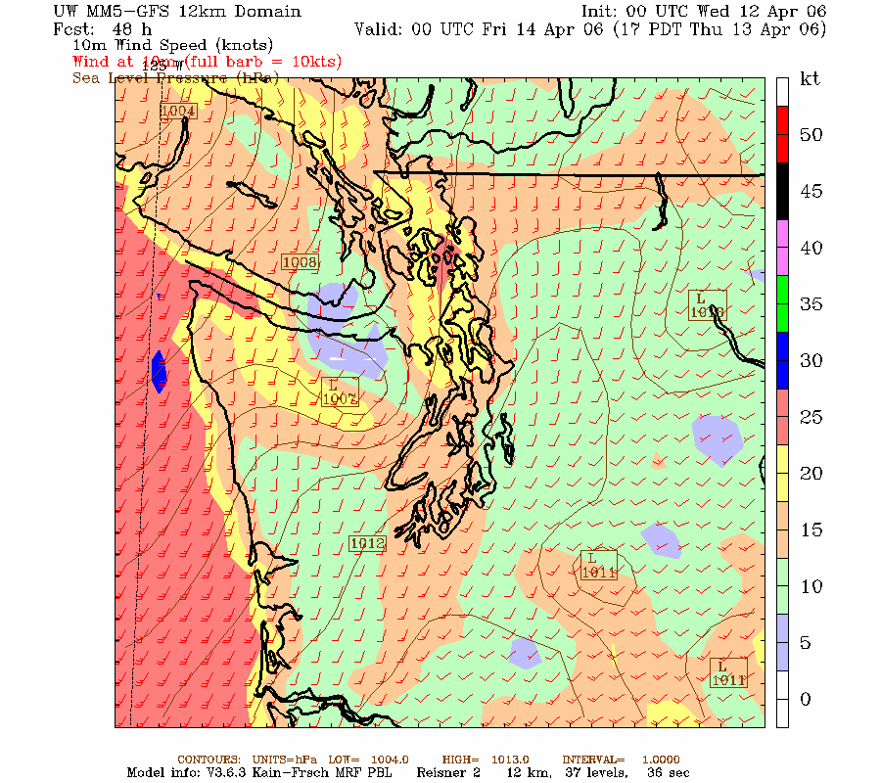
12 km

Slide 10
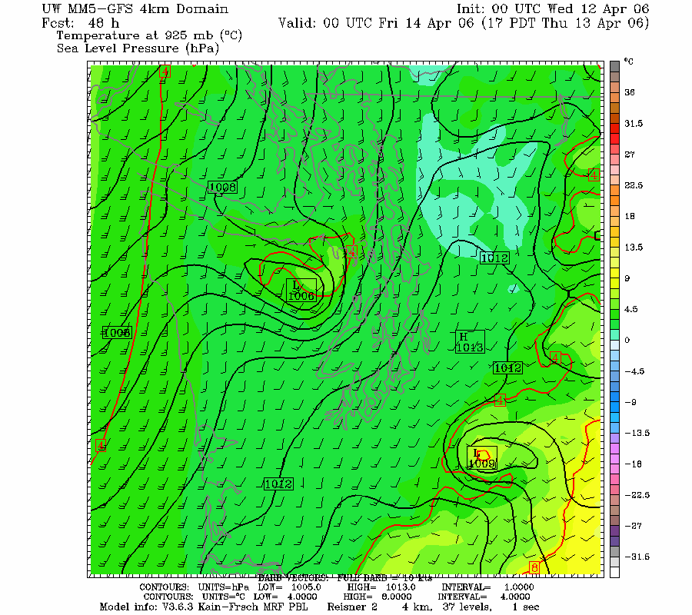
4km

Slide 11
Pressure “Reduction” to Sea Level
A Major Problem

Slide 12
Major Problem in Pressure Reduction for BOTH Analyses and Forecasts
Model pressure fields at sea level and geopotential heights at lower levels below terrain (e.g., 925 hPa) are based on assuming a 6.5 K per km lapse rate through the ground
Can give deceiving or WACKY results when actual lapse rate differs

Slide 13
Often the free atmosphere has a different lapse rate than assumed in terrain and that can lead to problems
Can result in fictious pressure features in model output
And the fictious pressure features change during the day.

Slide 14
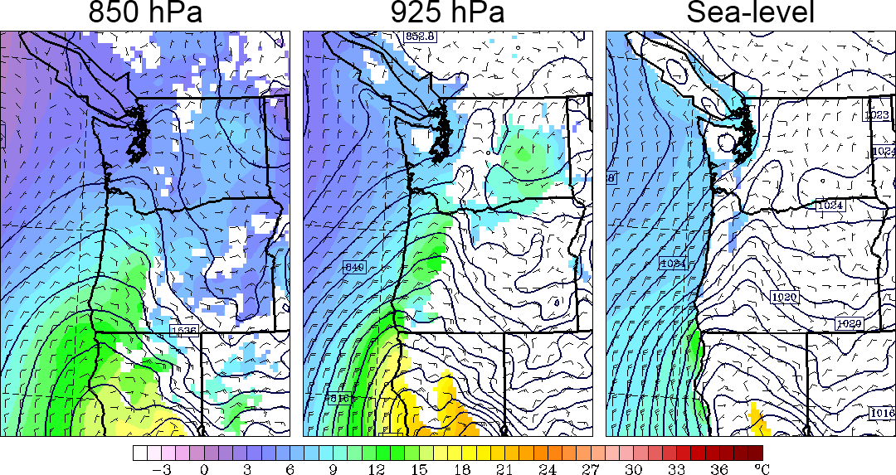
At Night During Warm Season: phony troughs under terrain during night

Slide 15
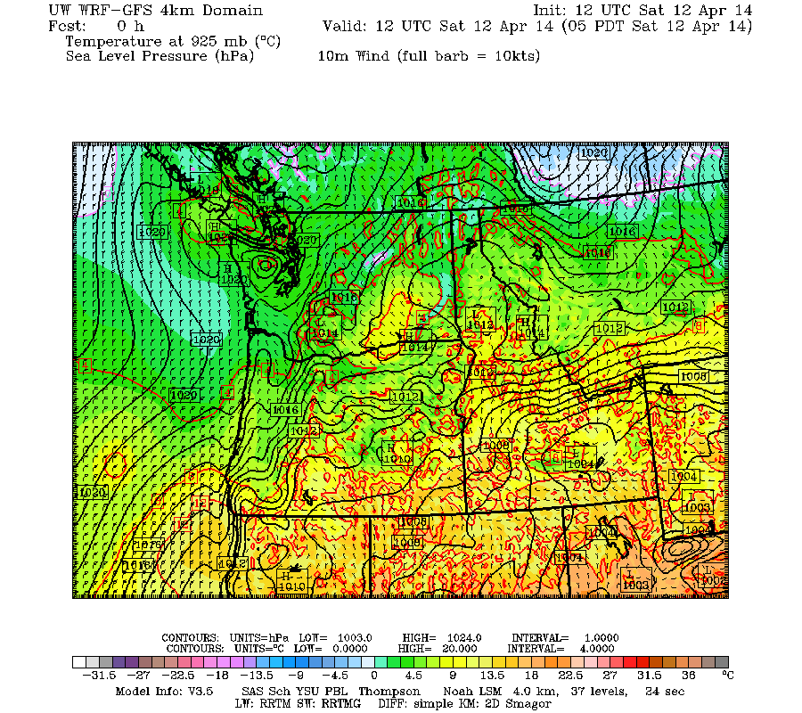

Slide 16
Why?
Models usually use the U.S. Standard Atmosphere for pressure reduction
During the night, as the lower atmosphere stabilizes (cools), the free (real) atmosphere can develop a smaller decrease of temperature with height than the U.S. Standard Atmosphere at low levels (smaller lapse rate than 6.5 C per km).
Too warm under model terrain.
This produces an artificial pressure gradient, with unreasonable low pressure under terrain

Slide 17
Nighttime Situation
Same pressure at 1 km
0C
0 C
1km
Free
Atmosphere
cooler
US Standard
Atmosphere
warmer
4 C
6.5 C
Higher SLP
Warmer…Lower SLP
Thus, the model atmosphere under terrain is warmer than in the real world producing unrealistic low pressure.
Away from terrain there are no reduction issues.

Slide 18
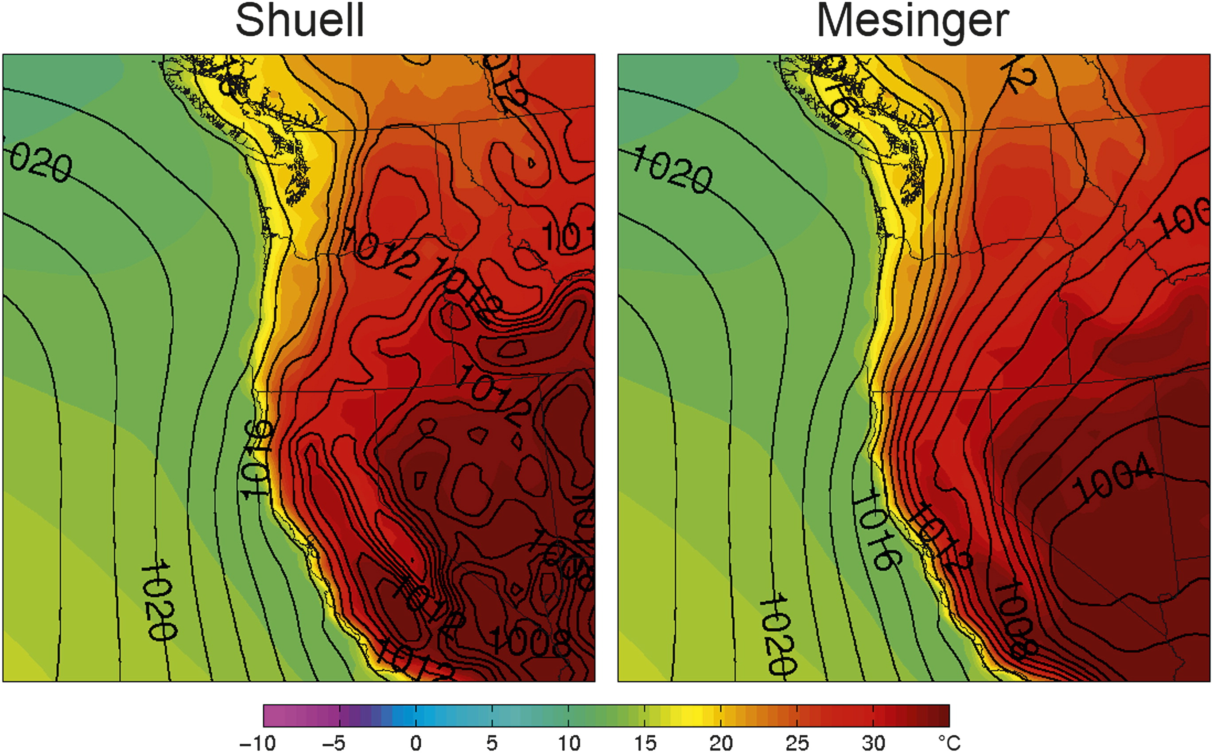
During the day just the opposite, phony troughs inland at low elevations
Fig. 5. Composites of sea level pressure (solid lines, hPa) and 1000-hPa temperature (color shading, C) for JJA at 0000 UTC.

Slide 19
Why?
During the day, the real atmosphere over the Central Valley is ~dry adiabatic (9.8 C per km), while over the mountains we assume U.S. Standard atmosphere (6.5C per km).
Becomes cooler at low levels inside the mountains…thus higher pressure.

Slide 20
Why?
During day, the atmosphere in the free atmosphere can be near dry adiabatic (9.8 C per km), while over the mountains we assume U.S. Standard atmosphere valley (6.5C per km).
Becomes cooler at low levels inside the mountains…thus higher pressure.

Slide 21
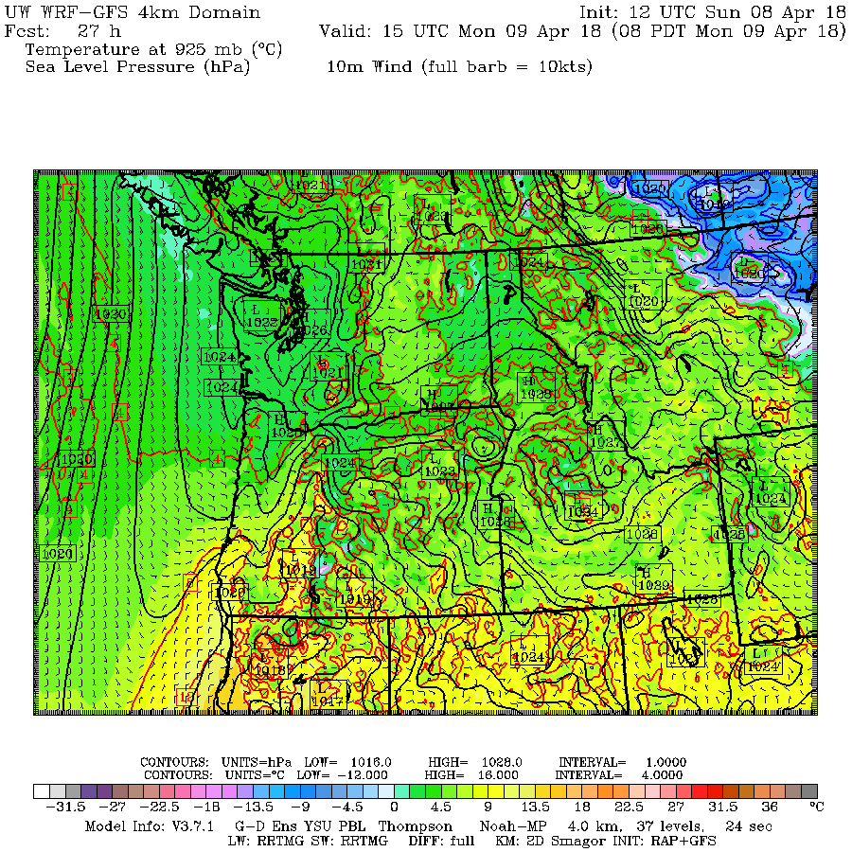
These problems are still evident in WRF

Slide 22
Although model improvements have occurred, significant pressure errors sometimes occur

Slide 23
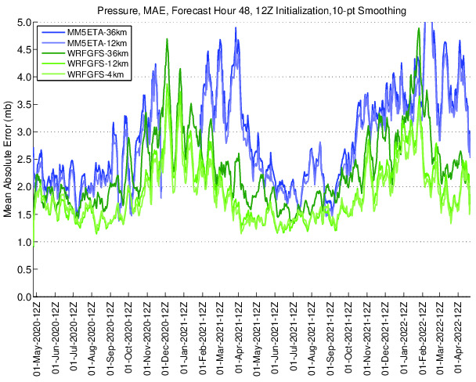
Errors Large in Winter

Slide 24
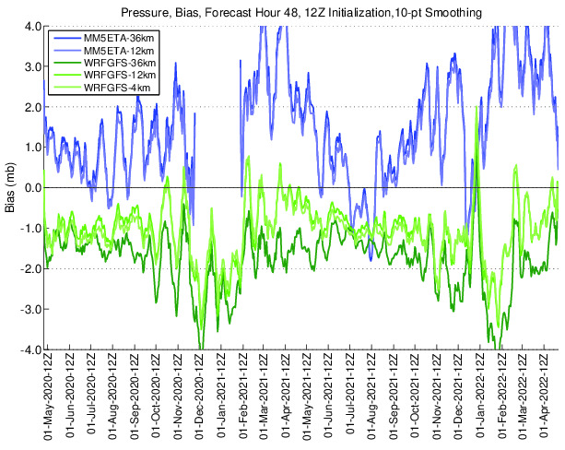
Different modeling systems have different biases

Slide 25
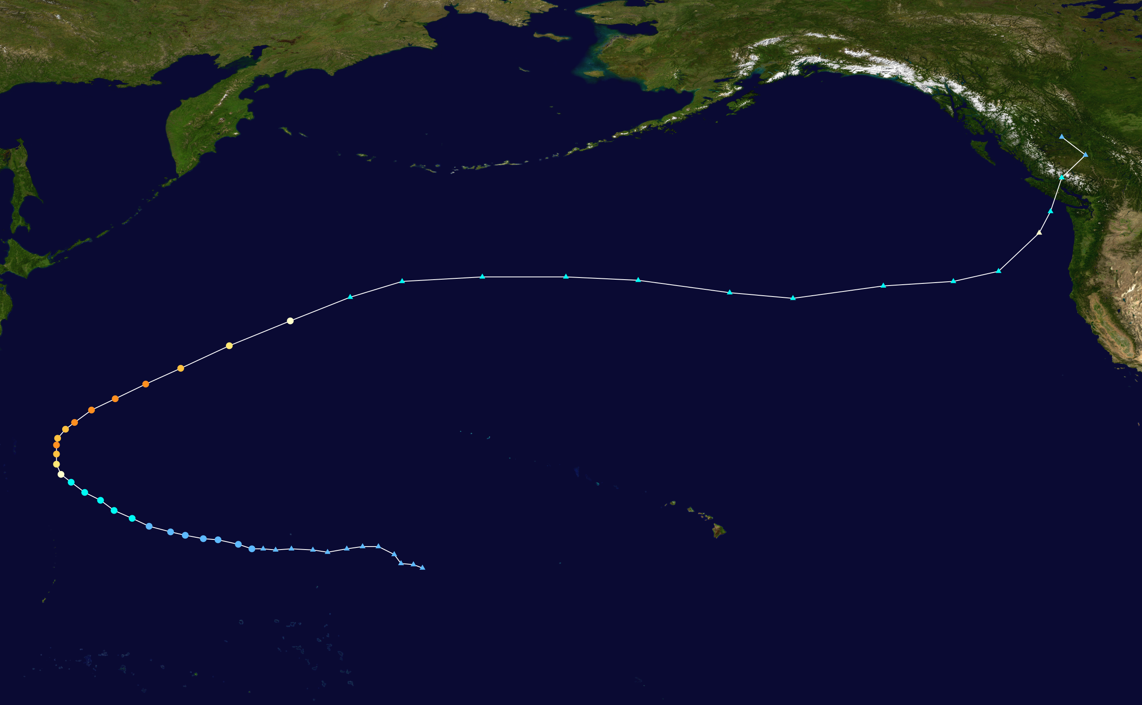
Major Pressure Errors Still Occur with Extratropic Transition Events
Typhoon Songda: October 2016

Slide 26
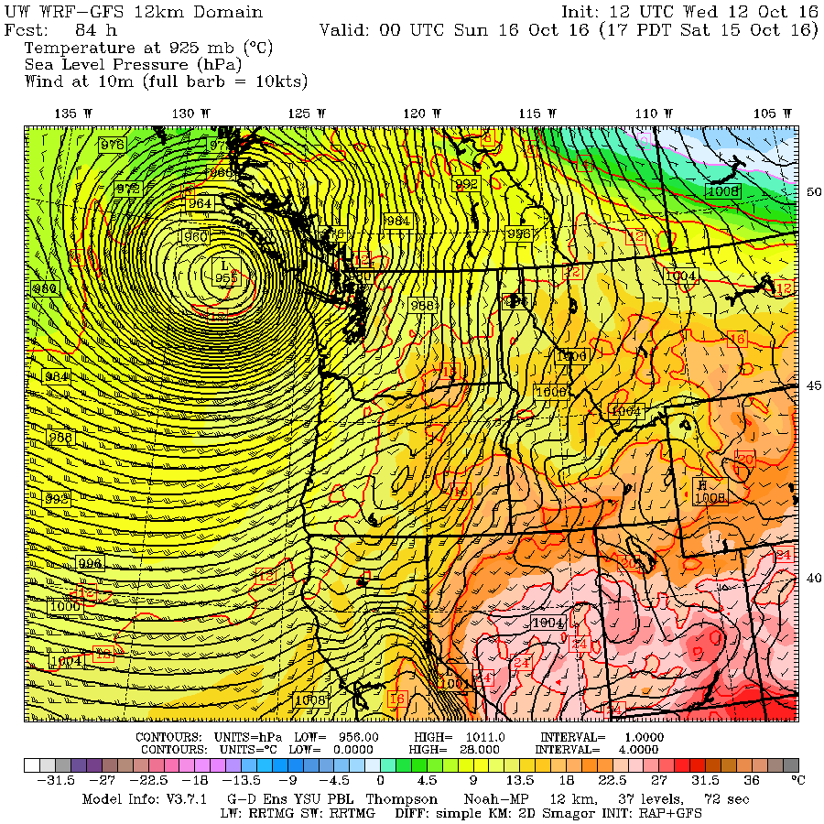
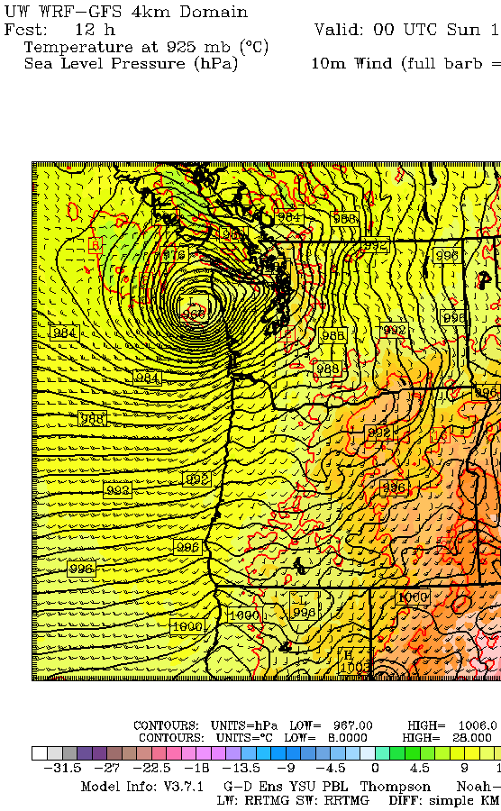

Slide 27
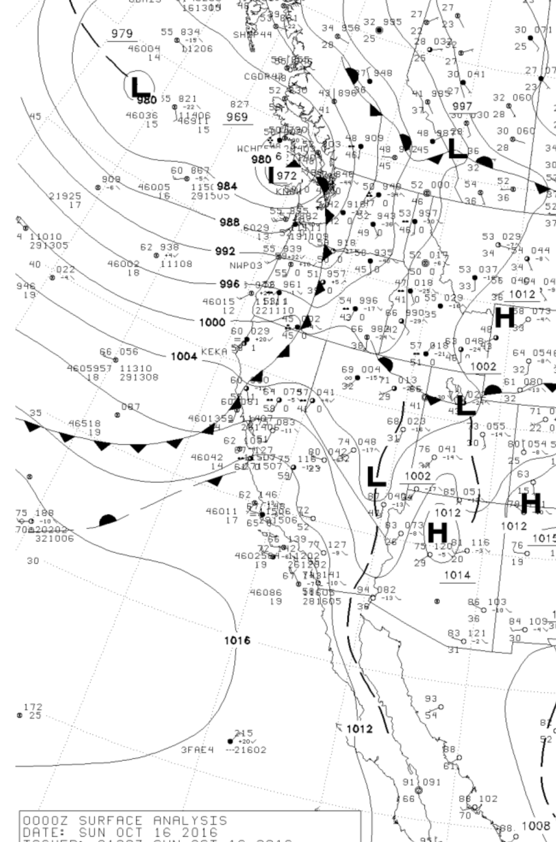

Slide 28
GFS Generally Has Far Better Pressure Forecasts Than NAM

Slide 29
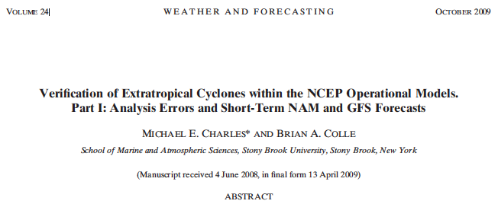
The NCEP GFS has more skillful cyclone intensity and position forecasts than the NAM over the continental United States and adjacent oceans
Over the eastern Pacific the NAM has a large positive (underdeepening) bias in cyclone central pressure.
For the short-term (0–60 h) forecasts, the GFS and NAM cyclone pressure errors over western North America are larger than the other regions to the east.

Slide 30
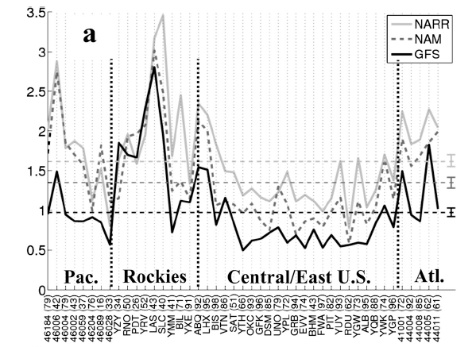
SLP analysis MAE for the GFS (solid black), NAM (dashed), and NARR (gray). The numbers of cyclones verified between 2002 and 2007 are shown in the parentheses. The dashed horizontal lines represent the average error during the period and the 90% confidence intervals are shown using the vertical bar on the right.
Pressure Errors Vary Spatially

Slide 31
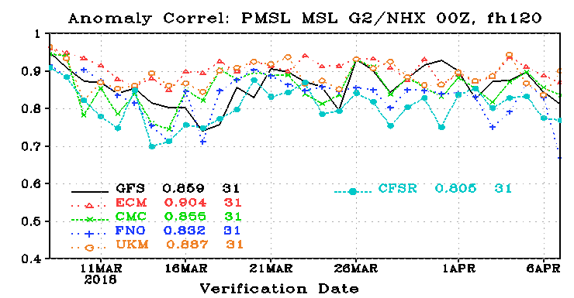
Global Models: ECMWF is best. UKMET is second
GFS is more likely to have pressure “drop outs”

Slide 32
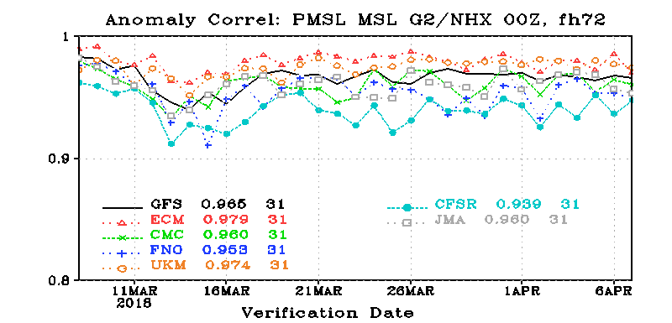

Slide 33
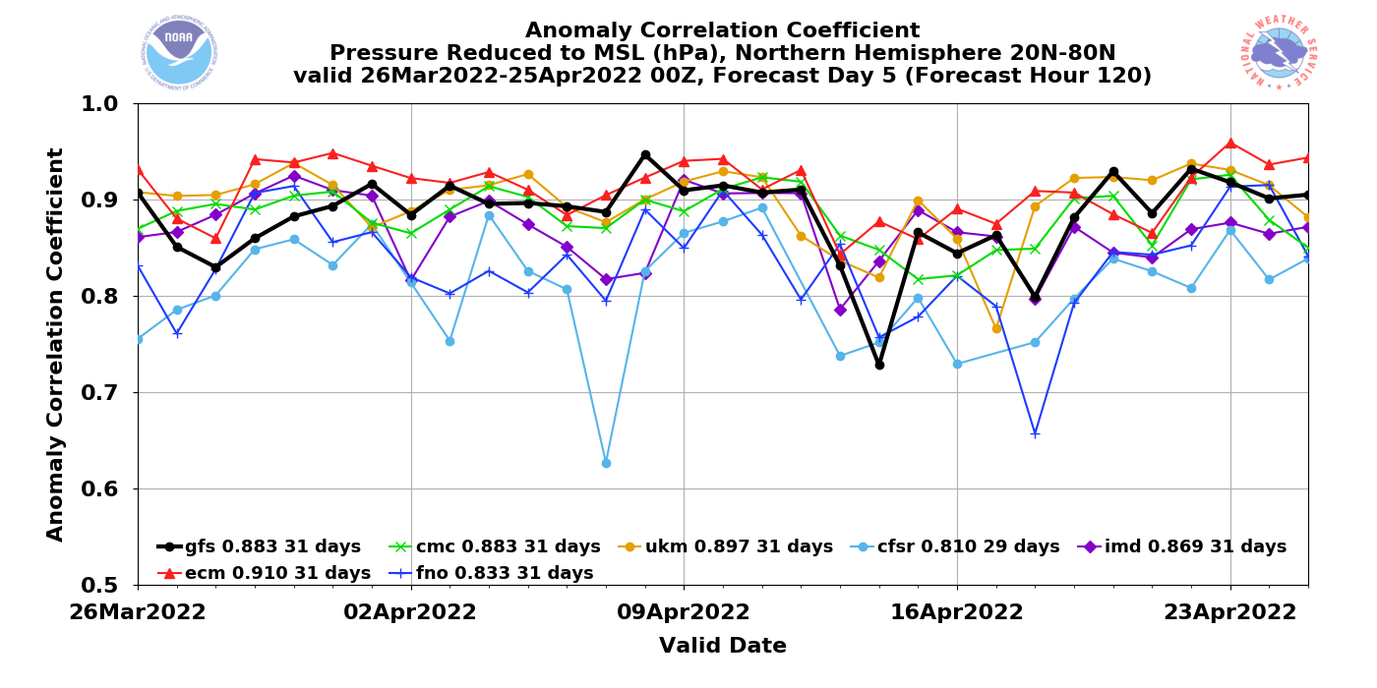

Slide 34
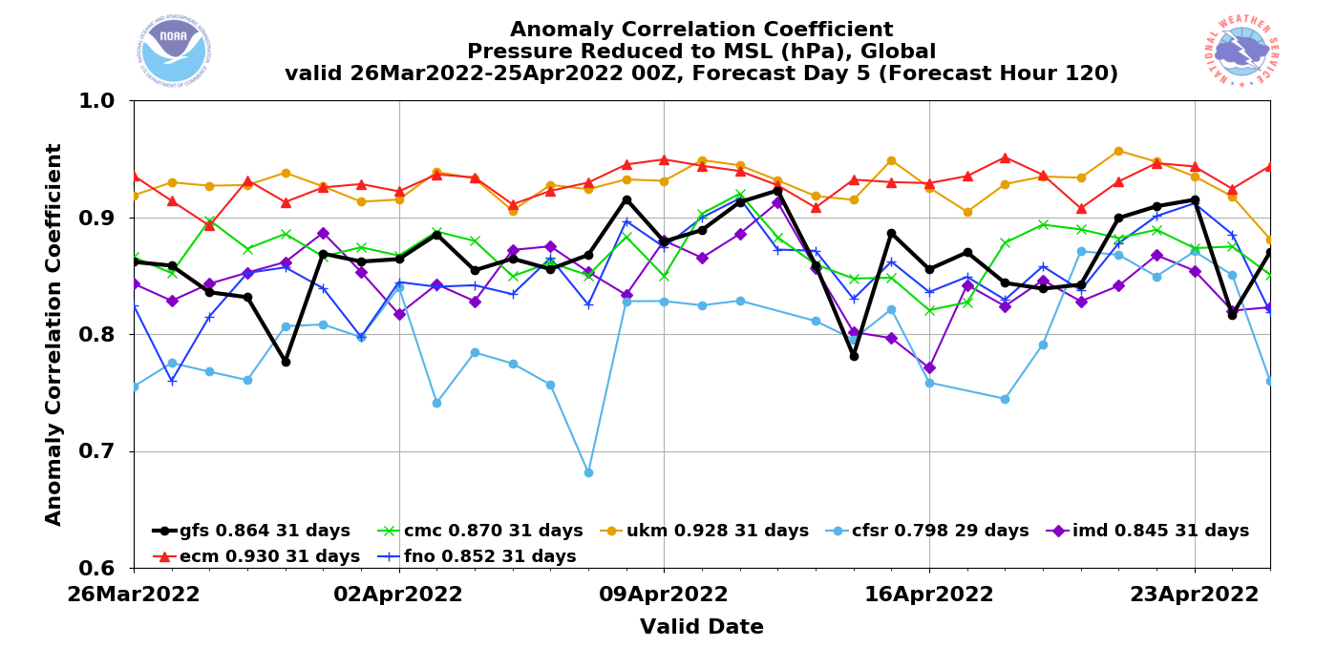

Slide 35
Smartphone Pressures
Some smartphones measure pressure information
Encouraging data assimilation experiments using this data source.

Slide 36
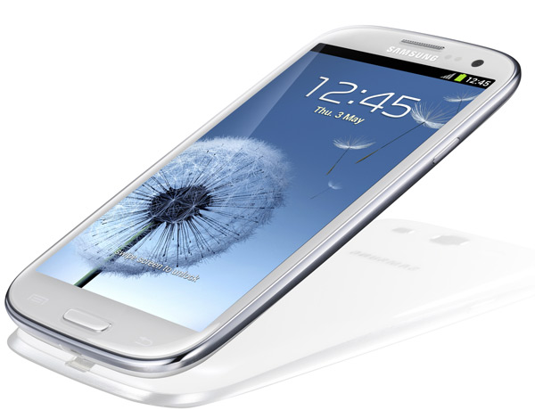
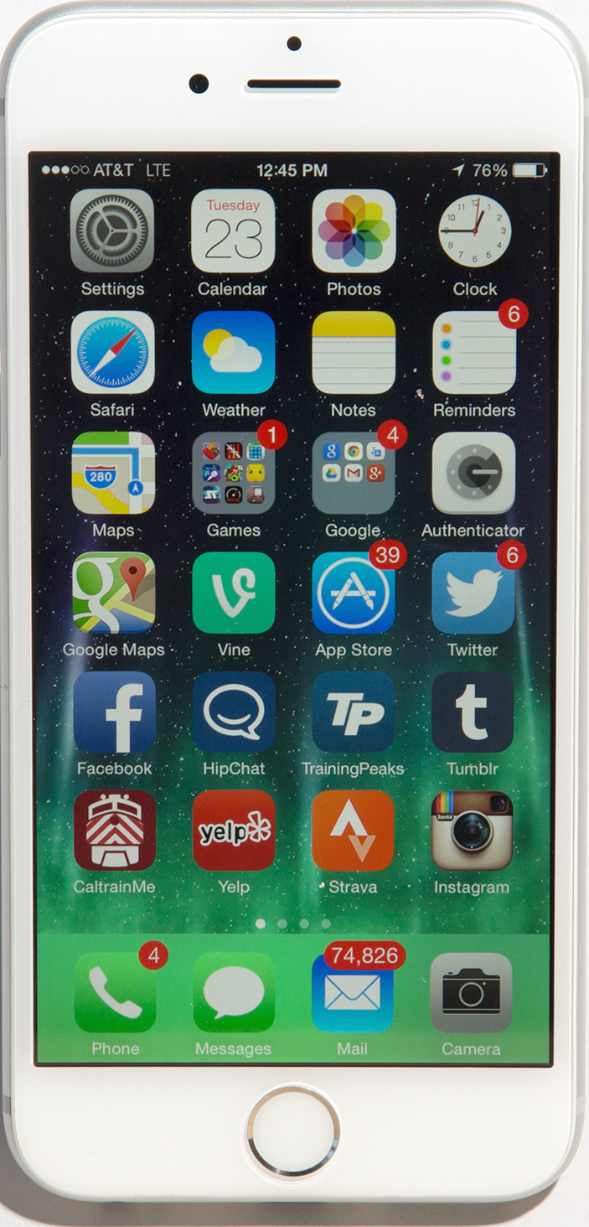
Some of the smartphones/pads with pressure sensors
iPhone
Samsung Galaxy III, IV, V, VI
Nexus 4 and 10
Some Sony, Nokia, and Chinese phones

Slide 37
Smartphone Pressures
Currently getting 60 million a day from IBM/weather.com
Excellent calibration using machine learning.
There may be a new source with much more data.

Slide 38
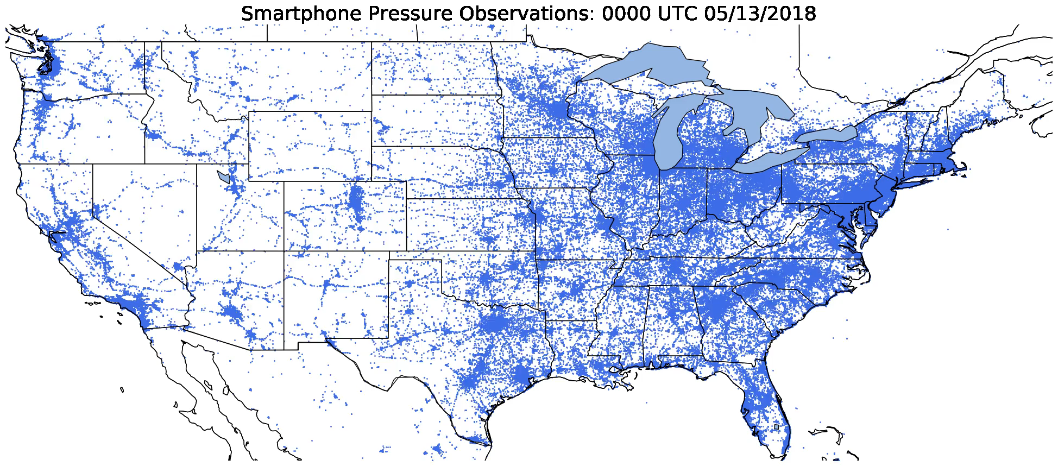
Notes:
Hook: Show time-lapse of madis pressure observation locations in the United States. Then show time-lapse of smartphone pressure observations (ask what if it looked like this).
Reasons why more surface data is necessary:
- Extending predictability requires better initial conditions (Zhang et al., 2019)
- Increased surface observation density in space and time has been shown to be beneficial for convective forecasting (Sobash and Stensrud, 2015; Gasperoni et al. 2018)
- Verification for high resolution numerical models.

Slide 39
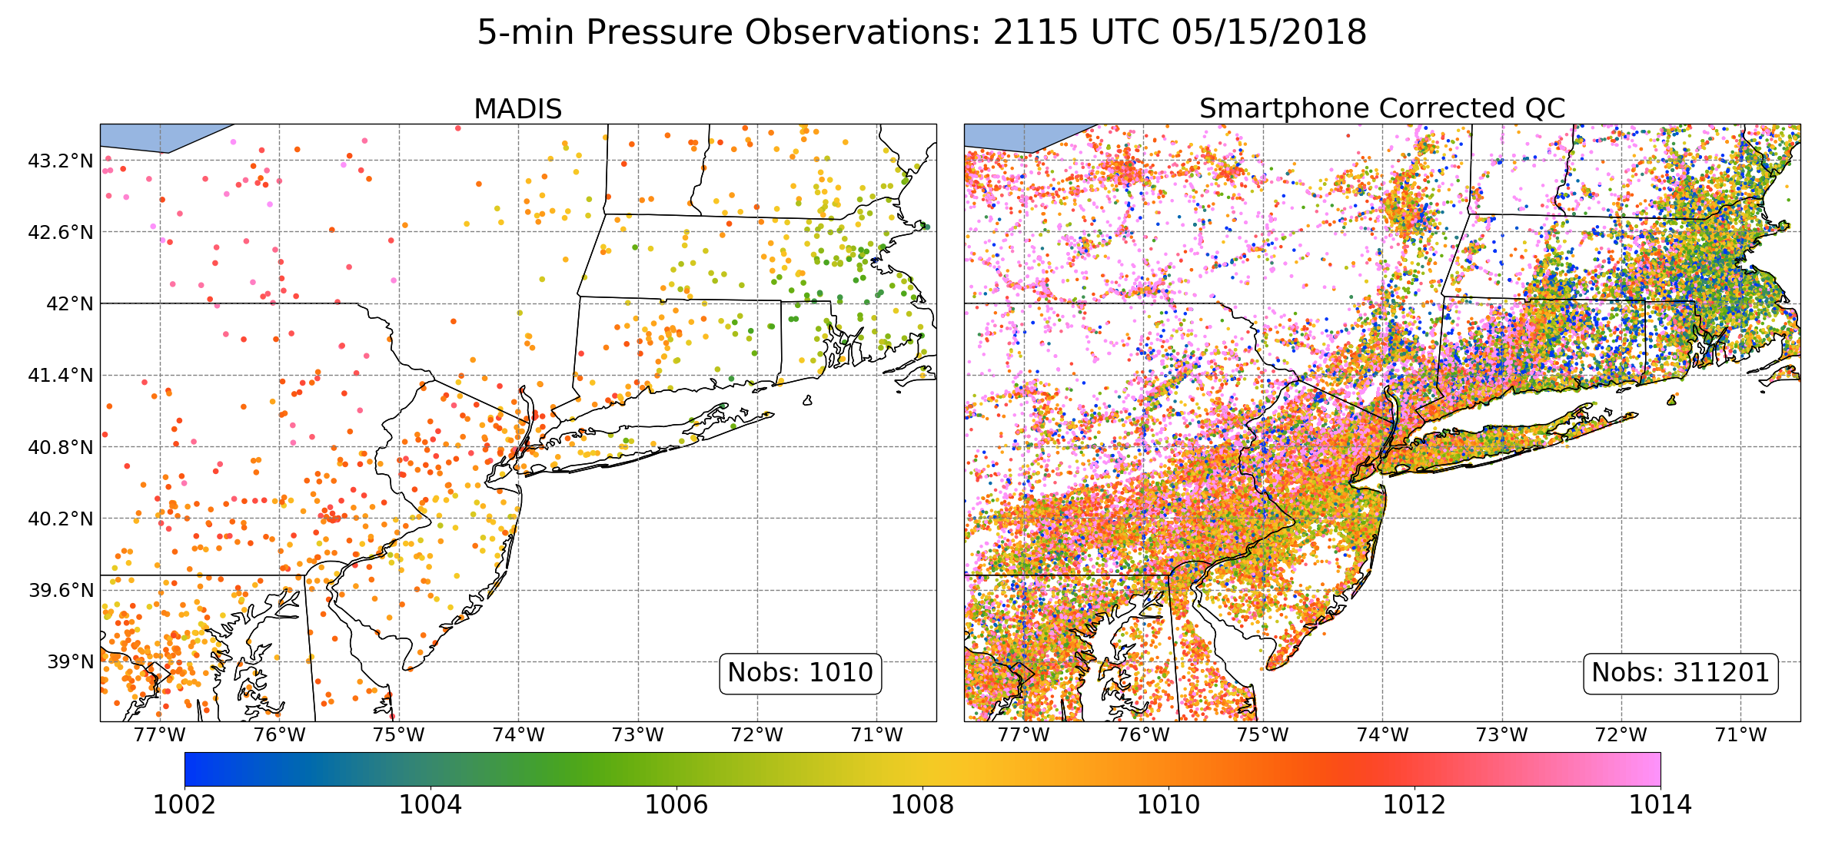
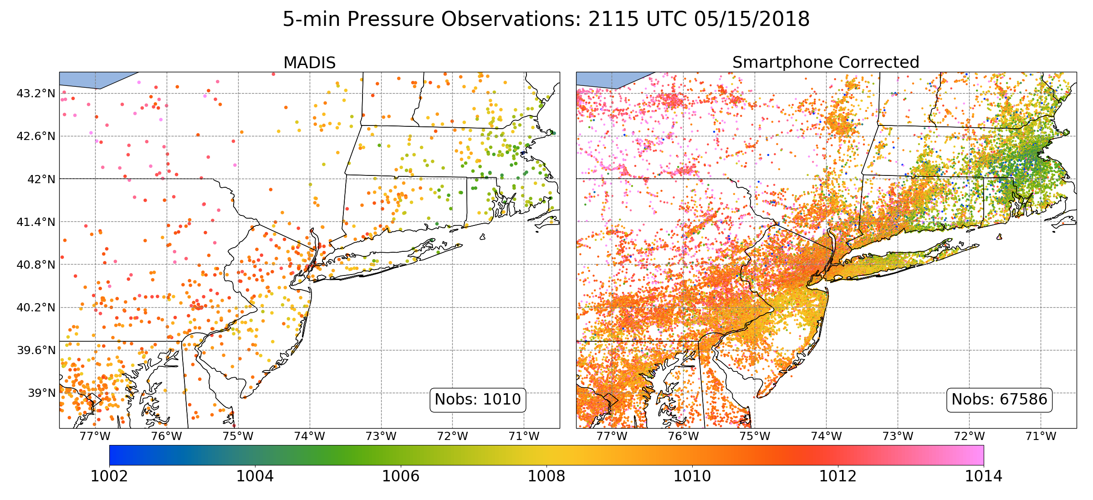
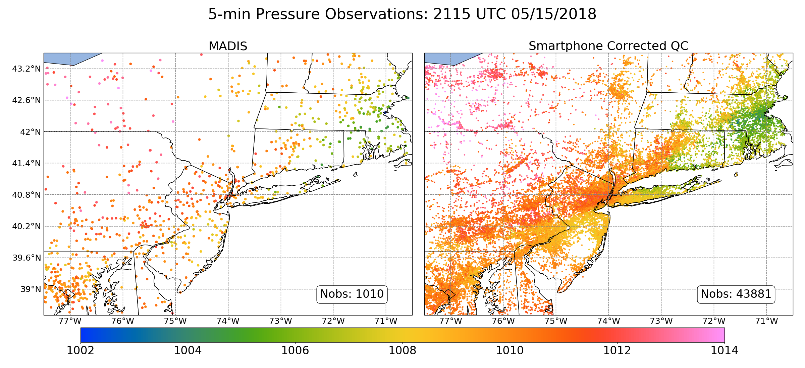
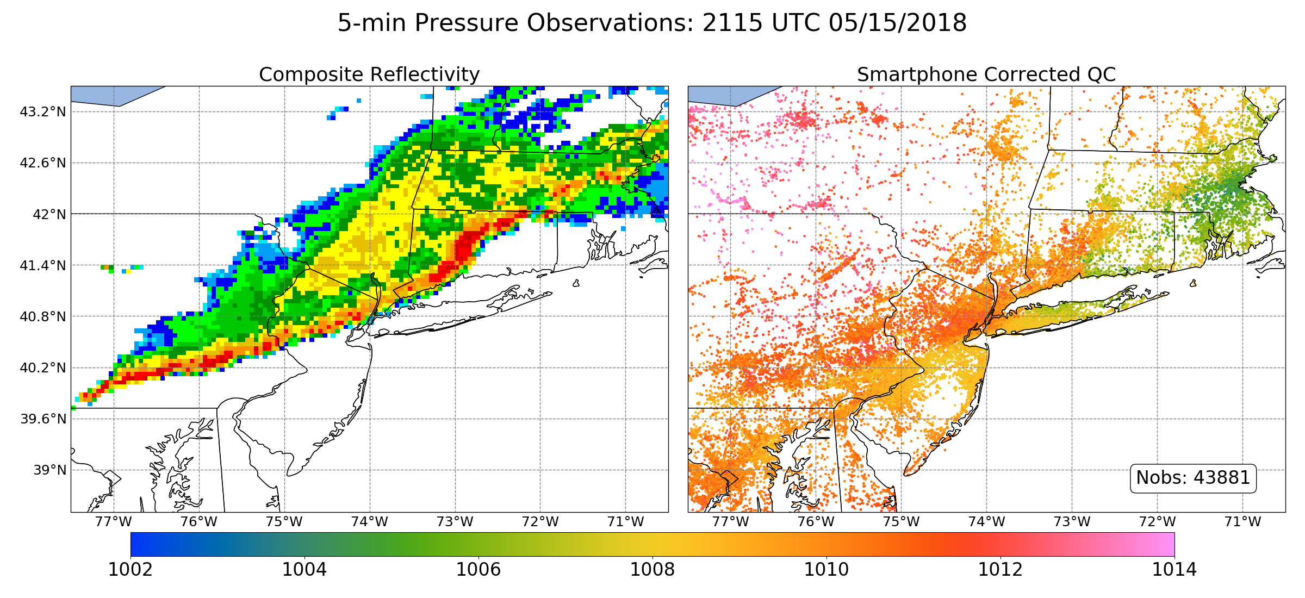
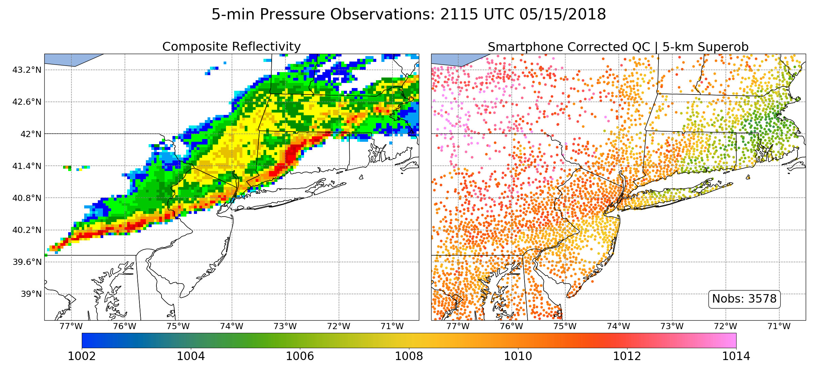
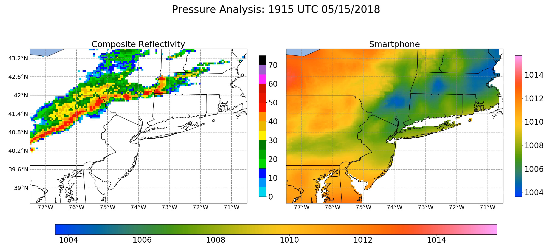
Notes:
Hook: Show time-lapse of madis pressure observation locations in the United States. Then show time-lapse of smartphone pressure observations (ask what if it looked like this).

Slide 40
Forecasting Strategy for Pressure
You are dependent on the models
Your task is to pick the best one for your area.
ECMWF/UKMET generally the best synoptic pressures across the globe.
High-resolution models needed to get pressures right in areas of complex terrain.
Learn about model pressure biases for locations of interest.

Slide 41
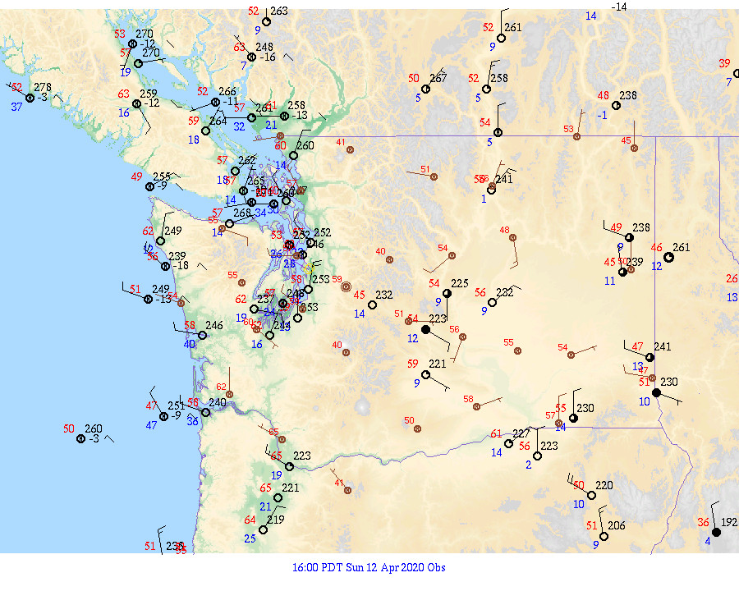
The value of isallobaric analyses and pressure tendency
Isallobar: lines of constant pressure change.

Slide 42
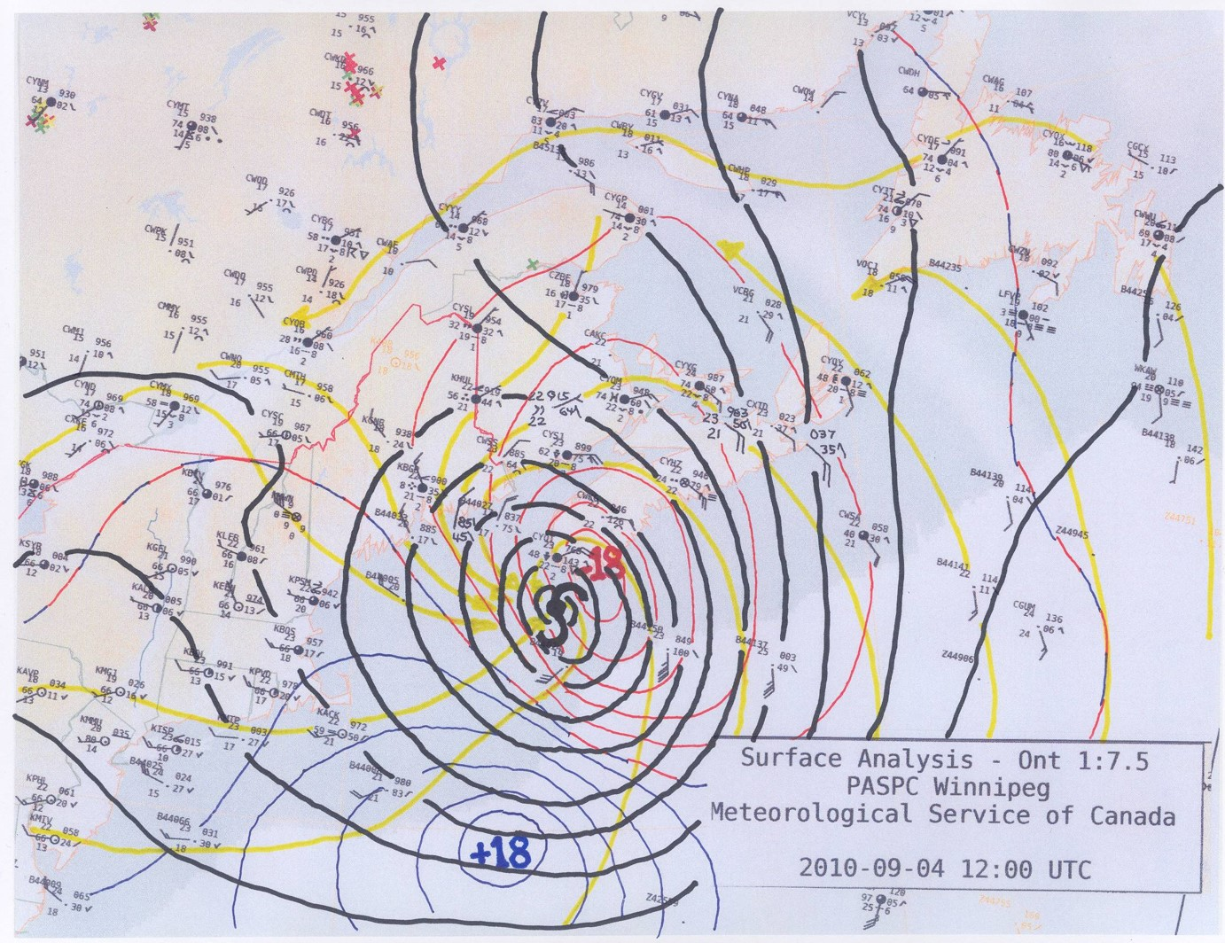
Isallobaric analysis

Slide 43
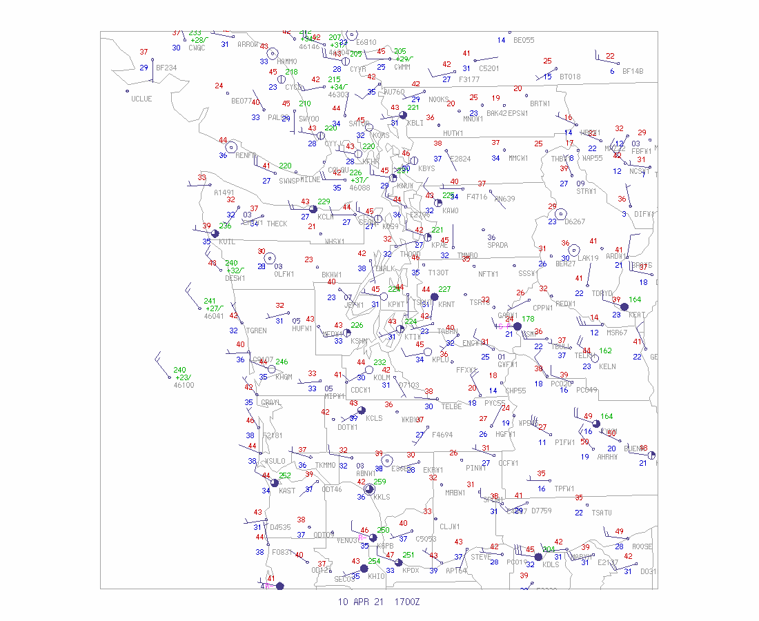
When models are going bad
The use of pressure change can help identify where low centers are heading if NWP has problems.

