Slide 1
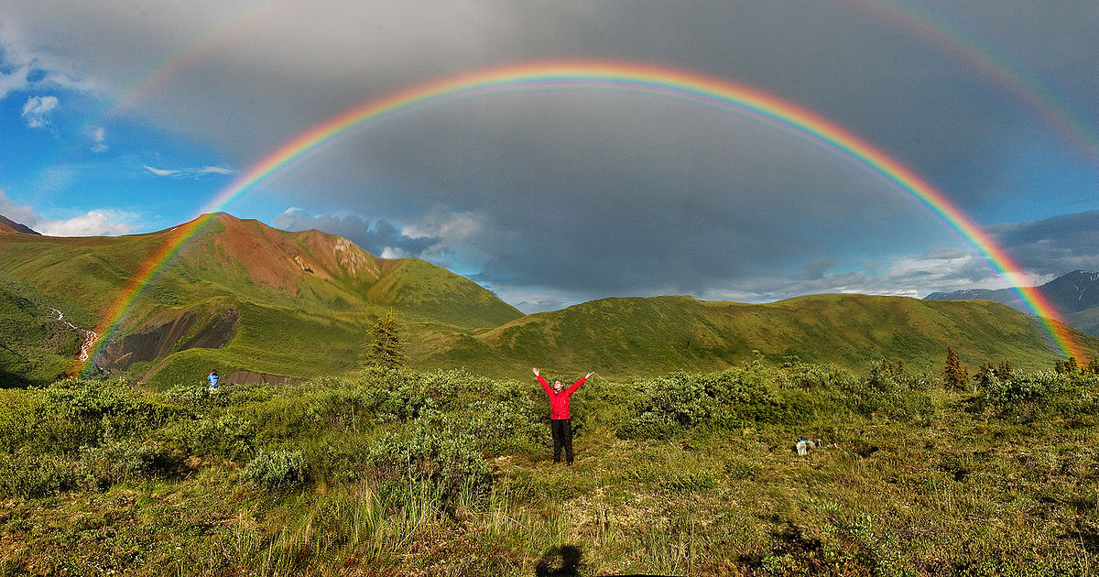
Optical Effects and Phenomena
Atmospheric Sciences 101, Autumn 2023
The effects of the atmosphere and hydrometeors (e.g., rain) on visible light

Slide 2
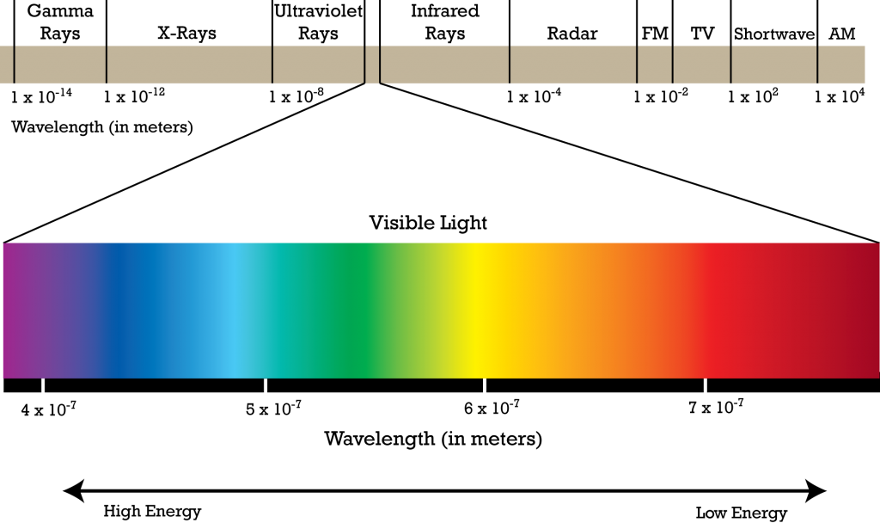
Visible light is made up of a spectrum of colors from red (long wavelengths) to violet (short wavelengths)
.4 micron
.7 micron

Slide 3
Visible light is influenced by the density of the medium through which it travels
In a vacuum, light travels at 186,000 miles per second.
Denser medium causes light to slow down

Slide 4
When light interacts with a medium, various things can happen:
Refraction
Reflection
Scattering
Absorption
Diffraction

Slide 5
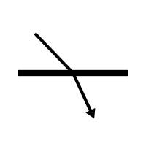
Refraction
Definition: The process in which the direction of light is changed as result of the change in density of the medium through which light travels.

Slide 6
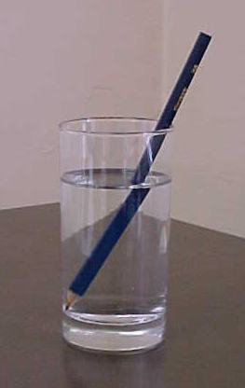
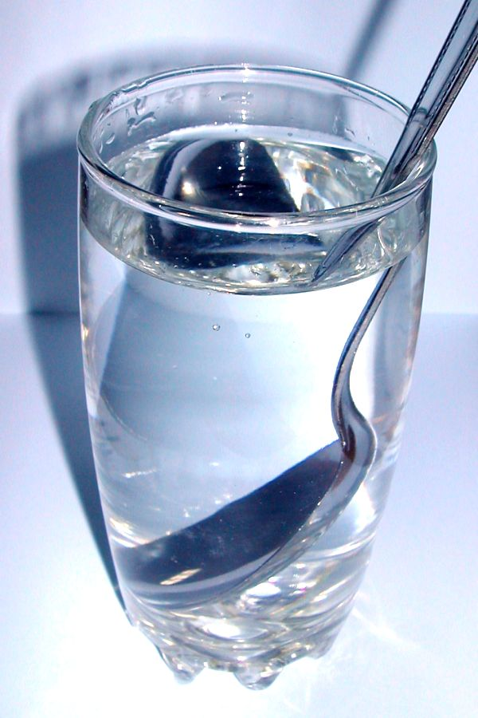
Refraction

Slide 7
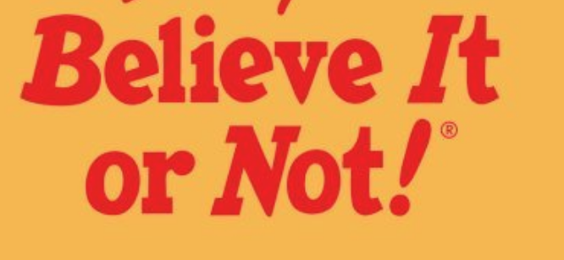

Slide 8
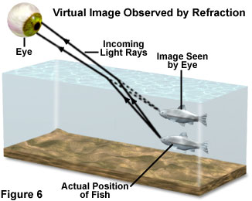
Many objects are NOT where you think they are!
The sun at sunset is another!

Slide 9
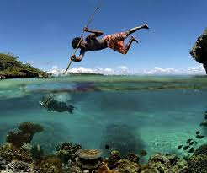
Useful information

Slide 10
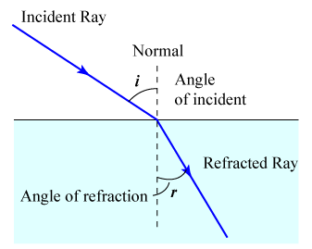
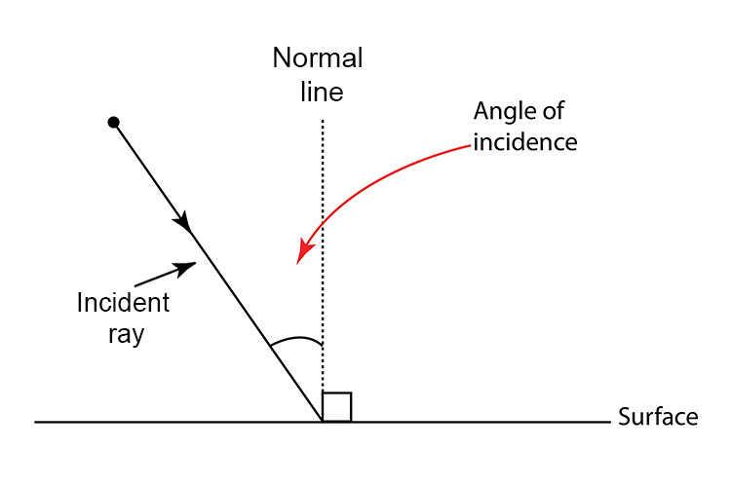
Refraction Rule
When light travels from a less dense to a more dense medium, it loses speed and bends towards the normal.
When light travels from a more dense to a less dense medium, it speeds up and bends away from the normal.

Slide 11
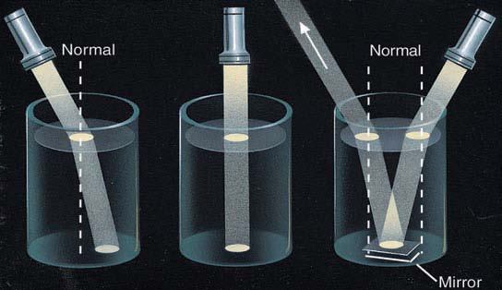

Slide 12
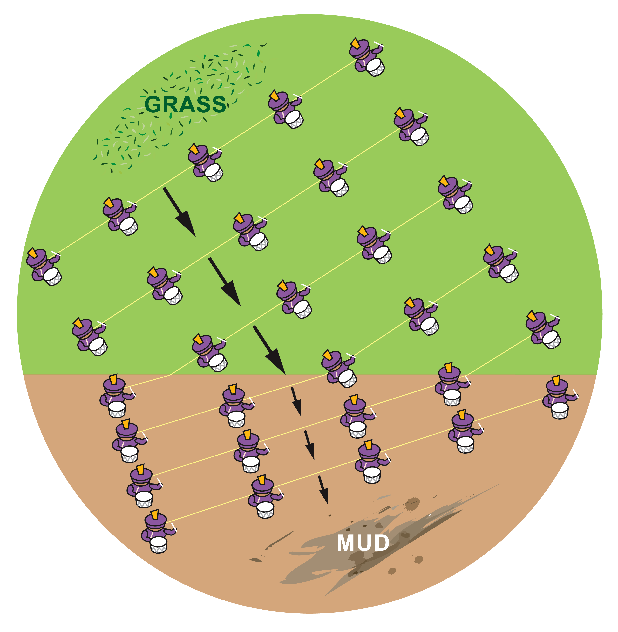
A good
analog

Slide 13
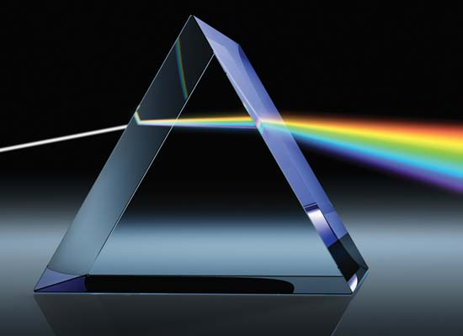
The refraction of light depends on its wavelength

Slide 14
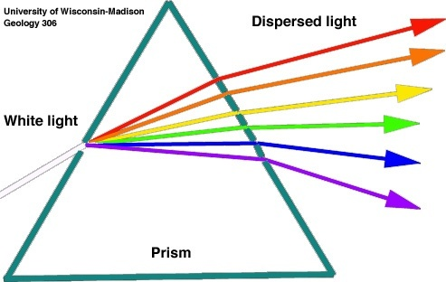
Shorter wavelengths (e.g., blue) are refracted more than longer wavelengths (e.g., red)

Slide 15
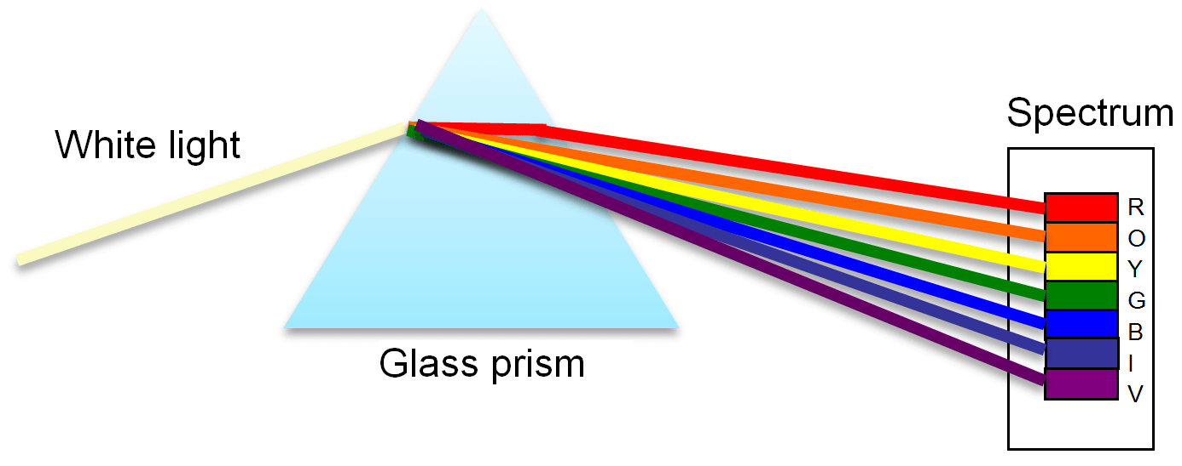
This process is called dispersion dispersion: a process in which radiation is separated into its component wavelengths

Slide 16
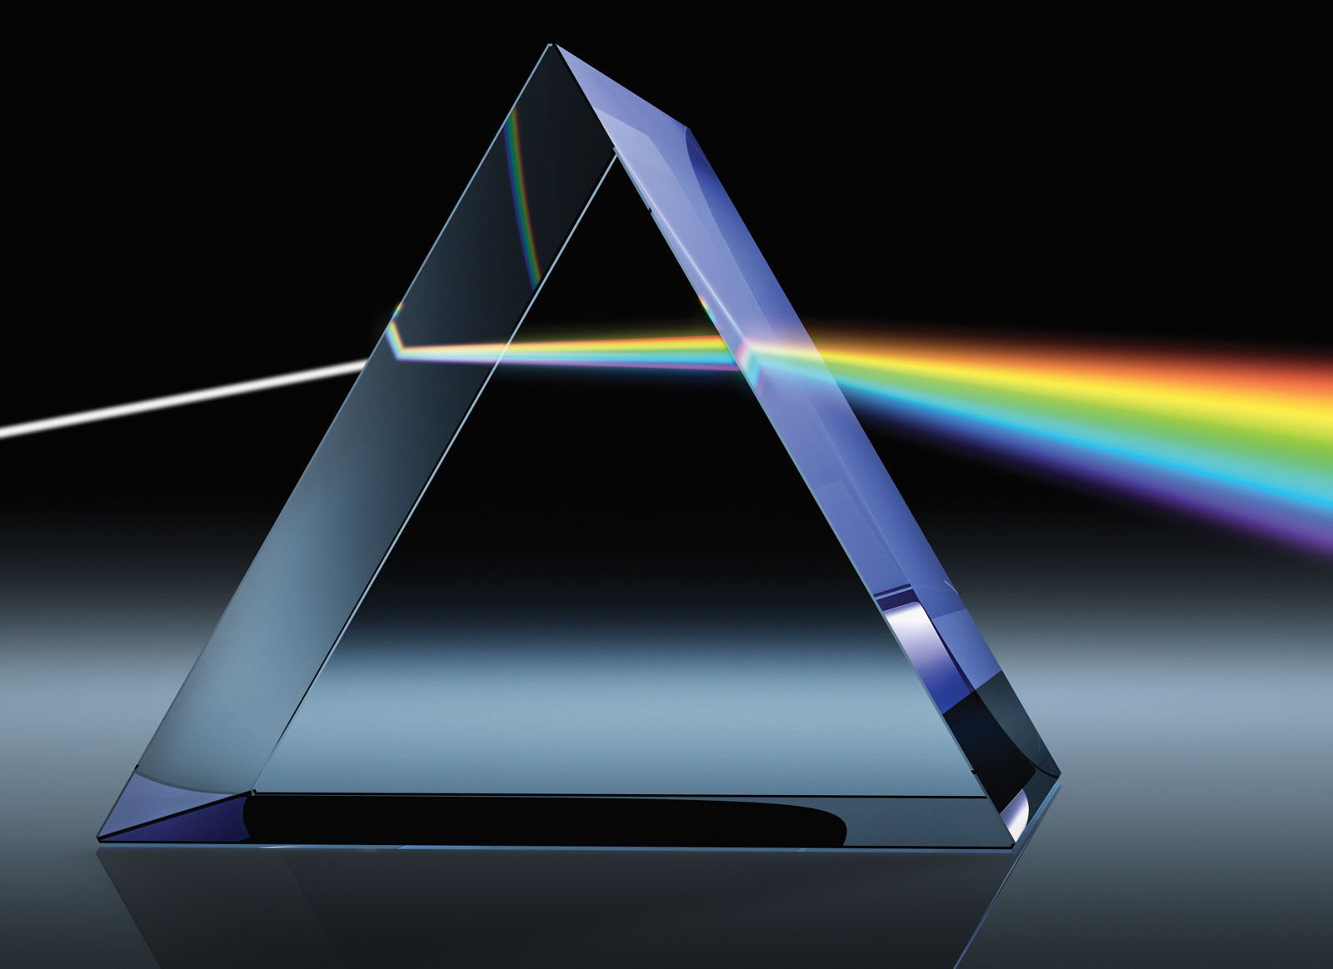

Slide 17
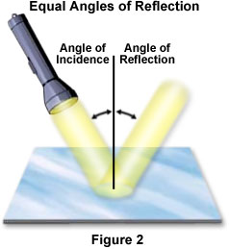
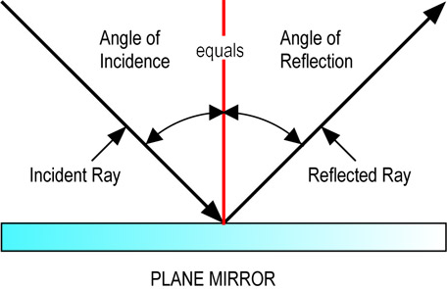
Reflection: occurs when light is incident on solid objects.
Normal
The angle of incidence equals the angle of reflection

Slide 18
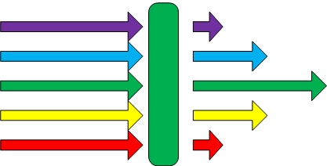
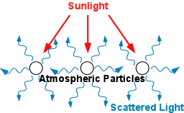
More processes
Absorption: when radiation (light) is absorbed by the medium.
Scattering: usually associated with small particles and molecules. Radiation (e.g., light) is absorbed and reemitted in the same or other direction.

Slide 19
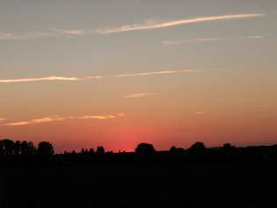
Light Scattering

Slide 20
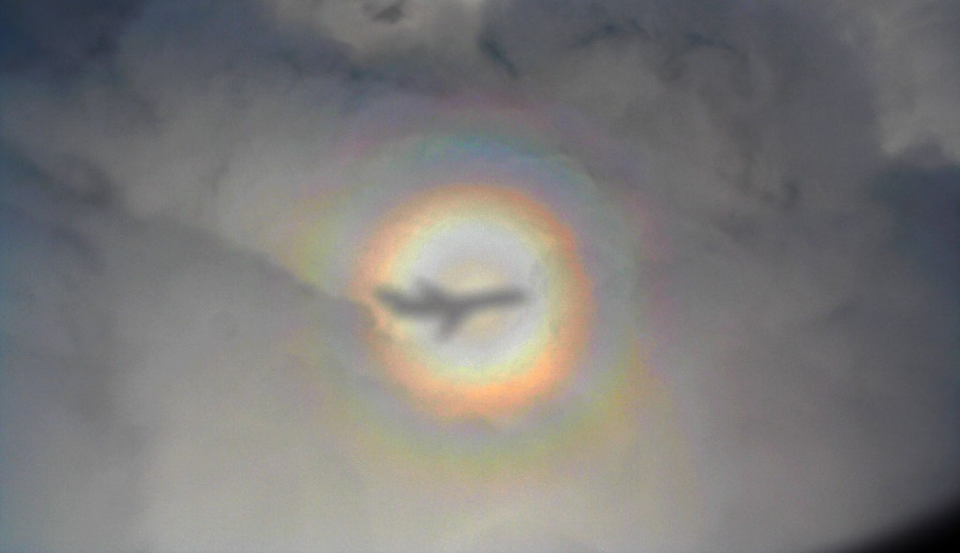
More Processes
Diffraction: a phenomenon dependent on the wave-like nature of light. Often occurs when light bends around objects. Can get dispersion.
A glory

Slide 21
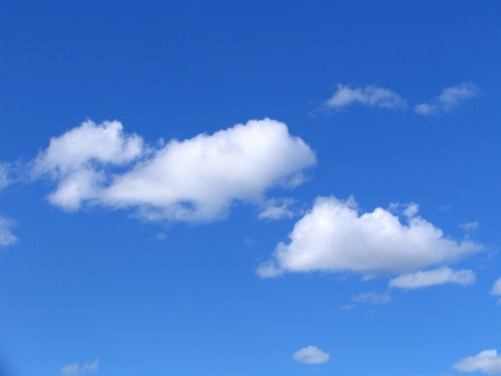
Why is the sky blue?

Slide 22


Slide 23
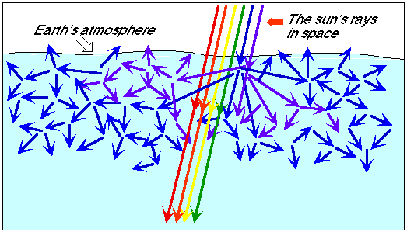
Answer: Rayleigh Scattering-which occurs when visible light interacts with atmospheric molecules and particles much smaller than the wavelength of light.

Slide 24
Why is the sky blue?
Rayleigh scattering occurs when visible light is scattered by air molecules that are small compared to the wavelength of light.
Visible light has a wavelength (λ) of ~ .5 microns (.5 x 10⁻⁶ m)
Molecules have a size of ~ 10⁻¹⁰ m
So λ_{visible}>> size of molecules

Slide 25
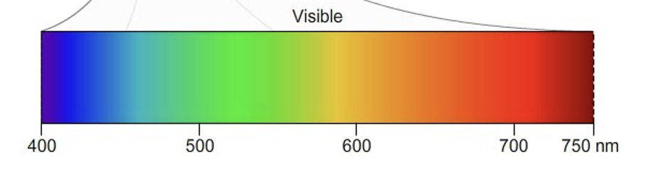
In Rayleigh scattering the amount of scattering depends on the wavelength of the light.
Shorter
Longer

Slide 26
Rayleigh Scattering Formula
Scattering ~ 1/λ⁴
Where λ is wavelength
Thus, short wavelengths (e.g., blue) are scattered more than long wavelengths (e.g., red)

Slide 27
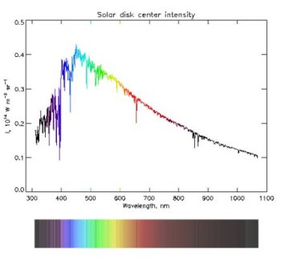
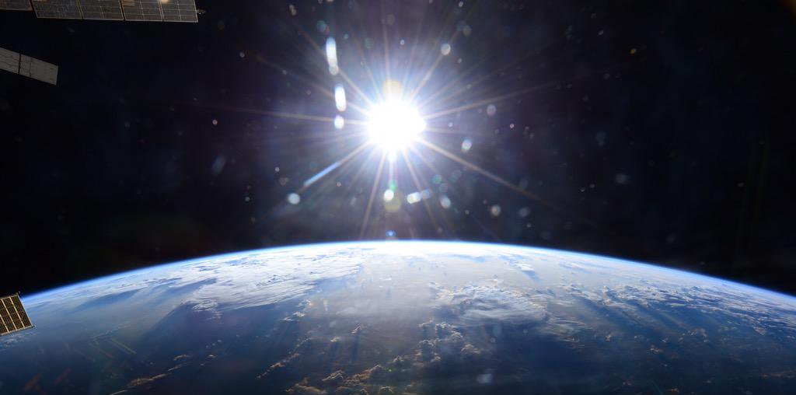
Sun’s Light Coming In
(looks white in space)

Slide 28
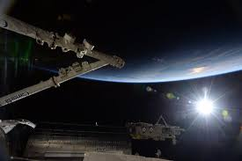

Slide 29
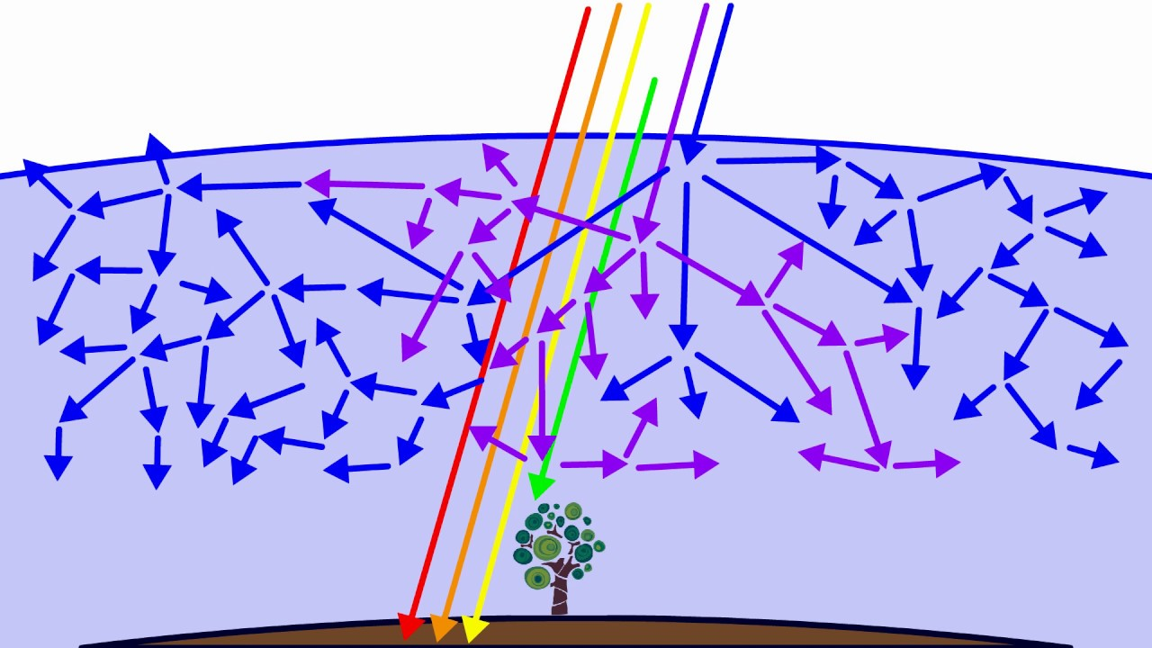
Sun’s Light Has All Wavelengths
Shorter wavelengths preferentially scattered by atmosphere

Slide 30
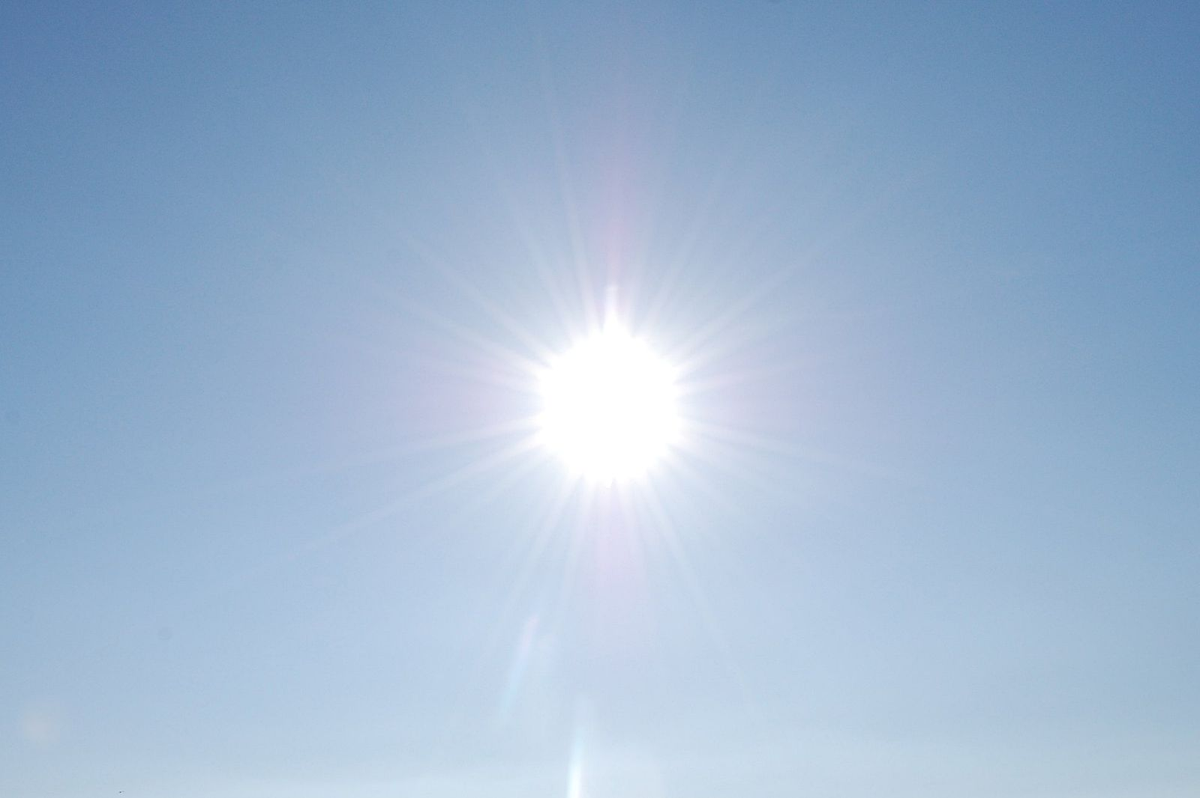
Sunlight (all wavelengths)
Blue/violet scattered
Blue/violet scattered
Red/yellow gets through

Slide 31
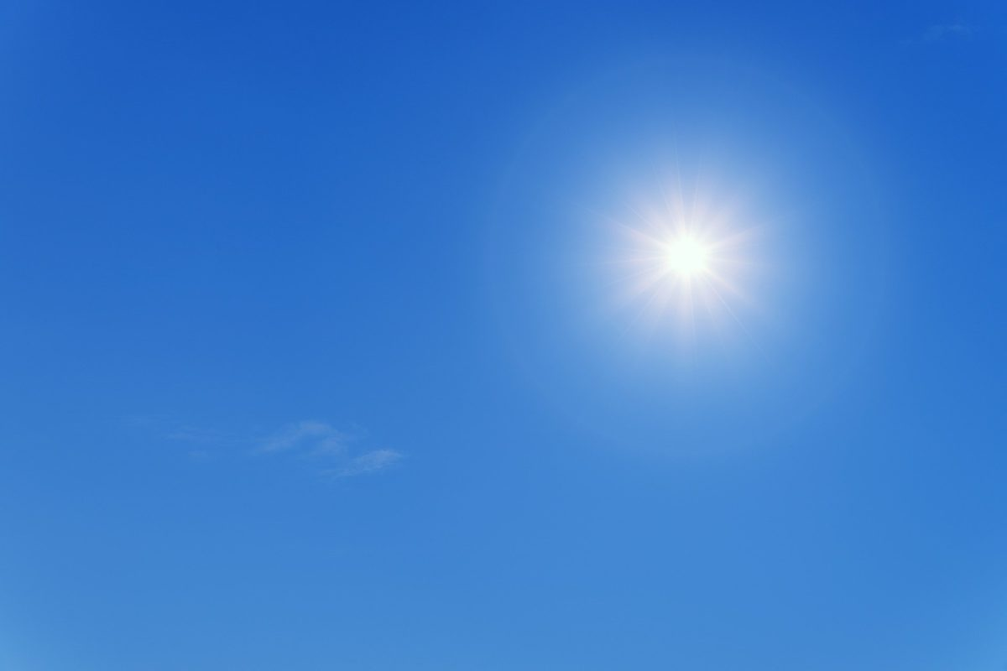
When you look at sky, you see blue light scattered by the atmosphere

Slide 32
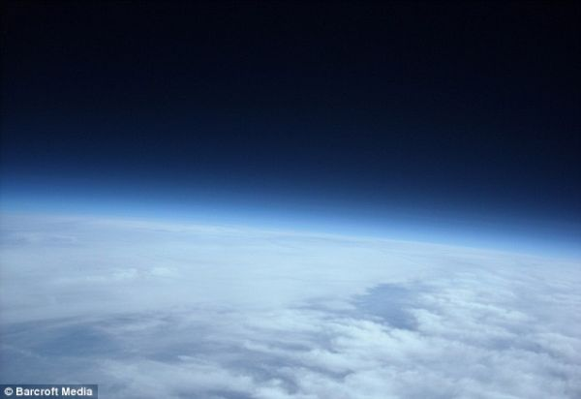
Higher in the atmosphere as density decreases, there is less scattering and the sky turns dark

Slide 33
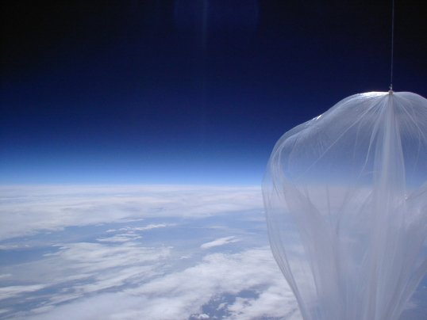

Slide 34
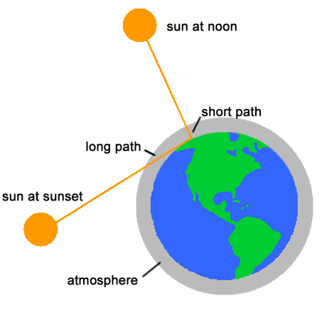
Why Red Sky and Sun at Sunset?
Answer: light goes through more atmosphere, allowing more time for shorter wavelengths to be take out—first blue, then green, then yellow, leaving red.

Slide 35
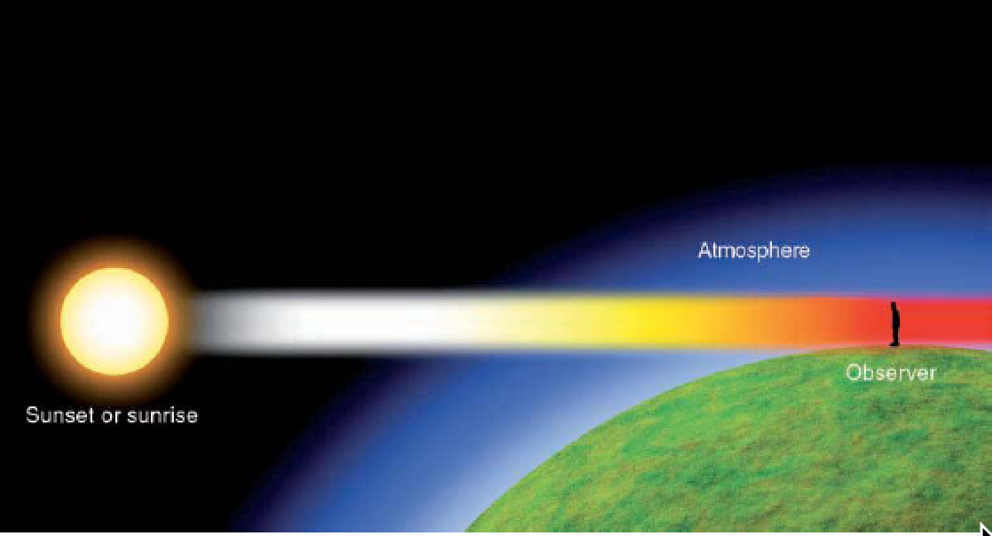

Slide 36
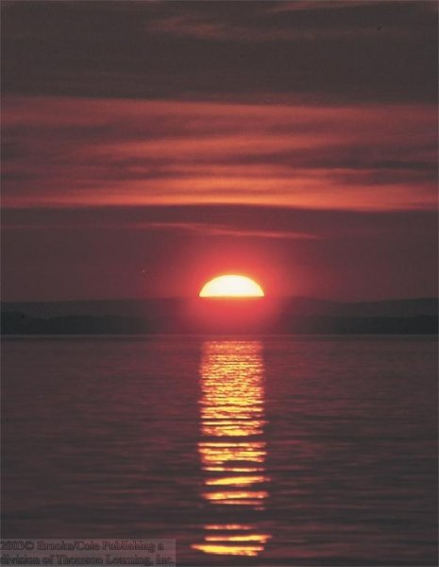

Slide 37
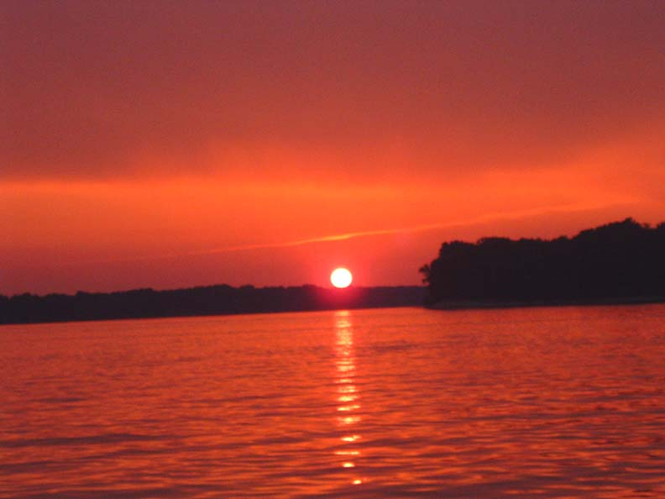

Slide 38
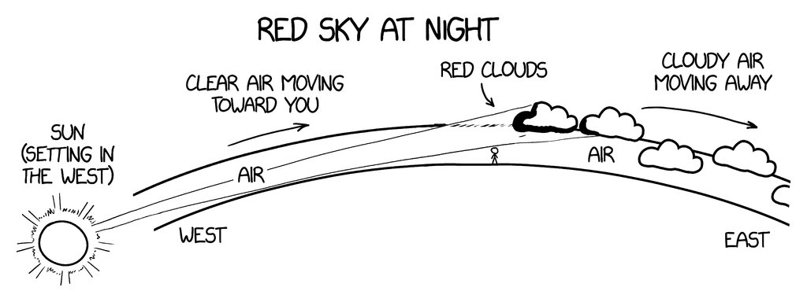
Red sky at night, sailors' delight; red sky in the morning sailors take warning

Slide 39
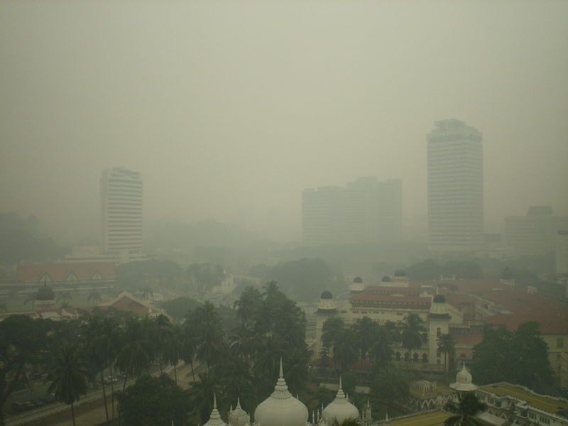
But sometimes the sky looks white. Why?

Slide 40
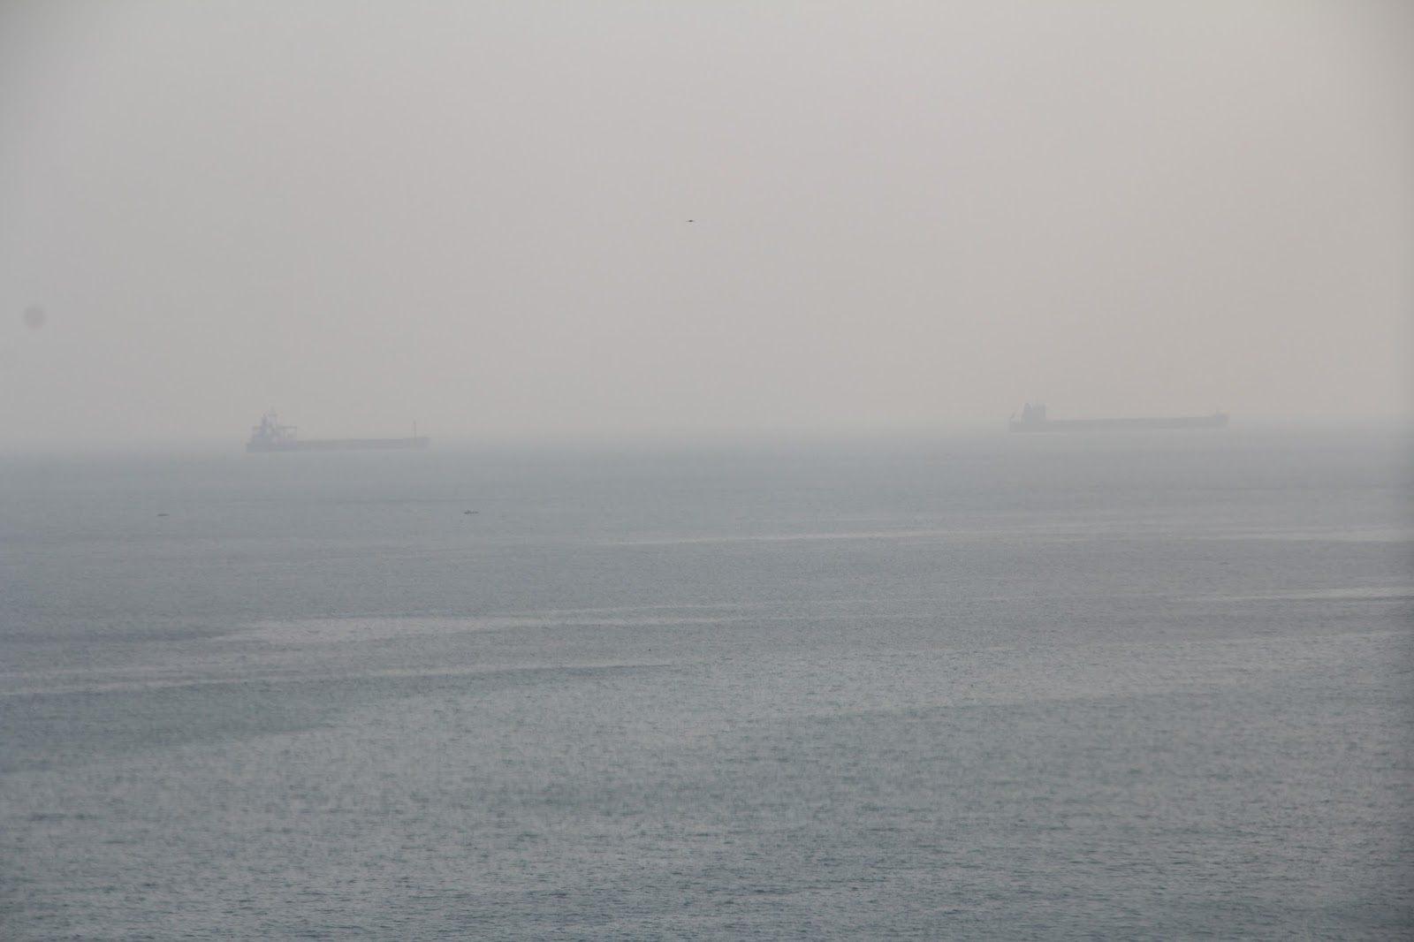

Slide 41
Mie Scattering
Occurs when atmospheric particles are roughly the same size as the wavelength of light.
Such big particles could be water droplets, industrial pollution, smoke, or from another source.
Mie scattering of larger particles is NOT wavelength dependent, so scatters all wavelengths the same.
Thus, sky has a whitish, milky look.

Slide 42
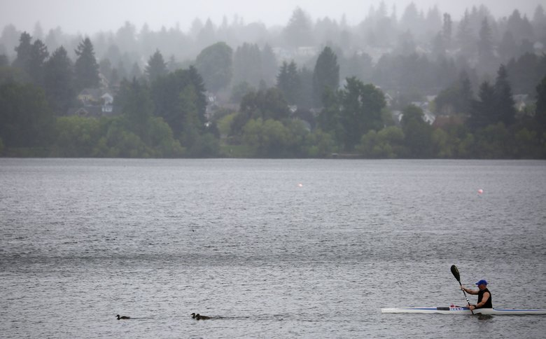
Onshore push of marine air in the NW frequently produces Mie Scattering
Large salt particles from breaking waves
Water is attracted to them.
Mie scattering
When marine air surges in with such particles, visibility can decline and the sky can turn whitish.

Slide 43
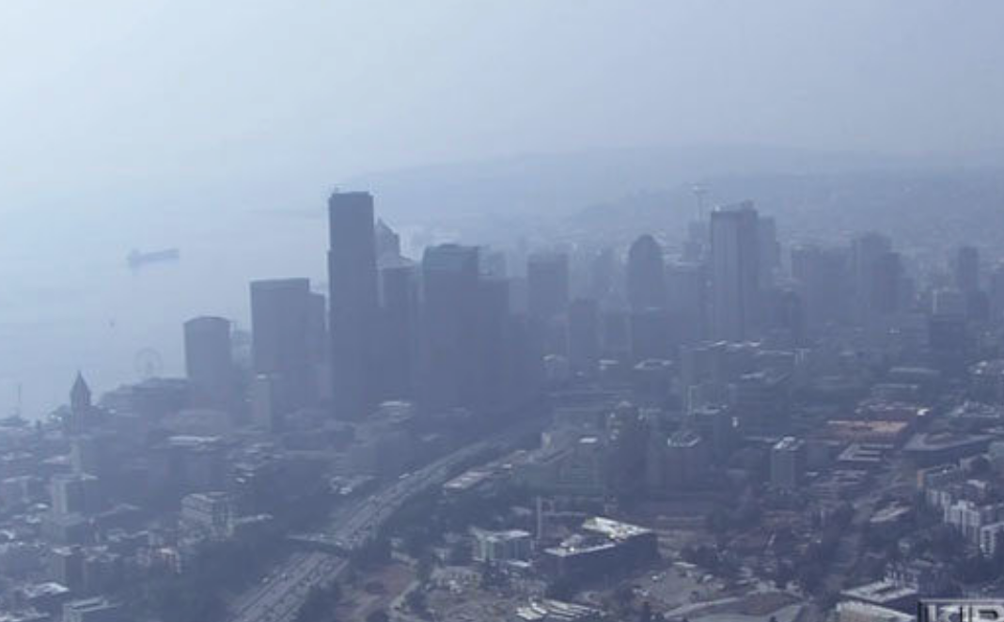
Wildfire Smoke: Again Big Particles and Mie Scattering

Slide 44
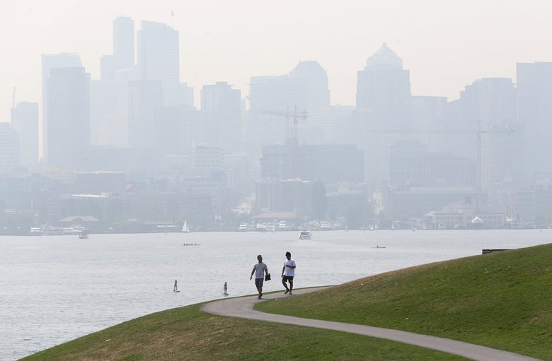

Slide 45
Rainbows
Produced by the refraction and reflection of water droplets (usually from precipitation)
One or two bows
Rumors of a pot of gold at their ends.

Slide 46
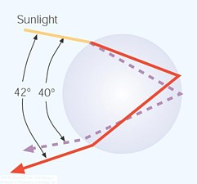
Primary Bow (two refractions and one reflection)
Refraction
Reflection
Droplet
Refraction

Slide 47
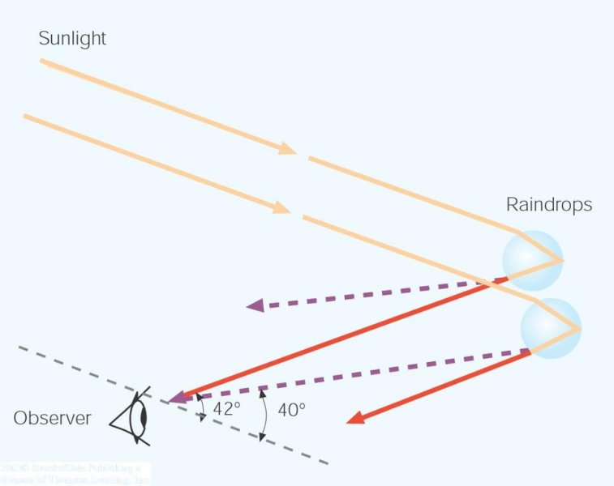
The geometry: the sun is behind you

Slide 48
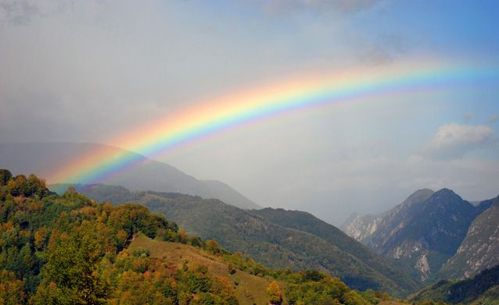
The correct color sequence of primary bow: violet (inside) to red (outside)

Slide 49
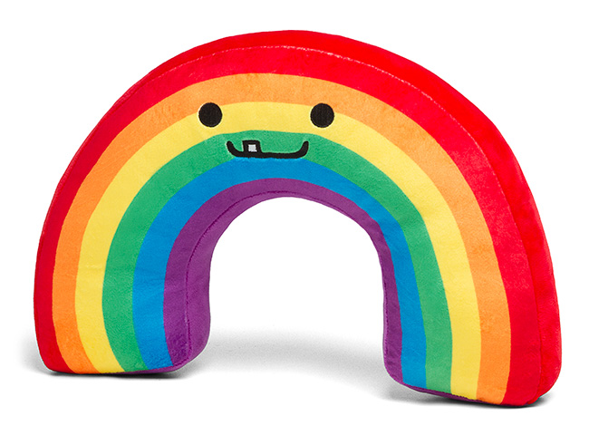
Correct!

Slide 50
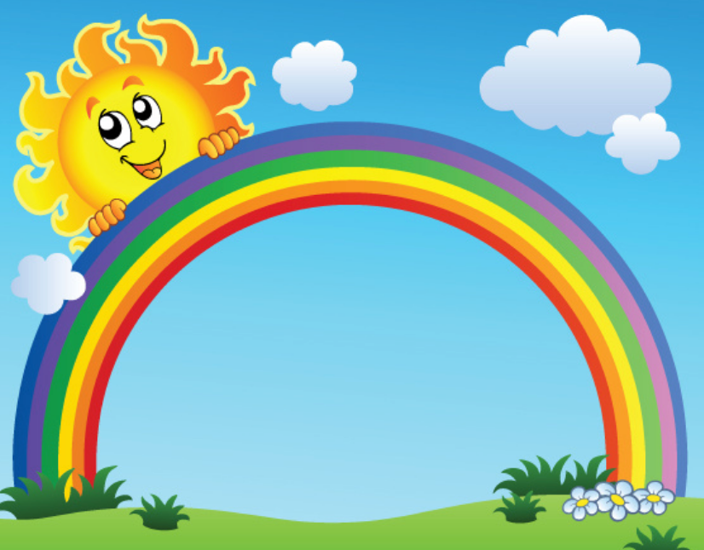
Not Correct

Slide 51
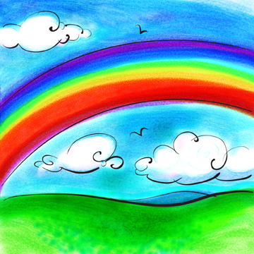
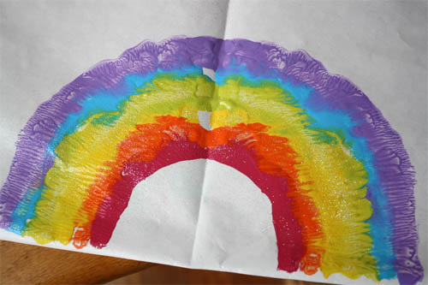
Sometimes artists get rainbows wrong

Slide 52

Sometimes a double rainbow

Slide 53

Why? When there is a second reflection off the back side of the droplet
Secondary Rainbows

Slide 54
Colors are reversed for secondary rainbows

Slide 55


Can be a full circle if you are in the air or in mountains

Slide 56

Legend: The Pot of Gold At the End of the Rainbow

Slide 57

No
Scientific
Evidence for This!

Slide 58

Serious journalism

Slide 59

Halos

Slide 60


Slide 61

Halo
Associated with ice crystals, usually with cirrostratus clouds
Ice crystals are hexagonal (six-sided) crystals and can be in columns or plates.
Most haloes associated with columns
plate
column

Slide 62

Two ways for visible light to go through ice crystals: refracting the light by either 22 or 46 degrees

Slide 63

If ice crystals are small and randomly oriented we get 22 and 46 degree halos (22 more frequently apparent)

Slide 64

The Sun Dog a.k.a. mock suns or parhelia

Slide 65


Slide 66


Slide 67

Why sun dog?
Large (> 30 micron) ice crystals are shaped like plates. Horizontal orientation, so no circular halo

Slide 68

If you drop a pile of papers they tend to get a horizontal orientation

Slide 69

Colors with sundog from dispersion during refraction in ice crystals

Slide 70
Some folks believed that halos had special meaning….

Slide 71



Slide 72
Before the Battle of Mortimer's Cross in 1461, the future King Edward IV tried to convince his troops, frightened by the appearance of three suns, that they represented the Holy Trinity and presaged a great victory. (He won).

Slide 73
Shakespeare, Henry IV, Part 3
EDWARD Dazzle mine eyes, or do I see three suns?
RICHARD Three glorious suns, each one a perfect sun;
Not separated with the racking clouds,
But sever'd in a pale clear-shining sky.
See, see! they join, embrace, and seem to kiss,
As if they vow'd some league inviolable:
Now are they but one lamp, one light, one sun.
In this the heaven figures some event.
EDWARD 'Tis wondrous strange, the like yet never heard of.
I think it cites us, brother, to the field,
That we, the sons of brave Plantagenet,
Each one already blazing by our meeds,
Should notwithstanding join our lights together
And over-shine the earth as this the world.
Whate'er it bodes, henceforward will I bear
Upon my target three fair-shining suns.

Slide 74

Mirages
The world really is not what it appears to be!
Atmospheric mirages depend on large density differences of the atmosphere in the vertical--normally associated with a layer of cool or warm air near the surface

Slide 75

Two Types of Mirages
Inferior Mirage: objects appear lower than they actually are.
Superior Mirage: objects appear higher than they actually are.

Slide 76
Water on the Road Mirage!
An Example of an Inferior Mirage

Slide 77


Slide 78


Slide 79


Slide 80

Associated with sunny days in which a road and adjacent air are heated. Reduced density of air near the surface

Slide 81


Slide 82

If the surface is warm enough you can even get objects turned upside down in addition to being an inferior mirage

Slide 83

Superior Mirage
Object is projected higher than it actually is
Occurs when the surface and nearby air is much colder than the air above.
Thus, we have less dense air above more dense air near the surface.

Slide 84

Objects look bigger or higher than they should! Often associated with an inversion

Slide 85

Why?

Slide 86

Fata Morgana: Castles in the Sky
Named after King Arthur’s half sister, who lived in a crystal palace beneath the water and could build fantastic palaces out of thin air.
Small (or big objects) on earth’s surface can appear as castles in the sky!

Slide 87


Slide 88


Slide 89


Slide 90


Slide 91
Superior Mirages Occur Many Times During the Summer Near Puget Sound
Puget Sound is cool (around 50F)
Warm air from land moves over it.
Some good examples are found here:
http://cliffmass.blogspot.com/2013/10/superior-mirage-watch.html

Slide 92


Slide 93

https://vimeo.com/76869403

Slide 94


Slide 95

Did a mirage take out the Titanic?

Slide 96


Slide 97



Slide 98

Superior mirage: ocean surface raised into sky obscuring icebergs

Slide 99

An Everyday Mirage: the Sun and the Moon
They aren’t where you think they are.
They are actually lower
Everyday there is a superior mirage

Slide 100


Less Dense
Dense

Slide 101

So when the sun appears about to set….it is already set!

Slide 102
The Green Flash
Scottish saying:
“He or she who sees the green flash will never err in matters of love”
Seen during some sunsets over water.

Slide 103


Slide 104


Slide 105

Why a green flash?
Caused by refraction and scattering.
Red bent less than blue/green
Less Dense
More Dense
Blue-Green are refracted more…so seem higher

Slide 106
Green Flash
As sun sets, red/yellow lost first.
Leaves green and blue.
Blue tends to be scattered out by atmospheric molecules.
Leaves green.

Slide 107
http://www.youtube.com/watch?v=lwus2nqU0SY

Slide 108

Also a cocktail

Slide 109
The END

