Slide 1
Atmospheric Sciences 370 Observing Systems Winter 2025
Observations are the foundation of all meteorological applications

Slide 2
Two Types of Observations: Direct versus Indirect
Direct: measurement at the location of the instrument
Indirect: remotely sensed using radiation measurements
Direct: surface weather stations, radiosondes
Indirect: satellite sensing of the temperature of clouds, atmosphere, and the surface. Cloud-track winds.

Slide 3
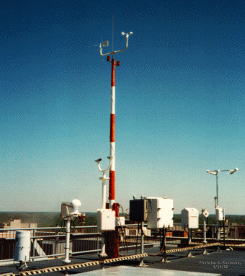
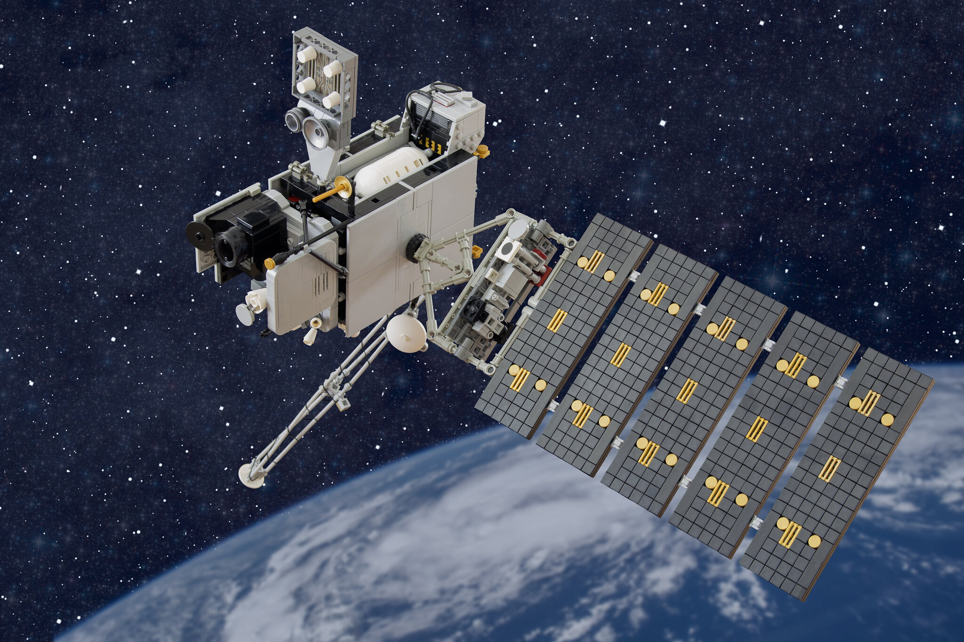
Over the Past Decades, A Trend to Dominance of Indirect Observations

Slide 4
ASOS: Automated Surface Observing System Backbone Surface Observing System in the U.S.

Slide 5
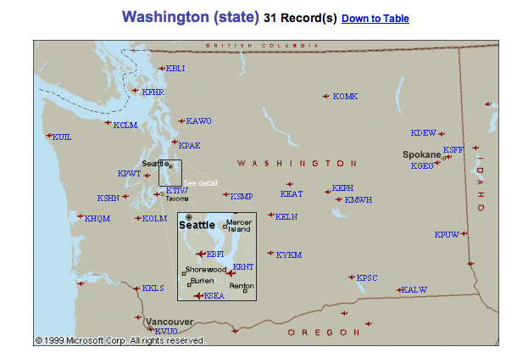
ASOS
Located at primary and secondary airports
Supported by the FAA and NWS
High-quality instrumentation that is well maintained and calibrated.
Reported in METAR format

Slide 6
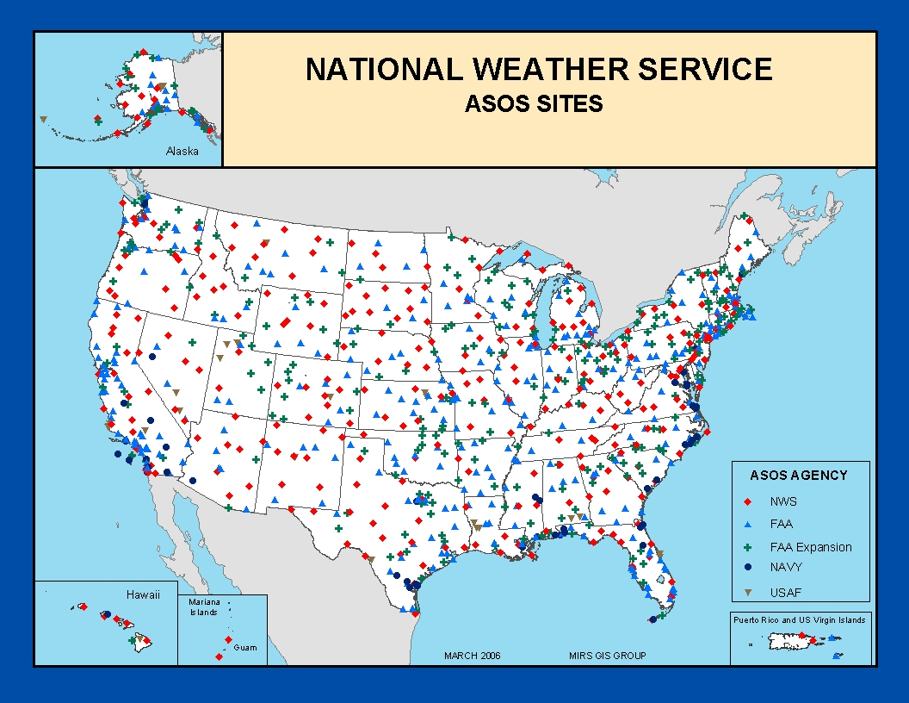

Slide 7
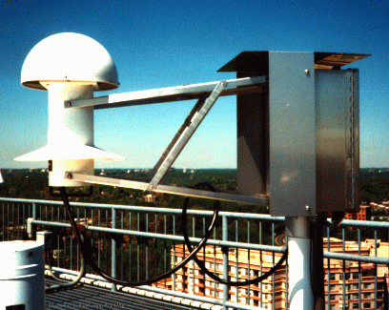
Hydrothermograph

Slide 8
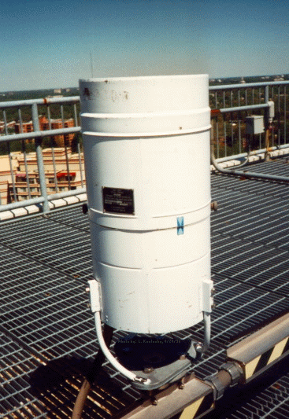
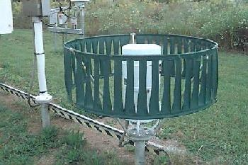
Many are shielded
Precipitation Gauges

Slide 9
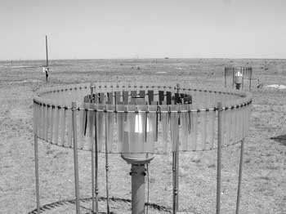
Some Even with Double Shields
Shields reduce wind and turbulent eddies around gauges which can lessen catch efficiency. The largest effect of wind is on snow.

Slide 10
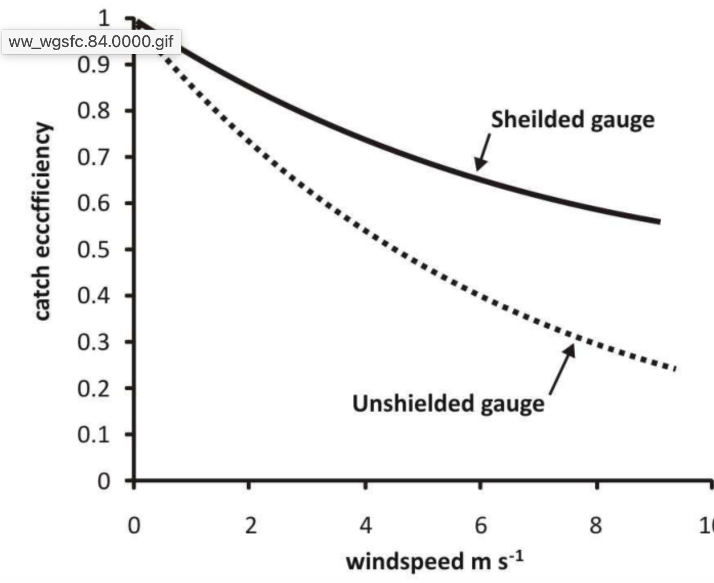
Catch Efficiency: Better for Shielded Gauges

Slide 11
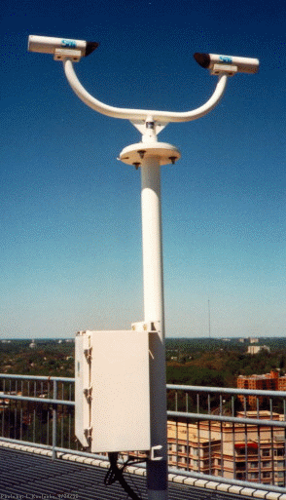
Laser Weather
Identifier
No human intervention!
Rain versus snow, etc.

Slide 12
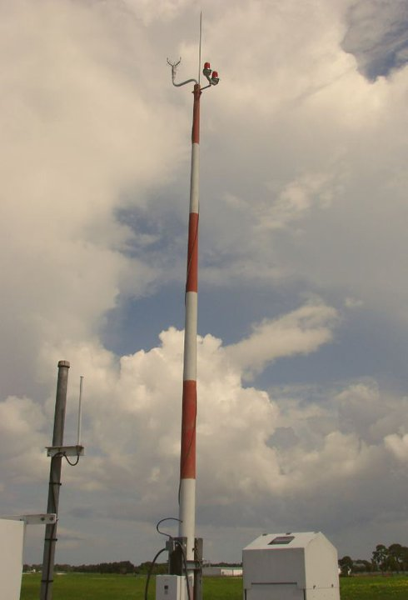
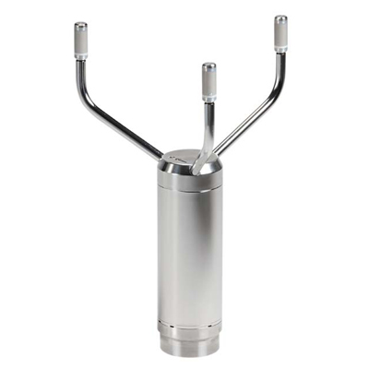
Acoustic Anemometer/Wind Direction

Slide 13
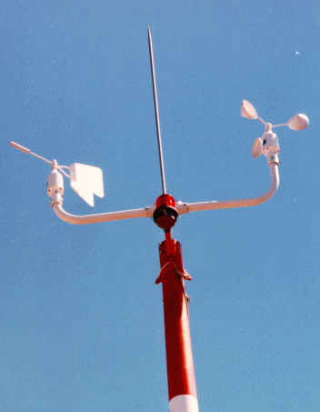
Mechanical wind instruments no longer used in ASOS!
Suffered from icing.
Did not measure low speeds well.
Anemometer
Wind Vane

Slide 14
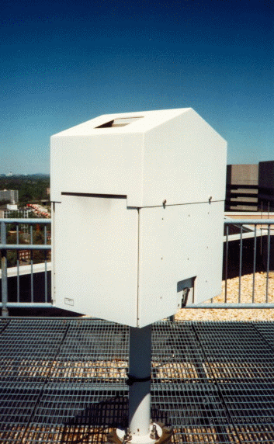
The ceiling is the height of the lowest cloud layer
Measures time for laser pulse to reflect off clouds
Very important for aviation.
Laser Ceilometer

Slide 15
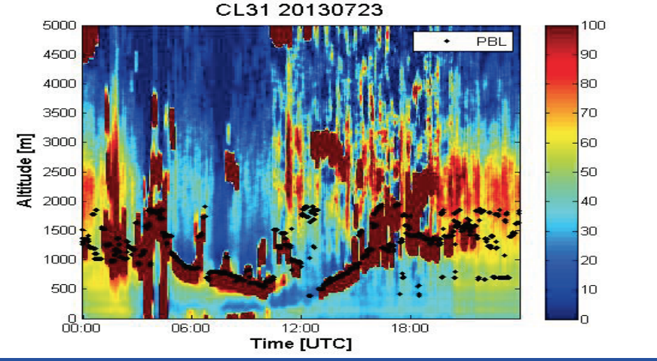
Can Also Provide Vertical Profiles of Clouds and Smoke

Slide 16
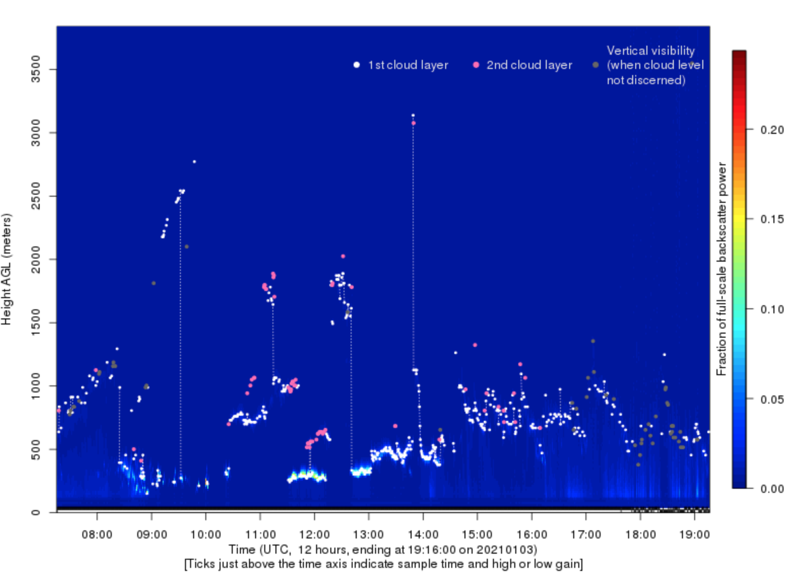
UW Ceilometer

Slide 17
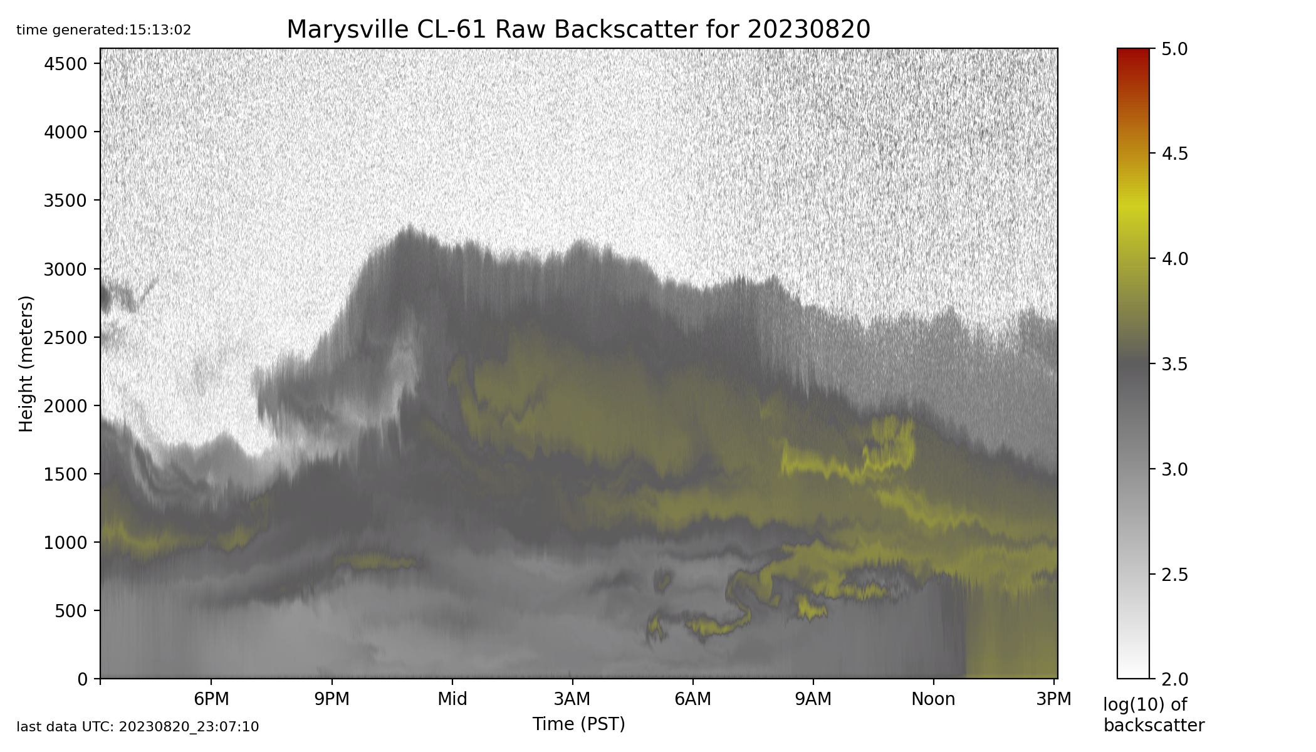
Can Sense Wildfire Smoke

Slide 18
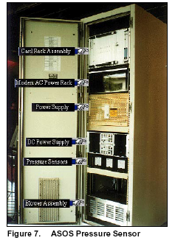
ASOS Pressure Sensor

Slide 19
ASOS Pressure Sensors
Gold Standard
Three sensors, requires agreement of at least two.
Accuracy: +-.02 inches of mercury ( .67 hPa)
Resolution: .003 inches, .1 hPa

Slide 20
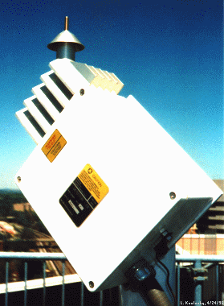
The ASOS Freezing Rain Sensor
Uses an ultrasonically vibrating probe to detect the presence of icing conditions. The vibrating frequency of the probe decreases with the accumulation of ice.

Slide 21
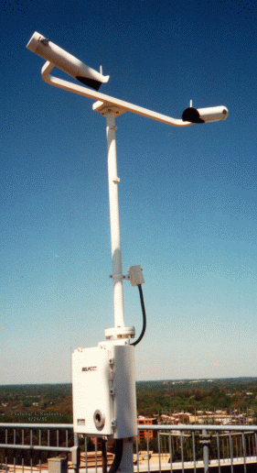
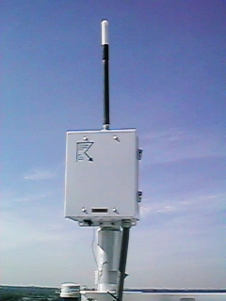
Lightning Sensor
Visibility Sensor

Slide 22
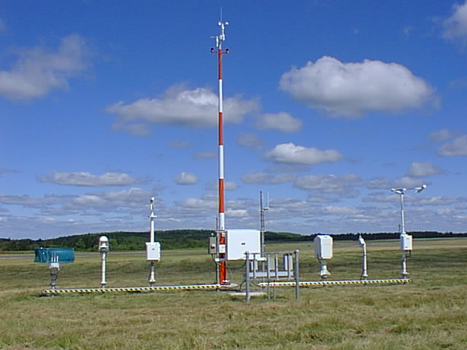
Observing Heights (ASOS and Most Official Obs)
Temperature and dew point (2-m)
Wind speed and direction (10-m)

Slide 23
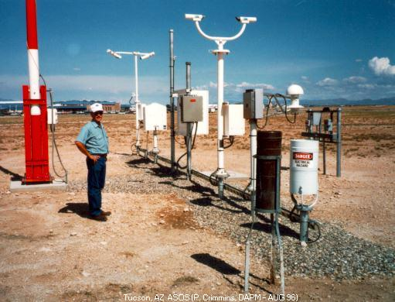
Full ASOS system in Arizona

Slide 24
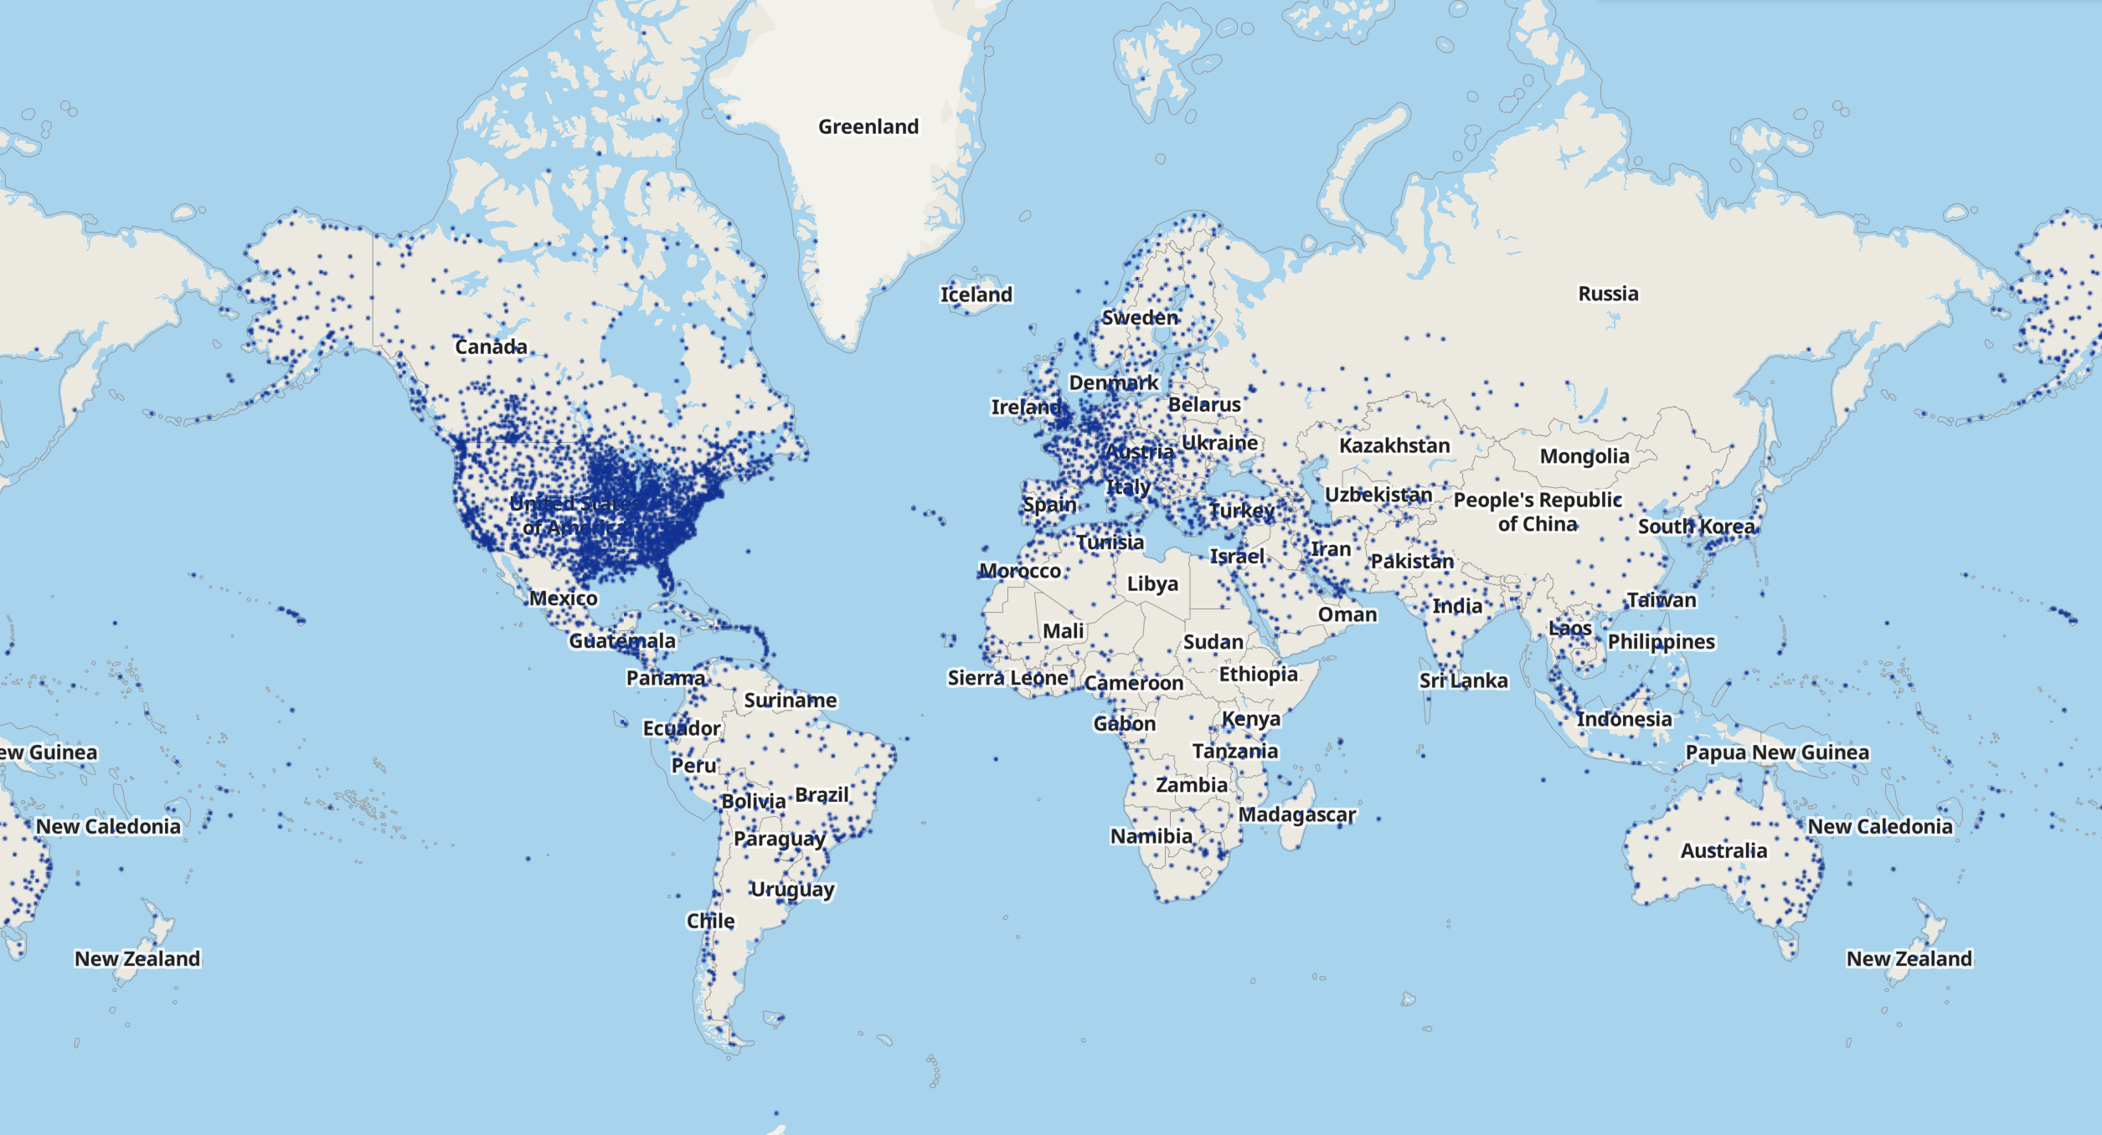
Most other nations have similar observations systems at airports

Slide 25
Airport Observation are Transmitted in METAR Format
Name came from the French words, MÉTéorologique ("Weather") Aviation Régulière ("Routine").
Example: KSEA 042353Z 11008KT 10SM FEW050 SCT070 OVC090 09/03 A2879 RMK AO2 SLP756 60001 T00940033 10117 20083 58013

Slide 26
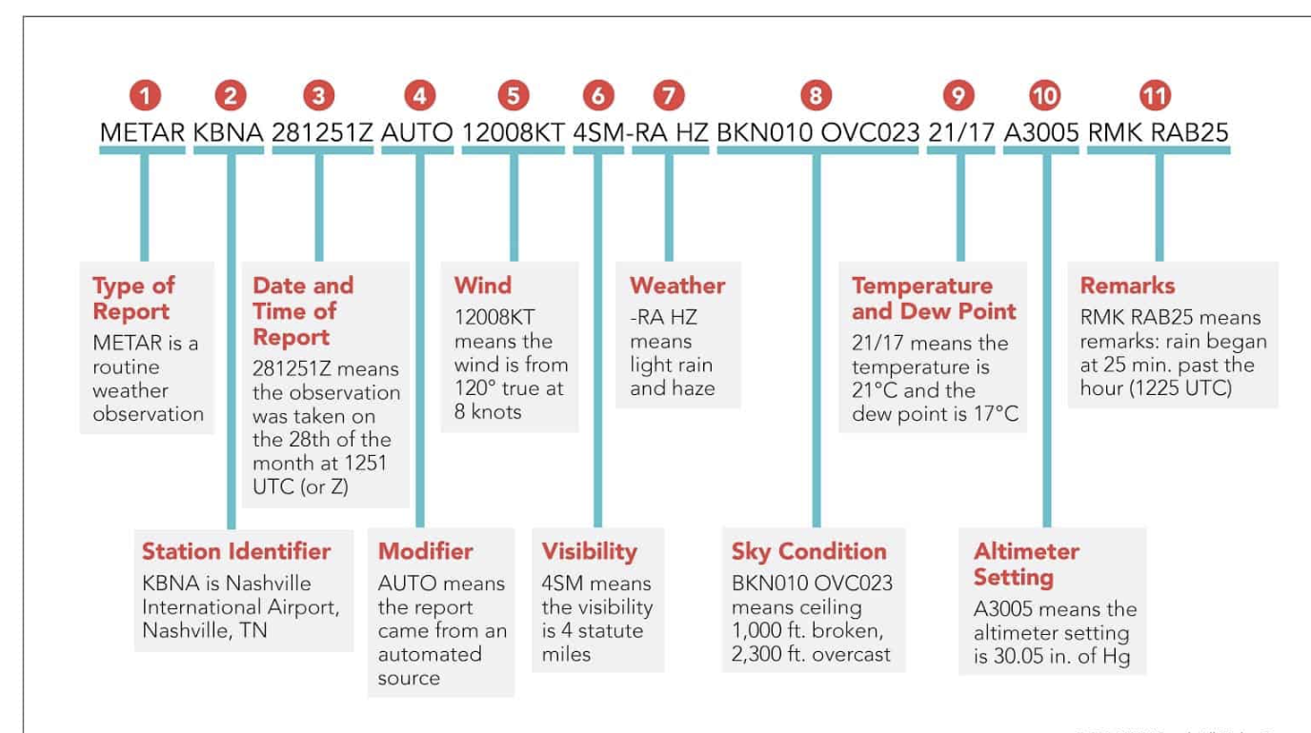
METAR Code

Slide 27
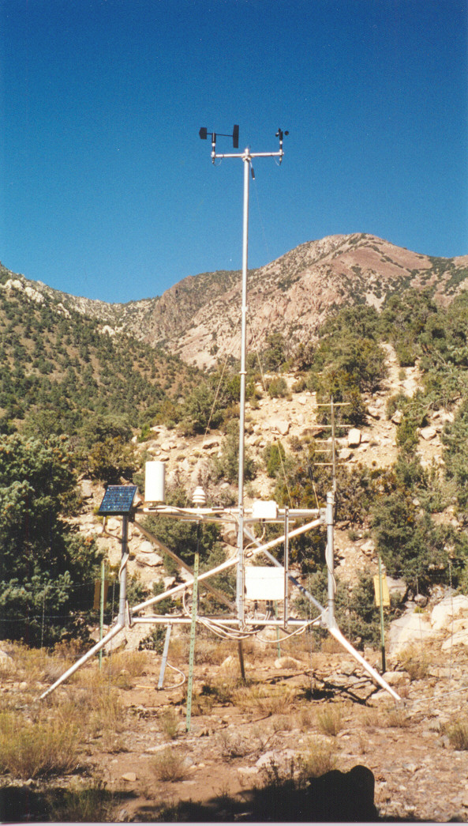
Many Other Surface Networks
Bureau of Land Management
USDA RAWS
Agrimet
PAWS
Department of Ecology
Puget Sound Clean Air
BC Hydro
Tempest
Purple Air
Weather Underground
Many more!

Slide 28
Several States Have Set Up Mesonets

Slide 29
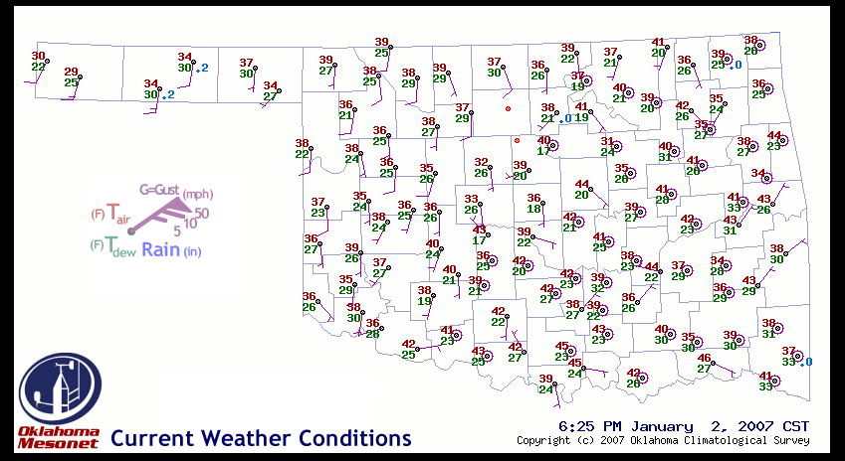
Oklahoma Mesonet

Slide 30
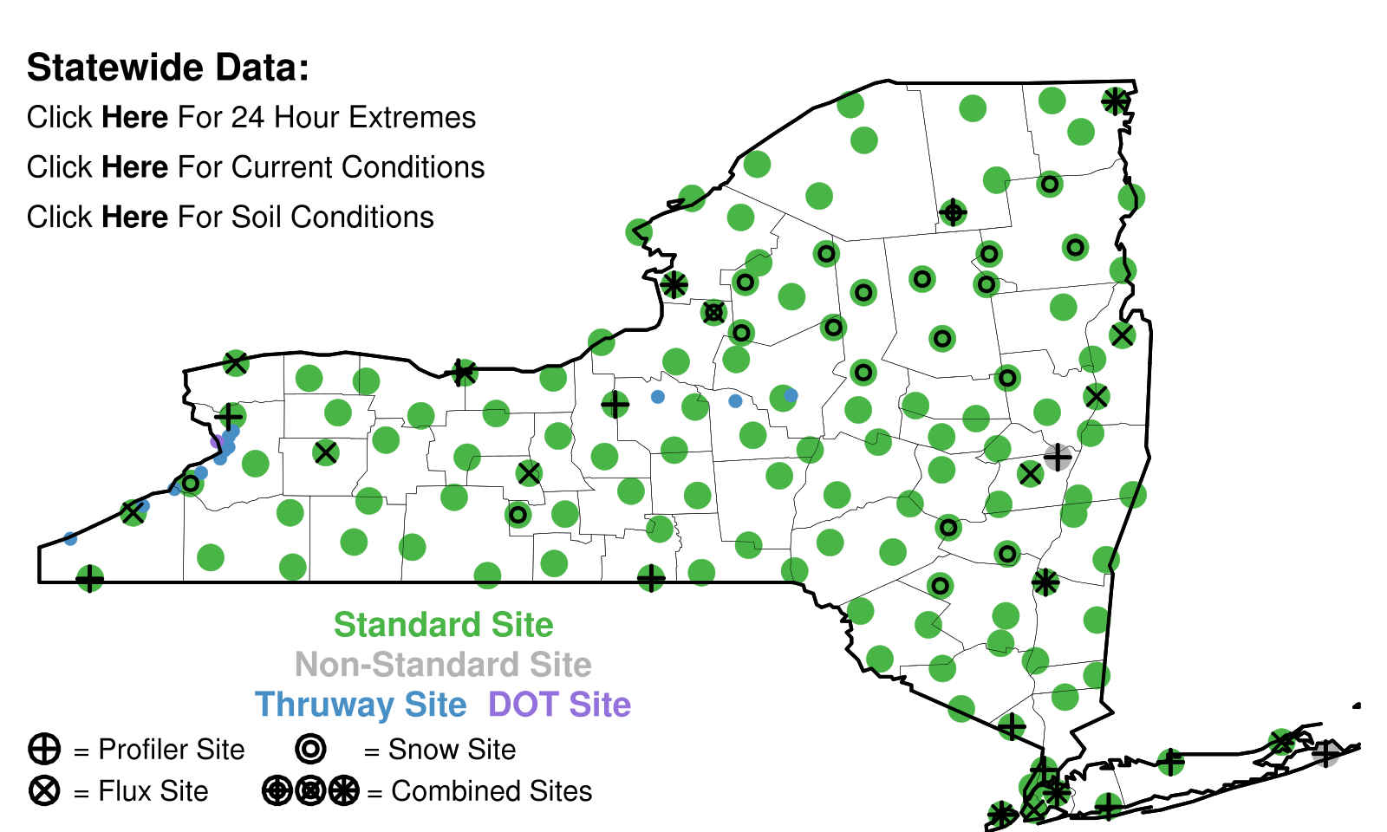
New York Mesonet

Slide 31
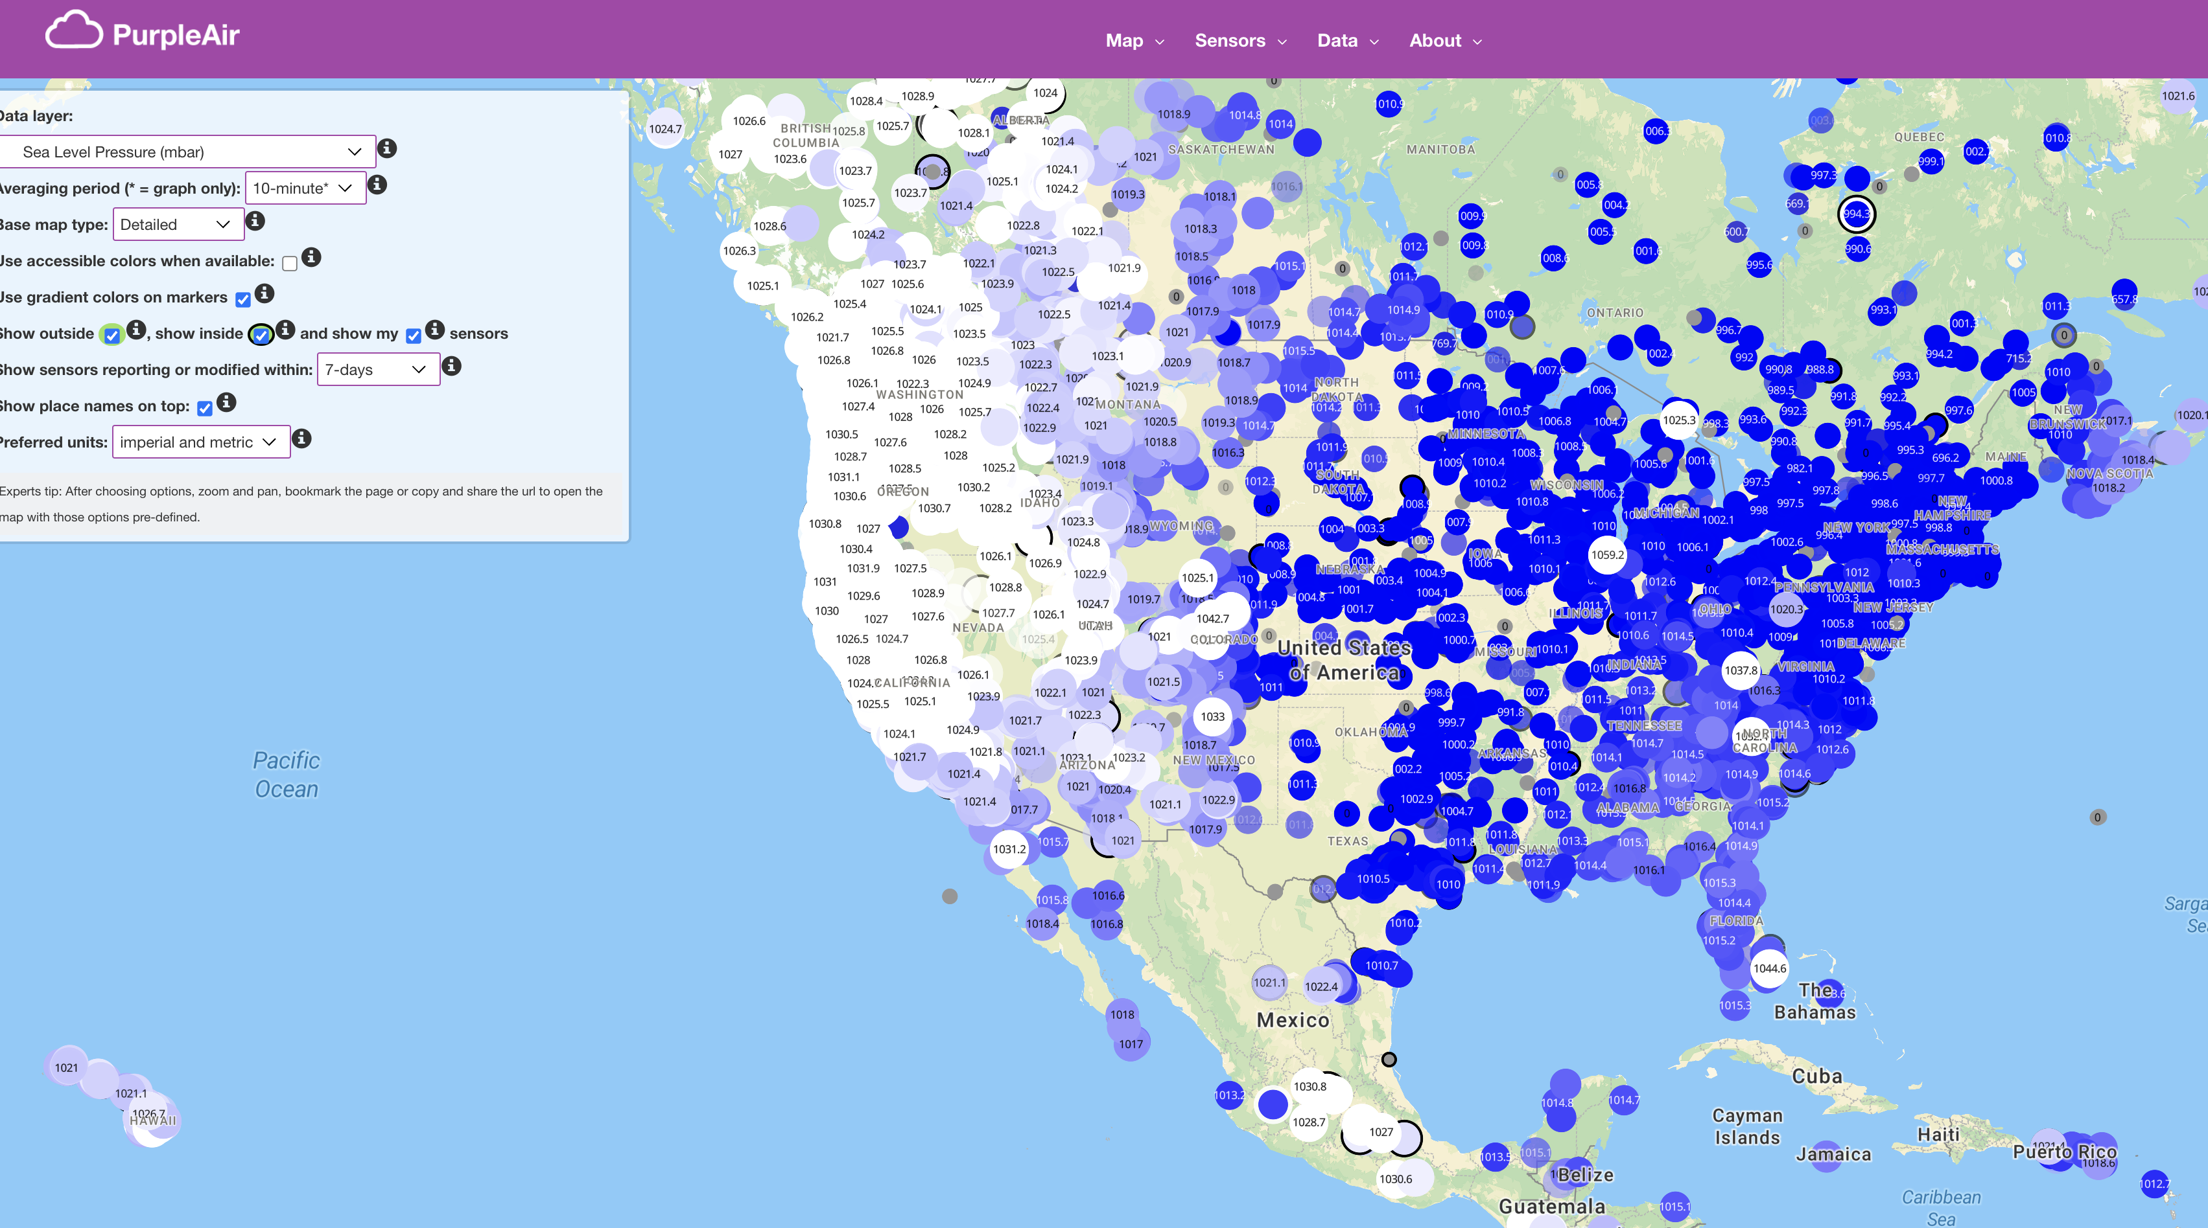

Slide 32
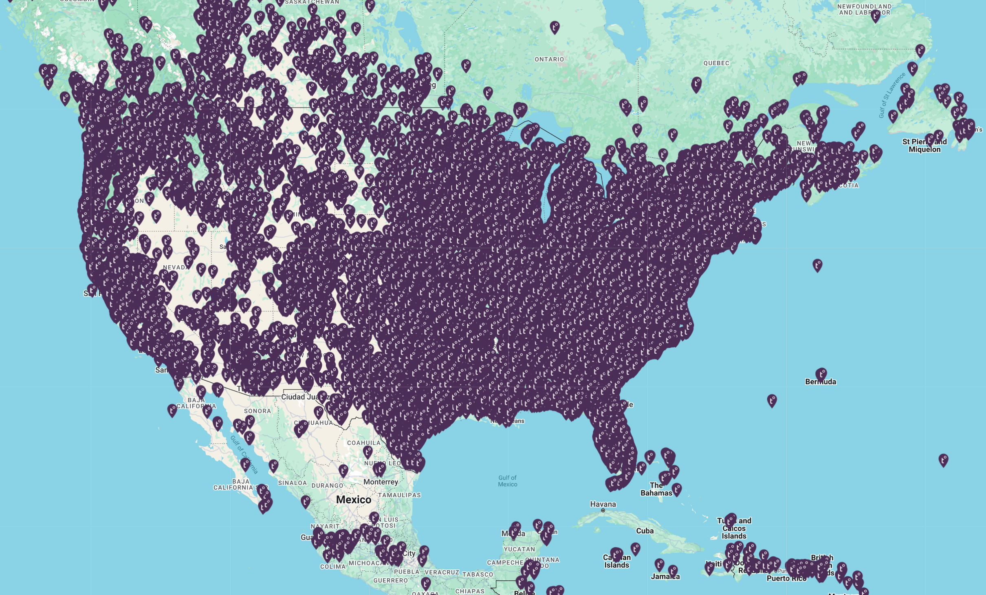
Tempest Network

Slide 33
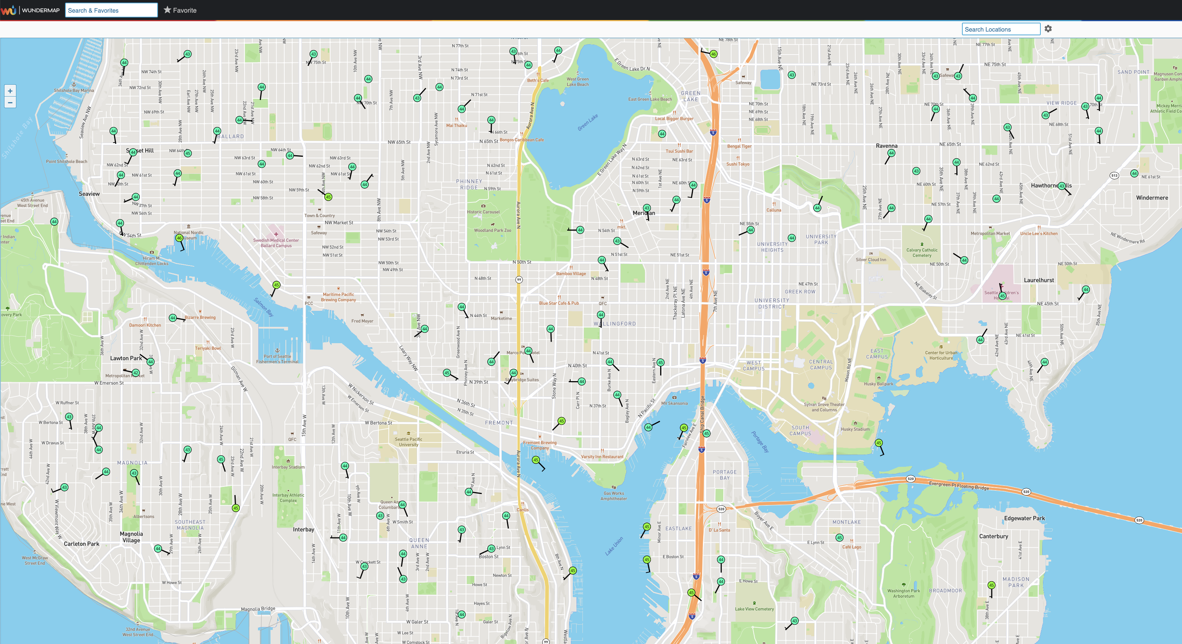
Weather Underground

Slide 34
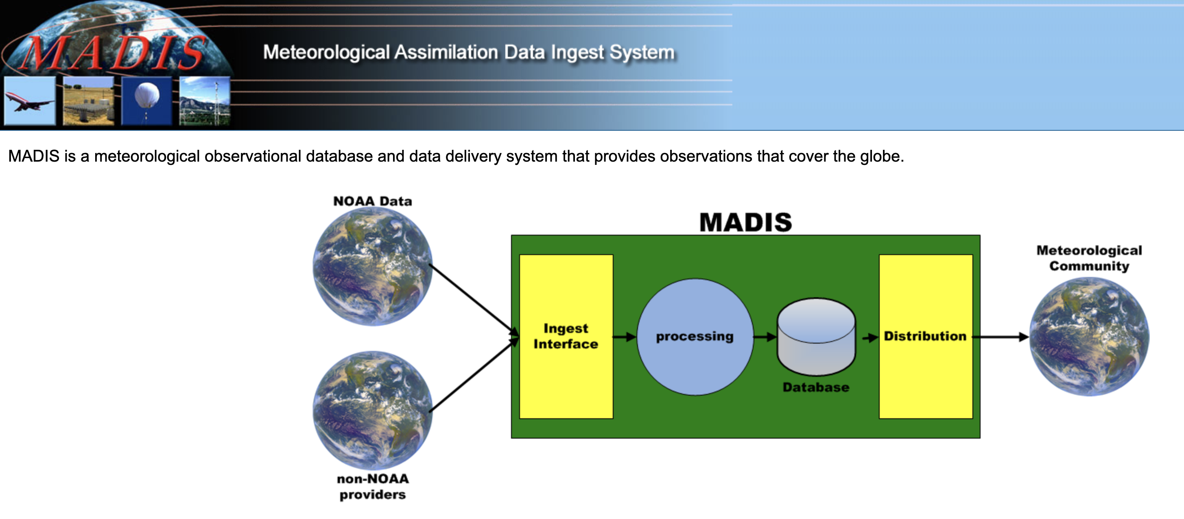
Networks of Networks
MesoWest: Collects about 100 networks over the western third of U.S.
MADIS: NOAA national collection of mesonets

Slide 35
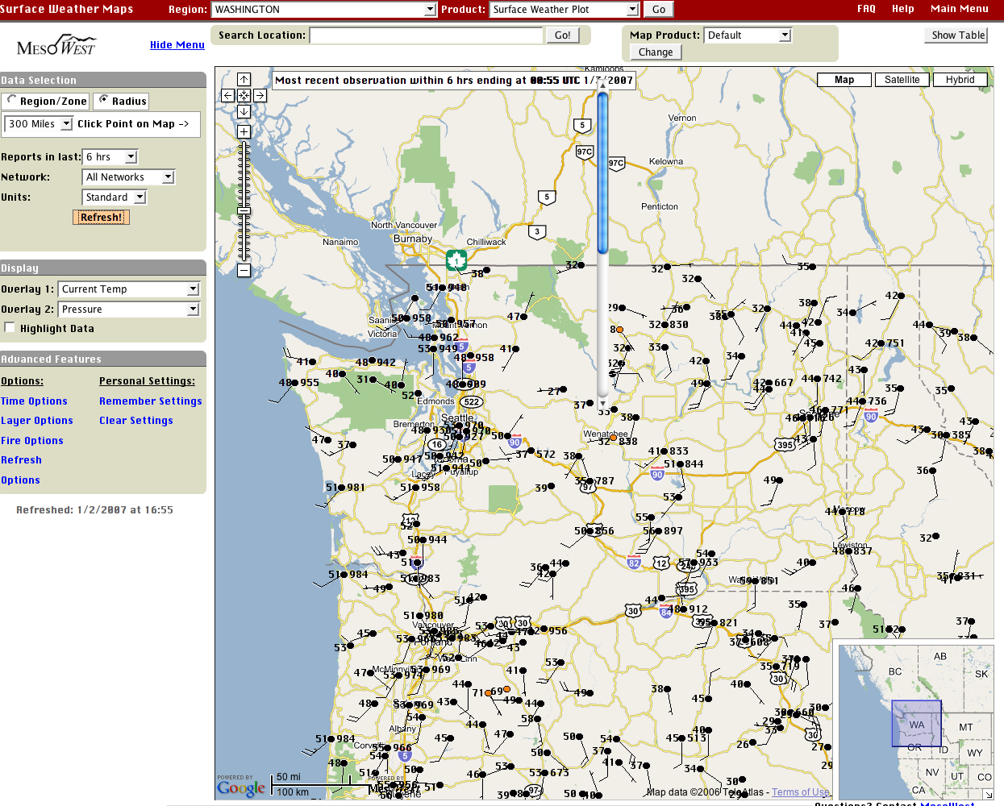

Slide 36
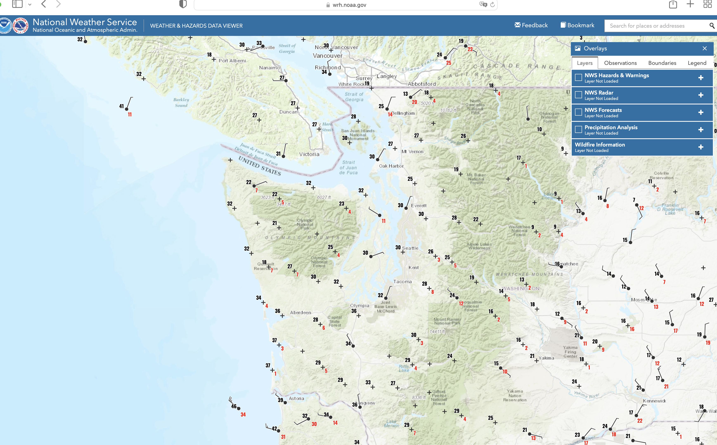
One of the best viewers of many networks: NOAA Weather/Hazards
https://www.wrh.noaa.gov/map/?obs=true&wfo=sew

Slide 37
https://www.wrh.noaa.gov/map/?obs=true&wfo=sew

Slide 38
Major Change
In 1980, there were approximately 1000 real-time surface observations in the U.S., mainly at airports
Today, with so many networks, there are several hundred thousand.

Slide 39
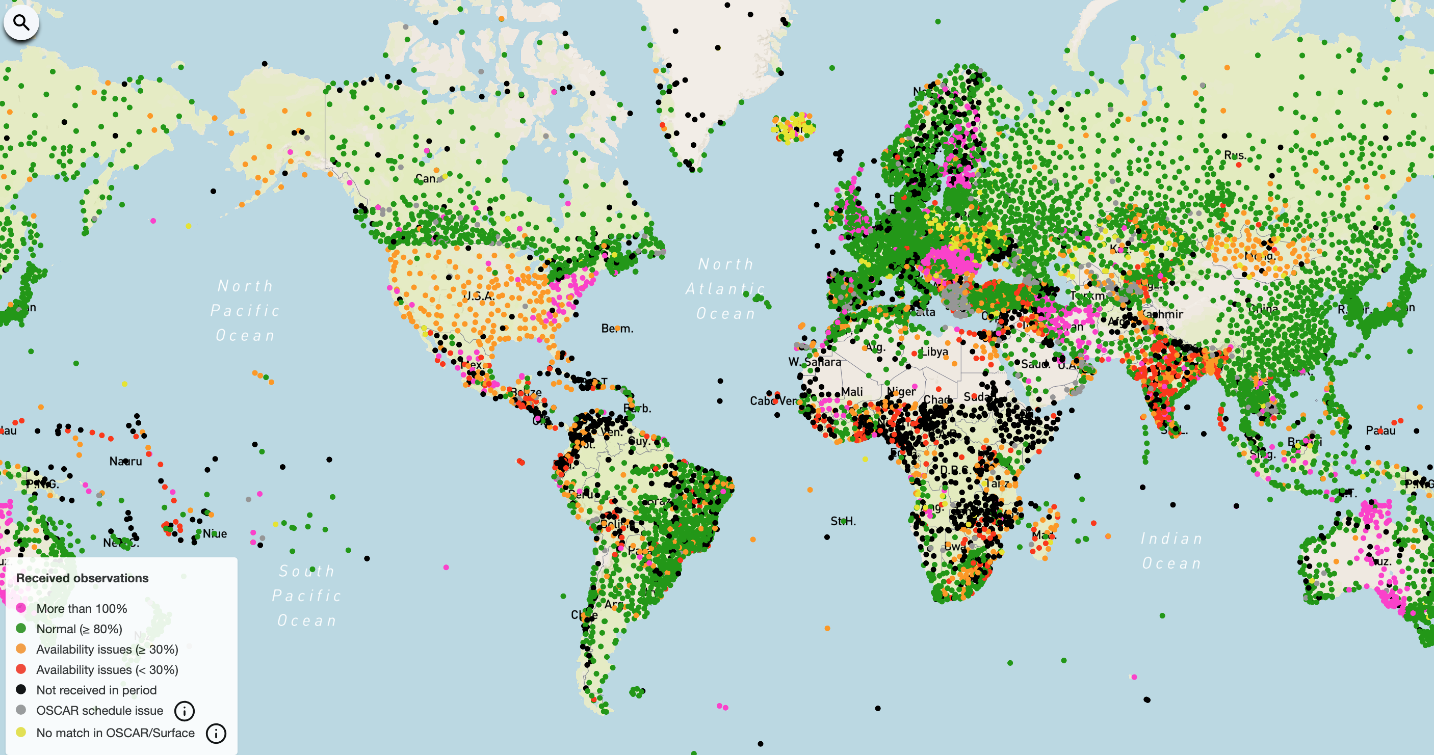
Global Coverage of Airport Stations

Slide 40
Marine Weather and Surface Ocean Reports

Slide 41
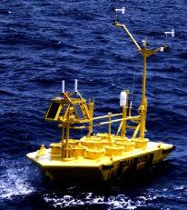
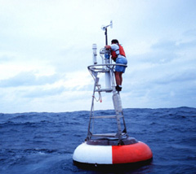
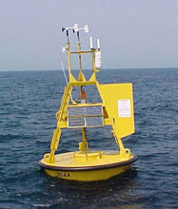
Ocean and Lake
Weather Buoys
Anchored

Slide 42
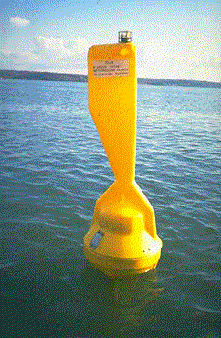
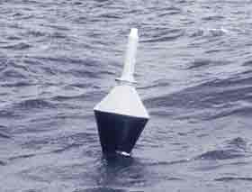
Drifting Buoys: Move Around!
Wind
Pressure

Slide 43
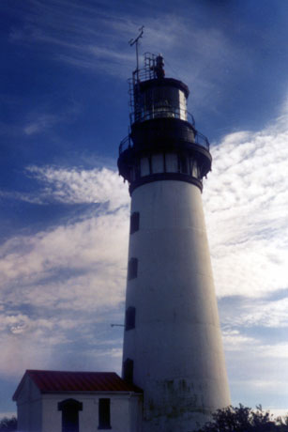
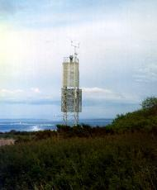
Coastal Marine (CMAN) Reports from the Coast Guard

Slide 44
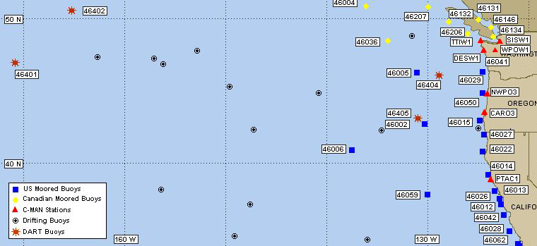
Northwest Buoy and CMAN Locations

Slide 45
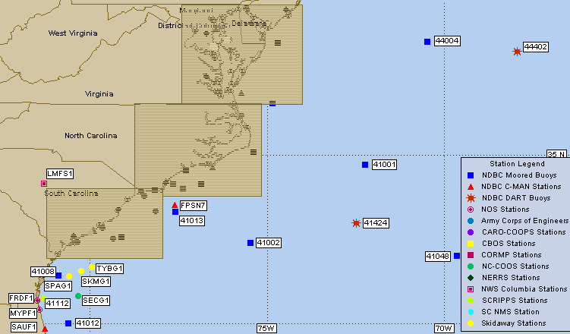

Slide 46
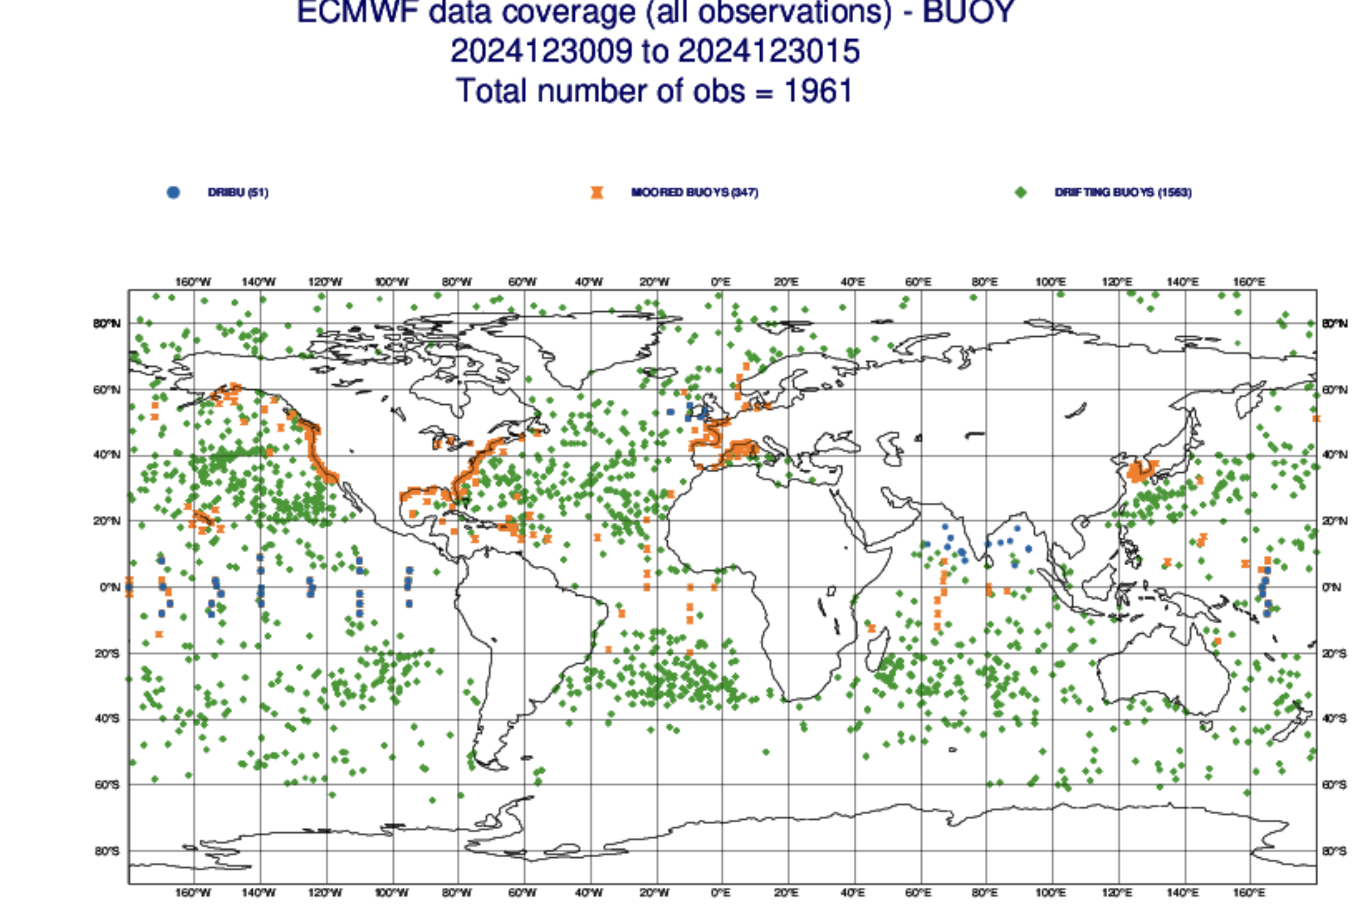

Slide 47
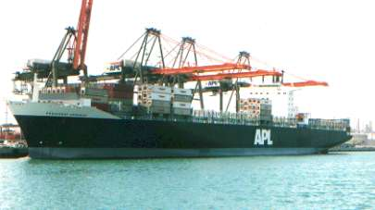

Ship Reports: Marine VOS Program
Volunteers Observers--generally 6-hourly reports
Highly variable quality and frequency

Slide 48
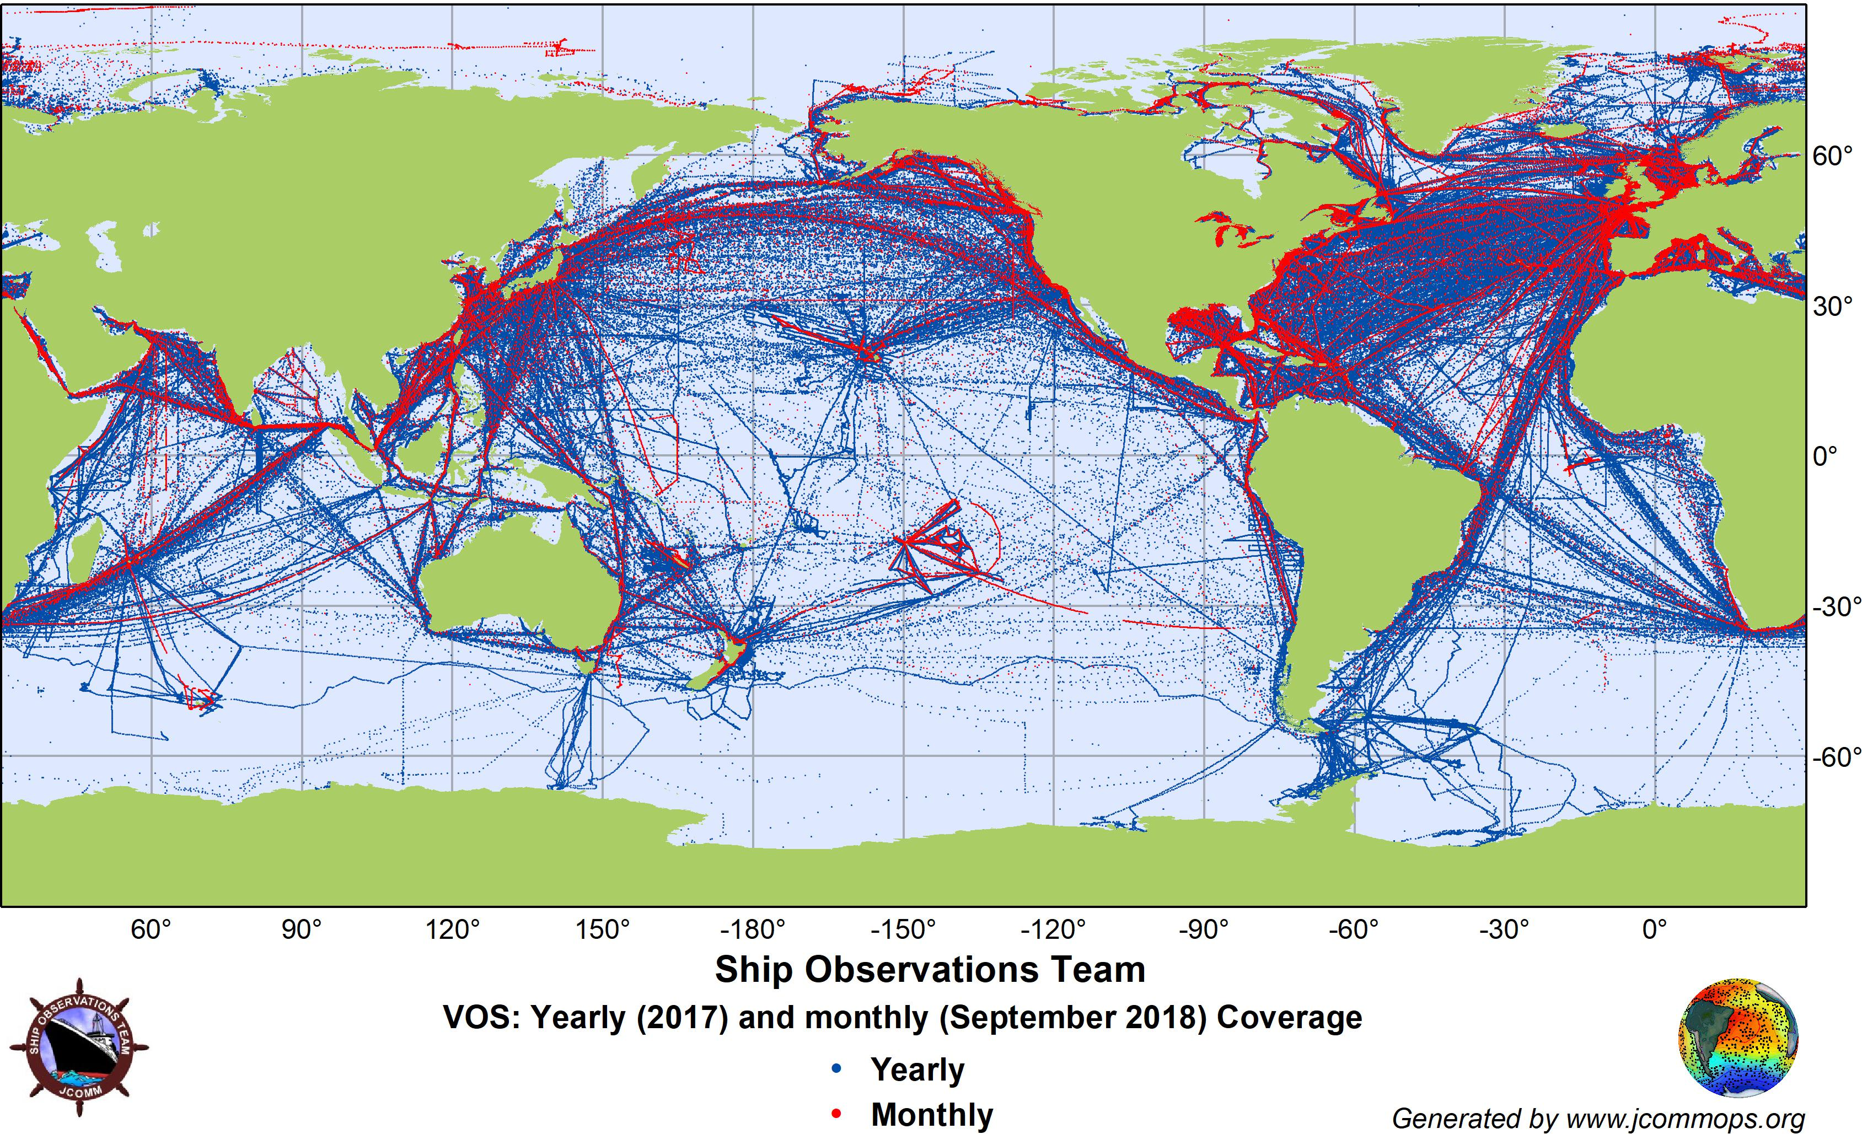

Slide 49
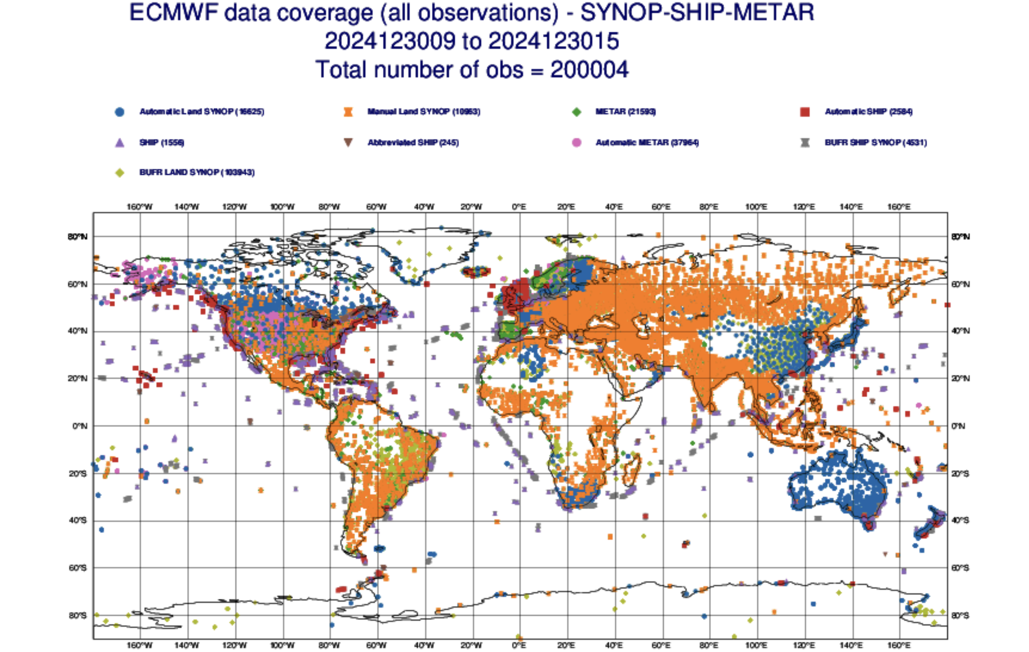

Slide 50
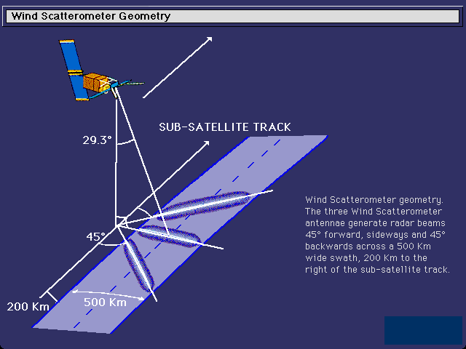
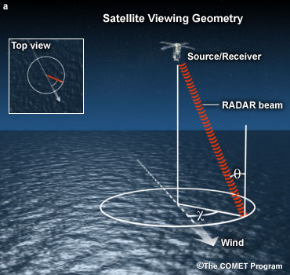
Satellite Microwave Scatterometers: Microwaves scattering off surface waves give surface wind and direction

Slide 51

QuickScat Satellite
Bounces microwaves off the ocean surface
Capillary waves dependent on wind speed and direction

Slide 52

Satellite
Microwave
Scatterometer
Winds

Slide 53


Slide 54

Satellite Scatterometer Coverage

Slide 55
Upper Air Data

Slide 56


Radiosondes
First launched in 1929

Slide 57
Radiosondes
Provides temperature, humidity (relative humidity), pressure, and wind speed/direction)
Generally launched twice a day (00 and 12 UTC).

Slide 58
Radiosondes
A typical radiosonde sounding ascent can last ~2 hours
In that time, the radiosonde can ascend to an altitude exceeding 35 km (about 115,000 feet) and drift more than 300 km (about 180 miles) from the release point.
Typical pressure at balloon burst about 5 hPa (1/200th of surface pressure).

Slide 59

Generally launched twice a day at 00 and 12 UTC
About 1000 locations around the world

Slide 60

There are websites that track them..

Slide 61

Radar Wind Profiler and RASS (Radio Acoustic Sounding System)
Can provide temperature and wind with height
Can also provide information on precipitation/clouds

Slide 62


Slide 63


Slide 64


Slide 65

Aircraft Observations
Often on wide-body aircraft
ACARS: Aircraft Communications Addressing and Reporting System

Slide 66


Slide 67

Can Get Soundings from Aircraft Ascent and Descent

Slide 68

Time
Height
Cross
Section
From
Aircraft
Obs
At SeaTac

Slide 69

Also data from Commuter and Short Haul Aircraft

Slide 70
Weather Satellites Now Provide Roughly 99% of the Weather Data Going into Weather Prediction

Slide 71


Satellite Data
Geostationary and Polar Orbiting Satellites
Geostationary
Polar Orbiter

Slide 72


GOES
Geostationary Operational Environmental Satellite

Slide 73

Geostationary satellites see the whole hemisphere

Slide 74

Generally View Sectors

Slide 75

Putting them together, one can monitor the entire planet

Slide 76


NOAA Polar
Orbiter Weather
Satellite
Polar Orbiter: Higher resolution/more sensors, lower (~800 km)

Slide 77

A polar
low
Polar Orbiters Provide a High-Resolution View

Slide 78
Weather Satellites Provide MUCH More Than Imagery

Slide 79

Cloud and
Water Vapor
Track Winds
Based on Geostationary Weather Satellites

Slide 80


Slide 81

Atmospheric Moisture Vectors from Satellites

Slide 82

GOES sounder Unit: observes atmosphere/earth’s emissions in several wavelengths

Slide 83

Views the Earth
at many wavelengths,
each wavelength/channel sensing temperature at a specific layer

Slide 84

Satellite Temperature and Humidity Soundings

Slide 85
Can do vertical soundings in both infrared and microwave wavelengths

Slide 86

High-Resolution Infrared Radiation Sounder

Slide 87

Microwave Sounders

Slide 88
GPS (Global Positioning System) Soundings
A constellation of GPS satellites orbit the earth.
A collection of special satellites can receive the GPS signal (called GPS-RO, GPS Radio Occultation)
By measuring the delay of the GPS signal as it is bent by the earth’s atmosphere, one can determine atmospheric density variations in the vertical that can be used to create temperature and humidity soundings.

Slide 89


Slide 90



Slide 91


Slide 92

Weather Radar
During the early 90s, the NWS installed a network of powerful Doppler Weather
radars, a.k.a.
NEXRAD
WSR88D

Slide 93

NWS Radar Sites

Slide 94

Weather Radar
Reflectivity (precipitation intensity)
Doppler Velocities (radial velocities)
Polarimetric Information (precipitation type and other information)

Slide 95

Camano
Island
Weather
Radar

Slide 96

Crowdsourced Weather Data
Securing weather data from devices intended for other purposes.
Example: pressure data from smartphones

Slide 97

Smartphone Pressures

Slide 98

Weather Data from the Purple Air Air Quality Network

Slide 99

mping: NWS acquiring crowdsourced weather observations from phones

Slide 100

Mping Example

Slide 101
A Synoptic Meteorologist Needs to Know The Accuracy of Various Observational Assets

Slide 102
Typical Observation Errors at the Surface (Important when doing analyses!)
Sea Level Pressure
Low-elevation land stations +-0.5 mb
Ships +- 1-5 mb
Temperature: +-1C
Wind Speed: +-2-5 knots, very light winds often a problem—especially for classical anemometers.
Relative Humidity: +-10%

Slide 103
Typical Radiosonde Errors
Geopotential heights:
700 mb (hPa): 5-10 m
500 mb 10-15 m
300 mb 15-20 m
100 mb 20-30 m
Temperature: +-0.5C
Wind speed: +-5%,+-10 degrees

Slide 104
Some Terminology Often Used
Synoptic scale
Mesoscale
Microscale

Slide 105

Synoptic Scale (1000 km and more)

Slide 106


Mesoscale (10-1000 km)

Slide 107


Microscale (smaller than 10 km)

Slide 108
The END

