Slide 1
Atmospheric Sciences 370 Observing Systems
Winter 2024
Observations are the foundation of synoptic meteorology

Slide 2
Observation Terminology
Direct versus Indirect observations
  Direct: measurement at the location of the instrument
  Indirect: remotely sensed using radiation measurements
Direct: surface weather station, radiosonde
Indirect: satellite sensing of cloud-top temperatures.

Slide 3
Observation Terminology
Active versus passive remote sensing
  Active: The instrument emits radiation, which interacts with target, and returns. Analyzes return
  Passive: analyzes incoming natural radiation
Radar is active
Infrared satellite imagery is passive.

Slide 4
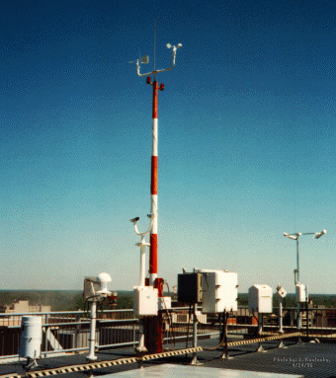
ASOS: Automated Surface Observing System
Backbone Surface Observing System in the U.S.

Slide 5
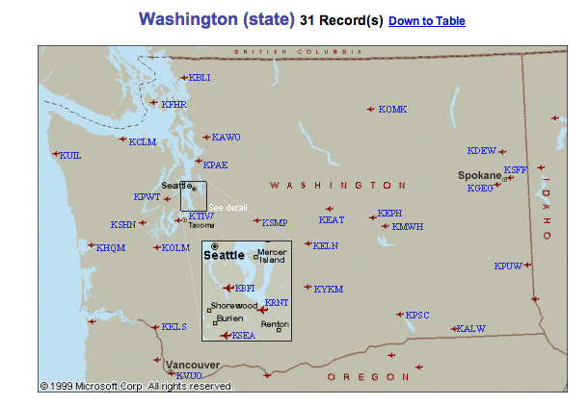
ASOS
Located at primary and secondary airports
Supported by the FAA and NWS
High-quality instrumentation that is well maintained and calibrated.
Reported in METAR format

Slide 6
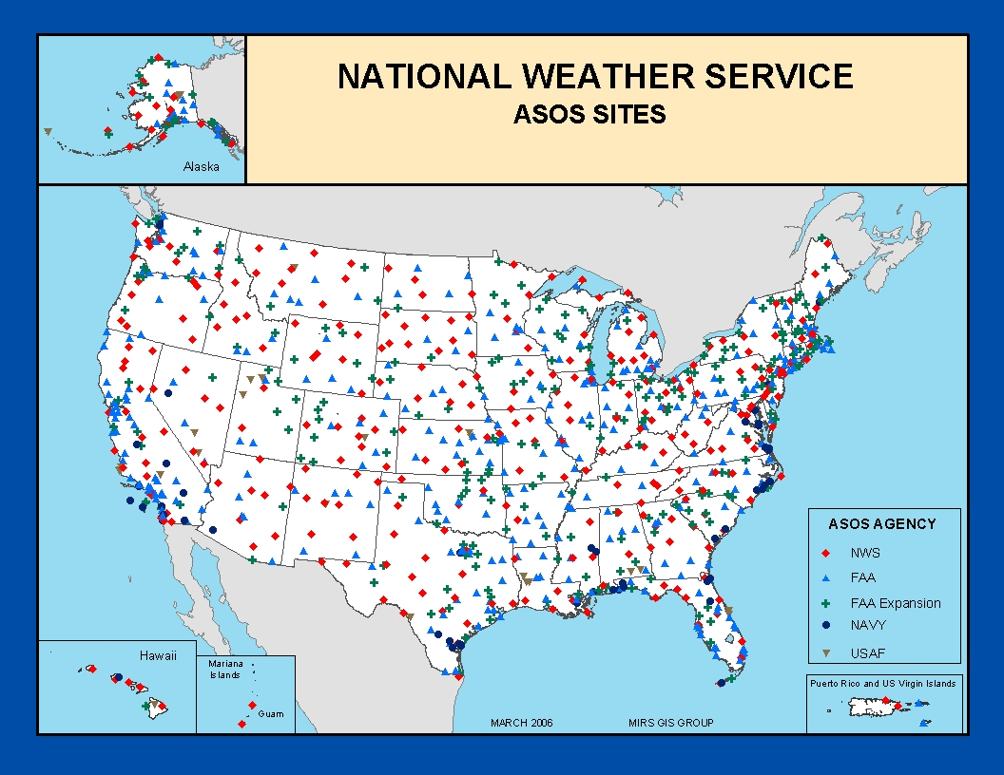

Slide 7
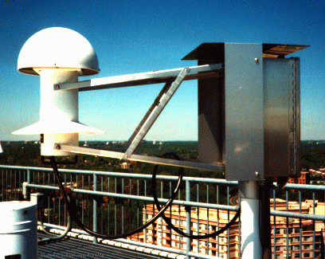
Hydrothermograph

Slide 8
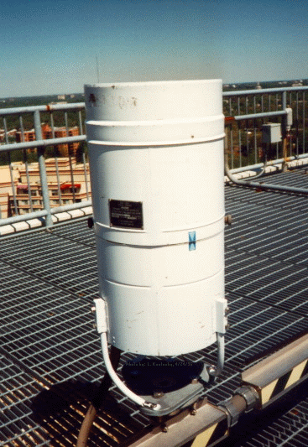
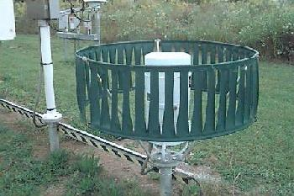
Many are shielded
Precipitation Gauges

Slide 9
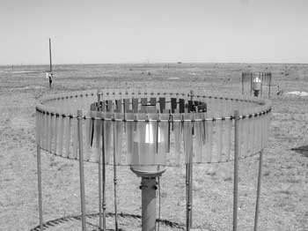
Some Even with Double Shields
Shields reduce wind and turbulent eddies around gauges which can lessen catch efficiency. The largest effect of wind is on snow.

Slide 10
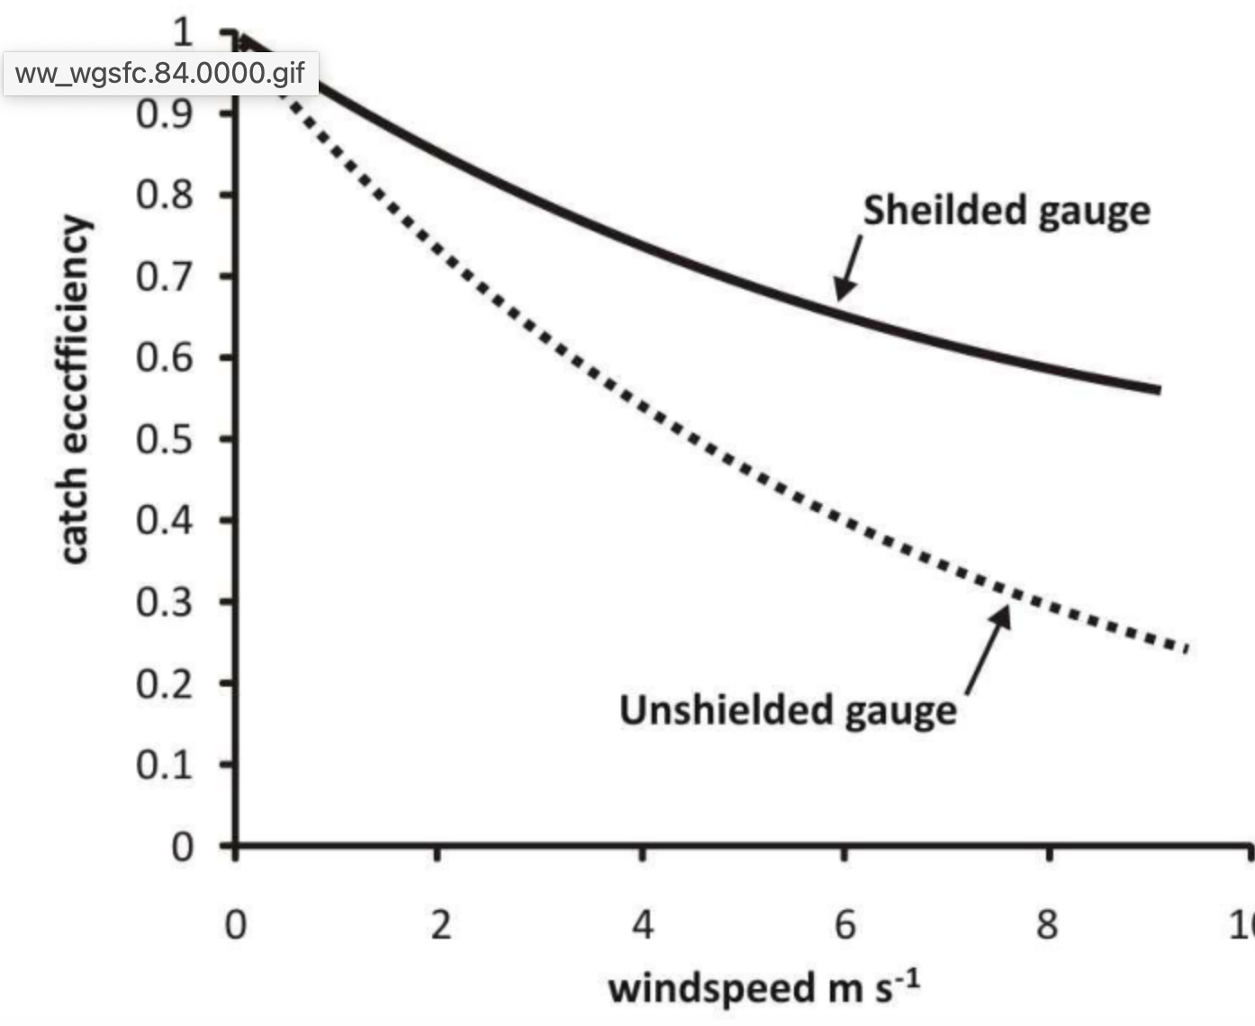
Catch Efficiency: Better for Shielded Gauges

Slide 11
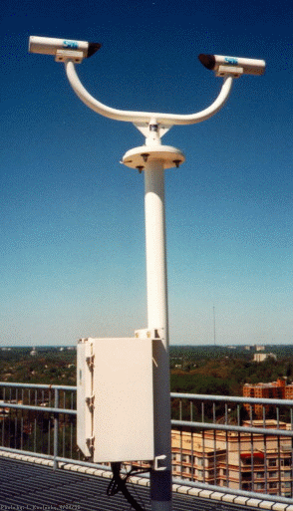
Laser Weather
Identifier
No human intervention!
Rain versus snow, etc.

Slide 12
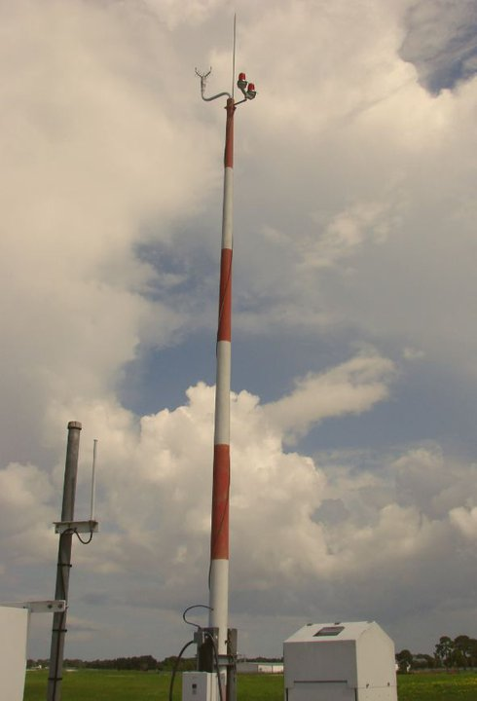
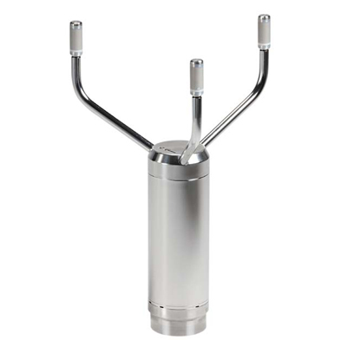
Acoustic Anemometer

Slide 13
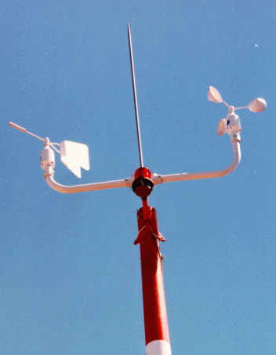
Mechanical wind instruments no longer used in ASOS!
Suffered from icing.
Did not measure low speeds well.
Anemometer
Wind Vane

Slide 14
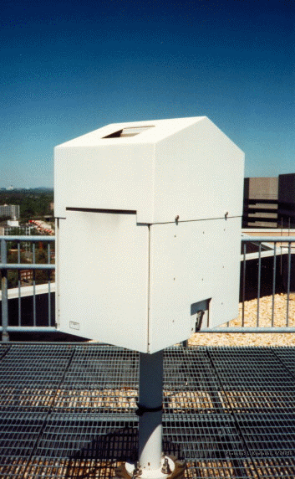
The ceiling is the height of the lowest cloud layer
Very important for aviation.
Laser Ceilometer

Slide 15
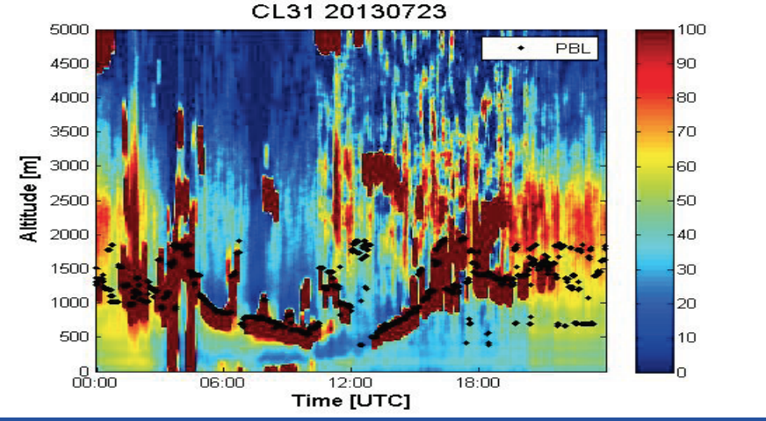
Can Provide Vertical Profiles of Clouds and Smoke

Slide 16
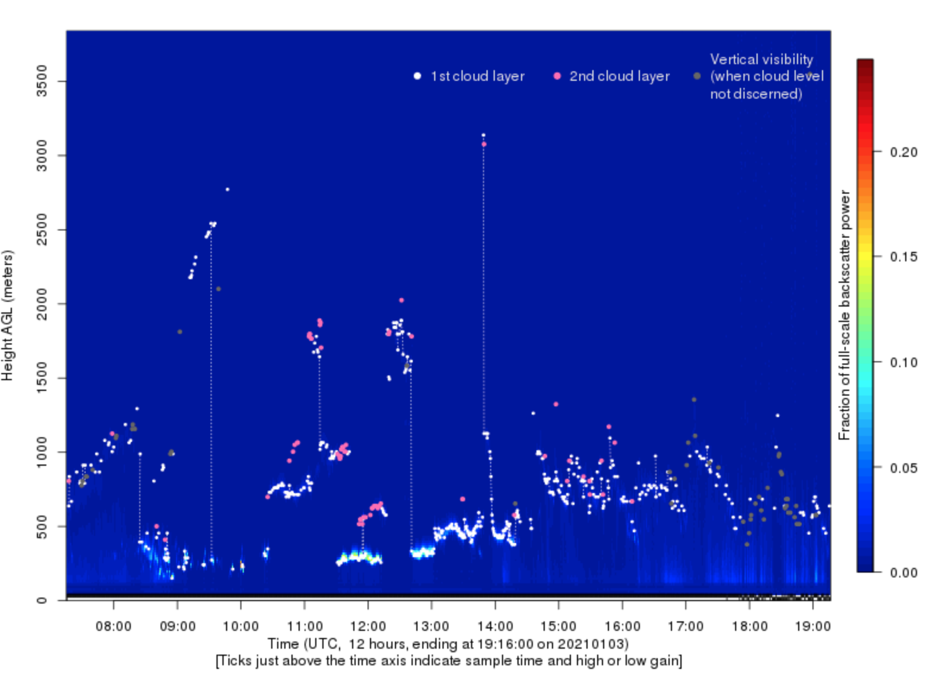
UW Ceilometer

Slide 17
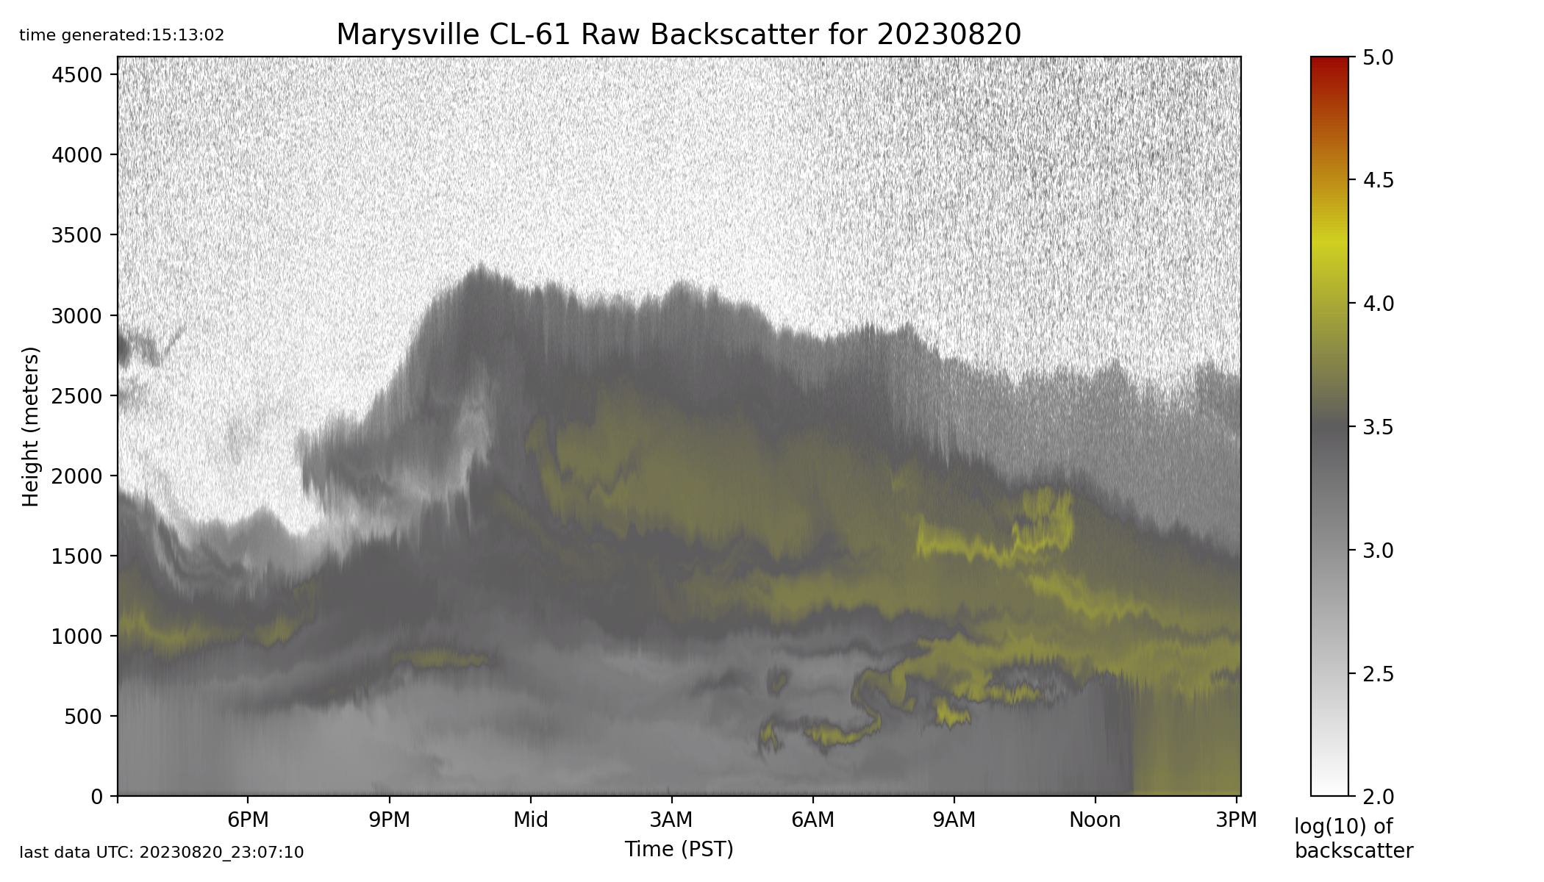
Can Sense Wildfire Smoke

Slide 18
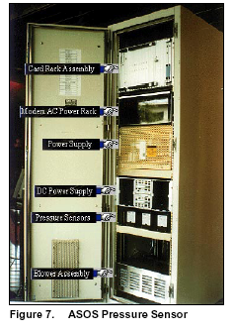
ASOS Pressure Sensor

Slide 19
ASOS Pressure Sensors
Gold Standard
Three sensors, requires agreement of at least two.
Accuracy: +-.02 inches of mercury ( .67 hPa)
Resolution: .003 inches, .1 hPa

Slide 20
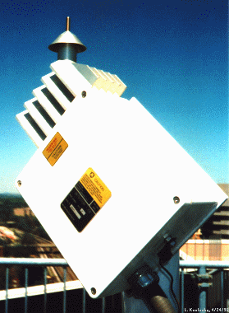
The ASOS Freezing Rain Sensor
Uses an ultrasonically vibrating probe to detect the presence of icing conditions. The vibrating frequency of the probe decreases with the accumulation of ice.

Slide 21
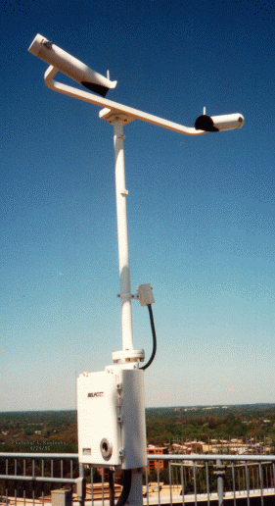
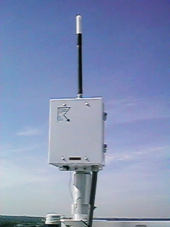
Lightning Sensor
Visibility Sensor

Slide 22
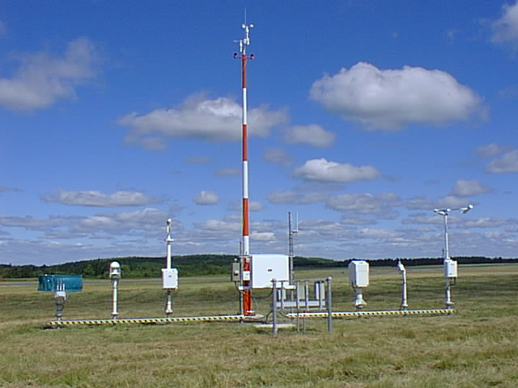
Observing Heights (ASOS and Most Official Obs)
Temperature and dew point (2-m)
Wind speed and direction (10-m)

Slide 23
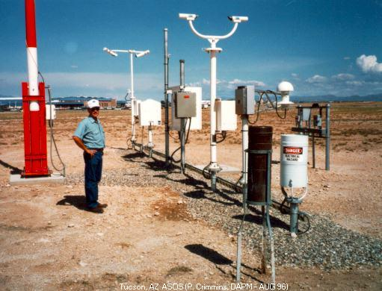
Full ASOS system in Arizona

Slide 24
METAR Format
ASOS data (and airport observations worldwide) are transmitted in METAR format.
Name came from the French words, MÉTéorologique ("Weather") Aviation Régulière ("Routine").
Example: KSEA 042353Z 11008KT 10SM FEW050 SCT070 OVC090 09/03 A2879 RMK AO2 SLP756 60001 T00940033 10117 20083 58013

Slide 25
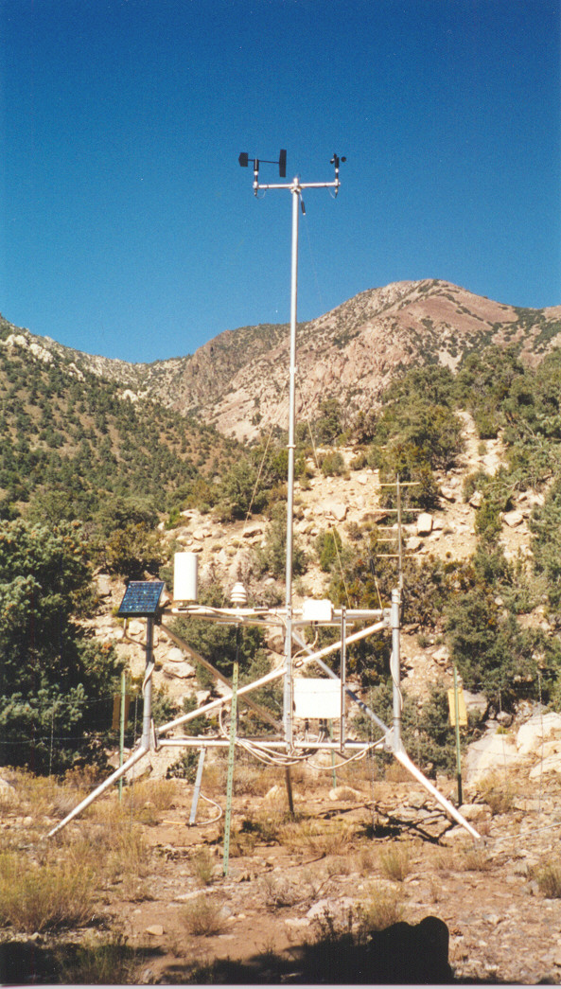
Many Other Surface Networks
Bureau of Land Management
RAWS
Agrimet
PAWS
Department of Ecology
Puget Sound Clean Air
BC Hydro
BC Olympics
Weather Underground
Many more!

Slide 26
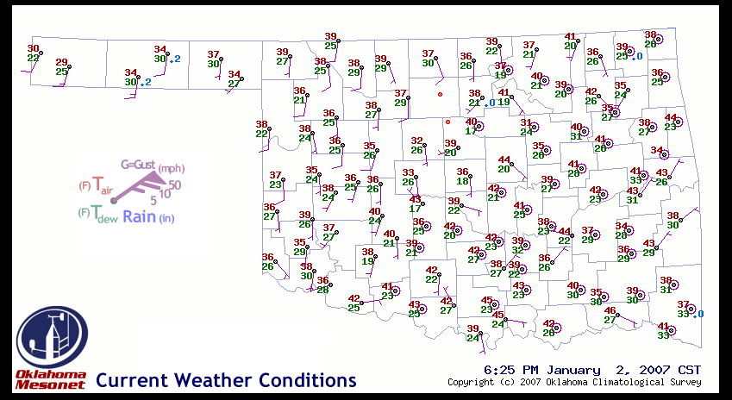
Oklahoma Mesonet

Slide 27
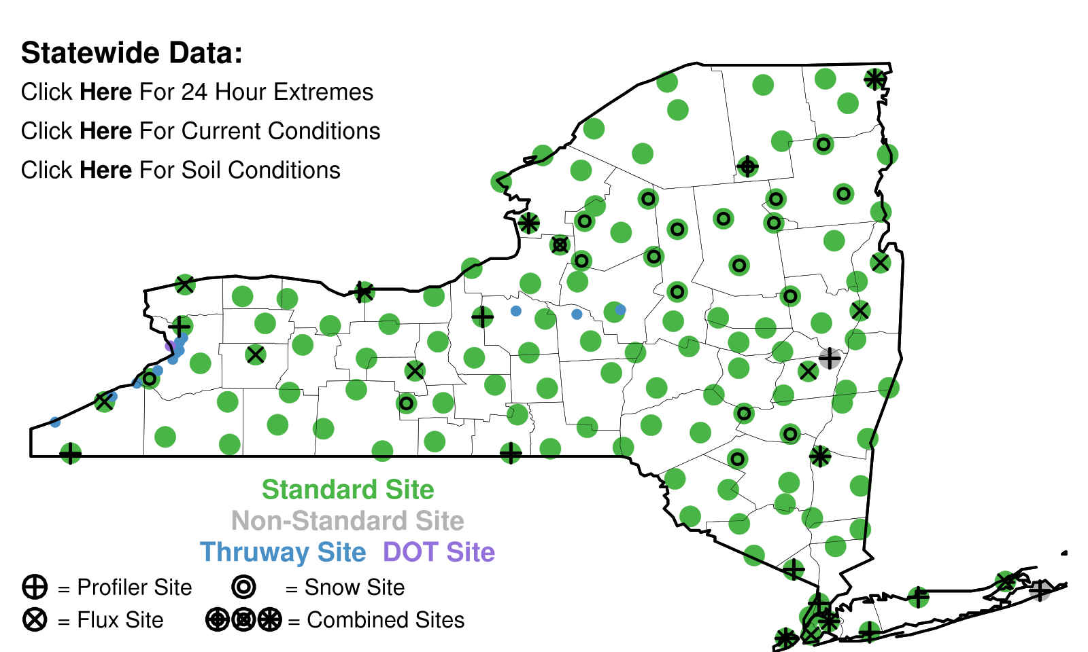
New York Mesonet

Slide 28
Networks of Networks
MesoWest: Collects about 100 networks over the western third of U.S.
MADIS: NOAA national collection of mesonets

Slide 29
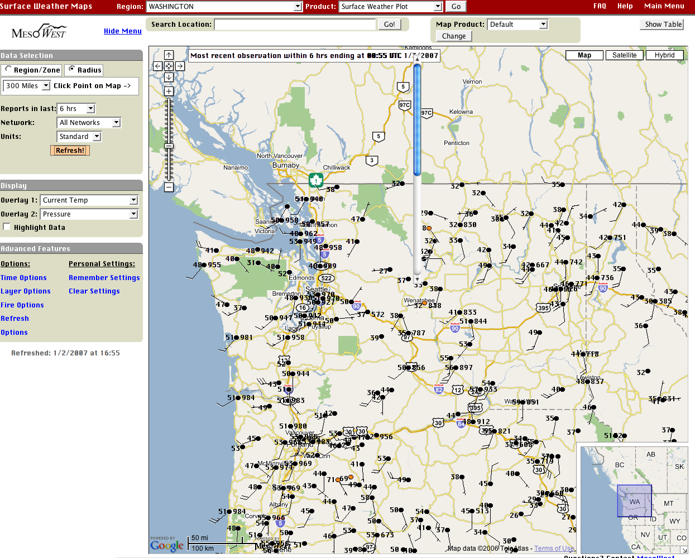

Slide 30
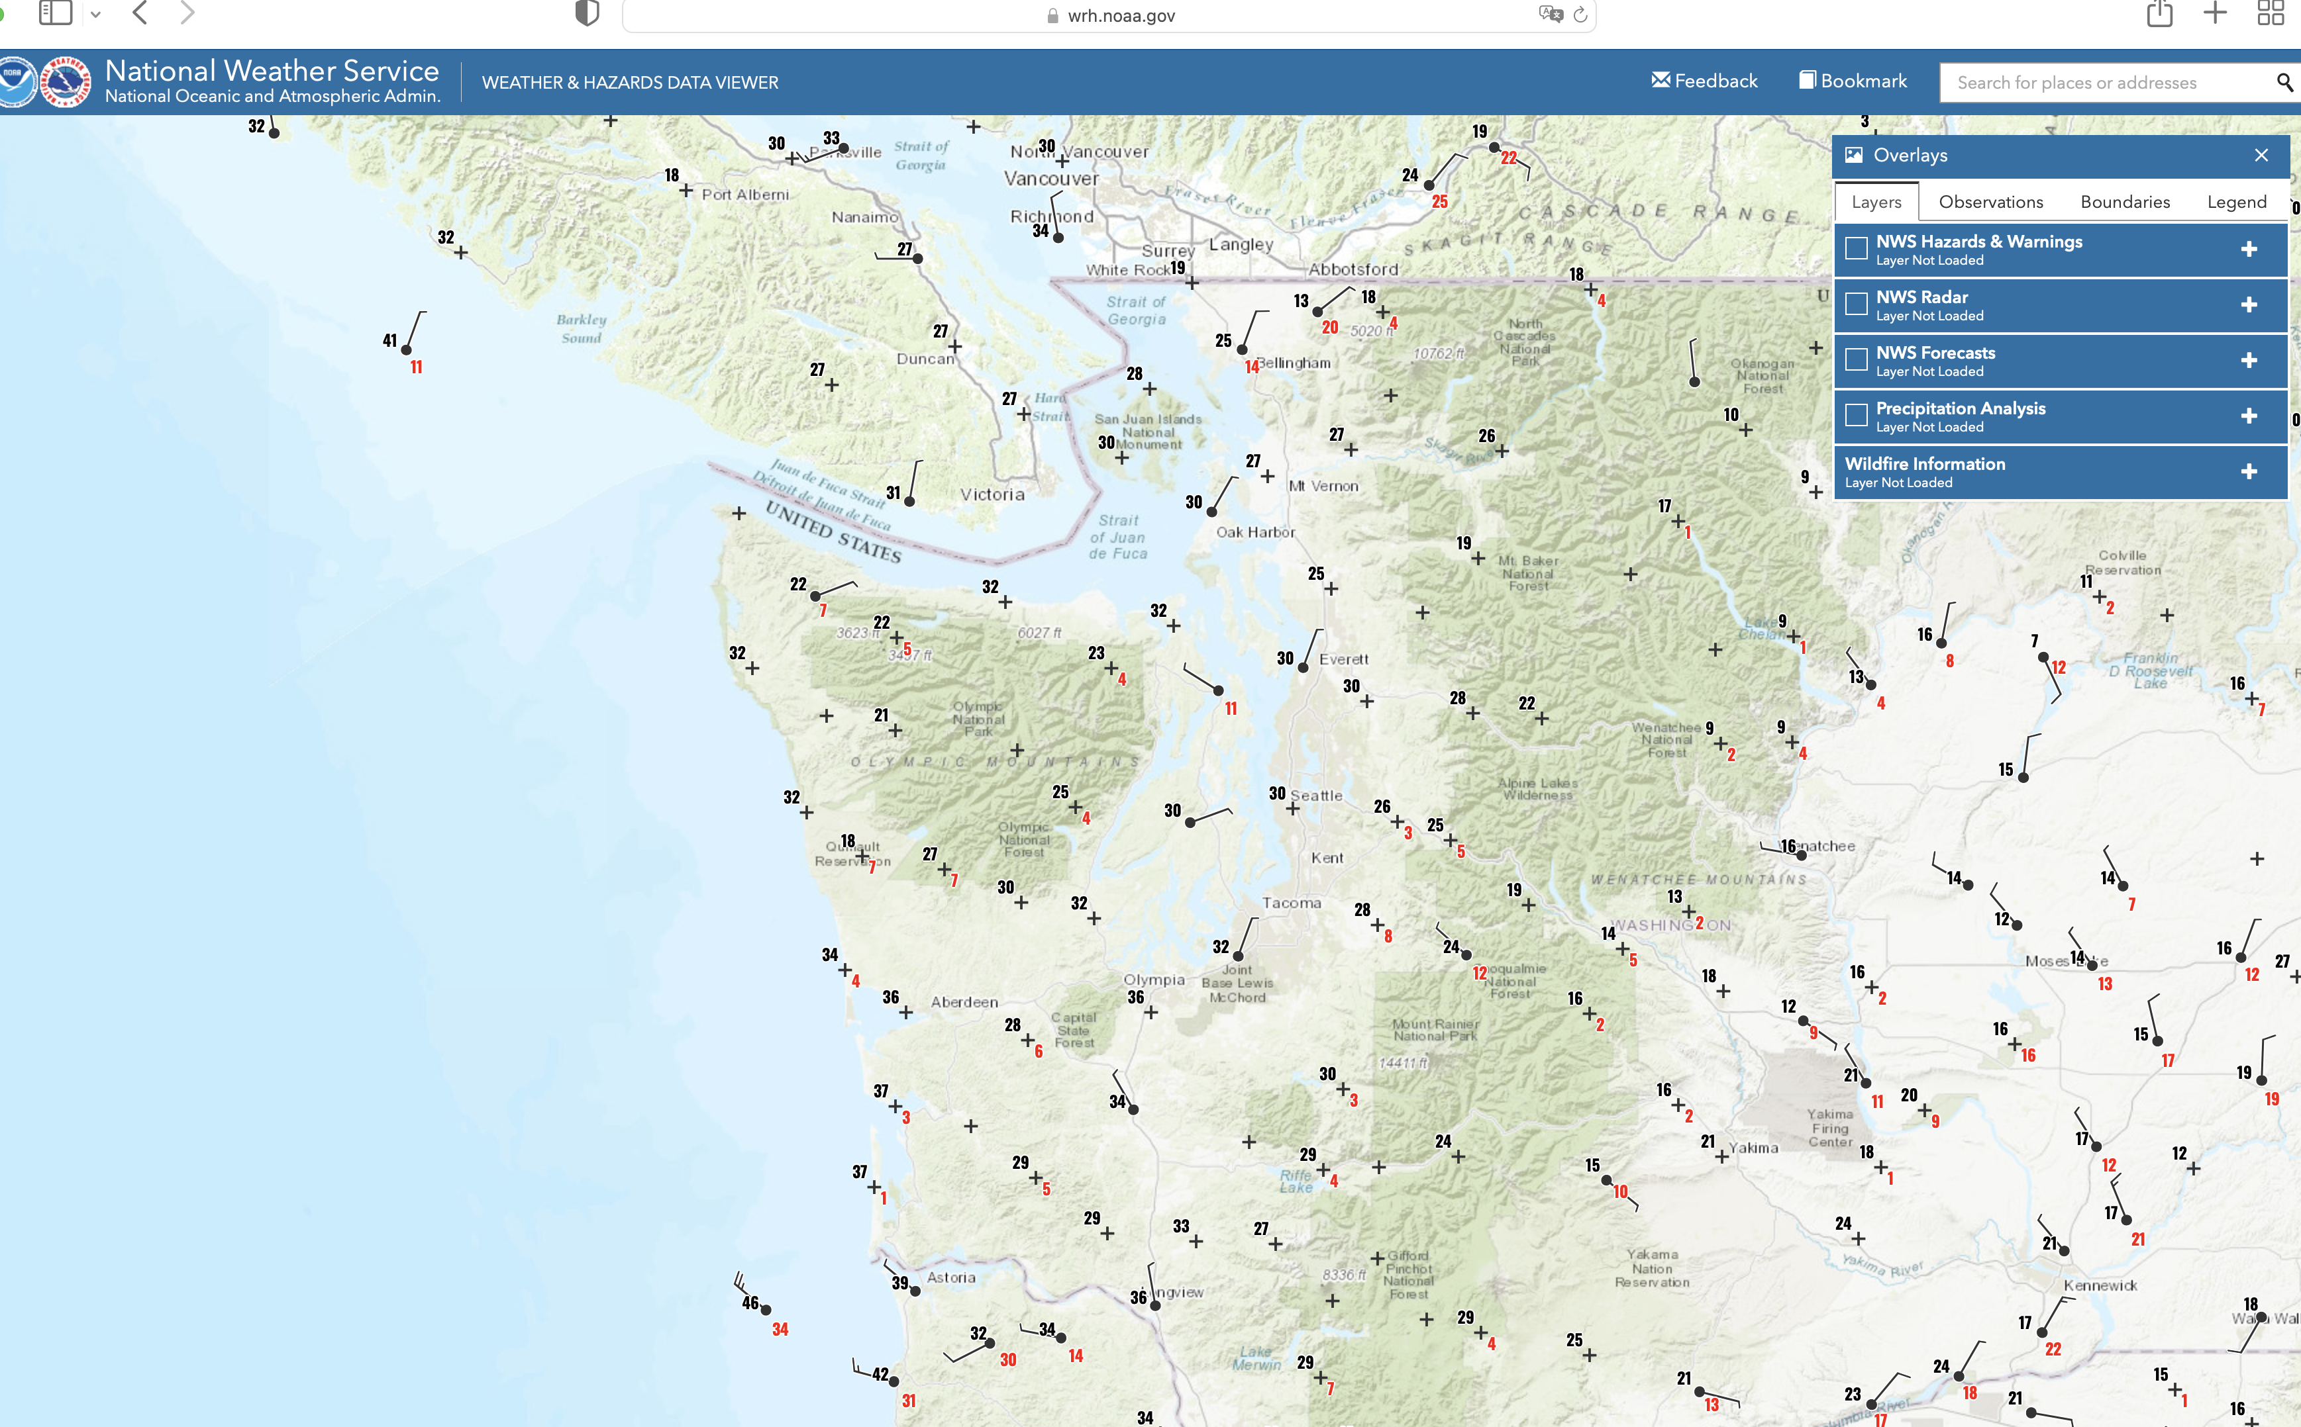
One of the best viewers of many networks: NOAA Weather/Hazards
https://www.wrh.noaa.gov/map/?obs=true&wfo=sew

Slide 31
Consider
In 1980, there were approximately 1000 real-time surface observations in the U.S., mainly at airports
Today, with so many networks, there are several hundred thousand.

Slide 32
Global Surface Observation Coverage

Slide 33
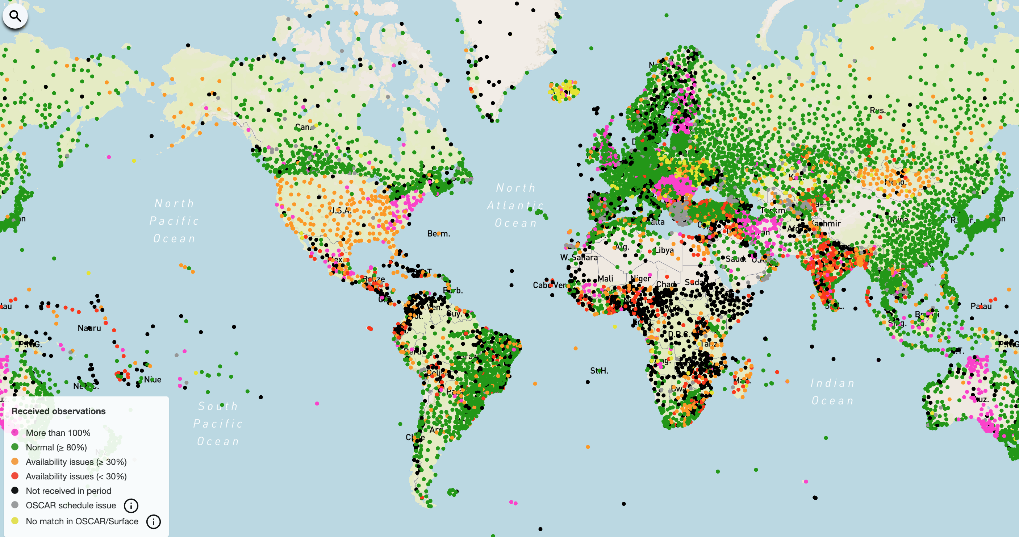
Global Coverage: Many More Northern Hem.

Slide 34
Marine Weather and Surface Ocean Reports

Slide 35
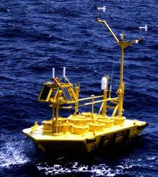
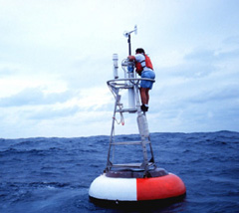
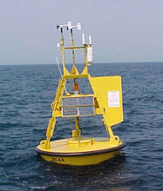
Ocean and Lake
Weather Buoys
Anchored

Slide 36
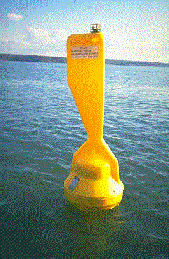
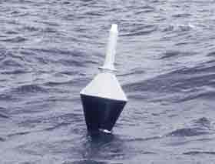
Drifting Buoys: Move Around!
Wind
Pressure

Slide 37
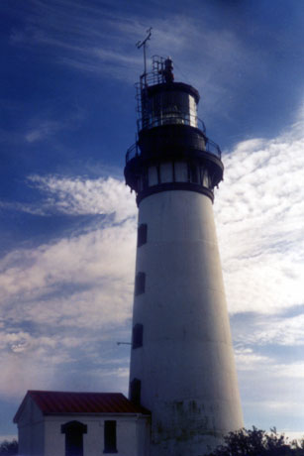
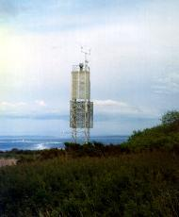
Coastal Marine (CMAN) Reports from the Coast Guard

Slide 38
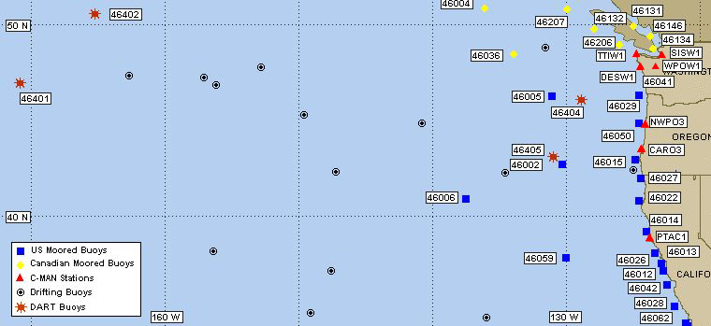
Northwest Buoy and CMAN Locations

Slide 39
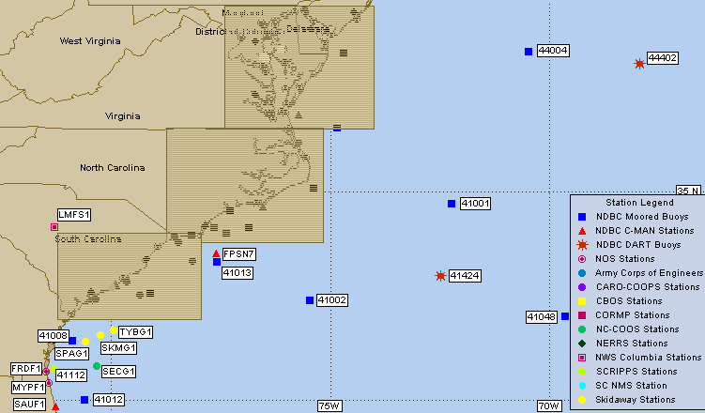

Slide 40
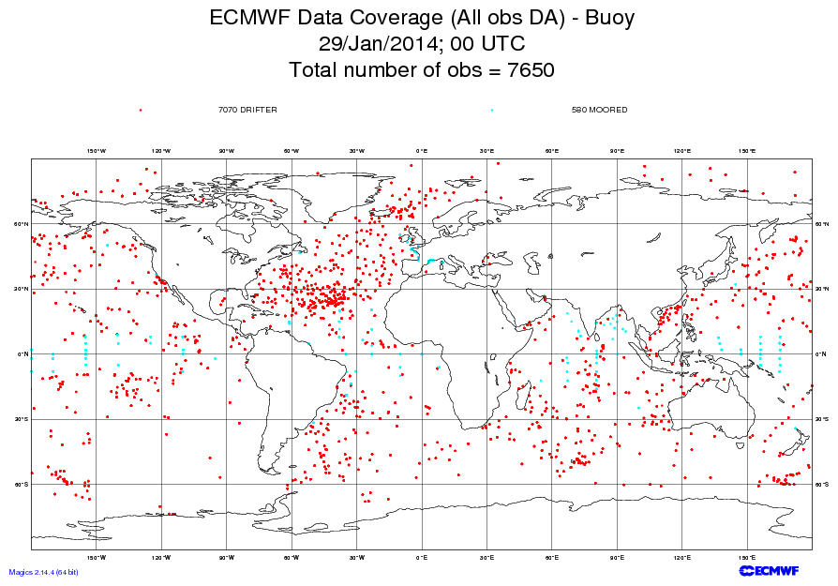

Slide 41
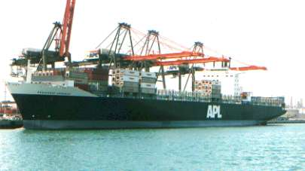

Ship Reports: Marine VOS Program
Volunteers Observers--generally 6-hourly reports
Highly variable quality and frequency

Slide 42
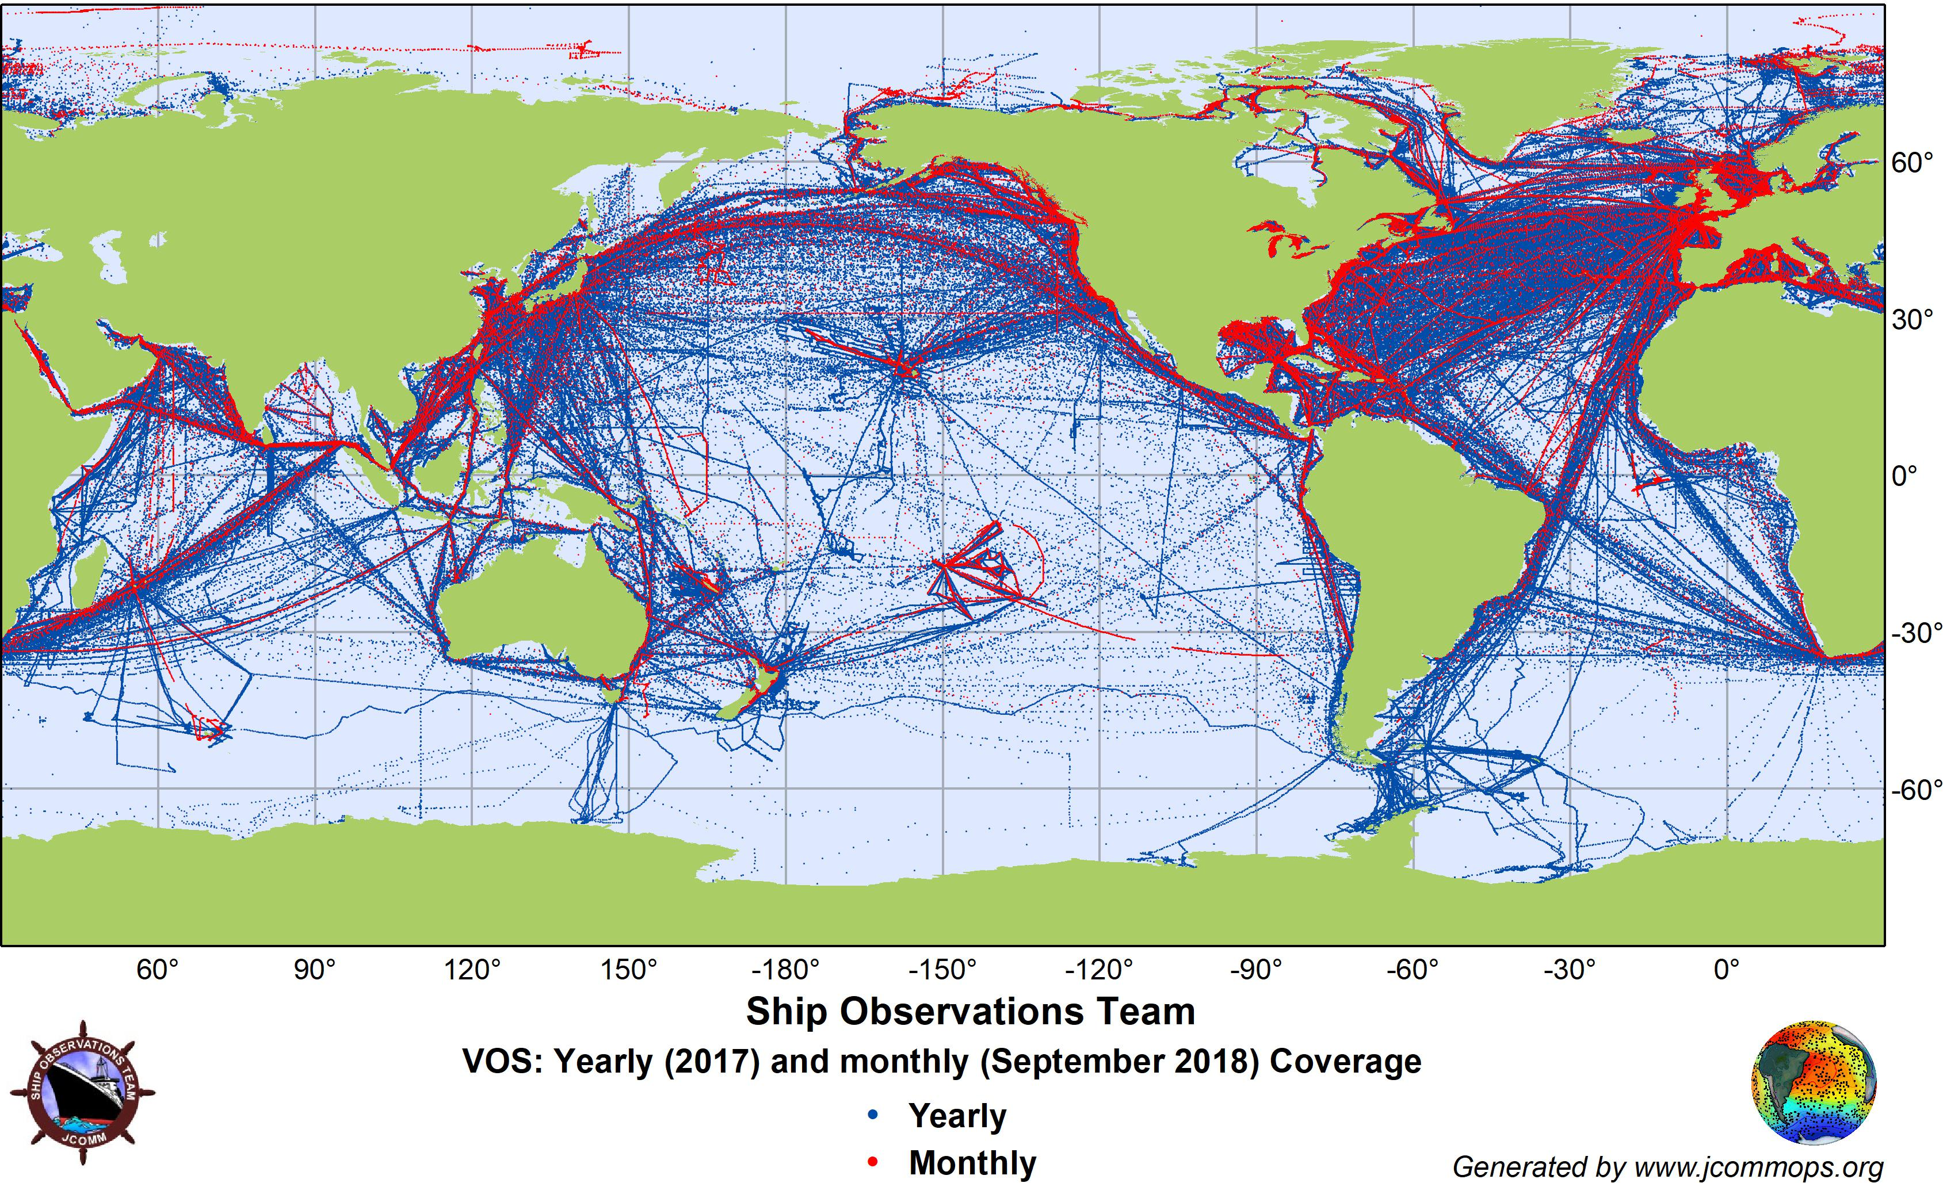

Slide 43
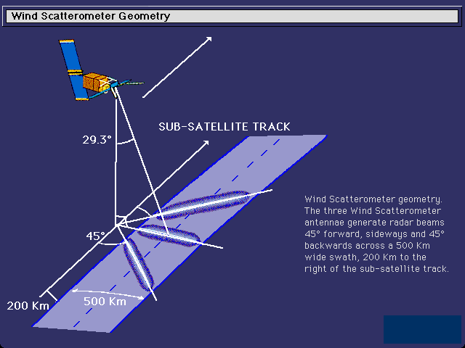
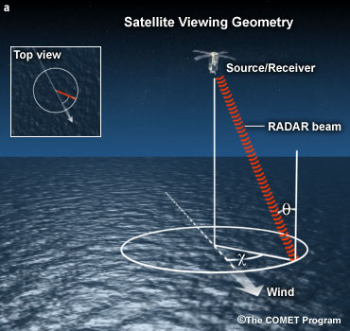
Satellite Microwave Scatterometers: Microwaves scattering off surface waves give surface wind and direction

Slide 44
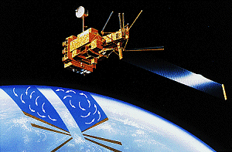
QuickScat Satellite
Bounces microwaves off the ocean surface
Capillary waves dependent on wind speed and direction

Slide 45
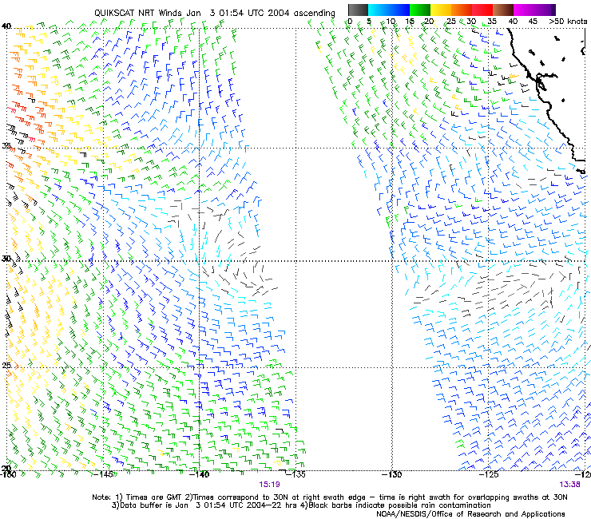
Satellite
Microwave
Scatterometer
Winds

Slide 46
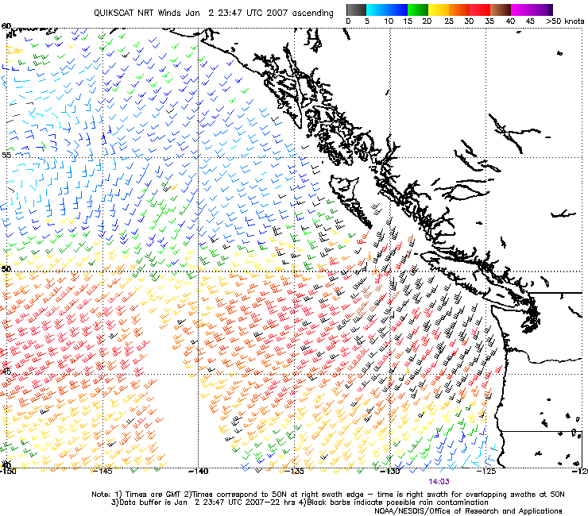

Slide 47
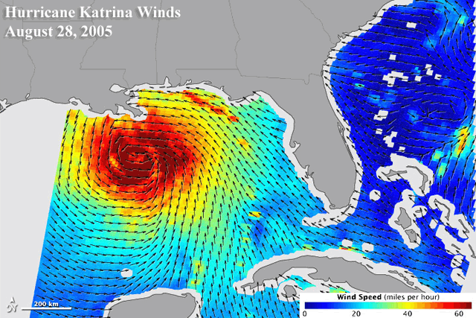
Satellite scatterometers

Slide 48
Upper Air Data

Slide 49
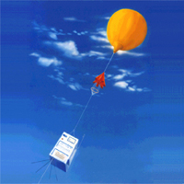
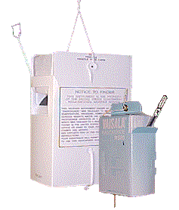
Radiosondes
First launched in 1929

Slide 50
Radiosondes
Provides temperature, humidity (relative humidity, pressure, and wind speed/direction)
Generally launched twice a day (00 and 12 UTC).

Slide 51
Radiosondes
A typical NWS radiosonde sounding ascent can last 2-3 hours
In that time, the radiosonde can ascend to an altitude exceeding 35 km (about 115,000 feet) and drift more than 300 km (about 180 miles) from the release point.
Typical pressure at balloon burst about 5 hPa (1/200th of surface pressure).

Slide 52
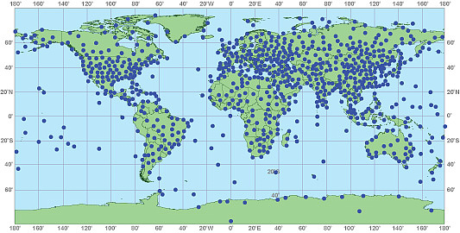
Generally launched twice a day at 00 and 12 UTC
About 1000 locations around the world

Slide 53
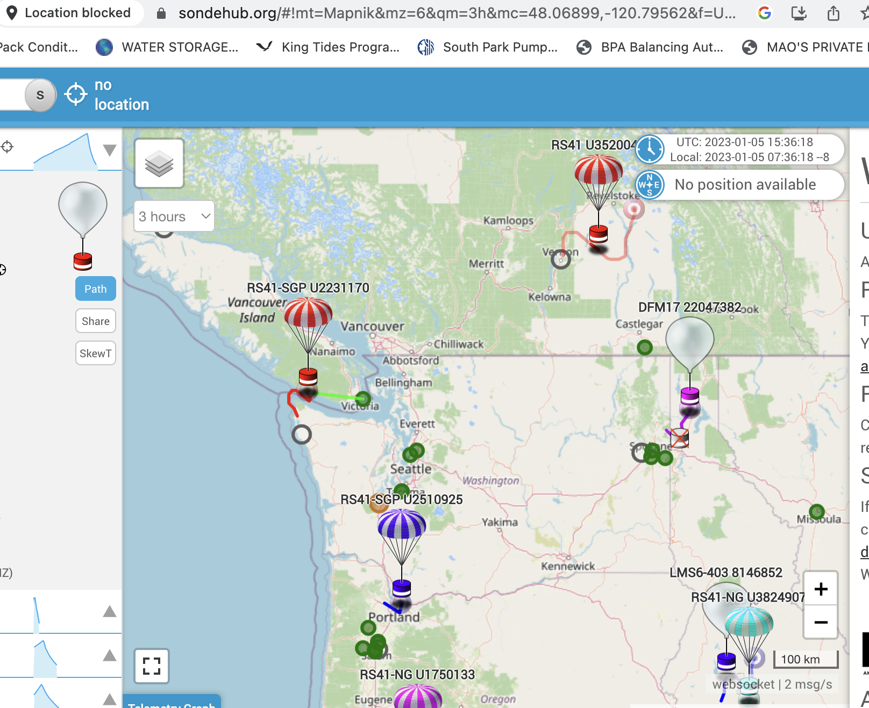
There are websites that track them..

Slide 54

Radar Wind Profiler and RASS (Radio Acoustic Sounding System)
Can provide temperature and wind with height
Can also provide information on precipitation/clouds

Slide 55


Slide 56


Slide 57


Slide 58

ACARS: Aircraft Observations
Often on wide-body aircraft
Aircraft Communications Addressing and Reporting System

Slide 59

Available at cruise altitude and ascent/descent.

Slide 60


Slide 61


Slide 62

Also data from AIRDAT/Panasonic: Commuter and Short Haul Aircraft

Slide 63

Weather Satellites Now Provide Roughly 99% of the Weather Data Going into Weather Prediction

Slide 64


Satellite Data
Geostationary and Polar Orbiting Satellites

Slide 65


GOES

Slide 66

Geostationary Image

Slide 67

Geostationary satellite see the whole hemisphere

Slide 68

Putting them together, one can monitor the entire planet

Slide 69


NOAA Polar
Orbiter Weather
Satellite
Polar Orbiter: Lower/higher resolution/more sensors

Slide 70

A polar
low
Polar Orbiters Provide a High-Resolution View

Slide 71
Weather Satellites Provide MUCH More Than Just Imagery

Slide 72

Cloud and
Water Vapor
Track Winds
Based on Geostationary Weather Satellites

Slide 73


Slide 74

Atmospheric Moisture Vectors from Satellites

Slide 75

GOES sounder unit: observes atmosphere/earth’s emissions in several wavelengths

Slide 76

Views the Earth
at many wavelengths,
each mainly sensing temperature at a specific layer

Slide 77

Satellite Temperature and Humidity Soundings

Slide 78

High-Resolution Infrared Radiation Sounder

Slide 79

Microwave Sounders

Slide 80
GPS Soundings
A constellation of GPS satellites orbit the earth.
A collection of special satellites can receive the GPS signal
By measuring the delay in time as the GPS signal is bent by the earth’s atmosphere, one can determine atmospheric density variations in the vertical that can be used to create temperature and humidity soundings.

Slide 81


Slide 82



Slide 83

Weather Radar
During the early 90s, the NWS installed a network of powerful Doppler Weather
radars, a.k.a.
NEXRAD
WSR88D

Slide 84

NWS Radar Sites

Slide 85
Weather Radar
Reflectivity (precipitation intensity)
Doppler Velocities (radial velocities)
Polarimetric Information (precipitation type and other information?
Much more later in class

Slide 86

Camano
Island
Weather
Radar

Slide 87

Crowdsourcing of Weather Data
Securing weather data from devices intended for other purposes.
Example: pressure data from smartphones
Example: smartphone reported weather conditons

Slide 88

Smartphone Pressures

Slide 89

Weather Data from the Purple Air Air Quality Network

Slide 90

mping: NWS effort of crowdsource weather observations

Slide 91
A Synoptic Meteorologist Needs to Know The Accuracy of Various Observational Assets

Slide 92
Typical Observation Errors at the Surface
(Important when doing analyses!)
Sea Level Pressure
  Low-elevation land stations +-.5 mb
  Ships +- 1-5 mb
Temperature: +-1C
Wind Speed: +-2-5 knots, very light winds often a problem—especially for classical anomemeters.
Relative Humidity: +-10%

Slide 93
Typical Radiosonde Errors
Geopotential heights:
  700 mb (hPa): 5-10 m
  500 mb 10-15 m
  300 mb 15-20 m
  100 mb 20-30 m
Temperature: +-0.5C
Wind speed: +-5%,+-10 degrees

Slide 94
Some Terminology Often Used
Synoptic scale
Mesoscale
Microscale

Slide 95

Synoptic Scale (1000 km and more)

Slide 96


Mesoscale (10-1000 km)

Slide 97


Microscale (smaller than 10 km)

Slide 98
The END

