Slide 1
Atmospheric Sciences 370 Observing Systems Winter 2022
Observations are the foundation of synoptic meteorology

Slide 2
Observation Terminology
Direct versus Indirect observations
Direct: measurement at the location of the instrument
Indirect: remotely sensed using radiation measurements
Active versus passive remote sensing
Active: instrument emits radiation, analyzes return
Passive: analyzes incoming natural radiation

Slide 3
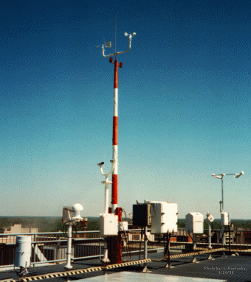
ASOS: Automated Surface Observing System Backbone Observing System in the U.S.

Slide 4
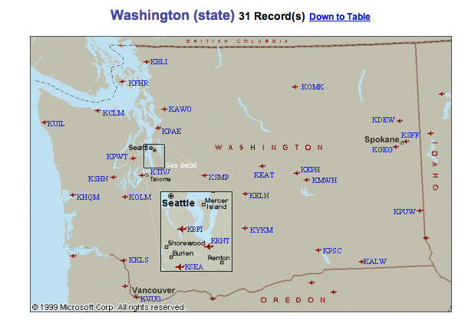
ASOS
Located at primary and secondary airports
Supported by the FAA and NWS
High quality instrumentation that is well maintained and calibrated.
Reported in METAR format (more later)

Slide 5
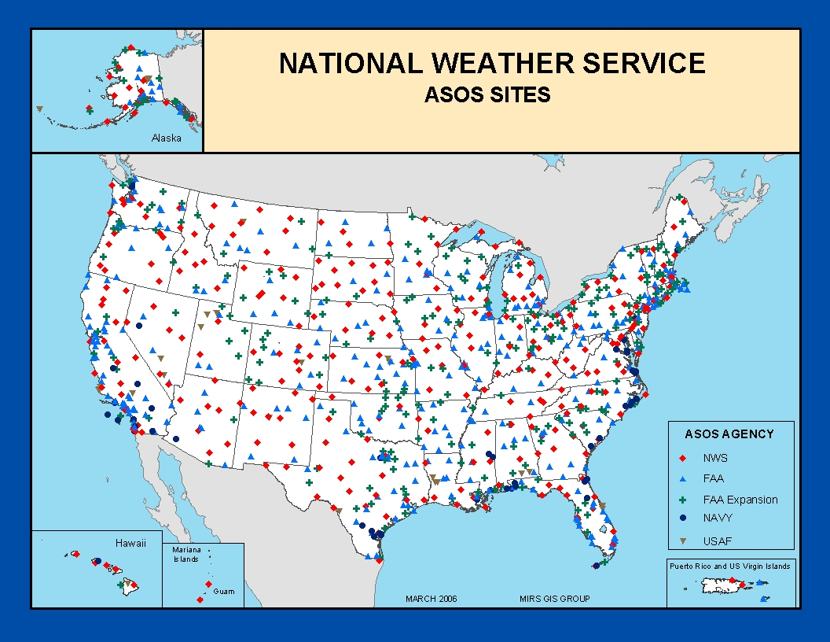

Slide 6
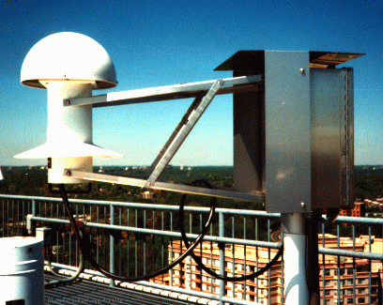
Hydrothermograph

Slide 7
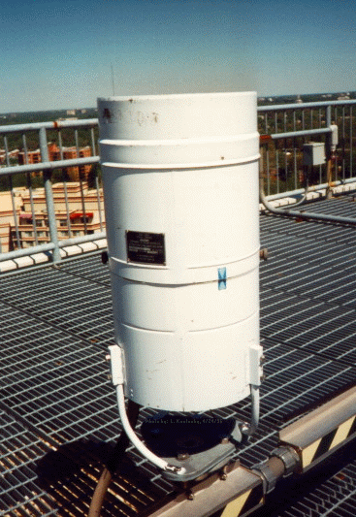
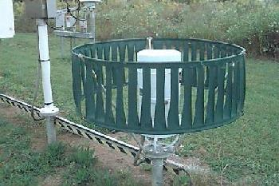
Many are shielded
Precipitation Gauges

Slide 8
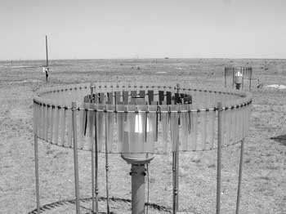
Some Even with Double Shields
Shields reduce wind and turbulent eddies around gauges than can lessen catch efficiency. The largest effect of wind is on snow.

Slide 9
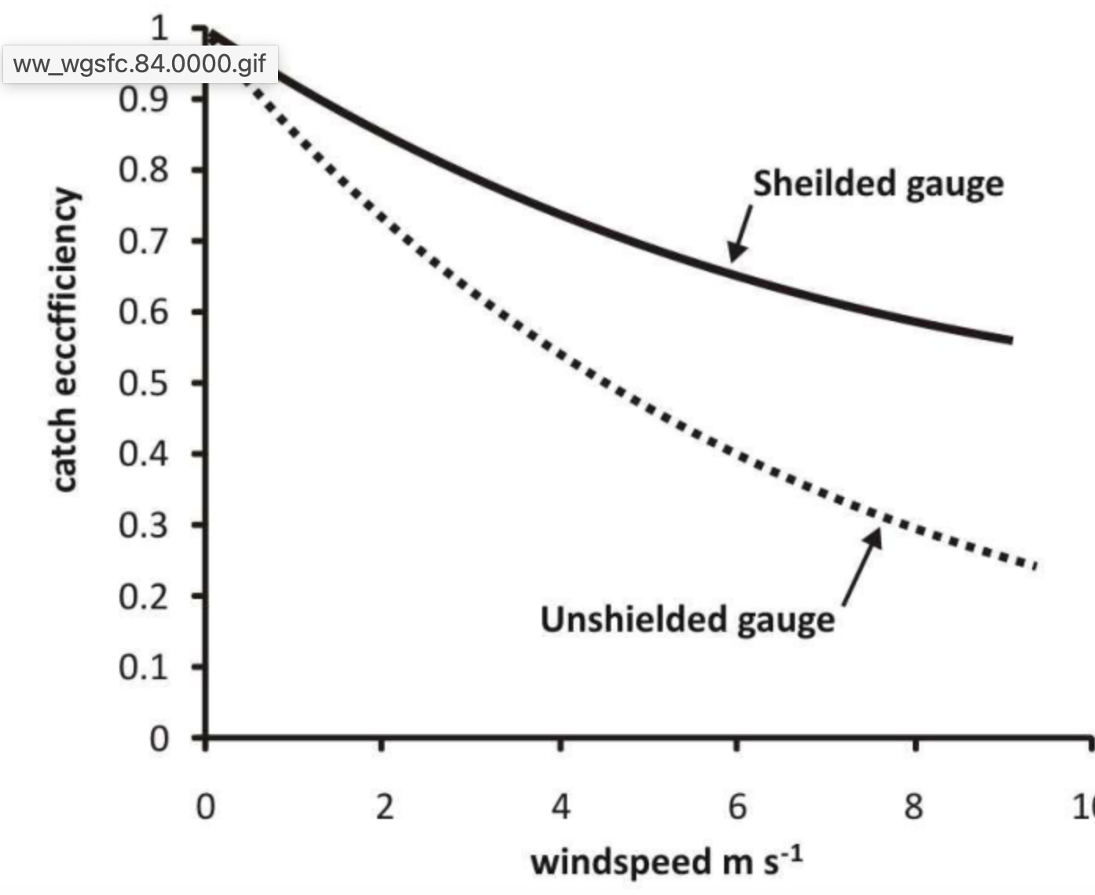

Slide 10
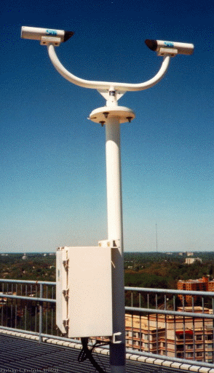
Laser Weather
Identifier
No human intervention!
e.g., R-, S+

Slide 11
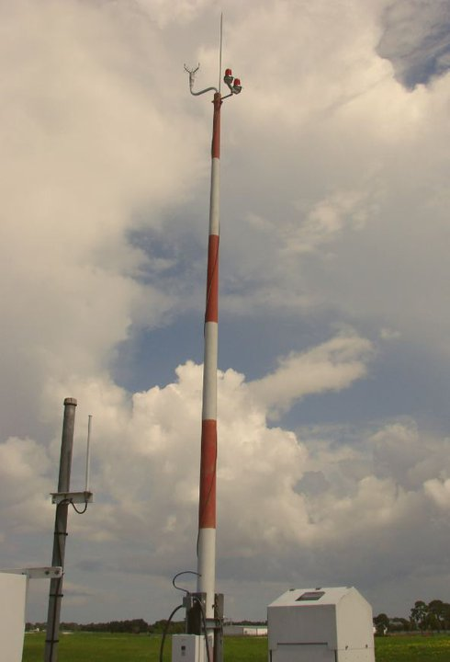
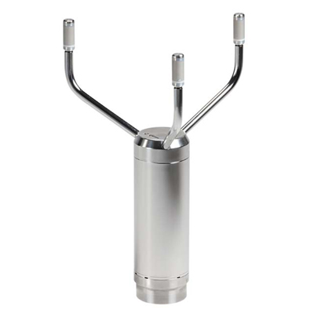
Acoustic Anemometer

Slide 12
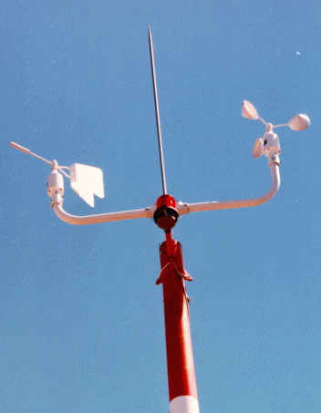
Mechanical wind instruments no longer used in ASOS!
Suffered from icing.
Did not measure low speeds well.
Anemometer
Wind Vane

Slide 13
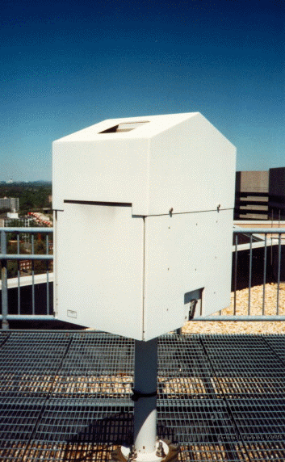
Ceiling is the height of the lowest cloud layer
Very important for aviation.
Laser Ceilometer

Slide 14
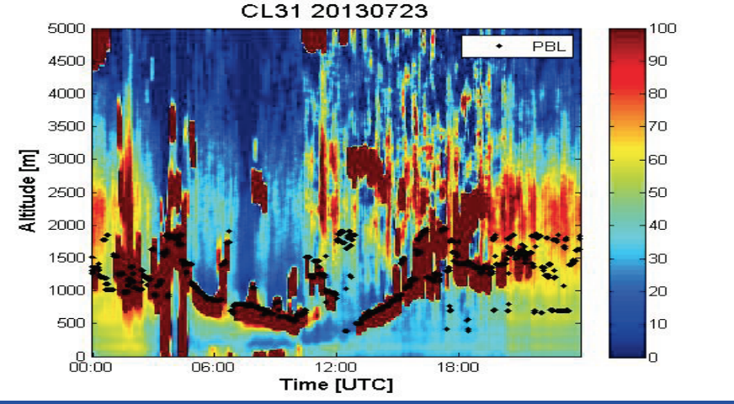
Can Provide Vertical Profiles of Clouds and Smoke

Slide 15
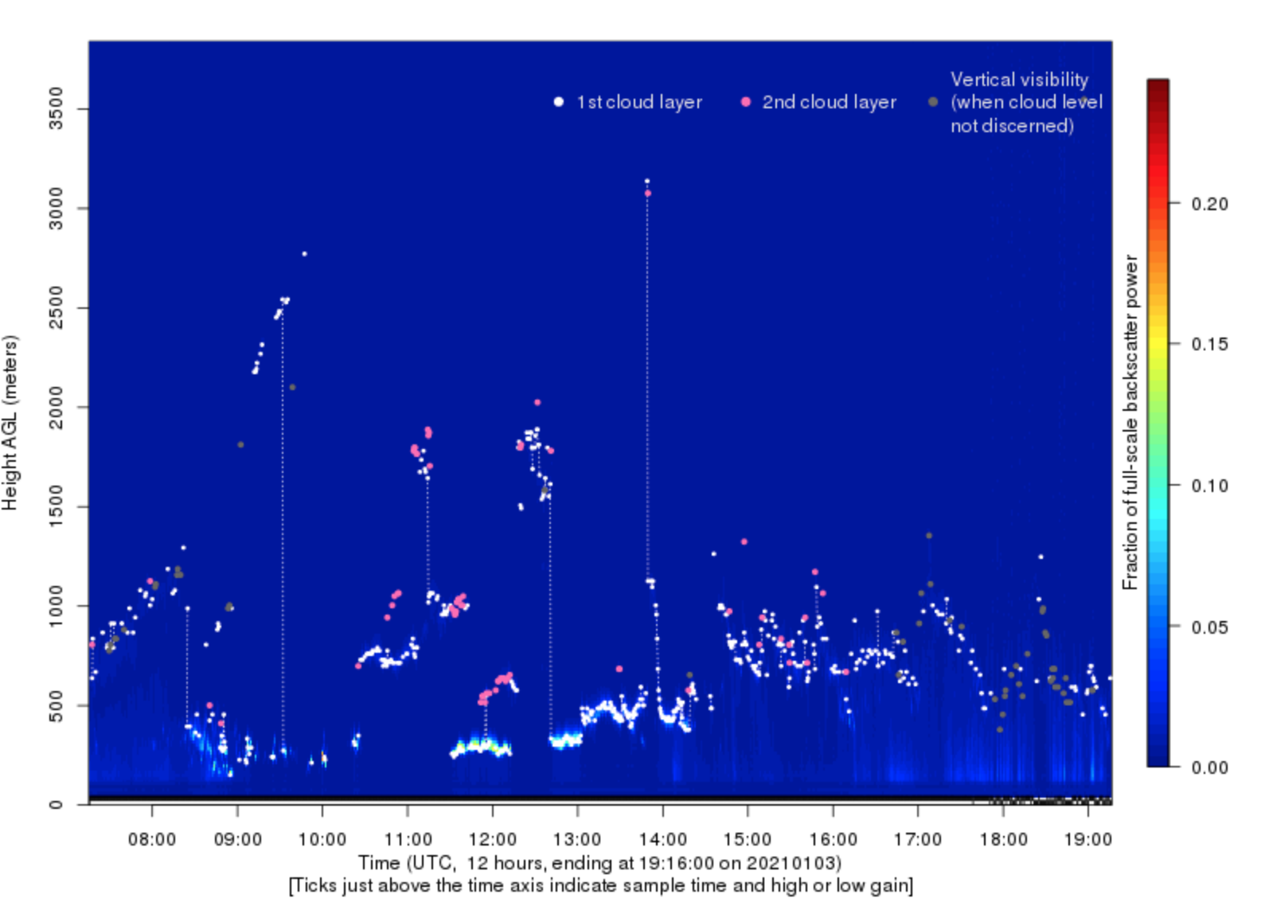
UW Ceilometer

Slide 16
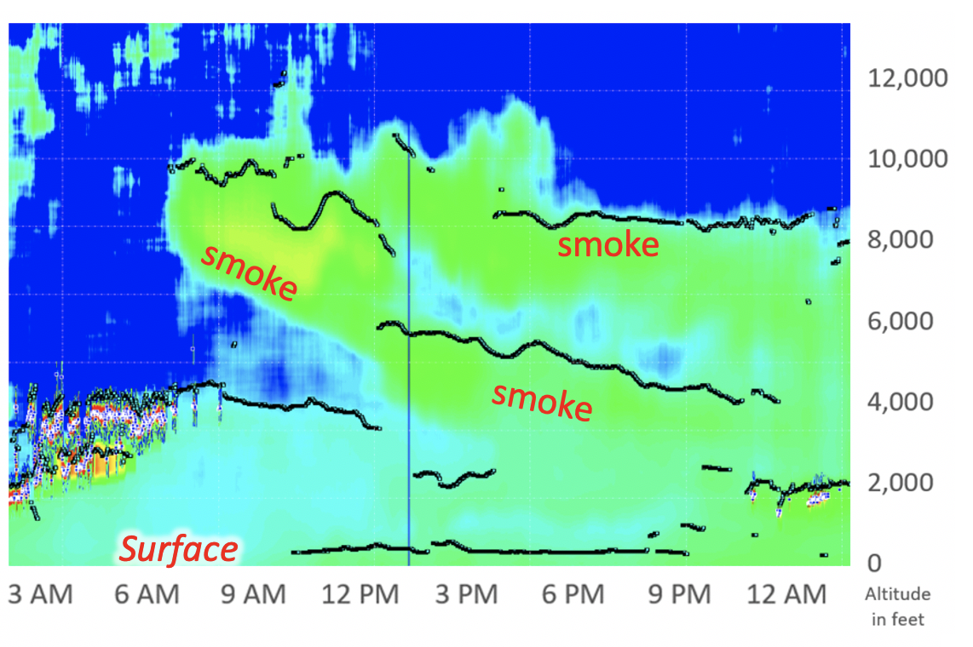
Can Sense Wildfire Smoke

Slide 17
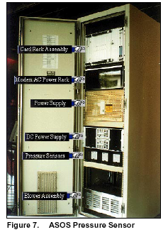
ASOS Pressure Sensor

Slide 18
ASOS Pressure Sensors
Gold Standard
Three sensors, requires agreement of at least two.
Accuracy: +-.02 inches of mercury ( .67 hPa)
Resolution: .003 inches, .1 hPa

Slide 19
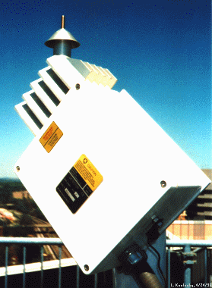
The ASOS Freezing Rain Sensor
Uses an ultrasonically vibrating probe to detect the presence of icing conditions. The vibrating frequency of the probe decreases with the accumulation of ice.

Slide 20
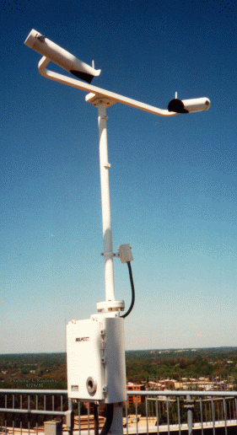
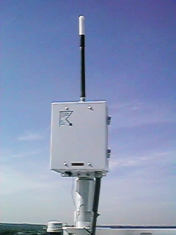
Lightning Sensor
Visibility Sensor

Slide 21
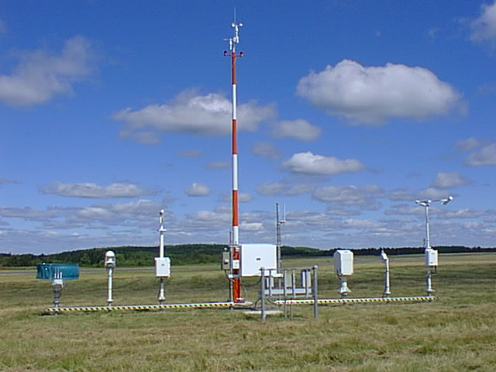
Observing Heights (ASOS and Most Official Obs)
Temperature and dew point (2-m)
Wind speed and direction (10-m)

Slide 22
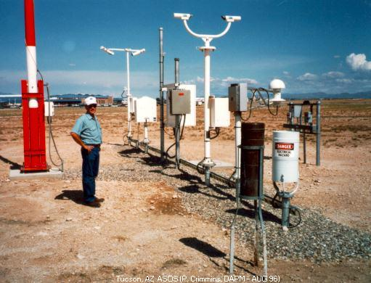
Full ASOS system in Arizona

Slide 23
METAR Format
ASOS data (and airport observations worldwide) are transmitted in METAR format.
Name came from the French words, MÉTéorologique ("Weather") Aviation Régulière ("Routine").
Example: KSEA 042353Z 11008KT 10SM FEW050 SCT070 OVC090 09/03 A2879 RMK AO2 SLP756 60001 T00940033 10117 20083 58013
Will learn more about it in Lab

Slide 24
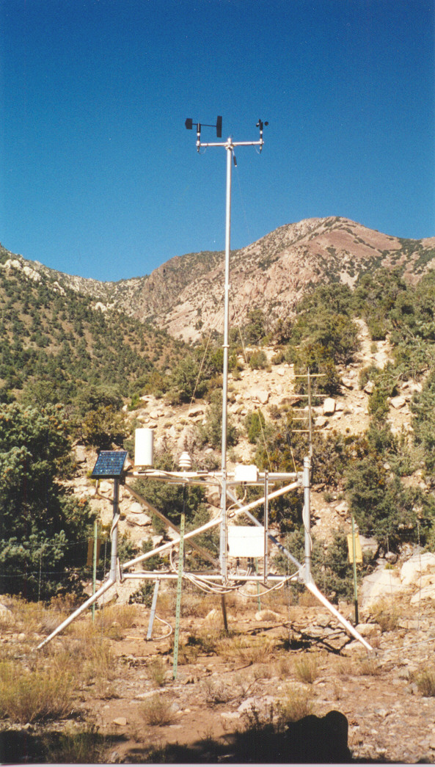
Many Other Surface Networks
Bureau of Land Management
RAWS
Agrimet
PAWS
Department of Ecology
Puget Sound Clean Air
BC Hydro
BC Olympics
Weather Underground
Many more!

Slide 25
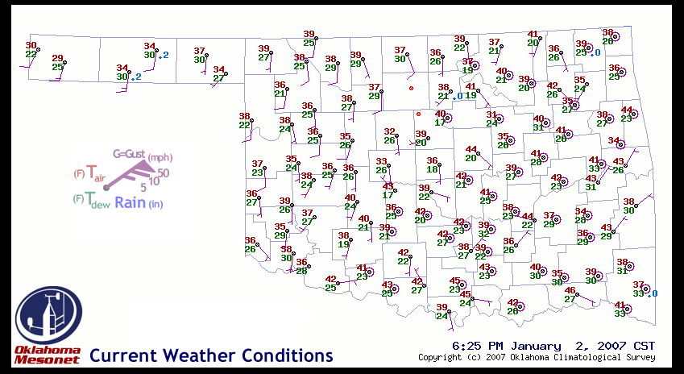
Oklahoma Mesonet

Slide 26
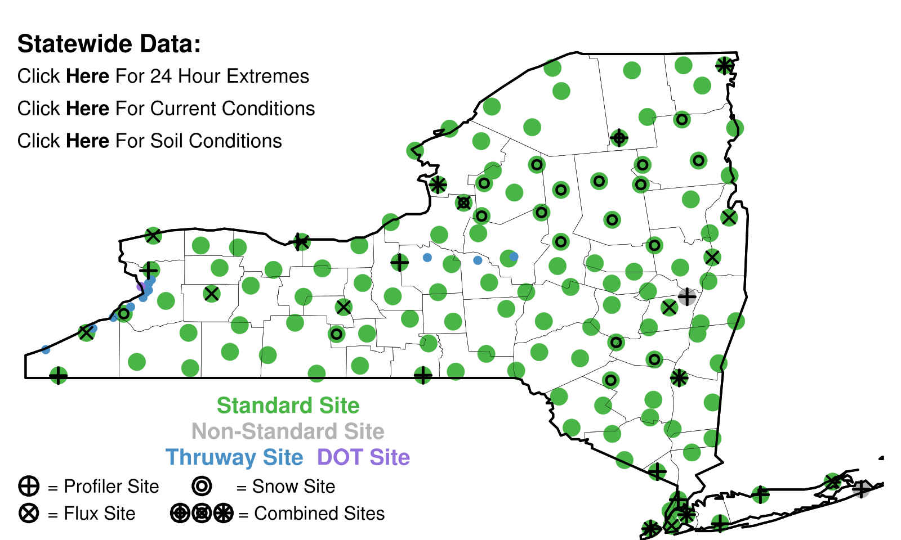
New York Mesonet

Slide 27
Networks of Networks
UW: We collect data from about 70 networks in real time over the Northwest
MesoWest: Collects about 100 networks over the western third of U.S.
MADIS: NOAA national collection of mesonets

Slide 28
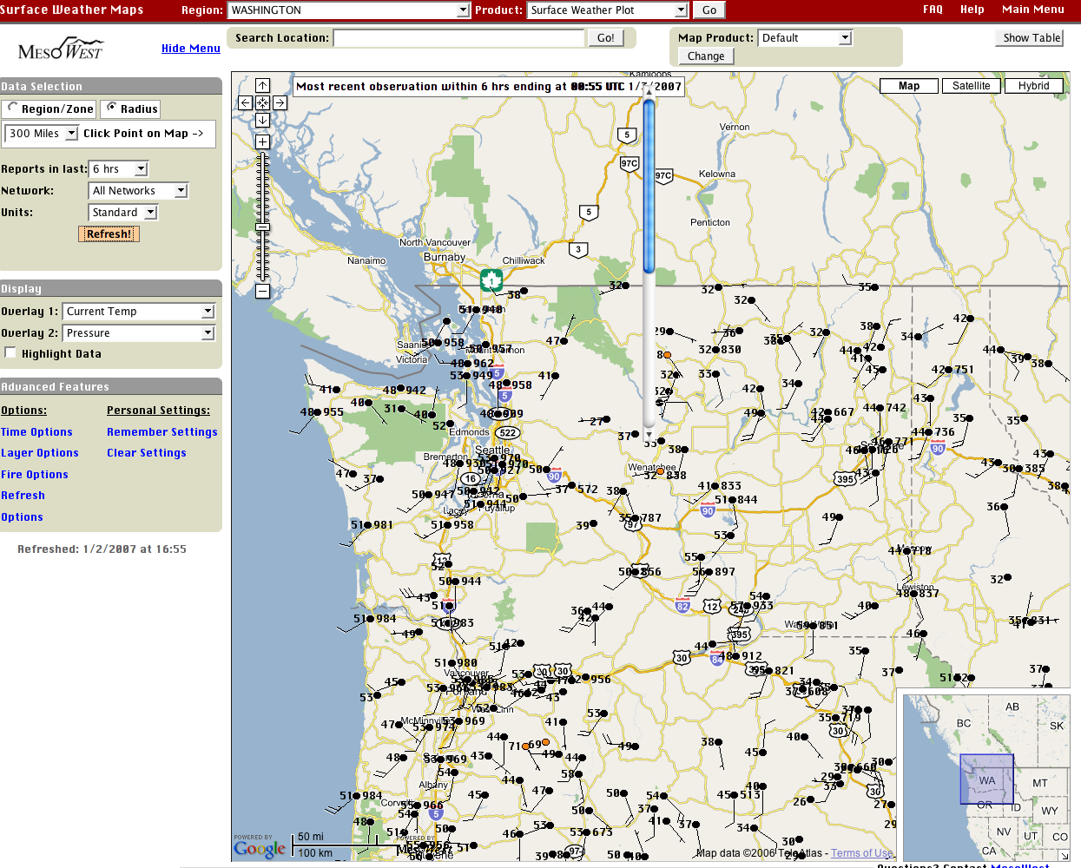

Slide 29
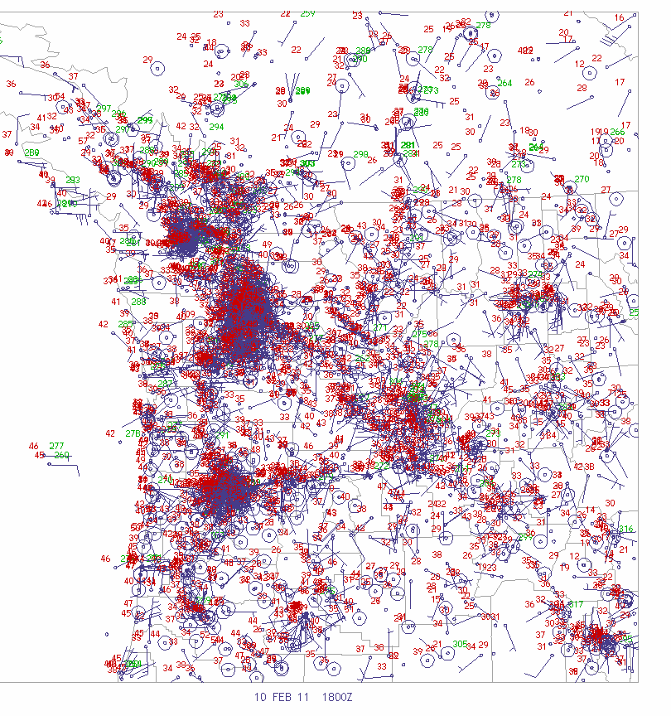
Pacific Northwest Surface Observations
3000-4000 observations per hour over WA and OR

Slide 30
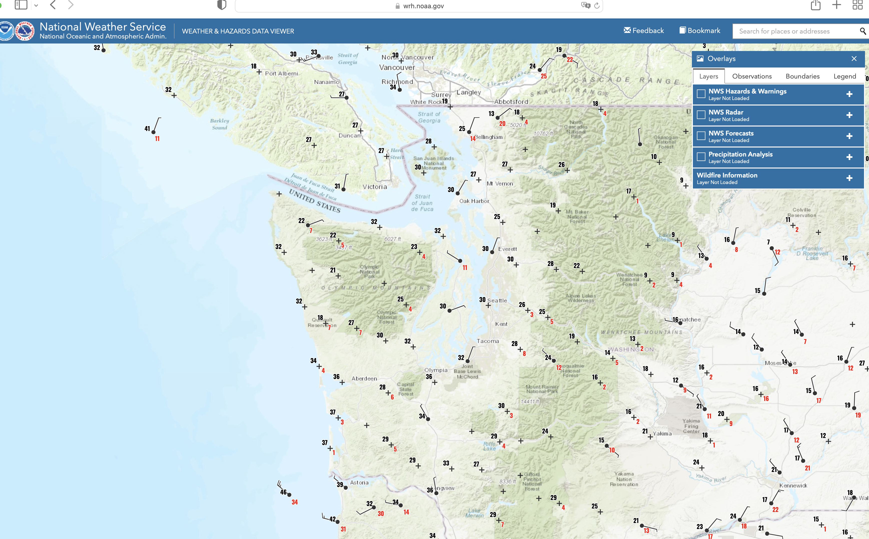
One of the best viewers of many networks: NOAA Weather/Hazards
https://www.wrh.noaa.gov/map/?obs=true&wfo=sew

Slide 31
Global Surface Observation Coverage

Slide 32
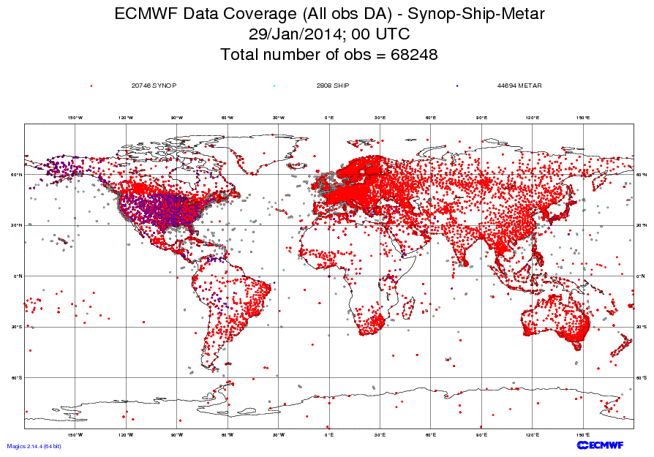
A lot more data over land/northern hemisphere

Slide 33
Marine Weather and Surface Ocean Reports

Slide 34
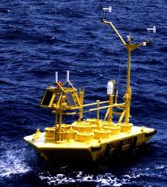
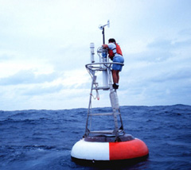
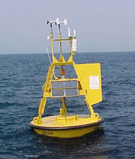
Ocean and Lake
Weather Buoys
Anchored

Slide 35
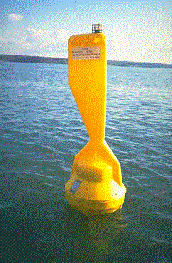
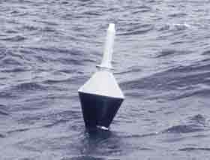
Drifting Buoys
Wind
Pressure

Slide 36
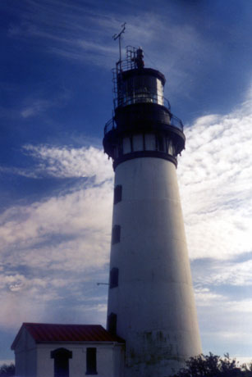
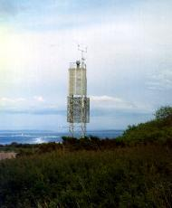
Coastal Marine (CMAN) Reports from the Coast Guard

Slide 37
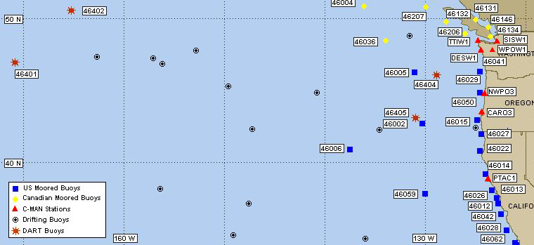
Northwest Buoy and CMAN Locations

Slide 38
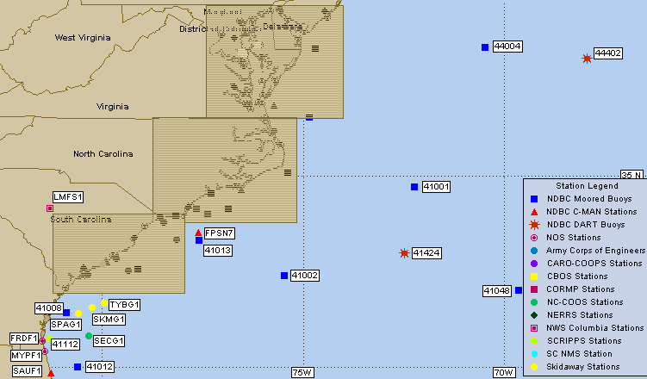

Slide 39
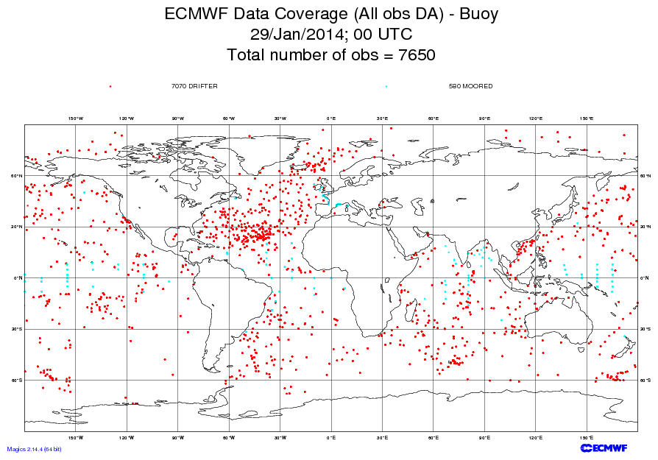

Slide 40
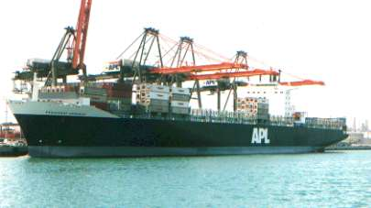

Ship Reports: Marine VOS Program
Volunteers Observers--generally 6-hourly reports
Highly variable quality and frequency

Slide 41
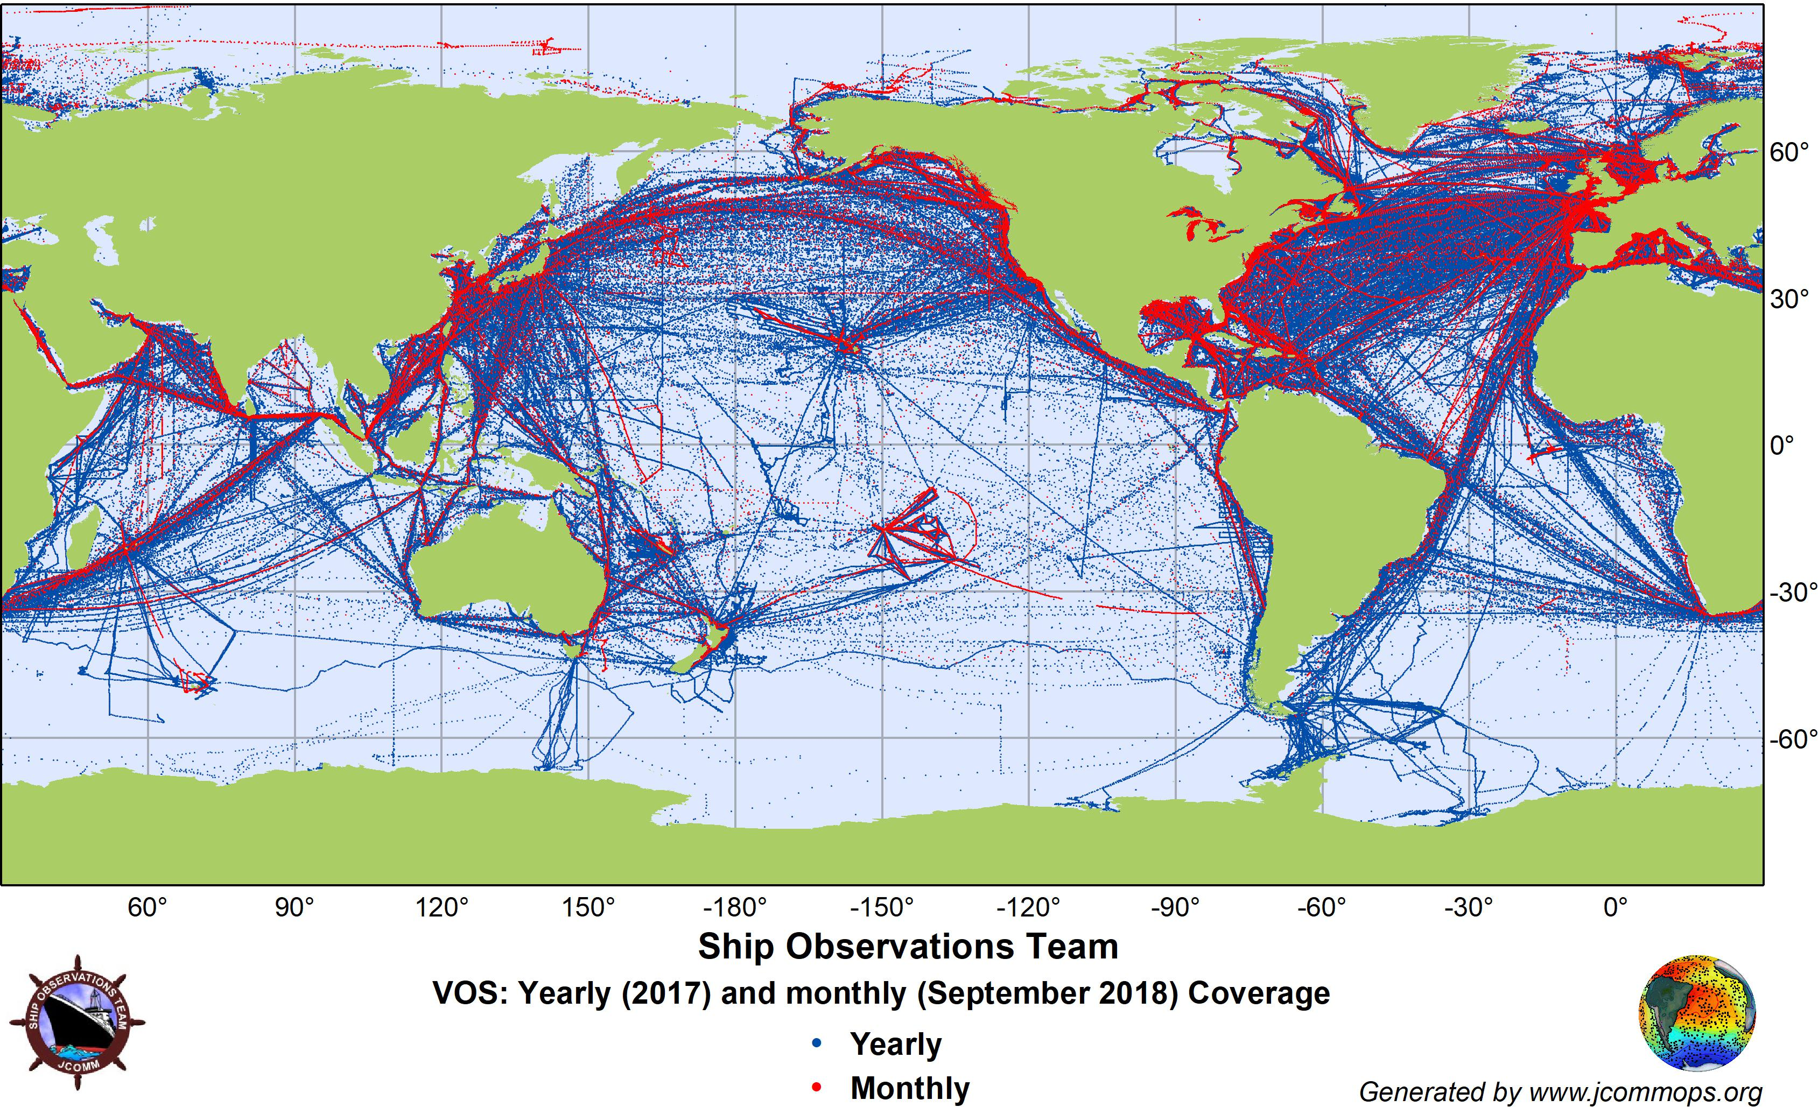

Slide 42
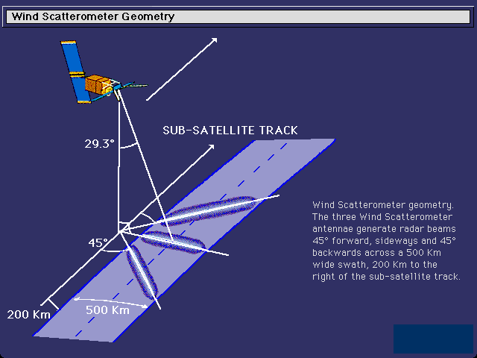
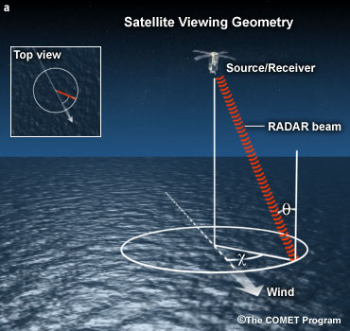
Satellite Scatterometers: Microwave Scattering Off Ocean Waves: surface wind and direction

Slide 43
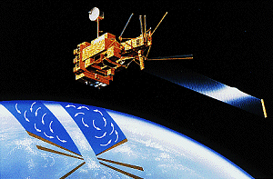
QuickScat Satellite
Bounces microwaves off the ocean surface
Capillary waves dependent on wind speed and directon

Slide 44
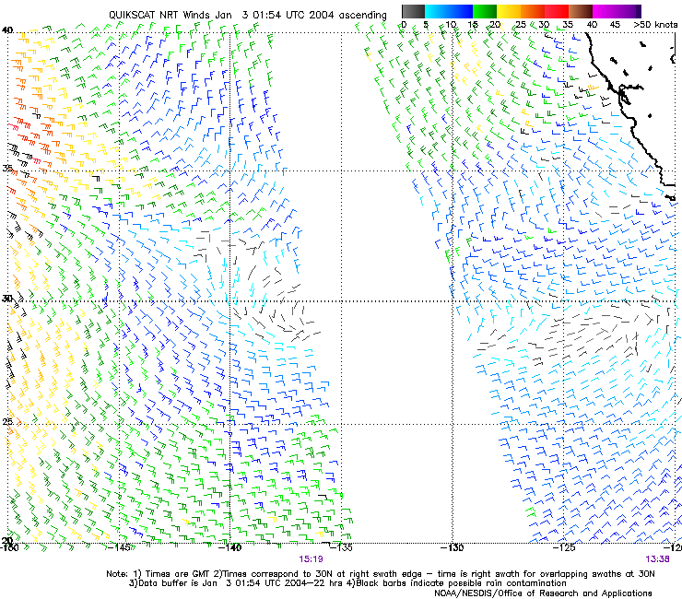
Satellite
Microwave
Scatterometer
Winds

Slide 45
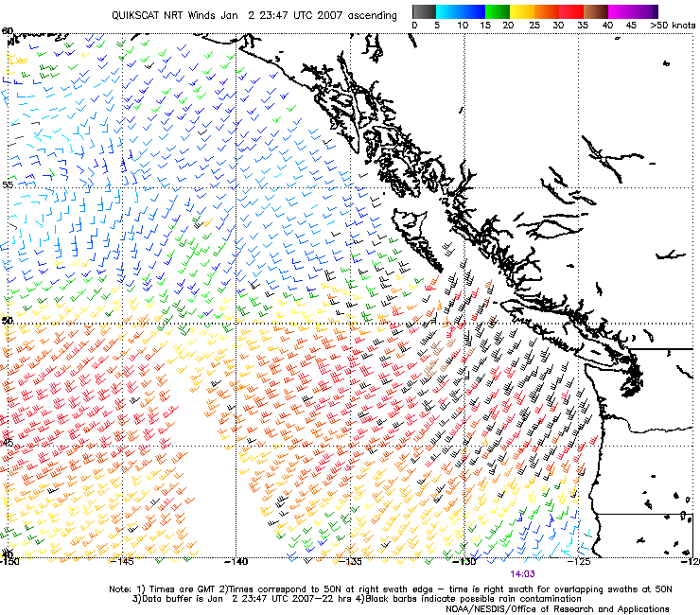

Slide 46
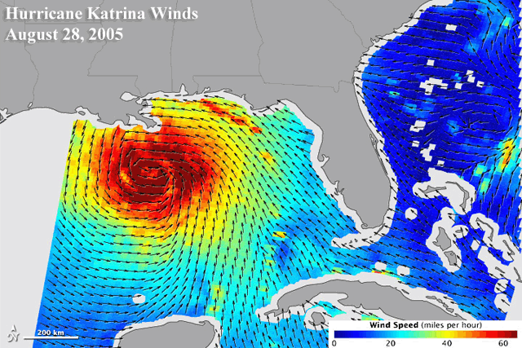
Satellite scatterometers

Slide 47
Upper Air Data

Slide 48

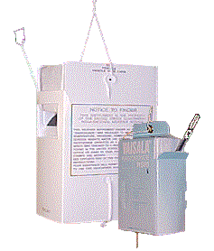
Radiosondes
First launched in 1929

Slide 49
Radiosondes
Provides temperature, humidity (relative humidity, pressure, and wind speed/direction)
Generally launched twice a day (00 and 12 UTC).

Slide 50
Radiosondes
A typical NWS radiosonde sounding ascent can last 2-3 hours
In that time, the radiosonde can ascend to an altitude exceeding 35 km (about 115,000 feet) and drift more than 300 km (about 180 miles) from the release point.
Typical pressure at balloon burst about 5 hPa (1/200th of surface pressure).

Slide 51
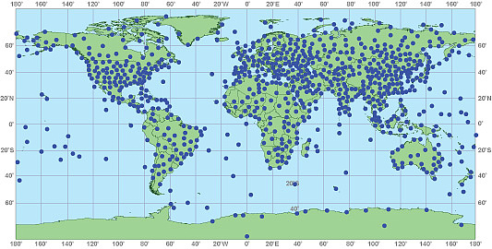
Generally twice a day at 00 and 12 UTC
About 1000 locations around the world

Slide 52
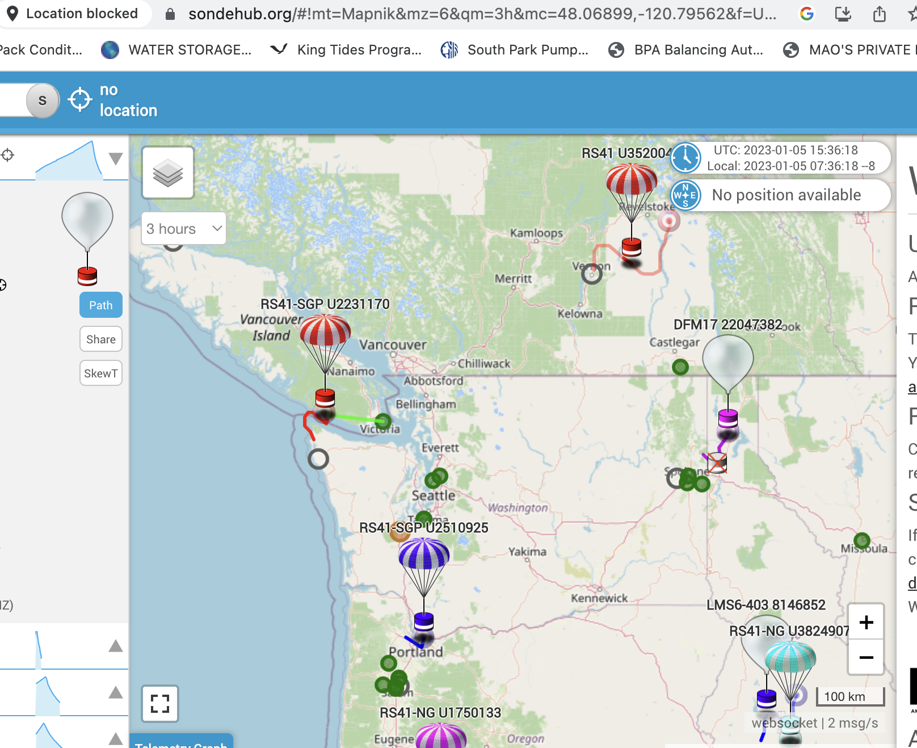

Slide 53

Radar Wind Profiler and RASS (Radio Acoustic Sounding System)
Can provide temperature and wind with height
Can also provide information on precipitation/clouds

Slide 54


Slide 55

Seattle Profiler/RASS

Slide 56


Slide 57


Slide 58

ACARS: Aircraft Observations
Often on wide-body aircraft
Aircraft Communications Addressing and Reporting System

Slide 59

Available at cruise altitude and ascent/descent.

Slide 60


Slide 61


Slide 62

Also TAMDAR data from AIRDAT/Panasonic: Commuter and Short Haul Aircraft

Slide 63

Weather Satellites Now Provide Roughly 99% of the Weather Data Going into Weather Prediction

Slide 64


Satellite Data
Geostationary and Polar Orbiting Satellites

Slide 65


GOES

Slide 66

Geostationary Image

Slide 67

Geostationary satellite see the whole hemisphere

Slide 68

Putting them together, one can monitor the entire planet

Slide 69


NOAA Polar
Orbiter Weather
Satellite
Polar Orbiter

Slide 70

A polar
low
Polar Orbiters Provide a High-Resolution View

Slide 71
Weather Satellites Provide MUCH More Than Just Imagery

Slide 72

Cloud and
Water Vapor
Track Winds
Based on Geostationary Weather Satellites

Slide 73


Slide 74

Atmospheric Moisture Vectors from Satellites

Slide 75

GOES sounder unit: observes atmosphere/earth’s emissions in several wavelengths

Slide 76

Views the Earth
At many Wavelengths,
Each mainly sensing temperature at a specific layer

Slide 77

Satellite Temperature and Humidity Soundings

Slide 78

High-Resolution Infrared Radiation Sounder

Slide 79

Microwave Sounders

Slide 80
GPS Soundings
A constellation of GPS satellites orbit the earth.
A collection of special satellites can receive the GPS signal
By measuring the delay in time as the GPS signal is bent by the earth’s atmosphere, one can determine atmospheric density variations in the vertical that can be used to create temperature and humidity soundings.

Slide 81


Slide 82



Slide 83

Weather Radar
During the early 90s, the NWS installed a network of powerful Doppler Weather
radars, a.k.a.
NEXRAD
WSR88D

Slide 84

NWS Radar Sites

Slide 85
Weather Radar
Reflectivity (precipitation intensity)
Doppler Velocities (radial velocities)
Polarimetric Information (precipitation type and other information?
Much more later in class

Slide 86

Camano
Island
Weather
Radar

Slide 87

Crowdsourcing of Weather Data
Securing weather data from devices intended for other purposes.
Example: pressure data from smartphones
Example: smartphone reported weather conditons

Slide 88

Smartphone Pressures

Slide 89

Weather Data from the Purple Air Air Quality Network

Slide 90

mping: NWS effort of crowdsource weather observations

Slide 91
A Synoptic Meteorologist Needs to Know The Accuracy of Various Observational Assets

Slide 92
Typical Observation Errors at the Surface (Important when doing analyses!)
Sea Level Pressure
Low-Elevation land stations +-.5 mb
Ships +- 1-5 mb
Temperature: +-1C
Wind Speed: +-2-5 knots, very light winds often a problem—especially for classical anomemeters.
Relative Humidity: +-10%

Slide 93
Typical Radiosonde Errors
Geopotential heights:
700 mb (hPa): 5-10 m
500 mb 10-15 m
300 mb 15-20 m
100 mb 20-30 m
Temperature: +-0.5C
Wind speed: +-5%,+-10 degrees

Slide 94
Some Terminology Often Used
Synoptic scale
Mesoscale
Microscale

Slide 95

Synoptic Scale (1000 km and more)

Slide 96


Mesoscale (10-1000 km)

Slide 97


Microscale (smaller than 10 km)

Slide 98
The END

