Slide 1
El Nino and La Nina
Atmospheric Sciences 101
Autumn 2024

Slide 2
El Nino and La Nina
An important atmospheric phenomenon that has an average period of three to seven years.
Goes between El Nino, Neutral, and La Nina (ENSO cycle, El Nino Southern Oscillation)
Has large influence both in the tropics and midlatitudes.
Main source of forecast skill beyond a few weeks.

Slide 3
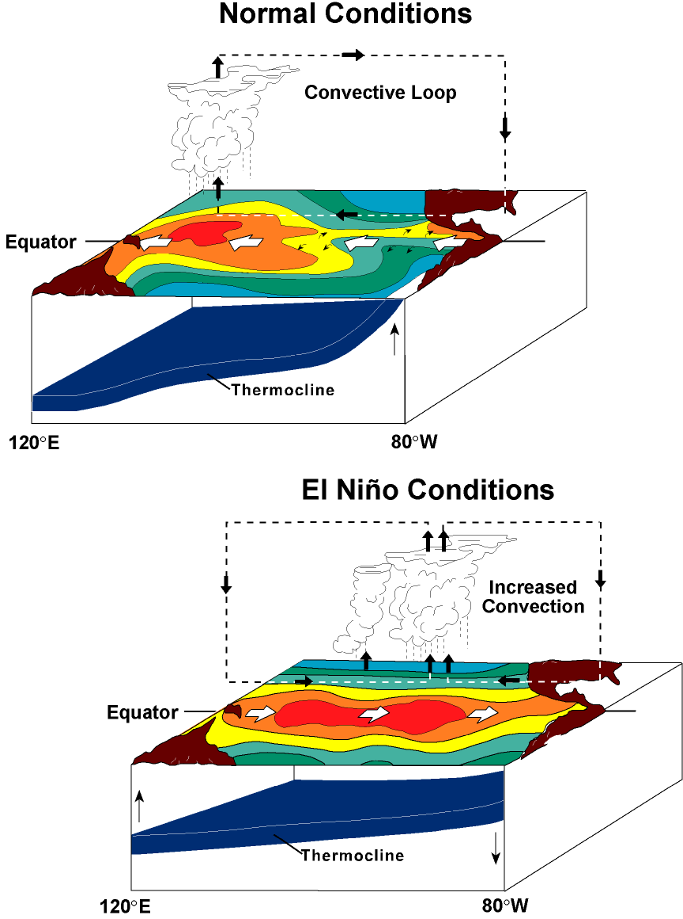

Slide 5
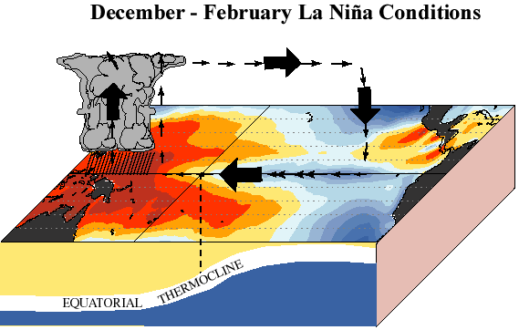

Slide 6
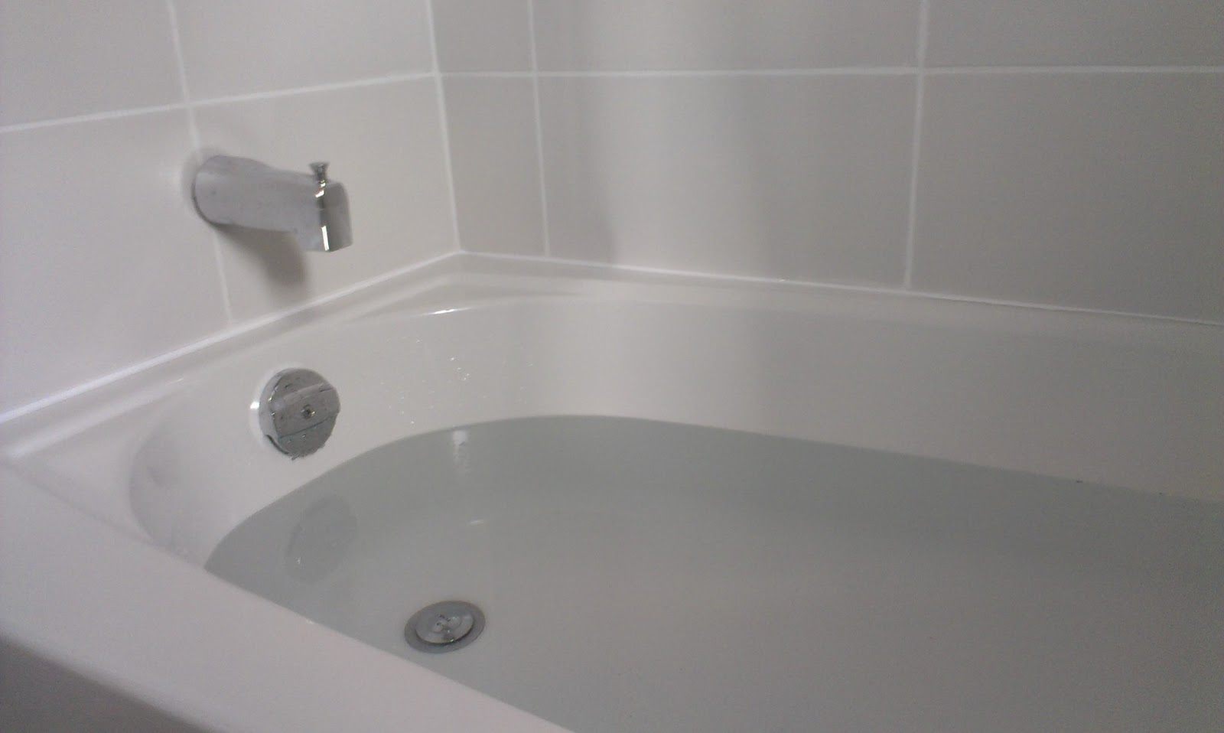
Not unlike sloshing water in a bathtub!

Slide 7
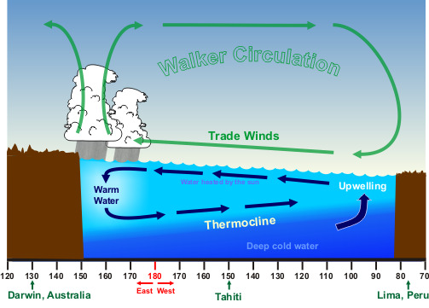
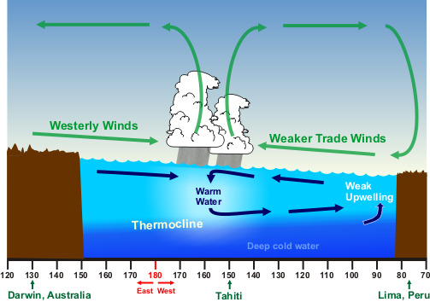
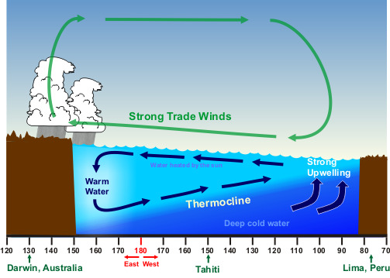
The Whole Cycle is Called the El Nino Southern Oscillation (ENSO for short)
El Nino
Neutral
La Nina

Slide 8
Why do we care?
The atmospheric flow in the midlatitudes are substantially different in El Nino, Neutral, and La Nina years.
Since the temperature of the tropical Pacific changes relatively slowly, this gives some meteorologist insights into the weather over the next several months.
We also have models to predict ENSO.

Slide 9
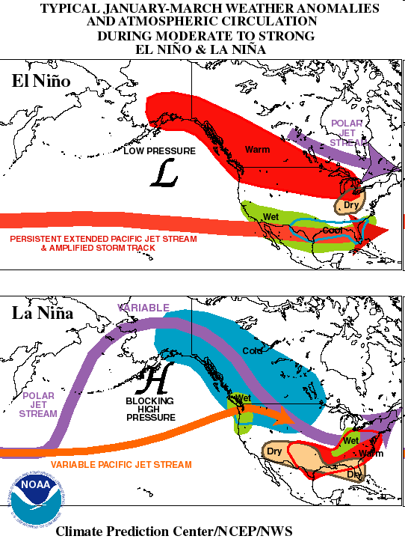
El Nino – weak Aleutian High

Slide 10
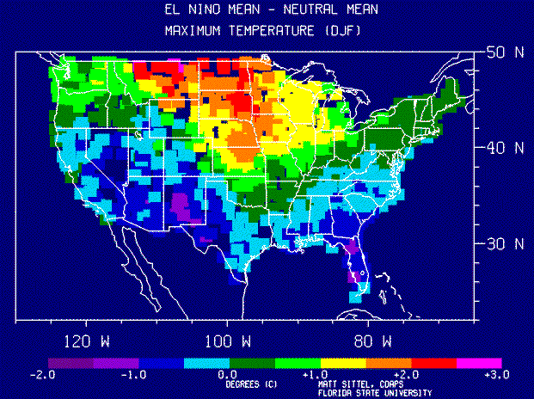

Slide 11
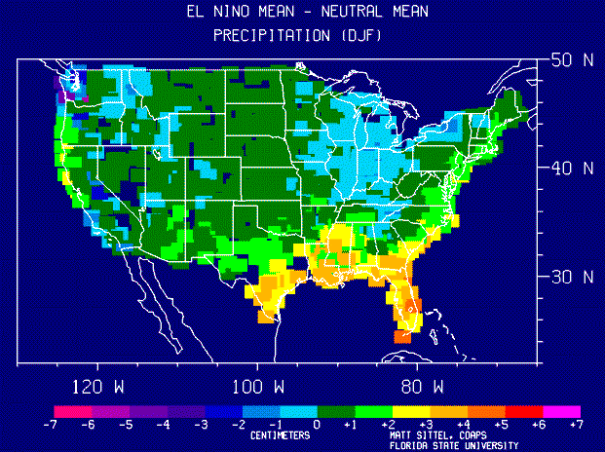

Slide 12
La Nina – strong Aleutian High

Slide 13

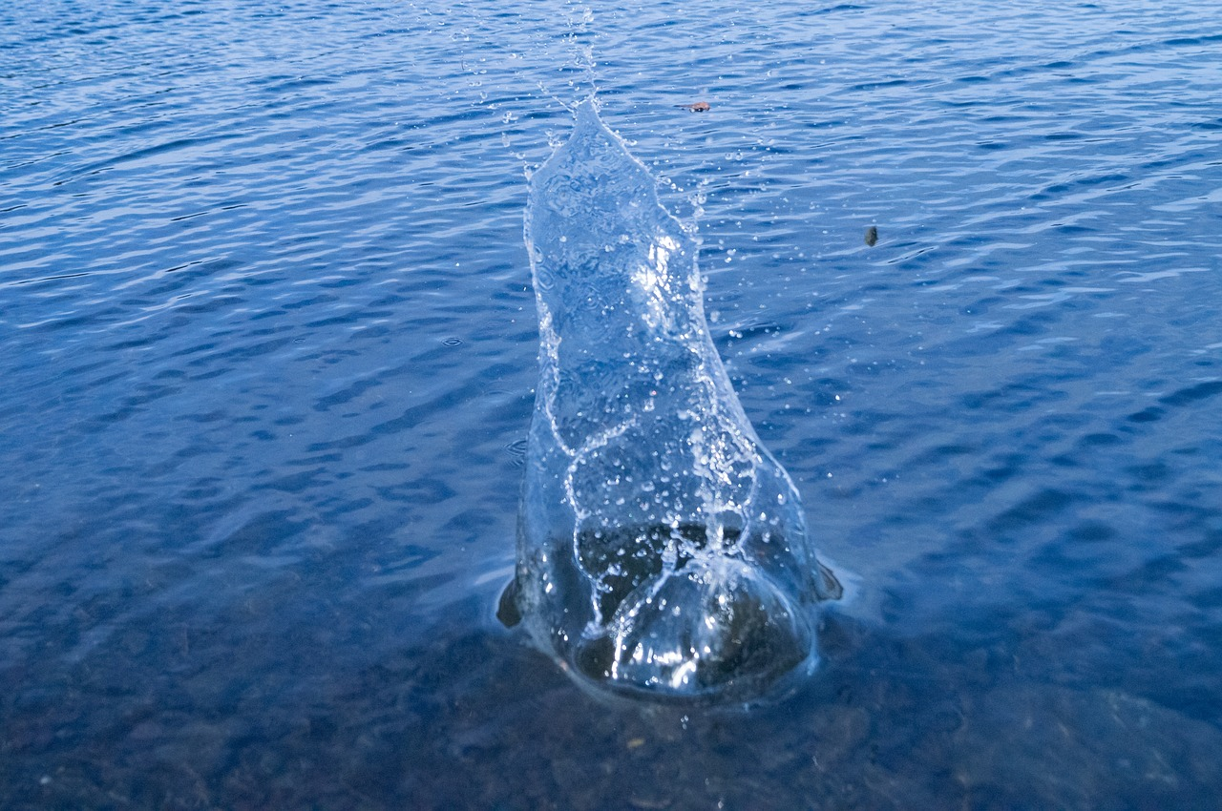
How Does the El Nino or La Nina Signal Spread Throughout the World?
Think about throwing a rock into a lake

Slide 14
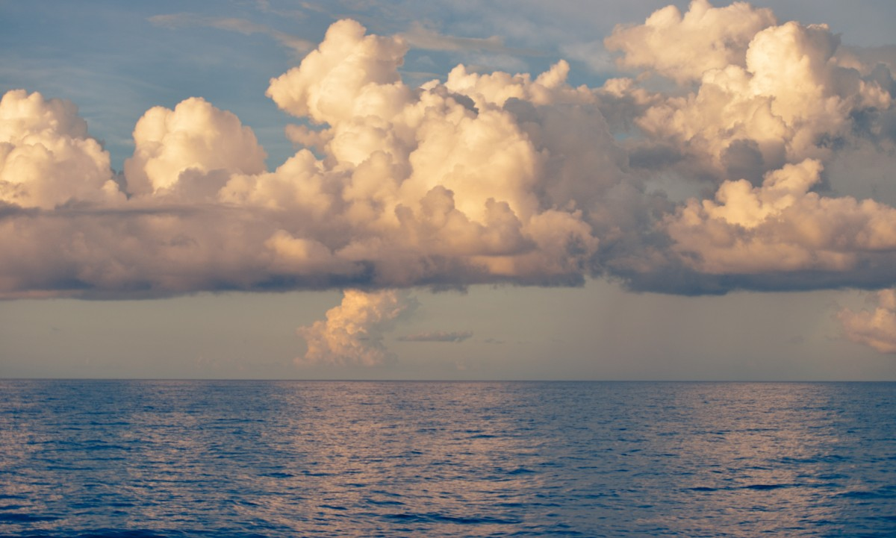
Just a difference in the rock and lake
Tropical “Rocks”

Slide 15
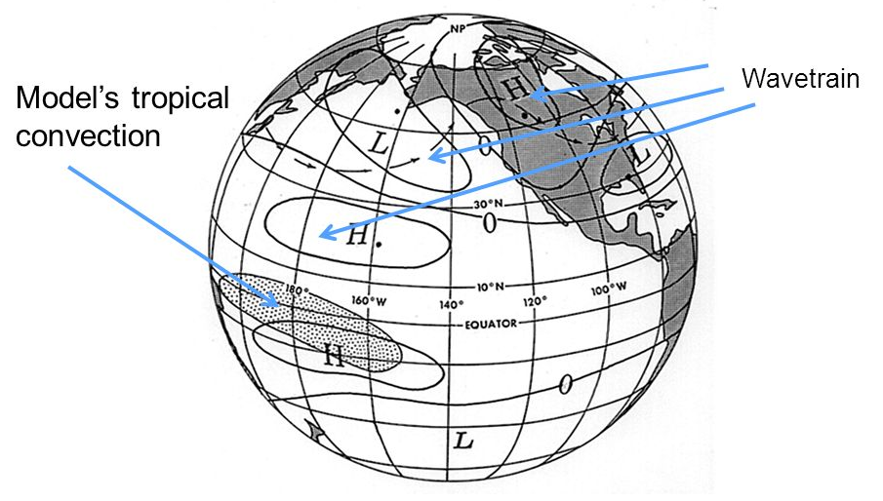
Teleconnections from the tropics
PNA Area

Slide 16
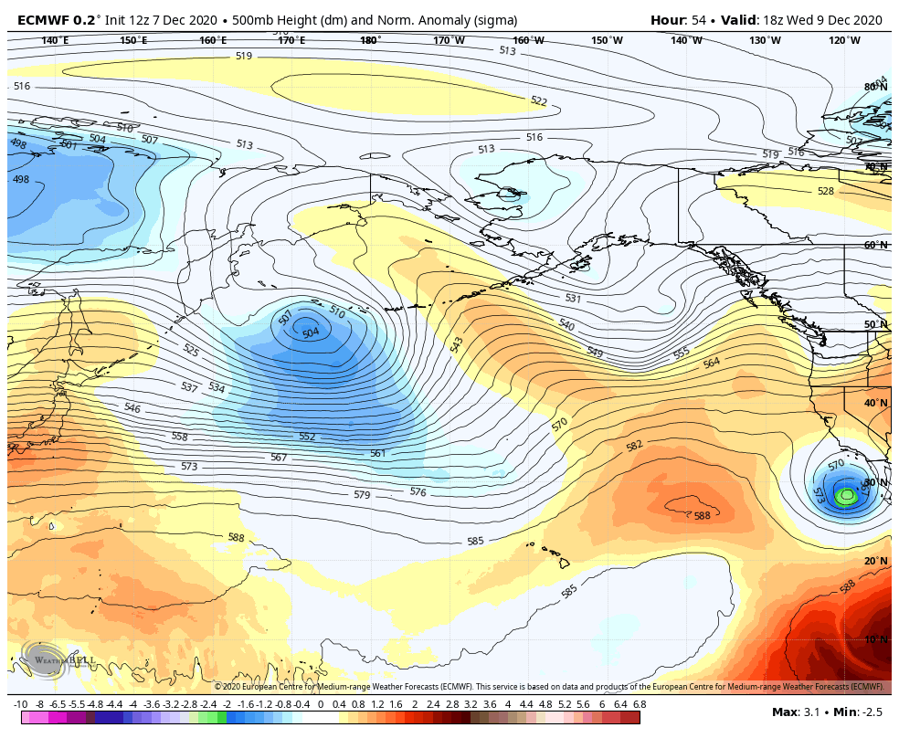
The “Lake”

Slide 17
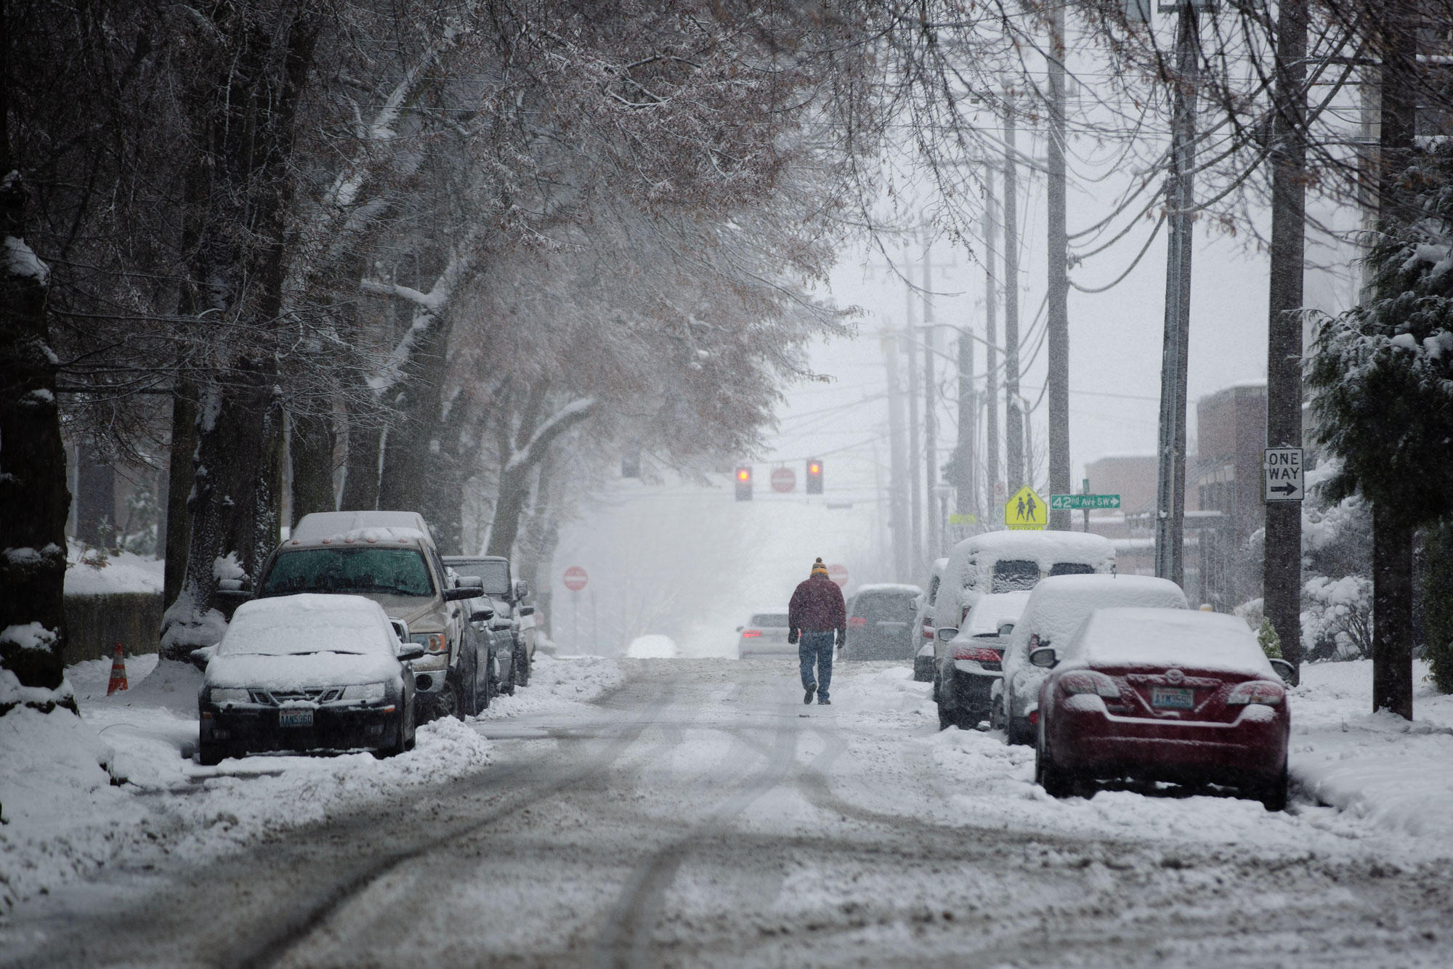
Washington Lowland Snow and La Nina
Typically more snow in La Nina years--but no guarantees. This is a statistical relationship.
Major impact after January 1

Slide 18
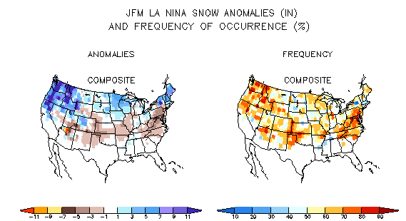

Slide 19
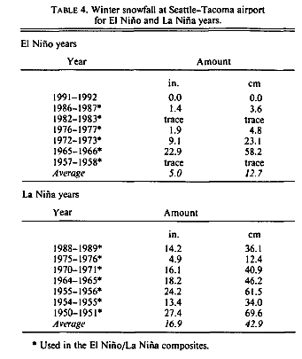

Slide 20
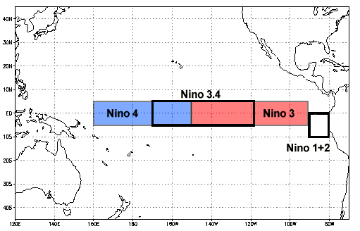
An important measure of El Nino/La Nina is the sea surface temperature anomaly in the central tropic Pacific: the Nino 3.4 area
El Nino: >.5C
La Nina:<-.5C
Neutral: .5 to -.5

Slide 21
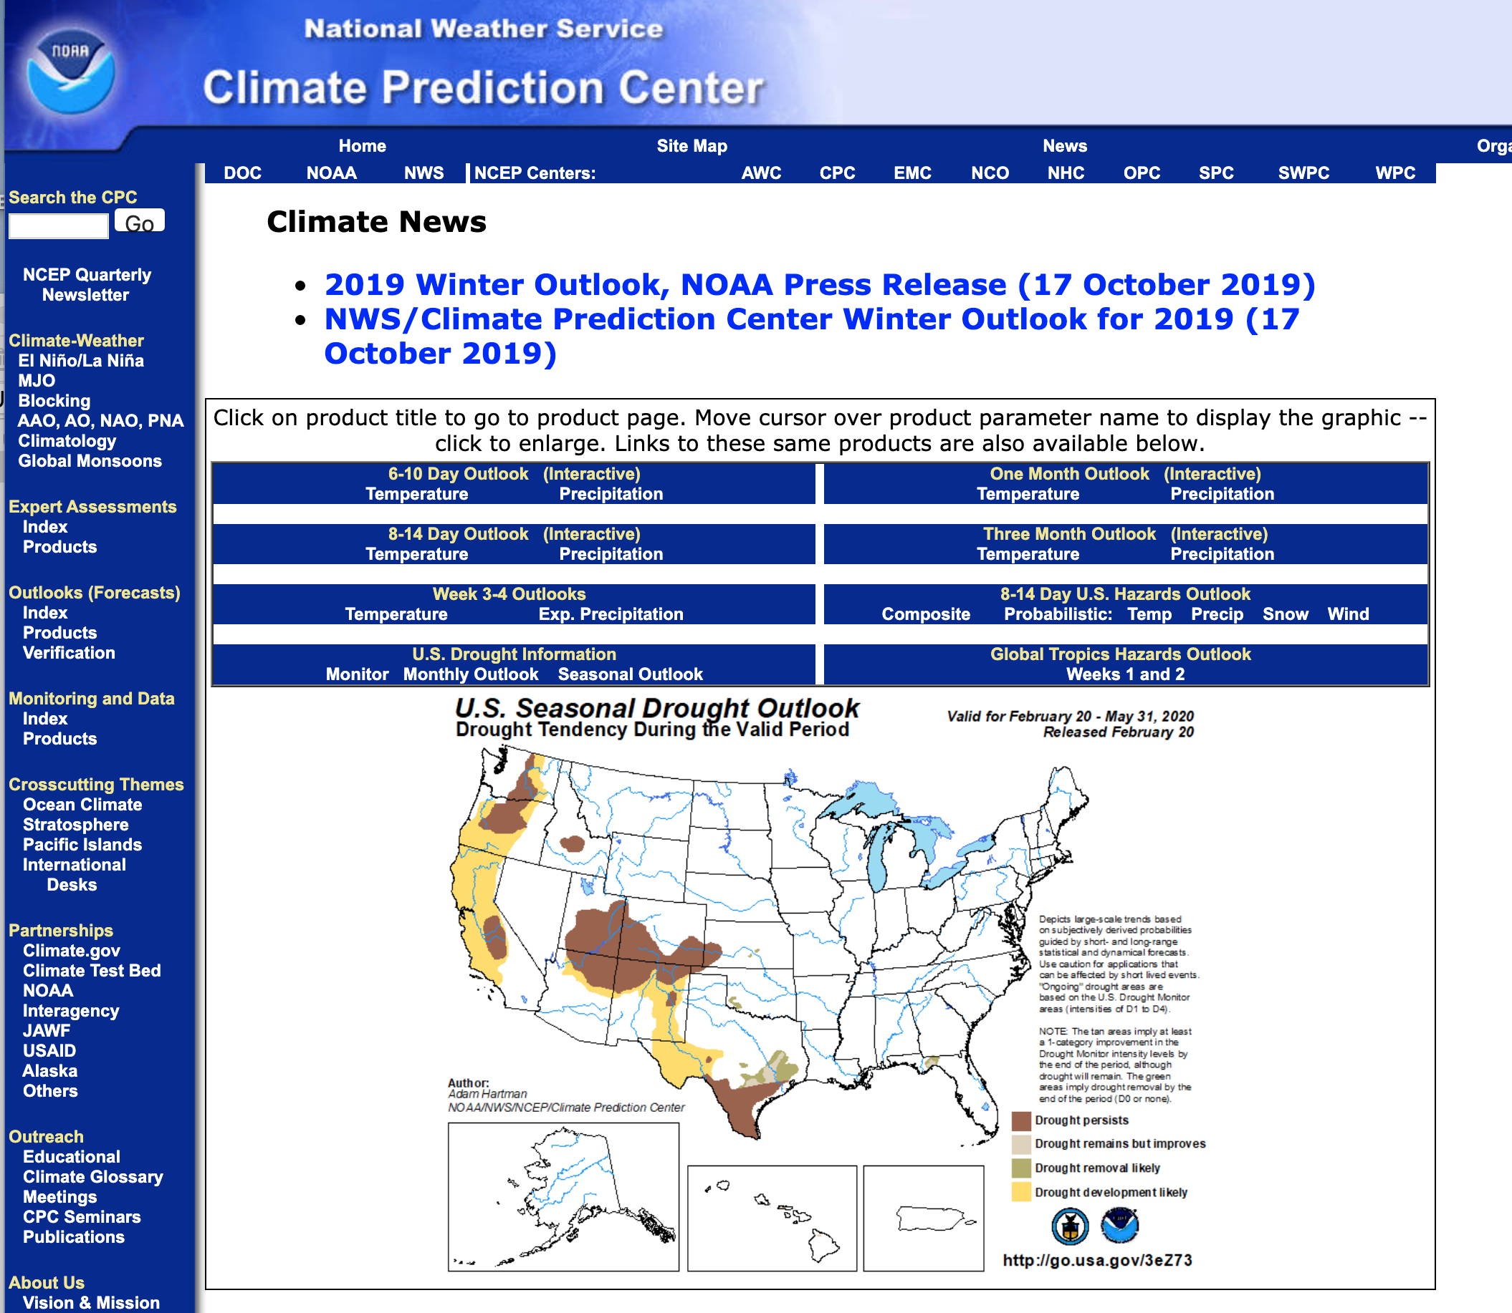
What about the current situation?
Latest information from the NOAA Climate Prediction Center (https://www.cpc.ncep.noaa.gov/)

Slide 22
Go to CPC

