Slide 1
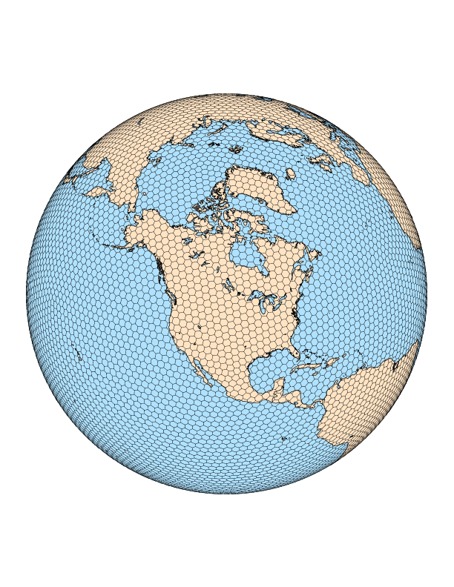
Convection Permitting Global Prediction: Evaluation for Operational Application in NOAA.
Cliff Mass¹
Nick Weber¹
¹University of Washington – Department of
Atmospheric Sciences, Seattle, WA
November 6th
NOAA NGGPS Presentation

Slide 2
The Project
Evaluate the impacts of global convection allowing resolution for weather and subseasonal prediction in NOAA
Evaluate various model configurations for potential use by NOAA to move to convection permitting resolution for global models.
Started with MPAS and hopefully will move to FV-3

Slide 3
Important Note
Attempted to use the public release of FV-3
Not ready for prime time
Computer dependencies
Inadequate pre and post processors
No support
Minimal documentation
Thus, decided to do all simulations with MPAS.
Hopefully, FV-3 will be ready for outside users in the future.

Slide 4
Our simulations
1.
introduction
2.
tropics
3.
convection
4.
extratropics
5.
discussion
The model: MPAS v5.1 (global)
Physics: ‘convection_permitting’ suite
Four cases (all integrated 28 days):
November 22, 2011 (DYNAMO)
February 8, 2013
December 2, 2003
December 8, 2013
Notes:
3km global = 65+ million cells

Slide 5
Convection-permitting suite
Scale-aware convection parameterization of Grell and Freitas (2014)
Cloud microphysics scheme developed by Thompson and Eidhammer (2014).
Gravity wave drag over orography: GWDO (WRF 3.6.1).
Long- and short-wave radiation: RRTMG (WRF 3.9.1), except for climatological aerosols.
PBL and surface layer: MYNN (WRF 3.9.1).
Land surface model: NOAH (WRF 3.9.1).

Slide 6
Our simulations
1.
introduction
2.
tropics
3.
convection
4.
extratropics
5.
discussion
Configurations:
15-km resolution, nTiedke cumulus scheme
3-km resolution, no cumulus scheme
15-km resolution, no cumulus scheme
15-to-3-km tropical channel, Grell-Freitas
NCEP FNL analyses used for ICs and BCs
SSTs fixed at initial value
Notes:
3km global = 65+ million cells

Slide 7
Computer resources per 3-km run
E
X
T
R
A
Supercomputer: Cheyenne (5.34 petaflops)
Run on 1024 nodes → 36,864 cores
Core hours: 2.7 million
Wall clock: 74 hours
Output: ~80TB

Slide 8
1.
introduction
2.
tropics
3.
convection
4.
extratropics
5.
discussion
Section 2
Tropical verification

Slide 9
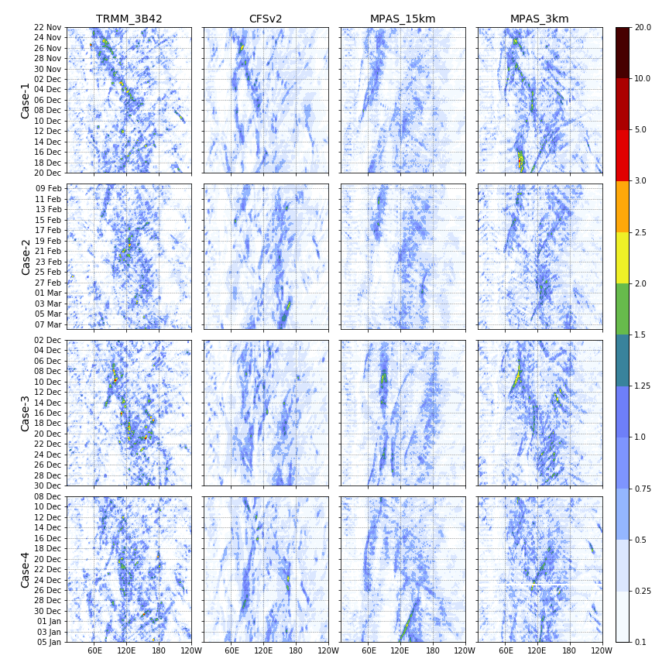
MJO propagation
1.
introduction
2.
tropics
3.
convection
4.
extratropics
5.
discussion
Precipitation (mm/h) Hovmöllers (15S-15N) reveal:
Weaker, more widespread rain in models with parameterized convection
Improved eastward MJO propagation in 3km model for three cases
Problematic westward propagation in 15km simulations

Slide 10
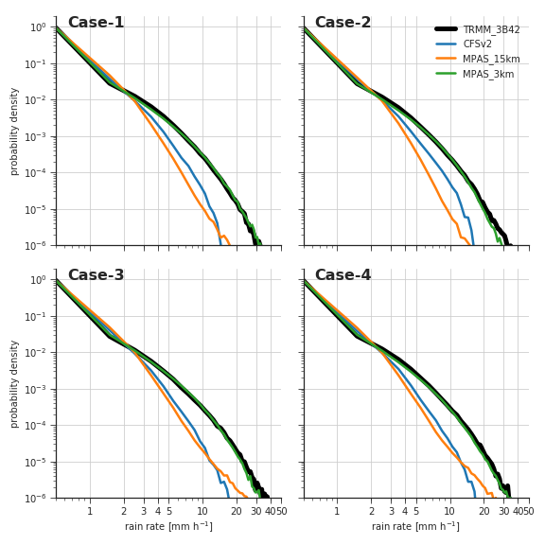
Precip. statistics: Rain rate distribution
1.
introduction
2.
tropics
3.
convection
4.
extratropics
5.
discussion
One Case
CFS and 15km MPAS produce too much (little) light (heavy) precipitation
3km MPAS closely matches TRMM estimates
Same result for all four cases!

Slide 11
Precip. statistics: Rain rate distribution
1.
introduction
2.
3km vs 15km
3.
15km no-Cu
4.
channel
5.
discussion

Slide 12
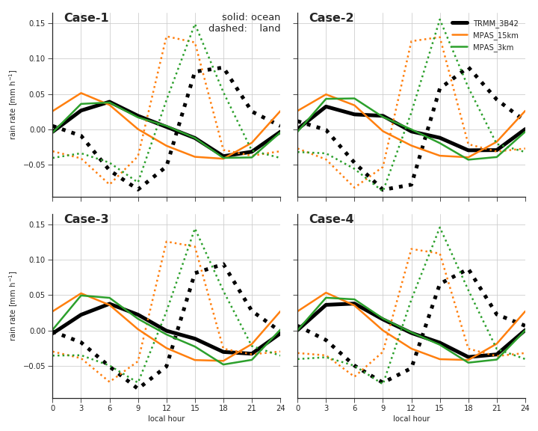
Precip. statistics: Diurnal cycle
1.
introduction
2.
tropics
3.
convection
4.
extratropics
5.
discussion
One Case
Improvement in diurnal timing over both land and water
Amplitude over land is still overestimated
Same result for all four cases
solid = ocean
dashed = land

Slide 13
Precip. statistics: Diurnal cycle
1.
introduction
2.
3km vs 15km
3.
15km no-Cu
4.
channel
5.
discussion

Slide 14
Is there a cheaper way to run a global CPM?
1.
introduction
2.
tropics
3.
convection
4.
extratropics
5.
discussion
What about the 15-km simulations without Cu parameterization?
Too much heavy precipitation
Way too dry
Too little light precipitation
Improved diurnal timing
No MJO
*Identical results for all four cases

Slide 15
Is there a cheaper way to run a global CPM?
1.
introduction
2.
tropics
3.
convection
4.
extratropics
5.
discussion
What about the 15-km simulations without Cu parameterization?
Too much heavy precipitation
Too little light precipitation

Slide 16
Is there a cheaper way to run a global CPM?
1.
introduction
2.
tropics
3.
convection
4.
extratropics
5.
discussion
What about the 15-km simulations without Cu parameterization?
No MJO

Slide 17
Is there a cheaper way to run a global CPM?
1.
introduction
2.
tropics
3.
convection
4.
extratropics
5.
discussion
What about the 15-km simulations without Cu parameterization?
too dry

Slide 18
Is there a cheaper way to run a global CPM?
1.
introduction
2.
tropics
3.
convection
4.
extratropics
5.
discussion
What about the 15-km simulations without Cu parameterization?
Improved diurnal timing

Slide 19
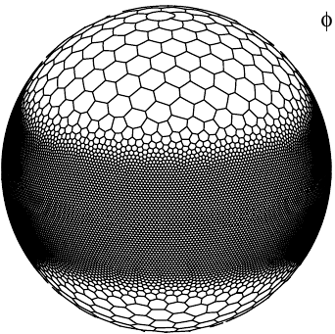
Is there a cheaper way to run a global CPM?
1.
introduction
2.
tropics
3.
convection
4.
extratropics
5.
discussion
What if we use 3-km resolution in the tropics only ?
15-km resolution
20N
3-km resolution
20S
15-km resolution

Slide 20
Is there a cheaper way to run a global CPM?
1.
introduction
2.
tropics
3.
convection
4.
extratropics
5.
discussion
What if we use 3-km resolution in the tropics only ?
Same benefits to tropical precipitation statistics
MJO propagation is not as well-captured as in the 3-km global run

Slide 21
Is there a cheaper way to run a global CPM?
1.
introduction
2.
tropics
3.
convection
4.
extratropics
5.
discussion
What if we use 3-km resolution in the tropics only ?
There seems to be some advantage to having global convection-permitting

Slide 22
1.
introduction
2.
tropics
3.
convection
4.
extratropics
5.
discussion
Section 3
Structure of organized tropical convection

Slide 23
Structure of organized convection
1.
introduction
2.
tropics
3.
convection
4.
extratropics
5.
discussion
Consider the the “Kelvin” wave in Case-1:

Slide 24
Structure of organized convection
1.
introduction
2.
tropics
3.
convection
4.
extratropics
5.
discussion
Latent heating and vertical motion:
Stronger LH release and vertical motions in 3-km run
Stronger downward motion behind the updraft:

Slide 25
Structure of organized convection
1.
introduction
2.
tropics
3.
convection
4.
extratropics
5.
discussion
Cloud water and rain water
More widespread cloud ice in 3-km simulation
More intense precipitation

Slide 26
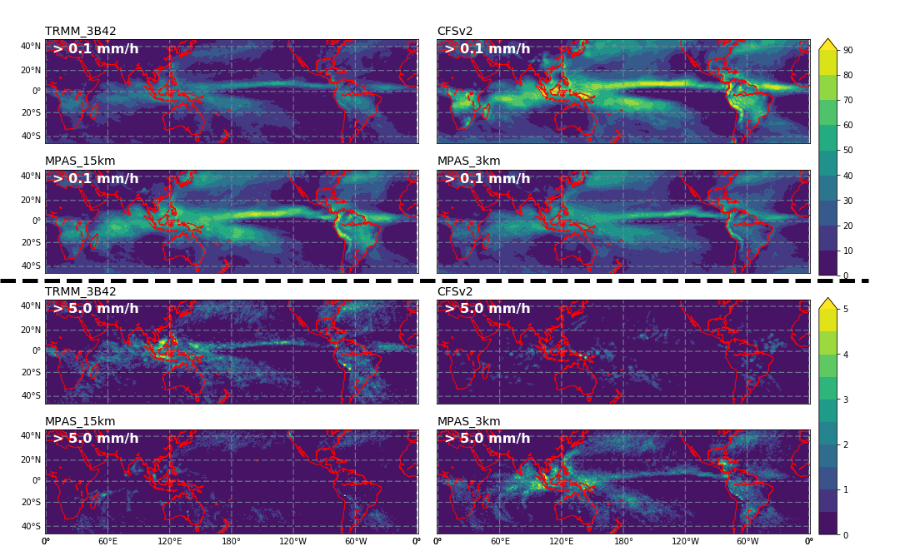
Precip. statistics: Rain frequency (%)
E
X
T
R
A

Slide 27
1.
introduction
2.
tropics
3.
convection
4.
extratropics
5.
discussion
Section 4
Extratropical verification
Notes:
Computationally cheaper!
Requires scale-aware physics
Have only done this for Case-1

Slide 28
Subseasonal extratropical skill: PNA
1.
introduction
2.
tropics
3.
convection
4.
extratropics
5.
discussion
CASE-1

Slide 29
Extratropical skill: weekly Z500 scores
1.
introduction
2.
tropics
3.
convection
4.
extratropics
5.
discussion
ALL CASES
The bulk of the improvement is in week-3
Similar results over the entire Northern Hemisphere
15-km no-Cu run performs worse than other MPAS configurations

Slide 30
Channel MJO and subseasonal PNA skill
E
X
T
R
A
MJO propagation not well-captured in the channel run
But good Z500 prediction in the PNA region for week-2 and week-3

Slide 31
Comparison to GOES satellite imagery over south America
https://atmos.washington.edu/~njweber2/figures_cheyenne/papers/mpas_overview/sat_comparison/SouthAmerica_w_obs/alooper/

Slide 32
Surface verification: CONUS
E
X
T
R
A

Slide 33
CONUS error reduction: MPAS_3km – MPAS_15km
E
X
T
R
A
Notes:
Standardizing/normalizing the precip errors highlights more of the west coast, mountains, and Midwest!
The bulk of these errors/differences occurs in weeks 3 and 4
Similar maps for RMSE and bias improvement

Slide 34
1.
introduction
2.
tropics
3.
convection
4.
extratropics
5.
discussion
Section 5
Discussion

Slide 35
Conclusions
1.
introduction
2.
tropics
3.
convection
4.
extratropics
5.
discussion
The global convection-permitting MPAS improves upon the 15-km configuration in several regards:
Tropical precipitation statistics
MJO propagation
Vertical structure of organized tropical convection
Weekly extratropical circulation forecast skill
Omitting the convection scheme at coarse (15-km) resolution and running a channel grid configuration both have their benefits, but were unable to replicate the MJO skill of the global 3-km configuration

Slide 36
Conclusions
Convection-permitting resolution has substantial benefits
Now evaluating improvements in the midlatitudes of both hemispheres.
Looking forward to using a viable version of FV-3
Bottom Line: Global convection-permitting resolution is going to be the future of global NWP.
The computational resources are not unreasonable…NOAA could do this once a week…but really could use additional computer resources to make this a reality.

Slide 37

The End of the Beginning

