Slide 1
Jet Stream
ATMS 370
Winter 2023

Slide 2
Jet Streams and Jets
A jet stream (or jet) is a narrow current of strong winds.
Can exist at several levels, but the term is most often applied to the high velocity winds in the vicinity of the midlatitude tropopause

Slide 3
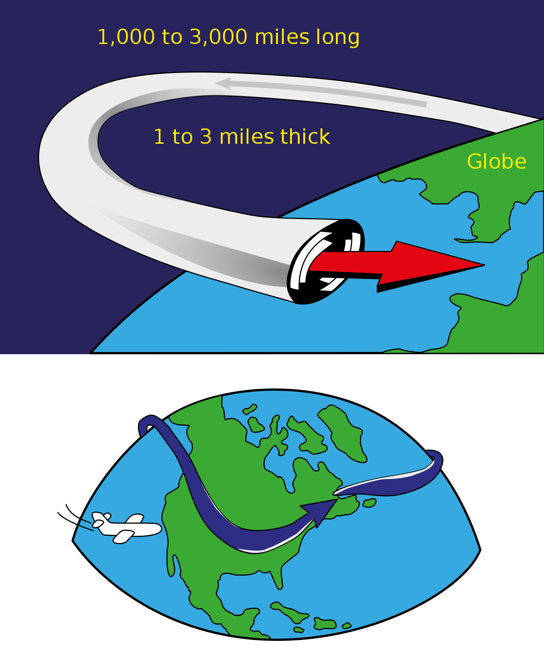

Slide 4
Midlatitude Jet Stream Facts
Can reach 250 mph (or more)
Centered on the upper troposphere…around 250 hPa
Stronger in winter. Generally, weakens and moves northward during summer.
Closely associated with a tropospheric horizontal temperature gradient (thermal wind!)
Not uniform zonally

Slide 5
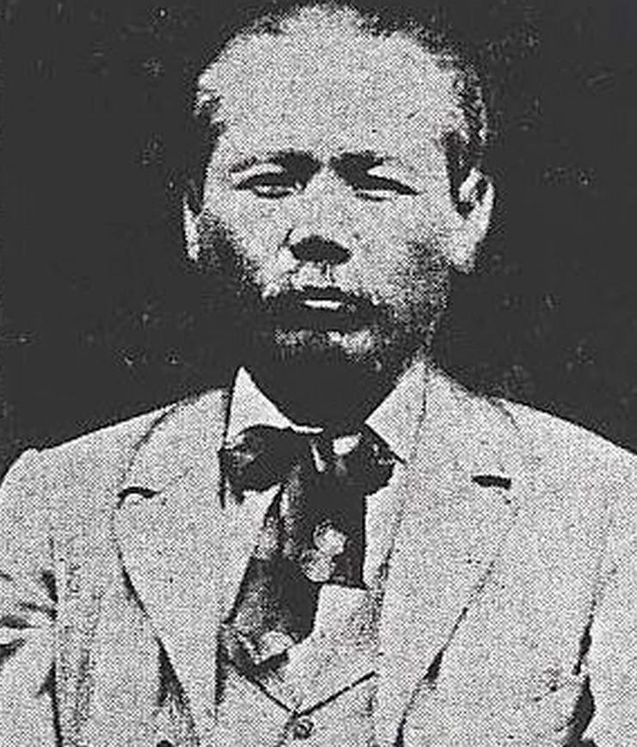
Wasaburo Oishi, Japanese Discoverer (1920s)

Slide 6
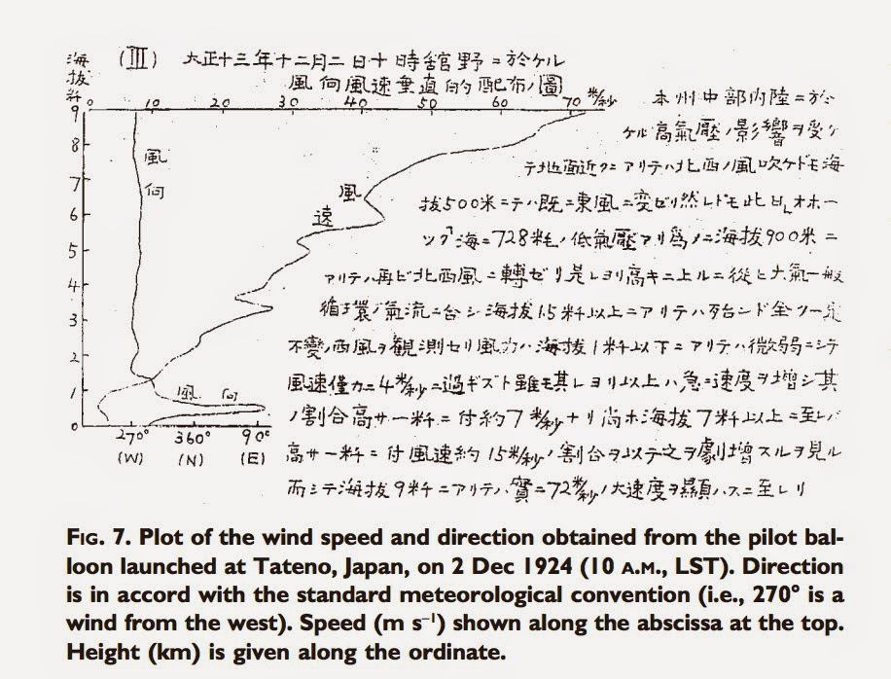

Slide 7
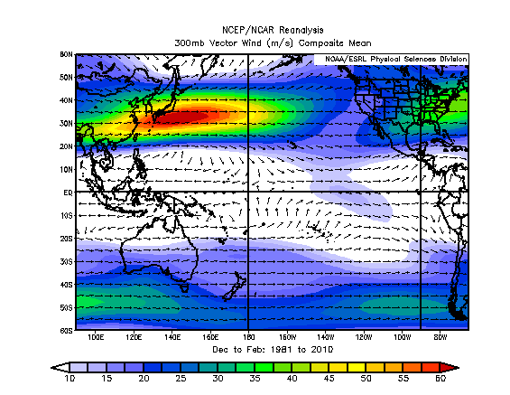
Strongest Jet Stream in the World
Crosses Southern Japan

Slide 8
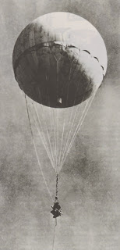
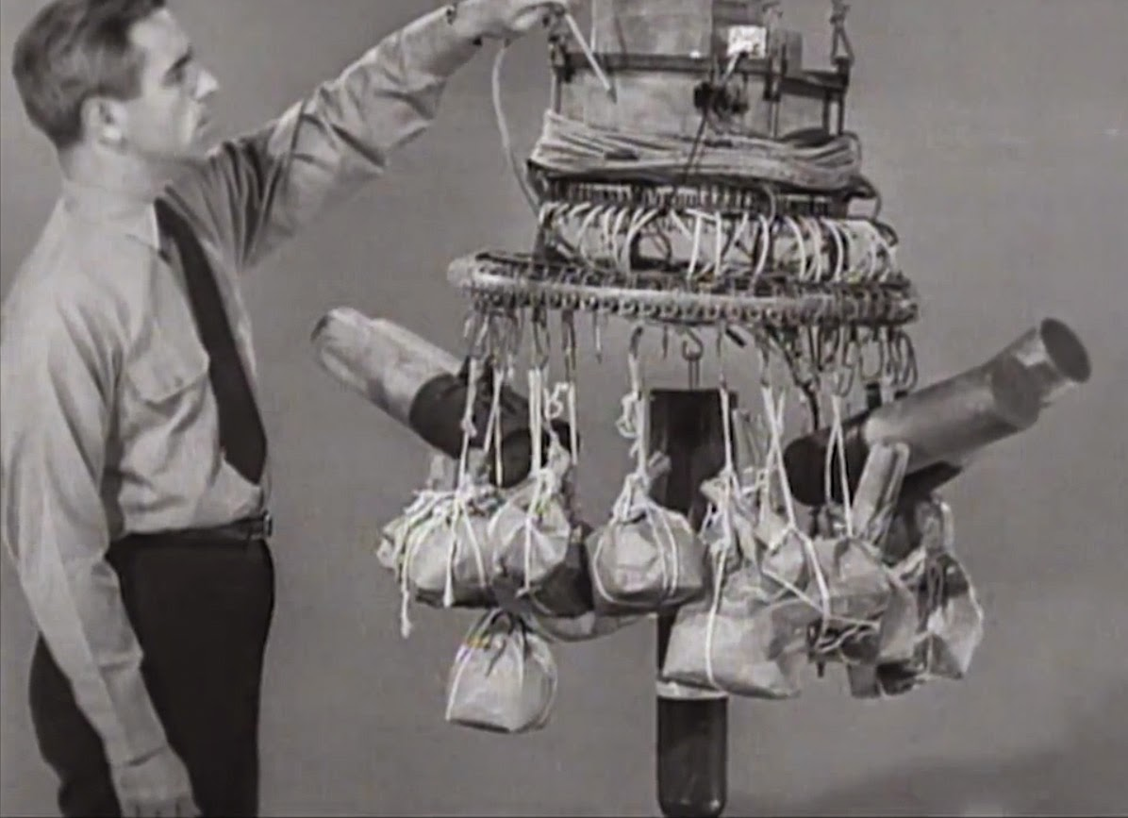
Fu-Go Balloon Weapon During WWII Used the Jet Stream

Slide 9
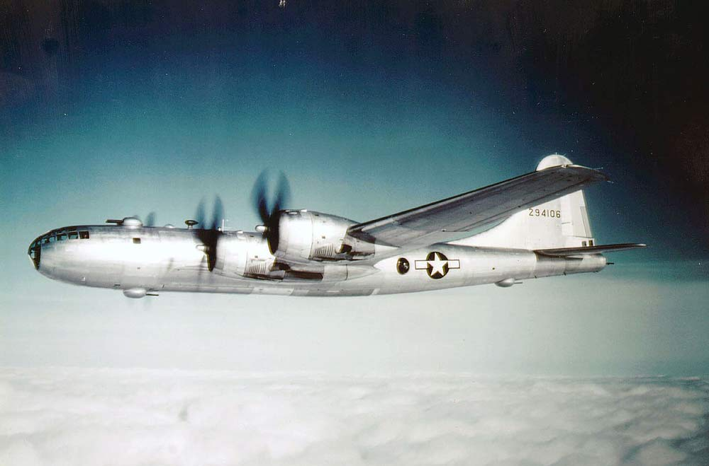
Strahlstromung (German) for “jet stream” first used in 1939
Big effects on bomber flights during WWII

Slide 10
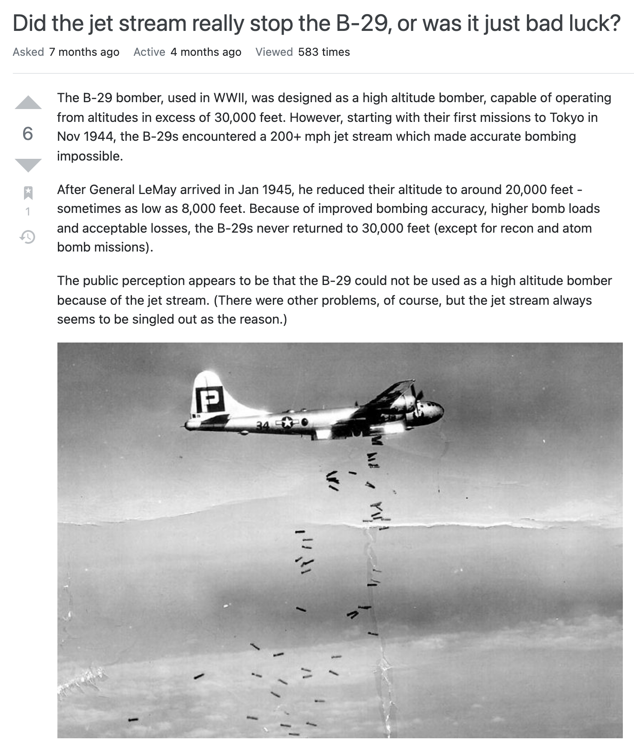

Slide 11
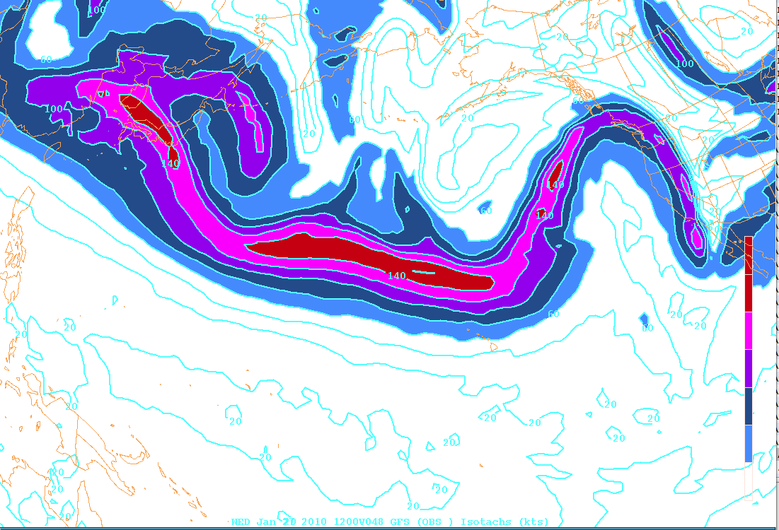
Jet Stream winds are not spatially uniform
Example: 250 mb isotach

Slide 12
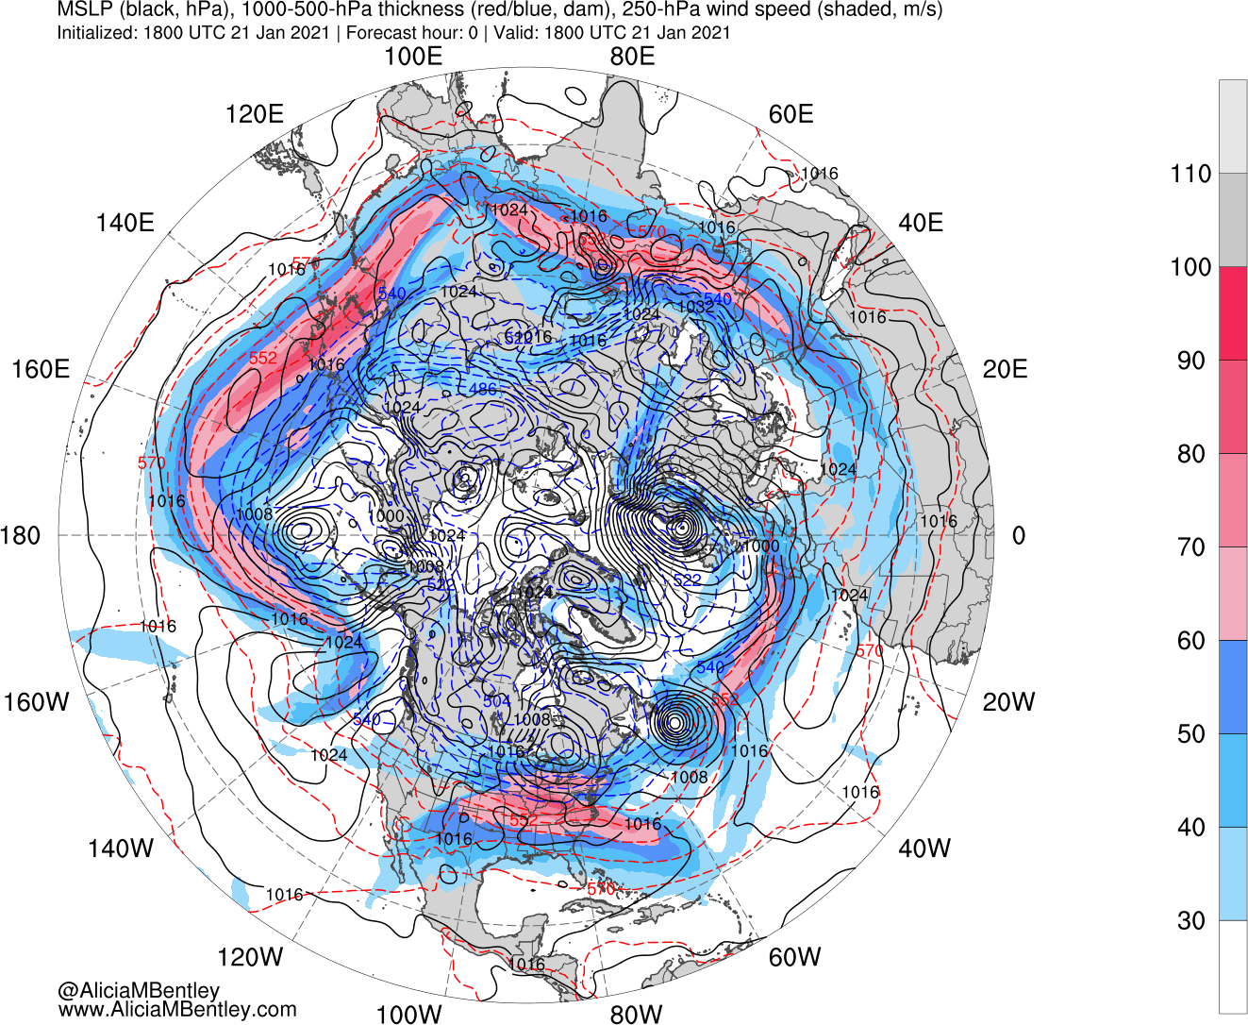

Slide 13
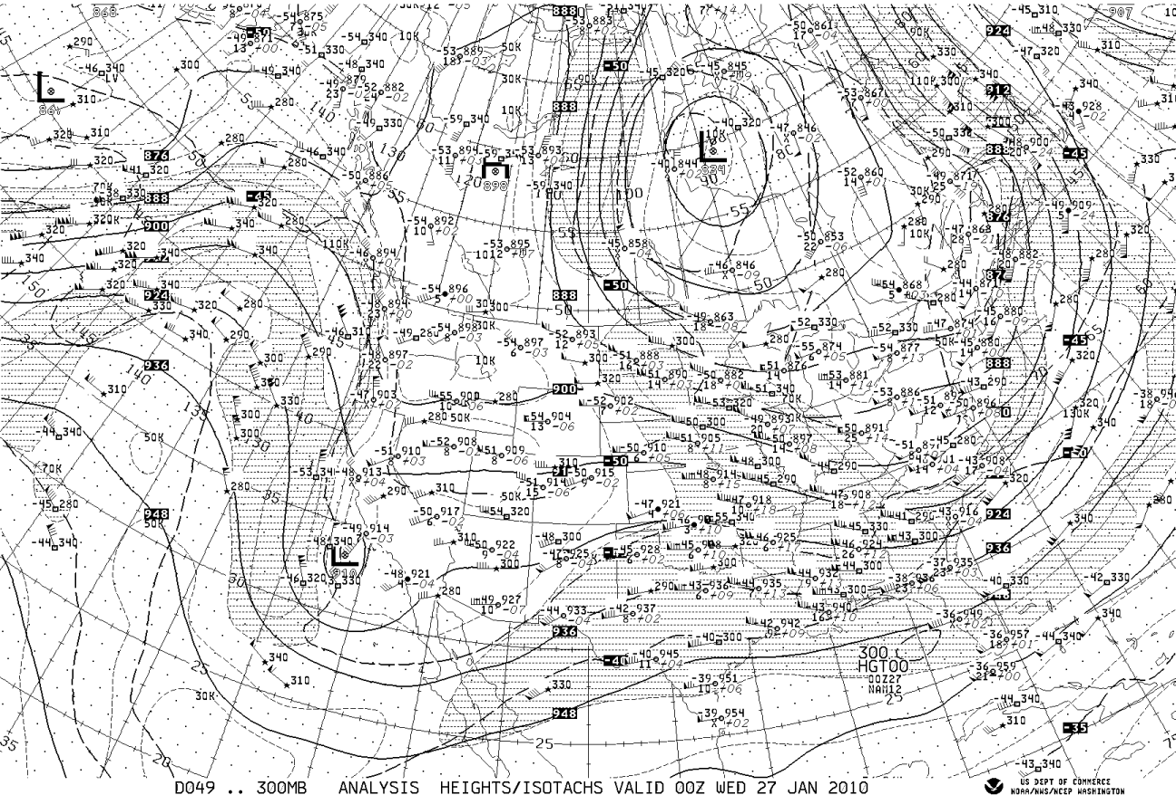
Shaded 70—110 knot

Slide 14
Jet Stream versus Jet Streak
A matter of size
Term ”jet stream” used for features of 1000’s of km in length. ”Jet streak” used for features of 100’s to 1000 km
Note that air blow through the jet streak isotachs…the feature propagates more slowly than the strongest winds.

Slide 15
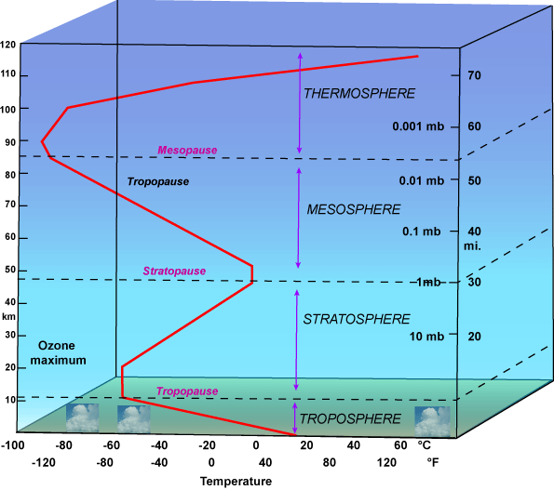
Main Upper Tropospheric Jets Closely Associated with the Tropopause

Slide 16
Tropopause Definition
Tropopause: the layer or surface between the troposphere and stratosphere
Marked by a change in lapse rate from a typical tropospheric lapse rate (~6.5C per km) to isothermal or inversion conditions.
Sometimes weak or absent, particularly near jet cores.
Can have multiple tropopauses above a location
Lower in polar region than in the tropics.

Slide 17

Official WMO Definition
“the point on soundings where the lapse rate becomes less than 2C per km and remains less than that for a least 2 km”

Slide 18
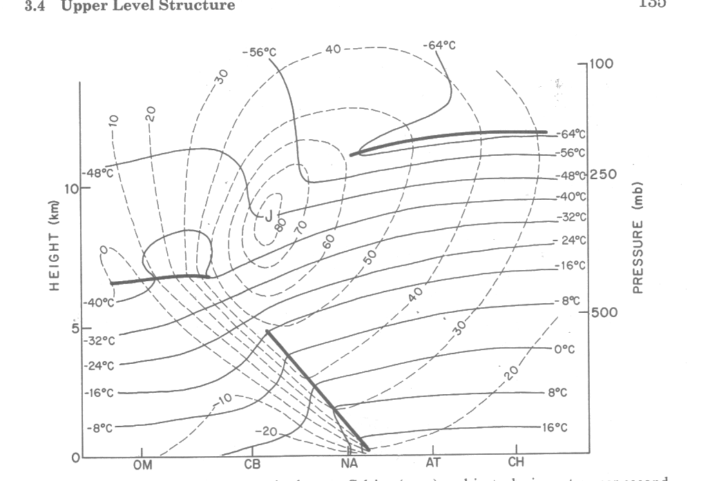
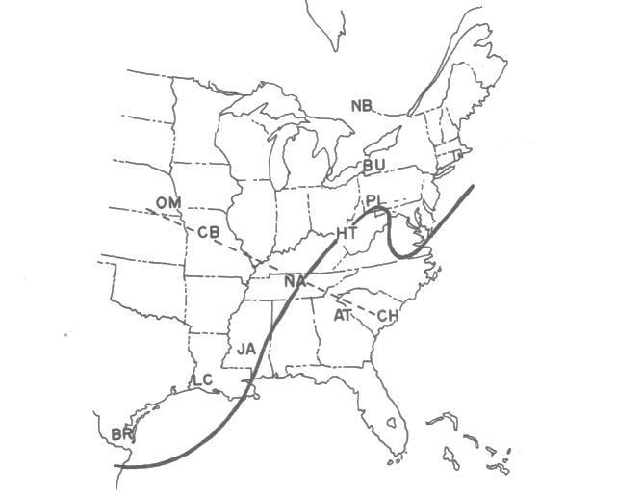
Finding the Tropopause

Slide 19
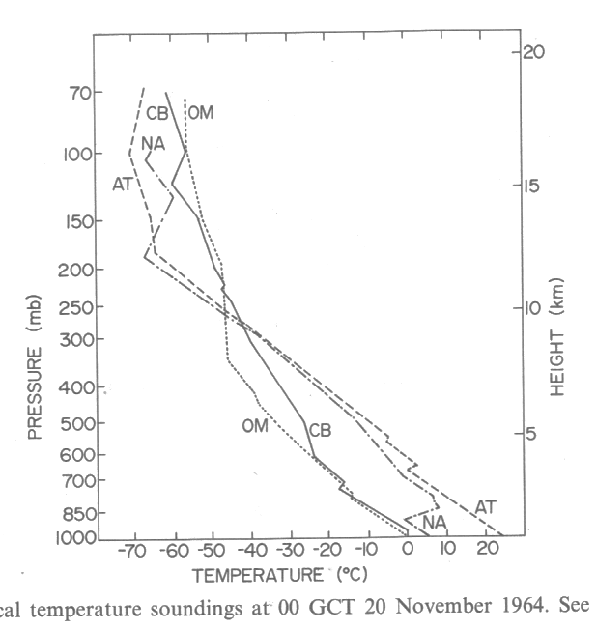

Slide 20
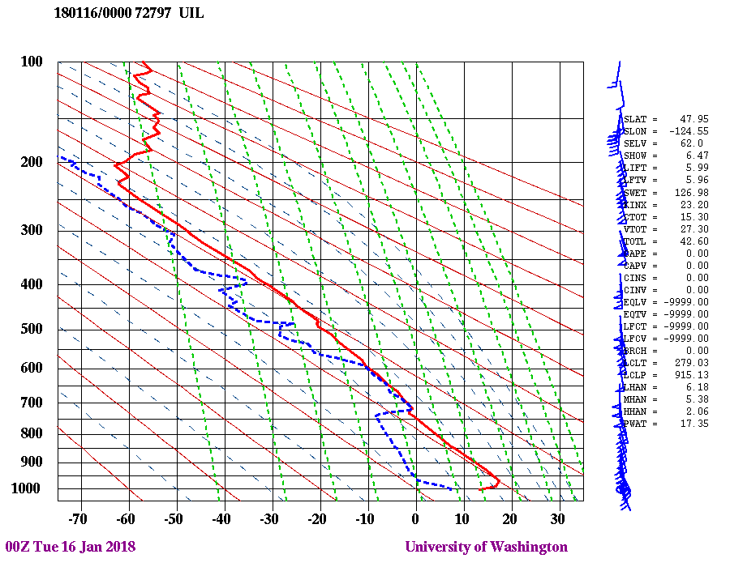
Real World Examples: http://weather.uwyo.edu/upperair/sounding.html

Slide 21
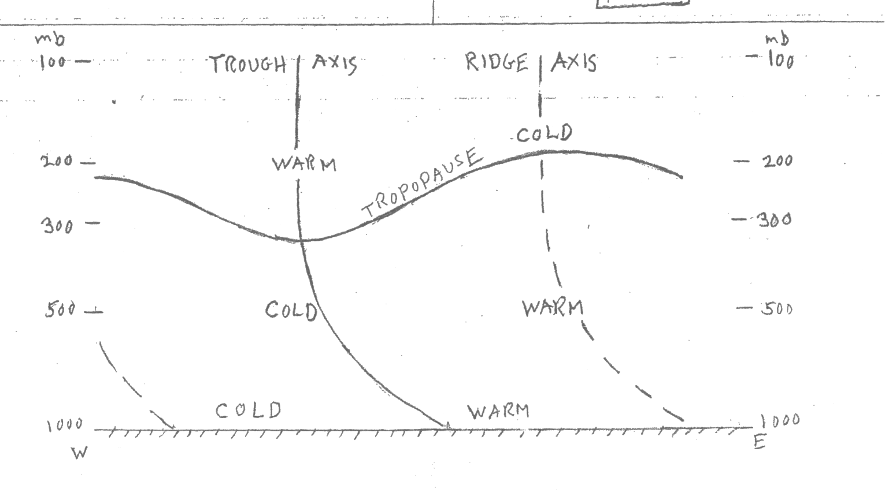
Tropopause is modulated synoptically
High in ridges, low in troughs
Higher in tropics, lower towards poles
L
H

Slide 22
Tropopause Height https://atmos.washington.edu/~hakim/tropo/trop_pres.html

Slide 23
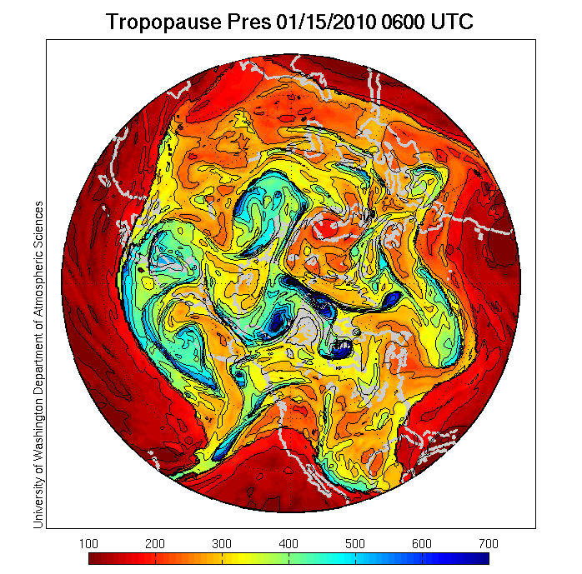

Slide 24
There are TWO types of upper tropospheric jet streams
Polar front jet (a.k.a. midlatitude jet): associated with main midlatitude frontal/baroclinic zone. Typically 30-45N, ~250-300 hPa
Subtropical jet: associated with the northern portion of the tropical Hadley circulation. Typically around 30N, ~200 hPa

Slide 25
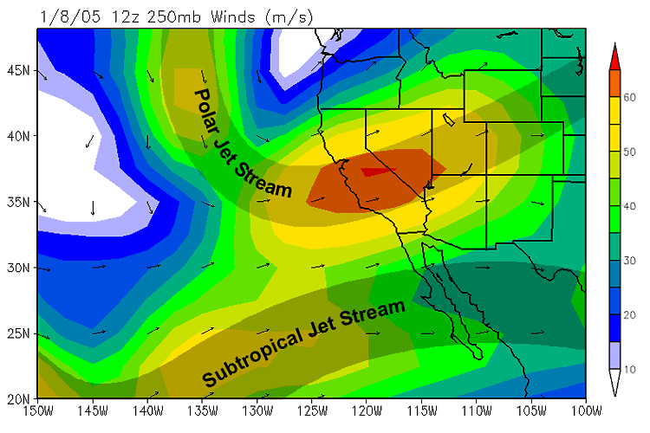
Two Jet Streams

Slide 26
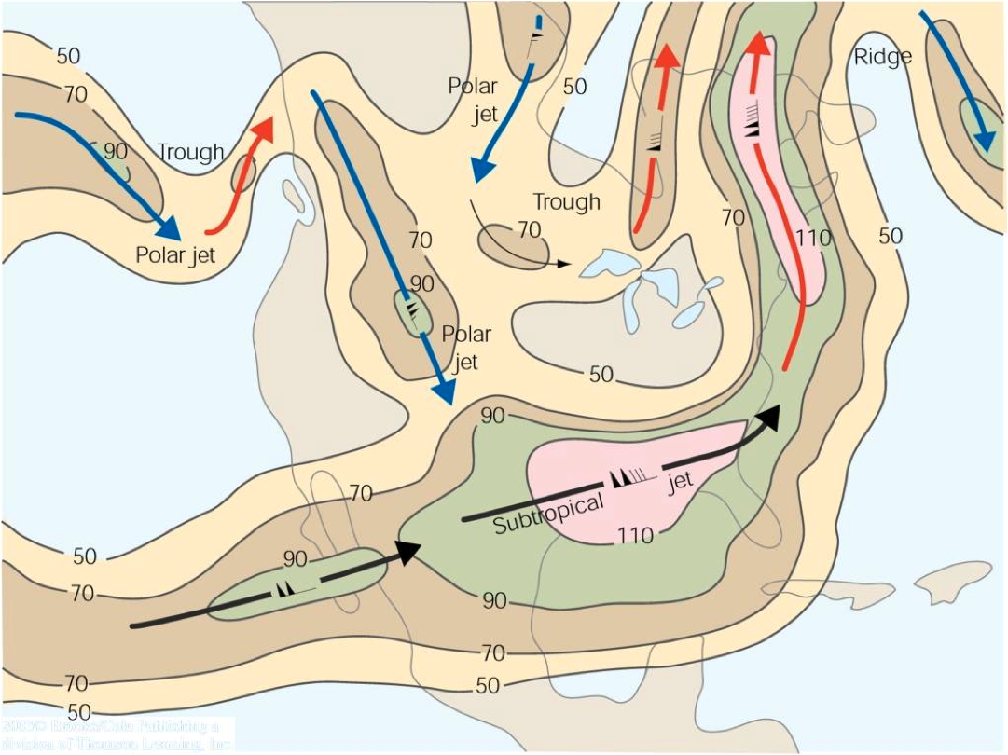

Slide 27
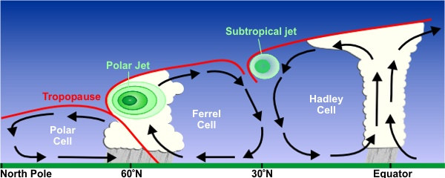
Two Jet Streams, Both Located Near the Tropopause

Slide 28
Note: Tropopause in Three Segments

Slide 29
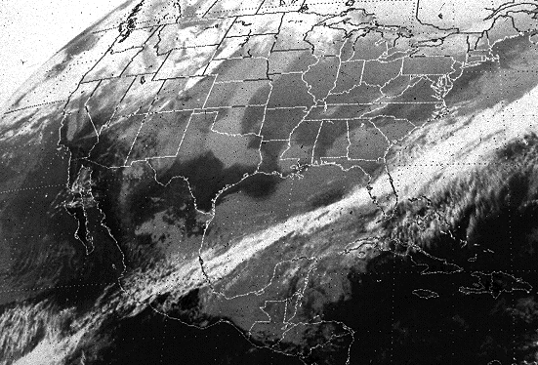
The Subtropical Jet Stream Often Associated with a cloud band

Slide 30
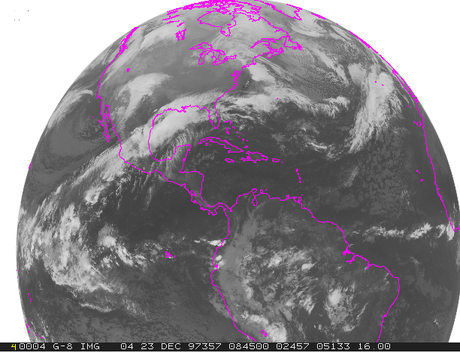

Slide 31
Jet Stream’s Relationship to Horizontal Temperature Gradient Can Be Explained Through Thermal Wind Arguments

Slide 32
Thermal Wind Equation
The large wind shear associated with a jet stream is directly connected to large horizontal temperature gradient

Slide 33
250 mb isotach

Slide 34
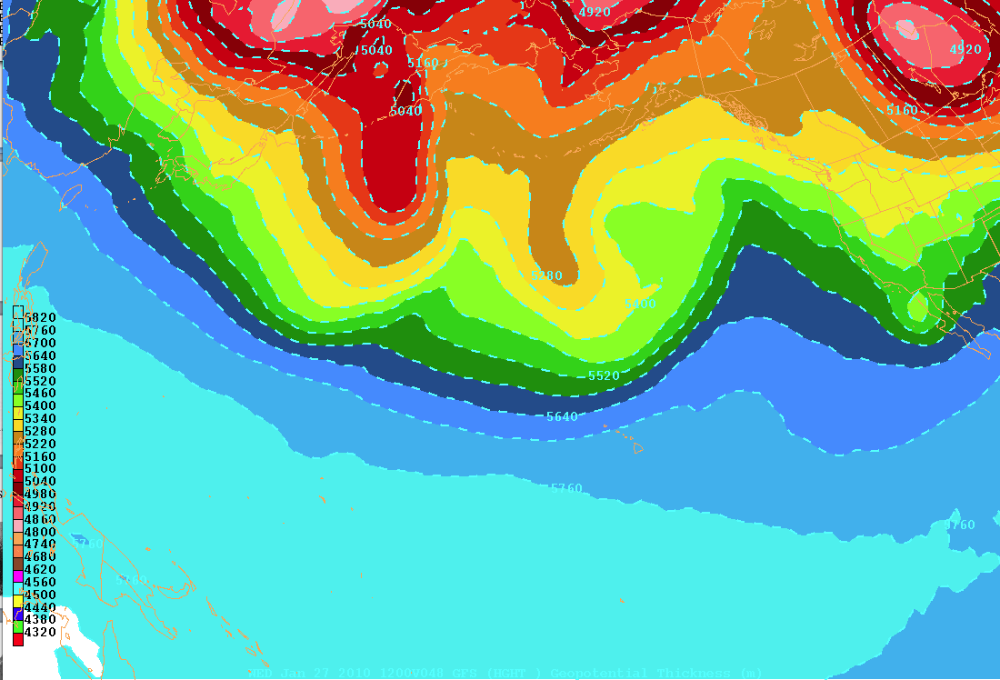
1000-500 mb thickness gradient is large near jet core

Slide 35
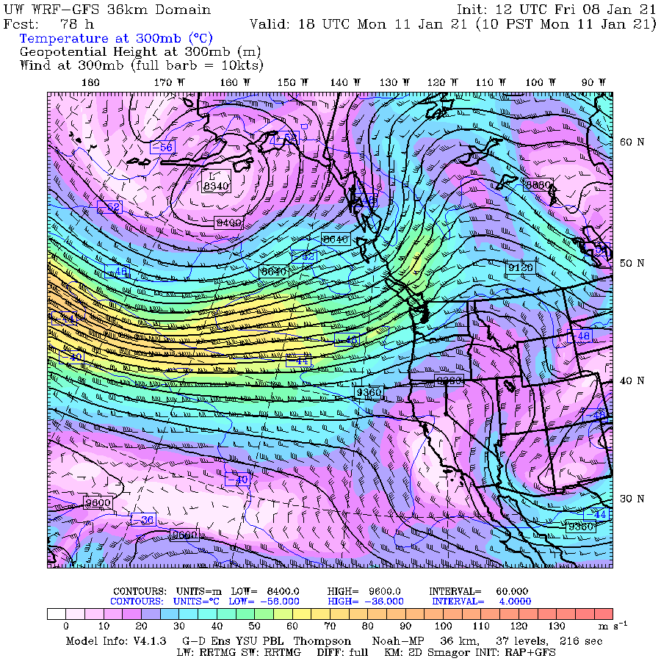

Slide 36
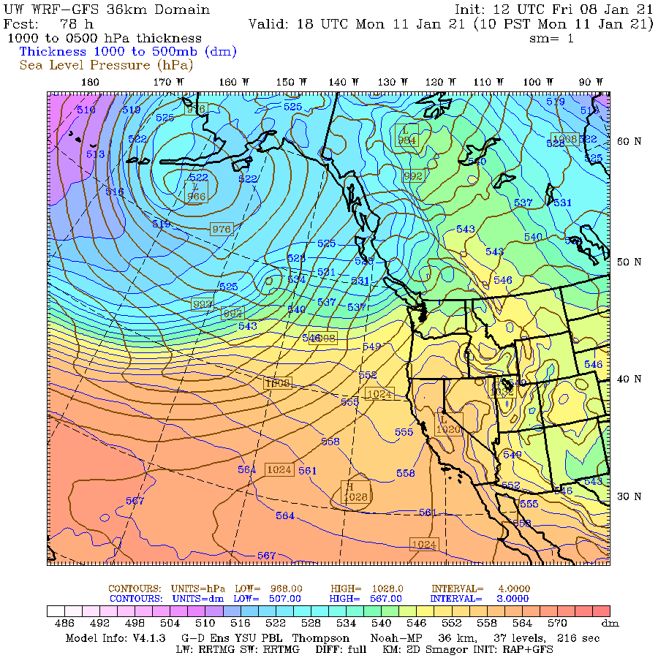

Slide 37
An alternative viewpoint

Slide 38
The Jet Stream
Horizonal temperature gradients can produce pressure gradients
500 mb
700 mb
Greater thickness
Lesser Thickness
850 mb
P_{surface}
Warm
Cold

Slide 39
The Jet Stream
The pressure gradients in turn produce wind.
Consider the balance of forces at each level:
C_{o}
PGF
500 mb
700 mb
850 mb
P_{s}
Warm
Cold

Slide 40
Why is the jet stream typically located at the tropopause?
?

Slide 41
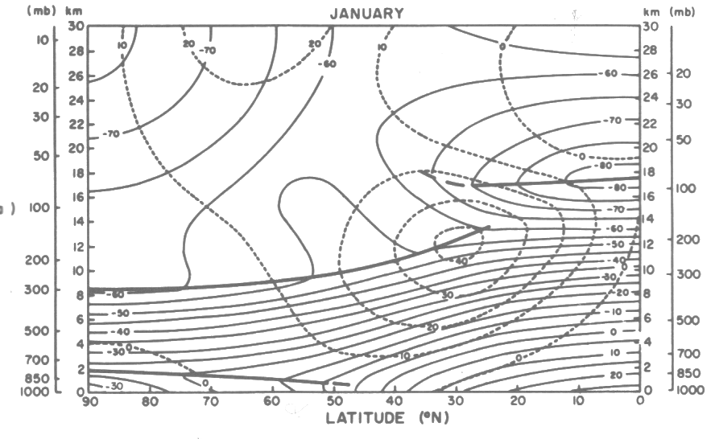

Slide 42
Because the horizontal temperature gradient reverses in the stratosphere.

Slide 43
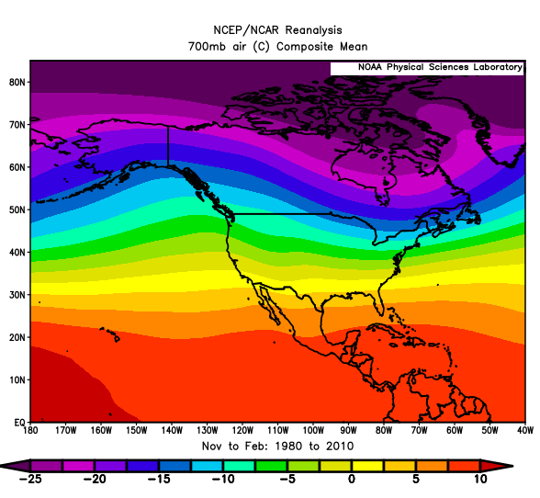
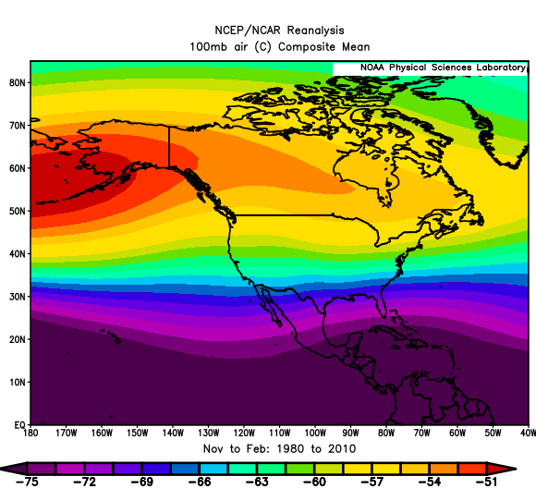
700 and 100 hPa Temperatures

Slide 44
Consider the Thermal Wind Equation for the Zonal (E-W) Winds
The sign and magnitude of the vertical wind shear depends on the horizontal temperature gradient

Slide 45
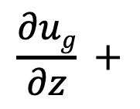
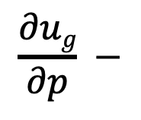
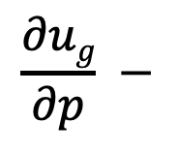
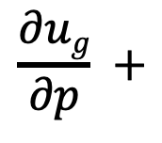
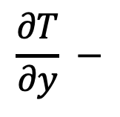
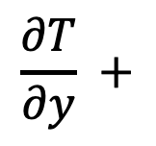
stratosphere
$$\frac{∂ug}{∂p} +$$
$$\frac{∂T}{∂y} +$$
cold
warm
J
tropopause
troposphere
$$\frac{∂ug}{∂p} −$$
$$\frac{∂T}{∂y} −$$
cold
warm
North
surface
South
$$\frac{∂ug}{∂p} −$$
$$\frac{∂ug}{∂z} +$$

Slide 46
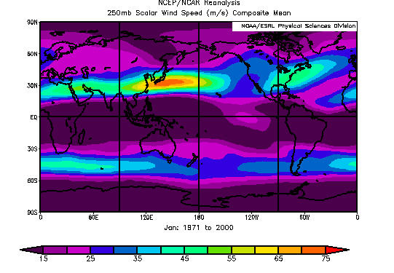
The midlatitude jet stream is not uniform, which has to do with the non-uniform temperature gradients

Slide 47
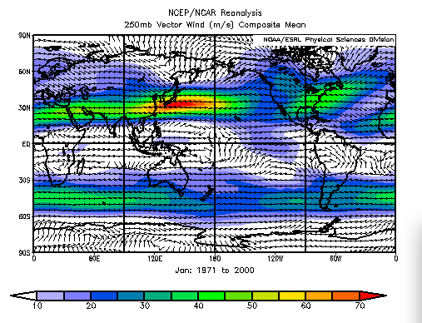
Why strongest off Japan and the eastern U.S?

Slide 48
That is where there are the largest tropospheric temperature gradients

Slide 49
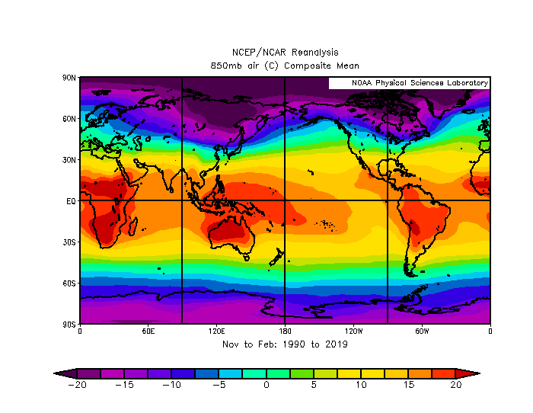

Slide 51
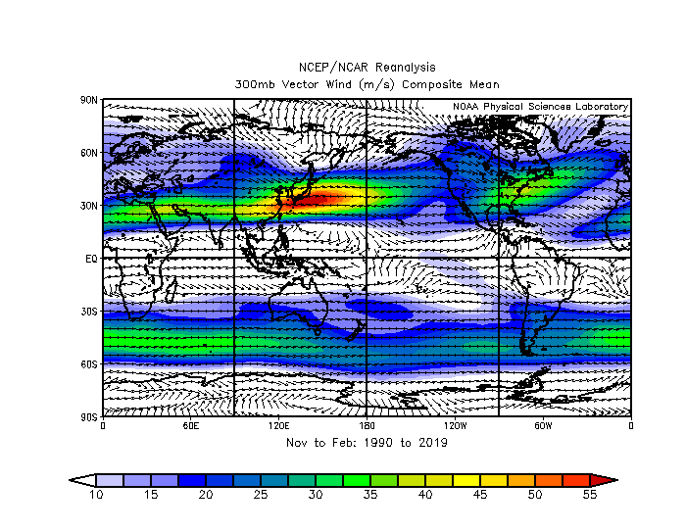

Slide 52
The thermal wind equation is a diagnostic equation. Something needs to supply the momentum for the jets
The polar or midlatitude jet is often called the “eddy driven jet” because the convergence of momentum by eddies (weather disturbances/storms) is important.
The subtropical jet is associated with Coriolis force acceleration of the upper branch of the subtropical jet.

Slide 53
Northward motion in upper tropical troposphere produces westerly acceleration

Slide 54
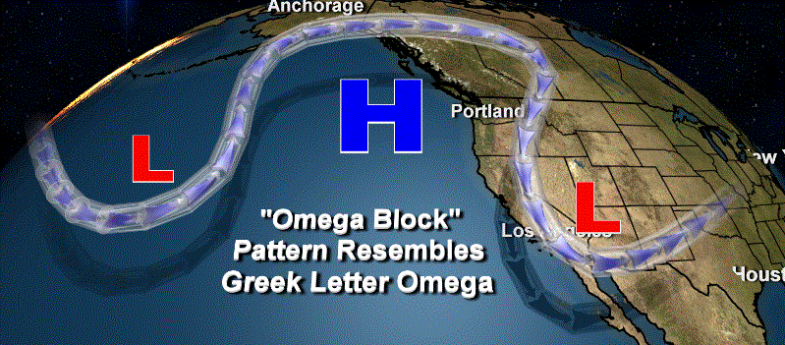
There are a variety of jet stream configurations that are well-known: blocks are one of them
Omega
Block

Slide 55
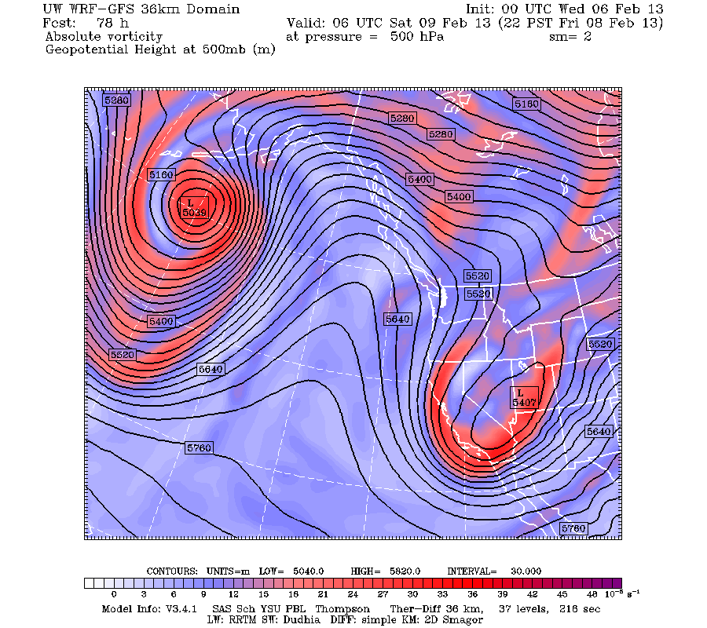

Slide 56
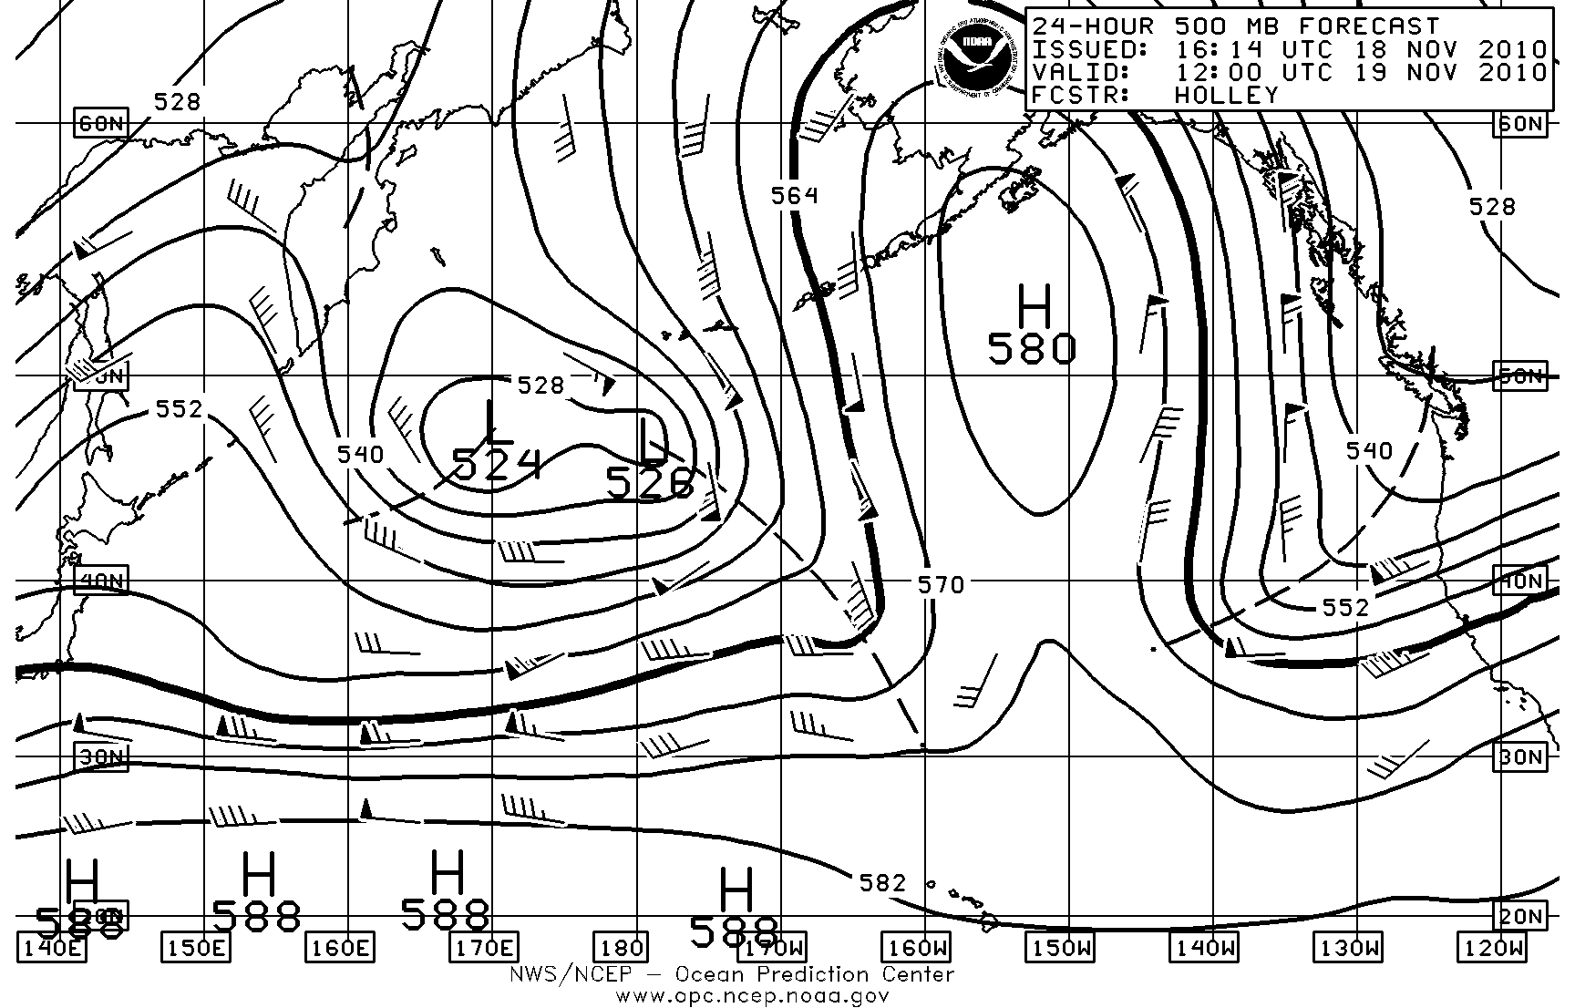

Slide 57
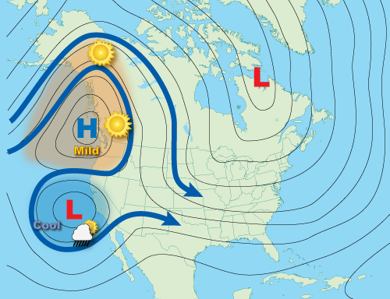
Rex
Block
Ridge with
A Trough
To the South

Slide 58
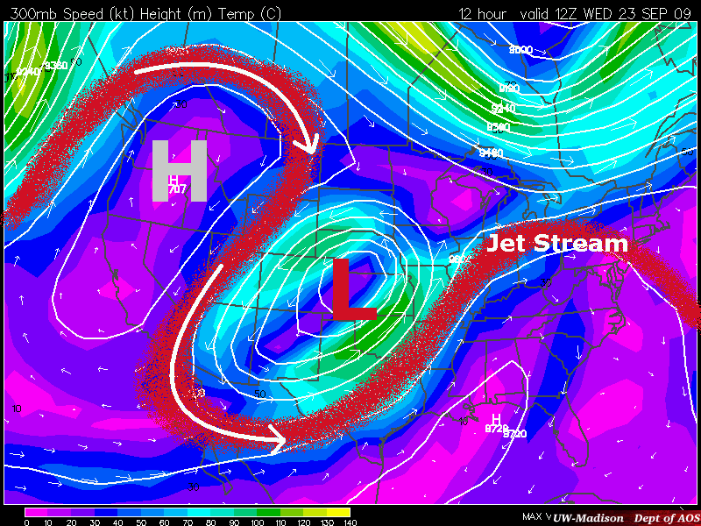

Slide 59
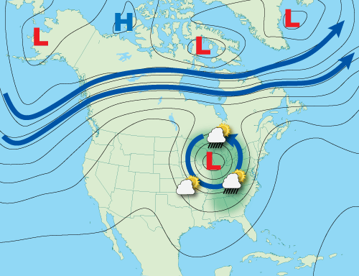
Cut Off Low: A Low/trough separates from the main jet stream

Slide 60
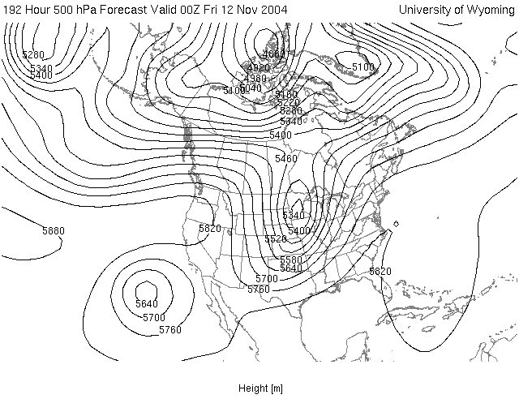

Slide 61
Horizontal maps and cross sections through the troposphere, jet, and stratosphere
Some major features to watch for include:
  Reversal of horizontal temperature gradient between troposphere and stratosphere
  Tropopause break at jet.
  Reversal of vertical wind shear above to below the jet

Slide 62
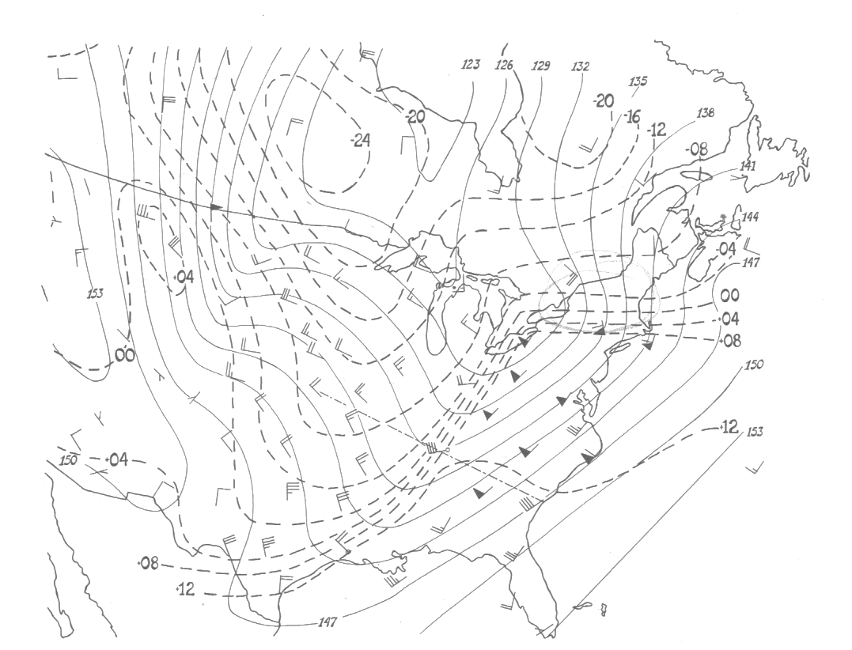
850 hPa

Slide 63
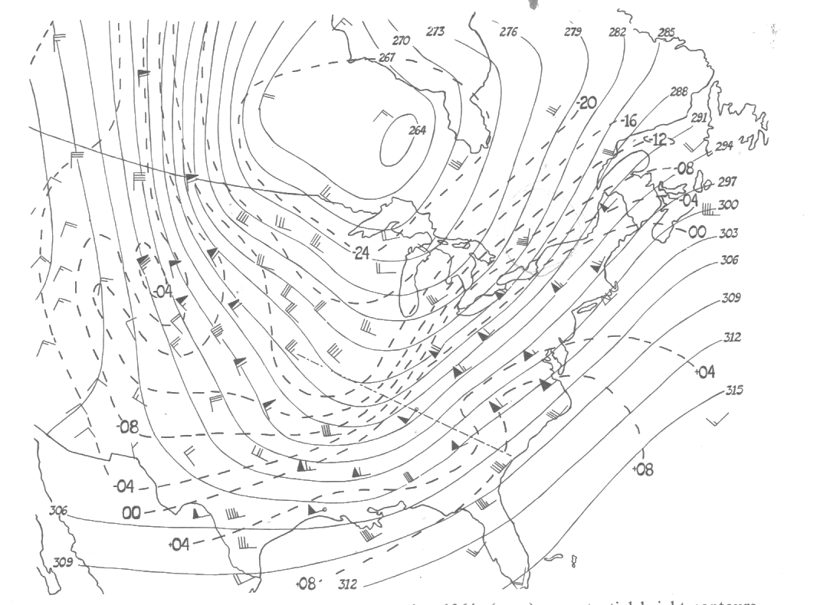
700 hPa

Slide 64
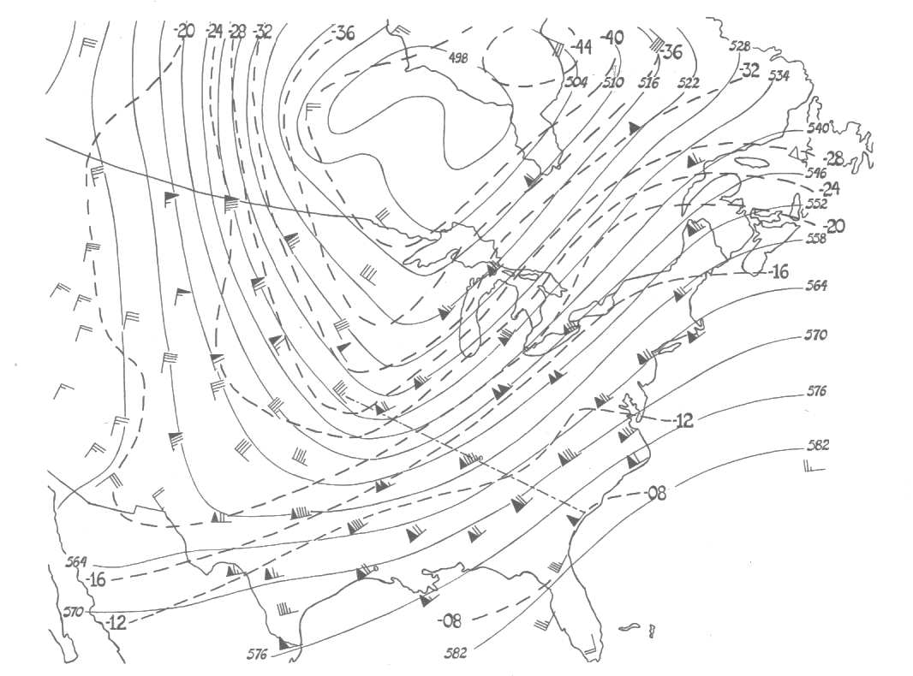
500 hPa

Slide 65
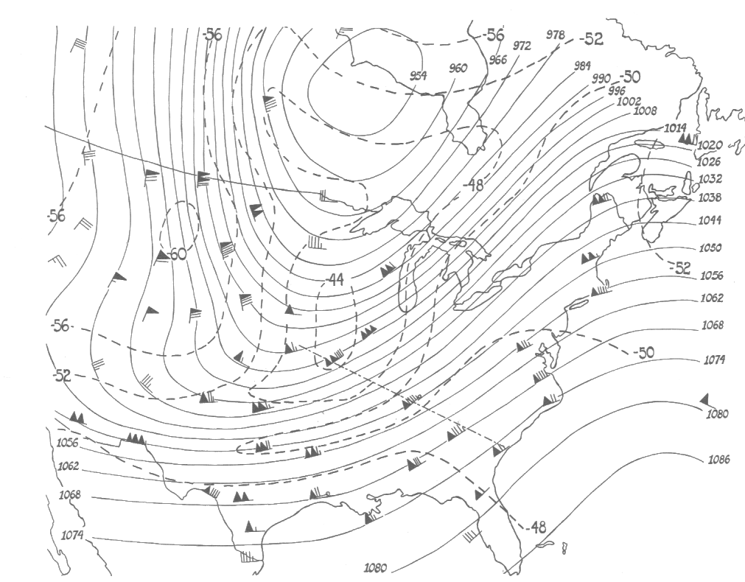
250 hPa

Slide 66

100 hPa
Note temperature reversal

Slide 67
TEMPERATURE

Slide 68

POTENTIAL TEMPERATURE

Slide 69

Potential Temperature (temperature air would have if compressed adiabatically to 1000 hPa)
More stable in stratosphere than troposphere.

Slide 70

Not all jets are near the tropopause
There are a variety of lower-tropospheric jets, many associated with terrain
Examples include: the Sierra Nevada jet (western slopes), the jet on eastern slopes of the Cascades, cold air damming jet on the eastern slopes of the Appalachians and many more.
Often called barrier jets

Slide 71


Sierra Nevada Barrier Jet

Slide 72
No Pressure Gradient Aloft
Warm
J
COOL
Sierra
Nevada
COOL
COOL
West
East
Low level cool air is banked on to the western slopes
The jet is southerly in this situation

Slide 73
No Pressure Gradient Aloft
Warm
COOL
J
Sierra
Nevada
L
H
COOL
COOL
West
East
The jet is southerly in this situation. High pressure near mountains, lower pressure over lowlands

Slide 74
L
H

Slide 75


$$\frac{∂T}{∂x} is −at level of J$$
Thus, by thermal wind
$\frac{∂Vg}{∂p} is+$ , $\frac{∂Vg }{∂Z}is −$
x
West
East
g

Slide 76

x
$$\frac{∂Vg }{∂Z}is −$$
This implies that southerly winds are decreasing with height above that level

Slide 77

Eastern Slopes of the Cascades and Appalachians Can Have Northerly Barrier Jets

Slide 78
No Pressure Gradient Aloft
Warm
H
NJ
L
COOL
Temperature gradient reversed
Now northerly winds weaken with
height in thermal wind
COOL
COOL
West
East

Slide 79
H
L

Slide 80

Example of Low-Level Jet Away from Terrain: the African Easterly Jet
Hot
Large low-level
Temperature
gradient
cooler
Centered around
10K ft ~ 700 hPa

Slide 81

Strongest during the summer

Slide 82


$$\frac{∂T}{∂y} is+at low levels$$
Thus, by thermal wind
$\frac{∂ug}{∂p} is+$ , $\frac{∂ug }{∂Z}is −$
Zonal winds more easterly with height
g

Slide 83
Jet strongest around 10K ft
High
Low

Slide 84


Slide 85

Vertical Circulations with Jet Streaks
Upward and downward motion associated with limited areas of strong winds aloft
Often mentioned in National Weather Service discussions
Can modulate threats of severe weather
Entrance
Exit

Slide 86


Slide 87

Four Quadrant Vertical Motion
With Jet Streaks
Severe weather often breaks out in the right entrance (front) and left exit (rear) quadrants where there is upward motion
Down
UP
Jet streak
UP
Down
Entrance
Exit

Slide 88
Why different vertical motions in the four quadrants of a jet streak?

Slide 89

These vertical circulations are the atmosphere’s attempt to maintain thermal wind equilibrium

Slide 90
cold
Exit
Region
Entrance
Region
warm

Slide 91
Why
In the entrance, converging flow is increasing the horizontal temperature gradient.
The secondary motions are trying to lessen the temperature gradient increases and to increase the vertical shear

Slide 92
Why
In the exit, the gradient is weakening,
The secondary motions are trying to increase the temperature gradient and to decrease the vertical shear

Slide 93

Really only true for straight jet streaks, many jets are in curved flow that greatly alters the story

Slide 94

Useful but not perfect
Down
UP
Up
Down

Slide 95

The Midlatitude Jet Stream is Often Associated with Upper Level Fronts: More Later!

