Slide 1
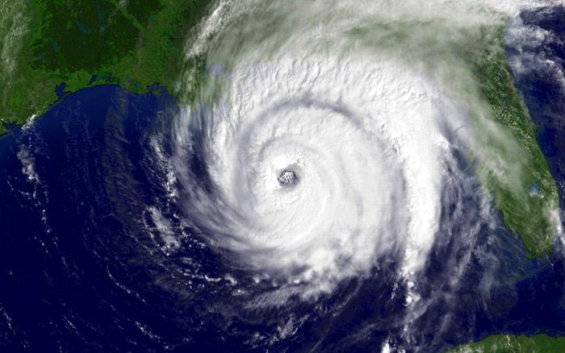
Hurricanes: ATMS 101Y2024

Slide 2
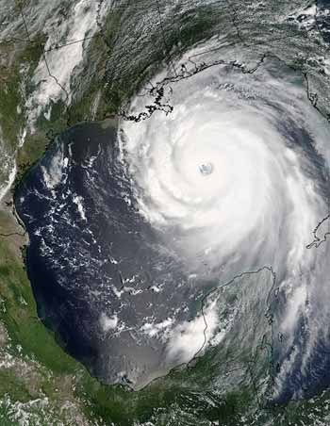
Hurricane Definition
A tropical cyclone with sustained one-minute winds of at least 74 mph (64 knots) at an elevation of 10 meters.
Derived from the Spanish word "huracan" , which was most likely inspired by Hunraken, the name for the ancient Mayan storm god or Hurakan, the Quiche god of thunder

Slide 3
Hurricane Facts
Strongest U.S. hurricane on record (Camille) had winds exceeding 200 mph.
Typically 500-1000 km in diameter (smaller than midlatitude cyclones).
Can be associated with heavy rain (10-20 inches or more!), tornadoes, and storm surges on the coast.
Also called typhoons (western Pacific)

Slide 4
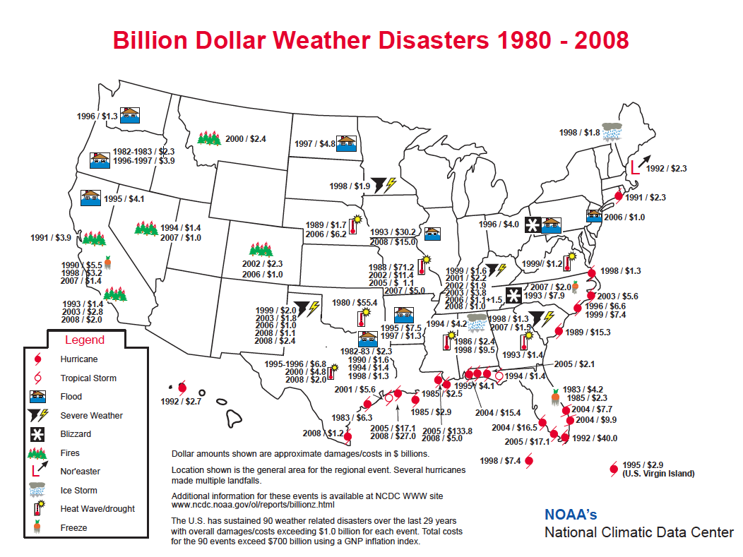
SE US

Slide 5
Katrina
1833 deaths
$125 billion in damage
Most destructive hurricane in U.S. history

Slide 6
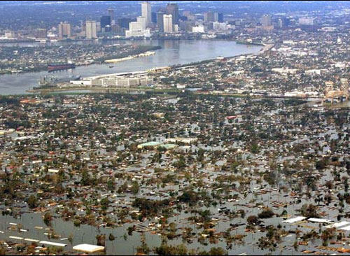
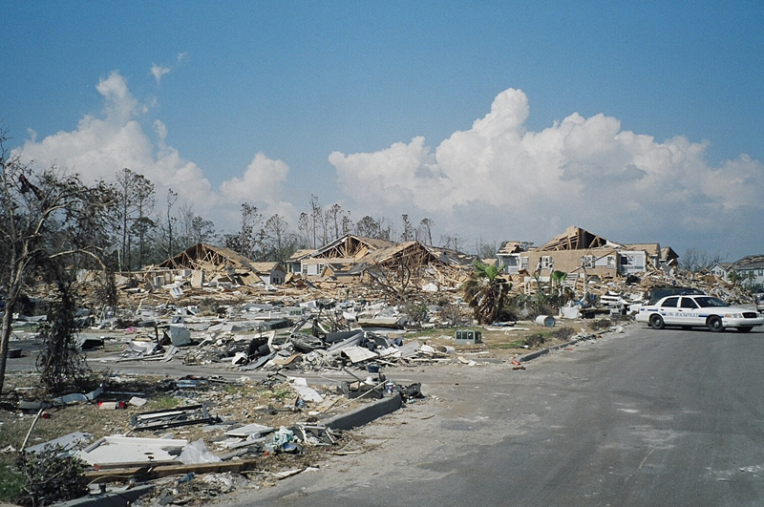
New Orleans
Flooded

Slide 7
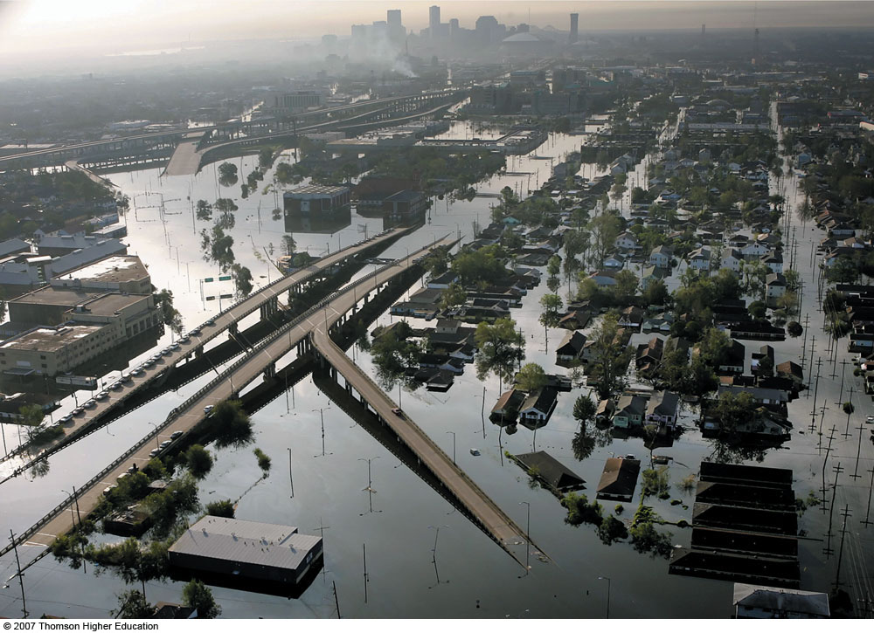
Fig. 11-24, p. 320
Notes:
Figure 11.24: Flood waters inundate New Orleans, Louisiana, during August, 2005, after the winds and storm surge from Hurricane Katrina caused several levee breaks.

Slide 8
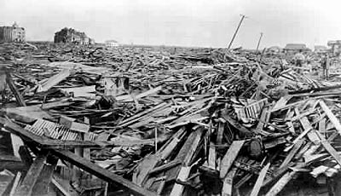
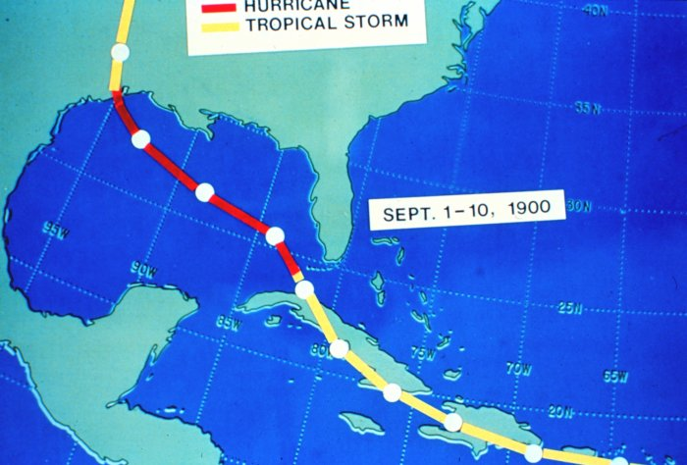
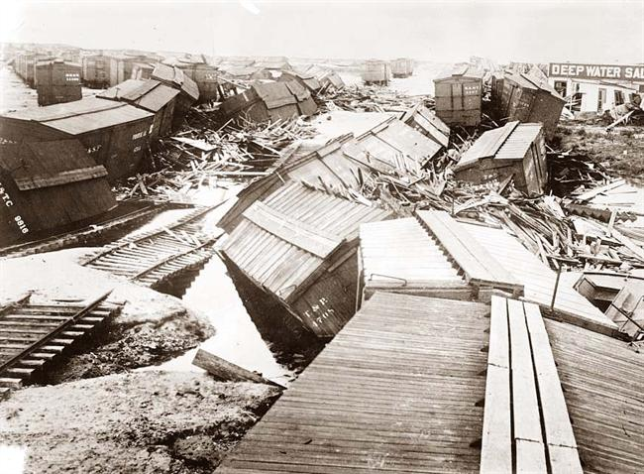
1900 Galveston, TX Hurricane: The Greatest Loss of Life of Any U.S. Meteorological Event (8000 died)

Slide 9
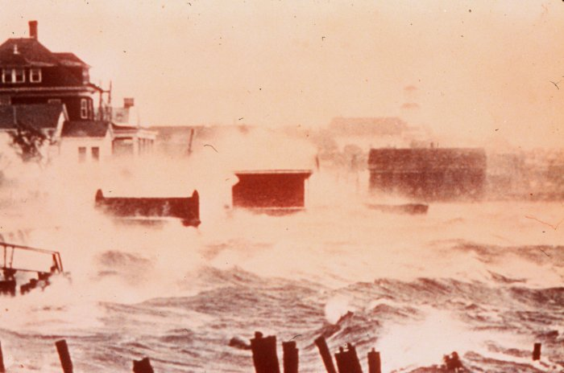

Slide 10
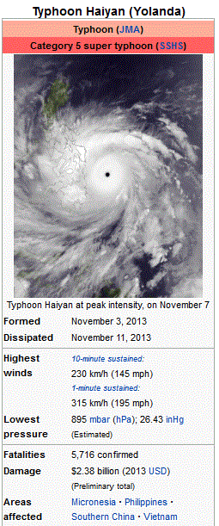
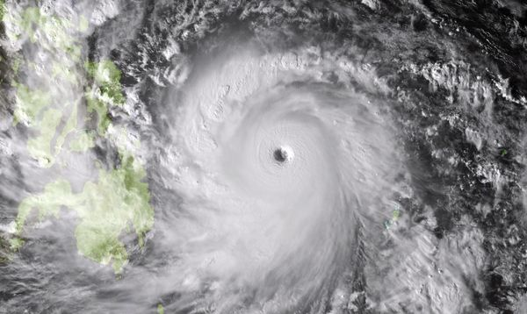
SuperTyphoon Haiyan

Slide 11
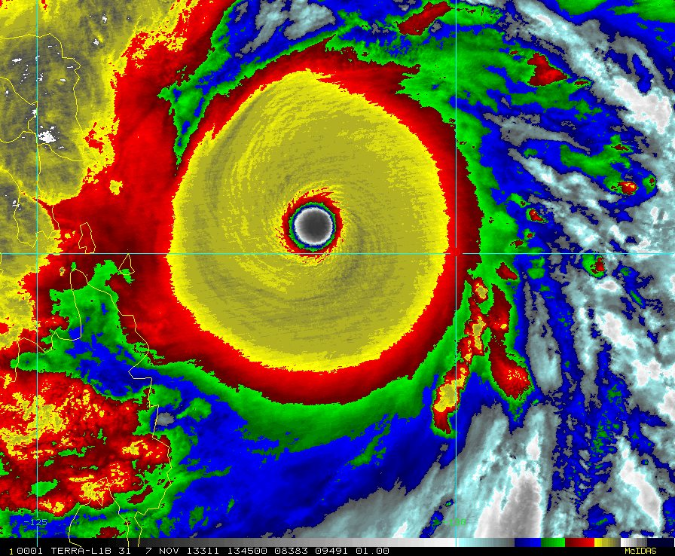

Slide 12
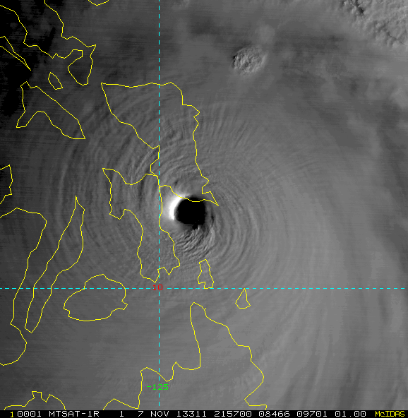

Slide 13
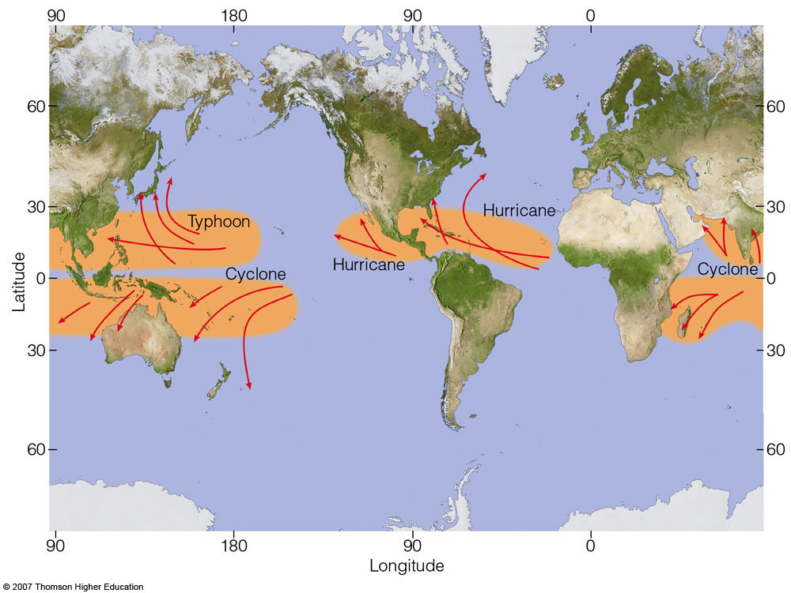
Tropics but not on the equator!
Fig. 11-10, p. 307
Notes:
Figure 11.10: Regions where tropical storms form (red shading), the names given to storms, and the typical paths they take (red arrows).

Slide 14
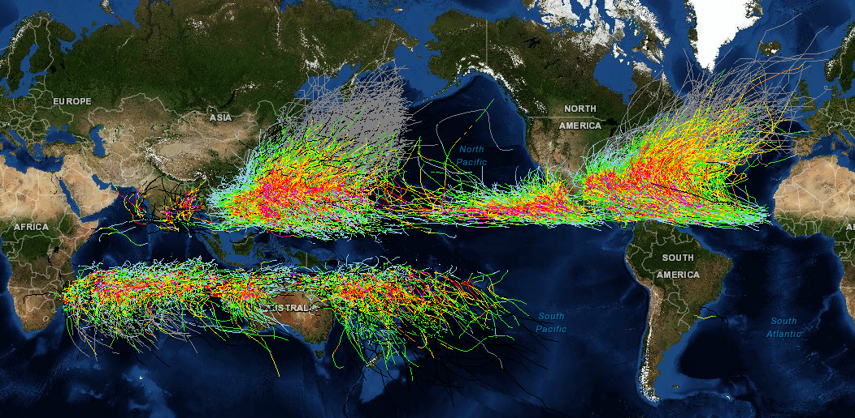
Hurricane Dislike the Equator!

Slide 15
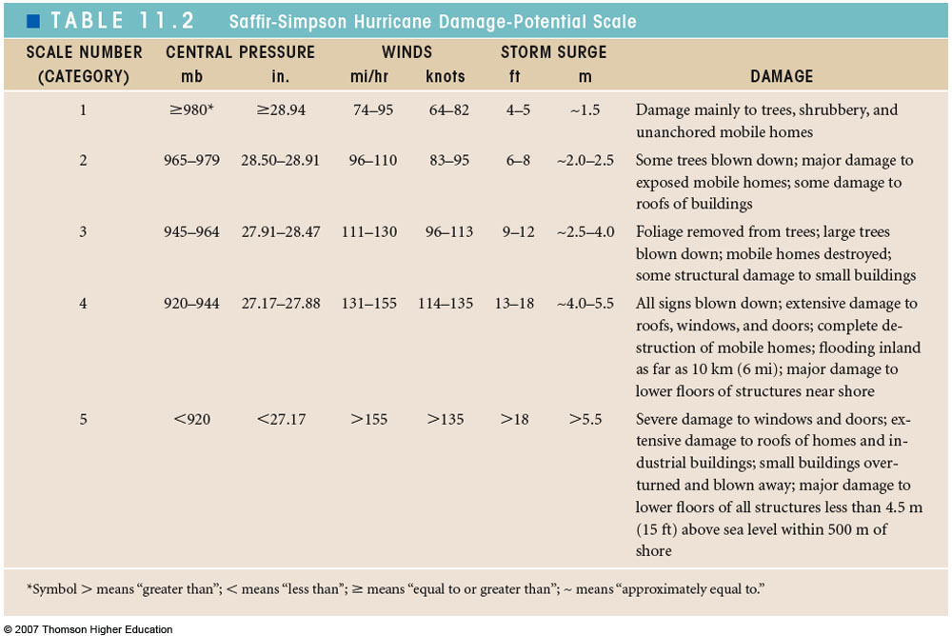
Saffir-Simpson Hurricane Category
Table 11-2, p. 313

Slide 16
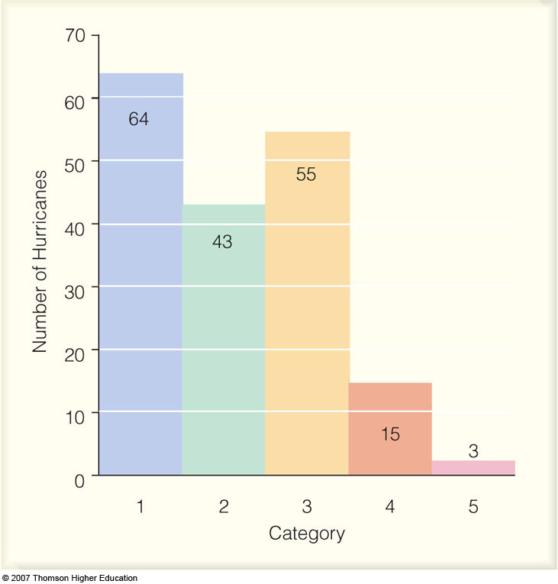
Category 4 and 5 Hurricanes are relatively rare
Fig. 11-16, p. 313
Notes:
Figure 11.16: The number of hurricanes (by each category) that made landfall along the coastline of the United States from 1900 through 2005. All of the hurricanes struck the Gulf or Atlantic coasts. Categories 3, 4, and 5 are considered major hurricanes.

Slide 17
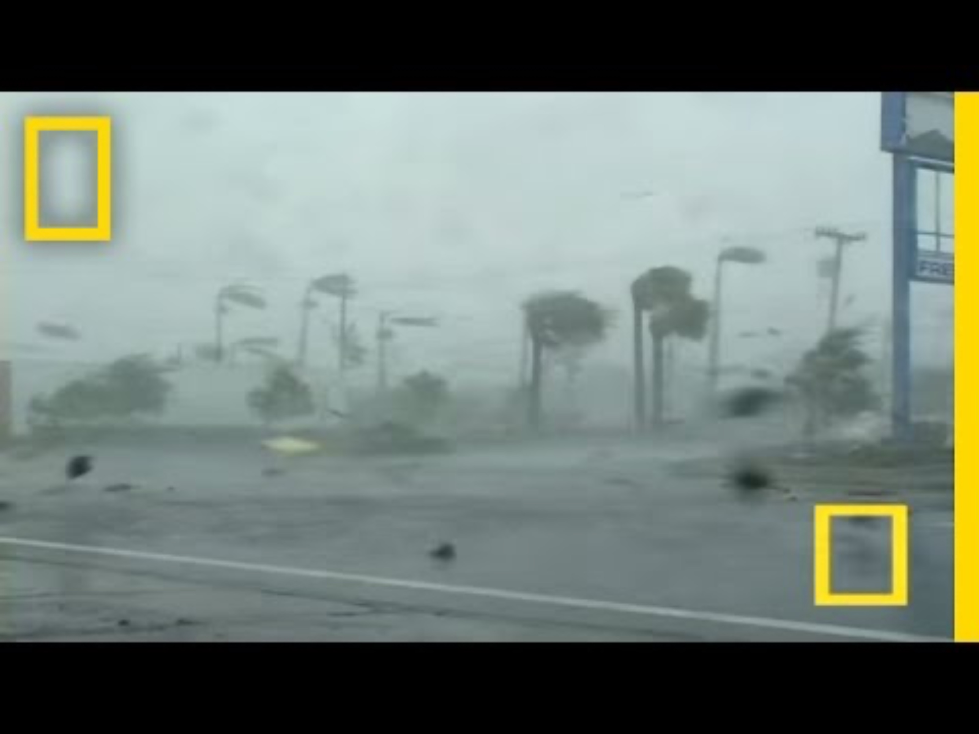

Slide 18
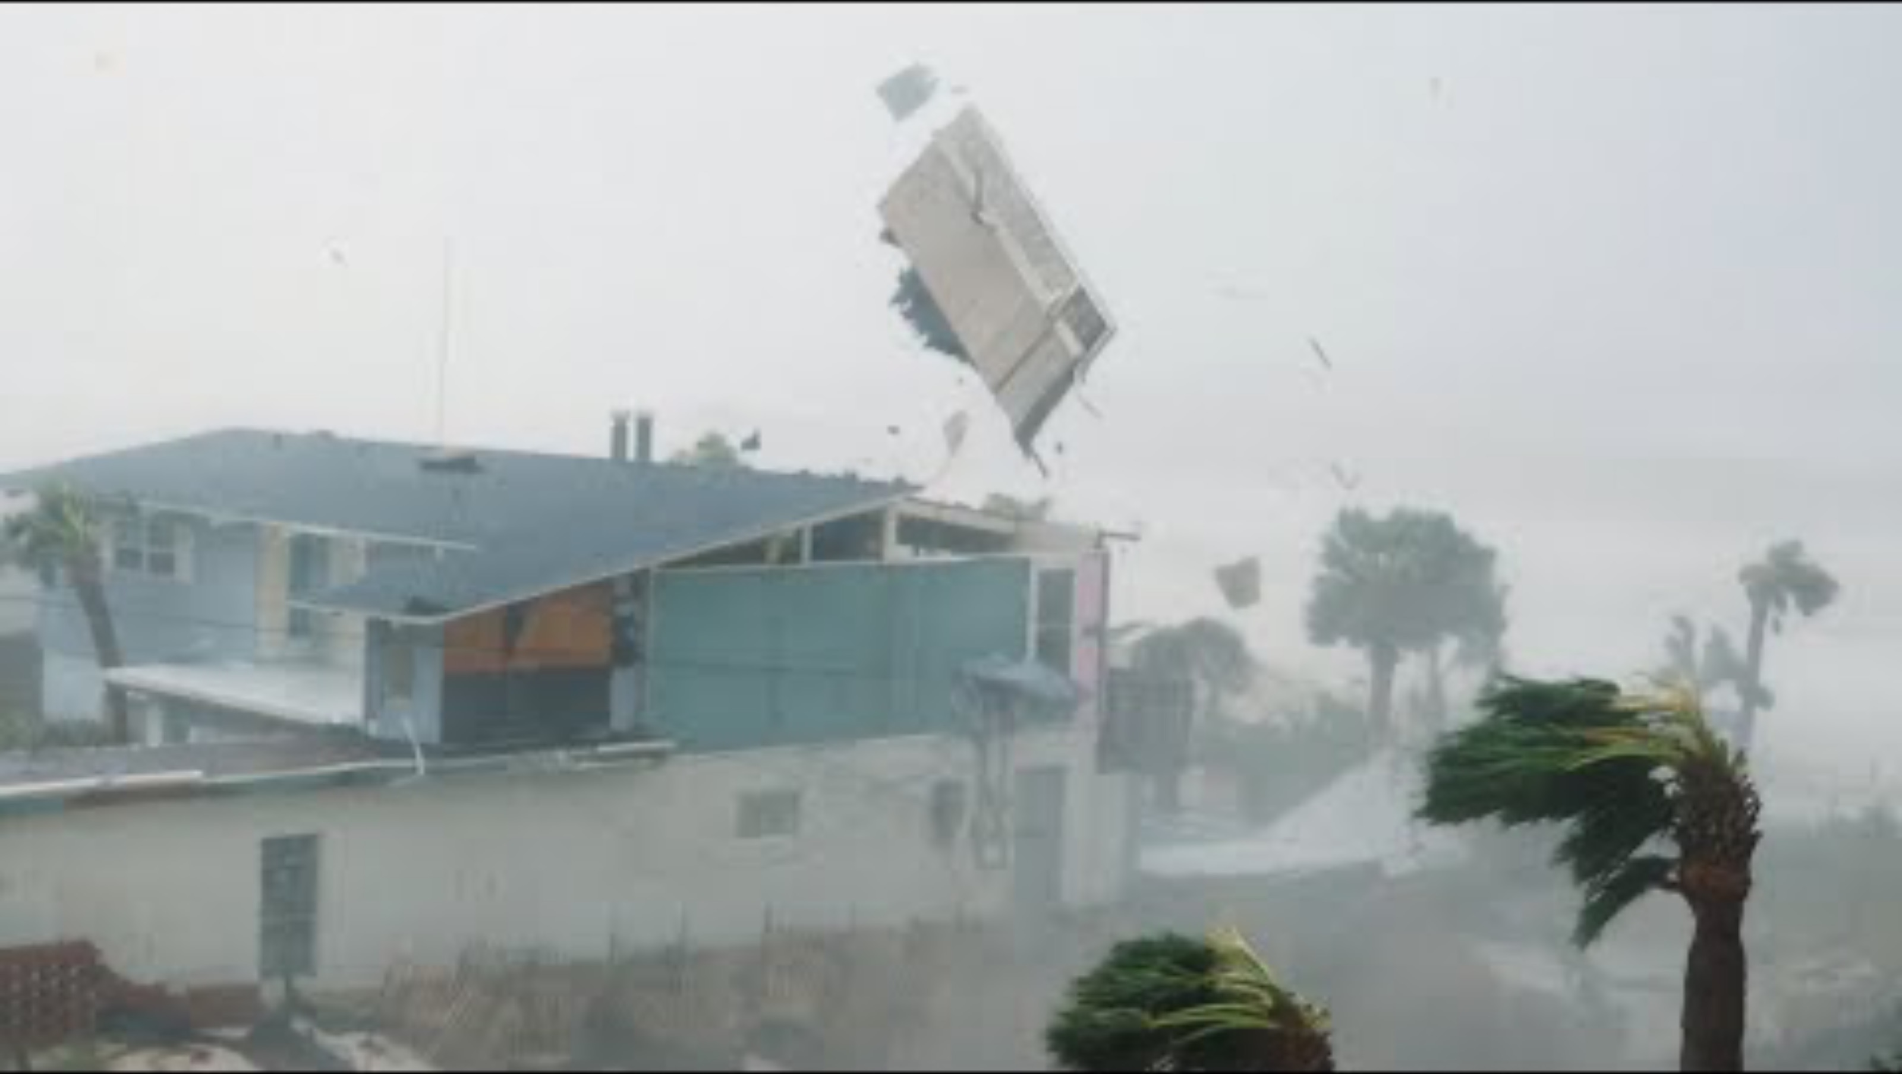

Slide 19


Slide 20
Experience a hurricane
http://www.youtube.com/watch?v=H9VpwmtnOZc
https://www.youtube.com/watch?v=wSXvcveNSTQ
https://www.youtube.com/watch?v=C6zGEMMMjws

Slide 21
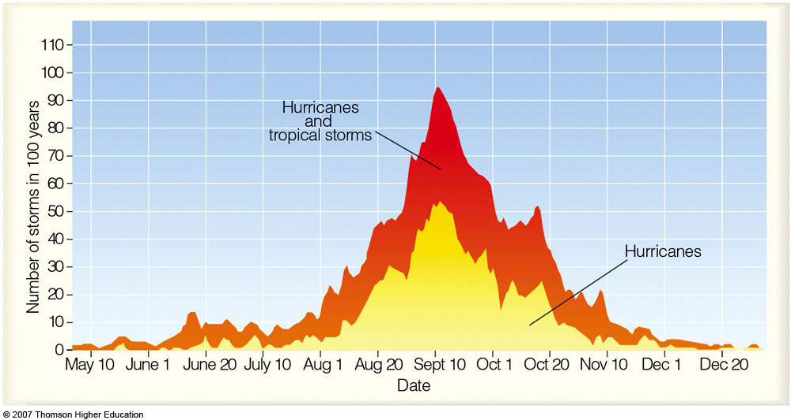
When is the Hurricane Season?
Hurricane
Season
Atlantic Basin Hurricanes and Tropical Storms
Notes:
Figure 11.7: The total number of hurricanes and tropical storms (red shade) and hurricanes only (yellow shade) that have formed during the past 100 years in the Atlantic Basin—the Atlantic Ocean, the Caribbean Sea, and the Gulf of Mexico.

Slide 22
Hurricane Structure

Slide 23
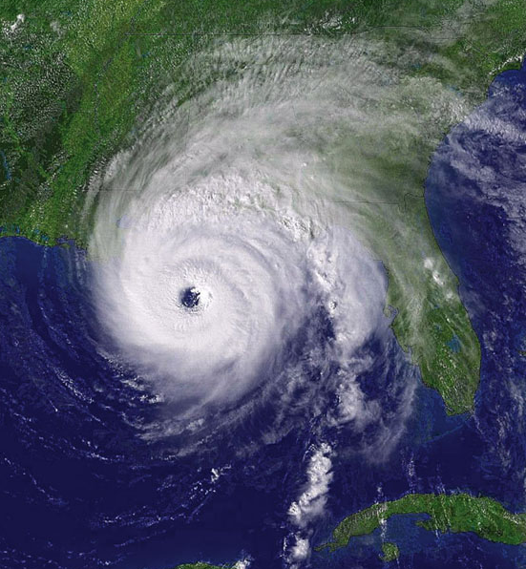
Major Features:
Eye (nearly clear)
Eye Wall Rainband
Spiral Rainbands
Notes:
Figure 11.20: Visible satellite image of Hurricane Ivan as it makes landfall near Gulf Shores, Alabama, on September 15, 2004. Ivan is a major hurricane with winds of 105 knots (121 mi/hr) and a surface air pressure of 945 mb (27.91 in).

Slide 24
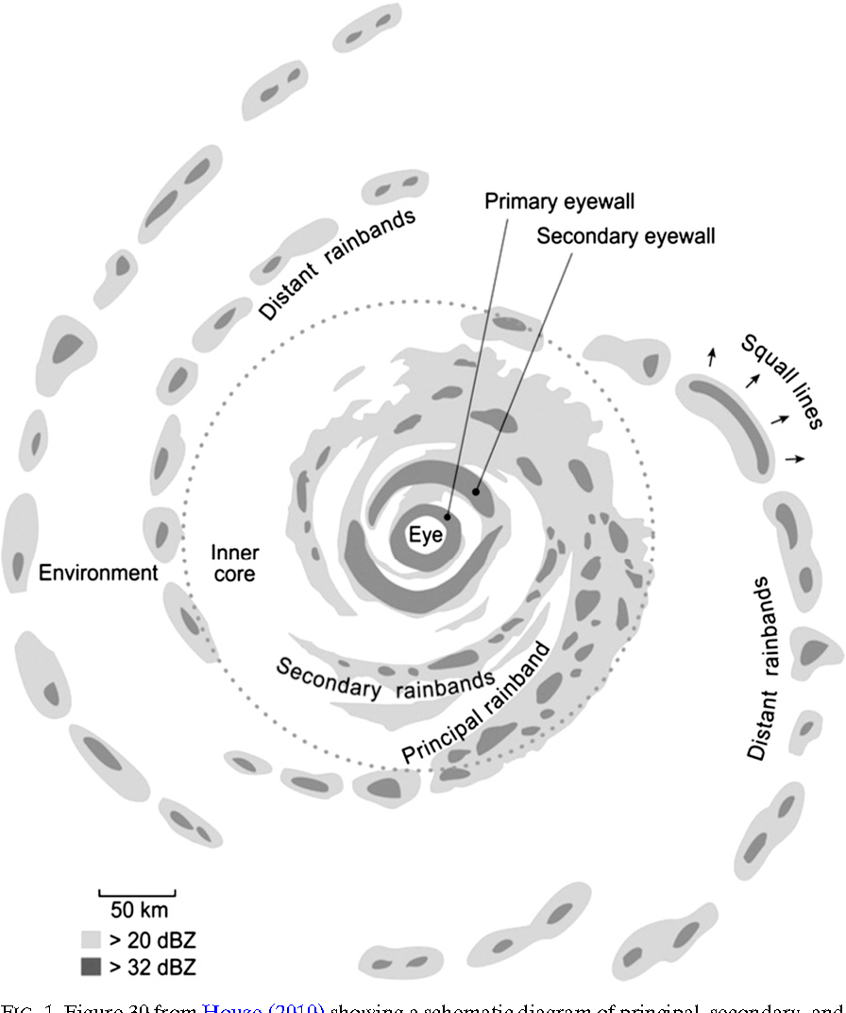

Slide 25
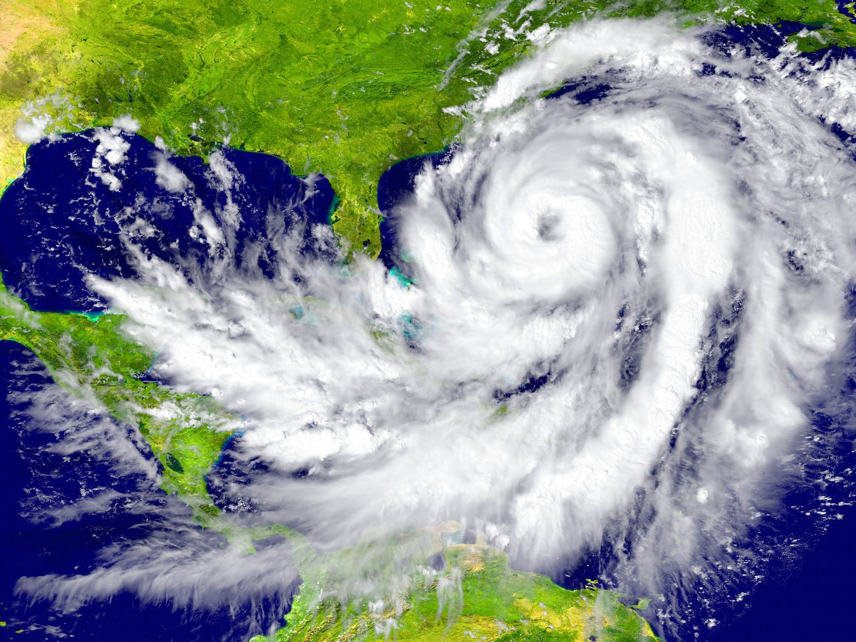

Slide 26
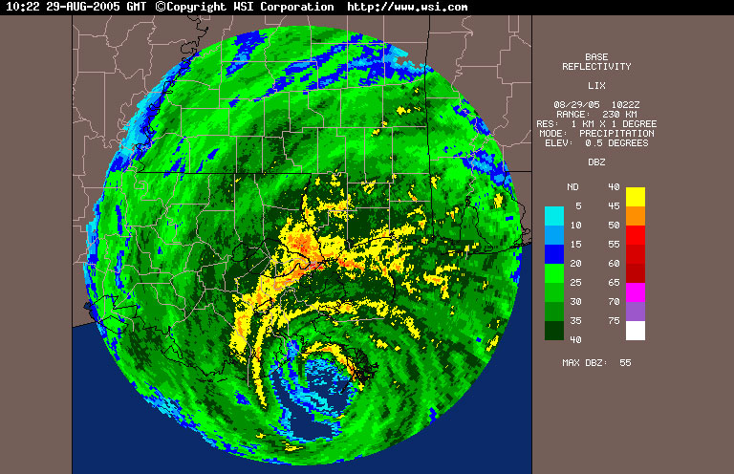

Slide 27
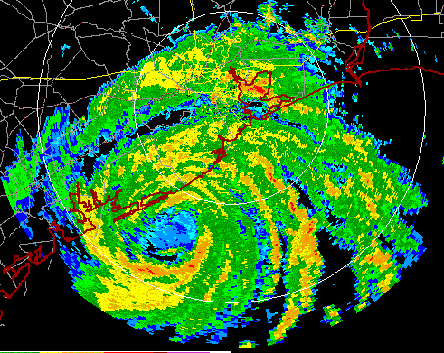

Slide 28
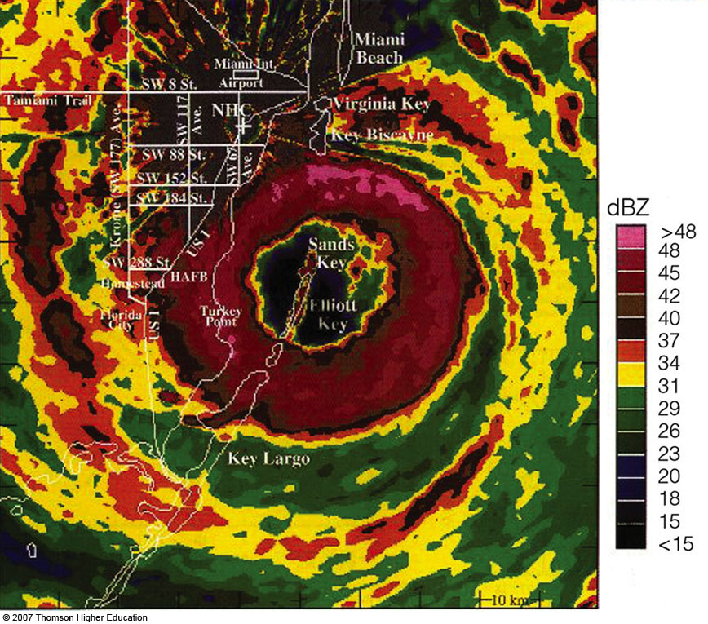
Fig. 11-18, p. 316
Notes:
Figure 11.18: Color radar image of Hurricane Andrew as it moves on shore over south Florida on the morning of August 24, 1992. The National Hurricane Center (NHC) is located about 30 km (19 mi) from the center of the eye.

Slide 29
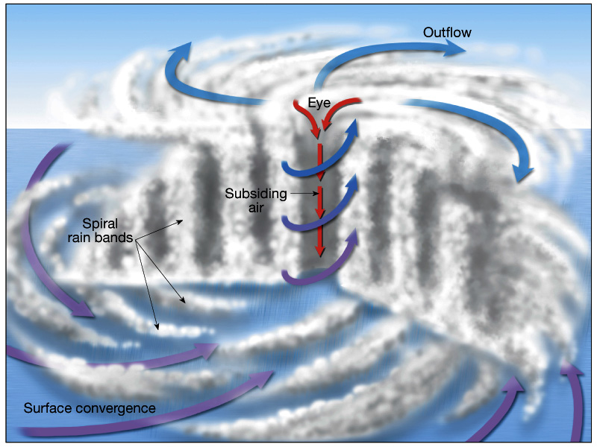

Slide 30
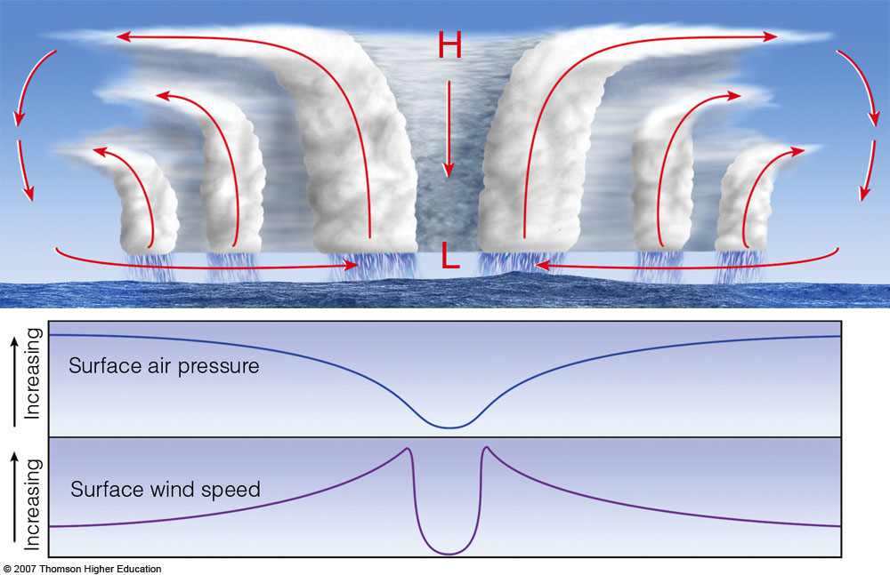
Fig. 11-8, p. 305
Notes:
Figure 11.8: The top diagram shows an intensifying tropical cyclone. As latent heat is released inside the clouds, the warming of the air aloft creates an area of high pressure, which induces air to move outward, away from the high. The warming of the air lowers the air density, which in turn lowers the surface air pressure. As surface winds rush in toward the surface low, they extract sensible heat, latent heat, and moisture from the warm ocean. As the warm, moist air flows in toward the center of the storm, it is swept upward into the clouds of the eyewall. As warming continues, surface pressure lowers even more, the storm intensifies, and the winds blow even faster. This situation increases the transfer of heat and moisture from the ocean surface. The middle diagram illustrates how the air pressure drops rapidly as you approach the eye of the storm. The lower diagram shows how surface winds normally reach maximum strength in the region of the eyewall.

Slide 31

Eye slopes outward

Slide 32
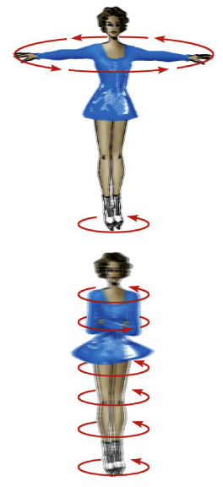
In much the same way an ice skater spins more quickly as her arms are tucked close to her body, air in a hurricane also moves faster near the eyewall than near the outer edge.

Slide 33
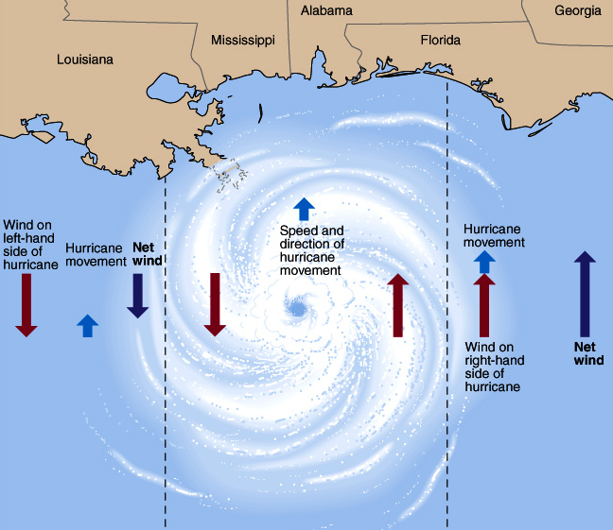
Destruction most intense on right front side of cyclone (wind + storm speed greatest) X marks the spot!
X
Notes:
33

Slide 34
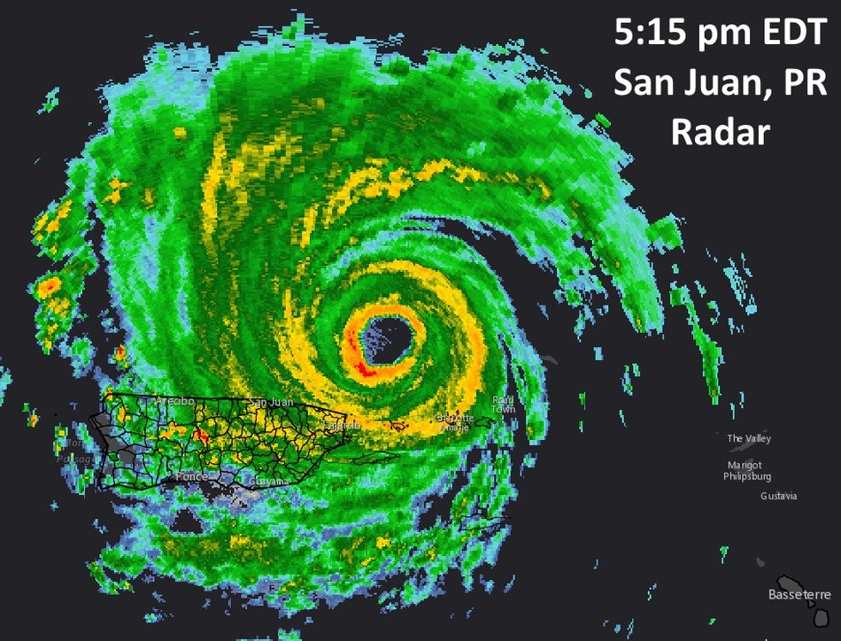
Eye wall replacement cycle
A shrinking eyewall is generally associated with storm intensification.
Some intense hurricanes develop double eye walls.
Eye wall replacement leads to weakening of the hurricane winds, followed by strengthening.

Slide 35
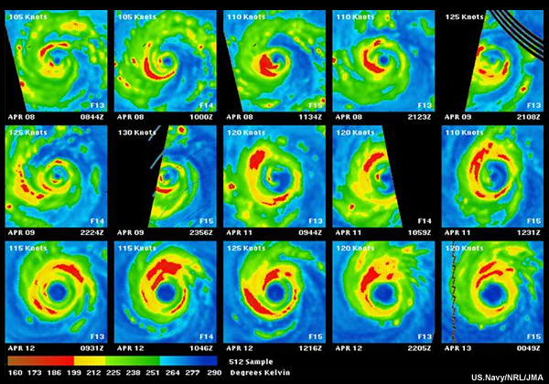

Slide 36
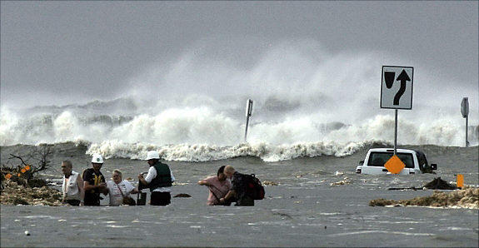
The Greatest Damage and Loss of Life from Hurricanes is Near the Coast Associated with Storm Surges

Slide 37
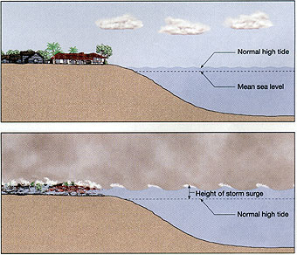

Slide 38
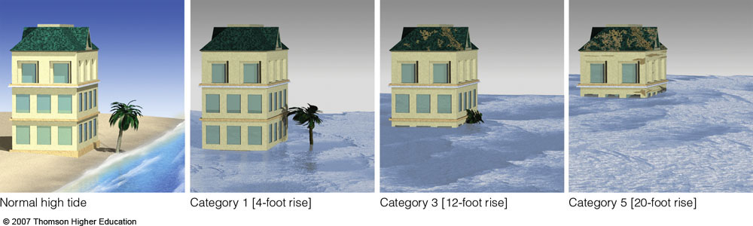
Fig. 11-15, p. 312
Notes:
Figure 11.15: The changing of the ocean level as different category hurricanes make landfall along the coast. Notice that the water typically rises about 4 feet with a Category 1 hurricane, but may rise to 22 feet (or more) with a Category 5 storm.

Slide 39
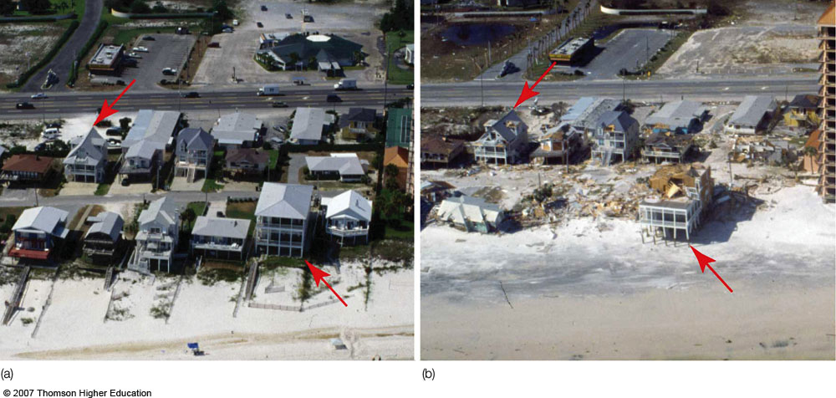
Before and after Hurricane Iva, Sept 2004, coastal Alabama
Notes:
Figure 11.21: Beach homes along the Gulf coast at Orange Beach, Alabama (a) before, and (b) after Hurricane Ivan made landfall during September, 2004. (Red arrows are for reference.)

Slide 40
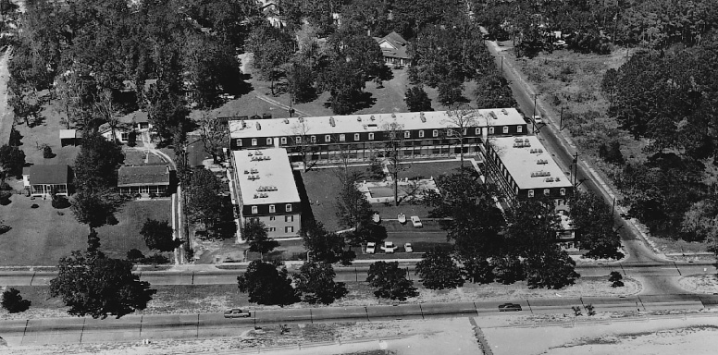
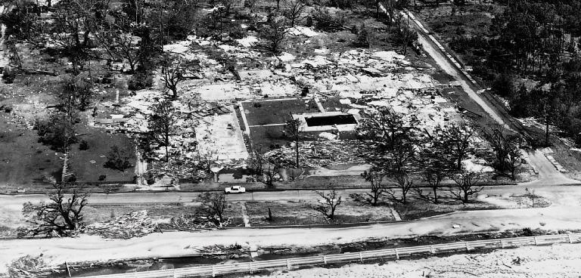
Before a hurricane…
After a hurricane.

Slide 41
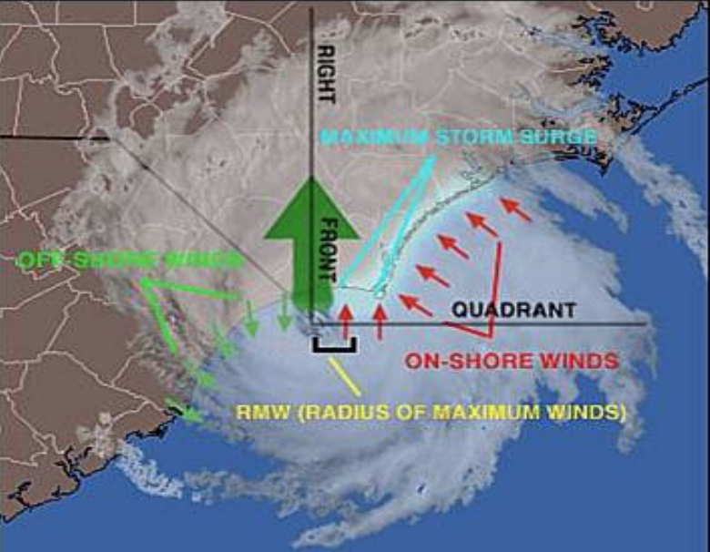
Storm Surge
Produced by the storm pushing water up on the coast AND
By the low pressure of the hurricane.

Slide 42
Storm Surge Video
http://www.youtube.com/watch?v=nV6Qtrt2CNQ&feature=fvsr
http://www.youtube.com/watch?v=l9vDSWugz08

Slide 43
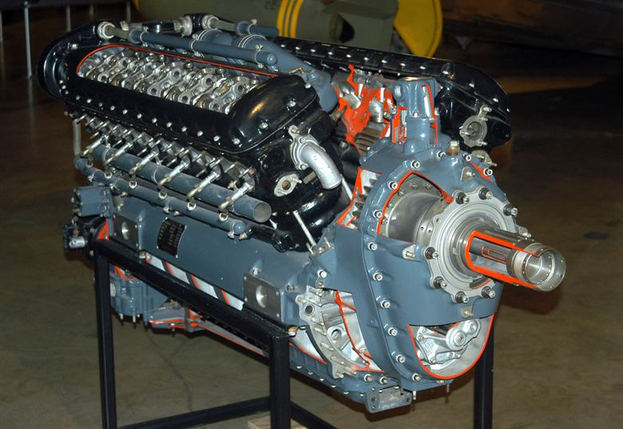
What is the energy source of Hurricanes?

Slide 44
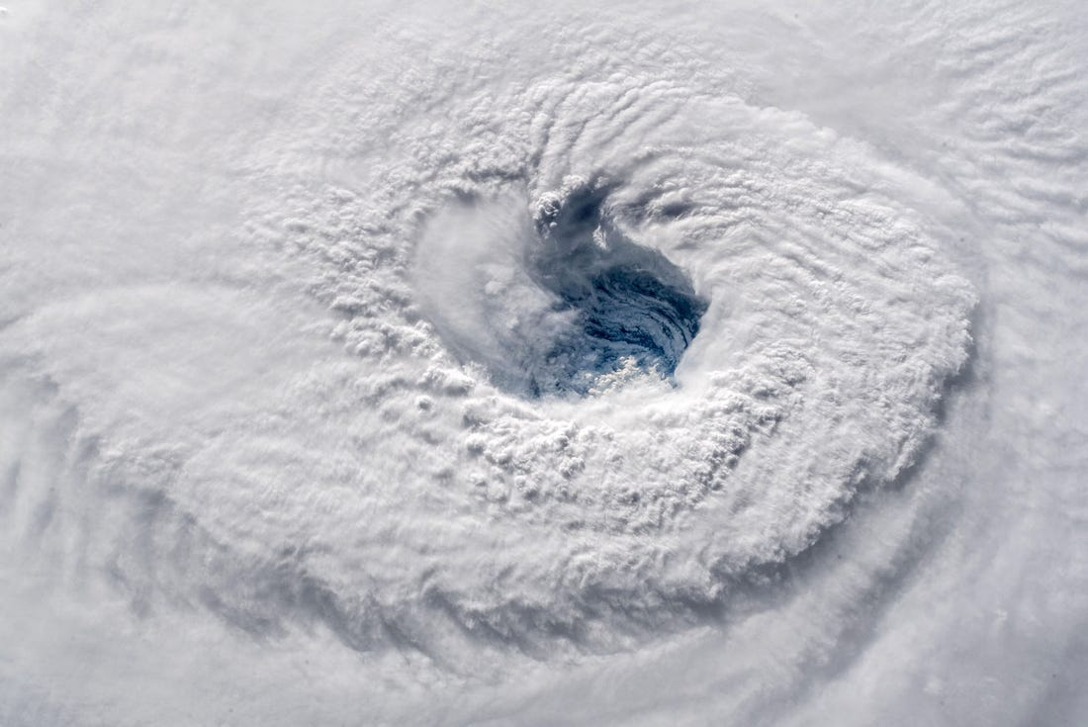
Hurricane Energy Source
Hurricanes get their energy from the warm, waters of the tropics.
Provides heat and moisture, which releases latent heat when condenses in hurricane clouds.

Slide 45
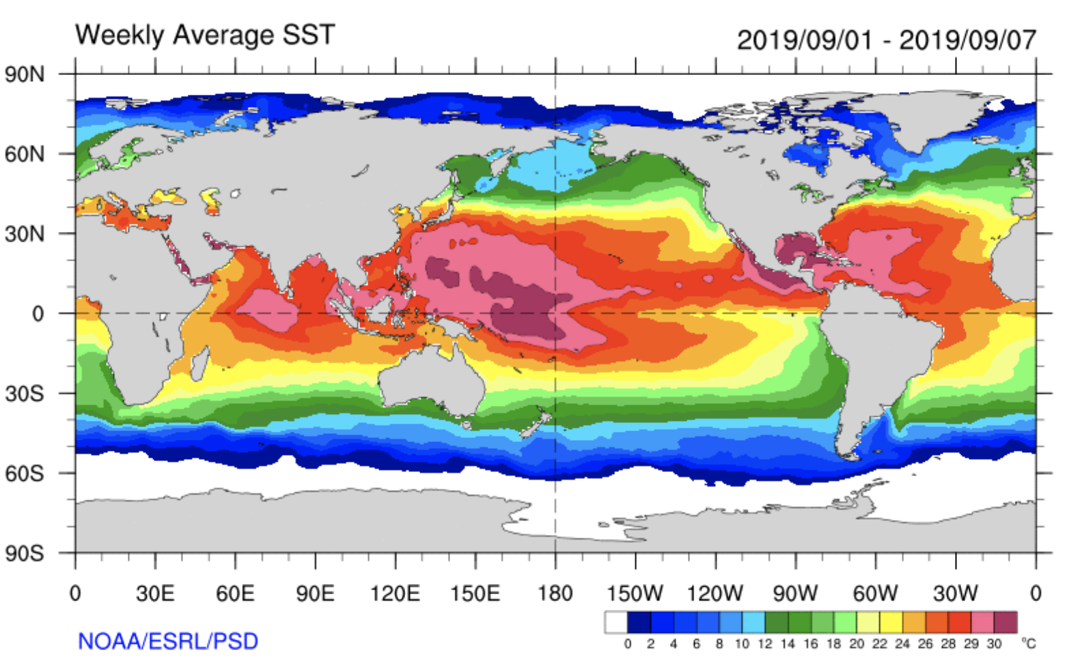
Necessary Conditions
Require the water surface to be at least 80F (27C)
Also need moist air through depth
Weak wind shear.
Starts with a weak tropical disturbance

Slide 47
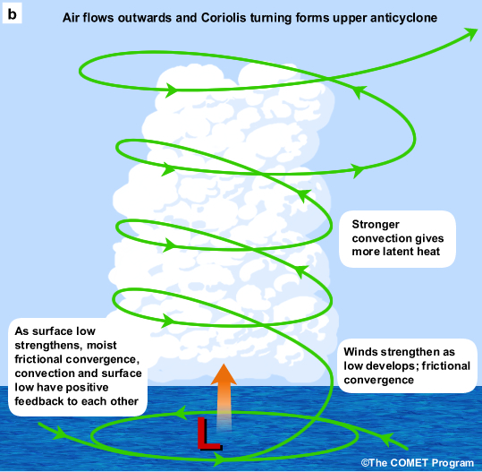
Revving Up a Hurricanes: Two Positive Feedbacks Involving Warm Water
Convergence-Convection (CISK—Conditional Instability of the Second Kind)
Surface flux-Convection (WISHE—Wind Induced Surface Heat Exchange)

Slide 48
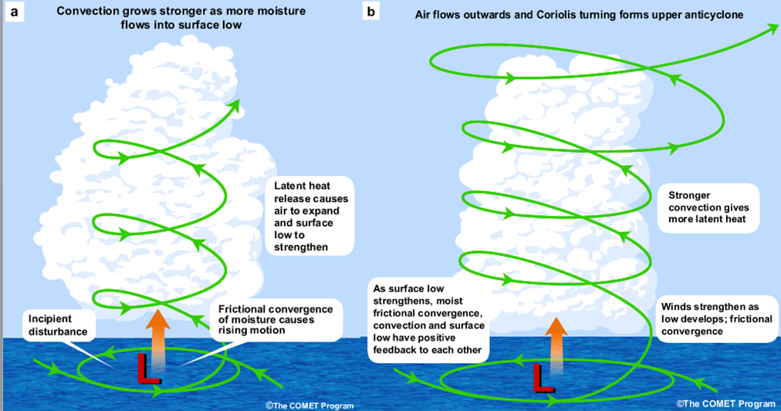
CISK
A weak disturbance starts it off. Air converges into low, producing upward motion and condensation, heating and pressure to fall. Lower pressure pulls in more moisture.

Slide 49
WISHE
A weak disturbance starts it off. Air converges into low, producing condensation, heating and pressure to fall. Winds pick up, which which causes more wave action and ejection of water into the atmosphere. More condensation, heating, pressure falls

Slide 50

Spray coming off big ocean waves provides water vapor
Stronger winds mean more waves and spray!

Slide 51
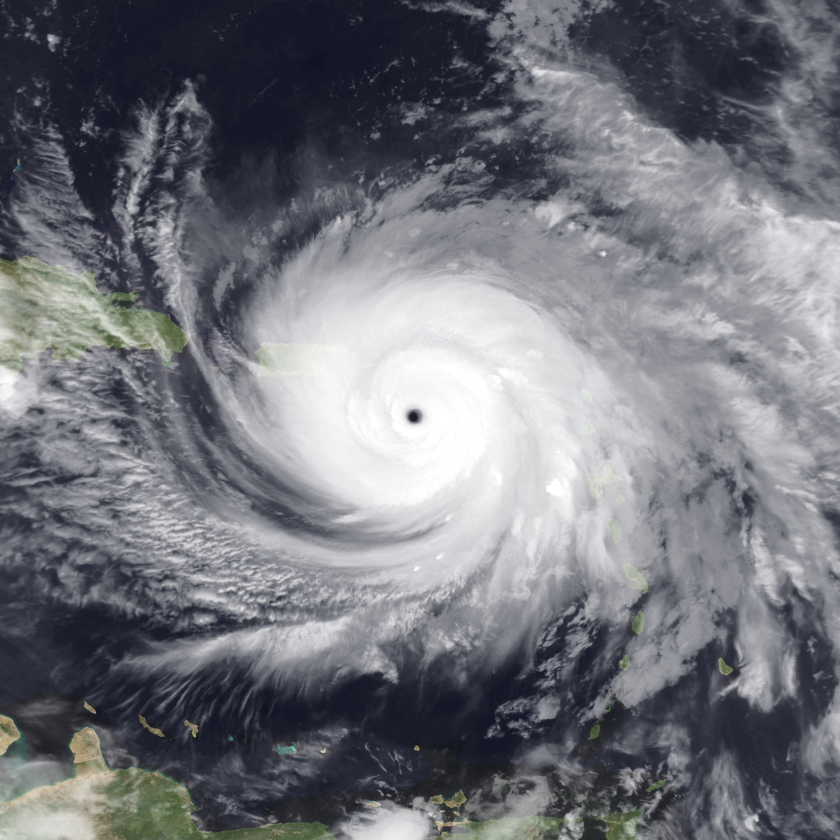
Hurricane Origins

Slide 52
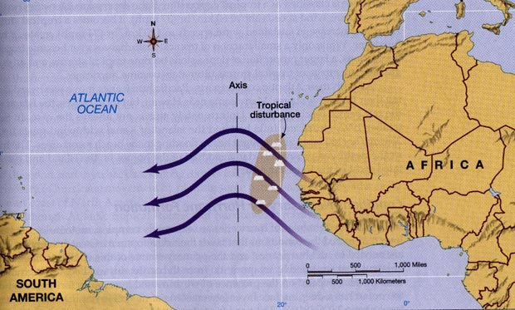
Many Atlantic Hurricanes Begin as Tropical Waves Over Africa
Also known as easterly waves

Slide 53
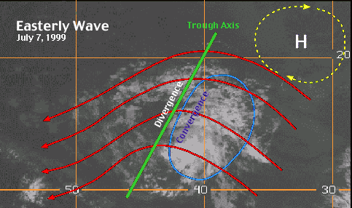

Slide 54
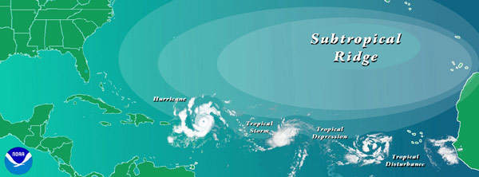
Some easterly waves transition into tropical storms and hurricanes
Need environments with warm ocean water
Lack of strong wind shear (change) in the vertical (which tears storms apart)
Moist atmosphere above

Slide 55
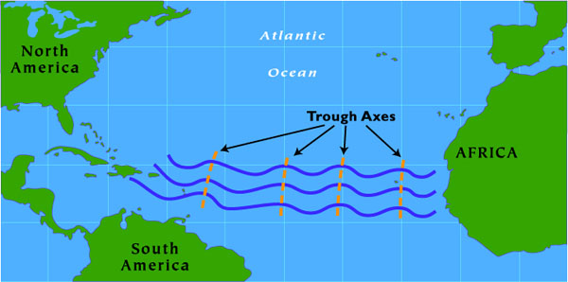


Slide 56


Slide 57
Hurricane Prediction: A Mixed Report
During the past thirty years there has been a substantial improvement in hurricane track forecasts as computer models improved and more data became available to describe the hurricane environment.
Over the same period only minimal improvement in hurricane intensity forecasts.

Slide 58


Slide 59


Slide 60

Intensity improvements have been small

Slide 61

Katrina
48-h Before: Virtually a Perfect Forecast of Track

Slide 62

Hurricane Irma 2017 Tour de Force
Actual path

Slide 63


Slide 64
Why track forecasts are so good?
Don’t need to predict the internal details of storm well.
Storms follow the large-scale flow, which today is relatively well forecast.

Slide 65
Hurricane Predictions Have Been Enhanced by In-situ Aircraft Observations in and Around Hurricanes

Slide 66


NOAA P3
“Hurricane Hunter”
Aircraft

Slide 67



Slide 68

Gulfstream IV-SP (G-IV) is a high altitude, high speed, twin turbofan jet aircraft: can release dropsondes into storm

Slide 69


New Technology: Drones

Slide 70

Saildrone
https://www.youtube.com/watch?v=TzgdSSb0T98

Slide 71


Substantial Promise in Numerical Weather Prediction
The use of higher resolution prediction and better data around and in hurricanes should result in better intensity predictions.
15-km grid spacing
1.67 km grid spacing

Slide 72

Why doesn’t the West Coast get hurricanes?
Cold water along the coast!

Slide 73

Global Warming and Hurricanes: What Should We Expect?

Slide 74
Hurricane Projections under GW
Sea level rise: should be causing higher coastal inundation levels for tropical.
Tropical cyclone rainfall rates will likely increase: Modeling studies on average project an increase on the order of 10-15% for rainfall rates averaged within about 100 km of the storm for 2 C global warming
Tropical cyclone intensities globally will likely increase on average (by 1 to 10% according to model projections for a 2 degree Celsius global warming).
The global proportion of tropical cyclones that reach very intense (Category 4 and 5) levels will likely increase due to anthropogenic warming over the 21st century.

Slide 75

U.S Hurricane Headquarters: National Hurricane Center

