Slide 1
Gas Laws Atmospheric Sciences 101 Autumn 2024
The atmosphere is made up of gases so we need to know the basic laws of how gases behave

Slide 2
Gas laws describe the relationships between the four key parameters describing the behavior of gases
Temperature
Pressure
Density
Volume

Slide 3
Key Gas Parameters
Temperature (T): a measure of the average kinetic energy (KE) of atoms and molecules. (°C, °F). Expressed in °K for calculations.
Pressure (P): Force per unit area: F/A. Expressed in Pascals (N/m²)-- Newtons per meter squared. Sometimes in terms of hPa (100 N/m²)

Slide 4
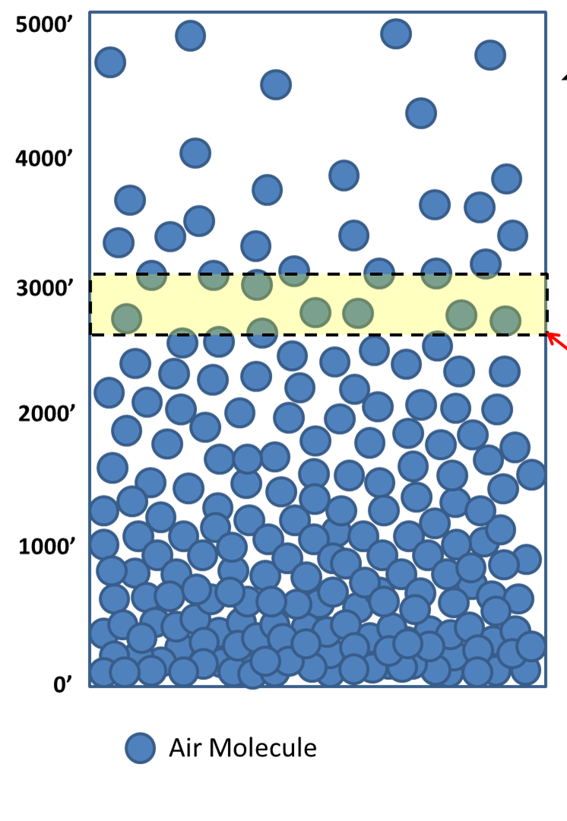
More Key Parameters
Density (ρ): ρ = Mass/Volume.
ρ= Μ/V
Expressed in kg/m³ in the metric system.
At the earth’s surface ρ ~ 1 kg/m³ , 1 kg = 1000 grams ~2.2 lbs
Volume (V): Expressed in m³

Slide 5
The Key Gas Parameters are Related by GAS LAWS

Slide 6
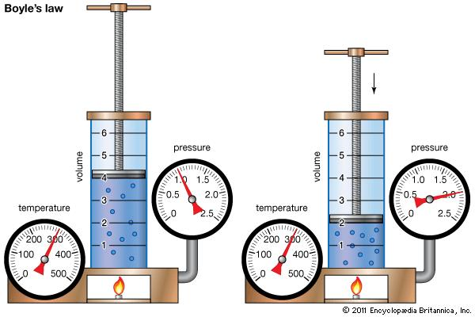
Boyle’s Law (~1660)
Start with a sample of air with a temperature (T), pressure (P), and volume (V). If T is kept constant, then:
PV=constant

Slide 7
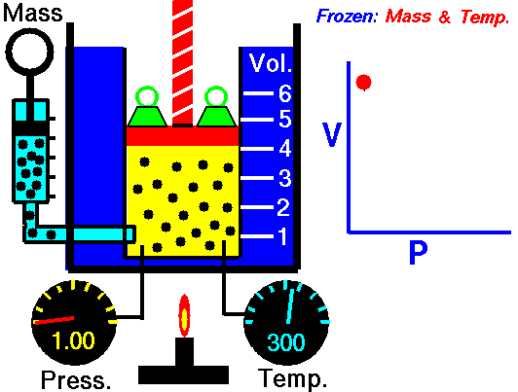
Boyles Law
Basis of air pumps we all use

Slide 8
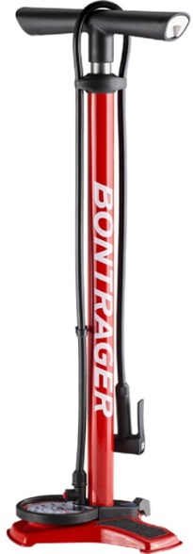
We are all familiar with Boyle’s Law in our daily lives.

Slide 9
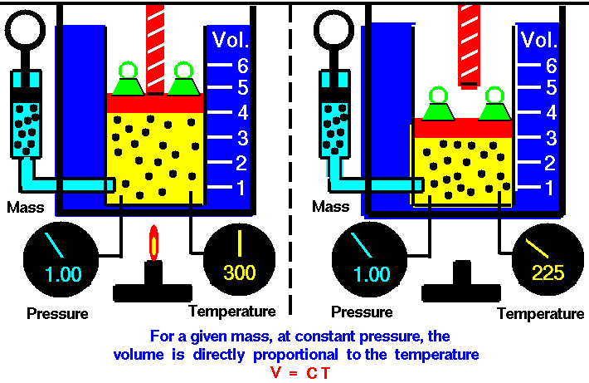
Law of Charles and Guy Lussac
If you increase temperature, while keeping pressure constant, volume will increase.
V= constant * T (°K)
V = CT
Basis of car engines.

Slide 10
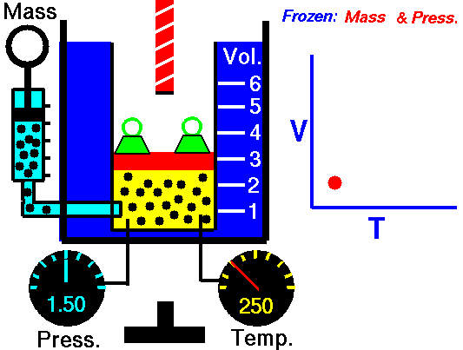

Slide 11
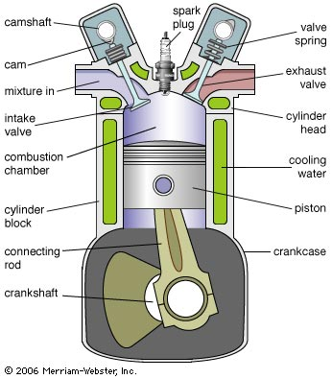
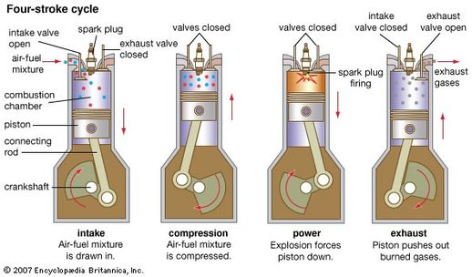

Slide 12
Why use two gas laws when you can use one?
?

Slide 13
Can combine both gas laws into one: the Perfect Gas Law (a.k.a., the Ideal Gas Law)
P= ρRT
Where ρ is density (kg m⁻³), R is a gas constant, P is pressure (Nm⁻²), and T is temperature (K)
One of the key relationships of meteorology

Slide 14
Let’s prove it contains the other laws Start with P= ρRT for a particular sample of air (thus mass is constant)
Assume T=constant.
Then you have: P= ρ *constant or
P = constant* M/V
or PV=constant
BOYLE’S LAW!

Slide 15
More fun: Law of Charles and Guy Lussac
Again start with P= ρRT
Assume P=constant. Then you have:
Constant=(M/V)*R*T
Since Mass and R are constants:
Constant= T/V
V = constant*T:
Law of Charles and Guy Lussac

Slide 16
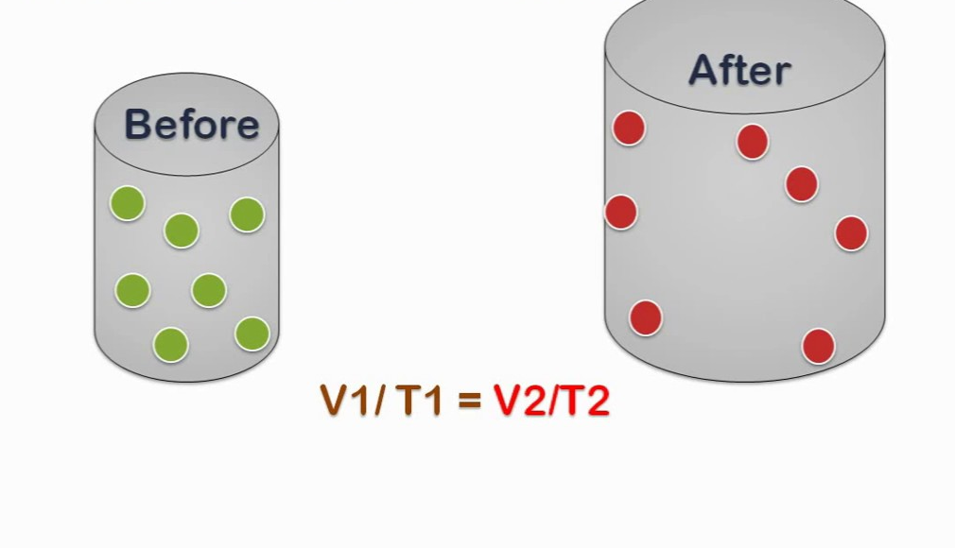
Gas Law Importance
We will use these gas laws to explain many weather features
The perfect gas law is one of the key relationships used in computer weather forecast models.

Slide 17

Adiabatic Processes
Clouds form as air cools when it rises.
But why does rising air cool?
And air warms as it forced to sink. Why?
Why does the spray from aerosol cans feel cold?
And why are bike pumps warm after use?

Slide 18

Explained by adiabatic processes!
Air parcel: An identifiable collection of air that stays together. Think of the air in balloon.
An adiabatic process is a process that occurs WITHOUT the exchange of energy with the surroundings.

Slide 19
Adiabatic processes
In a meteorological context, an adiabatic process is one in which there is no exchange of energy between an air parcel and the surrounding air.

Slide 20

Think of air in an insulated box

Slide 21
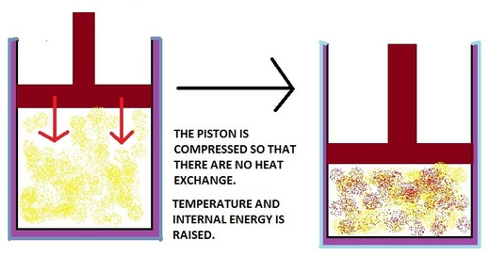
How do temperature and pressure vary for an air parcel during an adiabatic process?
Imagine an insulated cylinder with air in it, so there is NO heat exchange with the outside environment.
Push down the piston. Pressure and temperature increase.
P₂ > P₁
T₂ > T₁
T₁, P₁
T₂, P₂
1
2

Slide 22

Adiabatic processes
If an air parcel is compressed adiabatically, temperature will rise
If allow an air parcel to expand, its temperature will fall.
But why?

Slide 23
Adiabatic processes
When compressing an air parcel, you are doing work on the molecules in the parcel, giving them a “shove” and making them go faster. Temperature rises.
If an air parcel expands, energy is needed to push out the boundaries of the parcel, resulting in cooling.

Slide 24
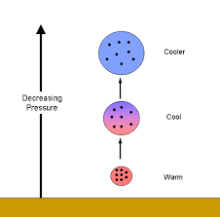
To Put It Another Way: The Adiabatic Law
In the absence of heat exchange with the outside, an air parcel warms when compressed and cools when it expands.
Explains a great deal of what it occurring in the atmosphere

Slide 25
The Adiabatic Law
When air is forced to rise, it moves into an environment of lesser pressure (since pressure decreases with height).
With less pressure on the air parcel, it expands
Expansion results in cooling

Slide 26
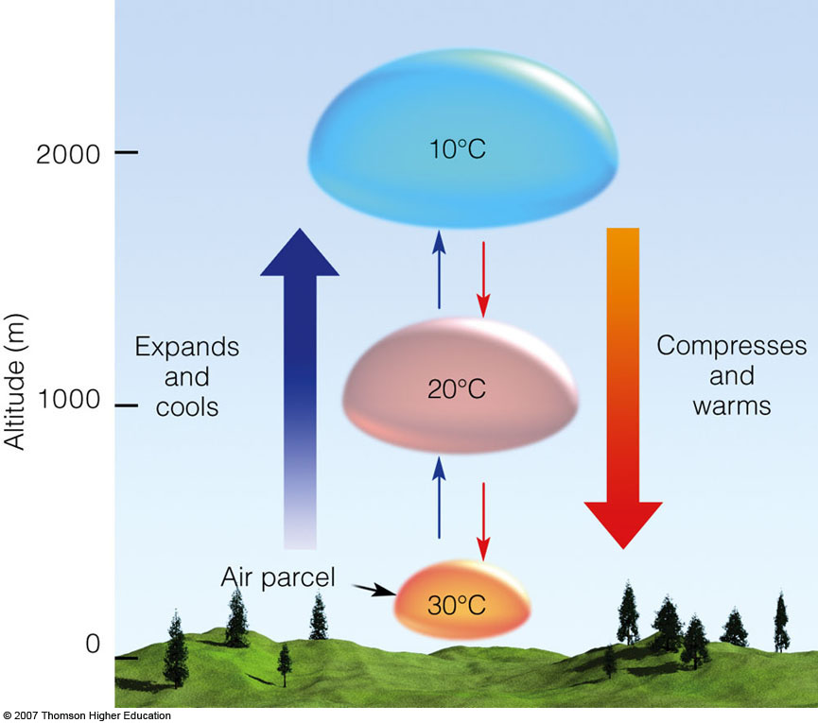
Adiabatic Law
When air sinks, it moves into an environment with higher pressure, compressing and warming the air parcel.

Slide 27

An example that many of you have experienced—a very cold spray from aerosol cans due to adiabatic expansion and cooling

Slide 28
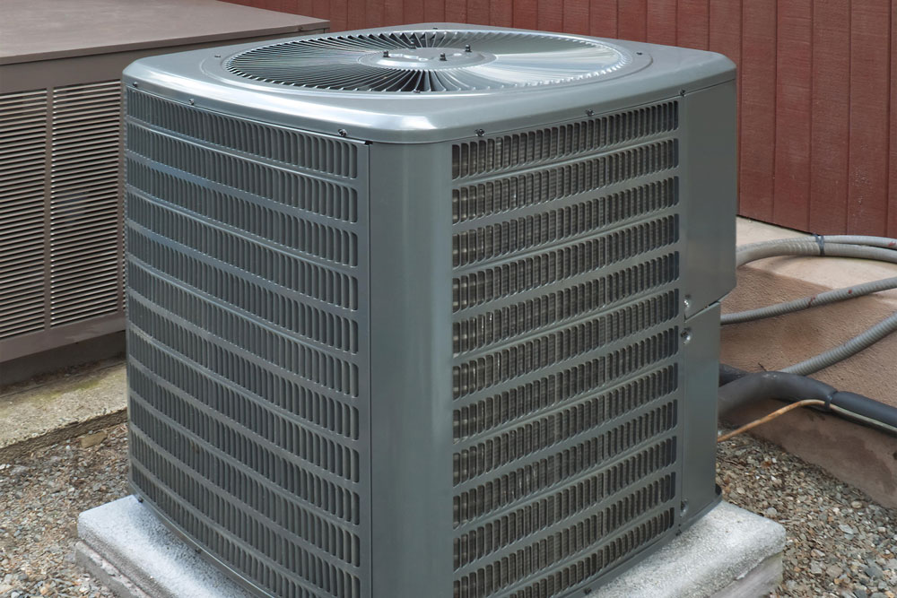
Heat pumps and AC Uses Adiabatic Principles

Slide 29
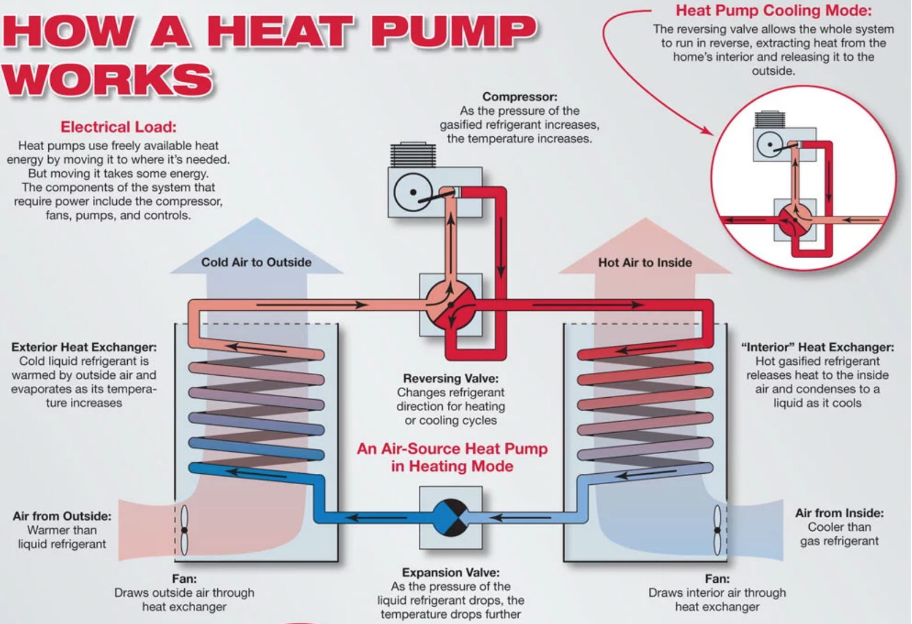

Slide 30
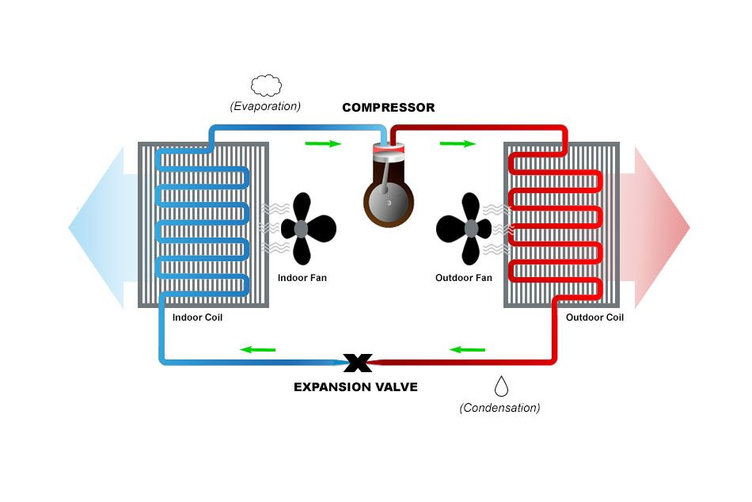
Heat Pump

Slide 31
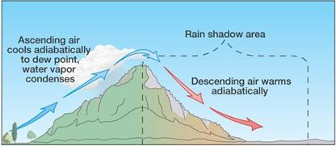
Influence on saturation and clouds
As an air parcel rises, adiabatic cooling can result in increased relative humidity and saturation.

Slide 32
Influence on saturation and clouds
The amount of water vapor in an air parcel does not change at first as it rises
As the temperature falls, the air parcel has less ability to hold water vapor. Thus, RH increases.
With enough vertical motion, the RH climbs to 100% and the air reaches saturation—any more rising leads to water condensing out and cloud formation.
Flow moving up mountains is a good example

Slide 33
Downslope warming and drying
On the other hand, sinking air warms adiabatically and relative humidity decreases. Thus, clouds evaporate, producing a cloud-free zone or rain shadow.

Slide 34
Great examples here in Washington

Slide 35
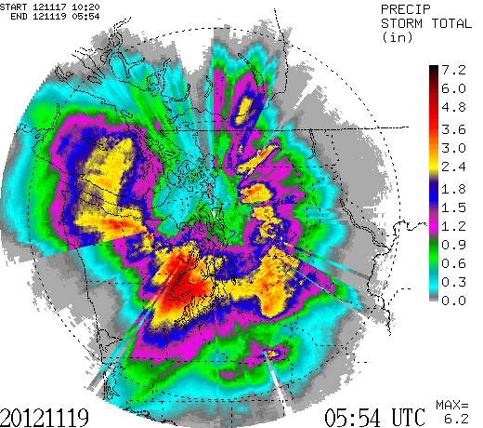

Slide 36
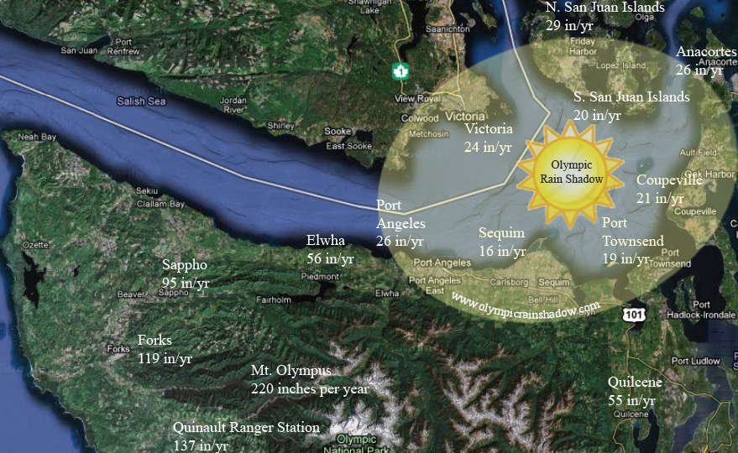


Slide 37
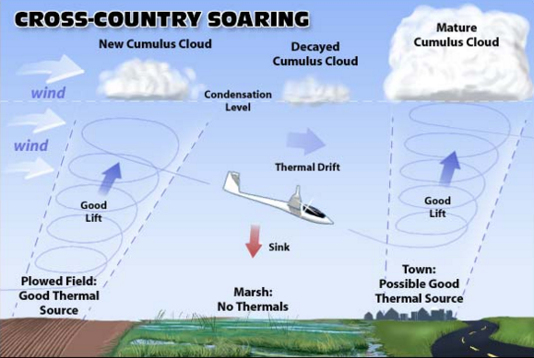
Adiabatic cooling/warming can occur outside of mountains as well

Slide 38
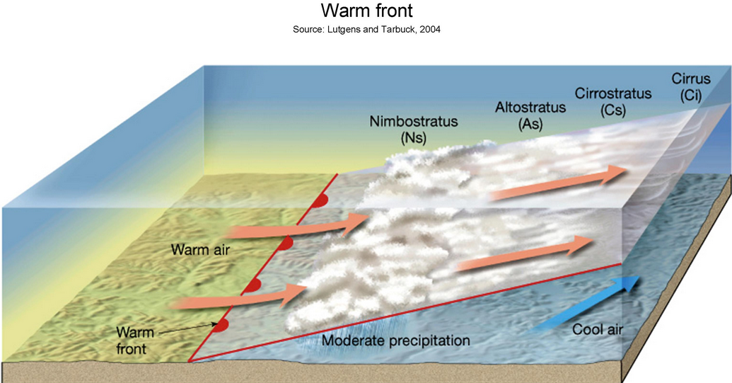
Warm Front: Rising air and adiabatic cooling

Slide 39

All of these clouds are associated with adiabatic cooling

