Slide 1
Frontogenesis
Frontogenesis: strengthening of horizonal temperature gradients
Frontolysis: weakening of horizontal temperature gradients

Slide 2
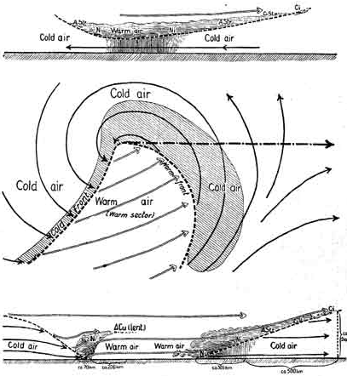
The Norwegian or Bergen School Meteorologists in the early 20th century were the first to describe fronts and their evolution
Bjernkes, 1919

Slide 3
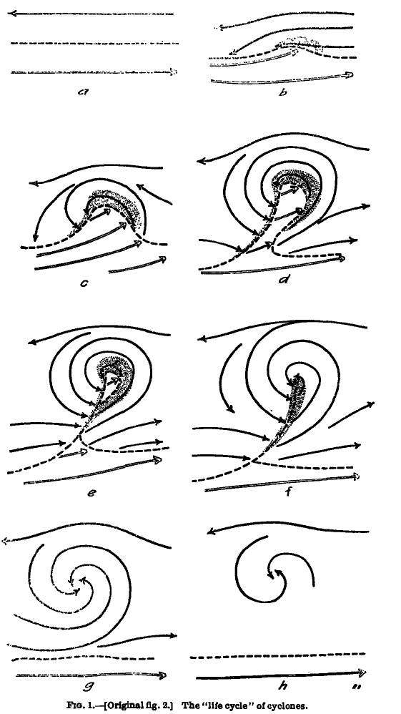
Concept of Evolution of Cyclones Bjerknes and Solberg 1922

Slide 4
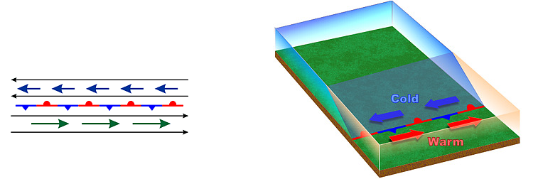
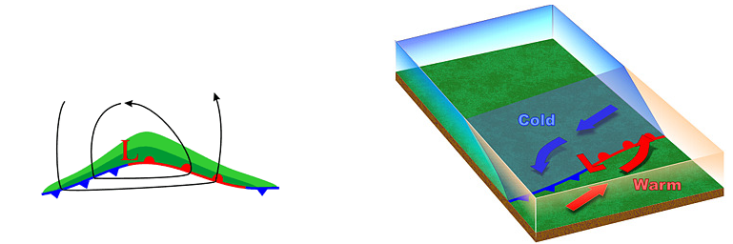
Stationary Polar Front
Wave Forming on Polar Front

Slide 5
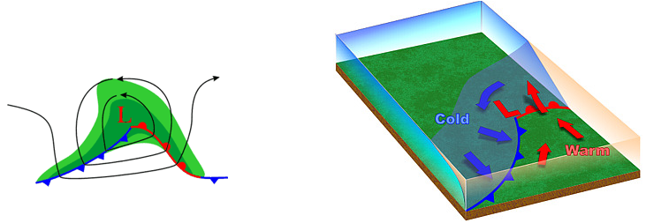
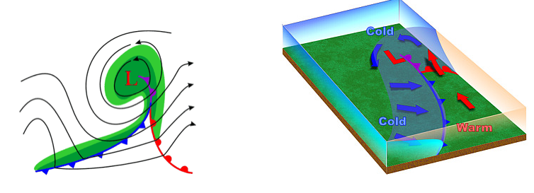
Wave Amplifies
Occlusion as Cold Front Catches Up to Warm Front

Slide 6
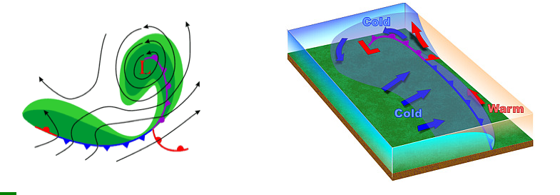
Occlusion Lengthens and System Weakens

Slide 7
The Norwegian Cyclone Model Started with a Strong Polar Front and Had Limited Discussion of How Fronts Formed

Slide 8
Why are there fronts?
First attempts were based on the kinematic description of frontogenesis
Kinematics regards the description of motions rather than the forces driving motions
How do wind and temperature fields interact to increase temperature gradients?

Slide 9
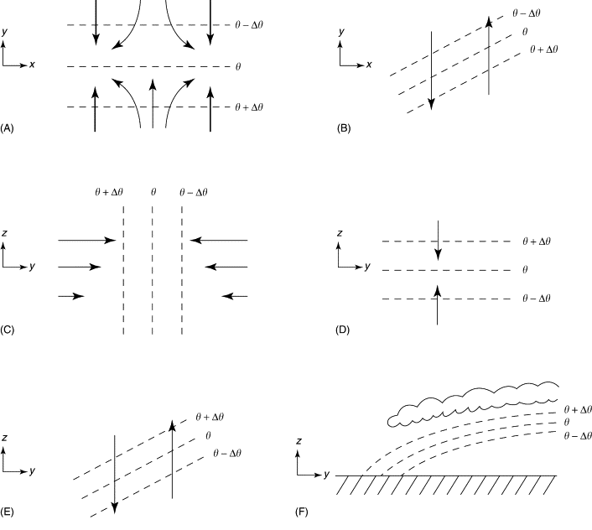
With a pre-existing temperature gradient, certain wind fields can concentrate the temperature gradient, resulting in frontogenesis

Slide 10
Kinematics 101: the wind around a point can be linearly decomposed into four key components
Translation
Rotation
Divergence
Deformation

Slide 11
Translation: movement in one direction

Slide 12
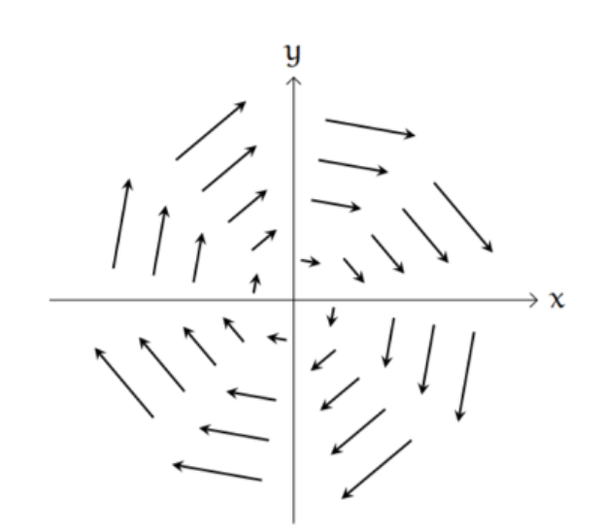
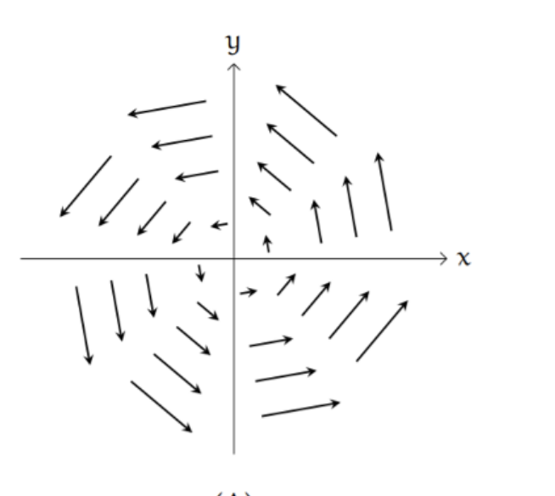
Rotation (cyclonic or anticyclonic)
clockwise
counterclockwise)
Anticyclonic (NH)
Cyclonic (NH)
Northern Hemisphere

Slide 13
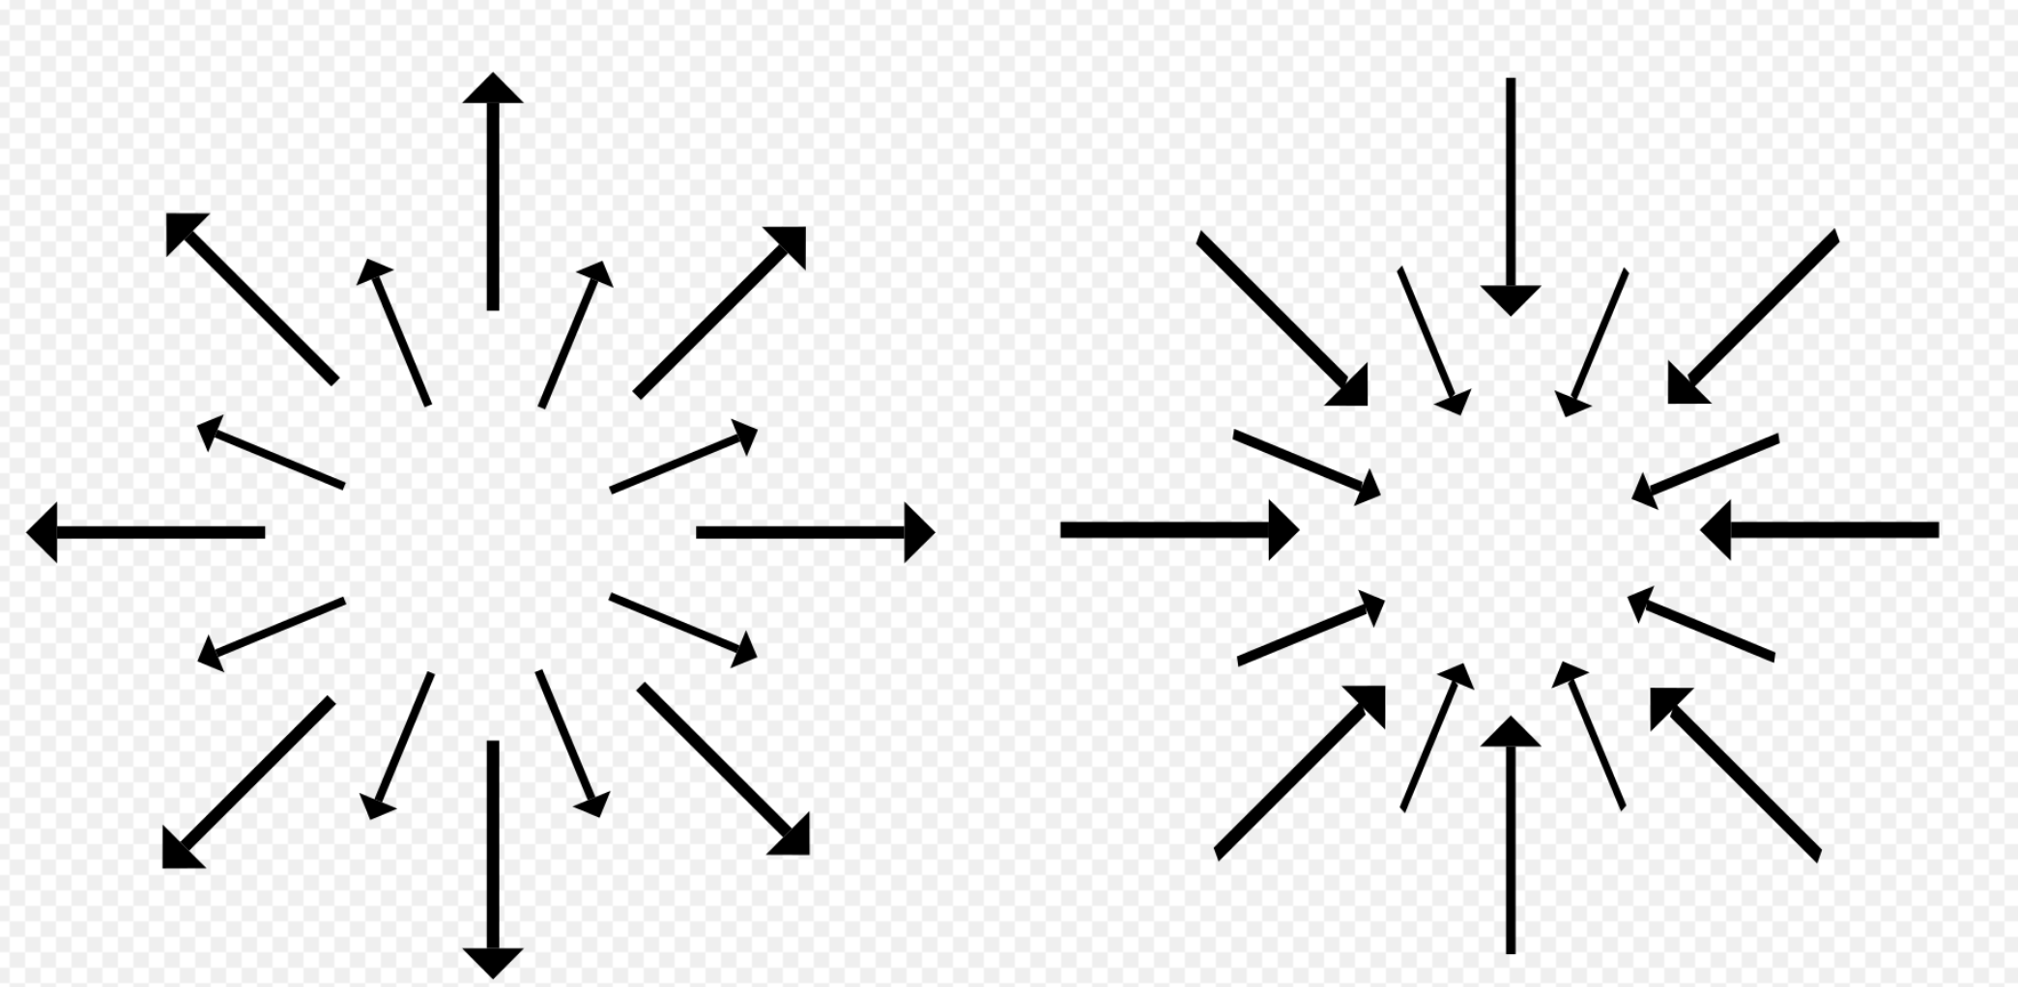
Divergence (or convergence)

Slide 14
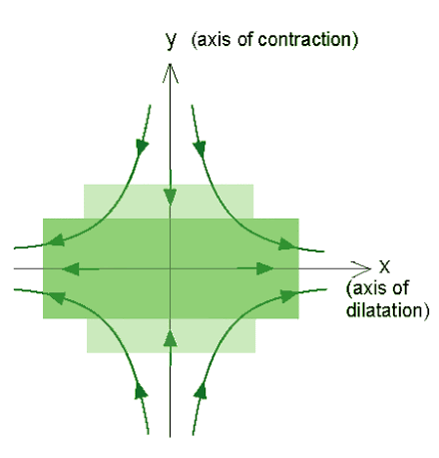
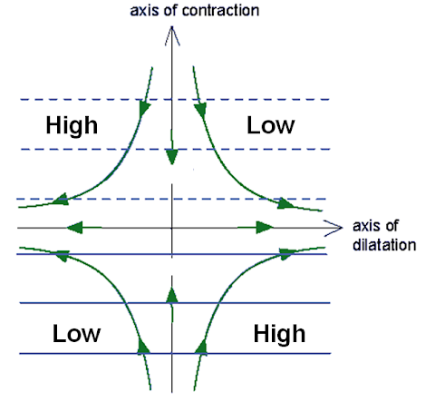
Deformation

Slide 15
The flow around a point can be decomposed into these kinematic components Combining these components can produce many important flow fields

Slide 16
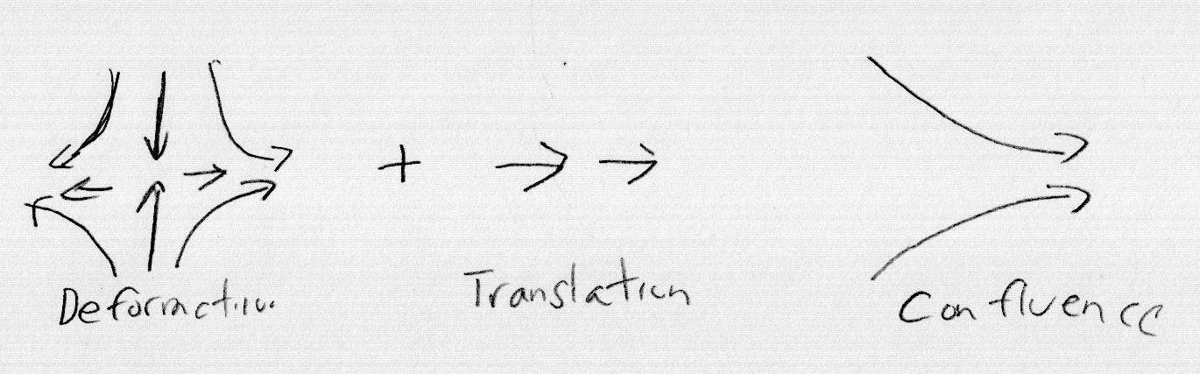
Deformation Plus Translation Results in Confluence

Slide 17
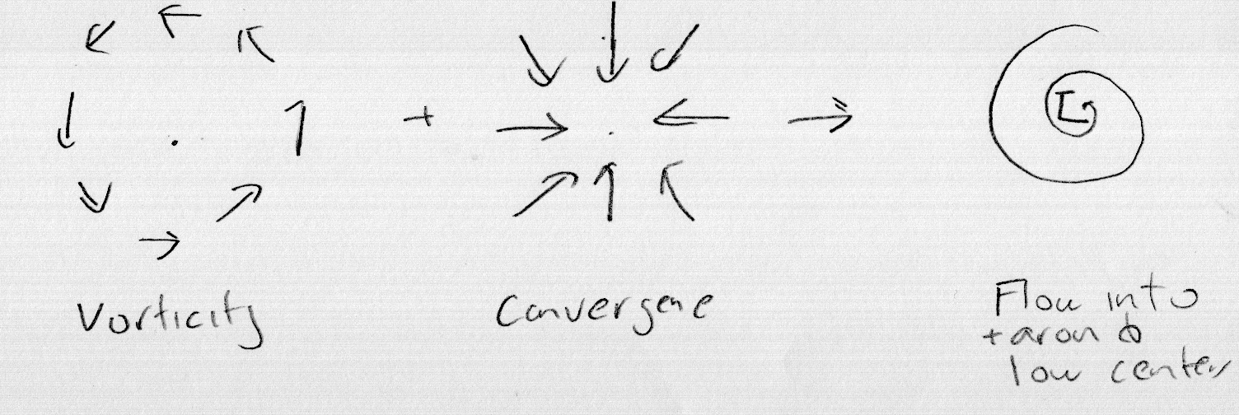
Vorticity Plus Convergence

Slide 18
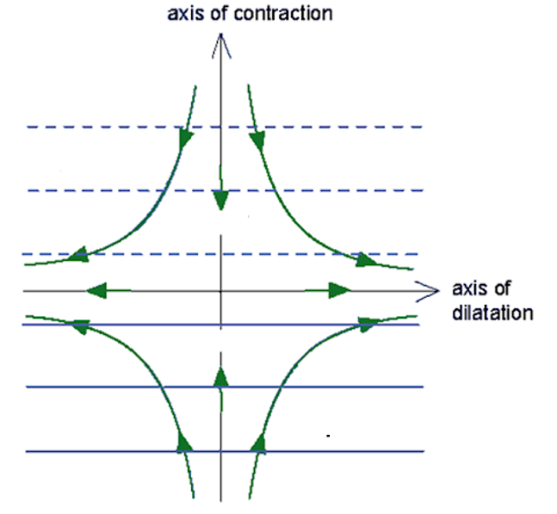
Bergeron (1928) was the first to show that fronts could form/strengthen when deformation acts on a preexisting temperature gradient.
T-ΔT
T
T+ΔT
T+2ΔT
T+3ΔT
T+4ΔT

Slide 19
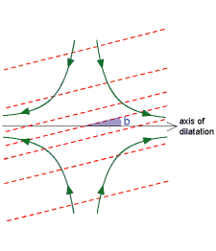
Bergeron also showed that the orientation of isotherms was important: had to be within 45°of the axis of dilation to get frontogenesis

Slide 20
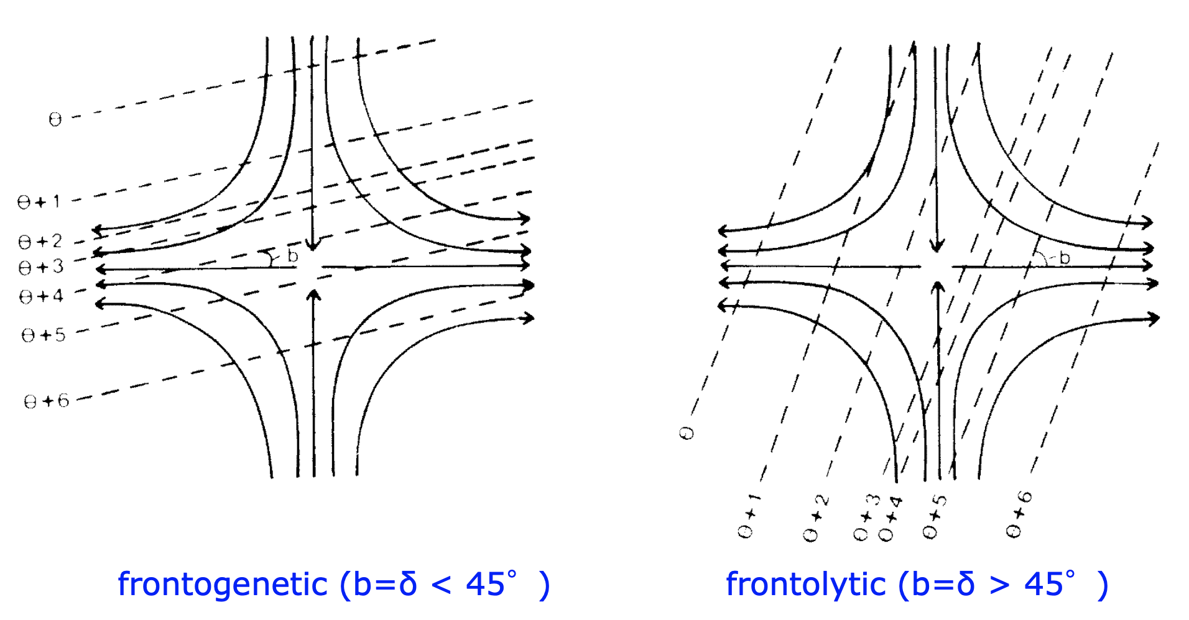
Frontogenetic Versus Frontolytic

Slide 21
Peterssen (1936) showed that convergence can force frontogenesis
cool
warm

Slide 22
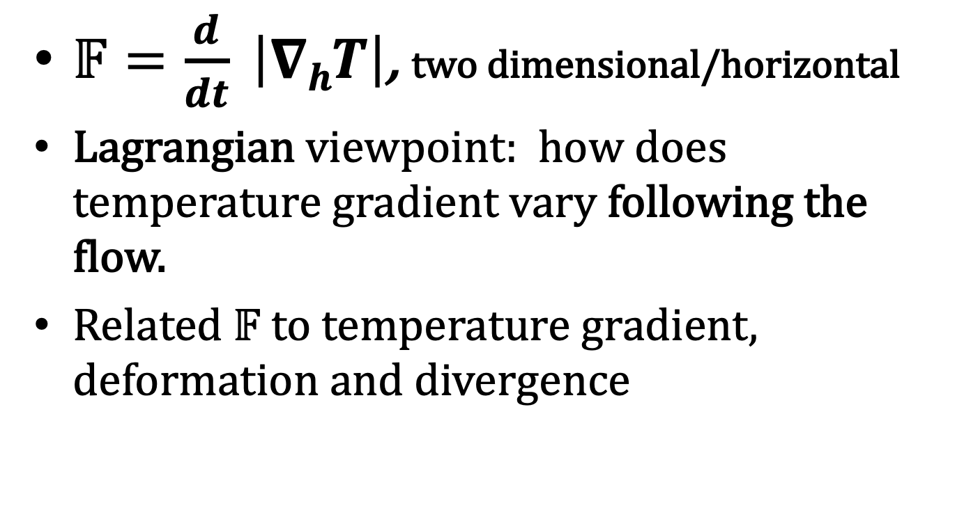
Peterssen Created a Frontogenesis Function
$𝔽=\frac{d}{dt} \left|∇hT\right|$, two dimensional/horizontal
Lagrangian viewpoint: how does temperature gradient vary following the flow.
Related $𝔽$ to temperature gradient, deformation and divergence

Slide 23
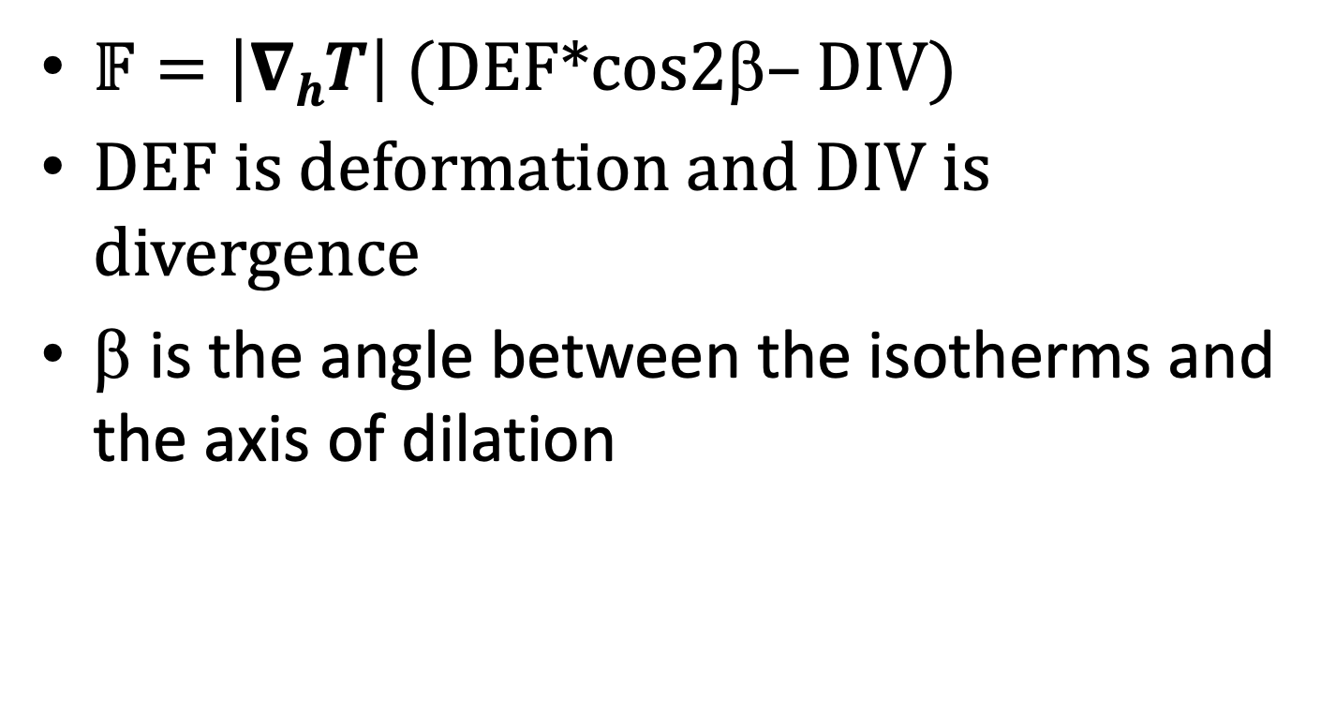
Frontogenesis Function (2D)
$𝔽=\left|∇hT\right|$ (DEF*cos2β– DIV)
DEF is deformation and DIV is divergence
β is the angle between the isotherms and the axis of dilation

Slide 24
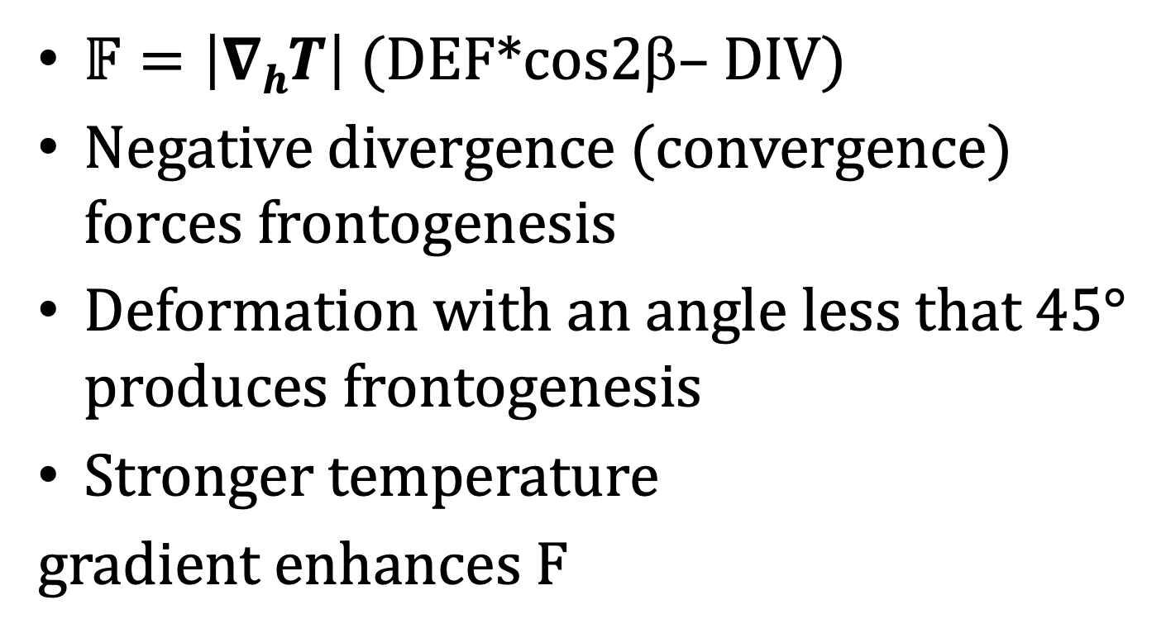
Frontogenesis Function (2D)
$𝔽=\left|∇hT\right|$ (DEF*cos2β– DIV)
Negative divergence (convergence) forces frontogenesis
Deformation with an angle less that 45° produces frontogenesis
Stronger temperature
gradient enhances F

Slide 25
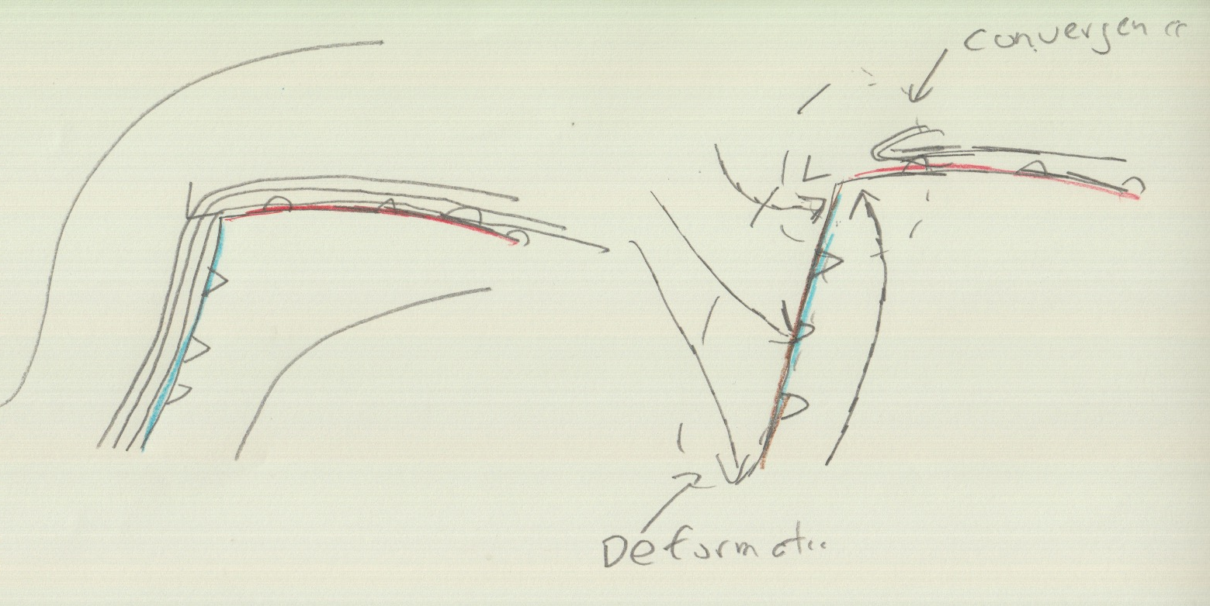
Both convergence and deformation contribute to frontogenesis for a typical midlatitude cyclone

Slide 26
Let’s Check Out Real Examples!

Slide 27
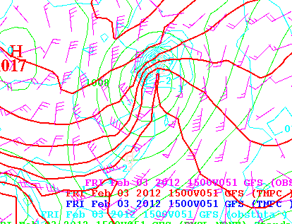
Light Blue is Frontogenesis

Slide 28
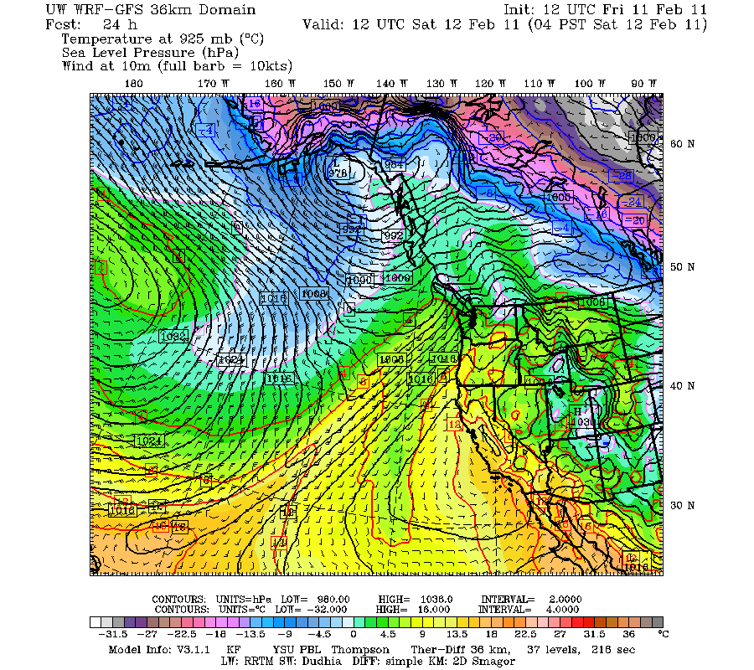

Slide 30
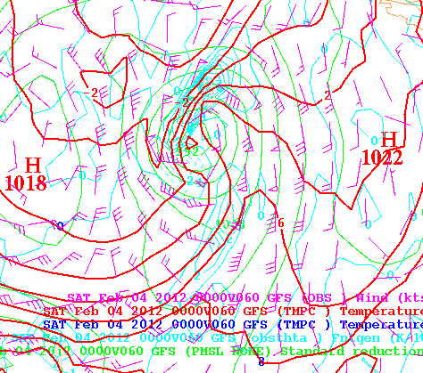

Slide 31
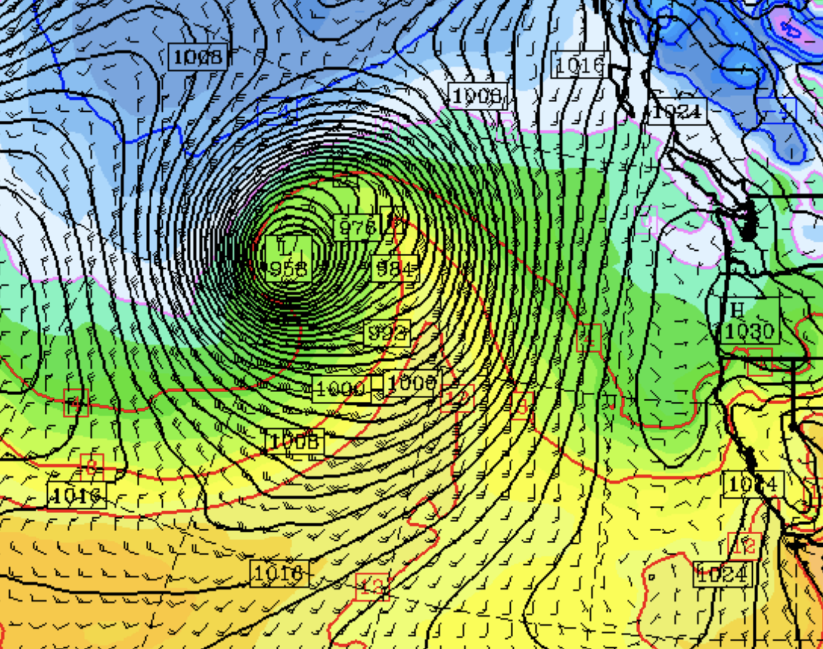

Slide 32
Theoretical Studies in the 1940s and 1950s Showed That Synoptic Scale Deformation and Convergence Was NOT Enough to Rapidly Produce Mesoscale Fronts
The “secret” was learned in the 1950s.
Mesoscale processes are needed for the final and rapid concentration of temperature gradients.

Slide 33
Synoptic Scale Winds Alone
Cold air
Warm air

Slide 34
Now the secret…..

Slide 35
Secondary Circulations: Help Tighten Up Front!
Cold air
Warm air

Slide 36
Secondary Circulations Occur to Attempt to Retain Thermal Wind Balance
Cold air
Warm air

Slide 37
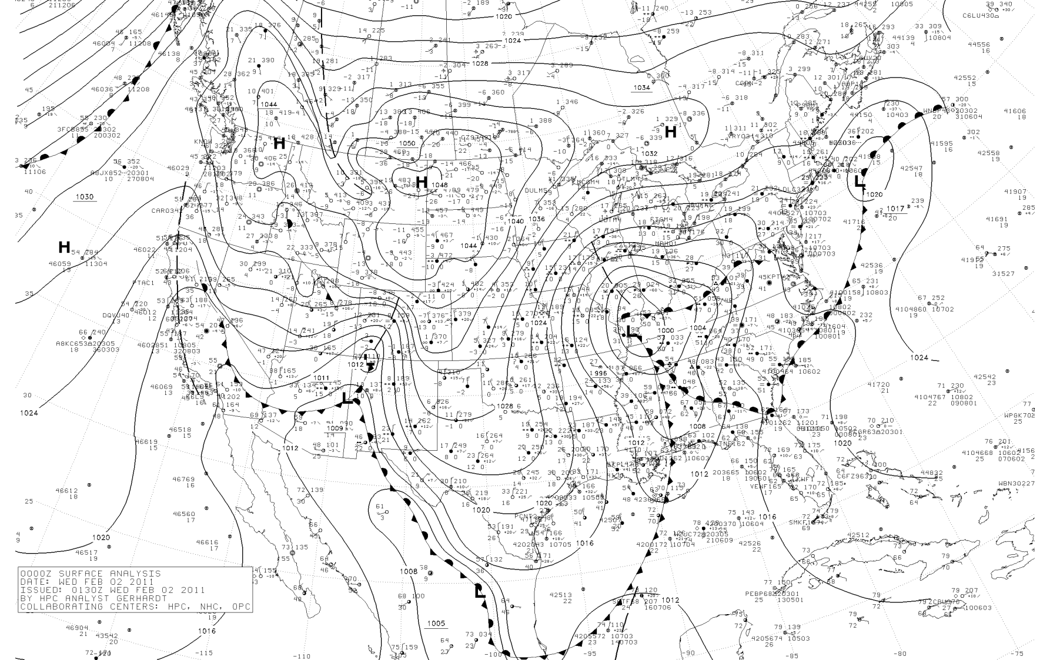
Typically, low-level fronts weaken with height (horizontal temperature gradients lessen with height)

Slide 39
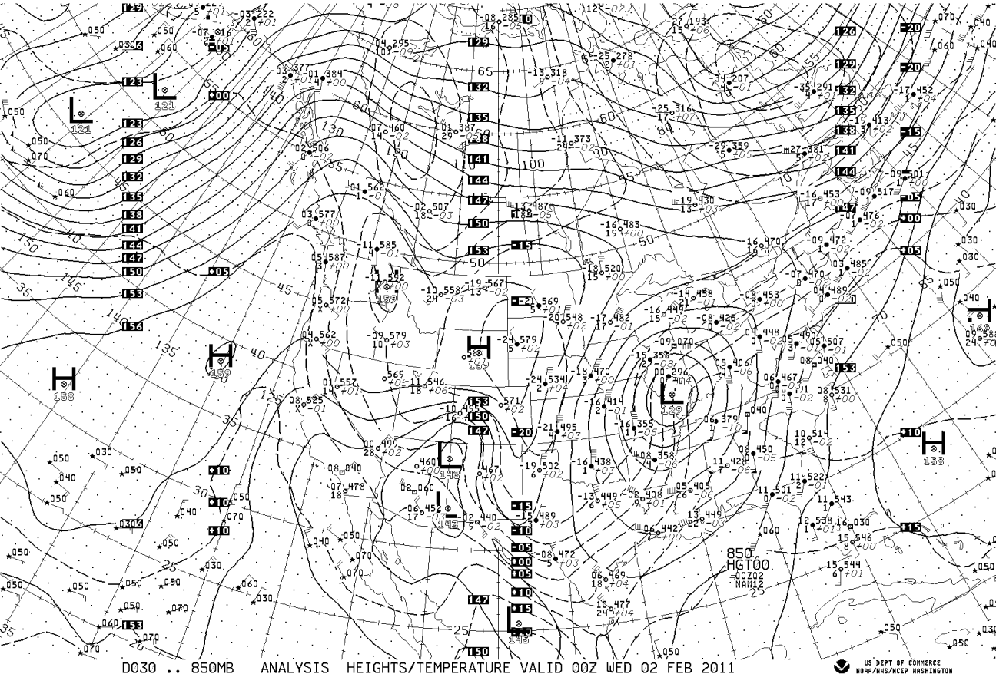

Slide 40
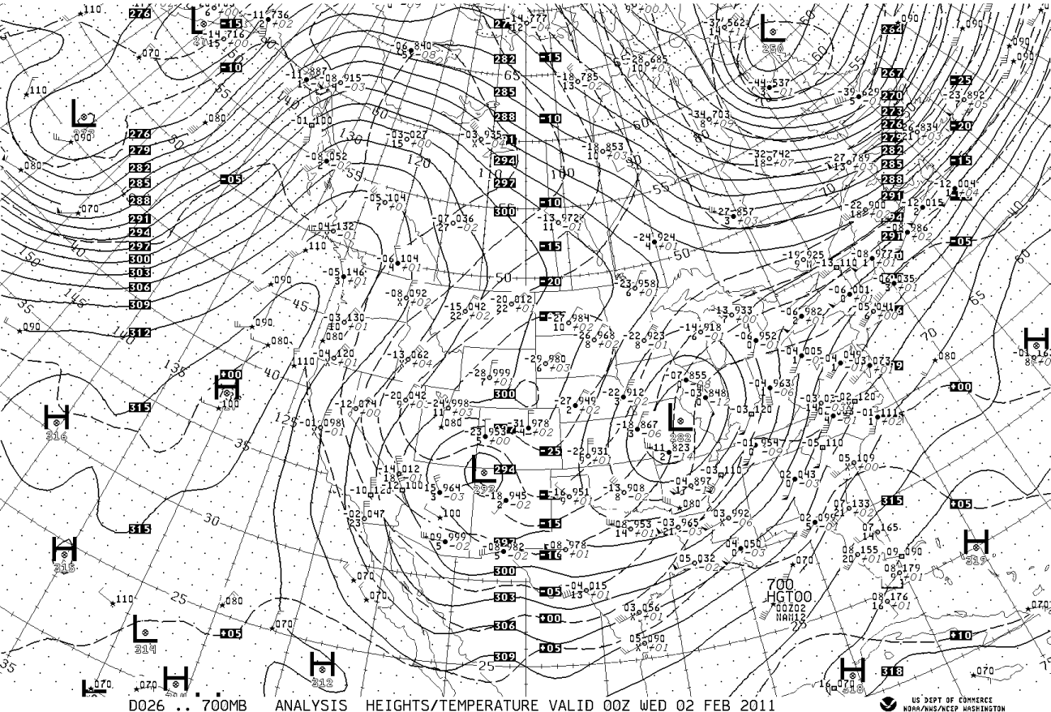

Slide 41
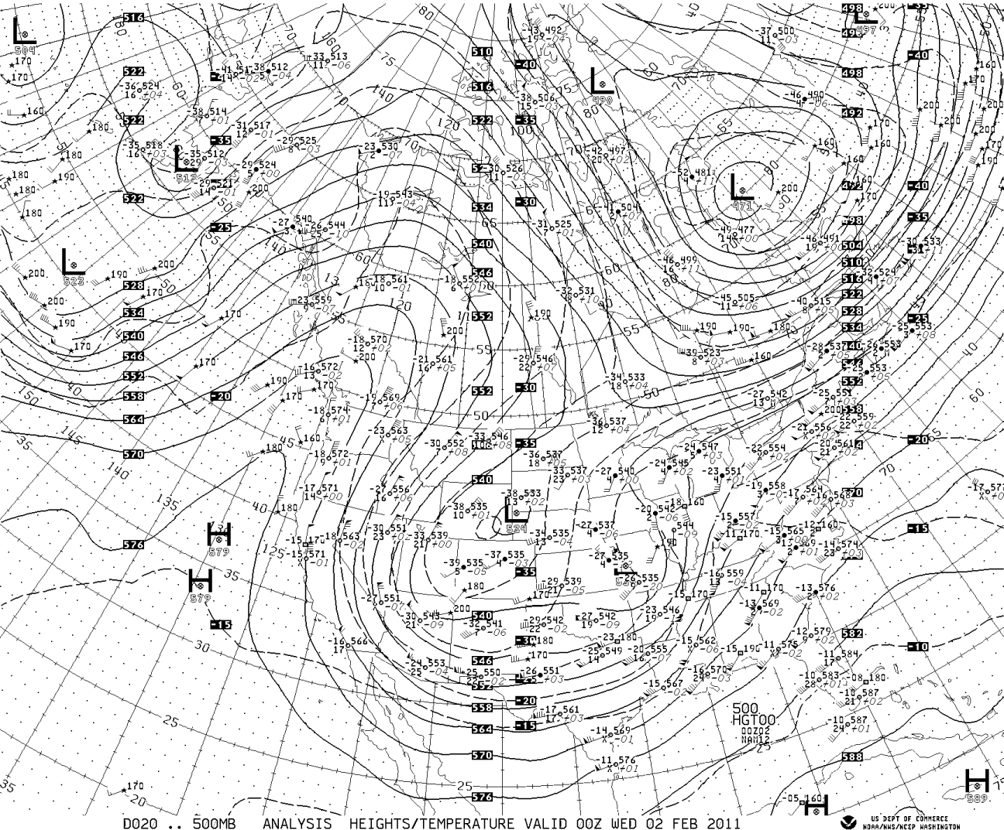

Slide 42
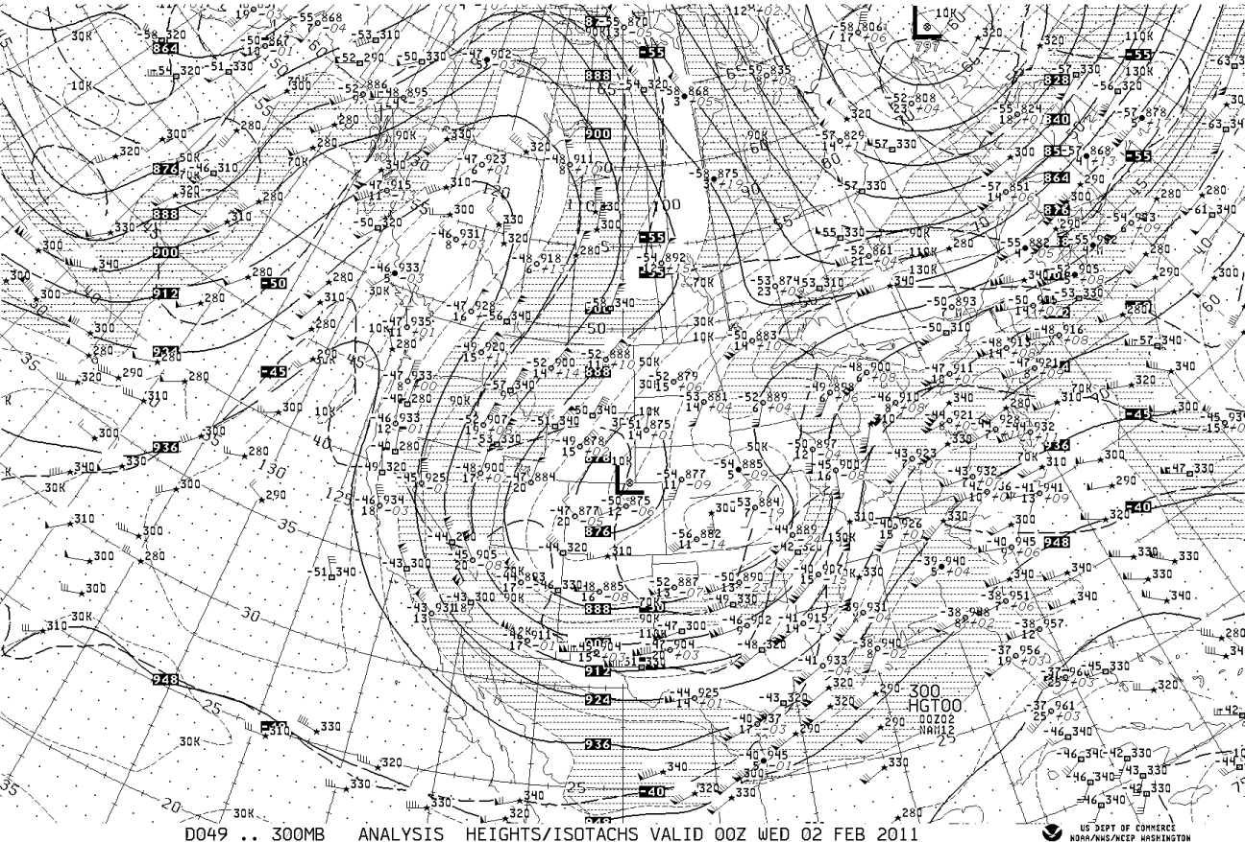

Slide 43
Why do fronts weaken away from the surface? Vertical motions!

Slide 44
Vertical motions increase with height and weaken temp. gradient
Adiabatic cooling on warm side
Adiabatic warming
On cold side
Warm air
Cold air
Thus, the effects of vertical motions on temperature increase with height

Slide 45
Vertical motions can also create and maintain fronts in some locations
Near the tropopause, vertical motions can create/strengthen upper-level fronts.
Horizontal ariations in vertical motion can produce horizontal temperature gradients through a mechanism called tilting.

Slide 46
Higher Potential Temperature
Adiabatic warming
UP
Adiabatic cooling
Lower Potential Temperature
Vertical Motions Can Create a Temperature Gradient
Called tilting frontogenesis

Slide 47
Fronts often develop and strengthen during midlatitude cyclone development
Frontogenesis and cyclogenesis go hand in hand!

Slide 48
Simulations of cyclogenesis/frontogenesis

Slide 49
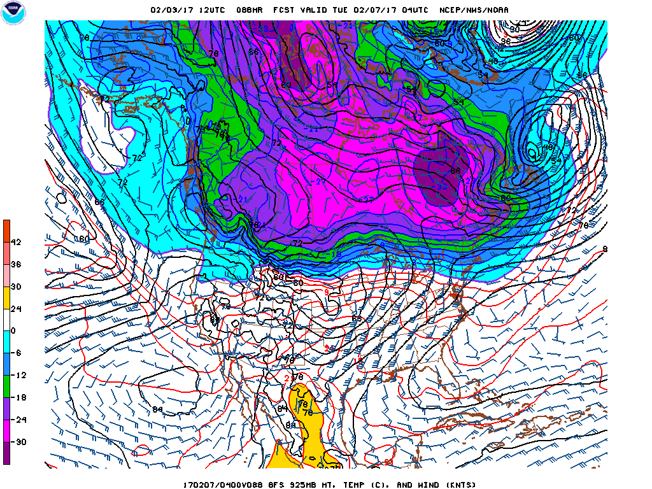

Slide 50
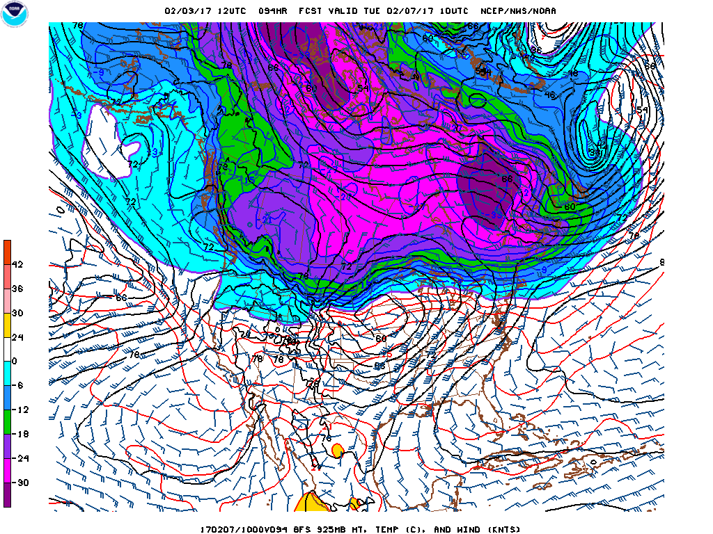

Slide 51
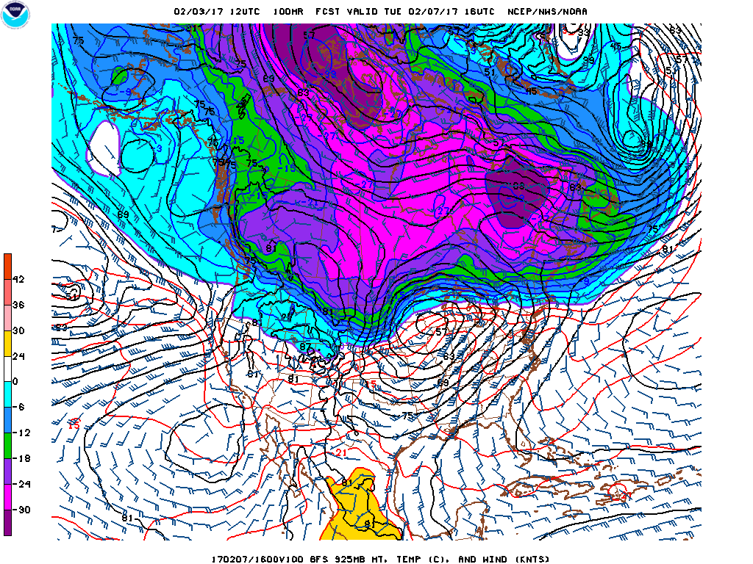

Slide 52
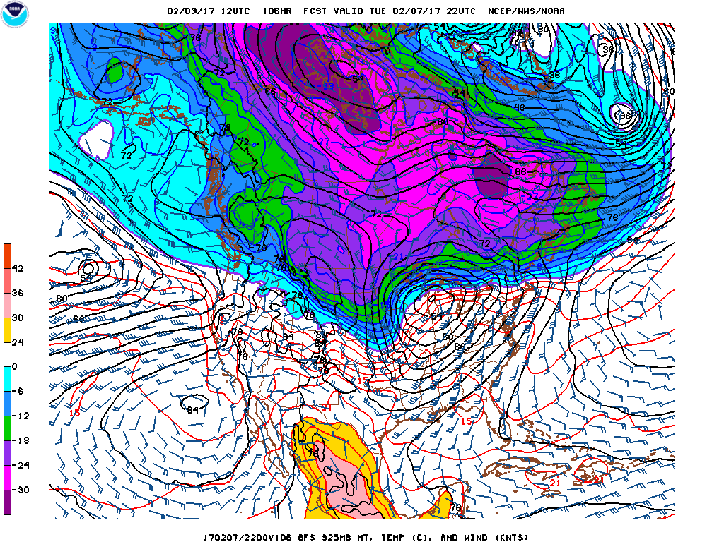

Slide 53
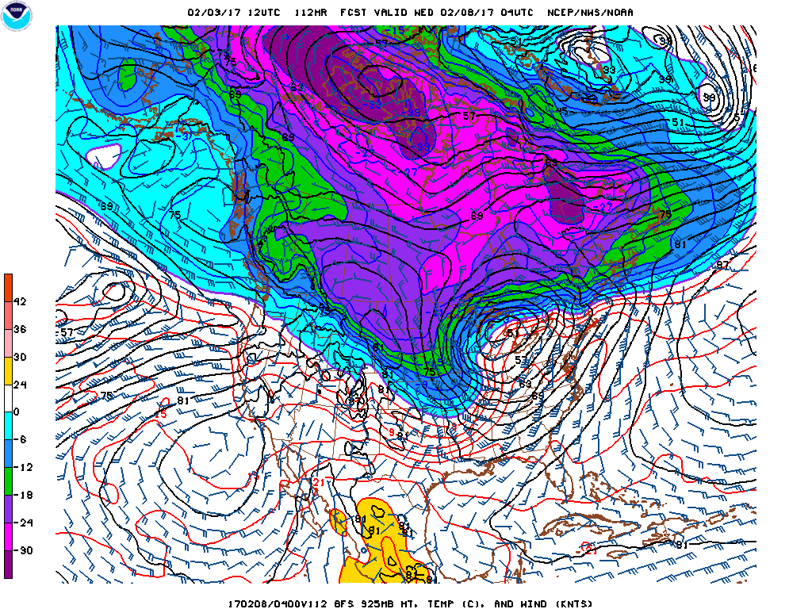

Slide 54
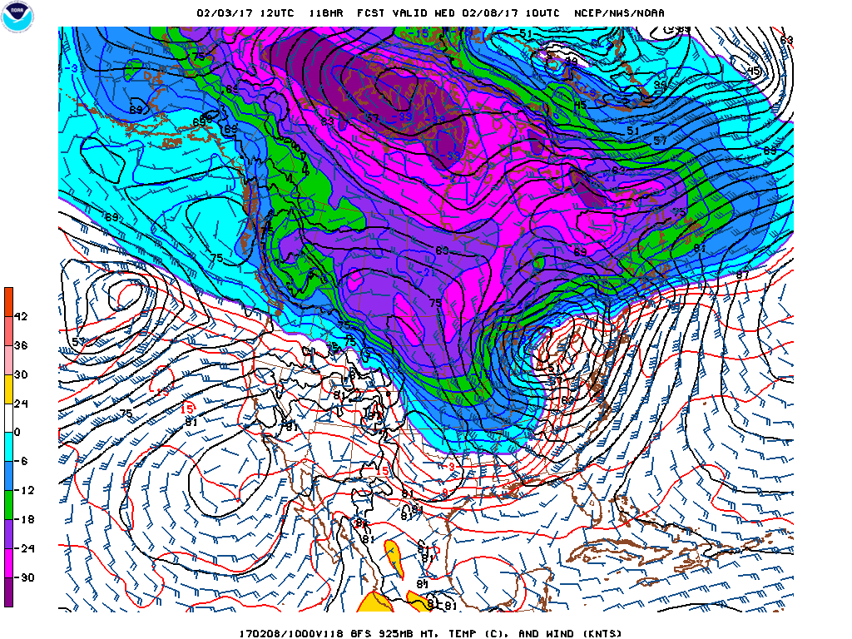

Slide 55
Frontal Width
Typically, most of the temperature drop occurs over 100-200 km.
In very sharp fronts the majority of the change can occur in 1-10 km
Over the oceans the frontal temperature change can weaken and expand.

Slide 56
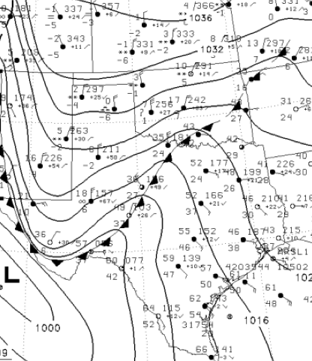
Some Fronts Are Very Sharp Particularly Near the Surface

Slide 57
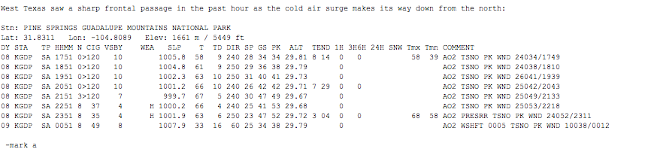

Slide 58
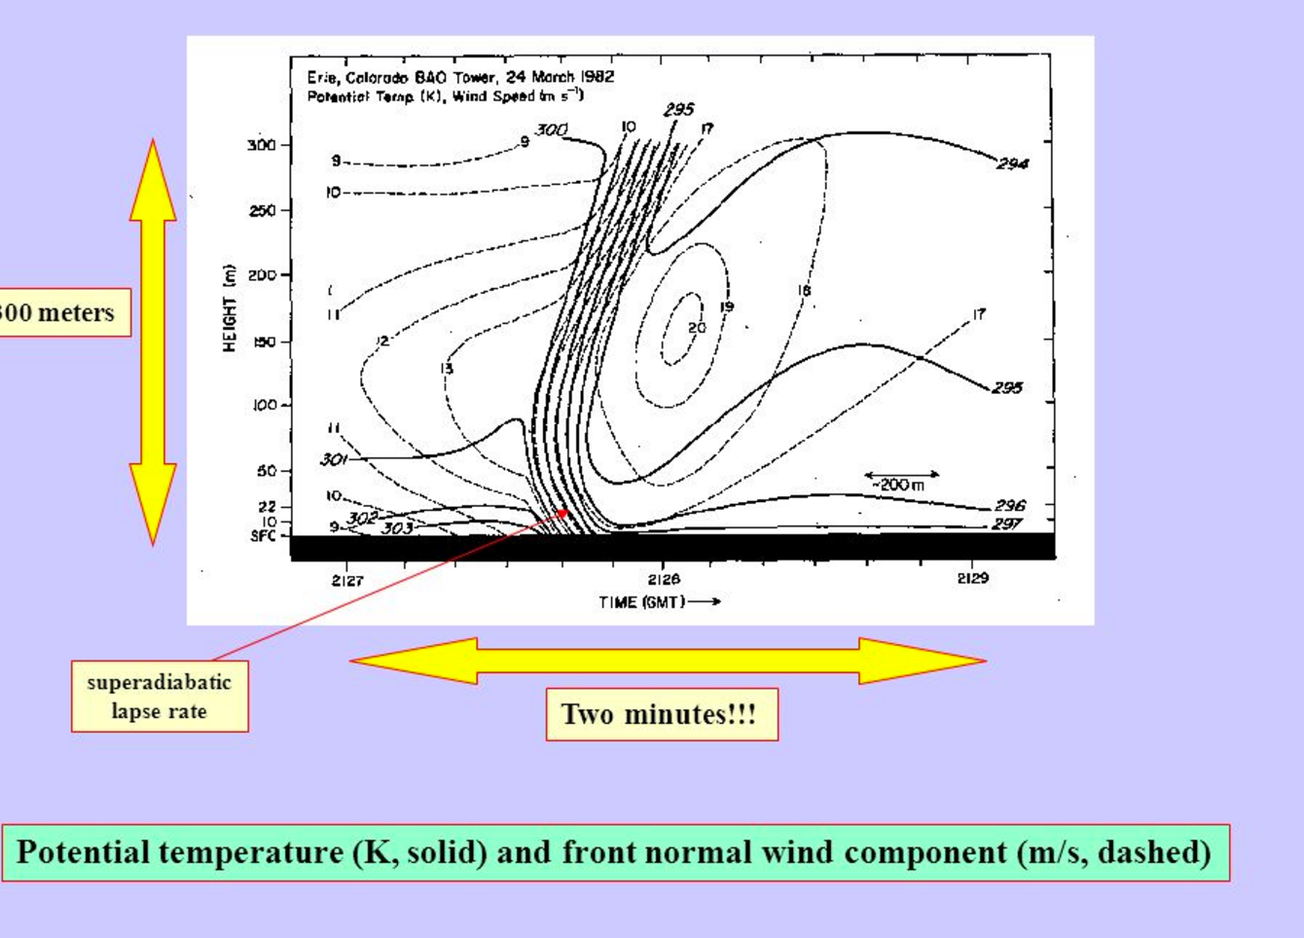
Colorado Event

Slide 59
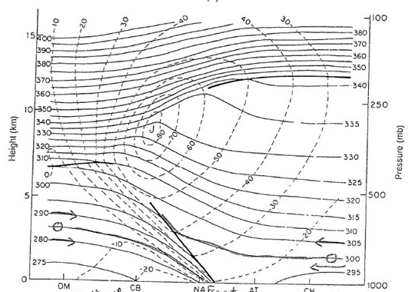
Fronts are strongest near “barriers”
Near the ground, where weak vertical motions don’t reduce temperature gradients.
Aloft near the tropopause (upper-level fronts), where distortions of the strong vertical potential temperature gradients can produce horizontal temperature gradients.

Slide 60
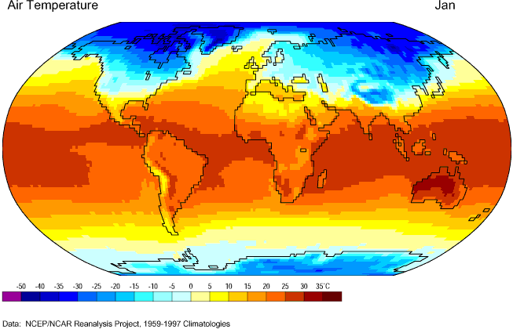
Fronts (and cyclones) tend to develop or are strongest in regions of naturally strong horizontal temperature gradients (e.g., SE US)

