Slide 1
Dew, Frost and Fog Atmospheric Sciences 101 Autumn 2024

Slide 2

Dew
Condensation on the surface when surface temperature falls to the dew point temperature
Often occurs on cold, clear nights in areas open to the sky.
On such nights, the surface emits infrared radiation to space, cooling surface to the dew point

Slide 3
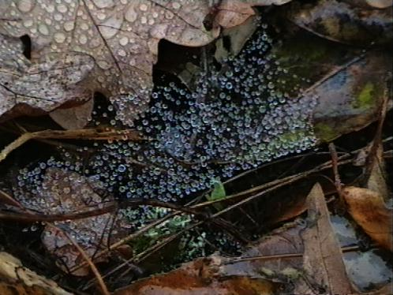

Slide 4
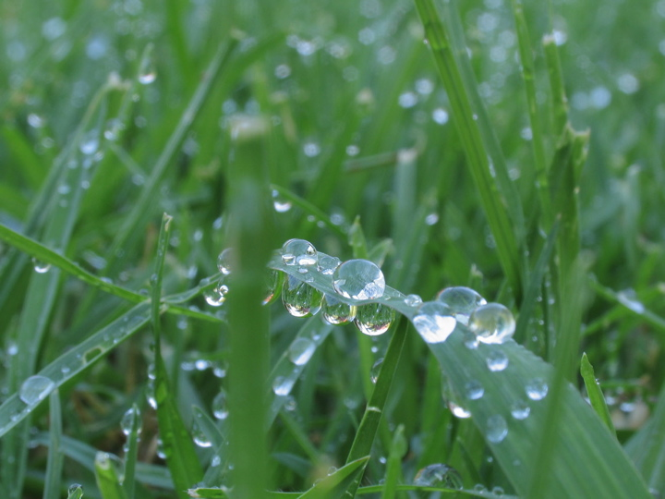

Slide 5
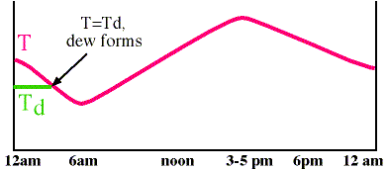
Temperature drops, dew point remains constant until dew forms

Slide 6
Dew
Often associated with periods when high pressure is overhead
High pressure areas bring clear skies and calm or weak surface winds.
Why are weak winds good for dew? Less mixing of warmer air from above!

Slide 7
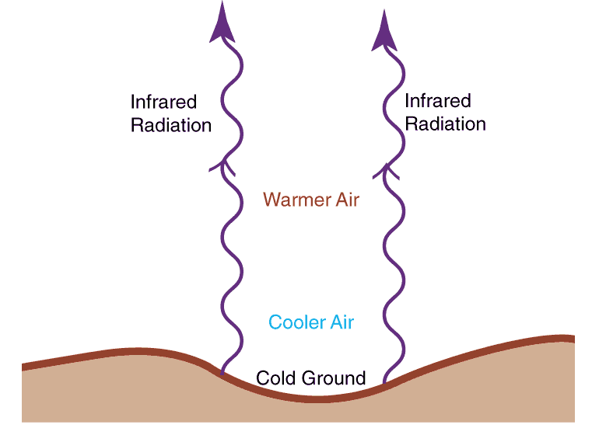
Clear Skies Allow Infrared Radiation Cooling from the Surface
Surface cools more effectively than the atmosphere
Cooling near the surface can produce an inversion

Slide 8
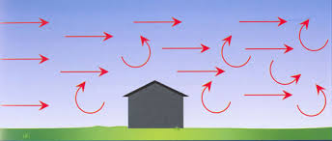
Winds can mix warmer, drier air down to the surface: bad for dew!

Slide 9
Cars in the open often get covered with dew Cars in a carport gather little dew Why?

Slide 10
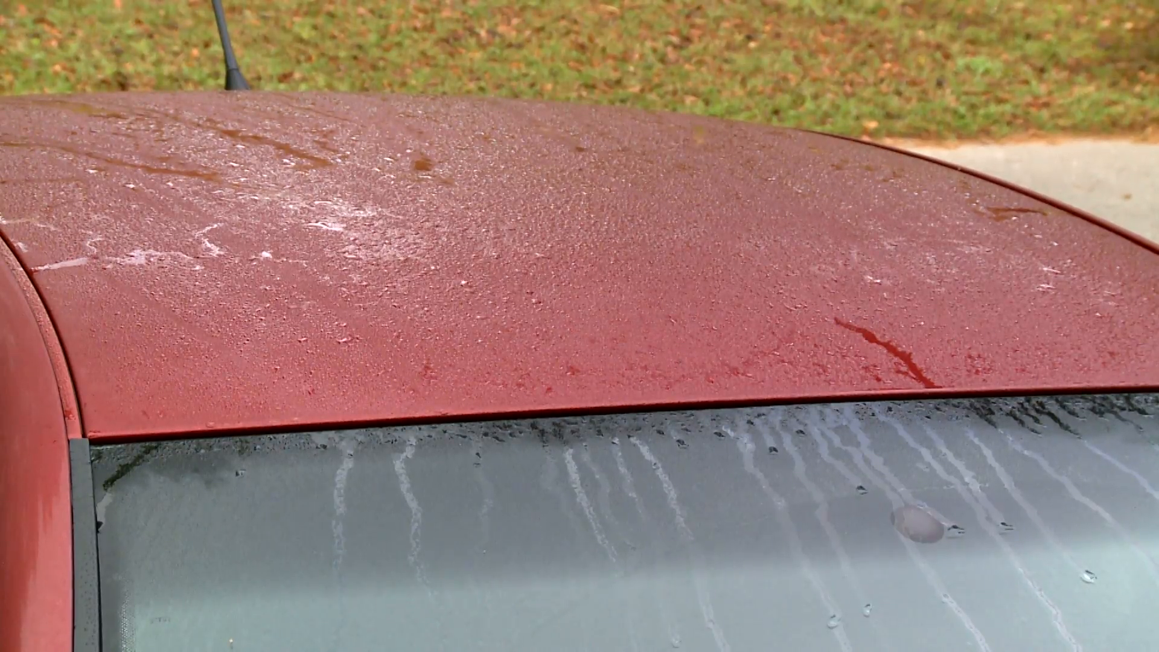

Slide 11
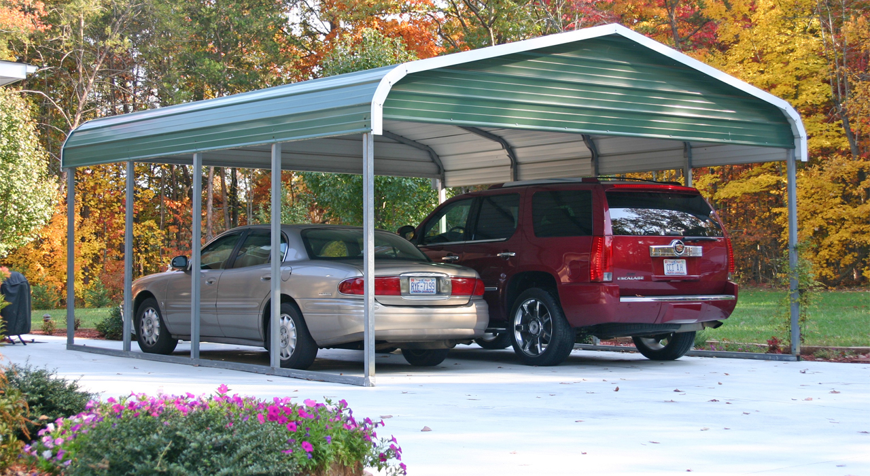

Slide 12
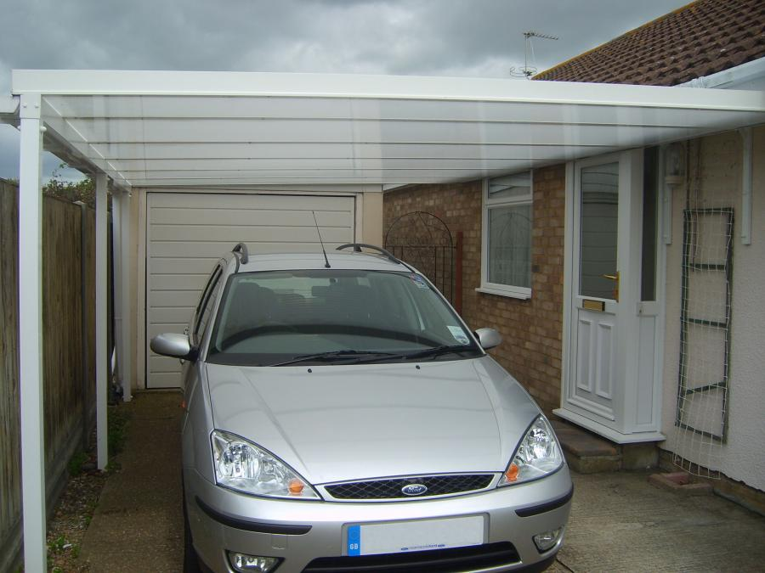
Dew Protection: Roof Lessens Infrared Cooling to Space

Slide 13
More Dew Facts
More dew after a moist period or in moist areas. Why? Higher dew point!
So easier for temperature to drop to the dew point temperature.
Dew releases the latent heat of condensation and reduces temperature drops after it starts to form

Slide 14
Heater

Slide 15
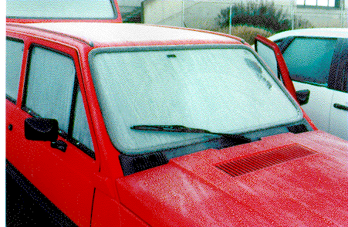
Frost

Slide 16
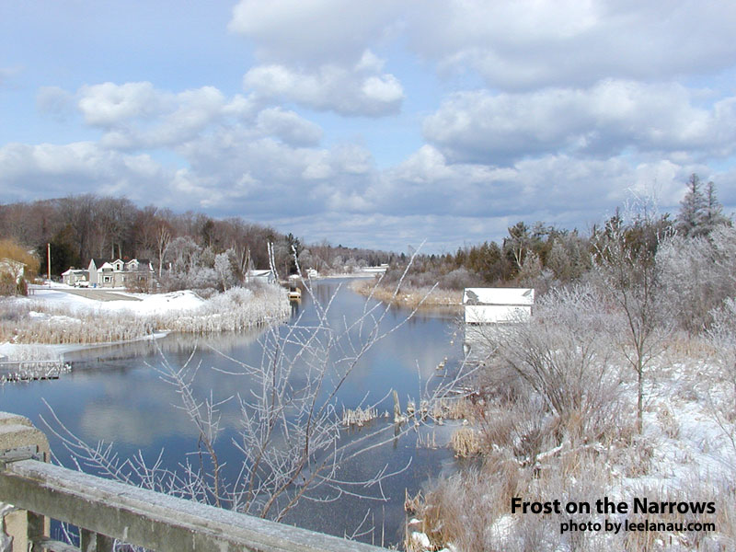

Slide 17
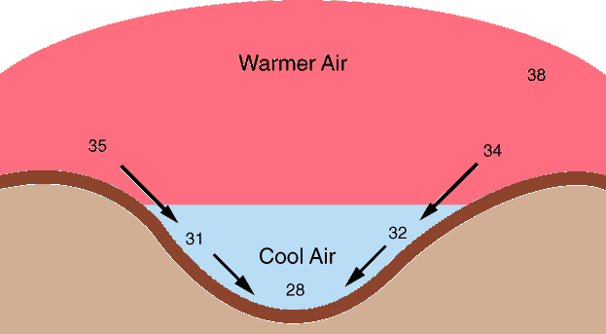
Frosty Facts
Frost forms by the process of deposition, with water vapor going directly to ice (frost)
Frost forms as the air temperature drops to the dew point, when the dew point is at or below 0C (a.k.a. frost point)
Frost is most frequent in low-lying areas, since cold air is denser than warm air and flows to low spots.

Slide 18
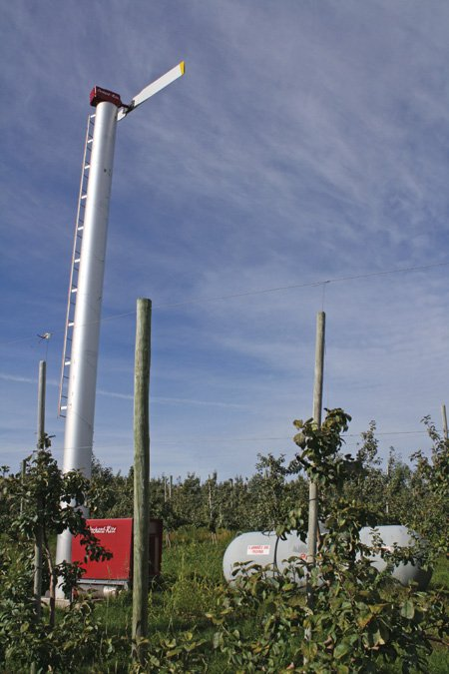
Frost is a problem for orchards in eastern Washington
Damages sensitive buds
Ways to attack the problem:
Fans
Heaters
Spraying water

Slide 19
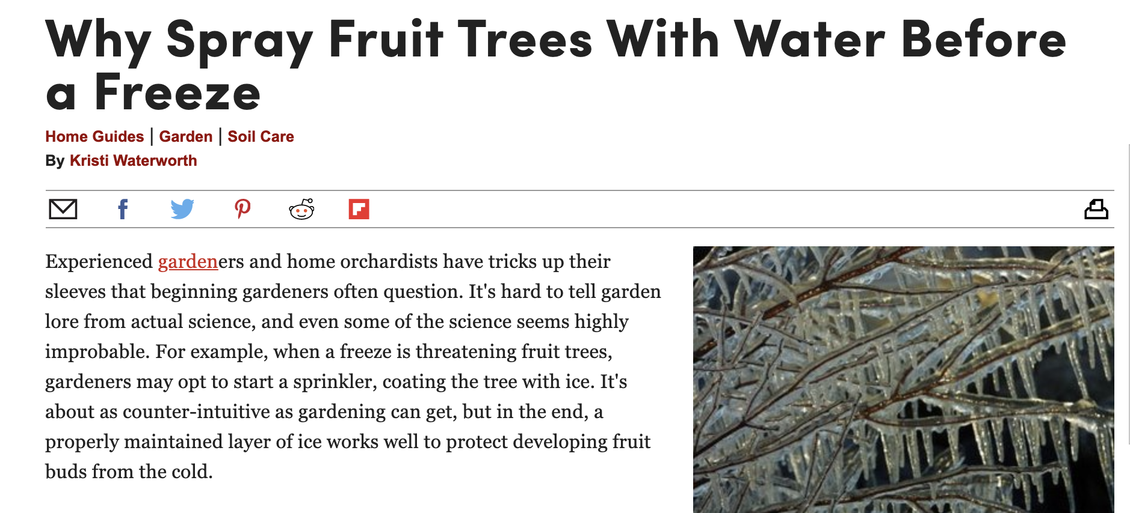
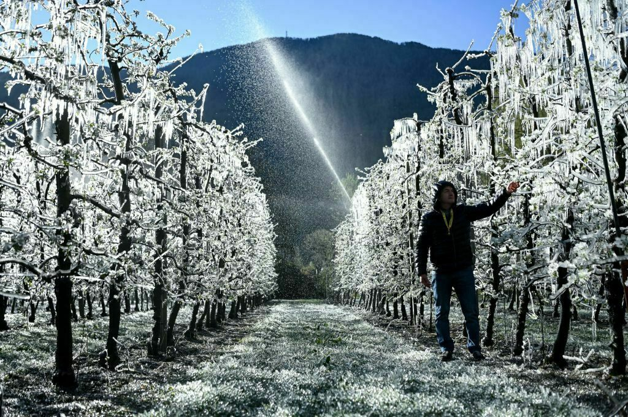
Why does spraying water help in cold weather?

Slide 20
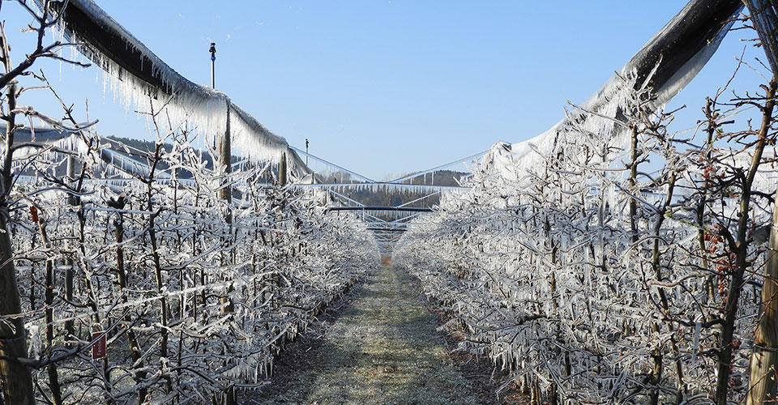
Answer
When water freezes, it releases the latent heat of fusion.

Slide 21
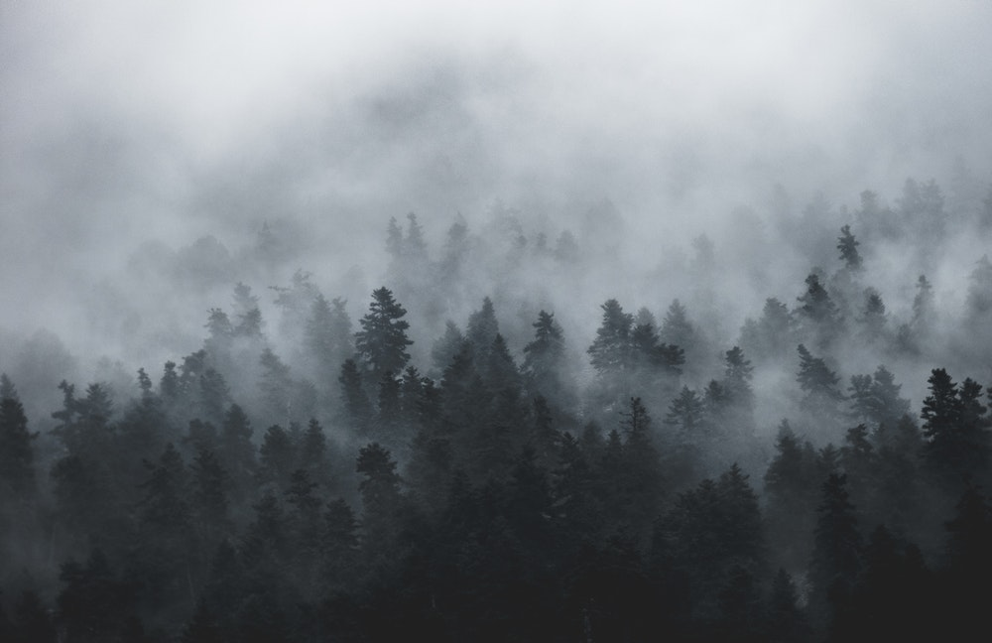
FOG

Slide 22
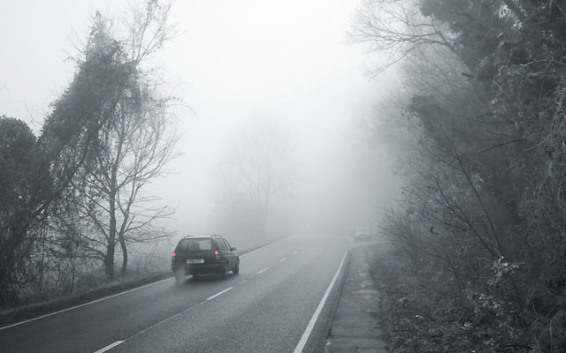
Fog is a cloud intersecting the ground
Can be made of liquid water droplets or ice crystals (ice fog)
Can get fog in three ways:
Cooling air to the dew or frost points
Adding moisture to the air (increasing dew point)
Mixing different air masses that are not saturated, but are when mixed

Slide 23
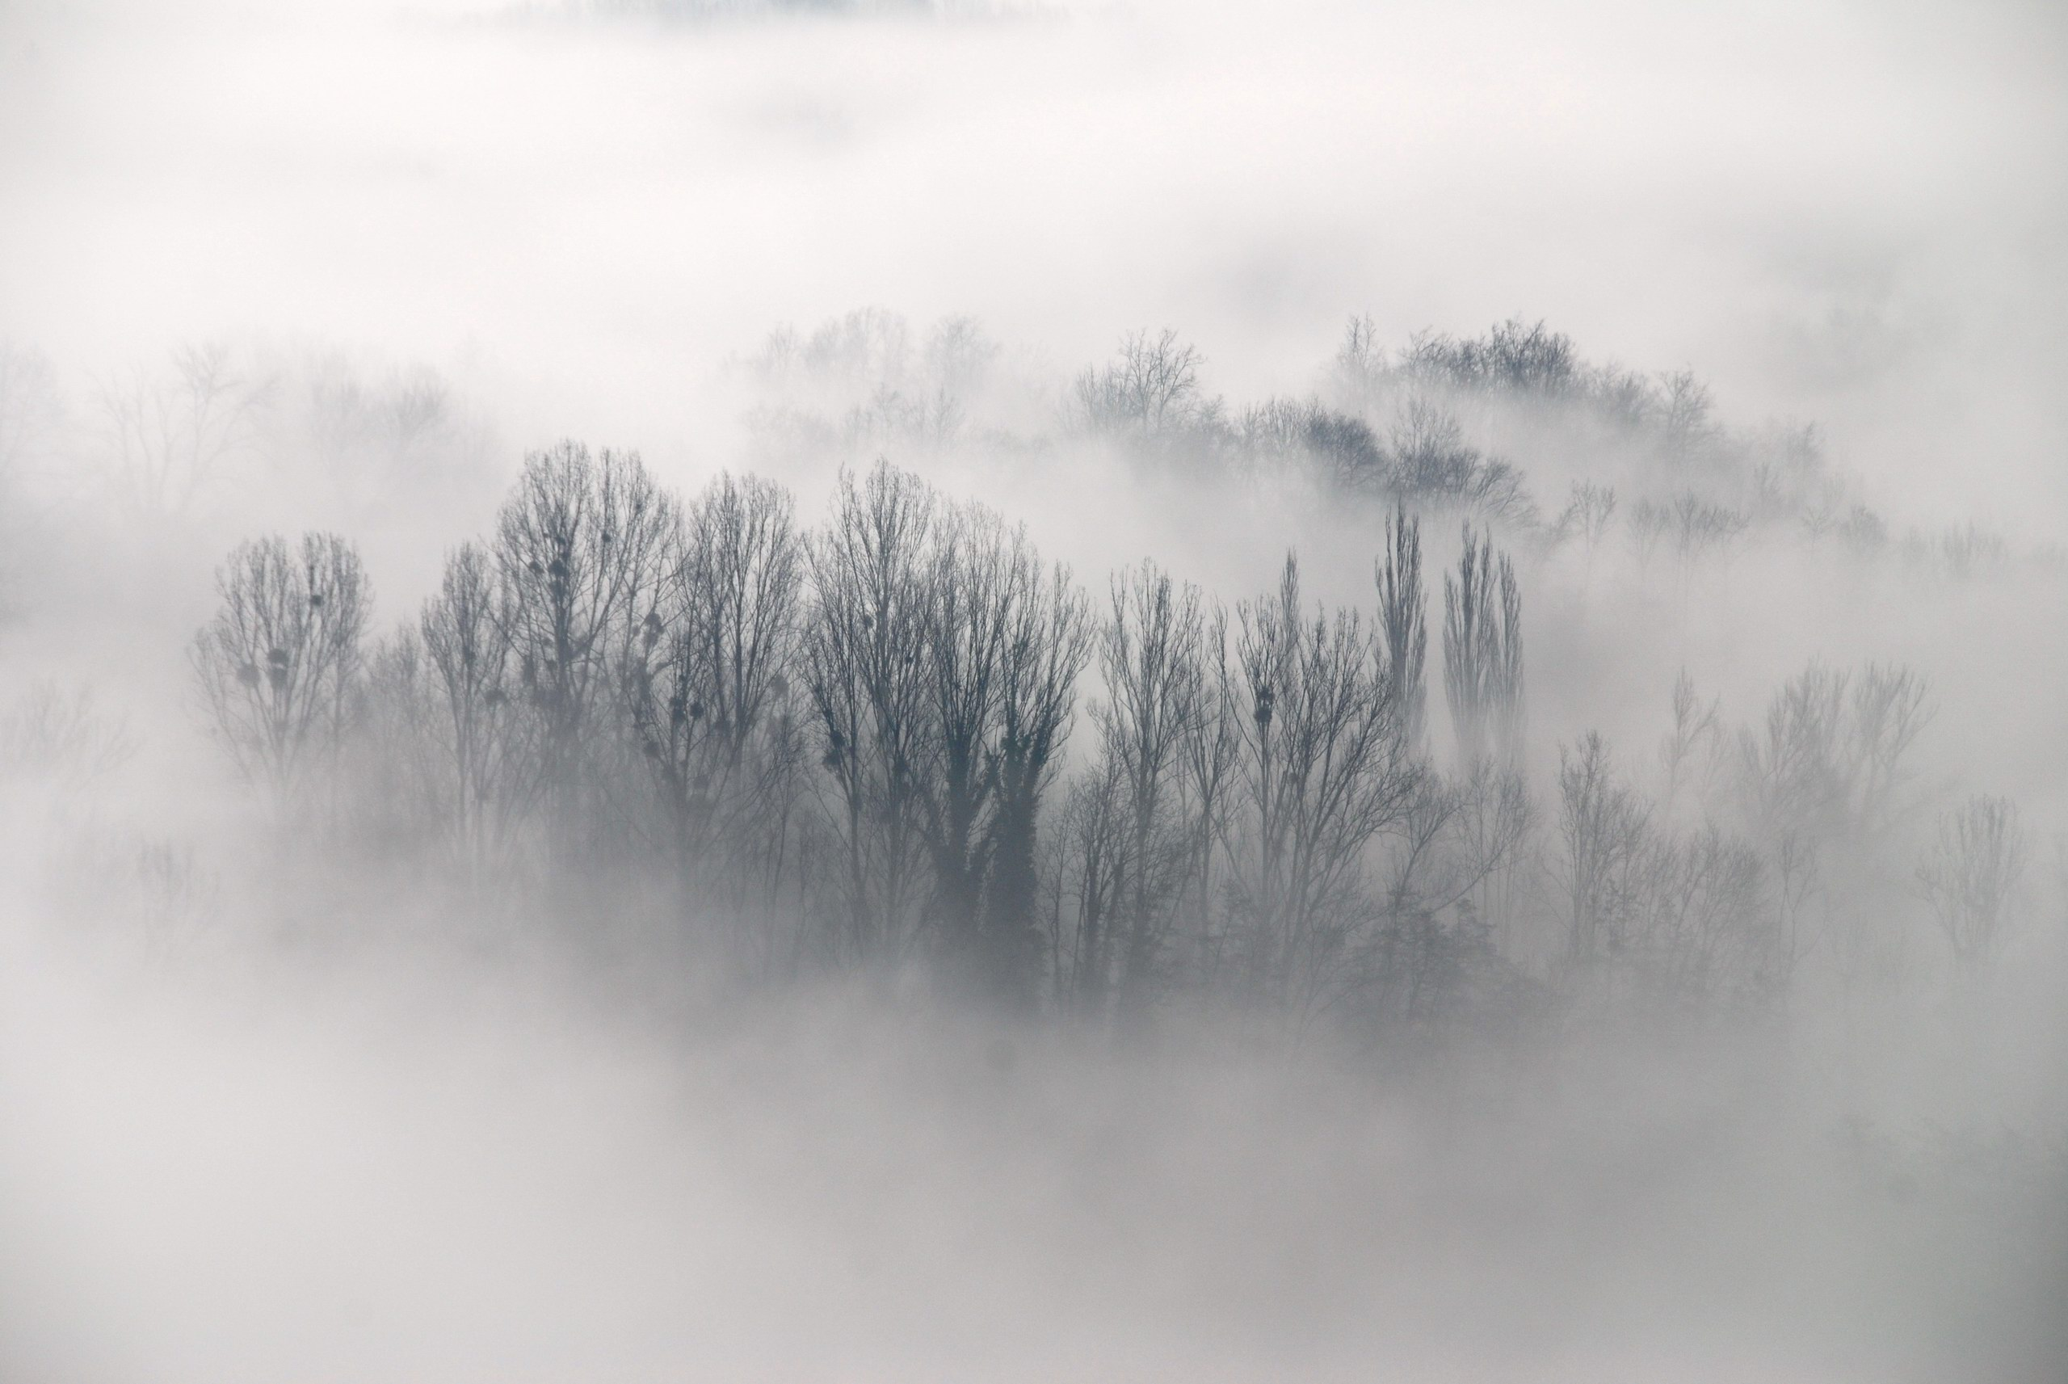
Types of Fog
Radiation
Advection
Upslope
Frontal
Steam fog

Slide 24
Radiation Fog
Associated with clear or nearly clear conditions, light winds, moist layer near the ground
Earth radiates infrared radiation to space and cools the surface
Light turbulence mixes cool air from surface into lower atmosphere, which cools air to the dew point

Slide 25
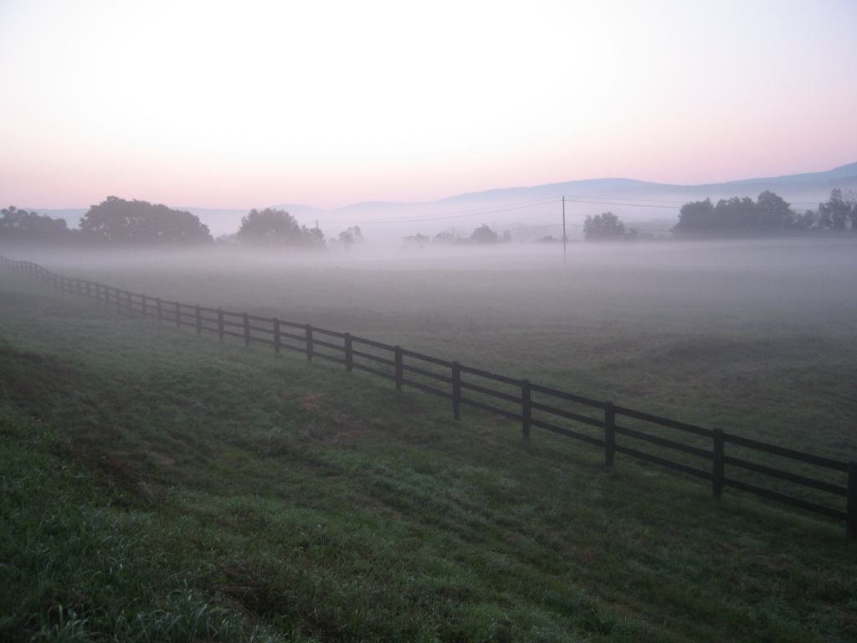
When there is little wind

Slide 26
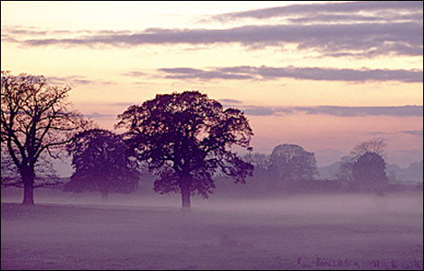
If winds are very light: Ground Fog

Slide 27
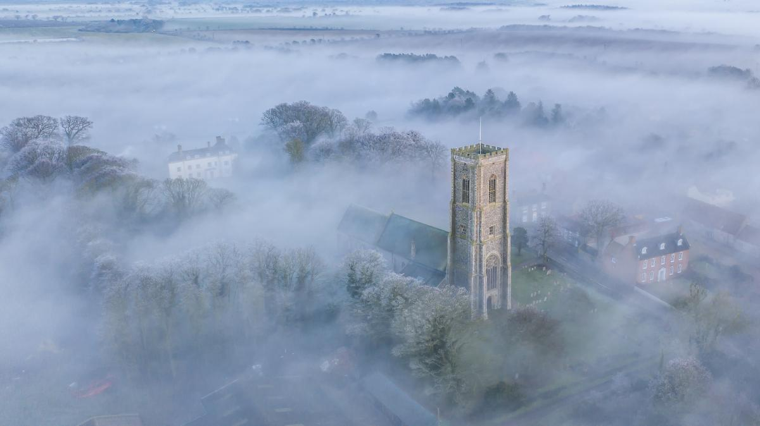

Slide 28
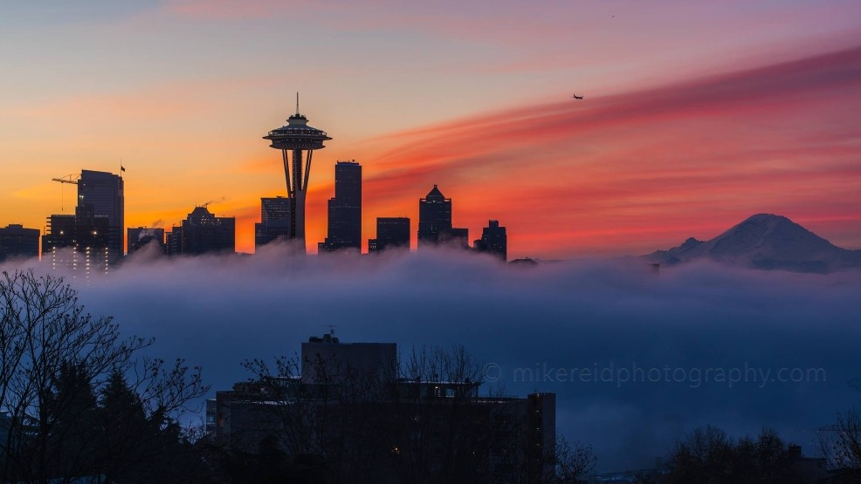
More wind mixing gives deeper fog

Slide 29
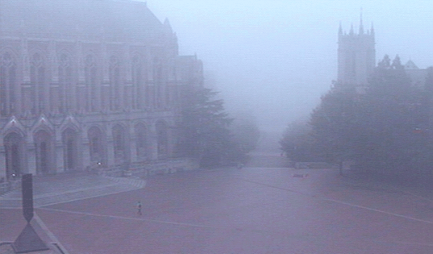

Slide 30
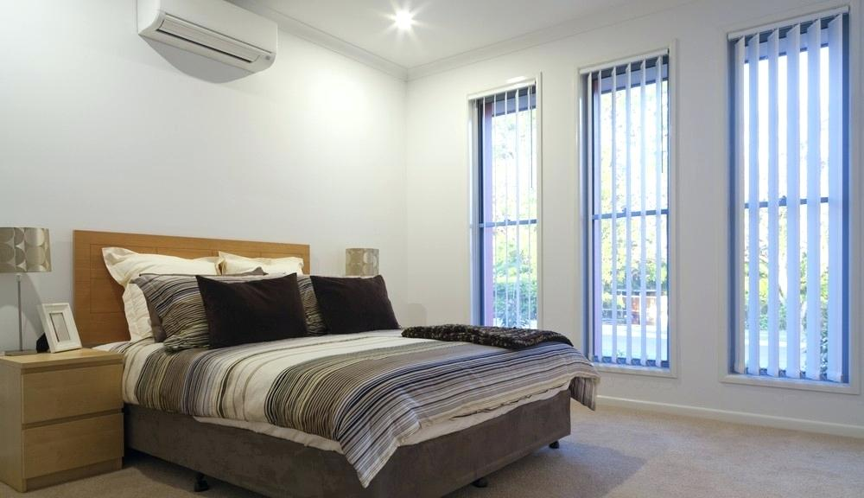
Radiation Fog
Light winds (2-7 knots) ideal. Why? Just the right amount of mixing. Too strong winds mixes too much dry warm air to the surface.
Storng winds like trying to cool a big house with a small AC

Slide 31
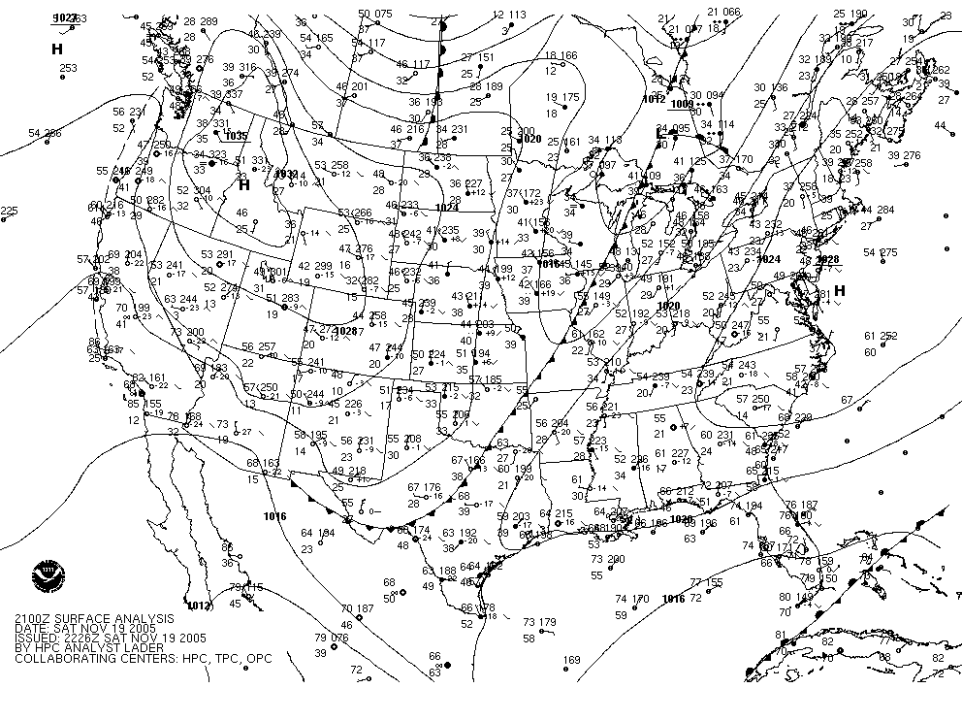
Fog often associated with high pressure (which is associated with clear skies, light winds)

Slide 32
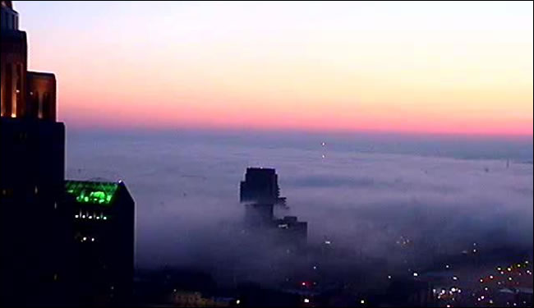
Radiation Fog is the Major Fog Here in the Northwest

Slide 33
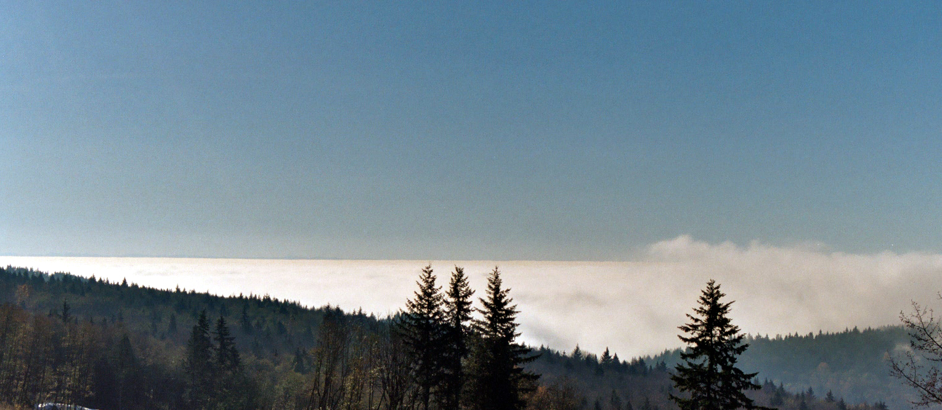
How deep?
Radiation fog can range from a few inches (ground fog) to a few hundred meters in depth

Slide 34
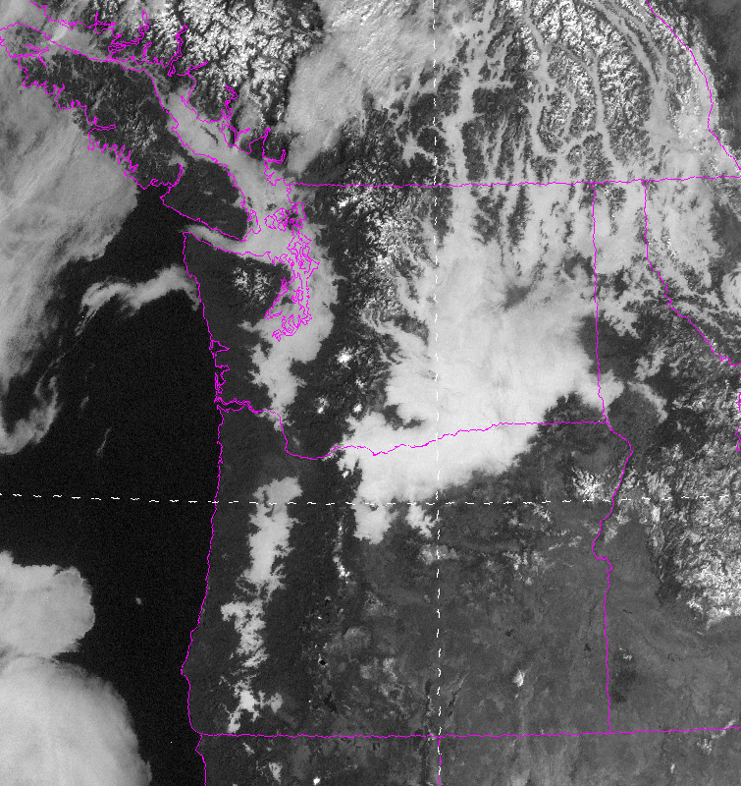
Fog from space

Slide 35
When is the foggiest time of the year here in the Northwest away from the Pacific?

Slide 36
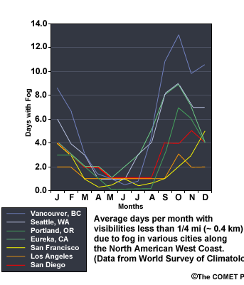
Early fall. Why?

Slide 37
The Answer
Early Fall
Lengthening nights (more time to cool)
Still clear or partly cloudy (good radiational cooling)
Surface is moister than in mid-summer
Atmosphere is relatively stable (atmosphere is still warm, surface cooling)

Slide 38
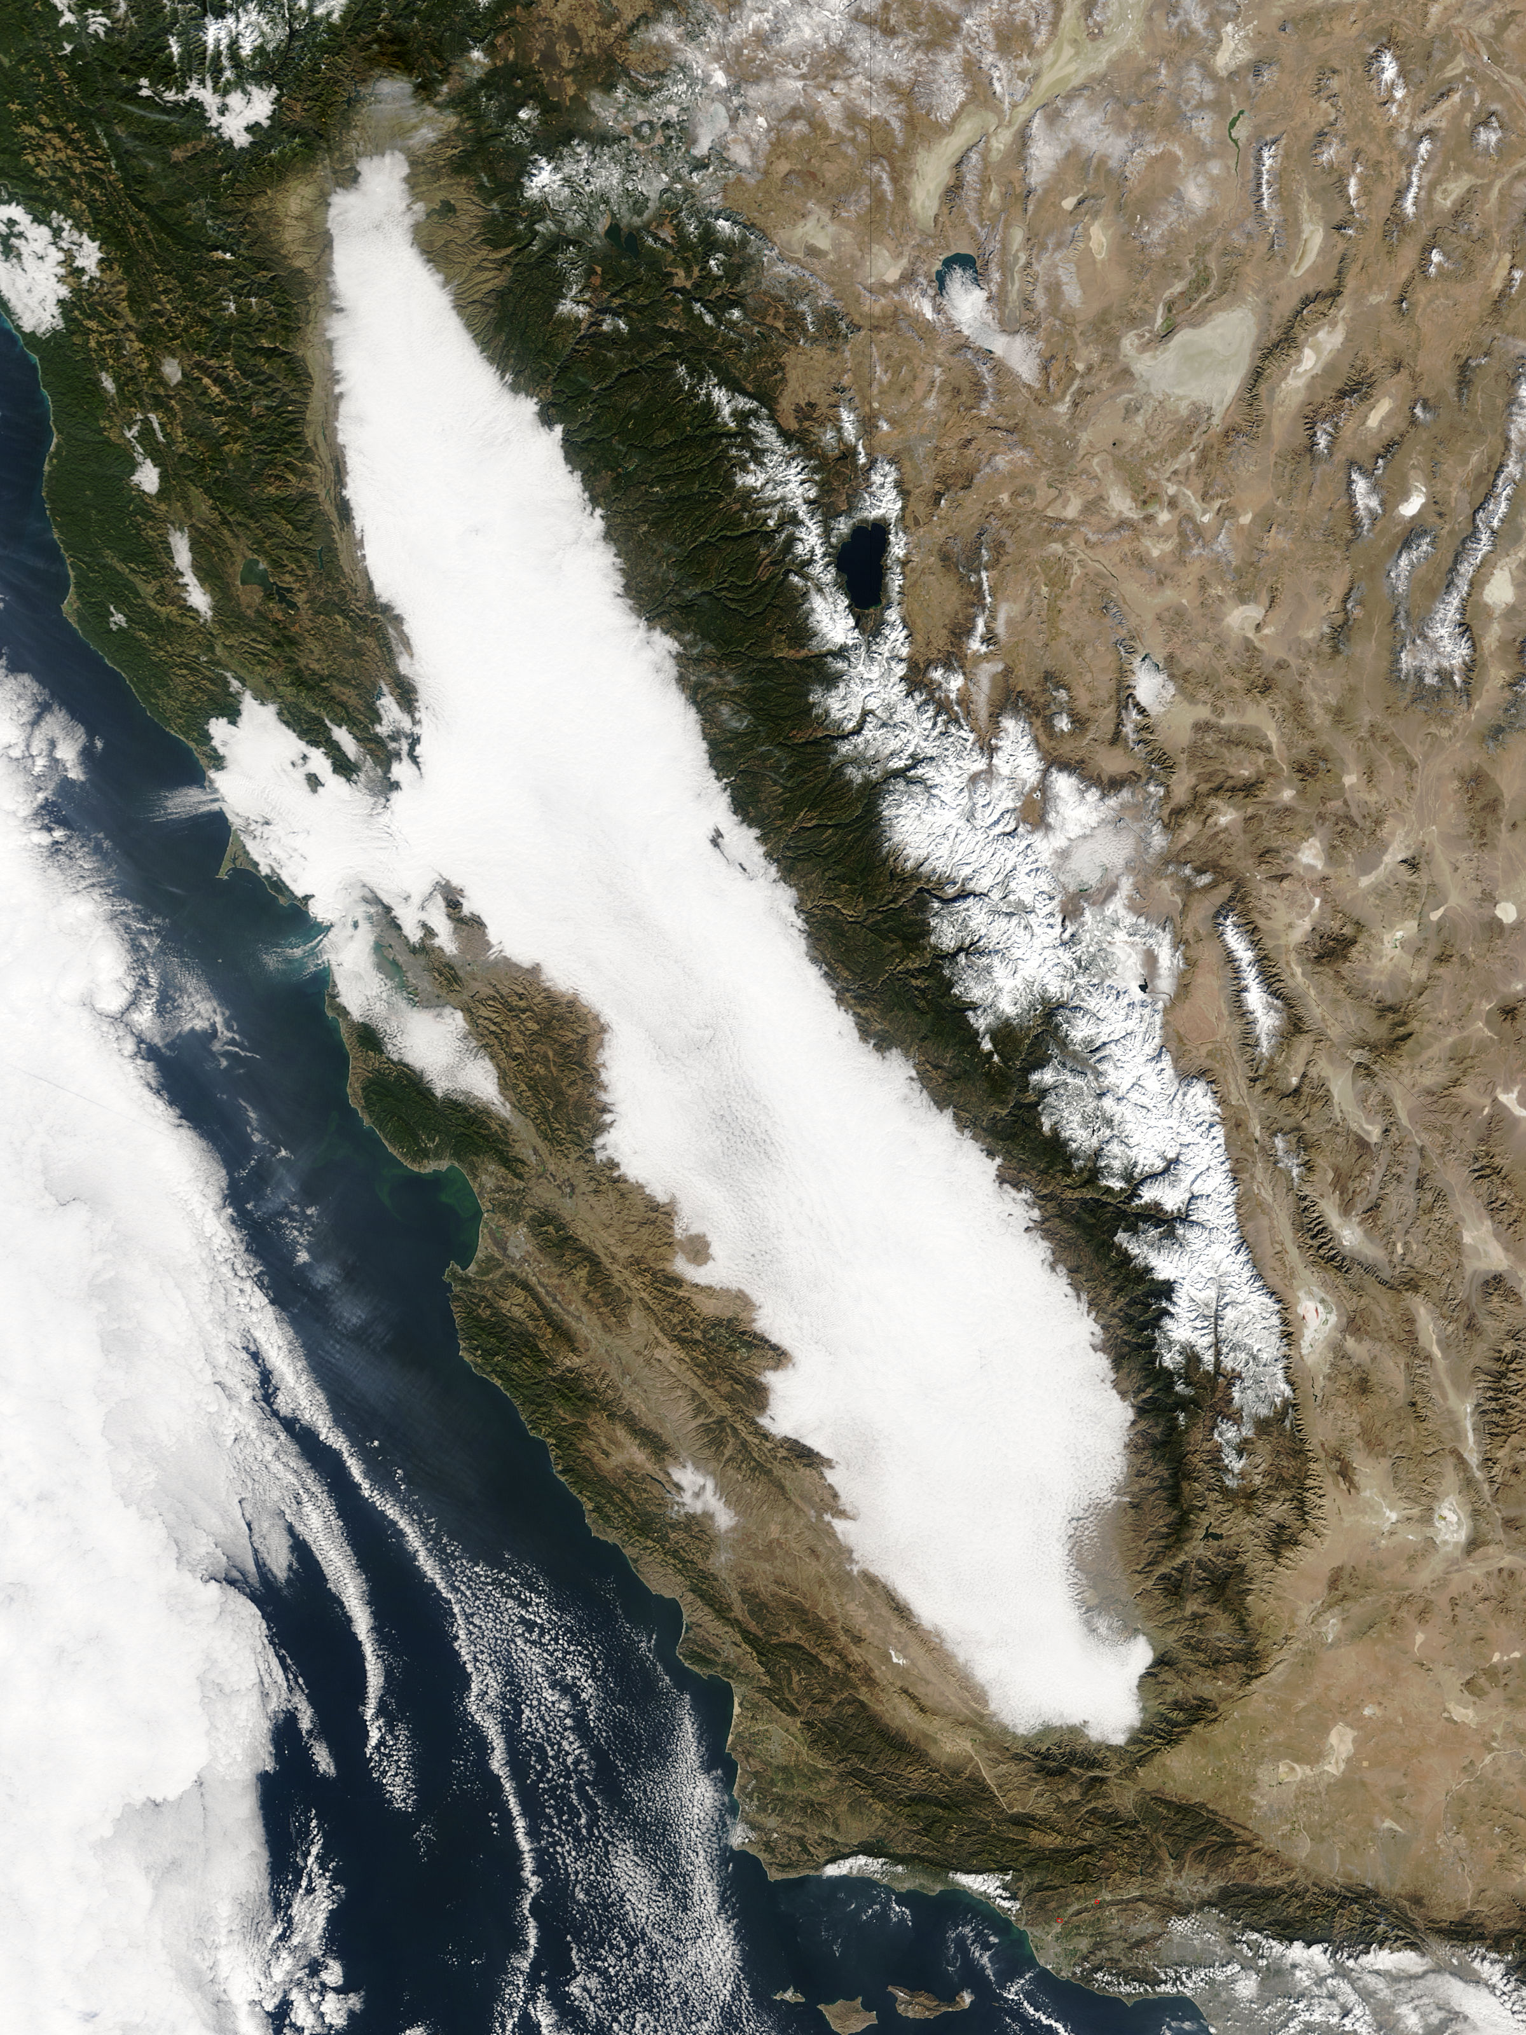
Radiation Fog Can Fill the Central Valley of CA Tule Fog

Slide 39
Advection Fog
advection: the horizontal transfer of any atmospheric property by the wind

Slide 40
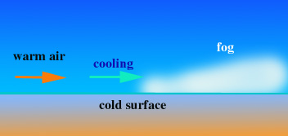
Warm air is advected over a cool surface

Slide 41
Advection Fog
Occurs when warm, moist air moves over a cooler surface
Frequently observed along the West Coast in summer. There is cold water just offshore during late spring into fall.
When warm, moist air from the Pacific goes over cool coastal water, can get saturation and fog.

Slide 42
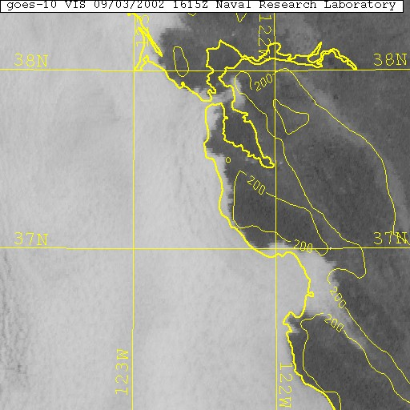

Slide 43
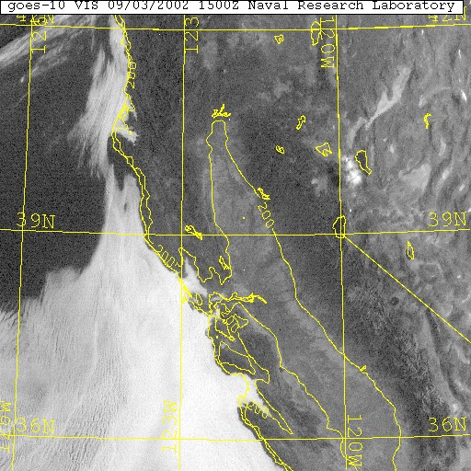

Slide 44
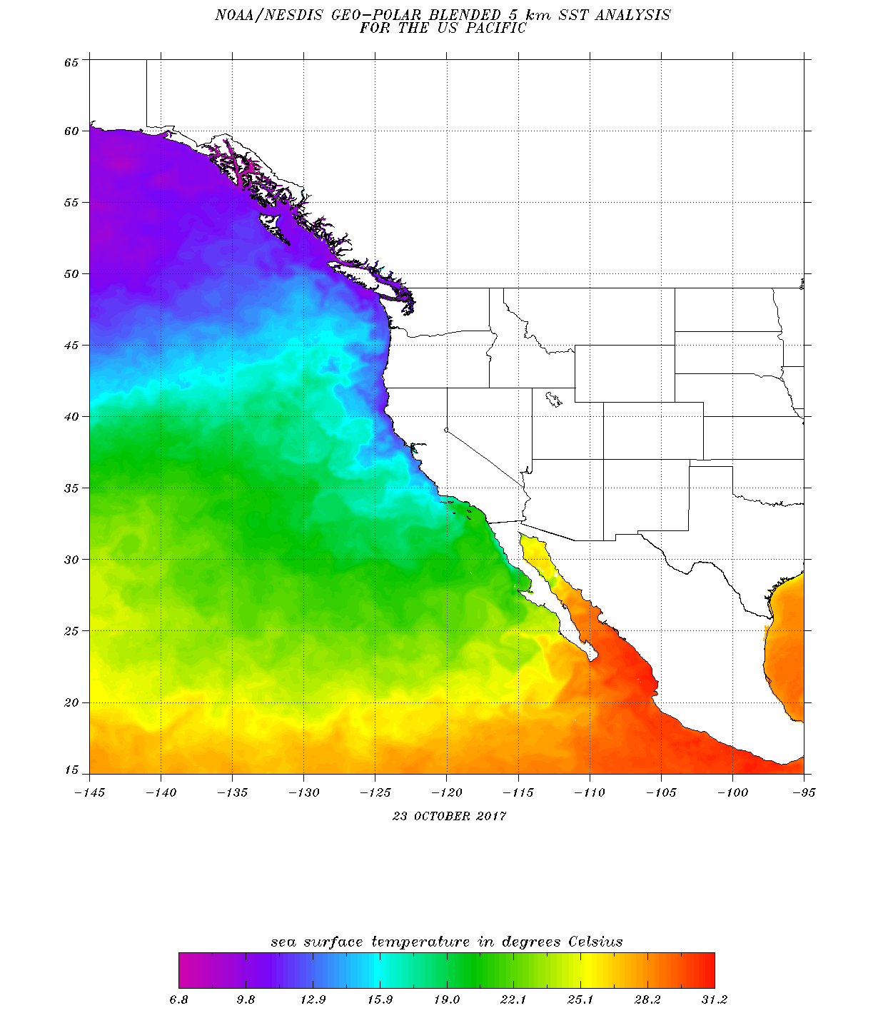
Sea Surface Temps (October 2017 shown)

Slide 45
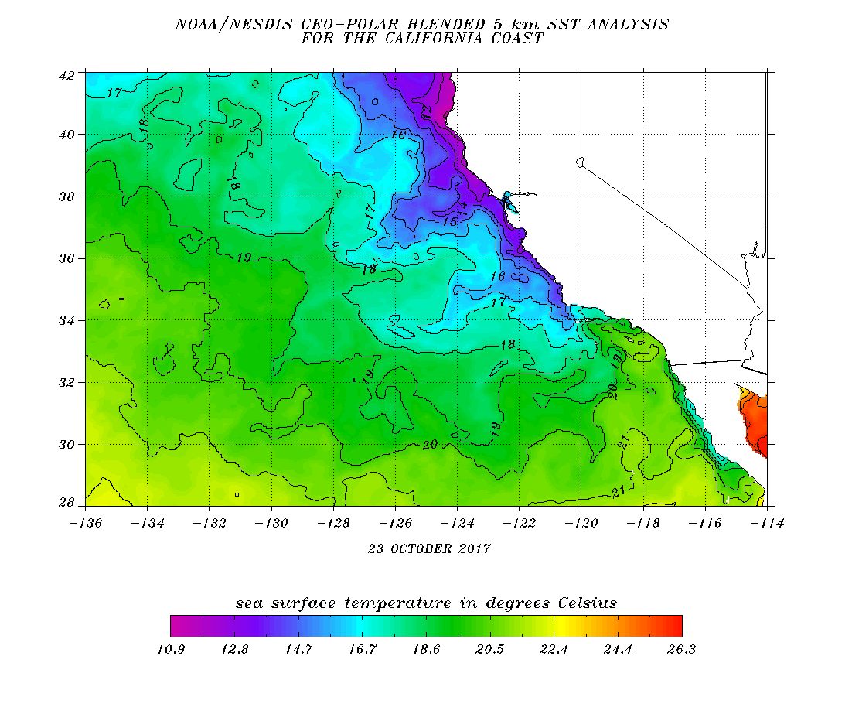

Slide 46
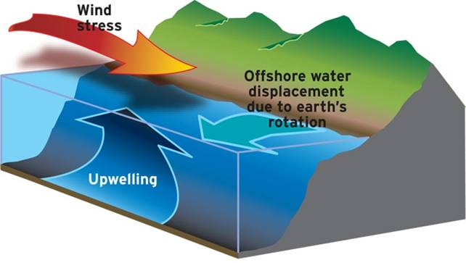
Why is the Pacific Ocean cool along the coast? Upwelling of colder subsurface water when there are northerly winds along the coast

Slide 47
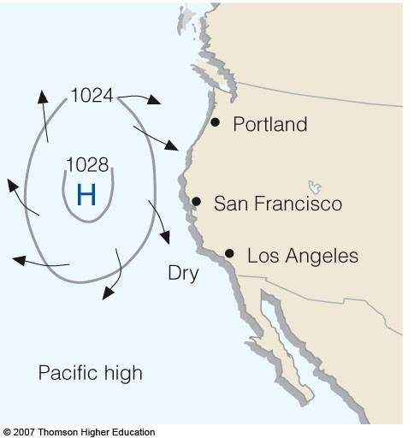
Summer East Pacific High is Important

Slide 48
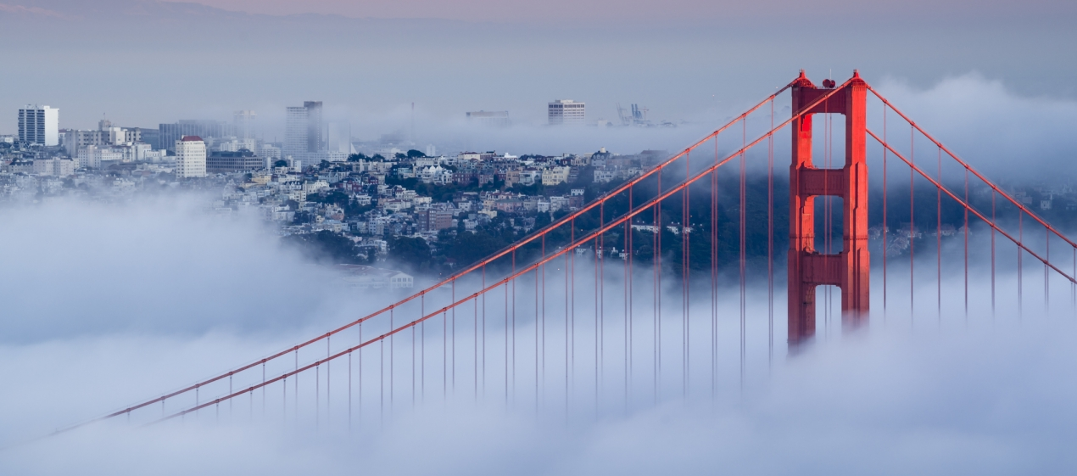
Golden Gate Bridge Fog is Classic Advection Fog

Slide 49
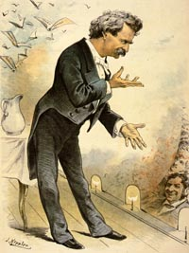
Mark Twain Quote
“The coldest winter I ever spent was a summer in San Francisco.”

Slide 50
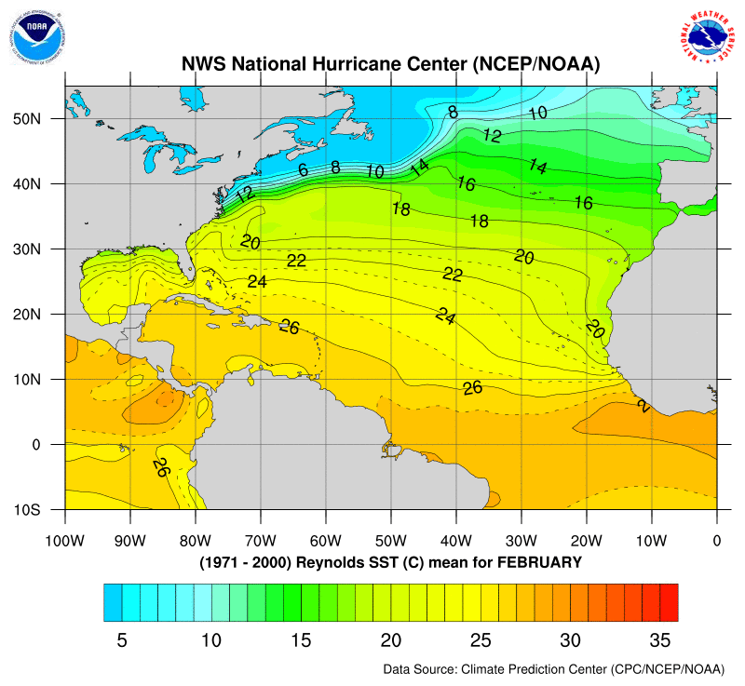
Also Advection Fog Along the Northeast Coast
Coastal New England has fog due to cold water along the coast and the warm Gulf Stream to the south
Warm, moist air moves northward over the Gulf Stream.

Slide 51
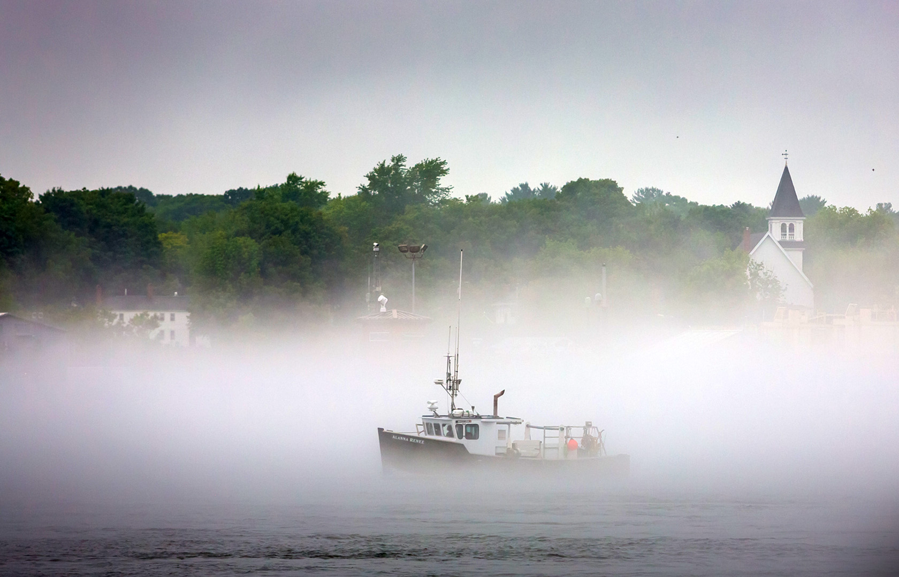
New England Advection Fog

Slide 52
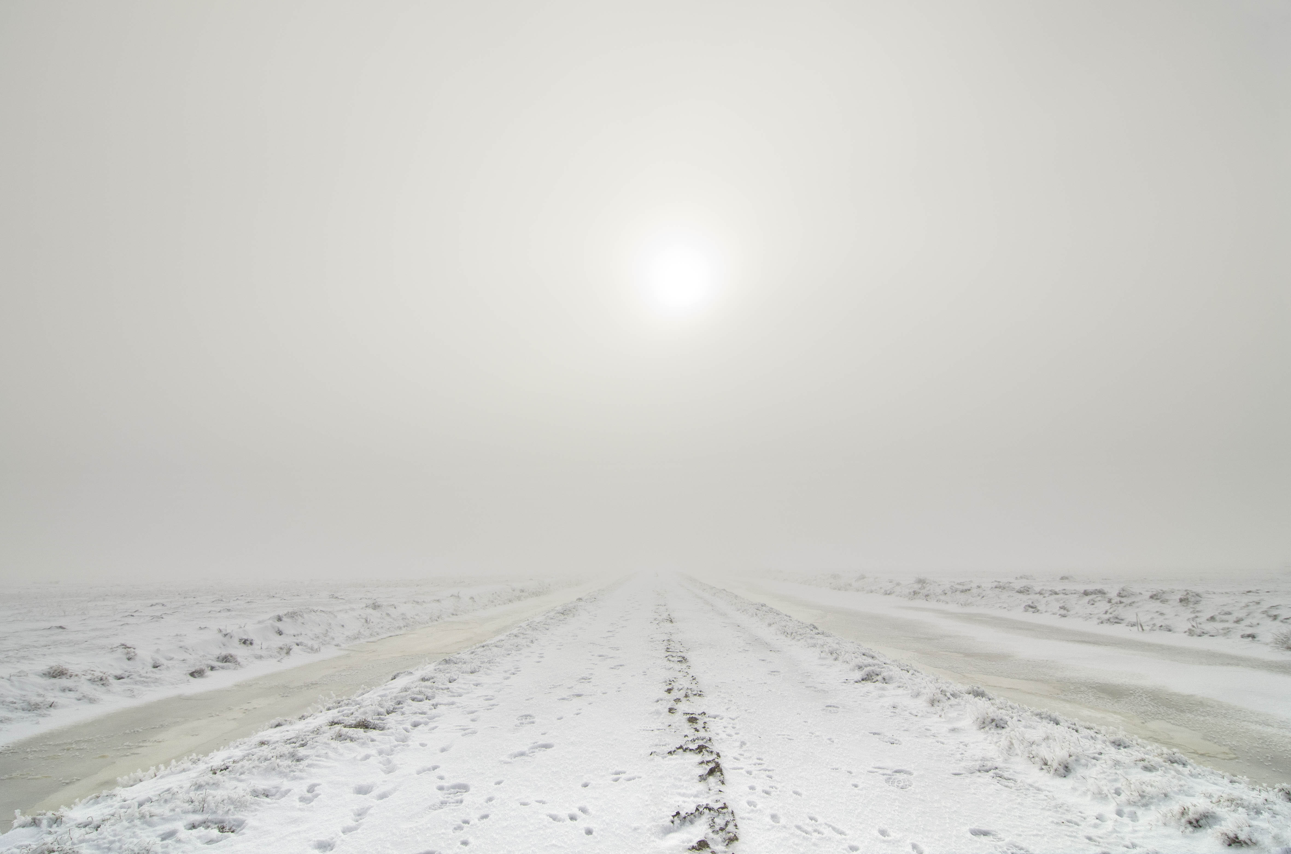
Advection fog over snow: warmer air over a colder surface

Slide 53
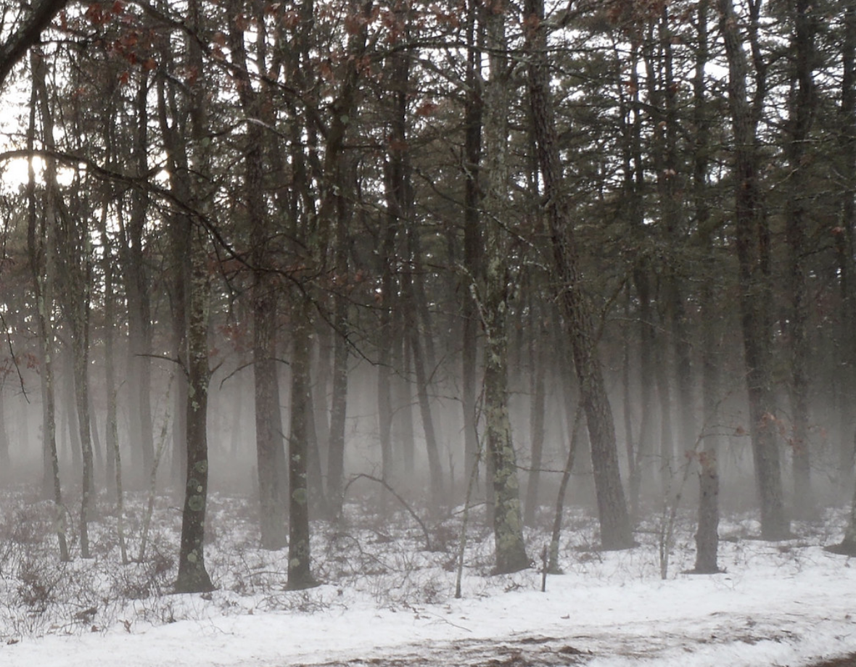
Advection fog over snow

Slide 54
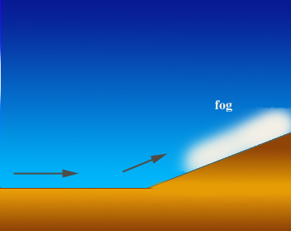
Upslope Fog
Air cools to saturation as it rises

Slide 55
Upslope Fog
Air moving up a slope cools adiabatically resulting in saturation and fog
Disliked by skiers.

Slide 56
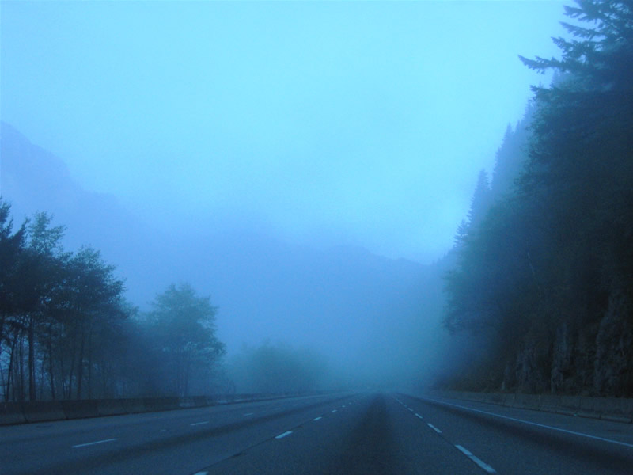
Upslope Fog: Snoqualmie Pass

Slide 57
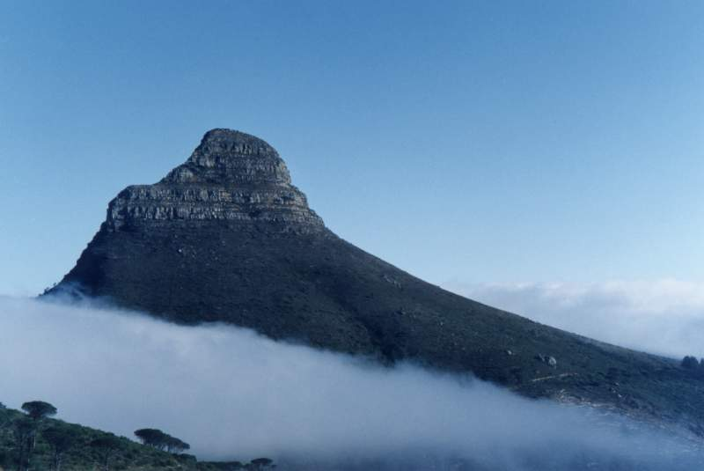

Slide 58
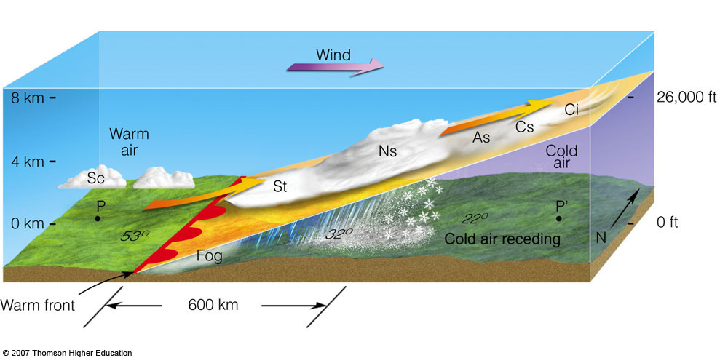
Frontal Fog: Particularly north of warm fronts

Slide 59
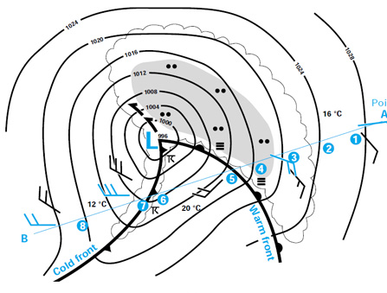
Frontal Fog
Precipitation falls into cool air, adding moisture and bringing the air to saturation.
Often found north of surface warm fronts.

Slide 60
Frontal Fog: adding moisture to cool air until is saturates

Slide 61
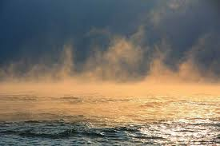
Steam Fog

Slide 62
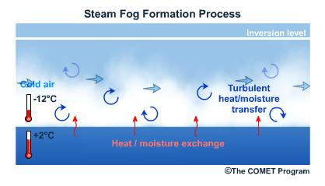
Cool, dry air mixing with warm, moist air near the surface

Slide 63

Steam Fog
Often associated with very cold air passing over warm water
A difference of 15-20F or more is needed between the water and air temperatures.

Slide 64



Slide 65


Slide 66


Slide 67


Slide 68


Slide 69
Where are the foggiest locations in the U.S.?

Slide 70

Average Number of Days with Dense Fog
Radiation fog
Advection fog
Upslope fog
Advection fog

Slide 71


Foggiest Place in U.S.: Cape Disappointment
106 days per year of heavy fog (<=.25 mile visibility)

Slide 72

Other fog facts
Fog tends to burn off from the edges
Fog accumulates in valleys and low areas
During the day, fog can lift into stratus

Slide 73
Local Fog Issues
SEA TAC is fogged in more than Boeing Field
MUCH less fog in Portland

Slide 74
Reason: SeaTac is on a hill
Fog Stratus
SEA
BFI

Slide 75

Portland has a lot of dry, easterly wind during winter: bad for fog
Troutdale
Notes:
Also note increased wind speed near CZK. Possible where the flow becomes supercritical. Also possibly Venturi.

Slide 76

Fog and Black Ice

Slide 77


Roadway Icing: Often called “Black Ice”
Dozens of people in WA state are killed by roadway icing each year. Many hundreds injured.

Slide 78

Biggest Threat: Fog Moving Over Cold Road
Typically, starts with a clear, cold night with light winds in which the surface rapidly cools.
A light frost occurs on the roadway, with nearby fog forming over a moist surface.
The fog drifts over the road depositing a thick coating of ice.

Slide 79

Be Worried…Very Worried

Slide 80
Roadway Icing 101: Temperature Facts
Air temperatures are generally measured at 2 meters (roughly 6 ft) above the surface.
Car thermometers measure temperatures a few feet above the road.
Temperatures at the surface can be cooler than air temperature a few feet above the surface during winter nights

Slide 81

Surface Temperature
On cold nights the ground temperature can be 2-6F colder than the official air temperature or your car thermometer temperature.
Thus, once the air temperature drops below roughly 36-37F, you should be careful.

Slide 82

Is ”Black Ice” Really Black? No, it is nearly clear.

Slide 83


Roadway Icing is Particularly Bad on Bridges

Slide 84

Why bridges so problematic? Insulating air under the bridge No conduction of heat from ground into bridge

