Slide 1
Cyclone and Frontal Structure and Evolution
Winter 2026
ATMS 370
Professor Cliff Mass
Department of Atmospheric Sciences
University of Washington

Slide 2
Reality is Usually More Complex Than the Norwegian Cyclone Model

Slide 3
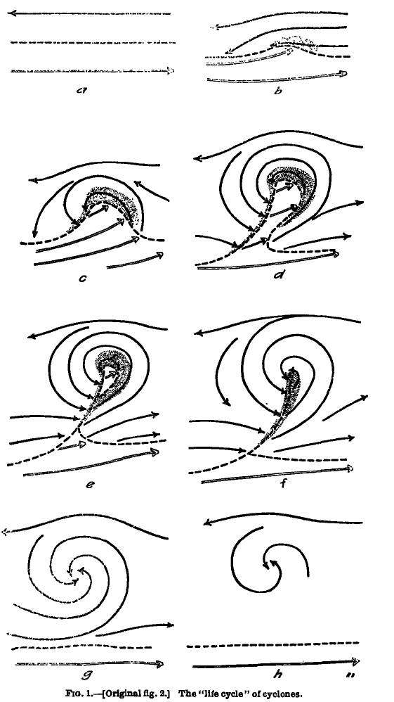
The Classic Evolution
Bjerknes and Solberg
1922

Slide 4
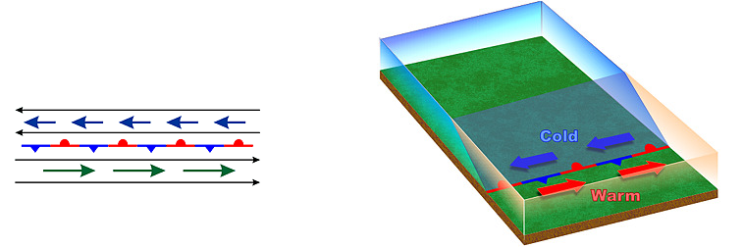
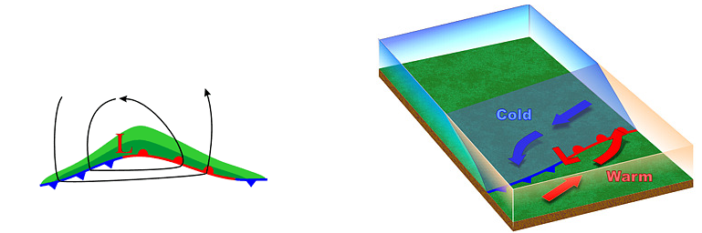
Stationary Polar Front
Wave Forming on Polar Front

Slide 5
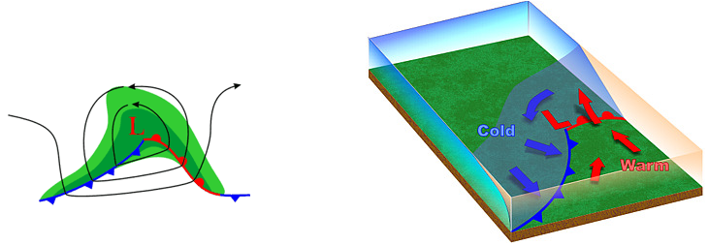
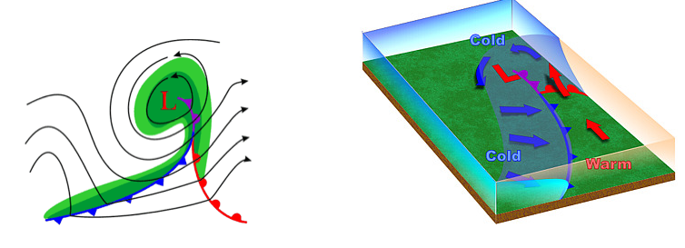
Wave Amplifies
Occlusion as Cold Front Catches Up to Warm Front

Slide 6
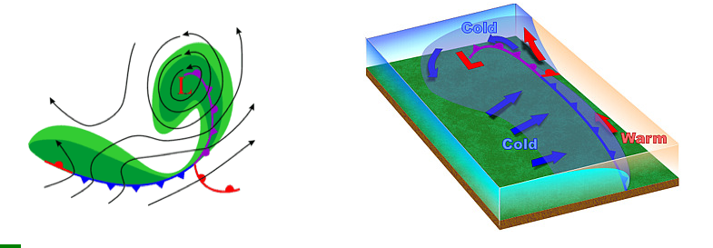
Occlusion Lengthens and System Weakens

Slide 7
The Norwegians Had Mainly Land Observations
But When More Ocean Observations Became Available a Different Structural Evolution in the Lower Troposphere Became Apparent

Slide 8
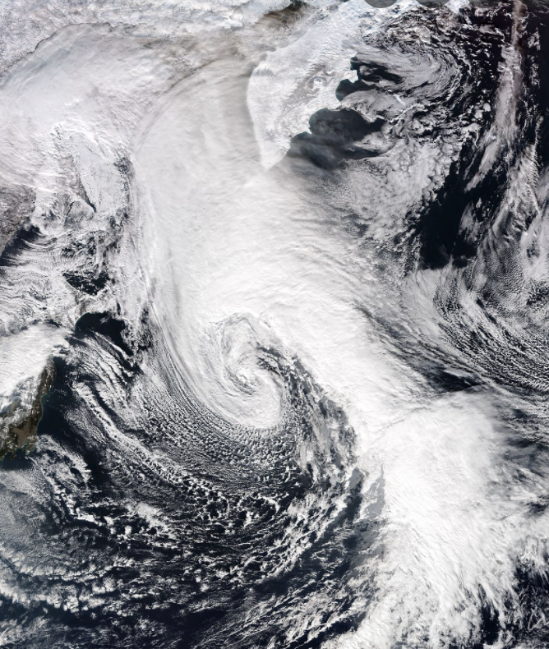
Low-Level Oceanic Cyclone Structure
Is Not the Same as over Land!

Slide 9
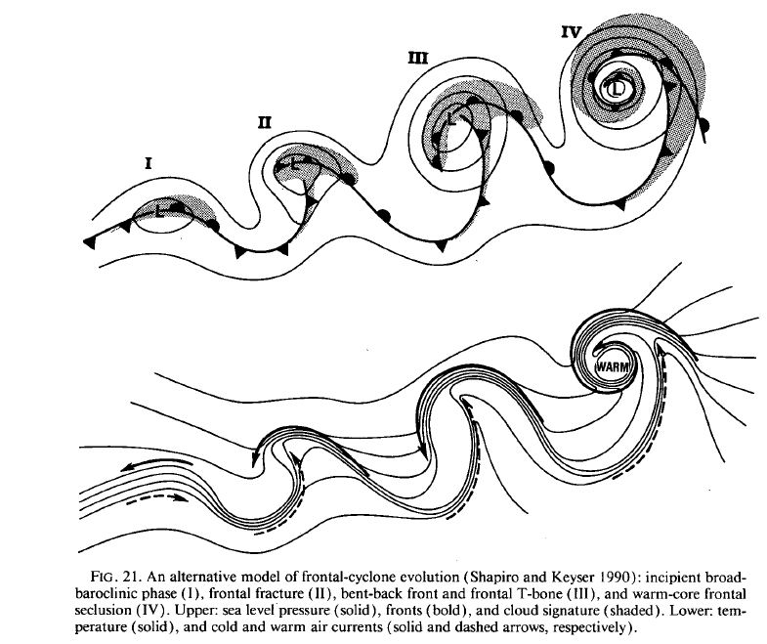
Shapiro-Keyser Model of Oceanic Cyclones
Four stages connected together

Slide 10
Major Elements of S-K Model
Weak cold front
Northern part of cold front is very weak (“fractured”)
No occlusion
Strong warm front that extends back into the low center
Solid lines are isotherms

Slide 11
Major Elements of S-K Model
“T-Bone” structure: cold front intersects the warms front at approximately a right angle
Strong back bent (or bent back) warm front.
Warm air seclusion near the low center.

Slide 12
Front/Pressure Evolution

Slide 13
Both New Observations and Improving Modeling Technology Showed the Different Structures
Over Water

Slide 14
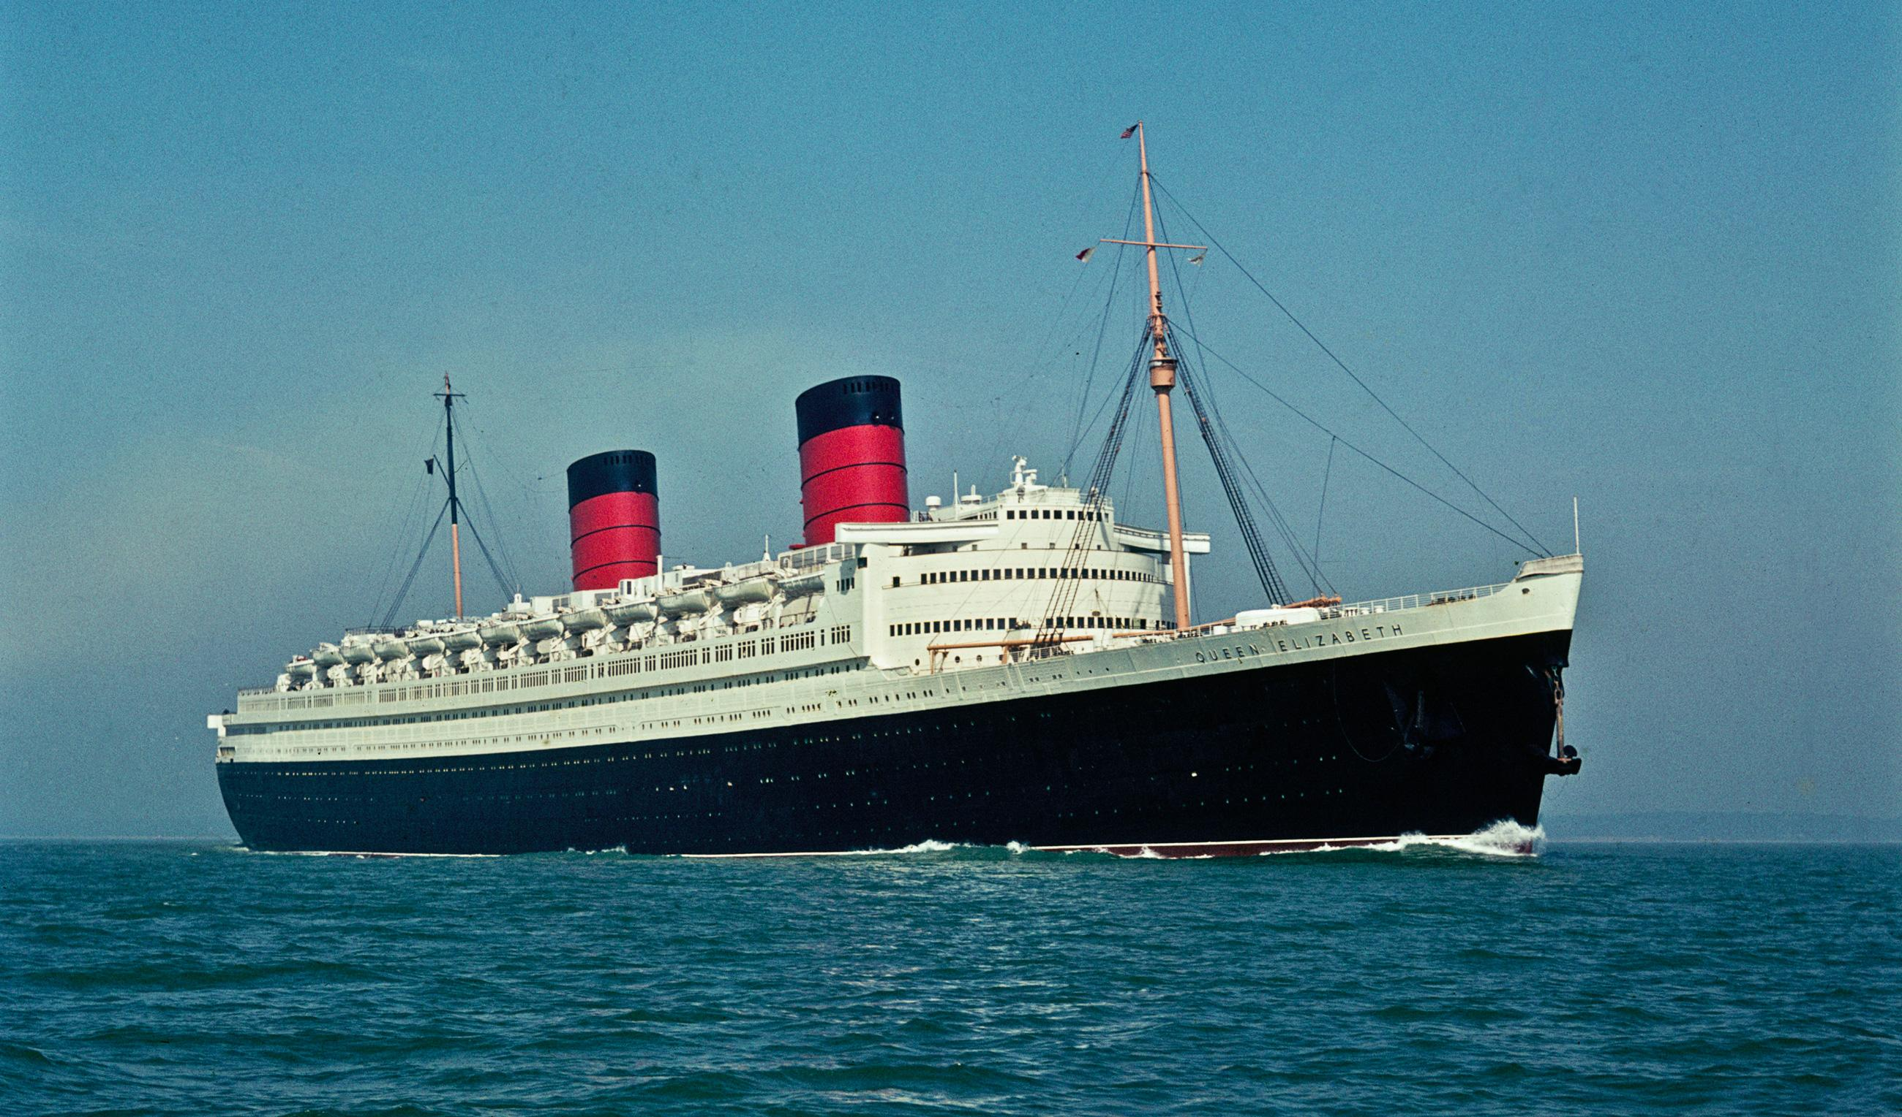
Simulation of the QE-2 Storm (Sept. 1978)

Slide 15
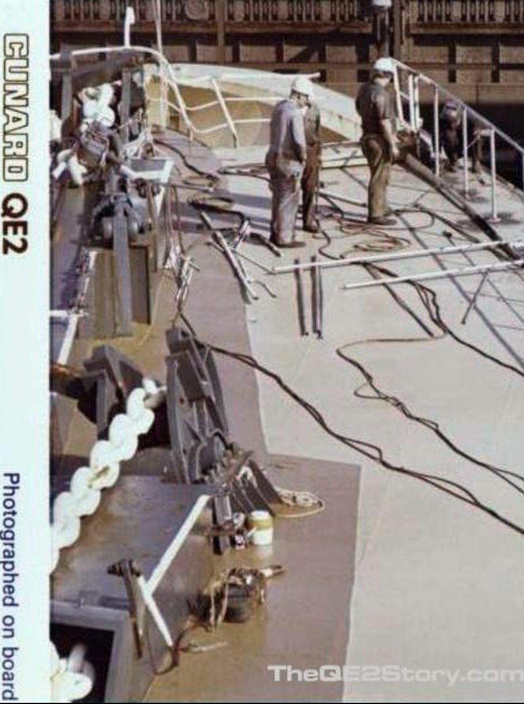
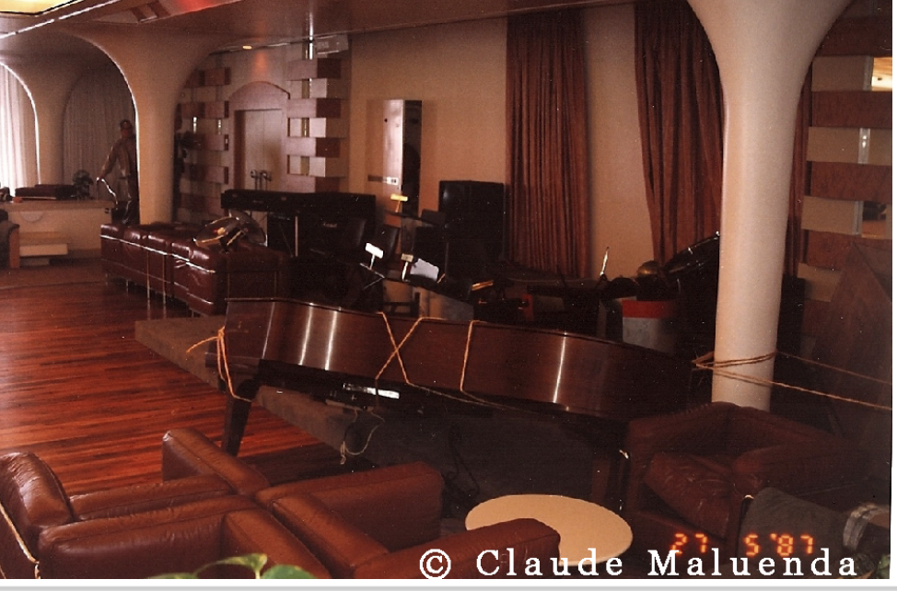
Major Damage As It Went Through a Powerful Cyclone

Slide 16
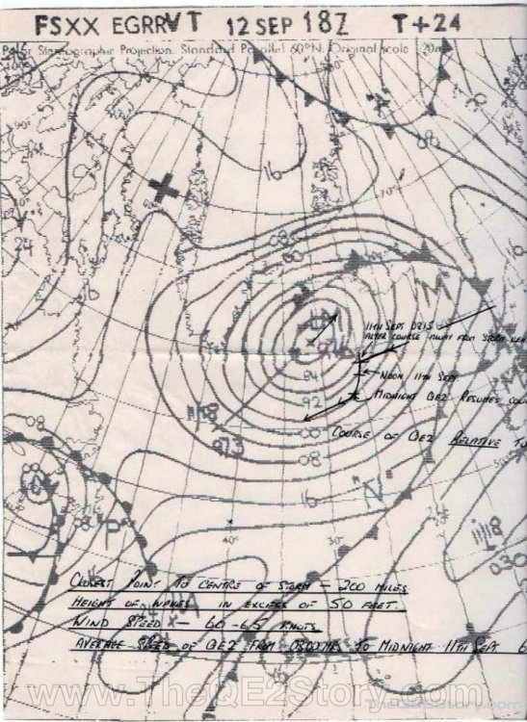

Slide 17
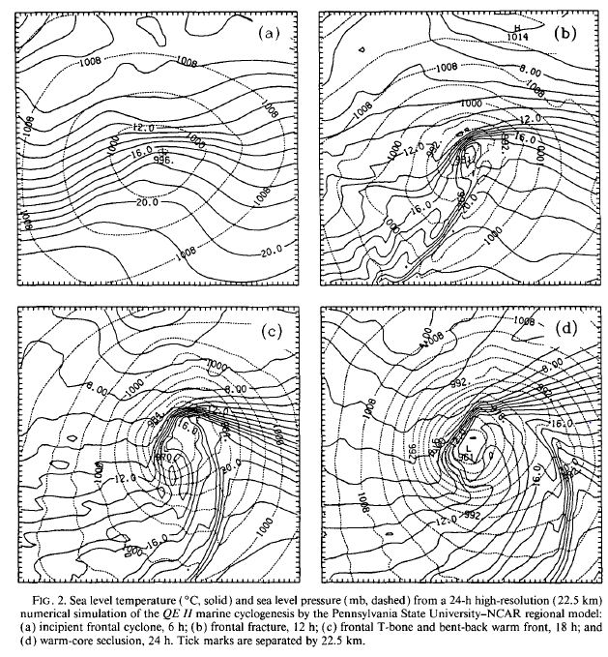
Simulation of the QE-II Storm
SL Temp and Pressure

Slide 18
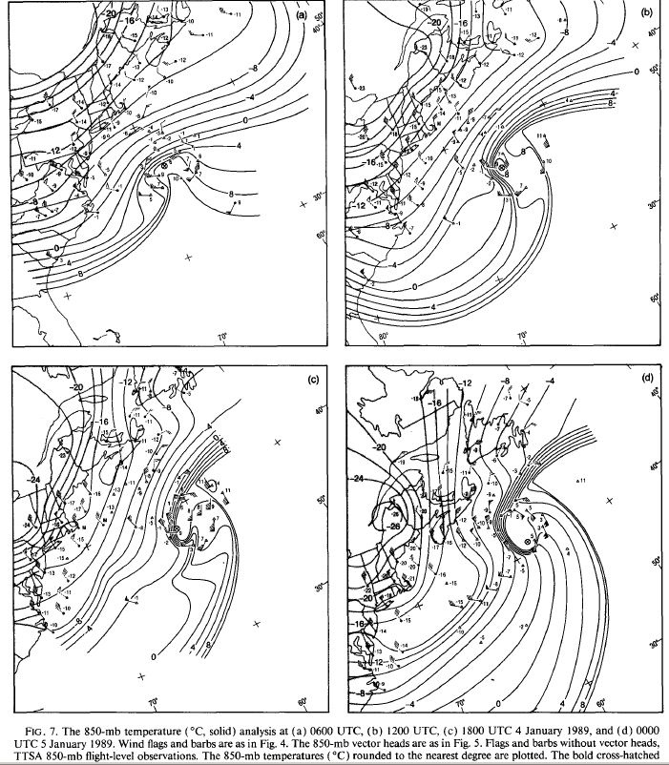
1989 storm
850 hPa
Temp
Neiman
and
Shapiro
1993

Slide 19
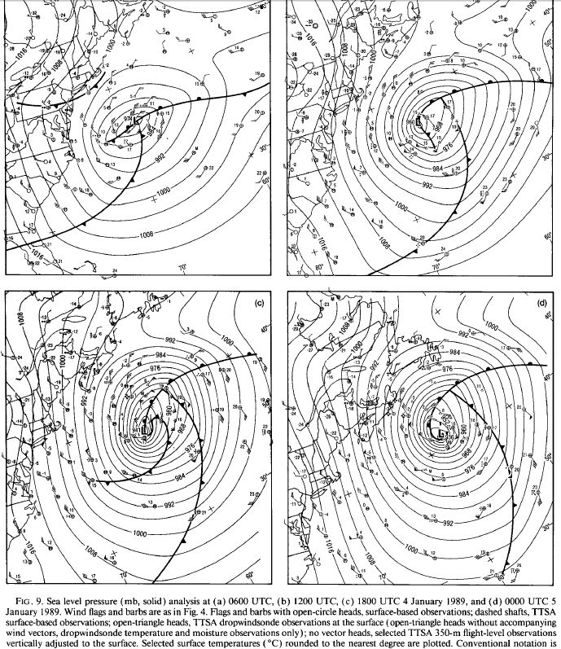
SLP

Slide 20
Why are cold fronts weak over the ocean?

Slide 21
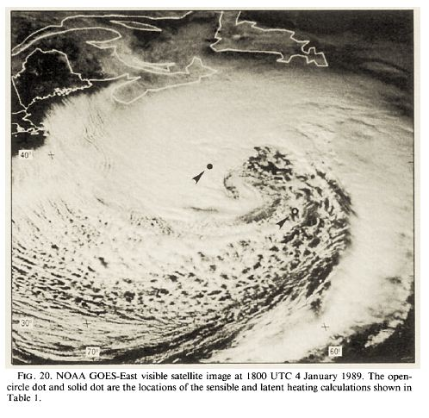
Air-Sea Interactions Warm the Cold Air, Weakened the Cold Front
Weak

Slide 22
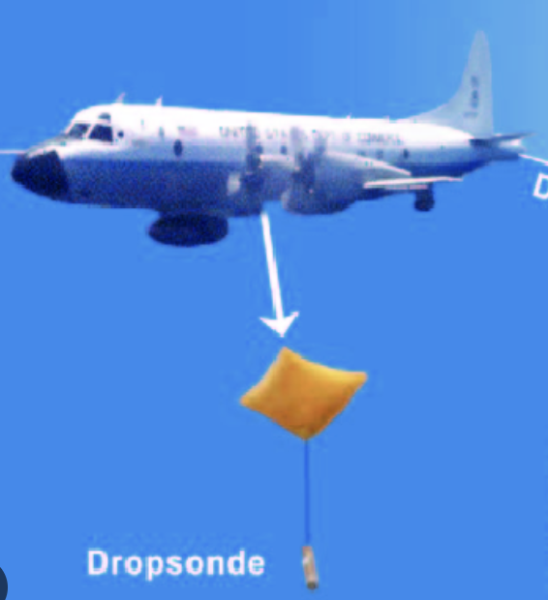
Special Observations from Aircraft for the 1989 Storm

Slide 23
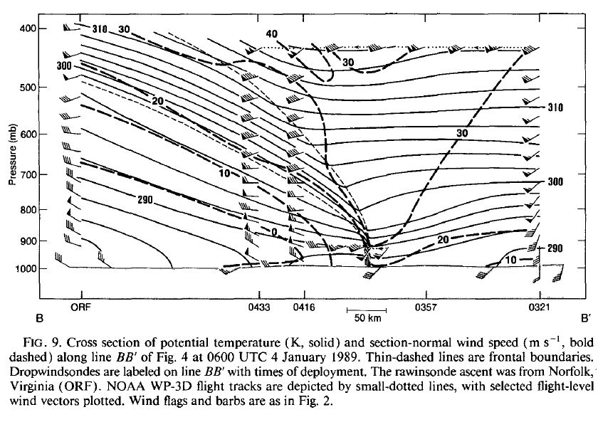
Cross Section Across Ocean Cold Front

Slide 24
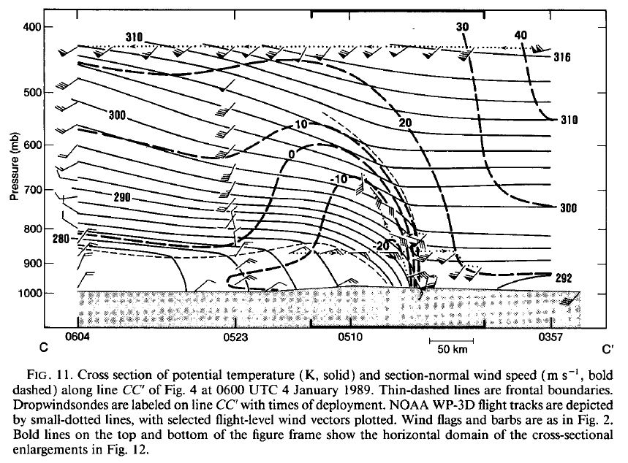
Cross Section Across Warm Front

Slide 25
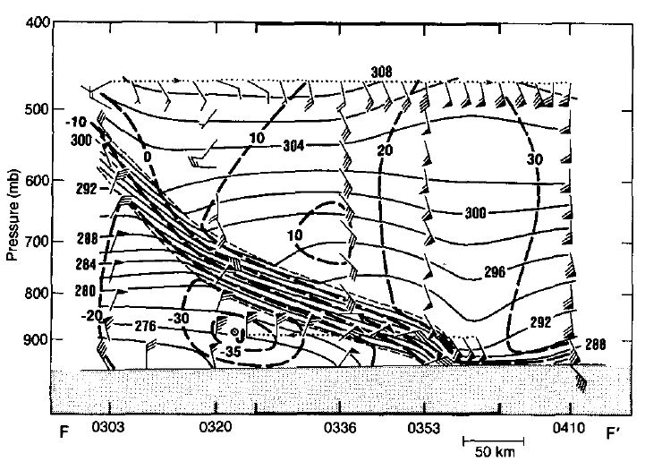
Cross Section Across Warm Front and Associated Low-level Jet

Slide 26
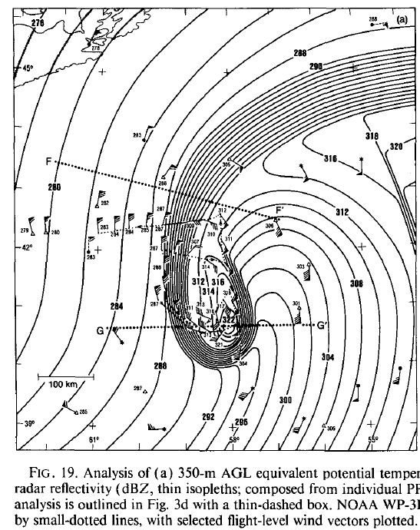
Warm
Seclusion
Stage

Slide 27
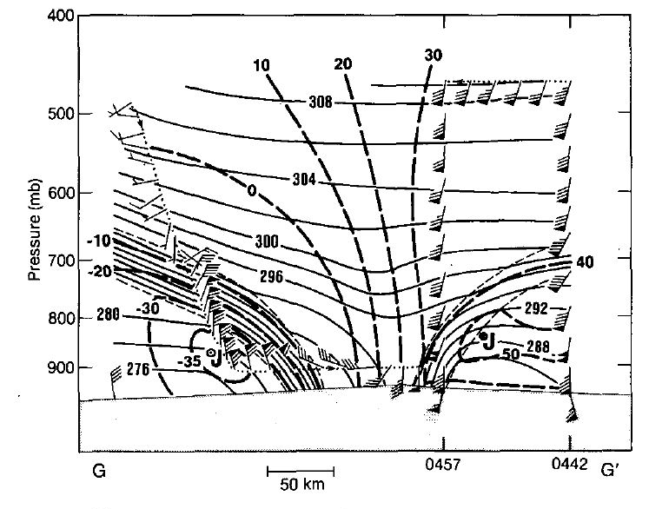
Cross Section Across Warm-Air Seclusion: Circulation Weakens With Height

Slide 28
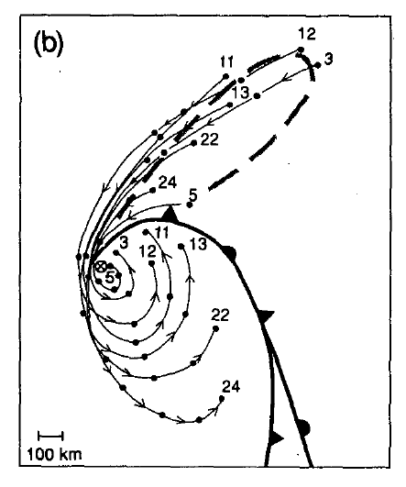
Why Warm Air Seclusion?

Slide 29
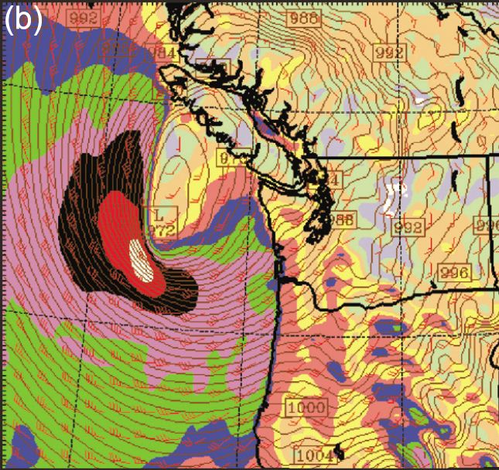
Strongest Winds With Back-Bent Warm Front

Slide 30
Why strongest wind west and SW of the low center?
Obviously, a large pressure gradient, but WHY?

Slide 31
The large temperature gradient with the bent-back warm front

Slide 32
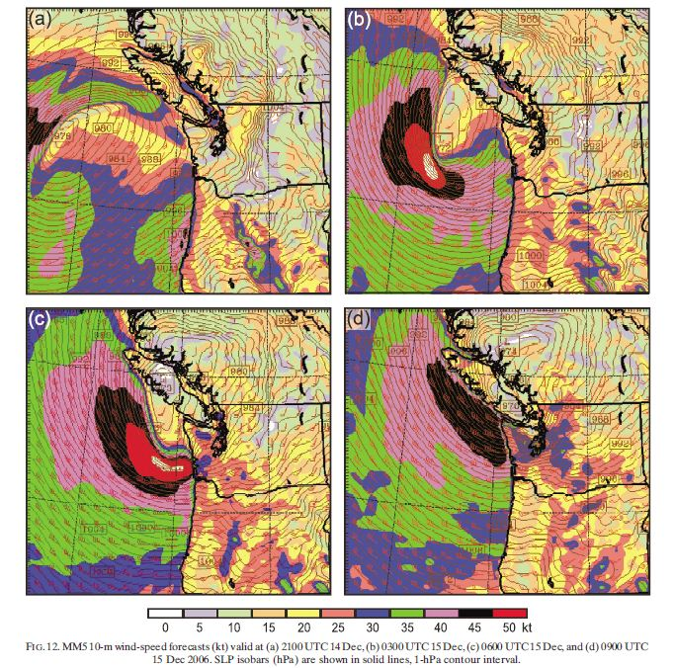
Another example: the 2006 Chanukah Eve Windstorm

Slide 33
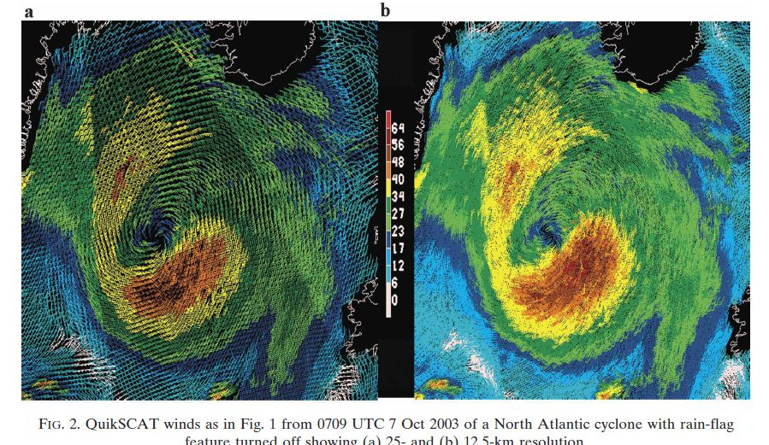
Can see this structure from scatterometer data

Slide 34
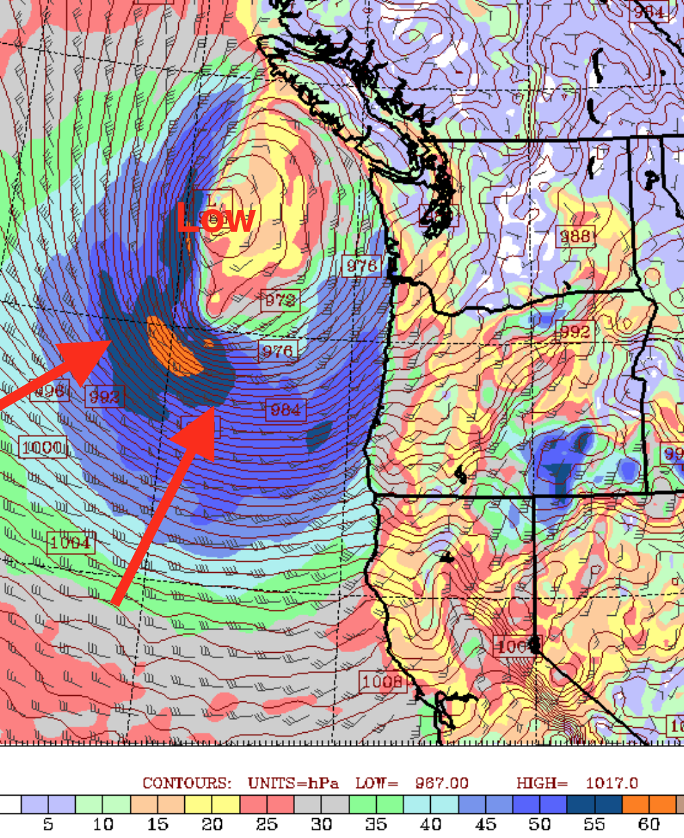
December 27, 2022

Slide 35
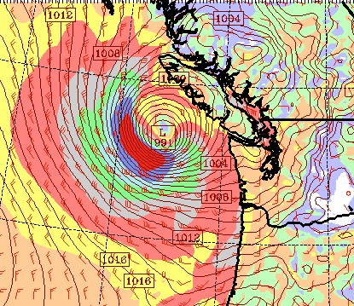

Slide 36
Why is cyclone structure different over the ocean than over land?

Slide 37
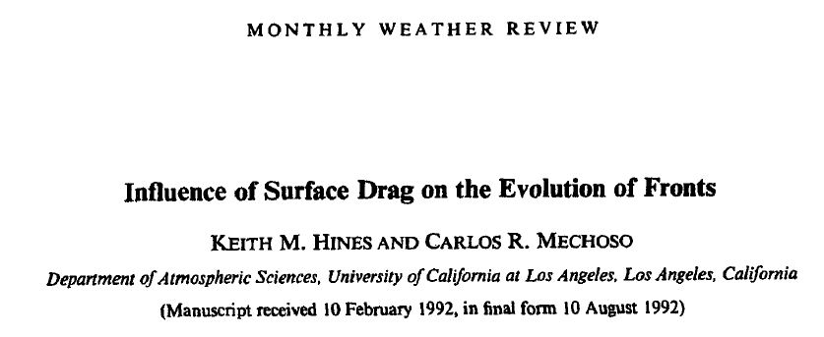
Differences in surface drag or friction are very important.

Slide 38
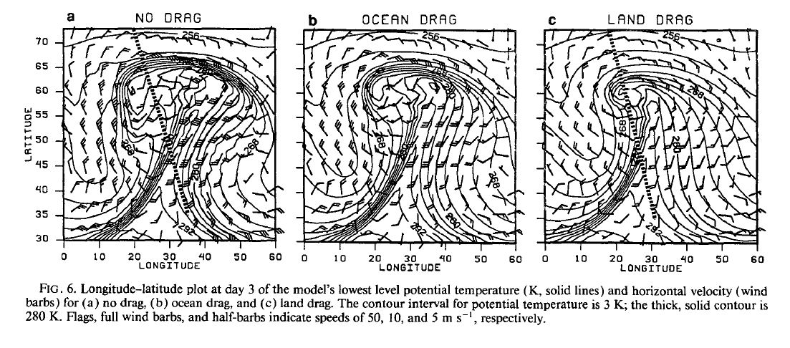
Numerical Model Simulations
Stronger low-level winds over ocean

Slide 39
Second, water surfaces are warmer than land during the cool season, modifying low level temperatures and weakening cold fronts

Slide 40
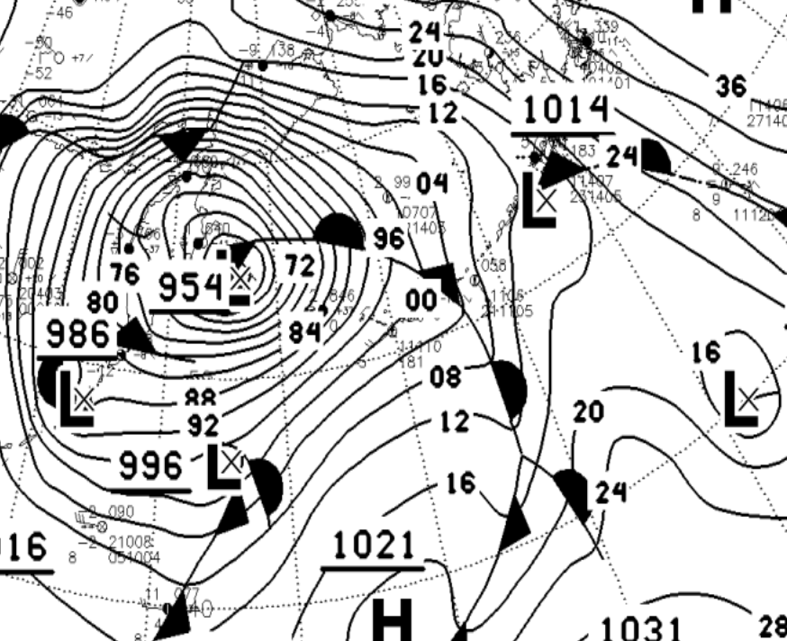
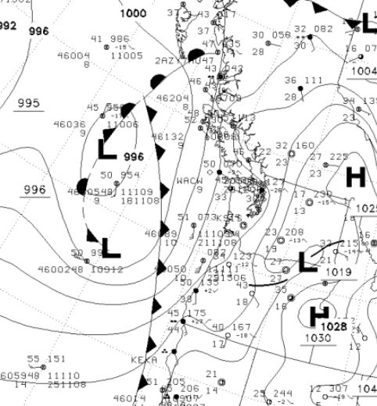
Often operational charts don’t reflect new understanding

Slide 41
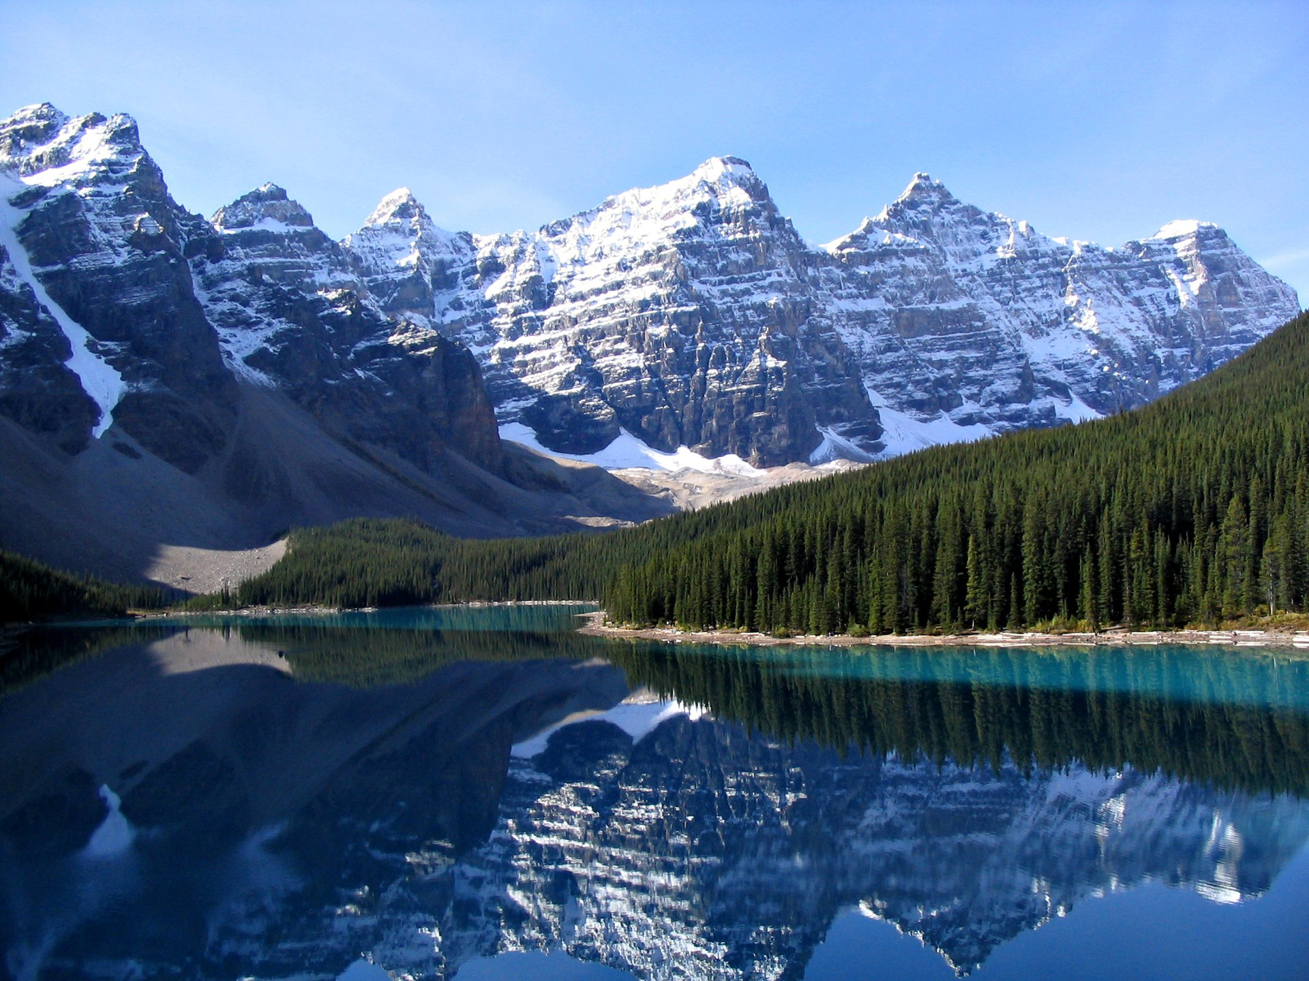
Mountains Can Greatly Influence Frontal and Cyclone Structures

Slide 42
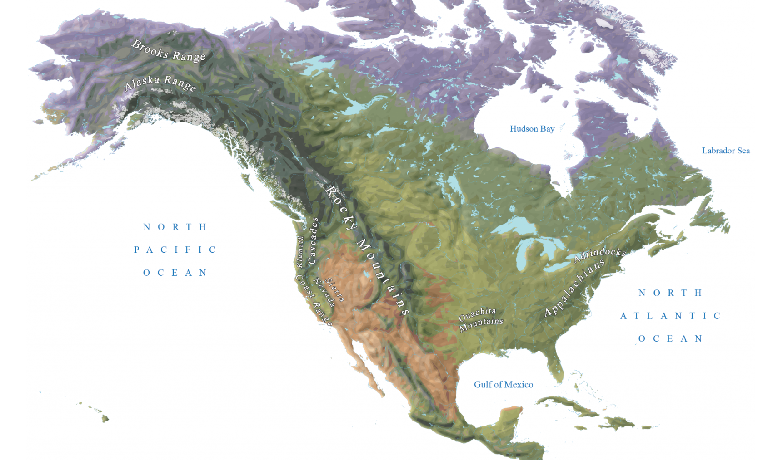

Slide 43
Mountains Can
Tear apart low-level frontal structures
Alter low level temperature structures and thus fronts
Produce additional features than obscure fronts, such as lee troughs, barrier jets, and windward highs.

Slide 44
Consider the U.S. Impacts of Terrain
When flow is relatively zonal (east-west), synoptic structures are greatly changed over and downstream of the Rockies.
Takes roughly 1000 km for frontal structures to appear more “classical” past the mountains.

Slide 45
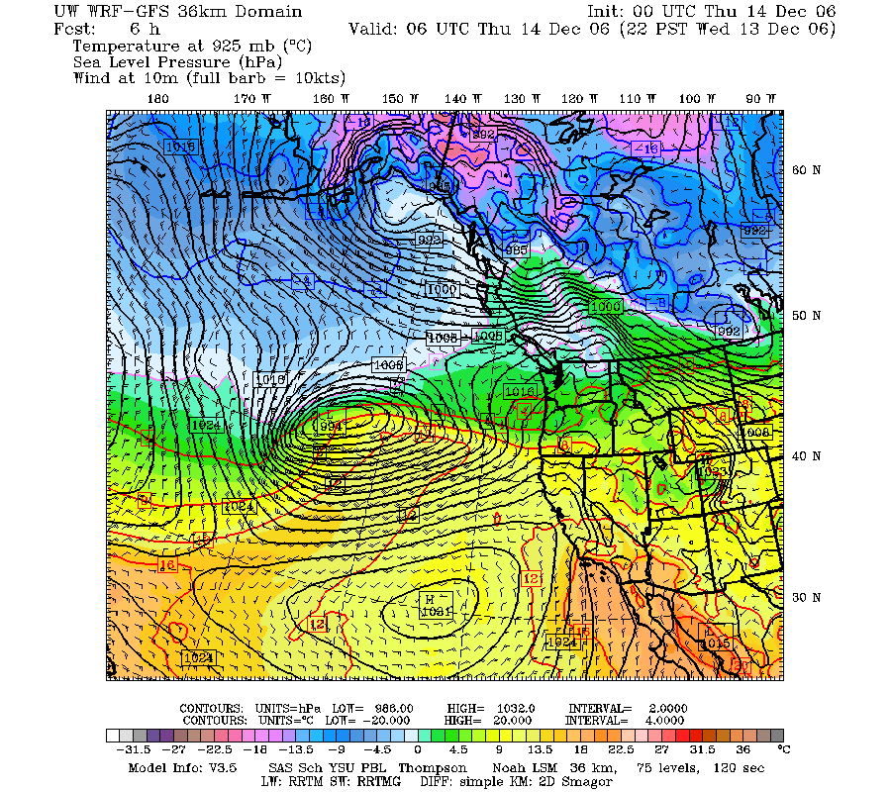

Slide 46
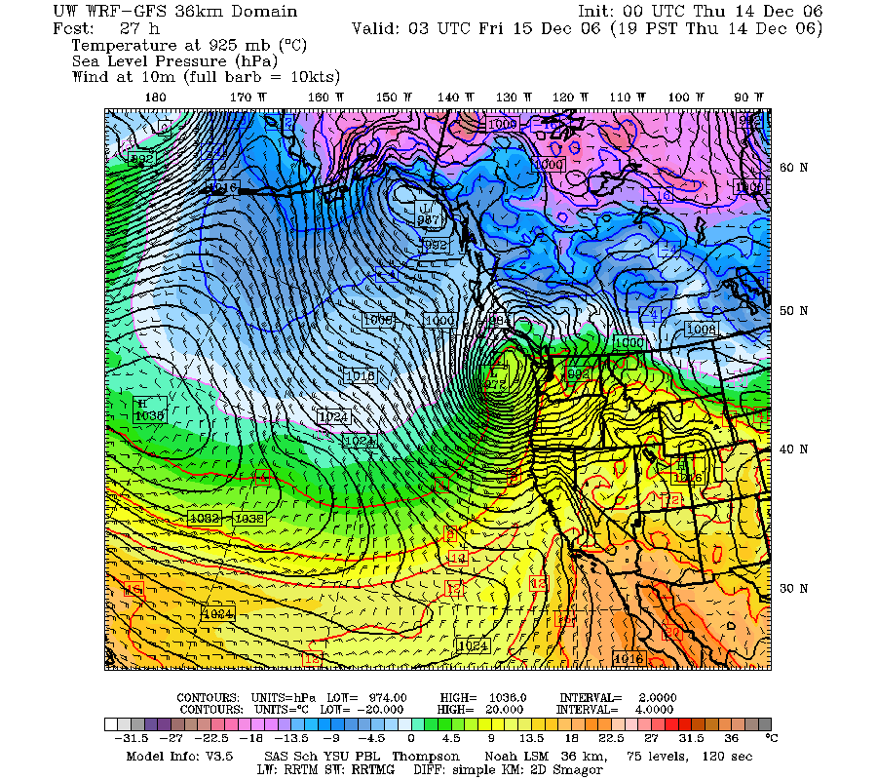

Slide 47
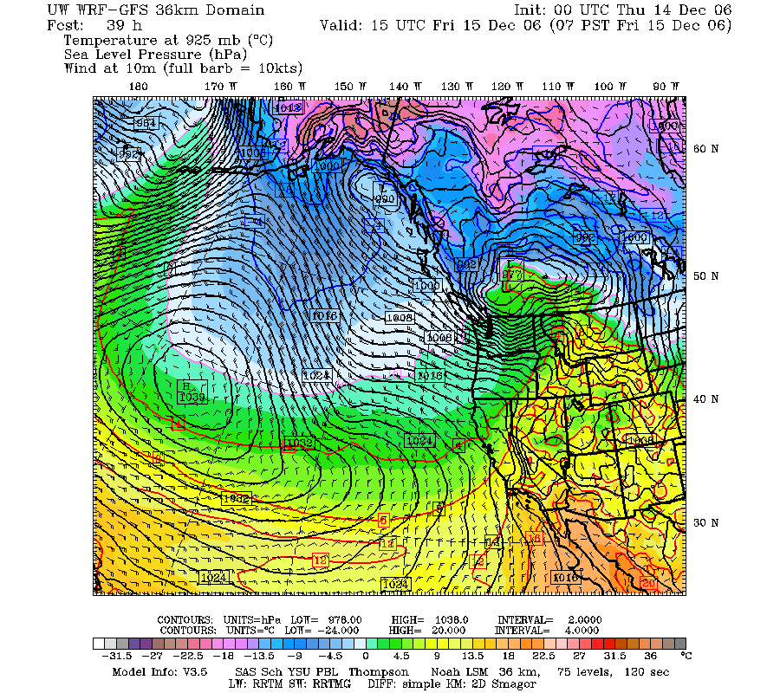

Slide 48
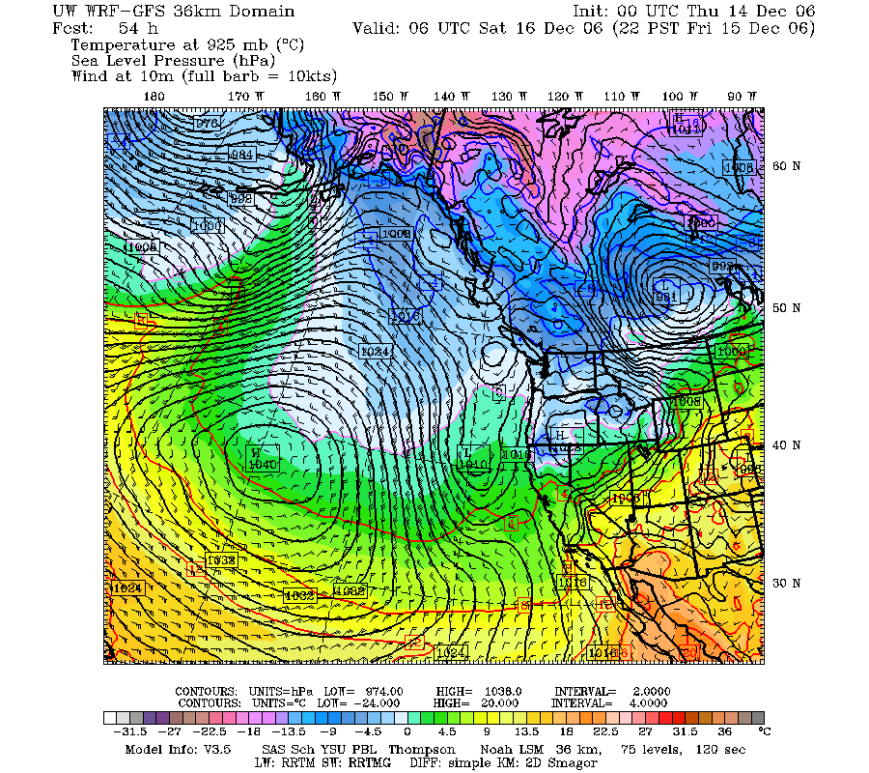

Slide 49
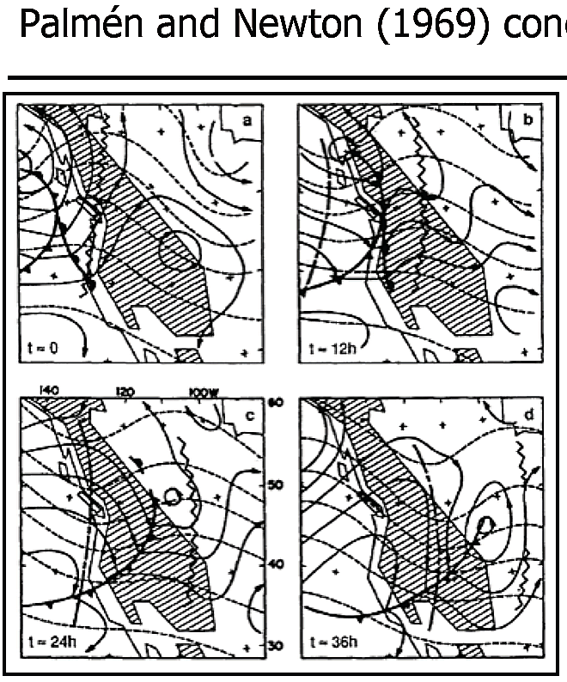
Low Center Weakens and Reforms to the east of the Rockies

Slide 50
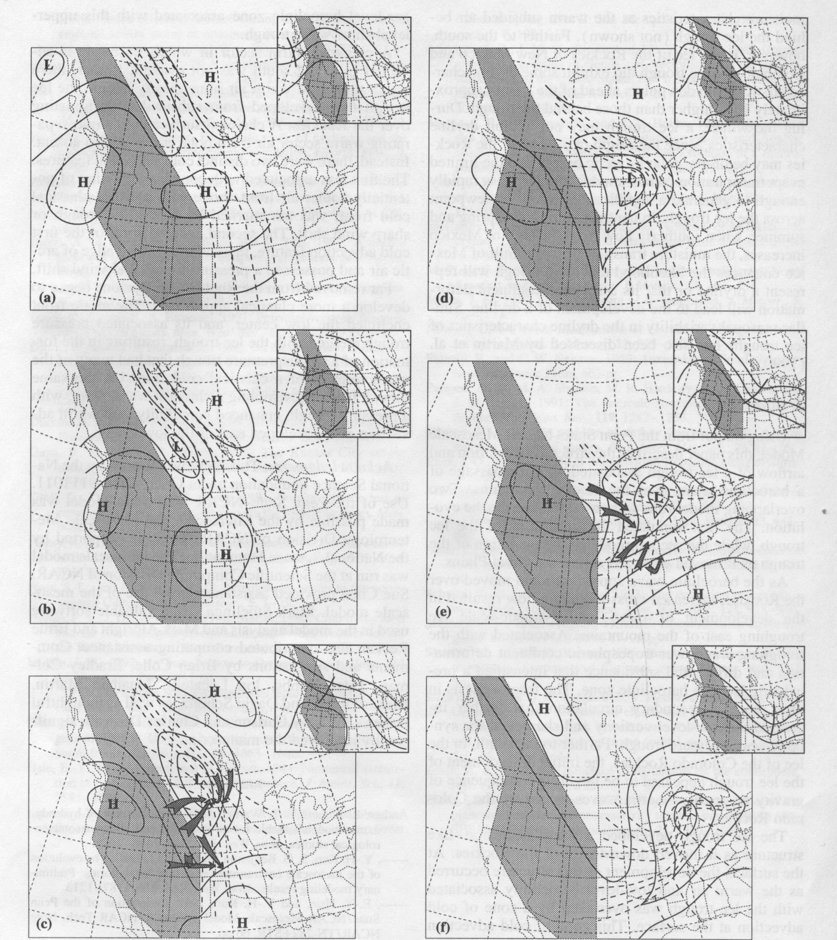

Slide 56
Takes several hundred miles east of Rockies for “classic” structures to restore themselves

Slide 57

Dry Lines in the Central U.S.
A product of terrain!
or

Slide 58
Dry Lines
Associated with large horizontal gradients in moisture, but not necessarily temperature.
Results from the interaction of cyclones and fronts with large-scale terrain (Rockies).
Found over the U.S. Midwest, northern India, China, central West Africa and other locations.

Slide 59
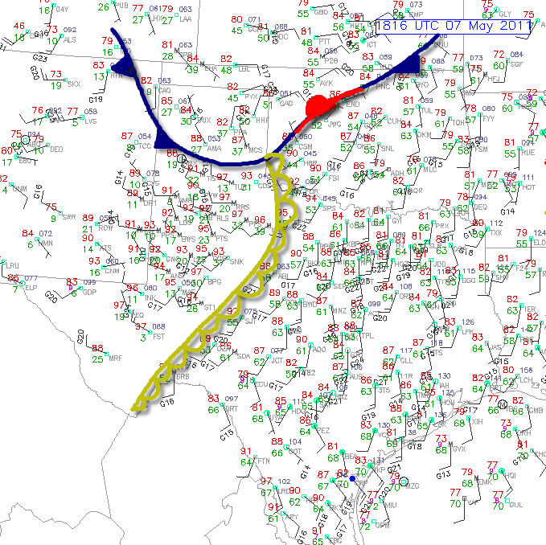
Dry Lines
Acts as a focus for convection, and particularly severe convection.
Most prevalent during spring/early summer in U.S. Plains

Slide 60
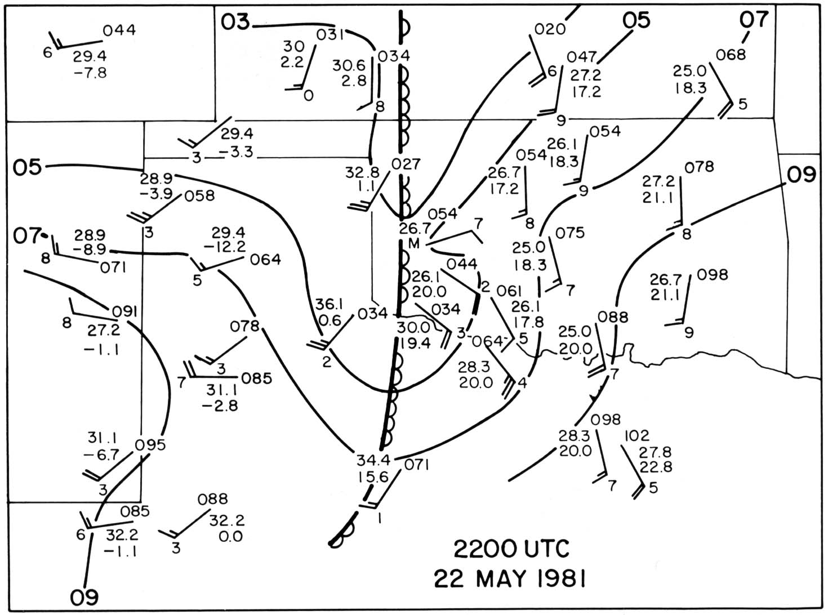
Typical Dryline
Temperatures in
degrees Celsius

Slide 61
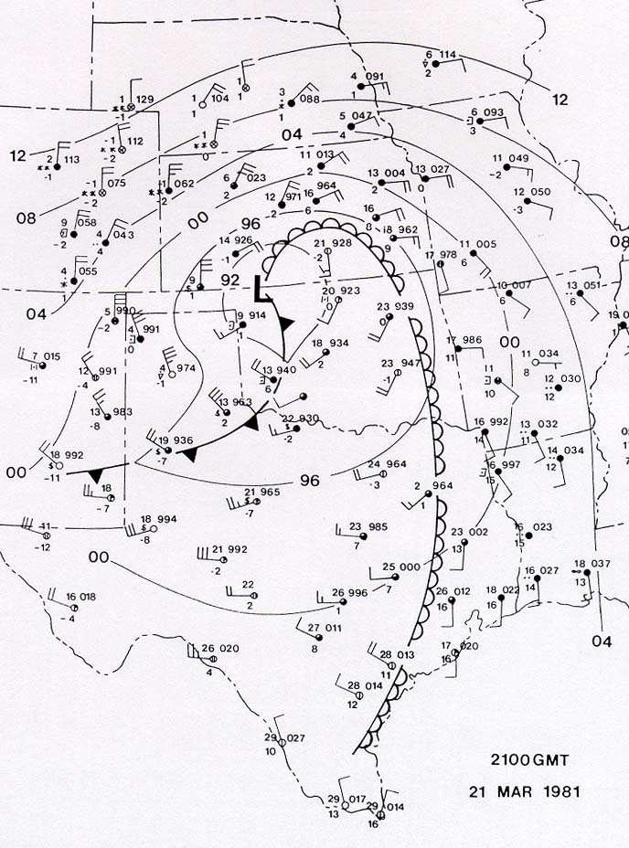
Southern Plains Dry Line
Dry Line
©1993 Oxford University Press -- From: Bluestein, Synoptic-Dynamic
Meteorology in Midlatitudes, Volume II
Temperatures in
degrees Celsius

Slide 62
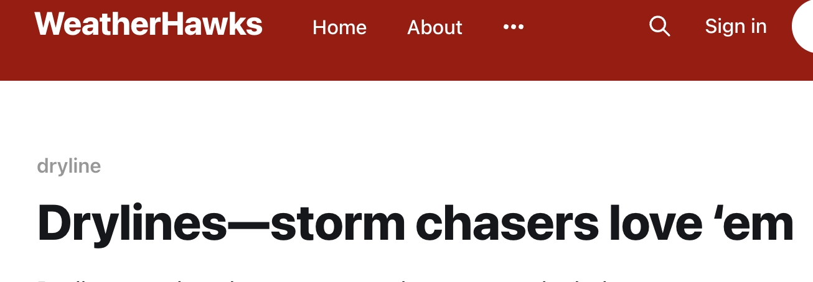


Slide 63
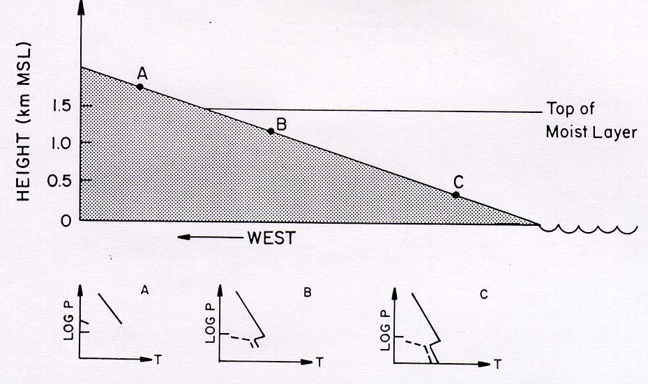
Dry Line
Surface boundary between warm, moist air and hot, dry air.
Surface dry line
Well-mixed warm air
DRY
Inversion or cap
Moist Air
MOIST

Slide 64

Vertical Structure of Dry Line
DRY AIR
Dry Line at surface
Moist Air
West
East

Slide 65
DRY LINE
Associated with Low Center crossing and moving east of the Rockies.
cold
L
Dry
Downslope air behind low is dry
Warm, Moist
Dry line

Slide 66
NO
DRY LINE After the low moves east—
Get Cold
Front
L

Slide 67
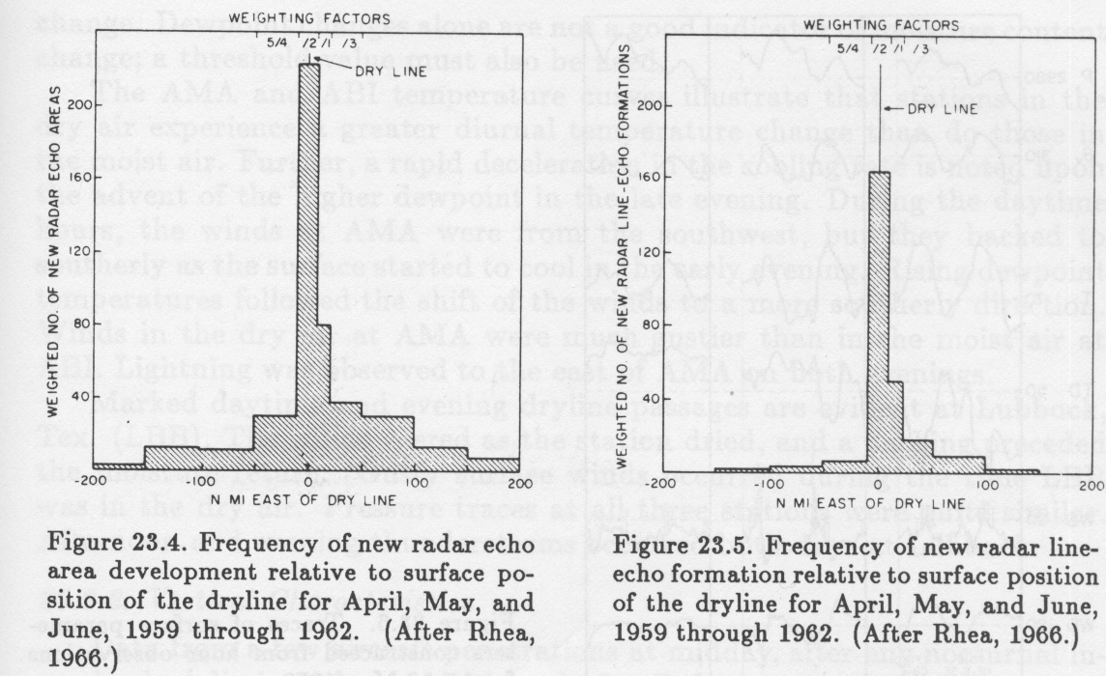
Convection Tends to Focus On the Dryline

Slide 68

This is why storm chasers love dry lines

Slide 69
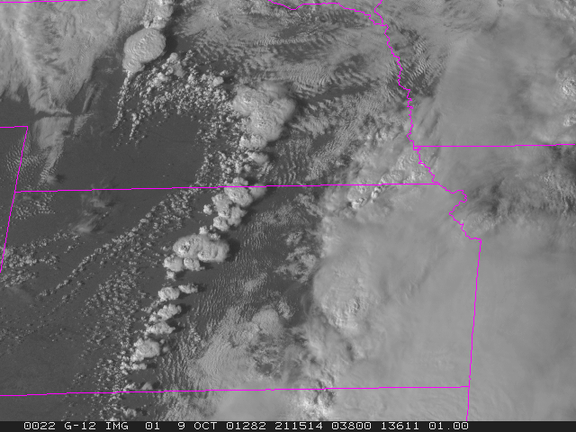
Storm Initiation Along a Dry Line

Slide 70
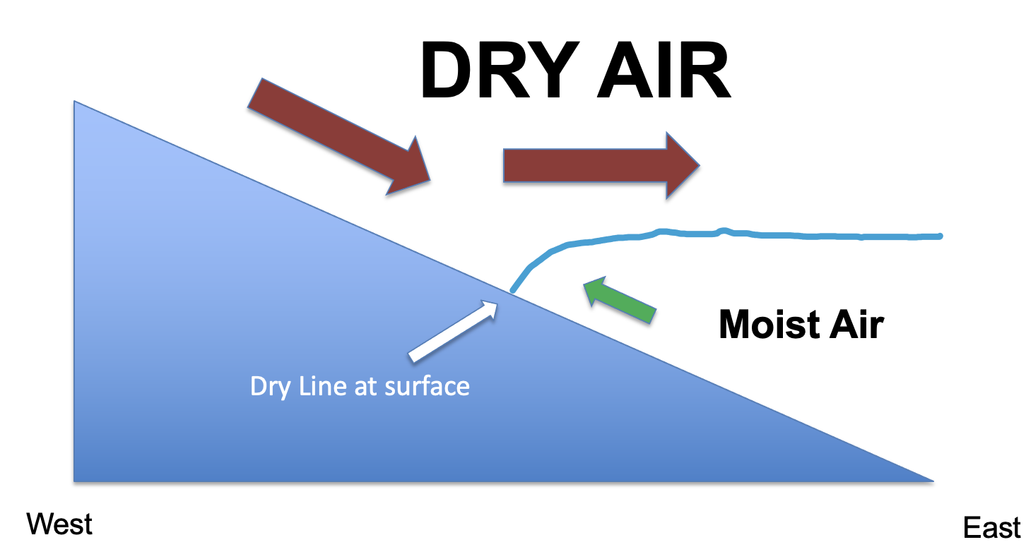
Why is a dry line conducive for strong convection?
Low level confluence and convergence produce upward motion.
Just east of the surface dry line, the existence of a layer of dry air over moist air enhances convective/potential instability.

Slide 71
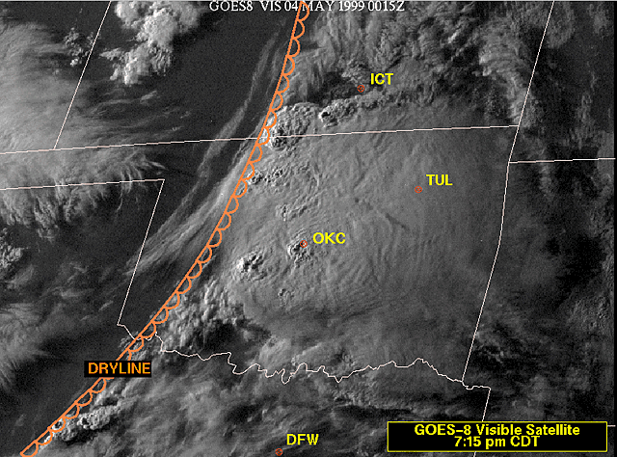
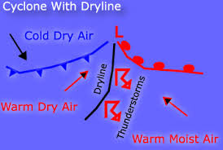
Convection Focus on Dry Lines

Slide 72

Indian Dryline

Slide 73


Slide 74

Dew Point Gradients Associated with Indian Dry Line

Slide 75
Downstream of Terrain, Fronts can Be Aloft and Tilt Forward

Slide 76

Cold Fronts
Aloft
(CFA)

Slide 77
Cold Front Aloft Origin
The lower portions of Pacific weather systems are destroyed as they cross the Rockies.
The upper short-wave and its associated thermal structure can pass across the barrier

Slide 78

Cold Front Aloft

Slide 79

Cold Air Damming: Another Example of Terrain Modifying Frontal Structure

Slide 80


Slide 81


Slide 82


Slide 83


Result in distortion of warm fronts

Slide 84
Coastal Fronts: Closely Associated with Cold Air Damming on Terrain
Forms at boundary between cold air in damming region and warmer marine air approaching it

Slide 85

Coastal Front: Southeast U.S.

Slide 86


Slide 88

New England Coastal Front

Slide 89
Bottom Line: The Norwegian Cyclone Model is Useful But the Real World Often Looks Different!

Slide 90


Slide 91


Slide 92


Slide 93


Slide 94


