Slide 1
Cyclone and Frontal Structure and Evolution
A First Look
Winter 2024
ATMS 370

Slide 2
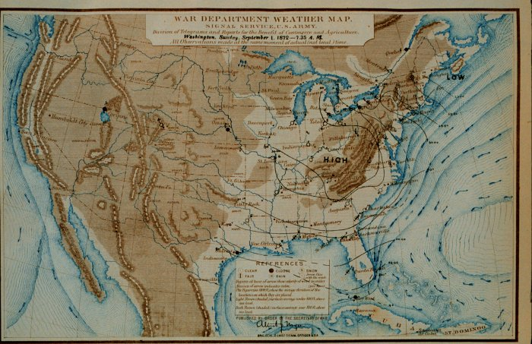
Early Surface Maps Had No Fronts
No real understanding of cyclones and their evolution

Slide 3
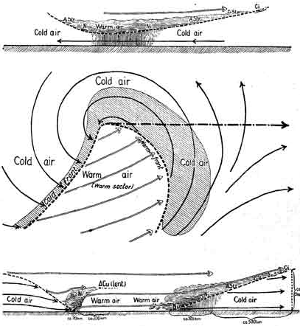
That all changed with the Norwegian Cyclone Model (Bergen School)
Bjernkes, 1919
Noted a direct
connection between
Low pressure center and fronts

Slide 4
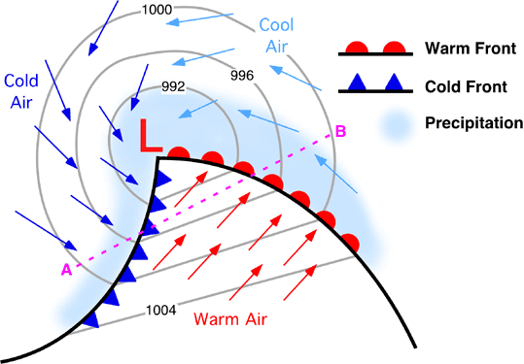
Modern Version
Midlatitude Cyclone And Fronts
Warm Sector

Slide 5
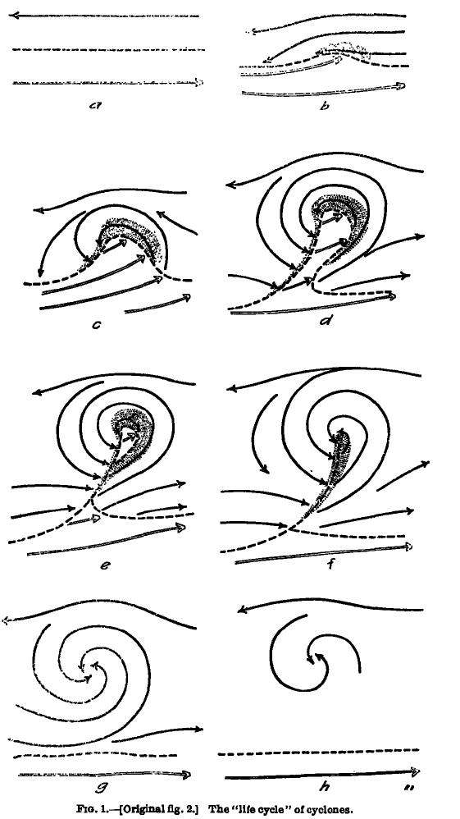
Concept of Evolution of Cyclones and Fronts
Bjerknes and Solberg
1922

Slide 6
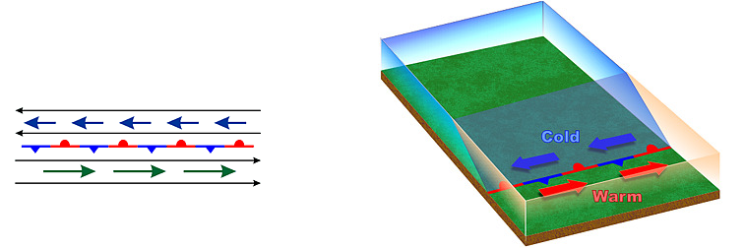
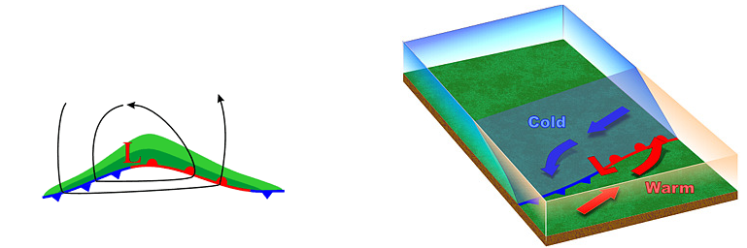
Stationary “Polar Front”
Wave Forming on Polar Front

Slide 7
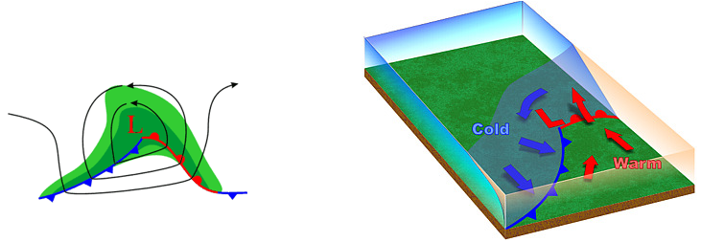
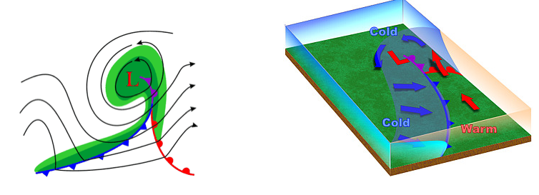
Wave Amplifies
Occlusion as Cold Front Catches Up to Warm Front
Triple
point

Slide 8
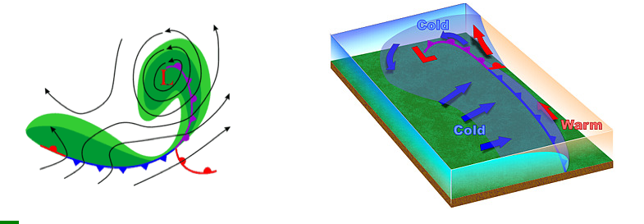
Occlusion Lengthens and System Weakens

Slide 9
As a front passes there are changes in:
Temperature (always)
Dew point
Wind direction
Pressure
Cloudiness

Slide 10
Where is the front?
A
B
C
D
54
54
55
57
59
62
62
63

Slide 11
Refresher
A front is a boundary between relatively uniform warm air and a zone in which temperatures cools rapidly

Slide 12
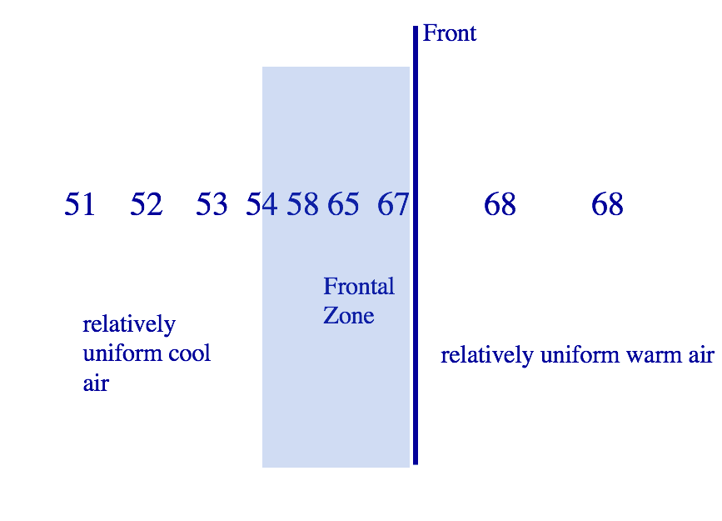

Slide 13
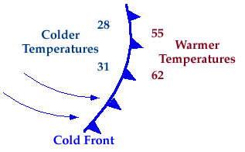
Four Main Types of Fronts
Frontal Zone is ALWAYS on the colder side

Slide 14
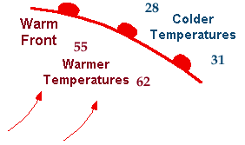
Warm Front

Slide 15
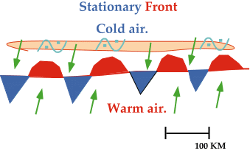
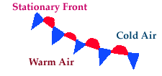
Stationary Fronts

Slide 16

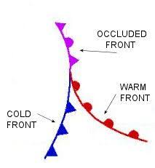
Occluded Front (a hybrid)

Slide 17
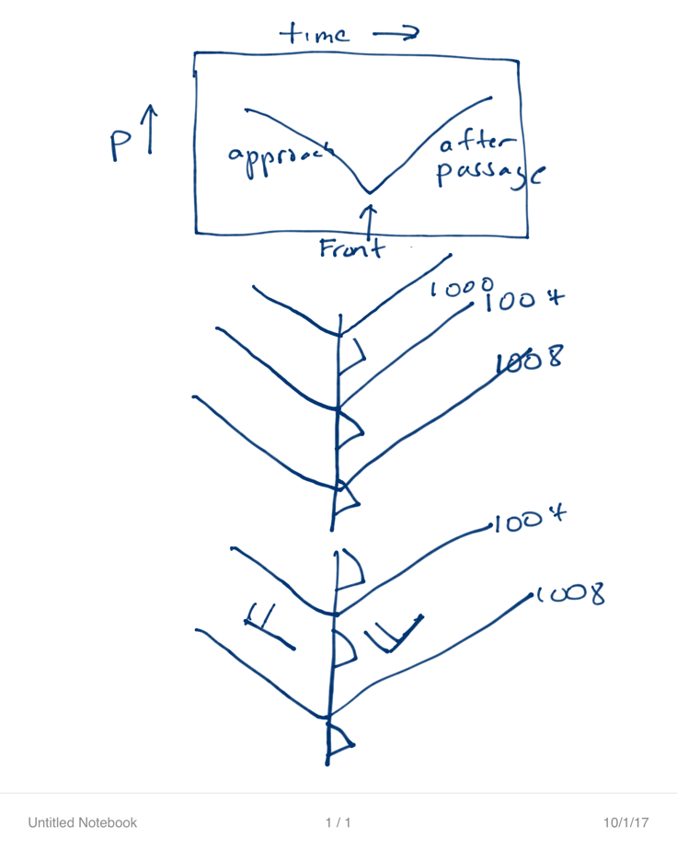
Fronts are usually associated with troughs of low pressure
L

Slide 18
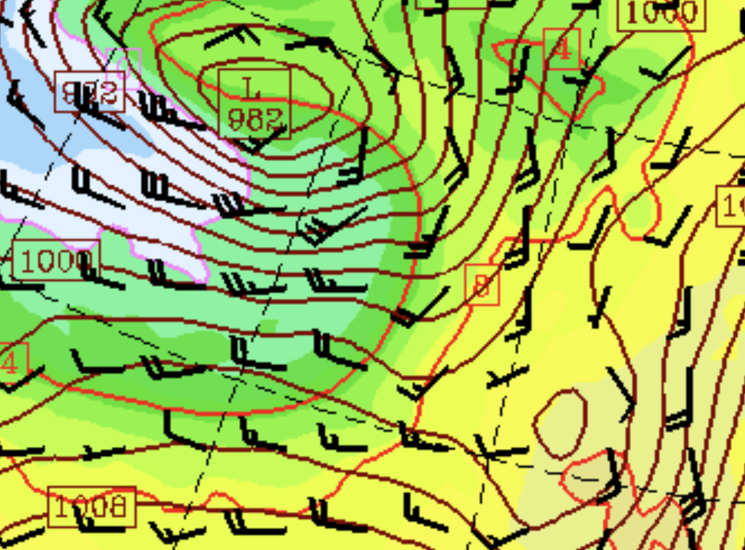

Slide 19
The trough is often evident in barograph traces

Slide 20
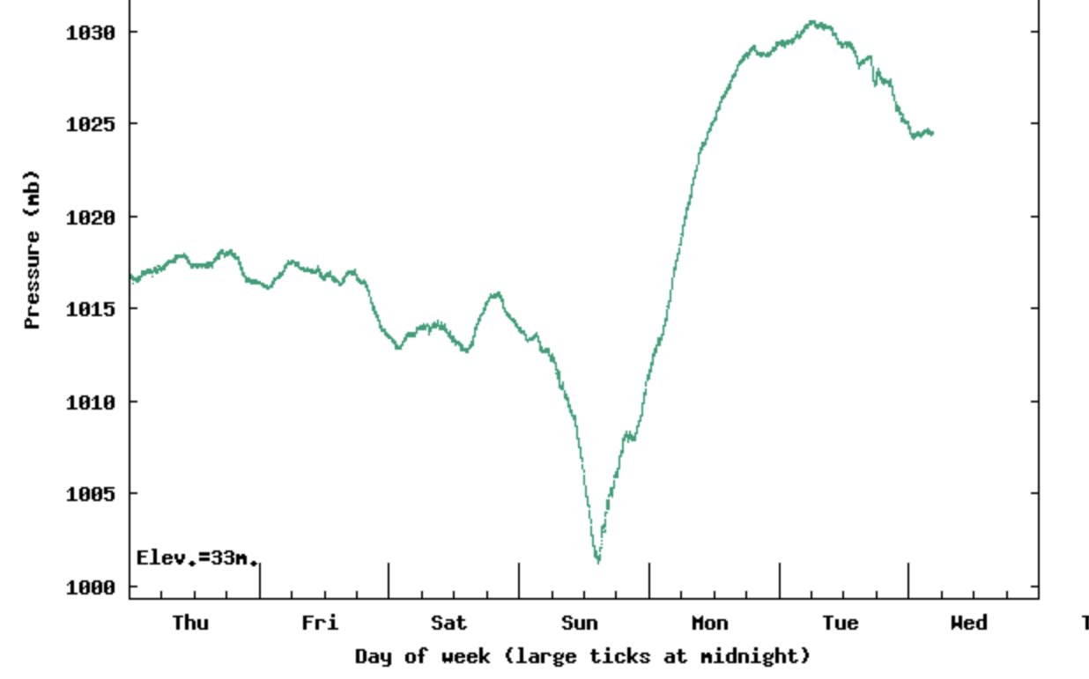

Slide 21
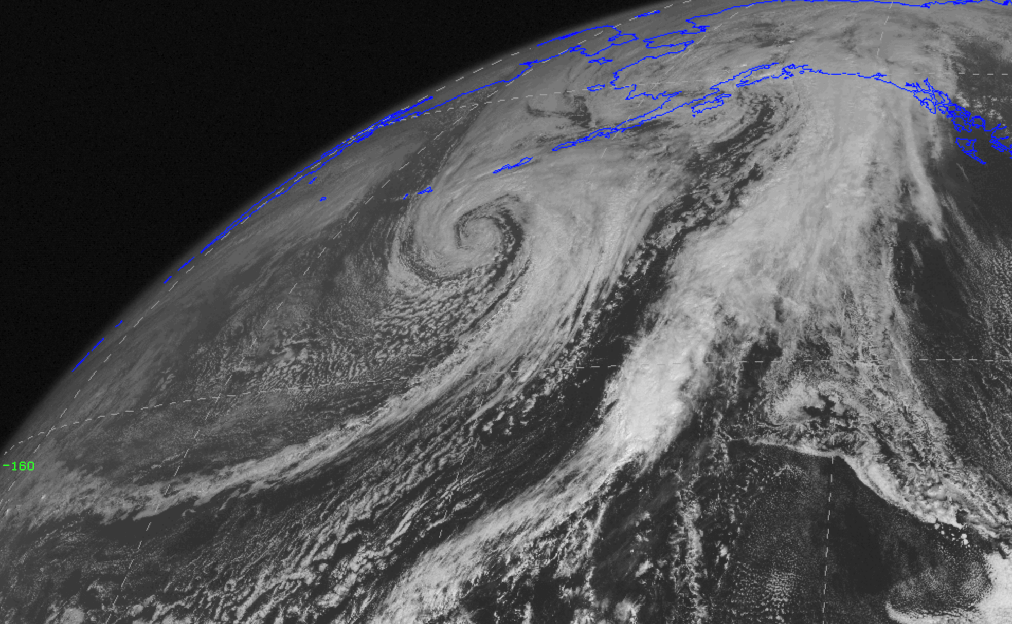
Fronts are associated with long bands of clouds

Slide 22
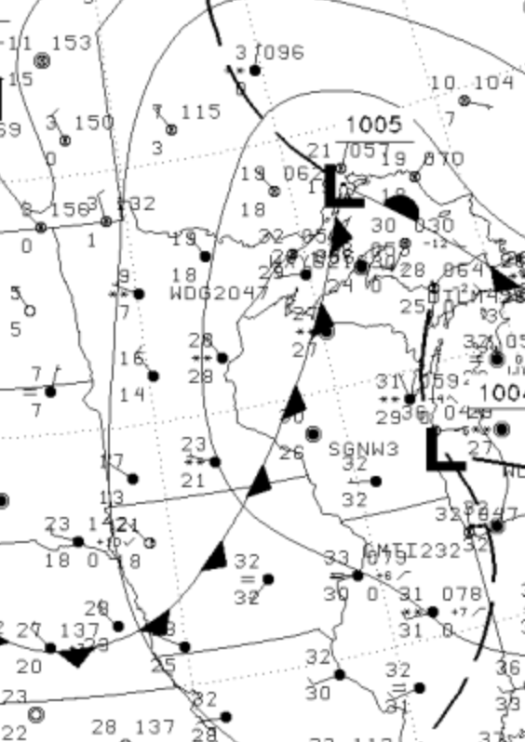
Dew point often falls behind fronts
The cold air behind front generally has less water vapor
Sometimes dew point is better than temperatures (more later)

Slide 23
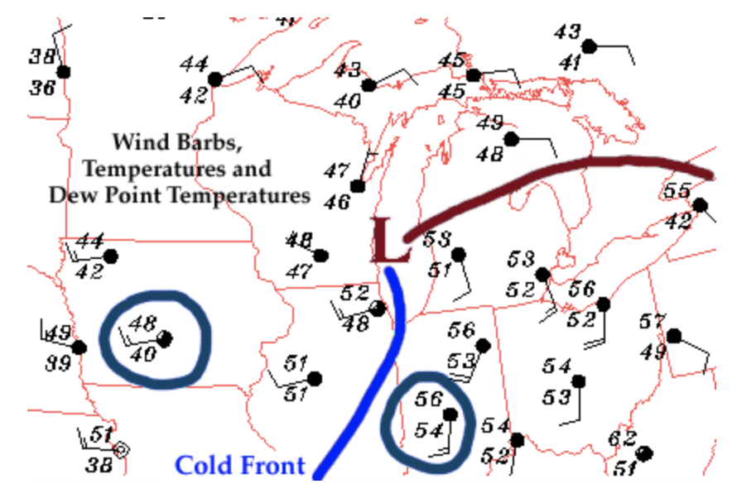

Slide 24
And there is generally a wind shift/change of direction in the frontal zone (clockwise turning over time)

Slide 26
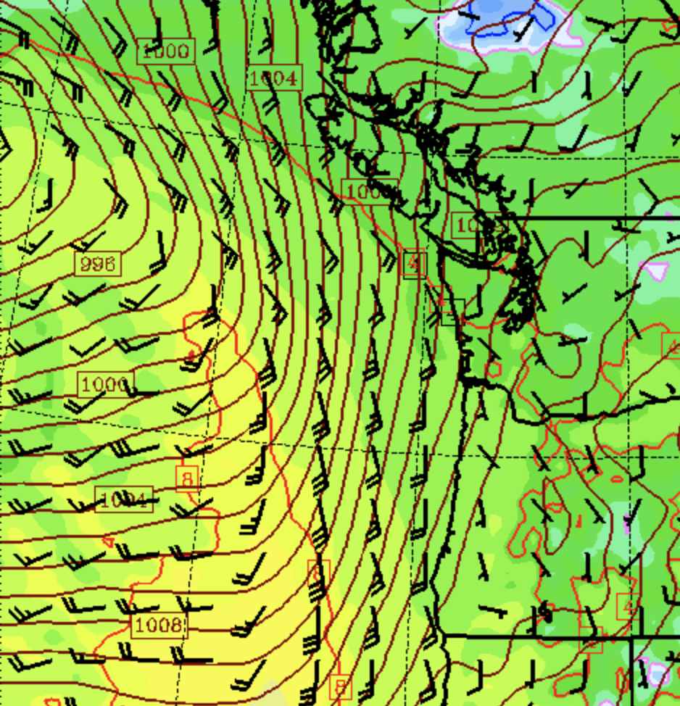

Slide 27
Vertical Structure of Fronts
You can’t understand the cloud and precipitation fields without understanding the 3-D air circulation in fronta and cyclones

Slide 28
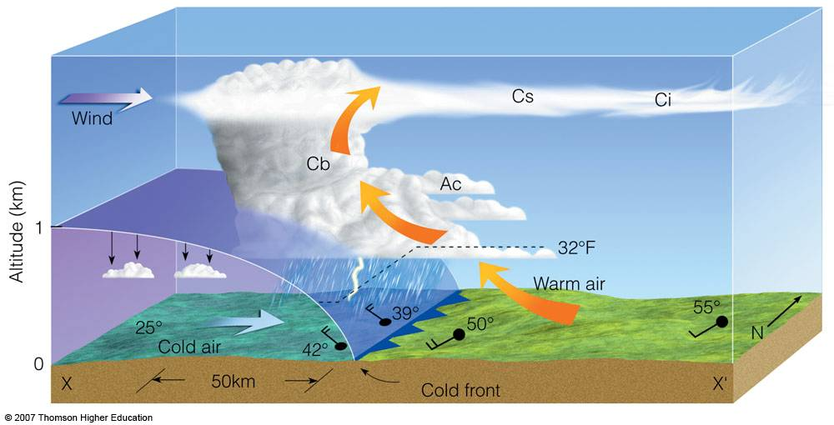
Cold Front
Slope 1:50, moves fast (20-30 mph), convection often on leading edge

Slide 29
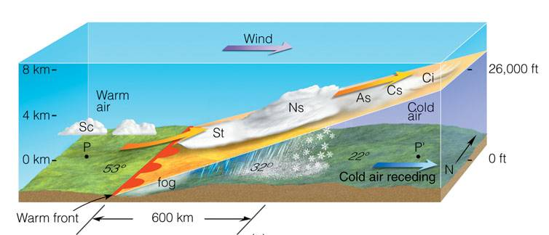
Warm Front
Lesser slope (1:200), slower (1—15 knots), more stratiform clouds

Slide 30
Stationary Front: similar structure to warm front, but without movement

Slide 31
There is a typical progression of clouds as cold and warm fronts approach and pass by
Cirrus
Cirrostratus
Altostratus
Nimbostratus
Cumulus after cold front

Slide 32
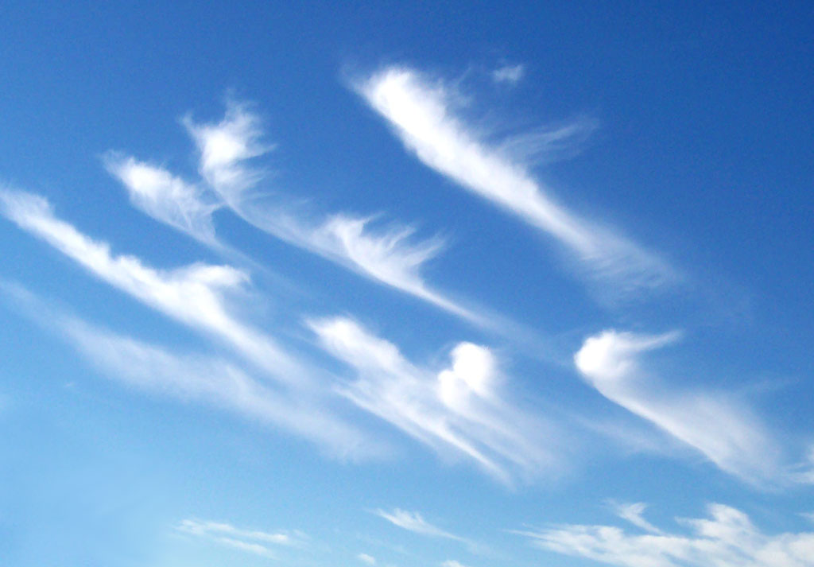
cirrus

Slide 33
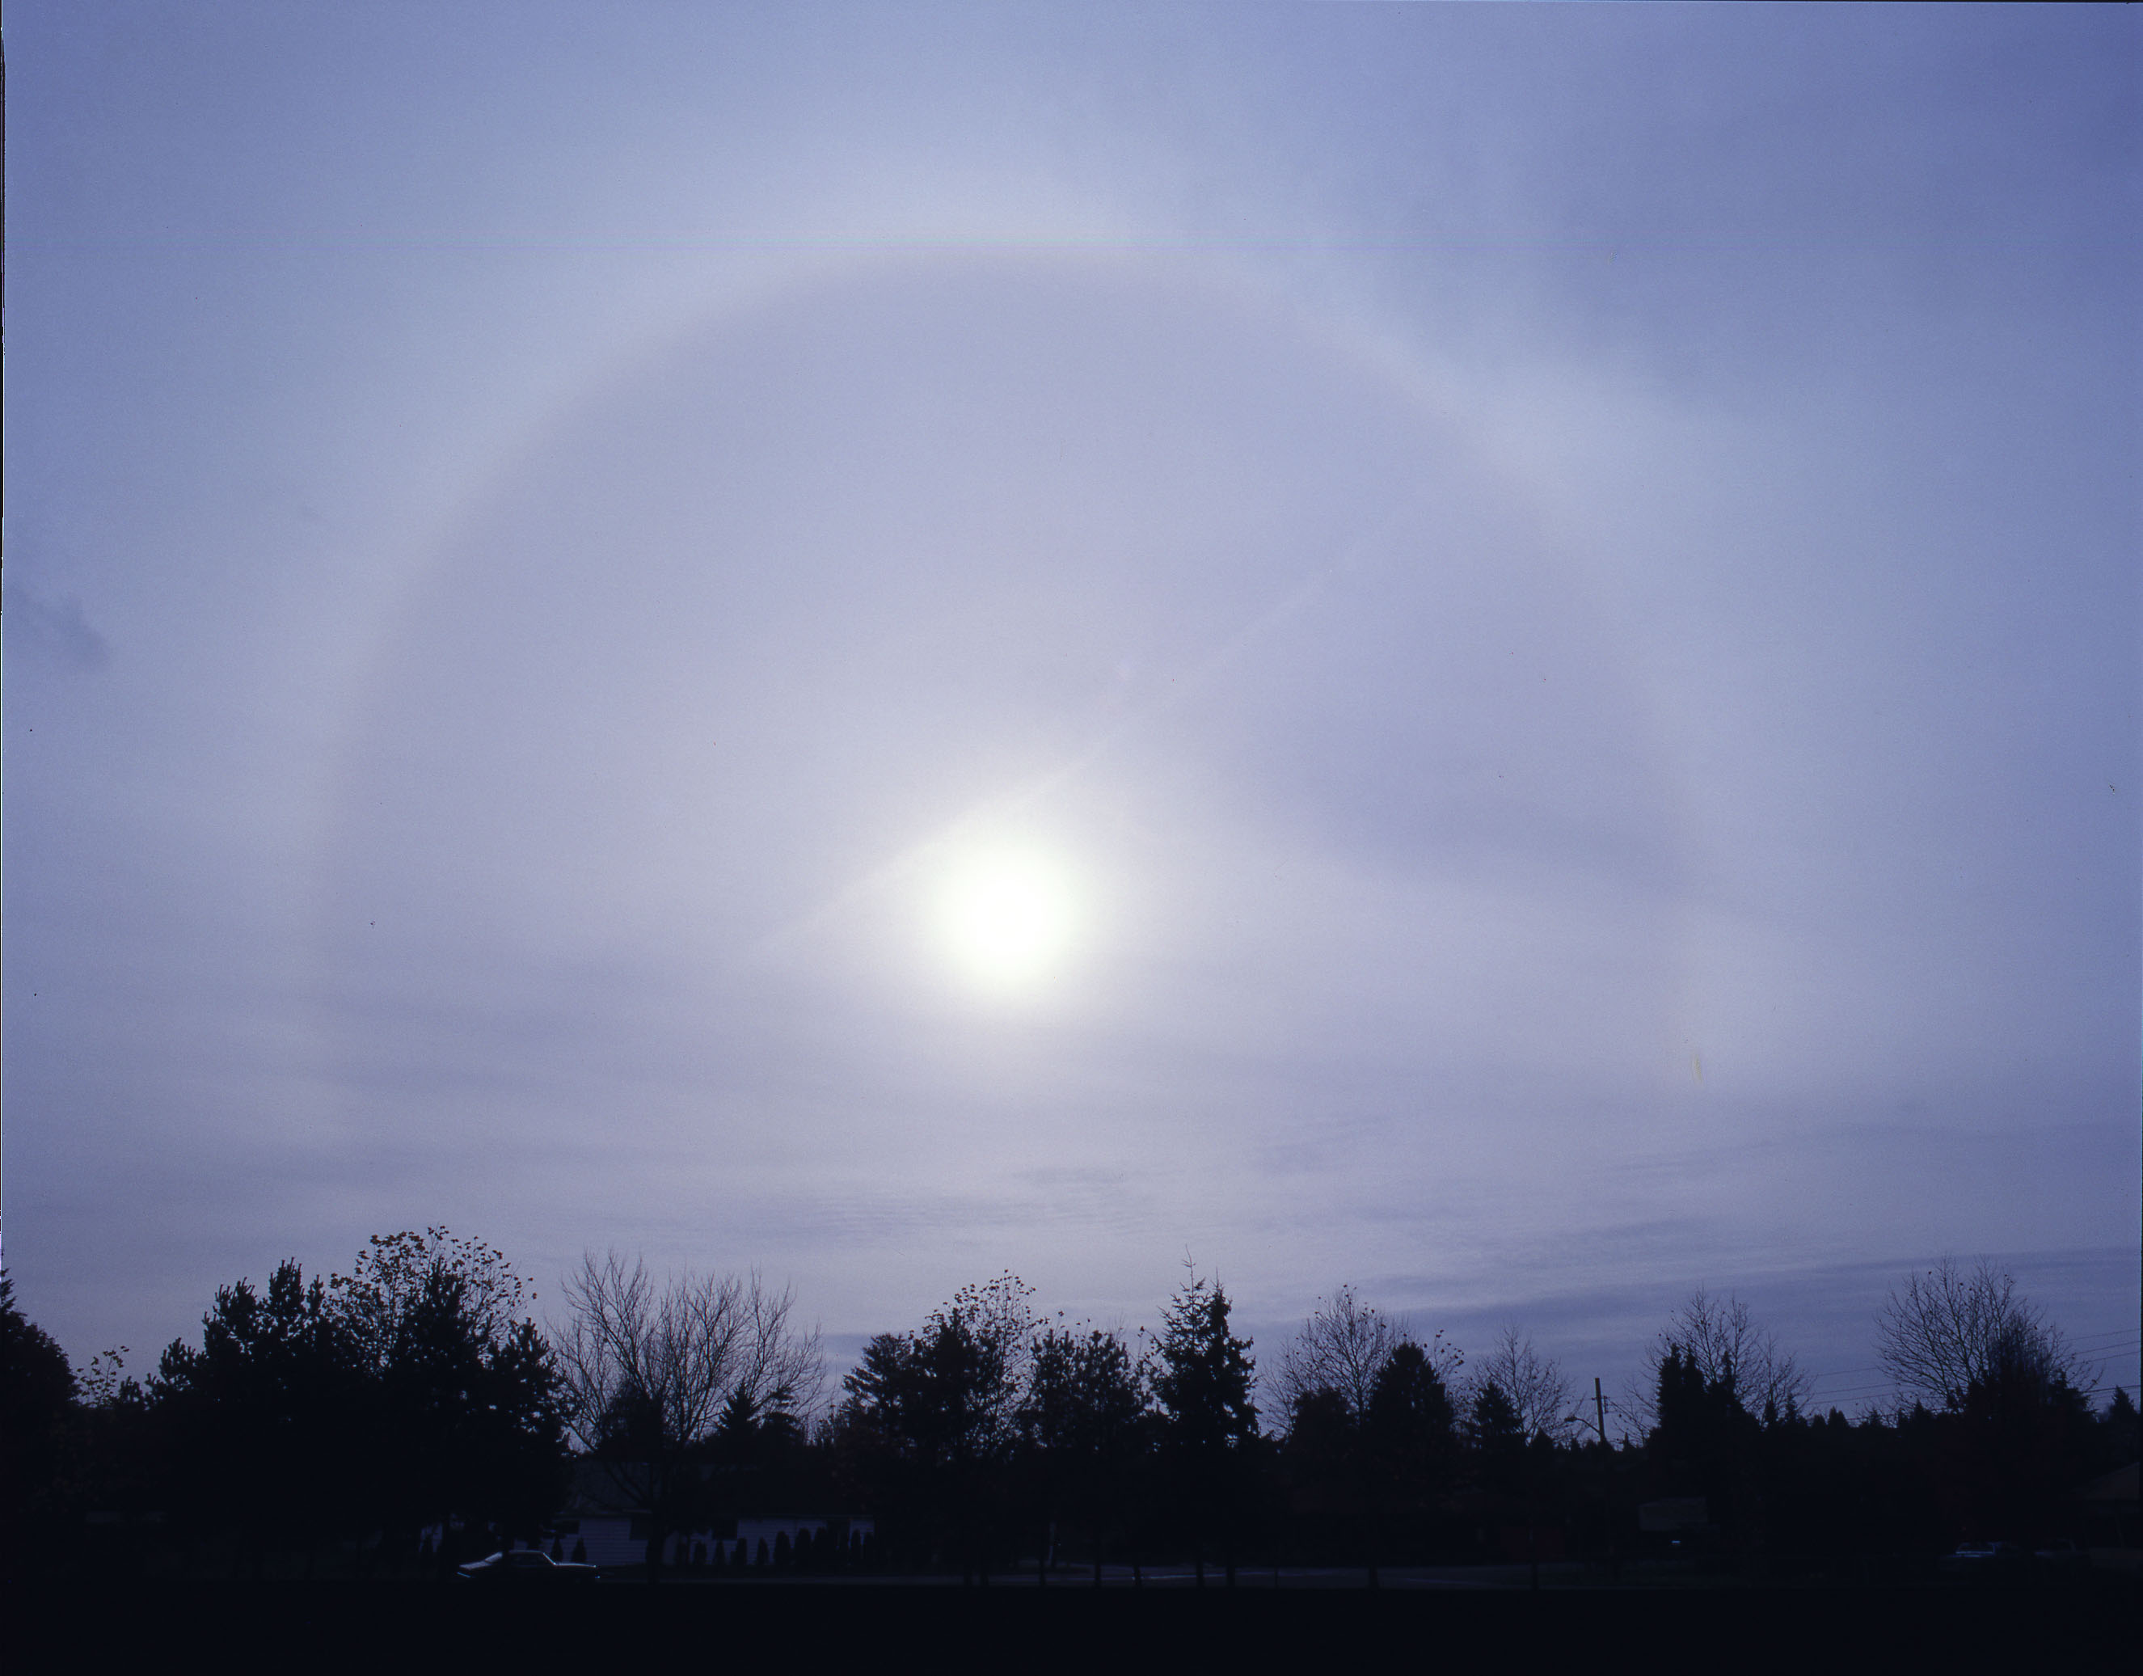
cirrostratus

Slide 34
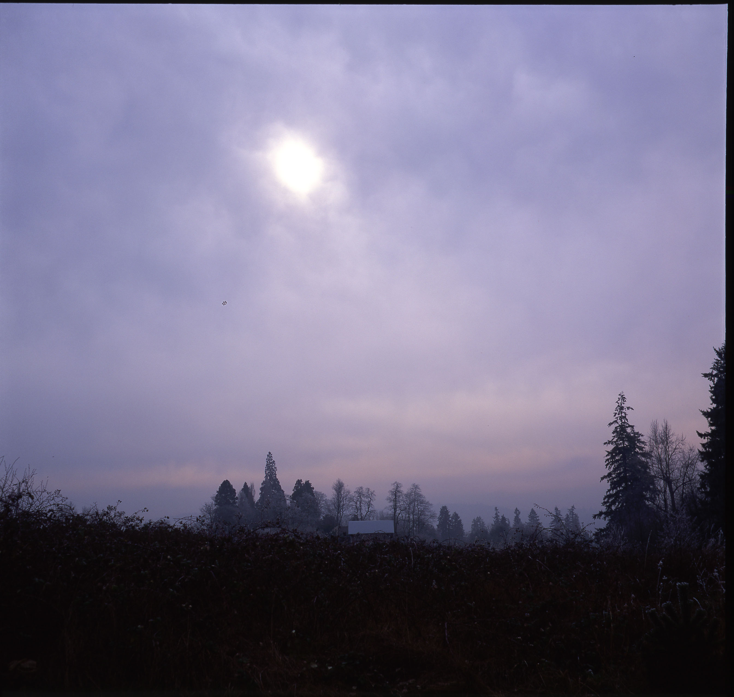
altostratus

Slide 35
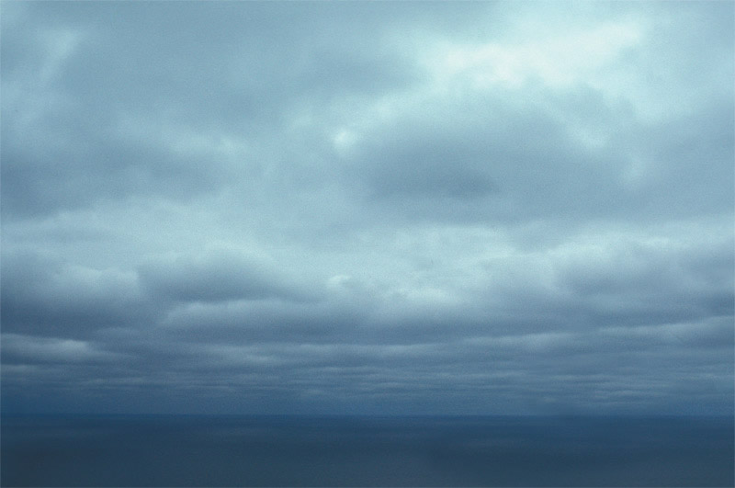
stratocumulus

Slide 36
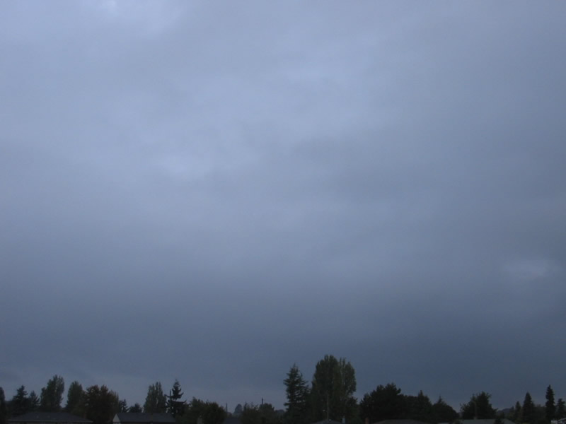
nimbostratus

Slide 37
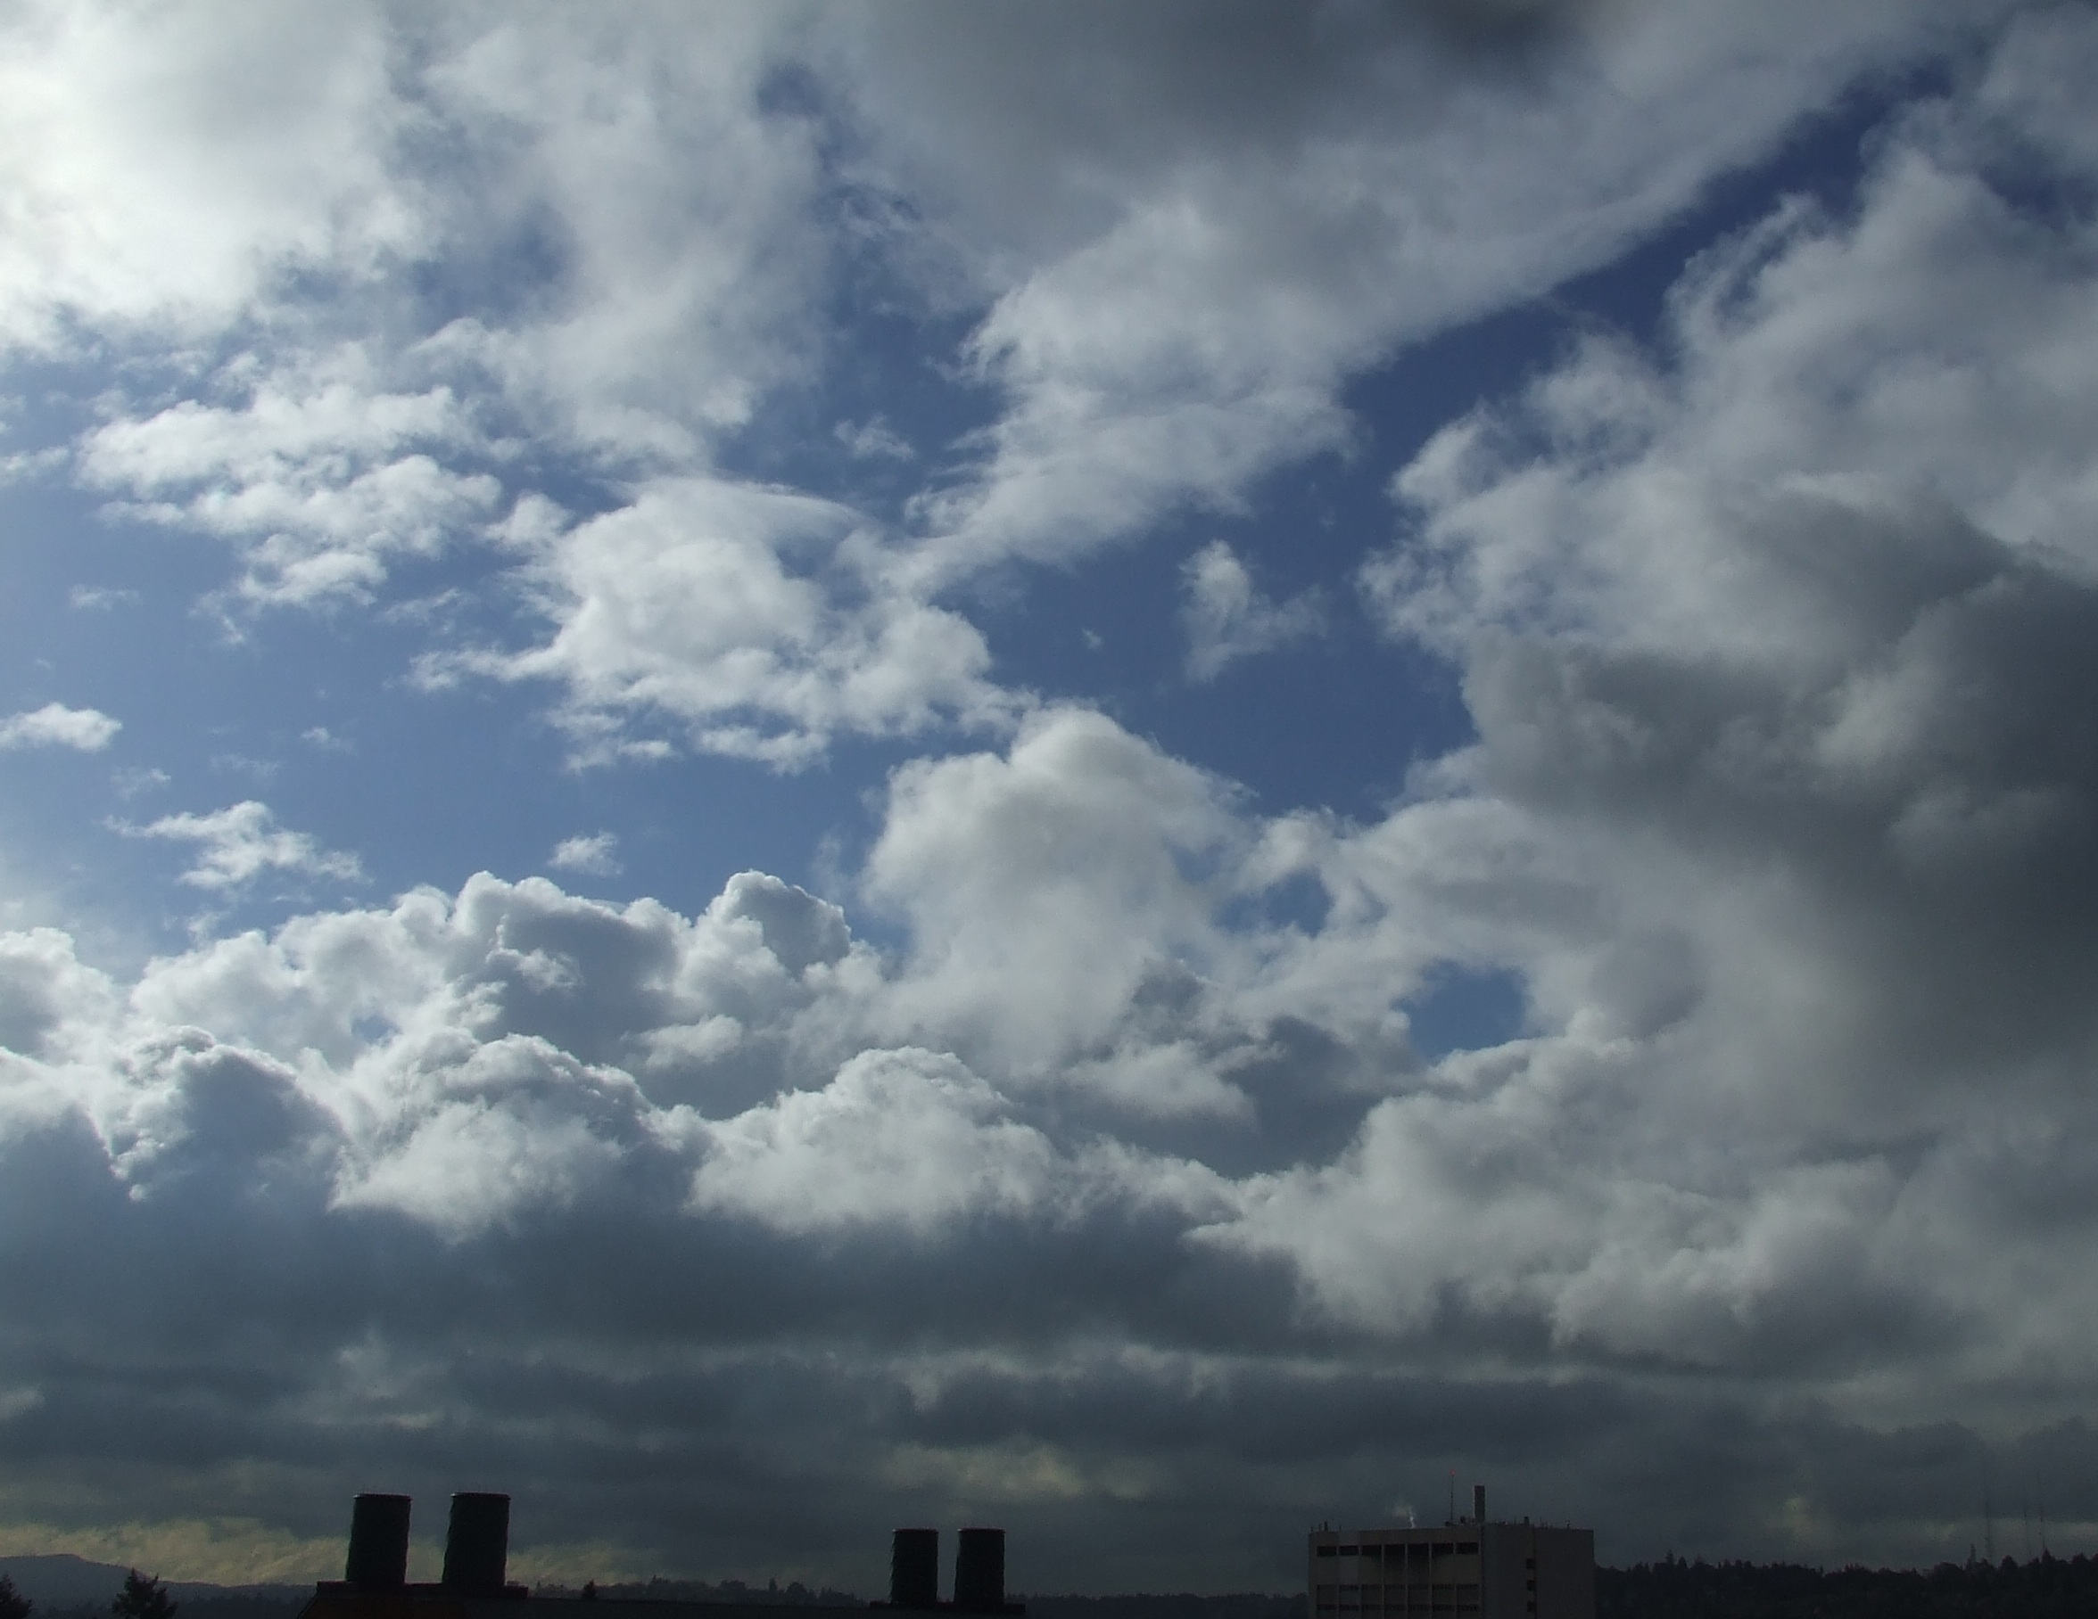
Cumulus, port frontoal

Slide 38
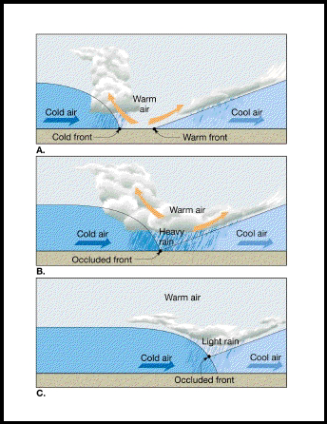
The Occlusion Process

Slide 39
In the occlusion process, the cold front moves faster than the warm front, catches up to the warm front, and joins with the warm front to create an occluded front

Slide 40
Stationary Polar Front
Wave Forming on Polar Front

Slide 41
Wave Amplifies
Occlusion as Cold Front Catches Up to Warm Front

Slide 42
Occlusion Lengthens and System Weakens

Slide 43
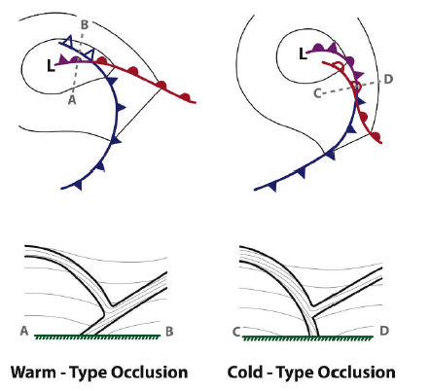
The Norwegians suggested there were both warm and cold occlusions depending on which side had the coldest air
cool
coldest
coldest
cool

Slide 44
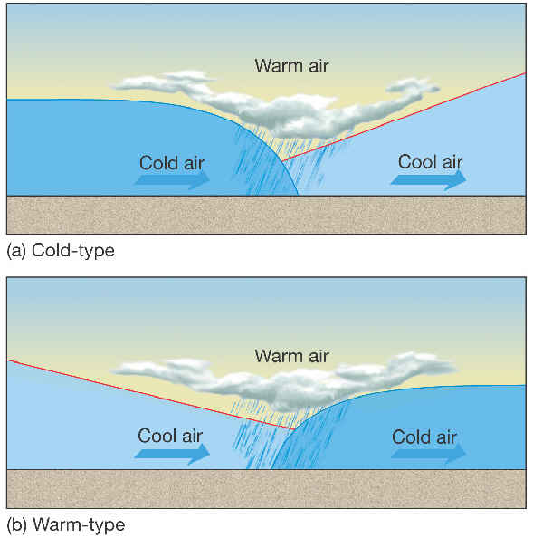
Warm and cold occlusions
Cold
Occlusion if
air behind is colder
Warm
wcclusion
air if air in front
Is colder

Slide 45
Cold-Type Occlusions Have Not Been Observed
X
cool
coldest
coldest
cool

Slide 46
In the real world, only the warm occlusion is observed

Slide 47
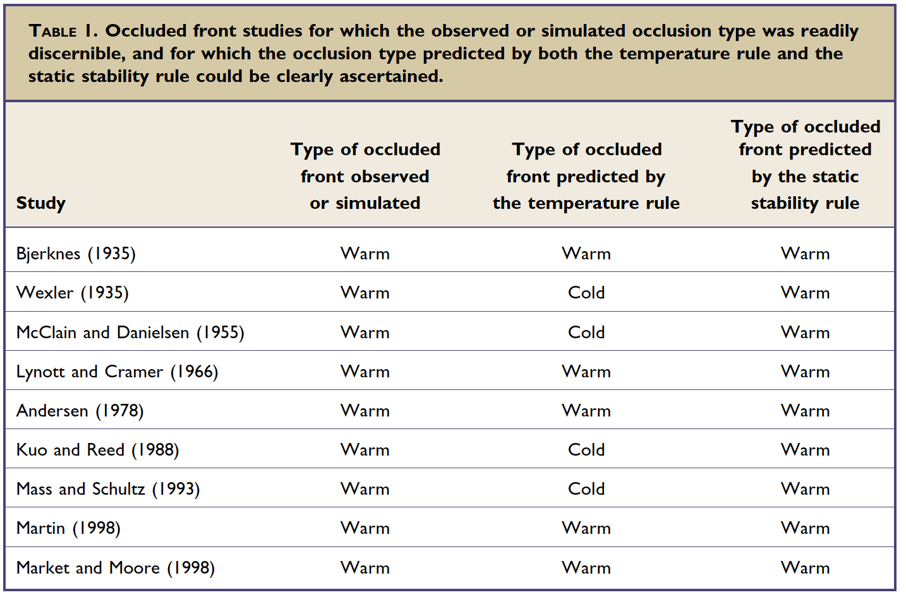
Only Warm Occlusions Observed
From Stoelinga et al 2002, BAMS

Slide 48
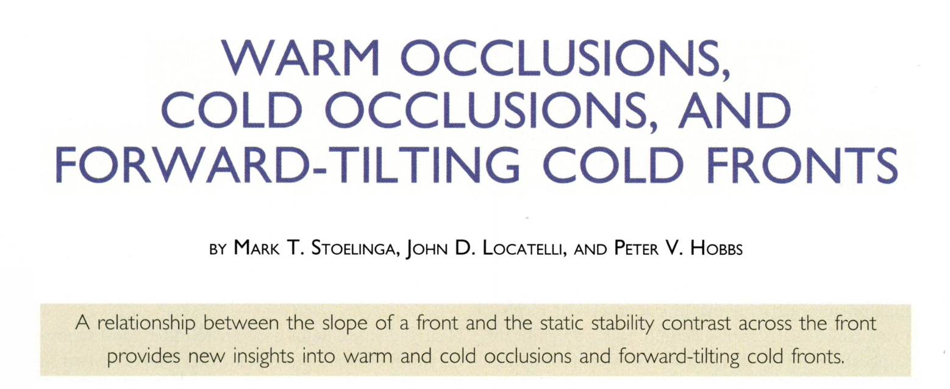

Slide 49
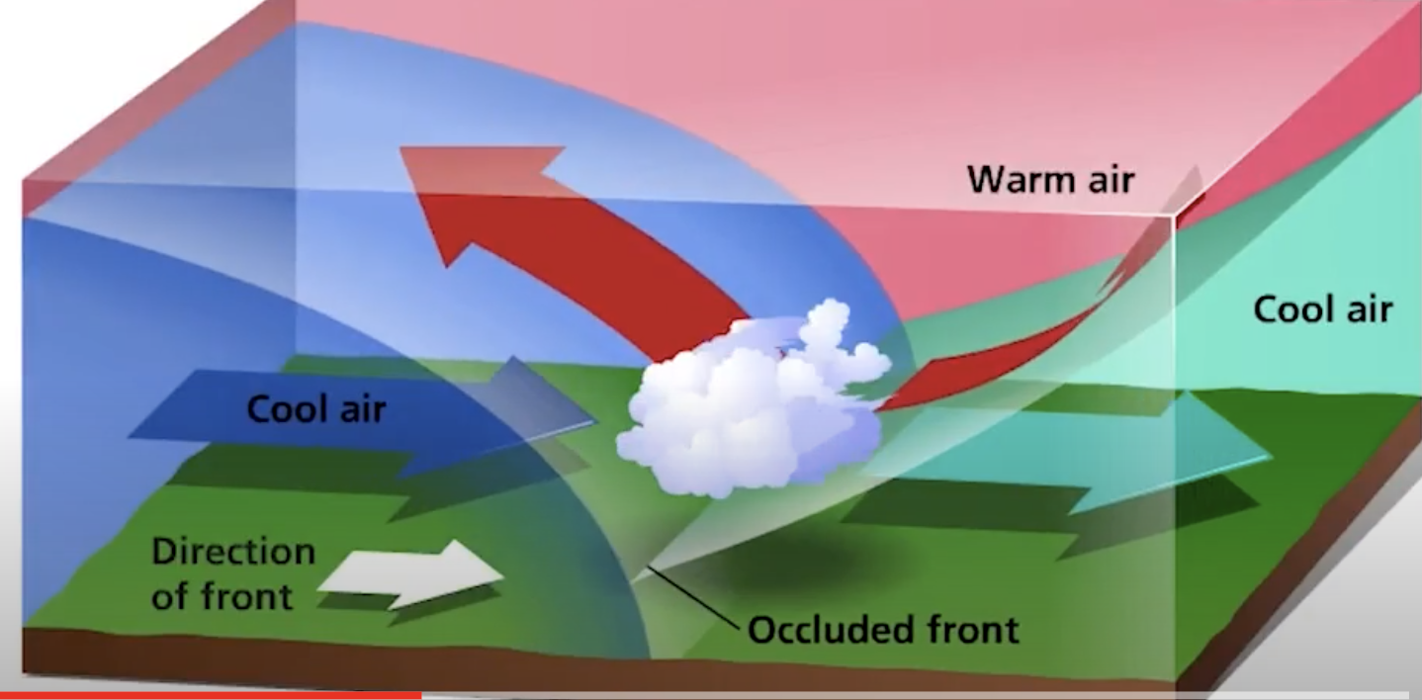
If the temperature rule doesn’t work, what controls the slope and structure of occluded front?

Slide 50
The Static Stability Rule of Occluded Front Slope
An occluded front slopes over the statically more stable air, not the colder air.
  A cold occlusion would occur when the statically more stable air is behind the cold front.
  When the statically more stable air lies ahead of the warm front, a warm occlusion is formed.
Stoelinga et al., 2002

Slide 51
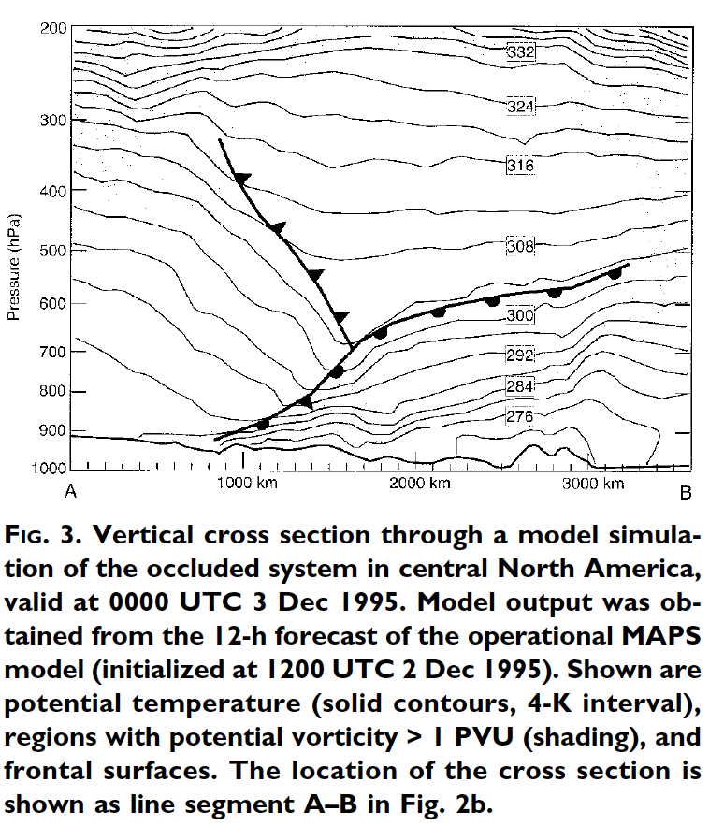
An Example
Less
Stable
More Stable

Slide 52
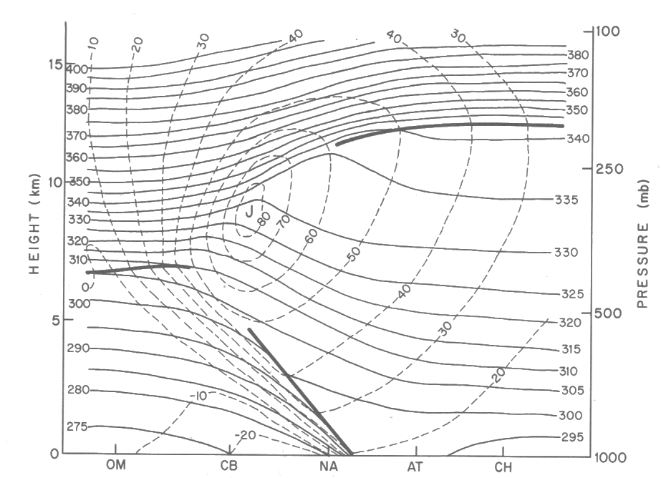
Remember we can evaluate vertical stability looking at the vertical gradient of potential temperature
stable
Less stable
POTENTIAL TEMPERATURE

Slide 53
Generally, statically stable air is in advance of weather systems so we generally observe warm occlusions

Slide 54
Less stable
More stable

Slide 55
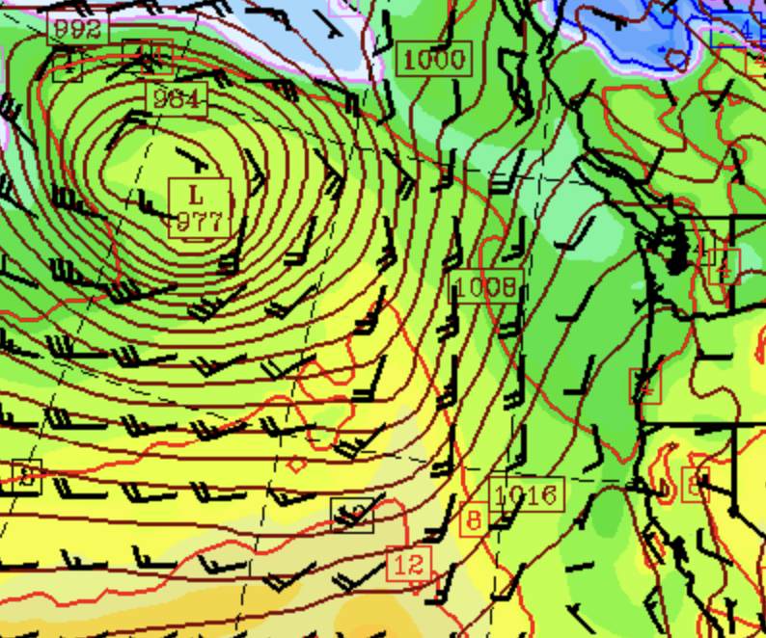
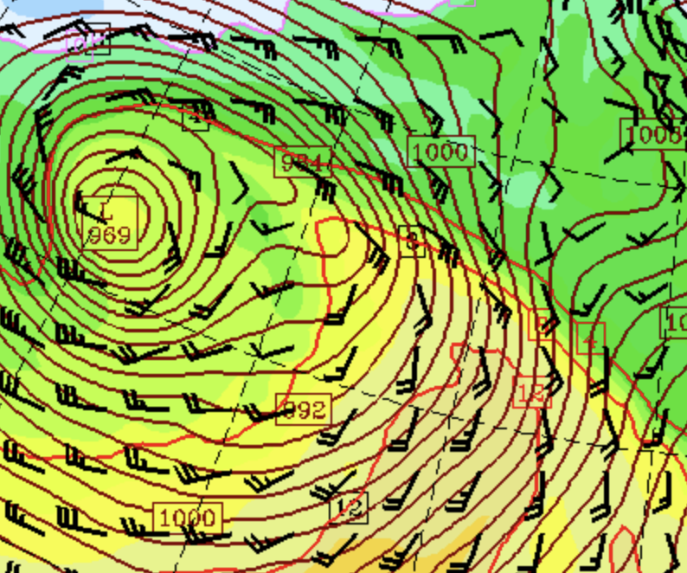
At low levels, the thermal structure of occlusions is characterized by a tongue of warm air along the occluded front

Slide 56
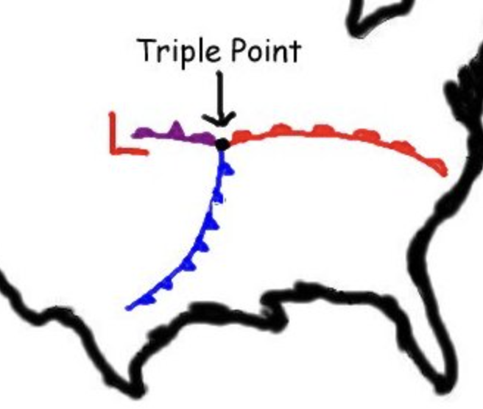
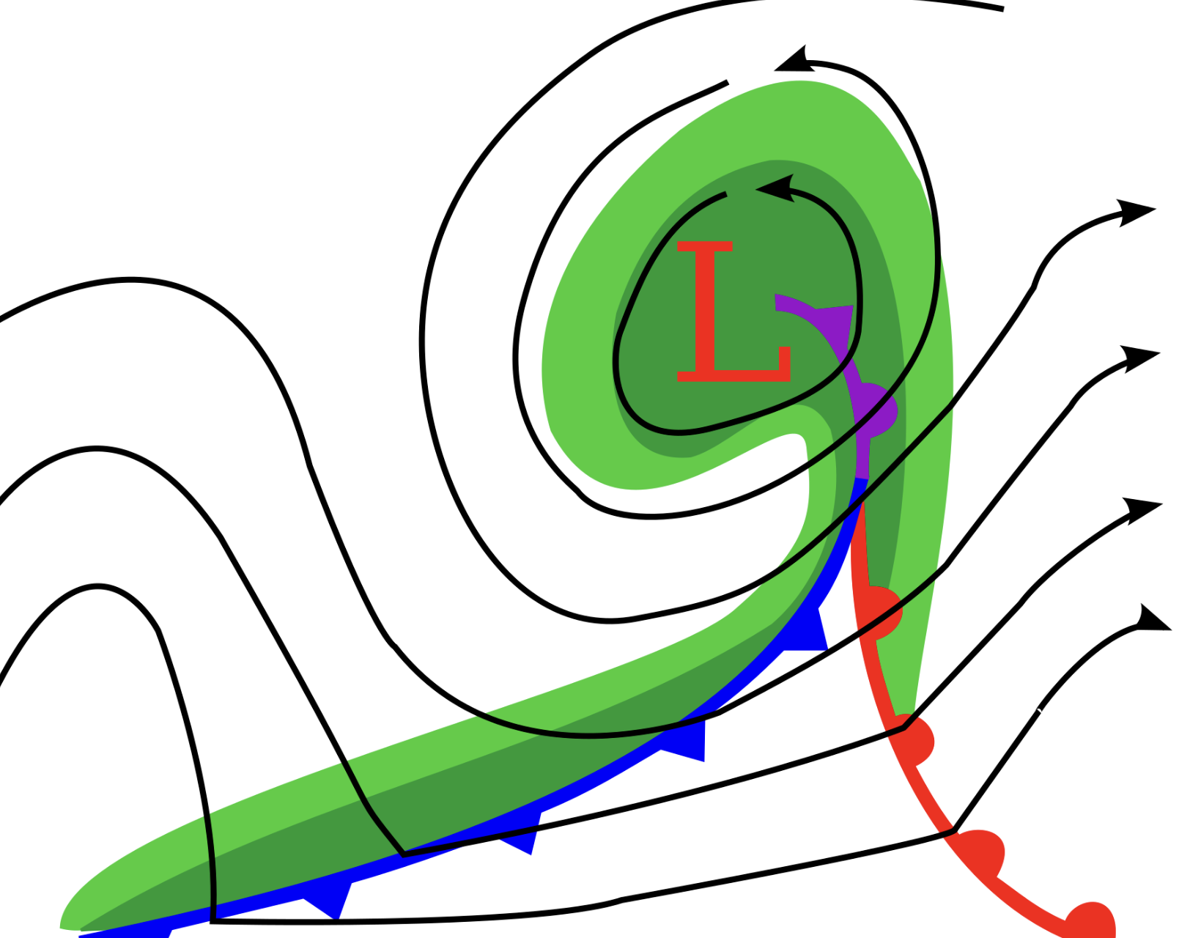
The Triple Point

Slide 57
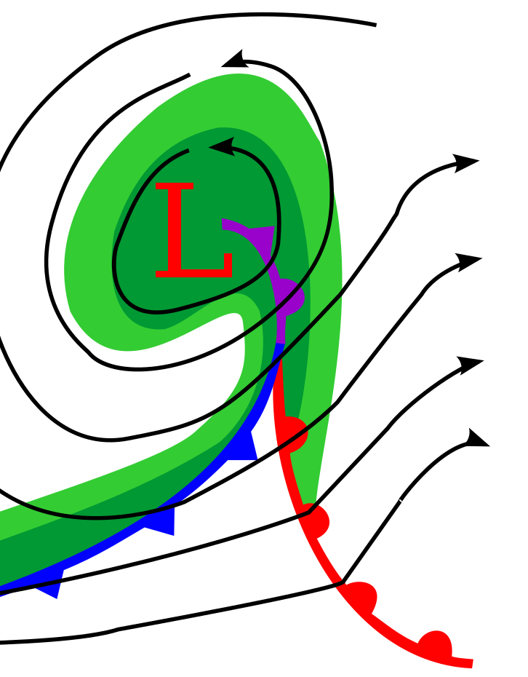
According to the Norwegian Cyclone Model Cyclones Begin to Weaken When They Start to Occlude
In reality, observations often show that cyclones continue to deepen for many hours after the formation of the occluded front.
Example: 29 of the 91 northeast United States cyclones deepen 8–24 mb during the 12–24 h after formation of the occluded front (Kocin and Uccellini, 2004)

Slide 58
Is Frontal Catch-Up an Essential Part of Occluded Front Development?
Not all occluded fronts developed from cold fronts overtaking warming fronts.
Far more fundamental is the distortion of warm and cold air by circulations around low centers/cyclones. More later on this.

Slide 59
The Norwegian Cyclone Model Is A Good Start but Reality Can Be Different
Low level structures can be altered over vast ocean areas
Terrain and distort, alter, and destroy frontal structures.
More on all of this later.

