Slide 1
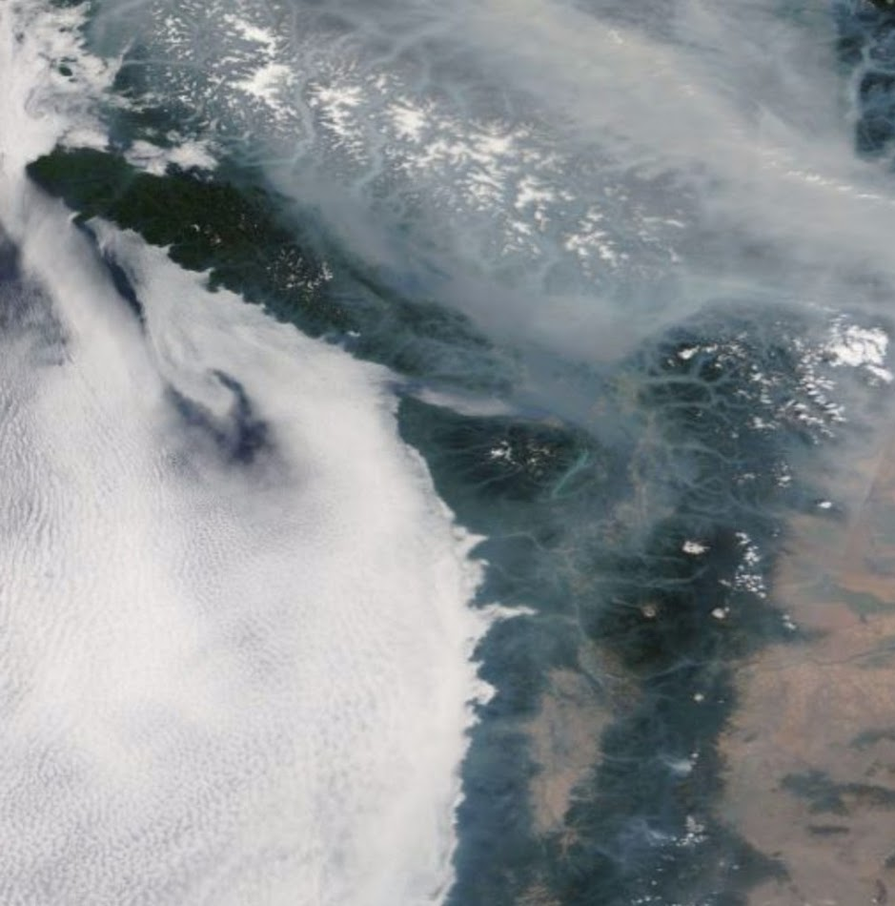
Consortium 10/2/18
Cliff Mass and David Ovens

Slide 2
Computers Moved
We are losing the previous home of the consortium computers (4th floor in our department)
UW does not like departmental computer centers, they want them all centralized.
UW maintains a large facility that has better bandwidth, good AC, and absolutely uninterruptable power (with diesel generations!).
The department webserver has already been moved
Last week, we made the huge move of SAGE. Some problems still, but essential functionality is in place.

Slide 3
Advantages
More bandwidth to outside users.
Should never go down from power outages.
More local bandwidth between our computers and the department server.

Slide 4
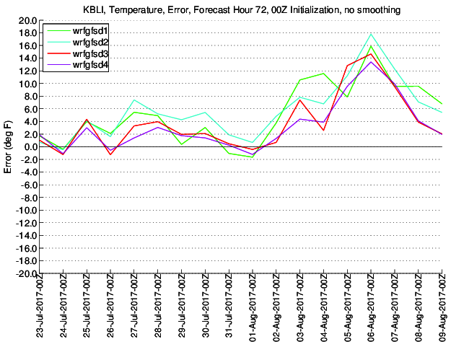
Last year, smoke-related cooling (as high as 15F) was not captured by the UW Operational WRF System
UW WRF Temperature Error
Bellingham, WA

Slide 5
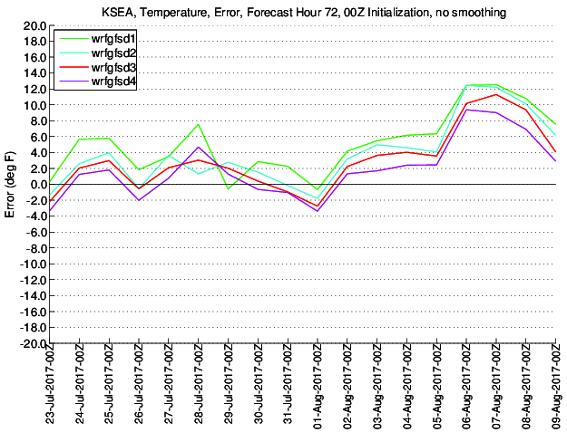
Seattle

Slide 6
Smoke System Went Operational on 8/15
8/15/2018 Beginning with the 2018081600 run, all WRF-GFS domains will be using aerosol optical depth and the aerosol angstrom exponent fields from NASA's GEOS system. Three-hourly values of these parameters will be used in WRF to interact with the radiation scheme in an effort to incorporate the temperature effects of smoke.

Slide 7
What we are doing
aer_opt = 2: A new way to input aerosol for RRTMG and Goddard radiation options.
Either AOD at 550 nm or AOD plus Angstrom exponent needed, plus single scattering albedo and cloud asymmetry parameters can be input via constant values from namelist or 2D input via auxiliary input stream 15.
Using the predicted 2-d aerosol optical depth (AOD) at 550 nm and the predicted 2-d aerosol Angstrom exponent from
NASA's GEOS-5 system.
WRF's aerosol single-scattering albedo (AERSSA2D) and aerosol asymmetry factor (AERASY2D) are set to the recommended fixed values of 0.85 and 0.9, respectively.

Slide 8
Impacts
Cools the surface
Reduces daytime PBL heights
Reduces the major warm bias we had when it was smoky (as much as 10-15F).

Slide 10
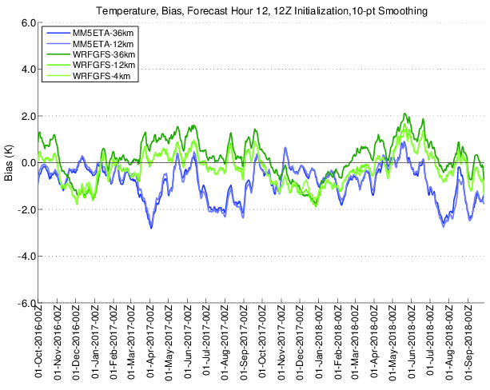

Slide 11
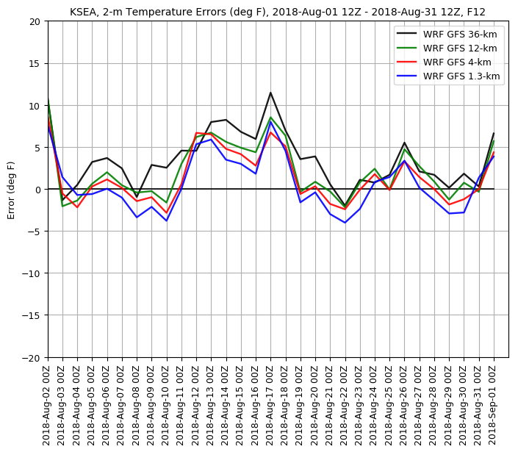

Slide 12
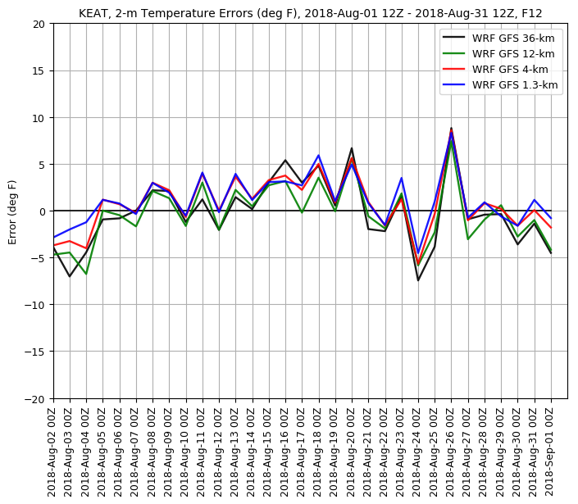

Slide 13
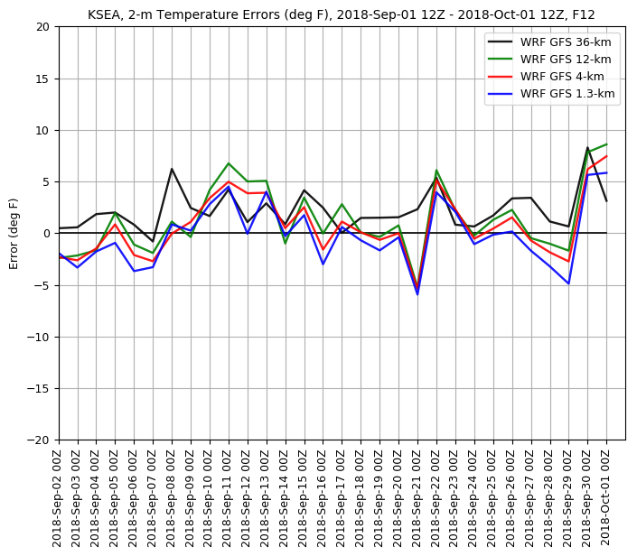
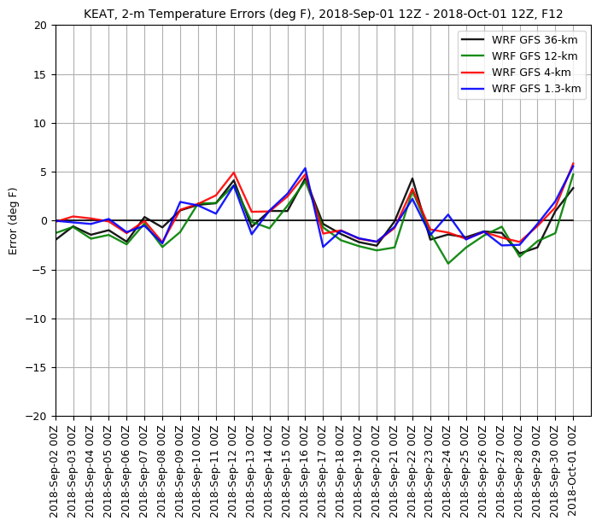

Slide 14
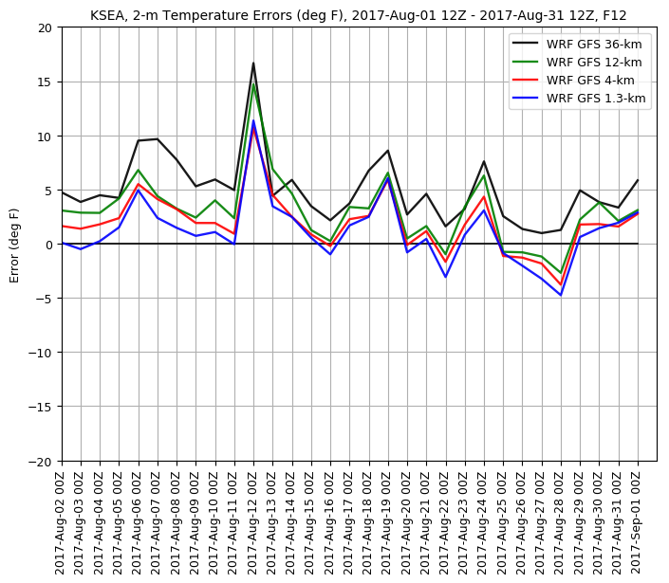
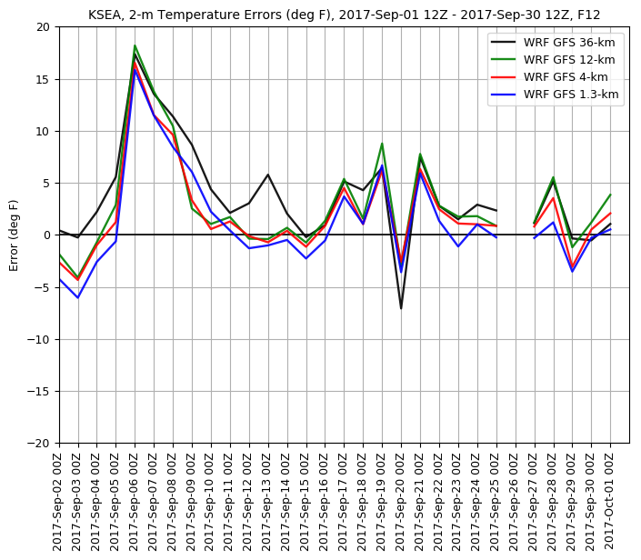
Last Year

Slide 15
Drop Smoke Until Next June?
Why not?
Would simply the scripts….less failure modes.

Slide 16
4-km Ensembles: Now Only 0000 UTC Initialization

Slide 18
Ensemble Expansion to Include 12 UTC
There were delays in the delivery of new computers
Also hardware problems with a few of them
Most of the problems are fixed.
As soon, as things are stable in our new home…probably within 2 weeks…we will start doing ensembles on both cycles (0000 and 1200 UTC) at 4-km.

Slide 19
Initial Stage: Both Cycles Will Include:
4-km deterministic from operational GFS
10 members from the GFS ensembles (GEFS)
4 additional members driven by Canadian, UKMET, Australian, Japanese, and Navy Global Models

Slide 20
Stage 2: Expansion
If there is additional time, can add stochastic physics to get more physics diversity.
Could also experiment with more vertical layers, etc.
May be able to get an additional 5 runs each cycle.
Let us know about new product ideas for ensembles

Slide 21
Possible System Upgrades to Test This Fall
Going to WRF 4.0
Adding vertical levels (say from 38 to 50)
Going to hybrid vertical coordinate
Evaluating new physics schemes, including PBL.

Slide 22
The End

