Slide 1
Clouds

Slide 2
Cloud Identification
Provides great insight into what is occurring aloft
Illustrates basic physics of the atmosphere.
Useful knowledge: gives one some forecasting skill.

Slide 3

What are clouds made of?
H2O droplets or ice crystals (or both)
Clouds form as air cools to saturation. Two ways this happens:
Upward motion (most clouds). Air expands and cools as it rises (adiabatic cooling)
Cooling of air by other means. Often by contact with a cool surface.

Slide 4
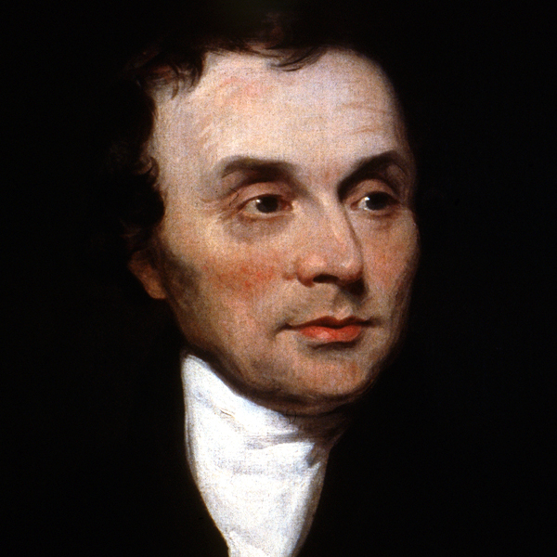
Cloud Classification
Current system developed in the early 1800s by French naturalist Lamarck and Englishman Luke Howard
Based on dividing clouds into 4 basic types based on their appearance
Also dividing by their heights.

Slide 5
Major Types
Stratus: layer or sheet-like clouds
Cirrus: thin, wispy clouds
Cumulus: puffy cotton-ball like clouds. Can have great vertical development
Nimbus: precipitating clouds

Slide 7
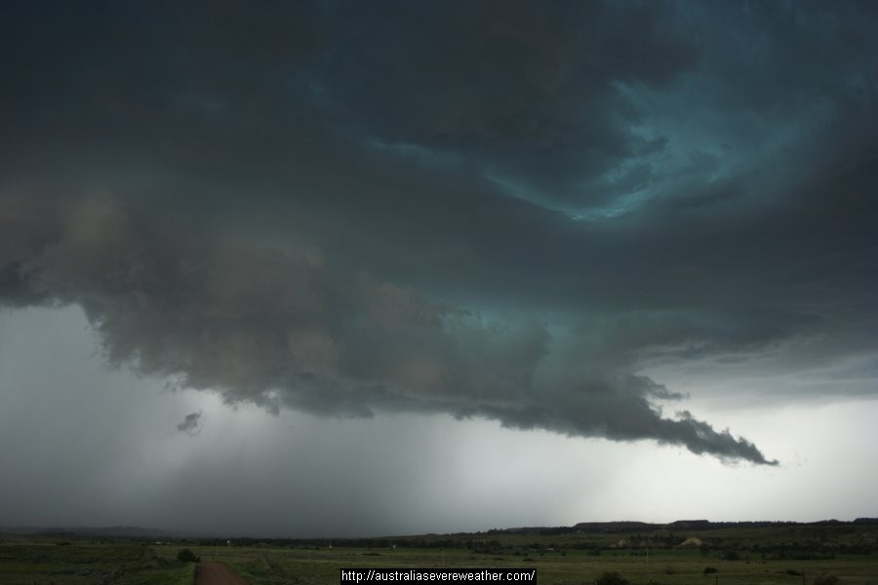
Nimbus

Slide 8
Cloud Heights
Divides clouds into high, medium, and low clouds
High: more than 7 km, often uses prefix ”cirro”
Middle: 2-7 km, prefix “alto”
Low: < 2 km

Slide 9
Building cloud names
Cirrostratus: a high ice cloud in a layer
Altocumulus: middle level cumulus
Cumulonimbus: precipitating cumulus
Additional suffixes:
Lenticularis- lens shaped clouds
Castellanus- turret shaped or castle like

Slide 10
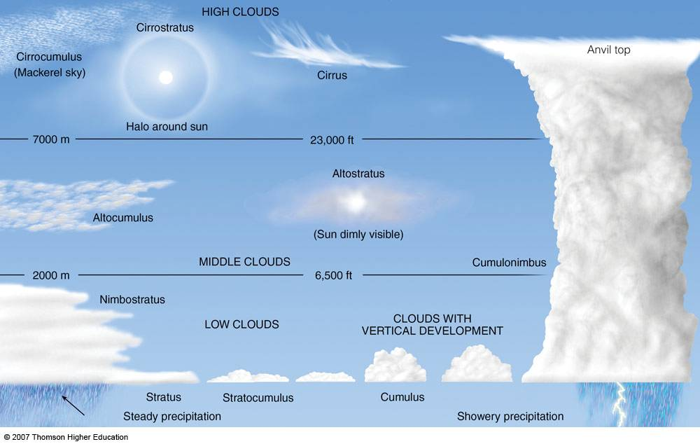

Slide 11
High Clouds (higher than 7 km)
Made of ice crystals
Diffuse edges

Slide 12
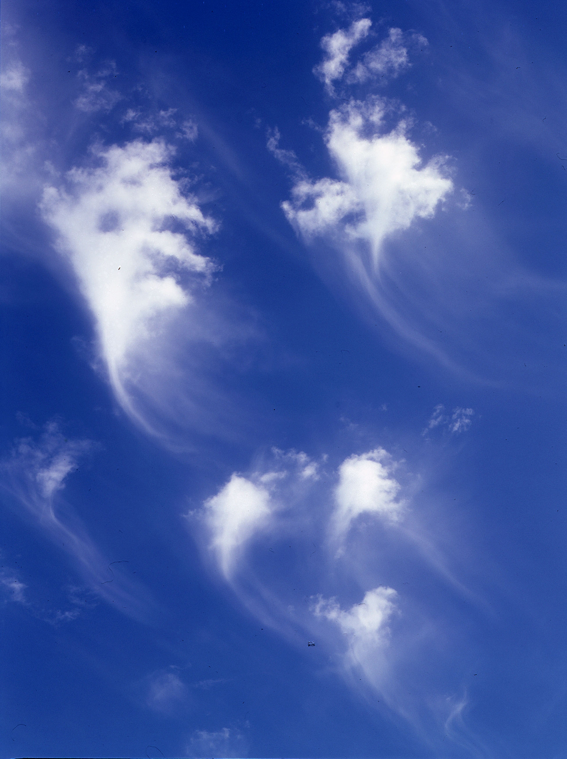
Cirrus

Slide 13
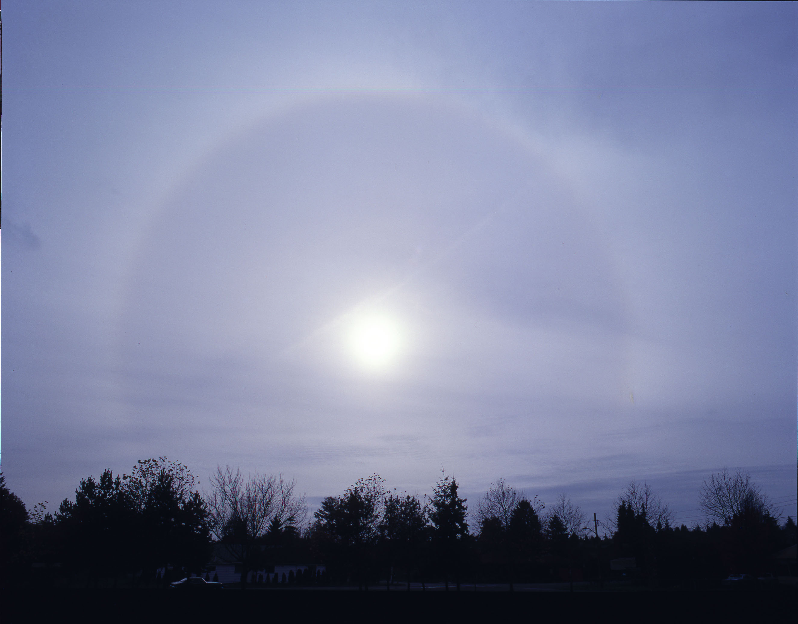
Cirrostratus (note Halo around the sun)

Slide 14
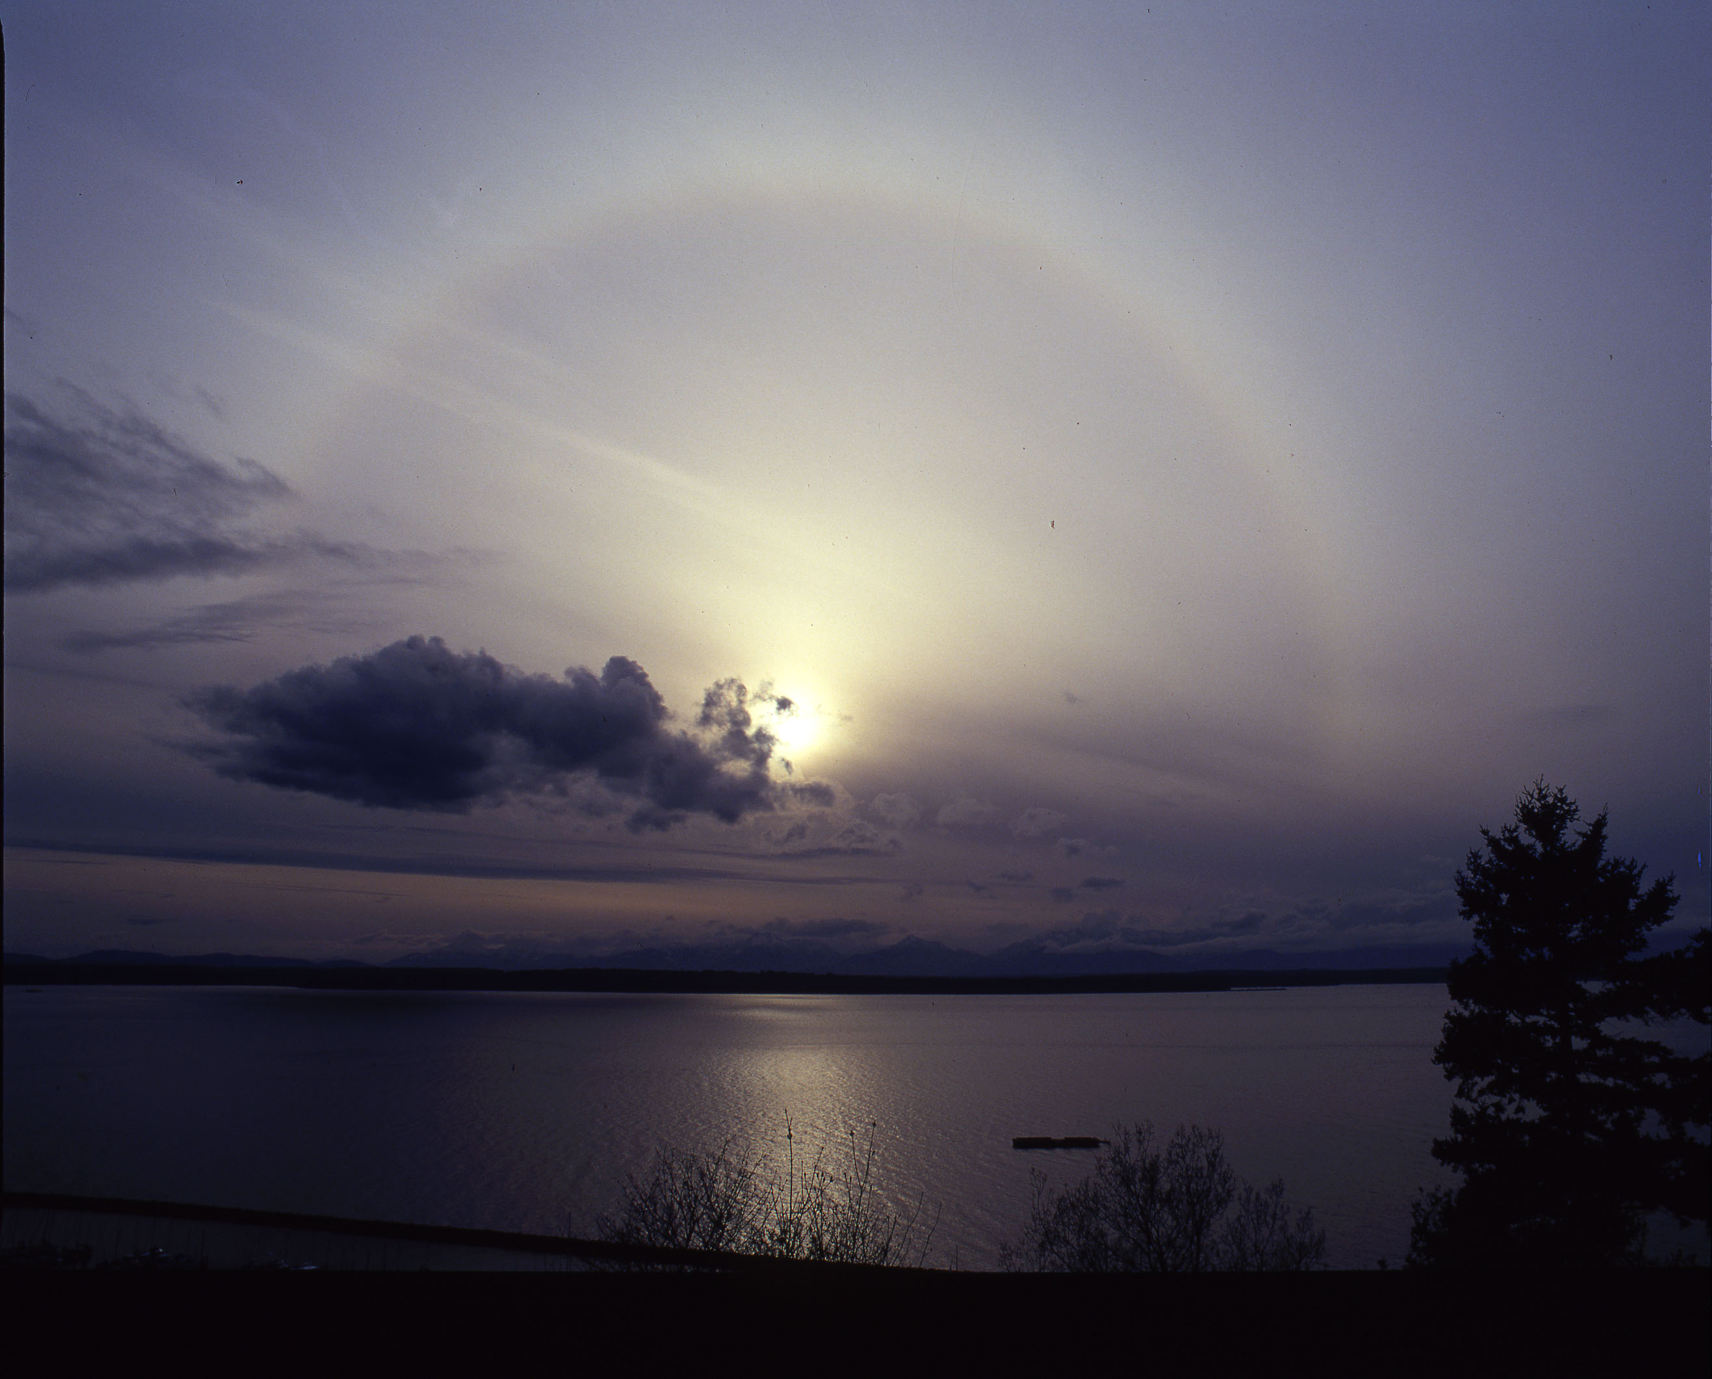

Slide 15
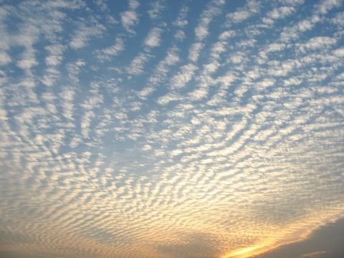
Cirrocumulus

Slide 16
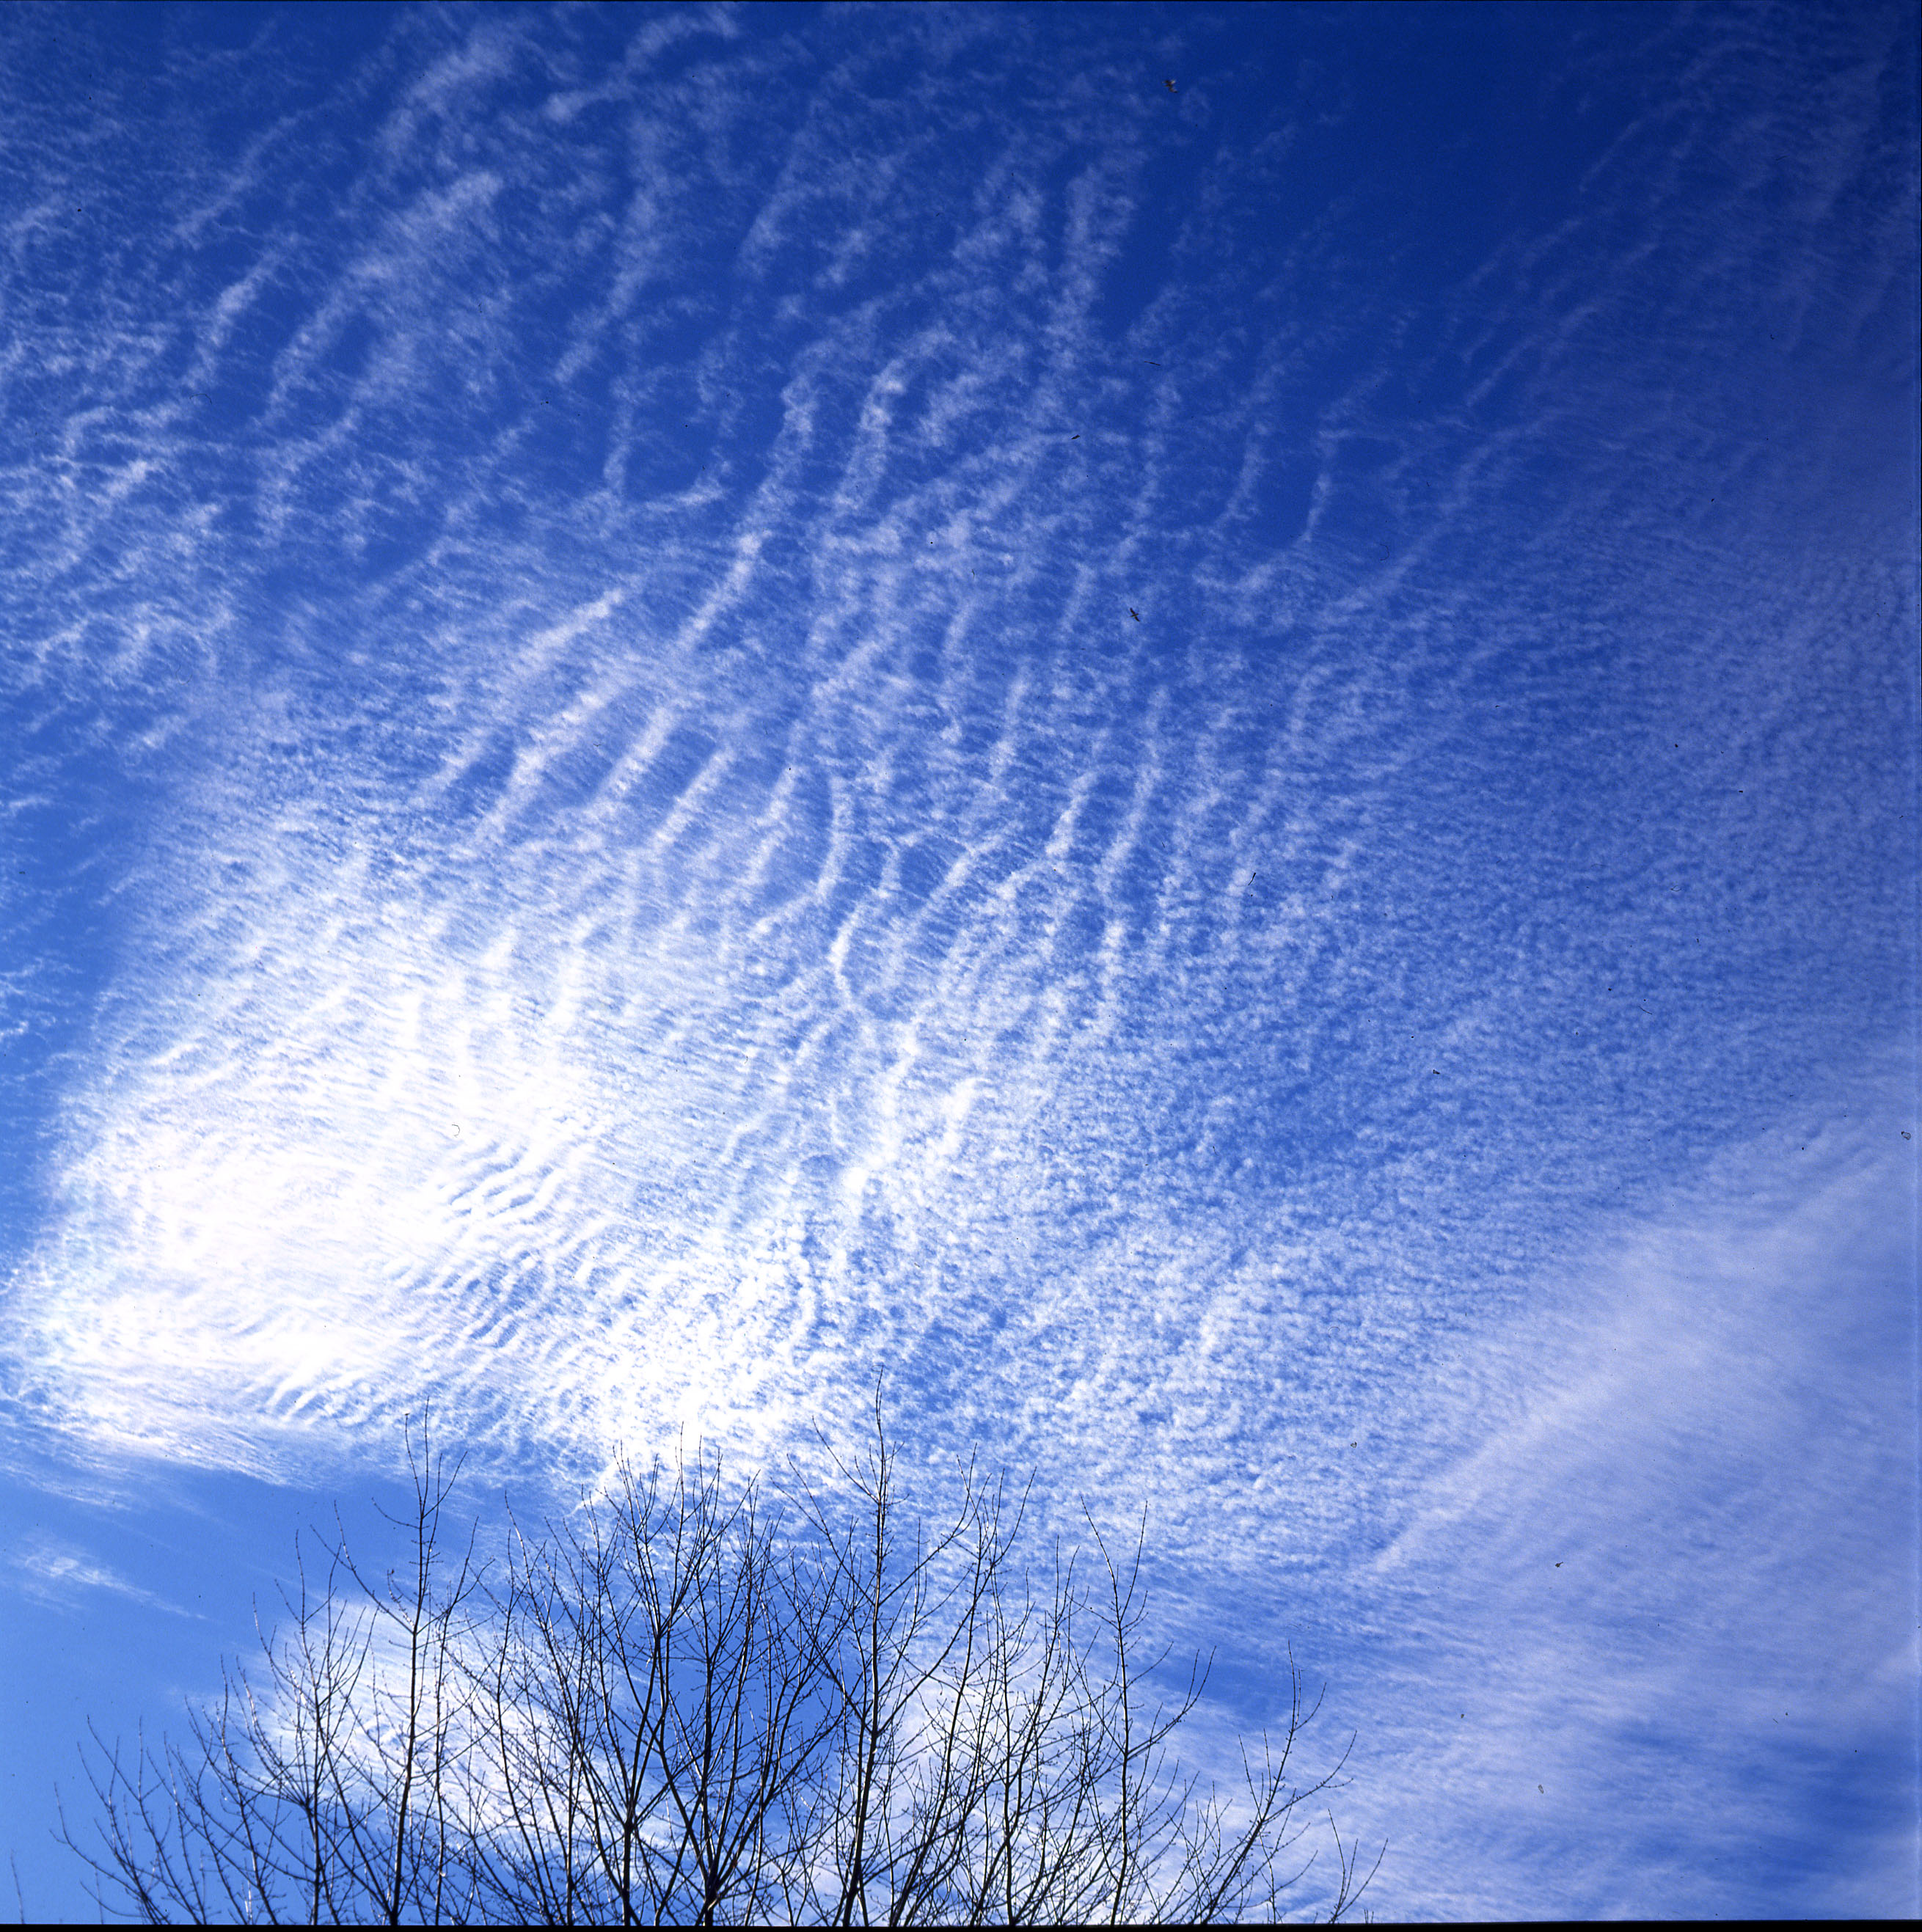
Cirrocumulus

Slide 17
Middle-Level Clouds (2-7km)
Water or ice clouds
Or a mixture of water and ice

Slide 18
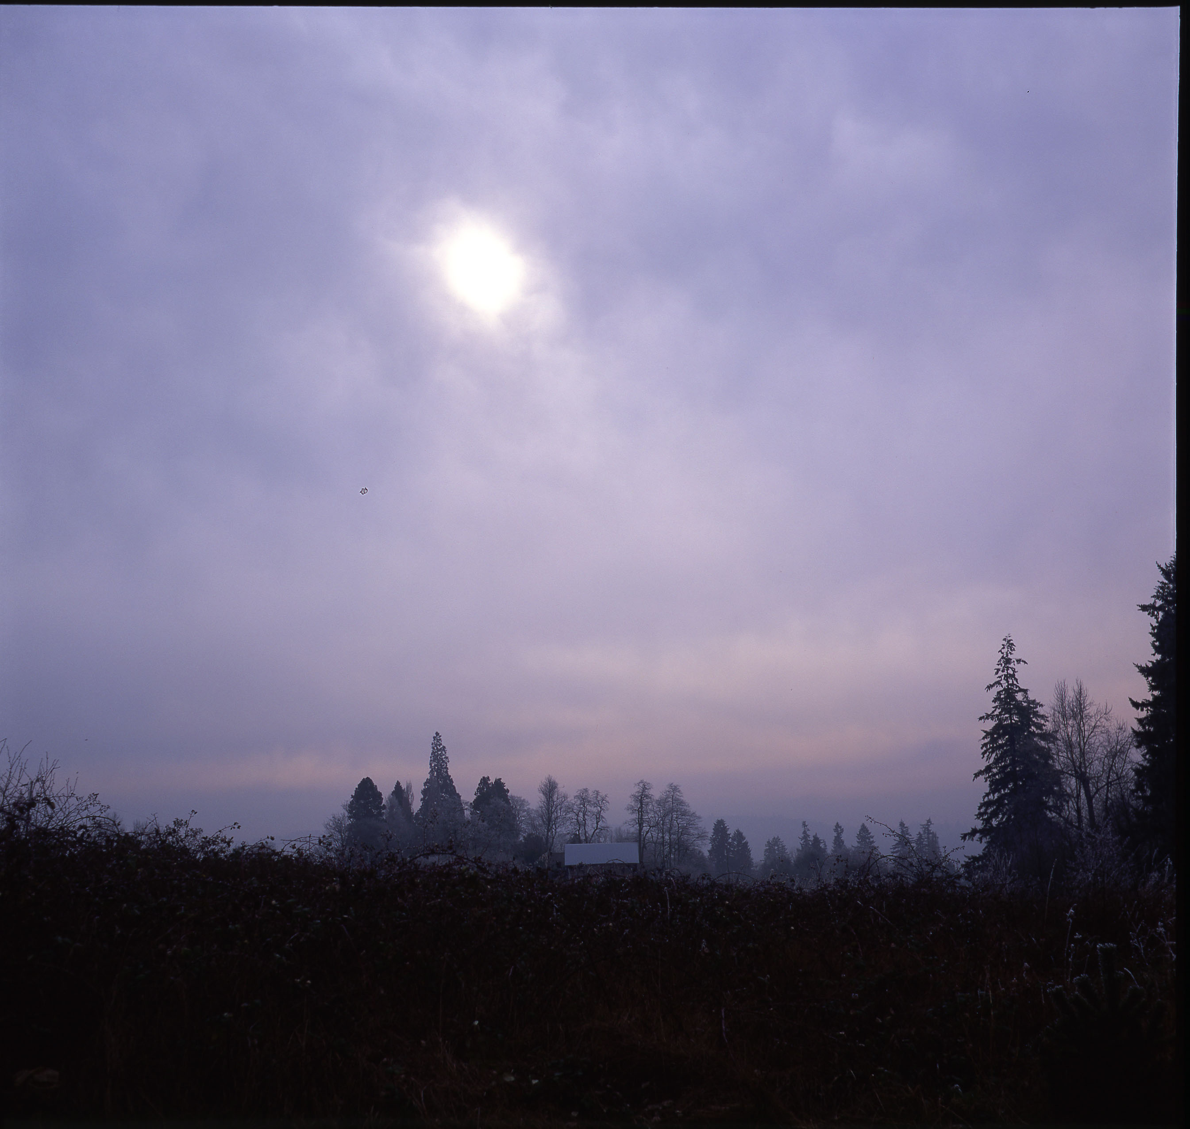
Altostratus (watery sun)

Slide 19
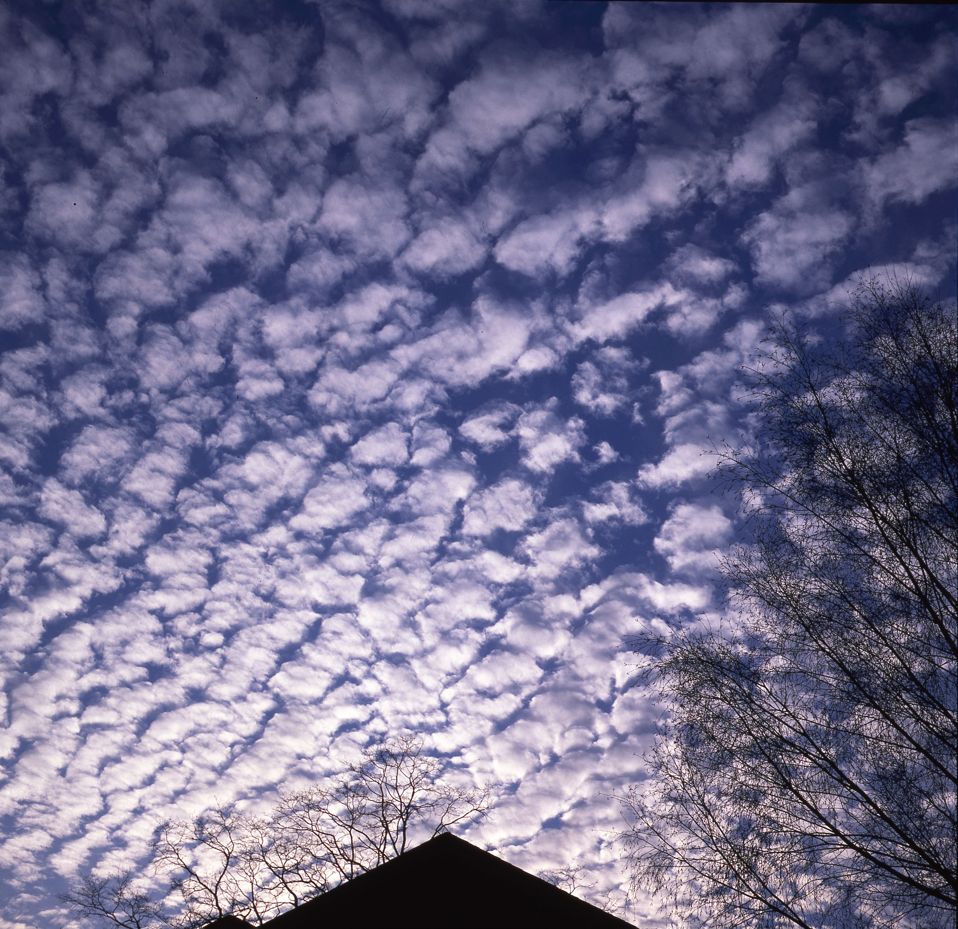
Altocumulus

Slide 20
Low Clouds

Slide 21
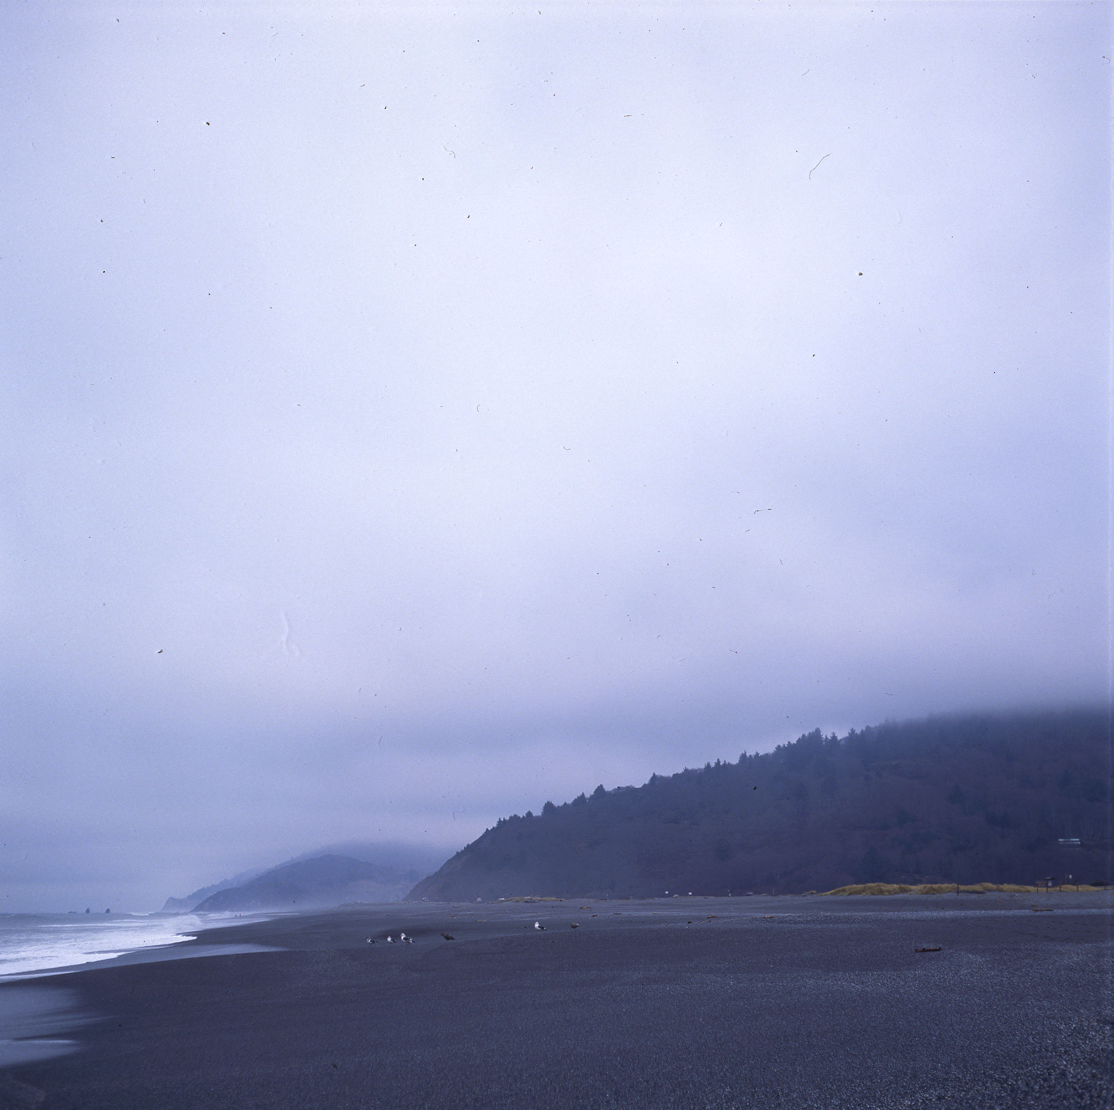
Stratus

Slide 22
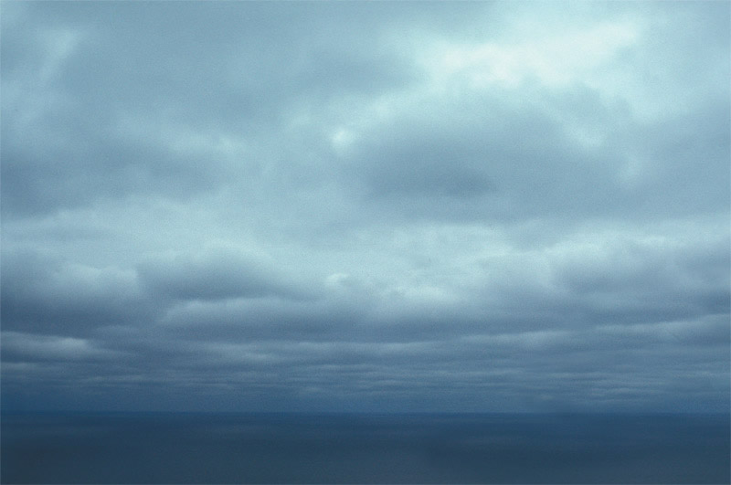
stratocumulus

Slide 23
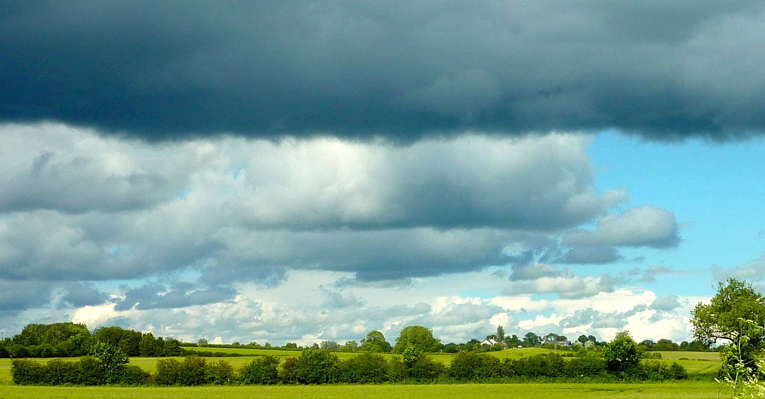
stratocumulus

Slide 24
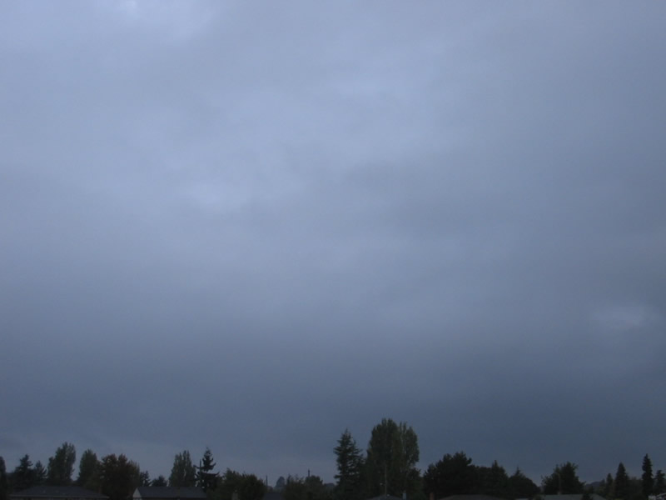
nimbostratus

Slide 25
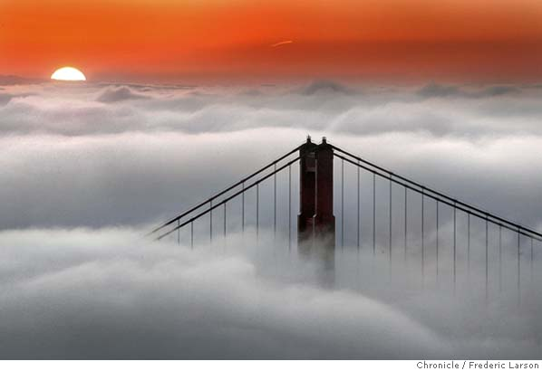
Fog

Slide 26
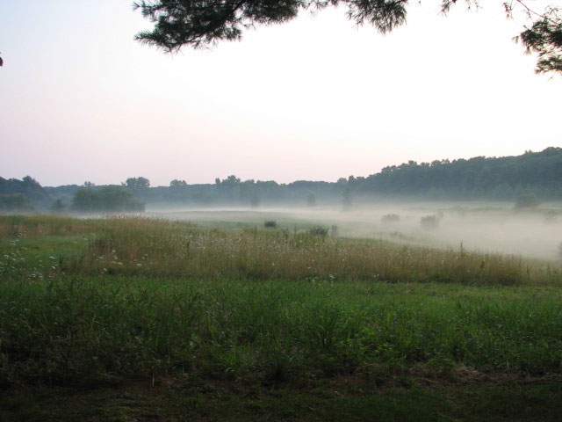
Ground fog

Slide 27
Clouds with vertical development
Cumulus

Slide 28
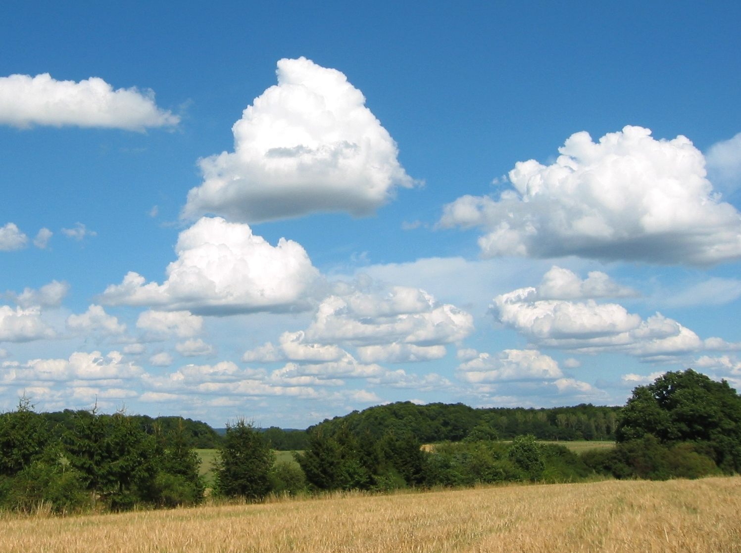
Fair weather cumulus

Slide 29
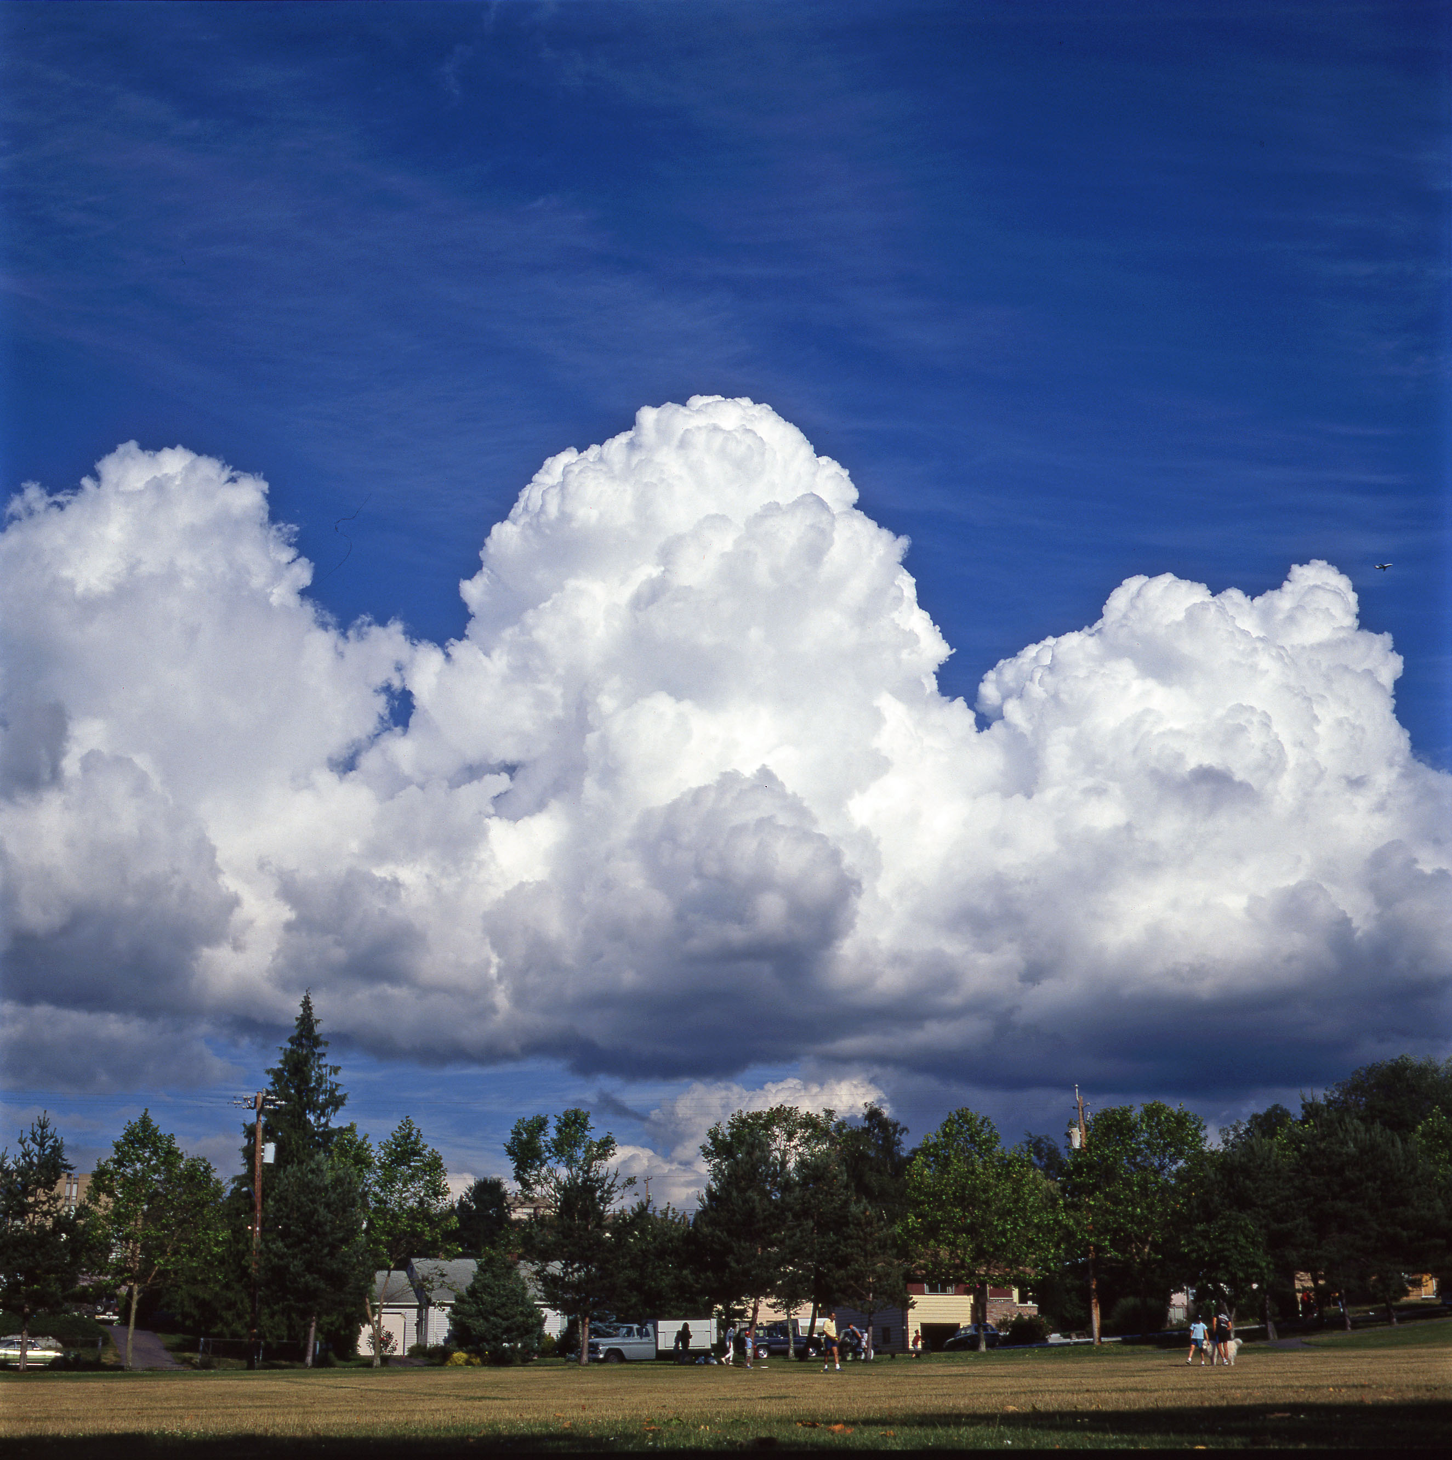
Cumulus Congestus: more vertical development

Slide 30
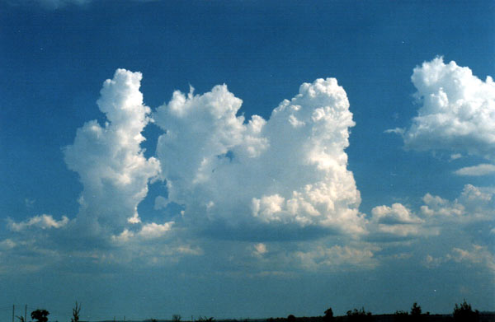

Slide 31
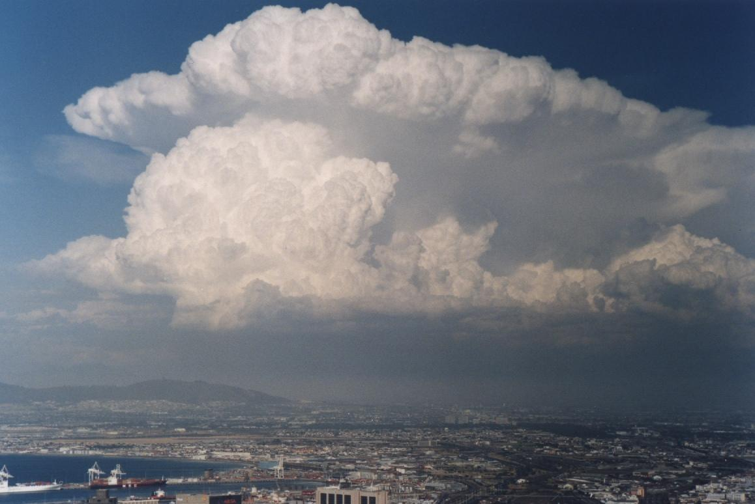
Cumulonimbus

Slide 32
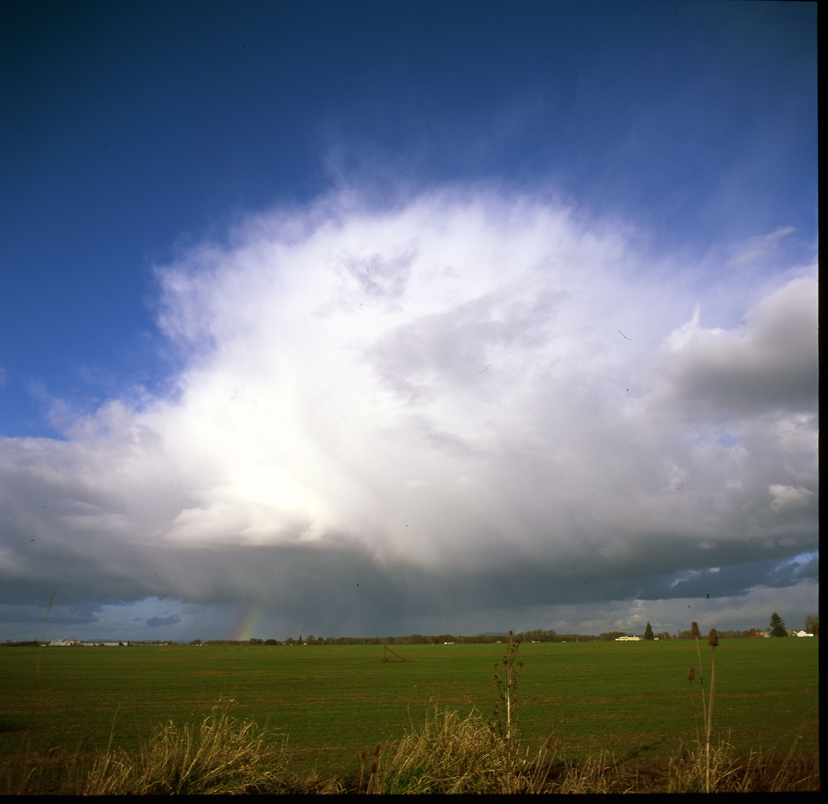

Slide 33
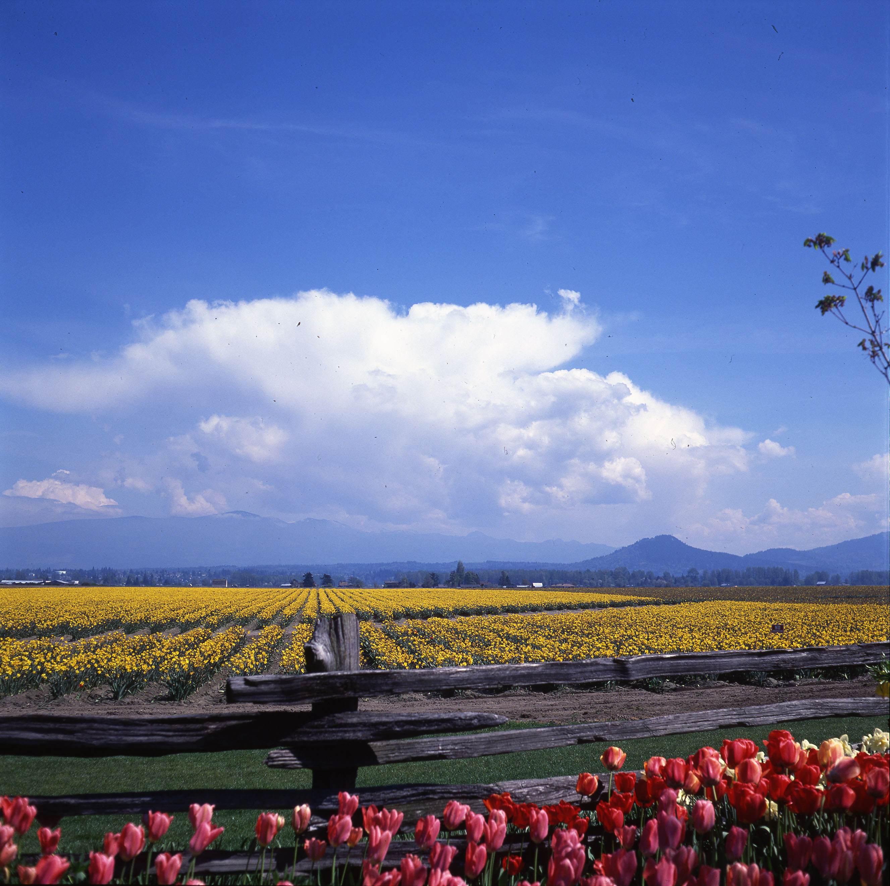

Slide 34
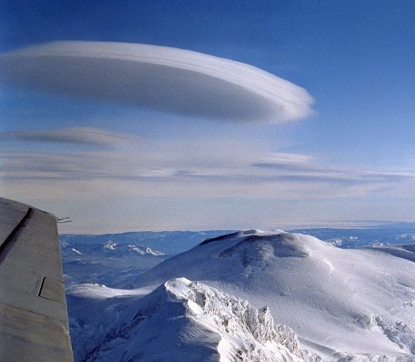
Lenticular or Mountain Wave Clouds
Altocumulus lenticularis

Slide 35
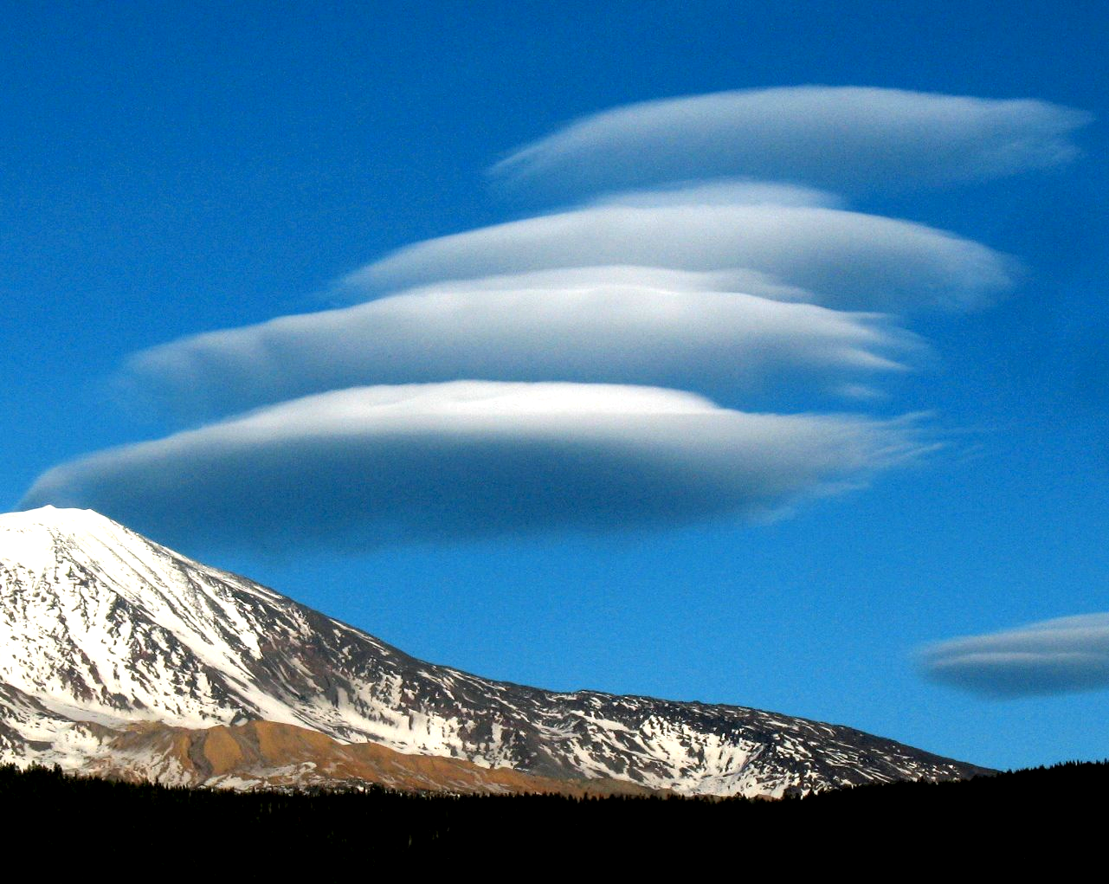
Also known as altocumulus lenticularis

Slide 36
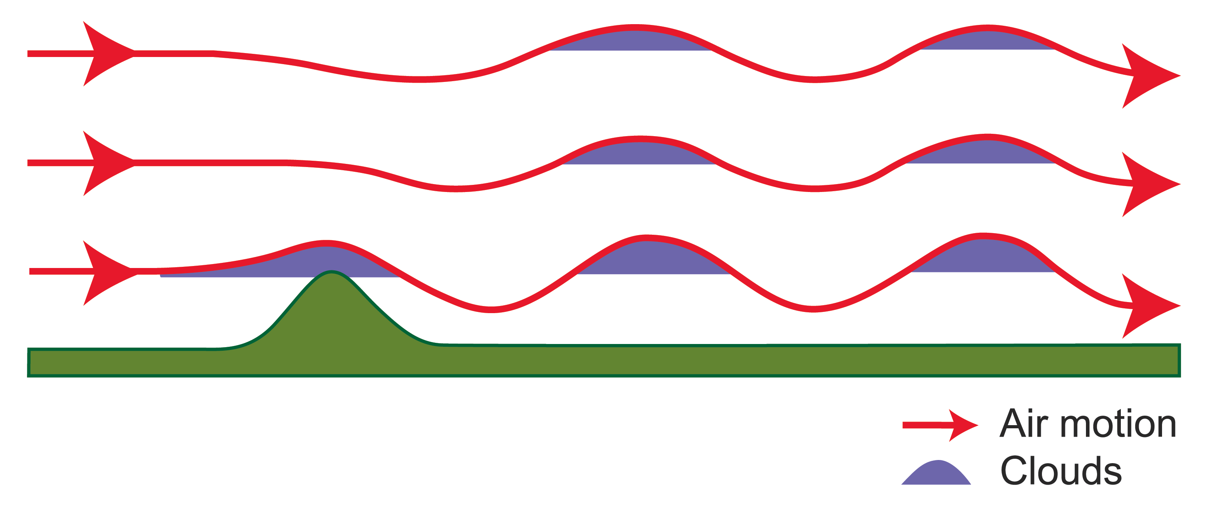
Mountain Wave Clouds

Slide 37
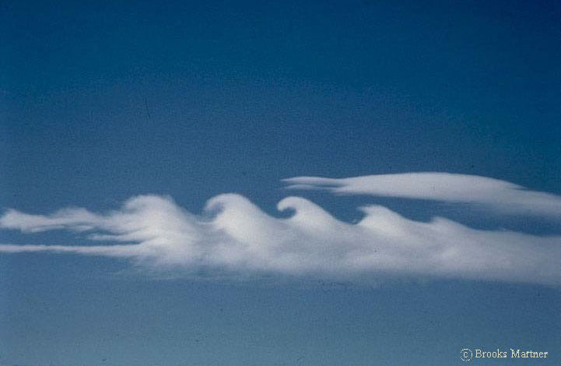
Kelvin-Helmholtz Billows
Kelvin-Helmholtz Instability Clouds
Associated with vertical wind shear

Slide 38
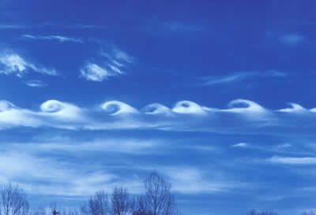
https://www.youtube.com/watch?v=qEGbzZM0Baw

Slide 39

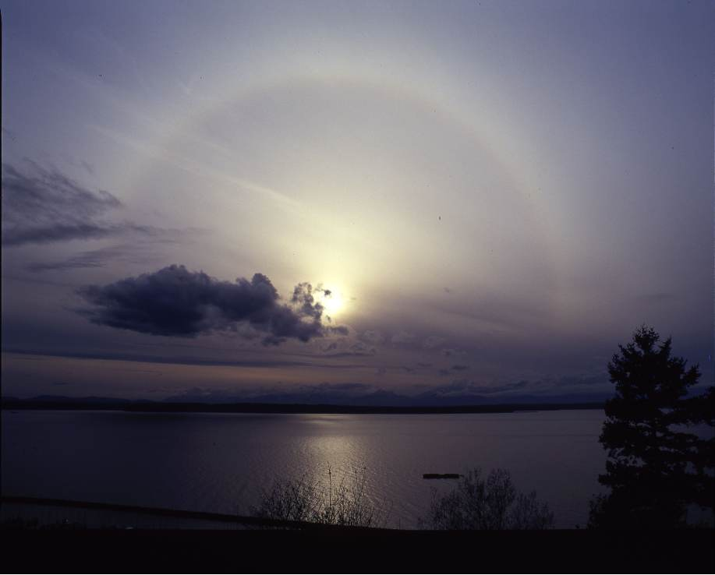
As fronts or storms approach there is a typical cloud progression with lowering and thickening of the cloud deck
Cirrostratus
Cirrus

Slide 40
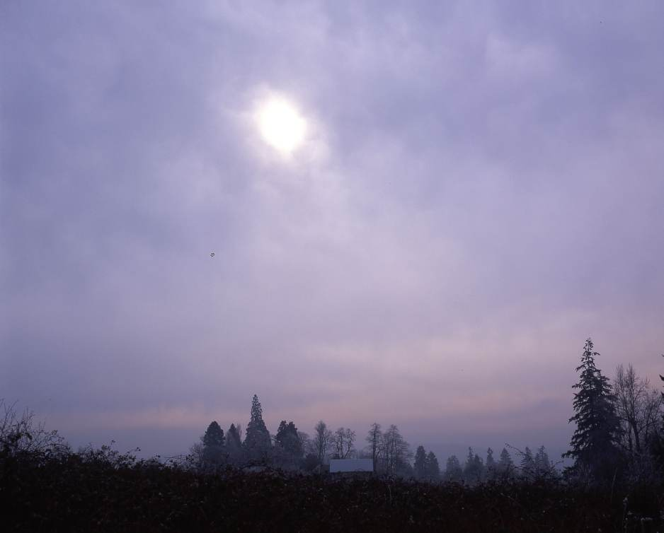
Altostratus: Watery Sun

Slide 41
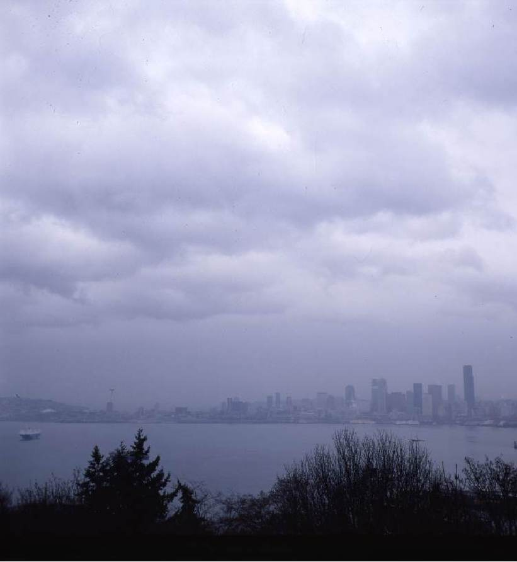
Nimbostratus

Slide 42
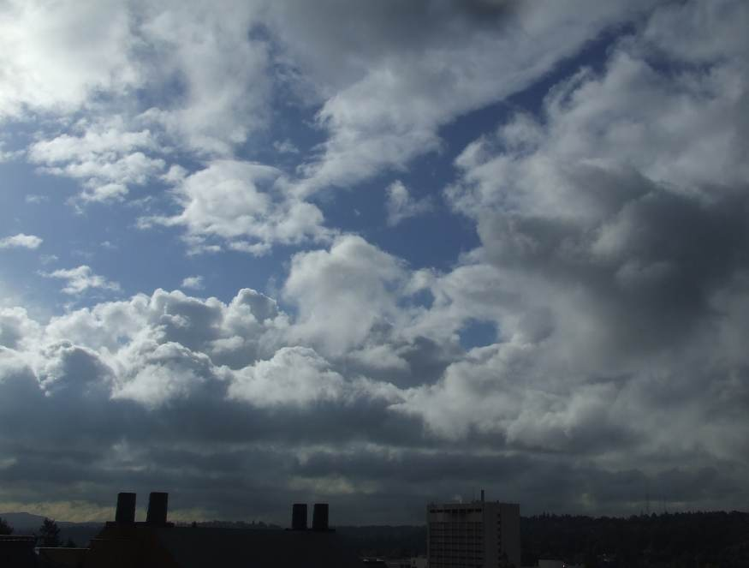
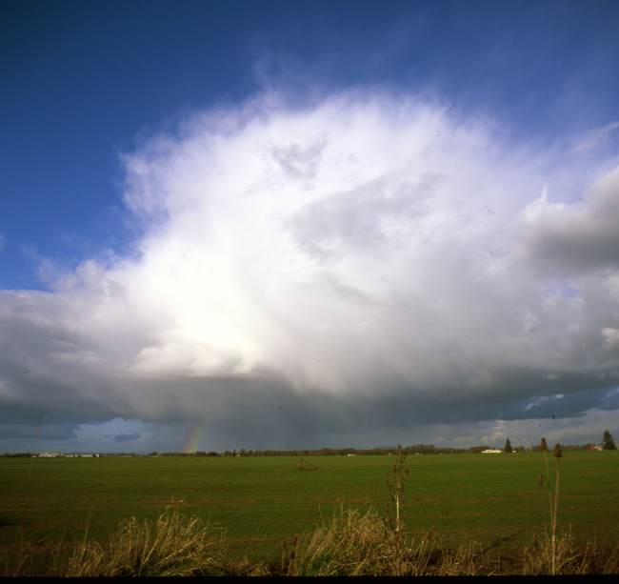
After the front: more cumuloform and instability clouds

Slide 43
Lenticular Clouds—often a sign of change. Higher relativity air moving in aloft. Front or storm may be approaching

Slide 44
Cloud ID Video
https://www.youtube.com/watch?v=ce_x20pr_N0

Slide 45
