Slide 1

Forecasting Boot Camp
ATMS 370

Slide 2
Major Steps in the Forecast Process
Data Collection
Quality Control
Data Assimilation
Model Integration
Post Processing of Model Forecasts
Product and graphics generation
Human Interpretation (sometimes)

Slide 3

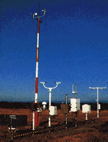
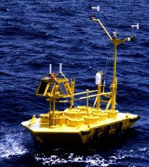

Observation and Data Collection

Slide 4
Data Collection
Weather is observed throughout the world and the data is distributed in real time.
Many types of data and networks, including:
  Surface observations from many sources
  Radiosondes and radar profilers
  Fixed and drifting buoys
  Ship observations
  Aircraft observations
  Satellite soundings
  Cloud and water vapor track winds
  Radar and satellite imagery

Slide 5
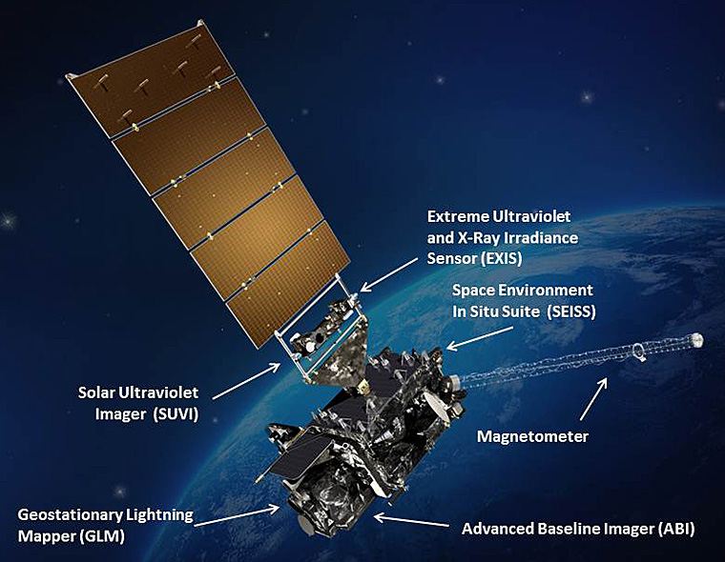
Data Collection
Satellite data is now the dominant data source for weather prediction (perhaps 99%)
Huge increases in the numbers of surface stations and aircraft reports.

Slide 6
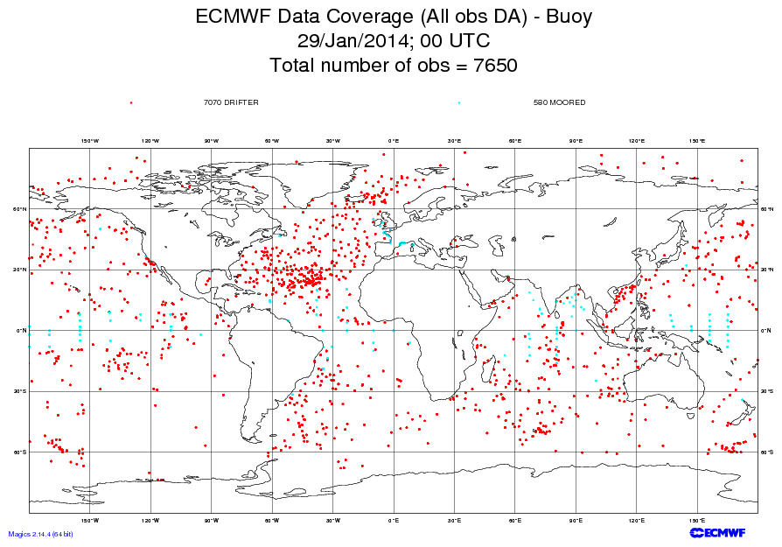

Slide 7
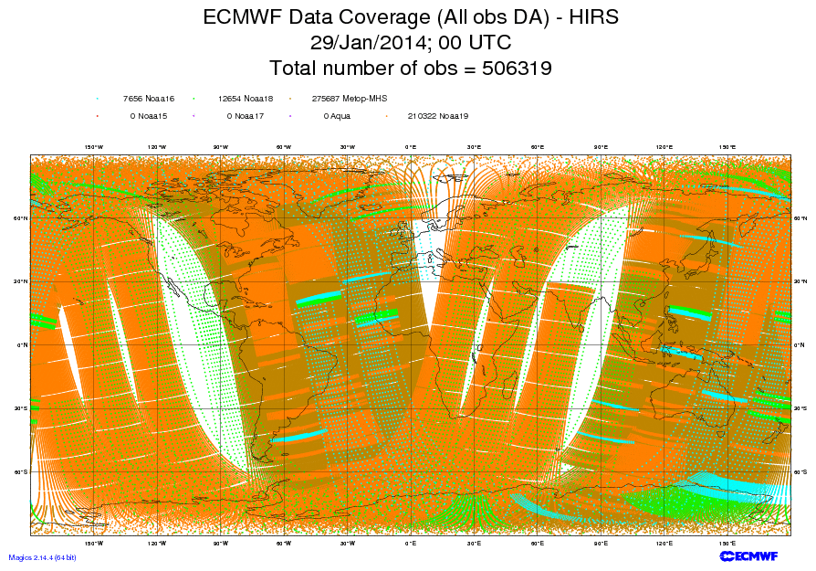
High-resolution Infrared Radiation Sounder

Slide 8
Quality Control
Automated algorithms and manual intervention to detect, correct, and remove errors in observed data.
Examples:
  Range check
  Buddy check (comparison to nearby stations)
  Comparison to first guess fields from previous model run
  Hydrostatic and vertical consistency checks for soundings.
An important issue for the forecaster--sometimes good data is rejected and vice versa.

Slide 9
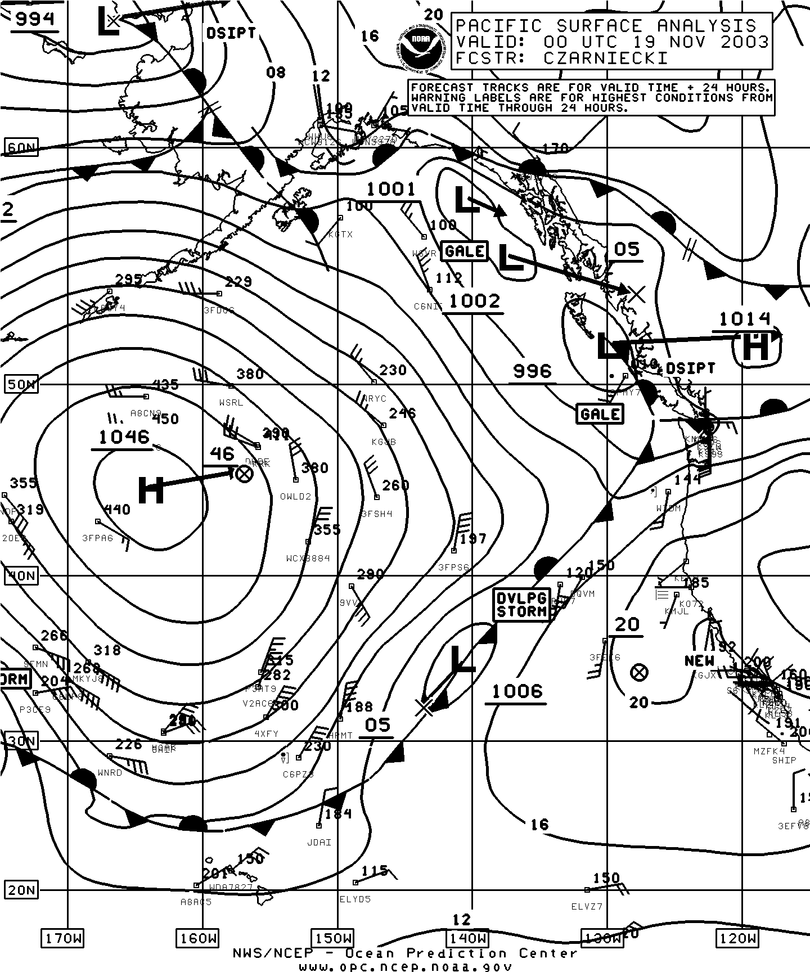
Pacific Analysis
At 4 PM
18 November
2003
Bad Observation

Slide 10
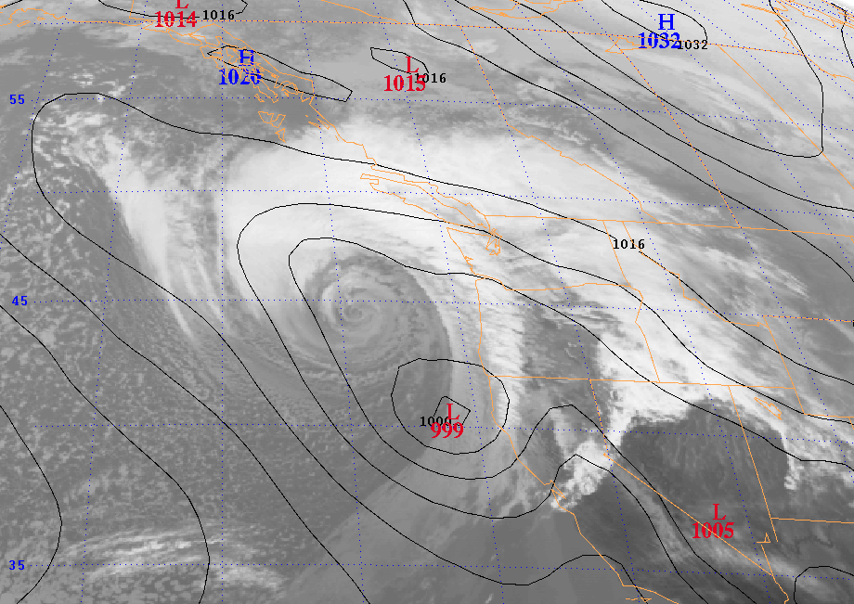
3 March 1999: Forecast a snowstorm … got a windstorm instead
Eta 48 hr SLP Forecast valid 00 UTC 3 March 1999

Slide 11
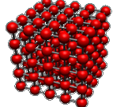
Objective Analysis/Data Assimilation
Numerical weather models are generally solved on a three-dimensional grid
Observations are scattered in three dimensions
Need to interpolate observations to grid points and to ensure that the various fields are physically plausible (e.g., most of the atmosphere in hydrostatic and gradient wind balance).

Slide 12
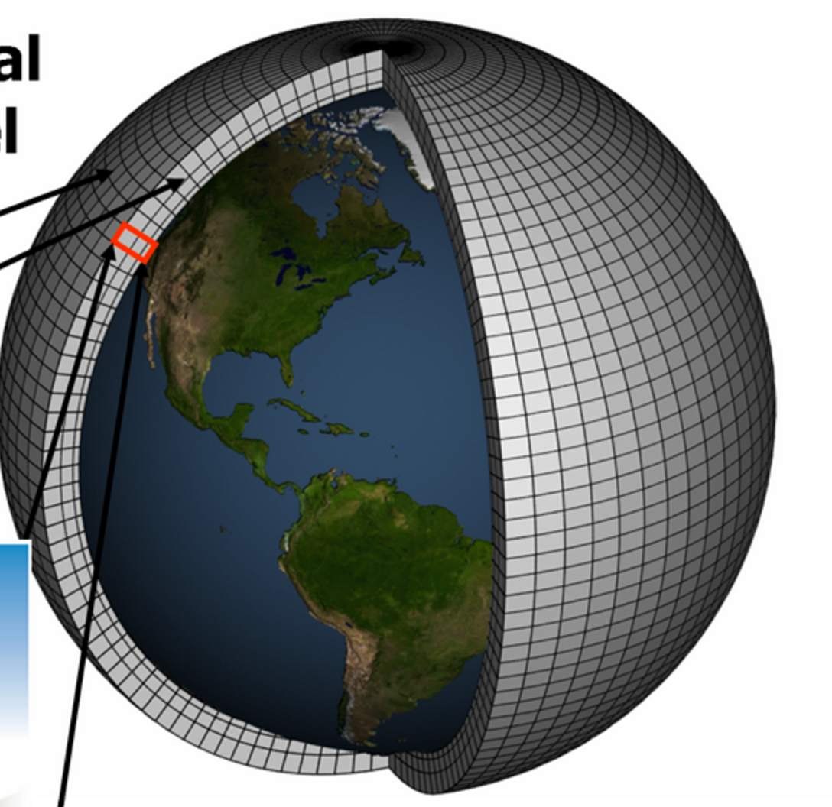
3D Grid Covering the Volume of Atmosphere

Slide 13
Objective Analysis/Data Assimilation
Often starts with a “first guess”, usually the gridded forecast from an earlier run (frequently a run starting 6 hr earlier)
This first guess is then modified by the observations.
Adjustments are made to insure proper physical balance.
Objective Analysis/Data Assimilation produces what is known as the model initialization, the starting point of the numerical simulation.

Slide 14
Model Integration: Numerical Weather Prediction
The initialization is used as the starting point for the atmospheric simulation.
Numerical models consist of the basic dynamical equations (“primitive equations”) and physical parameterizations for physics.

Slide 15
“Primitive” Equations
3 Equations of Motion: Newton’s Second Law
First Law of Thermodynamics
Conservation of mass
Perfect Gas Law
Conservation of water
With sufficient data for initialization and a means to integrate these equations, numerical weather prediction is possible.

Slide 16
Predicting the Future. Momentum Equations are Essentially:
F = ma
If we can observe the atmosphere, we know m, the amount of mass
We also can calculate all the forces, F (such as forces due to differences in pressure) based on observations.
Thus, we can calculate the acceleration, a.
Acceleration is the change of velocity in time.
THUS, WE KNOW THE FUTURE!

Slide 17
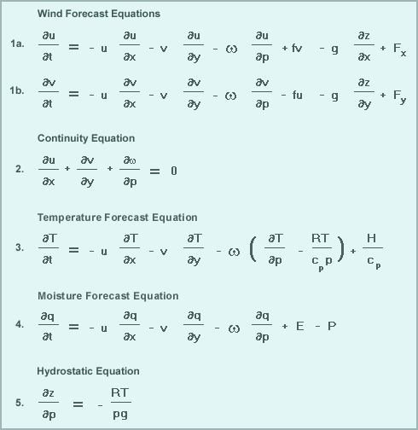
“Primitive” Equations

Slide 18

The Equations are a Time Machine

Slide 19
Physics Parameterizations
We need physics parameterizations to describe key unresolved physical processes.
Examples include radiation, cumulus convection, cloud microphysics, boundary layer physics, etc.
Why?
  Primitive equations lack such physics
  Insufficient resolution to resolve key processes
  Small scale physics has to be put in terms of larger scale variables

Slide 20
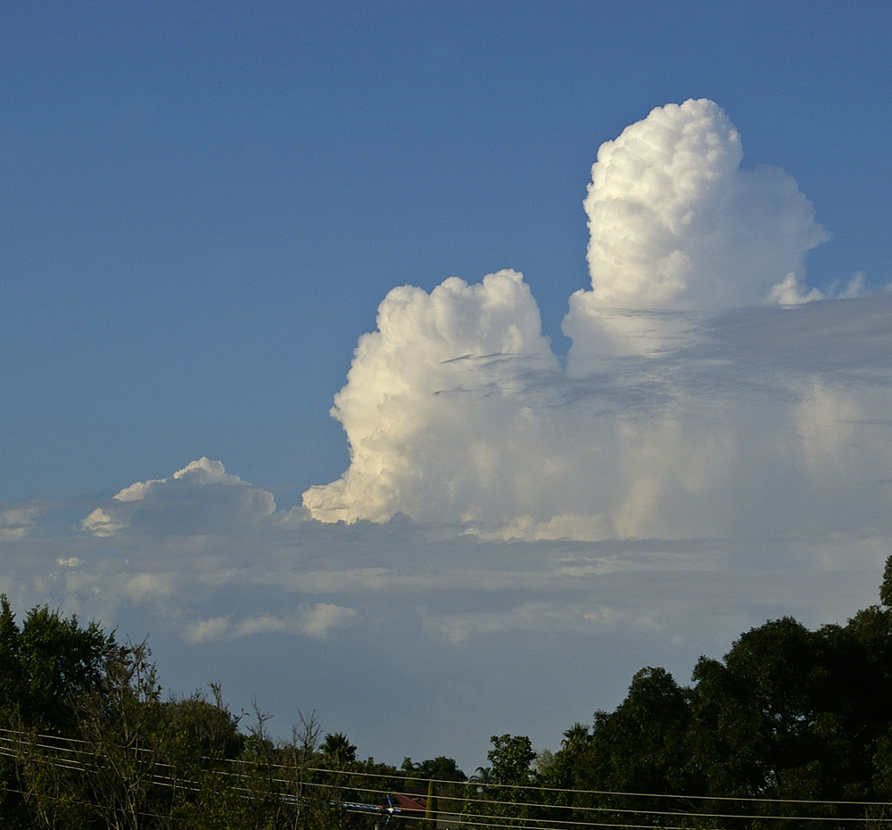
Example: Cumulus Parameterization
Most global numerical models (typical grid spacing of 9-12 km) cannot resolve convection (scales of a few km or less).
Cumulus parameterization represents the effects of sub-grid scale cumulus on the larger scales.

Slide 21
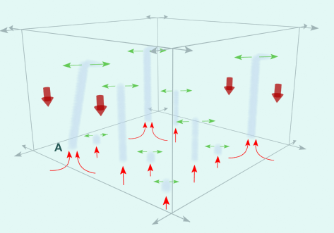

Slide 22
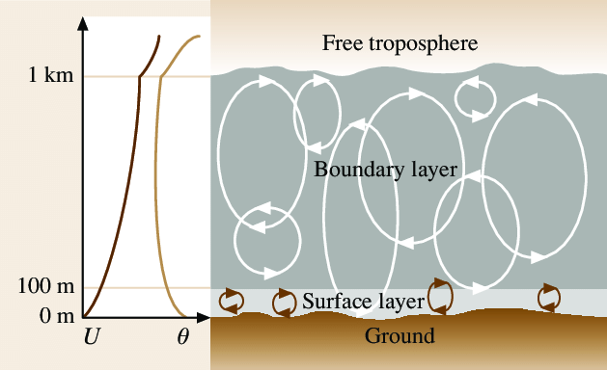
Similarly, boundary layer parametrization represent the effects of sub-grid scale boundary layer eddies
1 km

Slide 23
Solution
Meteorologists that simulate the effects of sub-grid scale phenomena
There are not perfect and have substantial flaws
But they are much better than ignoring critical phenomena

Slide 24
Numerical Weather Prediction
A numerical prediction model includes the primitive equations, physics parameterizations, and a way to solve the equations.
Solved or “integrated” using of powerful computers
Modeling systems include: NWS GFS, NCAR WRF and MPAS, ECMWP model

Slide 25
Model Resolution
Keep in mind that a model with a certain horizontal grid spacing is barely simulating phenomenon with a scale four times the grid spacing.
A 12-km model barely is getting 50 km scale features correct.
General rule of thumb: model resolves features 6X or more than its grid spacing.

Slide 26
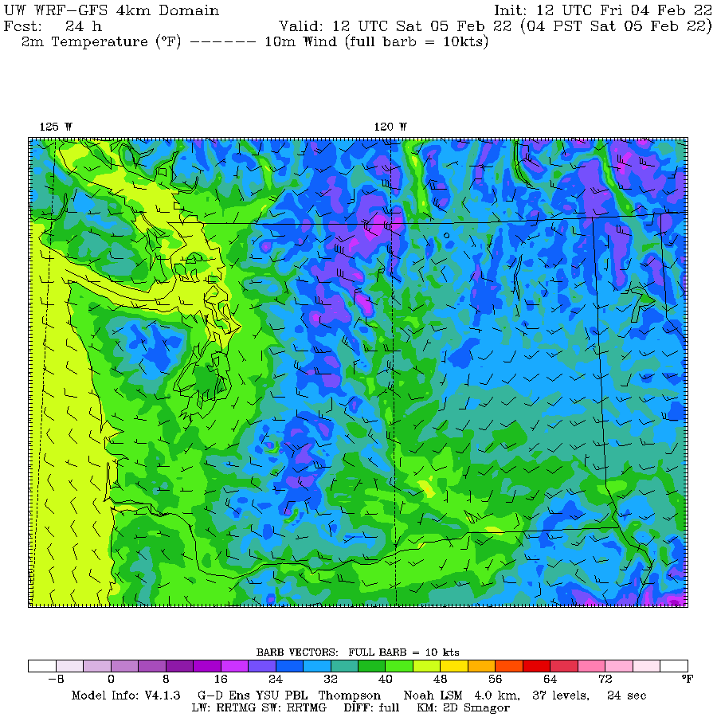
The WRF 4-km grid spacing barely resolves features of 24 km size

Slide 27
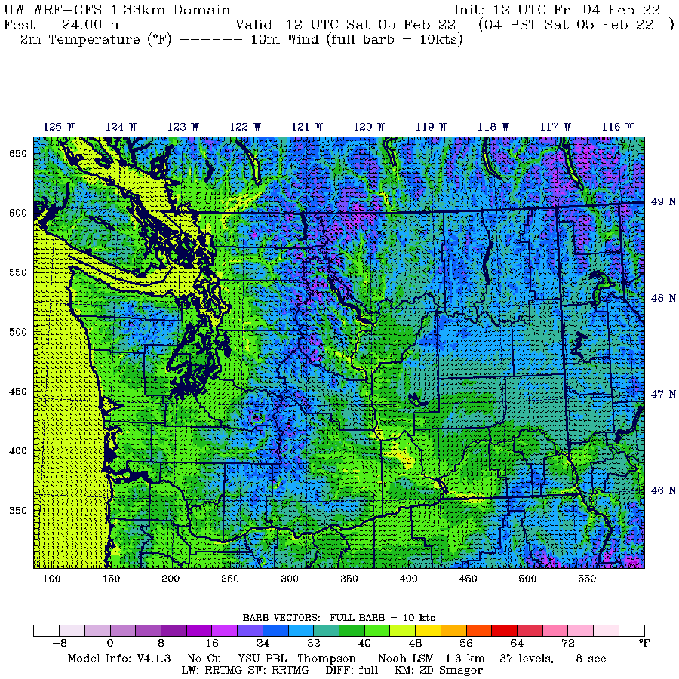
1.3 km grid spacing
Maybe
8 km size

Slide 28
Numerical Weather Prediction
Most global operational modeling systems are run four times a day (00, 06, 12, 18 UTC).
The main numerical modeling centers in the U.S. are:
  Environmental Modeling Center (EMC) at the National Centers for Environmental Prediction (NCEP)--part of the NWS. Located near Washington, DC.
  Fleet Numerical Meteorology and Oceanography Center (FNMOC)-Monterey, CA
  Air Force Weather Agency (AFWA)-Offutt AFB, Nebraska

Slide 29
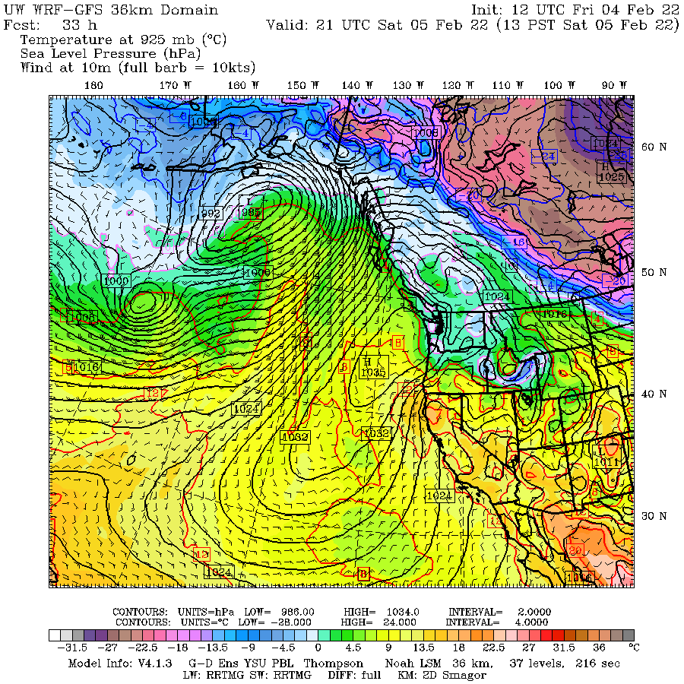
Terminology Reminder
Synoptic scale: 1000 km to global scale
Mesoscale: 10 to 1000 km
Microscale:1 to 10 km
Convection-allowing models (CAMs): generally 1-4 km grid spacing

Slide 30
Some Major U.S. Operational Models
Global Forecast System (GFS). FV-3 model. Global, resolution ~13 km grid. Run out to 384 hr, four times per day.
NAM Model (North American Mesoscale). Run by NWS/NOAA at 12 and 4 km. Four times a day.
Weather Research and Forecasting Model (WRF). WRF is a mesoscale modeling system system that is used by the NWS and the university/research community. Was used in HRRR and used in UW modeling system.

Slide 31
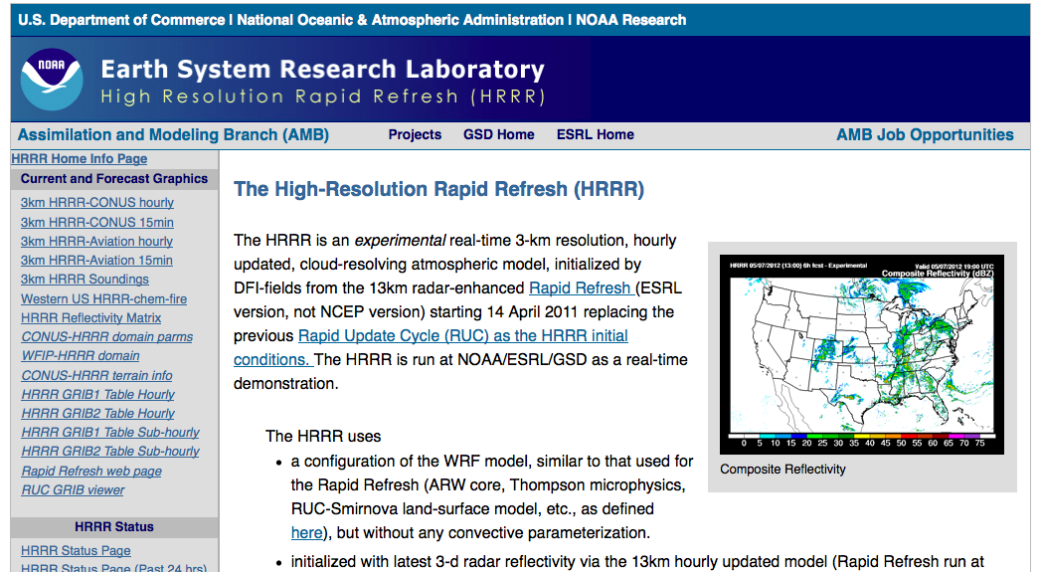
HRRR (High-Resolution Rapid Refresh). FV-3 model by NOAA/NWS with 3-km grid spacing. Run every hour to 18 or 36 h.

Slide 32
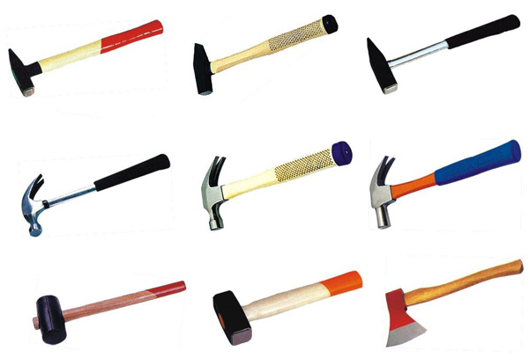
More U.S. Global Models
Navy Global Environmental Model (NAVGEM) has a model resolution of ~19 km.
Air Force Global Air-Land Weather Exploitation Model (GALWEM) at ~17 km horizontal resolution. Uses UKMET office model
There are others--you will hear more about this in 452.
Forecasters often have 6-10 different models to look at. Such diversity can provide valuable information.

Slide 33
Major International NWP Centers
ECMWF: European Center for Medium-Range Weather Forecasting. Their global model is considered the best.
UK Met Office: An excellent global model similar to GFS
Canadian Meteorological Center: GEM Model
Other lesser centers

Slide 34
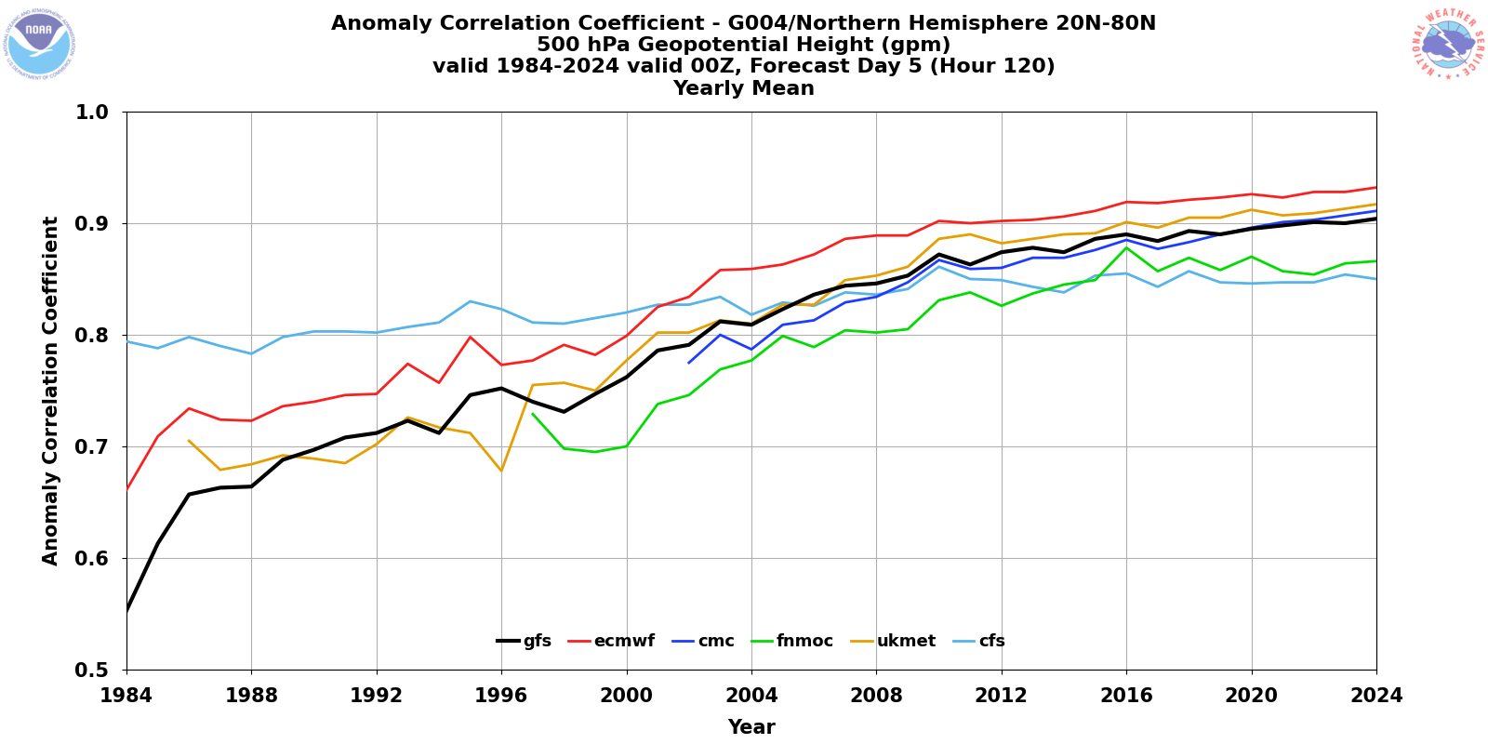
Global Forecasts Improving: EC is the Best

Slide 35
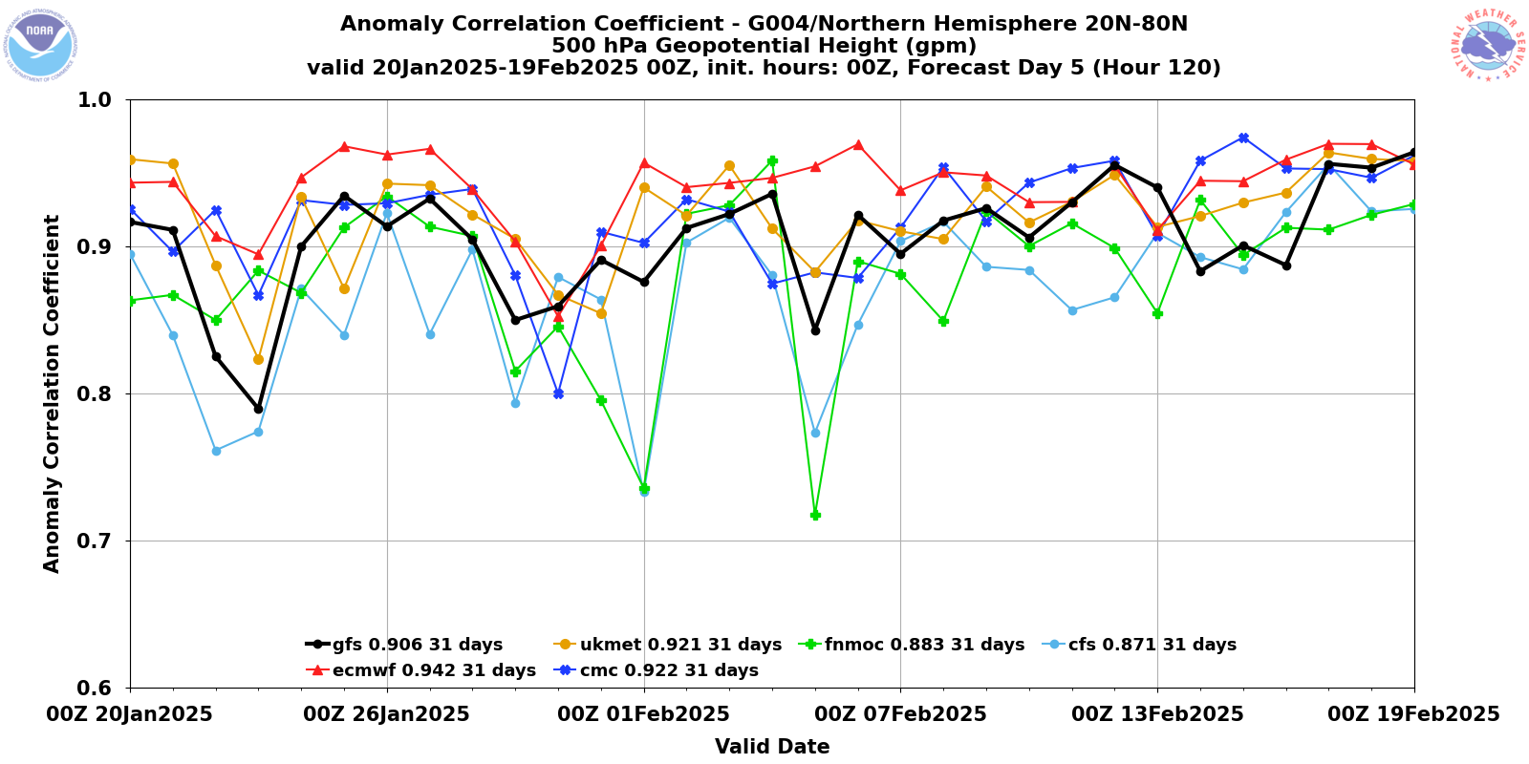
Model Skill Varies in Time

Slide 36
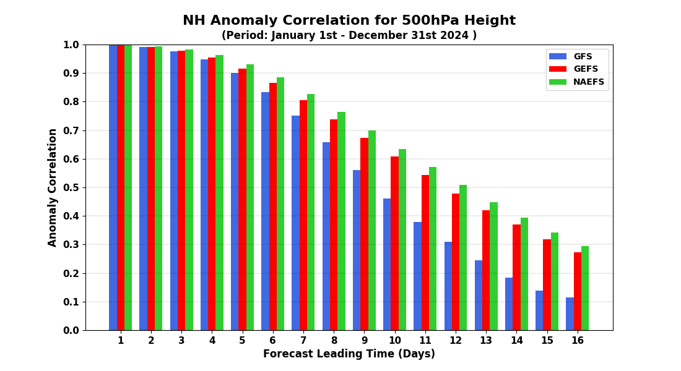
How Quickly Does Forecast Skill Decline with Time?

Slide 37
Accessing NWP Models
The department web site (go to weather loops or weather discussion) provides easy access to many model forecasts, including our WRF. Department regional modeling output.
http://www.atmos.washington.edu/mm5rt/
Tropical Tidbits
Pivotal Weather

Slide 38
A Palette of Models
Forecasters thus have a palette of model forecasts.
They vary by:
  Region simulated
  Resolution
  Model physics
  Data used in the assimilation/initialization process
The diversity of models can be a very useful tool to a forecaster. Also helps deal with uncertainty.

Slide 39
Ensemble Forecasting
So far, the model forecasts I have talked about so far reflect a deterministic approach.
This means that we do the best job we can for a single forecast run and not considering uncertainties in the model, initial conditions, or the very nature of the atmosphere.
Traditionally, deterministic prediction has been the way forecasting was done, but this is changing.

Slide 40

A More Fundamental Issue
The atmosphere is a chaotic system, in which small differences in the initialization…well within observational error… can have large impacts on the forecasts, particularly for longer forecasts.
Similarly, uncertainty in model physics can result in large forecast differences and errors.
Often referred to as the “butterfly effect”

Slide 41

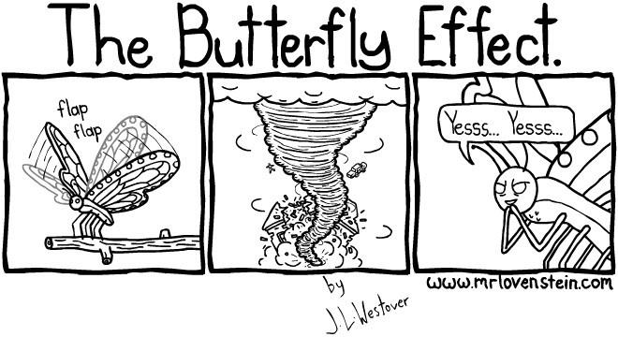

Slide 42

A Fundamental Problem
All forecasts have some uncertainty.
The uncertainty generally increases in time.
Thus, we should be providing forecast probabilities and forecast ranges and not single forecast values.

Slide 43
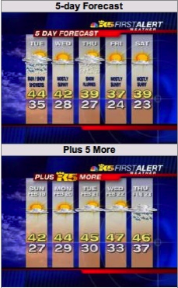
This is Ridiculous!

Slide 44
Forecast Probabilistically Using Ensembles
There is an approach to handling this issue that is being used by the forecasting community…ensemble forecasts
Instead of making one forecast…make many…each with a slightly different initialization or different model physics.
Possible to do this now with the vastly greater computation resources that are available.

Slide 45
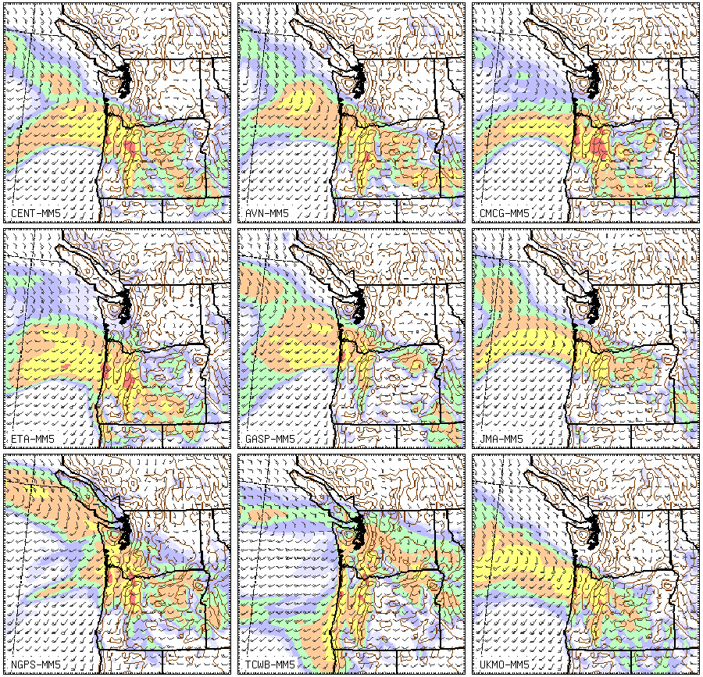

Slide 46
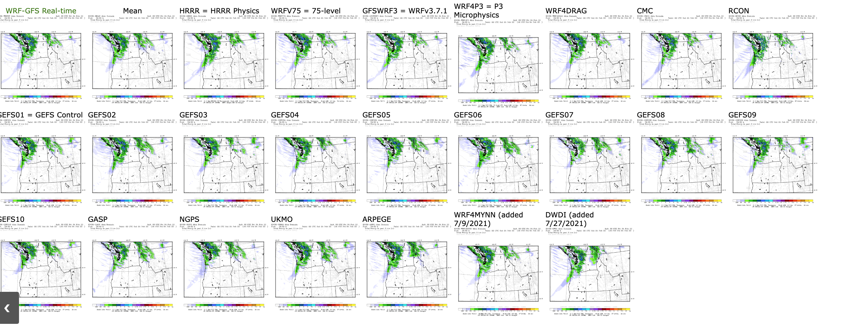

Slide 47
A
12h
forecast
24h
forecast
Forecast
e
36h
forecast
a
c
u
j
n
T
Analysis Region
g
t
M
Analysis/
Initialization
T
48h forecast Region

Slide 48

Ensemble Prediction
Ensembles can provide the probabilities that some weather feature will occur.
For example, if you have 50 ensemble members and half have rain, then the probability of rain is 50%.

Slide 49
Ensemble Prediction
The ensemble mean is more accurate than any individual member.
Can also predict forecast skill!
  When forecasts are similar, forecast skill is generally higher.
  When forecasts differ greatly, forecast skill is less.

Slide 50
Various Ways to Present Ensembles

Slide 51
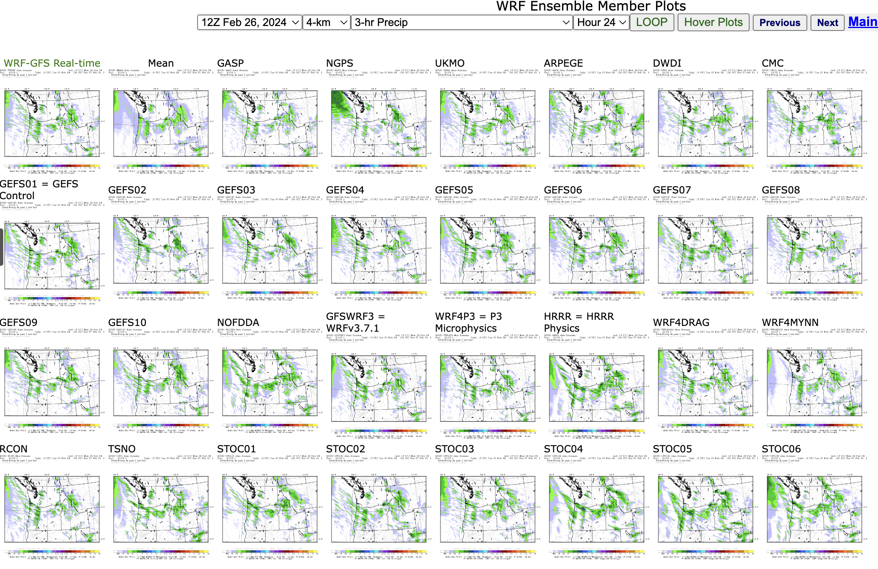
Postage Stamps

Slide 52
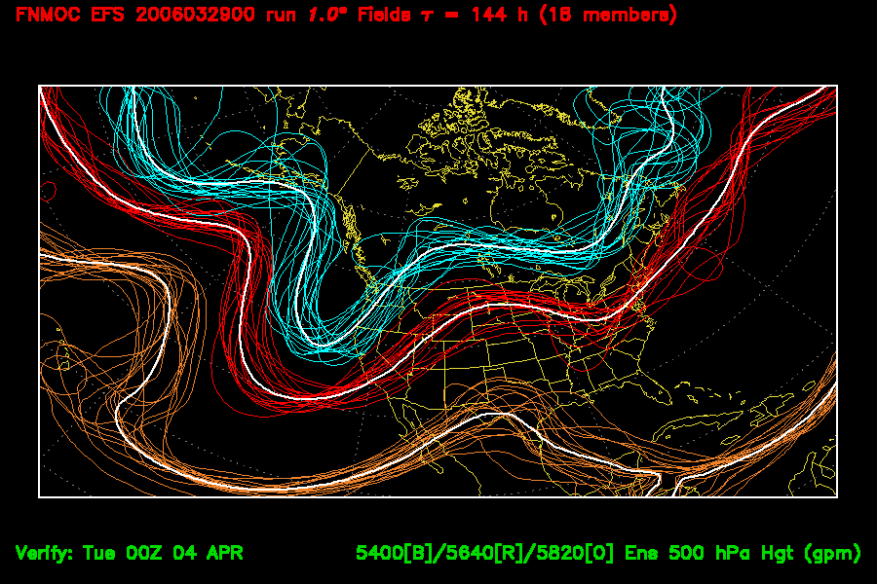
Spaghetti Diagrams

Slide 53
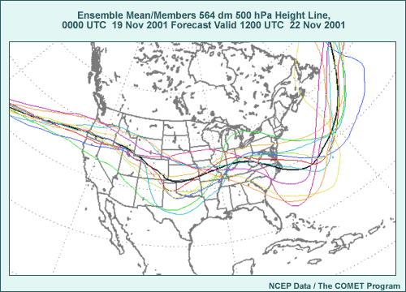

Slide 54
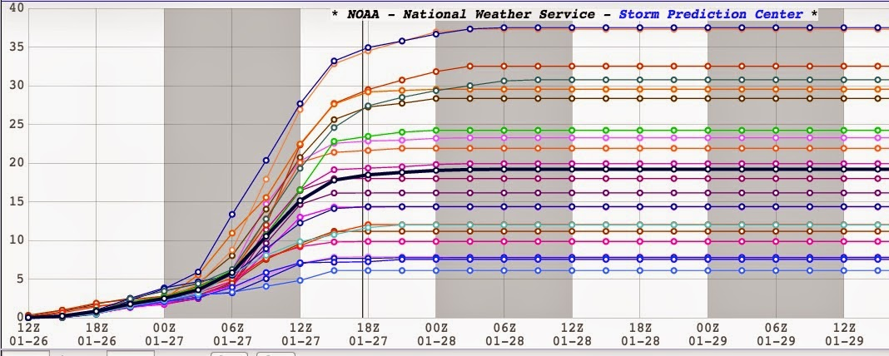
Ensemble Plume Diagrams

Slide 55
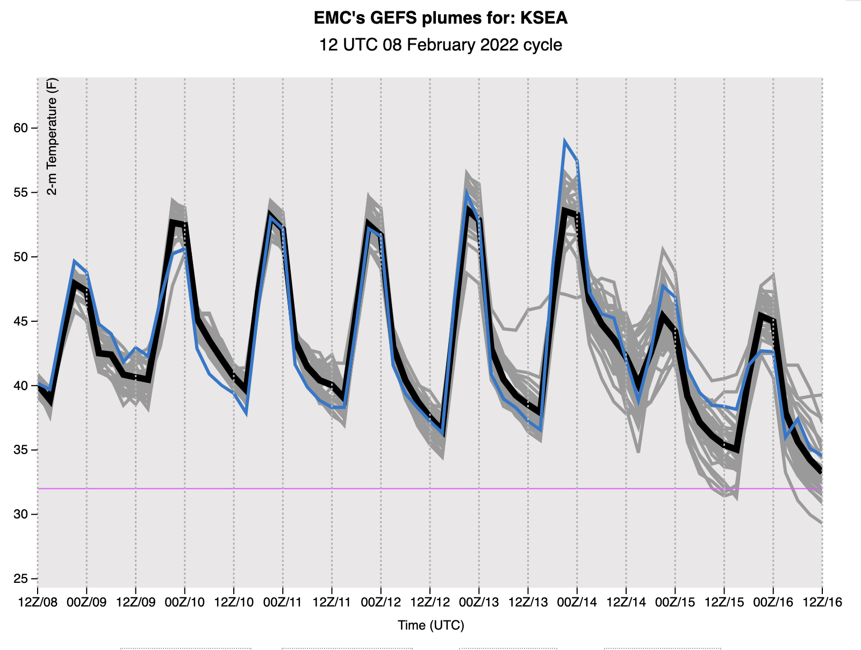

Slide 56
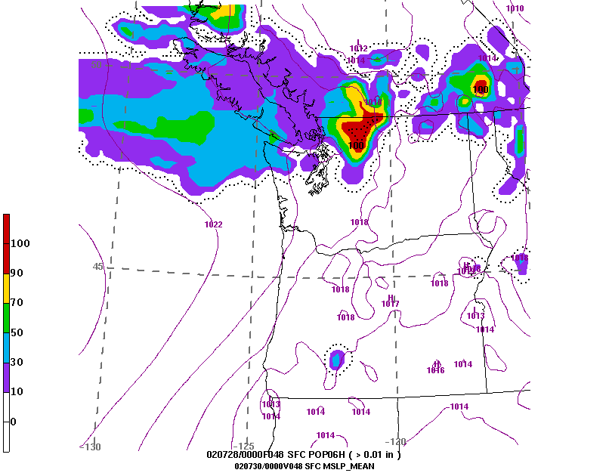
Ensembles can Produce Probability Maps

Slide 57
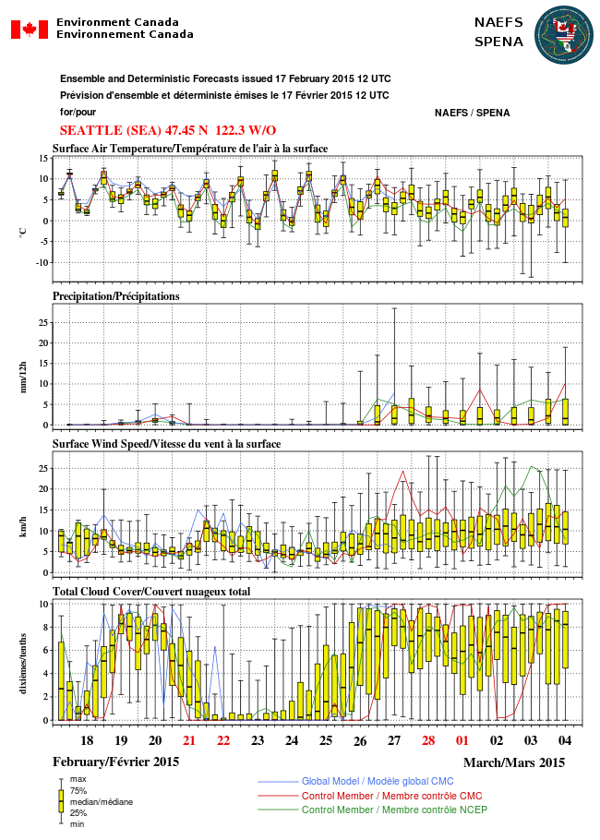
Box and Whisker Plot

Slide 58
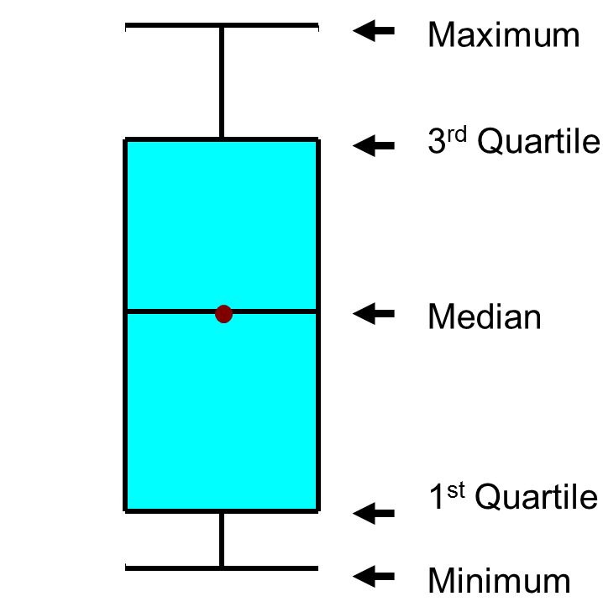

Slide 59
Major U.S. Ensemble Systems
NOAA/NWS GFS ensemble (GEFS), 20 members, 25 km resolution. Underdispersive
NOAA/NWS SREF (Short-Range Ensemble Forecast System). 26 members, 18 km. WRF and NMM members
NAEFS: North American Ensemble Forecasting System (GEFS plus CMC ensemble), Global

Slide 60
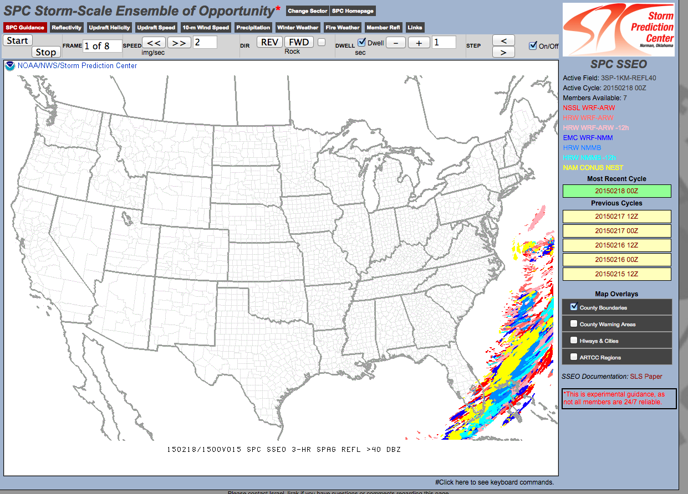
Smaller Ensemble System at Higher Resolution (about 4 km)
HREF (8-9 members)

Slide 61
Underdispersive Ensemble
None of the members captures reality.
Usually associated with ensembles that are too small or do not encompass reality.
MOST current ensembles are underdipersive.
That can one do to deal with the problem?

Slide 62
Post-Processing of Model Forecasts
Numerical model output often possesses systematic biases (e.g., too warm or too cold in certain situations). Why not correct such biases?
Numerical models may lack the resolution or physics to deal with certain problems (e.g., low level fog in a valley). Some information on local effects be derived from historical model performance.
Ensembles may be underdispersive—don’t encompass truth.
The solution: statistical post-processing of model forecasts.

Slide 63
Model Output Statistics (MOS)
In the 1960s and 1970s, the NWS developed and began using statistical post-processing of model output…known as Model Output Statistics…MOS
Based on linear regression: Y=a₀ + a₁X₁ + a₂X₂+ a₃X₃ + …
Y is the thing you want to predict. X is model output used to predict Y.
One “trains” the equation using historical model performance.

Slide 64
Day 2 (30-h) GFS MOS Max Temp Equation for KSLC
(Cool Season – 0000 UTC cycle)
N | Predictor (X_{N}) | Coeff. (a_{N})
0 |  | -467.7800
1 | 2-m Temperature (21-h proj.) | 1.7873
2 | 2-m Dewpoint (21-h proj.) | 0.1442
3 | 2-m Dewpoint (12-h proj.) | -0.2060
4 | 2-m Dewpoint (27-h proj.) | 0.1252
5 | Observed Temperature (03Z) | 0.0354
6 | 850-mb Vertical Velocity (21-h proj.) | 19.5759
7 | 925-mb Wind Speed (15-h proj.) | 0.6024
8 | Sine Day of Year | 1.7111
9 | 700-mb Wind Speed (15-h proj.) | 0.2701
10 | Sine 2*DOY | 1.5110

Slide 65
MOS is available for many parameters and greatly improves the quality of many model predictions.

Slide 66
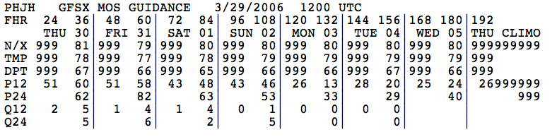
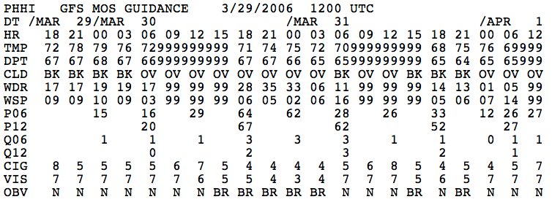

Slide 67

The National Blend of Models
The National Weather Service has the National Blend of Models, which statistically combines the forecasts of many models.
Better than MOS and has generally replaced it

Slide 68
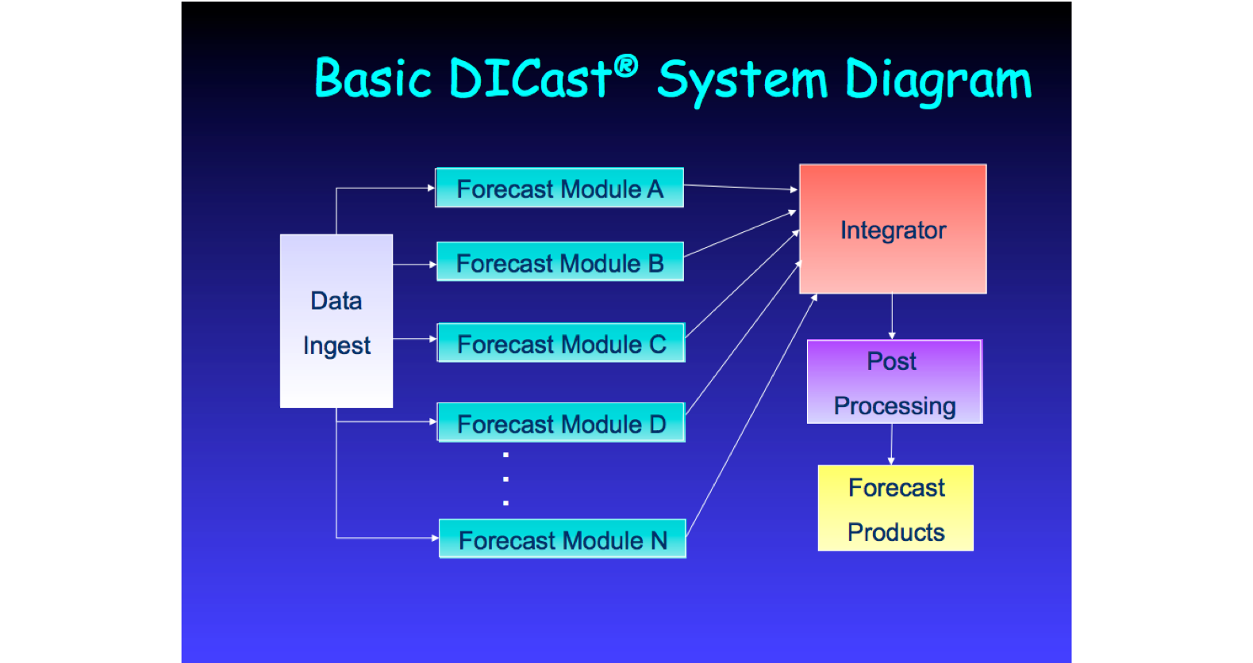
The Private Sector Is the Leader in Statistical Post-Processing
Examples: weather.com, accuweather, weatherunderground
Weather.com uses the Dicast System

Slide 69
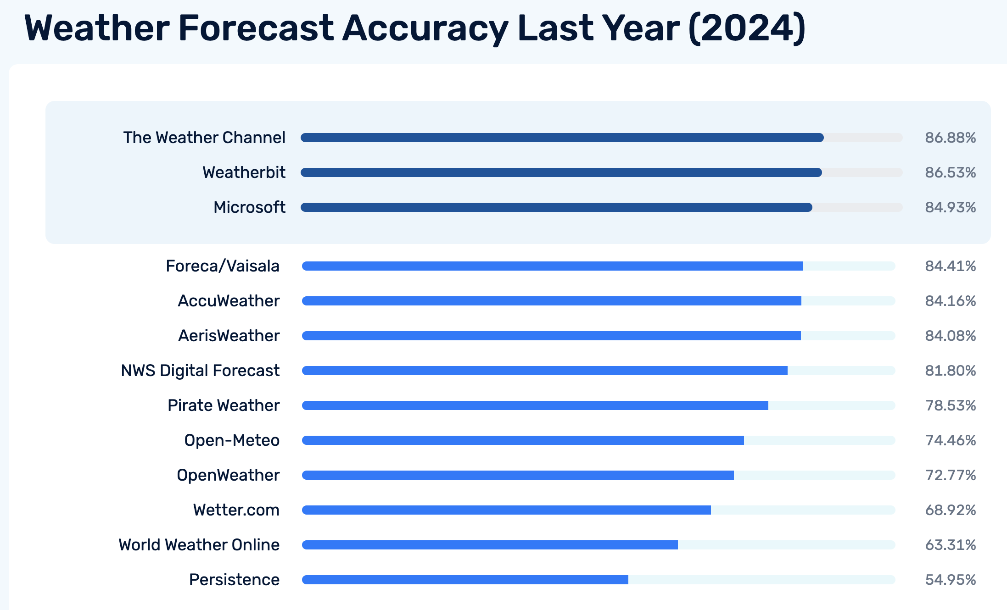

Slide 70
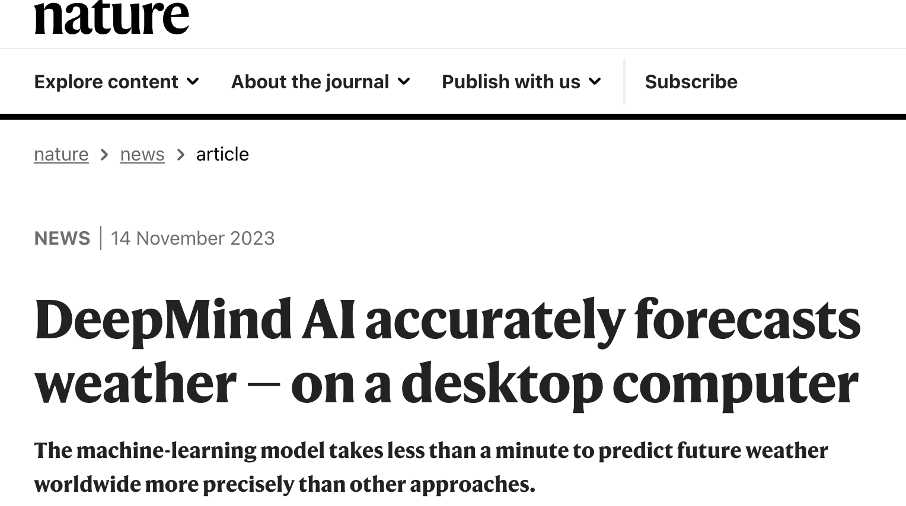
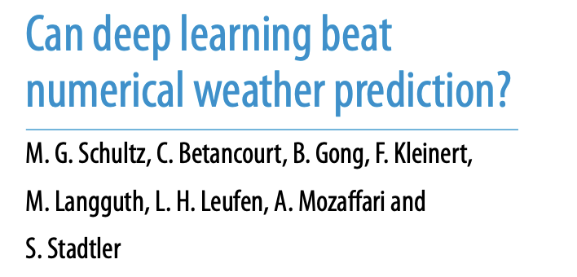
Machine Learning NWP: A Revolution
There has been a lot of recent publicity about machine learning taking over NWP.

Slide 71
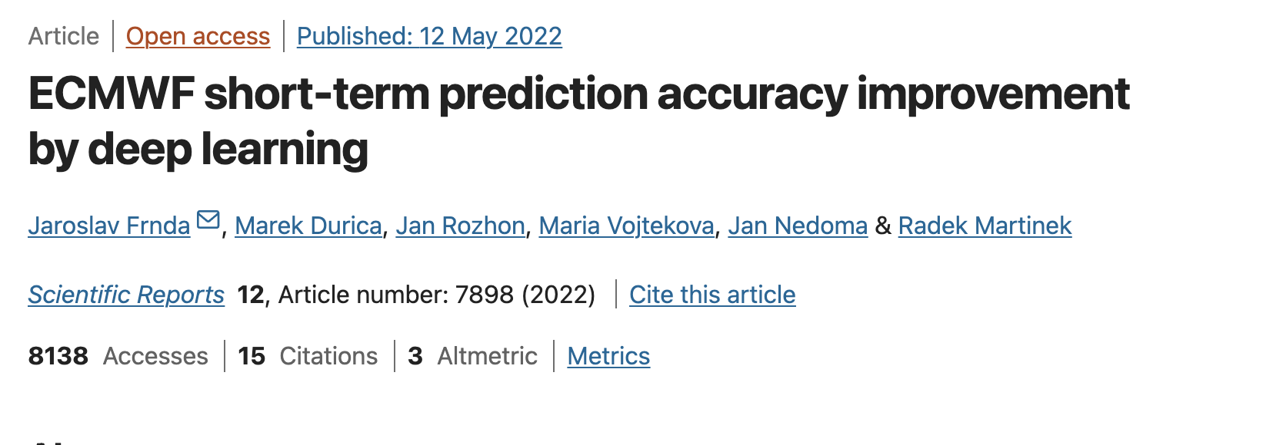
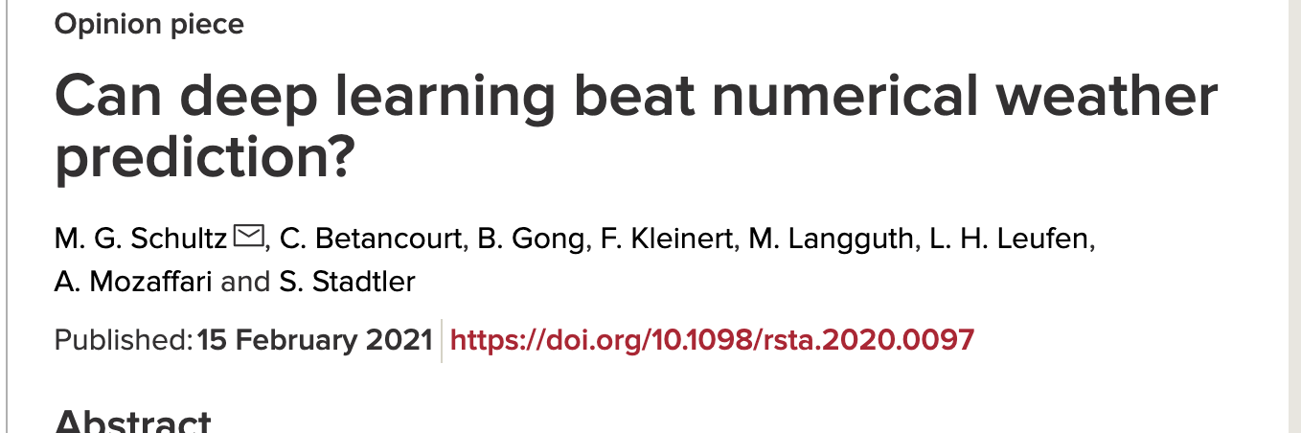
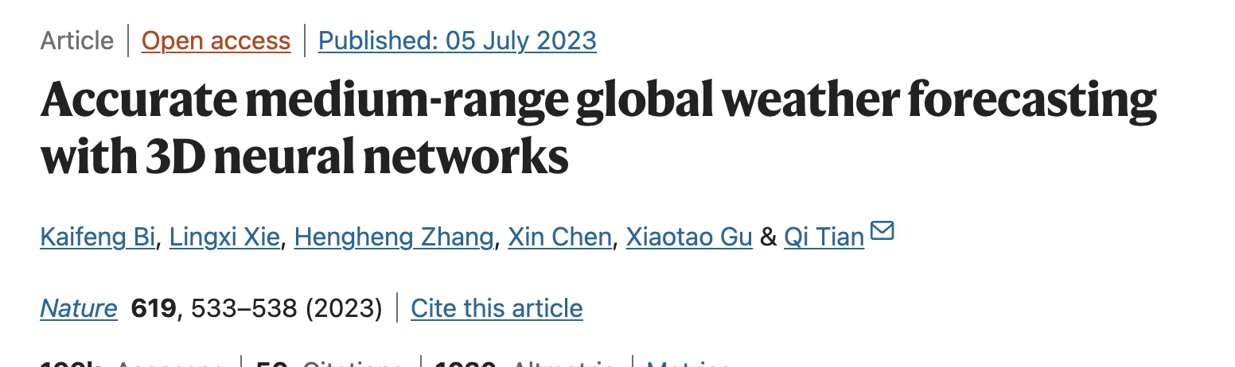

Slide 72
Current AI-NWP Systems
Start with extended-period gridded data set (such as ERA-5)
Train ML models over the the entire period (this is very compute intensive)
Then can can produce forecasts (generally at a very limited number of levels) very quickly.
Results at standard levels very promising.

Slide 73
European Center is Trying It
ECMWF is now running its own Artificial Intelligence/Integrated Forecasting System (AIFS) as part of its experiment suite.
These machine-learning based models are very fast (minutes to run)
Produce a 10-day forecast with 6-hourly time steps in approximately one minute.
The outputs are currently publicly available in graphical form.

Slide 74
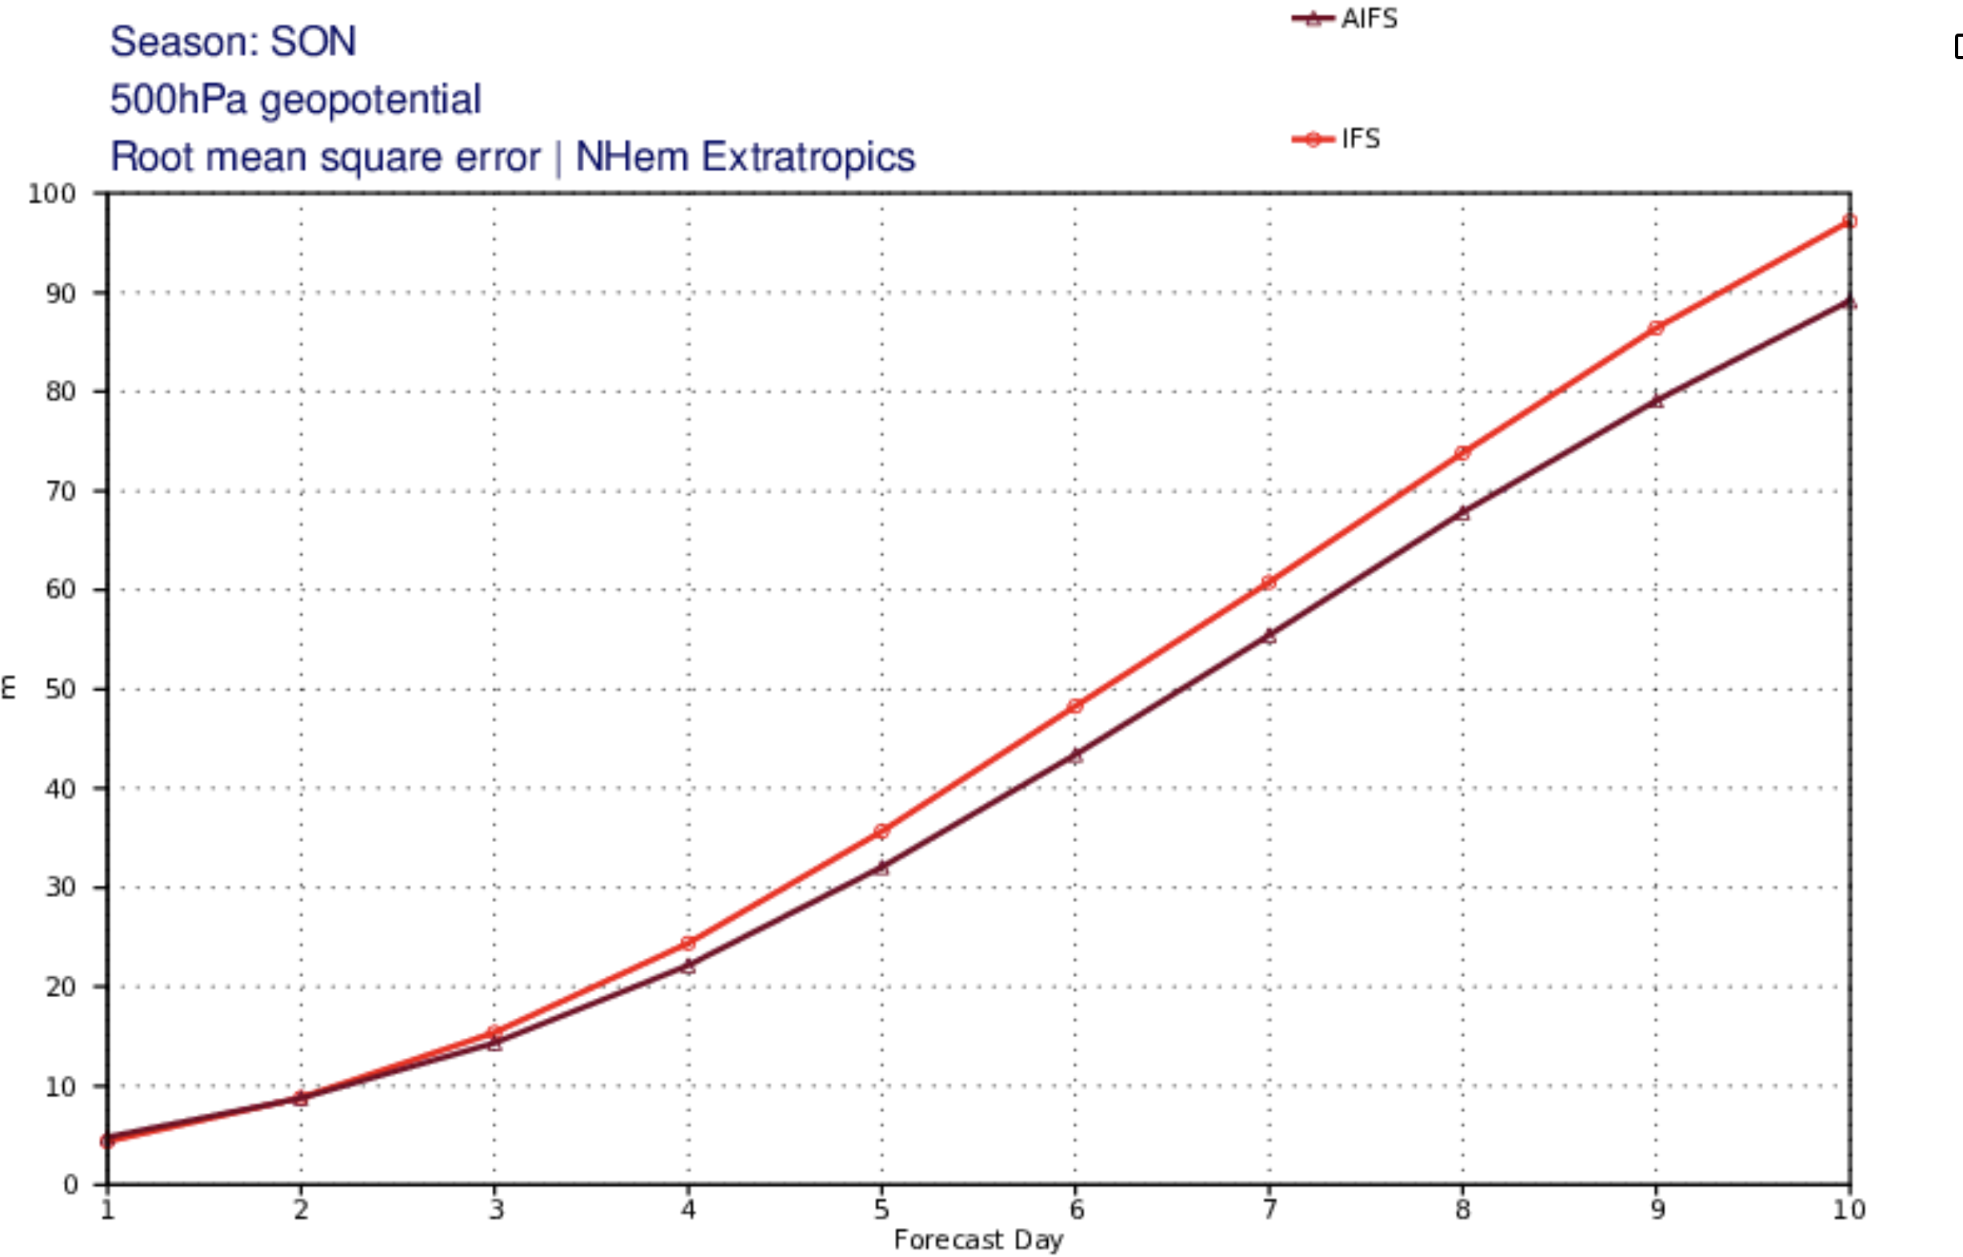
RMS

Slide 75
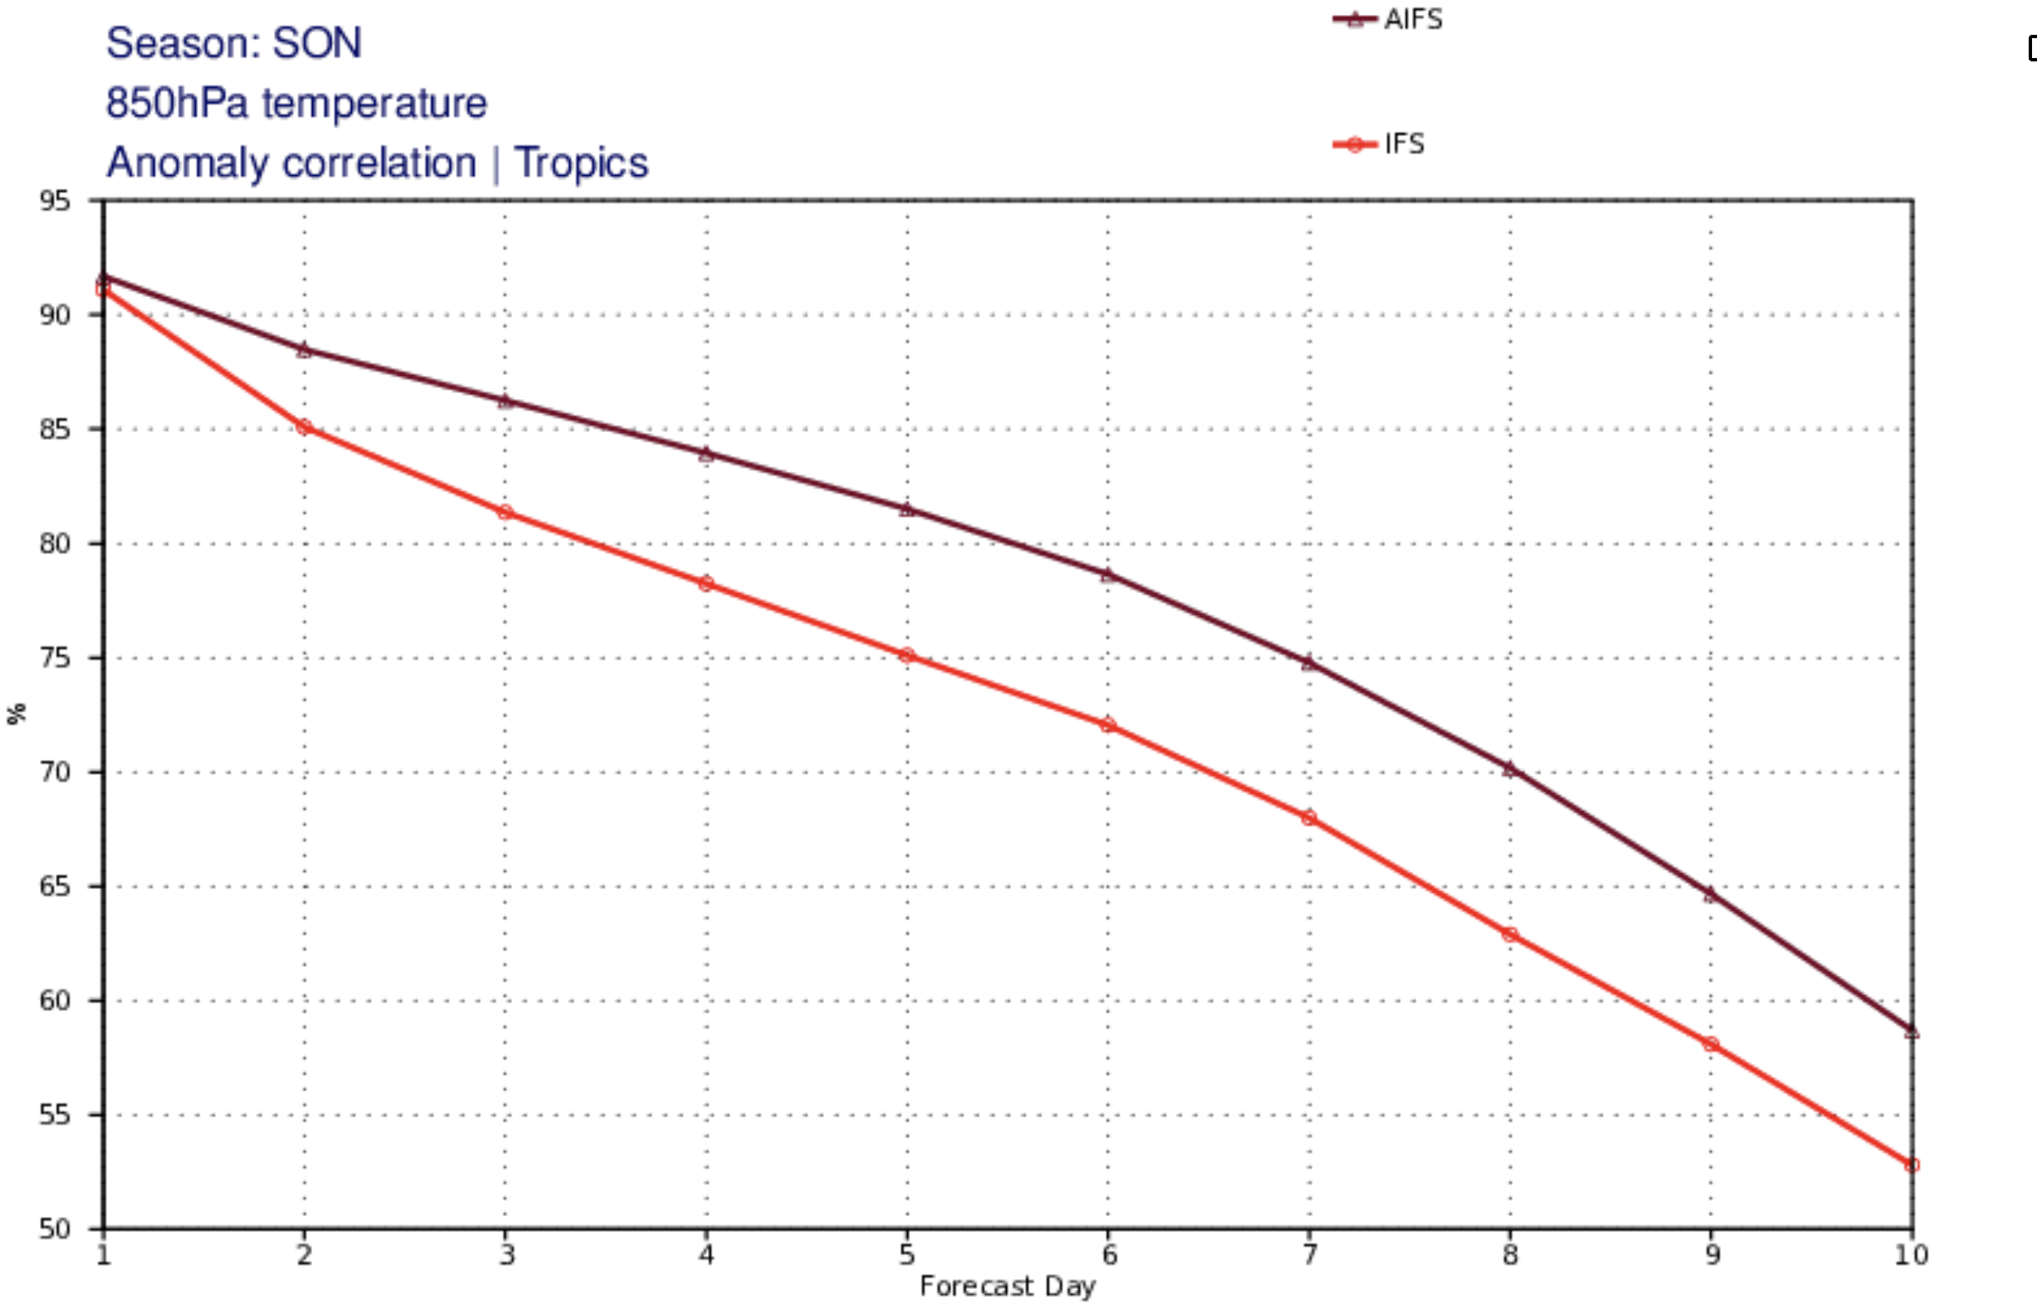

Slide 76
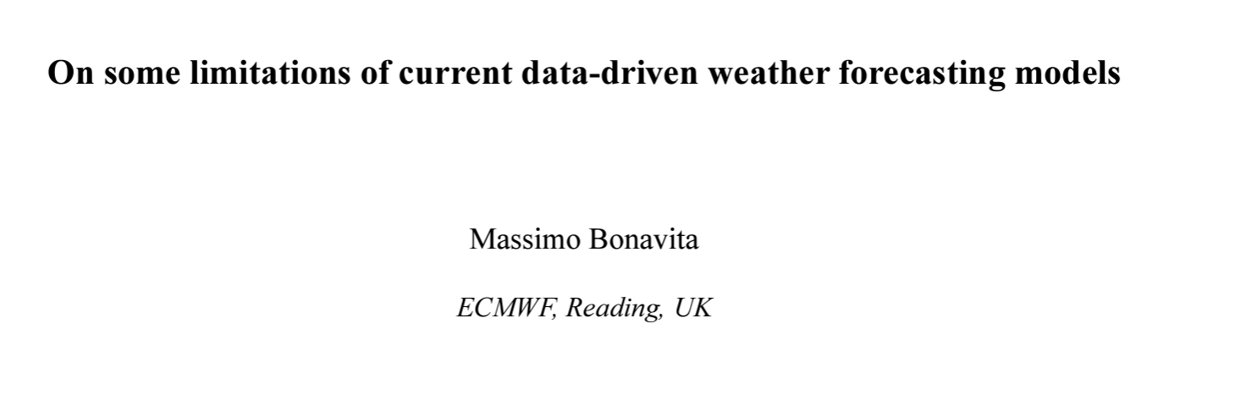
Major Issue: Although AI produces a good forecast for certain forecast quantities, the 3D fields are not balanced or necessarily physical (e.g., poor vertical motions)
“The main conclusion is that Pangu-Weather forecasts, and possibly those of similar ML models, do not have the fidelity and physical consistency of physics-based models”

Slide 77
It may be possible to add physical constraints and conservation to ML models….a lot of work needed on this front

Slide 78
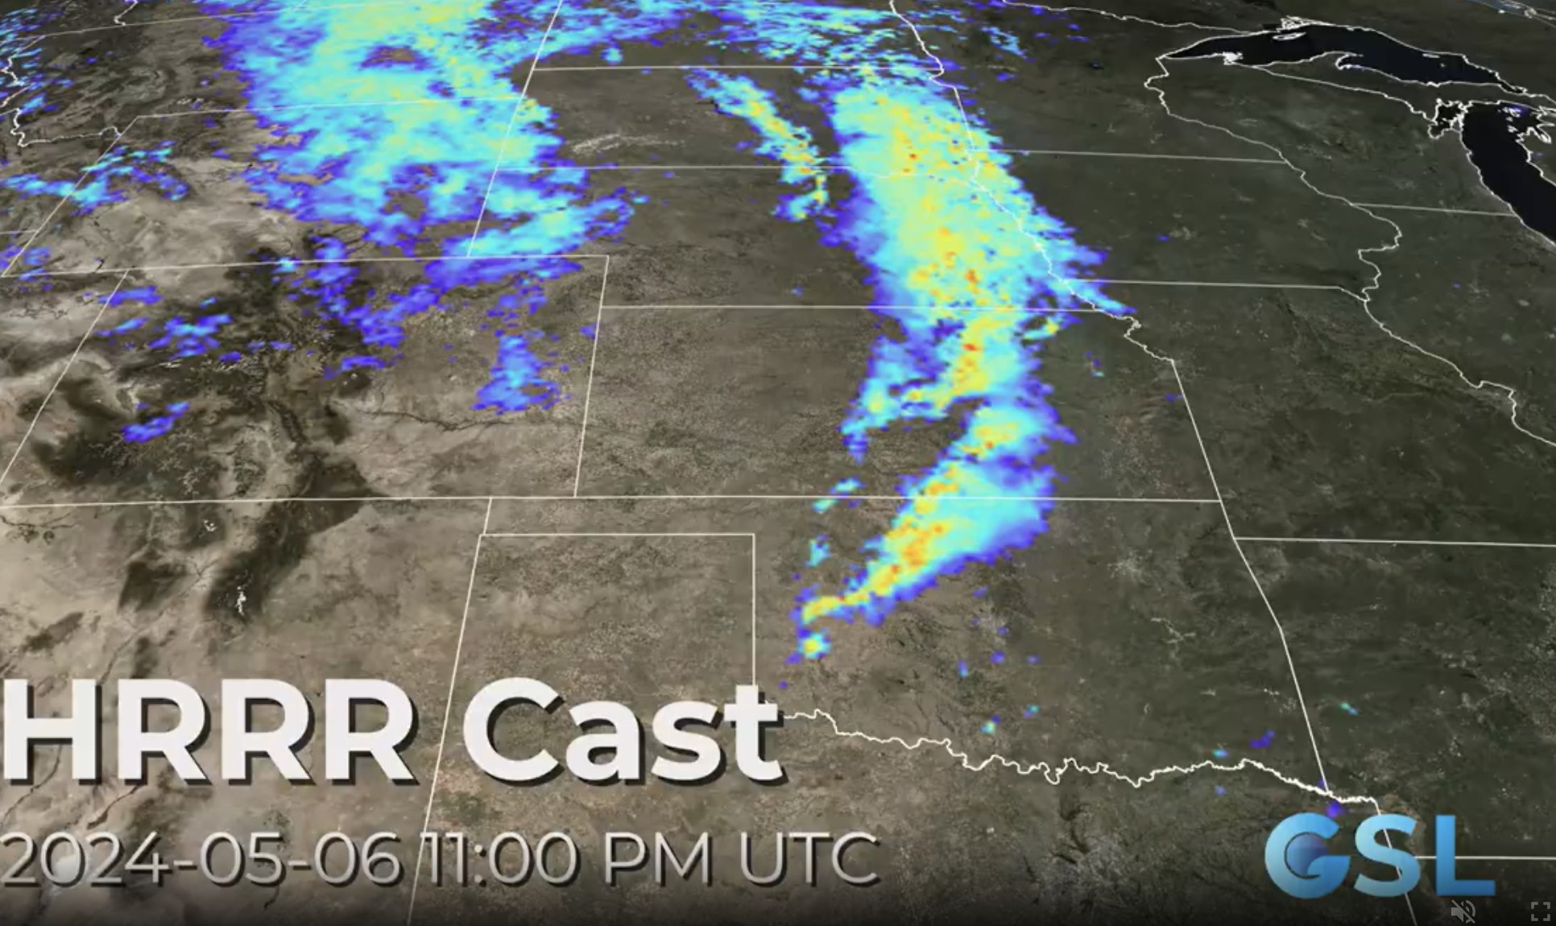
Another Question is How Well Machine-Learning NWP Will Work on the Mesoscale

Slide 79
The End

