Slide 1

Forecasting Boot Camp ATMS 370

Slide 2
Major Steps in the Forecast Process
Data Collection
Quality Control
Data Assimilation
Model Integration
Post Processing of Model Forecasts
Product and graphics generation
Human Interpretation (sometimes)

Slide 3

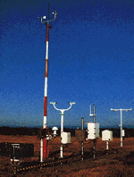
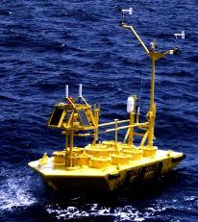

Observation and Data Collection

Slide 4
Data Collection
Weather is observed throughout the world and the data is distributed in real time.
Many types of data and networks, including:
Surface observations from many sources
Radiosondes and radar profilers
Fixed and drifting buoys
Ship observations
Aircraft observations
Satellite soundings
Cloud and water vapor track winds
Radar and satellite imagery

Slide 5
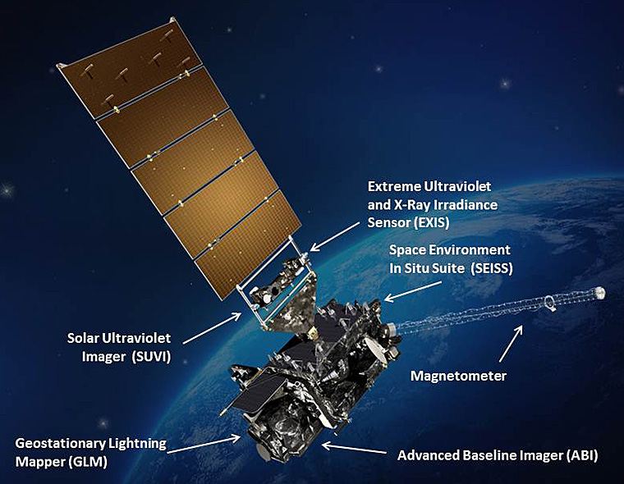
Data Collection
Satellite data is now the dominant data source for weather prediction (perhaps 99%)
Huge increases in the numbers of surface stations and aircraft reports.

Slide 6
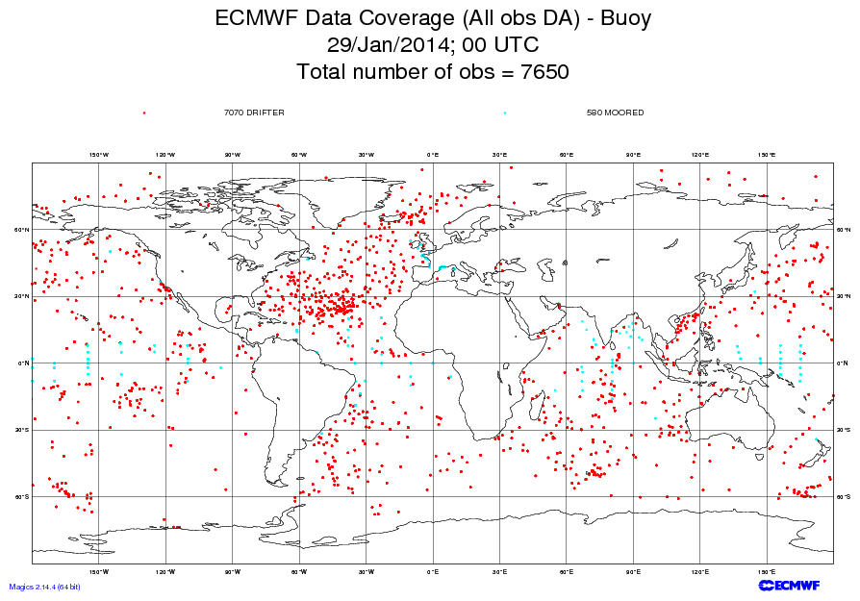

Slide 7
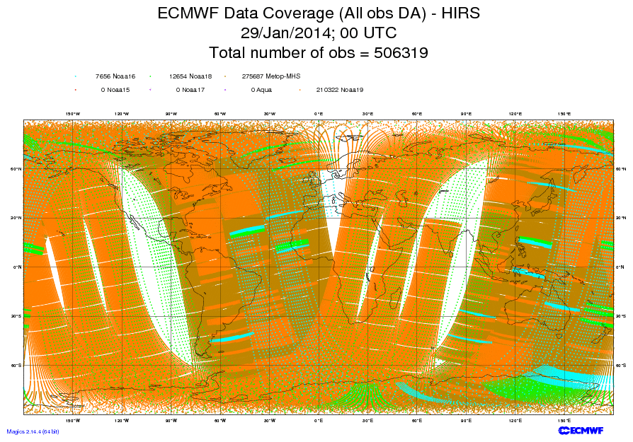
High-resolution Infrared Radiation Sounder

Slide 8
Quality Control
Automated algorithms and manual intervention to detect, correct, and remove errors in observed data.
Examples:
Range check
Buddy check (comparison to nearby stations)
Comparison to first guess fields from previous model run
Hydrostatic and vertical consistency checks for soundings.
An important issue for the forecaster--sometimes good data is rejected and vice versa.

Slide 9
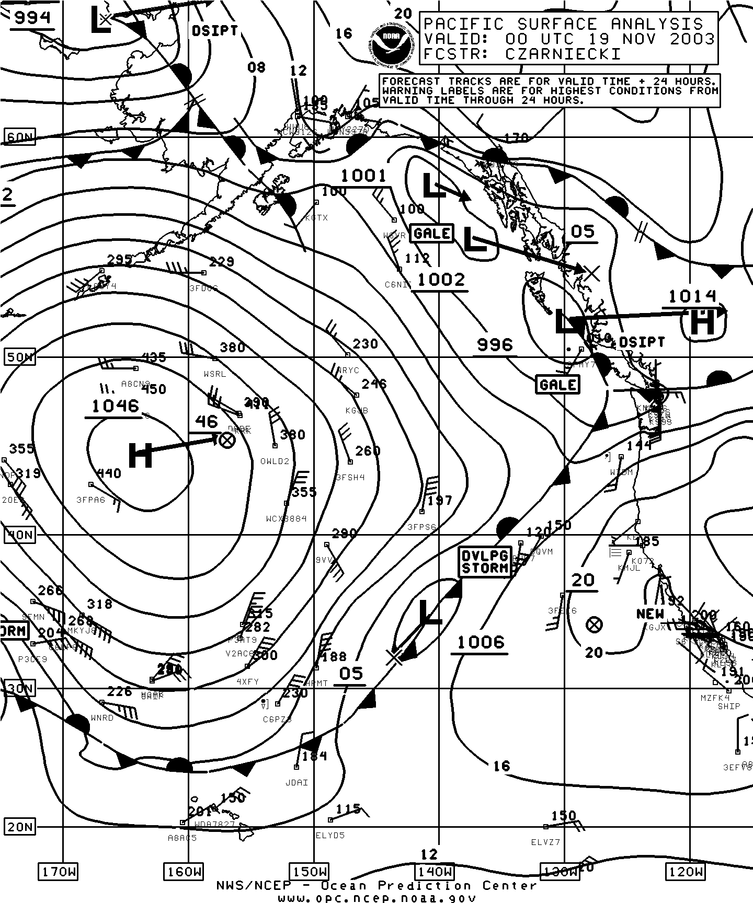
Pacific Analysis
At 4 PM
18 November
2003
Bad Observation

Slide 10
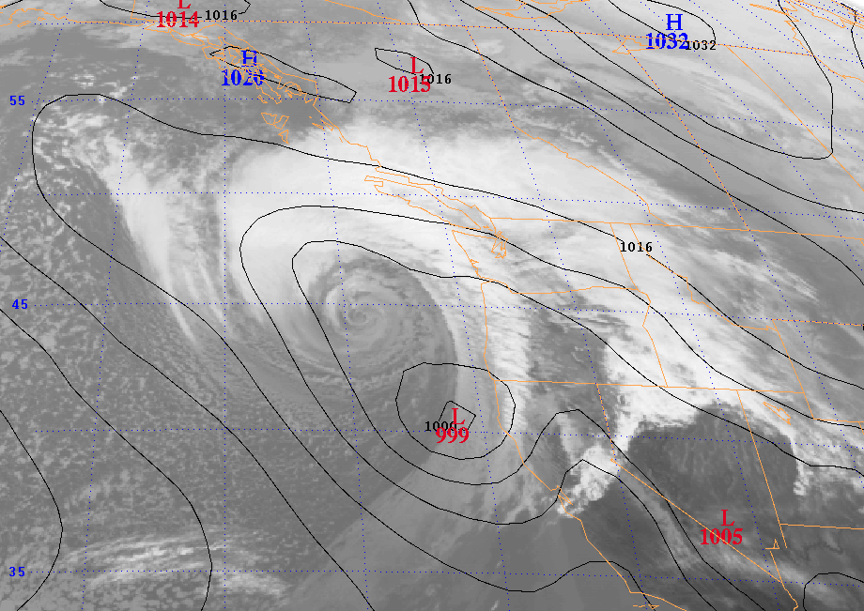
3 March 1999: Forecast a snowstorm … got a windstorm instead
Eta 48 hr SLP Forecast valid 00 UTC 3 March 1999

Slide 11

Objective Analysis/Data Assimilation
Numerical weather models are generally solved on a three-dimensional grid
Observations are scattered in three dimensions
Need to interpolate observations to grid points and to ensure that the various fields are physically plausible (e.g., most of the atmosphere in hydrostatic and gradient wind balance).

Slide 12
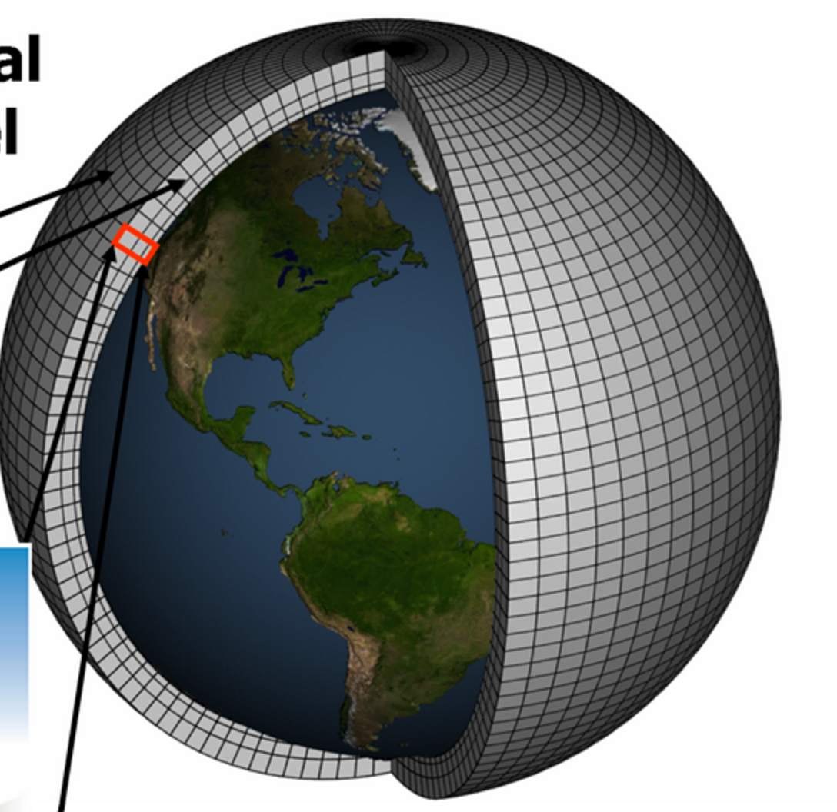
3D Grid Covering the Volume of Atmosphere

Slide 13
Objective Analysis/Data Assimilation
Often starts with a “first guess”, usually the gridded forecast from an earlier run (frequently a run starting 6 hr earlier)
This first guess is then modified by the observations.
Adjustments are made to insure proper balance.
Objective Analysis/Data Assimilation produces what is known as the model initialization, the starting point of the numerical simulation.

Slide 14
Model Integration: Numerical Weather Prediction
The initialization is used as the starting point for the atmospheric simulation.
Numerical models consist of the basic dynamical equations (“primitive equations”) and physical parameterizations.

Slide 15
“Primitive” Equations
3 Equations of Motion: Newton’s Second Law
First Law of Thermodynamics
Conservation of mass
Perfect Gas Law
Conservation of water
With sufficient data for initialization and a means to integrate these equations, numerical weather prediction is possible.

Slide 16
Predicting the Future. Momentum Equations are Essentially:
F = ma
If we can observe the atmosphere, we know m, the amount of mass
We also can calculate all the forces, F (such as forces due to differences in pressure) based on observations.
Thus, we can calculate the acceleration, a.
Acceleration is the change of velocity in time.
THUS, WE KNOW THE FUTURE!

Slide 17
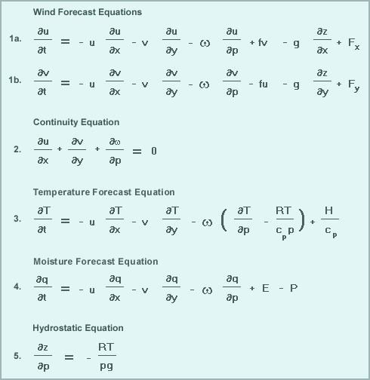
“Primitive” Equations

Slide 18
Physics Parameterizations
We need physics parameterizations to describe key unresolved physical processes.
Examples include radiation, cumulus convection, cloud microphysics, boundary layer physics, etc.
Why?
Primitive equations lack such physics
Insufficient resolution to resolve key processes
Small scale physics has to be put in terms of larger scale variables

Slide 19
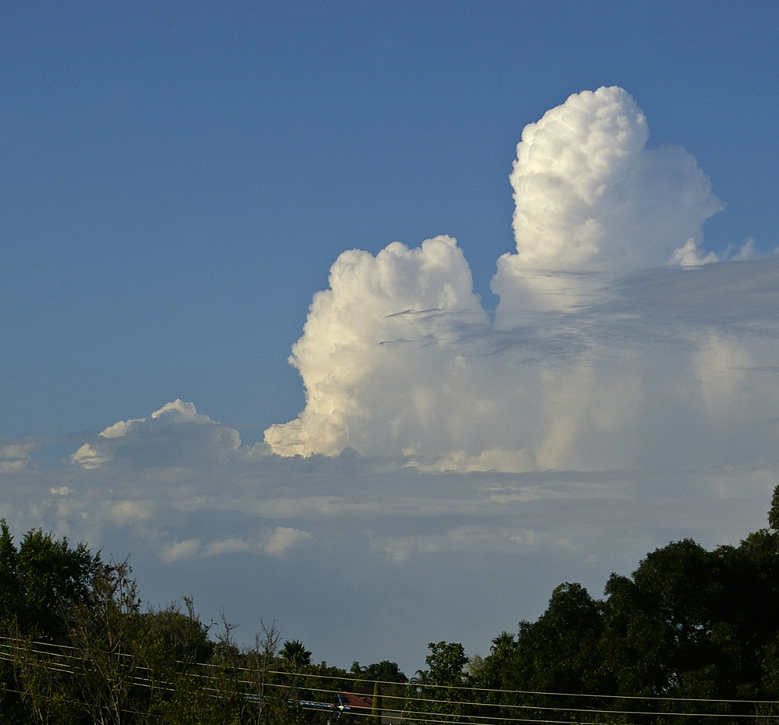
Example: Cumulus Parameterization
Most global numerical models (typical grid spacing of 9-12 km) cannot resolve convection (scales of a few km or less).
Cumulus parameterization represents the effects of sub-grid scale cumulus on the larger scales.

Slide 20
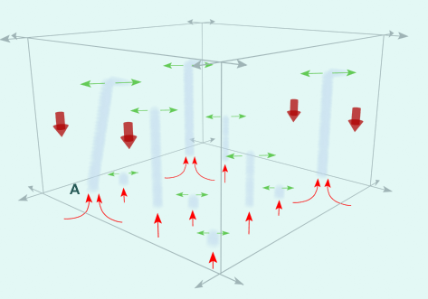

Slide 21
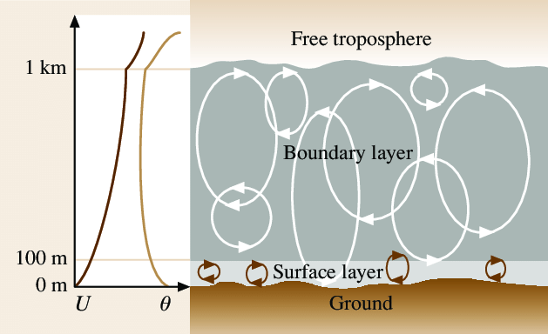
Similarly, boundary layer parametrization represent the effects of sub-grid scale boundary layer eddies
1 km

Slide 22
Numerical Weather Prediction
A numerical prediction model includes the primitive equations, physics parameterizations, and a way to solve the equations.
Solved or “integrated” using of powerful computers
Groups doing this include: NWS GFS, NCAR WRF, ECMWP model

Slide 23
Model Resolution
Keep in mind that a model with a certain horizontal grid spacing is barely simulating phenomenon with a scale four times the grid spacing.
A 12-km model barely is getting 50 km scale features correct.
General rule of thumb: model resolves features 6X or more than its grid spacing.

Slide 24
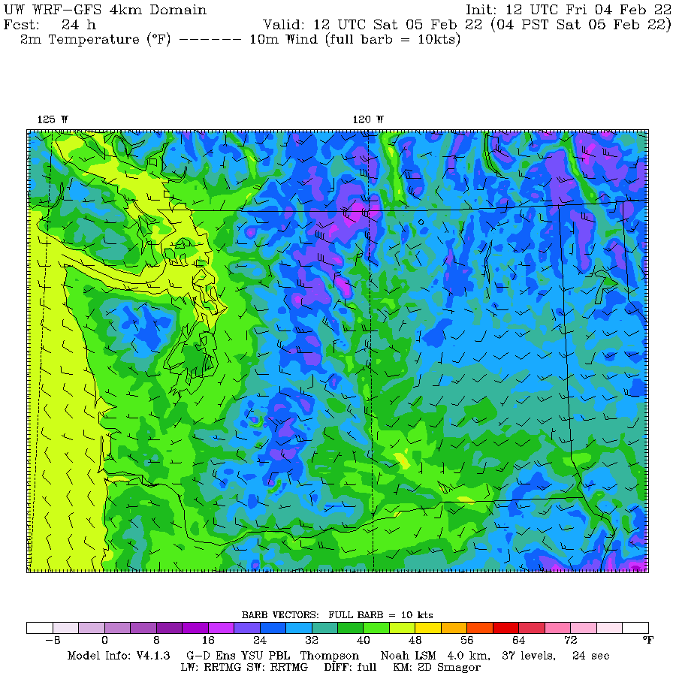
The WRF 4-km grid spacing barely resolves features of 24 km size

Slide 25
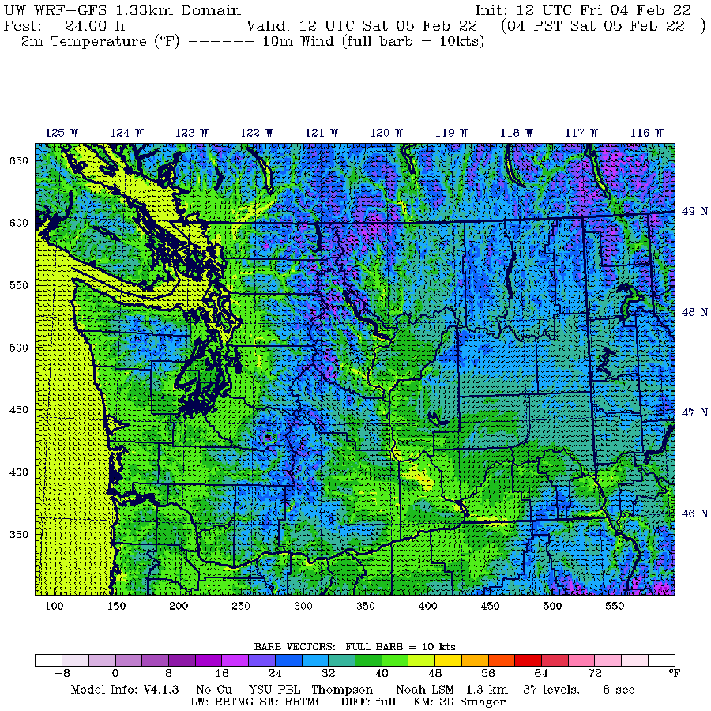
Maybe
8 km size

Slide 26
Numerical Weather Prediction
Most global operational modeling systems are run four times a day (00, 06, 12, 18 UTC).
The main numerical modeling centers in the U.S. are:
Environmental Modeling Center (EMC) at the National Centers for Environmental Prediction (NCEP)--part of the NWS. Located near Washington, DC.
Fleet Numerical Meteorology and Oceanography Center (FNMOC)-Monterey, CA
Air Force Weather Agency (AFWA)-Offutt AFB, Nebraska

Slide 27
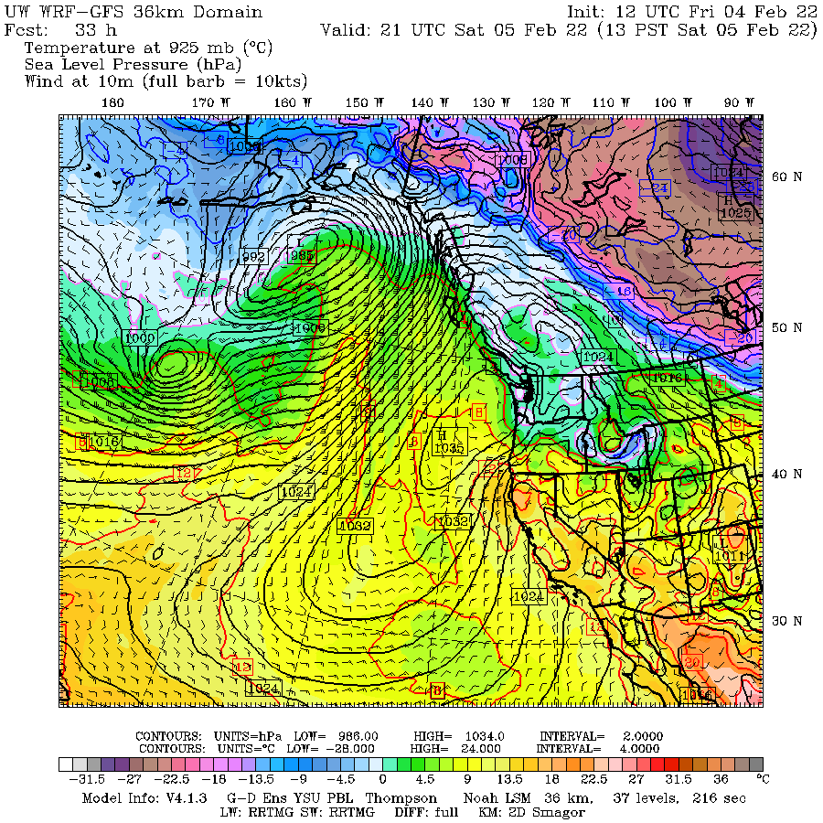
Terminology Reminder
Synoptic scale: 1000 km to global scale
Mesoscale: 10 to 1000 km
Microscale:1 to 10 km
Convection-allowing models (CAMs): generally 1-4 km grid spacing

Slide 28
Some Major U.S. Operational Models
Global Forecast System Model (GFS). FV-3 model. Global, resolution ~13 km grid. Run out to 384 hr, four times per day.
NAM Model (North American Mesoscale). Run by NWS/NOAA at 12 and 4 km. Four times a day.
Weather Research and Forecasting Model (WRF). WRF is a mesoscale modeling system system that is used by the NWS and the university/research community. Was used in HRRR and used in UW modeling system.

Slide 29
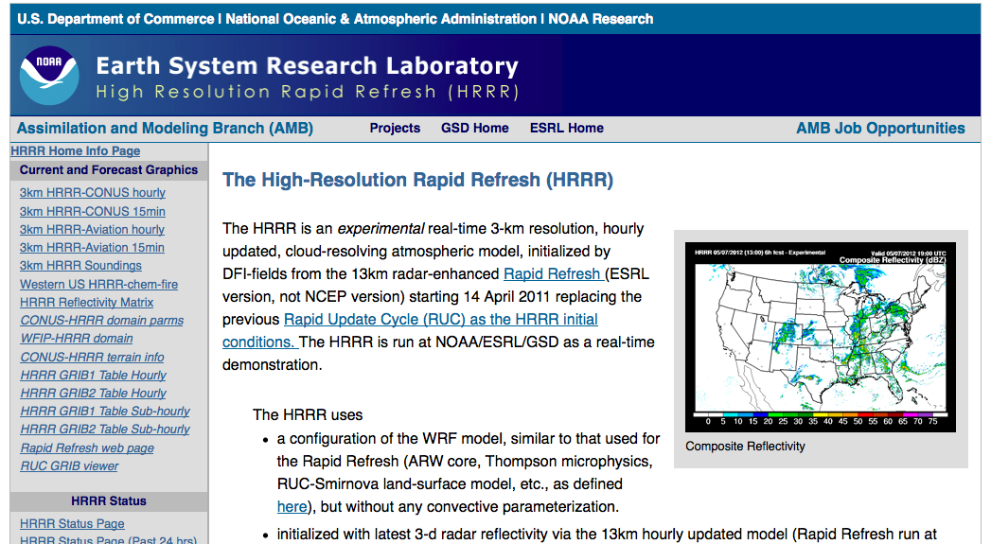
HRRR (High-Resolution Rapid Refresh). WRF model by NOAA/NWS with 3-km grid spacing. Run every hour to 18 or 36 h.

Slide 30
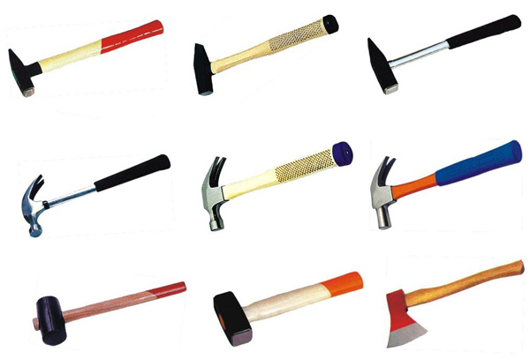
More U.S. Global Models
Navy Global Environmental Model (NAVGEM) has a model resolution of ~19 km.
Air Force Global Air-Land Weather Exploitation Model (GALWEM) at ~17 km horizontal resolution. Uses UKMET office model
There are others--you will hear more about this in 452.
Forecasters often have 6-10 different models to look at. Such diversity can provide valuable information.

Slide 31
Major International NWP Centers
ECMWF: European Center for Medium-Range Weather Forecasting. Their global model is considered the best.
UK Met Office: An excellent global model similar to GFS
Canadian Meteorological Center: GEM Model
Other lesser centers

Slide 32
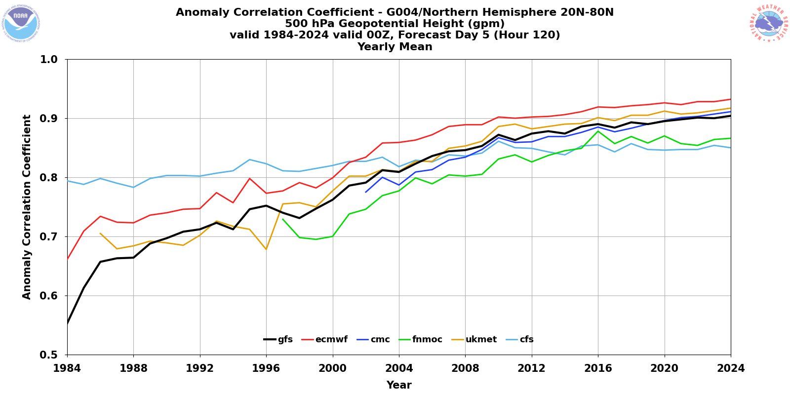

Slide 33
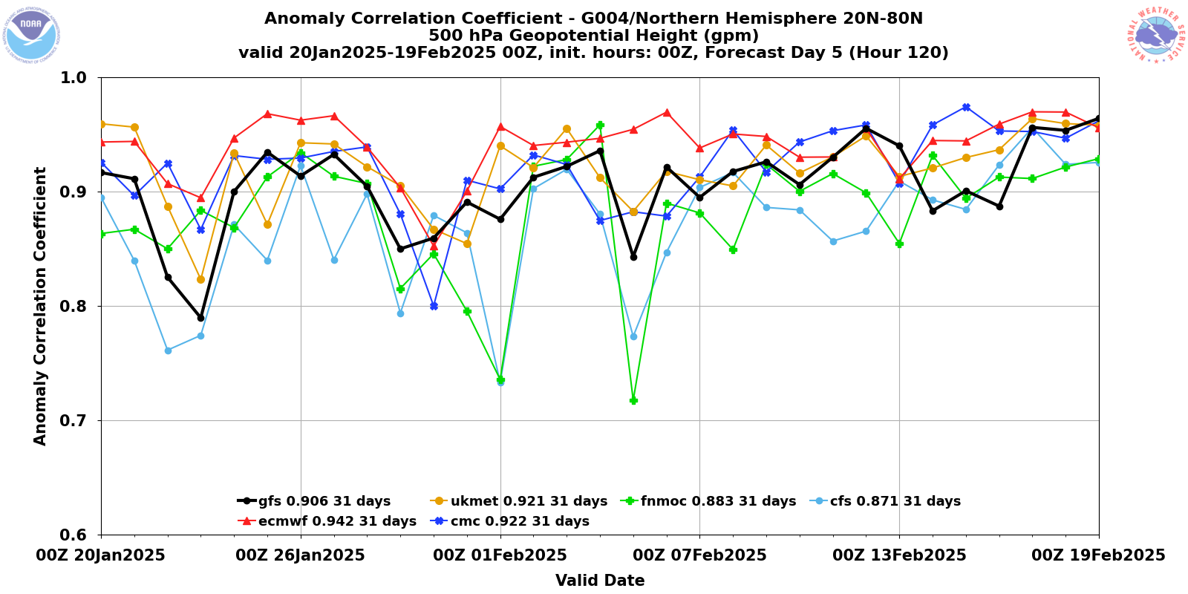
Model Skill Varies in Time

Slide 34
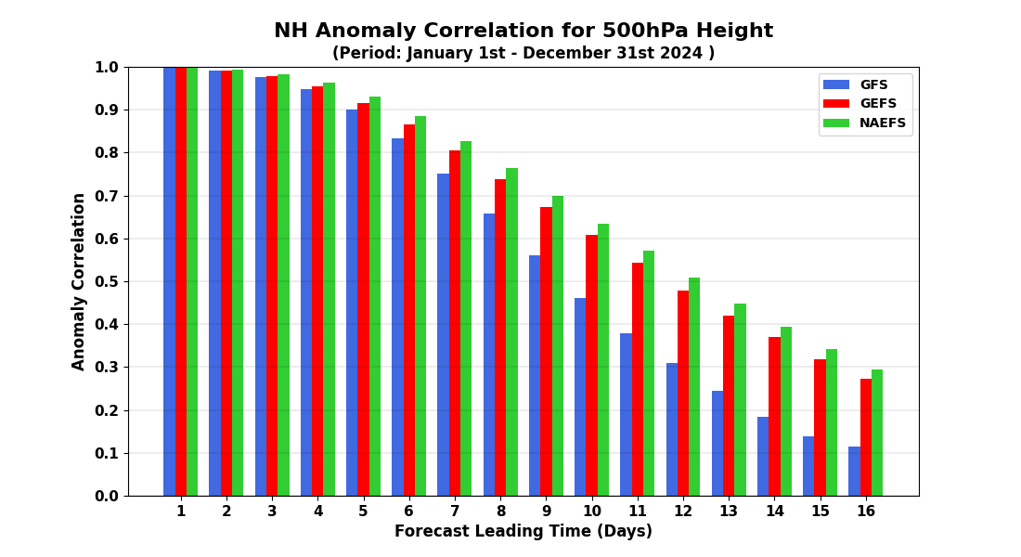
How Quickly Does Forecast Skill Decline with Time?

Slide 35
Accessing NWP Models
The department web site (go to weather loops or weather discussion) provides easy access to many model forecasts, including our WRF. Department regional modeling output.
http://www.atmos.washington.edu/mm5rt/
Tropical Tidbits
Pivotal Weather

Slide 36
A Palette of Models
Forecasters thus have a palette of model forecasts.
They vary by:
Region simulated
Resolution
Model physics
Data used in the assimilation/initialization process
The diversity of models can be a very useful tool to a forecaster. Also helps deal with uncertainty.

Slide 37
Ensemble Forecasting
All of the model forecasts I have talked about so far reflect a deterministic approach.
This means that we do the best job we can for a single forecast and do not consider uncertainties in the model, initial conditions, or the very nature of the atmosphere.
Traditionally, deterministic prediction has been the way forecasting was done, but this is changing.

Slide 38

A More Fundamental Issue
The atmosphere is a chaotic system, in which small differences in the initialization…well within observational error… can have large impacts on the forecasts, particularly for longer forecasts.
Similarly, uncertainty in model physics can result in large forecast differences and errors.
Often referred to as the “butterfly effect”

Slide 39

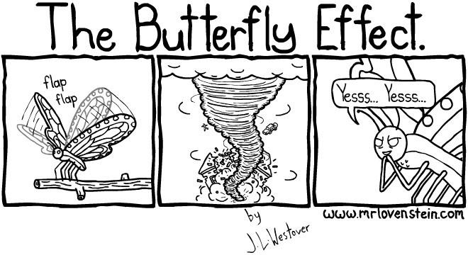

Slide 40

A Fundamental Problem
All forecasts have some uncertainty.
The uncertainty generally increases in time.
Thus, we should be providing forecast probabilities and forecast ranges and not single forecast values.

Slide 41
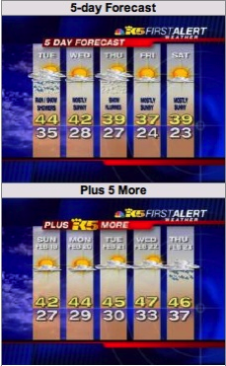
This is Ridiculous!

Slide 42
Forecast Probabilistically Using Ensembles
There is an approach to handling this issue that is being used by the forecasting community…ensemble forecasts
Instead of making one forecast…make many…each with a slightly different initialization or different model physics.
Possible to do this now with the vastly greater computation resources that are available.

Slide 43
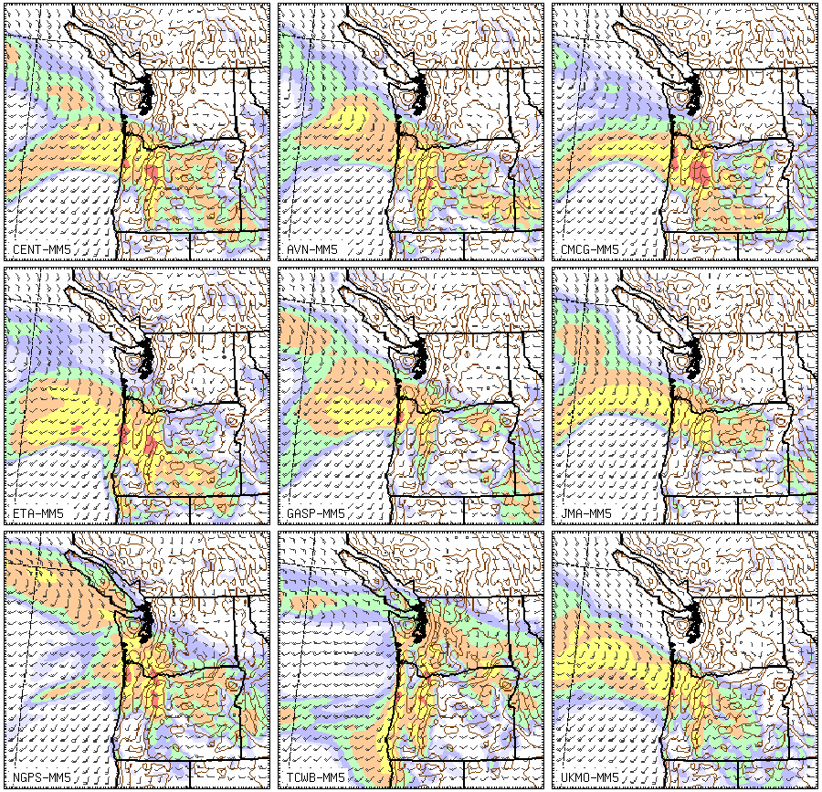

Slide 44
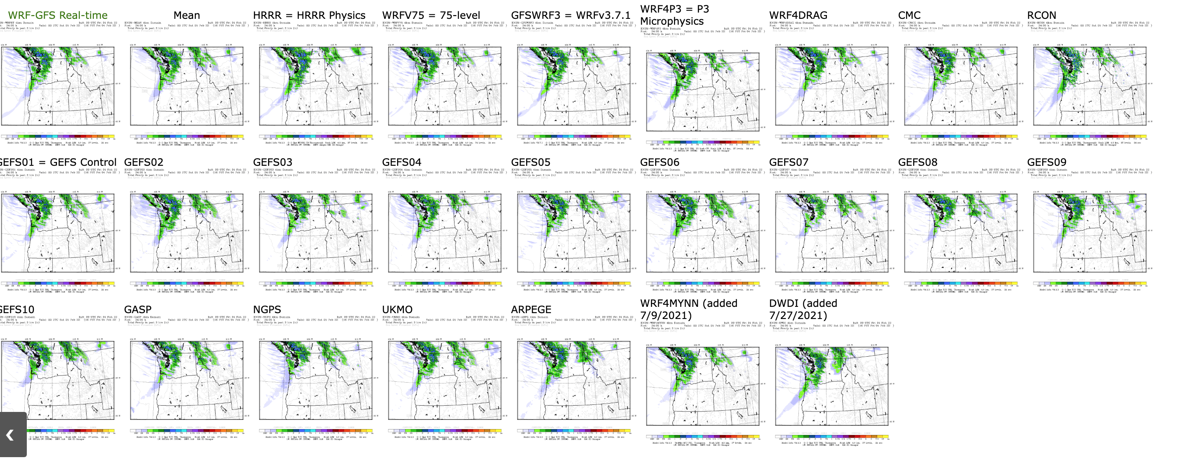

Slide 45
A
12h
forecast
24h
forecast
Forecast
e
36h
forecast
a
c
u
j
n
T
Analysis Region
g
t
M
Analysis/
Initialization
T
48h forecast Region

Slide 46

Ensemble Prediction
Ensembles can provide the probabilities that some weather feature will occur.
The ensemble mean is more accurate than any individual member.
Can also predict forecast skill!
When forecasts are similar, forecast skill is generally higher.
When forecasts differ greatly, forecast skill is less.

Slide 47
Various Ways to Present Ensembles

Slide 48
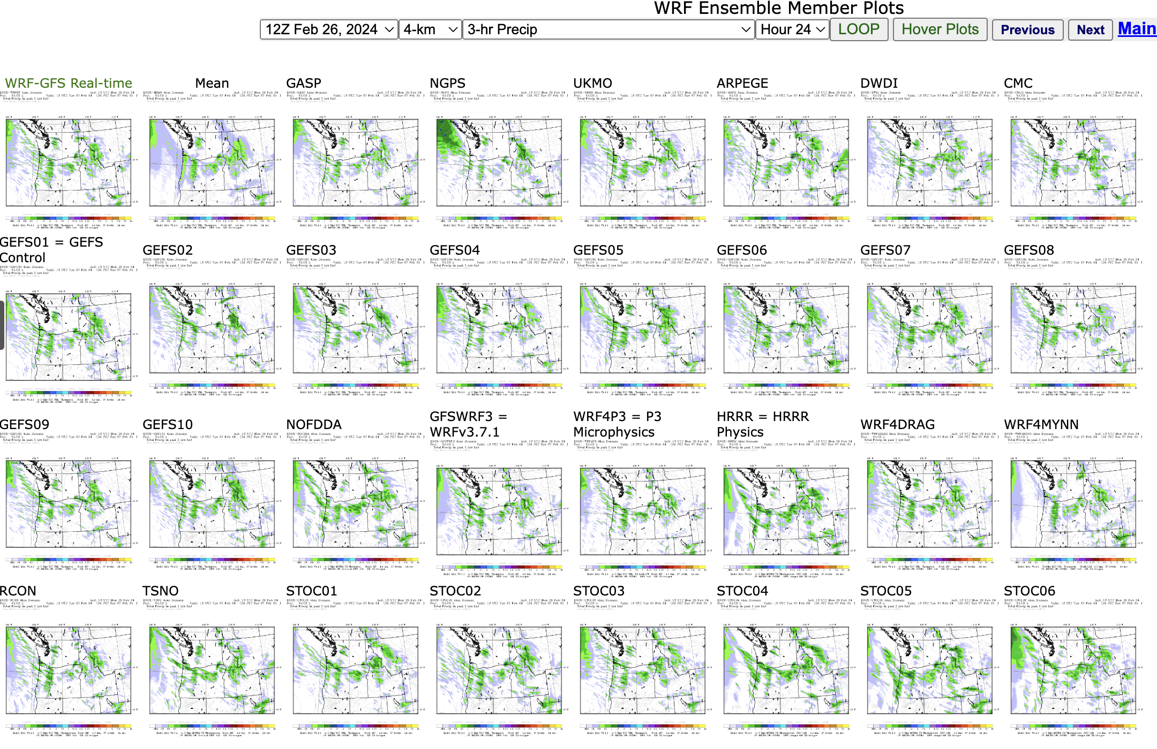
Postage Stamps

Slide 49
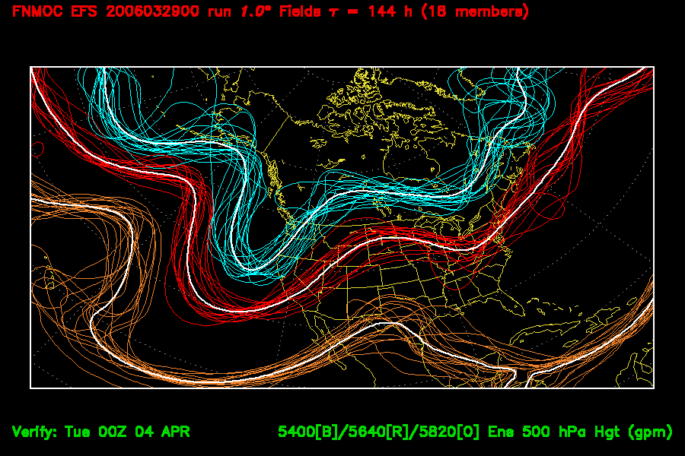
Spaghetti Diagrams

Slide 50
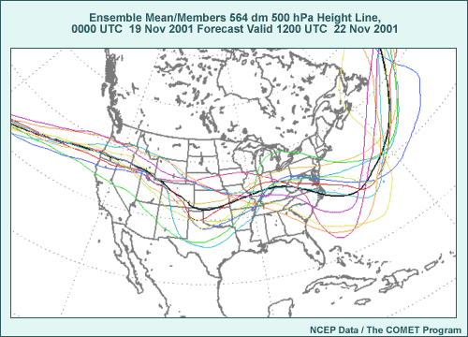

Slide 51
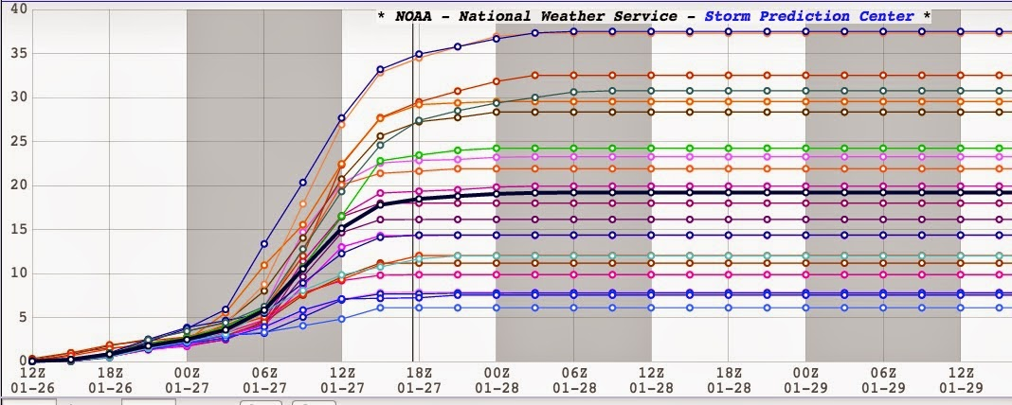
Ensemble Plume Diagrams

Slide 52
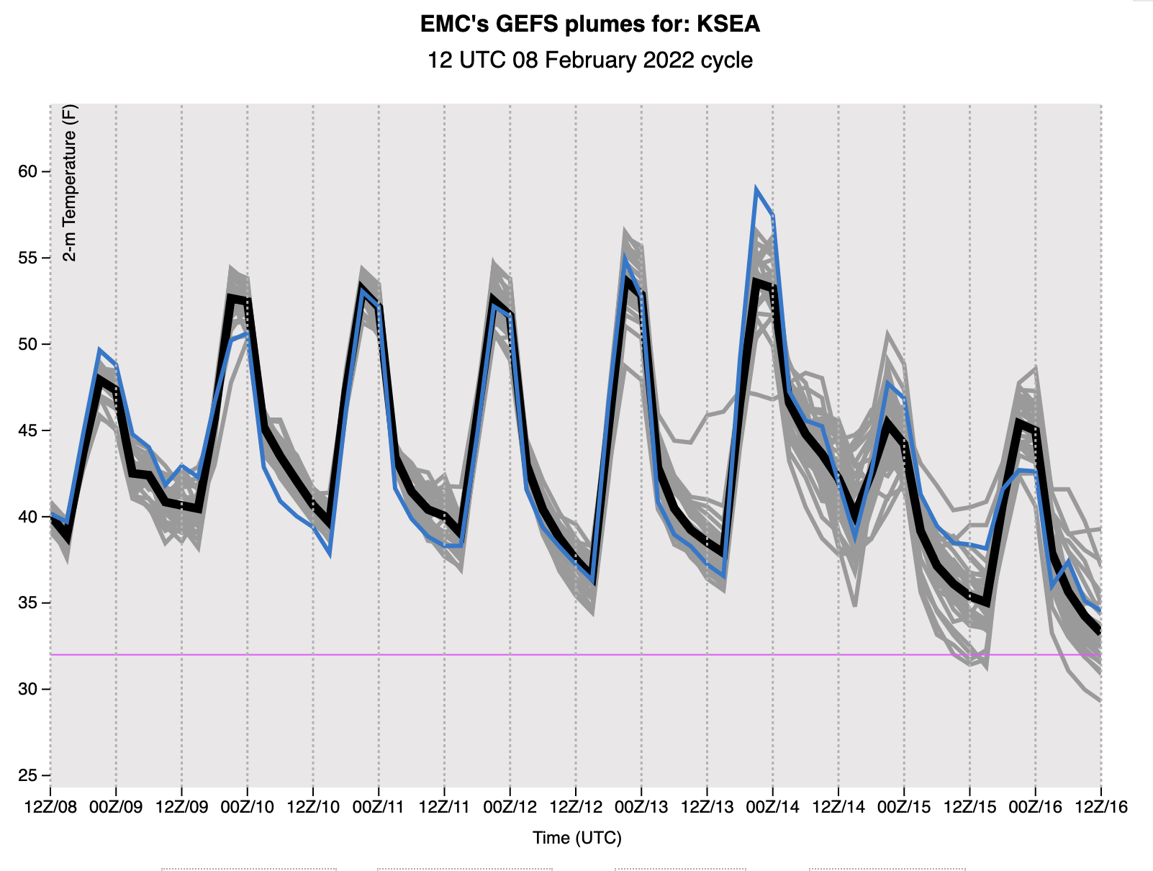

Slide 53
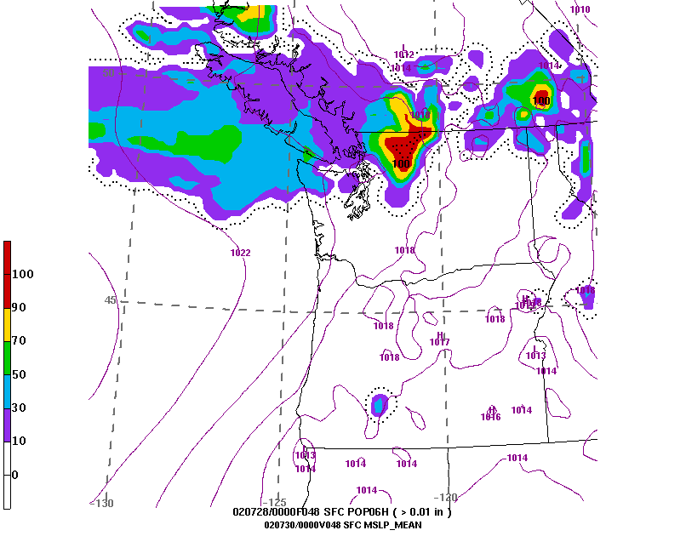
Ensembles can Produce Probability Maps

Slide 54
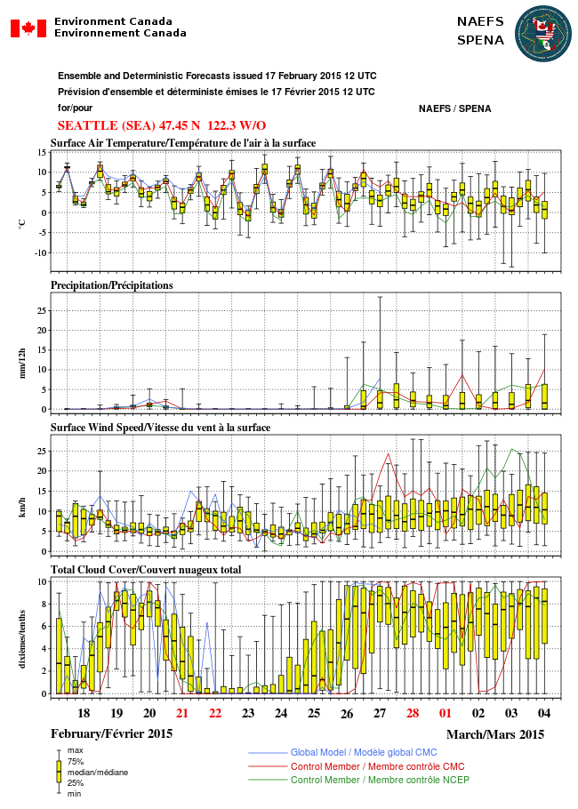
Box and Whisker Plot

Slide 55
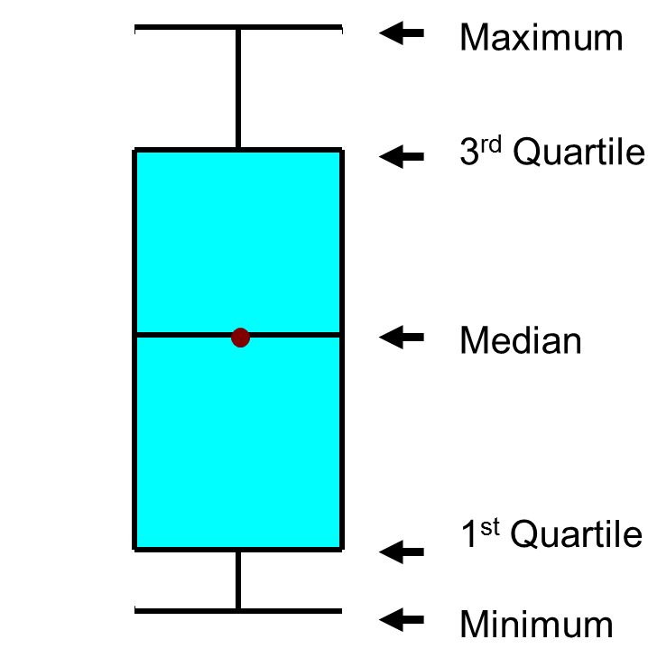

Slide 56
Major U.S. Ensemble Systems
NOAA/NWS GFS ensemble (GEFS), 20 members, 25 km resolution. Underdispersive
NOAA/NWS SREF (Short-Range Ensemble Forecast System). 26 members, 18 km. WRF and NMM members
NAEFS: North American Ensemble Forecasting System (GEFS plus CMC ensemble), Global

Slide 57
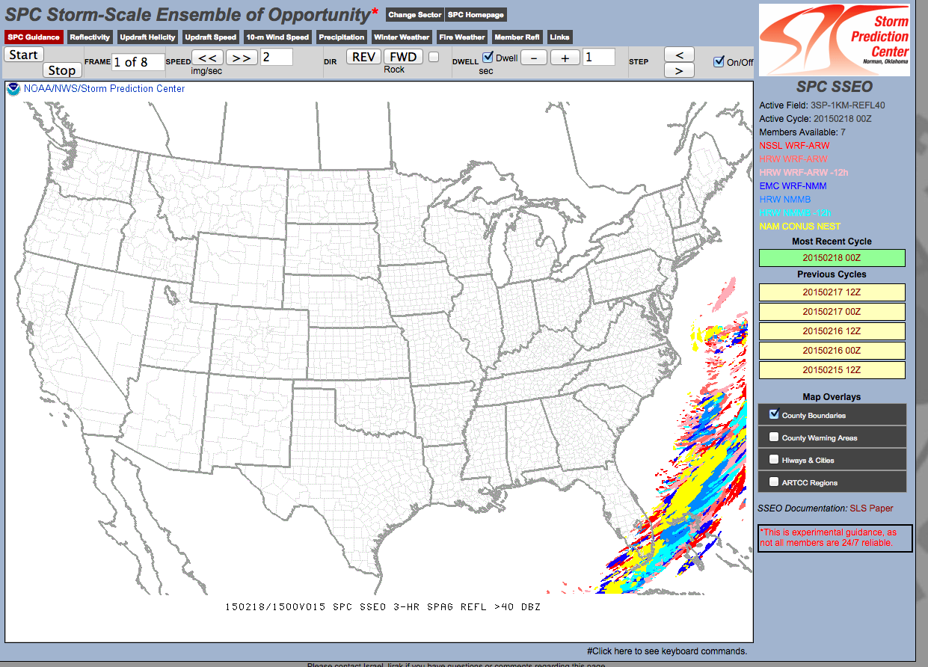
Smaller Ensemble System at Higher Resolution (about 4 km) HREF (8-9 members)

Slide 58
Post-Processing of Model Forecasts
Numerical model output sometimes often systematic biases (e.g., too warm or too cold in certain situations). Why not correct such biases?
Numerical models may lack the resolution or physics to deal with certain problems (e.g., low level fog in a valley). Some information on local effects be derived from historical model performance.
The solution: statistical post-processing of model forecasts.

Slide 59
Model Output Statistics (MOS)
In the 1960s and 1970s, the NWS developed and began using statistical post-processing of model output…known as Model Output Statistics…MOS
Based on linear regression: Y=a₀ + a₁X₁ + a₂X₂+ a₃X₃ + …
Y is the thing you want to predict. X is model output used to predict Y.
One “trains” the equation using historical model performance.

Slide 60
Day 2 (30-h) GFS MOS Max Temp Equation for KSLC (Cool Season – 0000 UTC cycle)
N | Predictor (X_{N}) | Coeff. (a_{N})
0 |  | -467.7800
1 | 2-m Temperature (21-h proj.) | 1.7873
2 | 2-m Dewpoint (21-h proj.) | 0.1442
3 | 2-m Dewpoint (12-h proj.) | -0.2060
4 | 2-m Dewpoint (27-h proj.) | 0.1252
5 | Observed Temperature (03Z) | 0.0354
6 | 850-mb Vertical Velocity (21-h proj.) | 19.5759
7 | 925-mb Wind Speed (15-h proj.) | 0.6024
8 | Sine Day of Year | 1.7111
9 | 700-mb Wind Speed (15-h proj.) | 0.2701
10 | Sine 2*DOY | 1.5110

Slide 61
MOS is available for many parameters and greatly improves the quality of many model predictions.

Slide 62
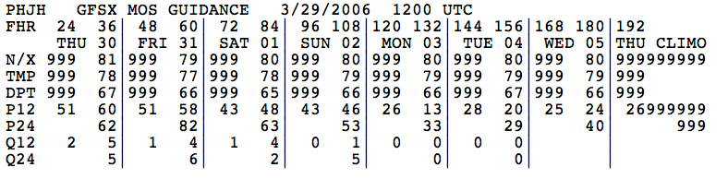
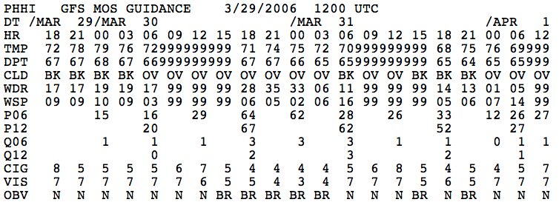

Slide 63

The National Blend of Models
The National Weather Service has been moving to the National Blend of Models, which statistically combines the forecasts of many models.
Better than MOS and has generally replaced it
Machine learning is becoming increasingly popular

Slide 64
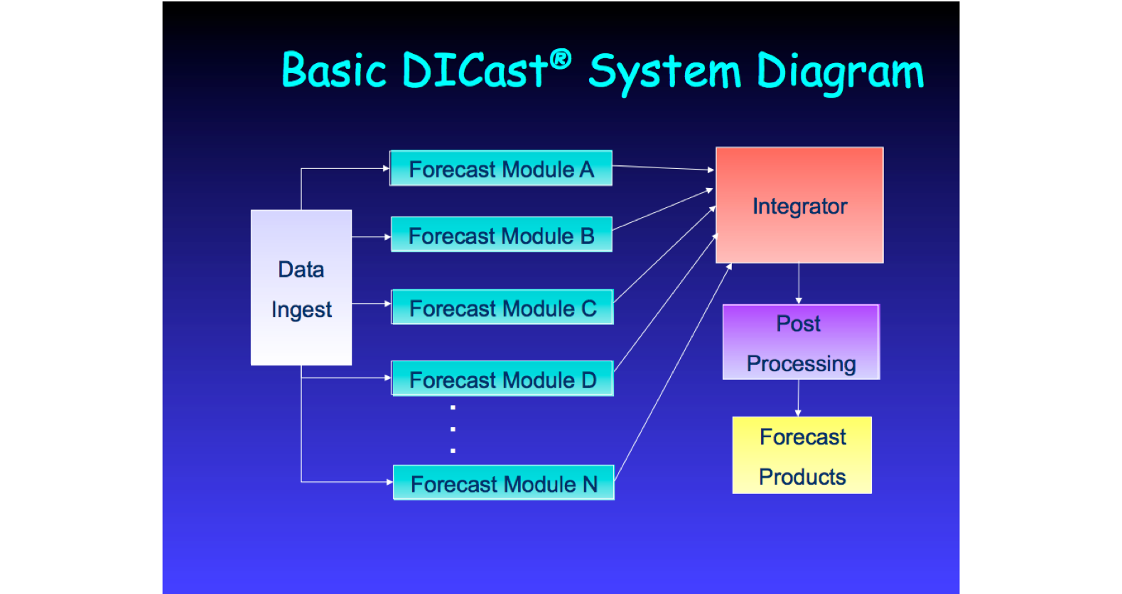
The Private Sector Is the Leader in Statistical Post-Processing
Examples: weather.com, accuweather, weatherunderground
Weather.com uses the Dicast System

Slide 65
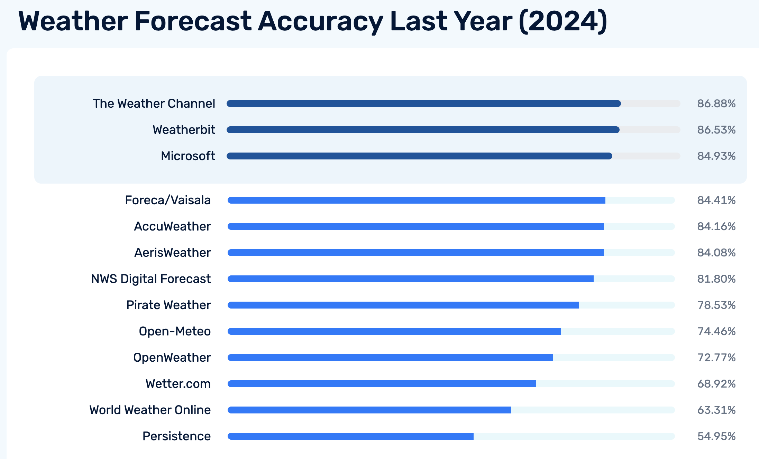

Slide 66
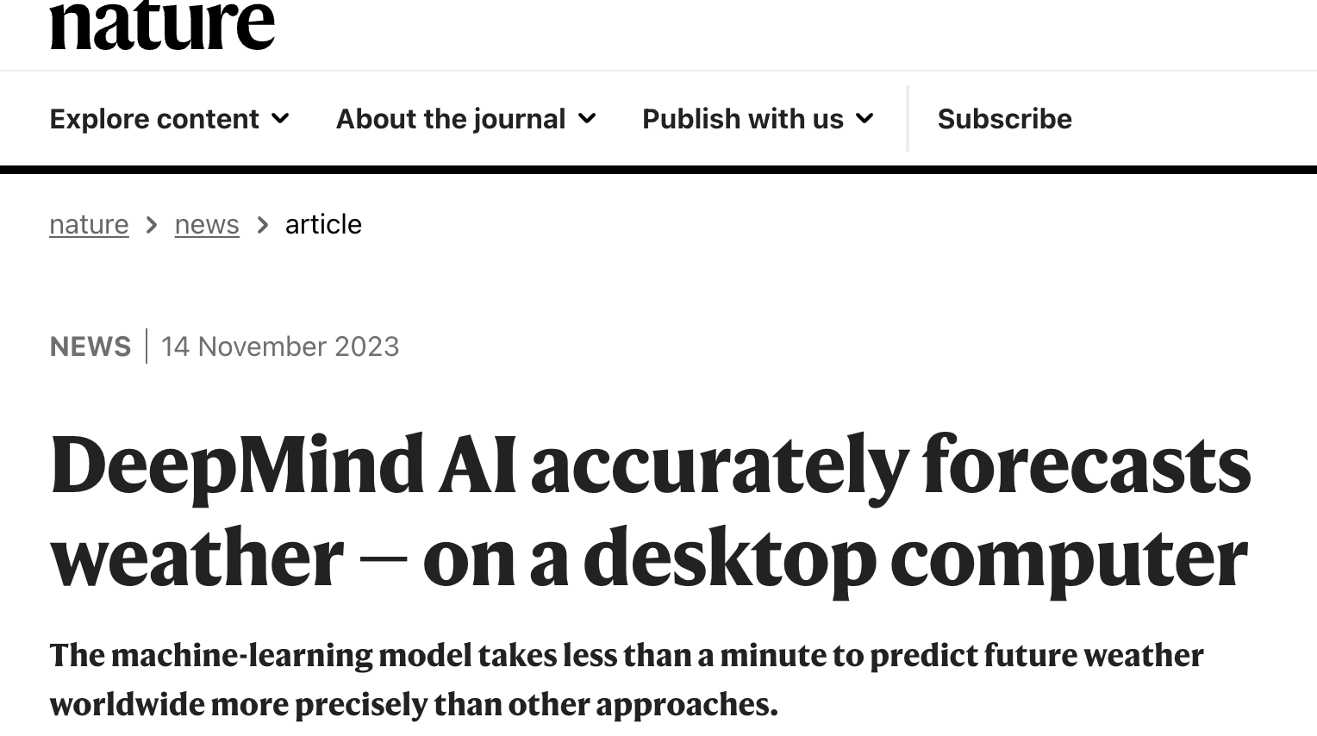
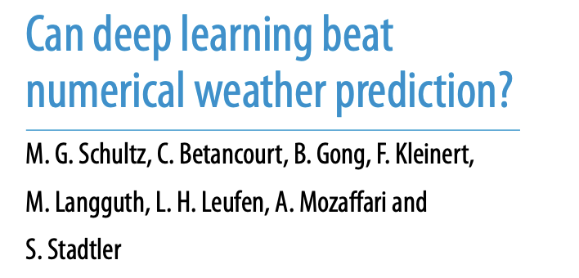
Machine Learning NWP: A Potential Revolution
There has been a lot of recent publicity about machine learning taking over NWP.

Slide 67
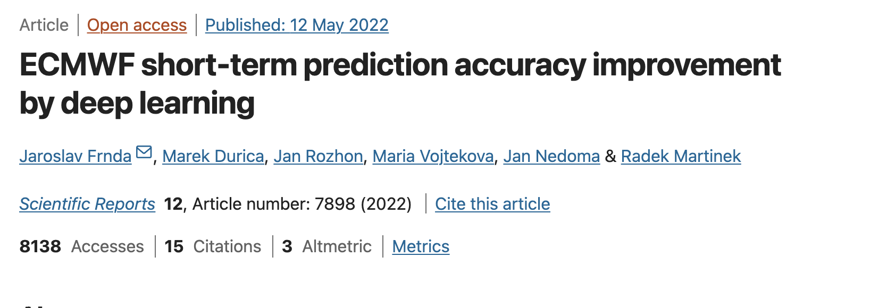
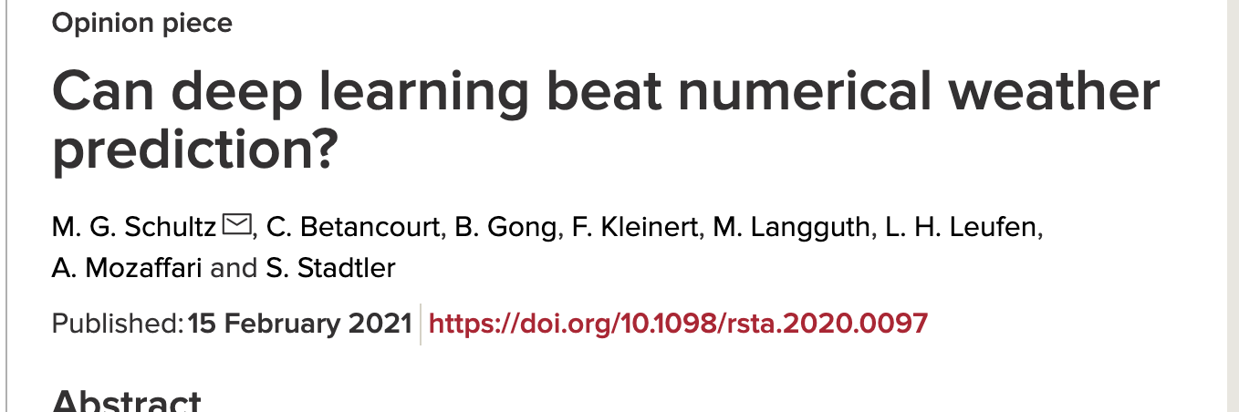
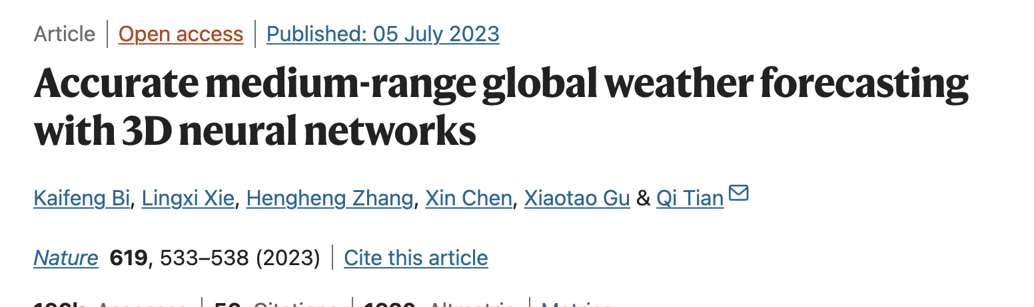

Slide 68
Current AI-NWP Systems
Start with extended-period gridded data set (such as ERA-5)
Train ML models over the the entire period (this is very compute intensive)
Then can can produce forecasts (generally at a very limited number of levels) very quickly.
Results at standard levels very promising.

Slide 69
European Center is Trying It
ECMWF is now running its own Artificial Intelligence/Integrated Forecasting System (AIFS) as part of its experiment suite.
These machine-learning based models are very fast (minutes to run)
Produce a 10-day forecast with 6-hourly time steps in approximately one minute.
The outputs are currently publicly available in graphical form.

Slide 70
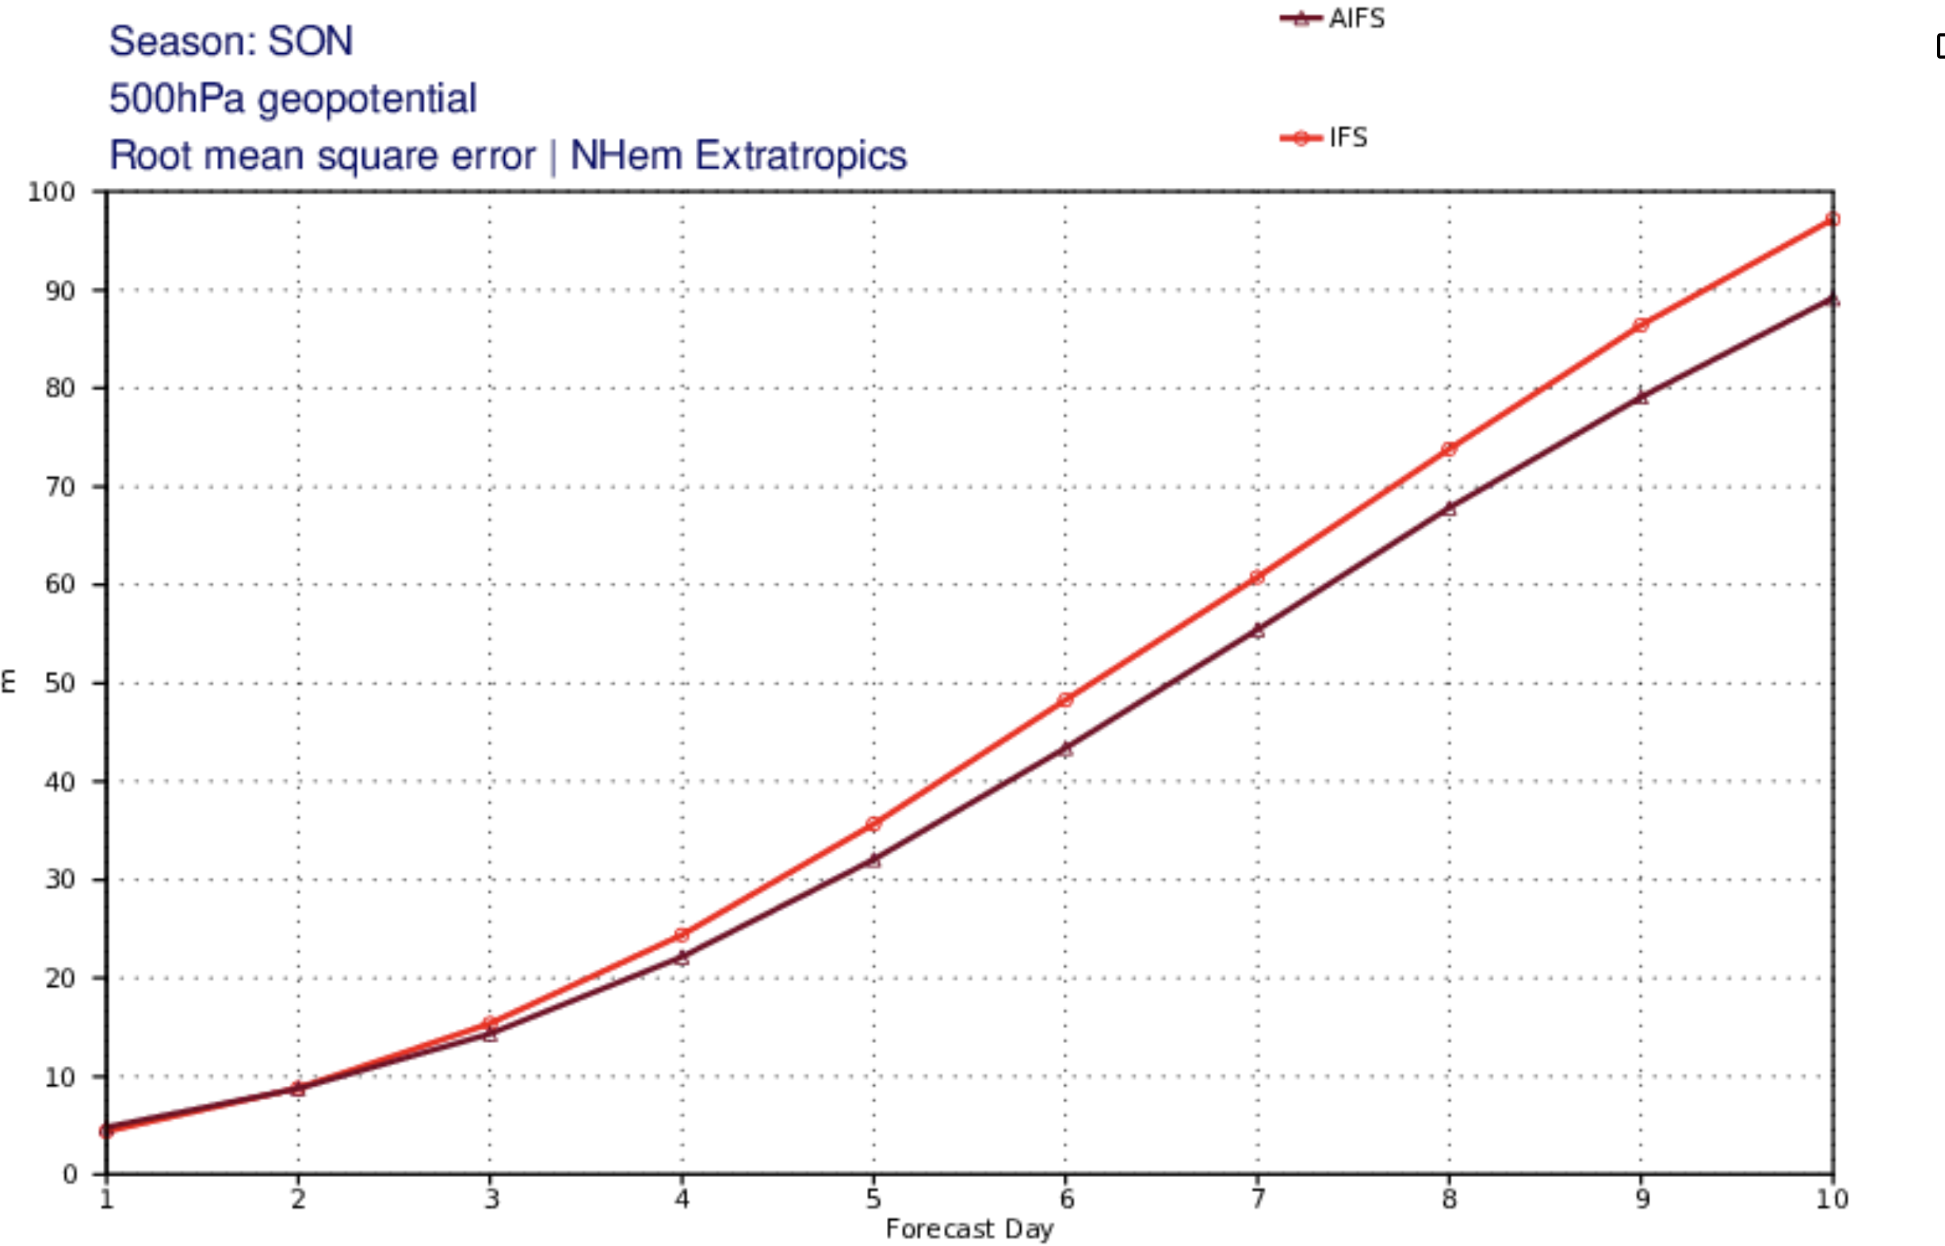
RMS

Slide 71
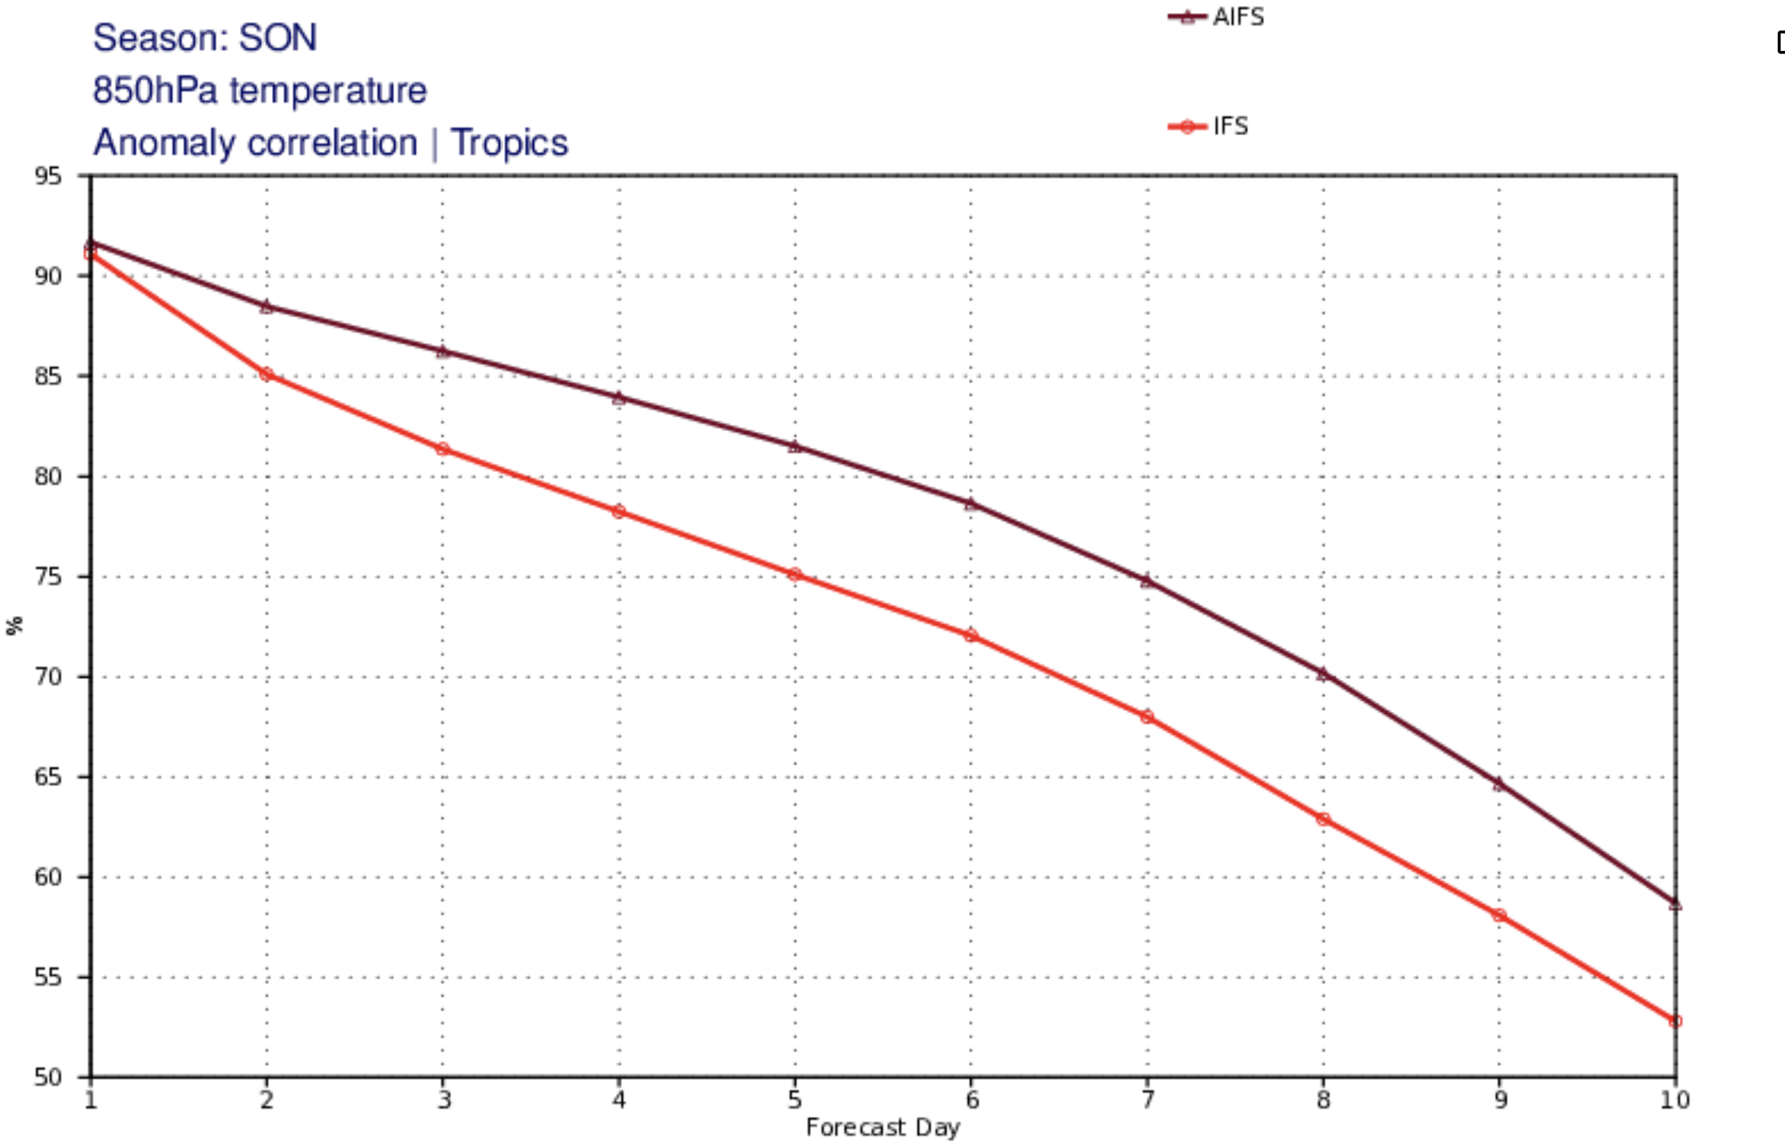

Slide 72
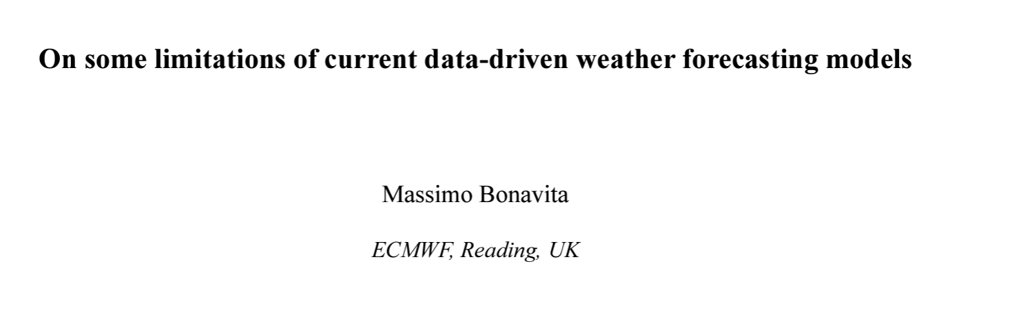
Major Issue: Although AI produces a good forecast for certain forecast quantities, the 3D fields are not balanced or necessarily physical (e.g., poor vertical motions)
“The main conclusion is that Pangu-Weather forecasts, and possibly those of similar ML models, do not have the fidelity and physical consistency of physics-based models”

Slide 73
It may be possible to add physical constraints and conservation to ML models….a lot of work needed on this front

Slide 74
The End

