Slide 1

Forecasting Boot Camp
ATMS 370

Slide 2
Major Steps in the Forecast Process
Data Collection
Quality Control
Data Assimilation
Model Integration
Post Processing of Model Forecasts
Human Interpretation (sometimes)
Product and graphics generation

Slide 3

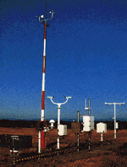
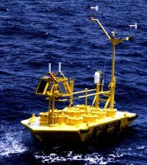

Observation and Data Collection

Slide 4
Data Collection
Weather is observed throughout the world and the data is distributed in real time.
Many types of data and networks, including:
  Surface observations from many sources
  Radiosondes and radar profilers
  Fixed and drifting buoys
  Ship observations
  Aircraft observations
  Satellite soundings
  Cloud and water vapor track winds
  Radar and satellite imagery

Slide 5
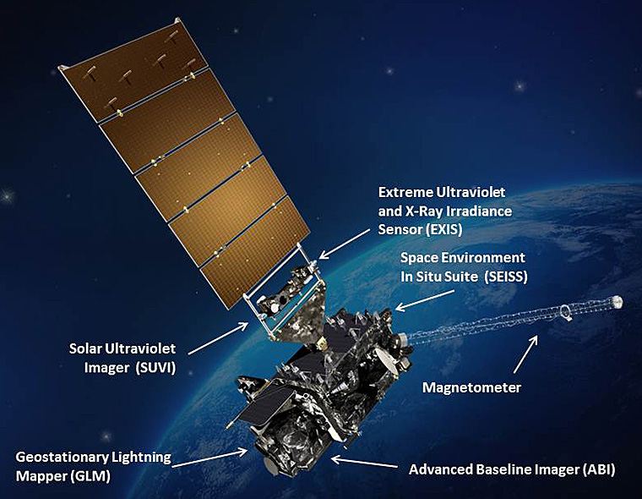
Data Collection
Satellite data is now the dominant data source for weather prediction (perhaps 95%)
Huge increases in the numbers of surface stations and aircraft reports.

Slide 6
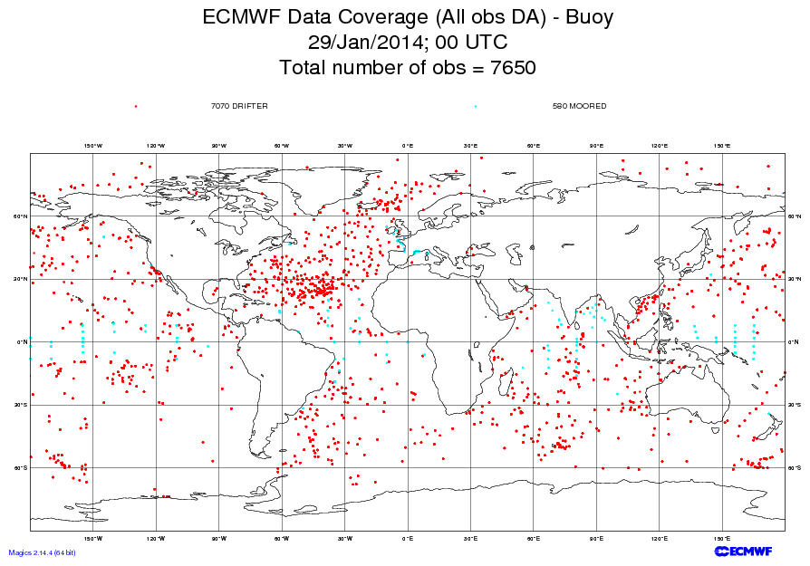

Slide 7
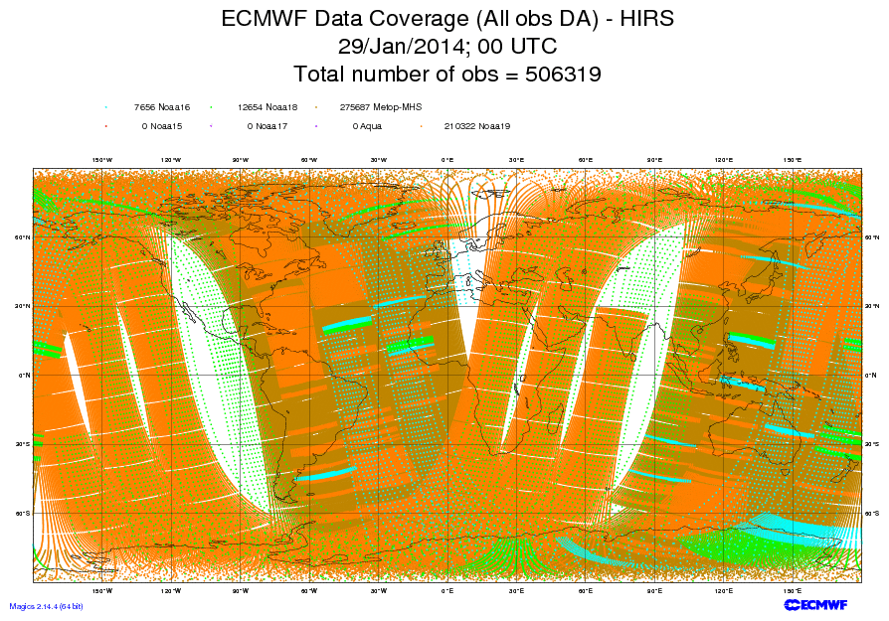
High-resolution Infrared Radiation Sounder

Slide 8
Quality Control
Automated algorithms and manual intervention to detect, correct, and remove errors in observed data.
Examples:
  Range check
  Buddy check (comparison to nearby stations)
  Comparison to first guess fields from previous model run
  Hydrostatic and vertical consistency checks for soundings.
An important issue for the forecaster--sometimes good data is rejected and vice versa.

Slide 9
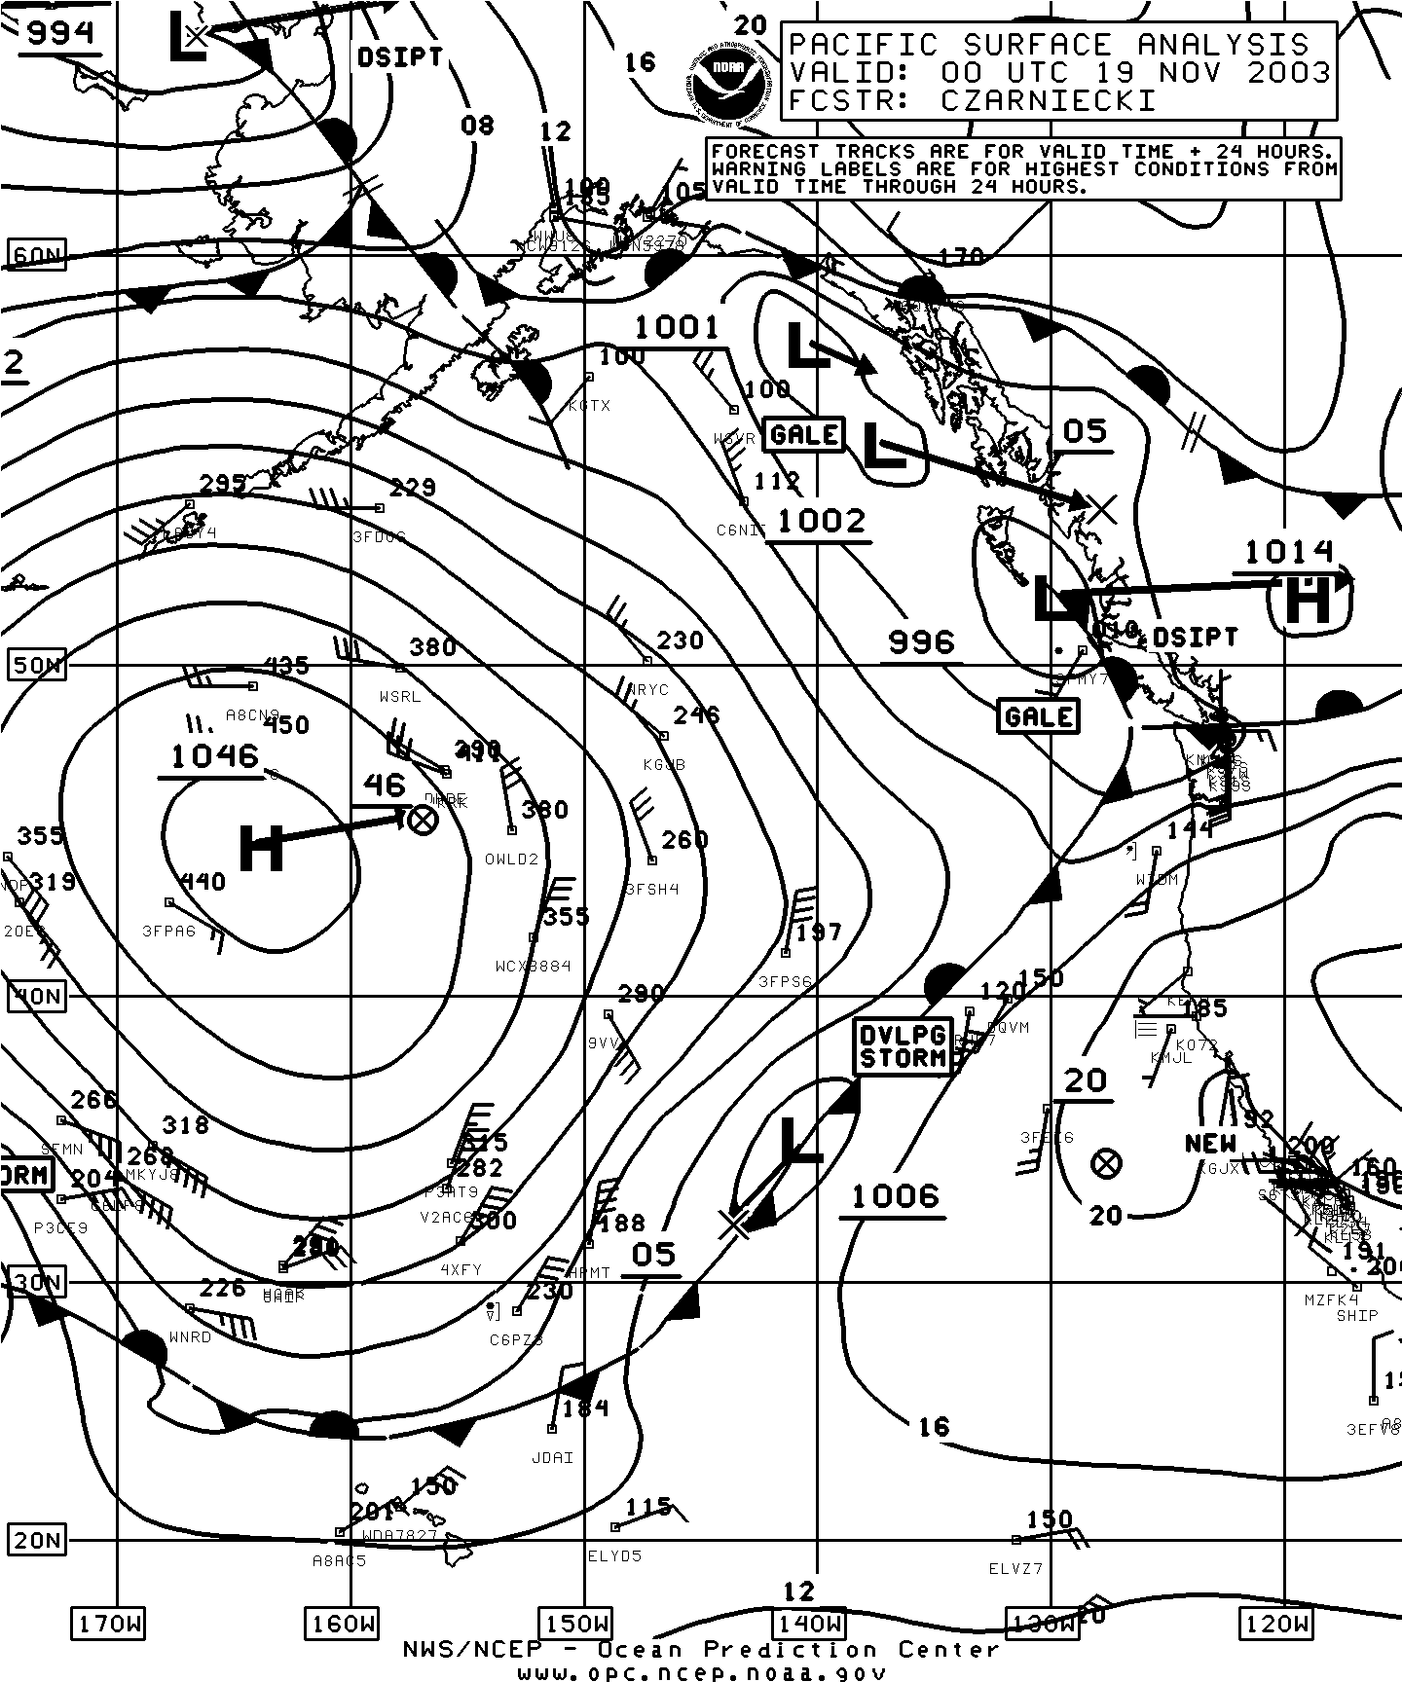
Pacific Analysis
At 4 PM
18 November
2003
Bad Observation

Slide 10
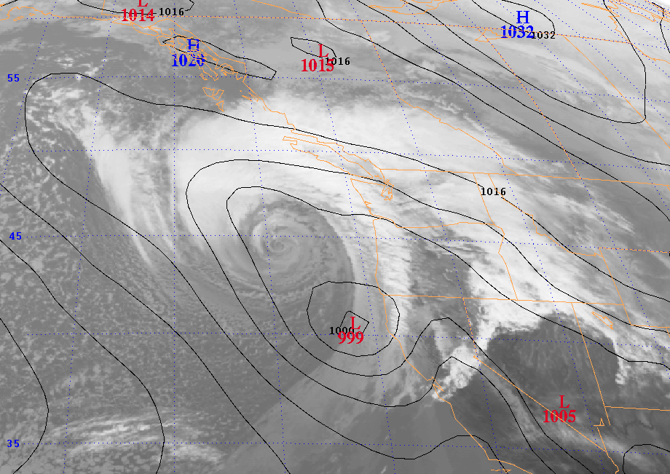
3 March 1999: Forecast a snowstorm … got a windstorm instead
Eta 48 hr SLP Forecast valid 00 UTC 3 March 1999

Slide 11

Objective Analysis/Data Assimilation
Numerical weather models are generally solved on a three-dimensional grid
Observations are scattered in three dimensions
Need to interpolate observations to grid points and to ensure that the various fields are consistent and physically plausible (e.g., most of the atmosphere in hydrostatic and gradient wind balance).

Slide 12
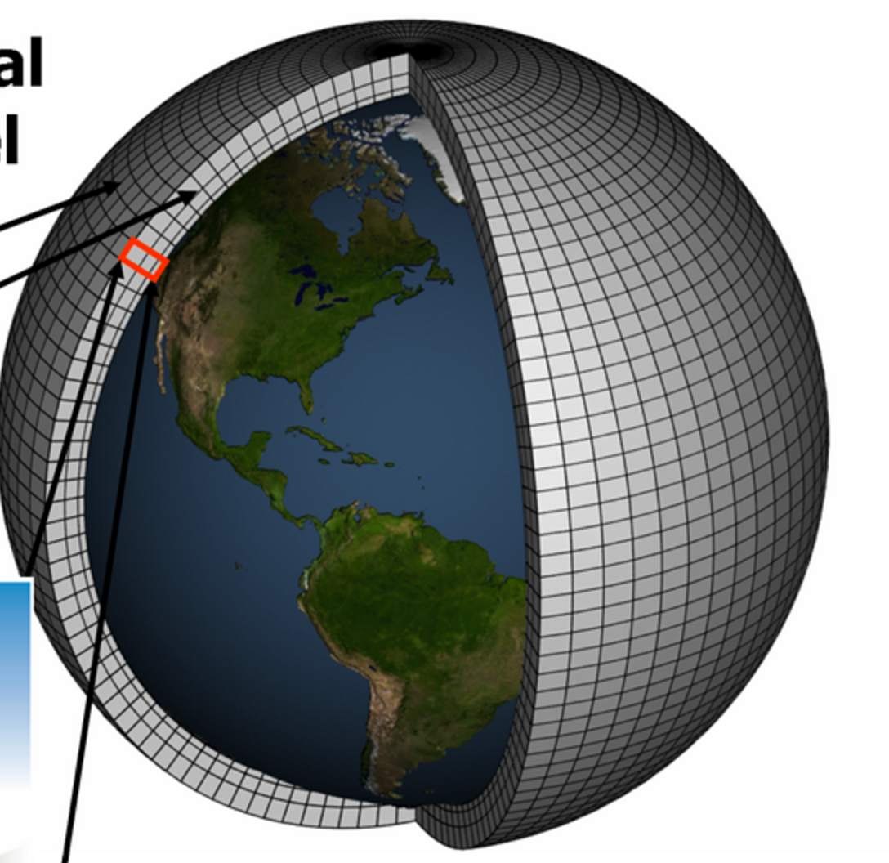
3D Grid Covering the Volume of Atmosphere

Slide 13
Objective Analysis/Data Assimilation
Often starts with a “first guess”, usually the gridded forecast from an earlier run (frequently a run starting 6 hr earlier)
This first guess is then modified by the observations.
Adjustments are made to insure proper balance.
Objective Analysis/Data Assimilation produces what is known as the model initialization, the starting point of the numerical simulation.

Slide 14
Model Integration: Numerical Weather Prediction
The initialization is used as the starting point for the atmospheric simulation.
Numerical models consist of the basic dynamical equations (“primitive equations”) and physical parameterizations.

Slide 15
“Primitive” Equations
3 Equations of Motion: Newton’s Second Law
First Law of Thermodynamics
Conservation of mass
Perfect Gas Law
Conservation of water
With sufficient data for initialization and a means to integrate these equations, numerical weather prediction is possible.

Slide 16
Predicting the Future. Momentum Equations are Essentially:
F = ma
If we can observe the atmosphere, we know m, the amount of mass
We also can calculate all the forces, F (such as forces due to differences in pressure)
Thus, we can calculate the acceleration, a.
Acceleration is the change of velocity in time.
THUS, WE KNOW THE FUTURE!

Slide 17
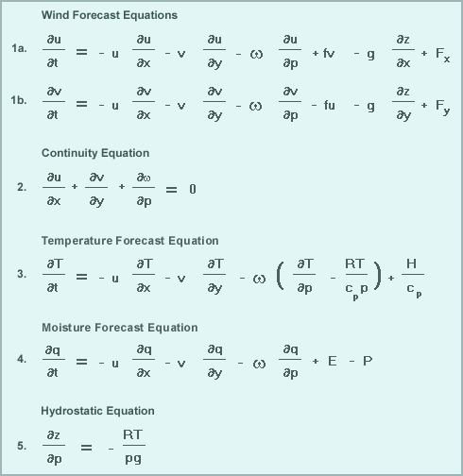
Encompassed In the “Primitive” Equations

Slide 18
Physics Parameterizations
We need physics parameterizations to describe key physical processes.
Examples include radiation, cumulus convection, cloud microphysics, boundary layer physics, etc.
Why?
  Primitive equations lack such physics
  Generally insufficient resolution to resolve key processes
  Small scale physics has to be put in terms of larger scale variables

Slide 19
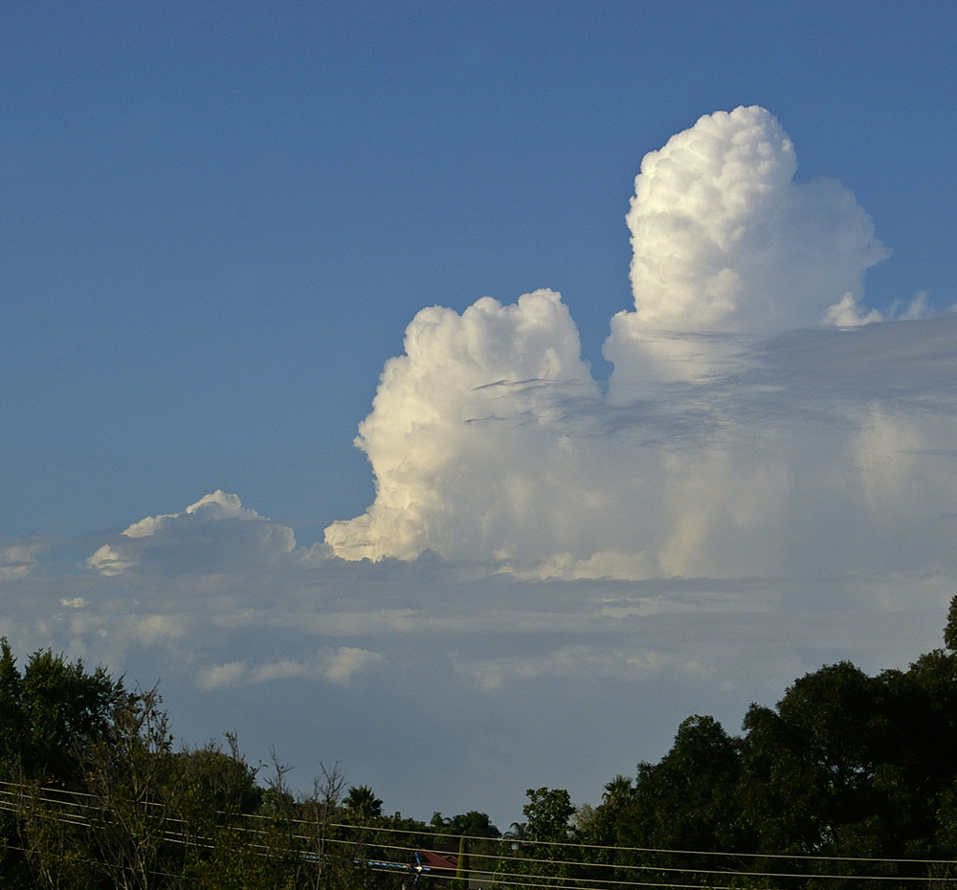
Example: Cumulus Parameterization
Most global numerical models (typical grid spacing of 9-12-km) cannot resolve convection (scales of a few km or less).
Cumulus parameterization represents the effects of sub-grid scale cumulus on the larger scales.

Slide 20
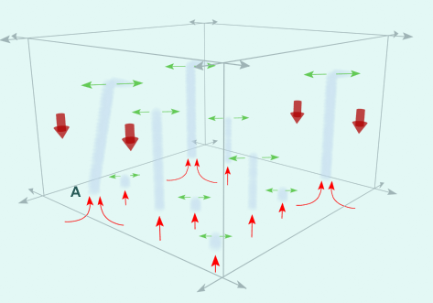

Slide 21
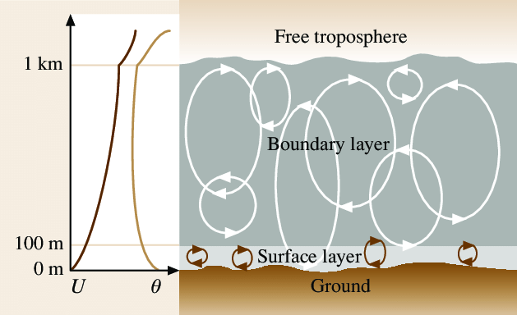
Similarly, boundary layer parametrization represent the effects of sub-grid scale eddies

Slide 22
Numerical Weather Prediction
A numerical model includes the primitive equations, physics parameterizations, and a way to solve the equations.
Makes use of powerful computers
Keep in mind that a model with a specific horizontal grid spacing is barely simulating phenomenon with a scale four times the grid spacing. So a 12-km model barely is getting 50 km scale features correct.
General rule of thumb: model resolves features 6X or larger than the grid spacing.

Slide 23
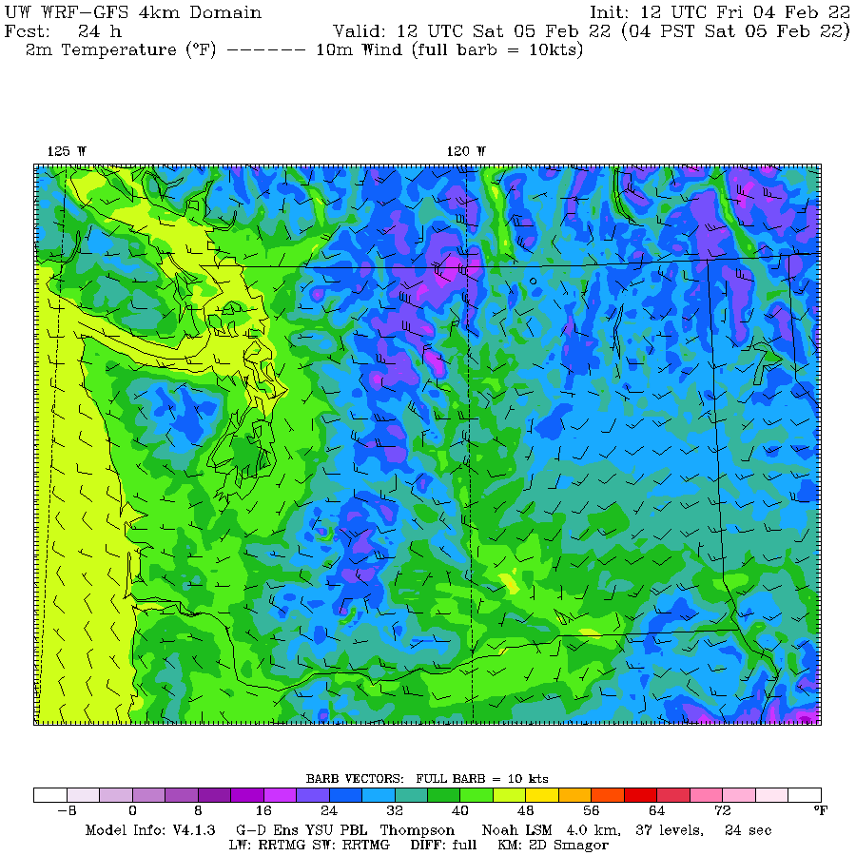

Slide 24
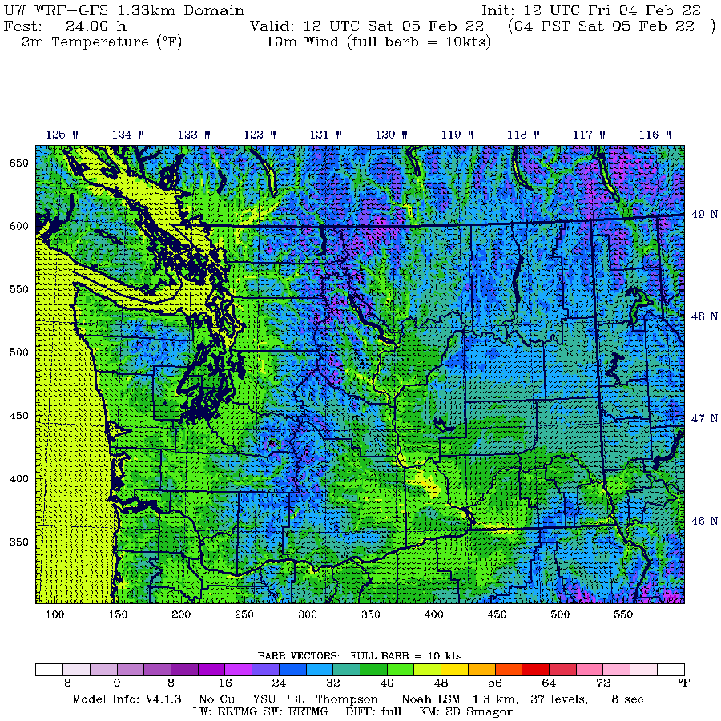

Slide 25
Numerical Weather Prediction
Most operational modeling systems are run four times a day (00, 06, 12, 18 UTC).
The main numerical modeling centers in the U.S. are:
  Environmental Modeling Center (EMC) at the National Centers for Environmental Prediction (NCEP)--part of the NWS. Located near Washington, DC.
  Fleet Numerical Meteorology and Oceanography Center (FNMOC)-Monterey, CA
  Air Force Weather Agency (AFWA)-Offutt AFB, Nebraska

Slide 26
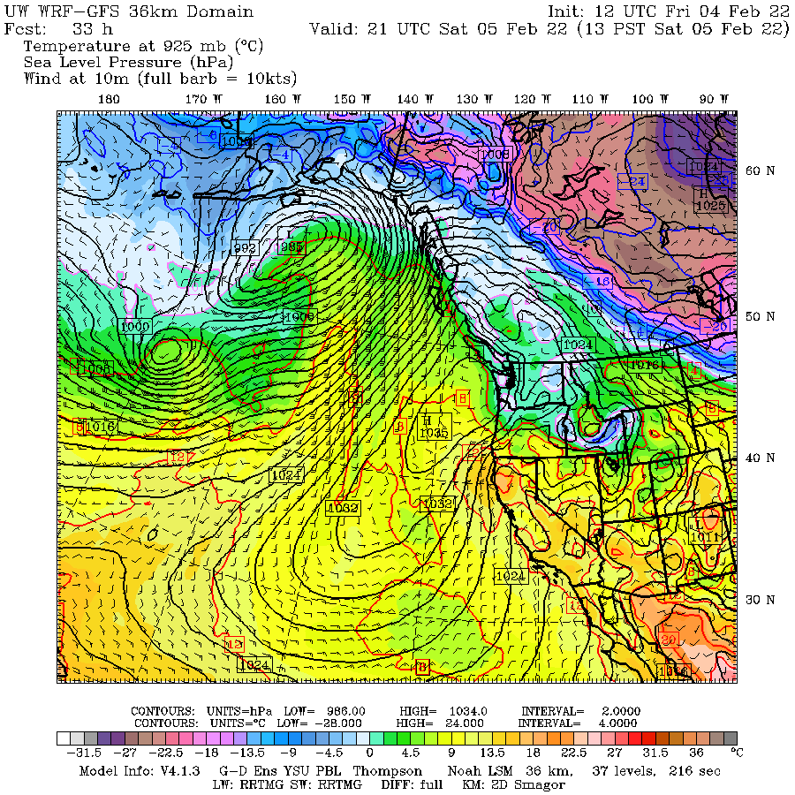
Terminology Often Used with Models
Synoptic scale: 1000 km-global scale
Mesoscale: 10-1000 km
Microscale:1-10 km
Convection-allowing models (CAMs): generally 1-4 km grid spacing

Slide 27
Some Major U.S. Operational Models
Global Forecast System Model (GFS). FV-3 model. Global, resolution ~13 km grid. Run out to 384 hr, four times per day.
NAM Model (North American Mesoscale). Run by NWS/NOAA at 12 and 4 km. Four times a day
Weather Research and Forecasting Model (WRF). WRF is a mesoscale modeling system system that is used by the NWS and the university/research community. Used in HRRR and UW modeling system

Slide 28
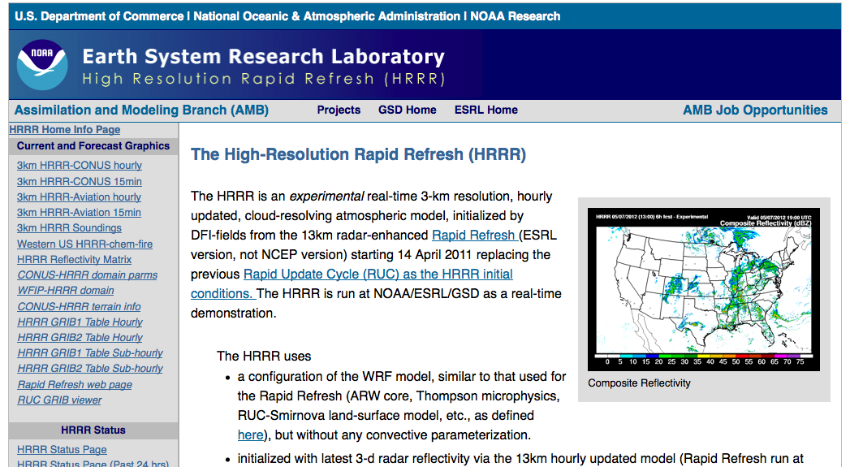
HRRR (High-Resolution Rapid Refresh). WRF model by NOAA/NWS with 3-km grid spacing. Run every hour to 18 or 36 h.

Slide 29
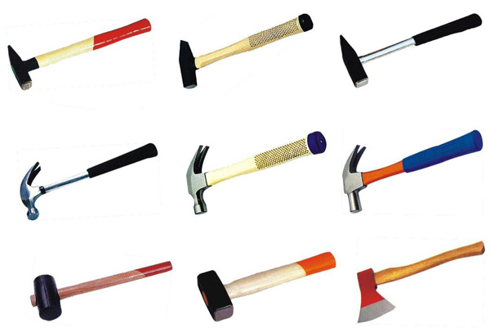
More U.S. Models
NAVGEM (Navy). The Navy model..
There are many others--you will hear more about this in 452.
Forecasters often have 6-10 different models to look at. Such diversity can provide valuable information.

Slide 30
Major International NWP Centers
ECMWF: European Center for Medium-Range Weather Forecasting. Their global model is considered the best.
UK Met Office: An excellent global model similar to GFS
Canadian Meteorological Center: GEM Model
Other lesser centers

Slide 31
Accessing NWP Models
The department web site (go to weather loops or weather discussion) provides easy access to many model forecasts, including our WRF. Department regional modeling output.
http://www.atmos.washington.edu/mm5rt/
Tropical Tidbits
Pivotal Weather

Slide 32
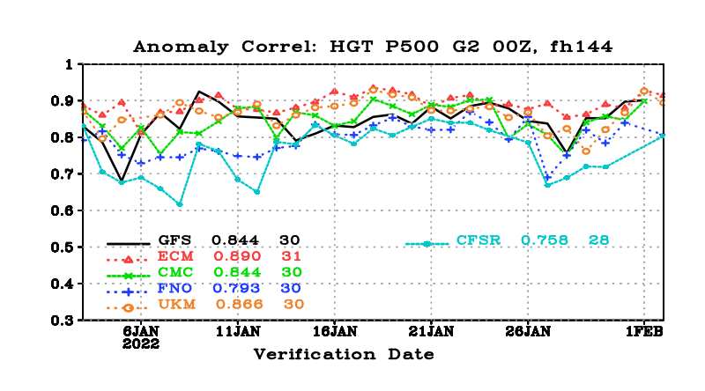
Model Skill Varies

Slide 33
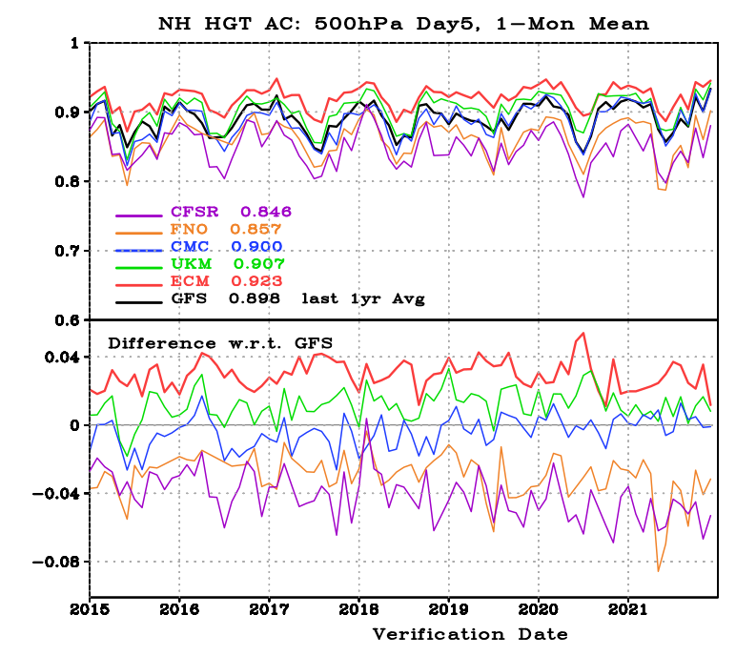

Slide 34
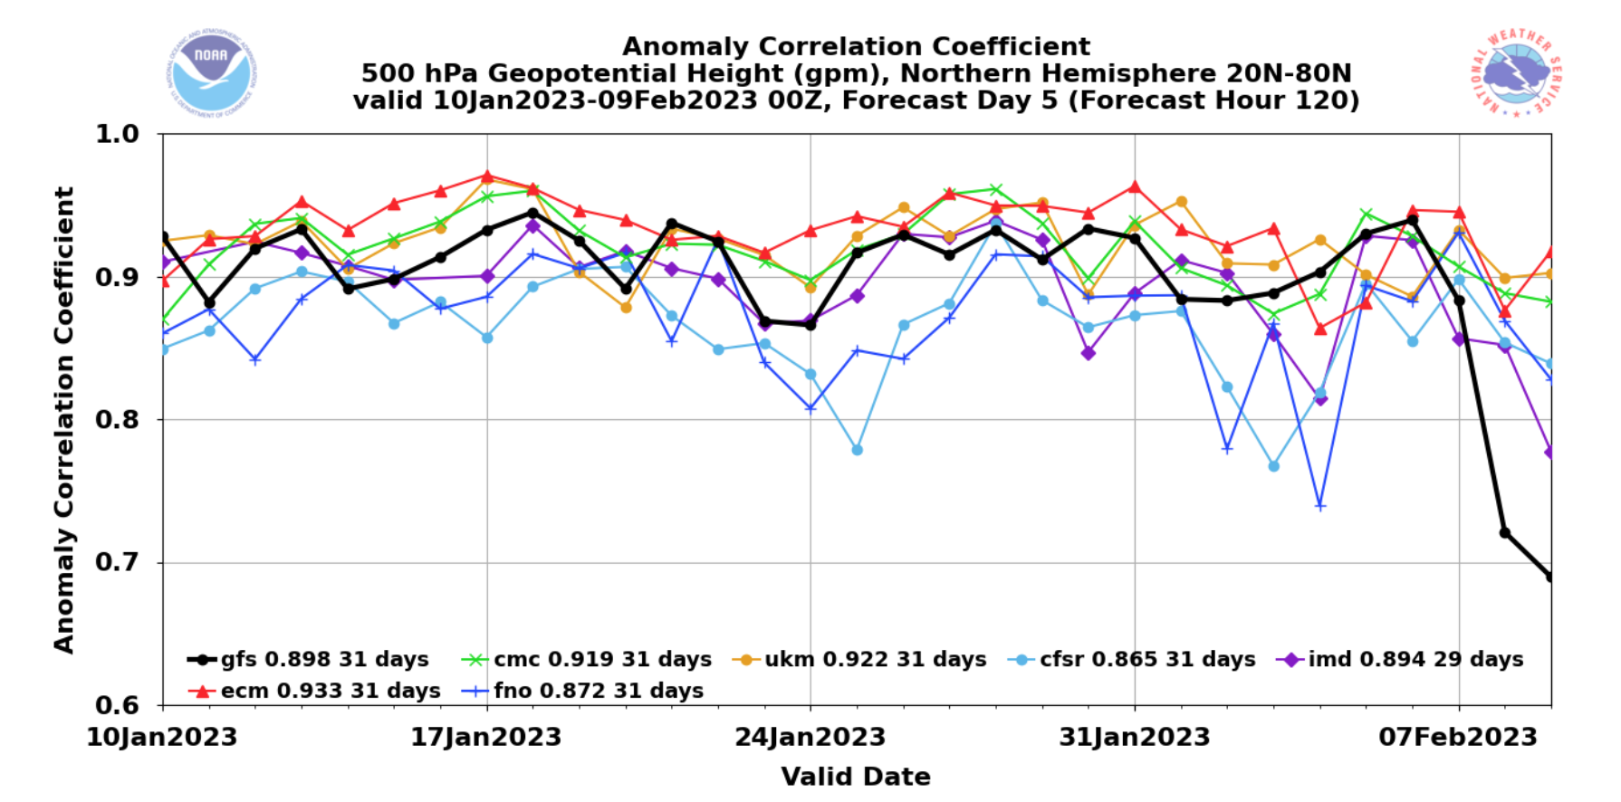

Slide 35
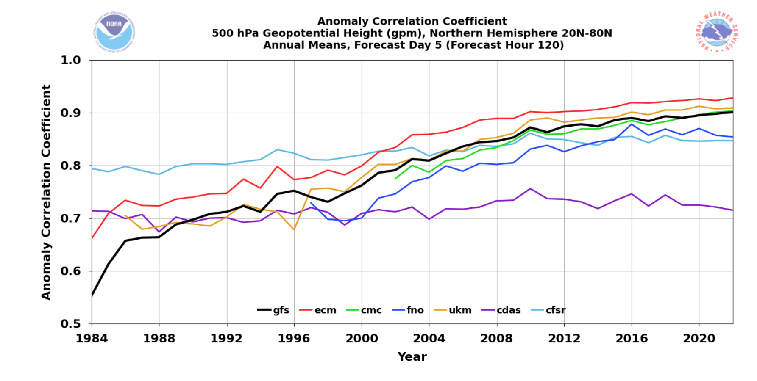

Slide 36
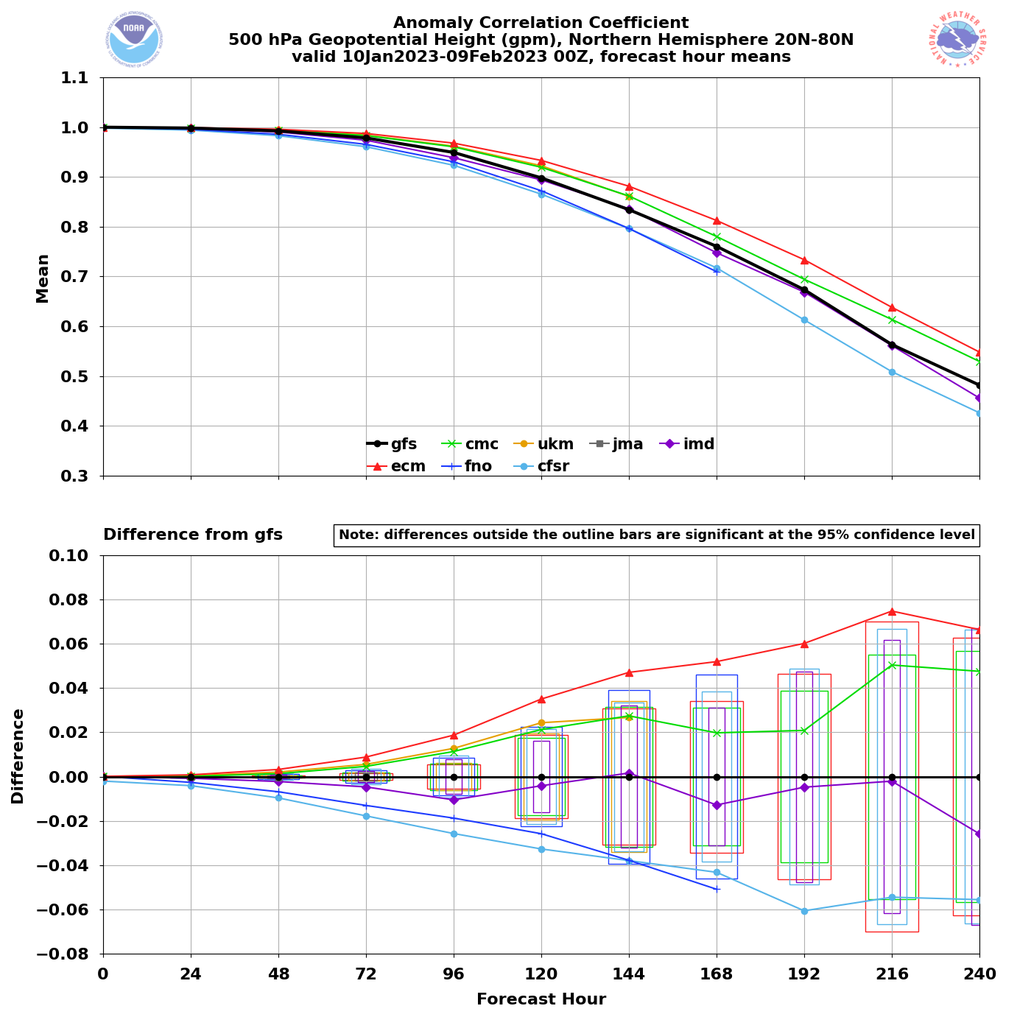
How Quickly Does Forecast Skill Decline with Time?

Slide 37
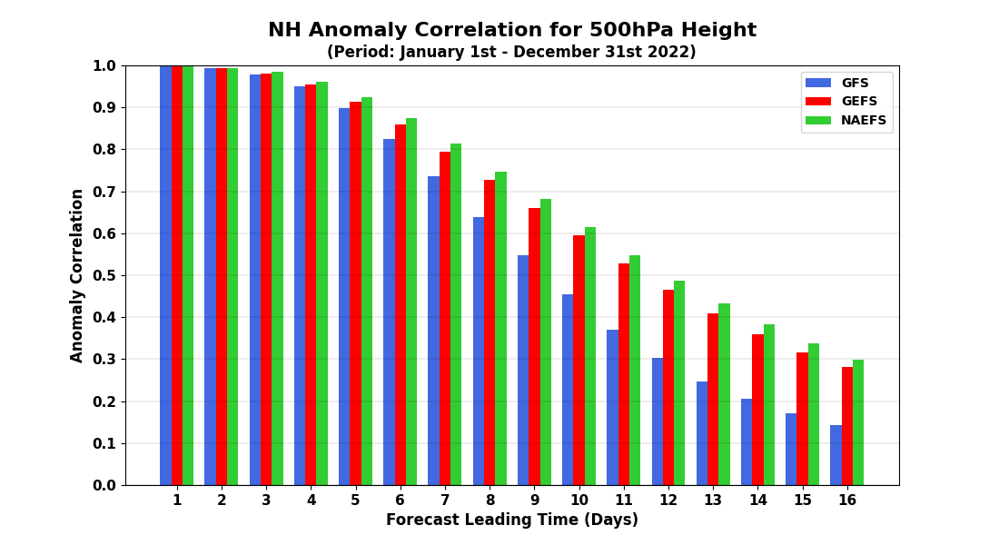

Slide 38
A Palette of Models
Forecasters thus have a palette of model forecasts.
They vary by:
  Region simulated
  Resolution
  Model physics
  Data used in the assimilation/initialization process
The diversity of models can be a very useful tool to a forecaster. Also helps deal with uncertainty.

Slide 39
Post-Processing of Model Forecasts
Numerical model output sometimes often systematic biases (e.g., too warm or too cold in certain situations). Why not correct such biases?
Numerical models may lack the resolution or physics to deal with certain problems (e.g., low level fog in a valley). Some information on local effects be derived from historical model performance.
The solution: statistical post-processing of model forecasts.

Slide 40
Model Output Statistics (MOS)
In the 1960s and 1970s, the NWS developed and began using statistical post-processing of model output…known as Model Output Statistics…MOS
Based on linear regression: Y=a₀ + a₁X₁ + a₂X₂+ a₃X₃ + …
Y is the thing you want to predict. X is model output used to predict Y.
One “trains” the equation using historical model performance.

Slide 41
Day 2 (30-h) GFS MOS Max Temp Equation for KSLC
(Cool Season – 0000 UTC cycle)
N | Predictor (X_{N}) | Coeff. (a_{N})
0 |  | -467.7800
1 | 2-m Temperature (21-h proj.) | 1.7873
2 | 2-m Dewpoint (21-h proj.) | 0.1442
3 | 2-m Dewpoint (12-h proj.) | -0.2060
4 | 2-m Dewpoint (27-h proj.) | 0.1252
5 | Observed Temperature (03Z) | 0.0354
6 | 850-mb Vertical Velocity (21-h proj.) | 19.5759
7 | 925-mb Wind Speed (15-h proj.) | 0.6024
8 | Sine Day of Year | 1.7111
9 | 700-mb Wind Speed (15-h proj.) | 0.2701
10 | Sine 2*DOY | 1.5110

Slide 42
MOS is available for many parameters and greatly improves the quality of many model predictions.

Slide 43
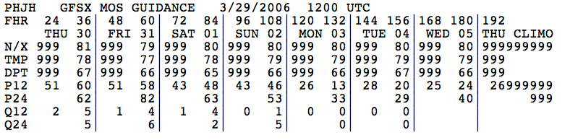
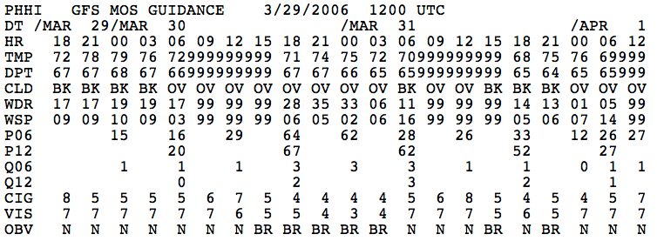

Slide 44

More Post-Processing
There are other types of post-processing.
The National Weather Service has been moving to the National Blend of Models, which statistically combines the forecasts of many models.
Machine learning is becoming increasingly popular

Slide 45
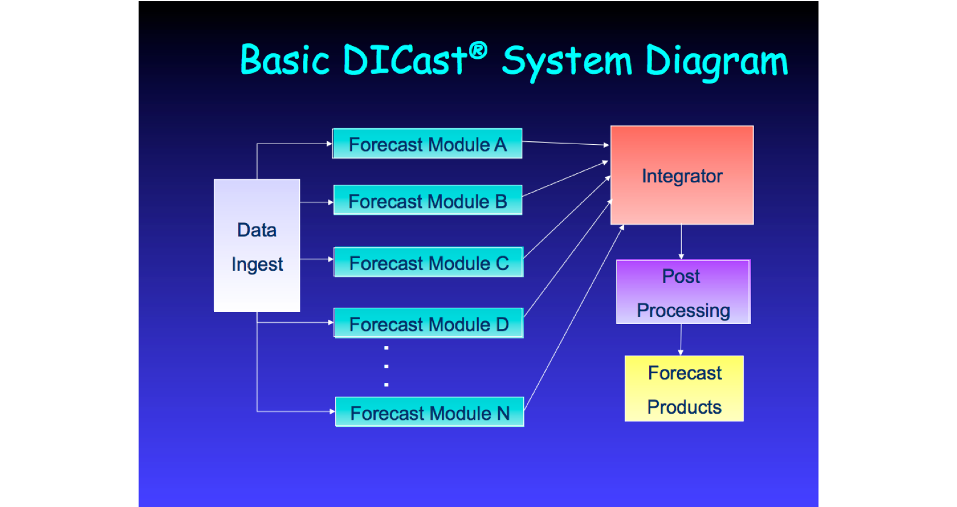
The Private Sector Is the Leader in Statistical Post-Processing
Examples: weather.com, accuweather, weatherunderground
Weather.com uses the Dicast System

Slide 46
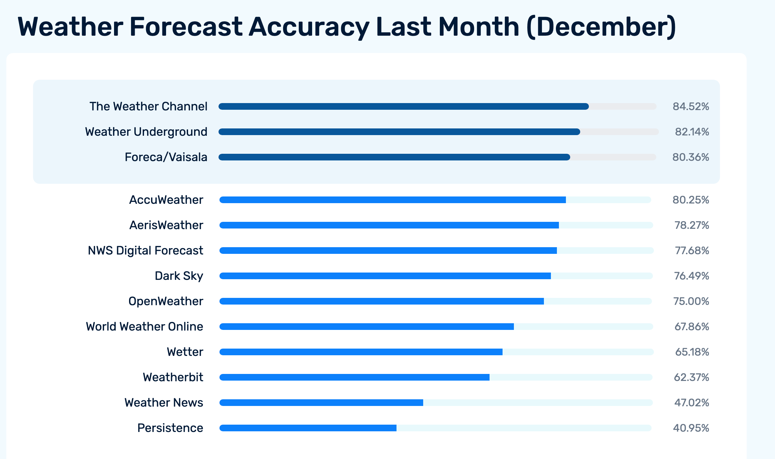

Slide 47
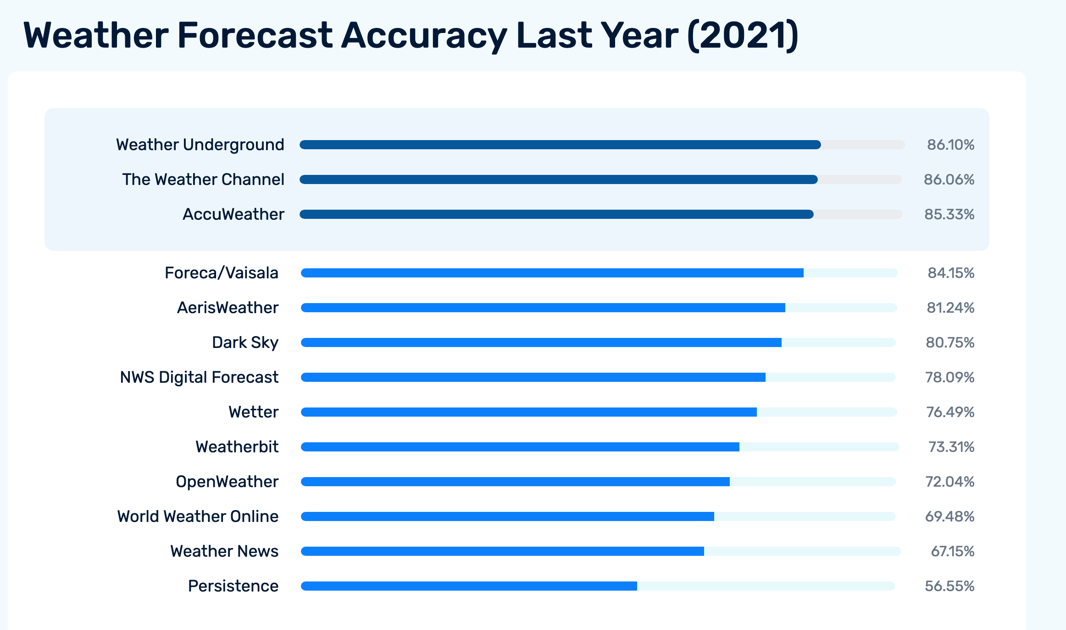

Slide 48
Ensemble Forecasting
All of the model forecasts I have talked about reflect a deterministic approach.
This means that we do the best job we can for a single forecast and do not consider uncertainties in the model, initial conditions, or the very nature of the atmosphere.
Traditionally, deterministic prediction has been the way forecasting was done, but this is changing.

Slide 49

A More Fundamental Issue
The atmosphere is a chaotic system, in which small differences in the initialization…well within observational error… can have large impacts on the forecasts, particularly for longer forecasts.
Similarly, uncertainty in model physics can result in large forecast differences and errors.
Often referred to as the “butterfly effect”

Slide 50

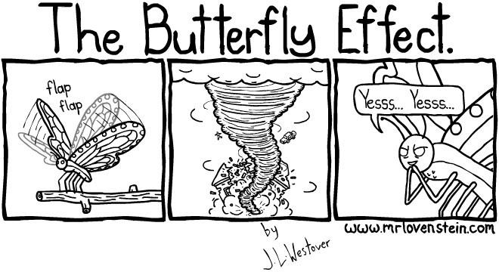

Slide 51

A Fundamental Problem
All forecasts have some uncertainty.
The uncertainty generally increases in time.
Thus, we should be providing forecast probabilities and forecast ranges and not single forecast values.

Slide 52
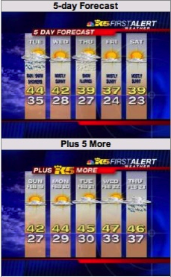
This is Ridiculous!

Slide 53
Forecast Probabilistically Using Ensembles
There is an approach to handling this issue that is being used by the forecasting community…ensemble forecasts
Instead of making one forecast…make many…each with a slightly different initialization or different model physics.
Possible to do this now with the vastly greater computation resources that are available.

Slide 54
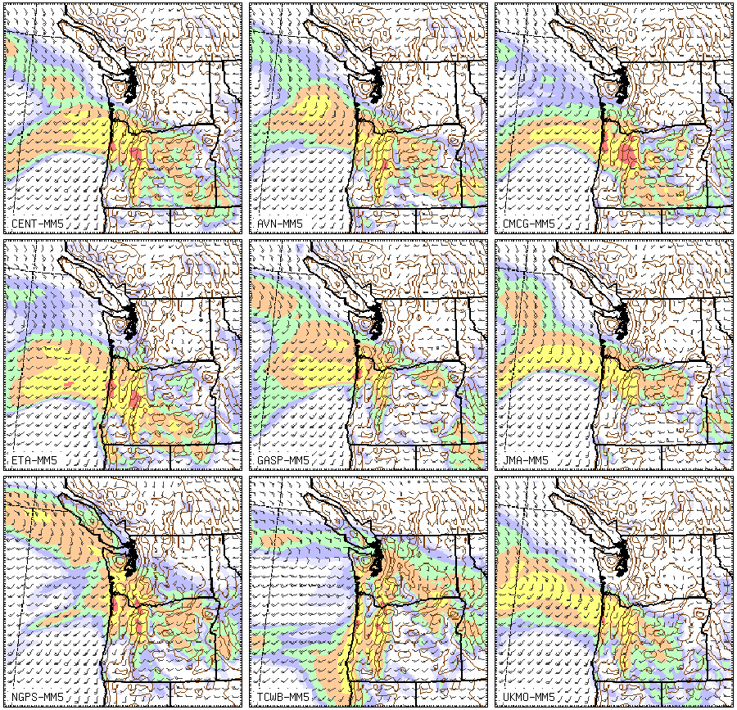

Slide 55
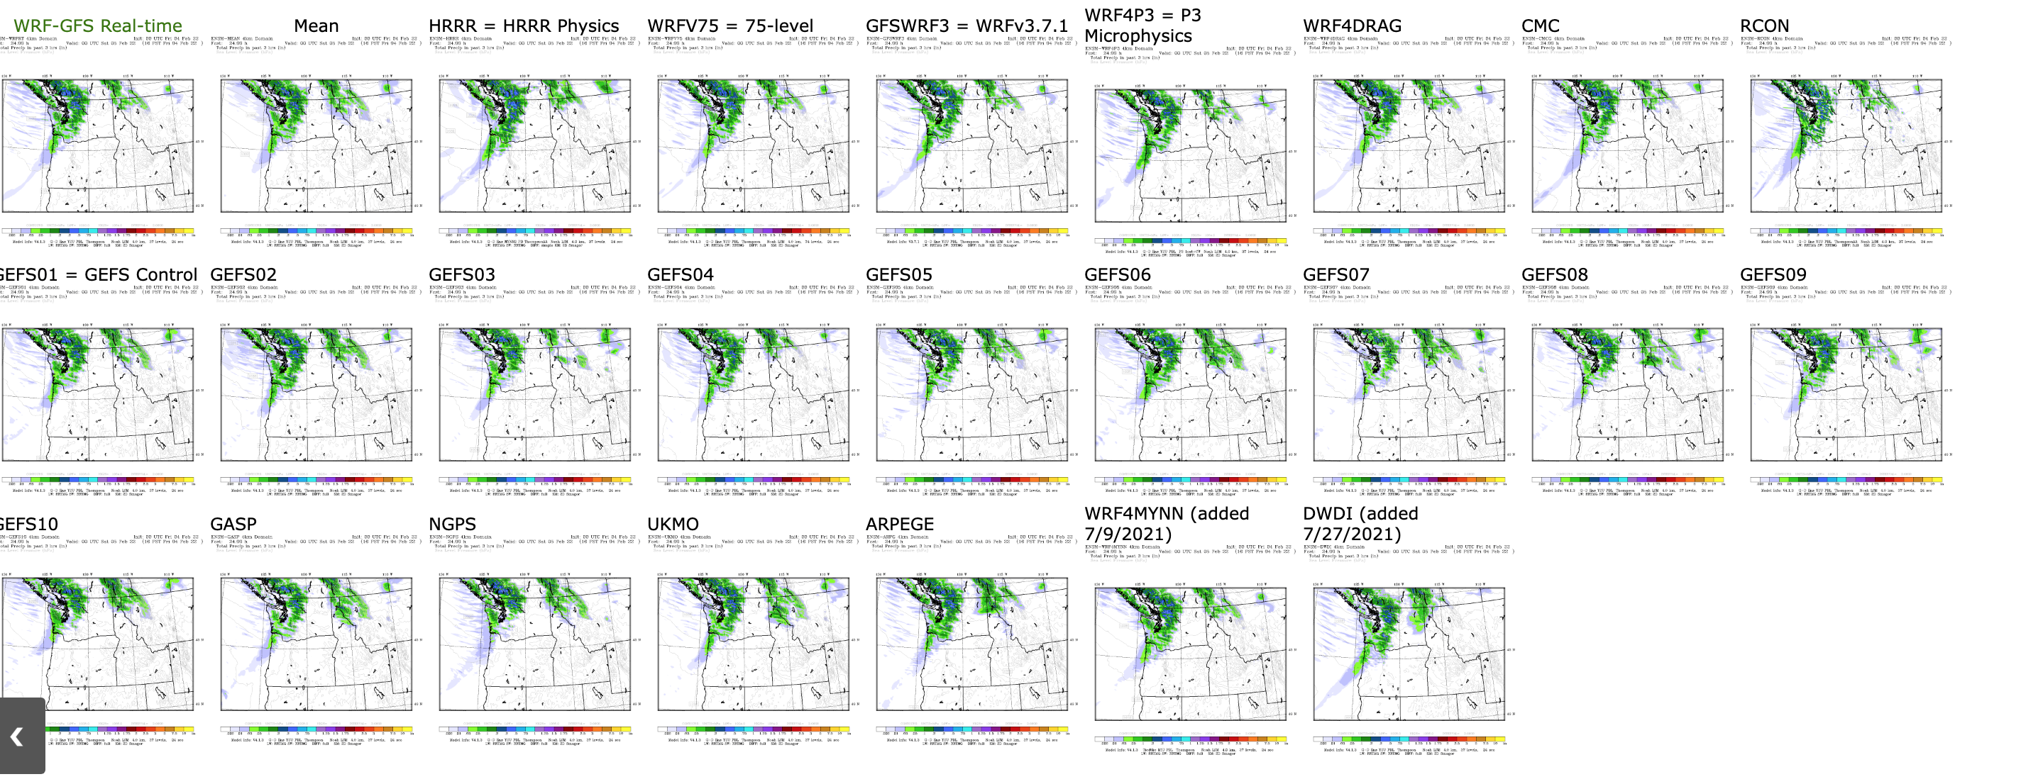

Slide 56
A
12h
forecast
24h
forecast
Forecast
e
36h
forecast
a
c
u
j
n
T
Analysis Region
g
t
M
Analysis/
Initialization
T
48h forecast Region

Slide 57

Ensemble Prediction
Ensembles can provide the probabilities that some weather feature will occur.
The ensemble mean is more accurate than any individual member.
Can also predict forecast skill!
  When forecasts are similar, forecast skill is generally higher.
  When forecasts differ greatly, forecast skill is less.

Slide 58
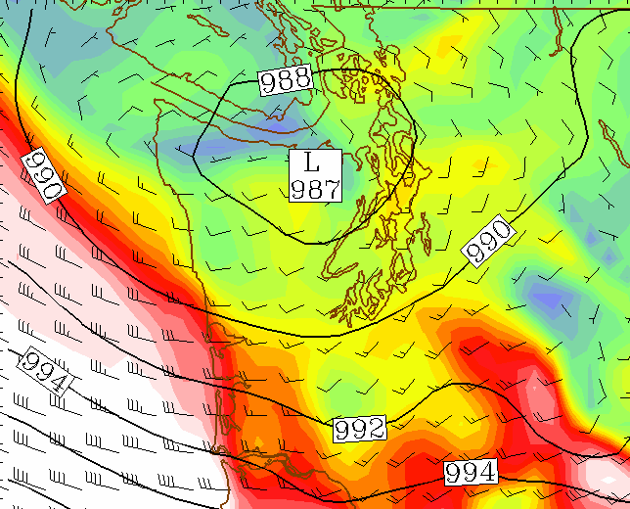
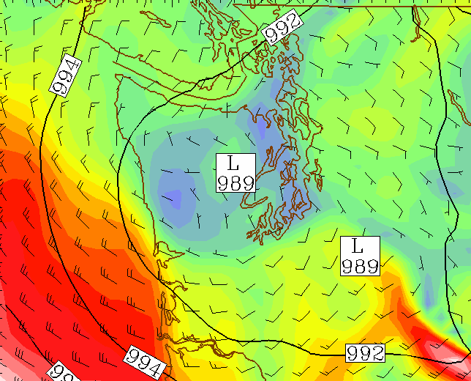
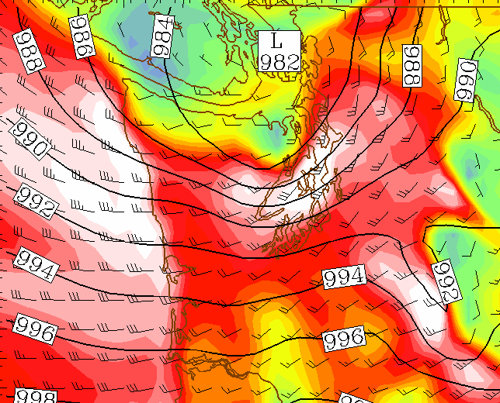
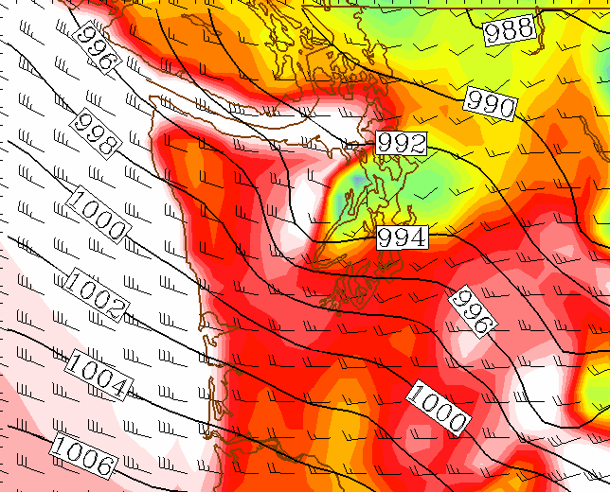
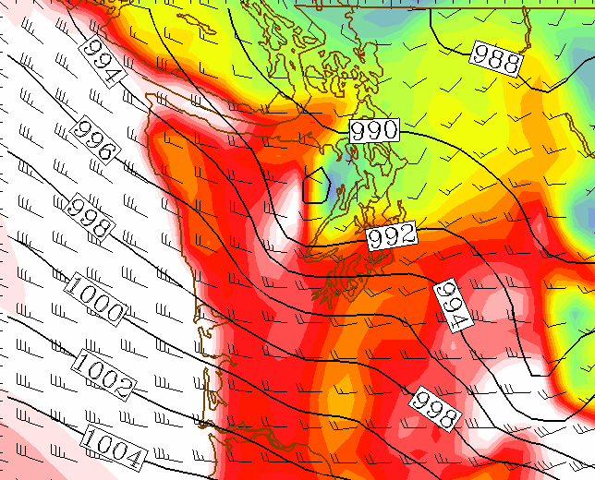
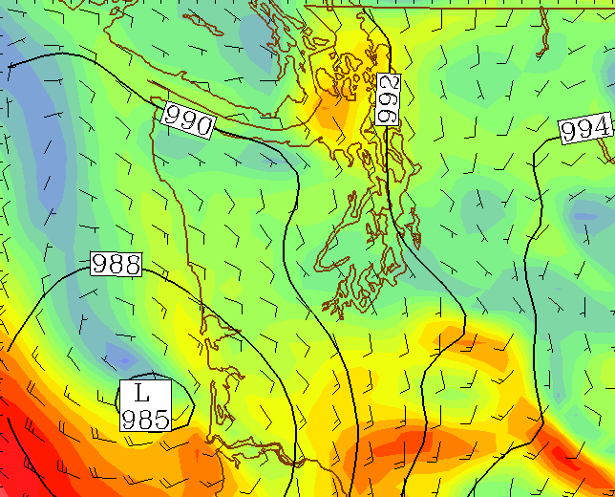
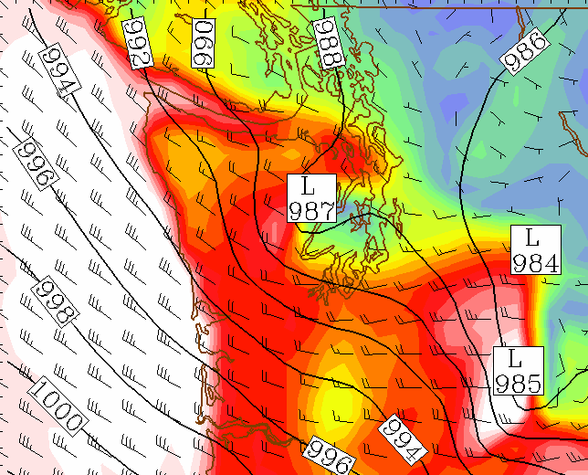
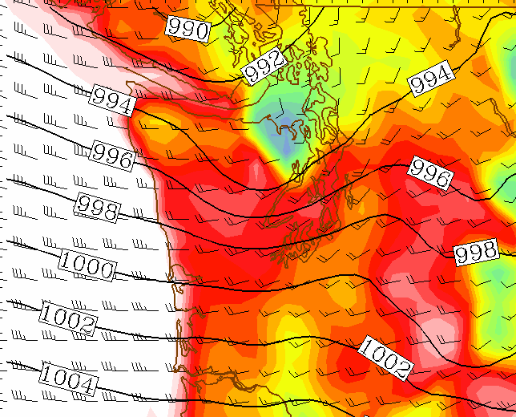
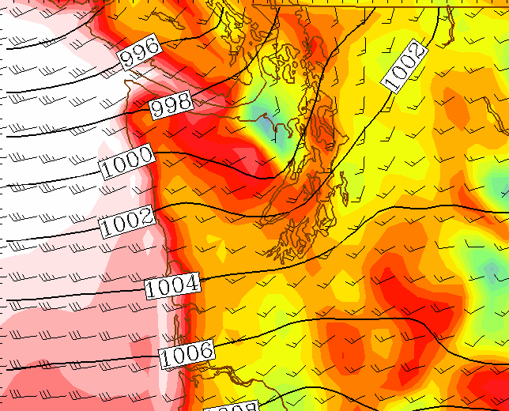
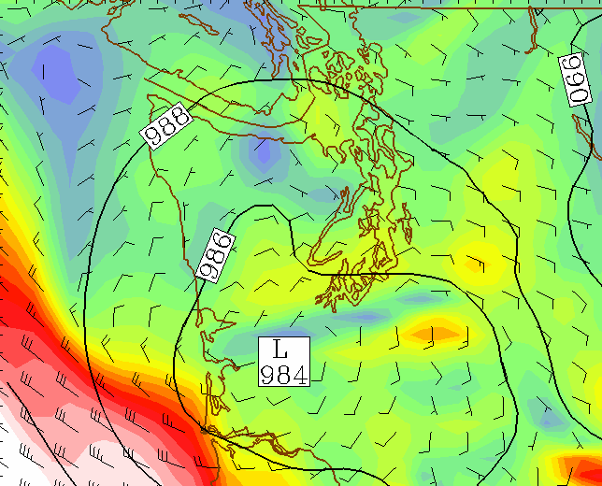
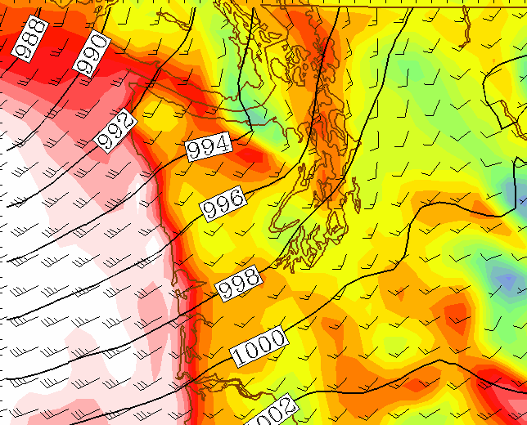
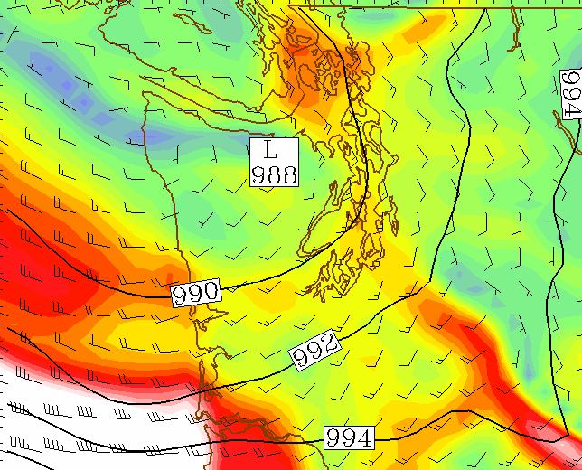
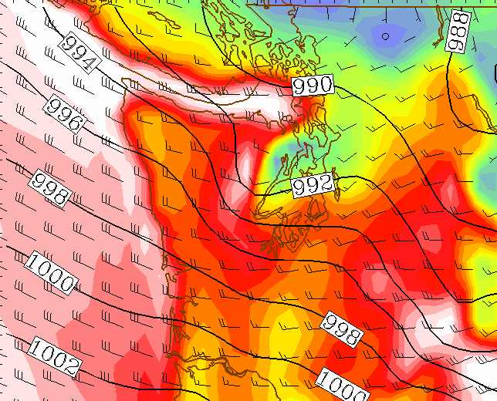
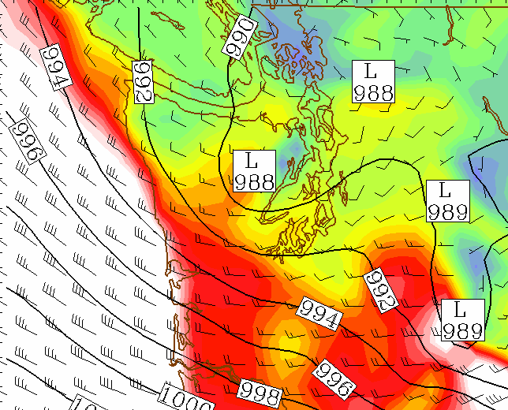
The Thanksgiving Forecast 2001
42h forecast (valid Thu 10AM)
Verification
SLP and winds
Reveals high uncertainty in storm track and intensity
Indicates low probability of Puget Sound wind event
1: cent
2: eta
5: ngps
8: eta*
11: ngps*
3: ukmo
6: cmcg
9: ukmo*
12: cmcg*
4: tcwb
7: avn
10: tcwb*
13: avn*

Slide 59
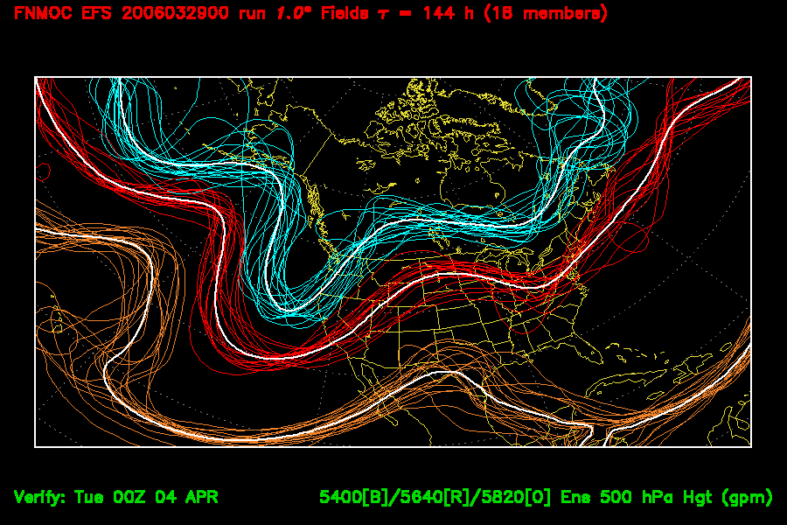
Spaghetti Diagram

Slide 60
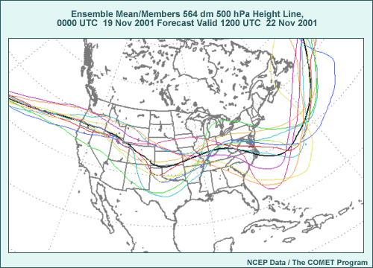
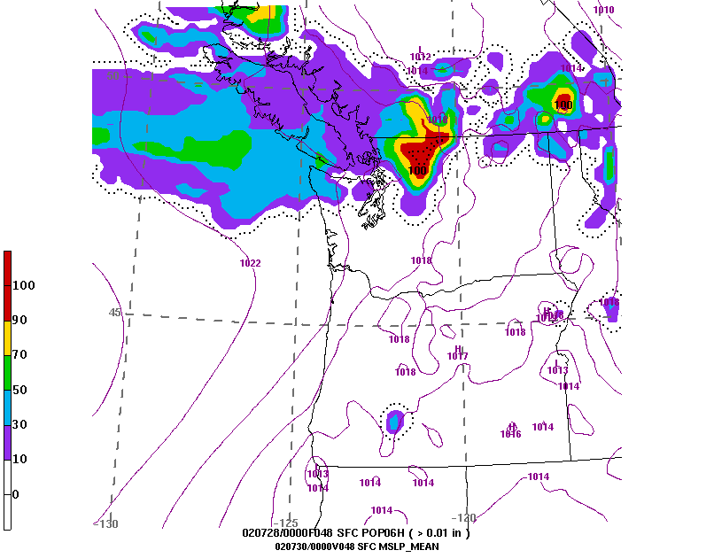
Ensembles can
Produce Probability
Maps

Slide 61
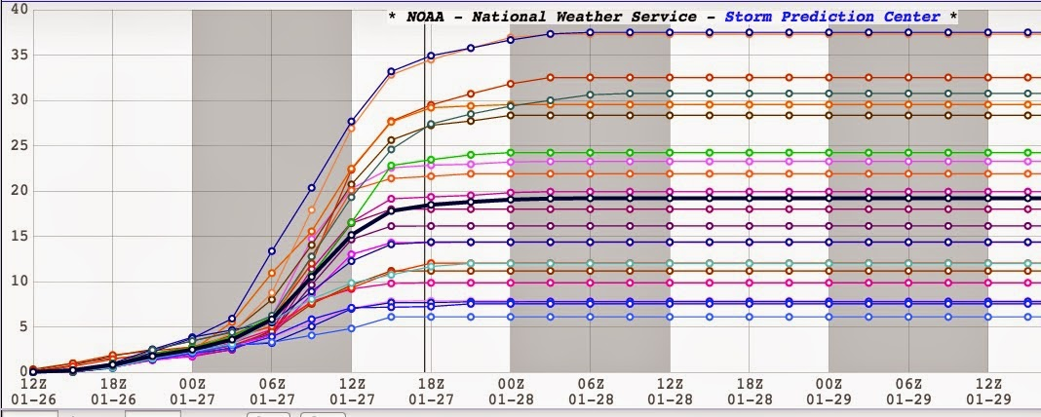
Ensemble Plume Diagrams

Slide 62


Slide 63

Box and Whisker Plot

Slide 64


Slide 65
Major U.S. Ensemble Systems
NOAA/NWS GFS ensemble (GEFS), 20 members, 25 km resolution. Underdispersive
NOAA/NWS SREF (Short-Range Ensemble Forecast System). 26 members, 18 km. WRF and NMM members
NAEFS: North American Ensemble Forecasting System (GEFS plus CMC ensemble), Global

Slide 66

Small Experimental Ensemble System at Higher Resolution (about 4 km)
HREF

Slide 67
Forecasting Tips
Know the climatology of the site you are forecasts
Look at several models, giving weight to those that have verified the best.
Look at statistical post-processing forecasts as well
Use ensembles to secure an idea of uncertainty and probabilities.

