Slide 1
Atmospheric Rivers
ATMS 370

Slide 2
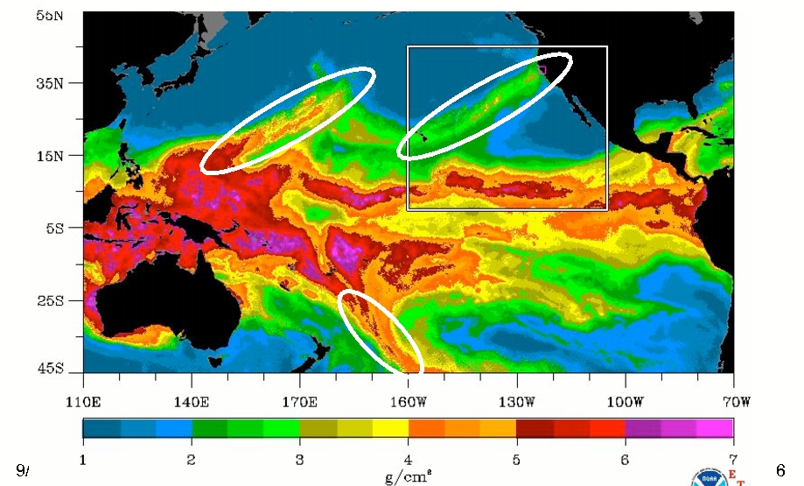
Atmospheric Rivers
A relatively narrow current of warm, moist air from the subtropics or subtropics.
Associated with most of the major flooding events over the W. Coasts of N. and S. America

Slide 3
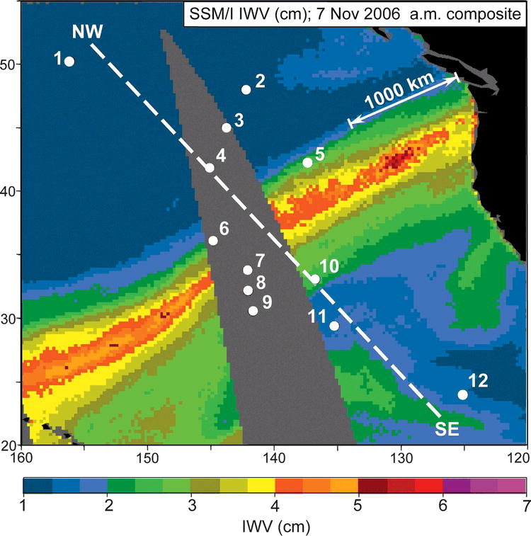
Local Version: The Pineapple Express:
November 6-7, 2006

Slide 4
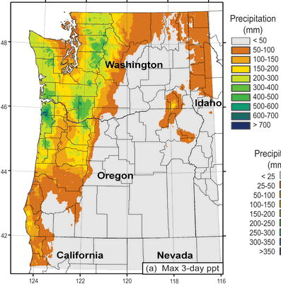
November 6-9,
2006
Dark Green: about 20 inches

Slide 5
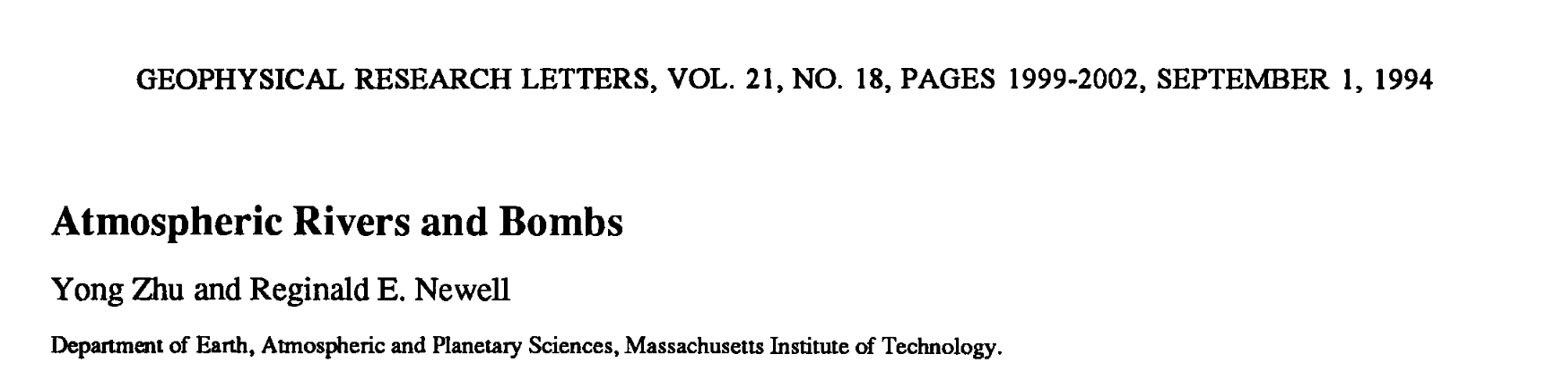
Atmospheric Rivers
In the seminal paper on the topic: Zhu and Newell (1994)
Found that greater than 90% of the hemispherical meridional moisture flux is transported by such features, with 4-5 AR’s evident at any given time.

Slide 6
AR Facts
AR name generally used for moisture plumes with greater than 20 mm (2 cm) of IWV content
Not all ARs bring heavy precipitation (e.g., AR’s during summer).
Why? Lesser winds are a big factor.

Slide 7
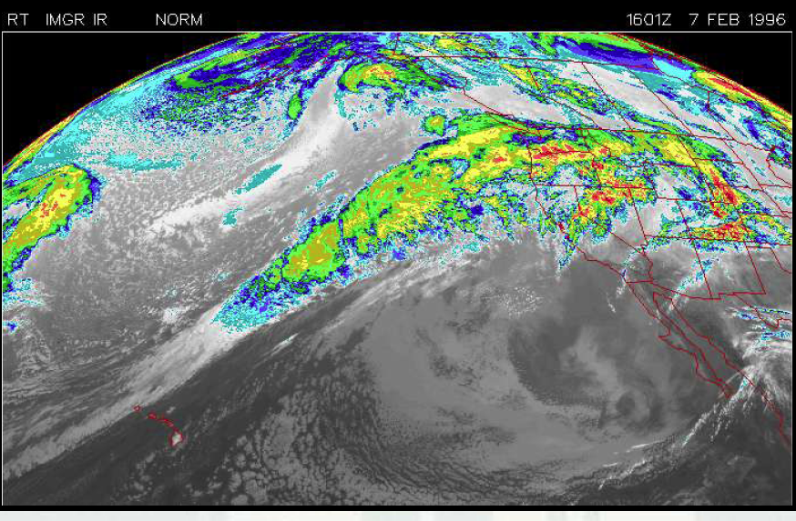
Often apparent in IR Imagery

Slide 8
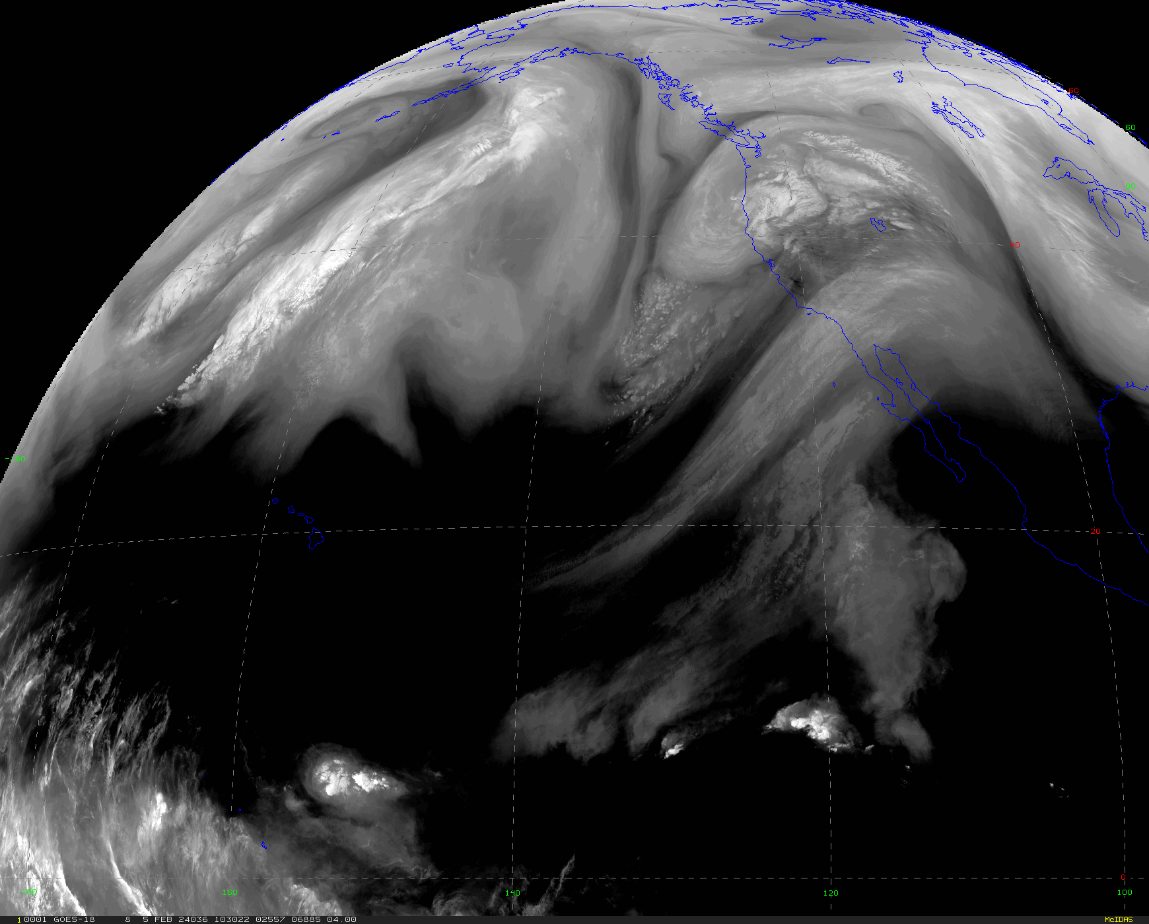
And Water Vapor Imagery

Slide 9
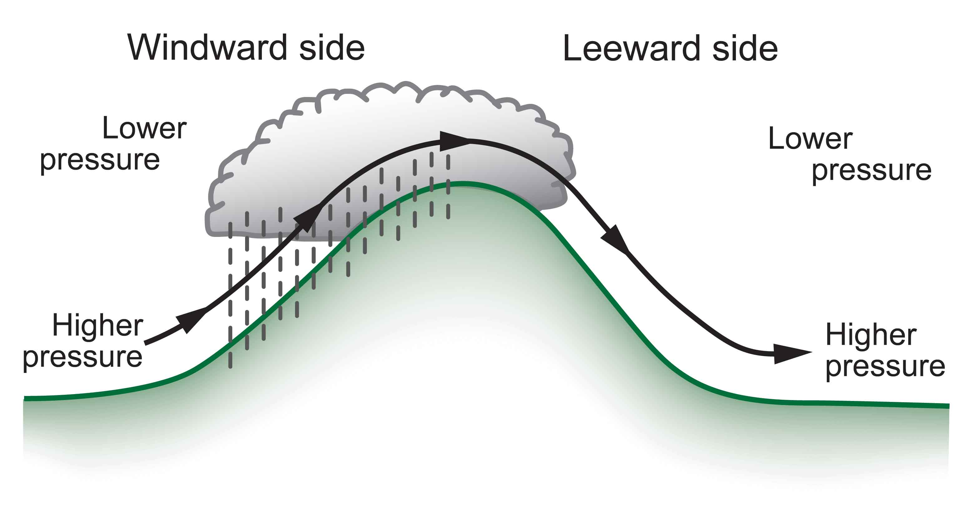
AR Precipitation is Greatly Enhanced by Terrain, Especially on West Sides of Continents

Slide 10
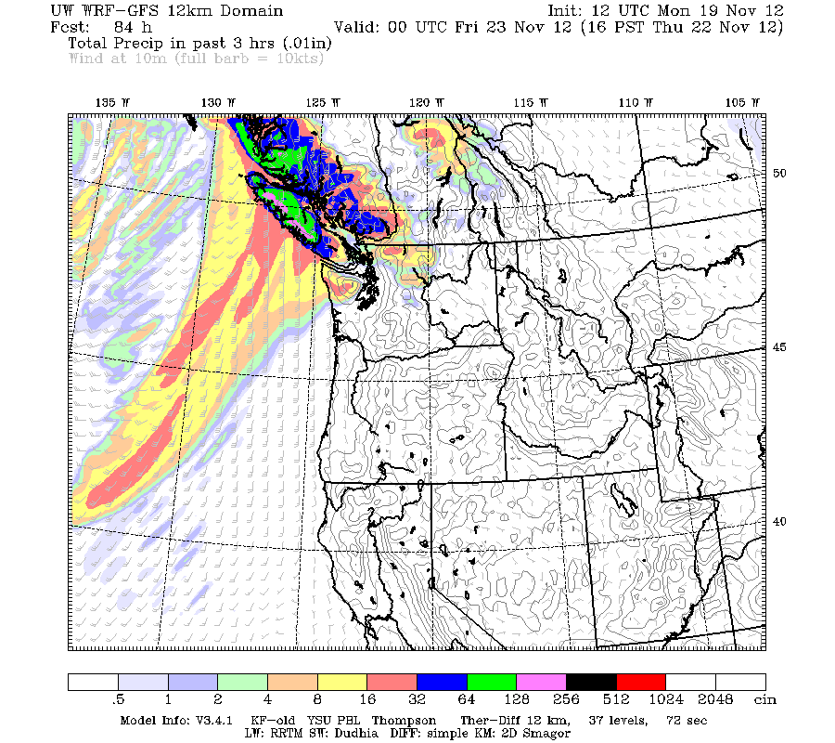

Slide 11
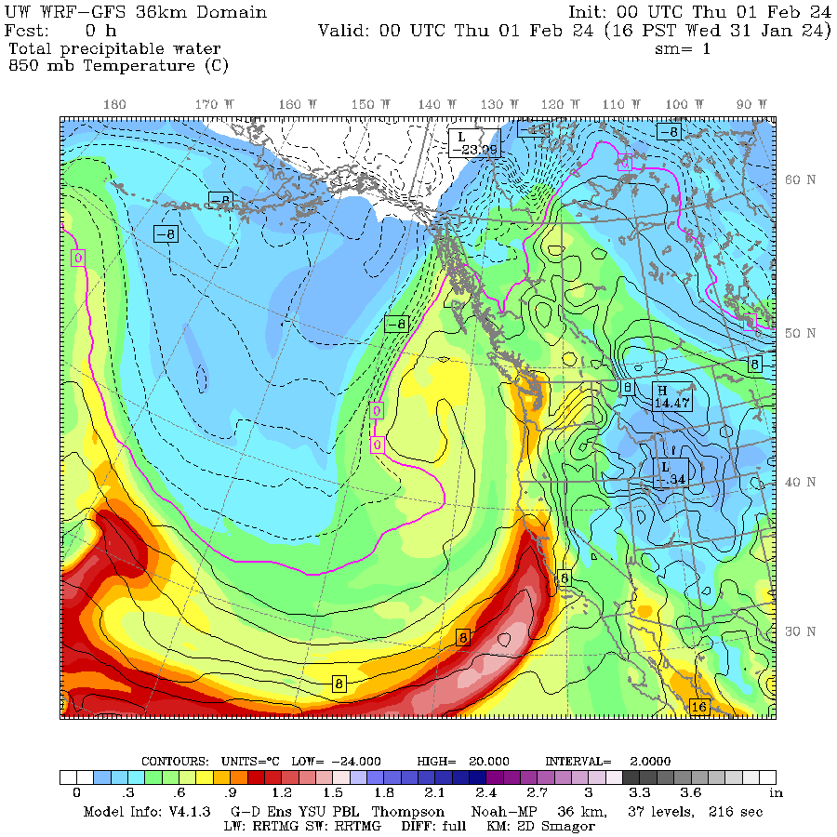
Two measures used to describe AR’s
Vertically integrated water vapor content of precipitable water (IWV)
The amount of liquid water produced by condensing all the water vapor in a vertical column of air.
Also called precipitable water

Slide 12
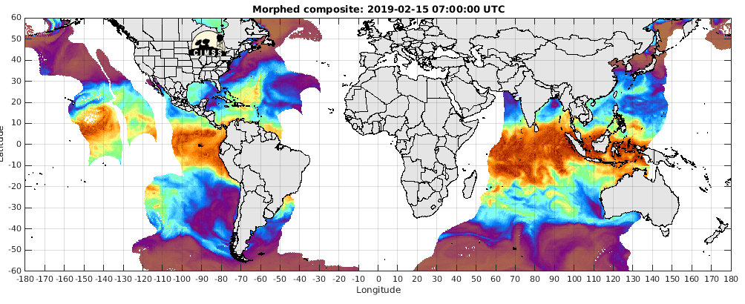
IWV Content. Large values in warm tropics

Slide 13
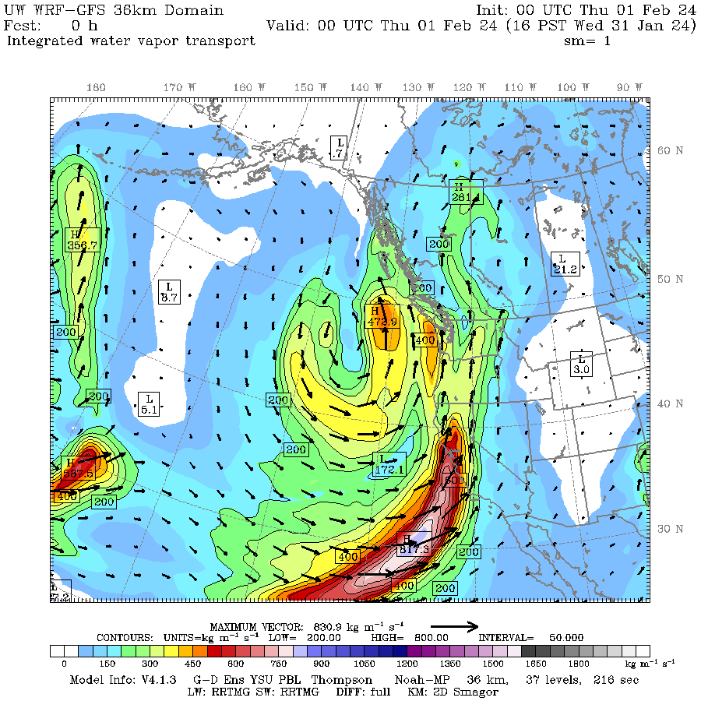
Integrated Water Vapor Transport (IVT) wind*water vapor content
Also called integrated water vapor flux

Slide 14
Integrated Water Vapor Transport (IVT)
More closely associated with precipitation

Slide 15
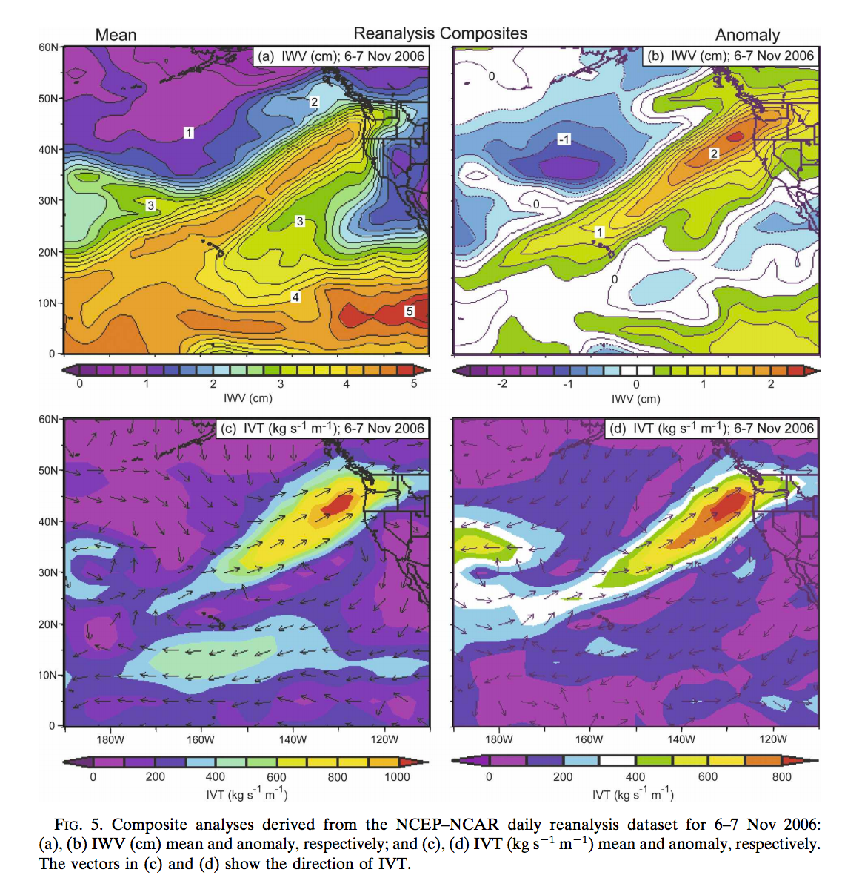

Slide 16
Most of the action is in the lower troposphere (below 700 hPa)
The bulk of the water vapor transport is BELOW 700 hPa.
A strong AR transports an amount of water vapor roughly equivalent to 10-20 times the average flow of liquid water at the mouth of the Mississippi River.

Slide 17
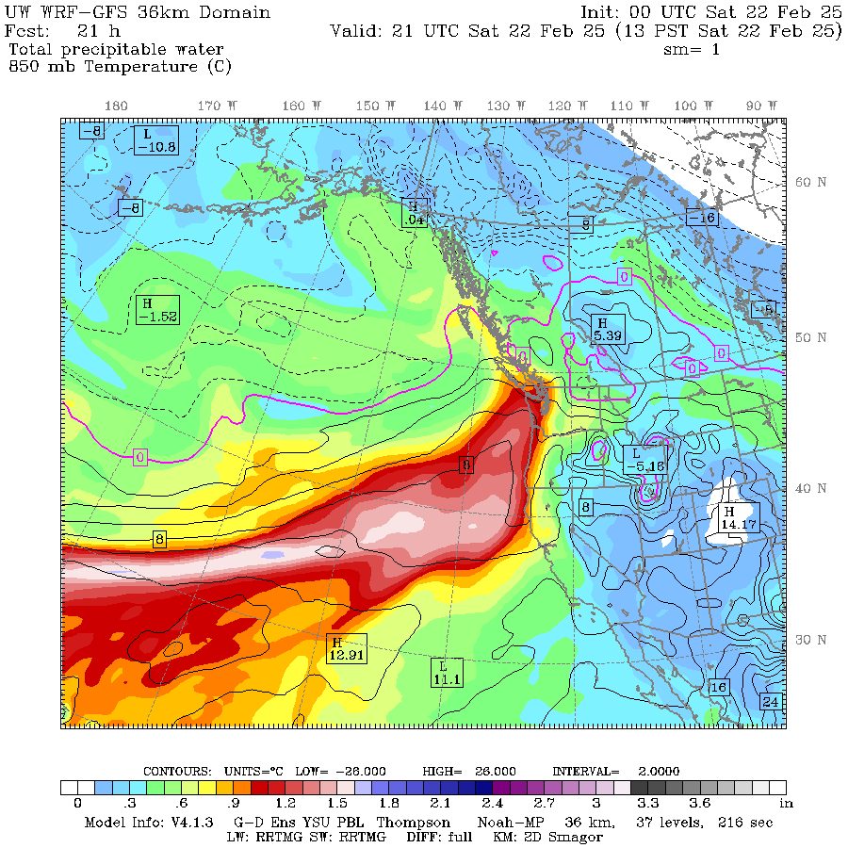

Slide 18
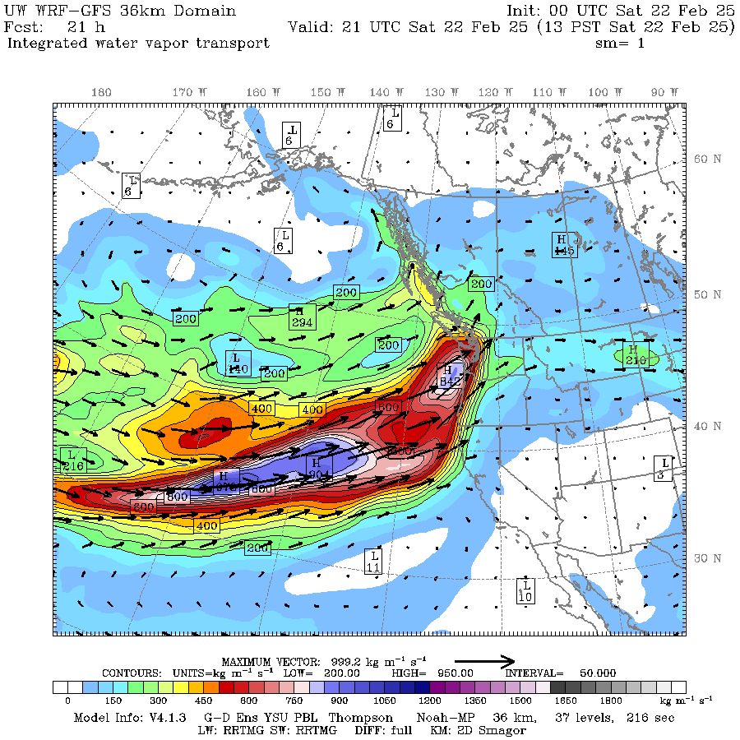

Slide 19
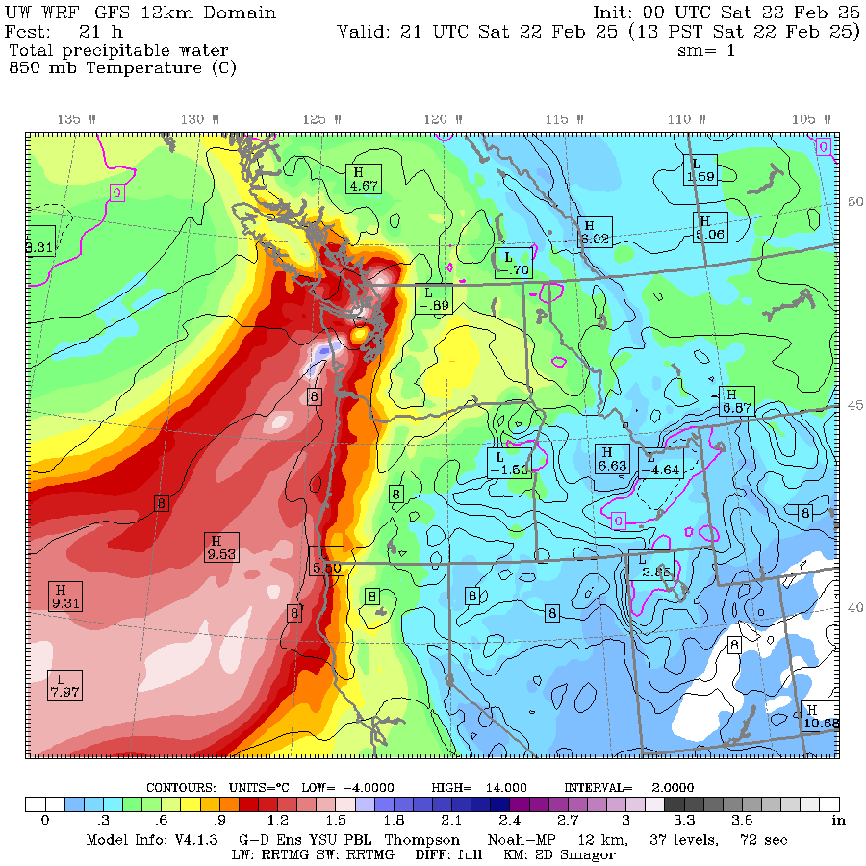
Why Does the AR End?
?

Slide 20
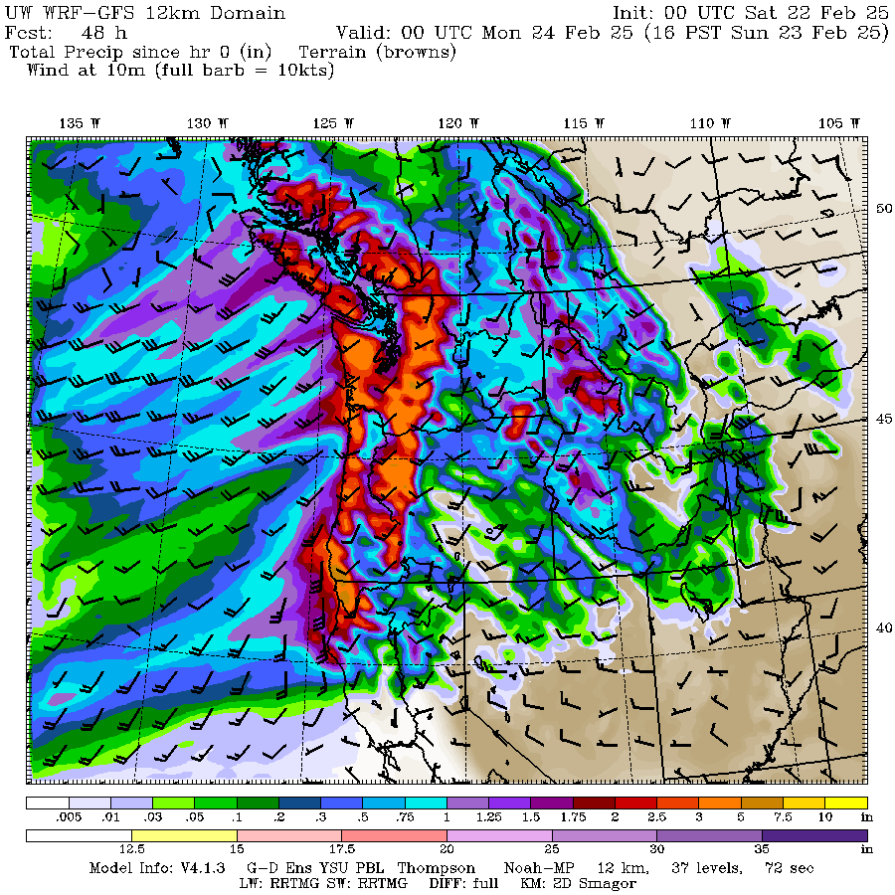

Slide 21
Satellite Sensors Can Describe the Global Distribution of Water Vapor

Slide 22
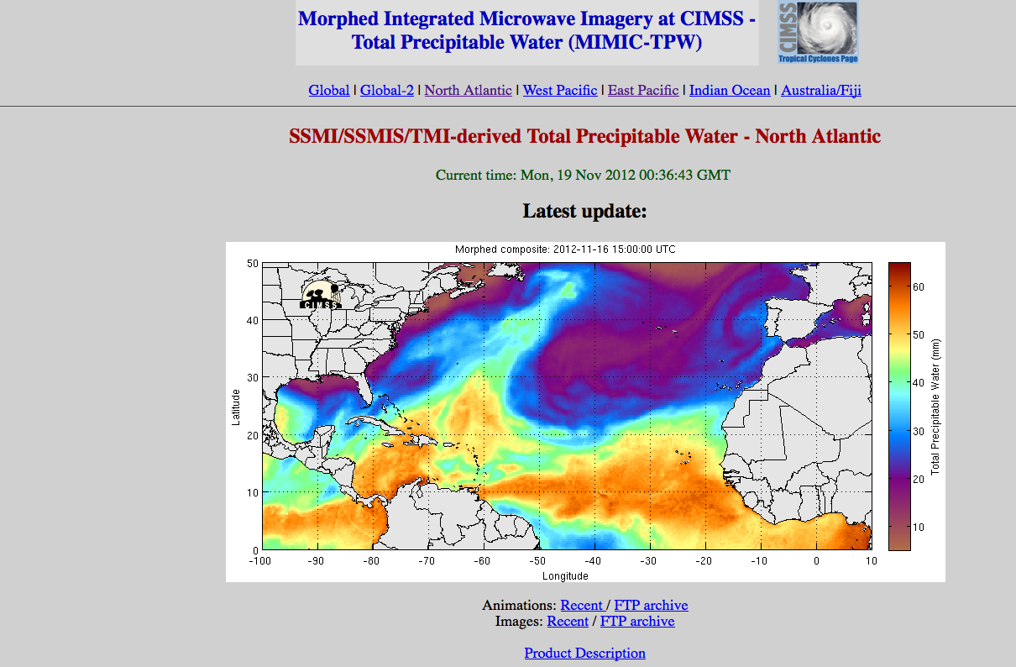
Evident in Vertically Integrated Water Vapor (IWV)-Precipitable Water Content from Satellite (Generally Microwave) Sensors
http://tropic.ssec.wisc.edu/real-time/mimic-tpw/natl/main.html

Slide 23
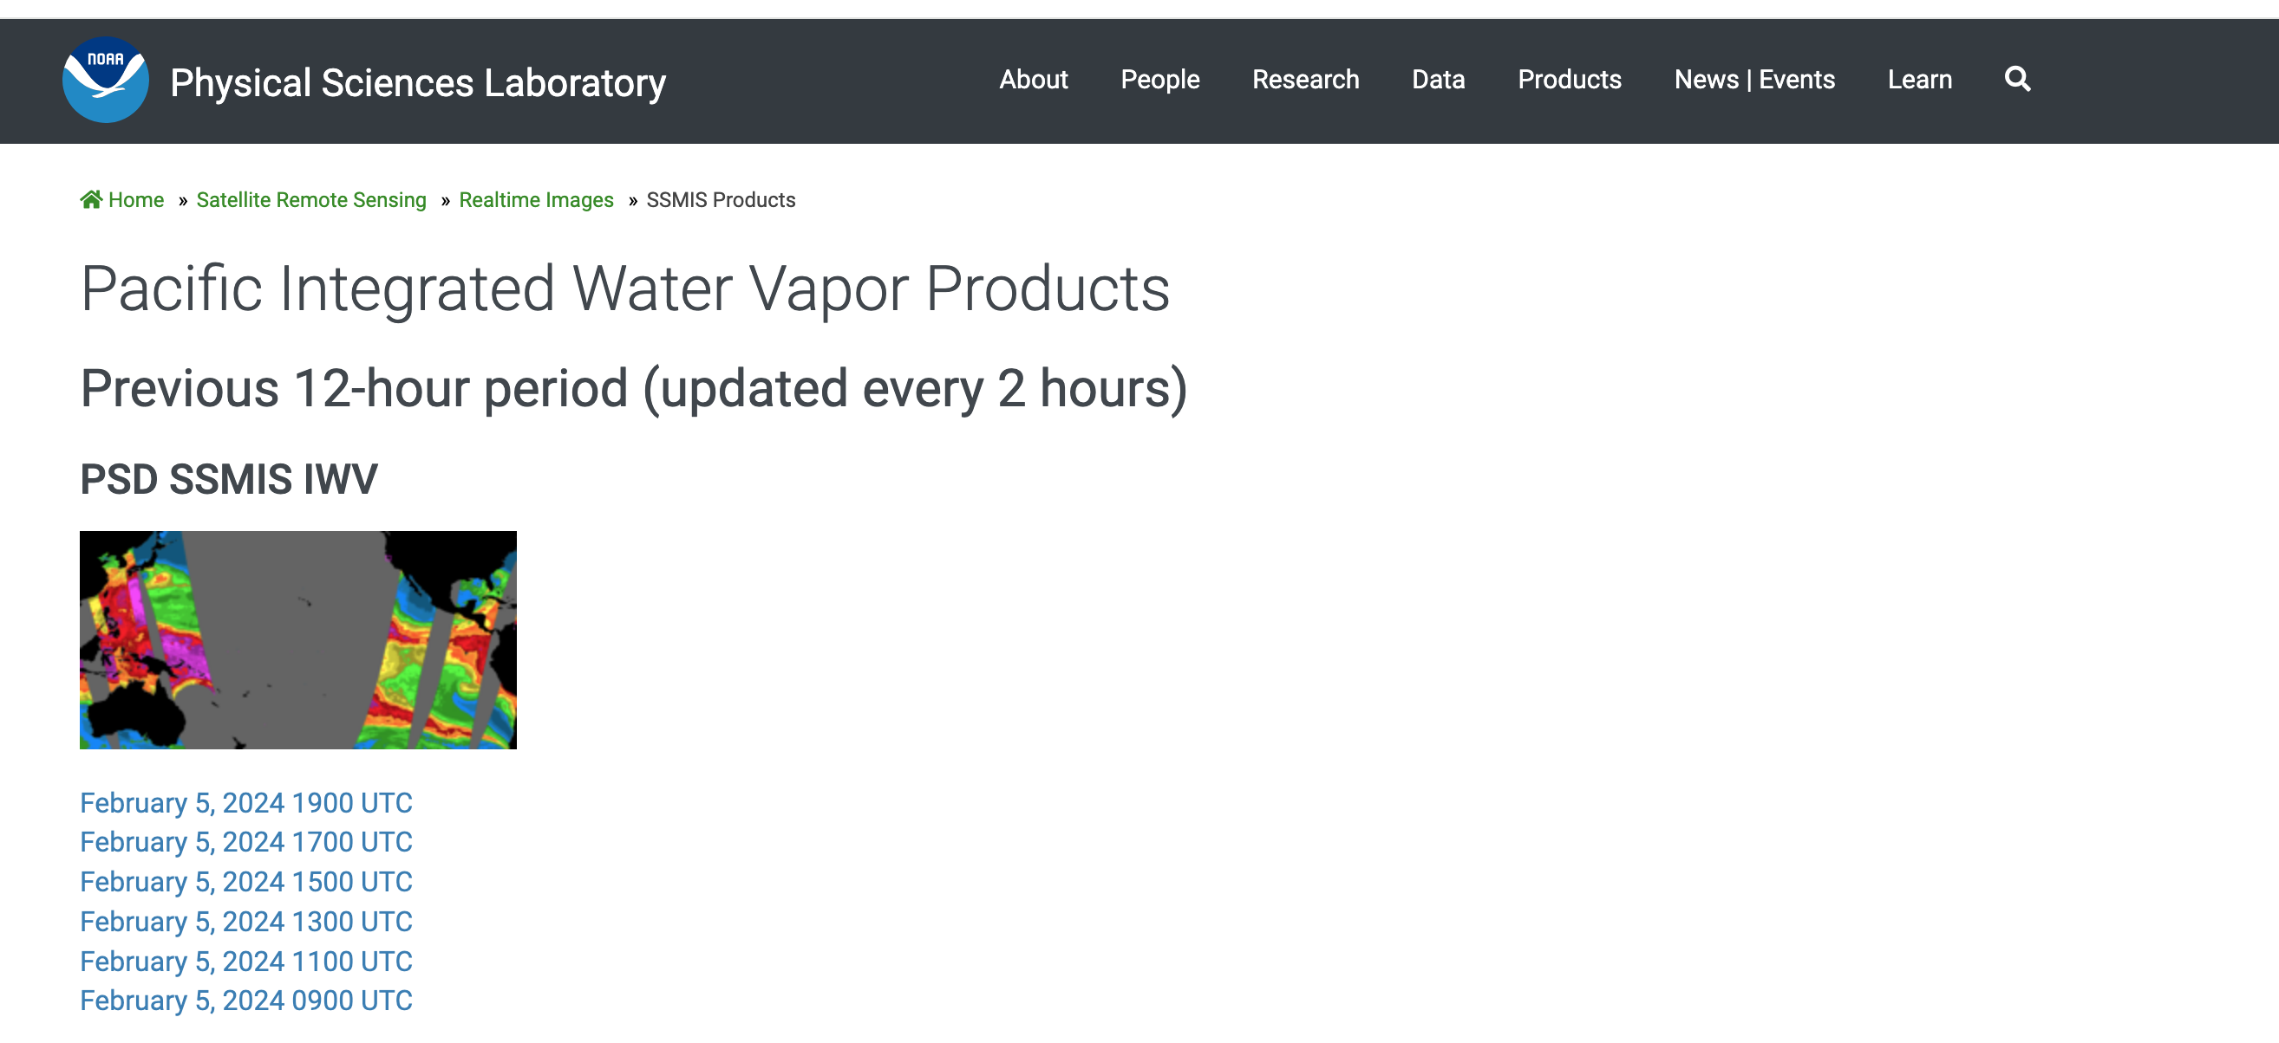
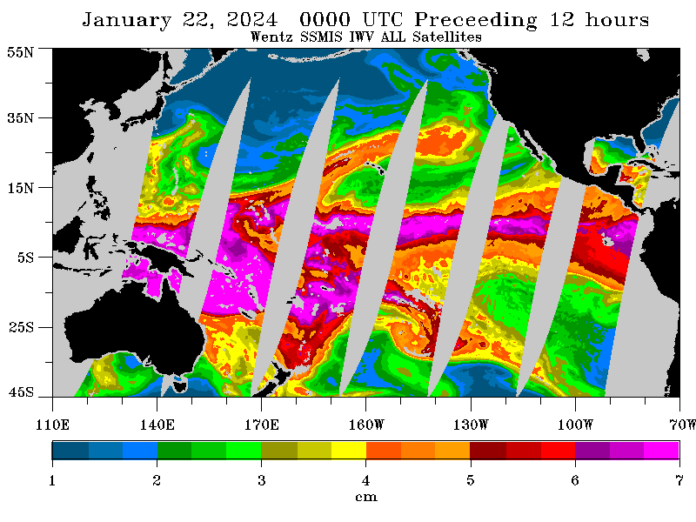

Slide 24
Typical Synoptic Structure That Produces Atmospheric Rivers

Slide 25
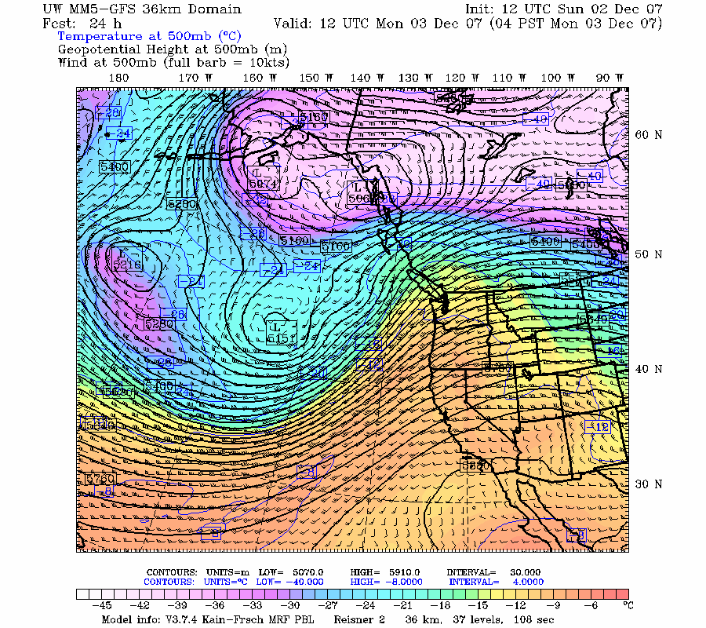
Typical Upper Level Set Up
LOW
High

Slide 26
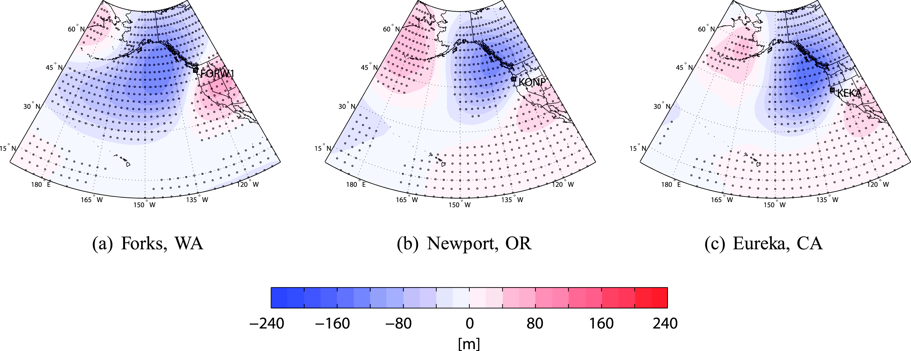
500 hPa Average Anomalies for an AR

Slide 27
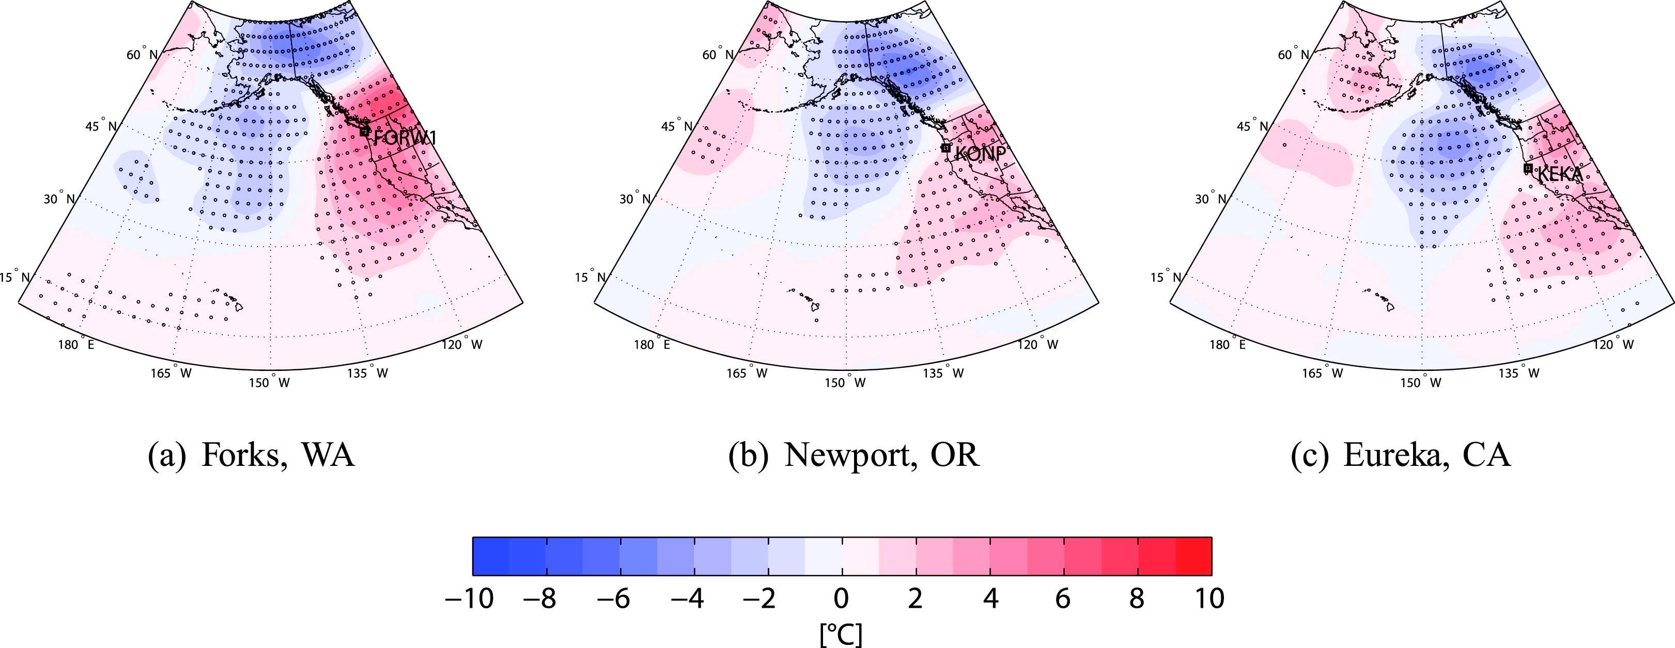
850 hPa Temp Anomalies

Slide 28
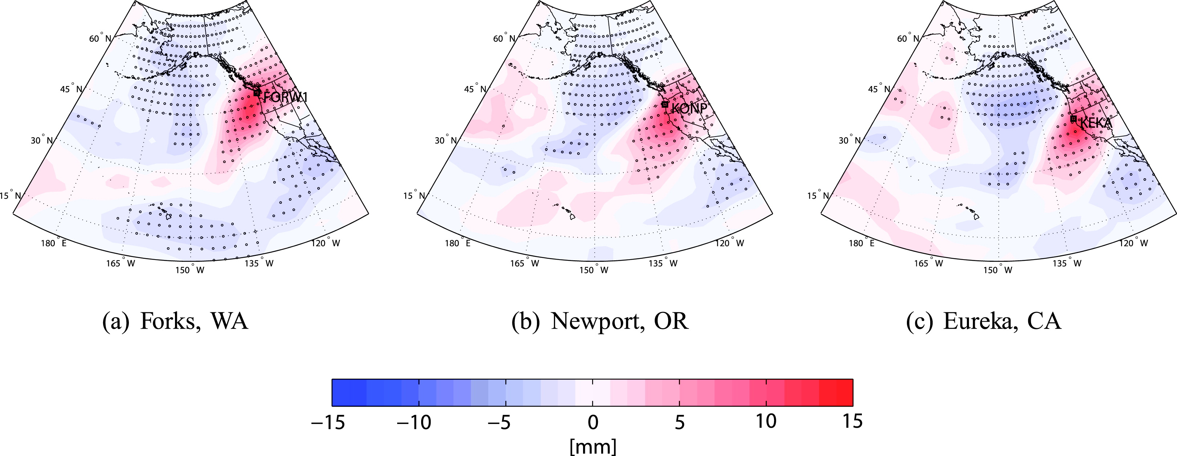
Integrated Water Vapor

Slide 29
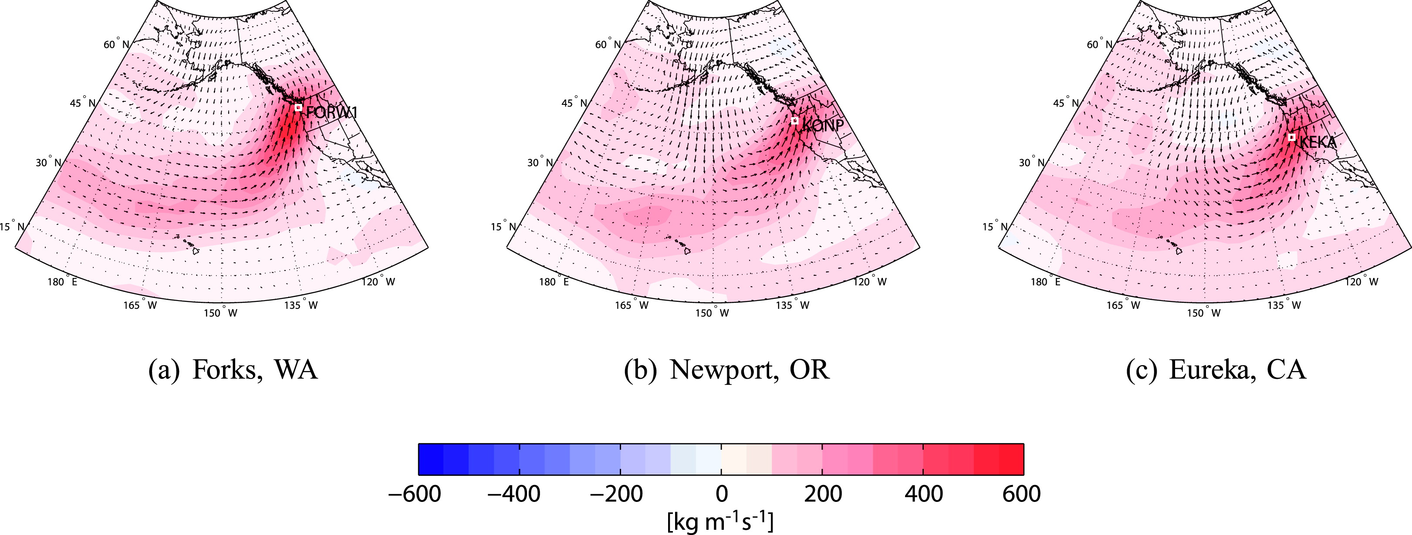
Integrated Water Vapor Flux

Slide 30
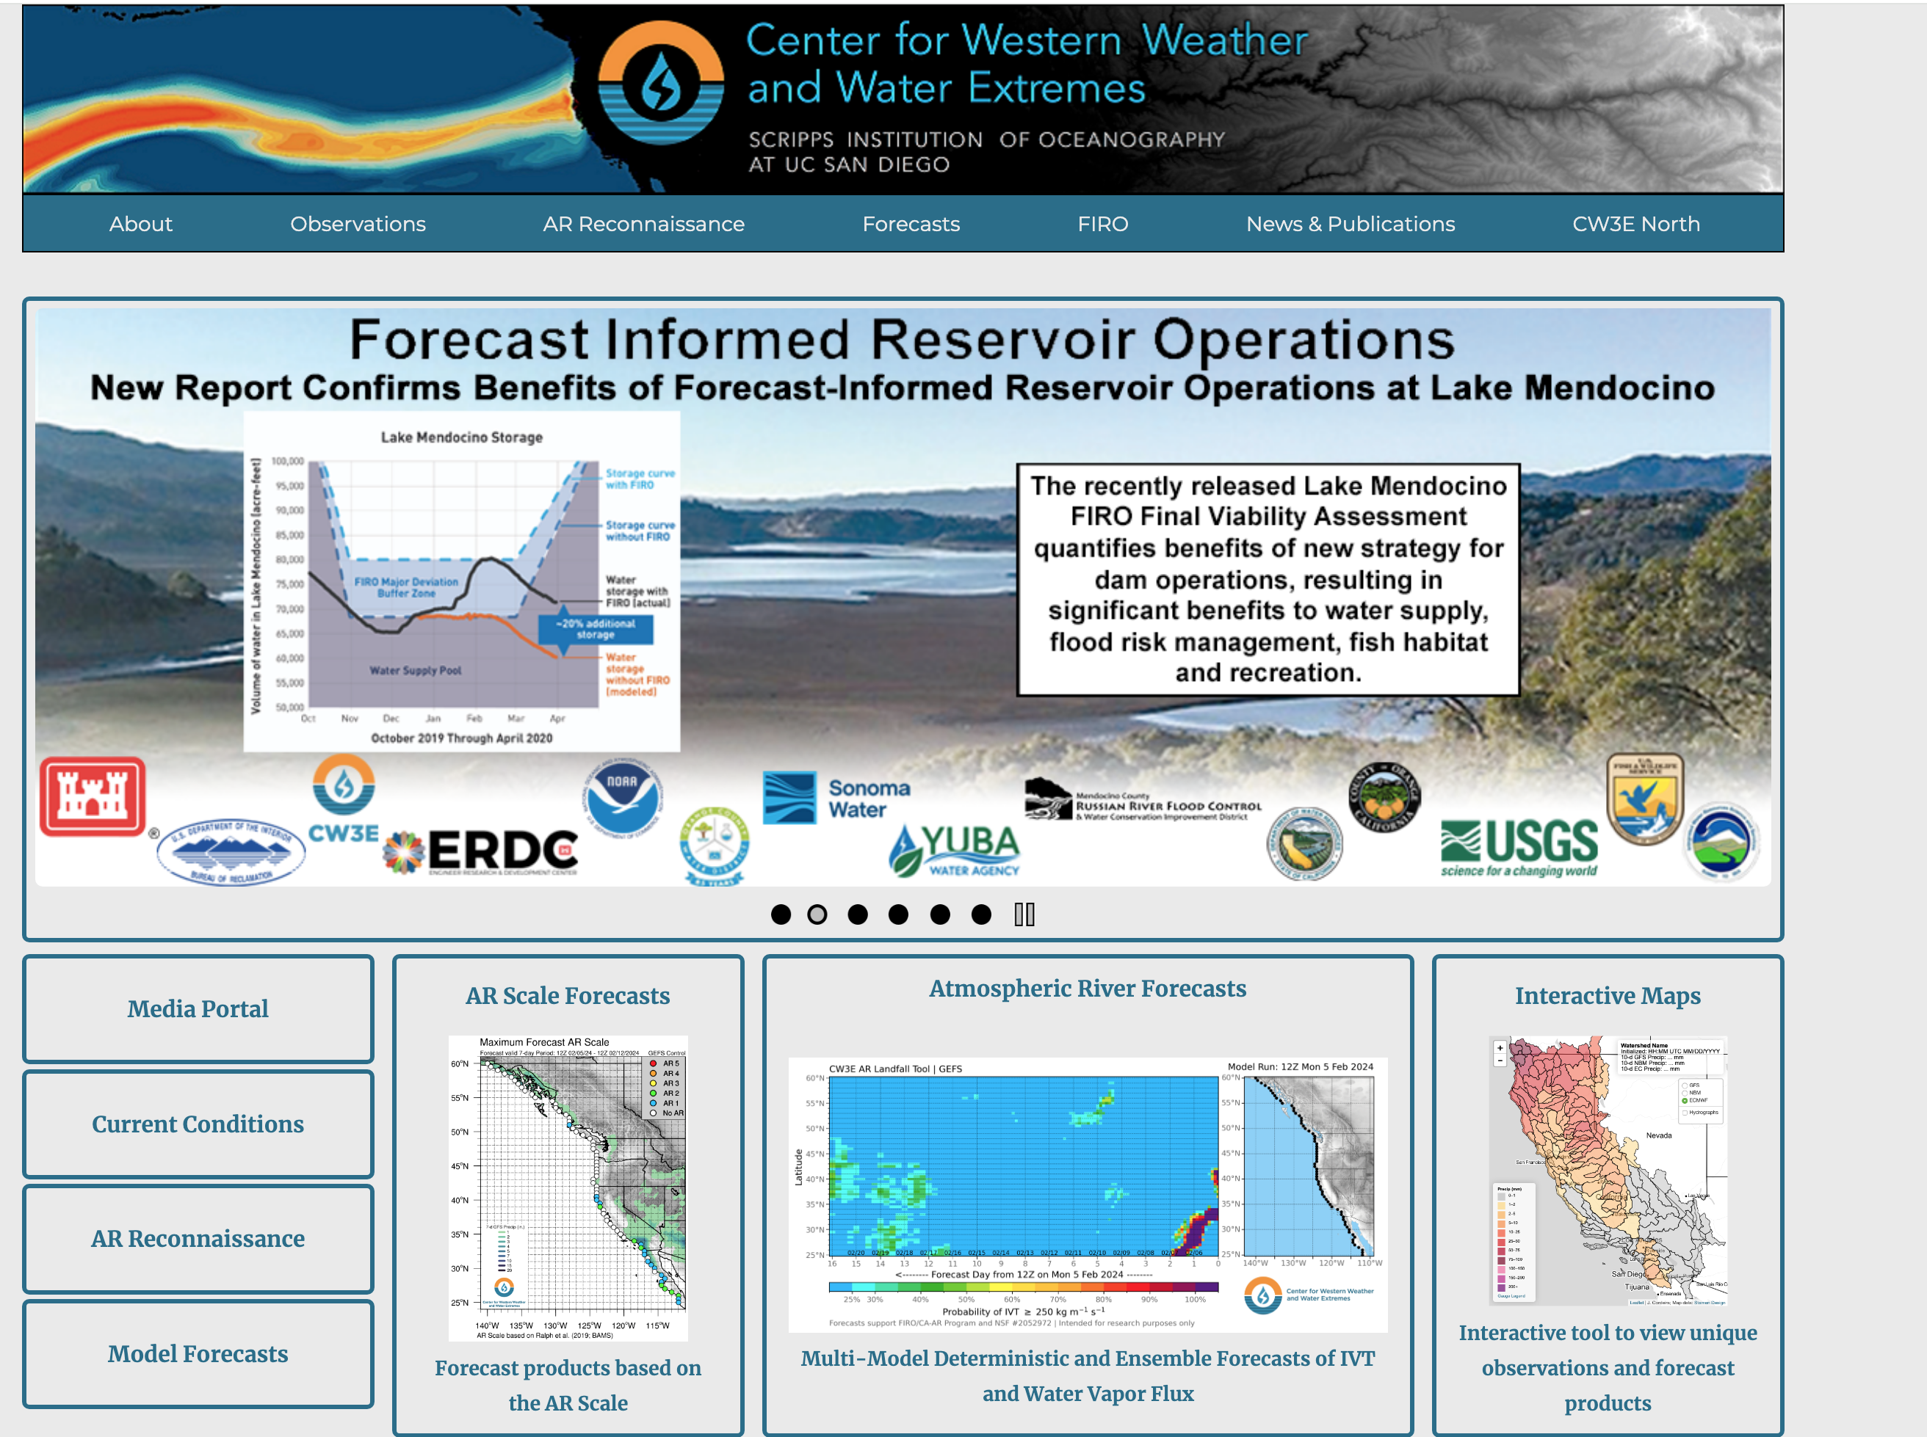
Dedicated AR Website https://cw3e.ucsd.edu/

Slide 31
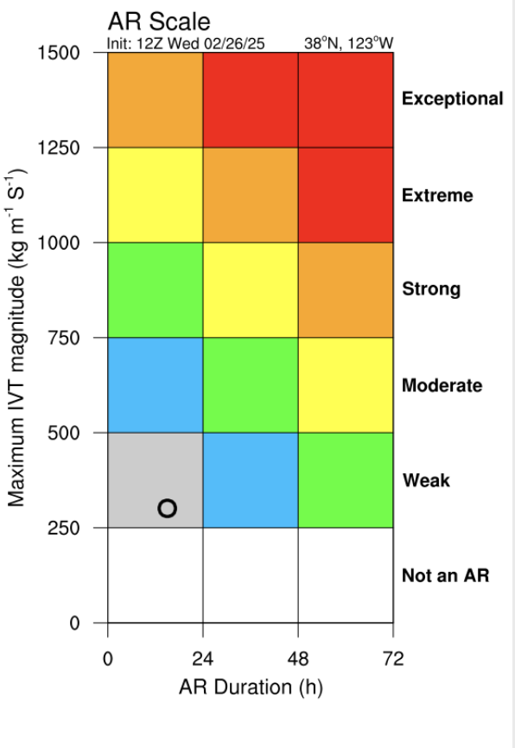
Even an AR Scale Like Hurricanes!

Slide 32
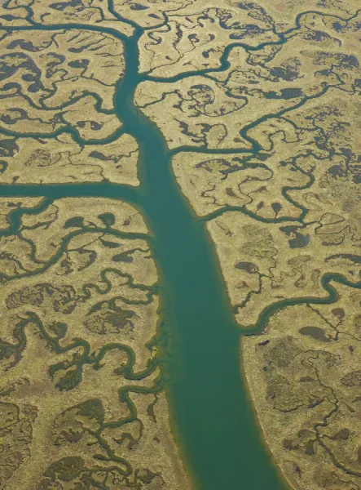
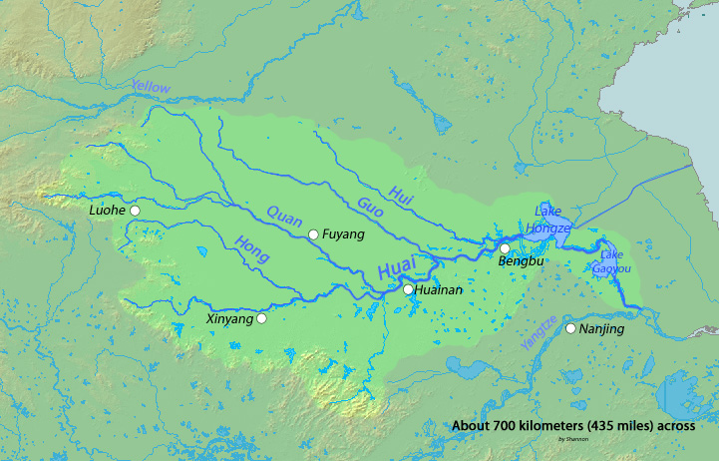
Atmospheric Rivers Are Like Real Rivers with Some Moisture Convergence on Its Whole Path

Slide 33
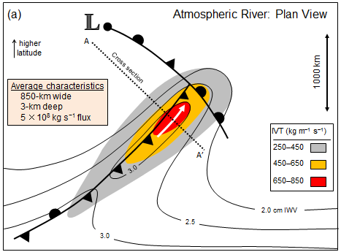
Atmospheric Rivers Are Located in Warm Sector Ahead of Cold Front

Slide 34
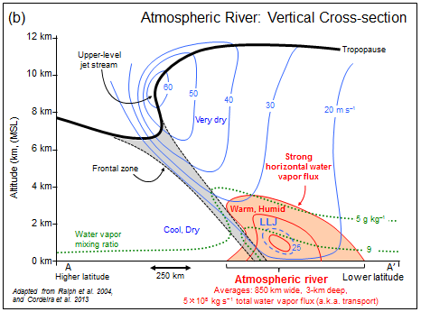
Associated with a Low-Level Jet in Front of Warm Front

Slide 35
The End

