Slide 1
Atmospheric Rivers

Slide 2
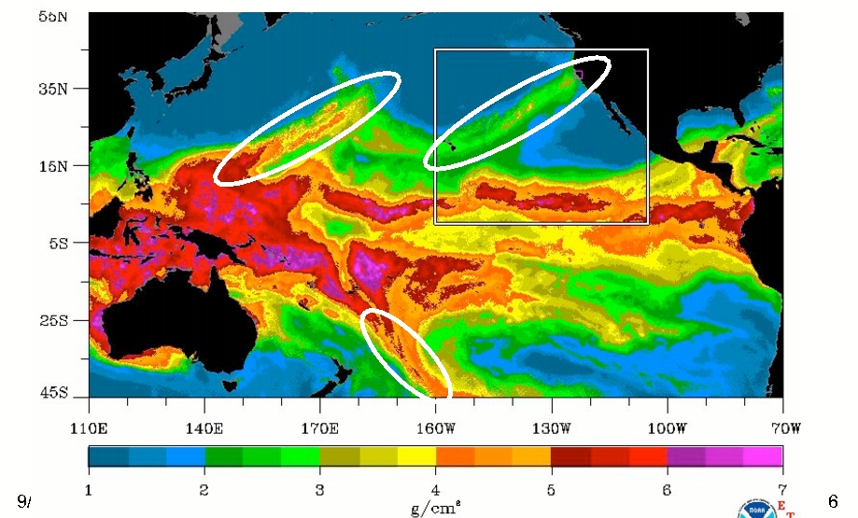
Atmospheric Rivers
A relatively narrow current of warm, moist air from the subtropics or subtropics.
Associated with most of the major flooding events over the W. Coasts of N. and S. America

Slide 3
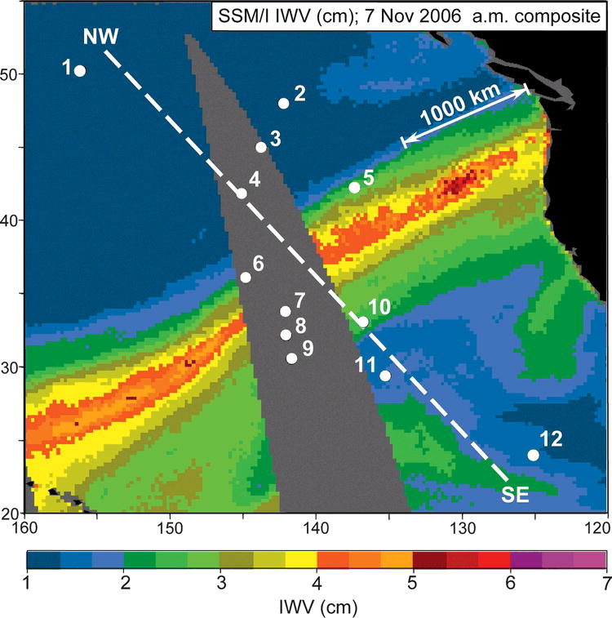
Local Version: The Pineapple Express:
November 6-7, 2006

Slide 4
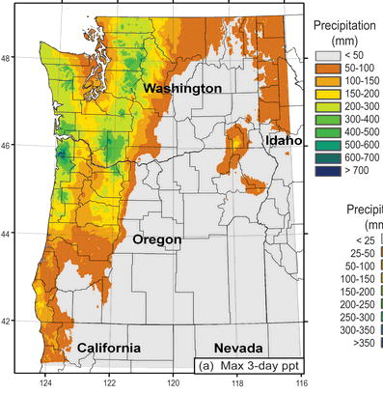
November 6-9,
2006
Dark Green: about 20 inches

Slide 5
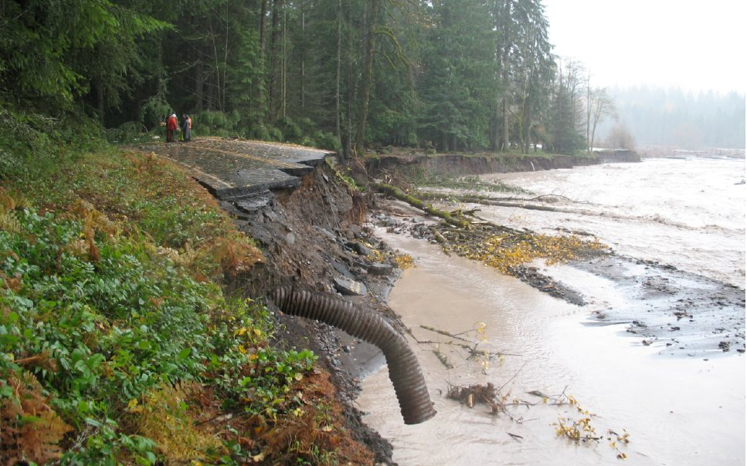
Mount Rainier National Park
18 inches in 36 hr (Nov 8, 2006)

Slide 6
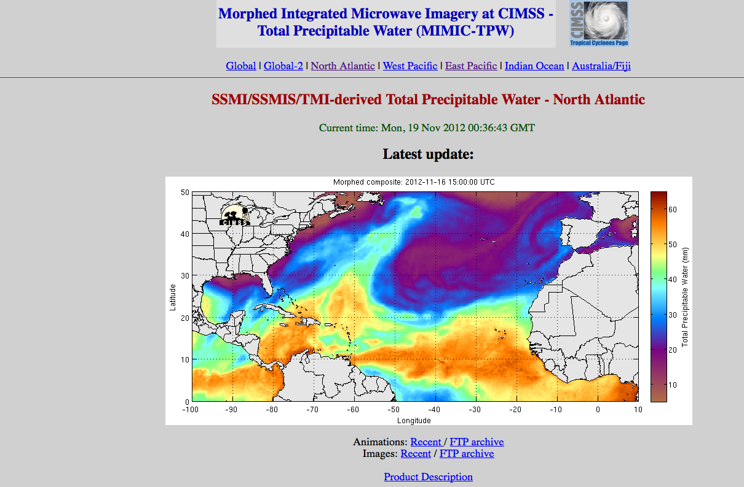
Evident in Vertically Integrated Water Vapor (IWV)-Precipitable Water Content from Satellite (Generally Microwave) Sensors
http://tropic.ssec.wisc.edu/real-time/mimic-tpw/natl/main.html

Slide 7
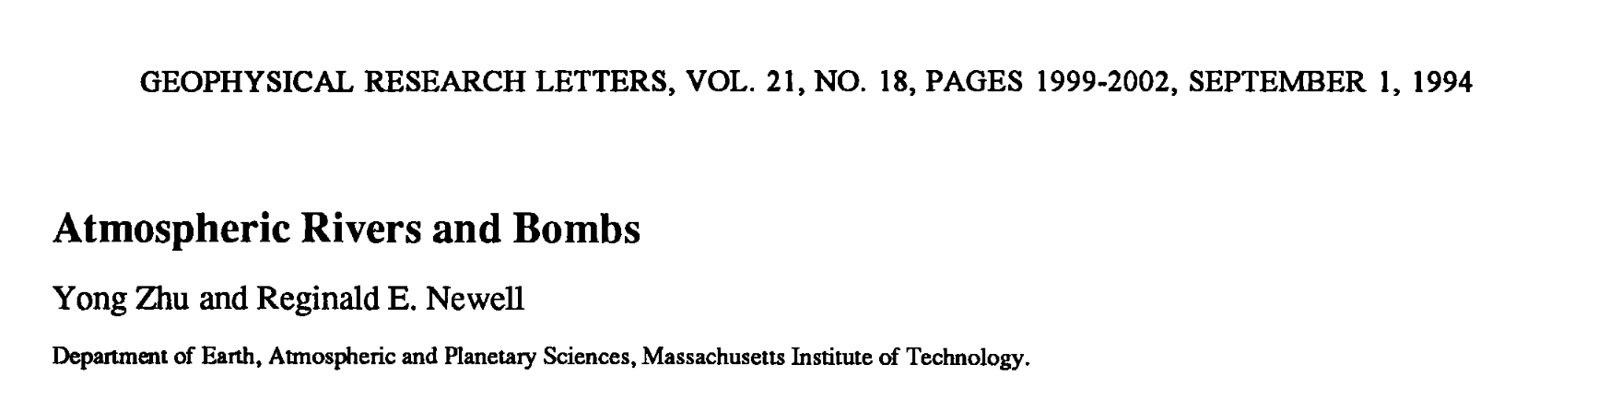
Atmospheric Rivers
In the seminal paper on the topic, Zhu and Newell (1994) found that greater than 90% of the hemispherical meridional moisture flux is transported by such features, with 4-5 evident at any given time.

Slide 8
AR Facts
AR terminology generally used for moisture plumes with greater than 20 mm (2 cm) of IWV content
Not all ARs bring heavy precipitation (e.g., ones during summer).
Need strong winds, moisture, and a less stable environment.

Slide 9
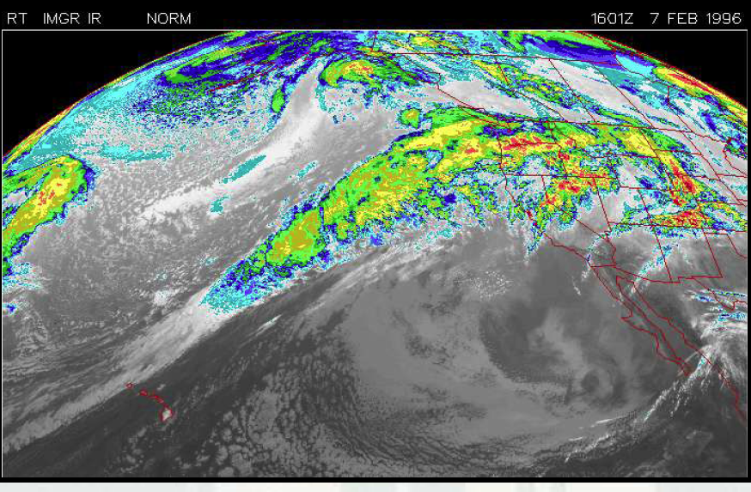
Often apparent in IR Imagery

Slide 10
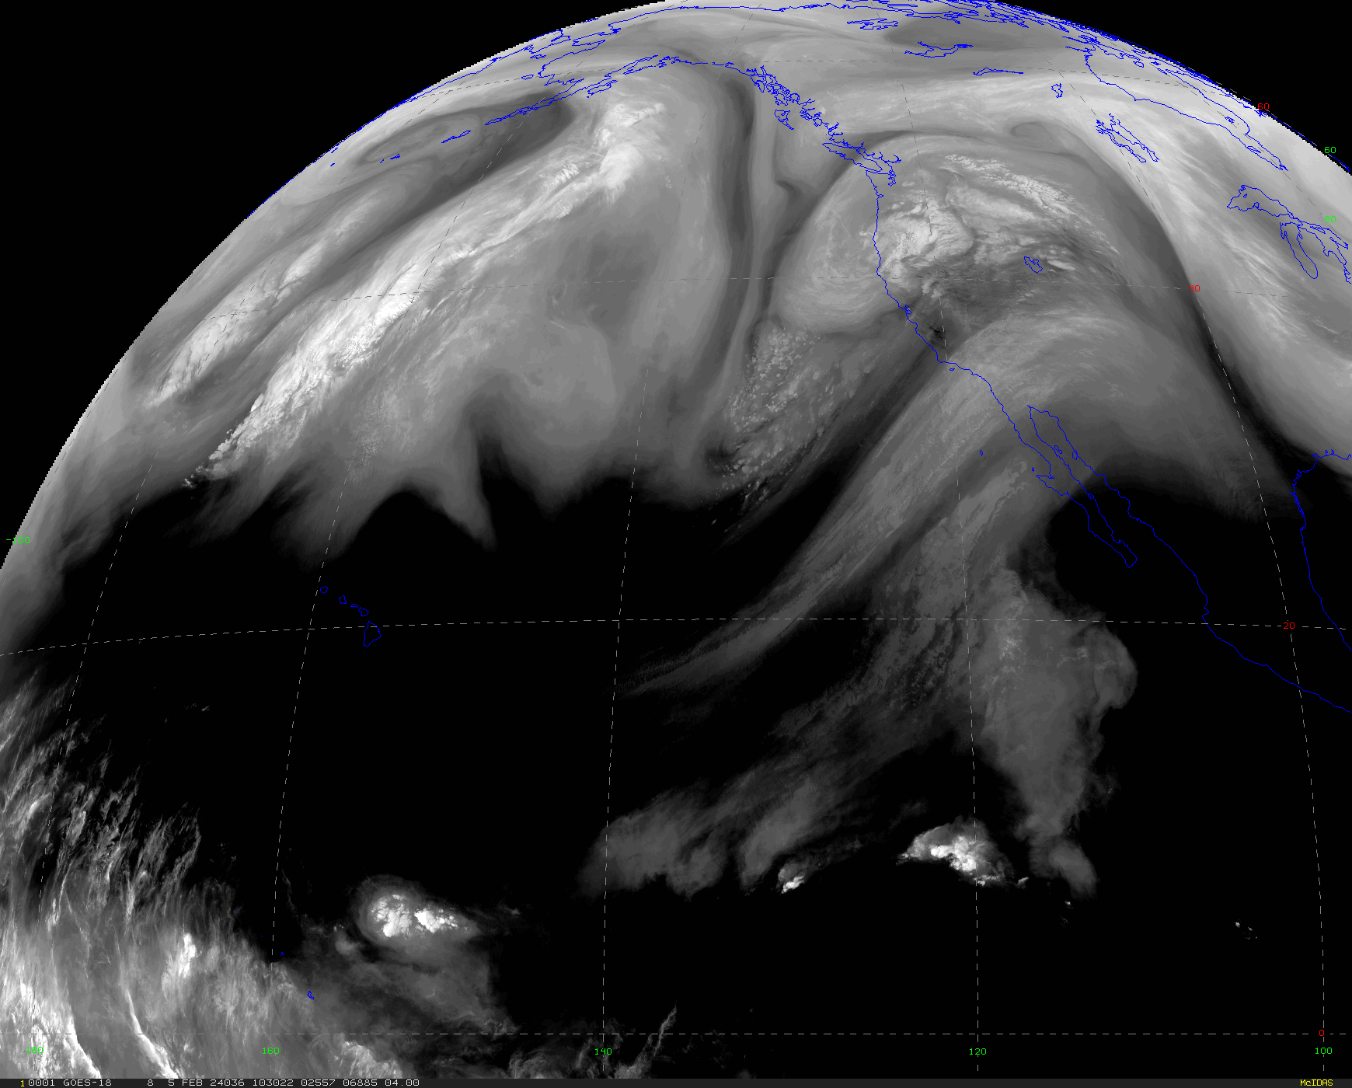
And Water Vapor Imagery

Slide 11
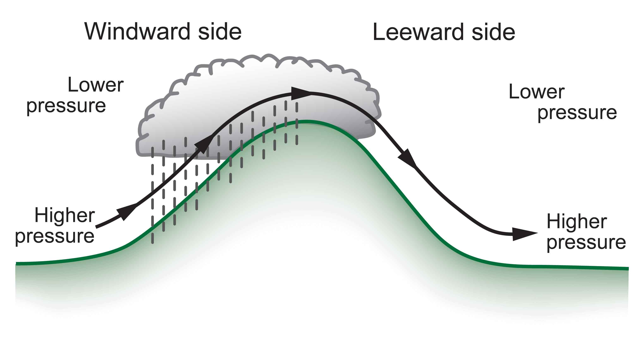
Terrain Greatly Enhance Precipitation Associated with Atmospheric Rivers on the West Sides of Continents

Slide 12
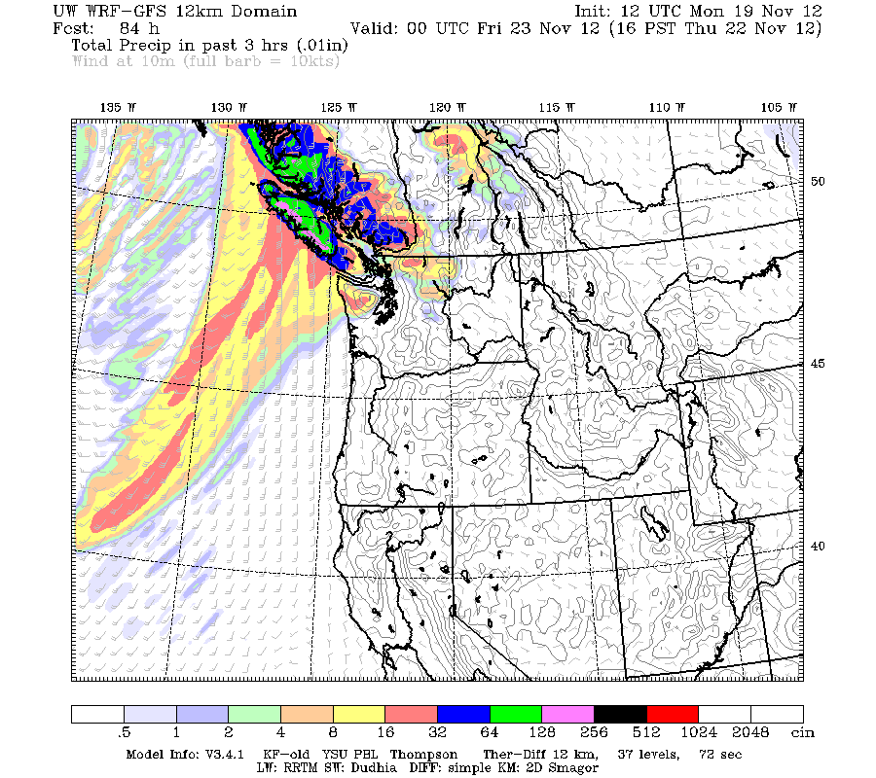

Slide 13
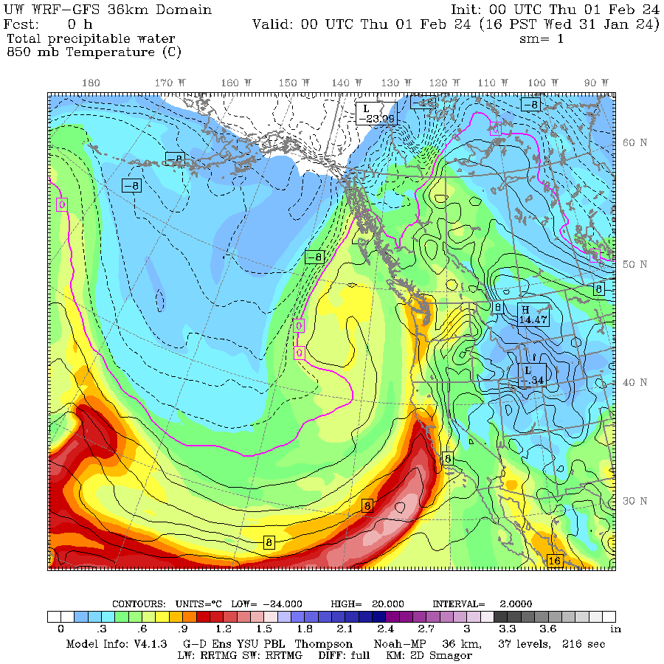
Two measures used to describe AR’s
Vertically integrated water vapor content of precipitable water
  This is the amount of liquid water produced by condensing all the water vapor in a vertical column of air.

Slide 14
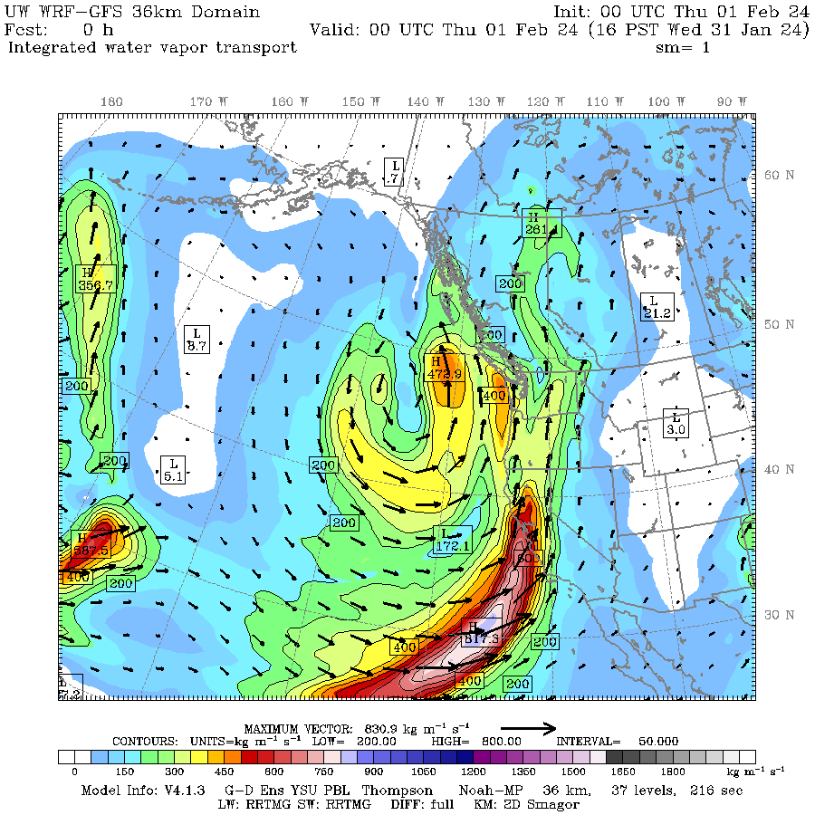
Integrated Water Vapor Transport (IVT) wind* water vapor content
Also called integrated water vapor flux

Slide 15
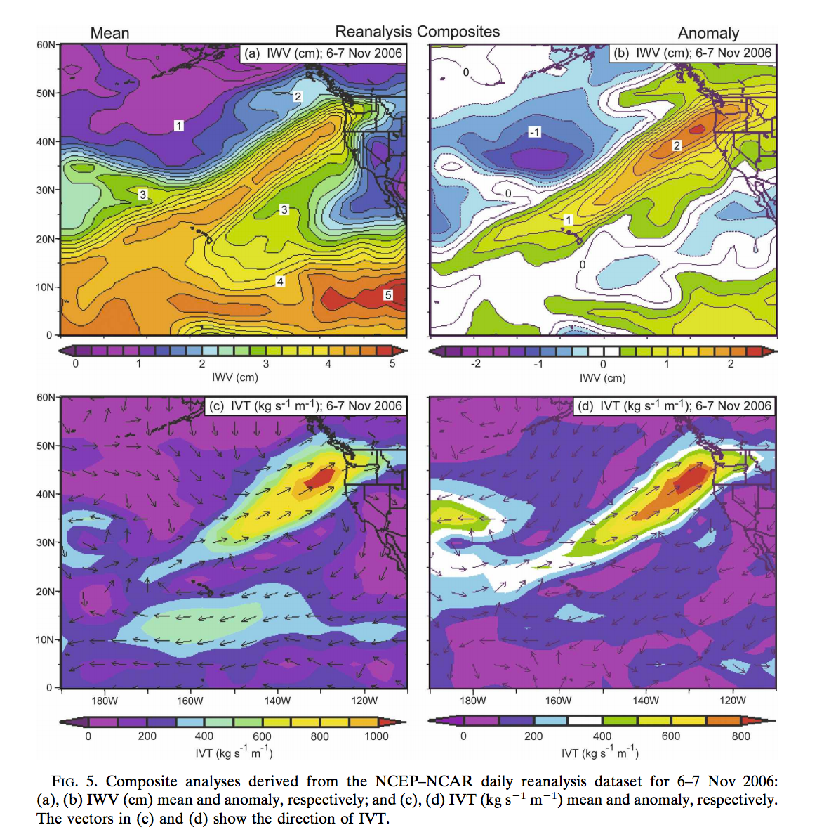

Slide 16
Most of the action is low down
The bulk of the water vapor transport is BELOW 850 hPa.
A strong AR transports an amount of water vapor roughly equivalent to 10-20 times the average flow of liquid water at the mouth of the Mississippi River.

Slide 17
Typical Synoptic Structure

Slide 18
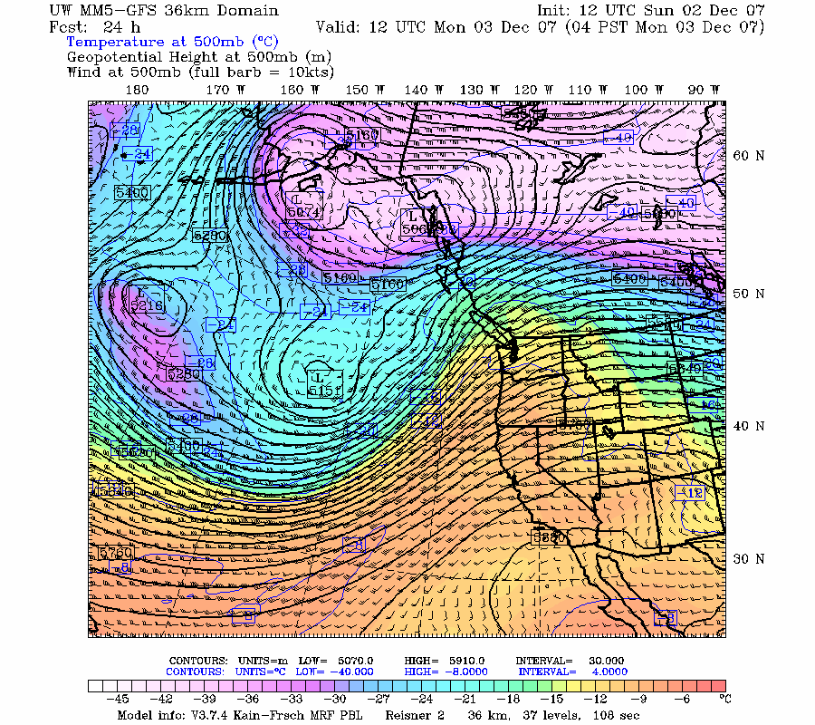
Typical Upper Level Set Up
LOW
High

Slide 19
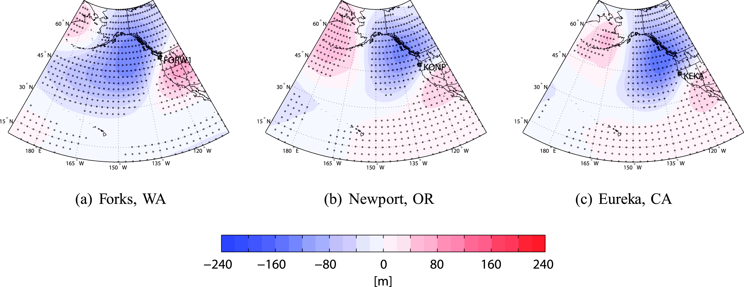
500 hPa Anomalies of Composite of a Few Dozen ARs

Slide 20
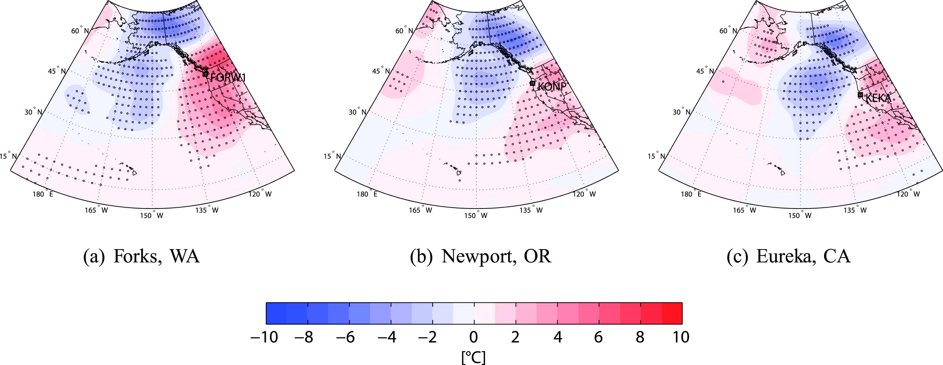
850 hPa Temp Anomalies

Slide 21
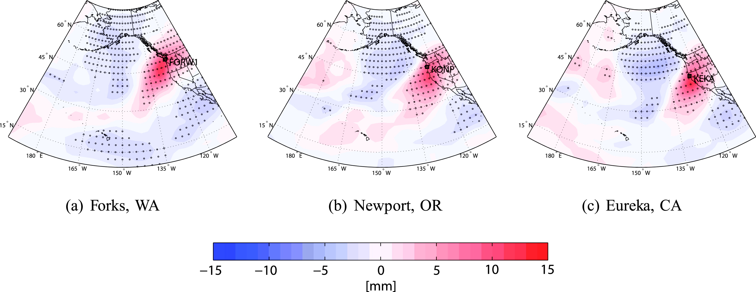
Integrated Water Vapor

Slide 22
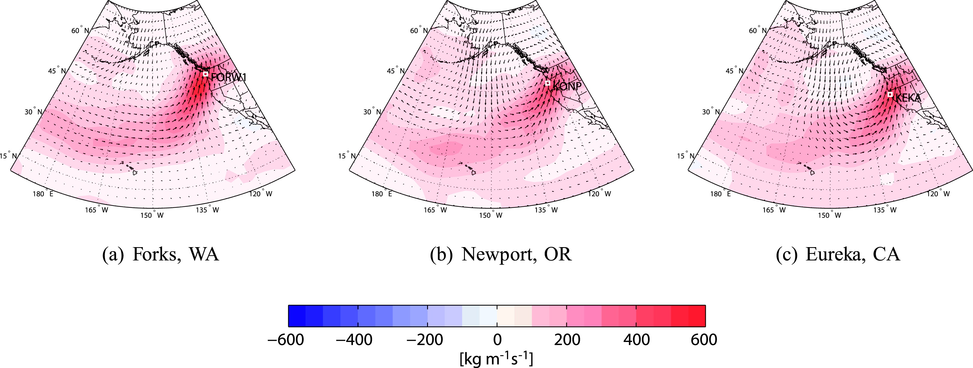
Integrated Water Vapor Flux

Slide 23
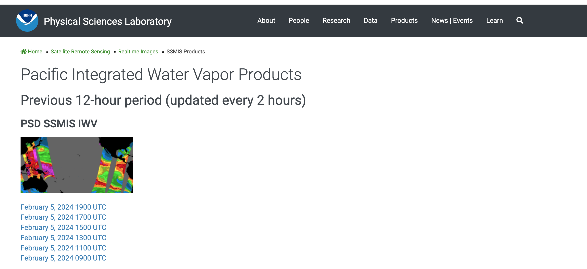
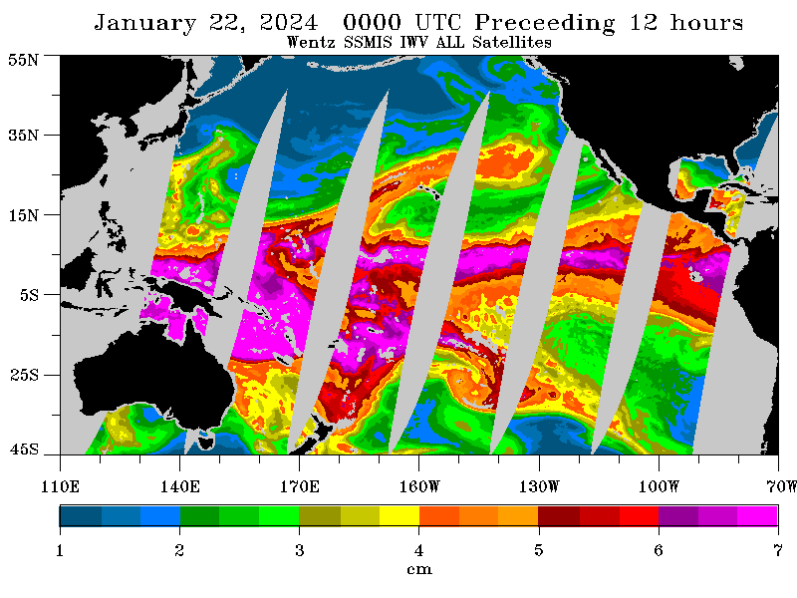

Slide 24
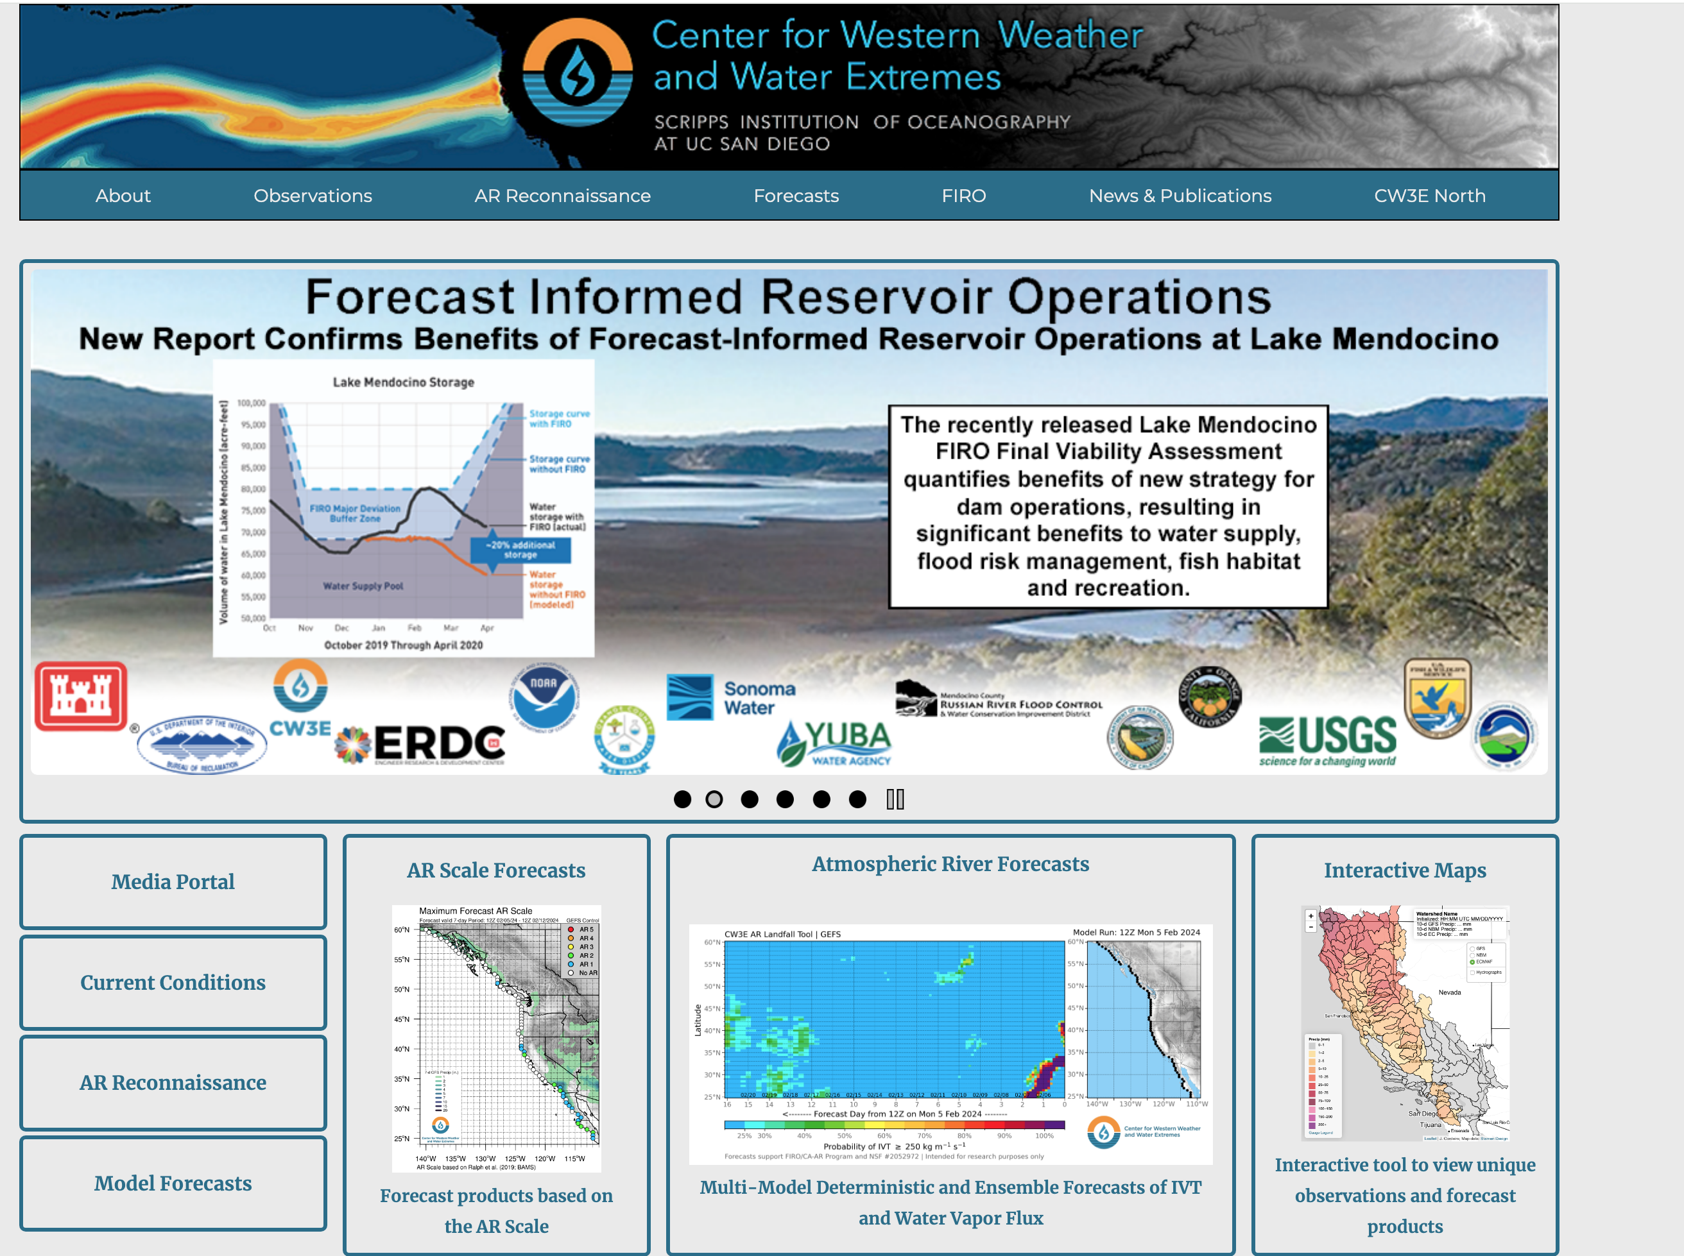
Best AR Website https://cw3e.ucsd.edu/

