Slide 1
Three-Dimensional Airflow Through Fronts and Midlatitude Cyclones
Atmospheric Sciences 370
Winter 2023

Slide 2
Importance of Air Flows
Great insights into cyclone structures and evolution can be derived from understanding the 3D air flows in midlatitude systems.
Great advances have been possible during the past several decades using model output.
Air flows and trajectories provide a more fundamental understanding than traditional (frontal) approaches.
Not all key structures are associated with fronts!

Slide 3

Some History

Slide 4
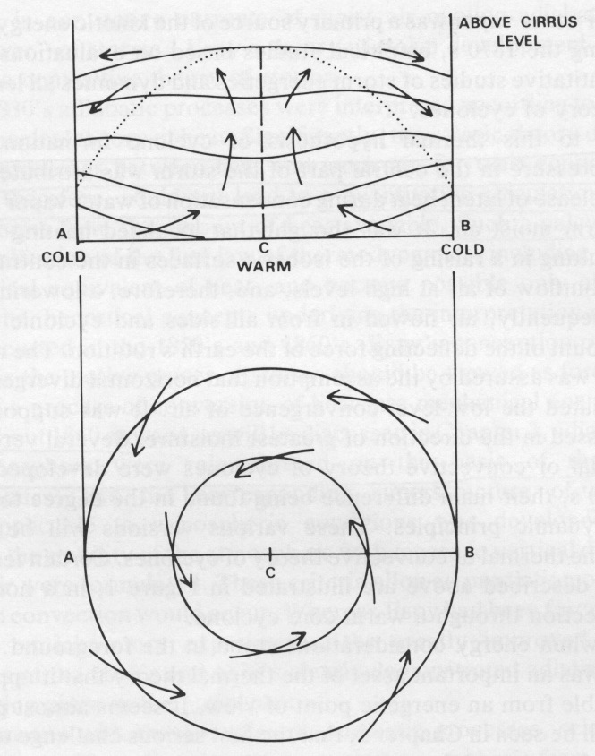
1800’s
The Thermal Theory of Cyclones conceptual model was dominant in the mid-1800s.
Cyclones considered warm core with hurricane-like circulation
Low
Espy 1831

Slide 5
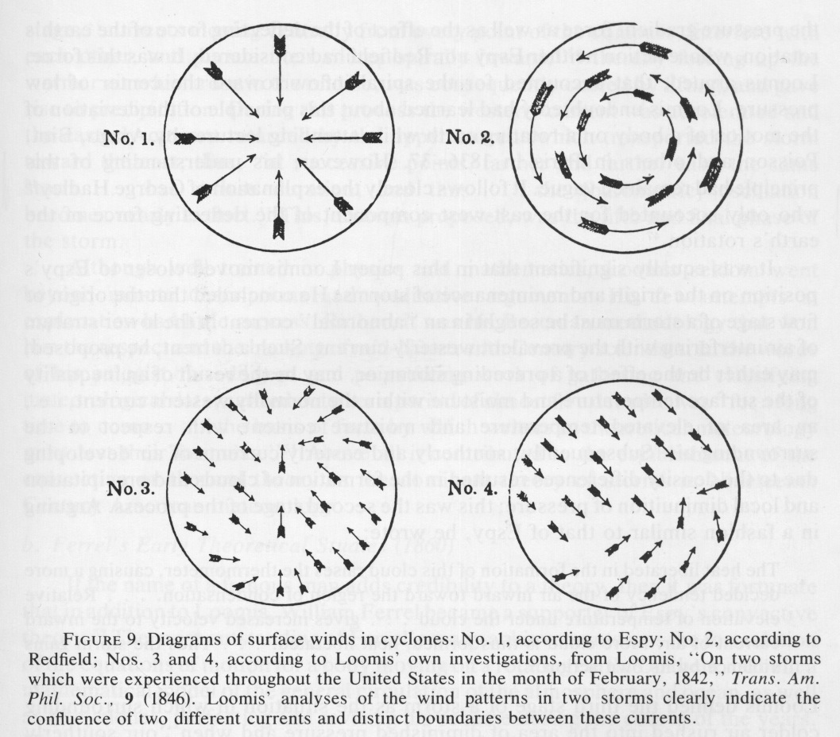
Major Debates on Cyclone Airflows During the Mid-1800s
circulation
convergence
Espy
Redfield
or both?
Loomis

Slide 6
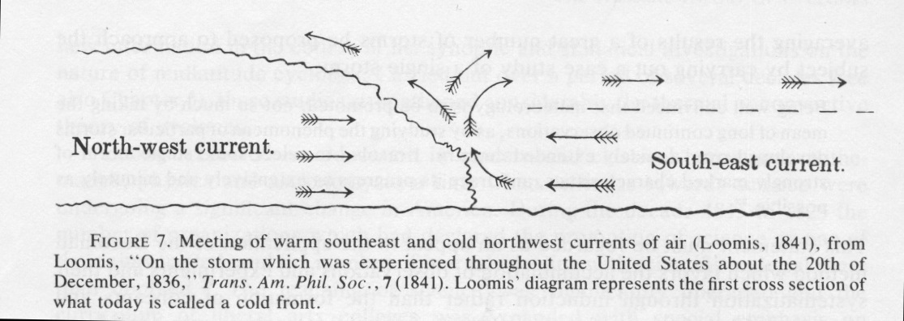
Loomis (1841): First Air Flow Schematic Over Cold Front

Slide 7
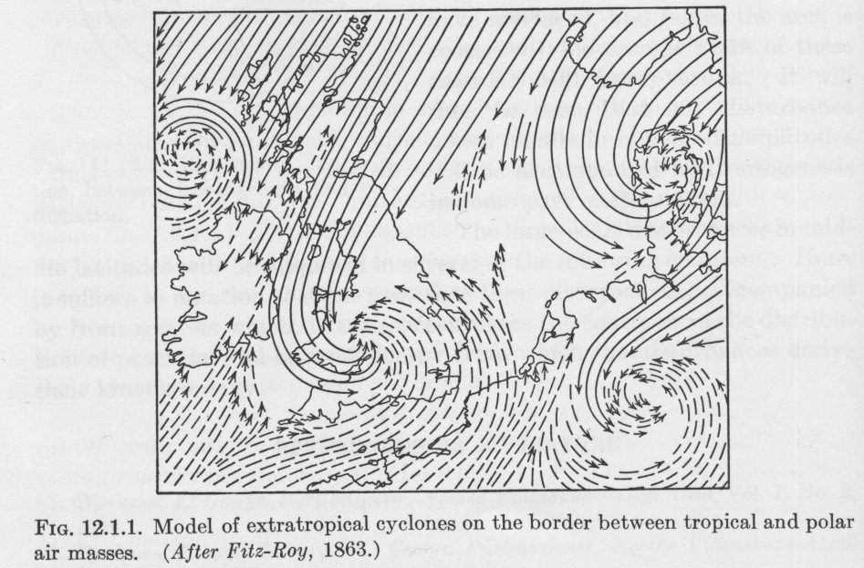
By 1860s the idea of two main airflows (warm and cold) was becoming accepted
cold
Fitz-Roy
1863
warm

Slide 8
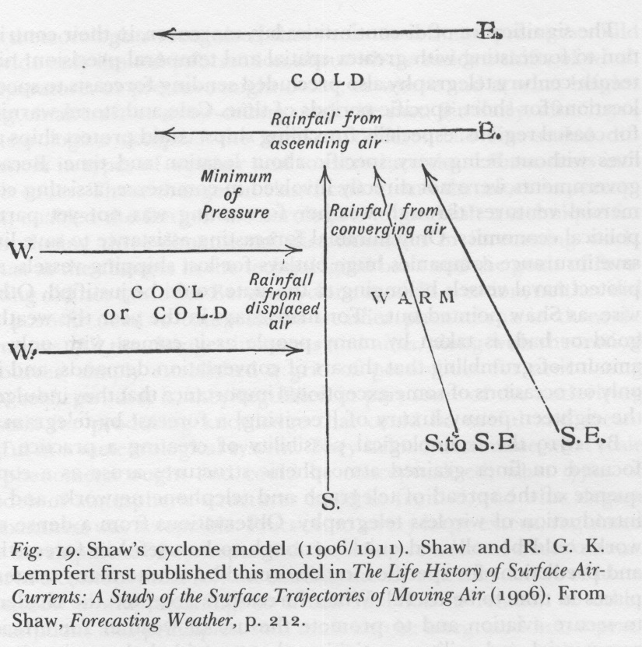
By the beginning of the 20th century the idea of three main airflows was being suggested.

Slide 9
The Norwegian Cyclone Model (Bjerknes 1918 and later) Connected Three-Dimensional Airflows with the Clouds and Temperature Structures of Midlatitude Fronts and Cyclones
A huge advance, but it had deficiencies

Slide 10
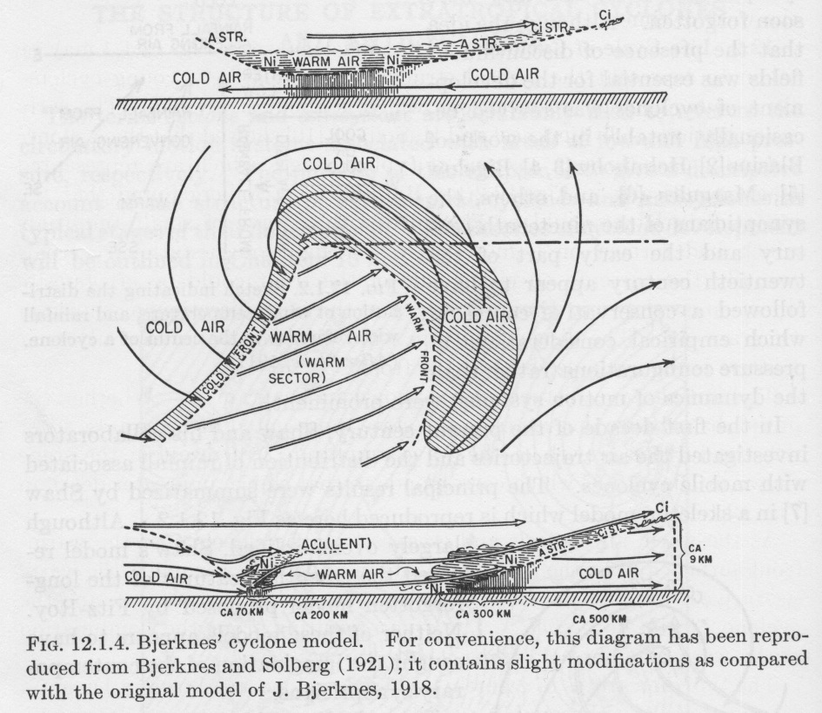

Slide 11
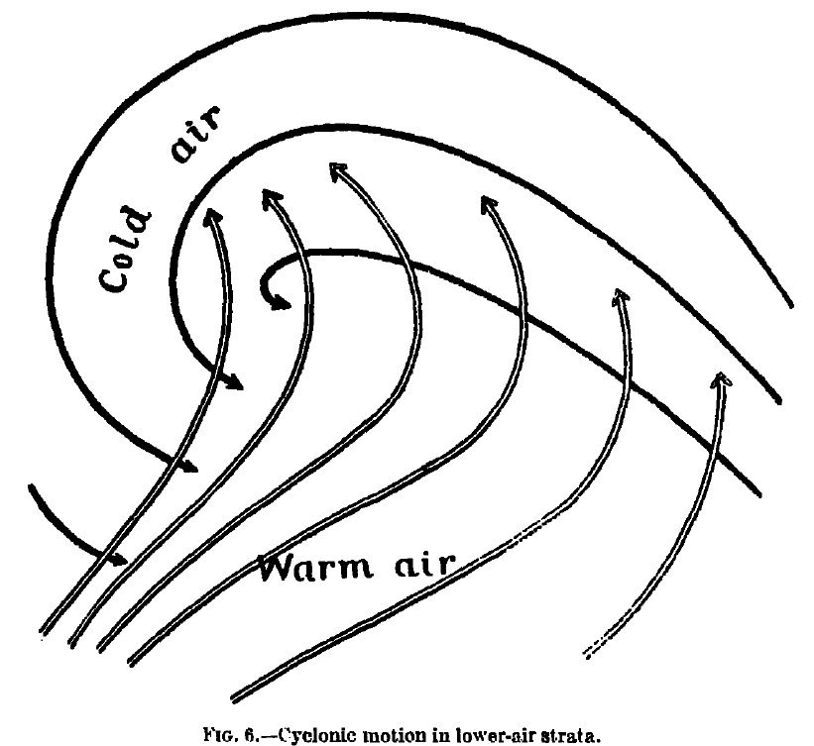
Norwegian Cyclone Model Concept of Air Flows in Cyclones

Slide 12

Missing Key Ingredients in the Norwegian Cyclone Model
Dry descending airstreams in the mid to upper troposphere.
Relationships of upper-level short-wave troughs and ridges with lower tropospheric structures.
And more…

Slide 13
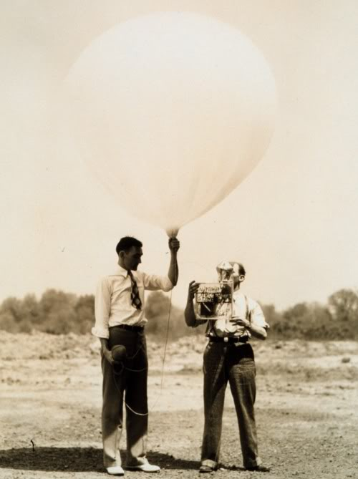
1930s-1950s
The availability of radiosonde data resulted in a revised picture of three-dimensional airflows and structures in fronts/cyclones and more.

Slide 14
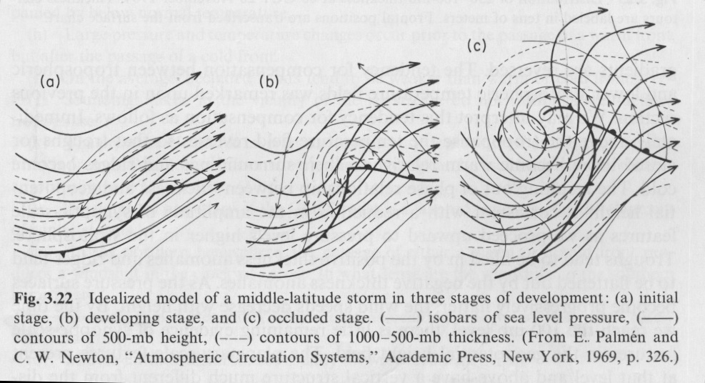
Palmen and Newton (1969)

Slide 15
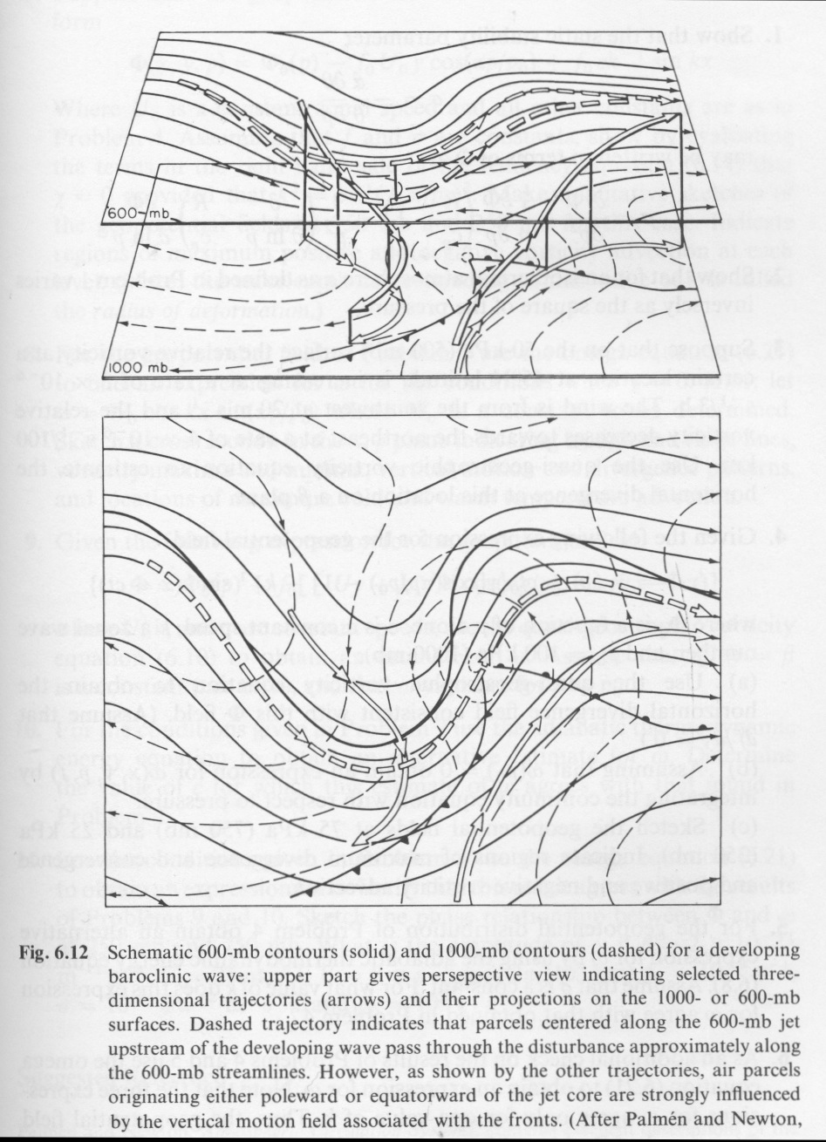

Slide 17
1950s-1980s
Several studies used relative flow isentropic analysis---assuming steady state conditions and displaying flow relative to the system to give a picture of trajectories and vertical motions.
Assumed air trajectories follow theta or thetae surfaces depending whether air parcels are unsaturated or saturated.
Eliassen and Kleinschmidt 57, Browning and Harrold 69, Harold 73, Carlson 80, Browning 86, Young et al., 87, Browning 90

Slide 18
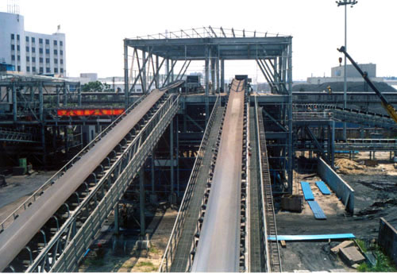
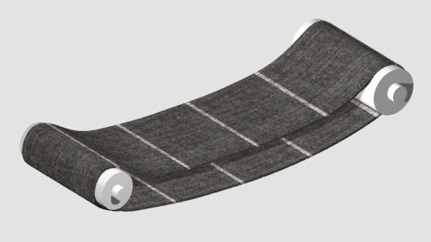
Conveyor Belts
Many of these studies described the major airflows in cyclones as occurring in a limited number of discrete airstreams or conveyor belts.

Slide 19
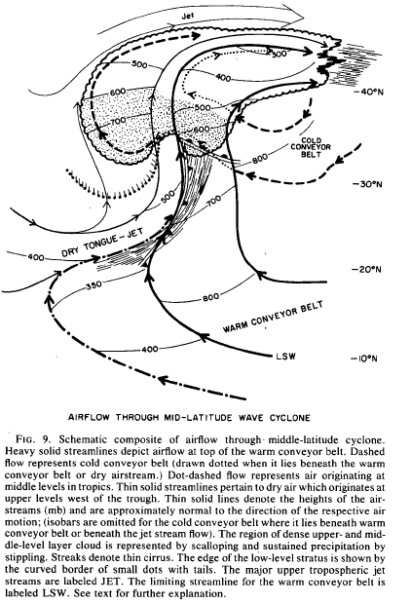
The Conveyor Belt Model of Cyclone Airflows (Carlson, 1980)

Slide 20
Three airstreams
Warm conveyor belt
Cold conveyor belt
Dry airstream or dry air intrusion

Slide 21
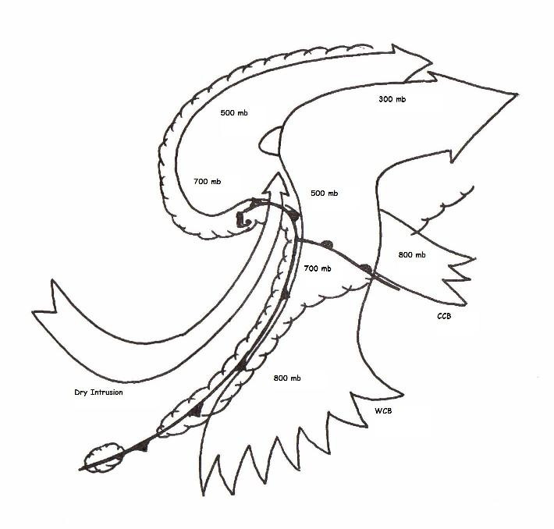
Clearer Version!

Slide 22
Three Main Airstreams or “Conveyor Belts”
Warm conveyor belt (WCB)
associated with most clouds and precipitation in cyclones.
begins at low levels within the southern part of the warm sector and climbs anticyclonically above the warm front.
Warm, moist air

Slide 23
Cold conveyor belt (CCB)
Originates in cold, low-level anticyclonic flow to the northeast of the cyclone and moves westward (relative to the eastward-moving cyclone) north of the warm front.
Undercuts the warm conveyor belt (WCB moves over the CCB)

Slide 24
Two ideas what happens after CCB bases under the WCM
Cold conveyor belt then rises and emerges beneath the western edge of the WCB (producing the western extension of the comma head) and then ascends anticyclonically to merge with the WCB.
The CCB descends cyclonically around the low center to a position behind the cold front.
(1)

Slide 25
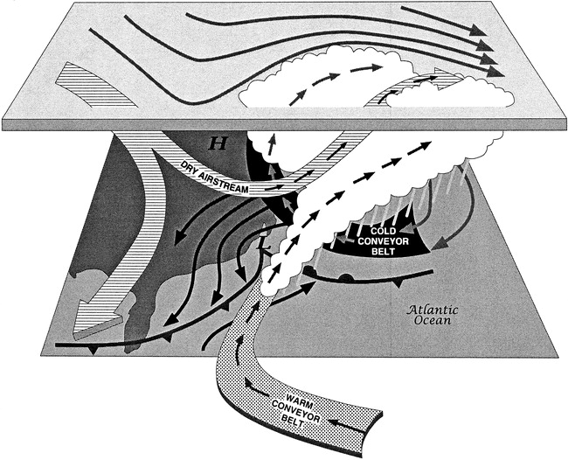
(2) Shown by
blue arrow

Slide 26
Dry Airstream or dry intrusion
Descends cyclonically from the upper troposphere or lower stratosphere into the lower troposphere and then ascends over the cyclone
Often advances over the warm sector of the cyclone
The warm sector is often NOT a region of uniform warm, moist air!

Slide 27
Strengths and Weaknesses of the Conveyor Belt Model
Strengths
If you ignore the details, one can often identify three broad air streams in cyclones and fronts
Gets us away from thinking that all the weather action is related to frontal boundaries. Not all vertical motion is directly related to fronts.
Weaknesses
A great simplification to consider only three air streams
There are all kinds of intermediary trajectories

Slide 28
1980s-now: The Model Revolution
Realistic model simulation at high resolution allows the creation of three-dimensional trajectories.
Modern graphics promotes visualization—a major challenge.
An early example: The President’s Day Storm of 1993:http://www.atmos.washington.edu/academic/videos/PresidentsDayStorm.html

Slide 29
A “Conveyor Belt” View Can Explain Some Cloud Structures Unexplained by the Norwegian Cyclone Model

Slide 30
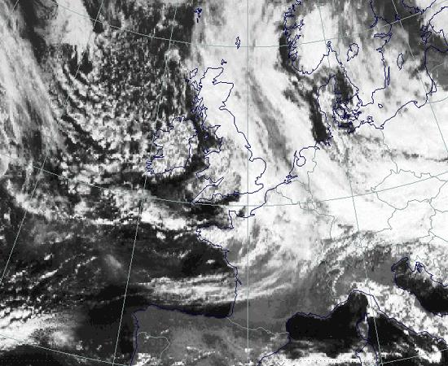
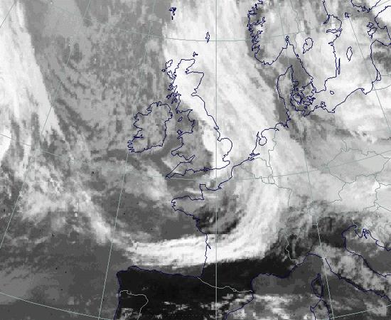
Split “Cold” Front
Often see this on satellite pictures, with a separation between surface front and middle/upper clouds.

Slide 31
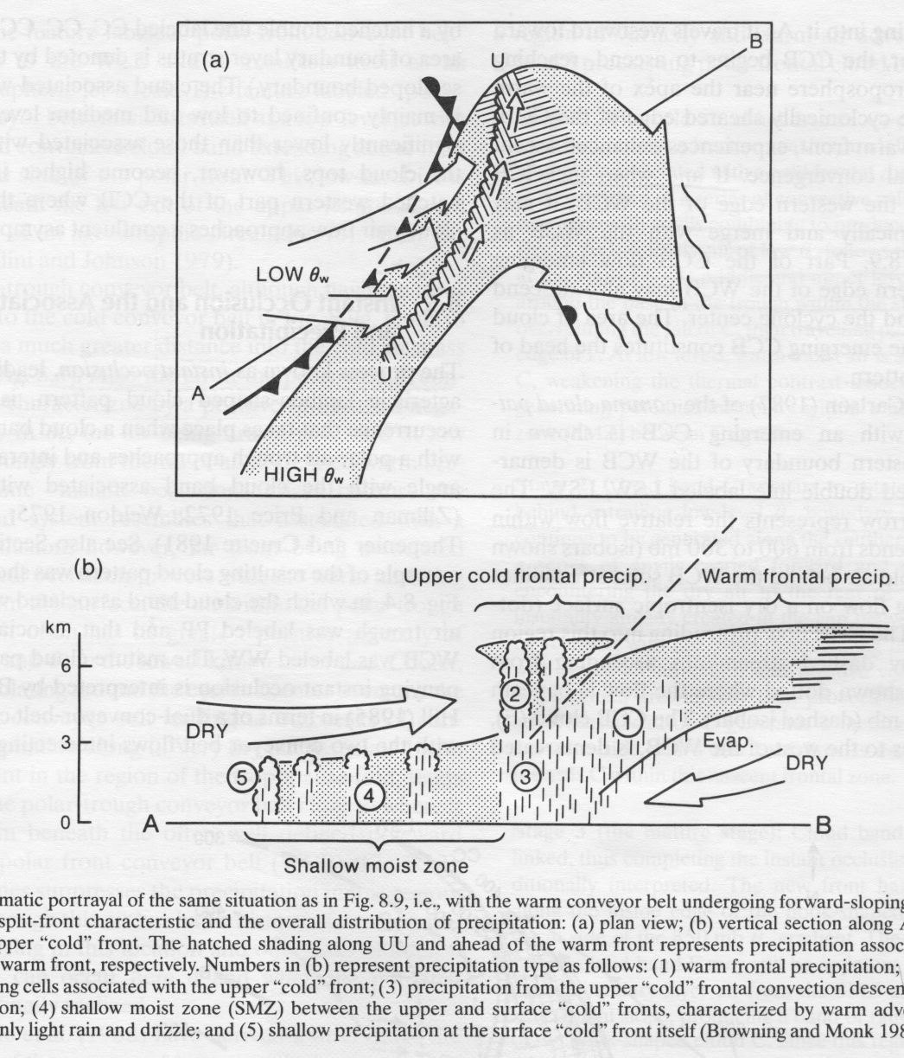
Airflow and Conveyor-Belt Studies Have Suggested Structures Not Described in the Norwegian Cyclone Model
Split and Upper “Cold” Front
Forward-tilting
Upper front is more of a moisture than temperature front
Leads to potential instability

Slide 32
Trajectories for a Relatively “Classical” Case over North America: December 14-16, 1987

Slide 33
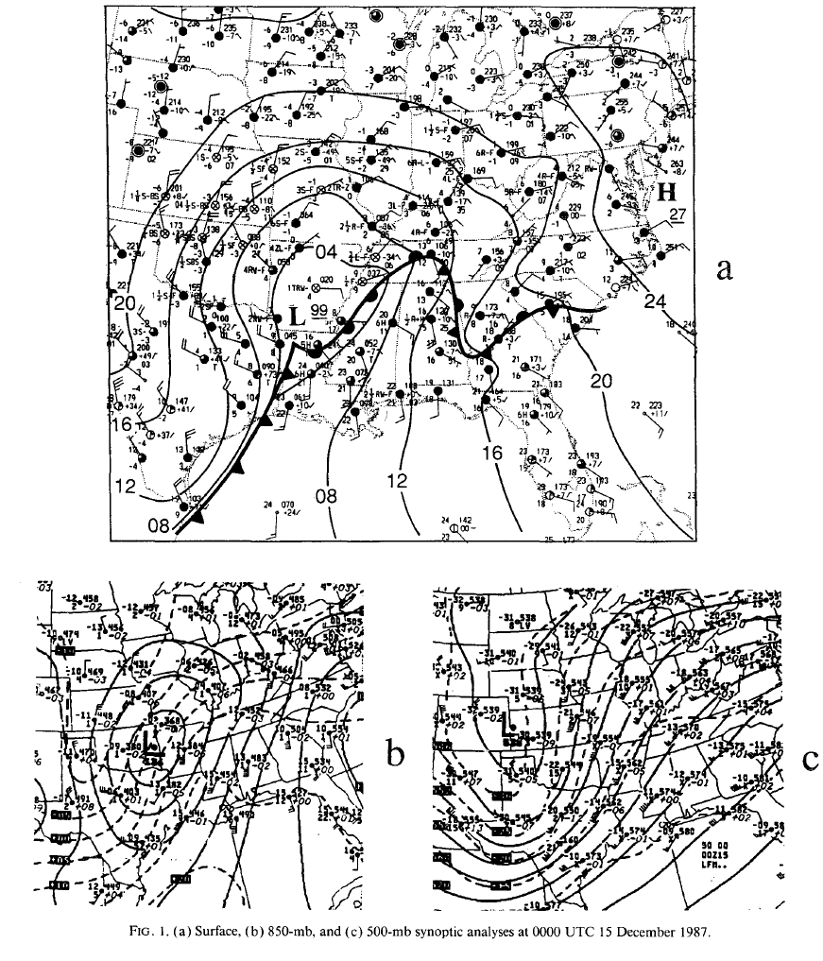
0000 UTC
15 December
surface
500
850

Slide 34
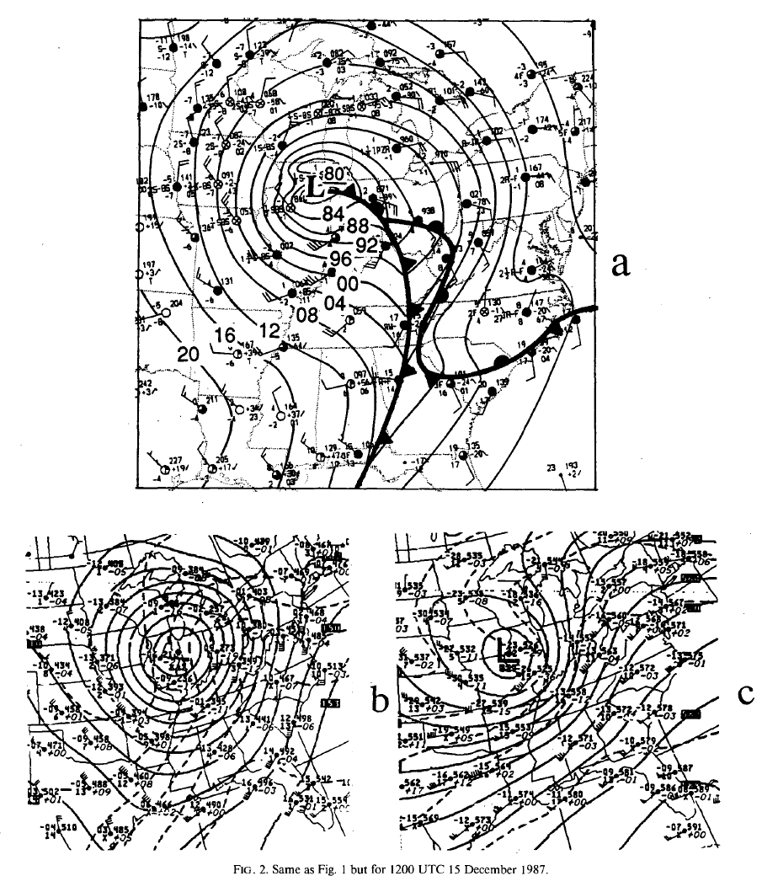
1200 UTC
15 December

Slide 35
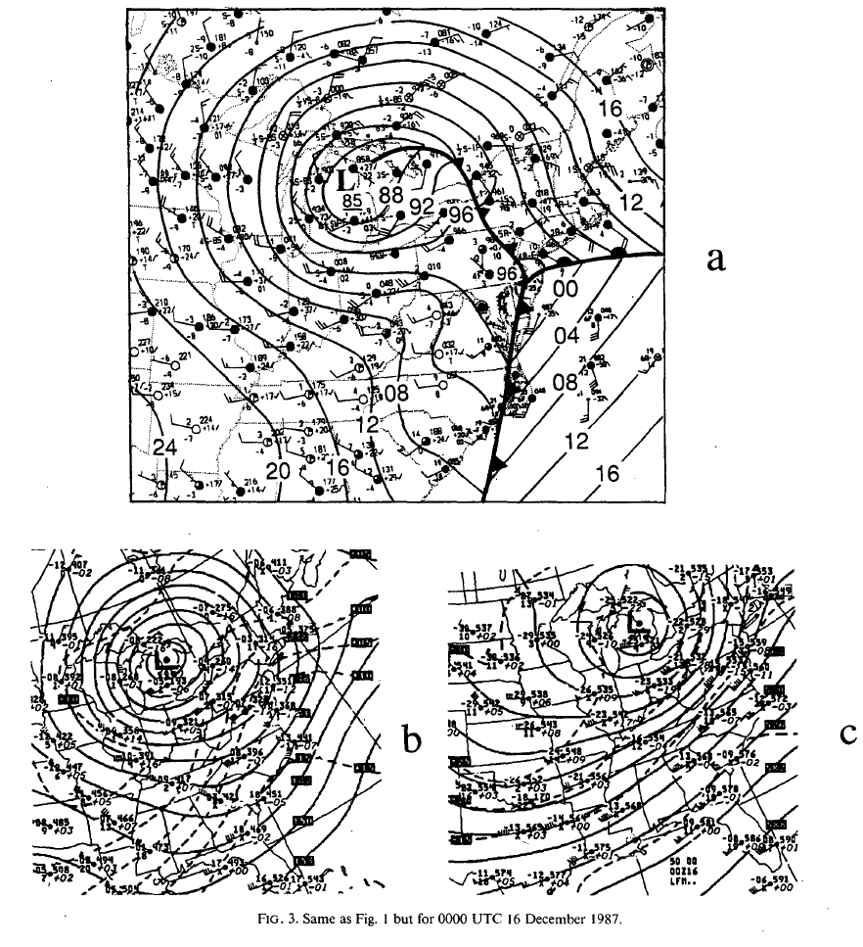
0000 UTC
16 December

Slide 36
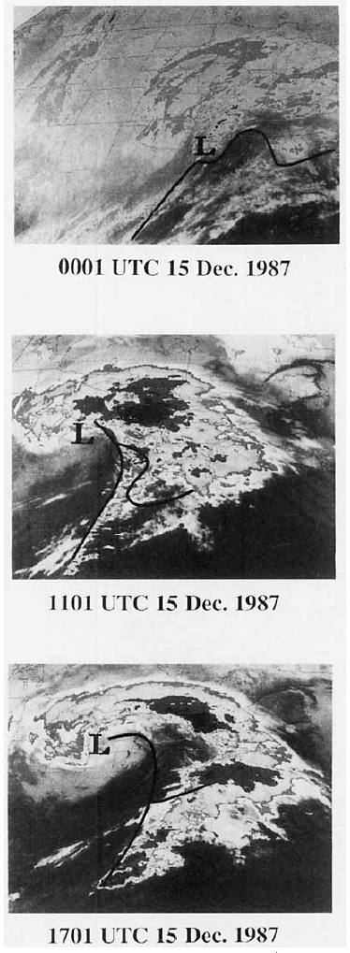

Slide 38
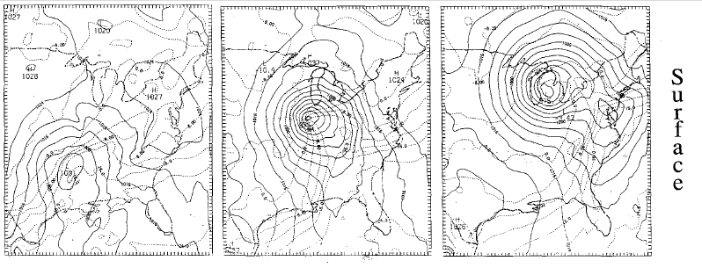
Realistic Model Simulation

Slide 39
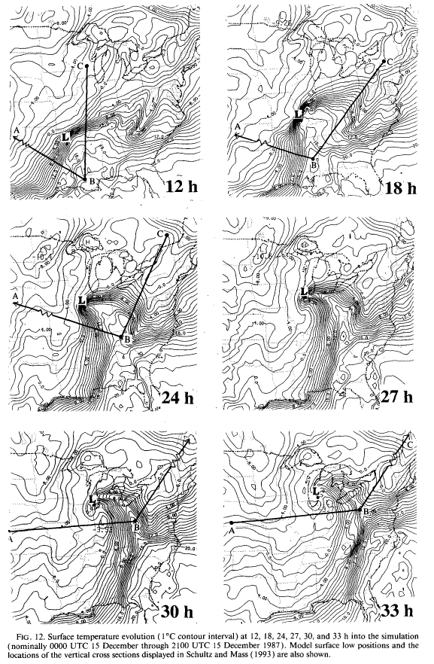

Slide 40
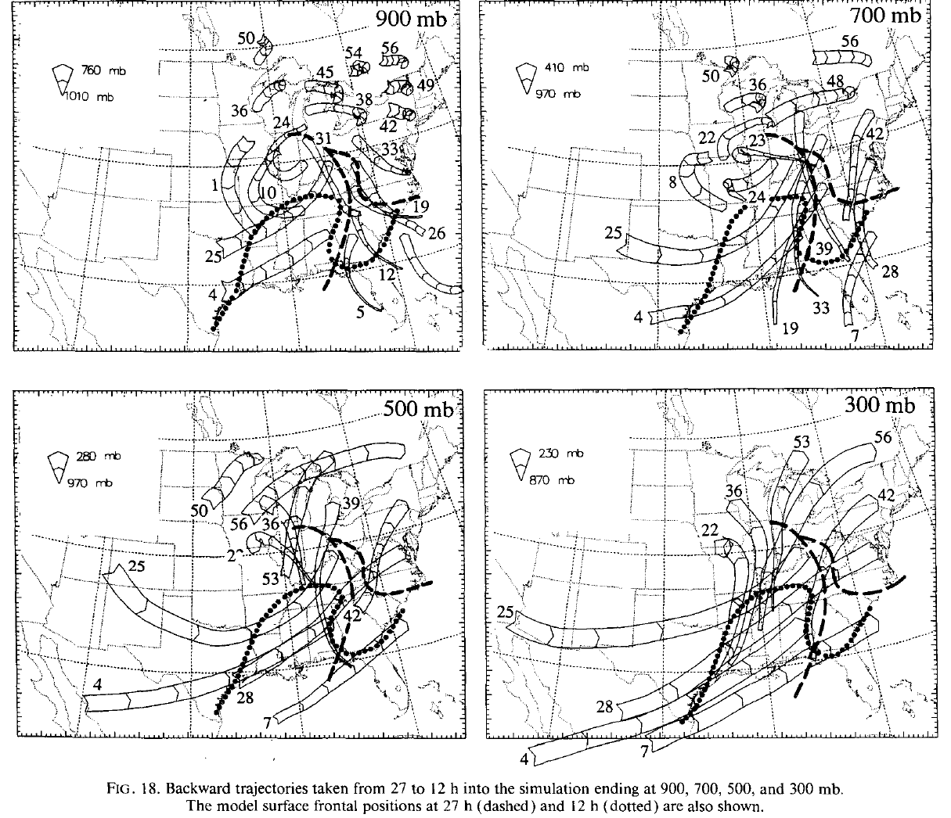
Model-Based
Trajectories
Backwards
Trajectories

Slide 41
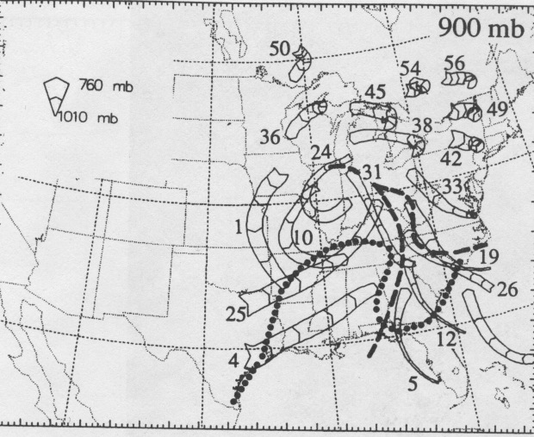

Slide 42
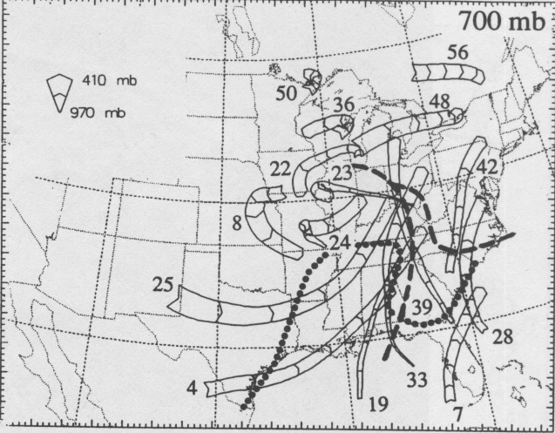

Slide 43
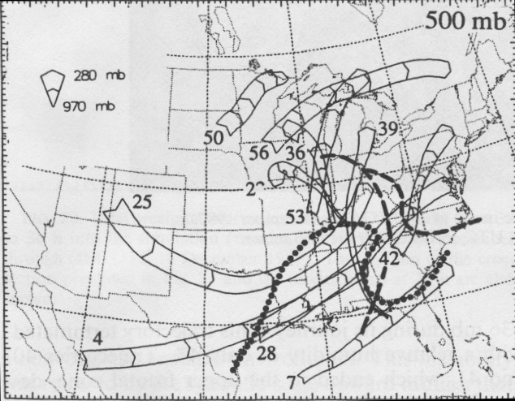

Slide 44
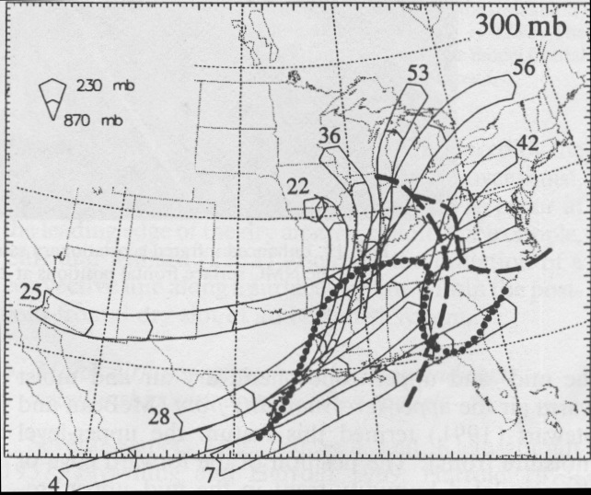

Slide 45
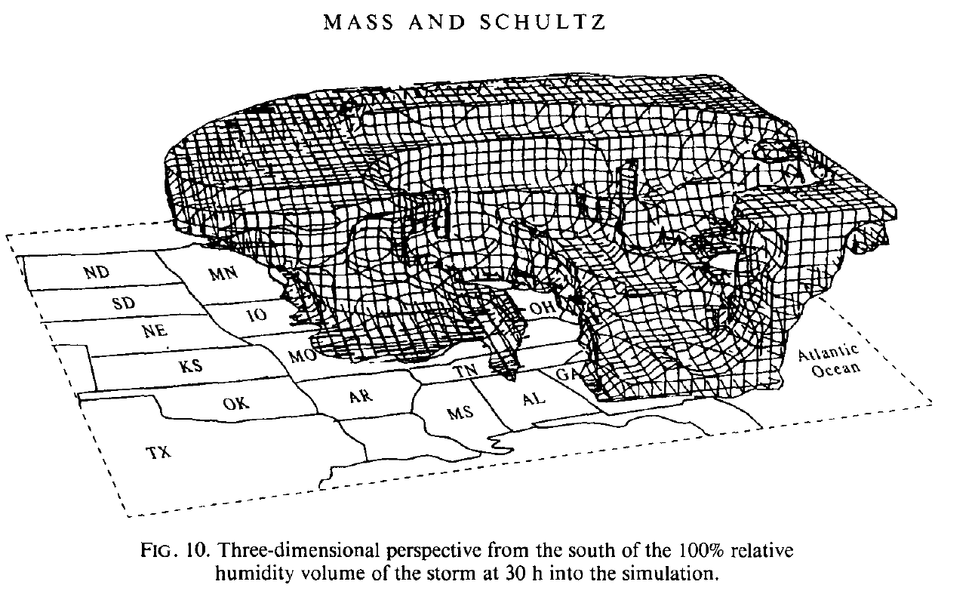
Saturated Volume at 1800 UTC 15 December

Slide 46
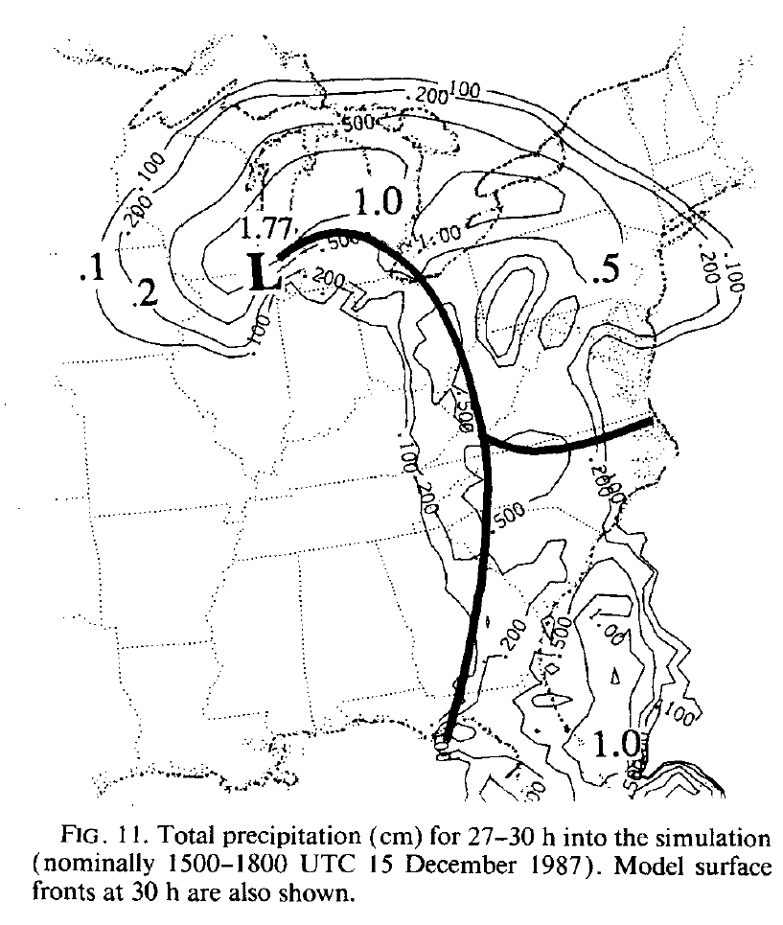

Slide 47
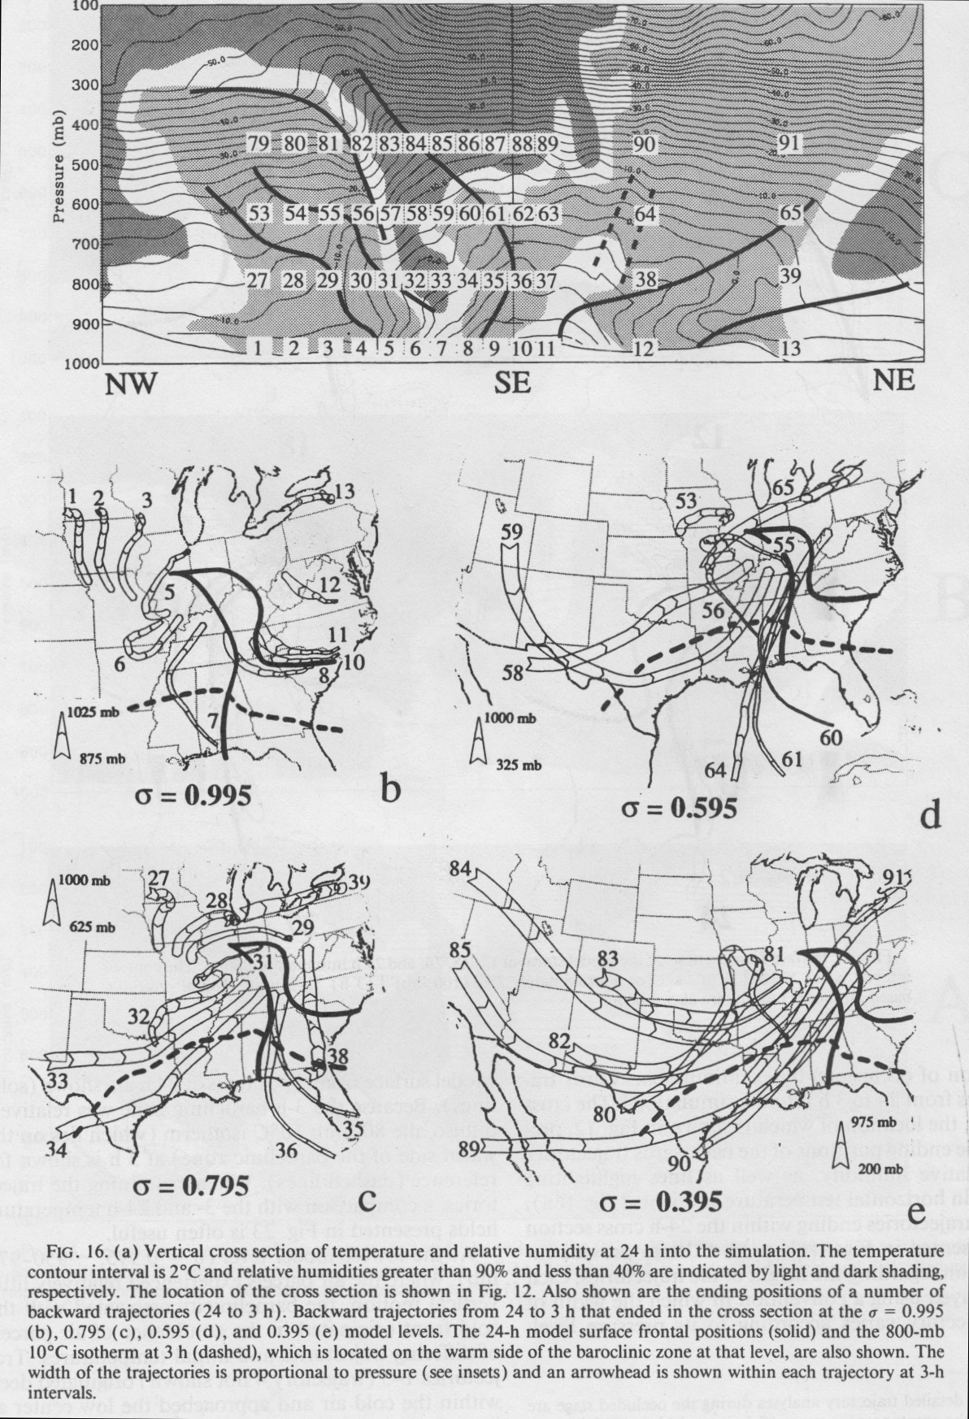
The Warm Sector Can Have Dry Air Overhead
Dry
Moist
Warm front
Cold front

Slide 49
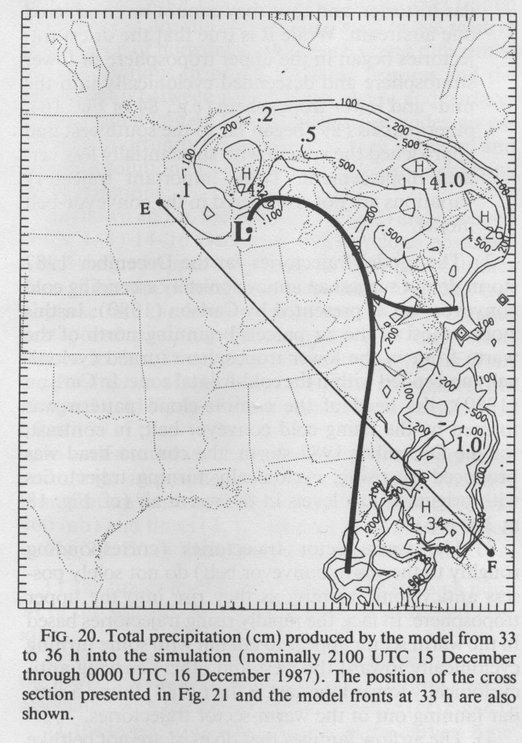
Can We Use Trajectories to Understand Why Precipitation Leads the Cold Front?

Slide 50
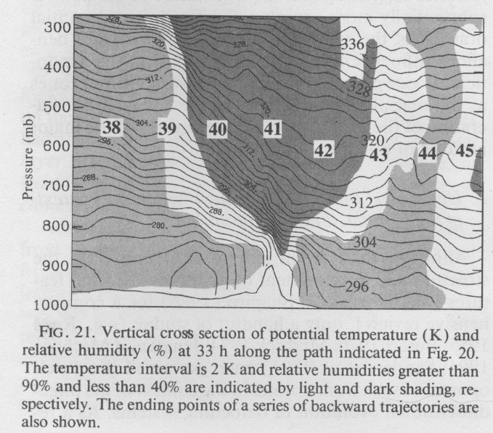

Slide 51
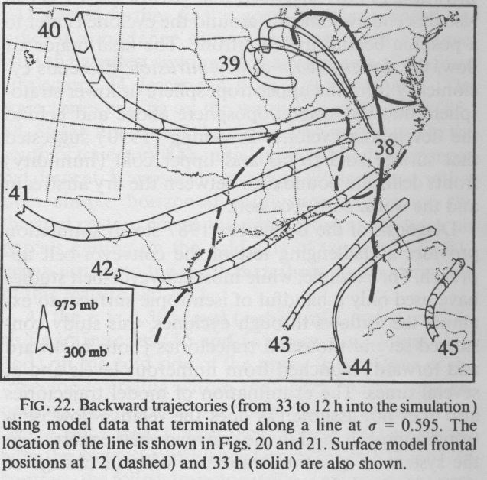

Slide 53
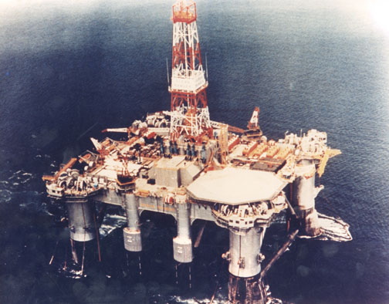
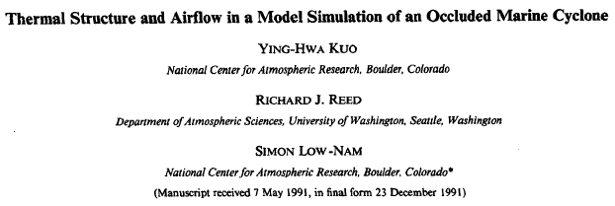
The Ocean Ranger Storm (1982)

Slide 54
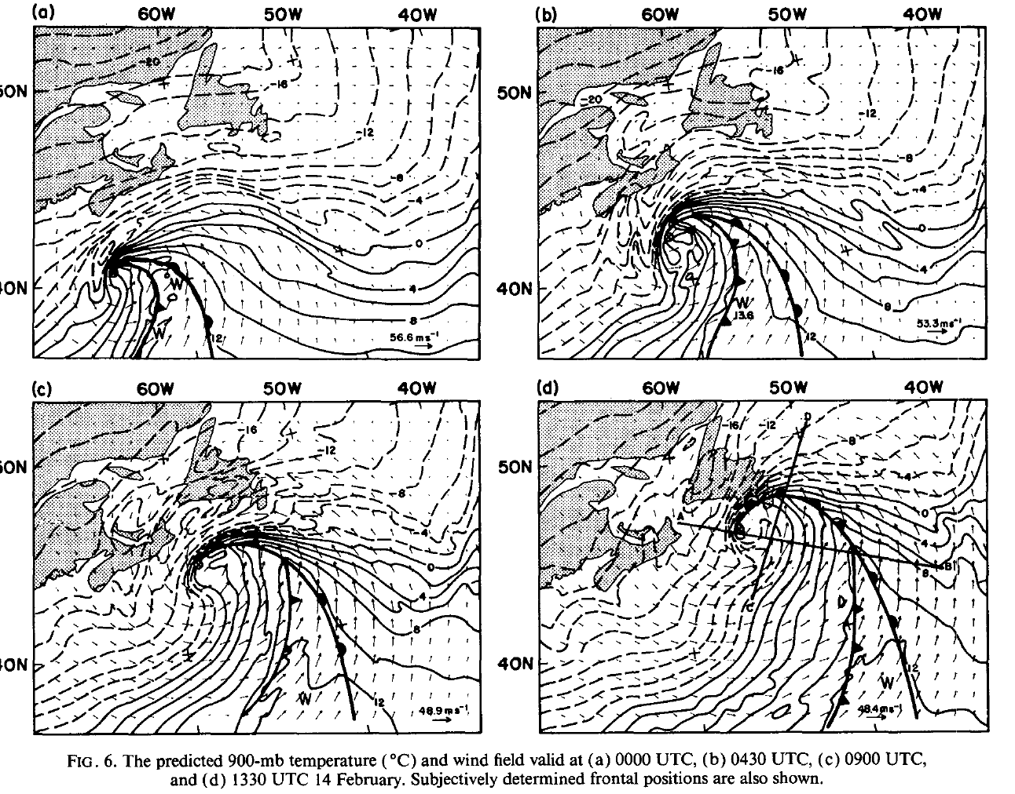

Slide 55
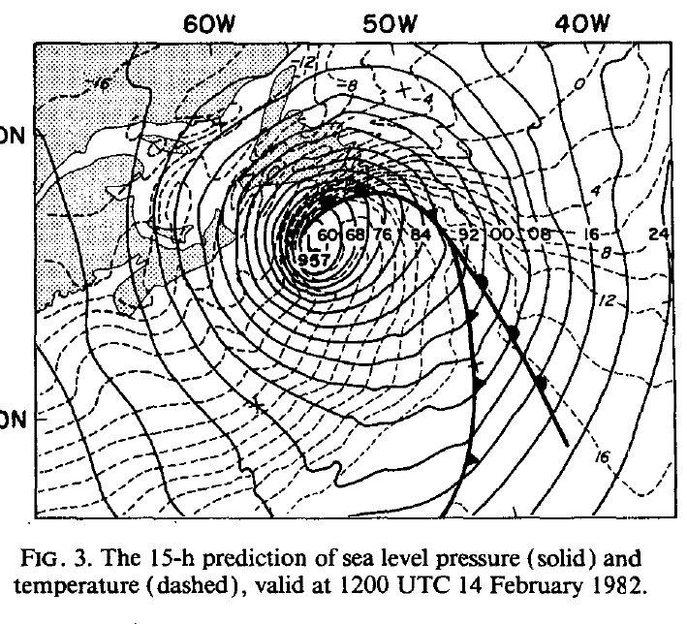

Slide 56
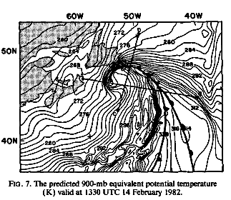

Slide 57
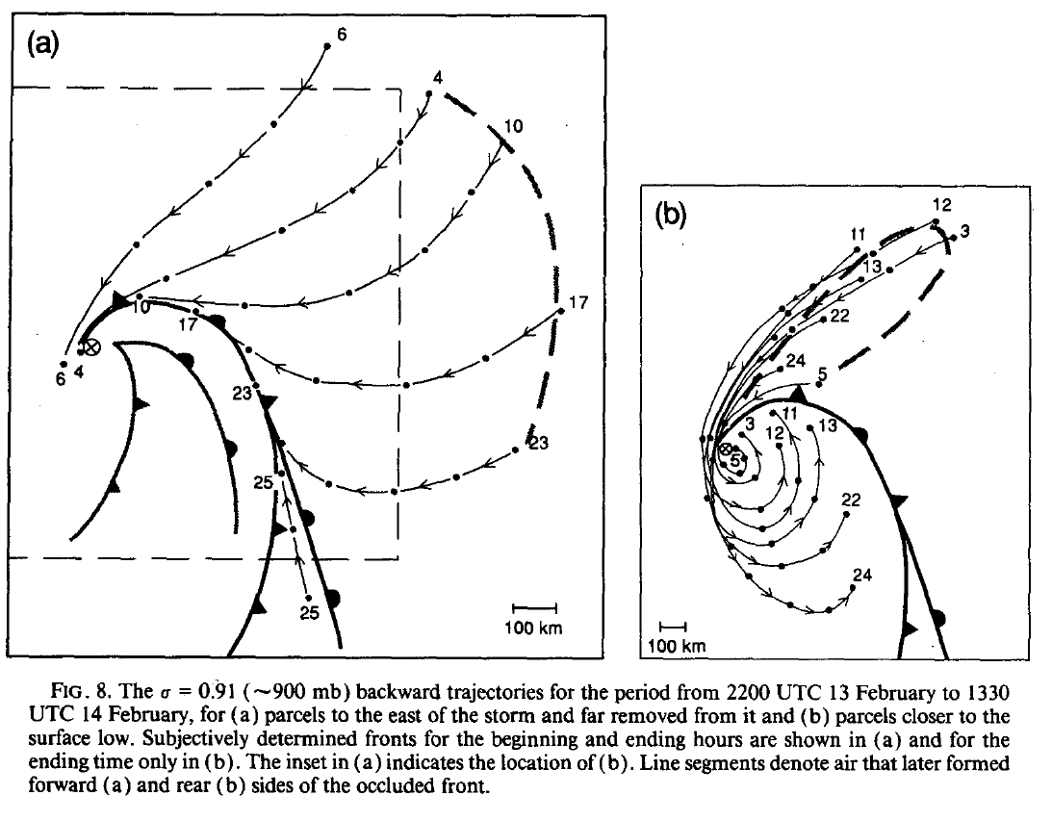
Low-level Trajectories Reveal the Origin of the Warm Seclusion

Slide 58
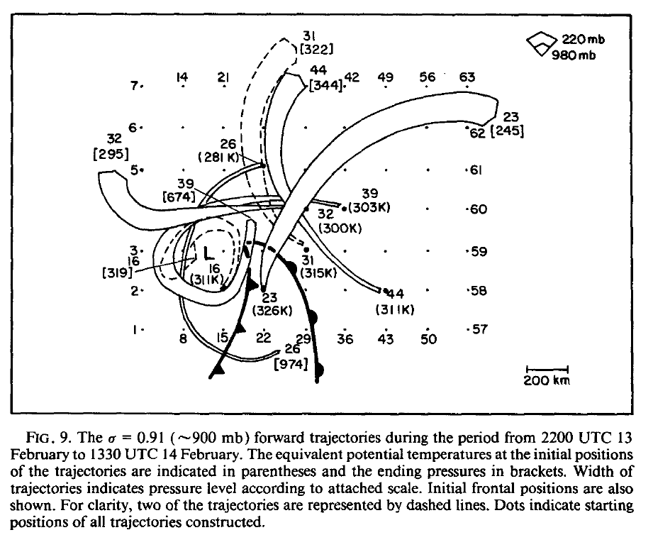

Slide 59
