Slide 1
Atmospheric Sciences 370
Atmospheric Structure and Analysis
Winter 2023
Instructors: Cliff Mass (lectures) and Rick Steed (lab)

Slide 2
Class Goals
Gain a basic understanding of the structure and evolution of synoptic systems such as fronts, jets, and cyclones.
Develop a better understanding of important dynamical concepts such as thermal wind, wind balances, and vorticity.
Develop facility with the basic tools of a synoptic meteorologist such as constant pressure/height charts, satellite imagery, and interactive analysis.
Develop skills in atmospheric analysis.
Understand essential elements of weather forecasting.

Slide 3
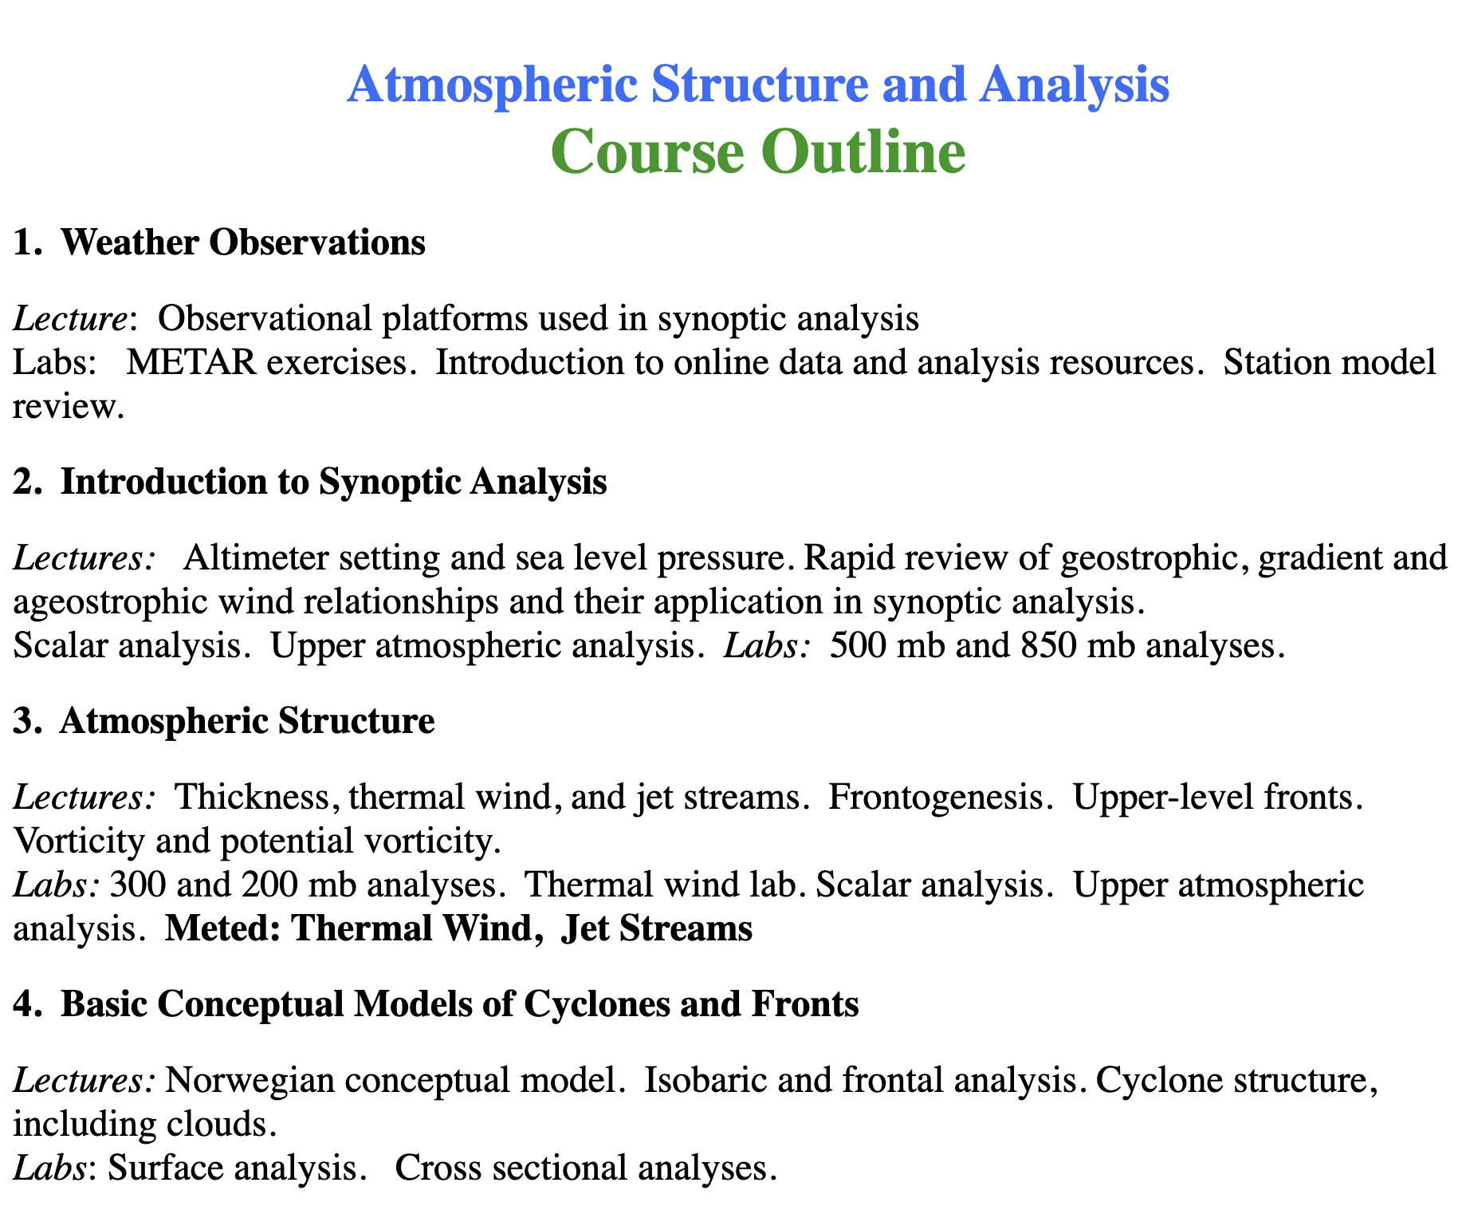
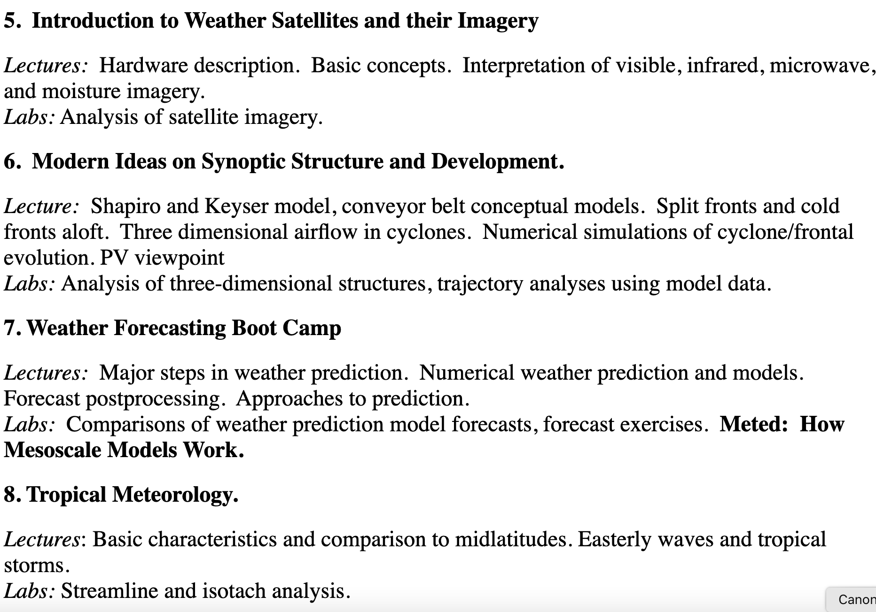

Slide 4
The Details
Class Times: MW, 1:30-4:20 PM; F 1:30-3:20 PM. Generally: first hour lecture, second and third hours map discussion and lab.
Office Hours: Flexible. Email to set up a time. In person, zoom session, or phone.
Textbook: Portions of Atmospheric Sciences: An Introductory Survey, by J.M. Wallace and P.V. Hobbs (Academic Press, 2006), COMET METED online modules, and supplementary handouts.
Grading: One midterm exam 30%; laboratory work 25%; homework and other assignments 15%, final exam 30%.

Slide 5
Details
Often a weather discussion between lectures and labs, with 5-10 minutes of break time between them
Labs include BOTH hand analysis and computer-based activities
Equipment needed: number two black pencils and an eraser. Red, blue, and purple pencils. Mechanical pencils don’t work.

Slide 6
Two Online Locations for Class
Class website, which included powerpoints used in class:
https://a.atmos.washington.edu/~cliff/370.html
Canvas website: includes assignments, grades, and more.
https://canvas.uw.edu/courses/1611497

