Slide 1
Atmospheric Sciences 101 Autumn 2023
Instructor: Cliff Mass
TA: Valeria Garcia

Slide 2

Goals of class
Become knowledgeable observers of the atmosphere
Learn how to interpret satellite and radar imagery, as well as weather maps
Acquire basic understanding of key atmospheric phenomena
Use the atmosphere to understand basic physical principles and laws
Basic introduction to climate change and global warming.
Become good weather consumers. Learn about best weather web sites, best weather apps, know what is hype and what is real.

Slide 3
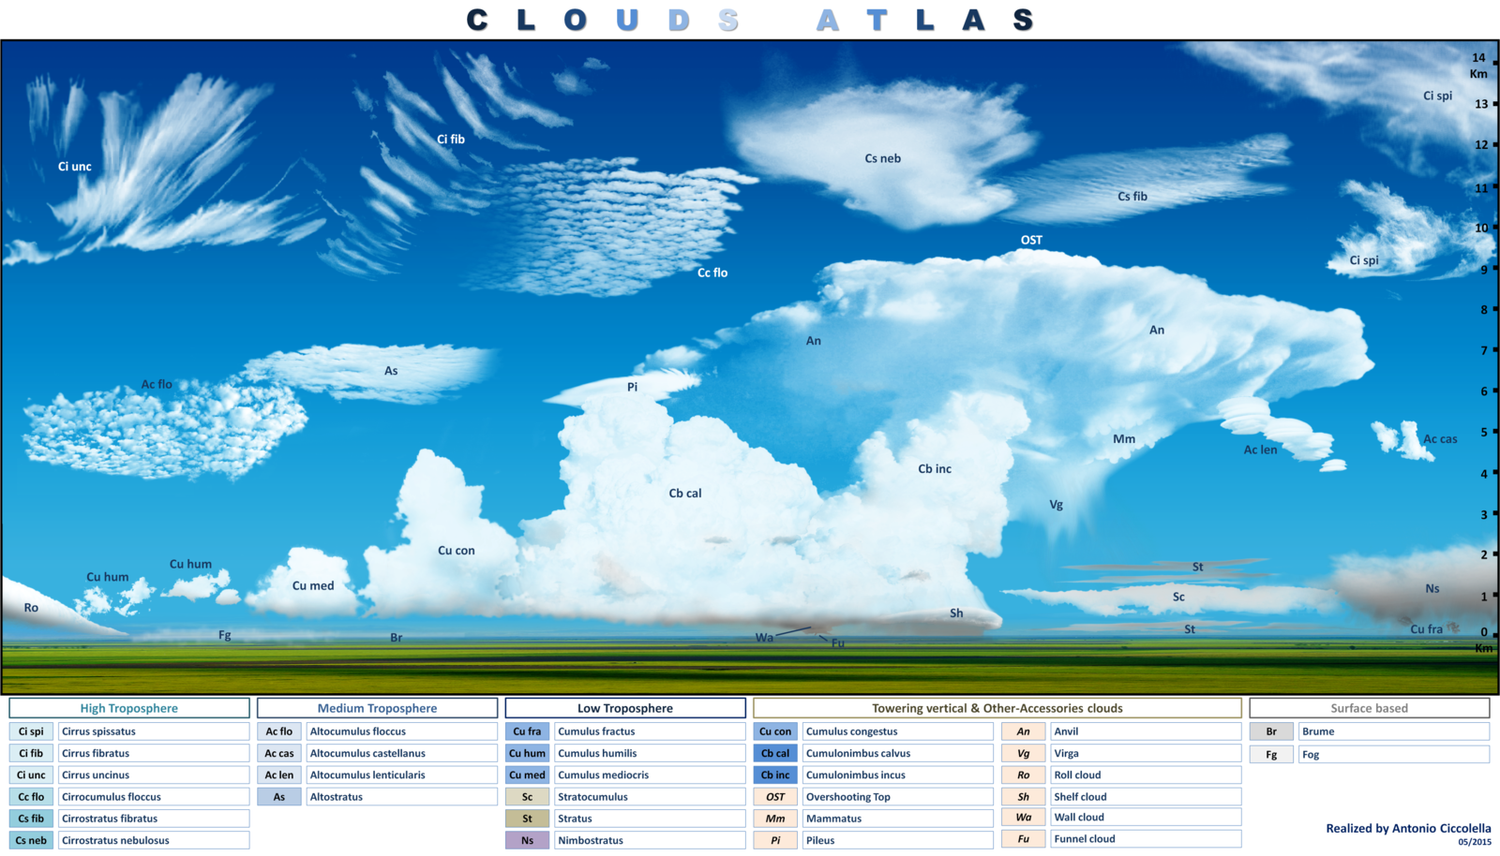
Course Outline
Quick Start Mini-Course
Introduction. Temperature and its measurement
Pressure and its measurement Wind and humidity Surface weather map Fronts and cyclones. Upper air observations Upper air charts. Weather satellite imagery
Weather radar
Identifying clouds

Slide 4

Course Outline
The Basics
Composition and origin of the atmosphere Vertical structure of the atmosphere Gas laws. Adiabatic warming and cooling Moisture and its measurement Condensation, evaporation, and latent heat Dew, frost, and fog Stability and instability Cloud development Precipitation mechanisms and weather modification Force and motion. Coriolis and pressure gradient forces Geostrophic balance. Effects of friction and topography Radiation laws. Solar and terrestrial (infrared) radiation Greenhouse effect and global warming Optical phenomena

Slide 5
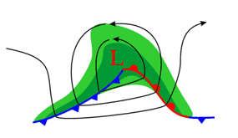
Course Outline
Storms and Weather Systems
Global wind systems Air masses and fronts Midlatitude cyclones and their development Local winds (sea breezes, mountain/valley winds) Thunderstorms Tornadoes Hurricanes and tropical meteorology
Weather Forecasting
Weather forecasting Personal weather forecasting; how to find reliable weather data on the net.
Additional Topics
El Nino/ENSO and it local/global effects Air pollution and the ozone hole

Slide 6
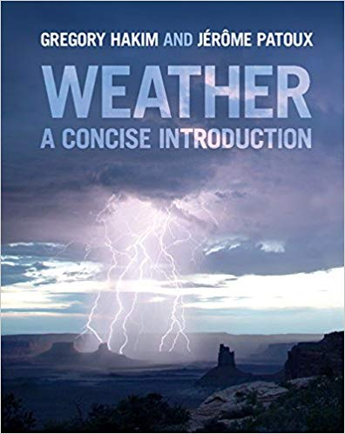
Books
No required book, but recommend Hakim/Patoux: Weather, A Concise Introduction
Generally parallels the lectures.

Slide 7
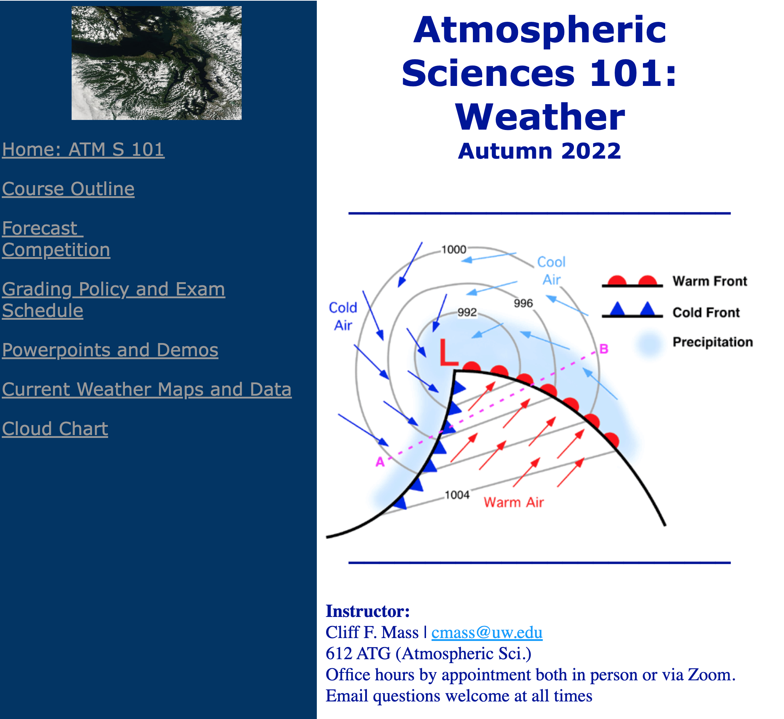
Class web site: Many class materials are there https://atmos.uw.edu/~cliff/ATMS101Y2023.html
Check frequently
Has course outline
All class powerpoints are found there
Forecast competition for extra credit
Cloud atlas and more!

Slide 8
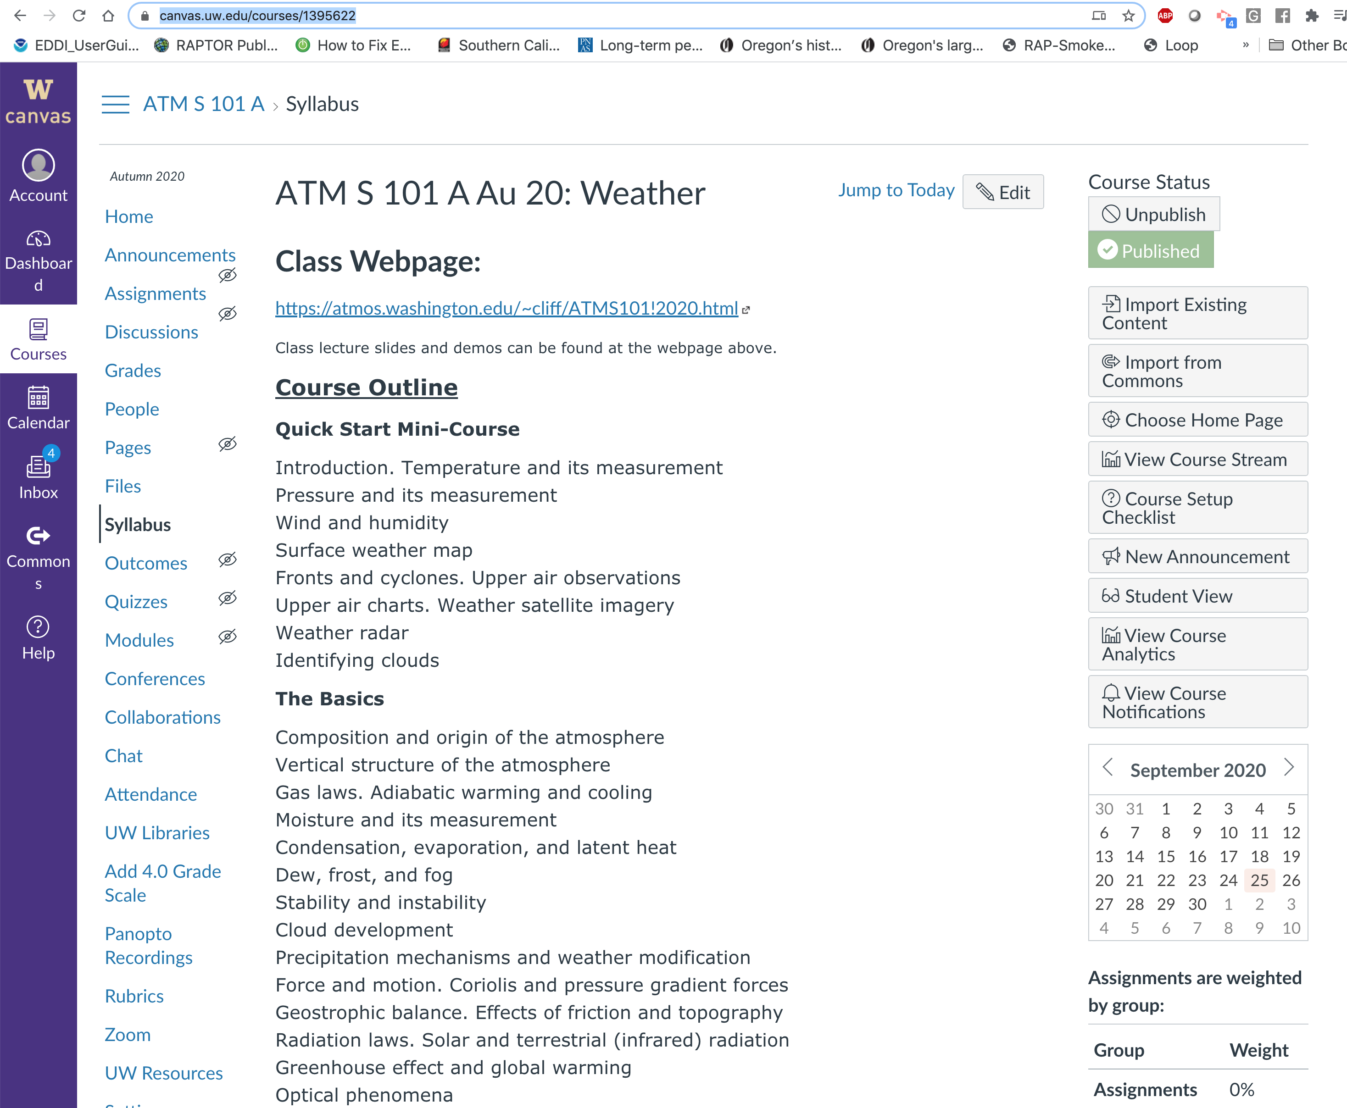
Exams, Quizzes, and Homeworks found on the class Catalyst Site
https://canvas.uw.edu/courses/1664105

Slide 9
Grading
Grading: Midterm: 25%; Quizzes: 25%; Homework 25%; Final exam, 25%.
Exam Schedule: Mid-Term Exam: TBD Final Exam: TBD
Homework: There will be five homework assignments--the lowest grade will be dropped. Homeworks will be due at the beginning of class on the dates specified. No late homework will be accepted.
Quizzes: There will be five quizzes. The lowest quiz grade will be dropped. There will be no quiz during the first week, the week before the midterm, the week of the midterm, and the last week. Extra credit available for those in the forecast competition (more on this later).

Slide 10
More
Each class will generally be divided into:
10 minutes weather discussion
40 minutes lecture
Office hours, etc.
Valeria will schedule both group and one-on-one office hours (in person and zoom)
We will be happy to schedue office hours by appointment (zoom or in person)
I will have some group question sessions before exams (in person or zoom)
Questions are WELCOME in class

Slide 11
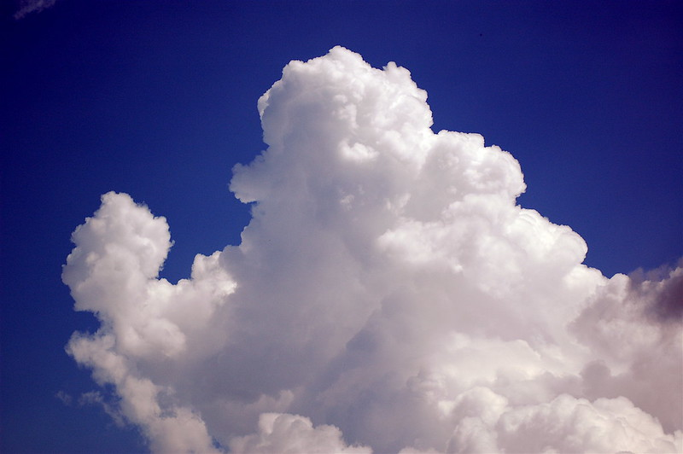
Questions?

Slide 12
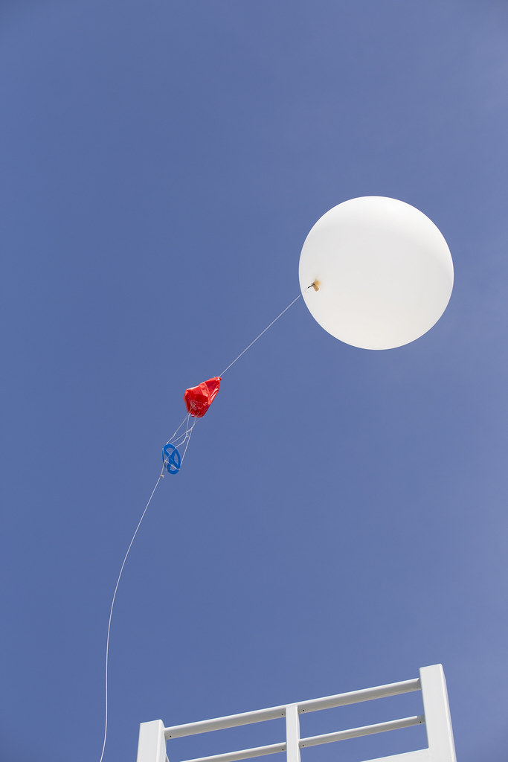
Meteorology and Atmospheric Sciences
Meteorology from
Meteoron –Greek for phenomenon or thing in the sky
ology—study of
the branch of science concerned with the processes and phenomena of the atmosphere
Atmospheric Sciences is basically the same thing.

