Slide 1
452 Precipitation Forecasting
ATMS 452
Spring 2024

Slide 2
Prediction of Clouds and Precipitation often Lack Skill
Most precipitation is inherently mesoscale and many models lack sufficient resolution.
H₂0 vapor is relatively poorly observed on both the mesoscale and synoptic scale.
Microphysics problems are substantial. Other physics problems (e.g., PBL) add to the difficulties.
Cumulus parameterizations are problematic.

Slide 3
Cloud and precipitation microphysics
Microphysics refers to the physical processes occurring at the scale of individual cloud and precipitation particles or hydrometeors (sub‐micron to several centimeters).

Slide 4
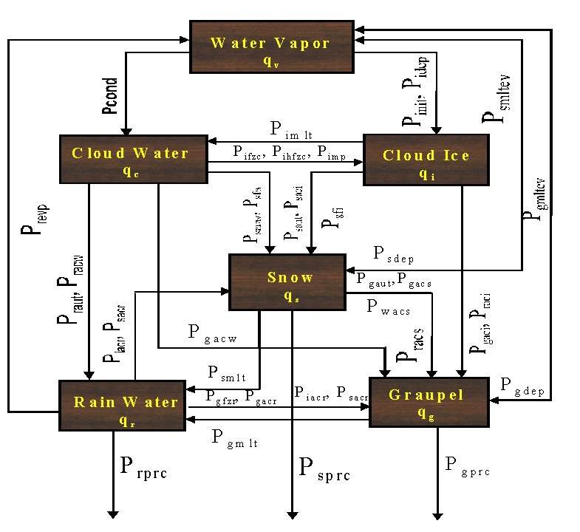
Model Microphysics: Highly Complex and Too Simple

Slide 5
Model Microphysics
Most models use bulk parameterizations that predict mixing ratios (g of water vapor to kg of dry air) of various cloud/precipitation species (like cloud water). Called single-moment schemes
Newer schemes are double moment, predicting mixing ratio and the number concentrations of each precipitation/cloud type.
Both single and double moment schemes assume size distributions for clouds and precipitation, often some kind of exponential.

Slide 6
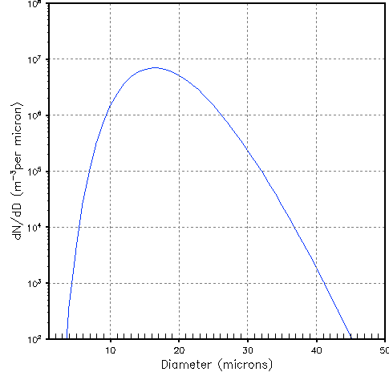
Cloud Droplet Size Distribution

Slide 7
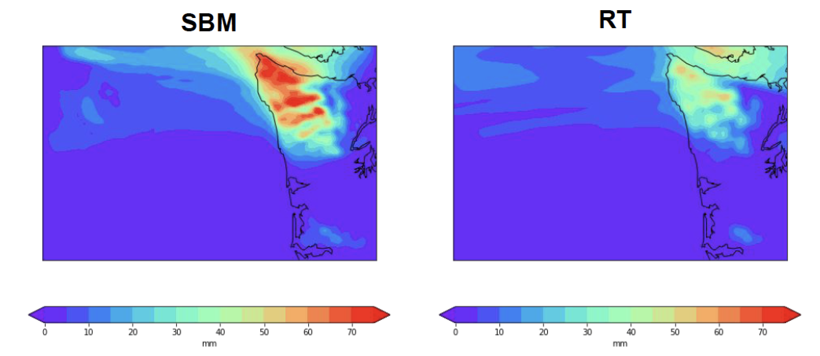
Spectral Bin Microphysics Schemes are even more sophisticated
They predict the details of the size distribution by dividing it into size bins, each of which is forecast over time.
Produces more skillful precipitation
Computationally expensive. Too much for operational application.

Slide 8
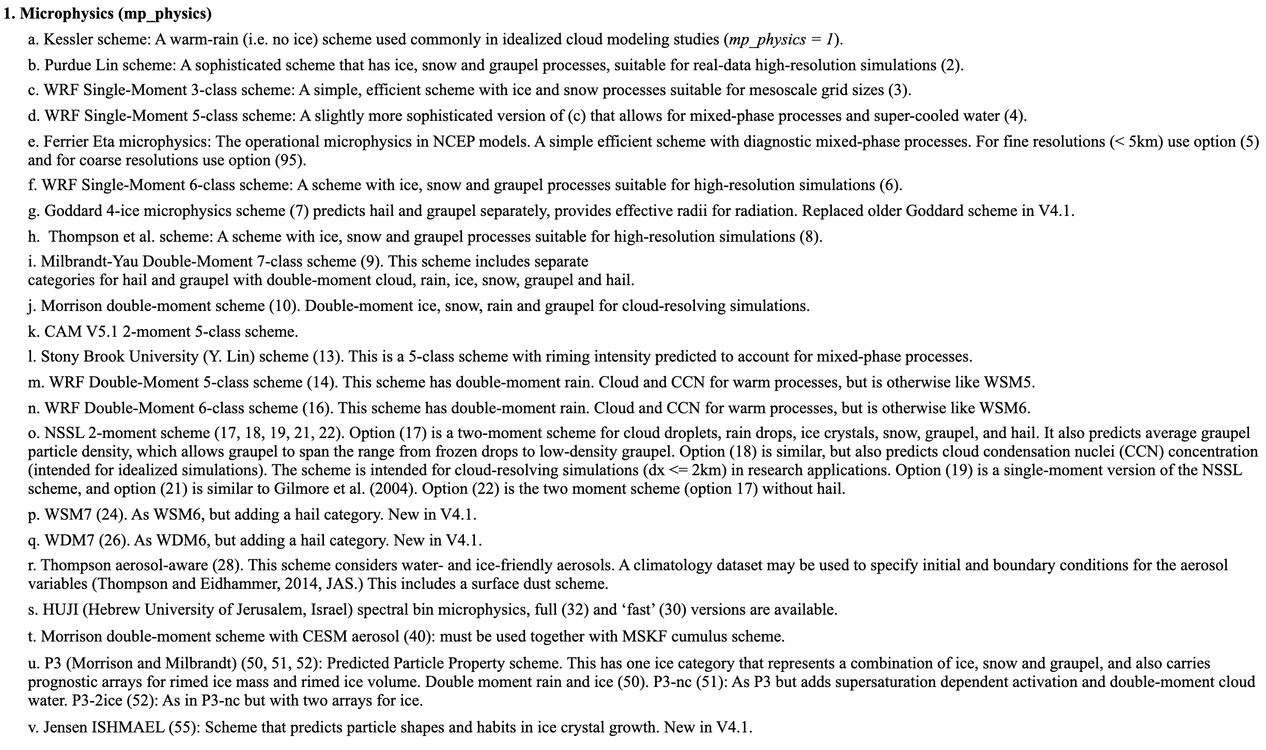
There are a LOT of Microphysics Parameterizations Available

Slide 9
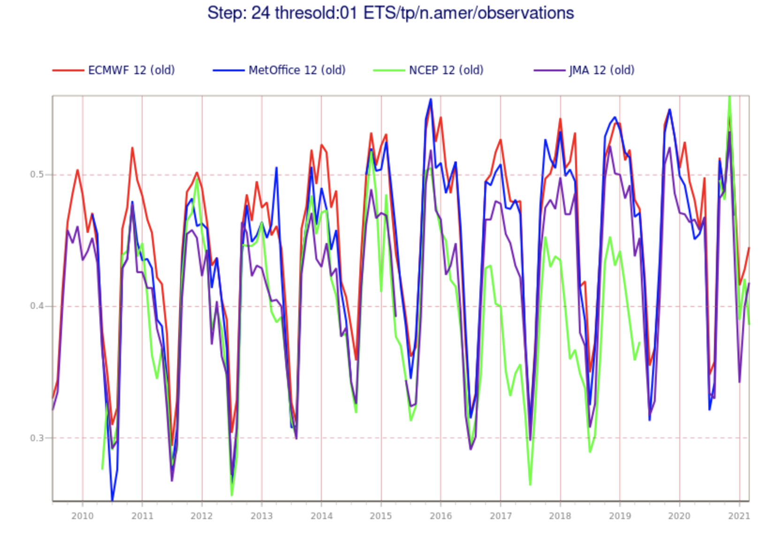
Precipitation Forecast Skill
Modest improvement during the past 30 years
Skill declines with intensity
Humans add less skill than for most other weather parameters

Slide 10

Question.
Is Precipitation Forecast Skill Generally Better in Summer or Winter?

Slide 11
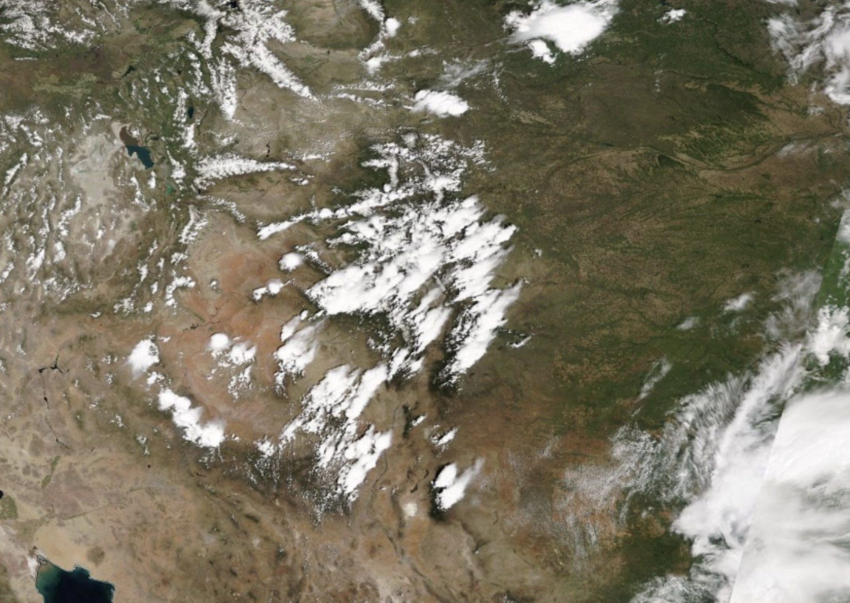
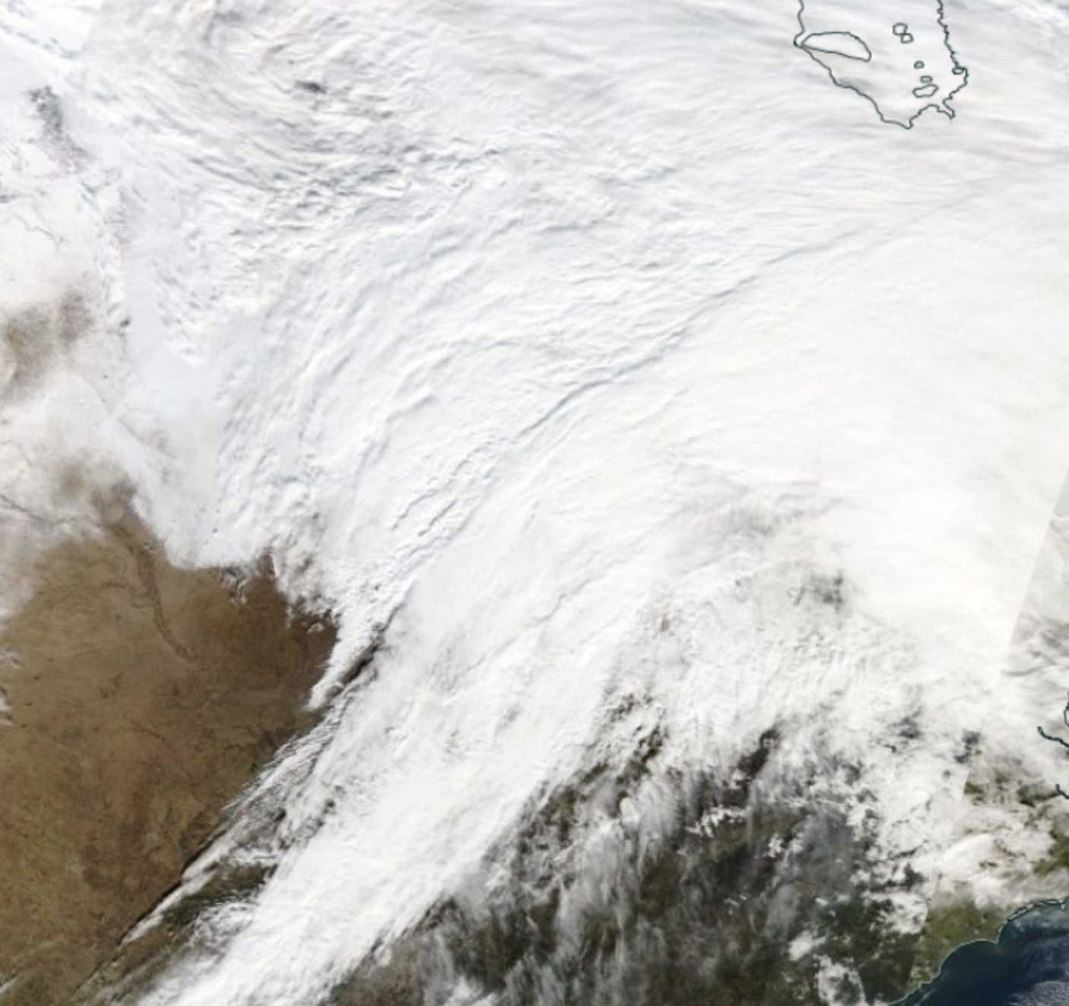
The Answer
Better in winter when precipitation is more synoptic and stratiform
Less skillful in summer when more convective
Less skillful
More Skillful

Slide 12
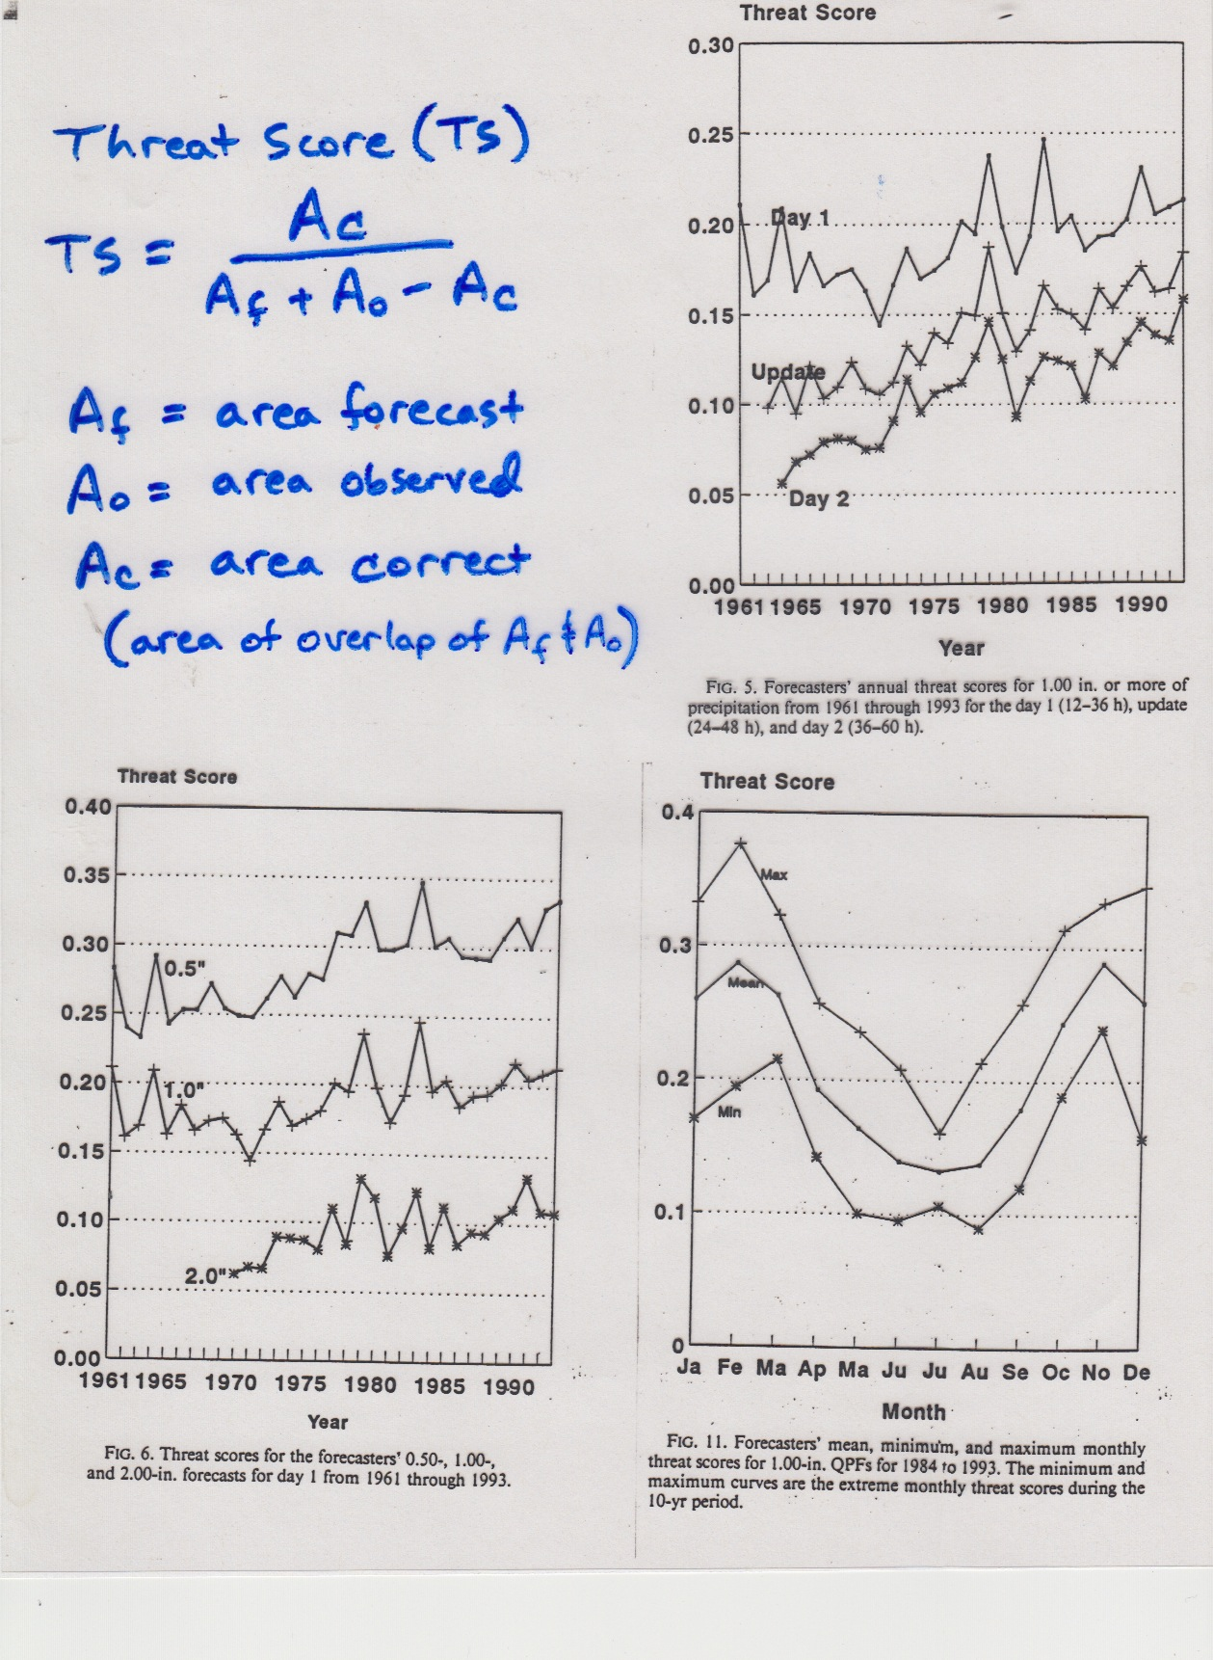

Slide 13
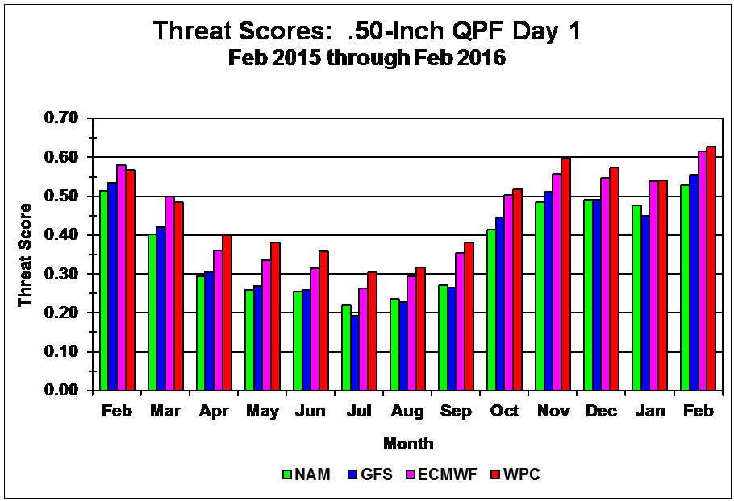
More recent

Slide 14
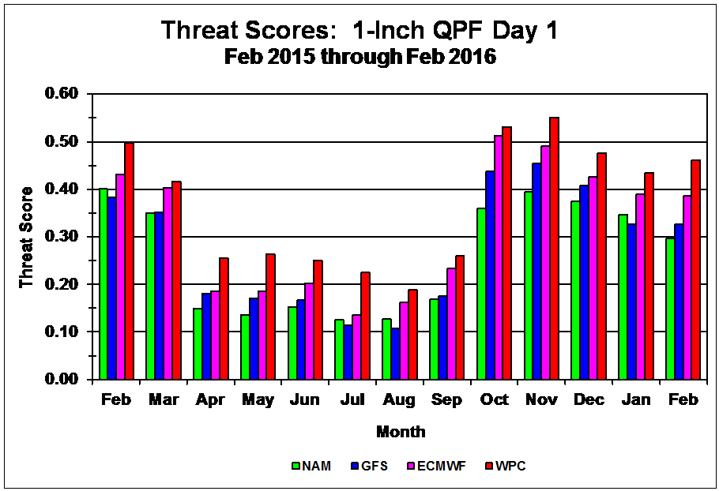

Slide 15
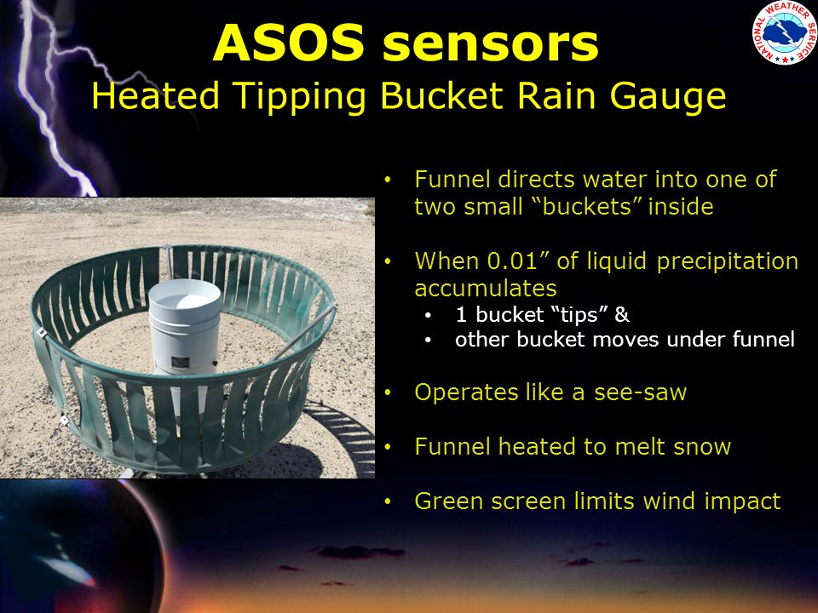
NWS ASOS Rain Gauge

Slide 16
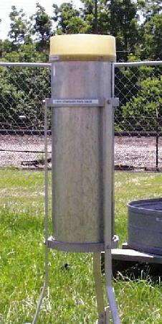
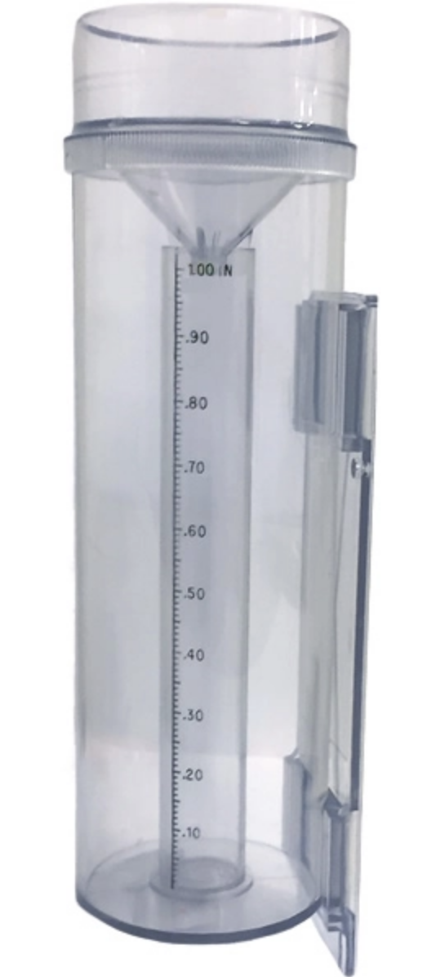
At lesser sites, 8” rain gauges typical, also plastic Cocorahs gauges

Slide 17
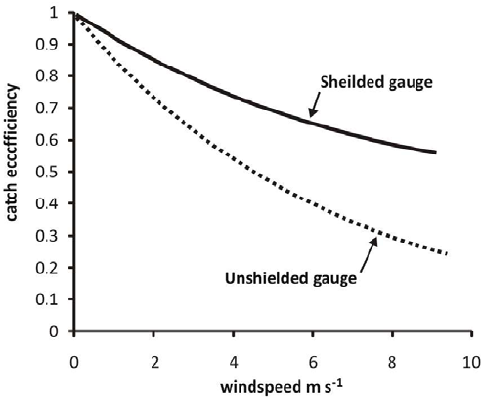
Undercatch can be a problem, particularly when wind speed increases
Worse for snow than rain
Worse for unshielded gauge

Slide 18
Mechanisms producing saturation, clouds and precipitation
Dynamical forcing as expressed by QG dynamics: broad frontal-scale clouds.
Topographic: upslope precip, mountain waves clouds.
Convection: produced by destablization of the atmosphere.
Total precipitation is the product of all three

Slide 19
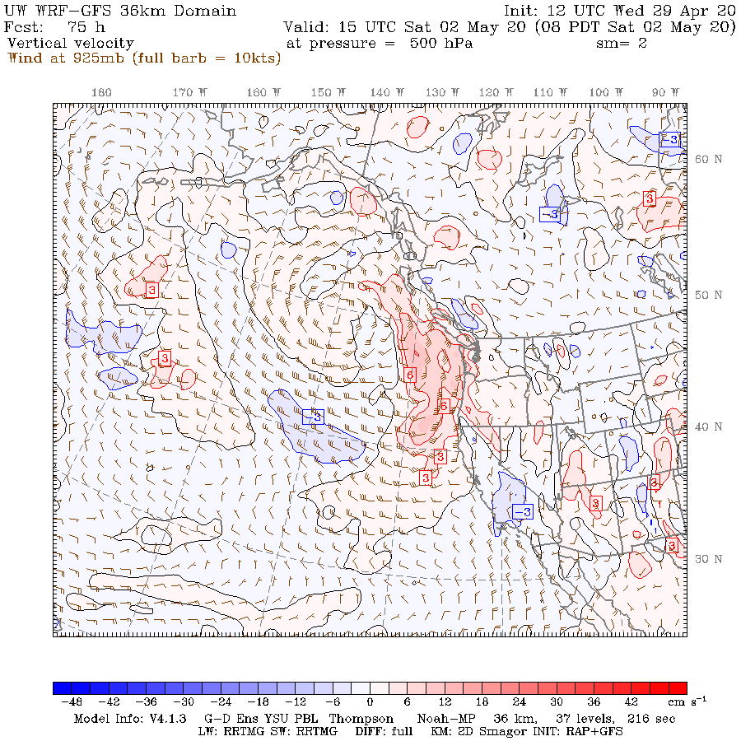
Dynamical forcing as expressed by QG dynamics
  Vertical motions acting to maintain thermal wind balance
  Can be diagnosed directly from model output or from Q-vectors (convergence of Q-vectors related to vertical motion)
  MODELS DO WELL WITH SUCH Large Scale Uplift

Slide 20
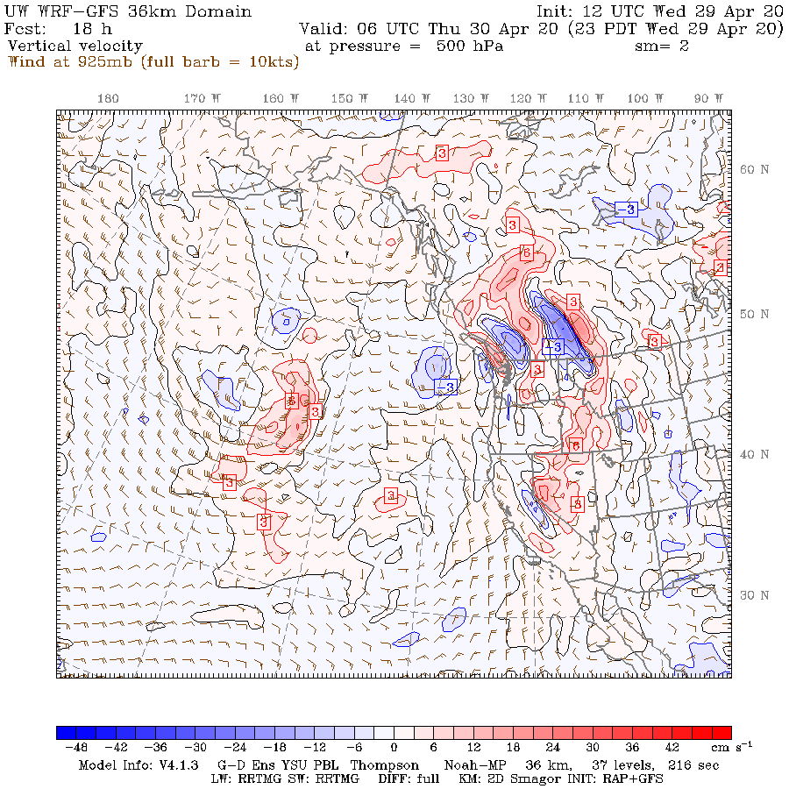
Topographic Forcing of Clouds and Precipitation
Topographic: upslope precip and clouds, mountain waves, rain shadows
  With sufficient resolution, often skillfully forecast by models
  Some problems with microphysics over terrain produce serious biases (e.g., underprediction along the NW coastal mountains)

Slide 21
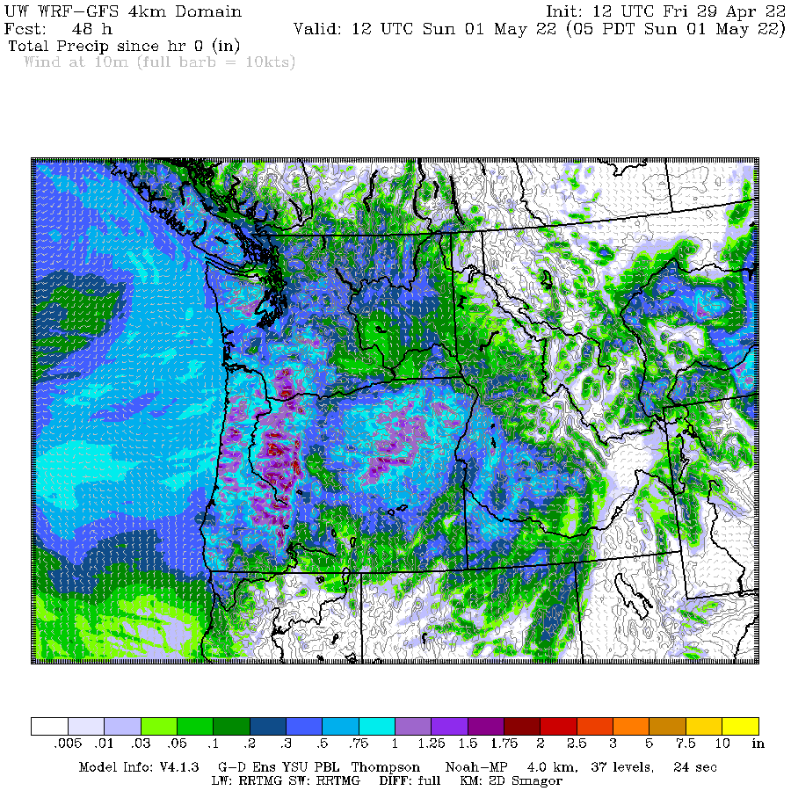
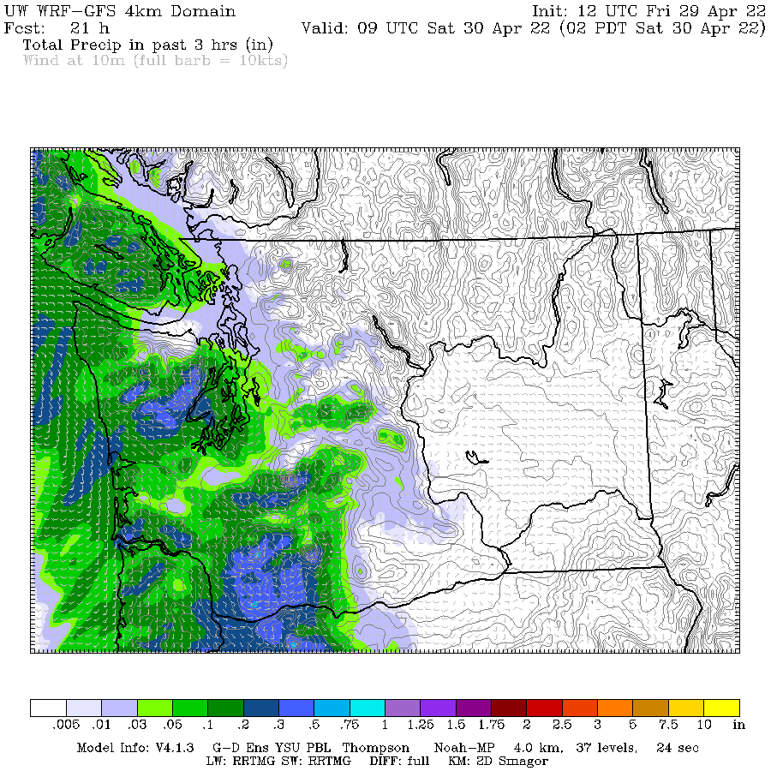
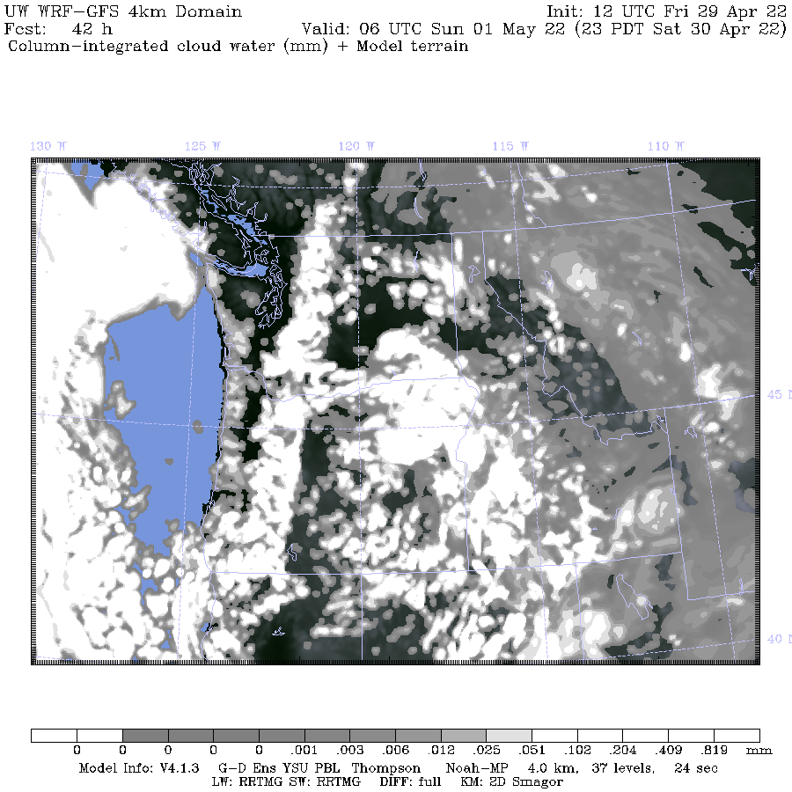

Slide 24
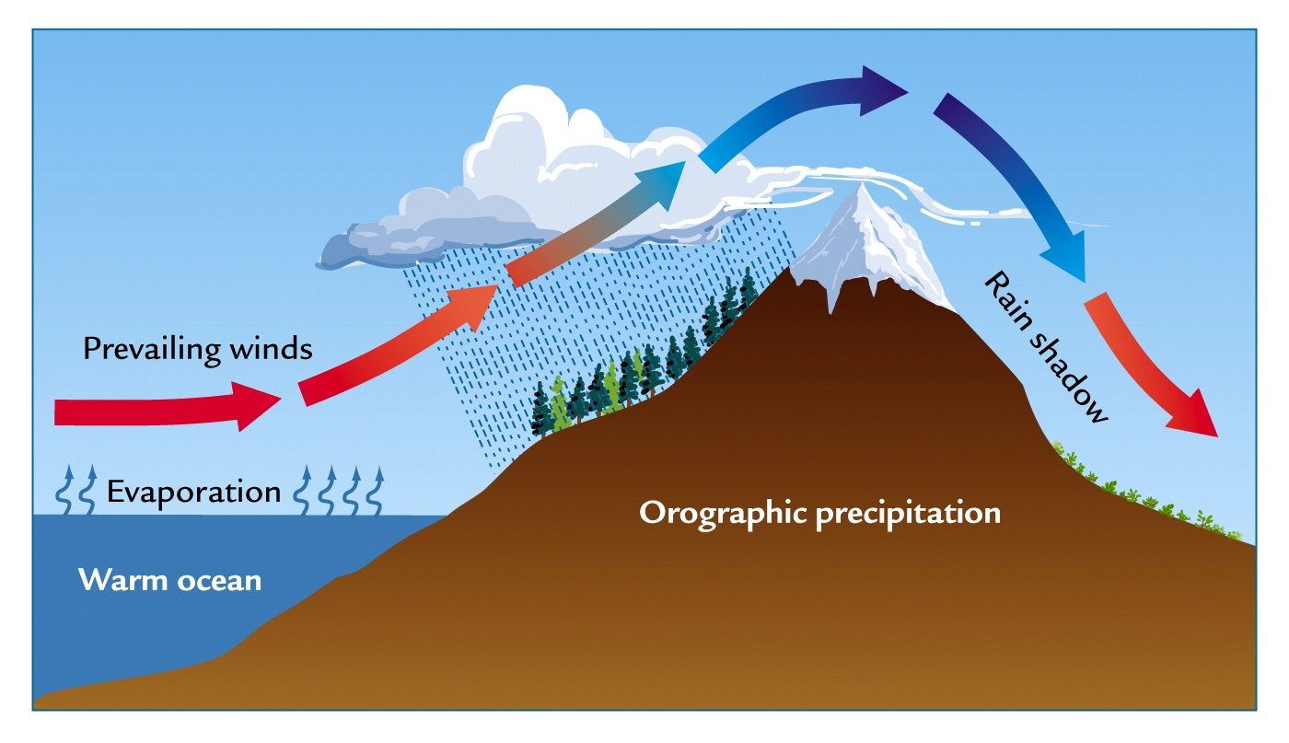
Topographic Forcing of Precipitation
Windward enhancement
Lee rain shadowing

Slide 25
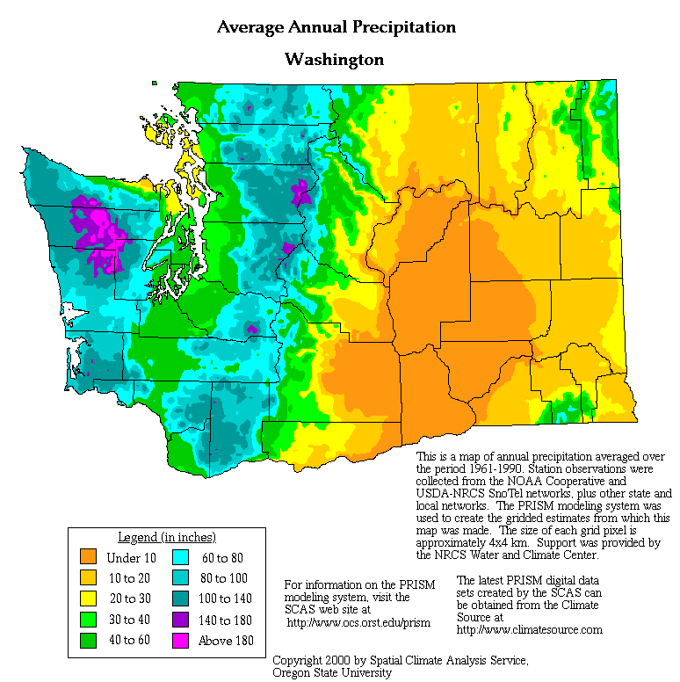
Annual Precipitation

Slide 26
Orographic precipitation can occur in isolation or in concert with precipitation from a synoptic scale system

Slide 27
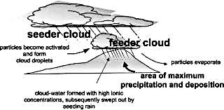
Example: Feeder-seeder mechanism

Slide 28
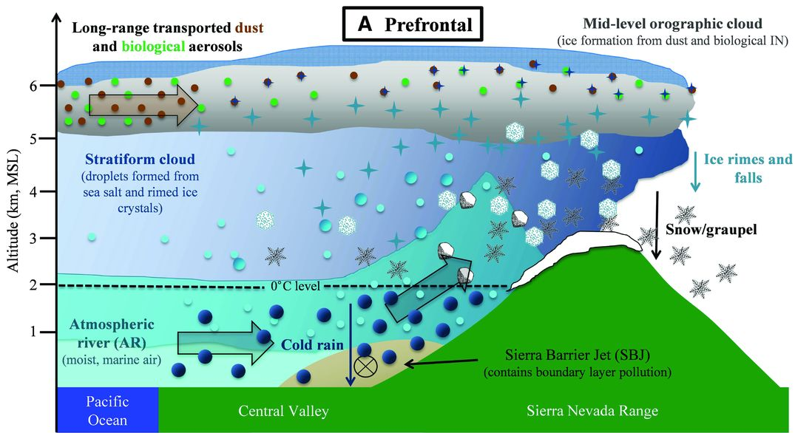

Slide 29
Warm Rain and Cold-Cloud Processes Versus Terrain
Warm rain processes tends to be most active on lower terrain (condensation and coalescence dominant). Can produce heavy rain at lower elevations, often with small to moderate droplet sizes.
Cold-cloud/mixed phase (snow, riming, etc) processes more dominant on upper slopes

Slide 30
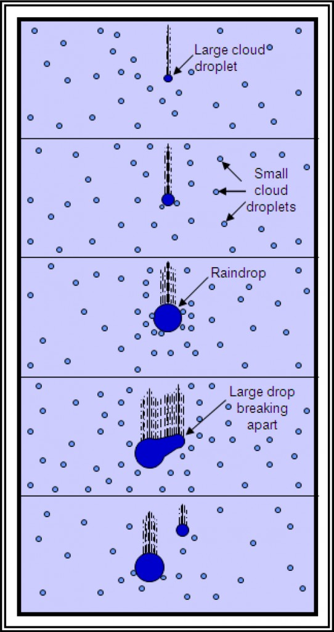
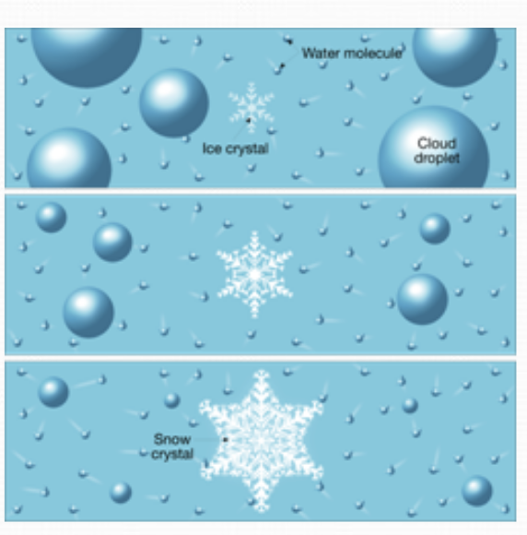
Cold cloud
Warm rain

Slide 31
Windward Enhancement
For relatively stable flow and typical barrier, max precip tends to be on upper slopes of barrier (typically 3000-6000 ft).
But does depend on height of mountains, stability, wind direction, shear, freezing level, and location.
Precip eventually starts to DECREASE at higher elevations. (moisture availability, terrain cross section)
Here in NW precipitation starts to lessen between 5000 and 7000 ft. Less on top of Mt. Rainier.

Slide 32
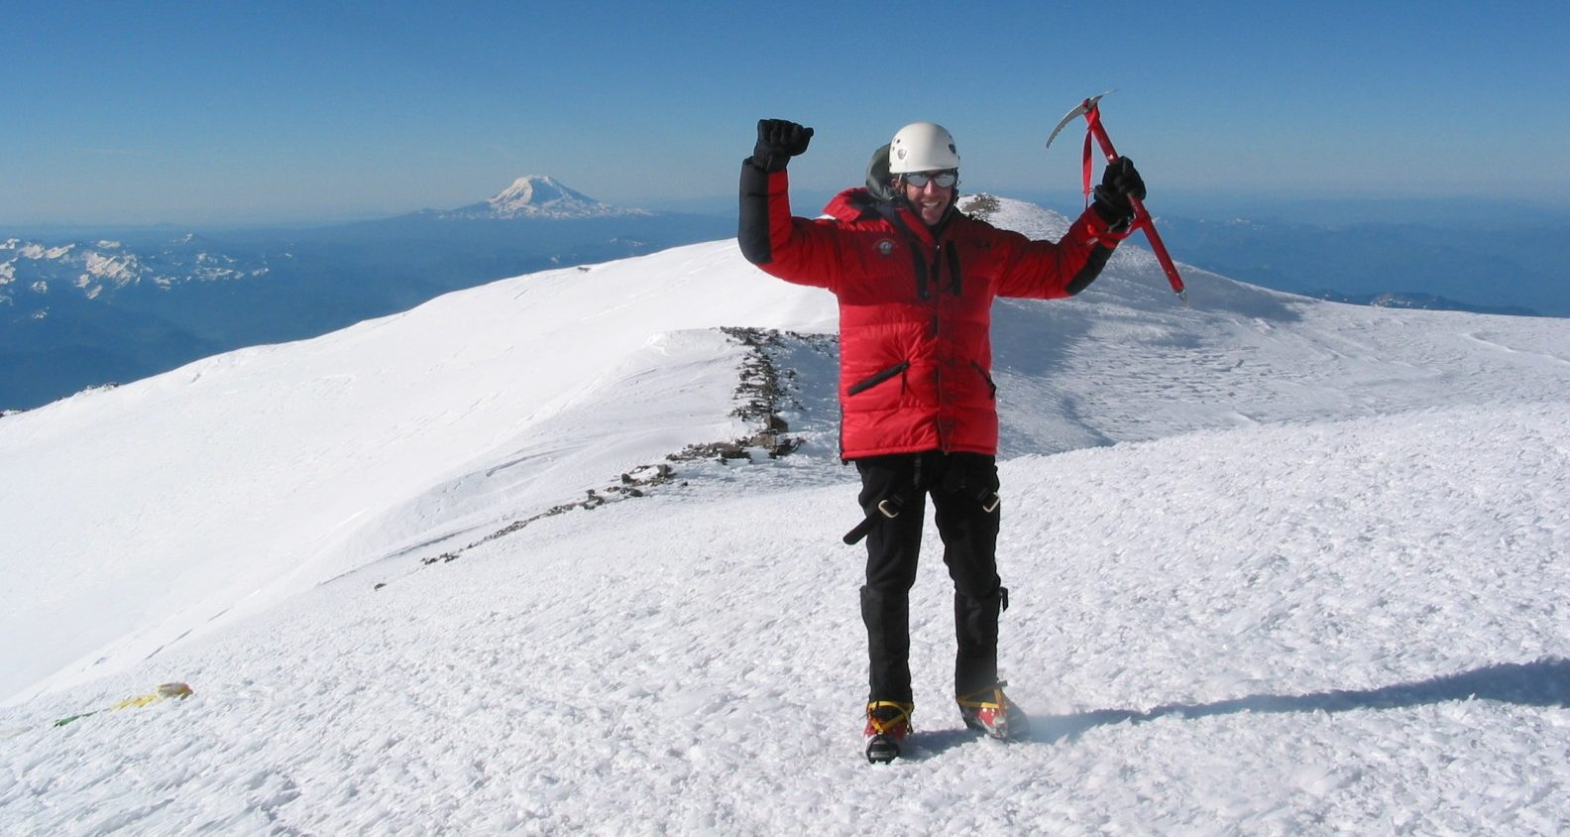
Drier up there

Slide 33
How large is orographic windward enhancement?
2-10x for major mountain barriers (thousands of feet high)
1-3x for smaller barriers (hundreds of meters)
Orographic effects are strongest when winds are perpendicular to barrier

Slide 34
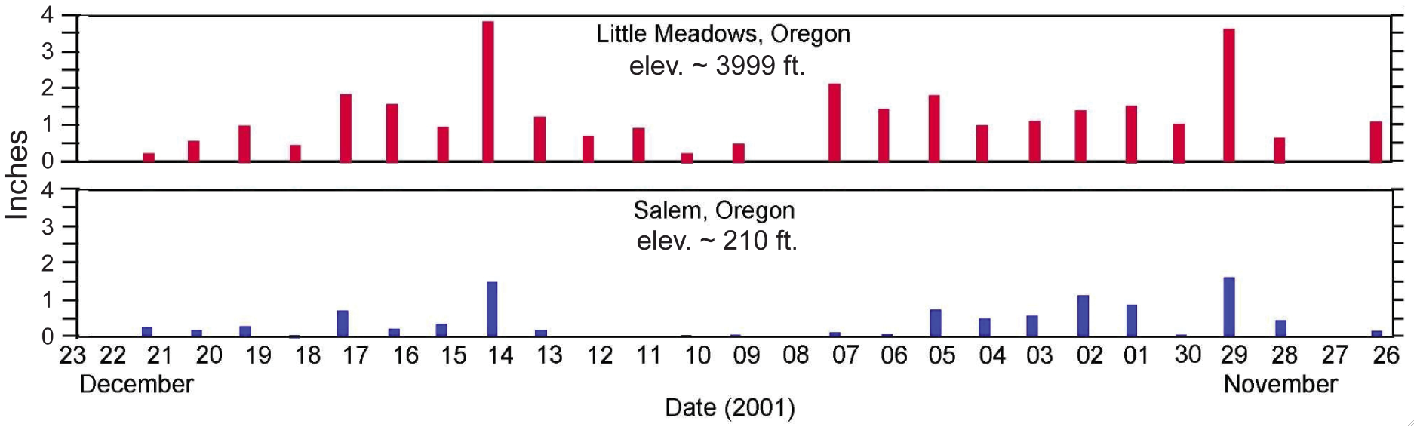
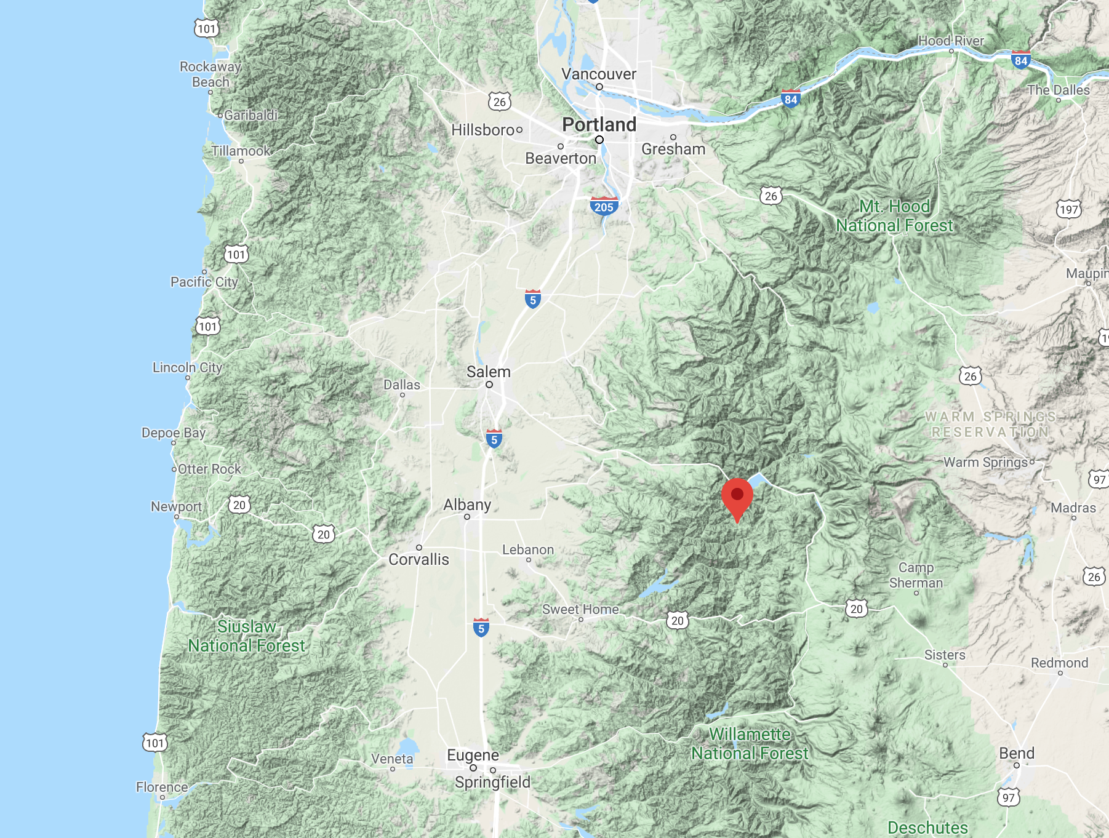

Slide 35
Orographic precipitation enhancement
Notes:
The basic idea is simple. The details of the dynamics and microphysics are more complicated. Flow over topography is a special case of dynamics that has to be considered separately or in addition to the other processes producing lifting and condensation. The pattern of fallout of the orographic precipitation is sensitive to the microphysical processes. How fast can the precip fall out?

Slide 36
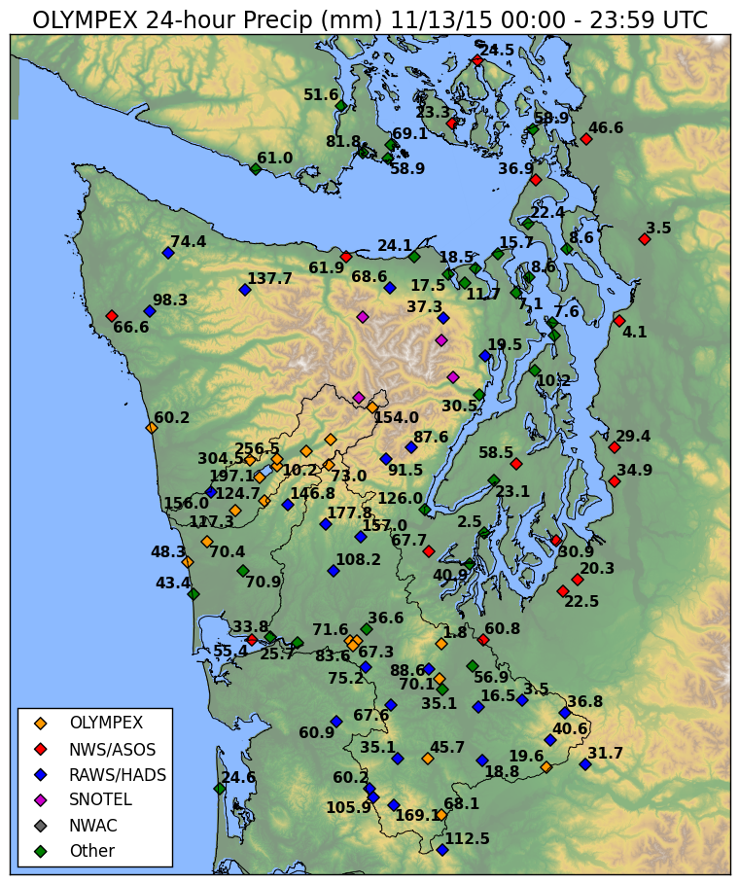

Slide 37
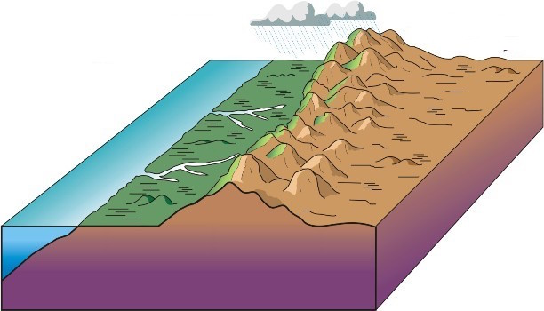
Orographic Precipitation Depends on Wind Direction
Heavier precipitation with flow perpendicular (normal) to the barrier.
Heavy
Light

Slide 38
For low stability conditions, convection can be released on the lower foothills of terrain, resulting in max precipitation at the lowest elevations rather than higher up on the terrain.

Slide 39
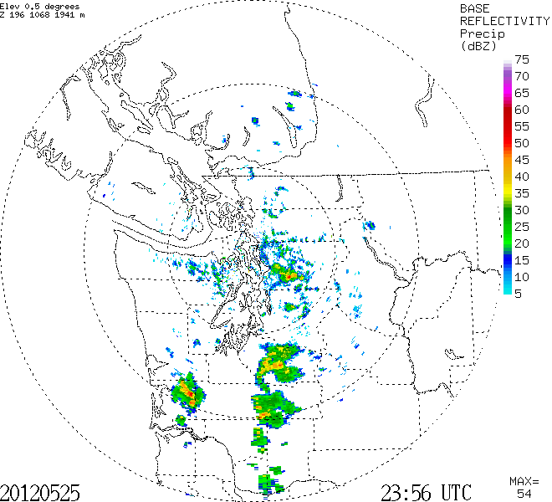

Slide 40
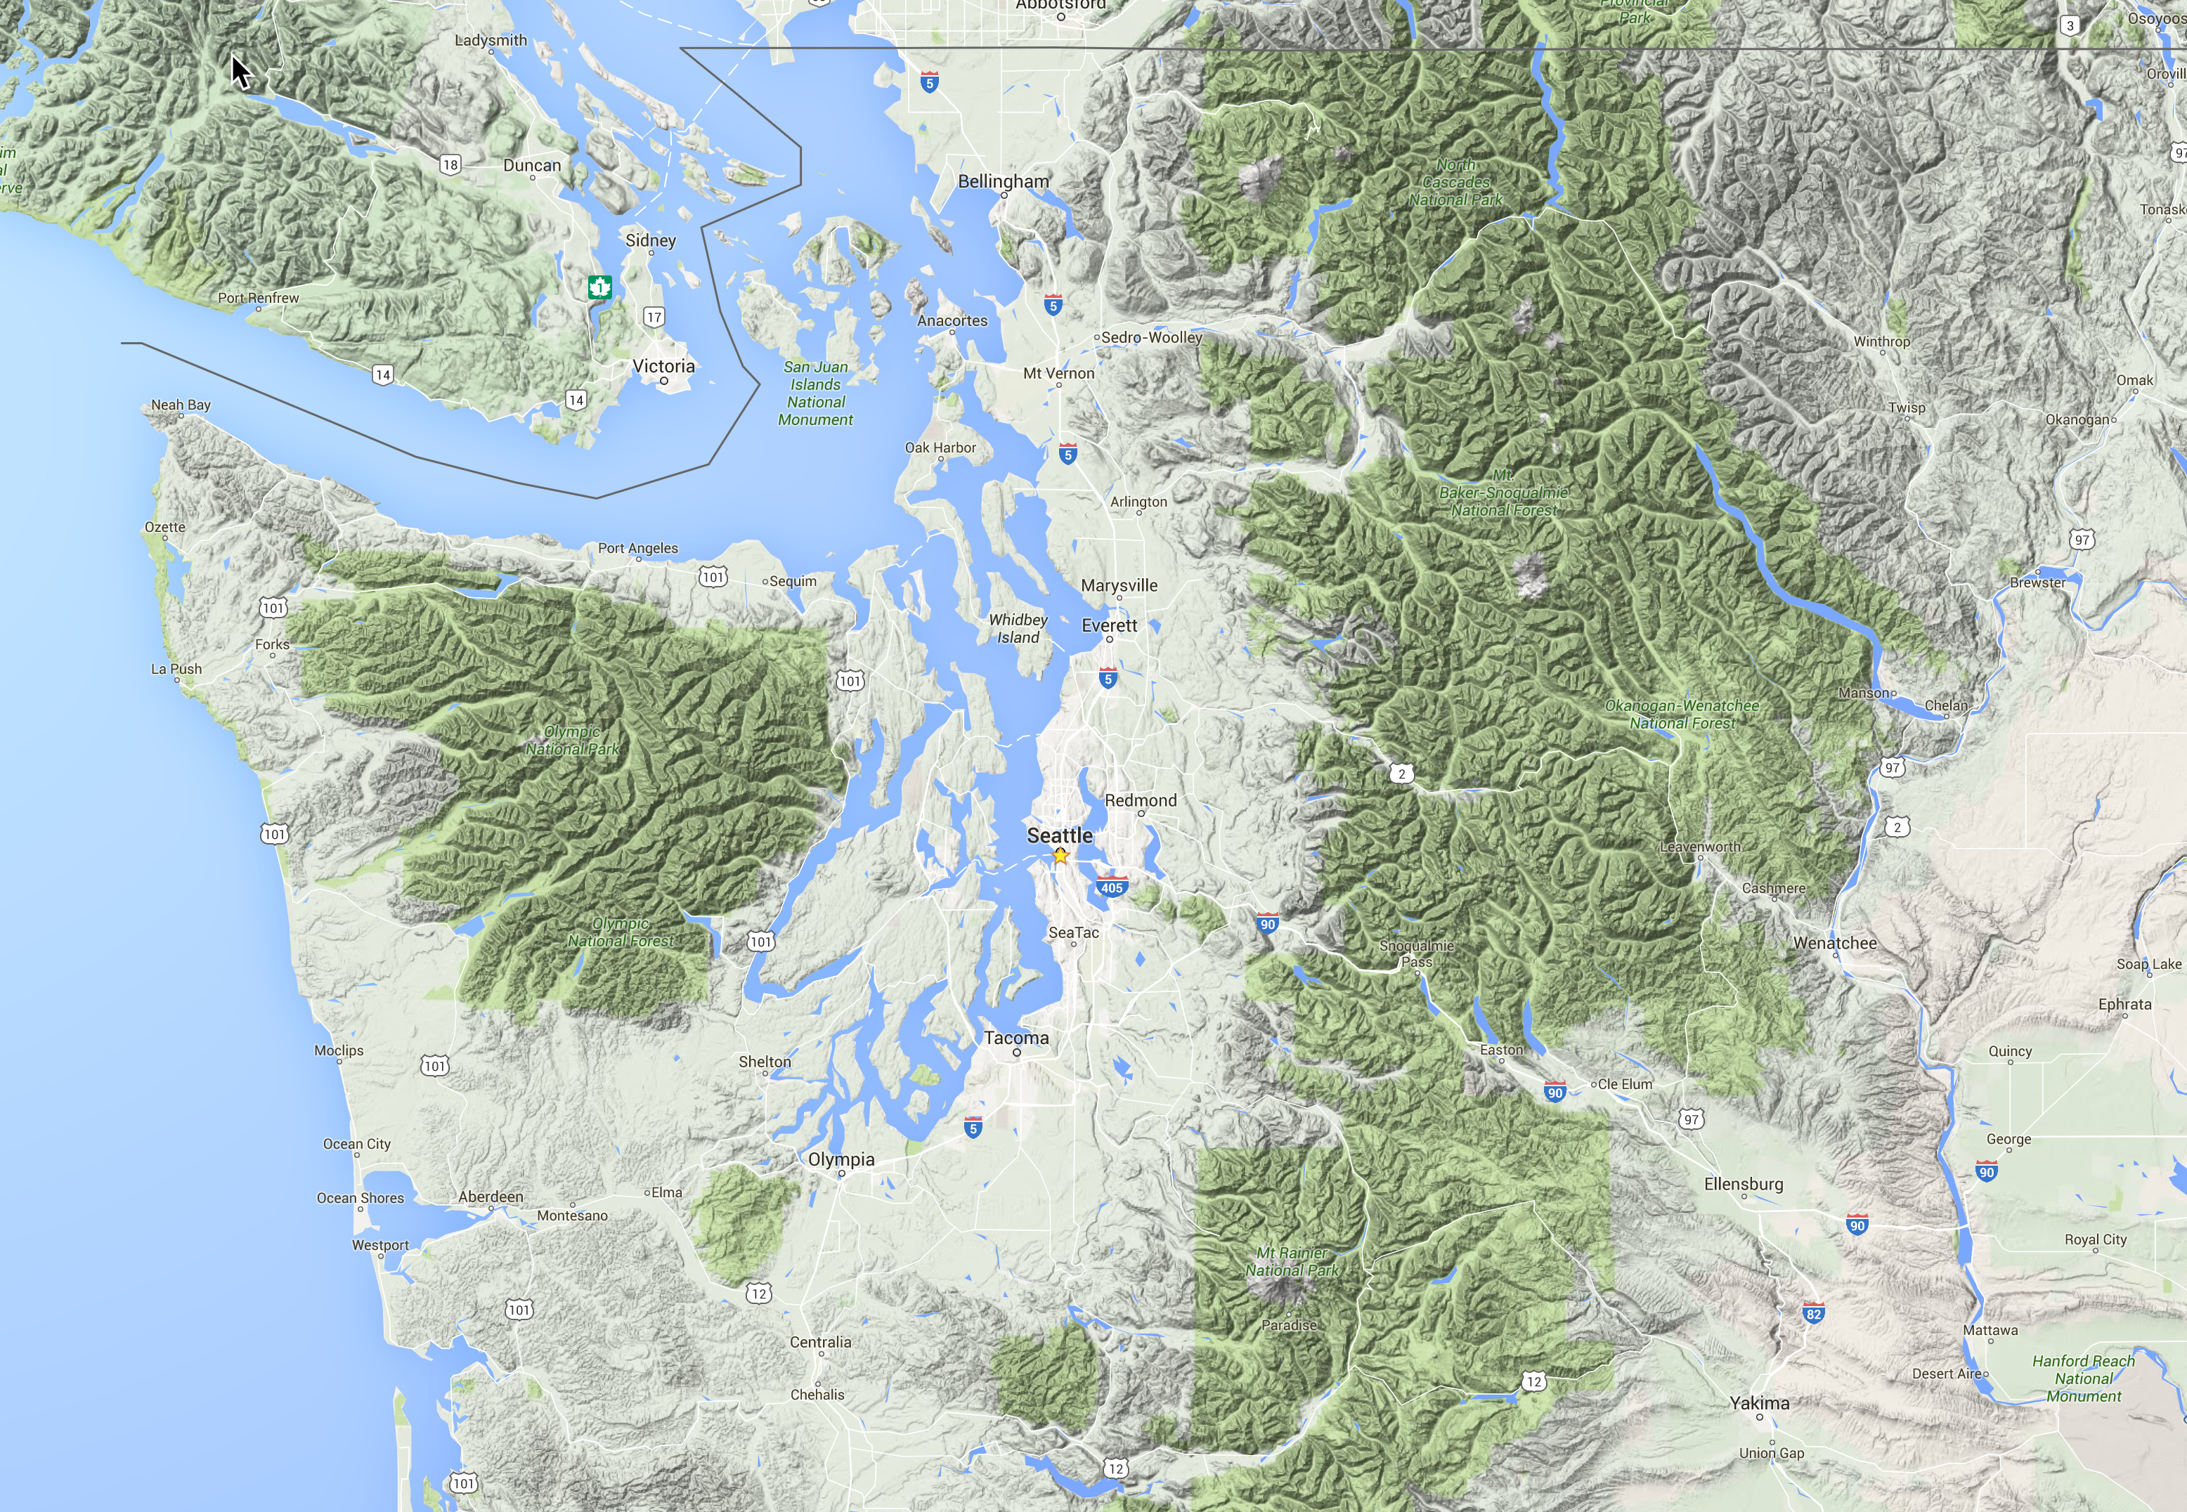

Slide 41
The Lake Whatcom Flood and Debris Flow Event of January 9, 1983
Moist, unstable flow climbed the mountains around Lake Whatcom (near Bellingham)
6-10 inches over 36 hr over the lower terrain
Substantial flooding and major debris flows down Smith Creek and other local streams.

Slide 42
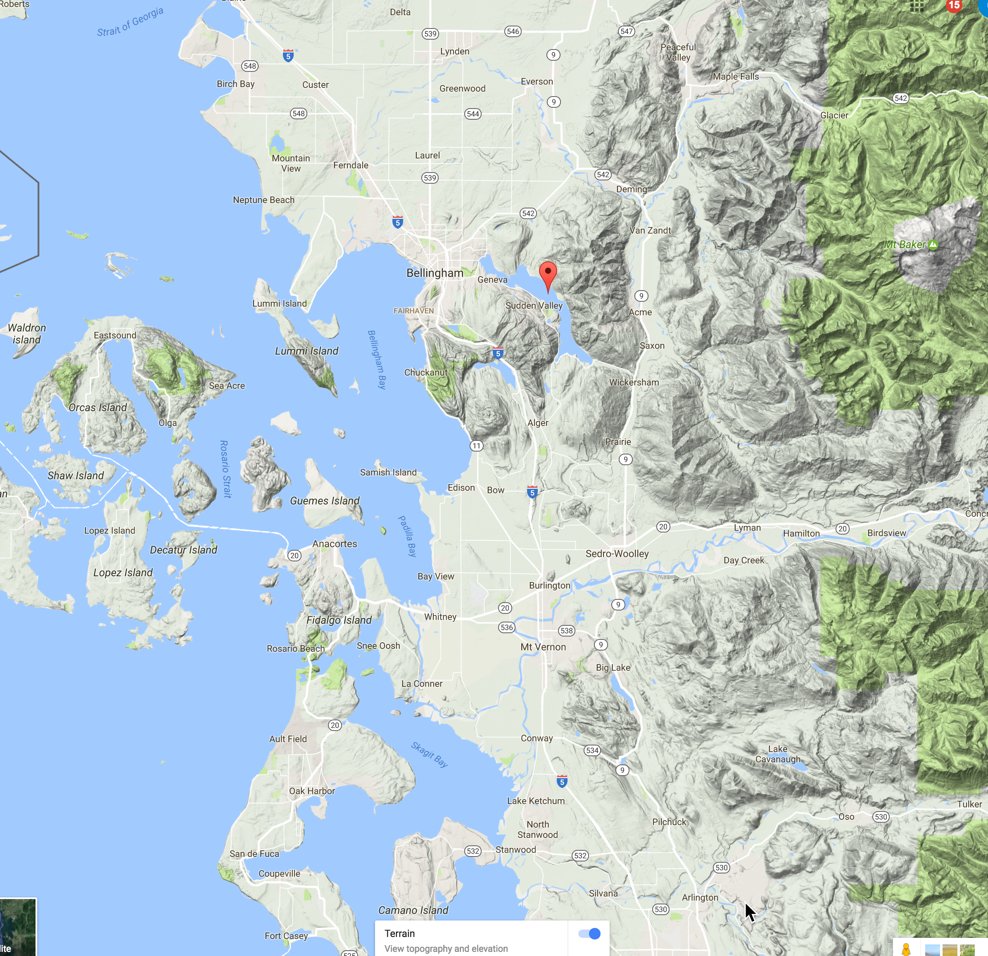

Slide 43
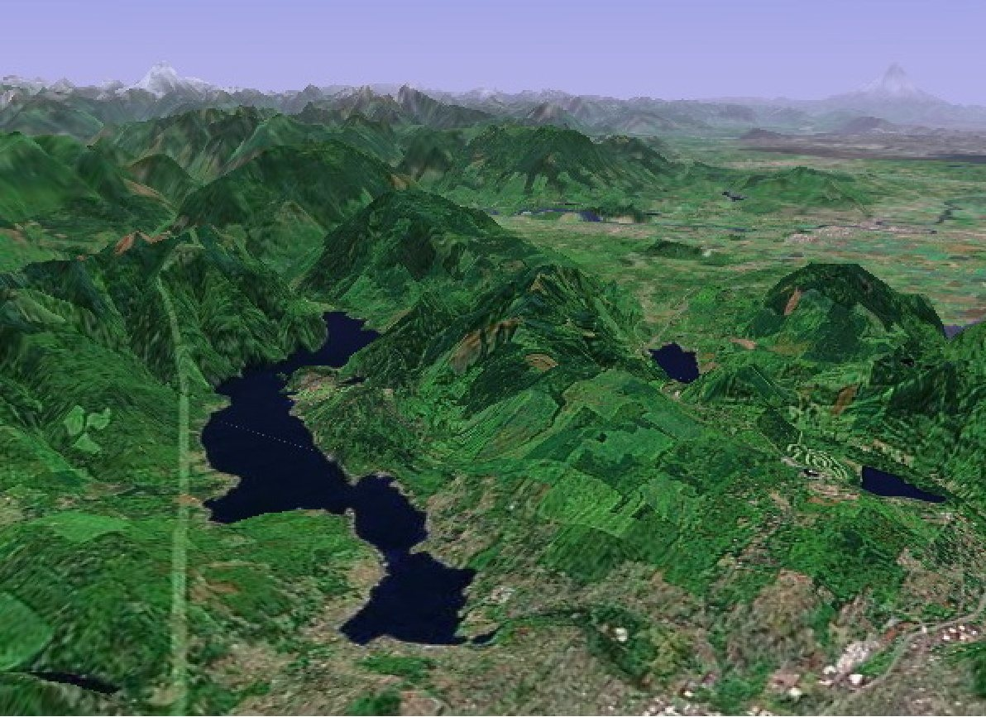

Slide 44
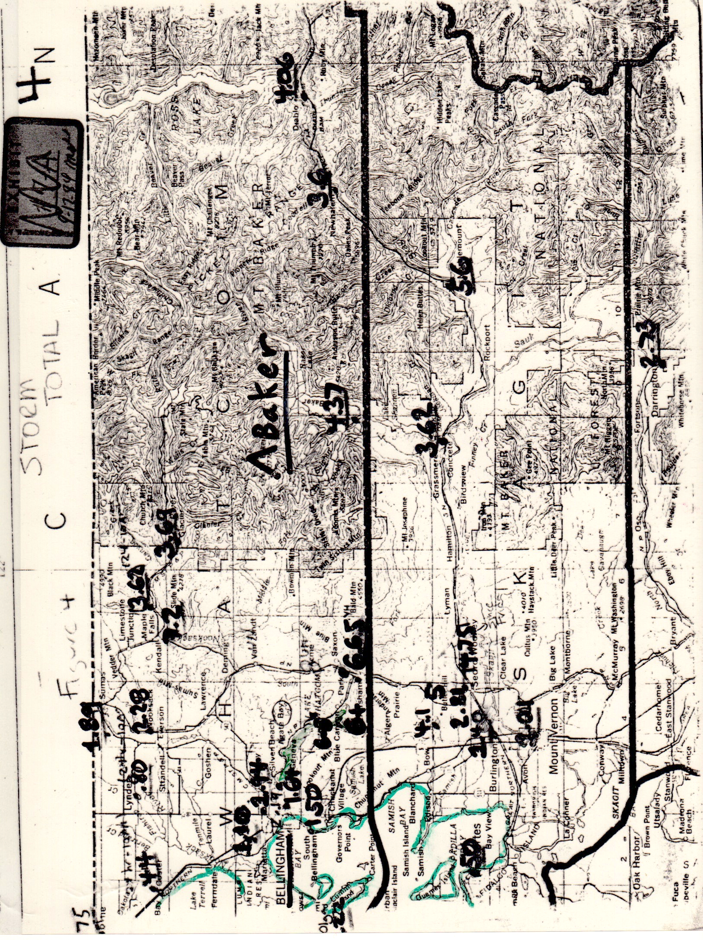

Slide 45
6-8

Slide 46
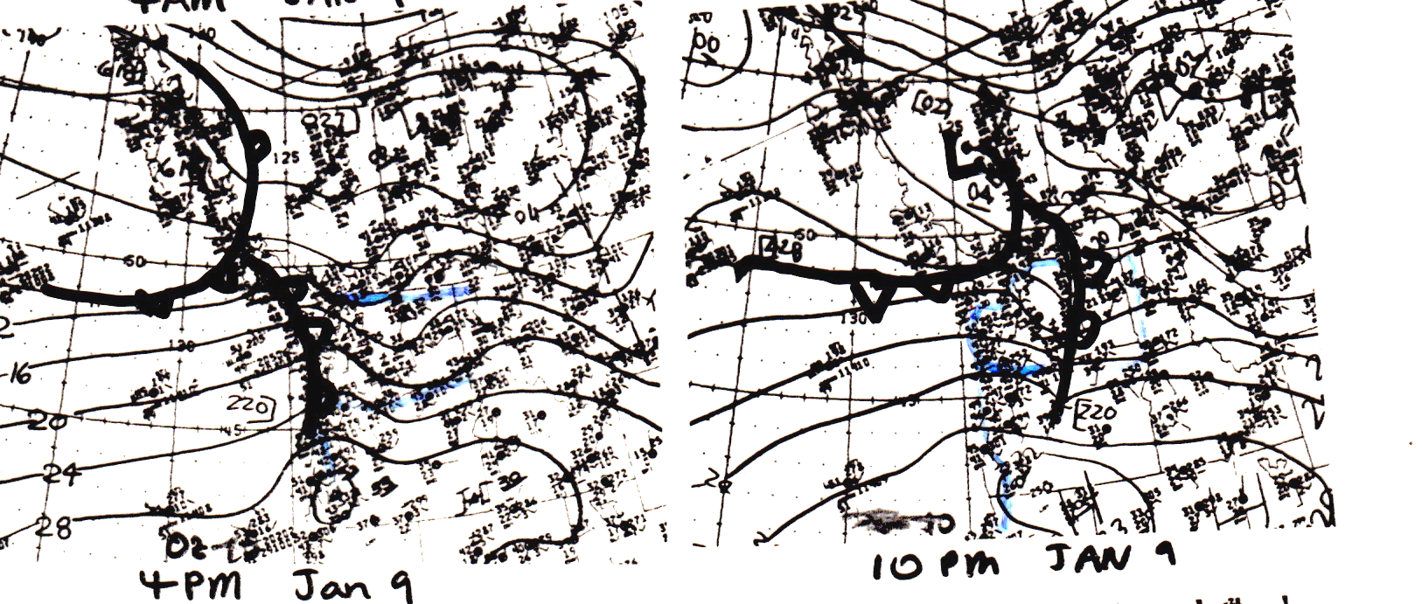

Slide 47
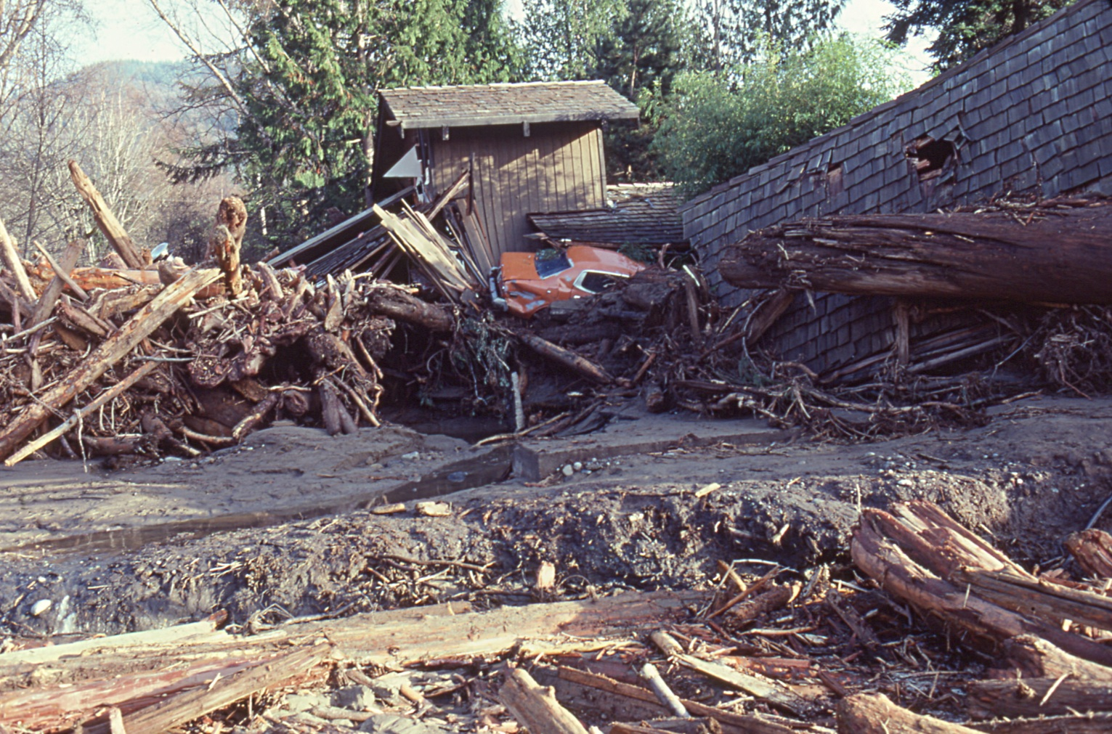
Picture Courtesy of Don Easterbrook, WWU

Slide 48
Rain Shadows
Lack of precipitation and clouds on lee sides of barriers.
Associated with subsiding flow.
Can extend 50-150 km downstream of terrain.
As the flow approaching a barrier changes direction, so does the orientation of the rain shadow.

Slide 49
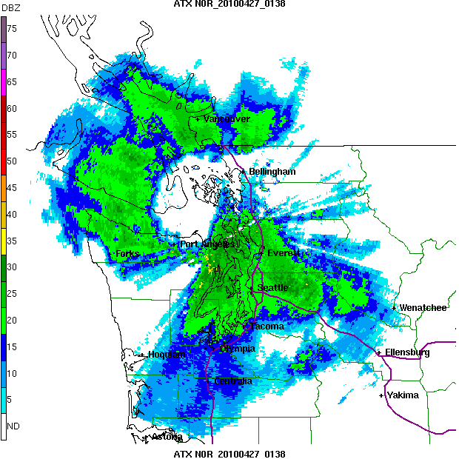
Rainshadow

Slide 50
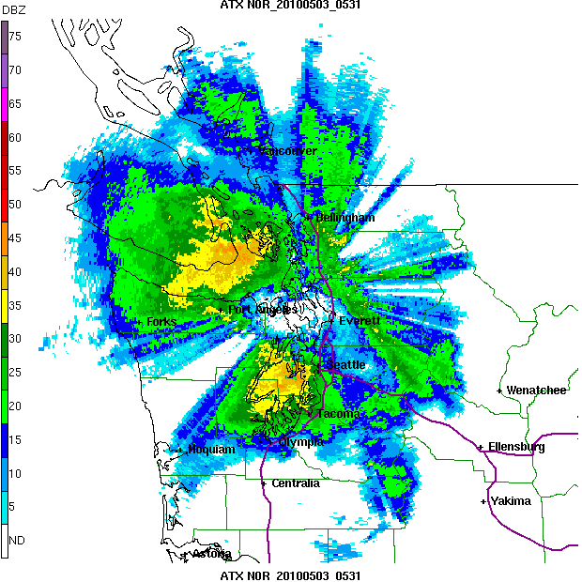

Slide 51
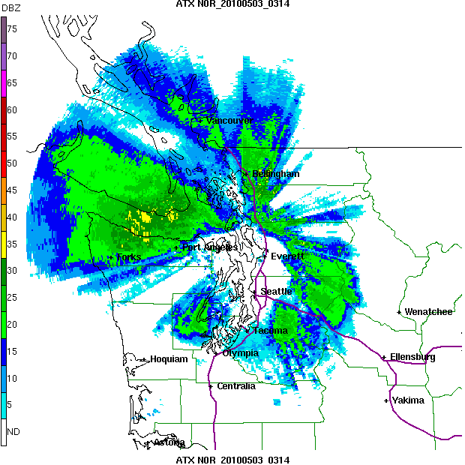

Slide 52
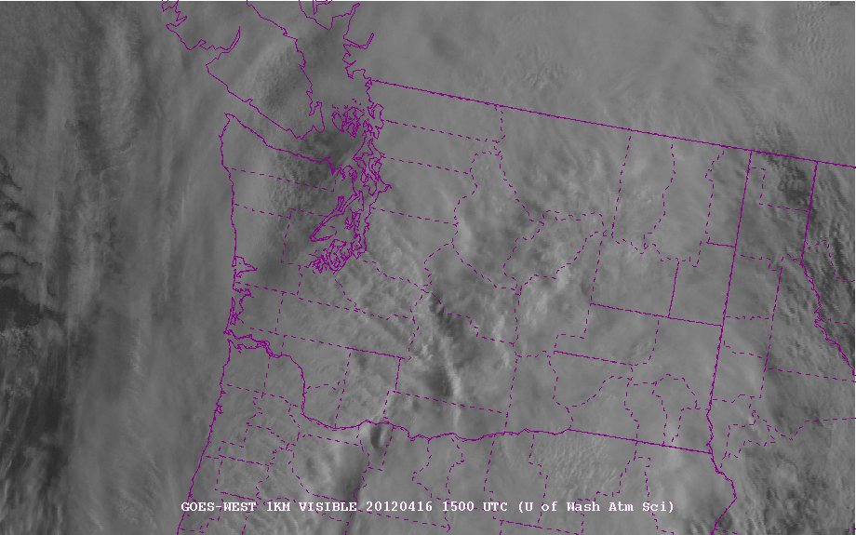
Apparent on Satellite Imagery

Slide 53
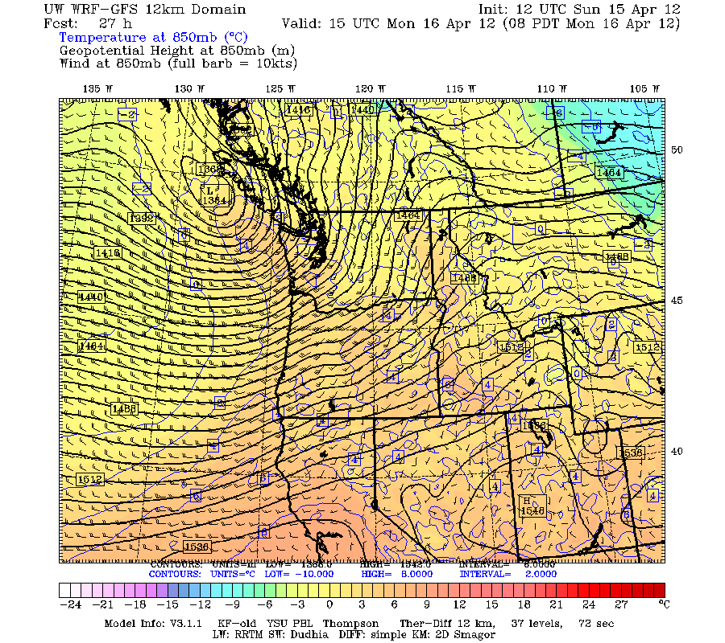
850 hPa at same time

Slide 54
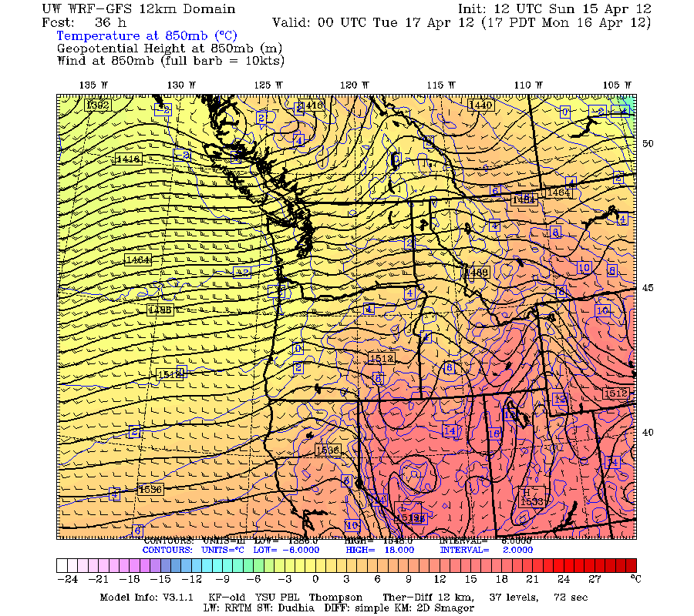
Change in approaching flow direction

Slide 55
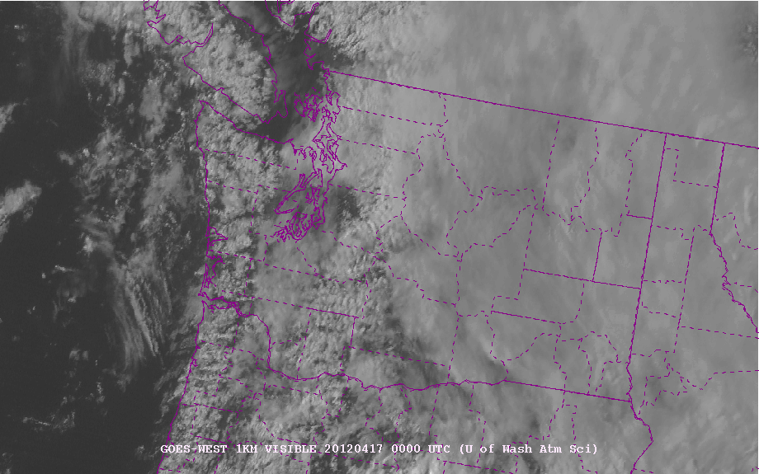

Slide 56
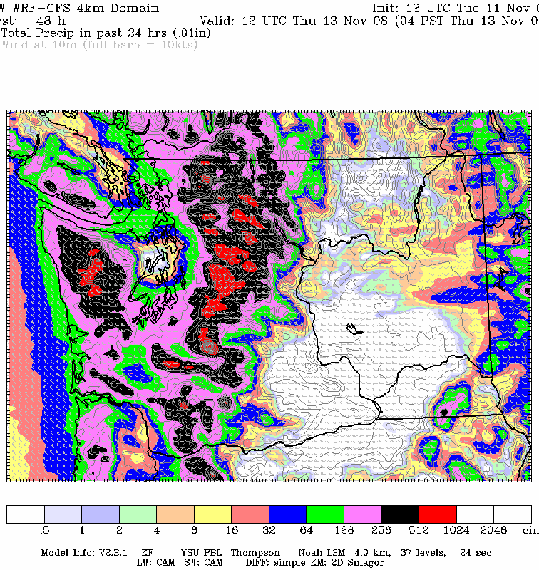
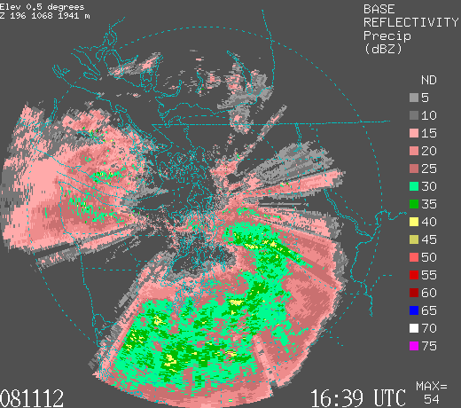
Models do a decent job with rainshadows

Slide 57
Two main
Rainshadows
In WA

Slide 58
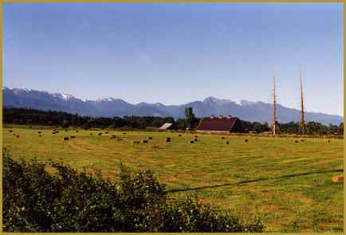
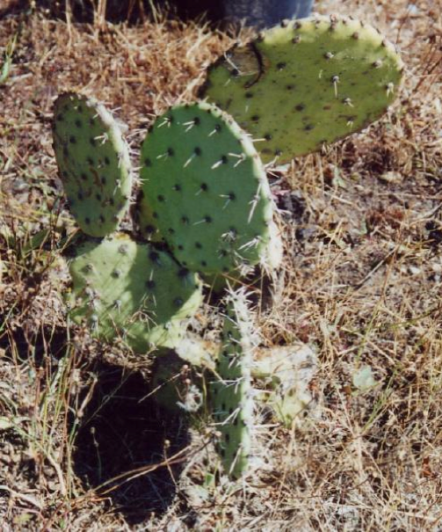
Sequim: roughly 15 inches per year.
.

Slide 59
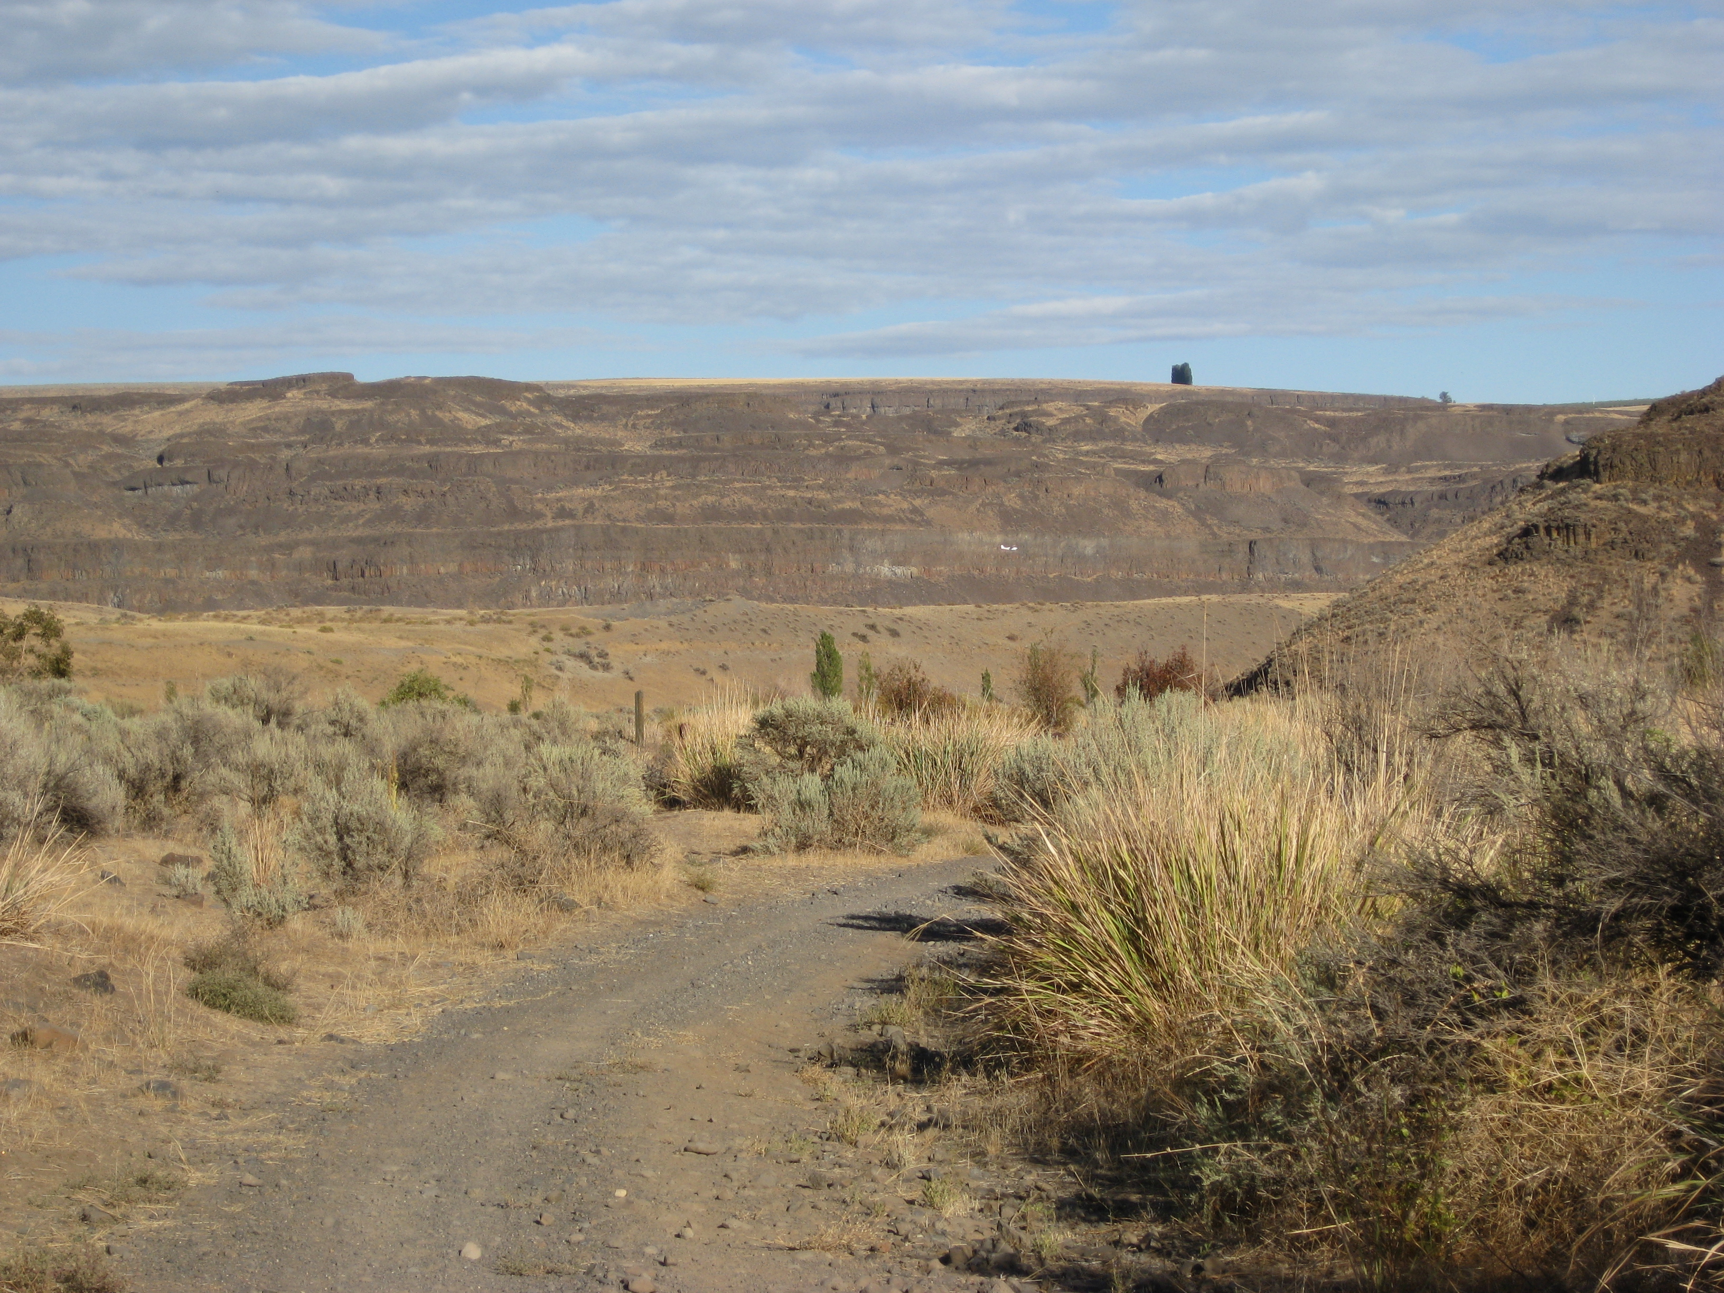
Eastern WA Desert ~10 inches a year

Slide 60
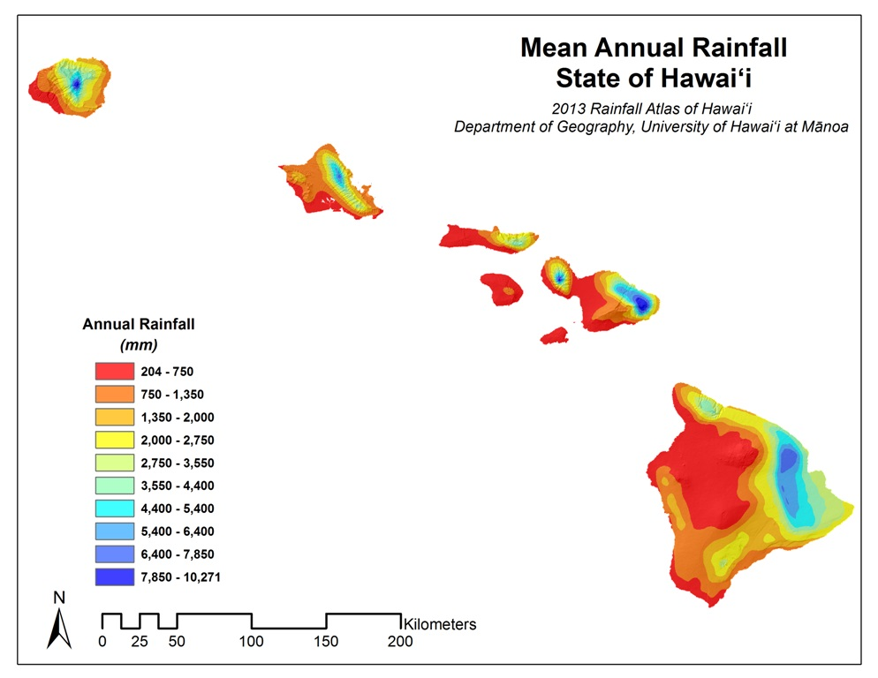
Many Examples Around the World

Slide 61


Slide 62


Slide 63
Convective clouds and precipitation
Convection: produced by destabilization of the atmosphere.
  Often controlled by synoptic scale features.
  Often poorly predicted by models.
  Most global models using parameterized convection---with a lot of problems
  Some higher-resolution models using convection-permitting resolution (4 km or smaller grid spacing). MUCH BETTER.
  More on this later!

Slide 64
Progress in Precipitation Prediction in Terrain Using Numerical Models

Slide 65

NGM, 80 km,
1995

Slide 66

NGM 1995

Slide 67

2001: Eta Model, 22 km

Slide 68


36-km
MM5
2005
12-km

Slide 69

NWS WRF-NMM (12-km)-2007

Slide 70

2007-2008
4-km MM5
Real-time

Slide 71


Slide 72
An Example of the Benefits of Resolution

Slide 73


Slide 74


Slide 75


Slide 76


Slide 77


Smaller Scale Terrain Modulates
Precipitation
10-km

Slide 78

Small-Scale Spatial Gradients in Climatological Precipitation on the Olympic Peninsula. Journal of Hydrometeorology
Volume 8, Issue 5 (October 2007)

Slide 79

Annual Climatologies of MM5 4-km domain

Slide 80

Verification of Small-Scale Orographic Effects

Slide 81


Slide 82
But With All the Advances in Predicting Orographic Precipitation Deficiencies Remain
One of the most serious is underpredicting precipitation on the windward side of coastal mountain barriers.

Slide 83

New Research
Today
Spatial forecast errors of the UW/GFS analyses for (a) 36 km, (b) 12 km, (c) 4 km, (d) 1.33 km WRF, and (e) 13 km NCEP GFS for Nomber-December 2015. The size and color indicate the magnitude and sign of the error, respectively. Red circles indicate underprediction and blue designate overprediction

Slide 84

Coastal Precipitation Underprediction
Appears to be a problem with the warm rain parameterization used in most model microphysics schemes.
A solution may be on the way.

Slide 85

Convective Precipitation Associated with Terrain Is Also a Problem

Slide 86
Coastal Precipitation Effects
Coastal convergence
Coastal destablization

Slide 87
Coastal Wind Convergence

Slide 88
Coastal Wind Divergence

Slide 89



Slide 90

Coastal Destabilization
Warming at surface increases lapse rate

Slide 91


Slide 92

One of the most profound examples of orographic enhancement occurs during atmospheric rivers on U.S. West Coast

Slide 93
Atmospheric Rivers
Meridional flow of moisture from the tropics to midlatitudes is often limited to relatively narrow currents of moisture accompanied by unusually warm temperatures.
Can release huge amounts of precipitation when ARs are forced to rise on terrain.

Slide 94

In the NW, often called the “Pineapple Express”
A relatively narrow current of warm, moist air from the subtropics…often starting near or just north of Hawaii.

Slide 95


Slide 96
Two main diagnostics: Integrated Water Vapor (IWV) and Integrated Water Vapor Transport (IVT)

Slide 97

IWV is the column total water vapor

Slide 98


Slide 99

IVT is water vapor times the wind: how much water vapor are the wind bringing into a region

Slide 100


Slide 101

The current of warm, moist air associated with atmospheric rivers are found in the warm sector, parallel, near, and in front of the cold front.
Used to be called the “warm frontal jet”

Slide 102

Upslope flow and enhanced moisture associated with ARs greatly increases precipitation rates on terrain.

Slide 103

A Devastating Pineapple Express:
November 6-7, 2006

Slide 104

November 6-9,
2006
Dark Green: about 20 inches

Slide 105

Forecasting Atmospheric Rivers
Models are really quite good.
A big issue is that slight changes in direction can have a huge impact on who gets precipitation

Slide 106


Slide 107

https://cw3e.ucsd.edu/
Group at Scripps in San Diego dedicated to ARs

Slide 108
Convective Precipitation
Associated with destablization of the atmosphere
Historically, subjective approaches have dominated (CAPE, shear, sounding interpretation, synoptic typing, etc)
Convection is associated with the least skillful precipitation forecasts in virtually all models.
Need at least 2-4 km grid spacing to get convection even half right.
If grid spacing is more coarse, then must have cumulus parameterization

Slide 109

Terminology
Explicit convection: model has enough resolution to simulate convection (less than ~4 km grid spacing). Also called convection-permitting resolution.
Parameterized convection: model parameterization uses large-scale variables to determine precipitation and other impacts of convection. Example: Kain-Fritsch, Grell, Kuo, SAS.

Slide 110
Convection
Convective parameterizations attempt to simulate the impacts of convection without explicitly simulating the details.
A kluge: relating convective impact to larger scale variables
Most convective parameterizations have serious flaws
But they are often necessary: can’t ignore the aggregate effects of convection.

Slide 111

What convective parameterizations need to account for

Slide 112

Convection is often sub-grid scale

Slide 113
Parameterized Convection in Models
Most operational models we work with have parameterized convection (GFS, NAM, ECMWF)
Some high-resolution operational models have dropped convective parameterization (e.g., 3-km HRRR)
WRF can be run with or without convective parameterization

Slide 114



Example of Explicit Convection
Real-time WRF 4 km BAMEX Forecast
Valid 6/10/03 12Z
4 km BAMEX forecast 36 h Reflectivity
4 km BAMEX forecast 12 h Reflectivity
Composite NEXRAD Radar

Slide 115




Real-time 12 h WRF Reflectivity Forecast
Valid 6/10/03 12Z
4 km BAMEX forecast
10 km BAMEX forecast
22 km CONUS forecast
Composite NEXRAD Radar
Parameterized

Slide 116


Hurricane Isabel Reflectivity at Landfall
18 Sep 2003 1700 Z
Radar Composite
41 h forecast from 4 km WRF

Slide 117


Slide 118


Slide 119


Slide 120
The Long Term
Within 10-15 years, all forecast models will transition to convection-permitting resolution.
This will result in convective parameterizations being dropped in general.
Convective skill will rise and result in generally more skillful overall forecasts.
Initialization of convection will still be an issue.
Predictability of convection is an issue.

Slide 121
Poor Parameterized Convection is Why Precipitation Skill Slides During the Summer, Particularly for Heavy Precipitation

Slide 122
Diurnal Effects on Convective Precipitation
Convection is highly modulated diurnally
  Sea breeze/land breeze effects
  Peninsulas amplify diurnal
  Terrain effects (uplope/downslope circulations)
Often models—and particularly those with parameterized convection-- get the diurnal variation wrong…humans can help.

Slide 123



Diurnal Effects
Sea Breeze Front (particularly strong for conditionally unstable conditions)
Clearing/drying behind

Slide 124


The Peninsula Effect

Slide 125
Slope winds and convergence over crests

Slide 126


Slide 127


Slide 128


Slide 129

Time of Peak Precipitation: JJA
Convection propagates
Eastward from Rockies

Slide 130

Virtually all models with parameterized convection do not get the eastward propagation form the Rockies correct
But those with explicit convection do!

Slide 131
Predicting Clouds
Zero-order approach: use relative humidity
70% 1000-500 mb RH often corresponds with thicker, middle-level clouds that have a serious impact on radiation.
700 and 850 mb RH is also used by some.

Slide 132



Slide 133



Slide 134

Time-Height Cross Sections of RH are Very Useful (70% or more)

Slide 135

Direct Use of Model Clouds
All modern models predict clouds, specifically mixing ratios of cloud liquid water and cloud ice.
The quality varies…and keep in mind there are serious deficiencies in even the best microphysical schemes.
And problems with other physical parameterizations: boundary layer turbulence or radiation can also mess up model clouds.

Slide 136
Direct Use of Model Clouds
Most problematic: stratus, stratocumulus, and FOG.
Remember, some models have spin-up issues: precipitation and clouds improve during the first 3-9 hours. Particularly true of UW WRF which is cold-started (no clouds at initialization!)

Slide 137


Slide 138


Slide 139


Slide 140
Cloud/Precip Forecasting Strategy
Very short-term (0-3 hr): persistence, temporal extrapolation (informed by human judgement) is HARD to beat. Nowcasting.
  Use radar and satellite animation. Models generally not that useful.
  New data assimilation/modeling systems: e.g., EnKF, RUC/RR/HRRR are becoming viable and eventually will take this on successfully.

Slide 141

HRRR model useful after 3 hr

Slide 142
Strategy
Short-term (2-6 hr): Satellite extrapolation becomes more important. Model becomes more dominant at the end
Daily (6-24 h): Satellite extrapolation and model, weighing models more at longer range.
Remember model spin up issues.

Slide 143

Strategy
Know regional precip/cloud climatology
  Diurnal and geographic features tend to be very repeatable, particularly during the warm season
  Example: front range convection
Know normal and records.

Slide 144

Ensemble Systems Are Improving: Laying the Foundation for Probabilistic Precipitation Prediction

Slide 145

The problem…most ensemble system are poorly constructed and not calibrated

Slide 146
Calibrated Probabilistic Prediction Using Ensembles and Machine Learning
Most ensemble systems are highly underdispersive (often miss reality)
Ensemble members are not equally likely
Machine learning and other approaches can be used to calibrate ensembles to produce improved and reliable probabilities
UW WRF-En Project Website:
https://a.atmos.washington.edu/mm5rt/precip/

Slide 147

Human Forecaster Issues
Precipitation is a parameter that in general forecasters add the least skill compared to objective guidance.
Psychological issues exist for high and low precipitation probabilities

Slide 148

Reliability Diagram

Slide 149

Reliability diagrams for Precipitation (48h forecast)

Slide 150
Rain Psychology
More than a day out….human forecasters tend to overpredict 10-30%
    exaggerating the threat of rain when it is not likely.
    “Its probably not going to rain…but I will throw in 10-30% anyway to cover myself”
And underpredict rain when it is highly probable
    Well it looks like it will rain…but I am unsure… so I will knock down the probabilities to 60-80% to cover myself”

Slide 151
Reliability diagrams for Precipitation (48h forecast)

Slide 152
Humans Help with Heavier Precipitation and Shorter Range Precipitation
http://www.wpc.ncep.noaa.gov/html/hpcverif.shtml#qpf

Slide 153


Slide 154


Slide 155


Slide 156

The End

