Slide 1
Temperature Atmospheric Sciences 101 Autumn 2024

Slide 2
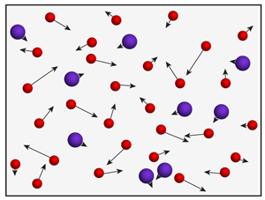
Temperature is a measure of the average speed of atoms and molecules
When a substance warms, atoms and molecules move faster

Slide 3
Temperature
In a solid, molecules remain bound together in a rigid crystalline structure and vibrate in position.
Solid

Slide 4
Temperature
In a liquid, molecules are bound together but can move around.

Slide 5
Temperature
In a gas, molecules move independently.

Slide 6
Definition
Temperature is a measure of the speed of atoms and molecules of a substance.
More exactly, temperature is proportional to the average kinetic energy of a substance’s atoms and molecules
Kinetic Energy (KE) = (1/2)mv², where m=mass, and v is speed
http://www.falstad.com/gas/

Slide 7
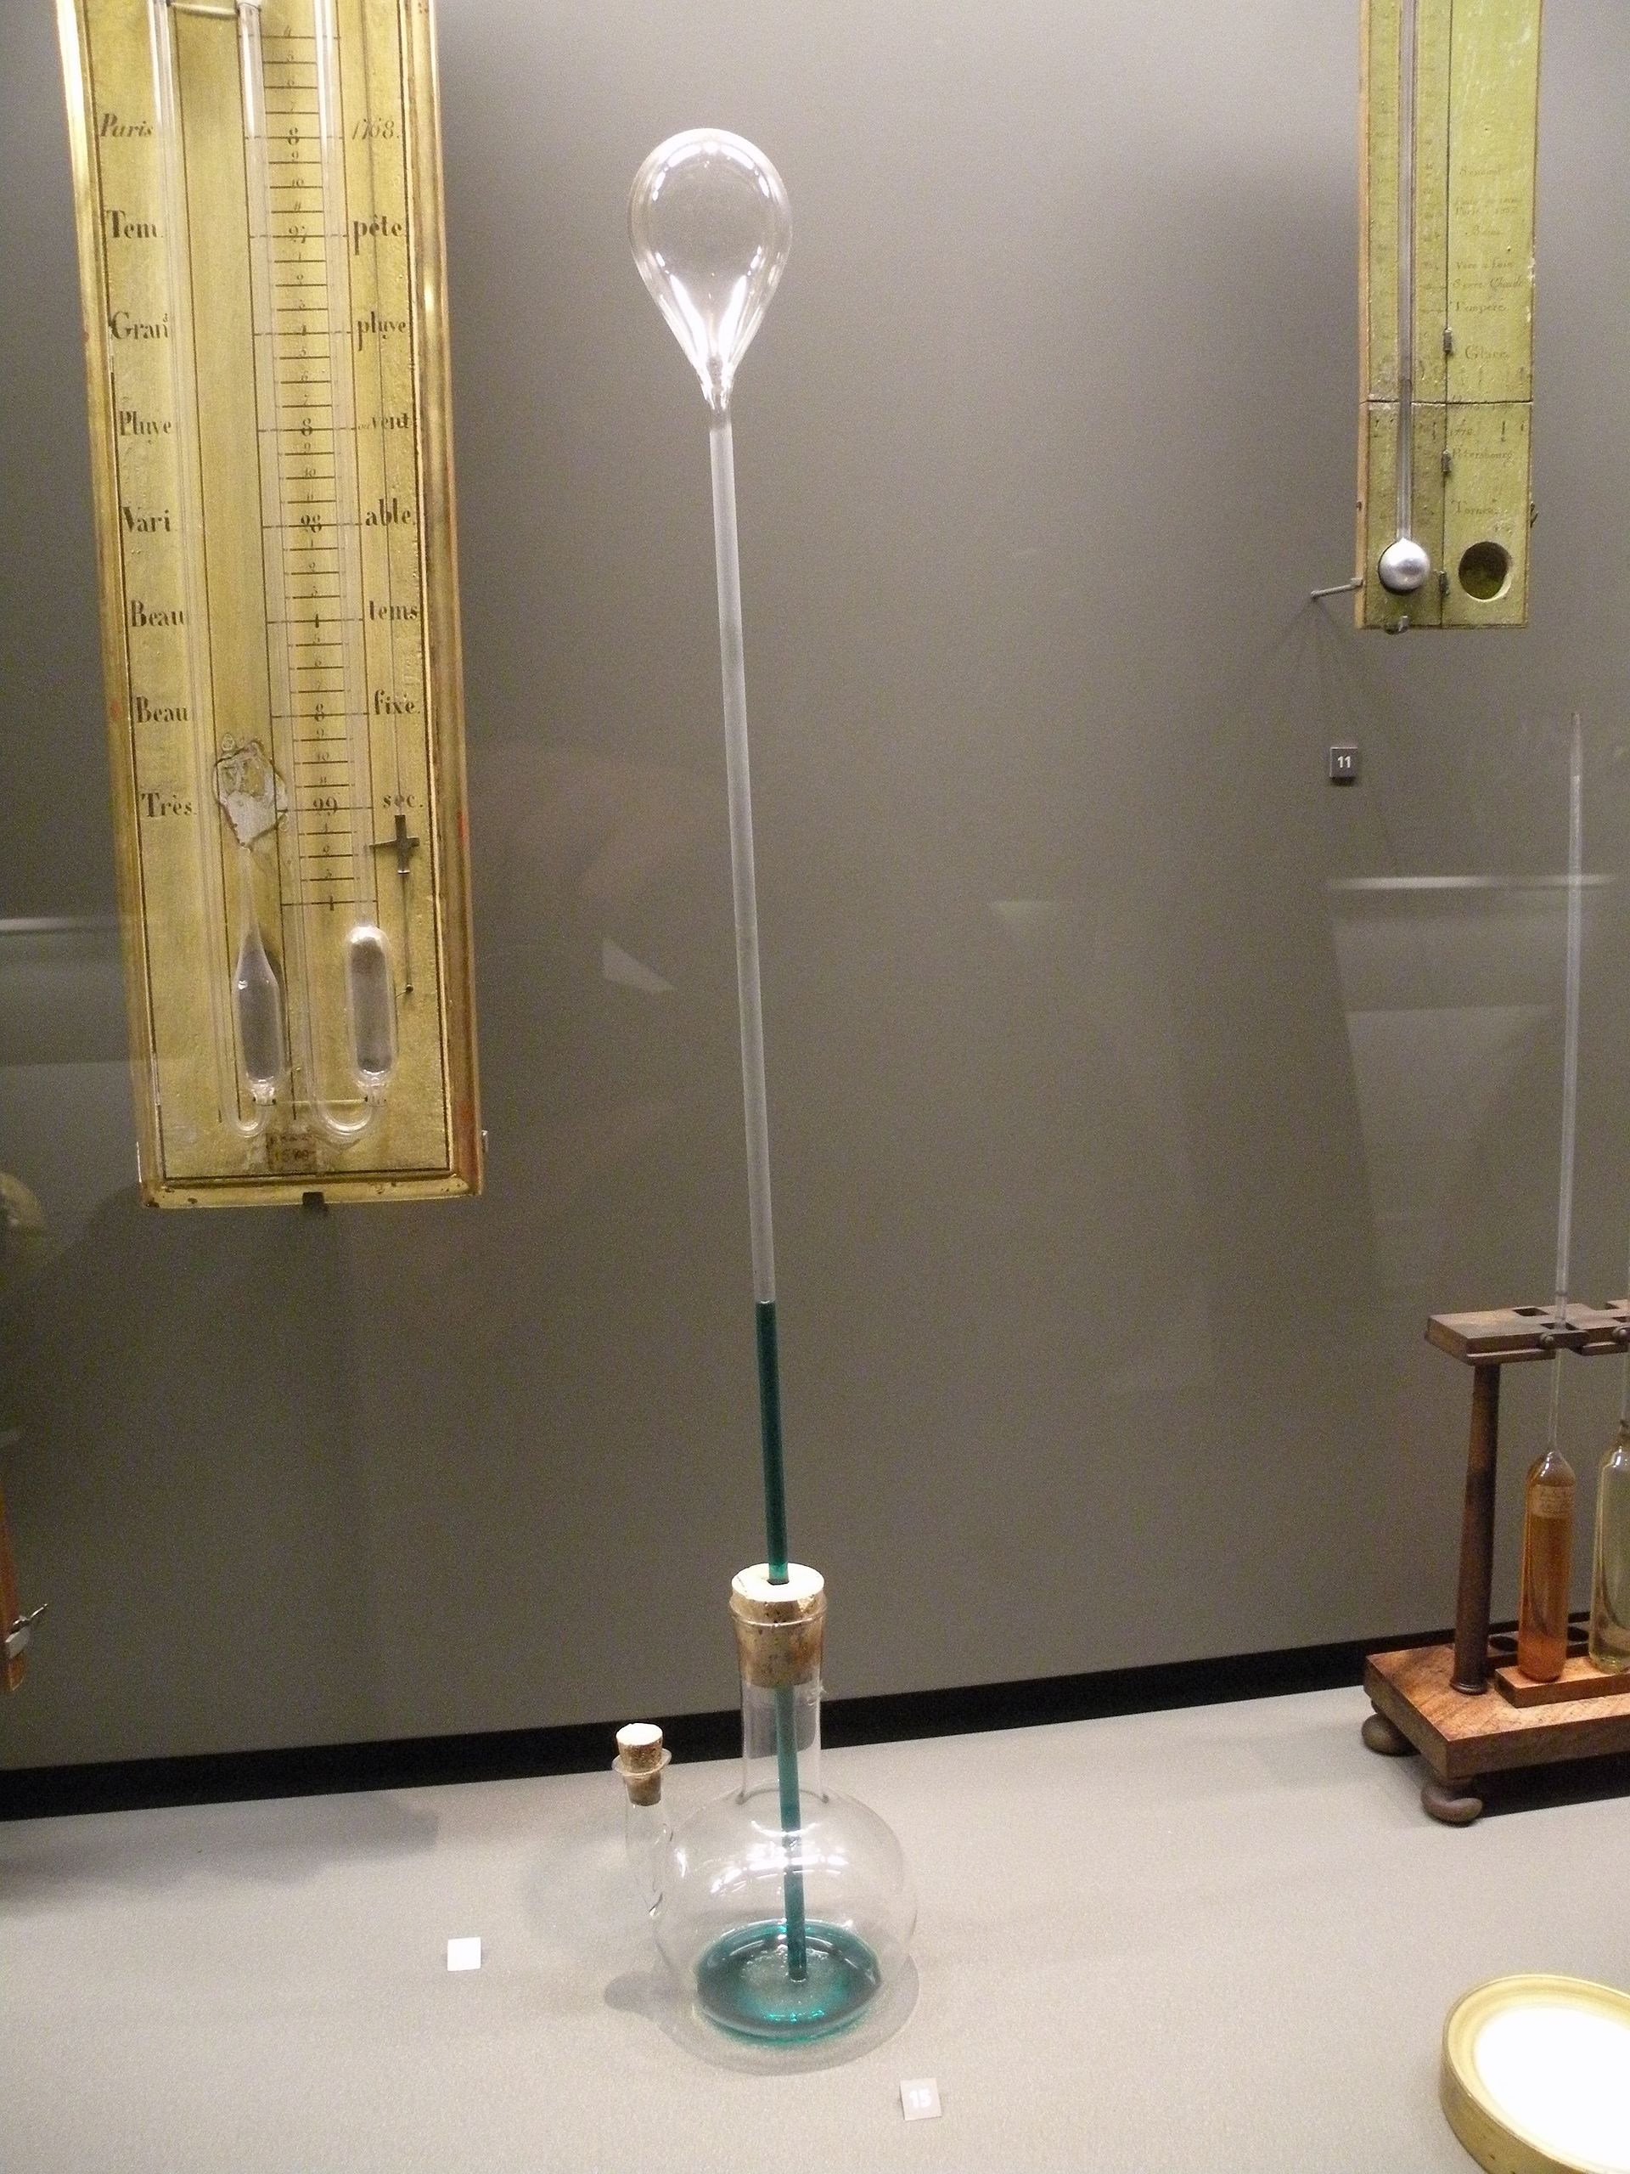
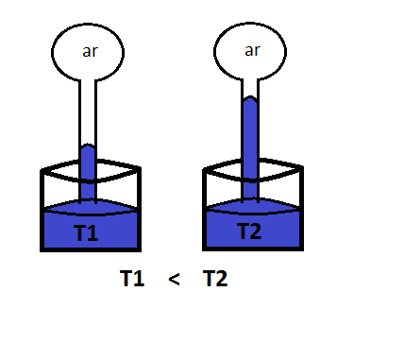
Temperature is measured with thermometers—and there are many types
Galileo developed the first thermometer in the late 1500s.
cooler
warmer

Slide 8
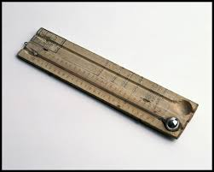
Thermometer History
In 1600s, alcohol thermometers came into use
In 1714, Gabriel Fahrenheit, a German physicist, constructed the first mercury thermometer.
A problem developed: different thermometers had different scales!
Promoted lots of confusion!

Slide 9
Three Major Scales Used Today, Based on Freezing/Boiling
Fahrenheit (°F)
Centigrade or Celsius (°C)
Kelvin or Absolute (°K, °A)
How to Convert Freezing Boiling (at SLP)
C =(5/9)(F-32) 0 100
F =(9/5)C + 32 32 212
K =C + 273 273 373
The rest of world uses C, only the U.S. uses F

Slide 10
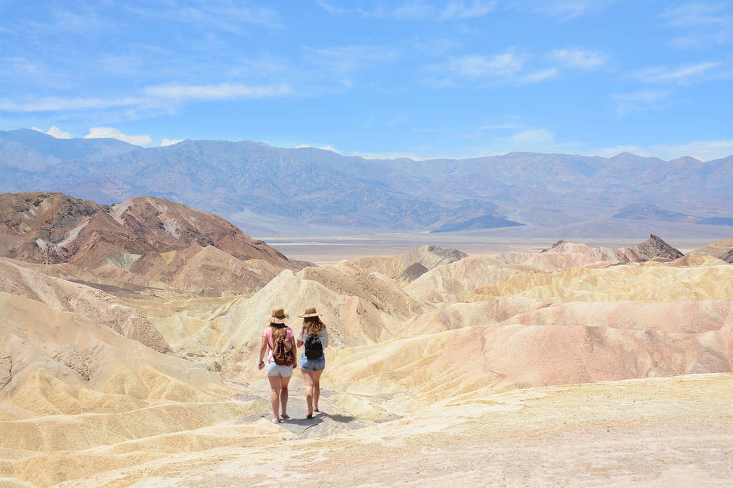
Temperatures in Celsius (F)
100 (212F) boiling point of water at sea level pressure
57 (134F) record high temperature (Libya)
50 (122F) typical summer high in Death Valley, CA
30 (86F) typical summer high over U.S. East Coast
20 (68F) normal room temperature
0 (32F) freezing
-10 (14F) super cold wave in Seattle
-40 (-40F) record cold in northern U.S.
-88 (-126F) record low temperature at South Pole
-273 (-460) absolute zero

Slide 11
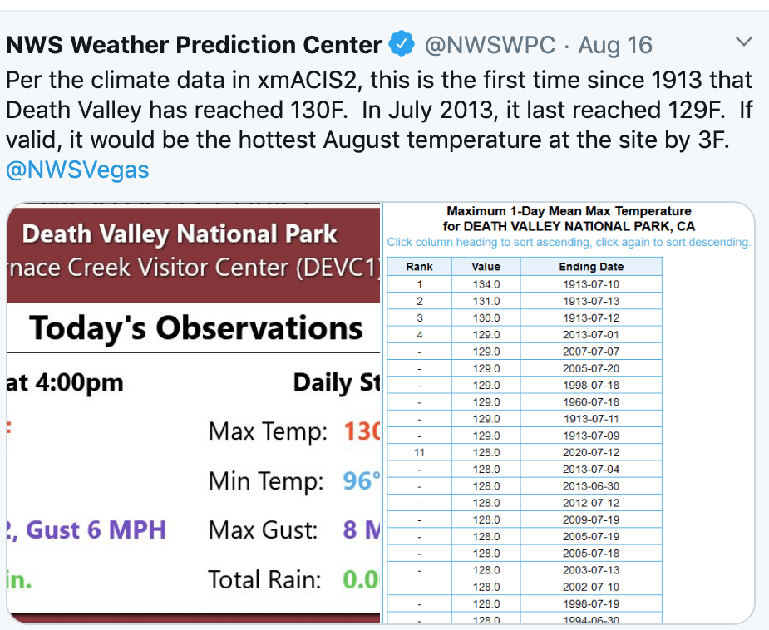
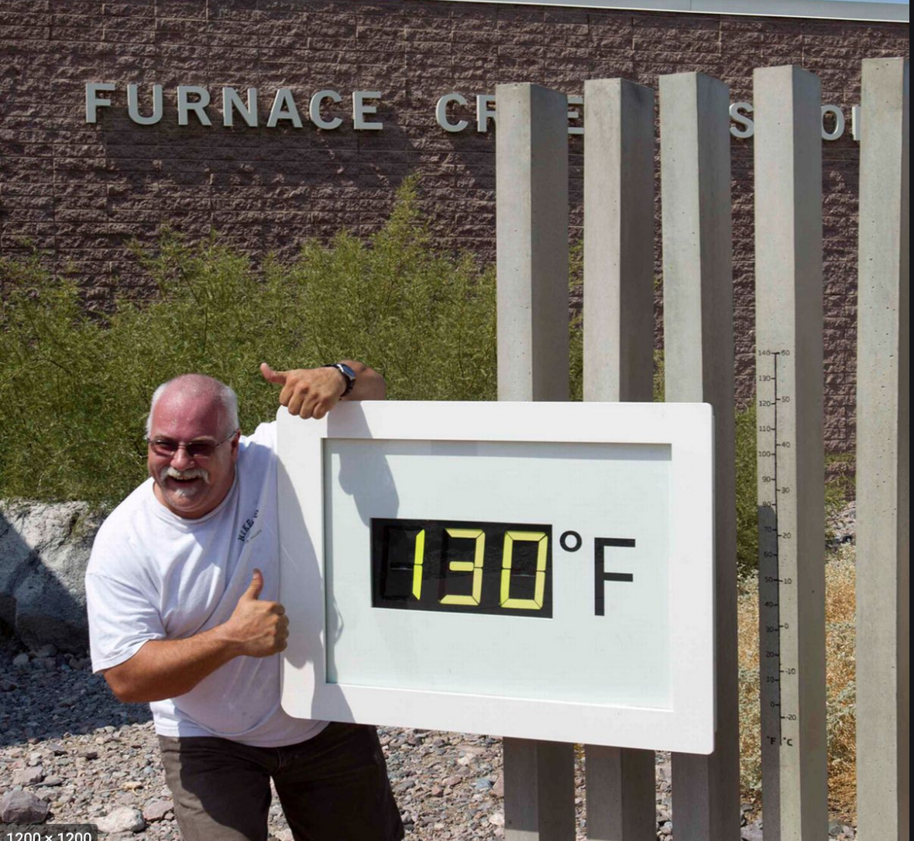
Recent News! 130F at Death Valley! August 16, 2020

Slide 12
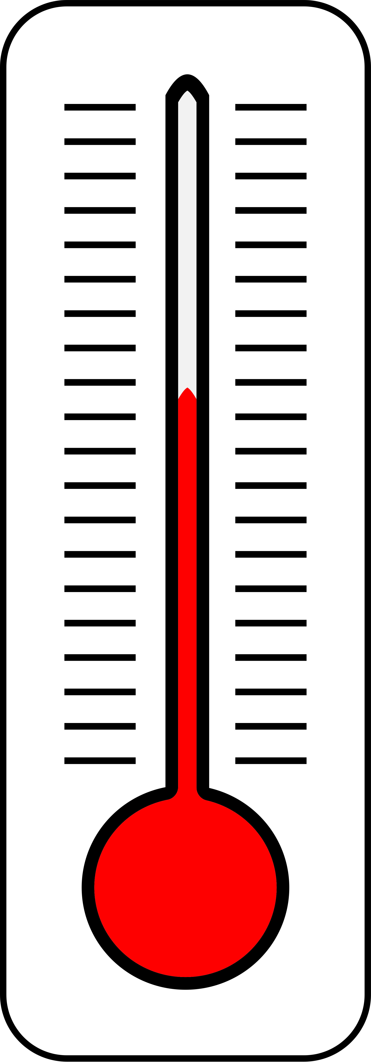
Types of Thermometers
The classic: hollow glass tube connected to a bulb filled with alcohol or mercury
Fluid expands or contracts as temperature changes
Fairly accurate. Typically good to about 1F.

Slide 13
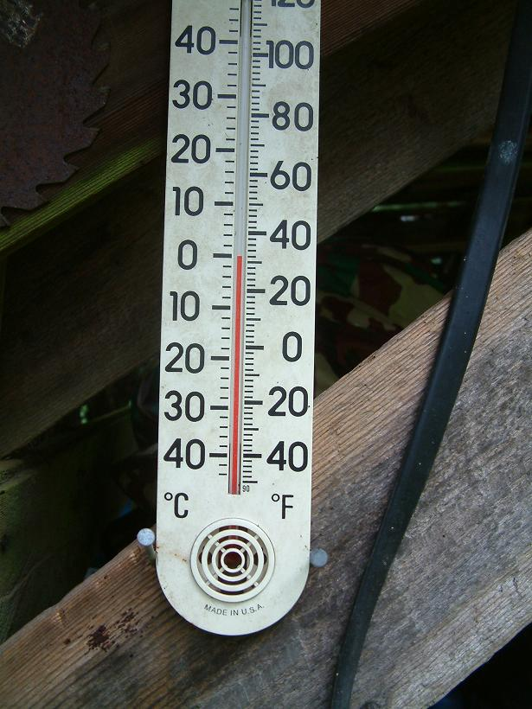
Alcohol
Thermometer

Slide 14
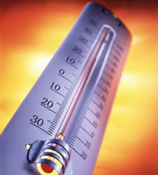
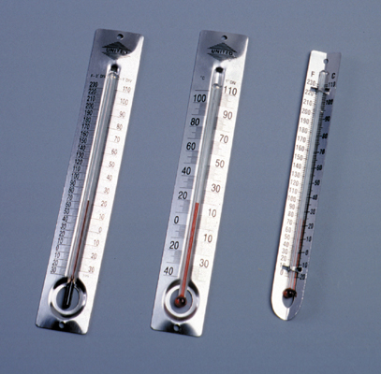
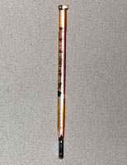

Slide 15
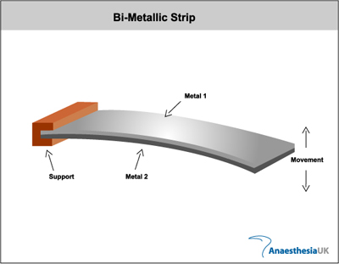
Bimetallic Strip Thermometers
2 different types of metals fused together
Different metals expand differently as temperature changes. Causes bending
Used in thermostats and cheap thermometers. Metal strips often in spirals.
Accuracy: typically 1-2F

Slide 16
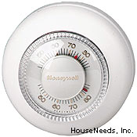
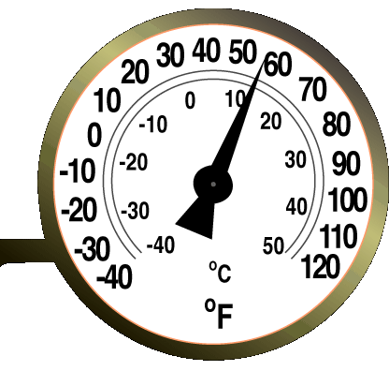
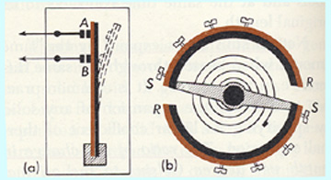

Slide 17
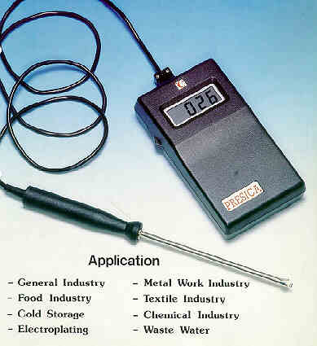
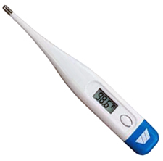
Electronic Thermometers
Often use thermistors, a device whose electrical resistance varies with temperature
Car thermometers, medical thermometers, home digital, etc.

Slide 18
Radiometers
A device that measures the amount of radiation emitted by a substance
Amount and wavelength of radiation emitted is a function of temperature (warmer objects emit more radiation and at shorter wavelengths)
Radiometers used by satellites to measure temperatures of clouds, the atmosphere, and surface
Example of remote sensing.

Slide 19
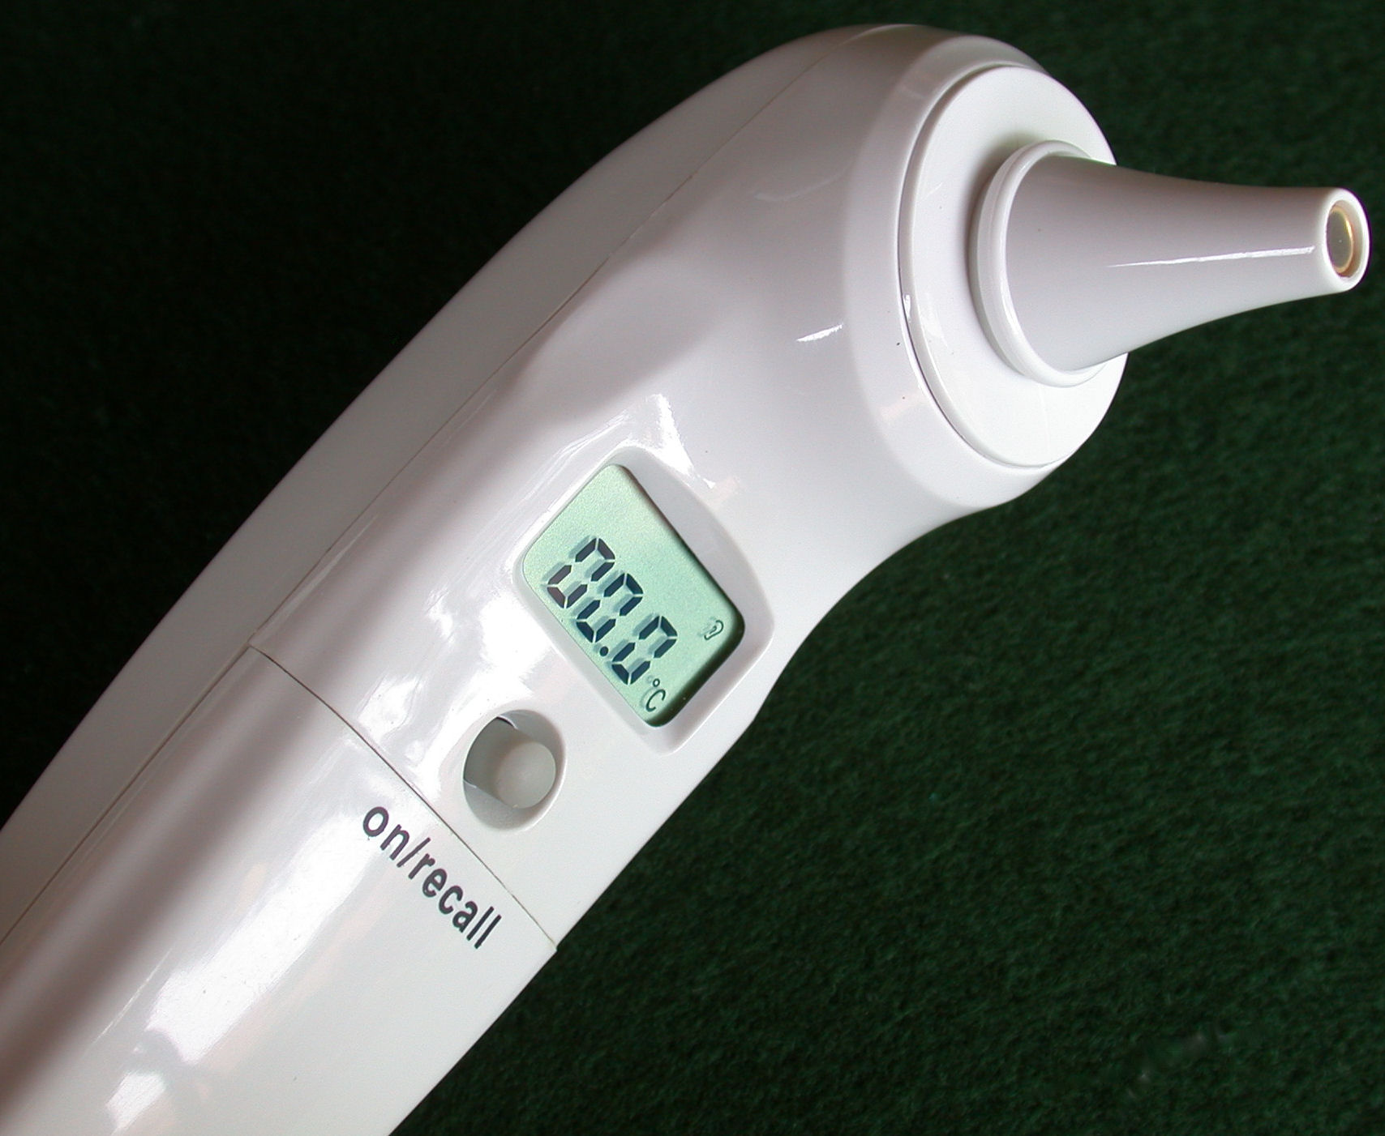
A radiometer you are familiar with

Slide 20
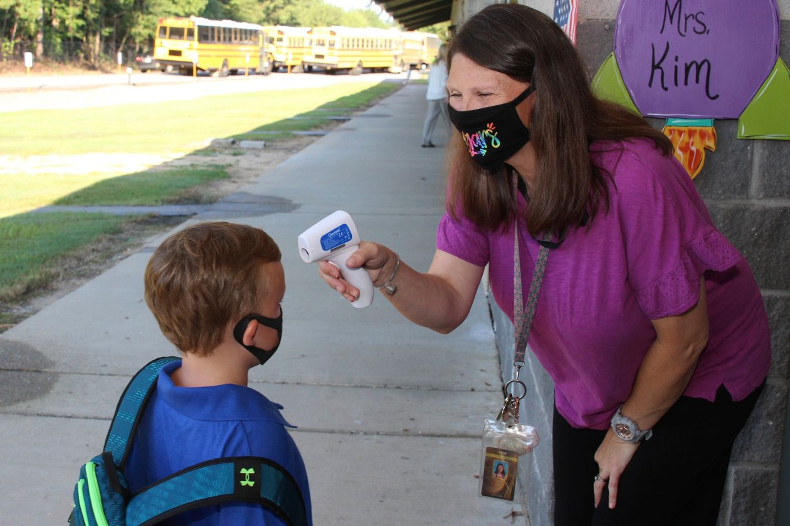
And after COVID we are REALLY familiar with radiometers….

Slide 21
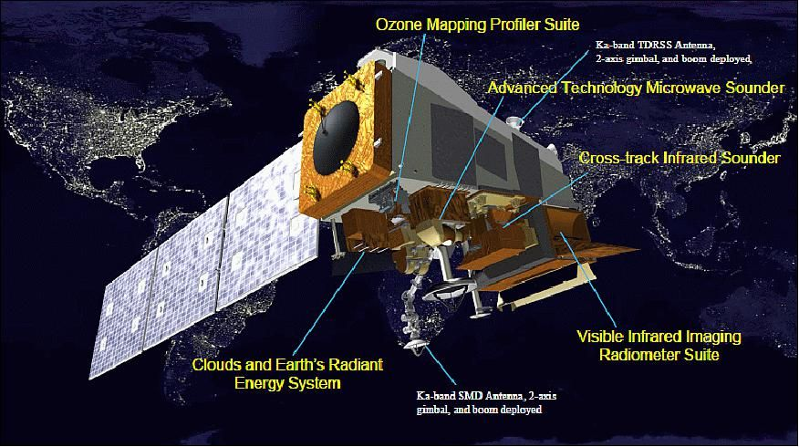
And one you might not be…
Weather Satellite

Slide 22
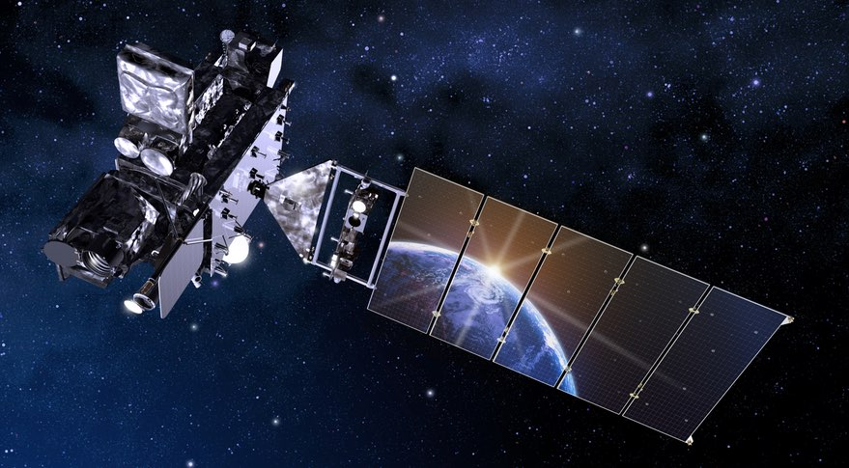
GOES Weather Satellite

Slide 23
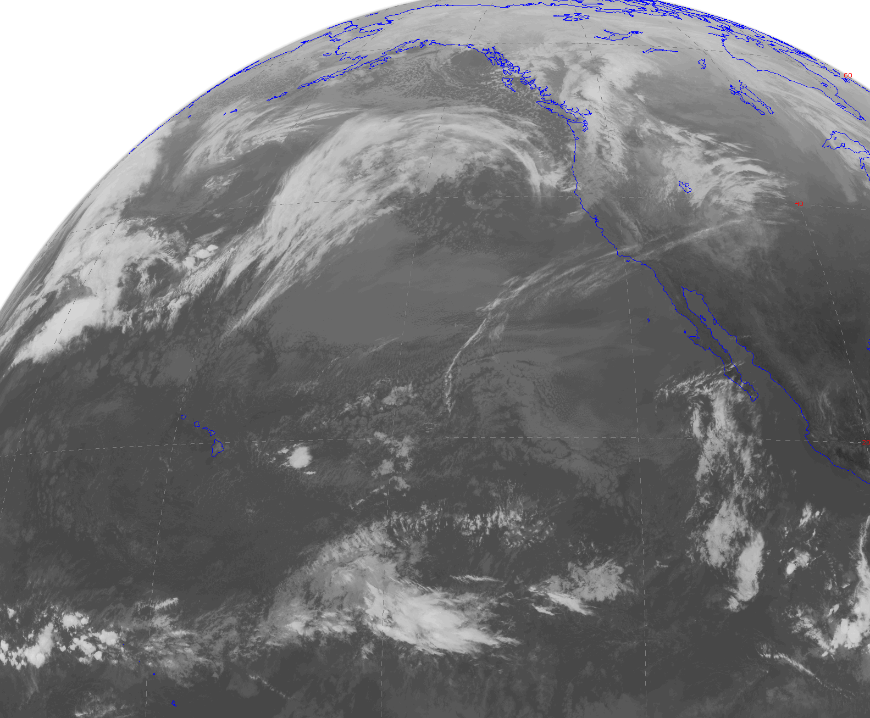
Infrared Satellite Image—shows temperatures of clouds and the surface

Slide 24
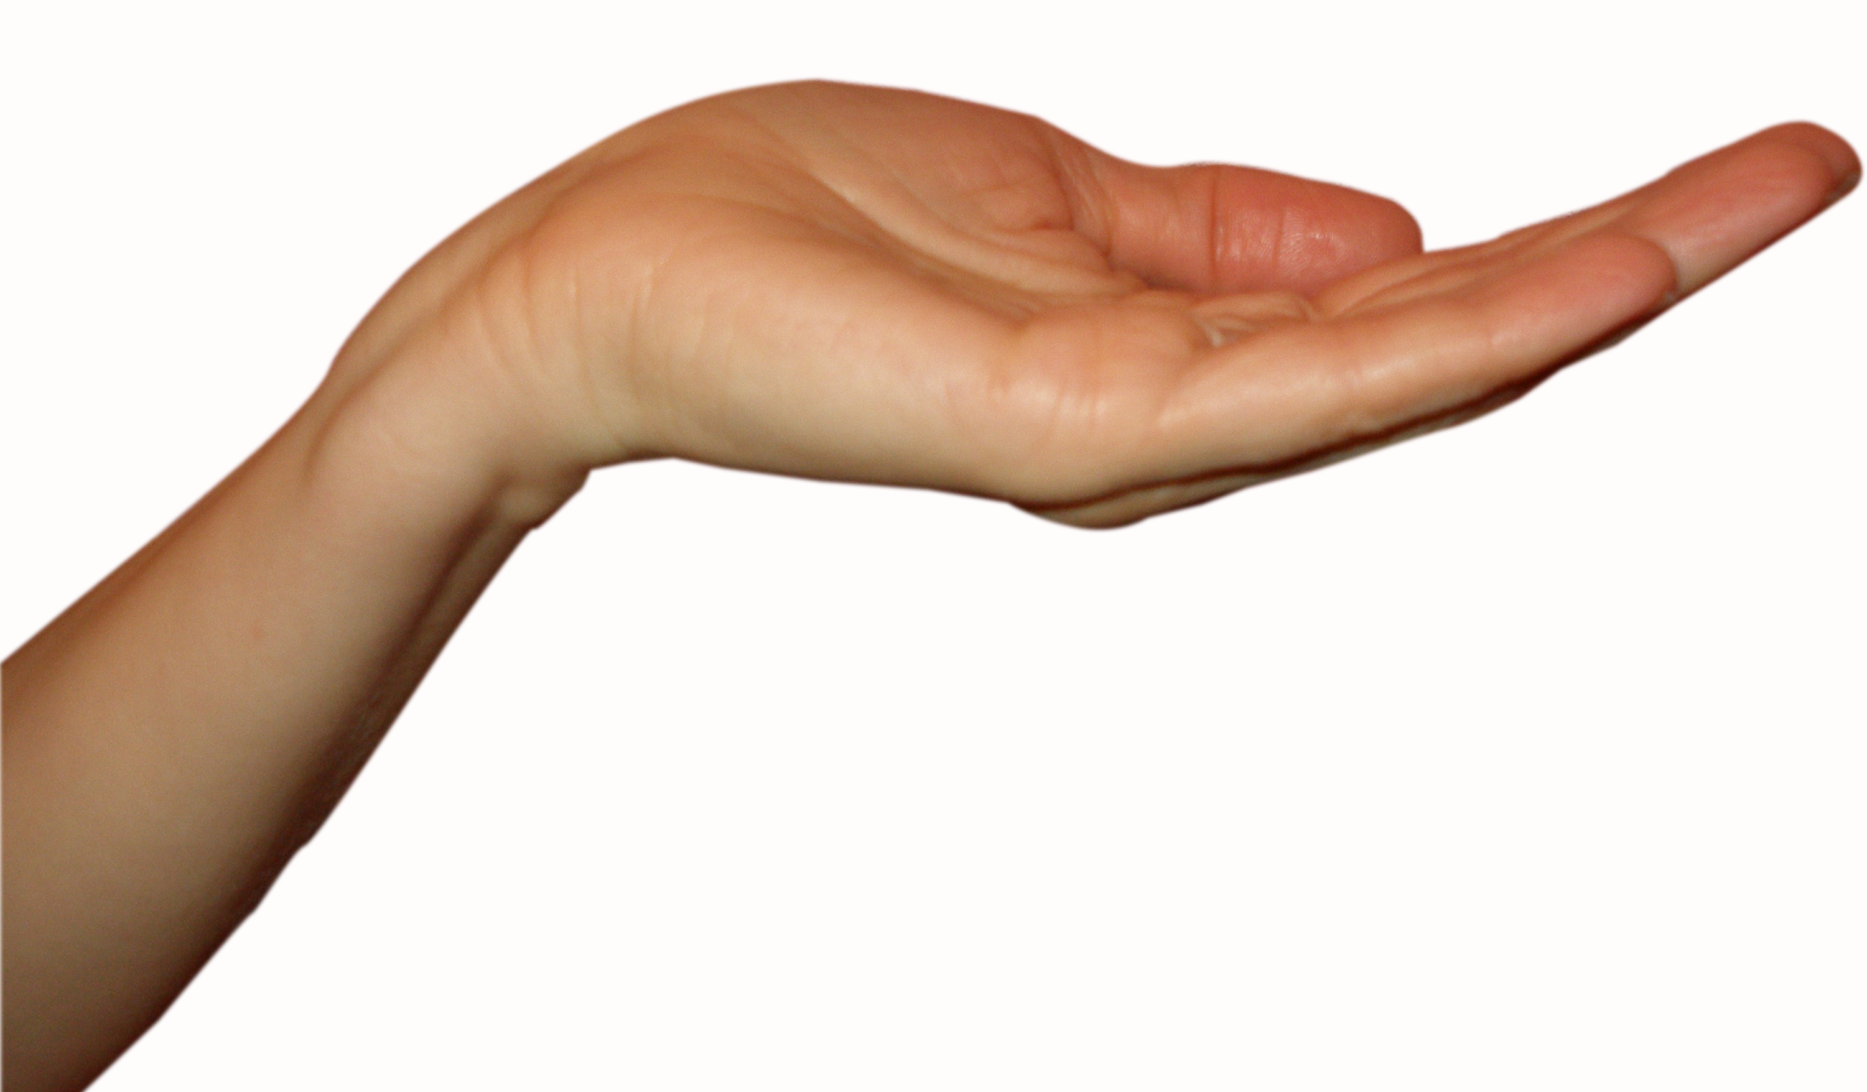
Human Skin
With practice…good to roughly 2F.

Slide 25
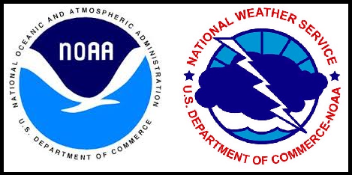
Official Surface Air Temperature Measurements
Always measured in the SHADE
Should be measured at 2-meters (about 6.6 ft) above surface.
Should be above grass or native vegetation

Slide 26
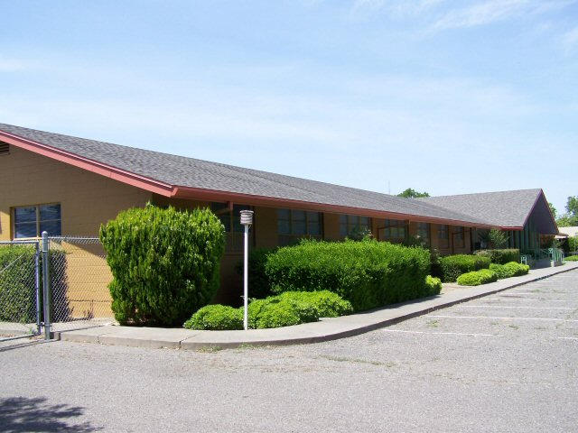
Bad Exposure Can Produce Poor Observations

Slide 27
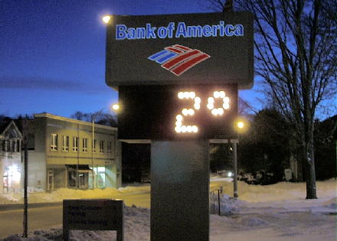
How NOT to Get Dependable Temperatures

Slide 28
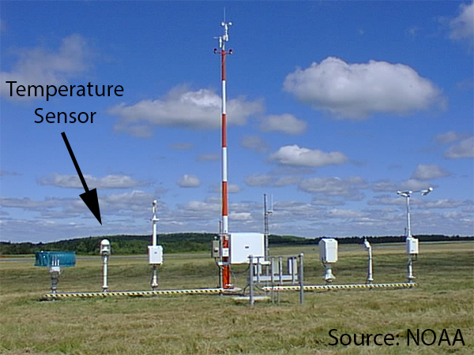
Much Better: Official Airport Sites

Slide 29
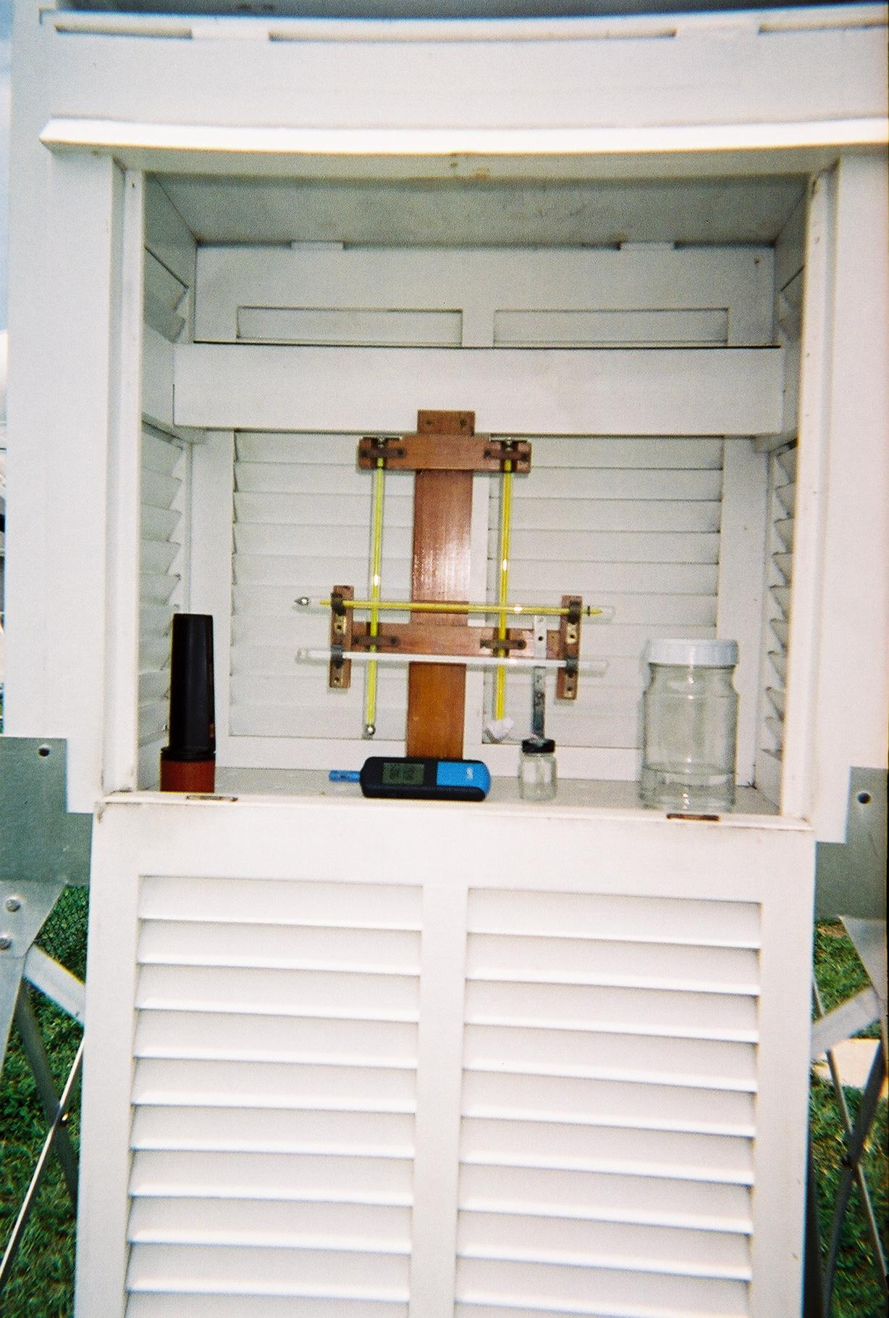
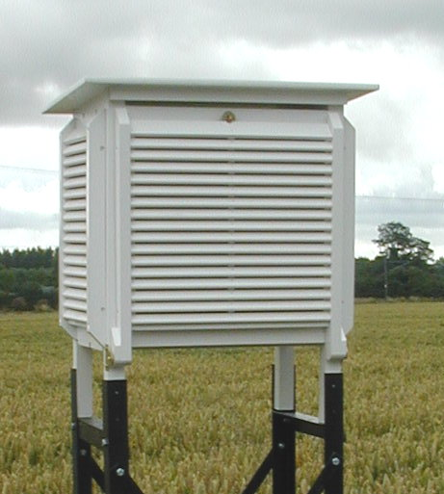
Traditional Stevenson Screen

Slide 30
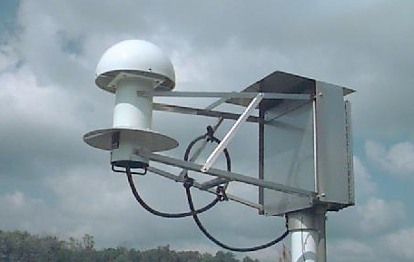
Current Weather Service Technology
NOAA/NWS/FAA ASOS Temperature/Humidity Sensor

Slide 31
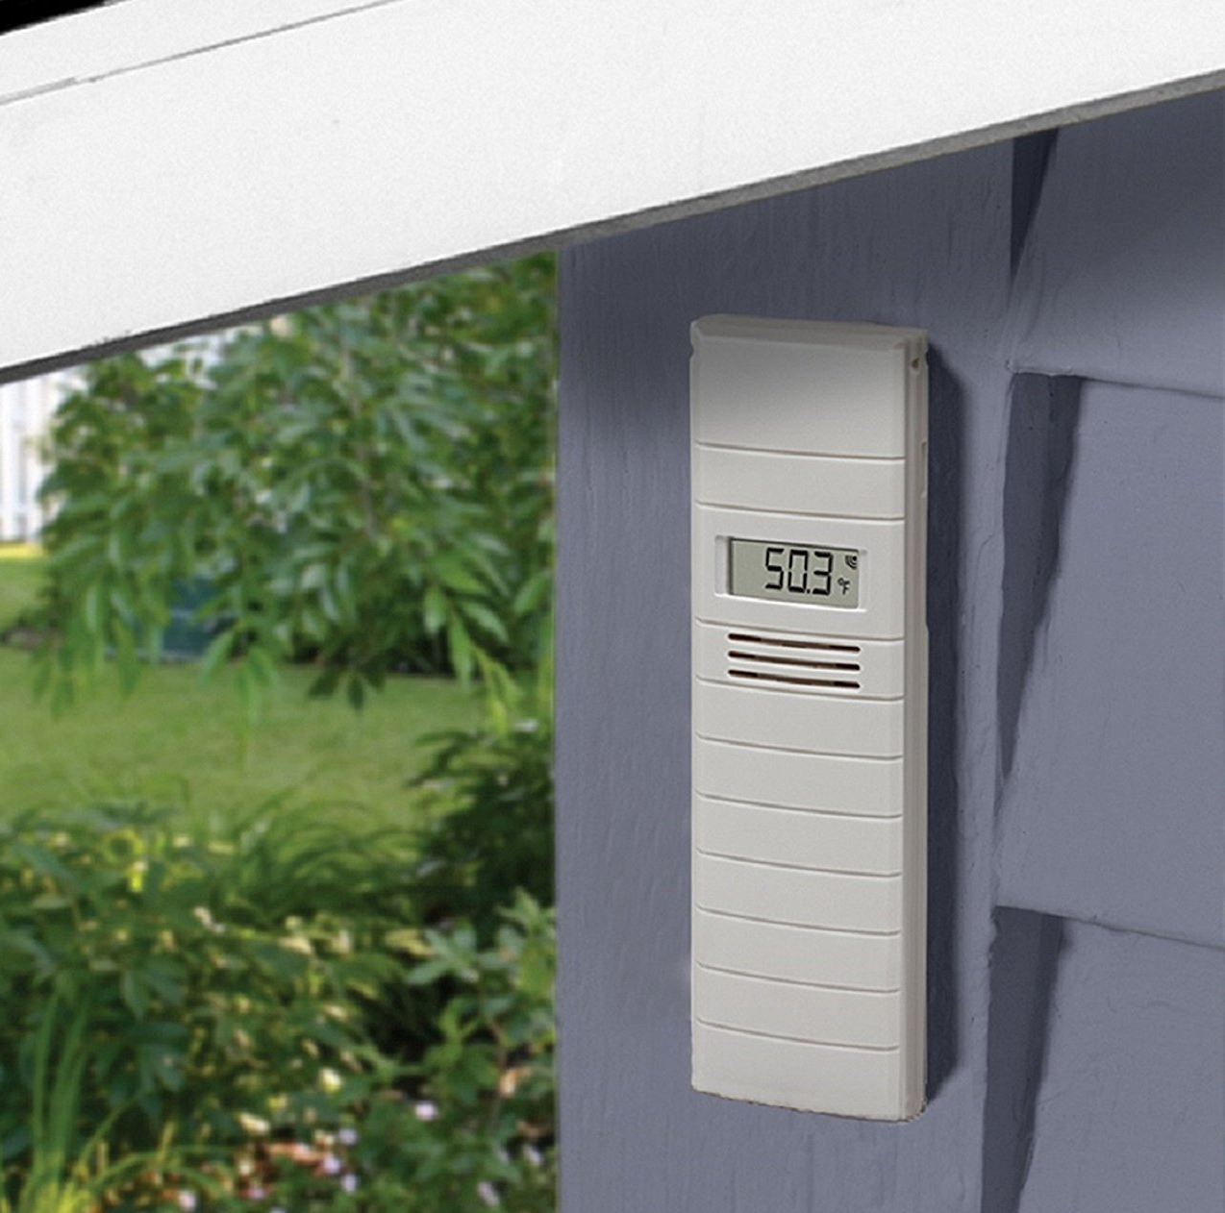
Home Thermometer Tips
Put sensor on north side of house/apartment IN PLACE THAT IS ALWAYS IN SHADE
Out of rain
Not above a BBQ!
About 6 ft above ground

Slide 32
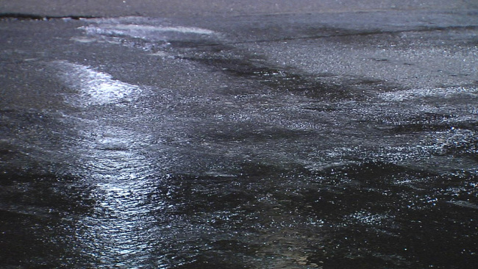
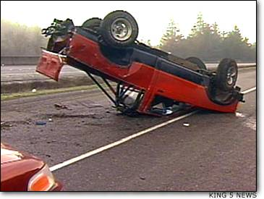
Knowing that temperatures are taken at 2-m can save your life!

Slide 33
Saving Your Life
On cold winter nights, the temperature of the road surface can be 2-5F cooler than at 2 meters (and thus cooler than measured by your car thermometer—at about 2ft)
Thus, when air temperature drop to around 35-37F, there is the possibility that the road temperatures have hit freezing, with ice.
Slow down!

Slide 34
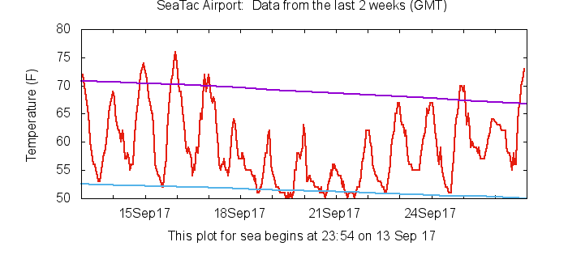
Diurnal (Daily) Temperature Variations
What time of day are temperatures generally warmest and coolest?

Slide 35
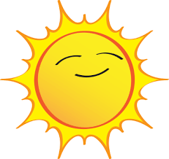
Temperature Quiz: during the summer, temperatures are warmest at what time?
At 1 PM when the sun is highest and strongest (daylight time)
3 PM
5 PM
Near sunset after a full day of heating by the sun?

Slide 36
ANSWER During Summer, Around 5 PM Sometimes as late as 6 PM

Slide 37
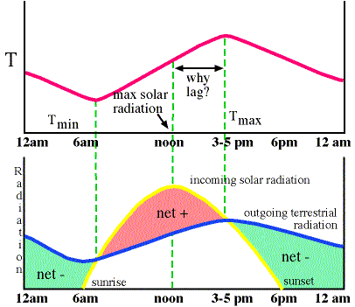
Diurnal (Daily) Temperature Variations
Minimum temperature generally occurs just after sunrise
Max temps 3-5 hours after solar noon.
In Seattle, max temps are typically 2-3 PM in winter, 5-6 PM midsummer.

Slide 38
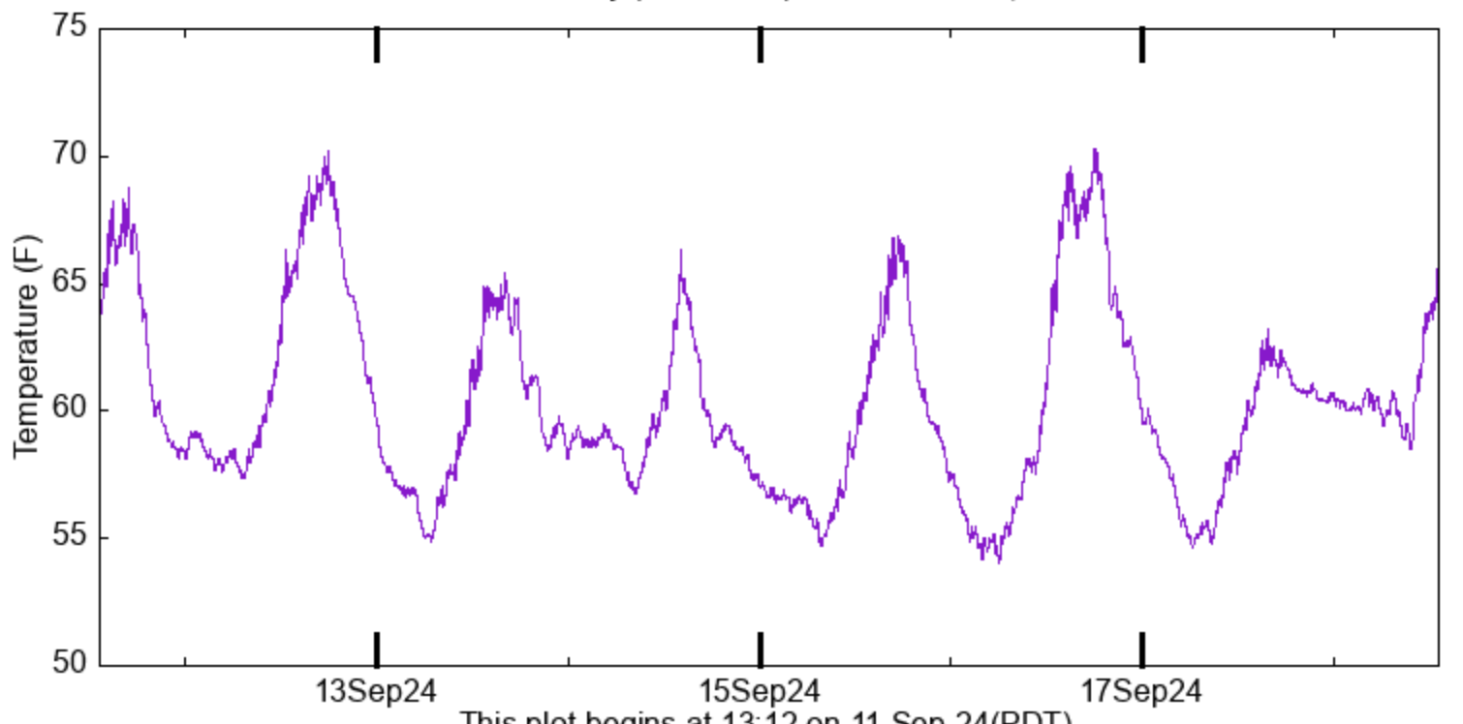
Diurnal Temperature Range
The difference between high and low temperatures over a day at a location.

Slide 39
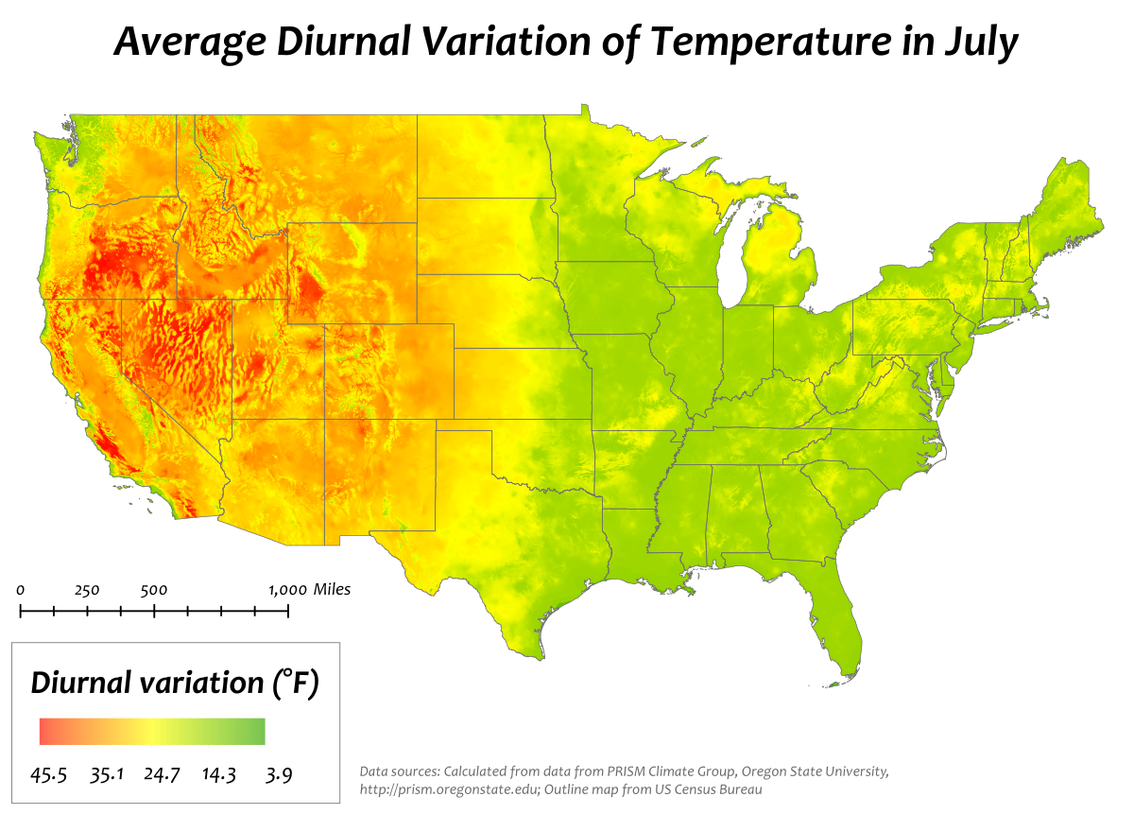
Diurnal Temperature Range Varies Spatially
Big Diurnal
Variations
Over West Deserts Where
Air is Dry
Less
Diurnal
Variation
Where Air
Is Moister

Slide 40
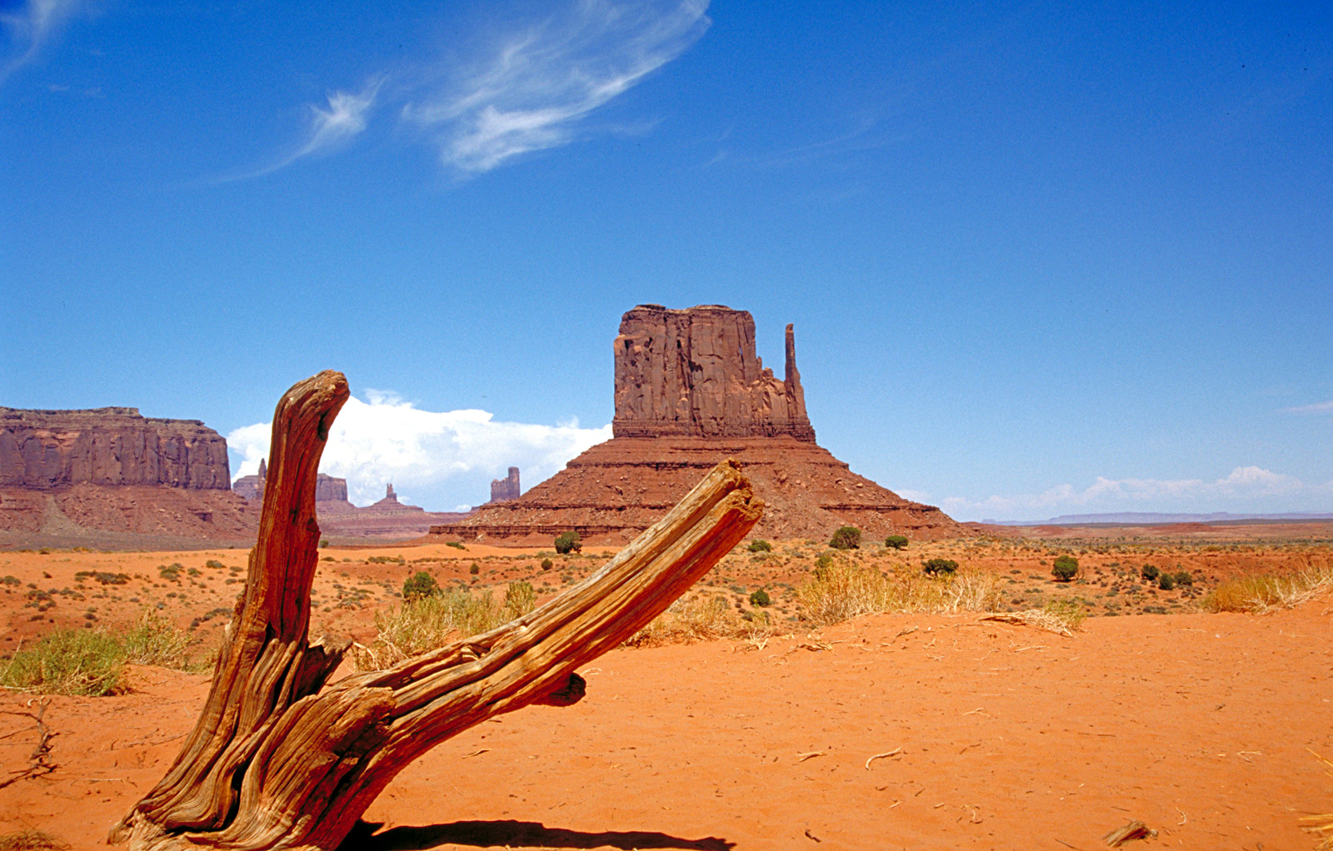
Why a big temperature range over the desert southwest?
Clear skies allow strong solar heating during day
More southern latitude has more heating
Clear skies allow enhanced cooling at night!

Slide 41
All Temperatures Are Local
Temperatures can vary over short distances due to a number of factors:
Proximity to water (usually cooler in summer, warmer in winter)
Elevation (usually cooler aloft, but cool air can pool near the surface at night/during winter)
Surface characteristics/urban heat island (warmer in urban core)

Slide 42
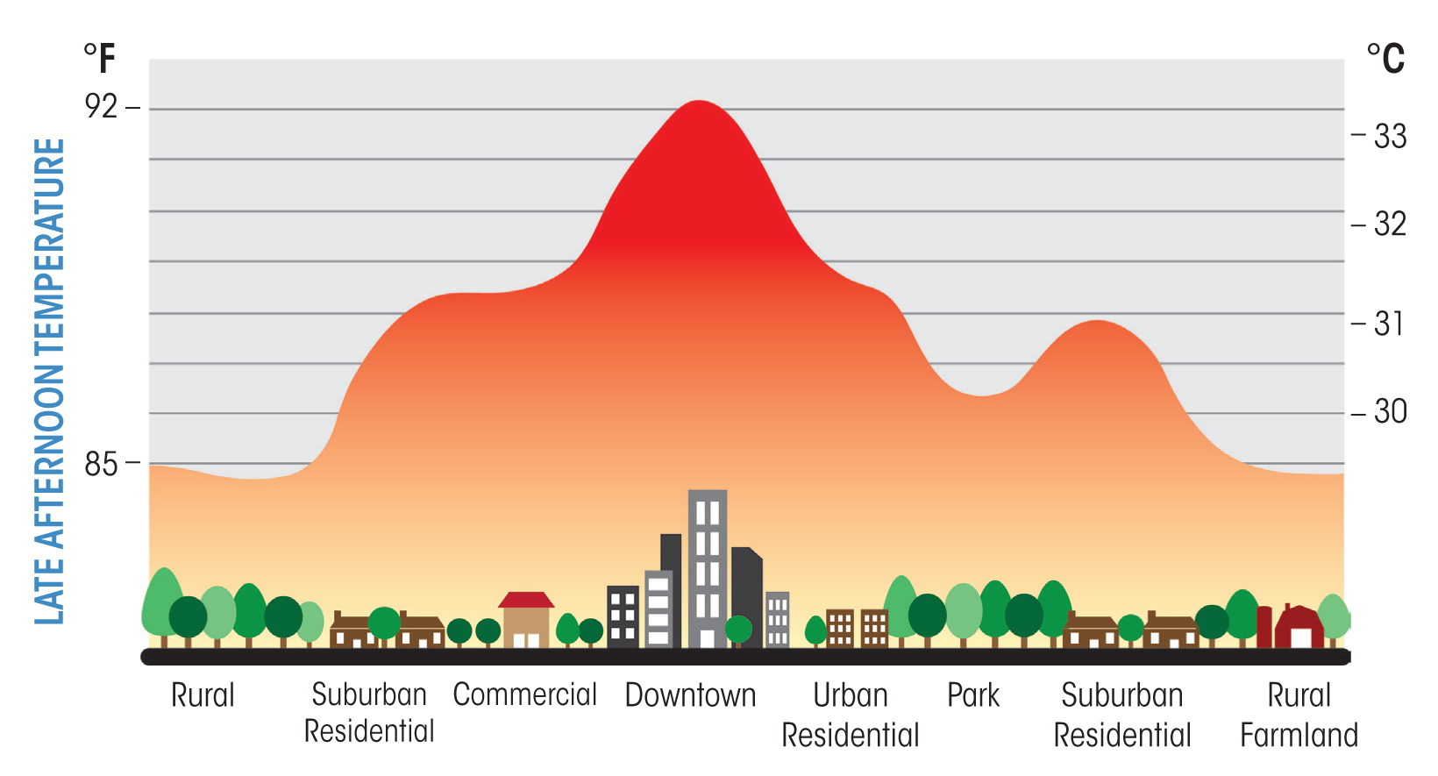
Urban Heat Island Can easily be 5-10F warmer in urban core

Slide 43
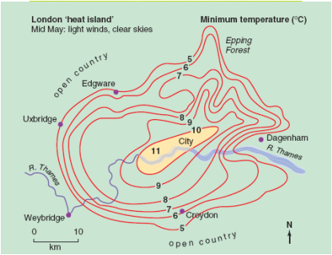
London in May

Slide 44
Why Urban Heat Island?
Concrete and stone absorb heat during day and release at night
Heating of buildings/combustion in engines
Less surface water and thus less cooling evaporation

Slide 45
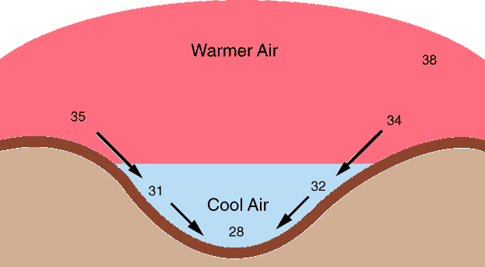
Elevation
During the night, cooler, denser air often drains into lower elevations

Slide 46
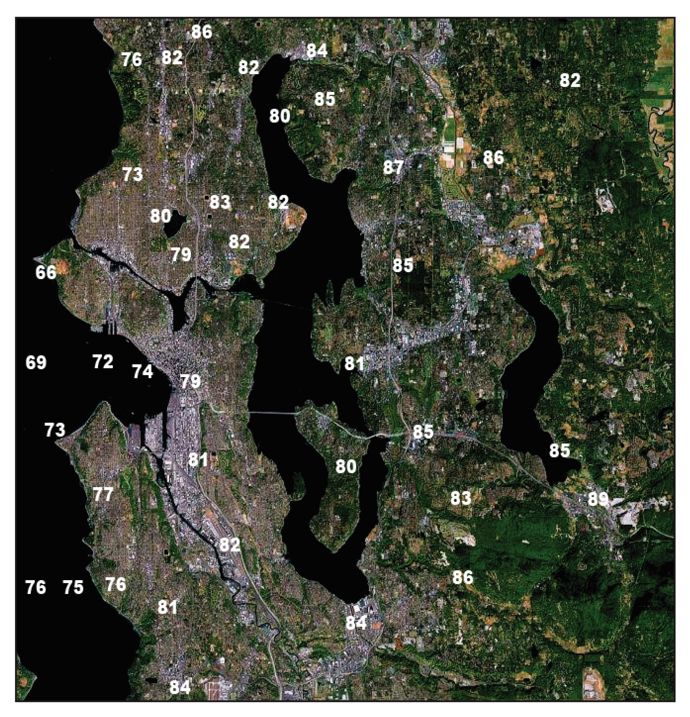
Typical
Summer
Day
Near 5 PM

Slide 47
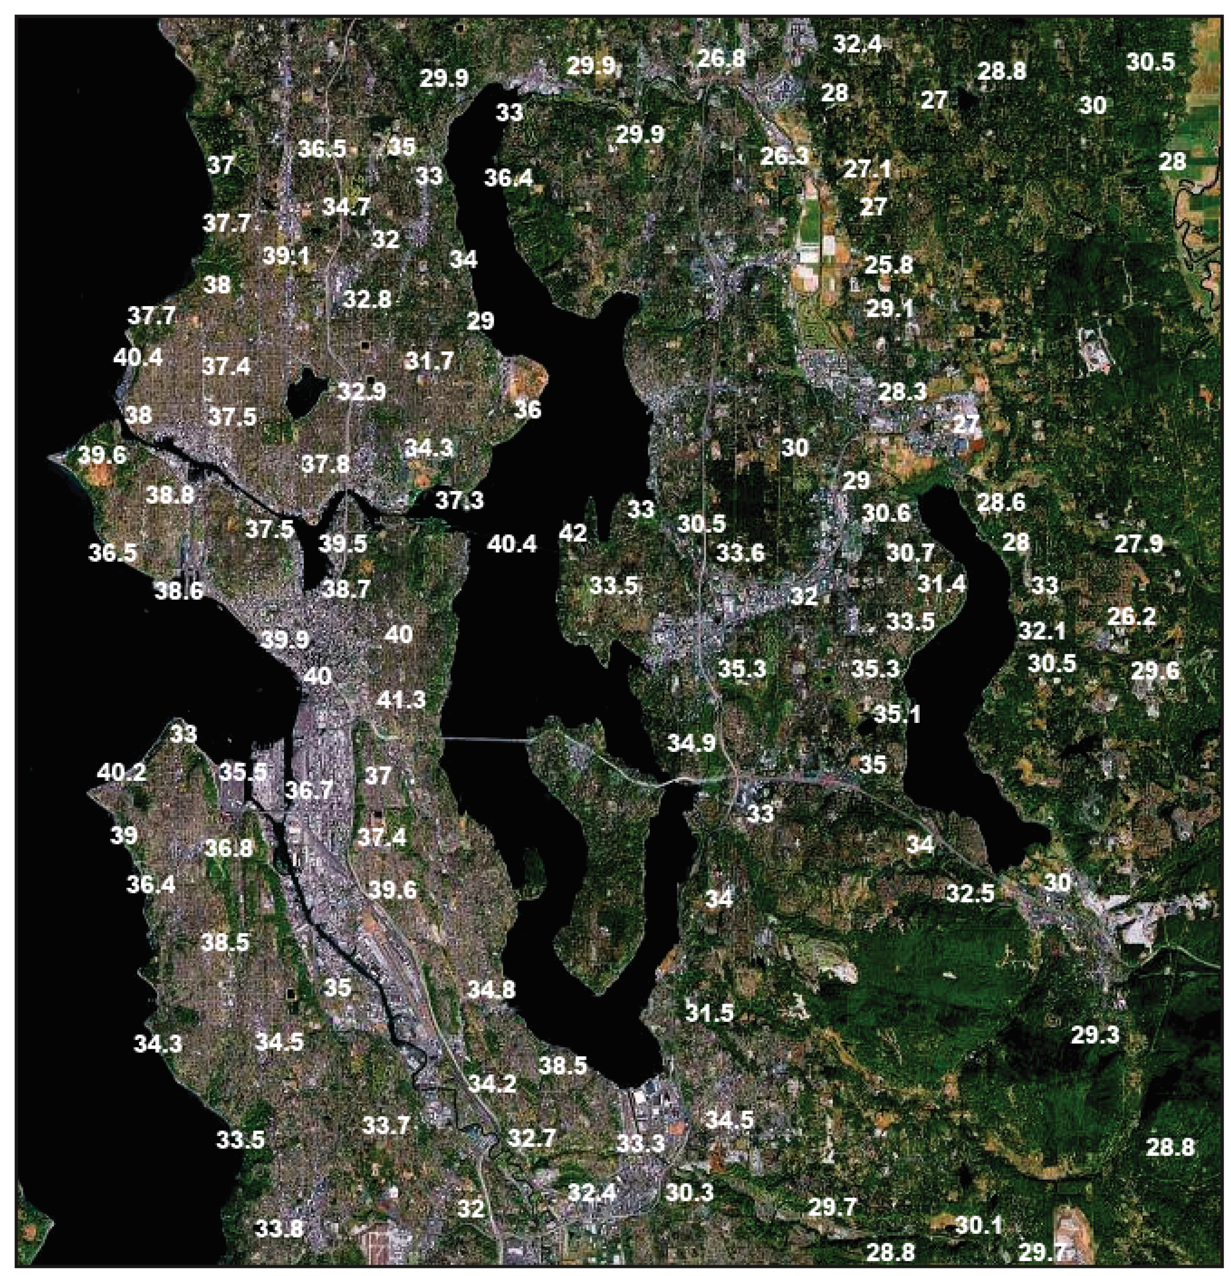
January
Temps
Around
6 AM

Slide 48
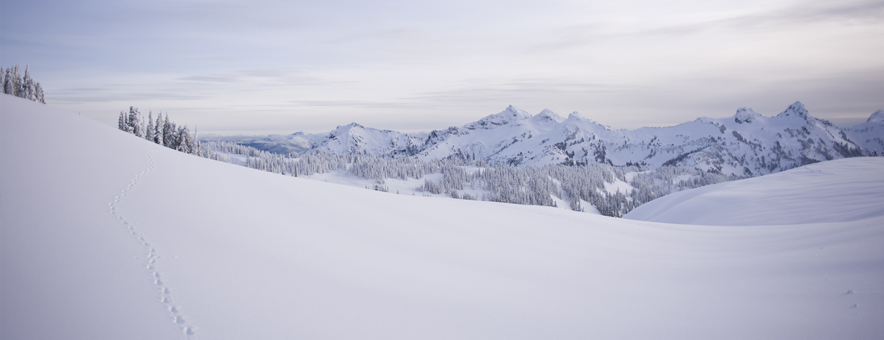
Snow Promotes Cooling Good in reflecting solar radiation, good emitter in infrared, good insulator Often record cold temperatures are associated with snow

Slide 49
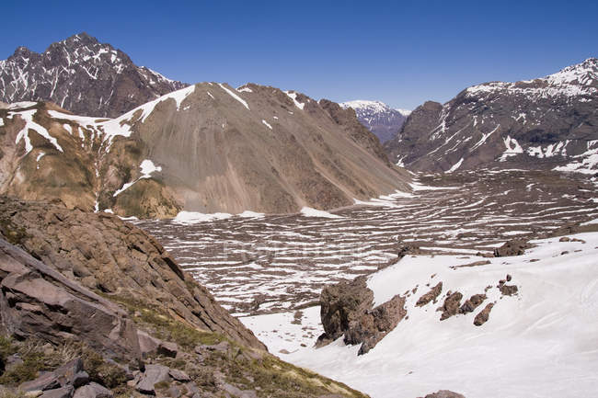
The Most Extreme Cold Locations Put the Three Elements of Cold
Elevated valley
Snow cover
Away from water

Slide 50
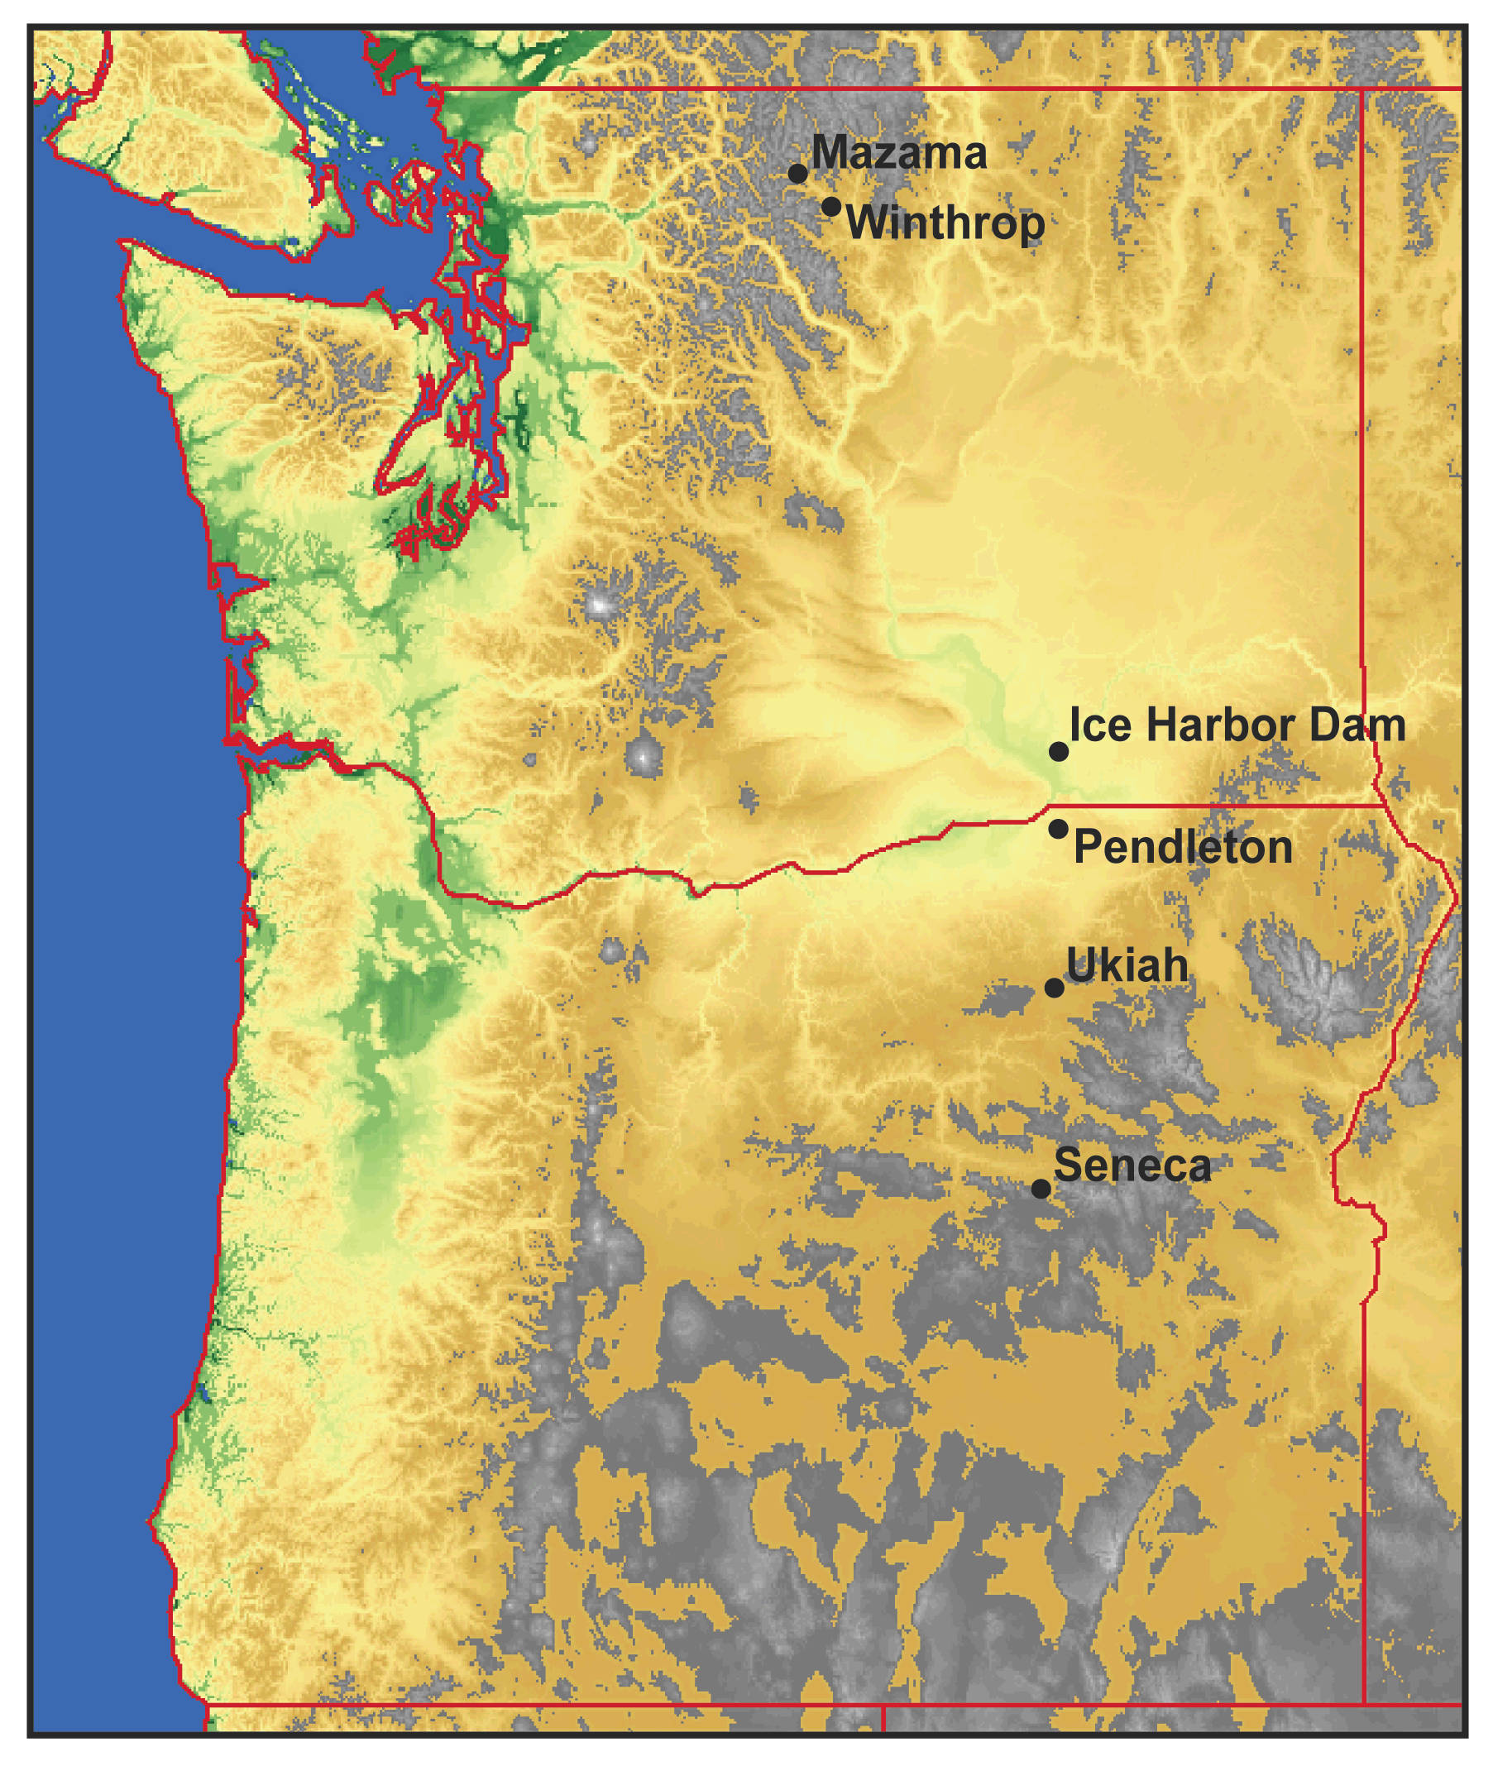
WA cold records are all east of the Cascades
On December 30, 1968 both Mazama and Winthrop, WA dropped to -48F, the state record.
Why there?

Slide 51
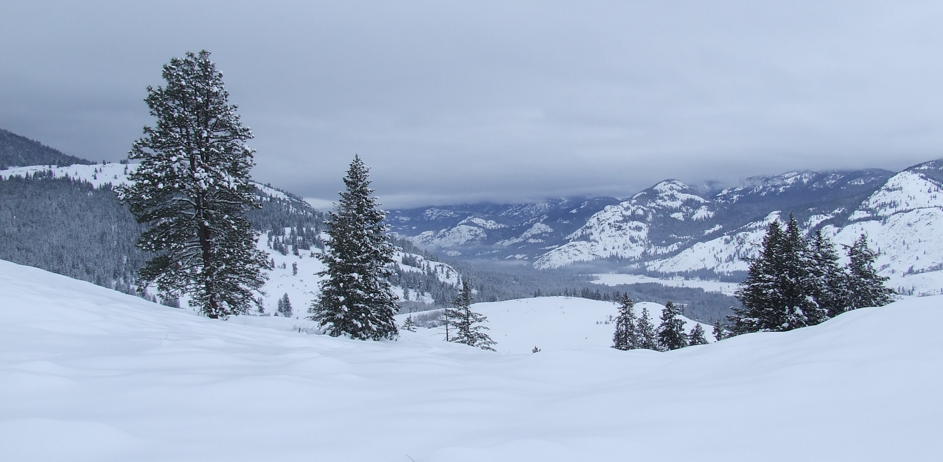
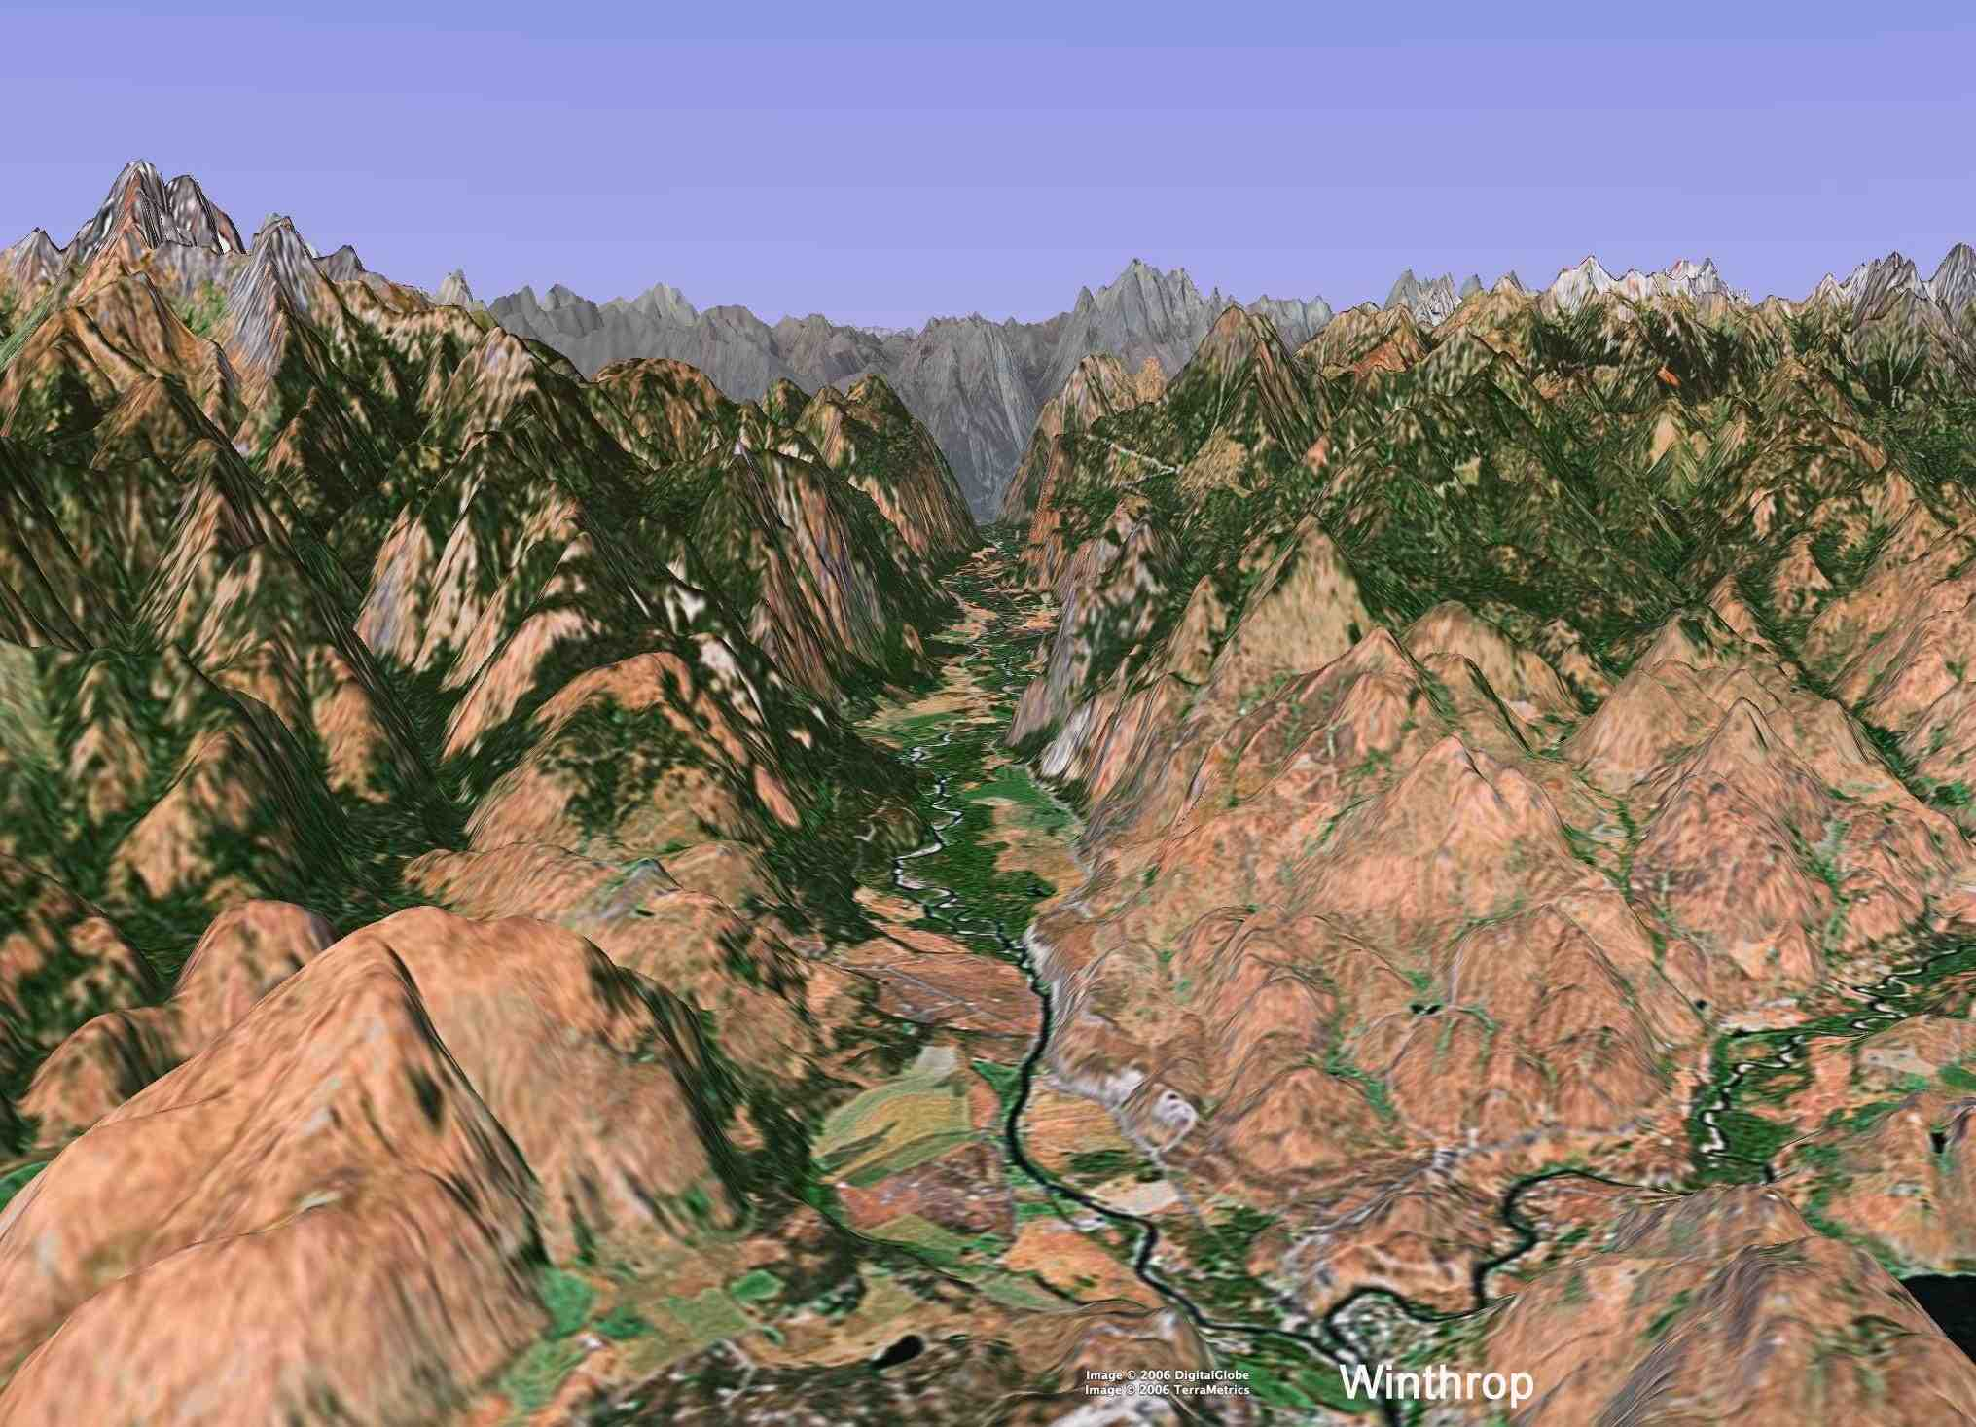
Winthrop and Mazama are in a deep valley of the northeast Cascades
When snow on ground

Slide 52
End of temperature

