Slide 1
Summary
WCC’s at Latitudes Greater Than 60N
Strong Thresholds
2014-2017
North America: 25
North Atlantic:0 (201403-201502)*
Europe: 21
Asia: 108
*using Moderate Thresholds: 3

Slide 2
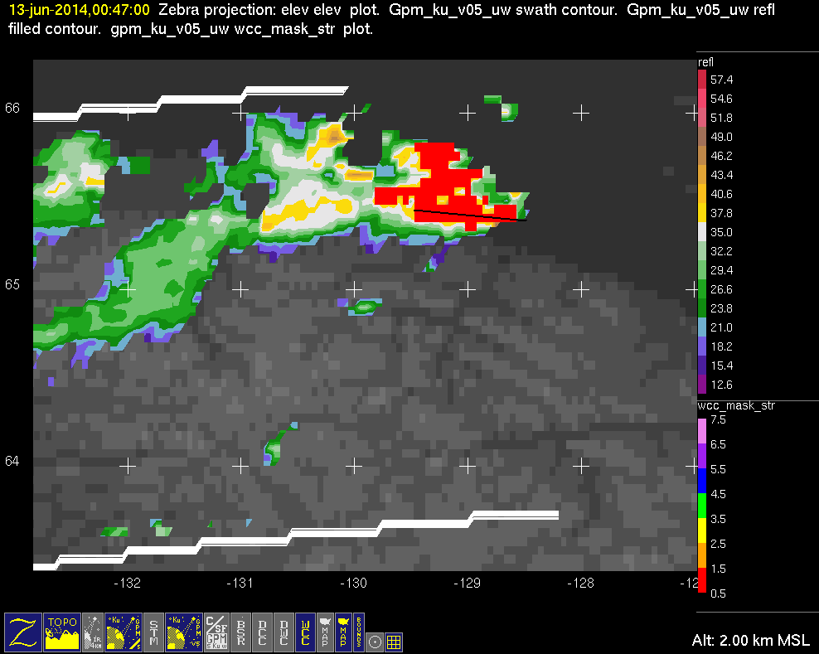
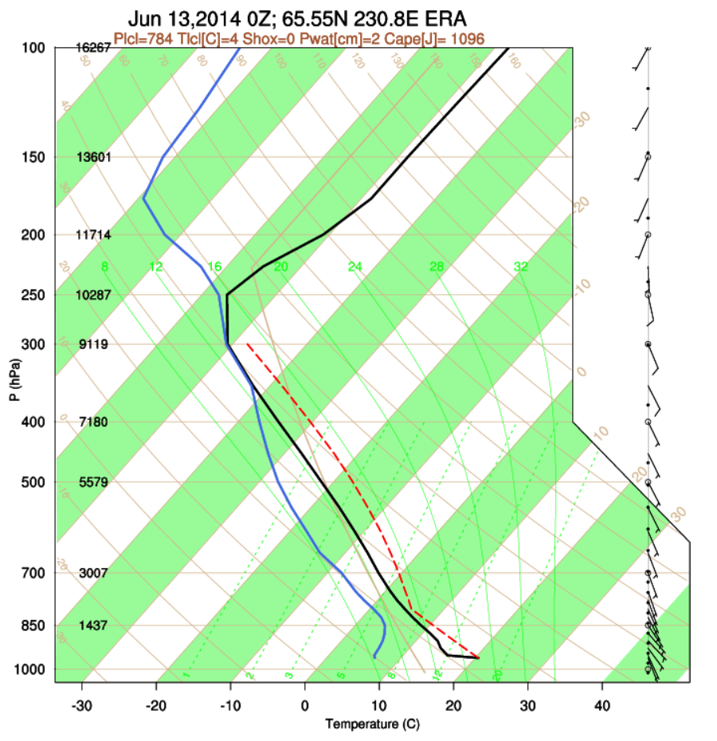
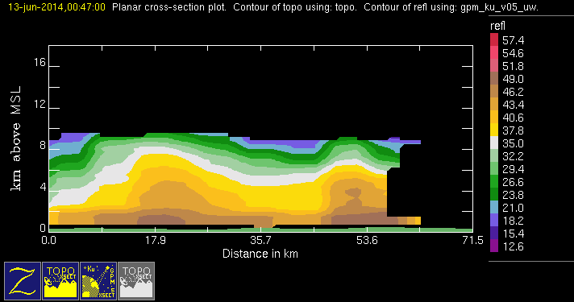
GPM 2Ku – WCC – 20140613 @ 004632
NAM (AKA)

Slide 3
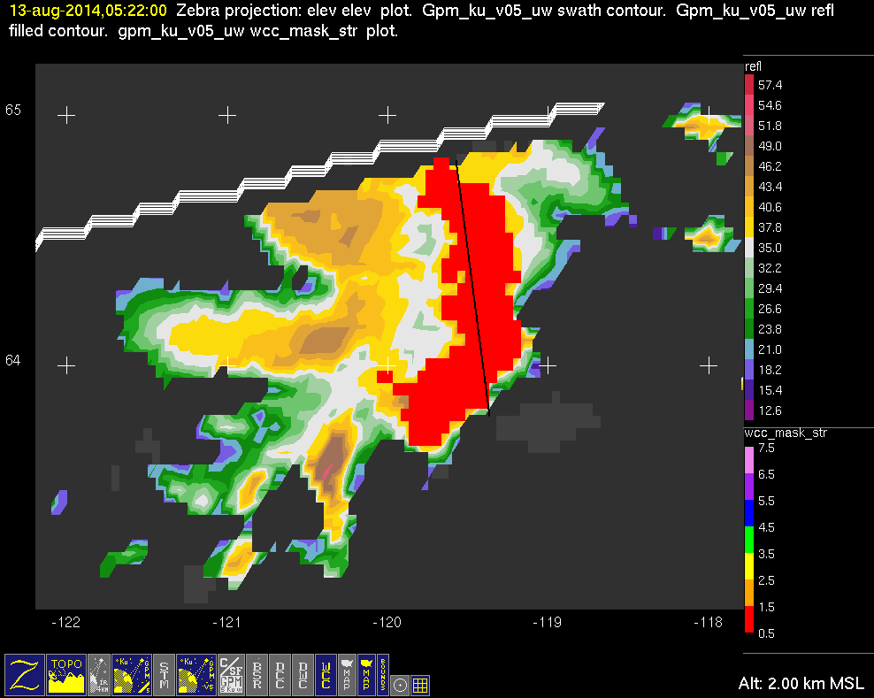
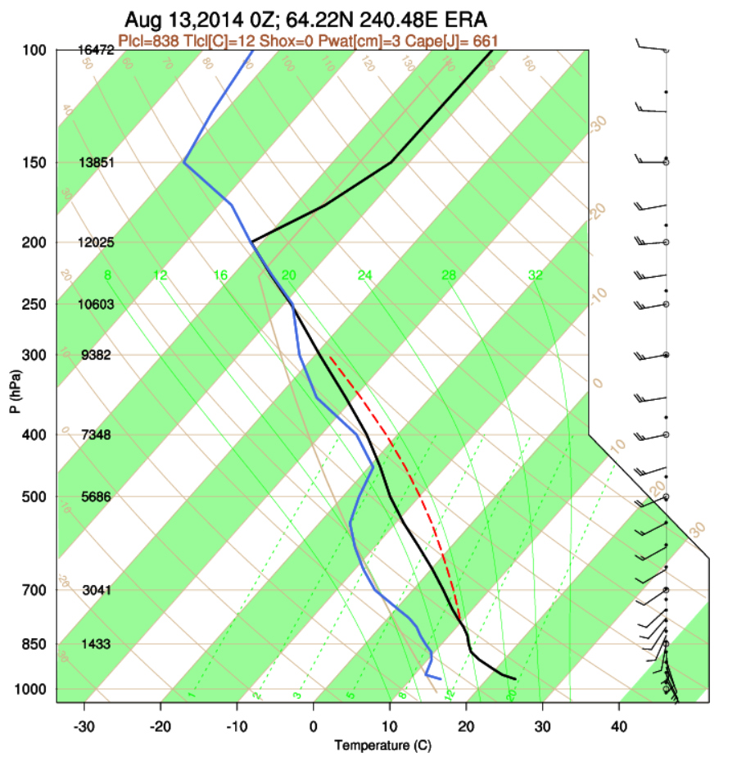
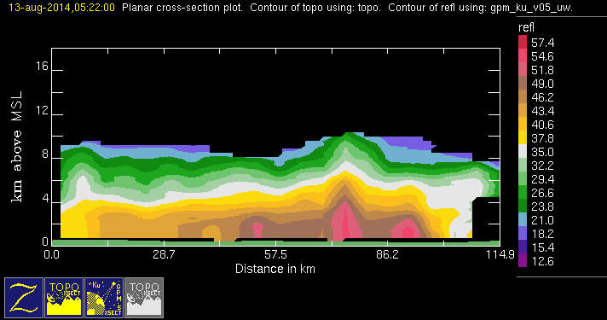
GPM 2Ku – WCC – 20140813 @ 052131
NAM (AKA)

Slide 4
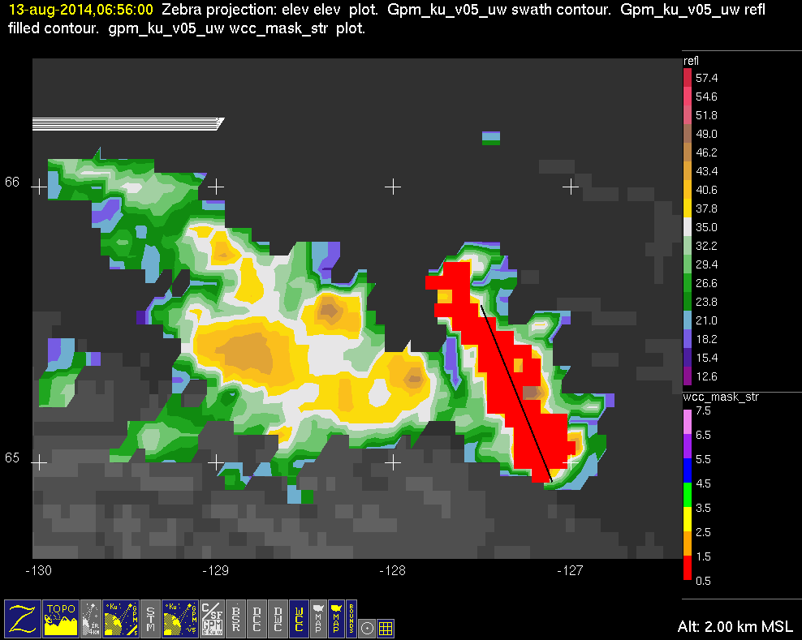
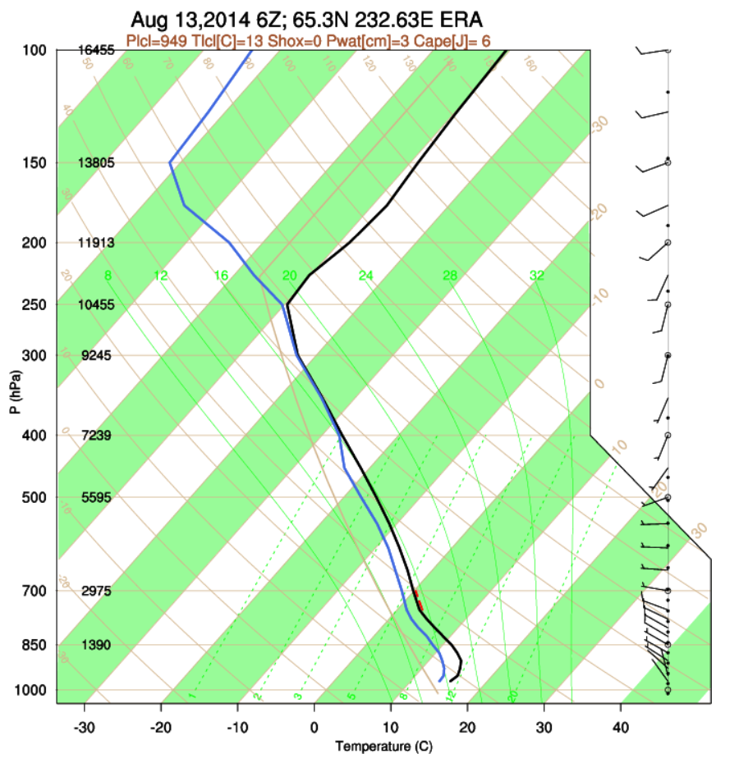
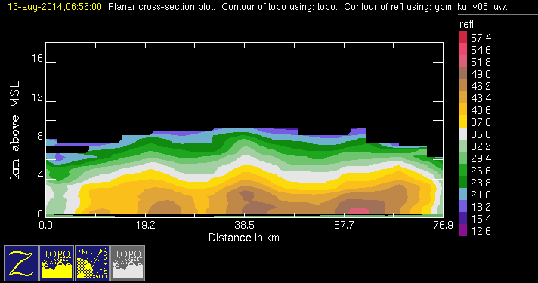
GPM 2Ku – WCC – 20140813 @ 065539
NAM (AKA)

Slide 5
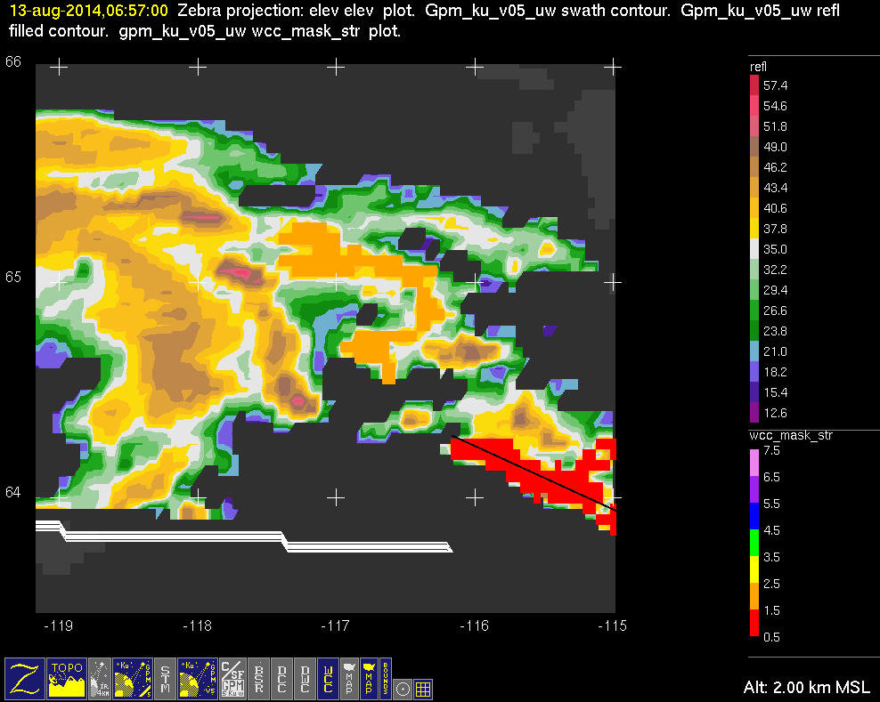
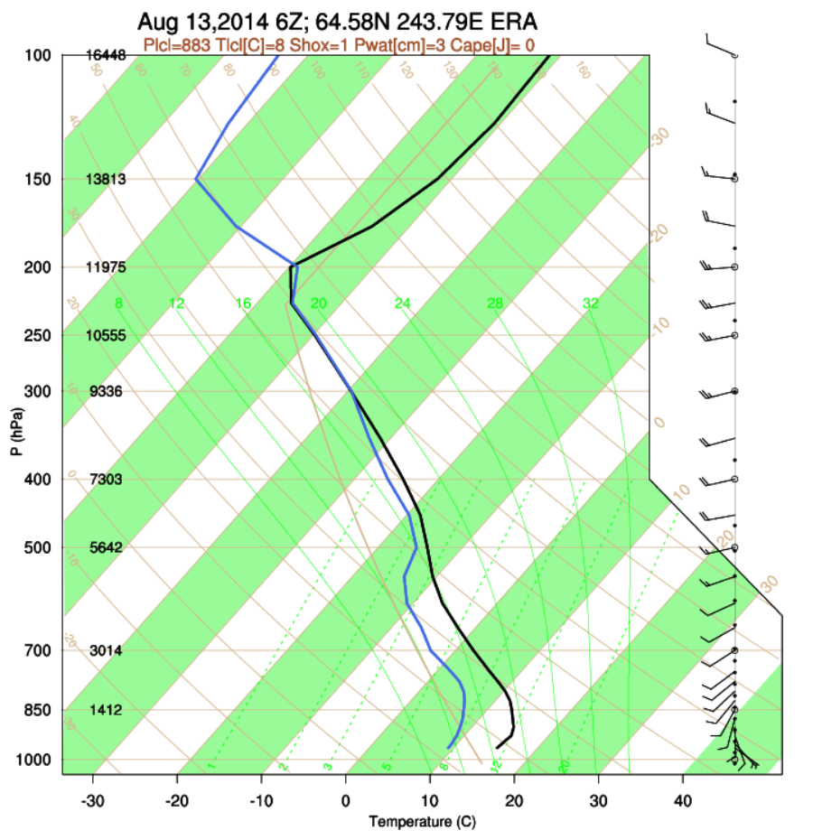
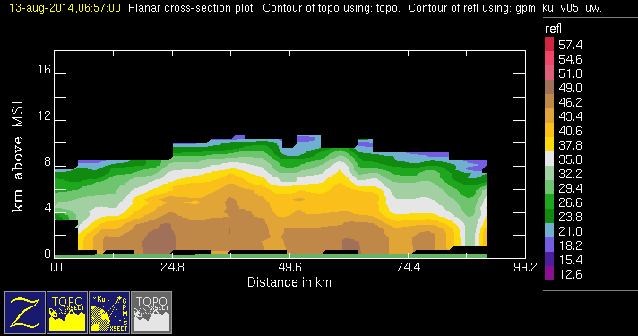
GPM 2Ku – WCC – 20140813 @ 065650 1/2
NAM (AKA)

Slide 6
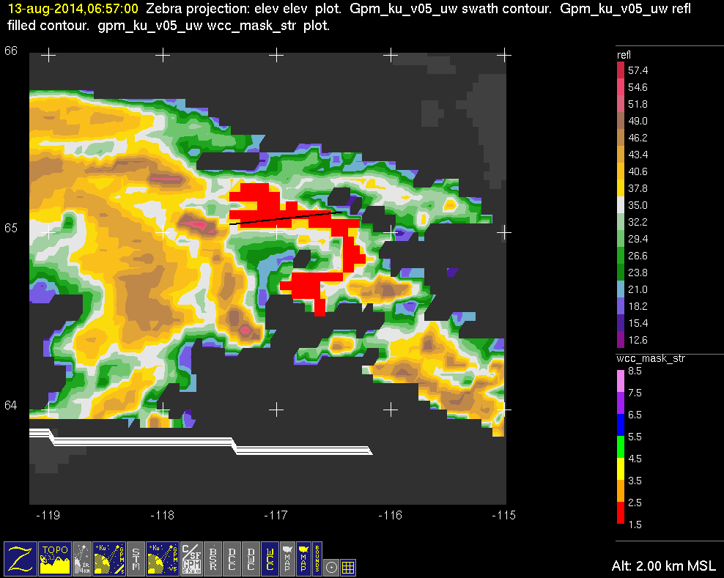
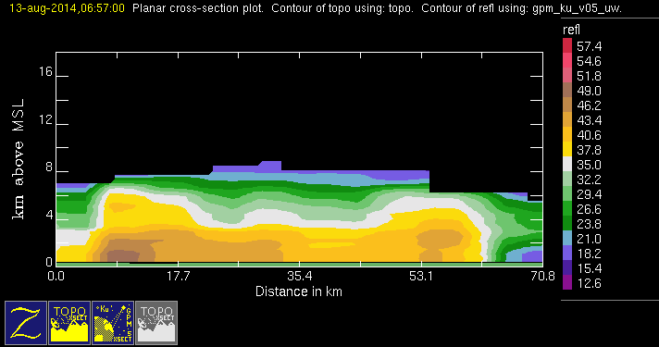
GPM 2Ku – WCC – 20140813 @ 065650 2/2
NAM (AKA)

Slide 7
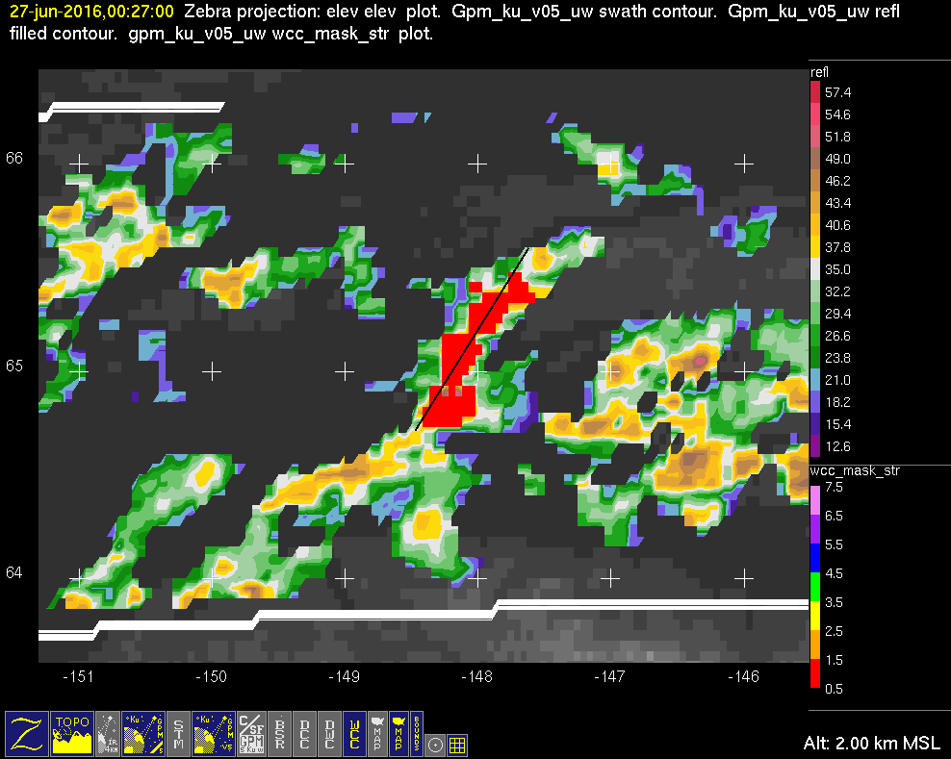
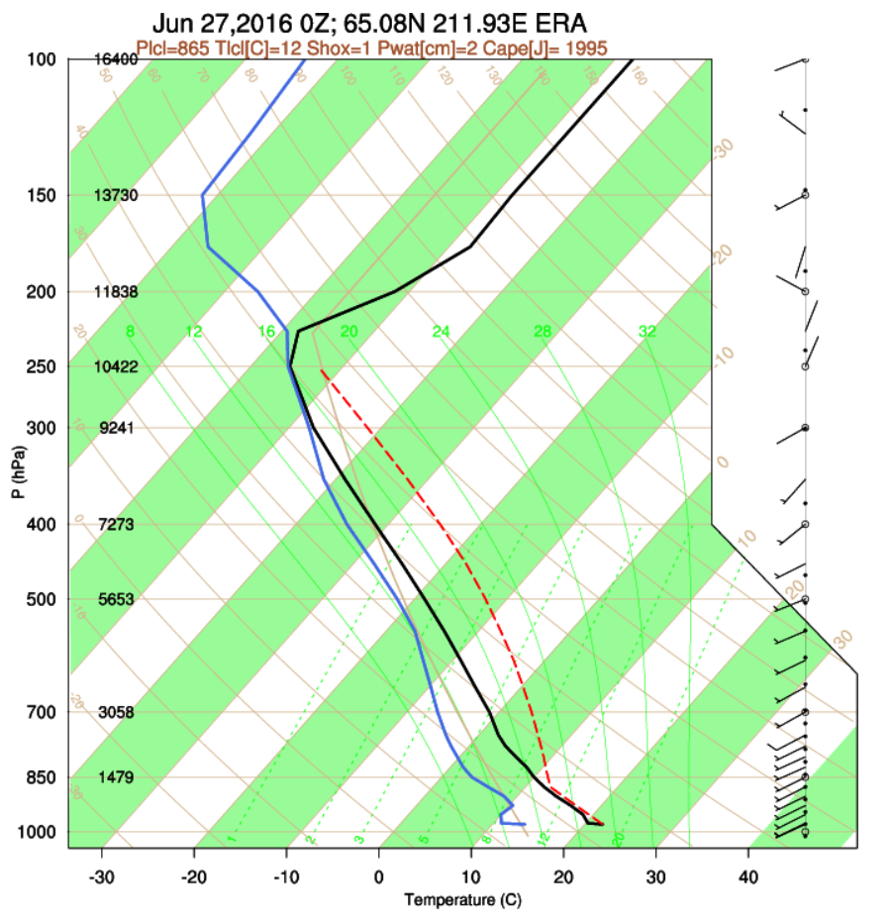
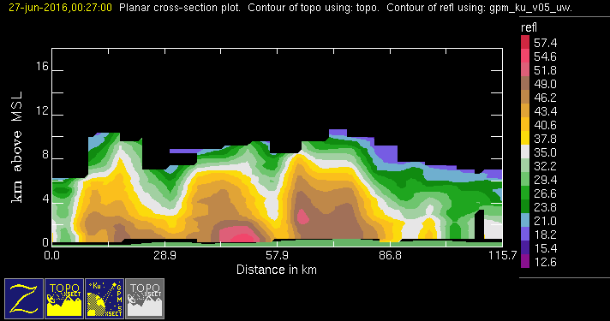
GPM 2Ku – WCC – 20160627 @ 002611
NAM (AKA)

Slide 8
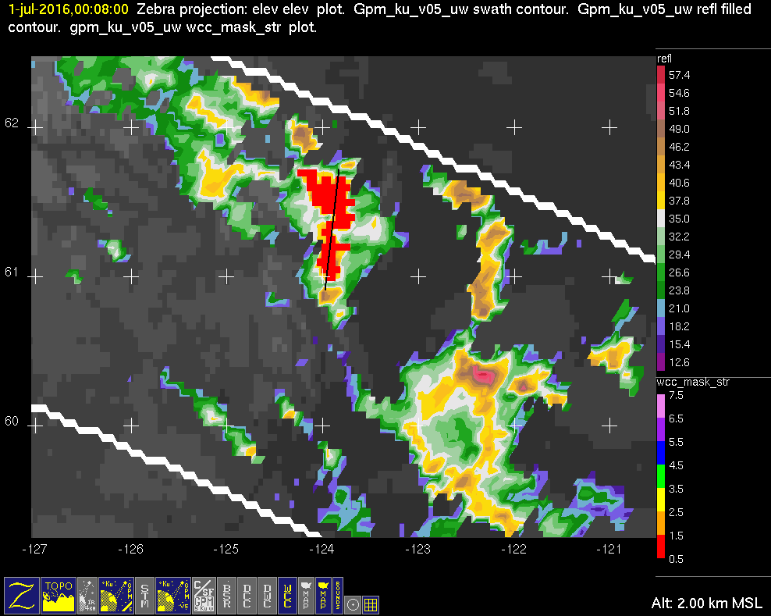
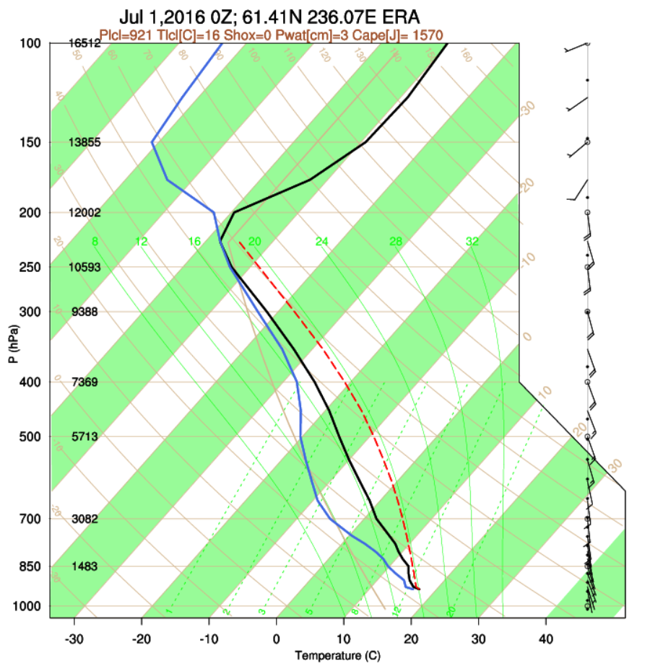
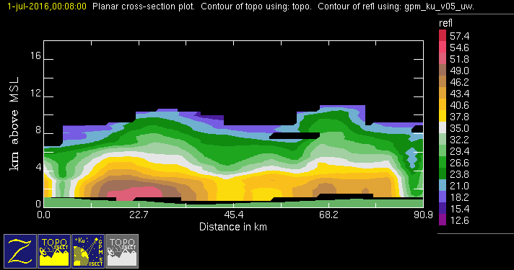
GPM 2Ku – WCC – 20160701 @ 000708
NAM (AKA)

Slide 9
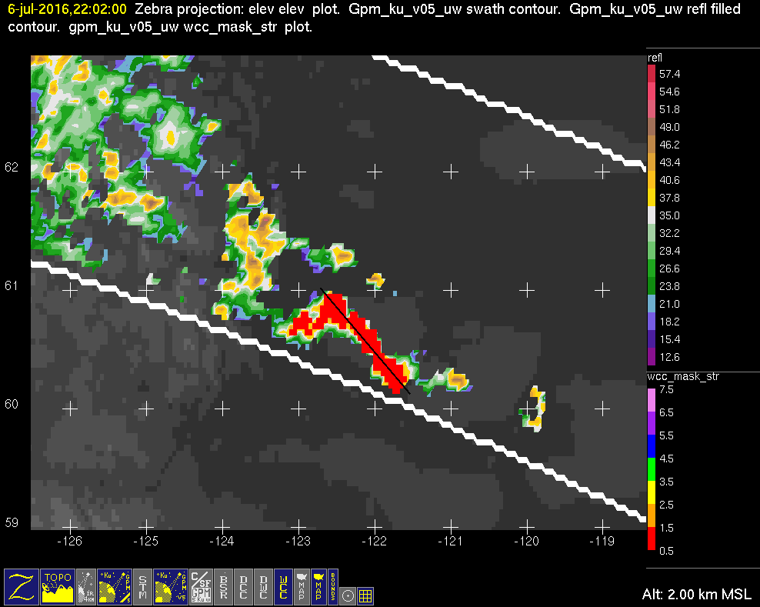
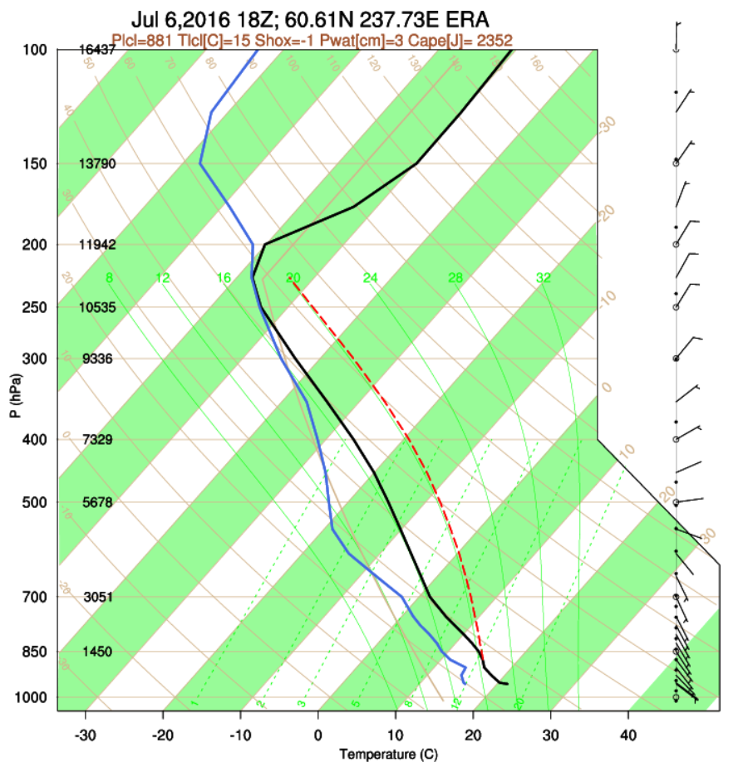
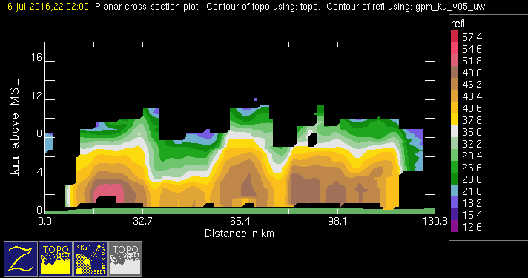
GPM 2Ku – WCC – 20160706 @ 220146
NAM (AKA)

Slide 10
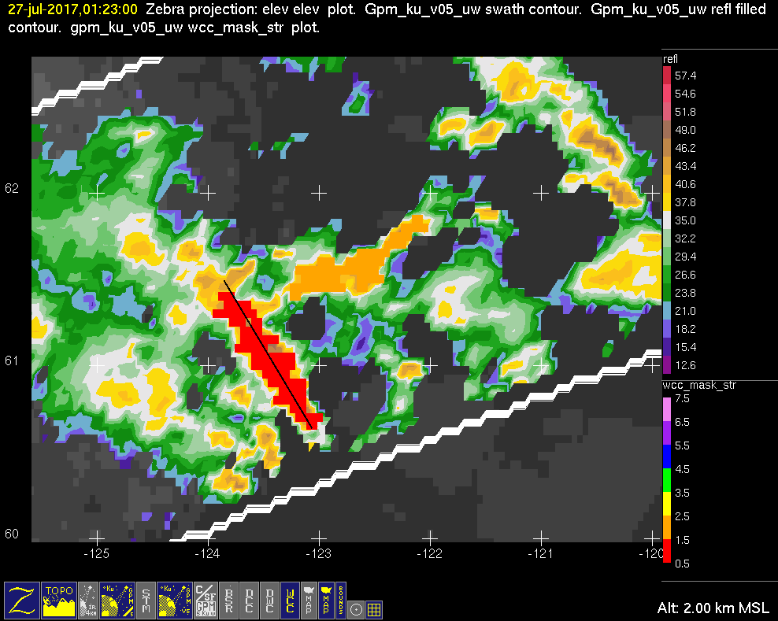
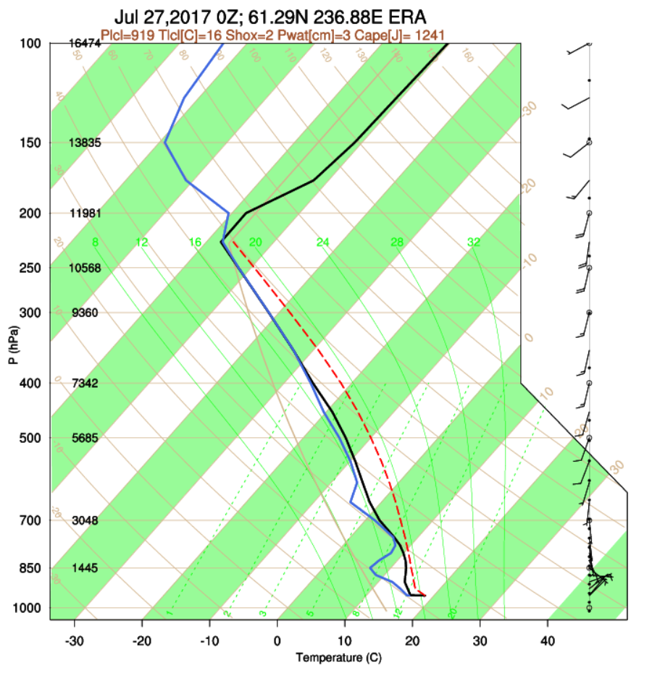
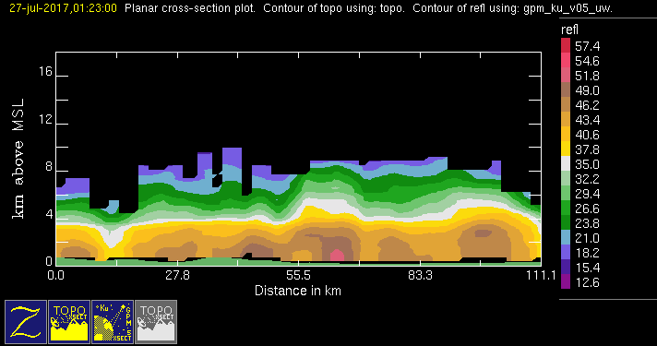
GPM 2Ku – WCC – 20170727 @ 012241 (1/2)
NAM (AKA)

Slide 11
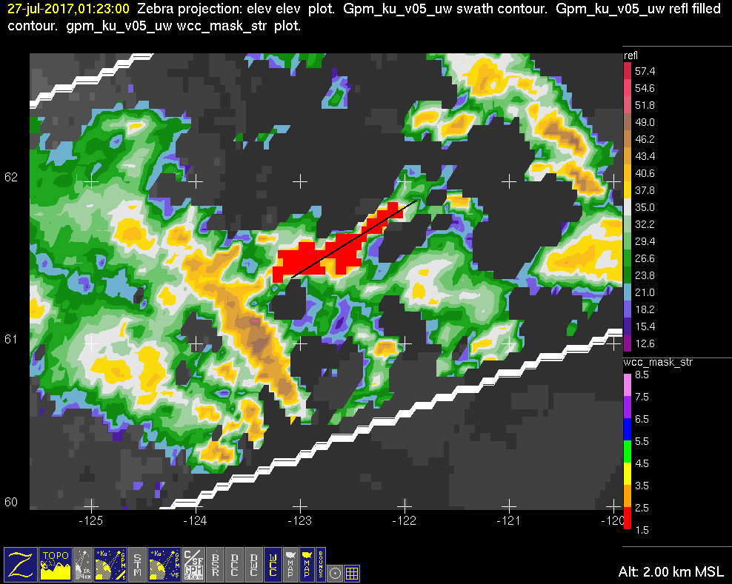
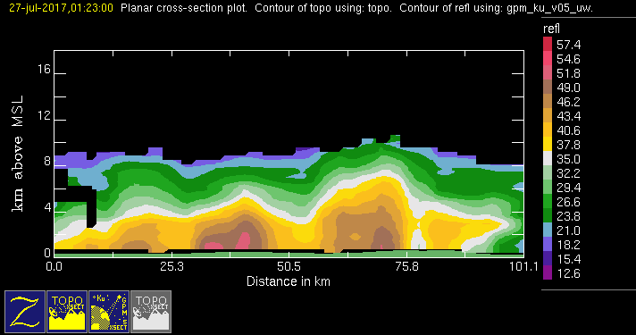
GPM 2Ku – WCC – 20170727 @ 012241 (2/2)
NAM (AKA)

Slide 12
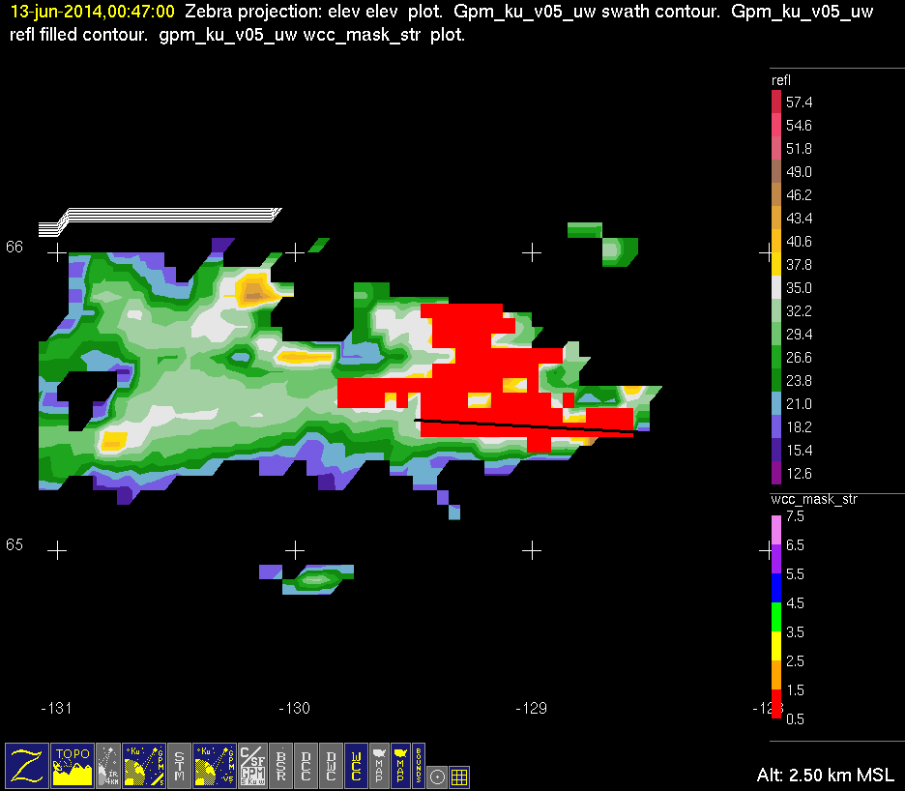

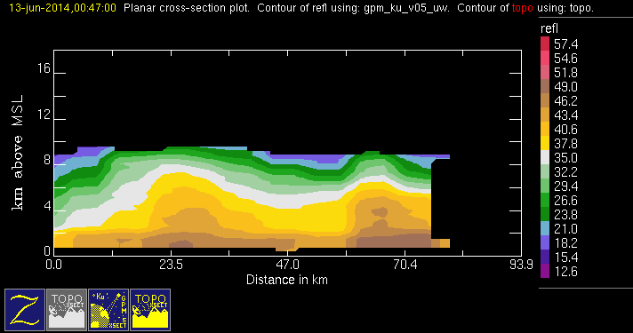
GPM 2Ku – WCC – 20140613 @ 004635
NAM

Slide 13
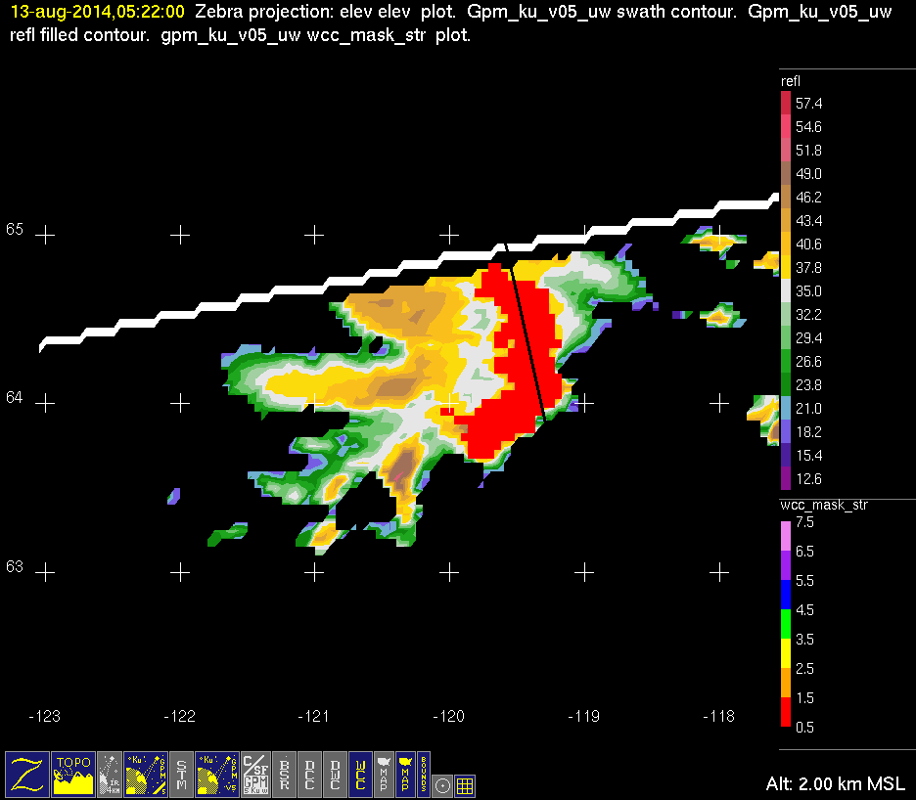

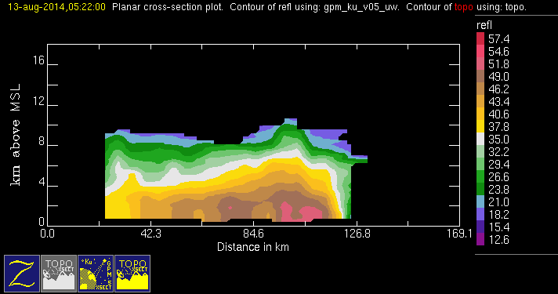
GPM 2Ku – WCC – 20140813 @ 052131
NAM

Slide 14
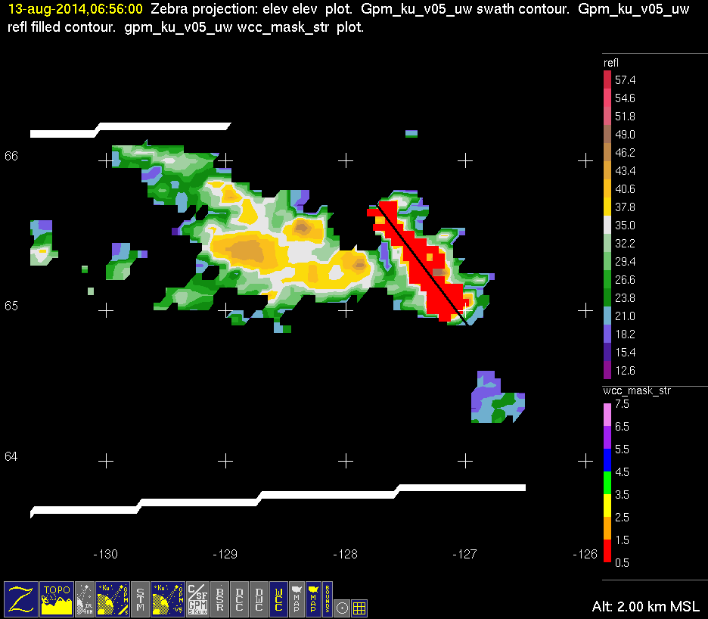

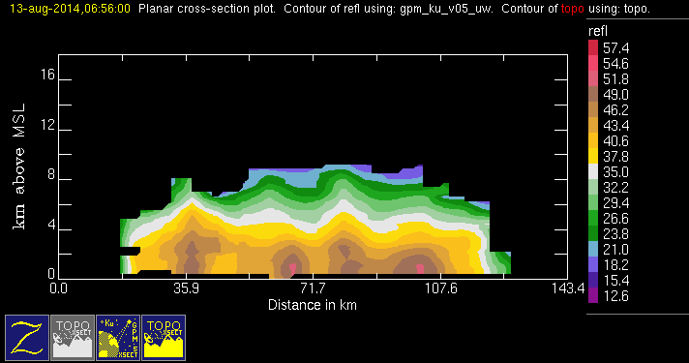
GPM 2Ku – WCC – 20140813 @ 065539
NAM

Slide 15
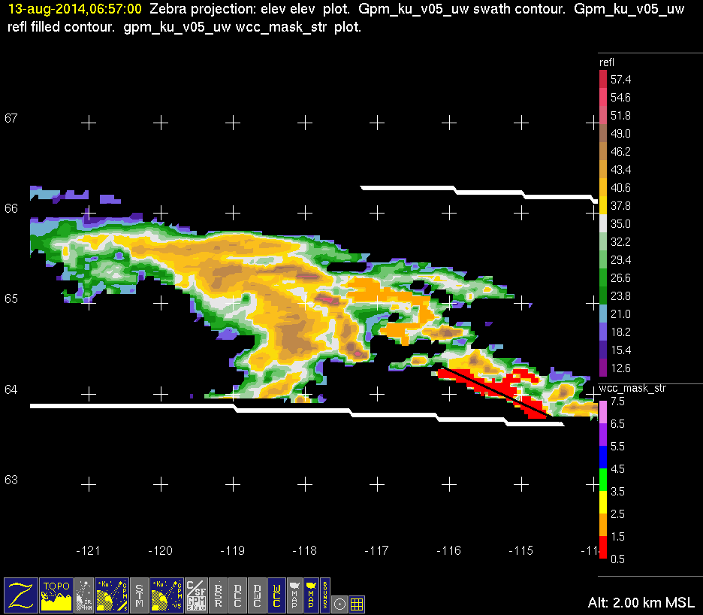
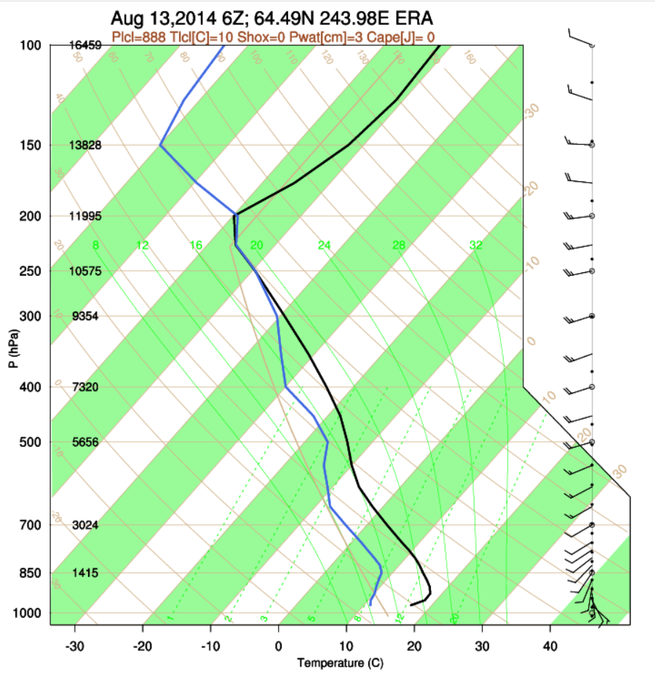
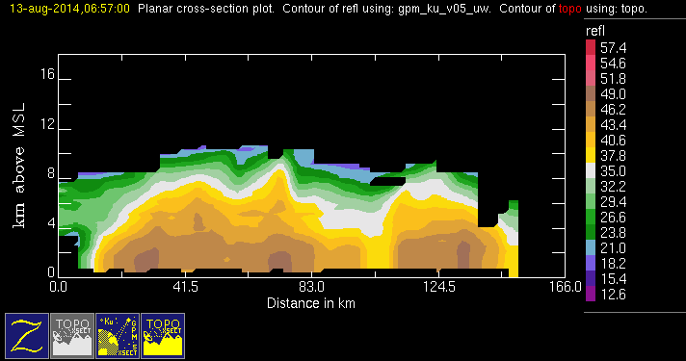
GPM 2Ku – WCC – 20140813 @ 065650
NAM

Slide 16
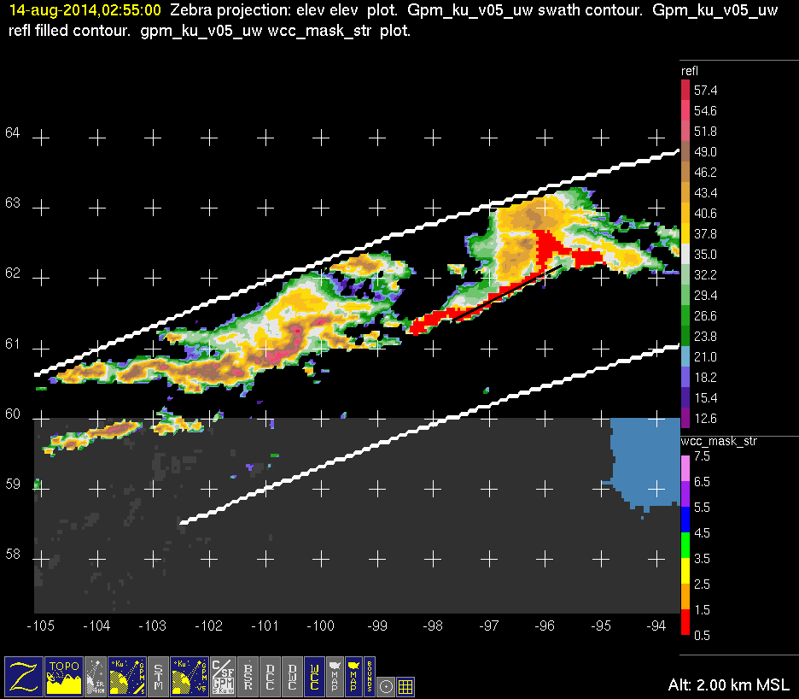
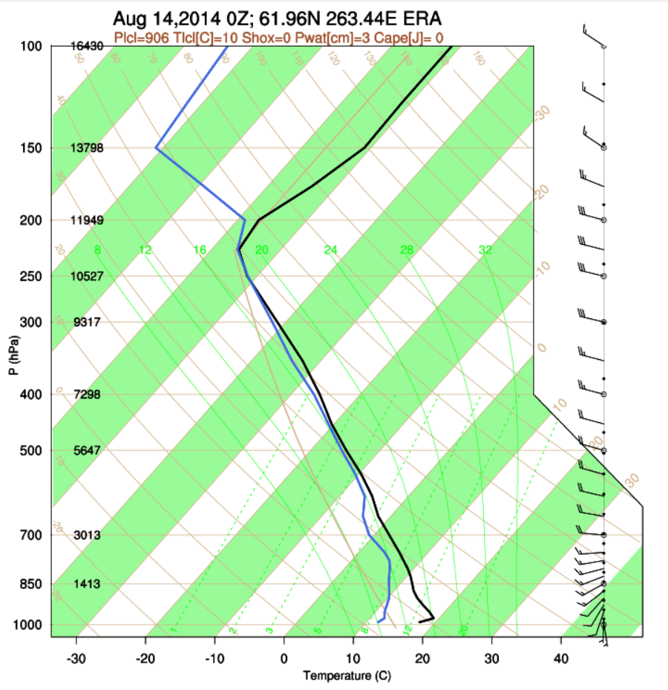
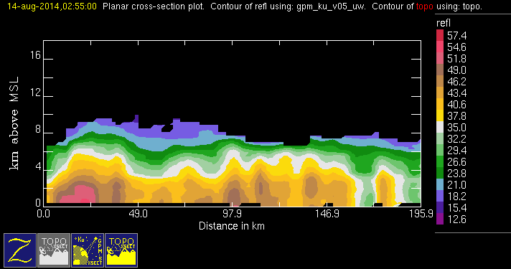
GPM 2Ku – WCC – 20140814 @ 025448
NAM

Slide 17
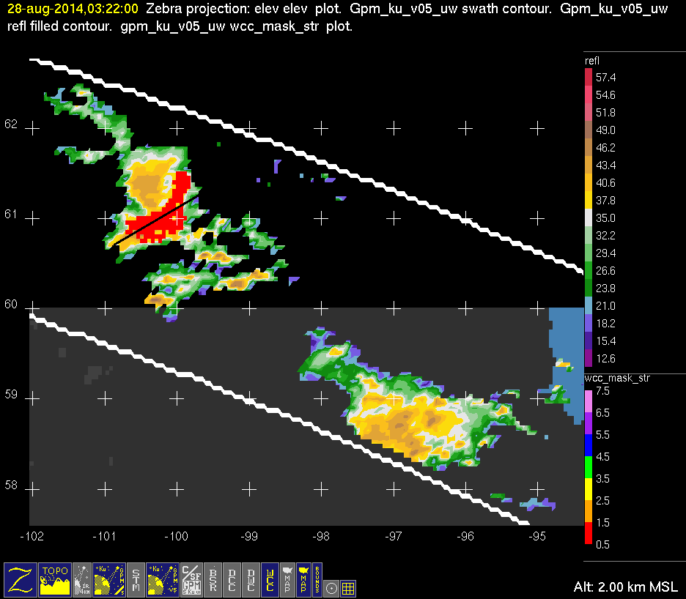

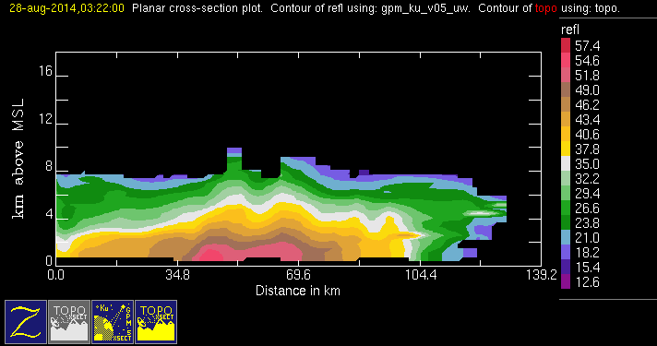
GPM 2Ku – WCC – 20140828 @ 032119
NAM

Slide 18
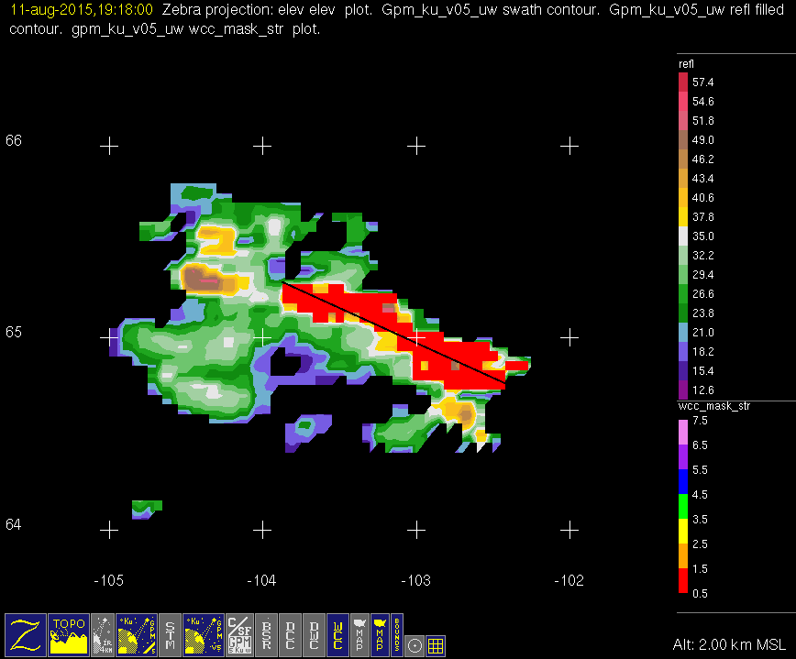
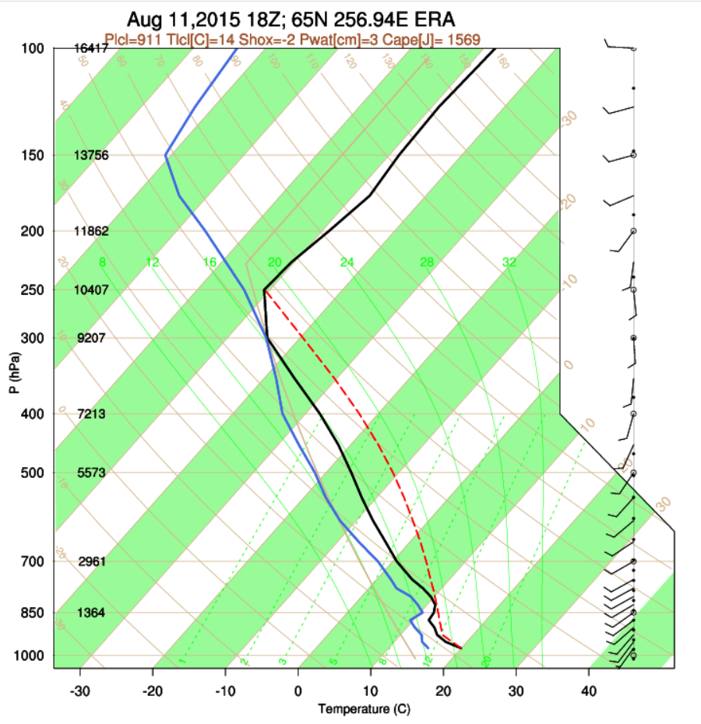
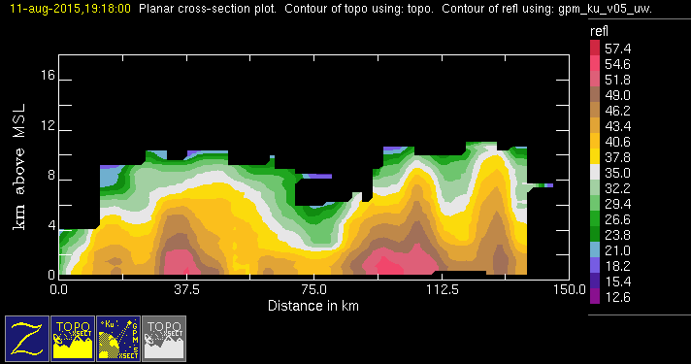
GPM 2Ku – WCC – 20150811 @ 191737
NAM

Slide 19
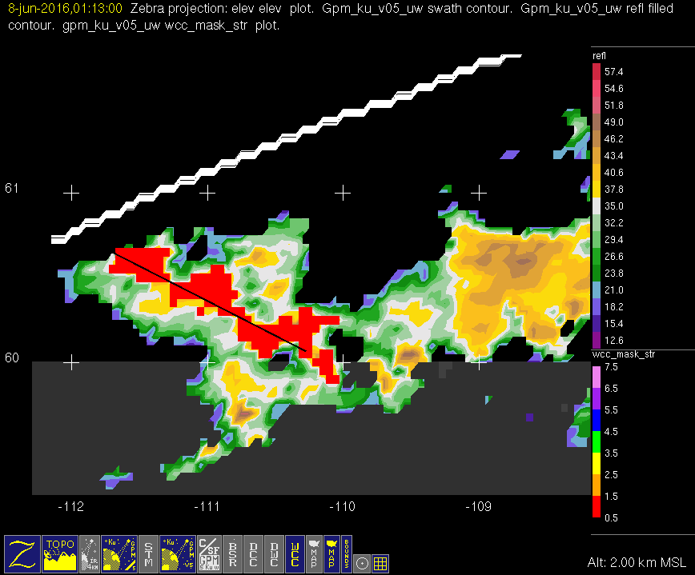
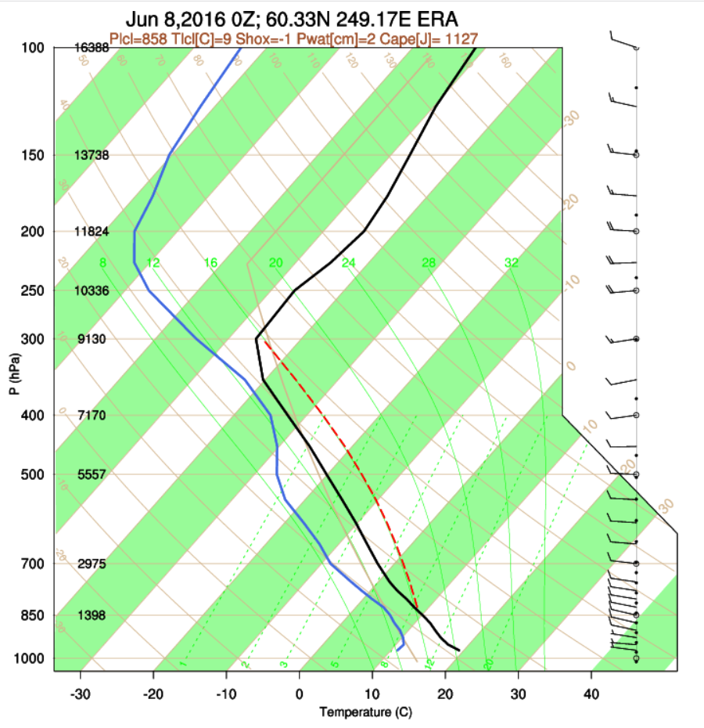
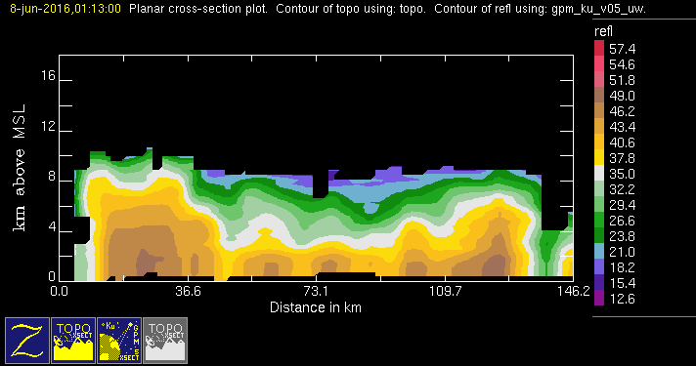
GPM 2Ku – WCC – 20160608 @ 011253
NAM

Slide 20
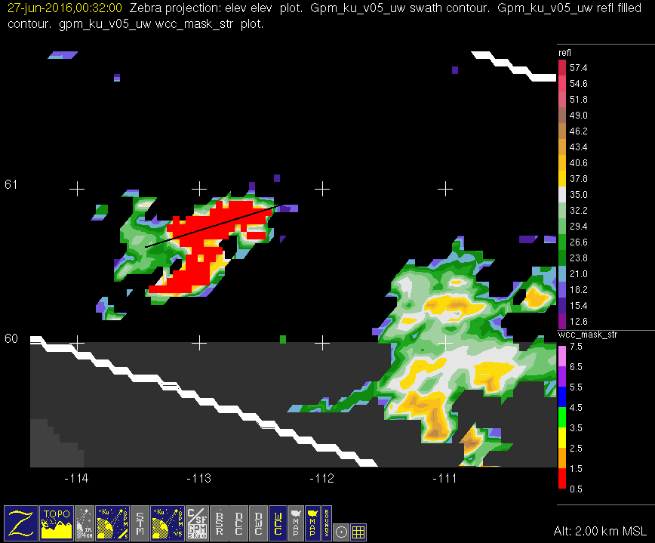
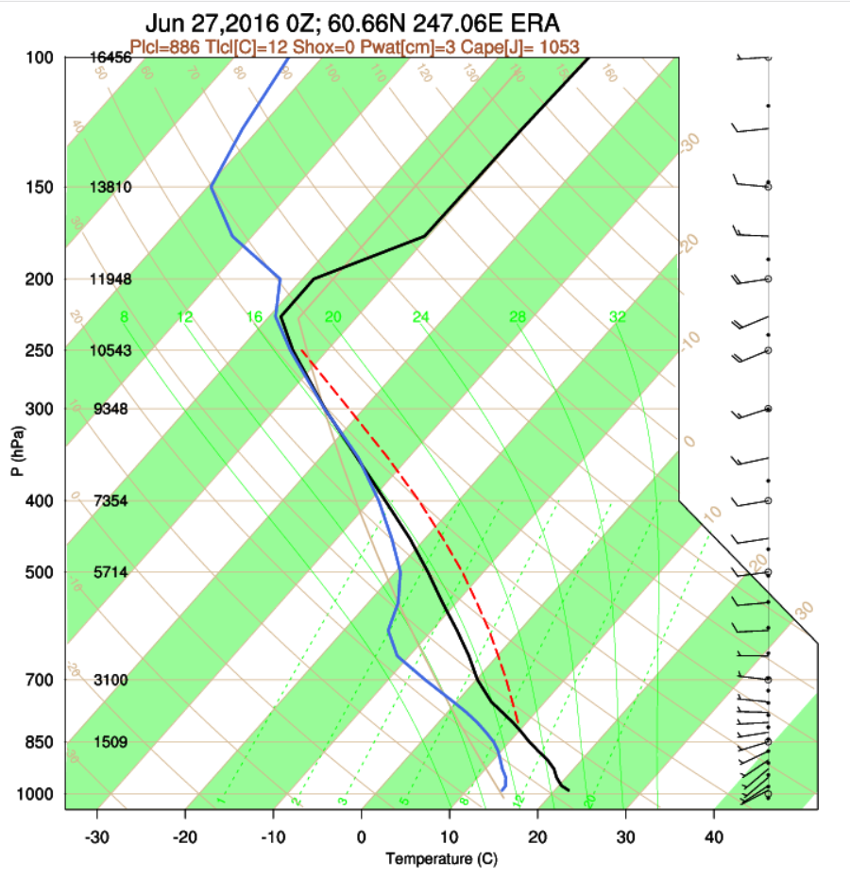

GPM 2Ku – WCC – 20160627 @ 003103
NAM

Slide 21



GPM 2Ku – WCC – 20160701 @ 000902
NAM

Slide 22



GPM 2Ku – WCC – 20160706 @ 220432
NAM

Slide 23



GPM 2Ku – WCC – 20170717 @ 052714
NAM

Slide 24


GPM 2Ku – WCC – 20170727 @ 012415 (1/2)
NAM

Slide 25


GPM 2Ku – WCC – 20170727 @ 012415 (2/2)
NAM

Slide 26



GPM 2Ku – WCC – 20170727 @ 230122
NAM

Slide 27



GPM 2Ku – WCC – 20170911 @ 125908
NAM

Slide 28


GPM 2Ku – WCC – 20140812 @ 013508
North Atlantic Moderate

Slide 29


GPM 2Ku – WCC – 20140830 @ 214102
North Atlantic Moderate

Slide 30


GPM 2Ku – WCC – 20141031 @ 015947
North Atlantic Moderate

Slide 31



GPM 2Ku – WCC – 20140519 @ 204253
EUR

Slide 32



GPM 2Ku – WCC – 20140519 @ 221815
EUR

Slide 33



GPM 2Ku – WCC – 20140607 @ 133541
EUR

Slide 34



GPM 2Ku – WCC – 20140608 @ 124216
EUR

Slide 35



GPM 2Ku – WCC – 20140611 @ 144848
EUR

Slide 36



GPM 2Ku – WCC – 20140702 @ 073232
Looks like some stra is misidentified as conv.
EUR

Slide 37



GPM 2Ku – WCC – 20140702 @ 090734
EUR

Slide 38



GPM 2Ku – WCC – 20140702 @ 104445
EUR

Slide 39



GPM 2Ku – WCC – 20140731 @ 024404
EUR

Slide 40



GPM 2Ku – WCC – 20150729 @ 150210
EUR

Slide 41



GPM 2Ku – WCC – 20160607 @ 173029
EUR

Slide 42



GPM 2Ku – WCC – 20160617 @ 133711
EUR

Slide 43



GPM 2Ku – WCC – 20160618 @ 141657
EUR

Slide 44



GPM 2Ku – WCC – 20160704 @ 095041
EUR

Slide 45



GPM 2Ku – WCC – 20160705 @ 103452 (1/3)
EUR

Slide 46


GPM 2Ku – WCC – 20160705 @ 103452 (2/3)
EUR

Slide 47


GPM 2Ku – WCC – 20160705 @ 103452 (3/3)
EUR

Slide 48



GPM 2Ku – WCC – 20170725 @ 153131
EUR

Slide 49



GPM 2Ku – WCC – 20170726 @ 161356 (1/2)
EUR

Slide 50


GPM 2Ku – WCC – 20170726 @ 161356 (2/2)
EUR

Slide 51



GPM 2Ku – WCC – 20170801 @ 154311
EUR

Slide 52



GPM 2Ku – WCC – 20140607 @ 133746
ASIA

Slide 53



GPM 2Ku – WCC – 20140608 @ 124450 1/2
ASIA

Slide 54


GPM 2Ku – WCC – 20140608 @ 124450 2/2
ASIA

Slide 55



GPM 2Ku – WCC – 20140612 @ 105659 1/2
ASIA

Slide 56


GPM 2Ku – WCC – 20140612 @ 105659 2/2
ASIA

Slide 57



GPM 2Ku – WCC – 20140617 @ 093828
ASIA

Slide 58



GPM 2Ku – WCC – 20140620 @ 070849
ASIA

Slide 59



GPM 2Ku – WCC – 20140621 @ 061558
ASIA

Slide 60



GPM 2Ku – WCC – 20140623 @ 090654 1/2
ASIA

Slide 61


GPM 2Ku – WCC – 20140623 @ 090654 2/2
ASIA

Slide 62



GPM 2Ku – WCC – 20140623 @ 104303
ASIA

Slide 63



GPM 2Ku – WCC – 20140624 @ 095239
ASIA

Slide 64



GPM 2Ku – WCC – 20140625 @ 090110
ASIA

Slide 65



GPM 2Ku – WCC – 20140626 @ 063223 1/2
ASIA

Slide 66


GPM 2Ku – WCC – 20140626 @ 063223 2/2
ASIA

Slide 67



GPM 2Ku – WCC – 20140626 @ 063540
ASIA

Slide 68



GPM 2Ku – WCC – 20140626 @ 080704
ASIA

Slide 69



GPM 2Ku – WCC – 20140628 @ 075829
ASIA

Slide 70



GPM 2Ku – WCC – 20140630 @ 092146
ASIA

Slide 71



GPM 2Ku – WCC – 20140704 @ 090222
ASIA

Slide 72



GPM 2Ku – WCC – 20140712 @ 002527
ASIA

Slide 73



GPM 2Ku – WCC – 20140712 @ 051311
ASIA

Slide 74



GPM 2Ku – WCC – 20140807 @ 181228
ASIA

Slide 75



GPM 2Ku – WCC – 20140808 @ 141601
ASIA

Slide 76



GPM 2Ku – WCC – 20140808 @ 172044
ASIA

Slide 77



GPM 2Ku – WCC – 20140810 @ 154332
ASIA

Slide 78



GPM 2Ku – WCC – 20140817 @ 185940
ASIA

Slide 79



GPM 2Ku – WCC – 20140823 @ 135025
ASIA

Slide 80



GPM 2Ku – WCC – 20140830 @ 104638
ASIA

Slide 81



GPM 2Ku – WCC – 20150430 @ 133945
ASIA

Slide 82



GPM 2Ku – WCC – 20150606 @ 050506
ASIA

Slide 83



GPM 2Ku – WCC – 20150618 @ 005918
ASIA

Slide 84



GPM 2Ku – WCC – 20150620 @ 221734
ASIA

Slide 85



GPM 2Ku – WCC – 20150621 @ 225915 (1/2)
ASIA

Slide 86


GPM 2Ku – WCC – 20150621 @ 225915 (2/2)
ASIA

Slide 87



GPM 2Ku – WCC – 20150622 @ 003443 (1/3)
ASIA

Slide 88


GPM 2Ku – WCC – 20150622 @ 003443 (2/3)
ASIA

Slide 89


GPM 2Ku – WCC – 20150622 @ 003443 (3/3)
ASIA

Slide 90



GPM 2Ku – WCC – 20150622 @ 021004
ASIA

Slide 91



GPM 2Ku – WCC – 20150622 @ 203352 (1/3)
ASIA

Slide 92


GPM 2Ku – WCC – 20150622 @ 203352 (2/3)
ASIA

Slide 93


GPM 2Ku – WCC – 20150622 @ 203352 (3/3)
ASIA

Slide 94



GPM 2Ku – WCC – 20150622 @ 220841
ASIA

Slide 95



GPM 2Ku – WCC – 20150622 @ 234352 1/2
ASIA

Slide 96


GPM 2Ku – WCC – 20150622 @ 234352 2/2
ASIA

Slide 97



GPM 2Ku – WCC – 20150703 @ 171519
ASIA

Slide 98



GPM 2Ku – WCC – 20150703 @ 185032
ASIA

Slide 99



GPM 2Ku – WCC – 20150709 @ 120213 1/2
ASIA

Slide 100


GPM 2Ku – WCC – 20150709 @ 120213 2/2
ASIA

Slide 101



GPM 2Ku – WCC – 20150714 @ 170814
ASIA

Slide 102



GPM 2Ku – WCC – 20150718 @ 115722
ASIA

Slide 103



GPM 2Ku – WCC – 20150718 @ 151144
ASIA

Slide 104



GPM 2Ku – WCC – 20150719 @ 080424
ASIA

Slide 105




GPM 2Ku – WCC – 20150719 @ 124038
ASIA

Slide 106



GPM 2Ku – WCC – 20150722 @ 083719
ASIA

Slide 107



GPM 2Ku – WCC – 20150722 @ 114842
ASIA

Slide 108



GPM 2Ku – WCC – 20150722 @ 114927
ASIA

Slide 109



GPM 2Ku – WCC – 20150725 @ 104020
ASIA

Slide 110



GPM 2Ku – WCC – 20150729 @ 084409
ASIA

Slide 111


GPM 2Ku – WCC – 20150729 @ 150427
ASIA

Slide 112



GPM 2Ku – WCC – 20150826 @ 001052
ASIA

Slide 113



GPM 2Ku – WCC – 20150827 @ 205105
ASIA

Slide 114



GPM 2Ku – WCC – 20160613 @ 170702
ASIA

Slide 115



GPM 2Ku – WCC – 20160614 @ 144117
ASIA

Slide 116



GPM 2Ku – WCC – 20160615 @ 121458
ASIA

Slide 117


GPM 2Ku – WCC – 20160617 @ 133739
ASIA

Slide 118



GPM 2Ku – WCC – 20160619 @ 132904
ASIA

Slide 119



GPM 2Ku – WCC – 20160620 @ 110134
ASIA

Slide 120



GPM 2Ku – WCC – 20160624 @ 104819 1/2
ASIA

Slide 121


GPM 2Ku – WCC – 20160624 @ 104819 2/2
ASIA

Slide 122



GPM 2Ku – WCC – 20160701 @ 075112
ASIA

Slide 123



GPM 2Ku – WCC – 20160702 @ 083428
ASIA

Slide 124



GPM 2Ku – WCC – 20160703 @ 060827
ASIA

Slide 125



GPM 2Ku – WCC – 20160705 @ 103541 1/2
ASIA

Slide 126


GPM 2Ku – WCC – 20160705 @ 103541 2/2
ASIA

Slide 127



GPM 2Ku – WCC – 20160707 @ 071843
ASIA

Slide 128



GPM 2Ku – WCC – 20160728 @ 200809
ASIA

Slide 129



GPM 2Ku – WCC – 20160801 @ 211911
ASIA

Slide 130



GPM 2Ku – WCC – 20160808 @ 195905
ASIA

Slide 131



GPM 2Ku – WCC – 20160817 @ 165432
ASIA

Slide 132



GPM 2Ku – WCC – 20160826 @ 134908
ASIA

Slide 133



GPM 2Ku – WCC – 20160826 @ 152413
ASIA

Slide 134



GPM 2Ku – WCC – 20160826 @ 165950
ASIA

Slide 135



GPM 2Ku – WCC – 20160827 @ 161017
ASIA

Slide 136



GPM 2Ku – WCC – 20160829 @ 111200
ASIA

Slide 137



GPM 2Ku – WCC – 20160831 @ 124149
ASIA

Slide 138



GPM 2Ku – WCC – 20170618 @ 040059
ASIA

Slide 139



GPM 2Ku – WCC – 20170619 @ 030743
ASIA

Slide 140



GPM 2Ku – WCC – 20170623 @ 180706
ASIA

Slide 141



GPM 2Ku – WCC – 20170717 @ 174332
ASIA

Slide 142



GPM 2Ku – WCC – 20170725 @ 153133
ASIA

Slide 143



GPM 2Ku – WCC – 20170726 @ 113530
ASIA

Slide 144



GPM 2Ku – WCC – 20170726 @ 113741
ASIA

Slide 145



GPM 2Ku – WCC – 20170726 @ 131105
ASIA

Slide 146



GPM 2Ku – WCC – 20170726 @ 161442
ASIA

Slide 147



GPM 2Ku – WCC – 20170728 @ 112021
ASIA

Slide 148



GPM 2Ku – WCC – 20170728 @ 143448
ASIA

Slide 149



GPM 2Ku – WCC – 20170801 @ 062502
ASIA

Slide 150



GPM 2Ku – WCC – 20170802 @ 100755
ASIA

Slide 151



GPM 2Ku – WCC – 20170803 @ 060833
ASIA

Slide 152



GPM 2Ku – WCC – 20170805 @ 091104 (1/2)
ASIA

Slide 153


GPM 2Ku – WCC – 20170805 @ 091104 (2/2)
ASIA

Slide 154



GPM 2Ku – WCC – 20170805 @ 104101 1/4
ASIA

Slide 155


GPM 2Ku – WCC – 20170805 @ 104101 2/4
ASIA

Slide 156


GPM 2Ku – WCC – 20170805 @ 104101 3/4
ASIA

Slide 157



GPM 2Ku – WCC – 20170805 @ 104101 4/4
ASIA

Slide 158



GPM 2Ku – WCC – 20170806 @ 095601
ASIA

Slide 159



GPM 2Ku – WCC – 20170815 @ 065203
ASIA

