Slide 1
Summary
DWC’s at Latitudes Greater Than 60N
Strong Thresholds
2014-2017
North America: 1
North Atlantic: 0 (201403-201502)*
Europe: 4
Asia: 9
*using Moderate Thresholds: 0

Slide 2
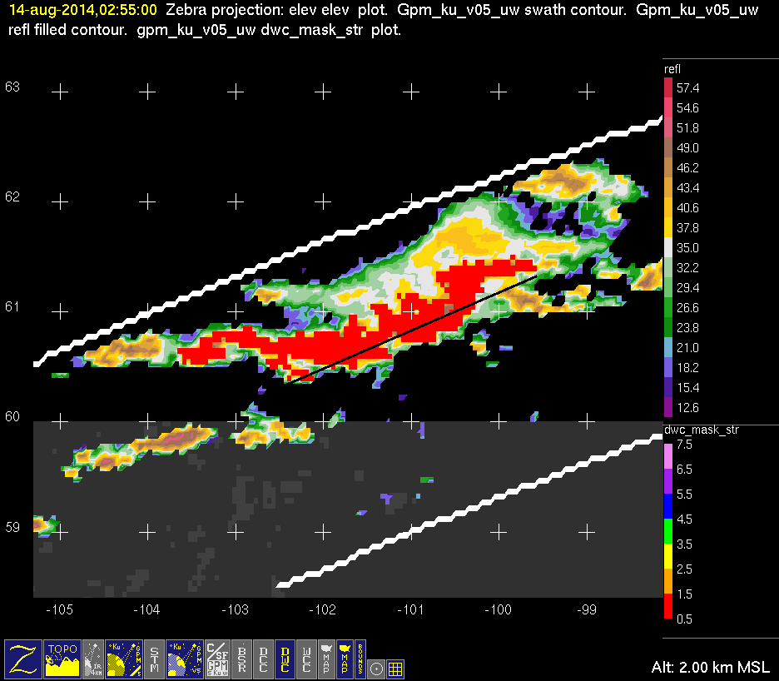
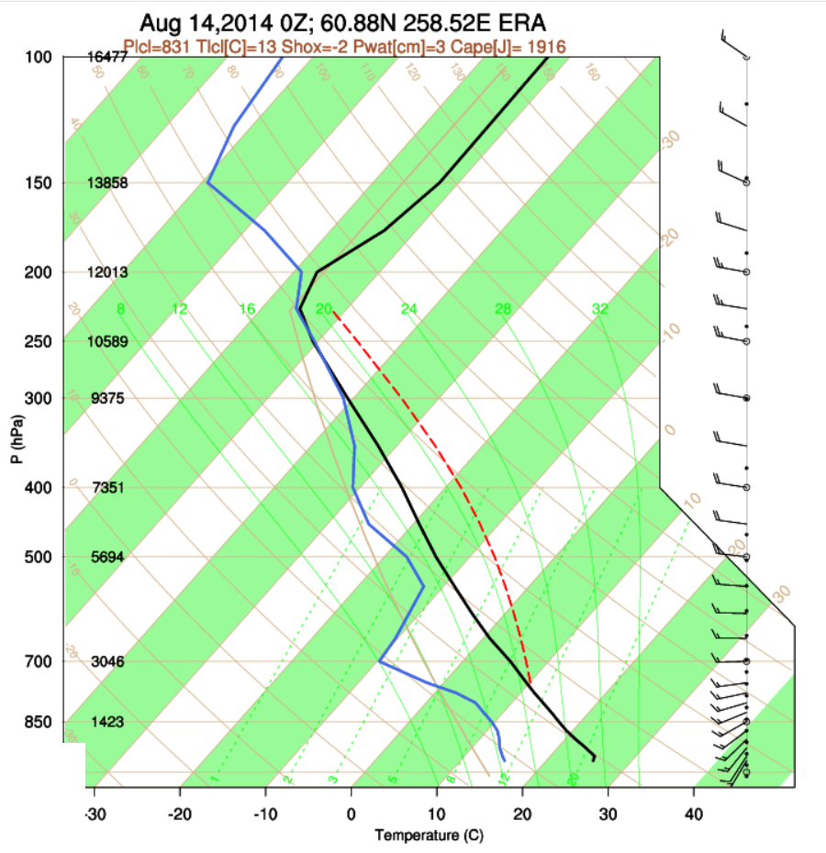
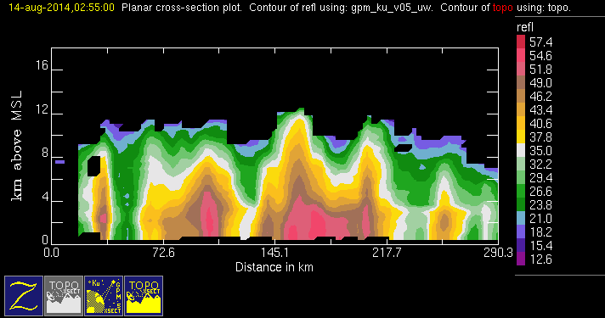
GPM 2Ku – DWC – 20140814 @ 025448
NAM

Slide 3
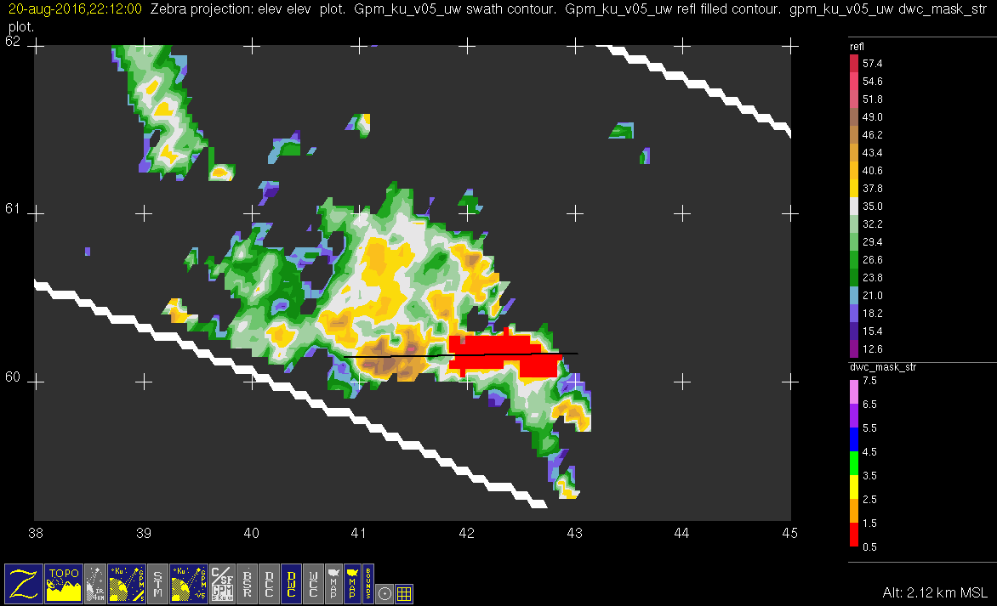
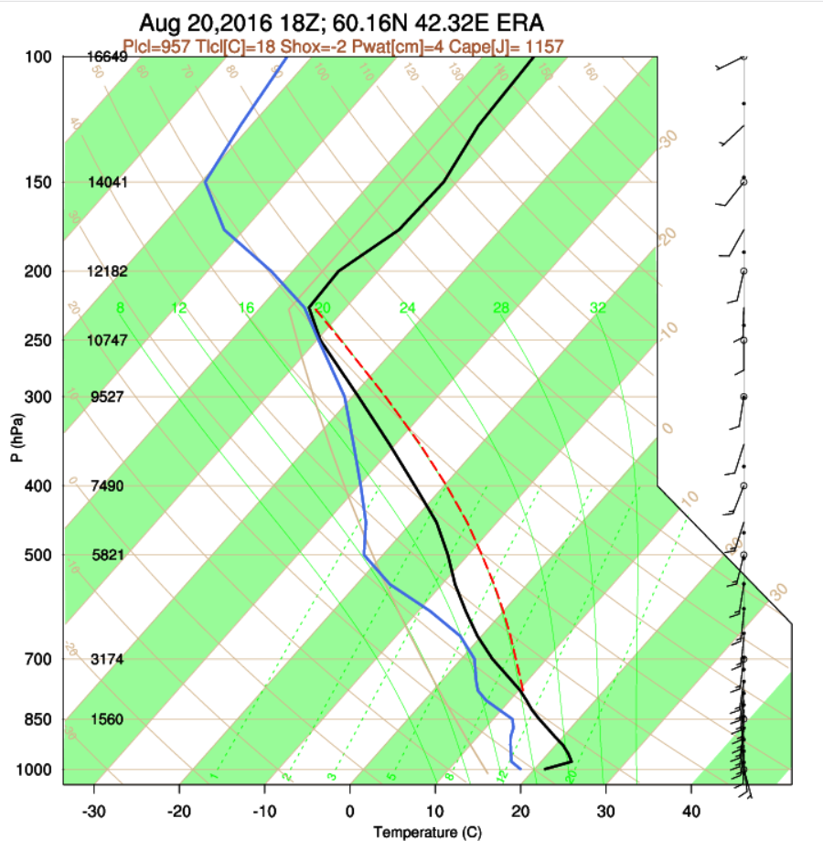
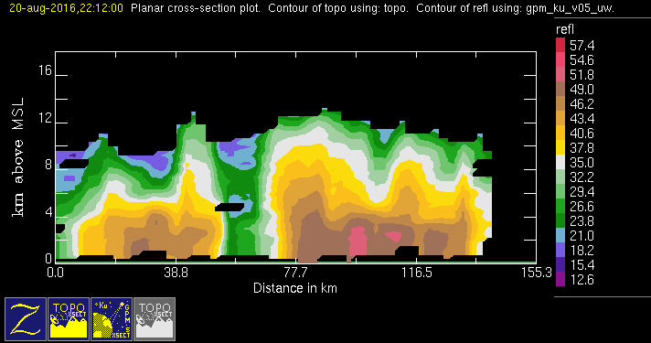
GPM 2Ku – DWC – 20160820 @ 220928
EUR

Slide 4
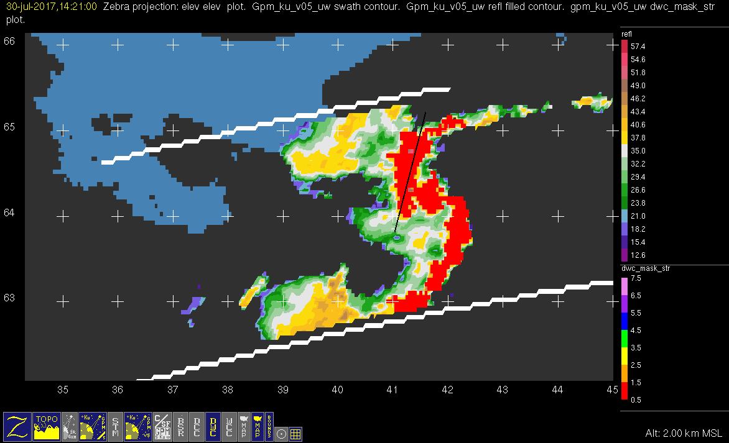
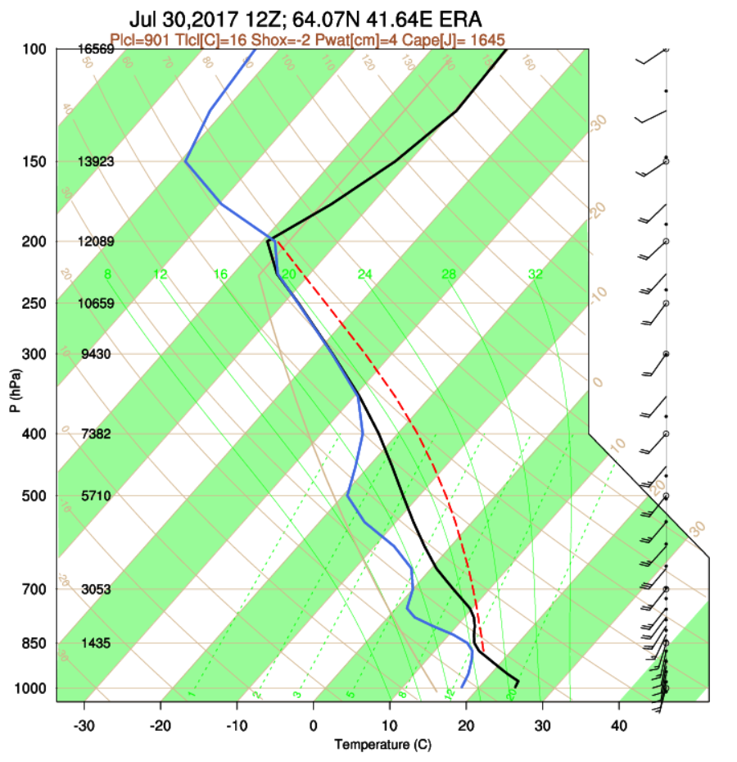
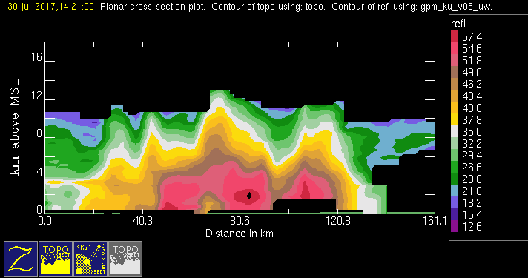
GPM 2Ku – DWC – 20170730 @ 142000
EUR

Slide 5
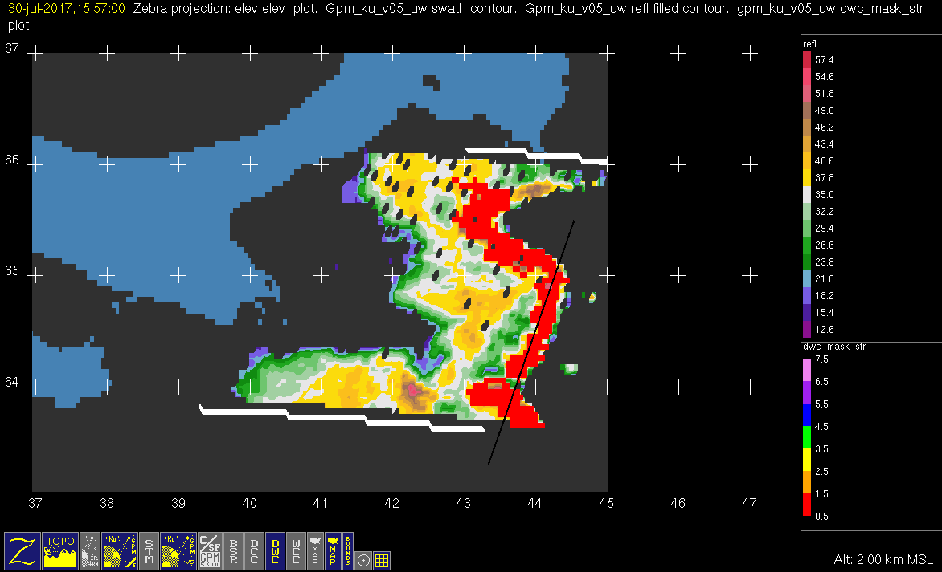
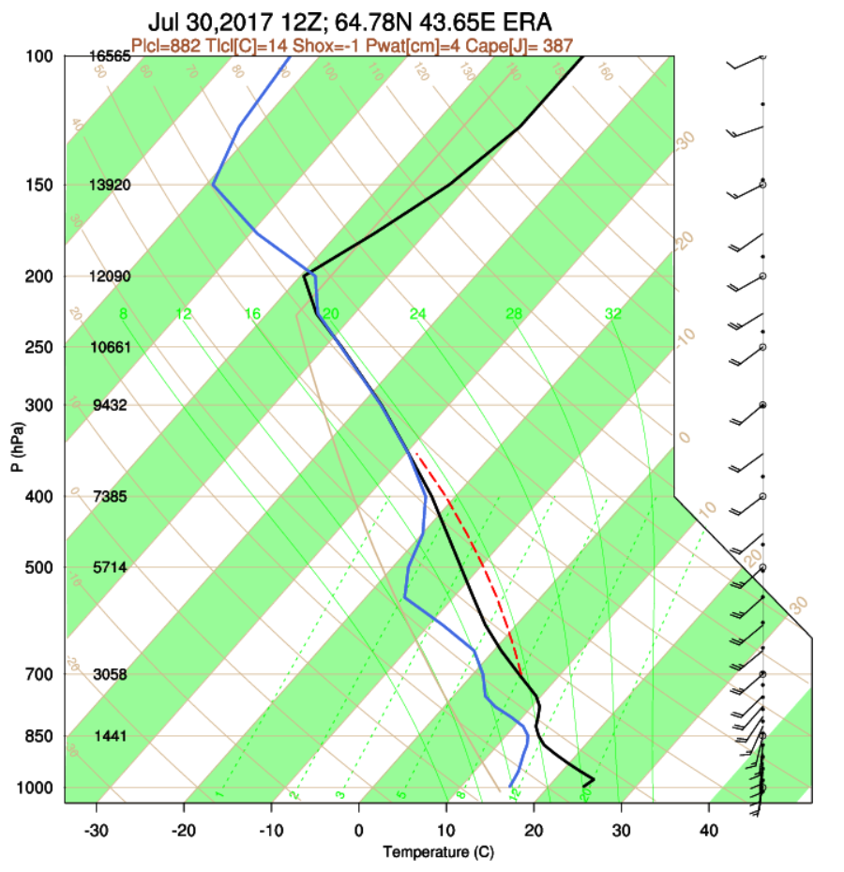
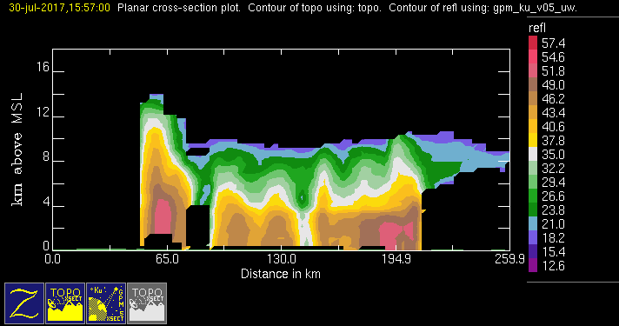
GPM 2Ku – DWC – 20170730 @ 155605
EUR

Slide 6
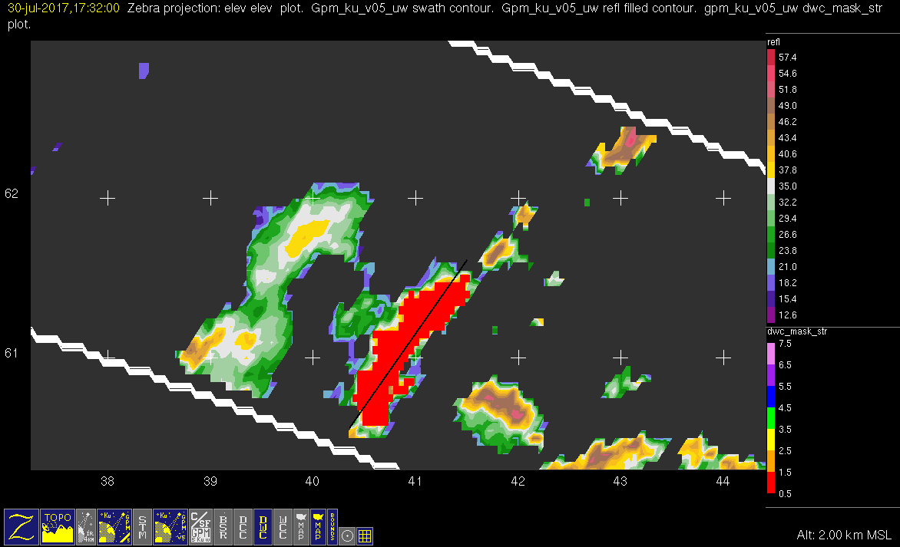
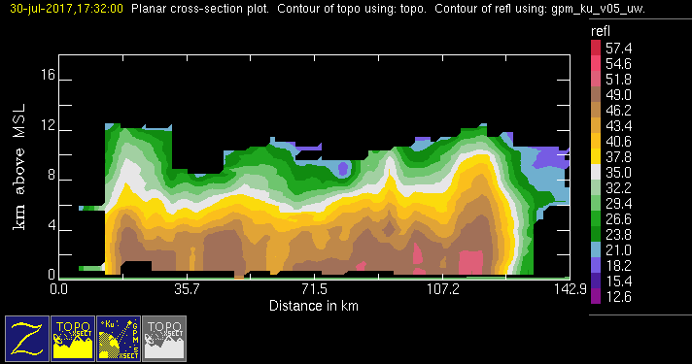
GPM 2Ku – DWC – 20170730 @ 173101
EUR

Slide 7
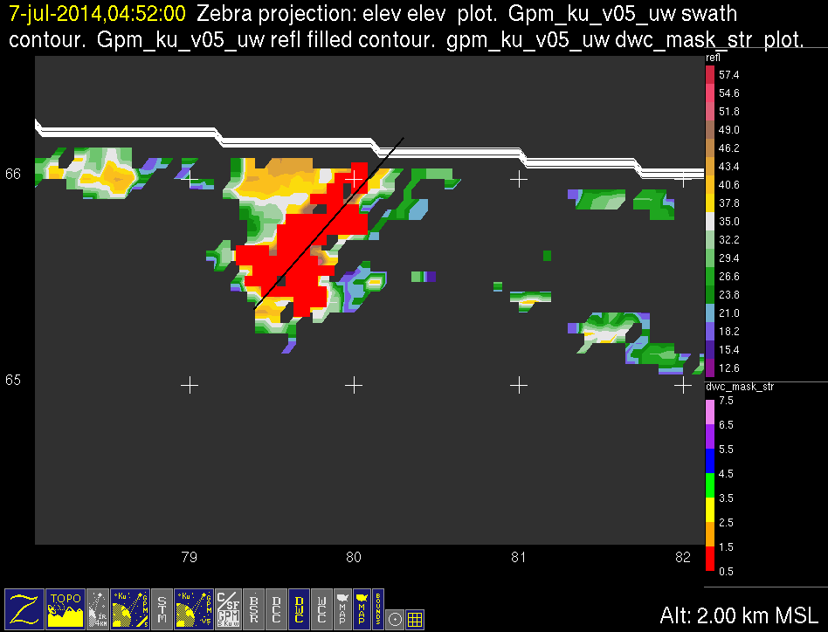
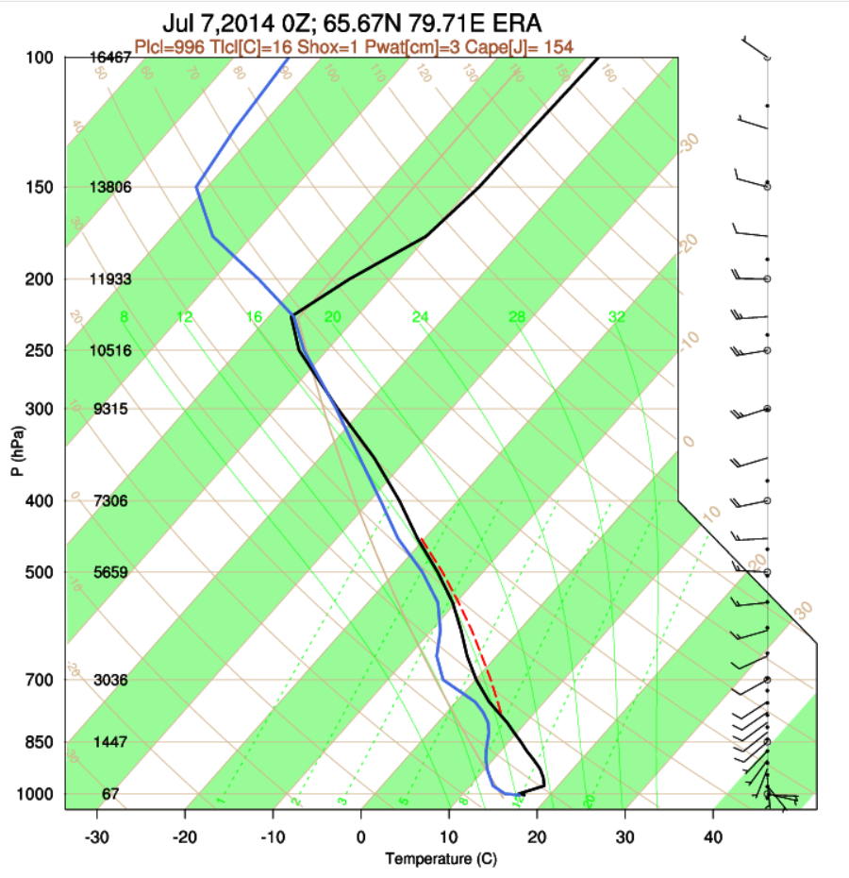
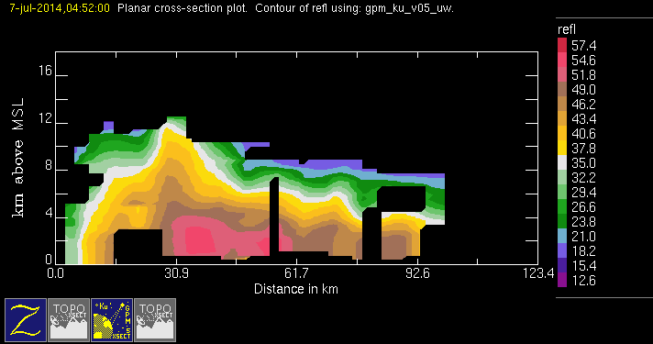
GPM 2Ku – DWC – 20140707 @ 045107
ASIA

Slide 8
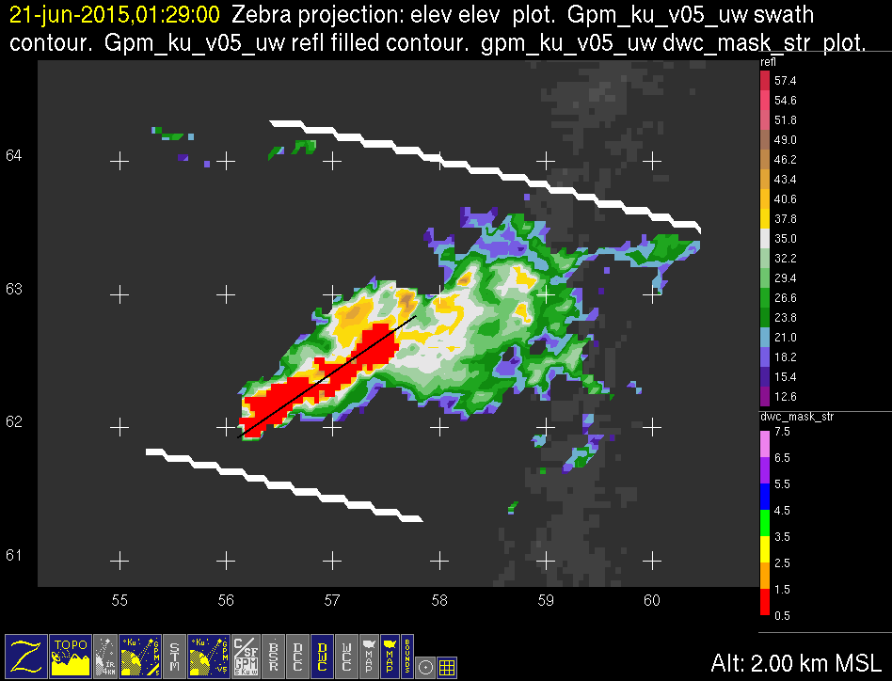
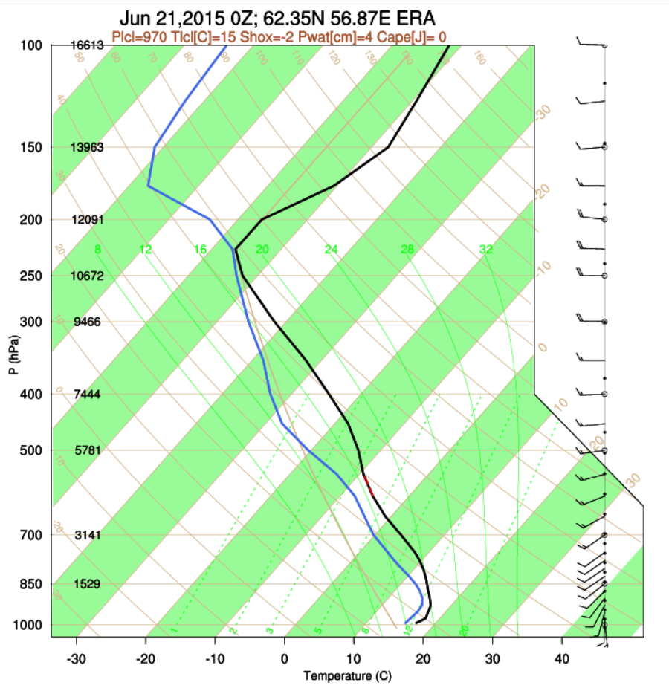
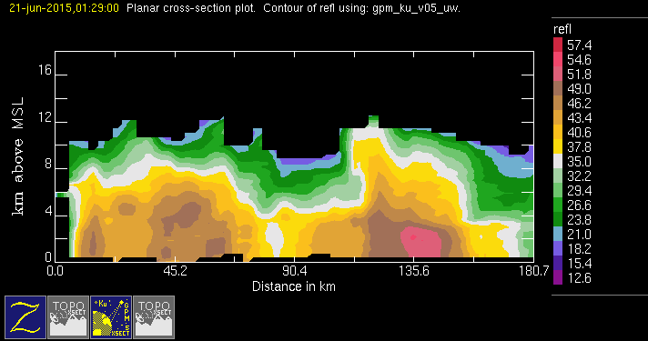
GPM 2Ku – DWC – 20150621 @ 012848
ASIA

Slide 9
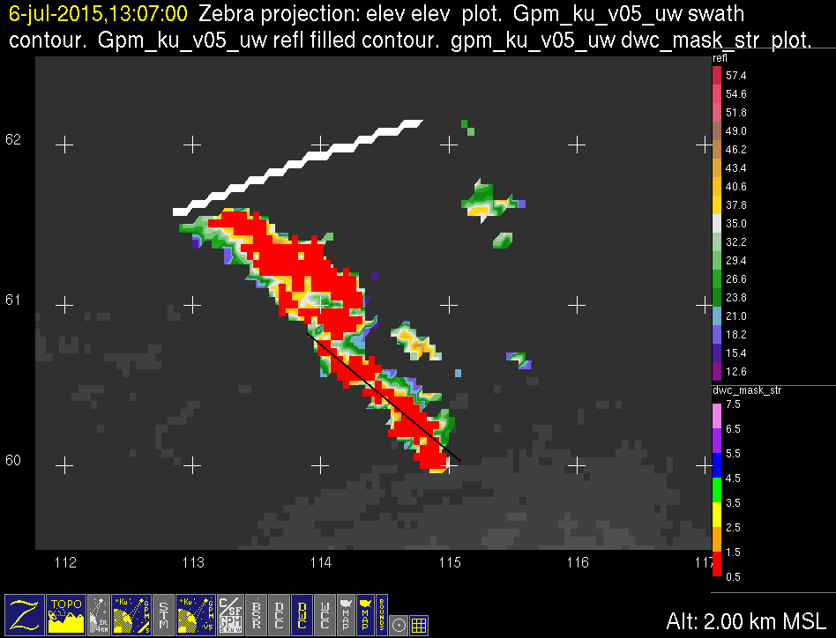
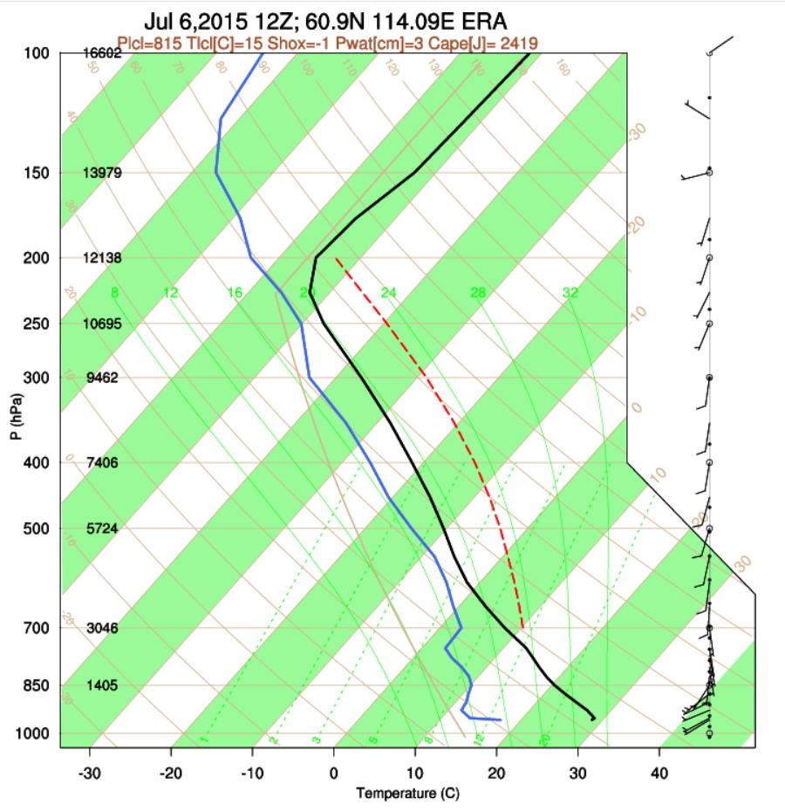
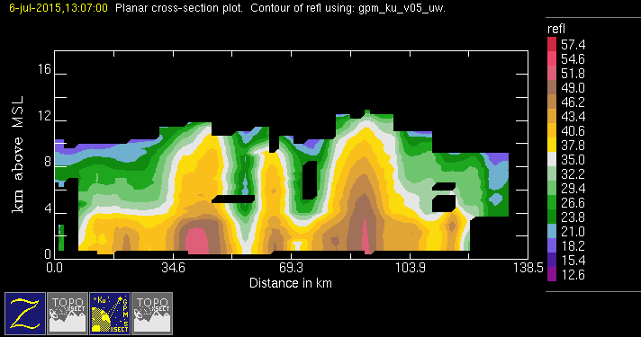
GPM 2Ku – DWC – 20150706 @ 130650
ASIA

Slide 10
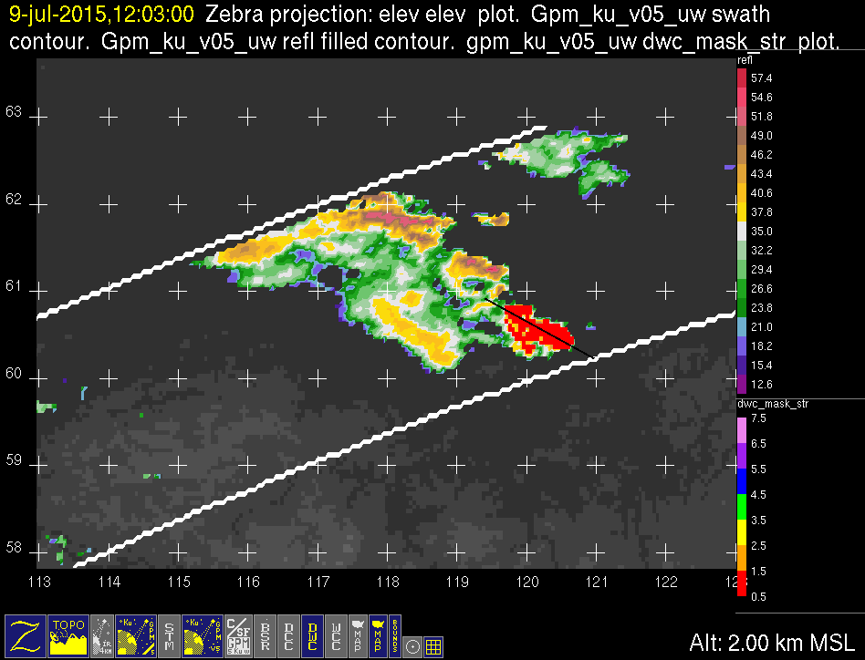
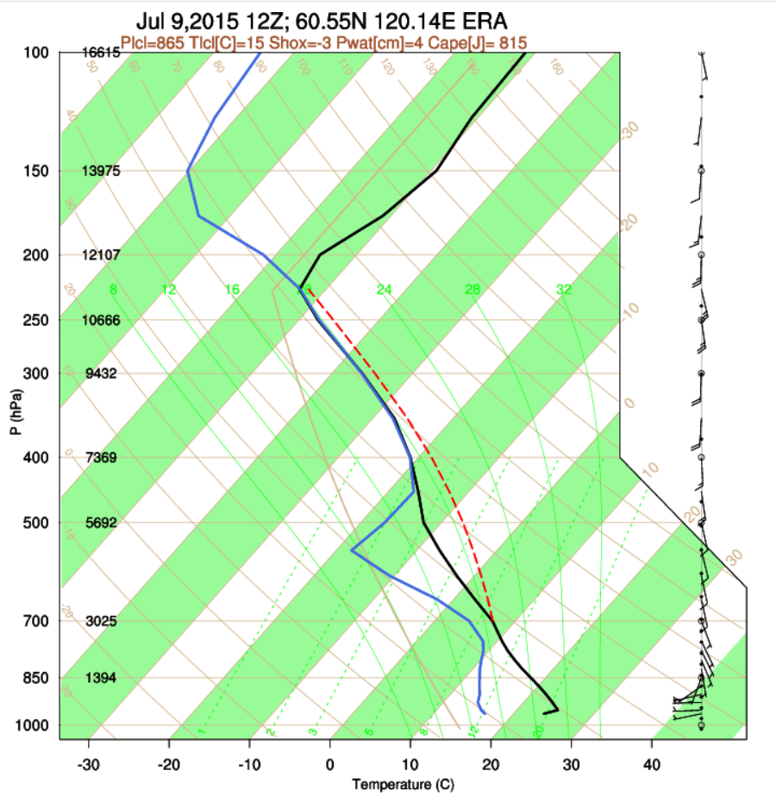
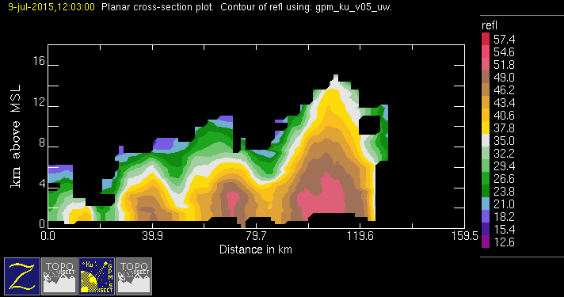
GPM 2Ku – DWC – 20150709 @ 120213
ASIA

Slide 11
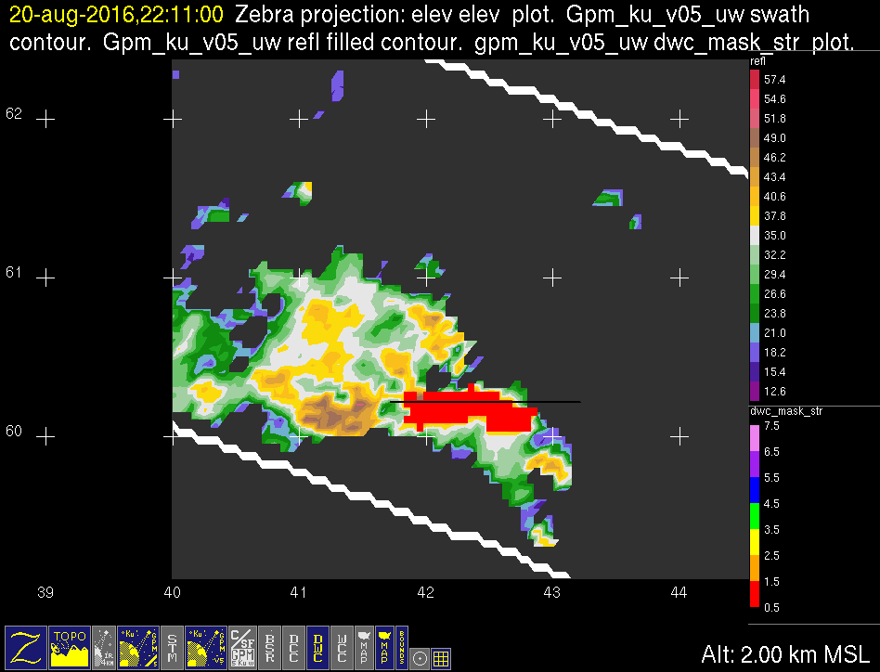
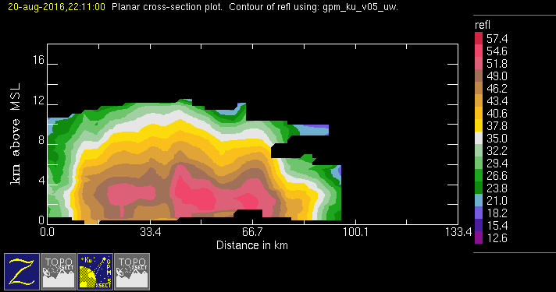
GPM 2Ku – DWC – 20160820 @ 221033
ASIA

Slide 12
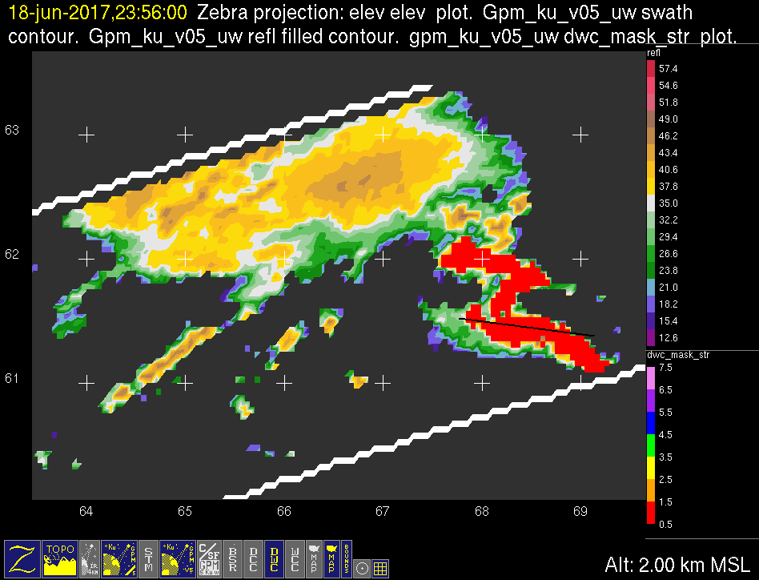
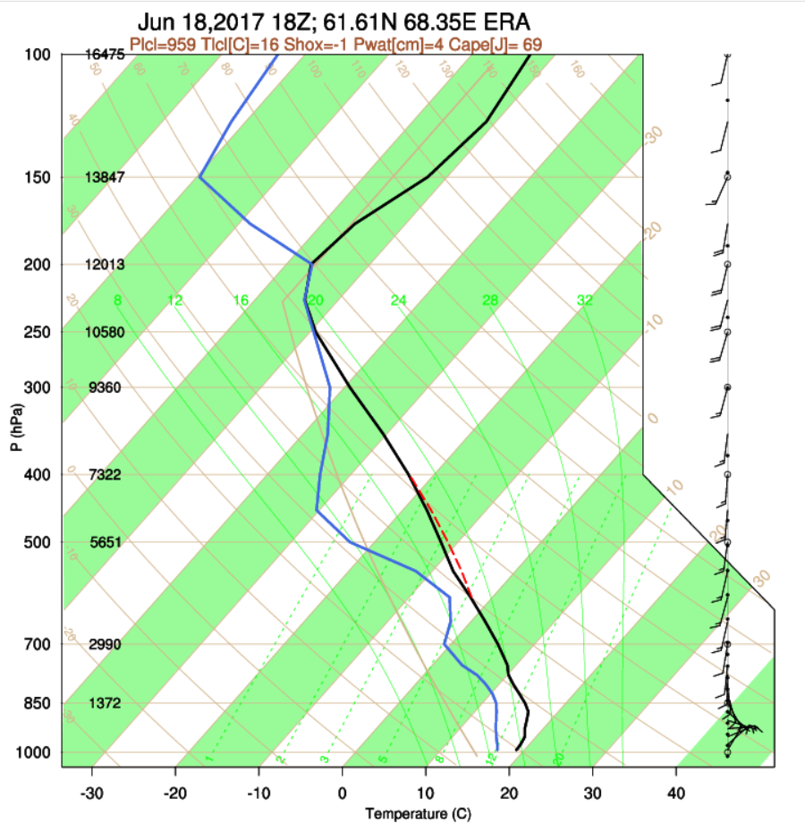
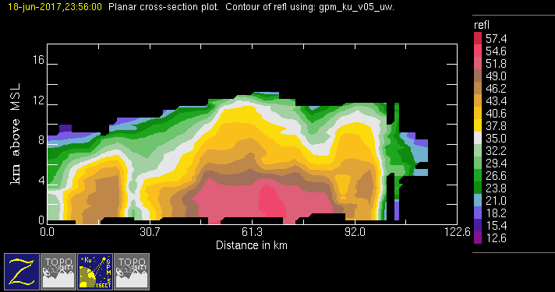
GPM 2Ku – DWC – 20170618 @ 235534
ASIA

Slide 13
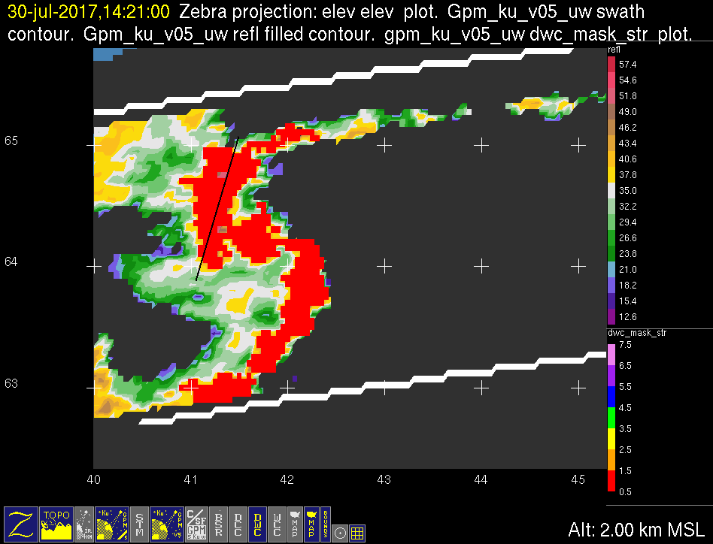

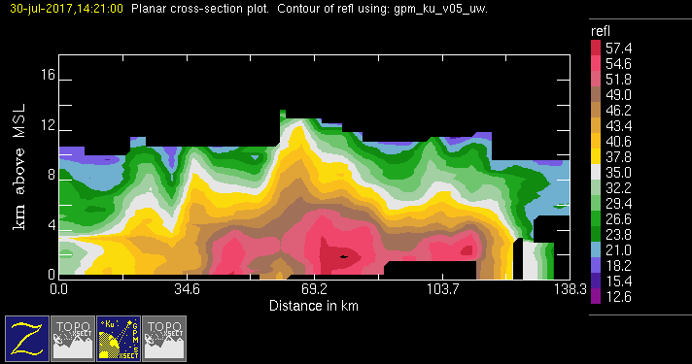
GPM 2Ku – DWC – 20170730 @ 142049
ASIA

Slide 14
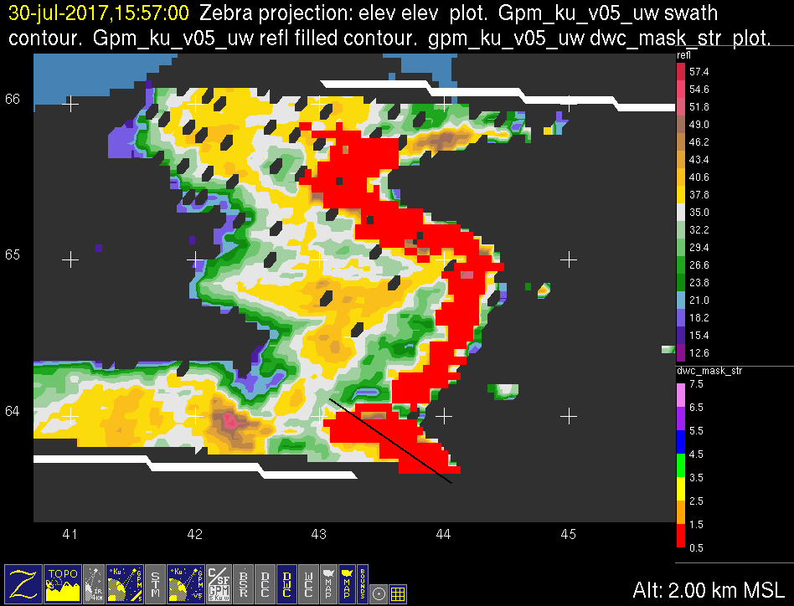

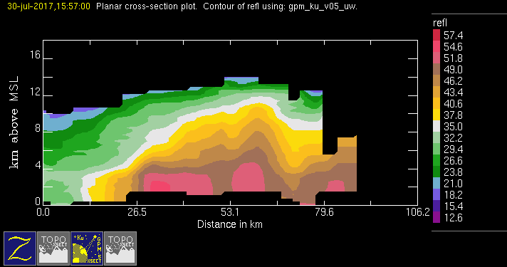
GPM 2Ku – DWC – 20170730 @ 155610
ASIA

Slide 15
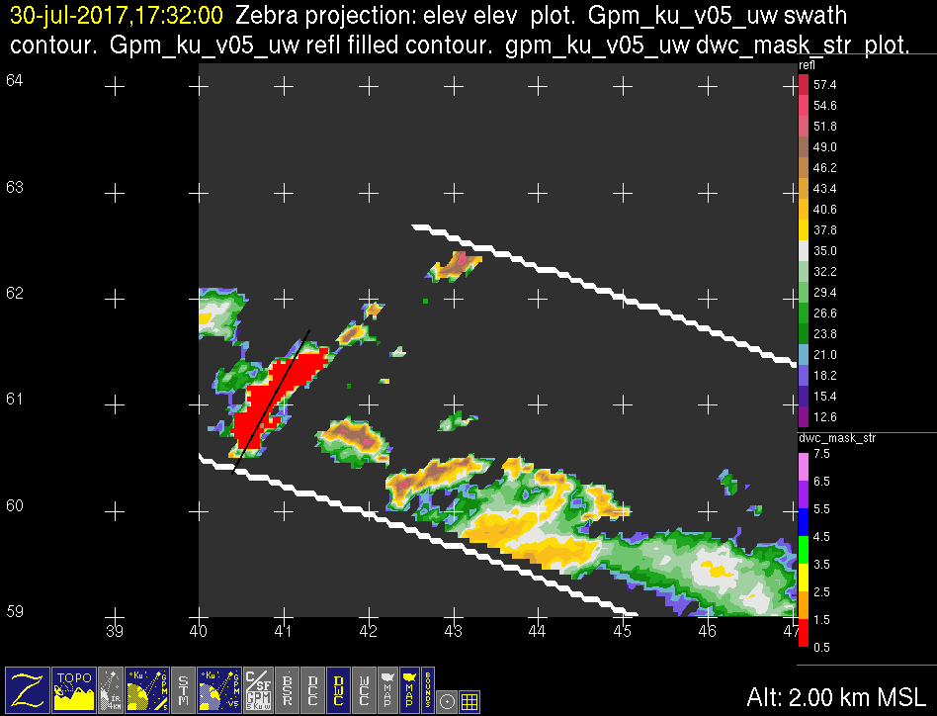
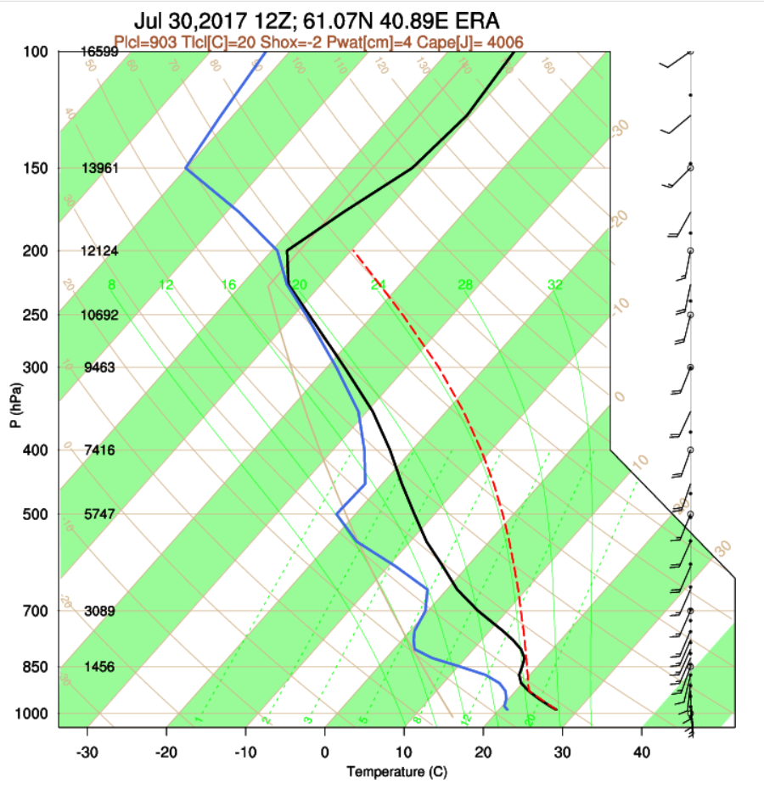
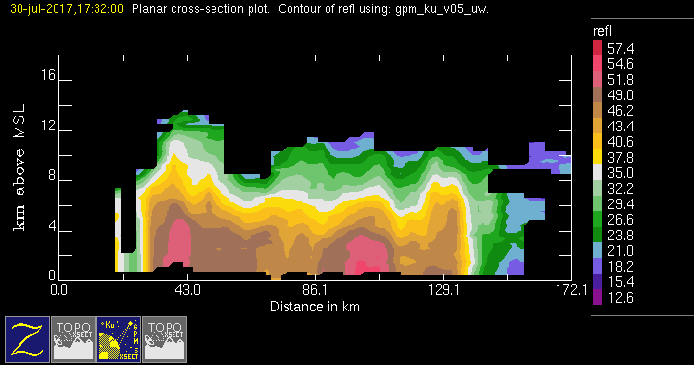
GPM 2Ku – DWC – 20170730 @ 173130
ASIA

