Slide 1
Summary
DCC’s at Latitudes Greater Than 60N
Strong Thresholds
2014-2017
North America: 2
North Atlantic: 0 (201403-201502)*
Europe: 3
Asia: 19
*using Moderate Thresholds: 0

Slide 2
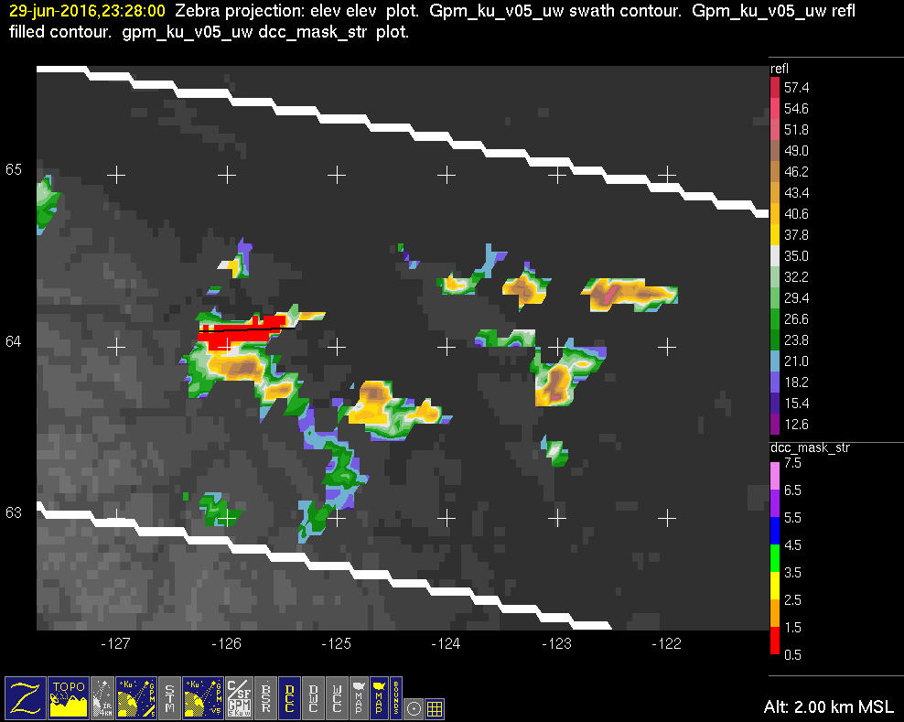
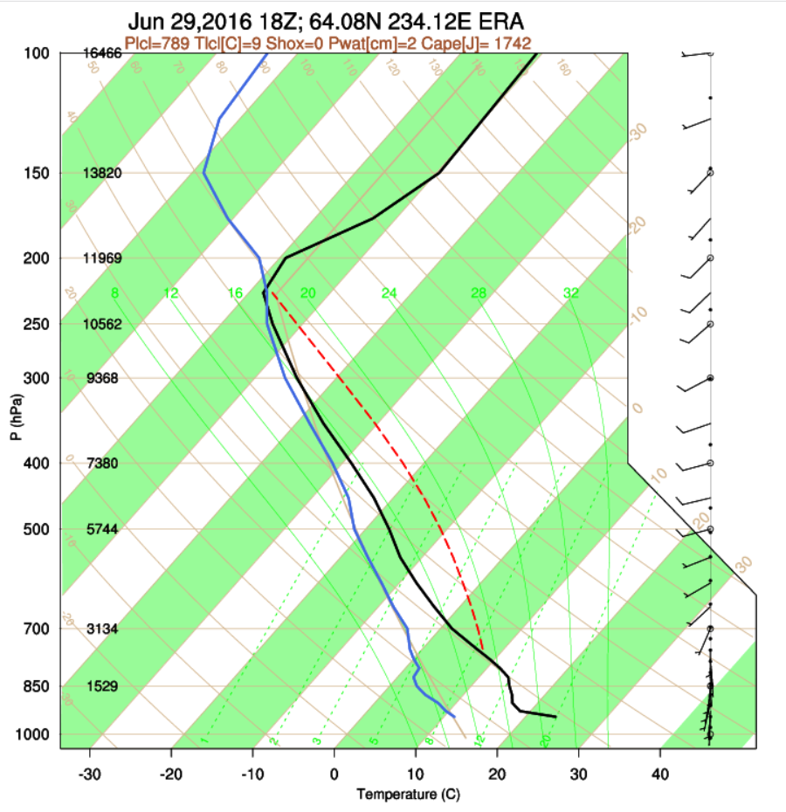
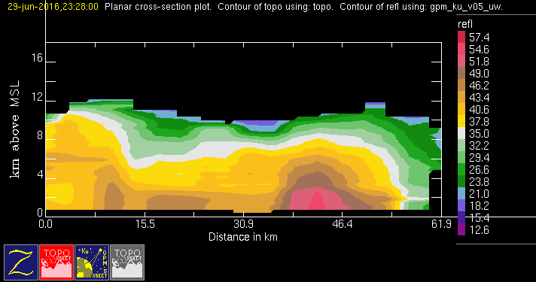
GPM 2Ku – DCC – 20160629 @ 232705
NAM (AKA)

Slide 3
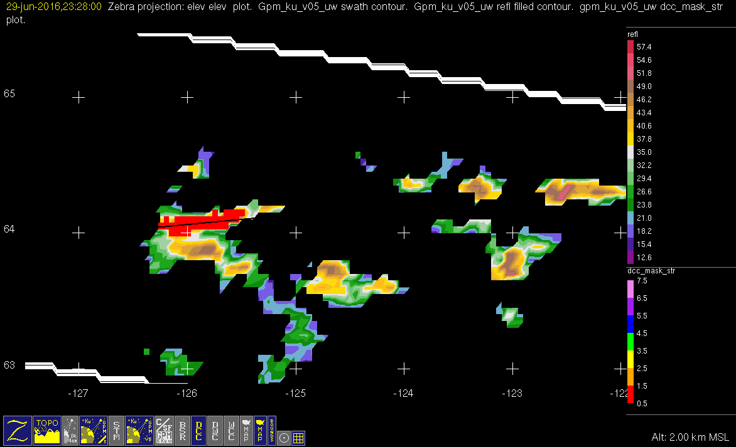
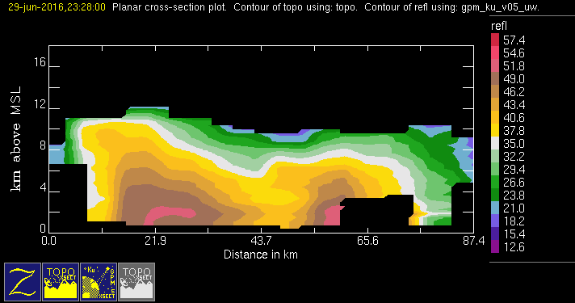
GPM 2Ku – DCC – 20160629 @ 232705
NAM – same as AKA case

Slide 4
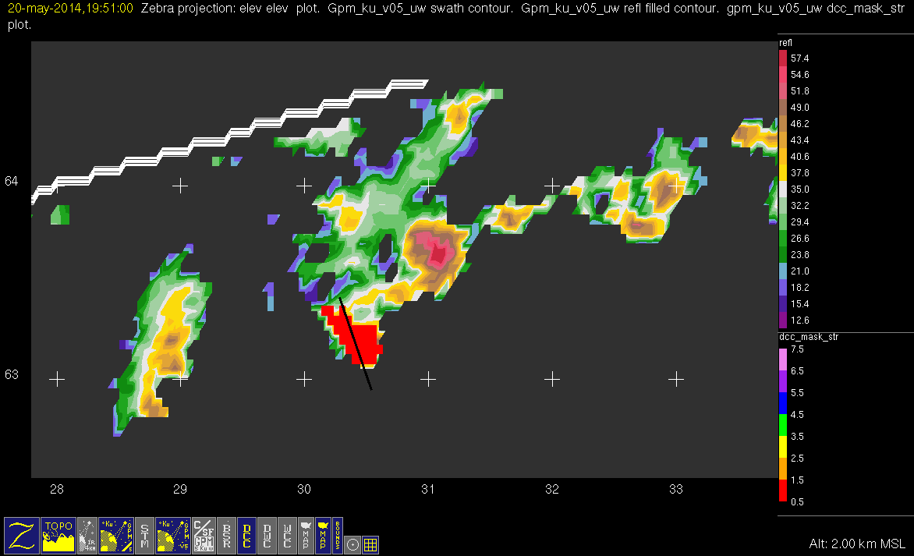
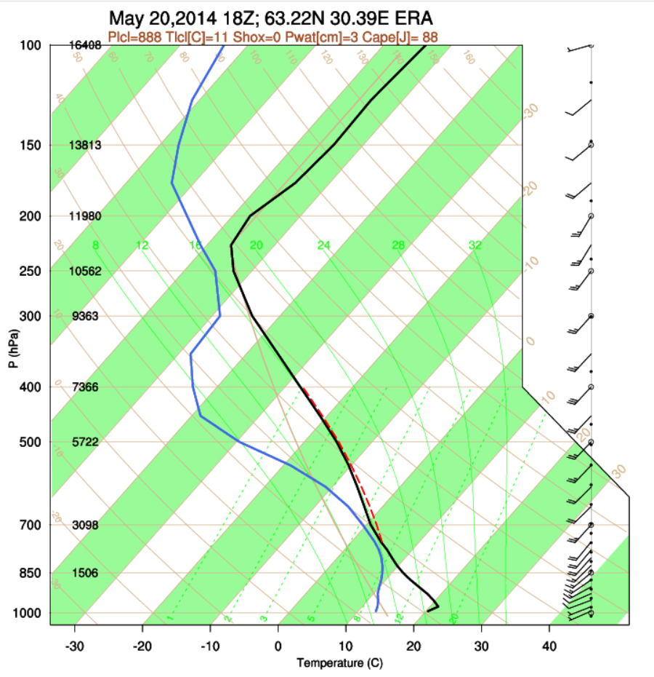
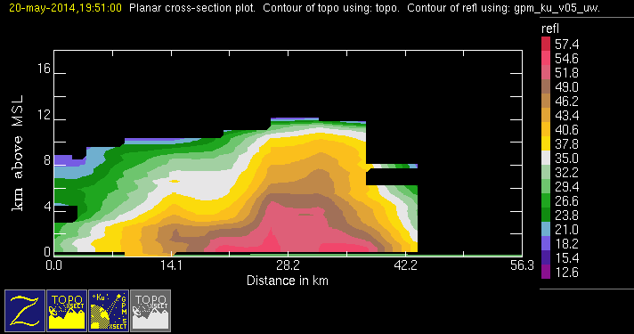
GPM 2Ku – DCC – 20140520 @ 195037
EUR

Slide 5
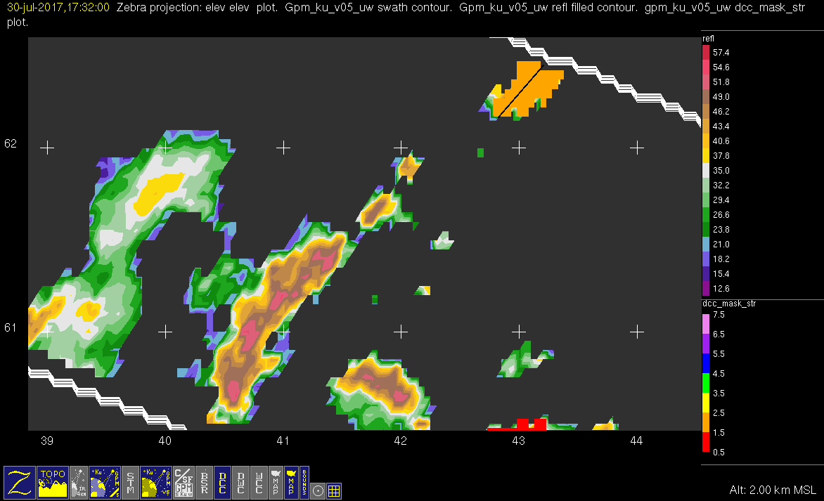
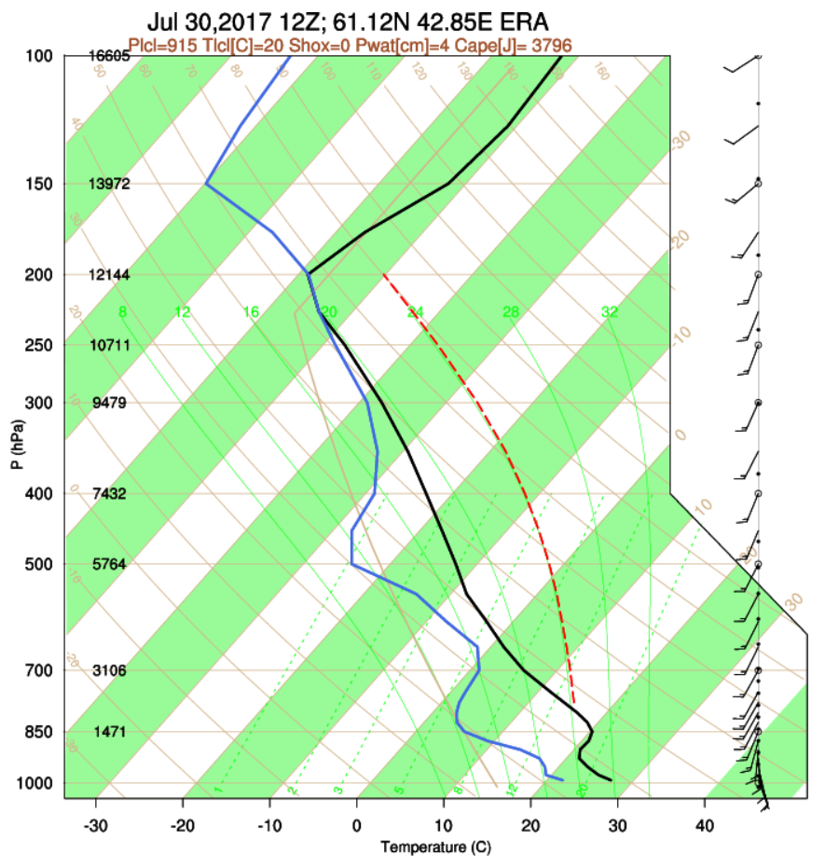
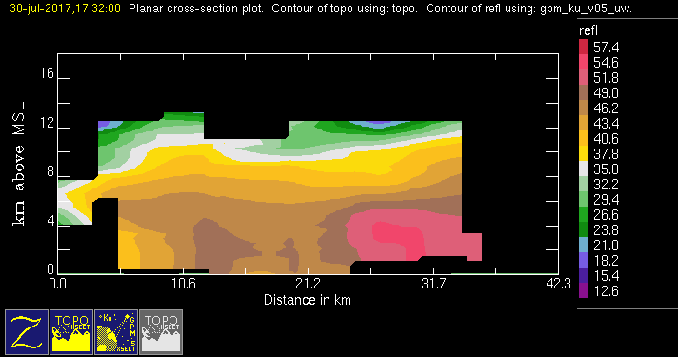
GPM 2Ku – DCC – 20170730 @ 173101 (1/2)
EUR

Slide 6
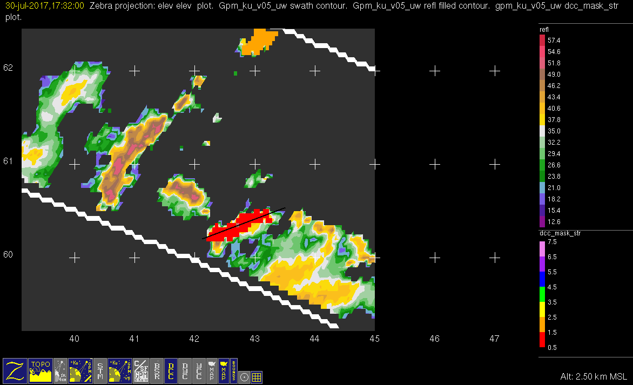
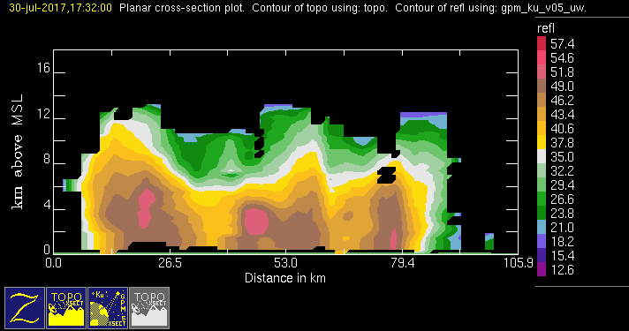
GPM 2Ku – DCC – 20170730 @ 173101 (2/2)
EUR

Slide 7
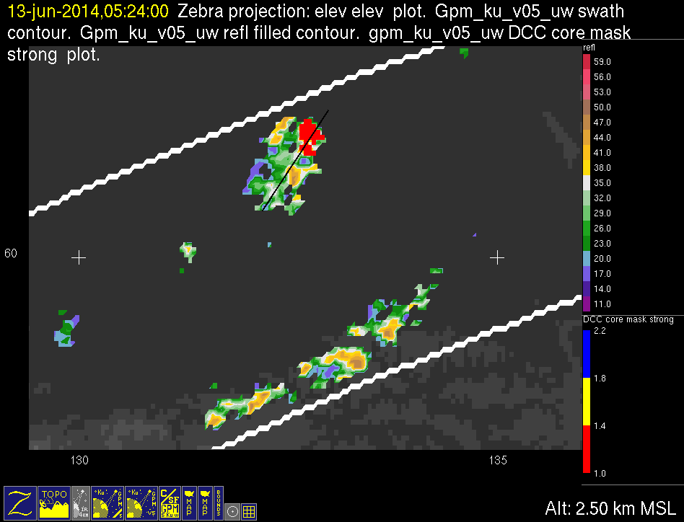
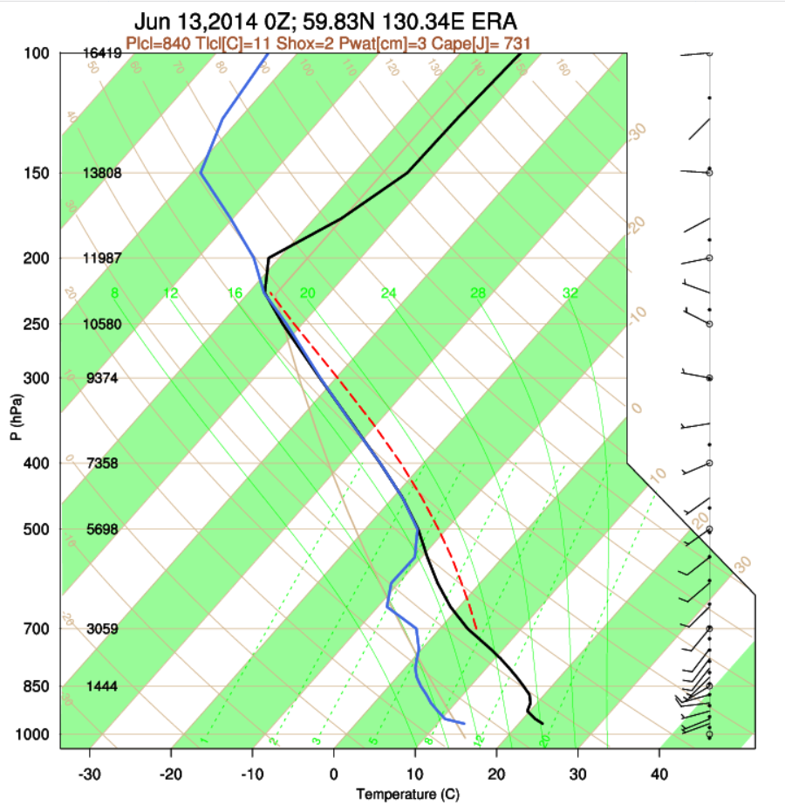
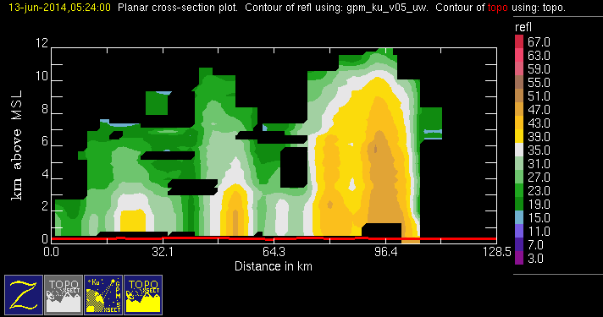
GPM 2Ku – DCC – 20140613 @ 051820
ASIA

Slide 8
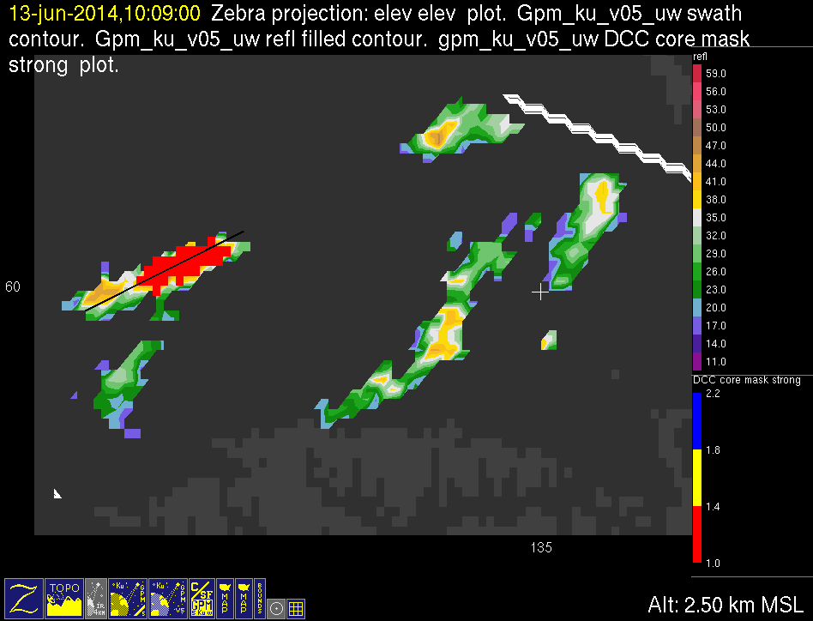
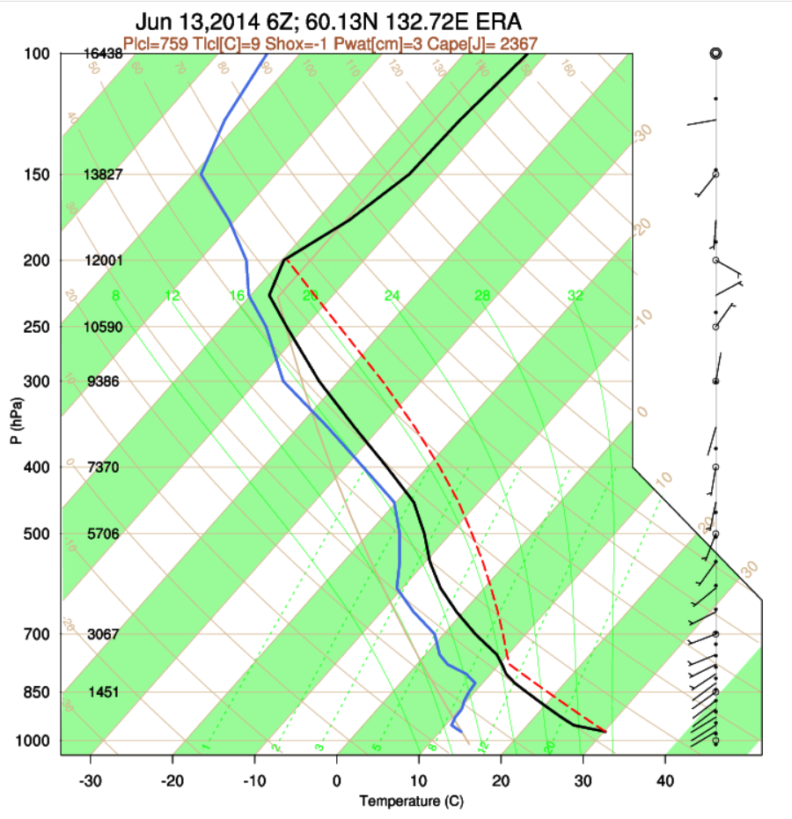
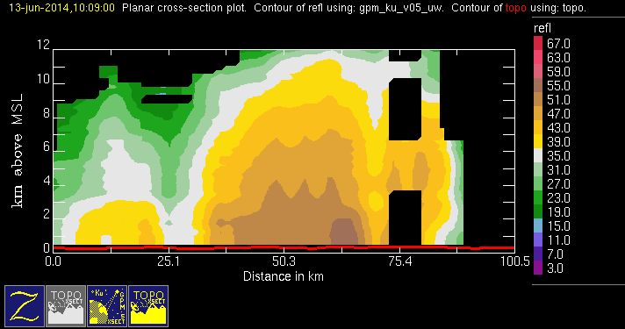
GPM 2Ku – DCC – 20140613 @ 100801
ASIA

Slide 9
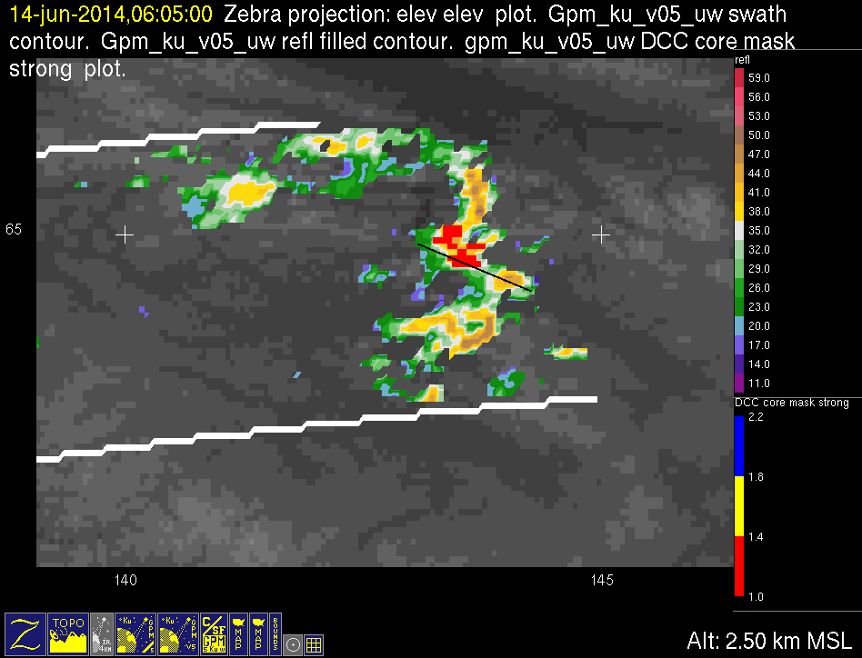
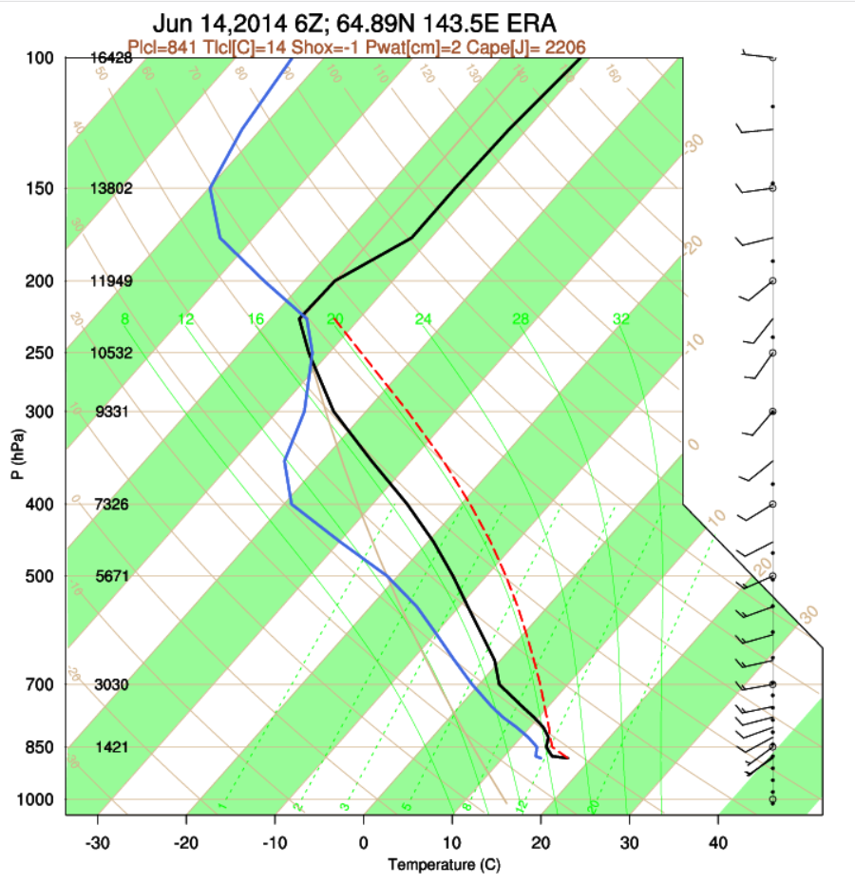
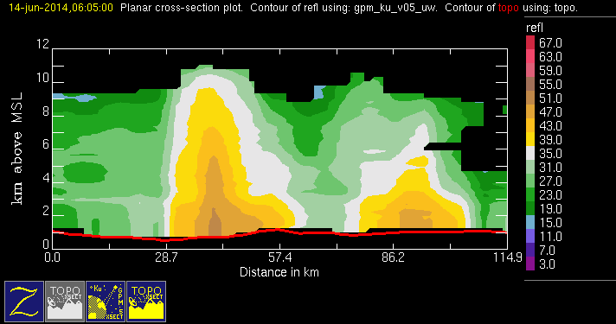
GPM 2Ku – DCC – 20140614 @ 060412
ASIA

Slide 10
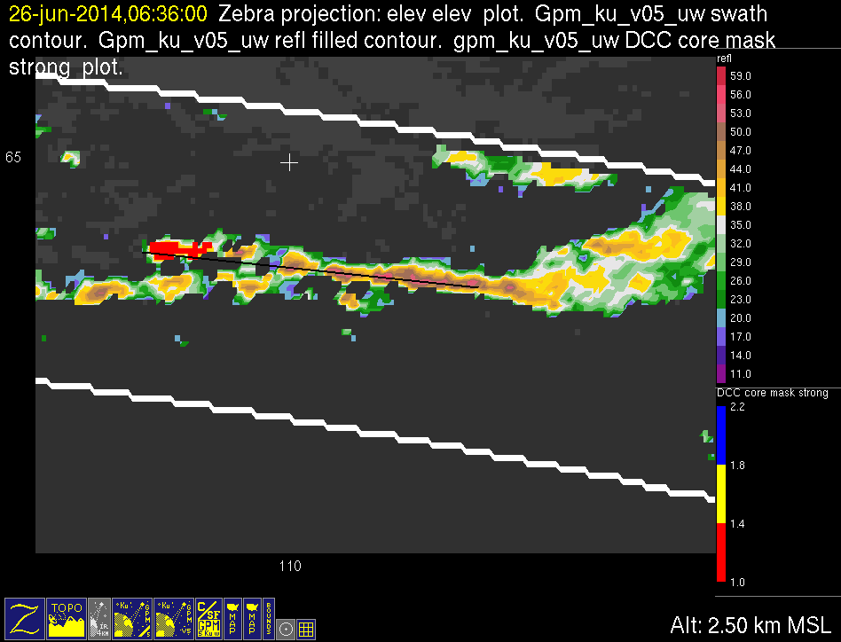
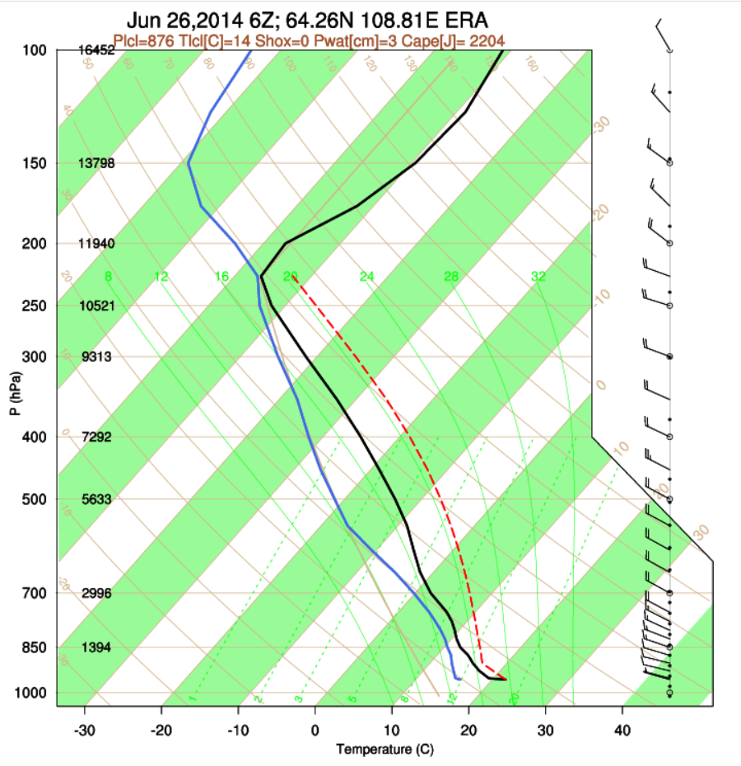
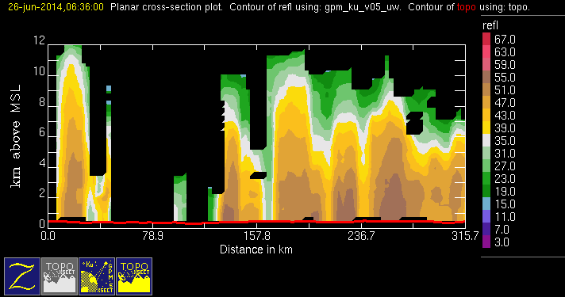
GPM 2Ku – DCC – 20140626 @ 063540
ASIA

Slide 11
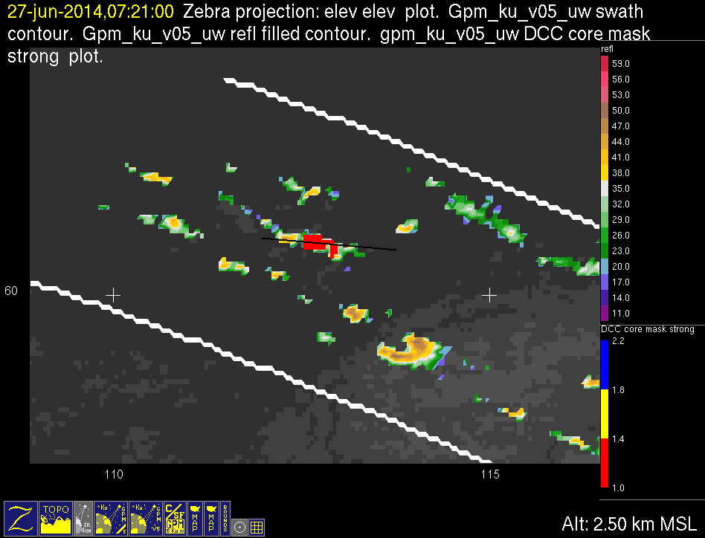
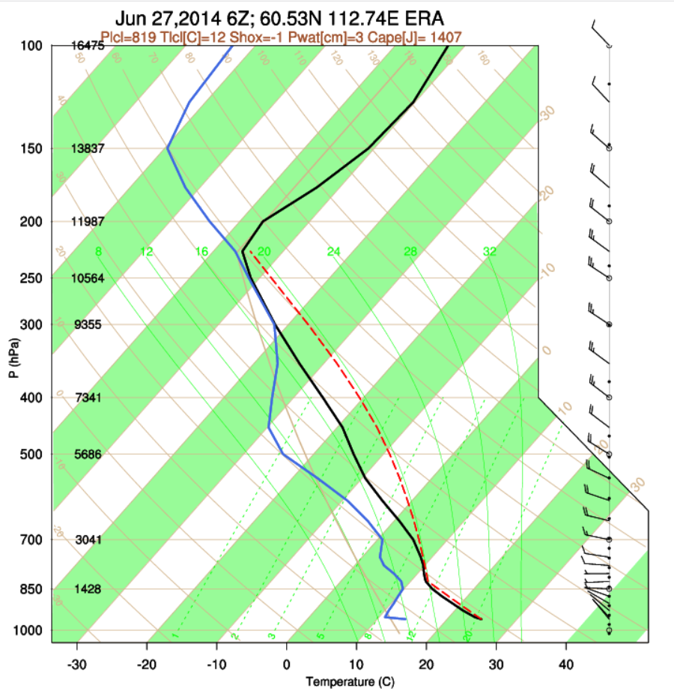
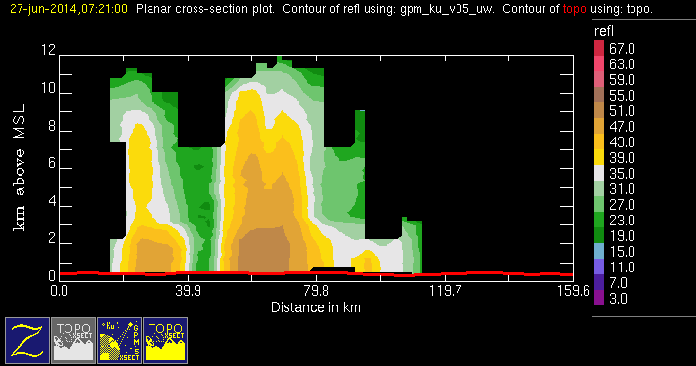
GPM 2Ku – DCC – 20140627 @ 072029
ASIA

Slide 12
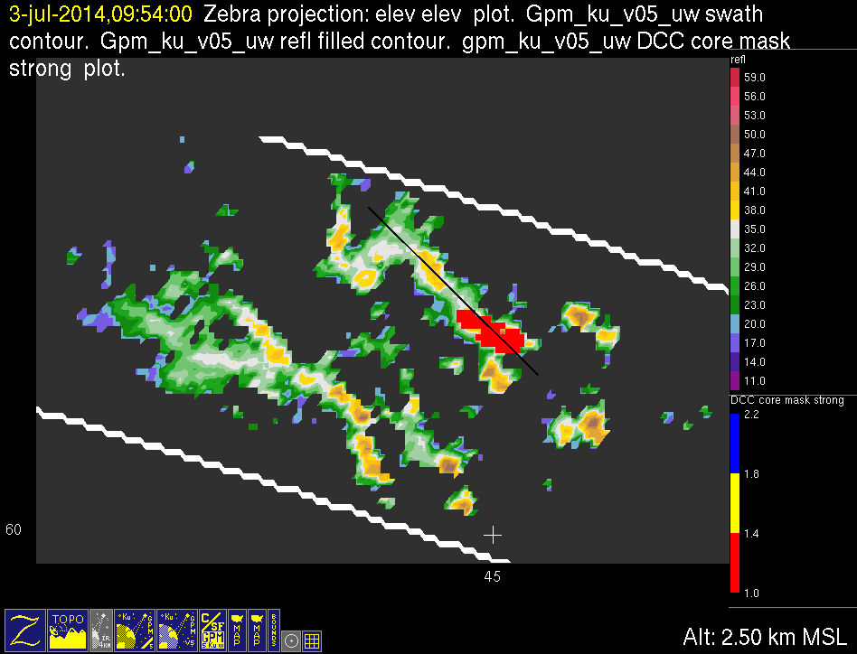
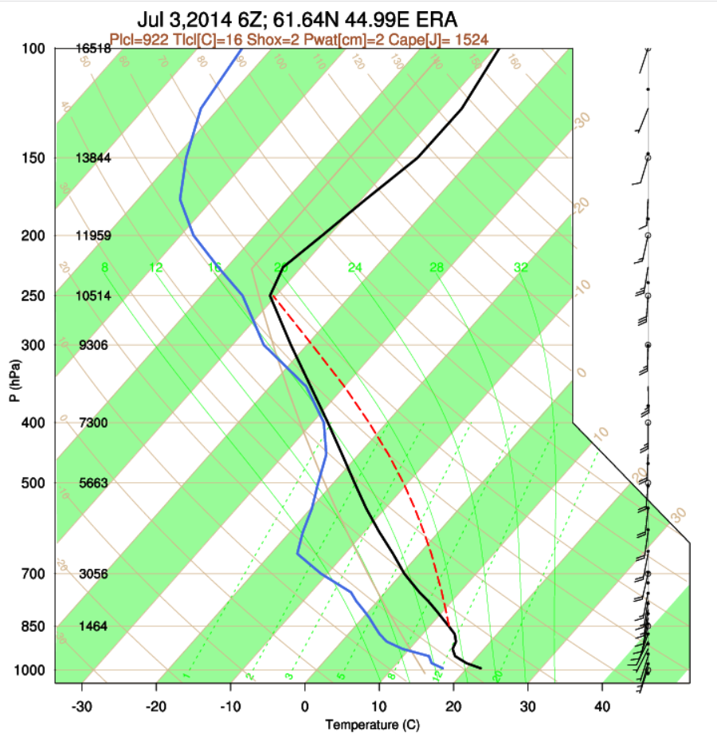
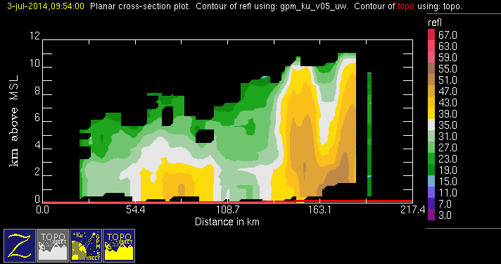
GPM 2Ku – DCC – 20140703 @ 095322
ASIA

Slide 13
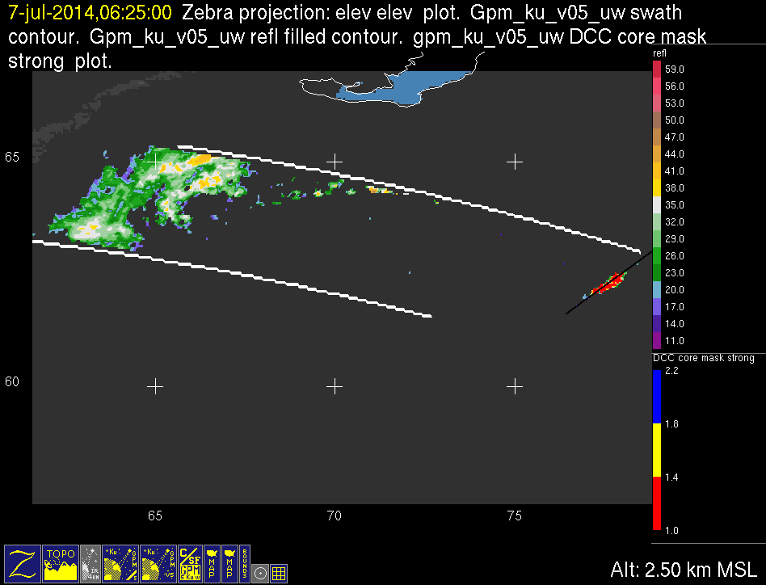
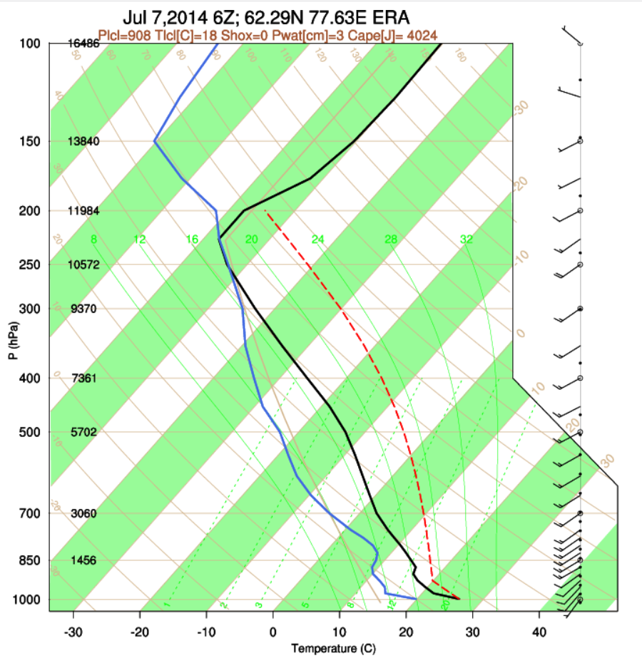
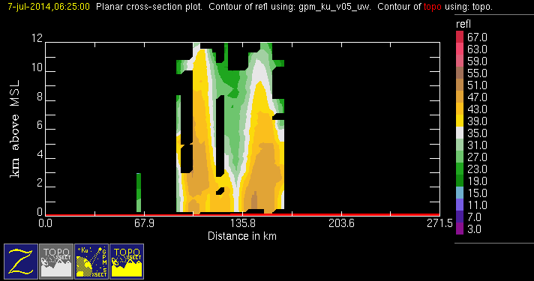
GPM 2Ku – DCC – 20140707 @ 062446
ASIA

Slide 14
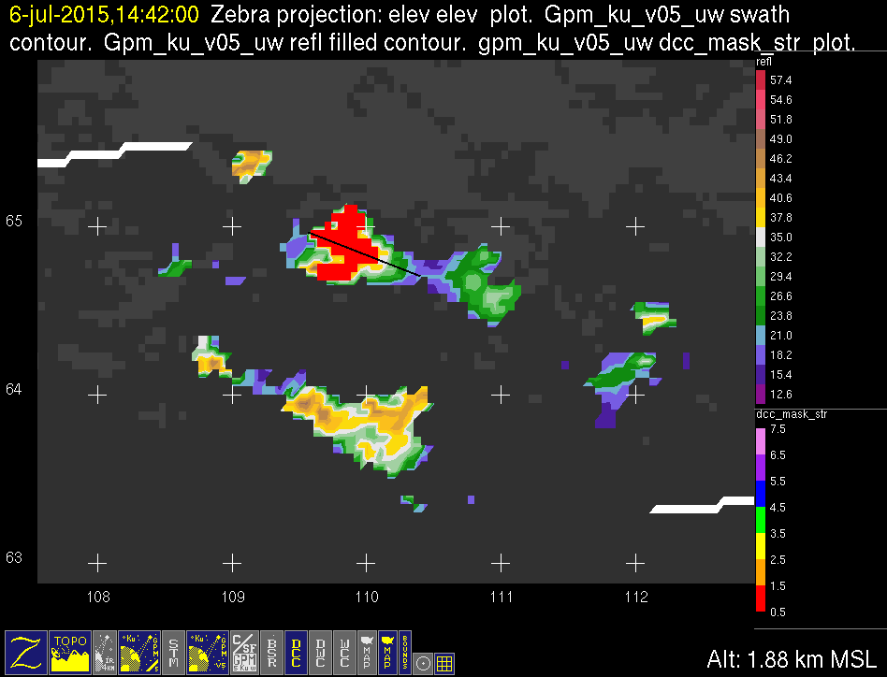
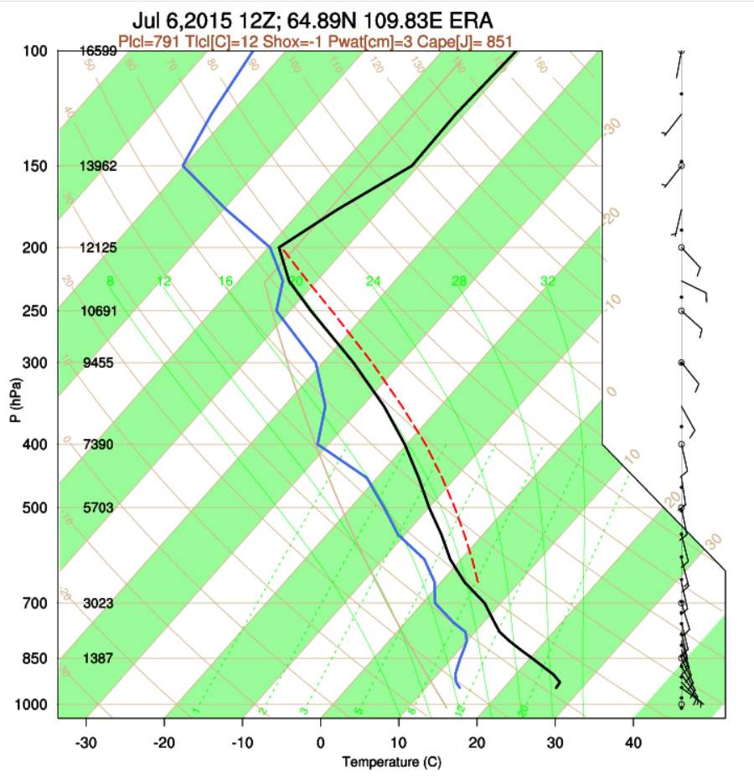
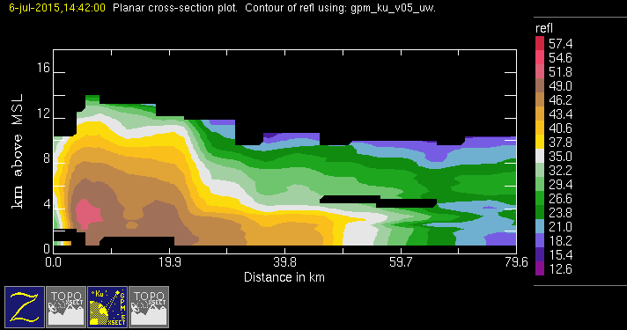
GPM 2Ku – DCC – 20150706 @ 144148
ASIA

Slide 15
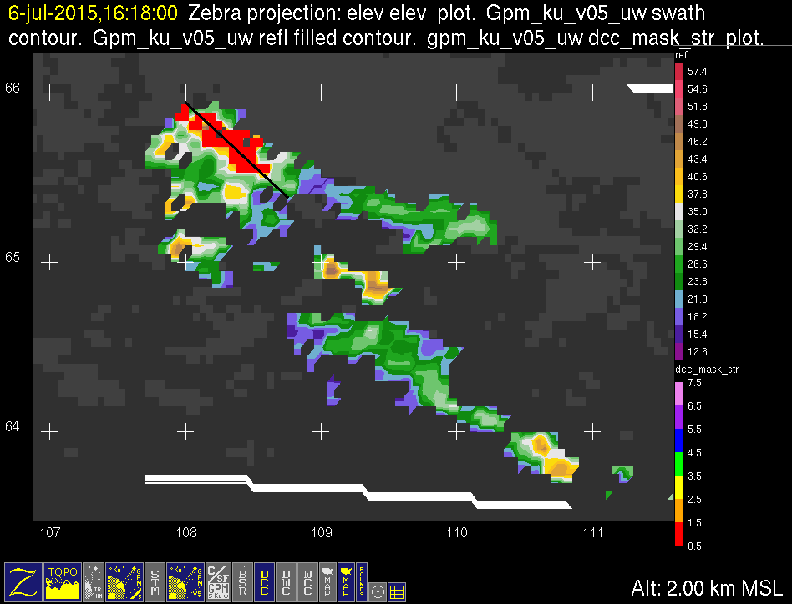
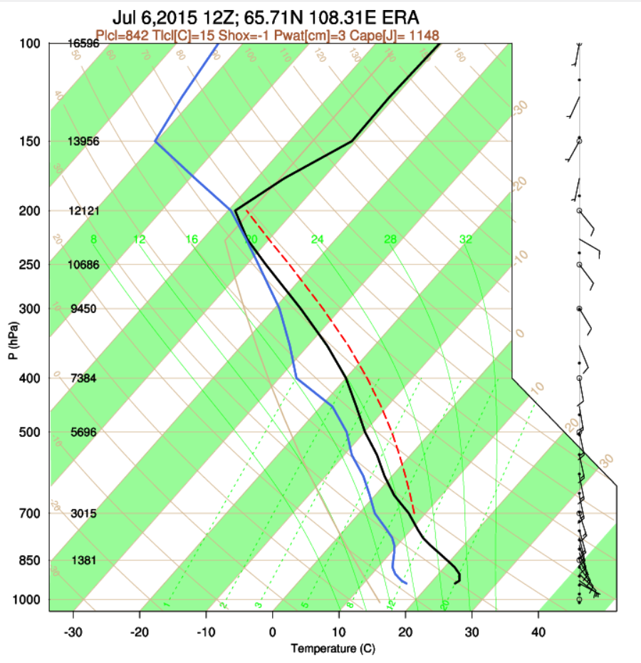
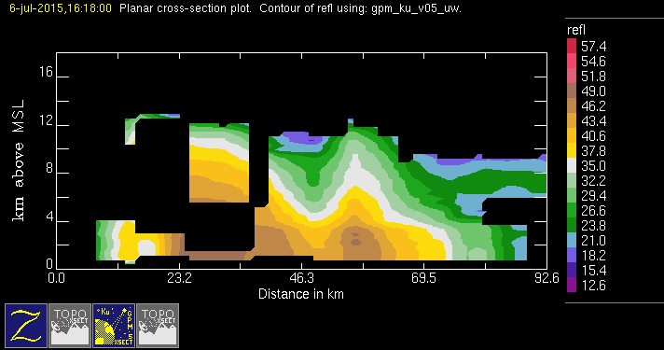
GPM 2Ku – DCC – 20150706 @ 161717
ASIA

Slide 16
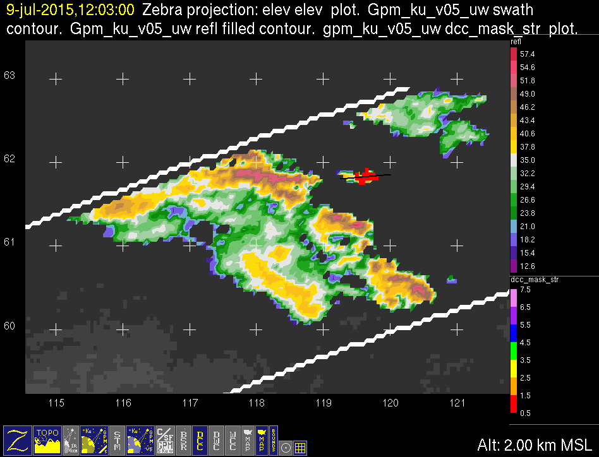

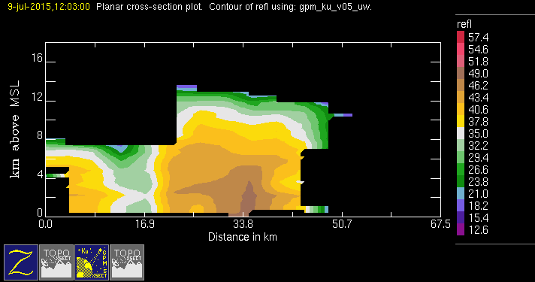
GPM 2Ku – DCC – 20150709 @ 120213
ASIA

Slide 17
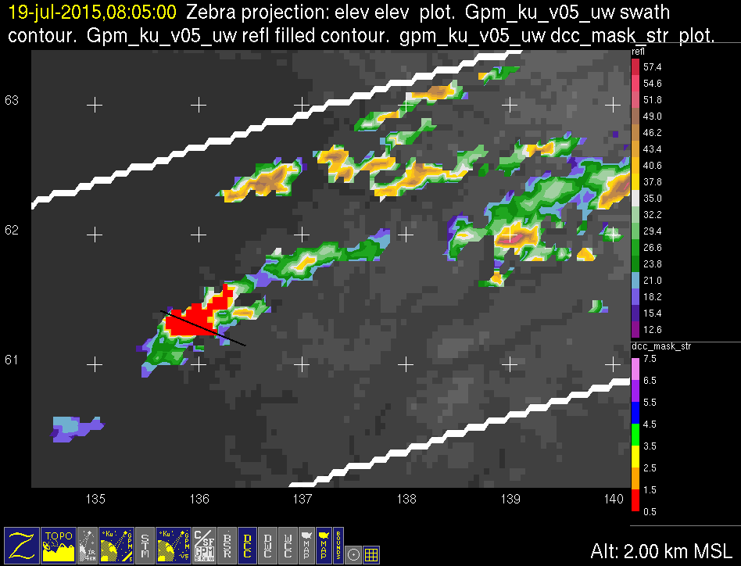
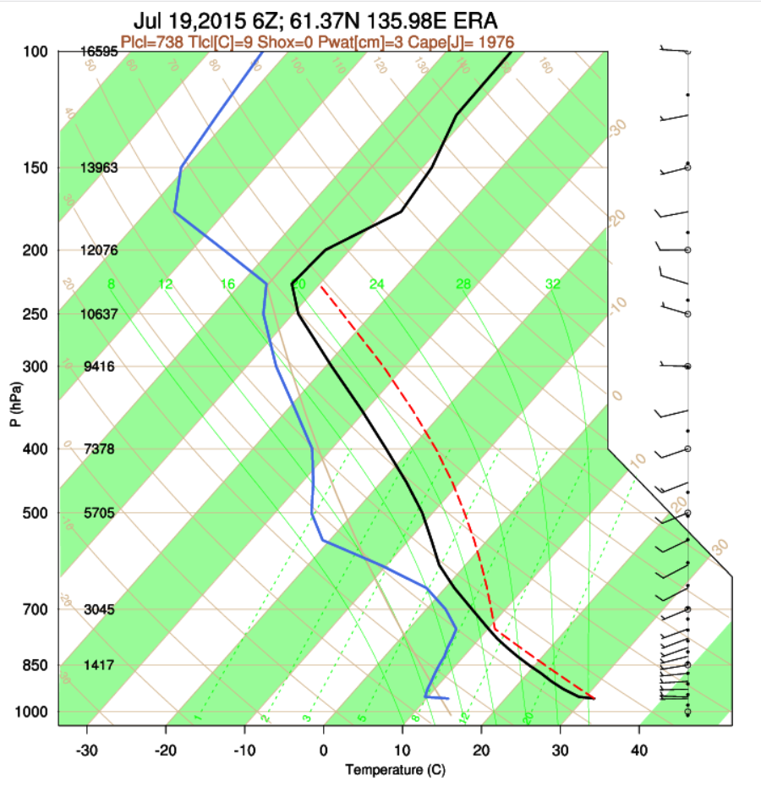
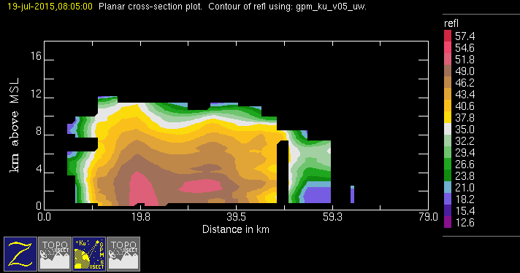
GPM 2Ku – DCC – 20150719 @ 080424
ASIA

Slide 18
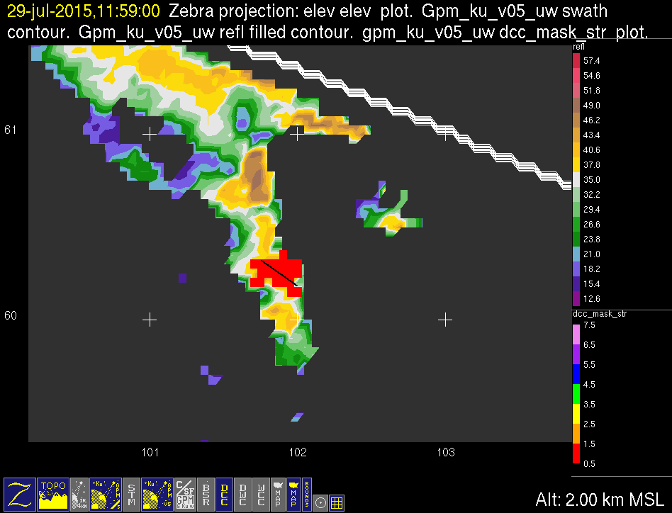
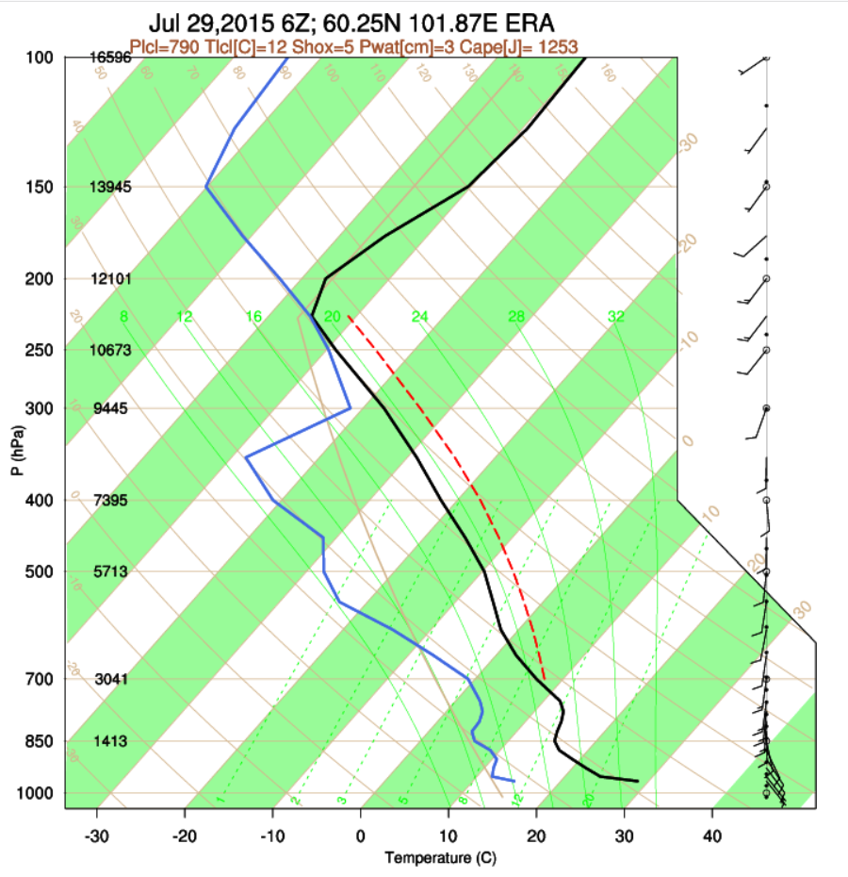
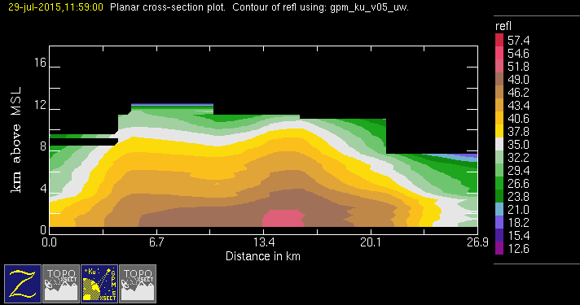
GPM 2Ku – DCC – 20150729 @ 115816
ASIA

Slide 19
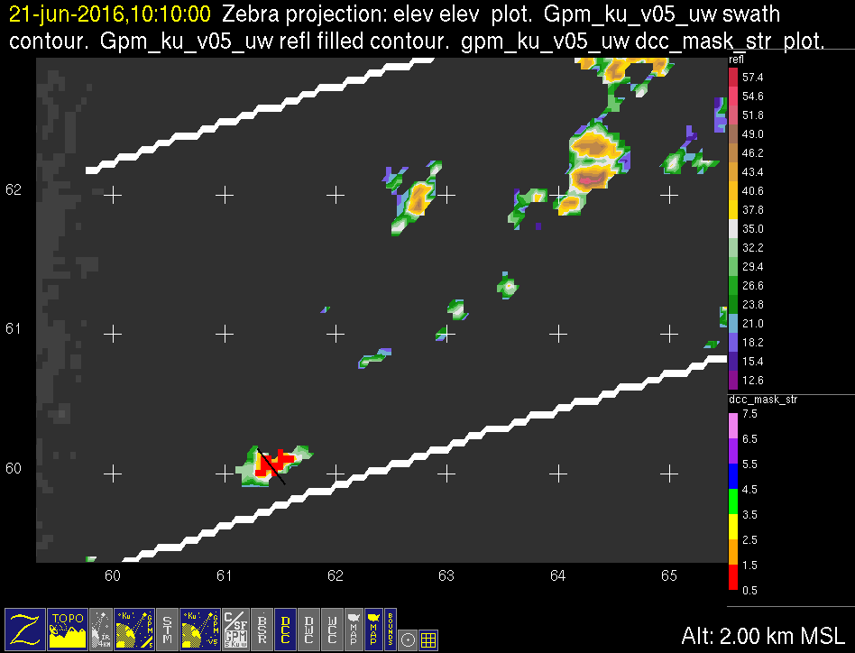
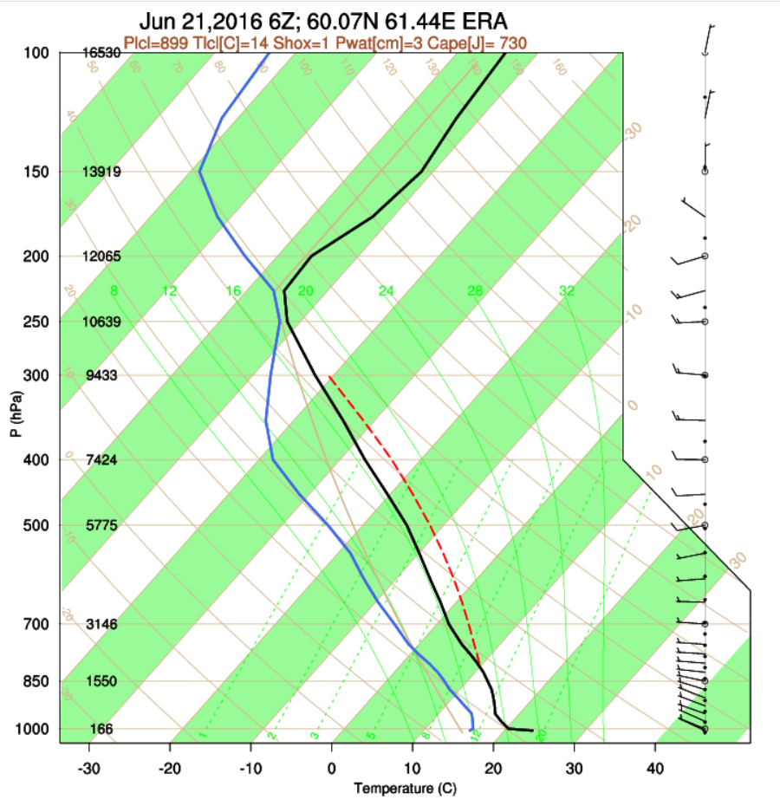

GPM 2Ku – DCC – 20160621 @ 100935
ASIA

Slide 20



GPM 2Ku – DCC – 20160621 @ 114635
ASIA

Slide 21




GPM 2Ku – DCC – 20160701 @ 075112 (1/2)
ASIA

Slide 22


GPM 2Ku – DCC – 20160701 @ 075112 (2/2)
ASIA

Slide 23



GPM 2Ku – DCC – 20170721 @ 141756
ASIA

Slide 24



GPM 2Ku – DCC – 20170730 @ 173130 (1/2)
ASIA

Slide 25


GPM 2Ku – DCC – 20170730 @ 173130 (2/2)
ASIA

