Slide 1
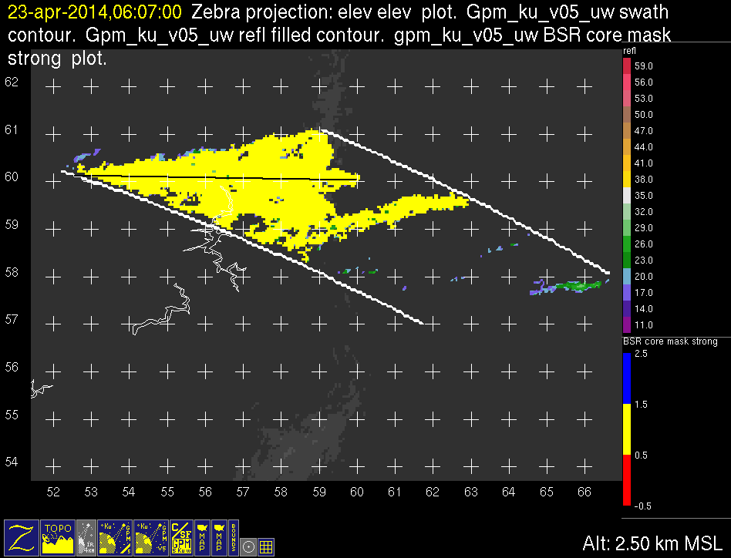
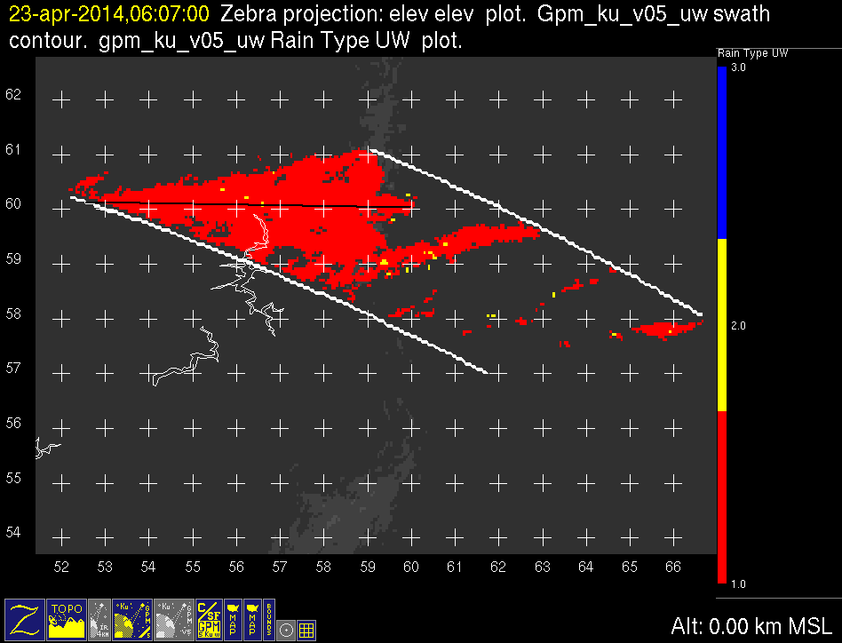
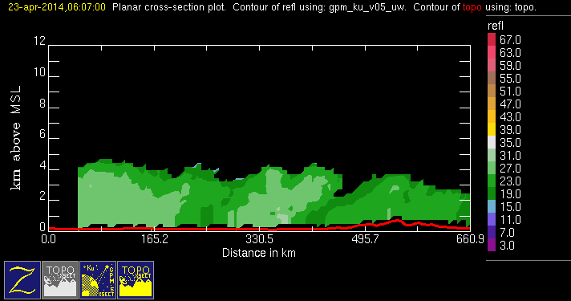
GPM 2Ku – BSR – 20140423 @ 060651
ASIA

Slide 2
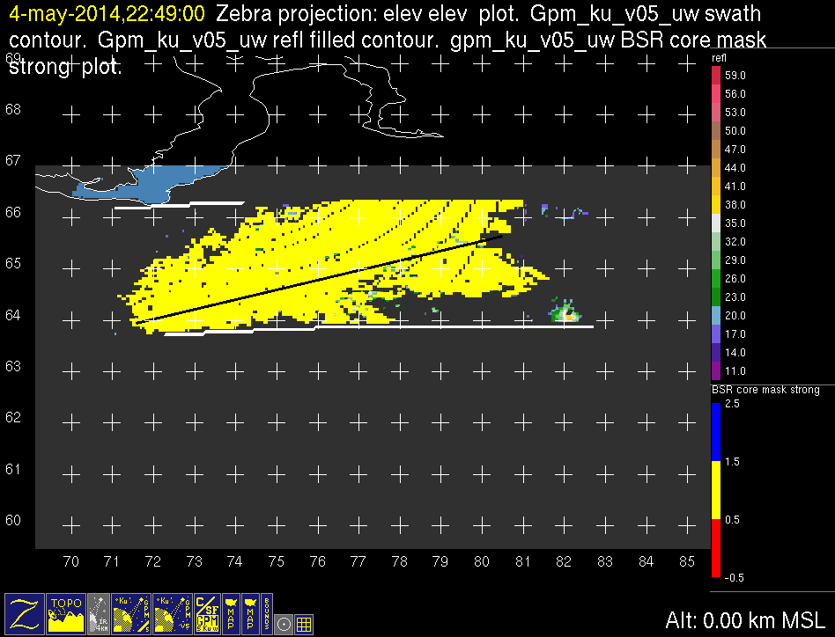
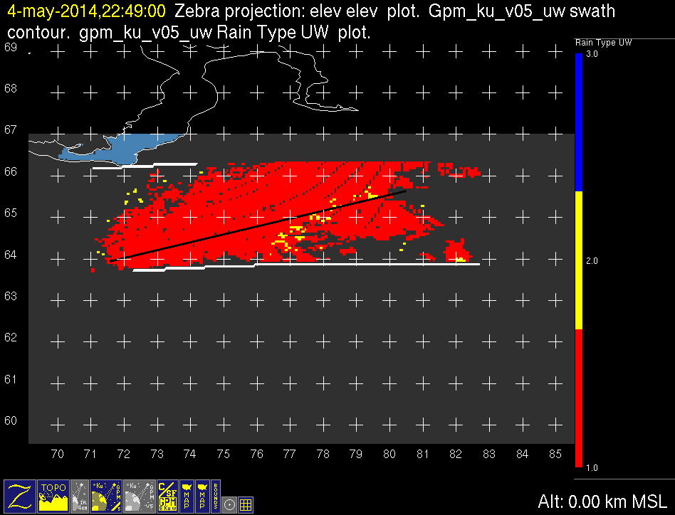
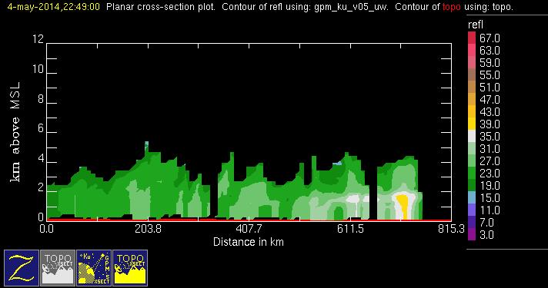
GPM 2Ku – BSR – 20140504 @ 224830
ASIA

Slide 3
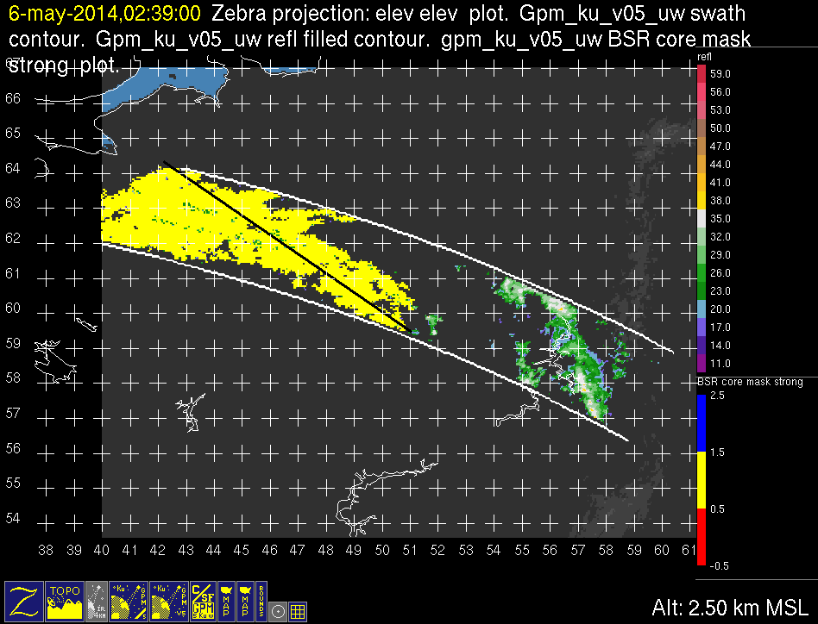
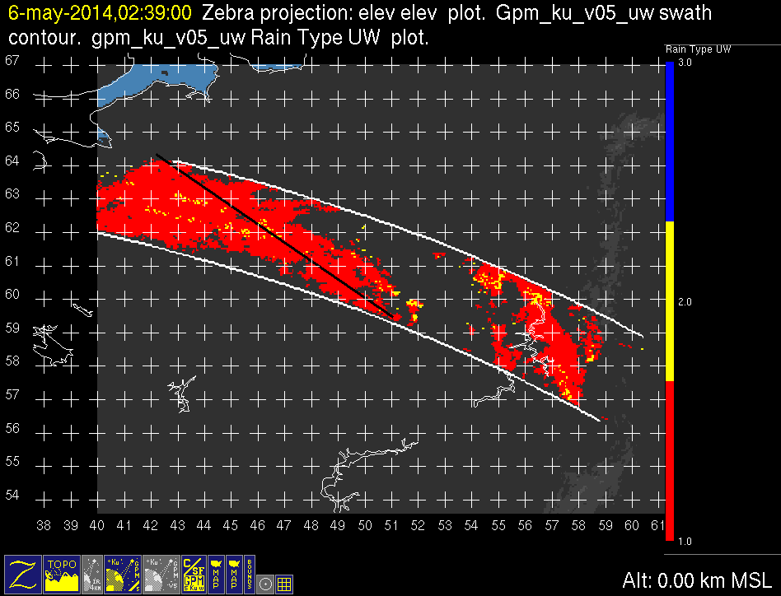
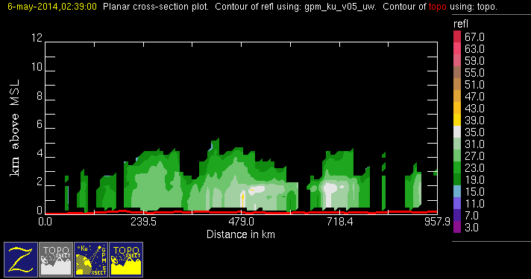
GPM 2Ku – BSR – 20140506 @ 023809
ASIA

Slide 4
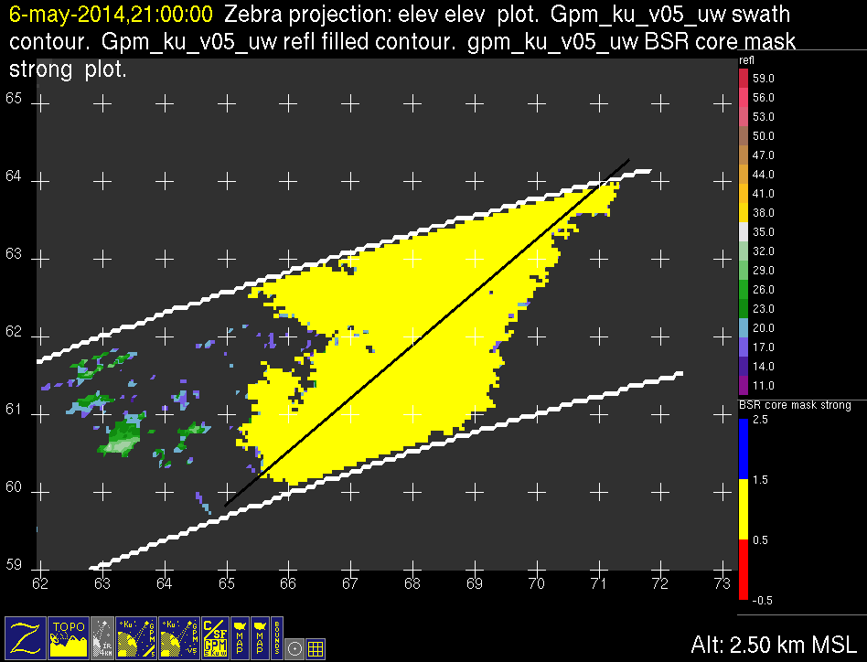
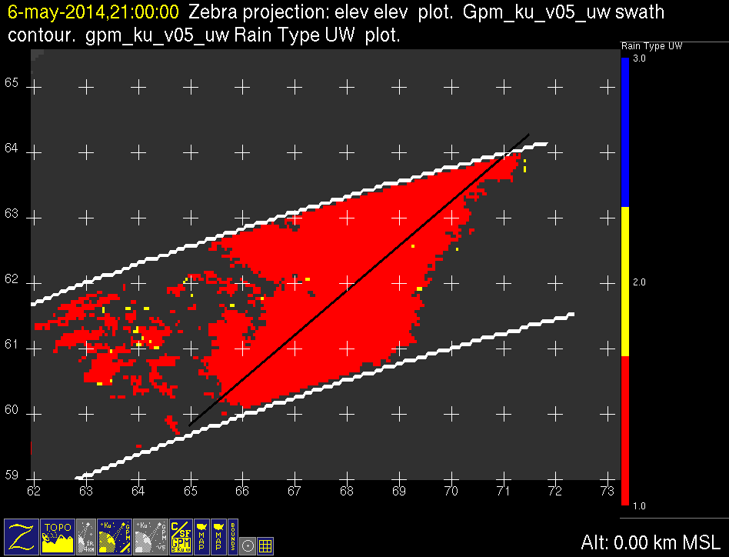
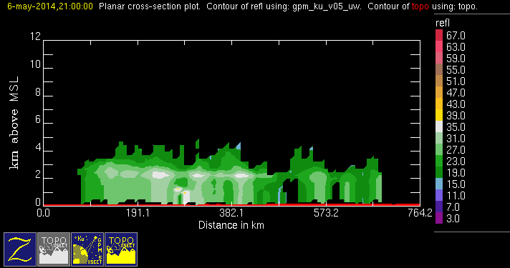
GPM 2Ku – BSR – 20140506 @ 205942
ASIA

Slide 5
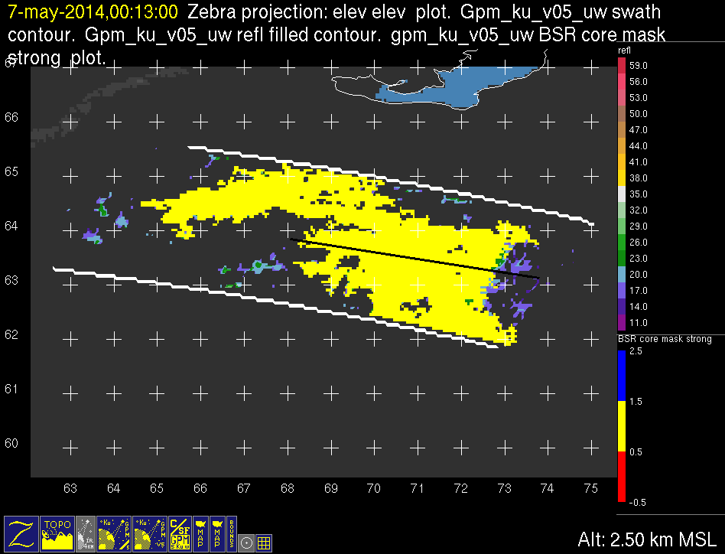
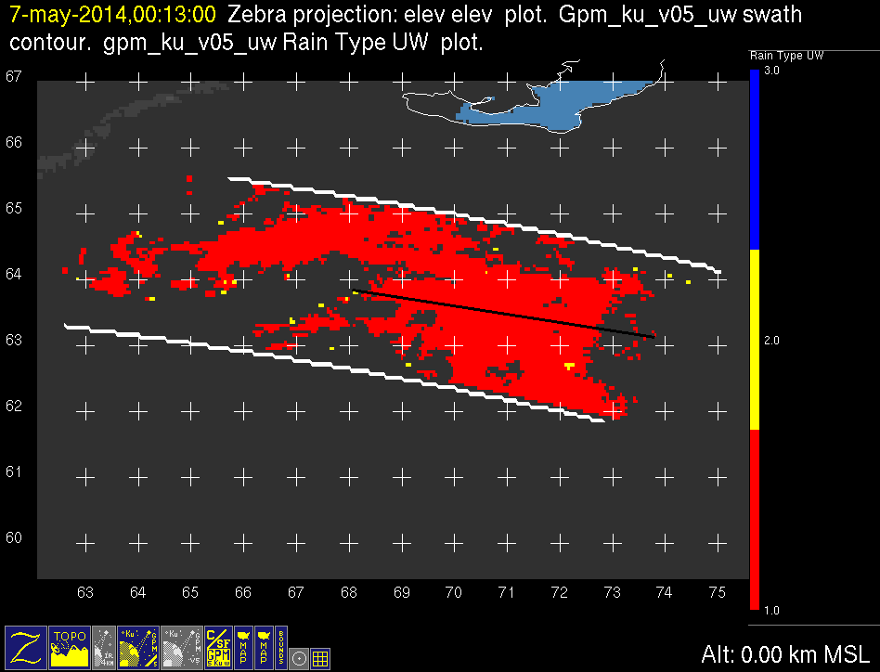
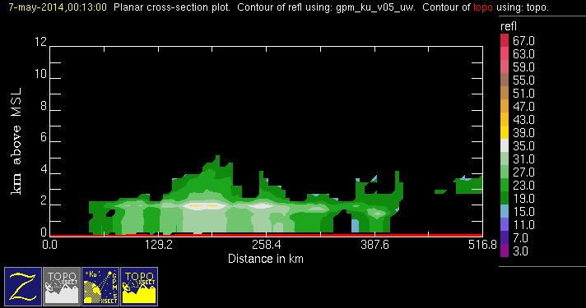
GPM 2Ku – BSR – 20140507 @ 001252
ASIA

Slide 6
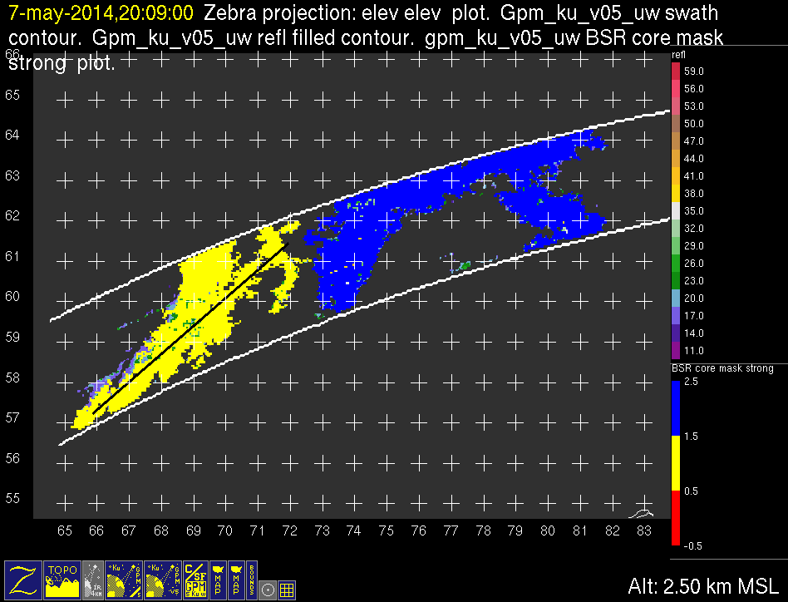
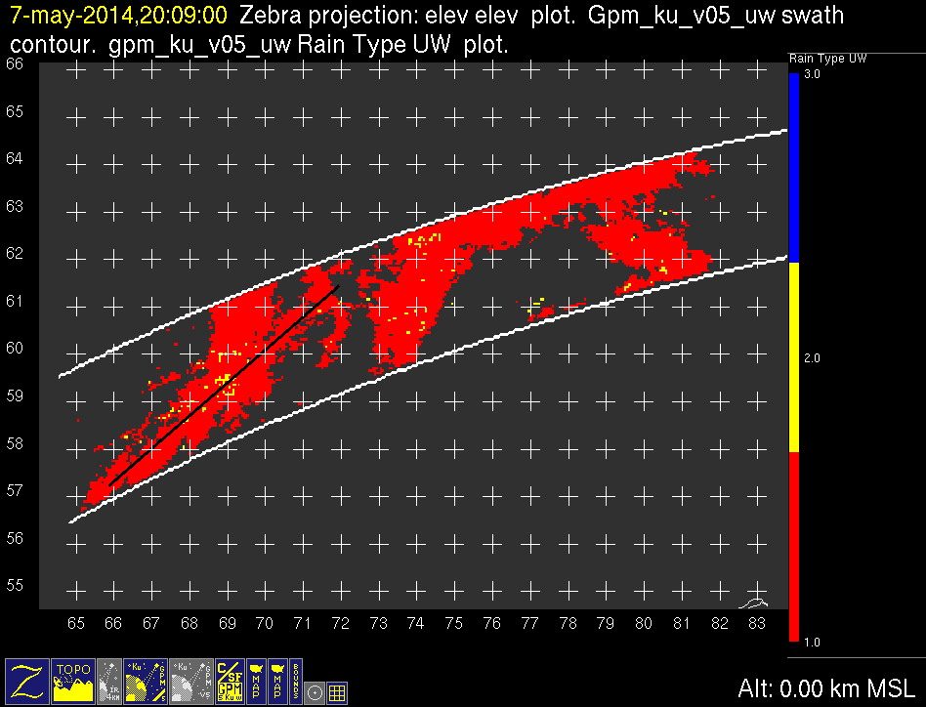
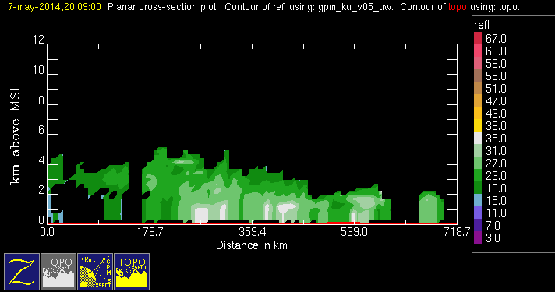
GPM 2Ku – BSR – 20140507 @ 200848 1/2
ASIA

Slide 7
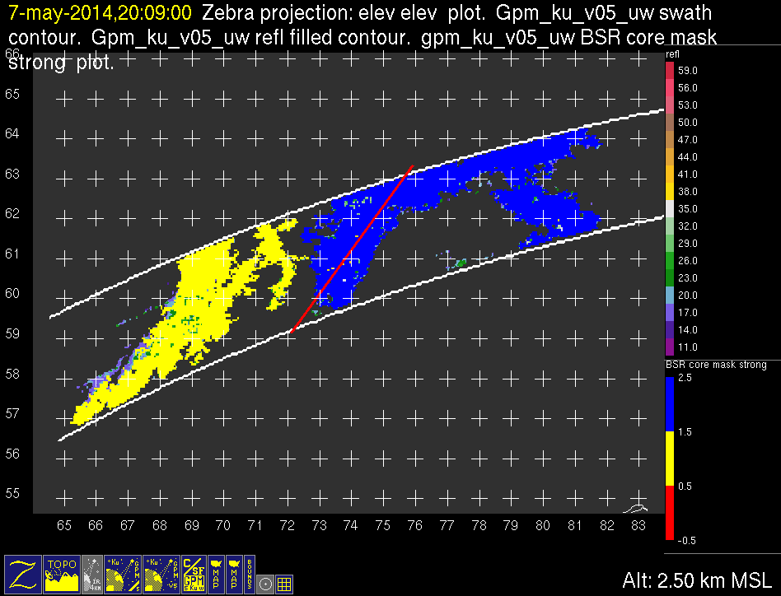
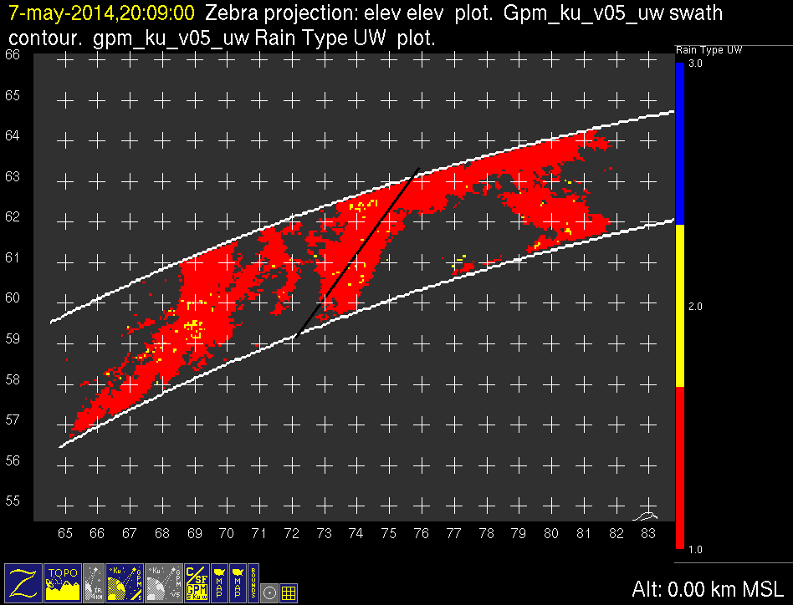
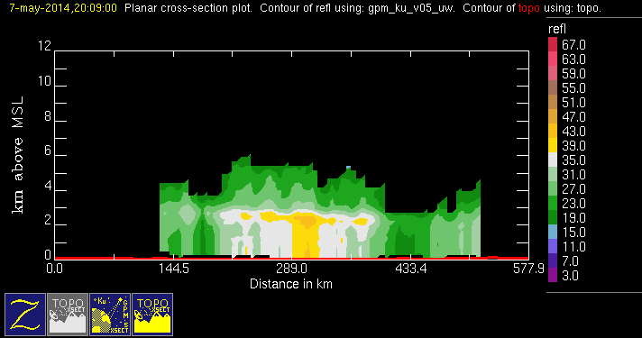
GPM 2Ku – BSR – 20140507 @ 200848 2/2
ASIA

Slide 8
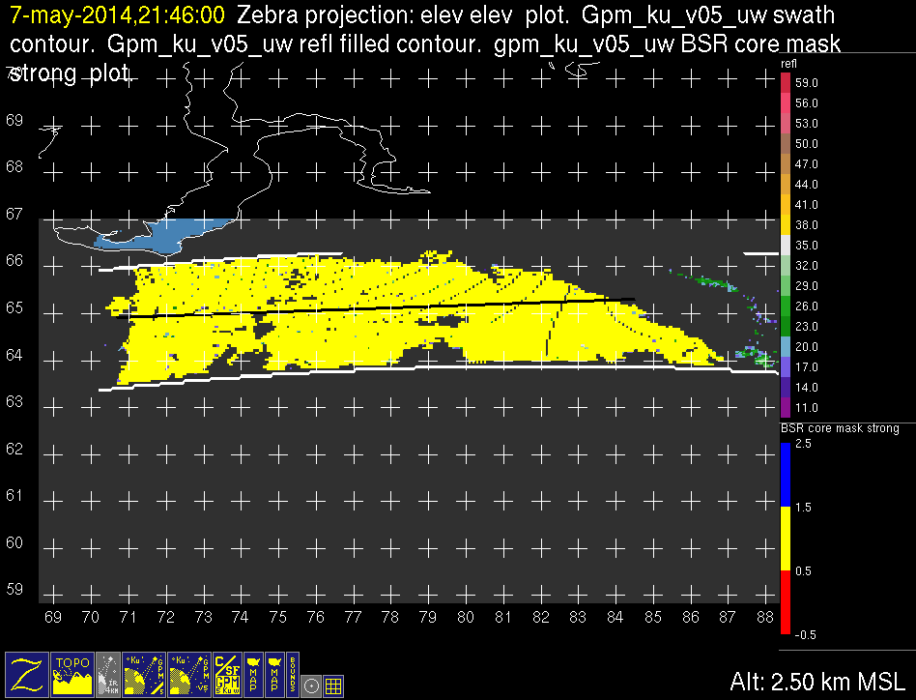
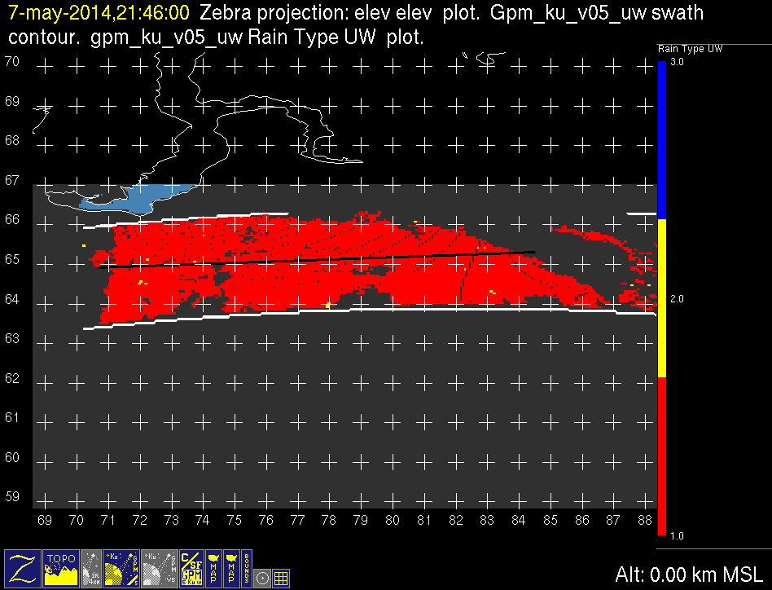
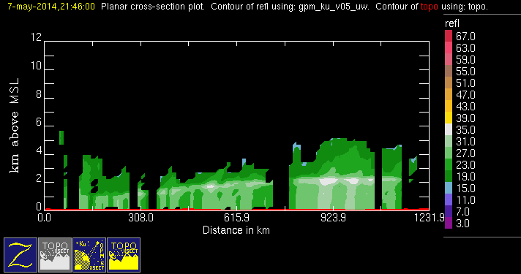
GPM 2Ku – BSR – 20140507 @ 214556
NOTE:
Rising bright band
ASIA

Slide 9
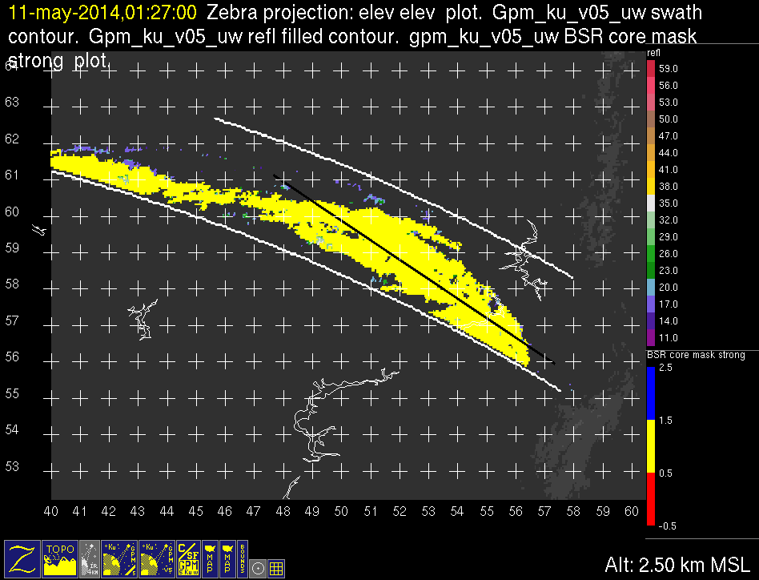
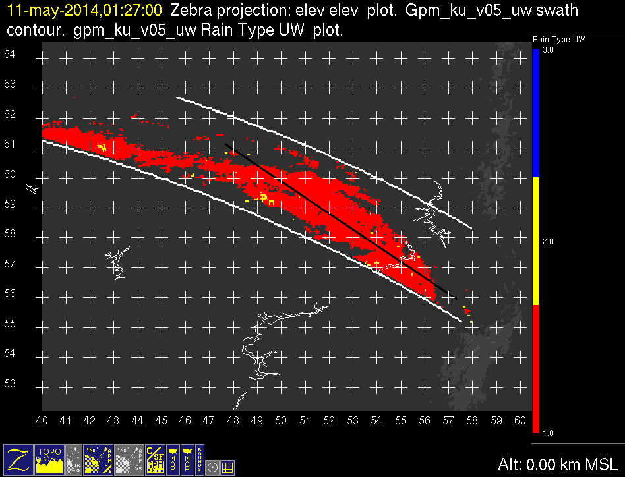
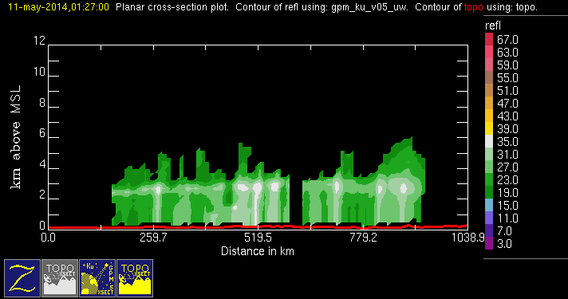
GPM 2Ku – BSR – 20140511 @ 012630
ASIA

Slide 10
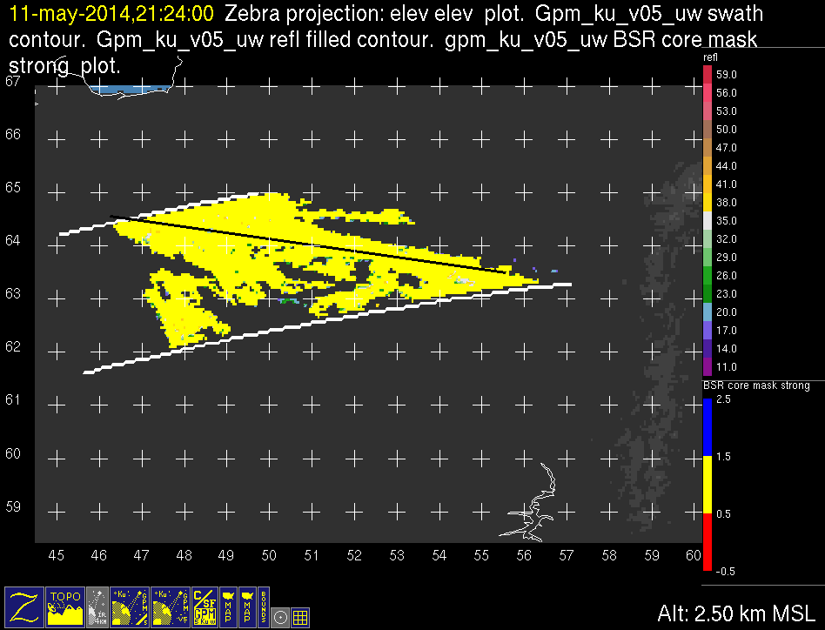
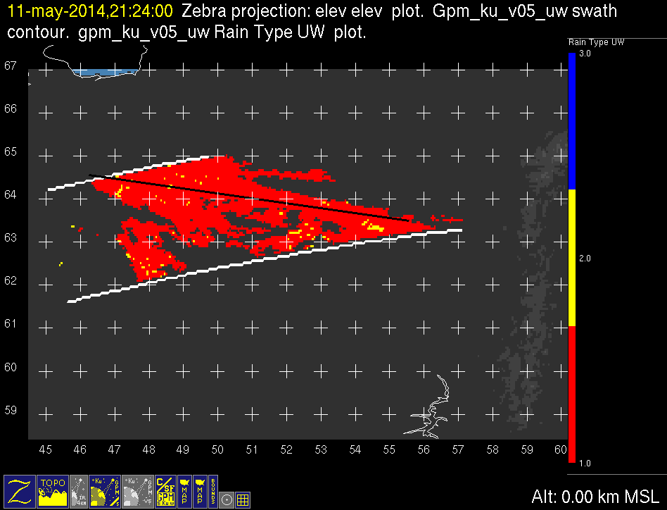
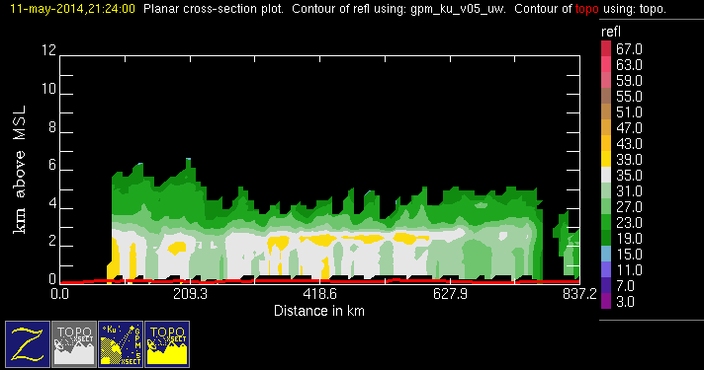
GPM 2Ku – BSR – 20140511 @ 212354
ASIA

Slide 11
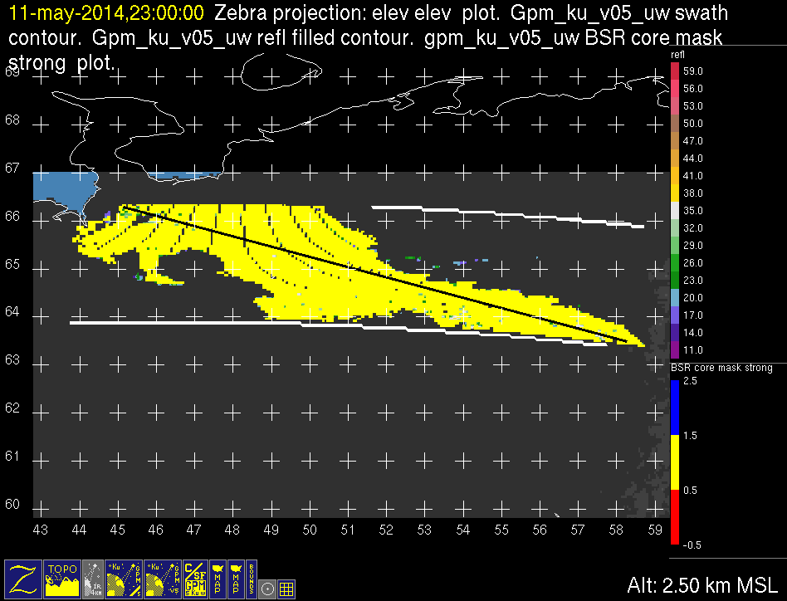
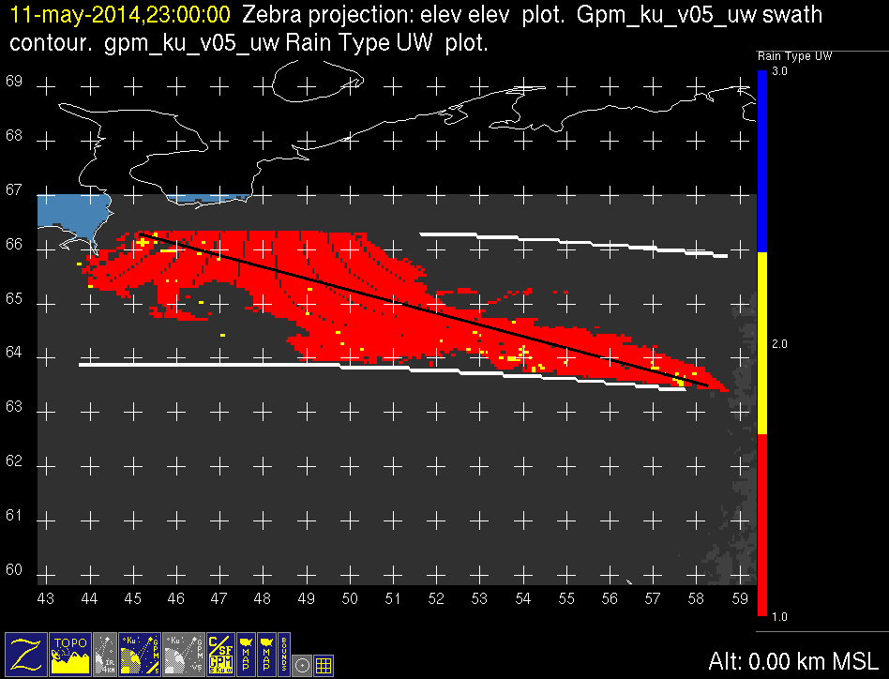
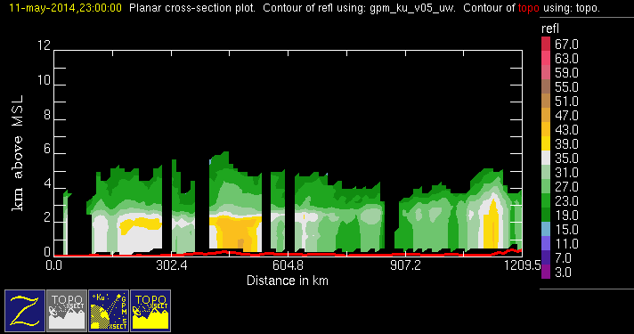
GPM 2Ku – BSR – 20140511 @ 225913
ASIA

Slide 12
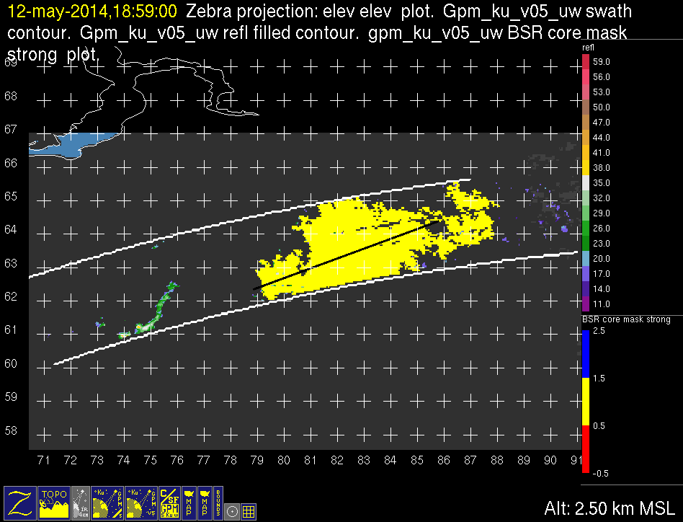
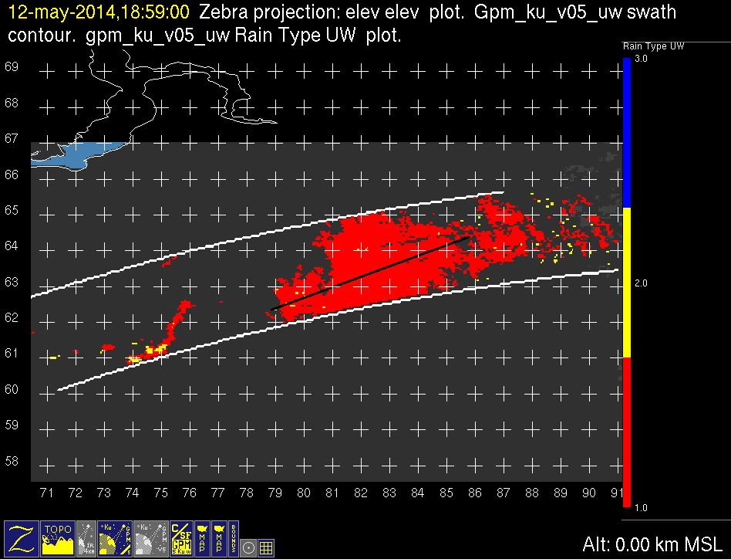
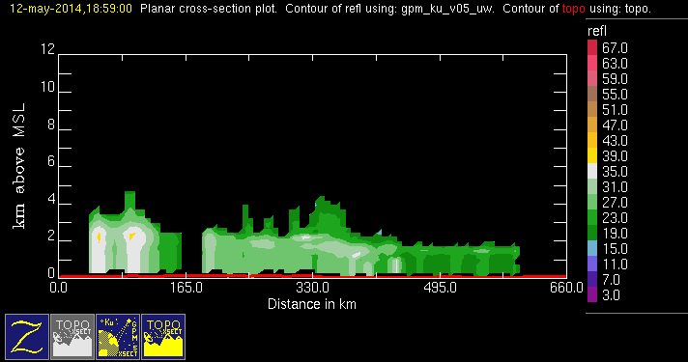
GPM 2Ku – BSR – 20140512 @ 185828
ASIA

Slide 13
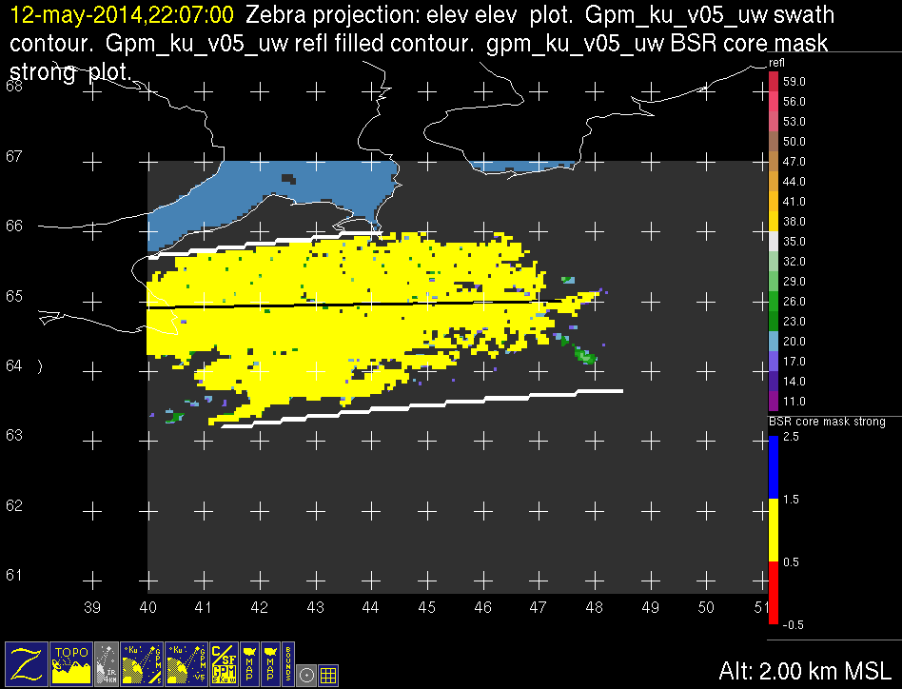
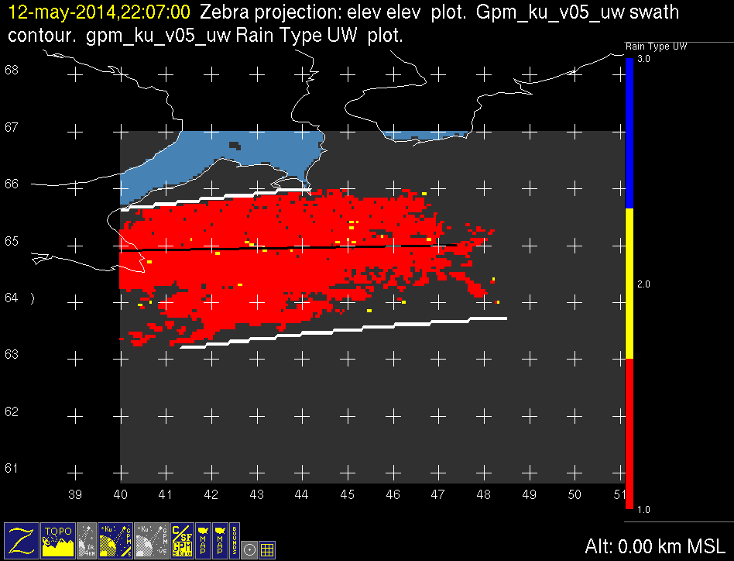
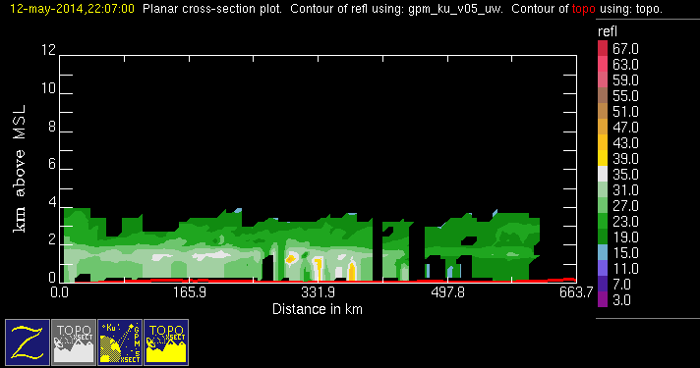
GPM 2Ku – BSR – 20140512 @ 220616
ASIA

Slide 14
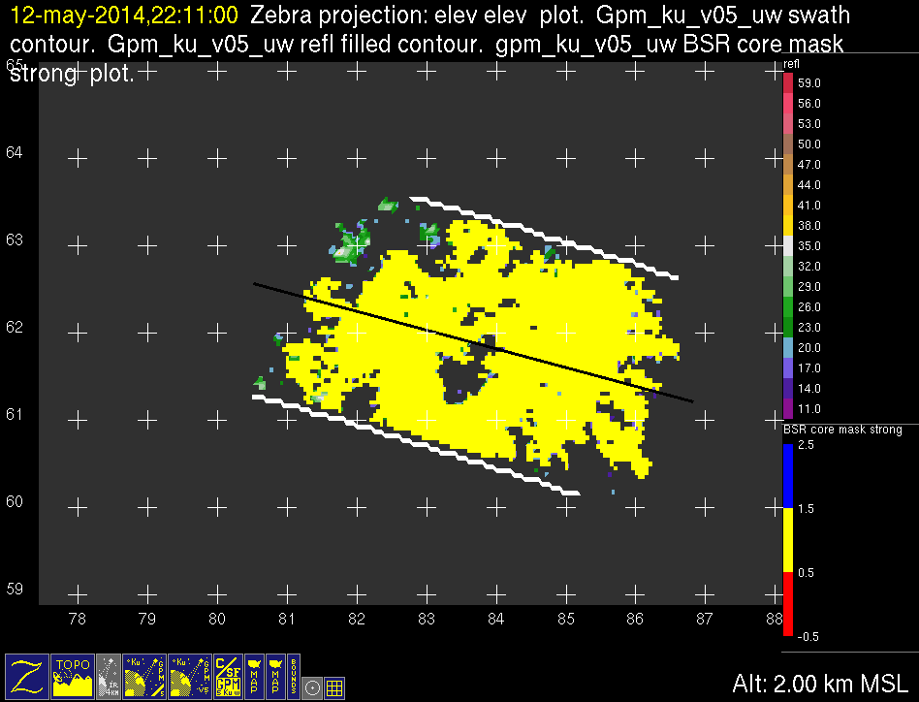
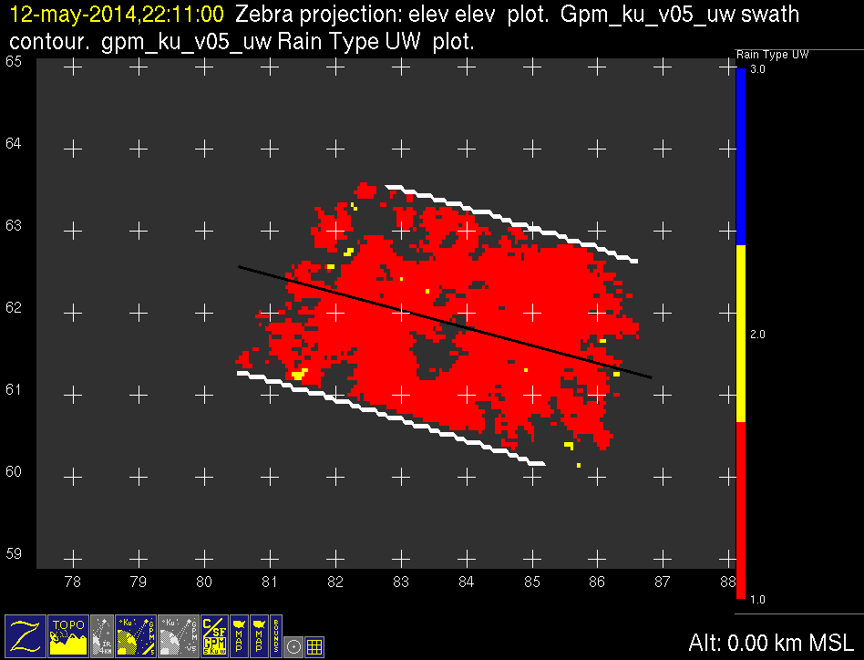
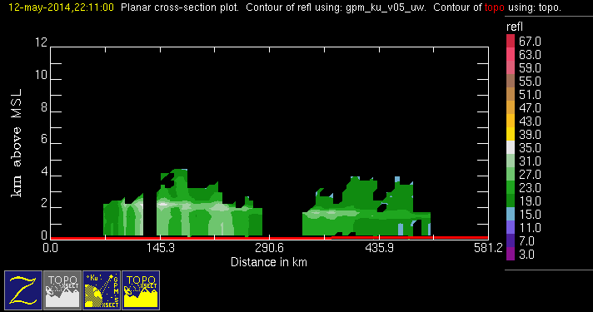
GPM 2Ku – BSR – 20140512 @ 221055
ASIA

Slide 15
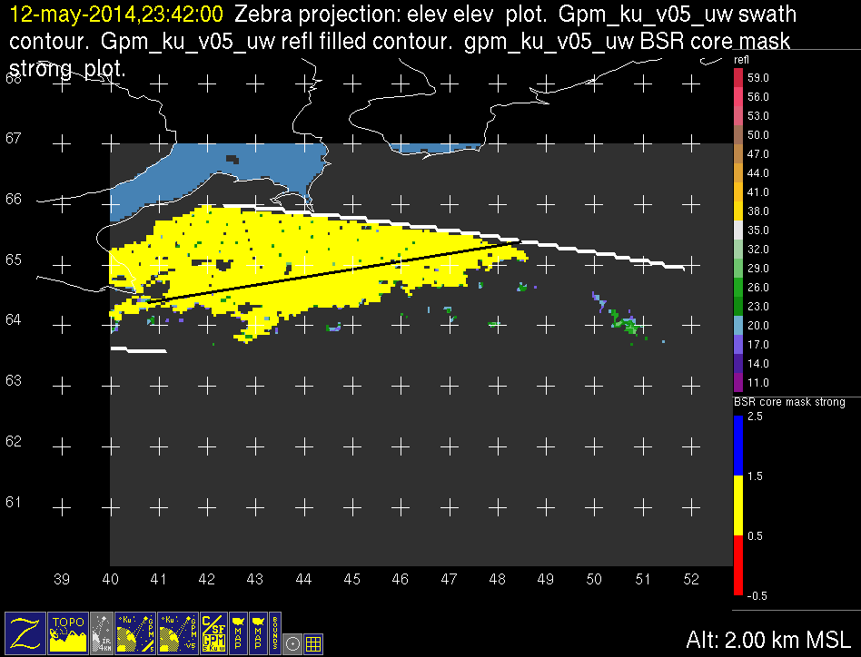
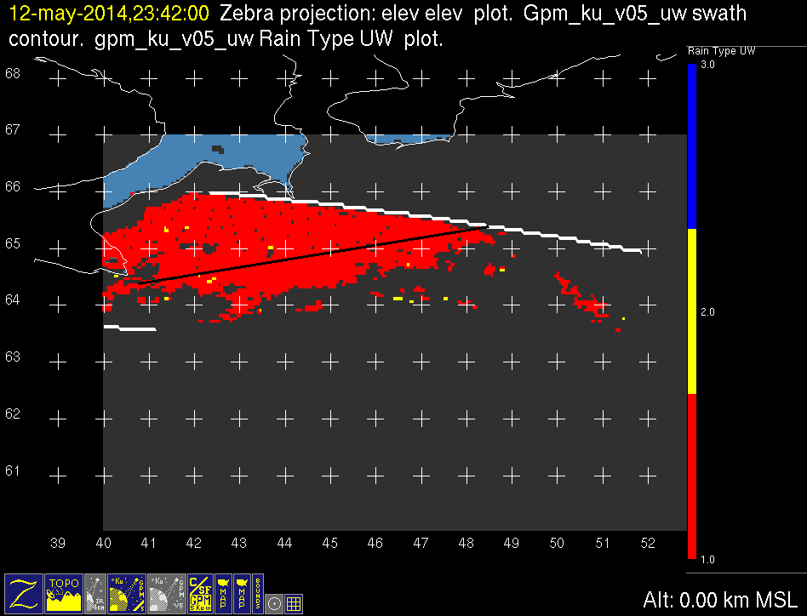
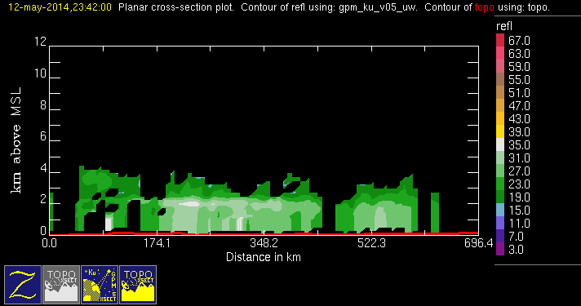
GPM 2Ku – BSR – 20140512 @ 234132
ASIA

Slide 16
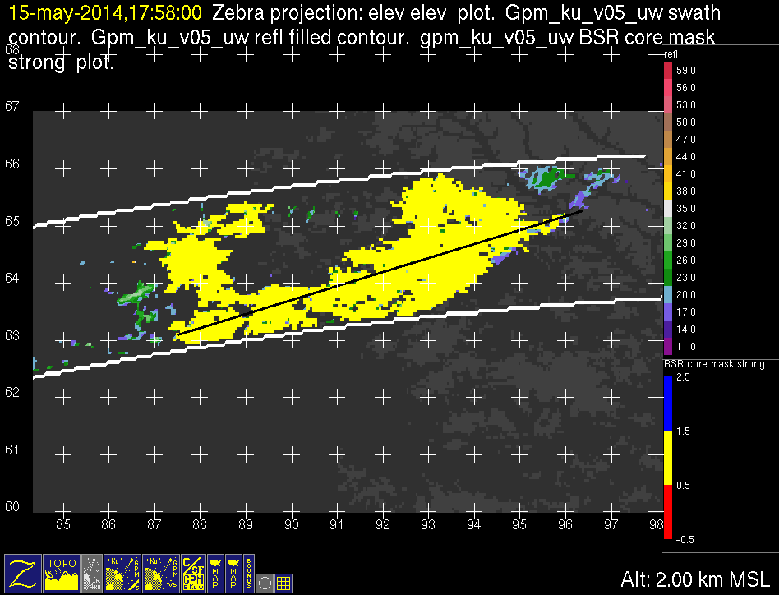
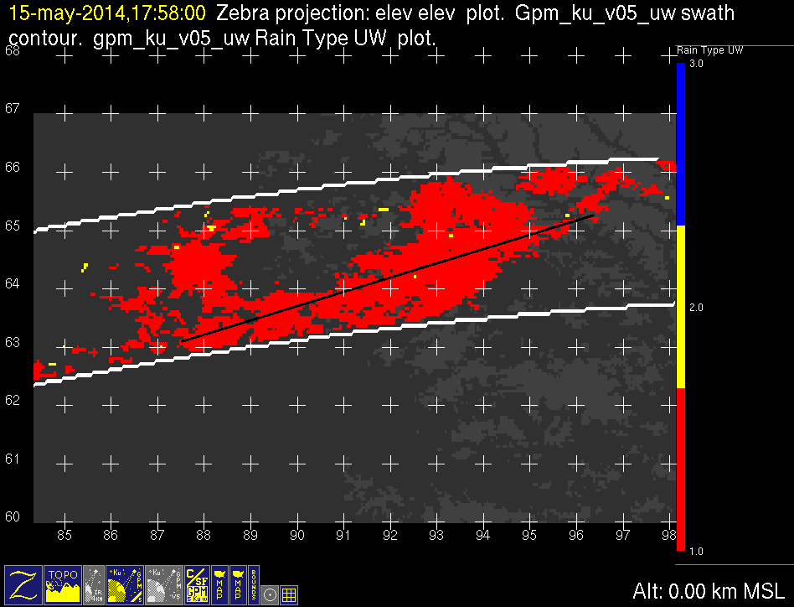
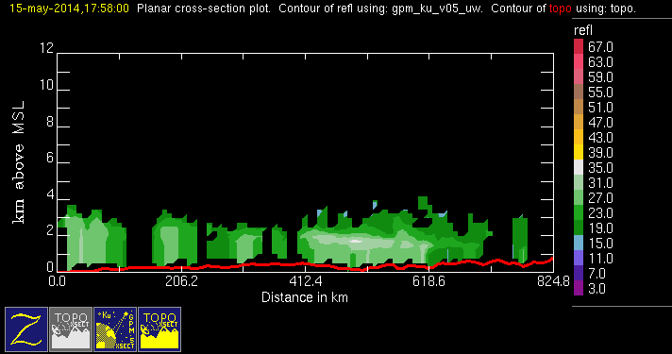
GPM 2Ku – BSR – 20140515 @ 175725
ASIA

Slide 17
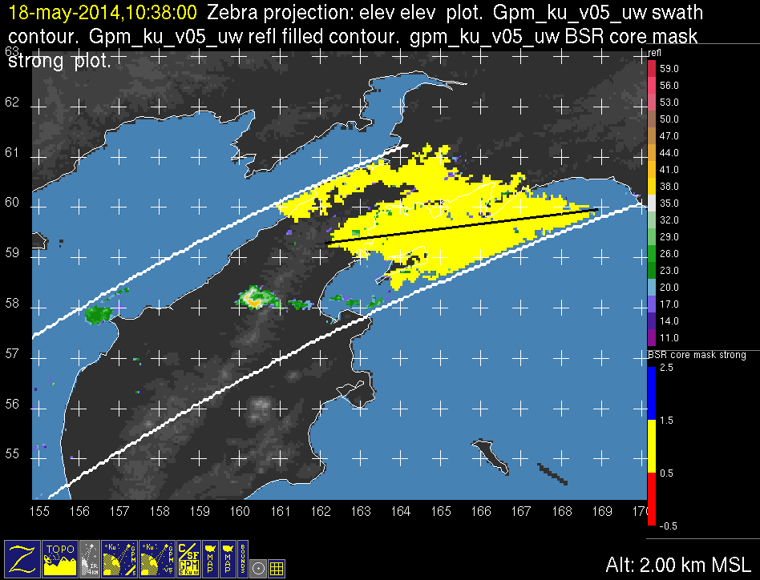
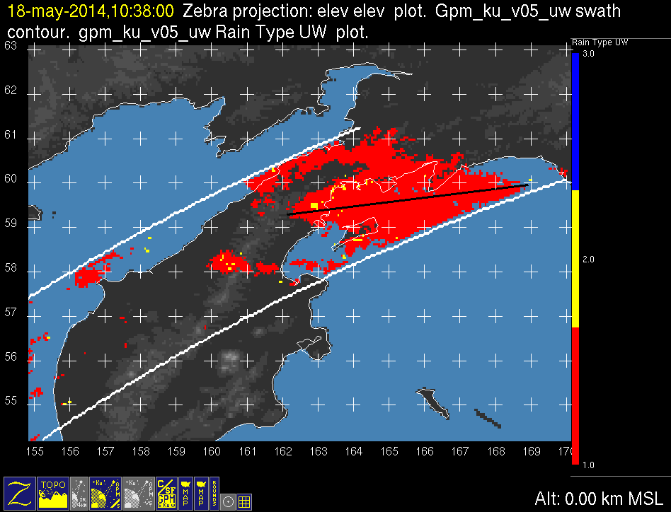

GPM 2Ku – BSR – 20140518 @ 103721
ASIA

Slide 18



GPM 2Ku – BSR – 20140519 @ 094804
ASIA

Slide 19



GPM 2Ku – BSR – 20140519 @ 143800
ASIA

Slide 20



GPM 2Ku – BSR – 20140524 @ 131241
ASIA

Slide 21



GPM 2Ku – BSR – 20140524 @ 180214
ASIA

Slide 22



GPM 2Ku – BSR – 20140409 @ 180628
NAM

Slide 23



GPM 2Ku – BSR – 20140521 @ 081509
NAM

Slide 24



GPM 2Ku – BSR – 20140531 @ 024140
NAM

Slide 25



GPM 2Ku – BSR – 20140602 @ 040645
NAM

Slide 26



GPM 2Ku – BSR – 20140602 @ 235918
NAM

Slide 27



GPM 2Ku – BSR – 20140603 @ 062258
NAM

Slide 28



GPM 2Ku – BSR – 20140604 @ 004242
NAM

Slide 29



GPM 2Ku – BSR – 20140604 @ 222331
NAM

Slide 30



GPM 2Ku – BSR – 20140604 @ 235801
NAM

Slide 31



GPM 2Ku – BSR – 20140606 @ 220555
NAM

Slide 32



GPM 2Ku – BSR – 20140607 @ 225328
NAM

Slide 33



GPM 2Ku – BSR – 20140608 @ 202655
NAM

Slide 34



GPM 2Ku – BSR – 20140608 @ 220357
NAM

Slide 35



GPM 2Ku – BSR – 20140614 @ 213259
NAM

Slide 36



GPM 2Ku – BSR – 20140703 @ 142528
NAM

Slide 37



GPM 2Ku – BSR – 20140707 @ 105502
NAM

Slide 38



GPM 2Ku – BSR – 20140707 @ 154032
NAM

Slide 39



GPM 2Ku – BSR – 20140710 @ 125730
NAM

Slide 40



GPM 2Ku – BSR – 20140710 @ 161101
NAM

Slide 41



GPM 2Ku – BSR – 20140710 @ 174421
NAM

Slide 42



GPM 2Ku – BSR – 20140712 @ 124909
NAM

Slide 43



GPM 2Ku – BSR – 20140712 @ 142549
NAM

Slide 44



GPM 2Ku – BSR – 20140712 @ 160014
NAM

Slide 45



GPM 2Ku – BSR – 20140719 @ 130431
NAM

Slide 46



GPM 2Ku – BSR – 20140722 @ 085052
NAM

Slide 47



GPM 2Ku – BSR – 20140722 @ 102712
NAM

Slide 48



GPM 2Ku – BSR – 20140806 @ 064637
NAM

Slide 49



GPM 2Ku – BSR – 20140807 @ 090336
NAM

Slide 50



GPM 2Ku – BSR – 20140807 @ 103520
NAM

Slide 51
GPM 2Ku – BSR – 20140712 @ 124909
NAM

