Slide 1

How Far Can the Intertropical
Convergence Zone (ITCZ) Shift?
How Useful Is the Concept of an ITCZ Shift?
Aaron Donohoe, Applied Physics Lab, UW
John Marshall, Brian Green, David McGee --MIT
David Ferreira – University of Reading
Dargan Frierson, Kyle Armour, David Battisti, Xioajuan Liu -- UW
Yen-Ting Hwang, National Taiwan University
Alyssa Atwood, UC Berkeley
Aiko Voigt– Columbia
Image: Wikipedia

Slide 2
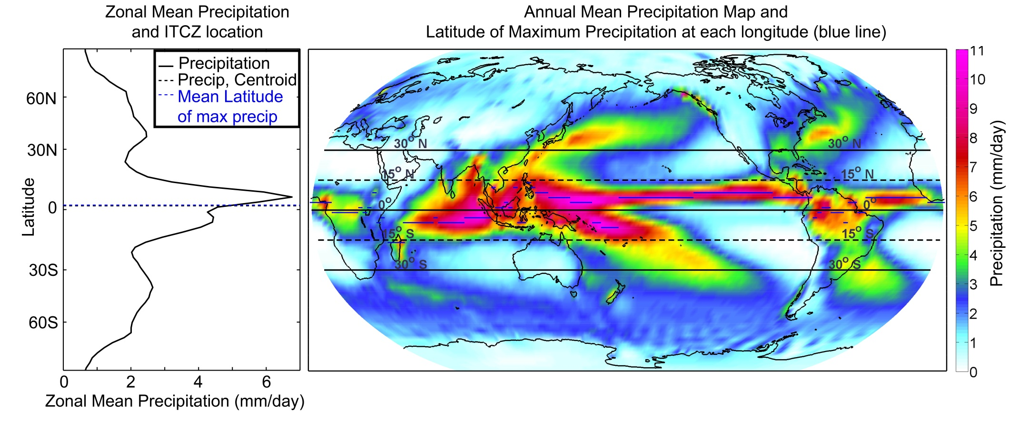
Annual mean precipitation
Noaa CPC merged analysis

Slide 3
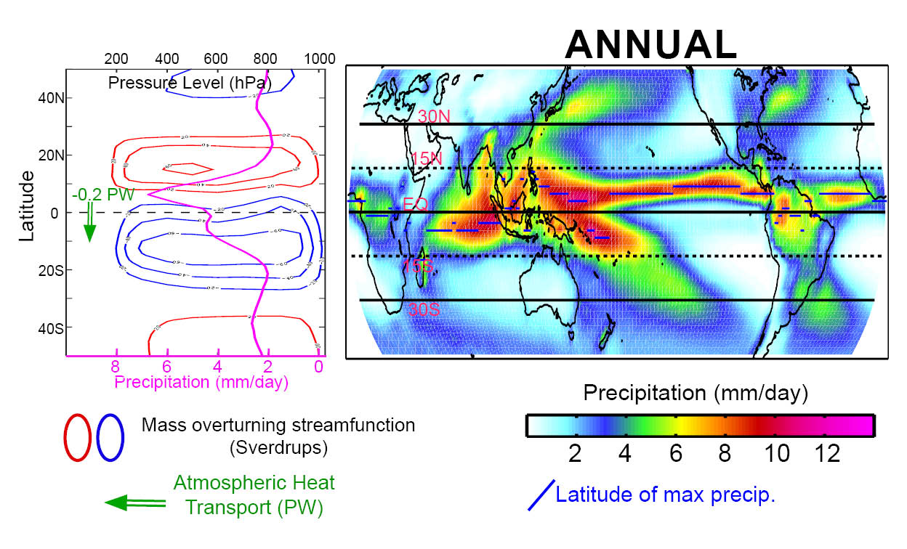
Dynamics perspective on ITCZ
ITCZ co-located with ascending branch of Hadley cell
Atmosphere exports energy in the upper branch of Hadley cell
Atmosphere fluxes energy (AHT_{EQ}) out of the hemisphere with the ITCZ

Slide 4
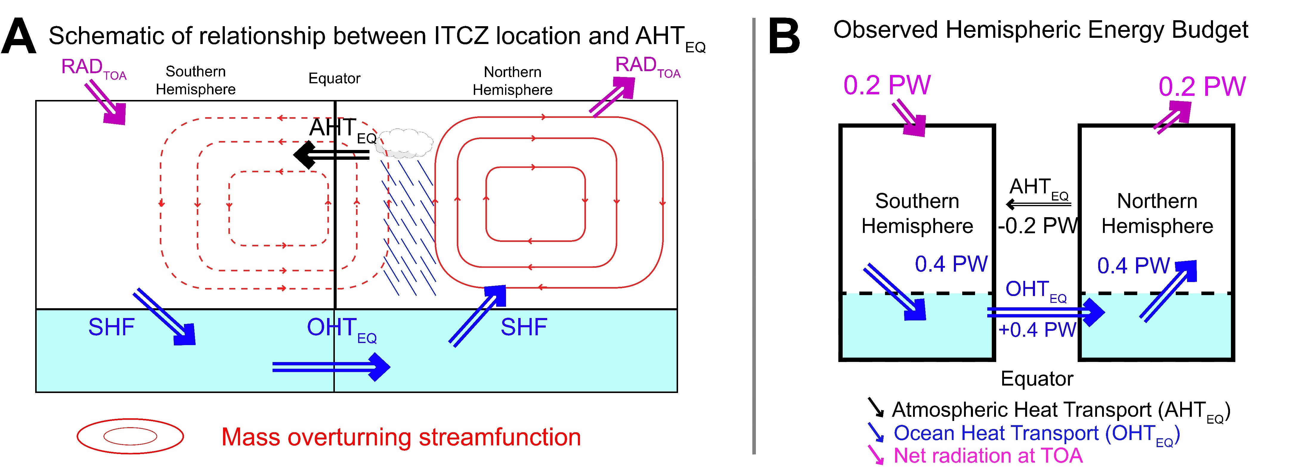
Dynamics perspective on ITCZ
Atmosphere moves energy away from the ITCZ
Hemisphere with the ITCZ exports energy
Therefore, ITCZ lives in the warmer hemisphere where the atmosphere is heated more strongly (by radiation or ocean heat transport)

Slide 5

Paleo perspective on ITCZ shifts
Assumption:
Changes in tropical precipitation are dominated by meridional shifts in the climatological annual mean precipitation
Approach:
Use concurrent paleo estimates of precipitation changes from locations North, South and within the ITCZ to infer past shifts of the ITCZ.
BUT WHAT IS THE MAGNITUDE OF SHIFTS?

Slide 6
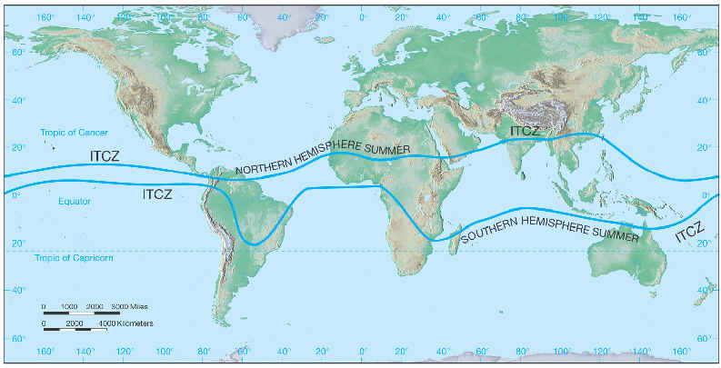
Paleo perspective on ITCZ shifts -- magnitude
Given the seasonal range of the ITCZ: if point B gets wetter and point A gets drier can we back out the magnitude of the ITCZ shift?
B
A
Glacial inter-glacial: > 4º Southward shift
Last glacial maximum: 7º Southward shift
Little Ice Age (1400-1850): 5º Southward shift
Northward during mid-Holocene: ??? º

Slide 7
Outline
How far can the ITCZ move?
--Energetic constraints from observational/model simulations (3º /PW)
--Magnitude of ITCZ changes under paleo forcing (Less than 1º)
--What determines the ITCZ sensitivity to external forcing
2. How useful is the concept of an ITCZ shift
--How much of precipitiation changes are explained by a translations of the ITCZ?

Slide 8
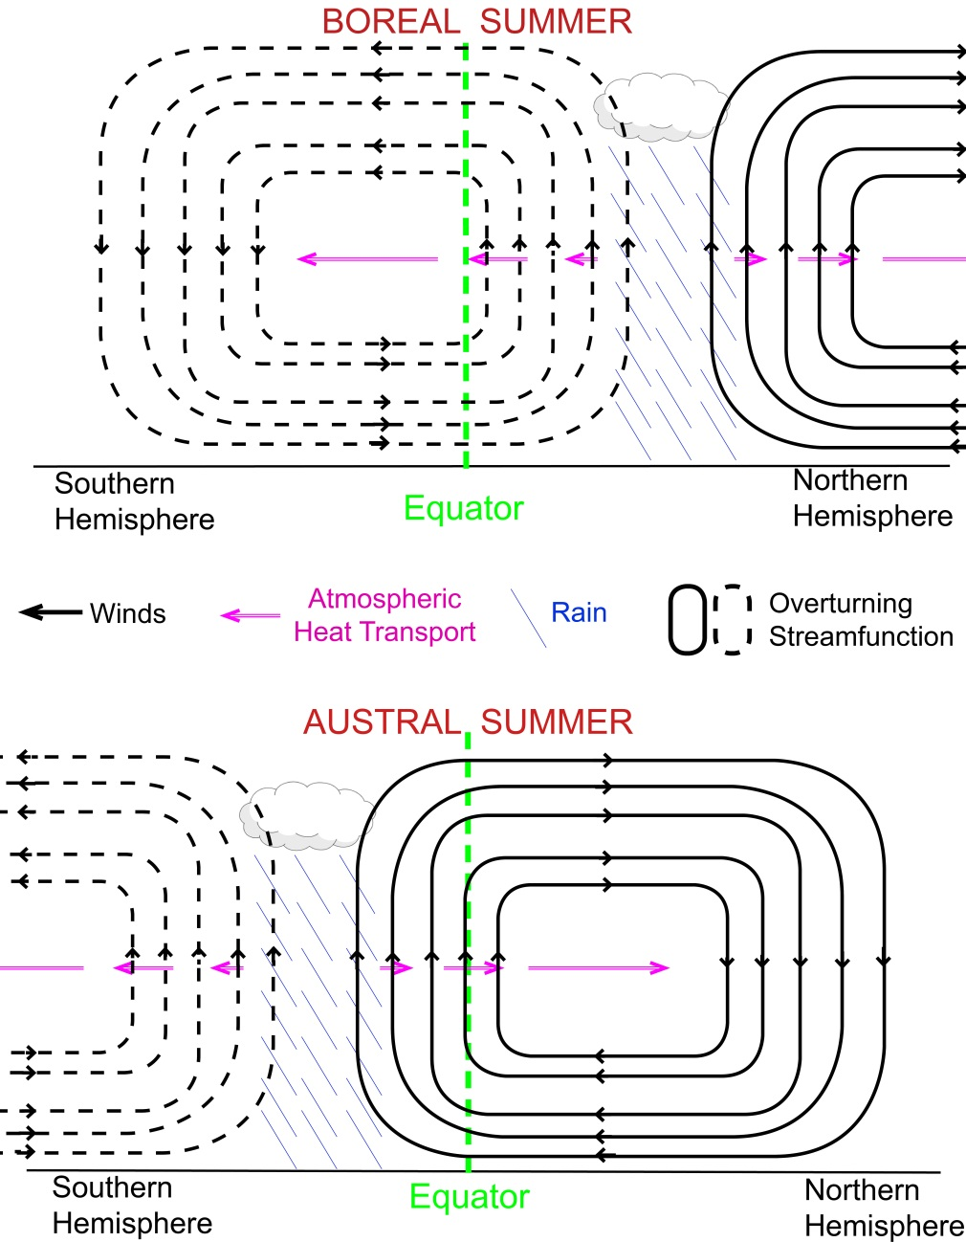
CLAIM: A 3 degree latitude shift in the ITCZ location requires 1 PW of atmospheric heat transport across the equator
1 PW (10¹⁵ W) is a lot of energy– equivalent to simultaneous doubling of CO₂ in on hemisphere and halving in the other
→ The zonal mean ITCZ location is relatively insensitive to external forcing and climate feedbacks
The above quantitative relationship follows from the seasonal relationship between ITCZ location and AHT_{EQ} because the seasonal cycle is large in magnitude as compared to any external forcing

Slide 9
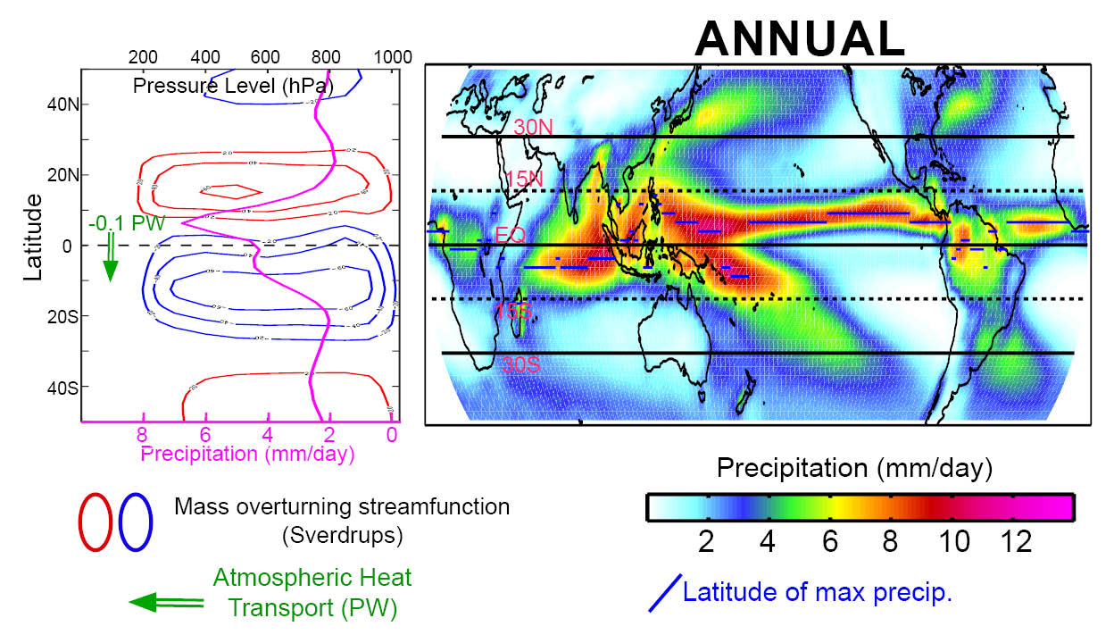
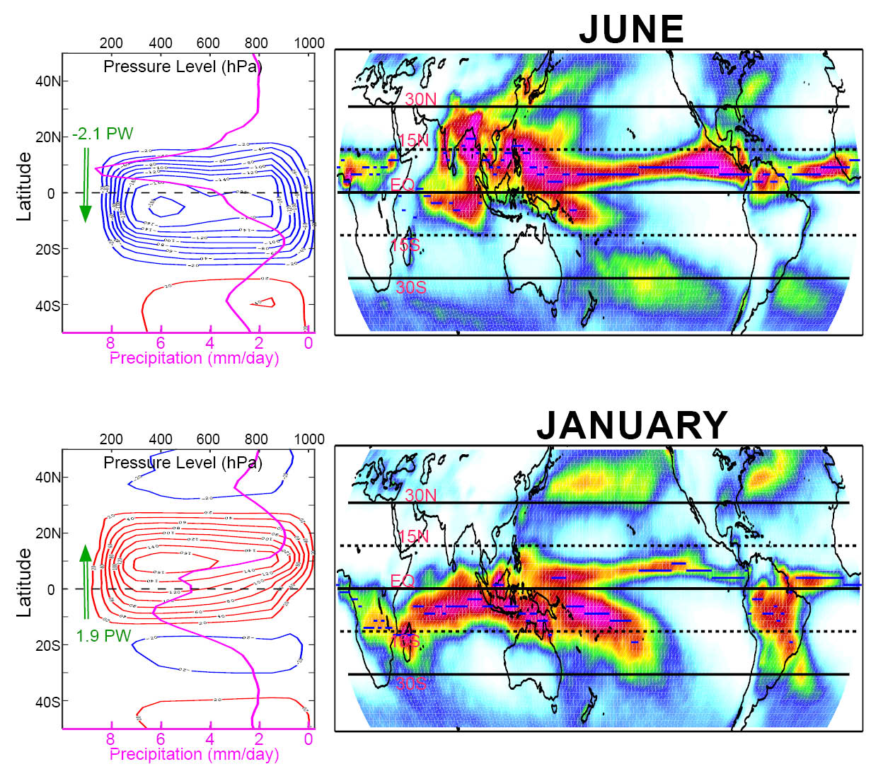
Annual mean precipitation, Hadley cell and atmospheric heat transport across the equator (AHT_{EQ)} is the small residual of large seasonal migrations
→ The annual mean is best characterized as the statistical average of a bi-modal system which is seldom realized.

Slide 10
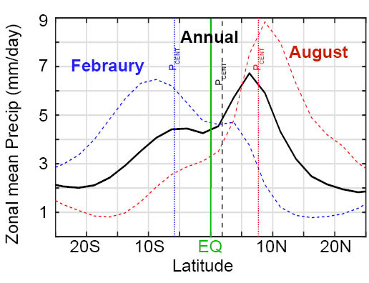
How to measure the position of the ITCZ?
We use the precipitation centroid (P_{CENT})– latitude which delineates regions of equal precipitation between 20S and 20N (Frierson and Hwang, 2012)
The annual mean precipitation and P_{CENT} and precipitation represents the small hemispheric asymmetry of large seasonal swings

Slide 11
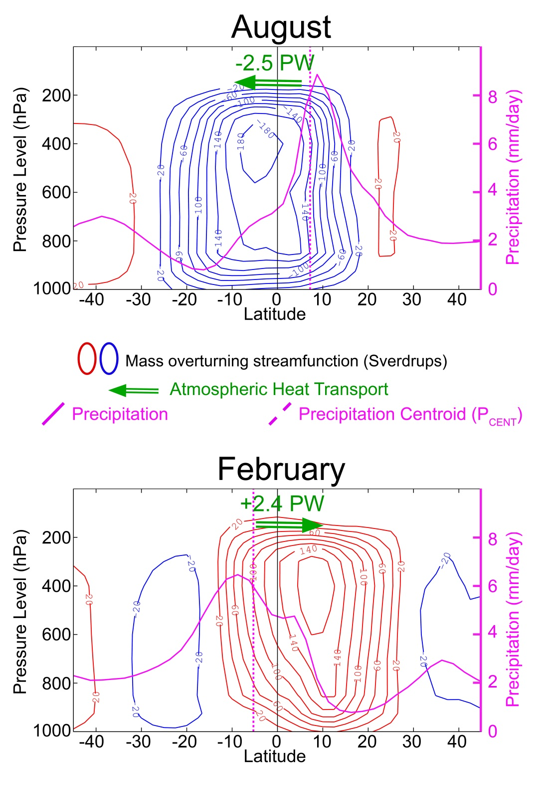
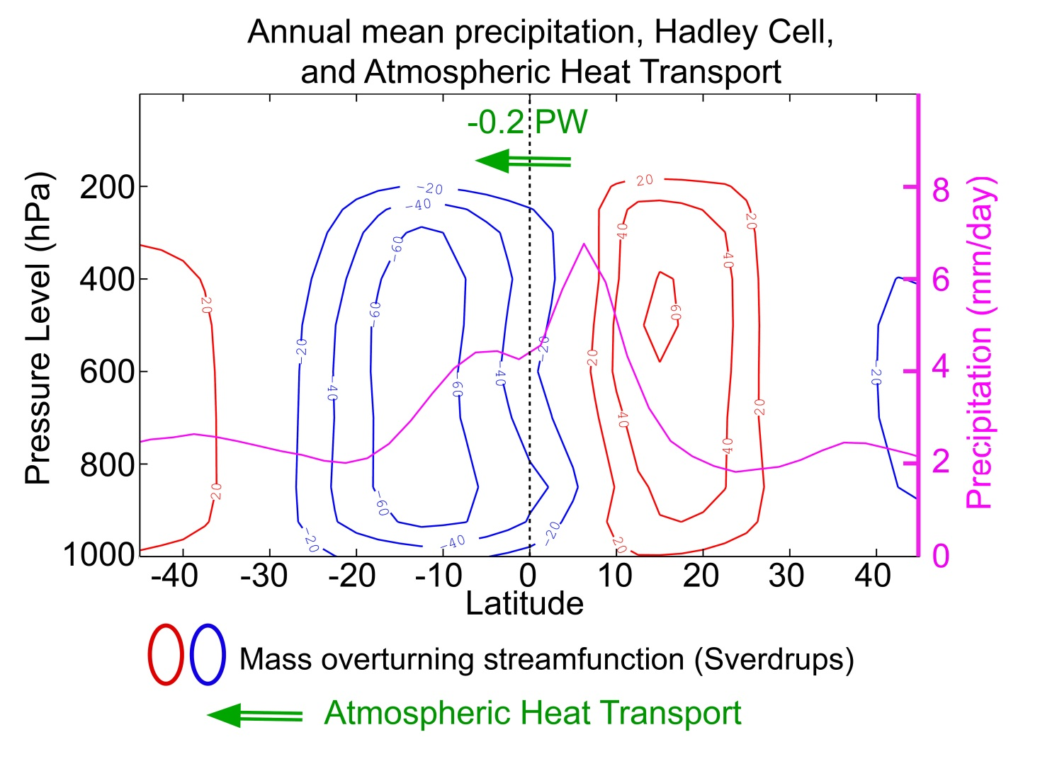
Annual mean is the small residual of large seasonal variations
Large amplitude asymmetry between the winter and summer Hadley cells
Precipitation maximum ( ) is clearly within the winter Hadley cell -- not where the streamfunction is zero– and is co-located with the maximum upward velocity (where the meridional gradient of the streamfunction is greatest)

Slide 12
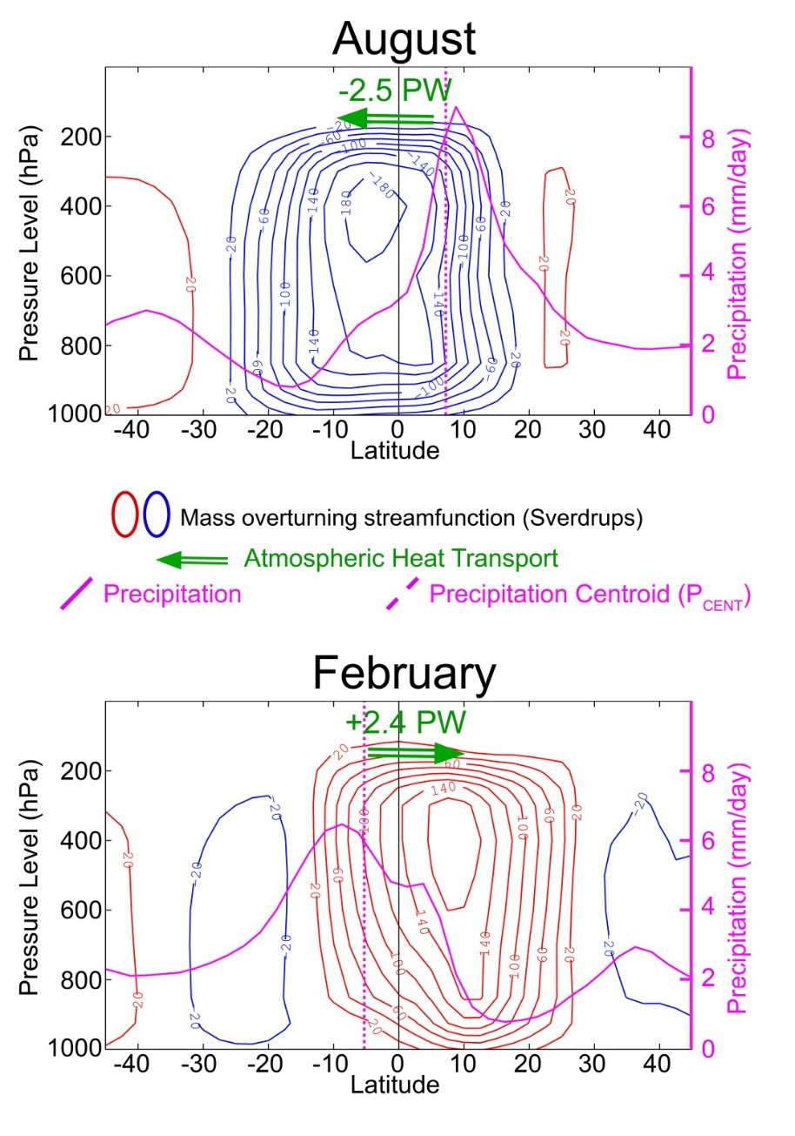
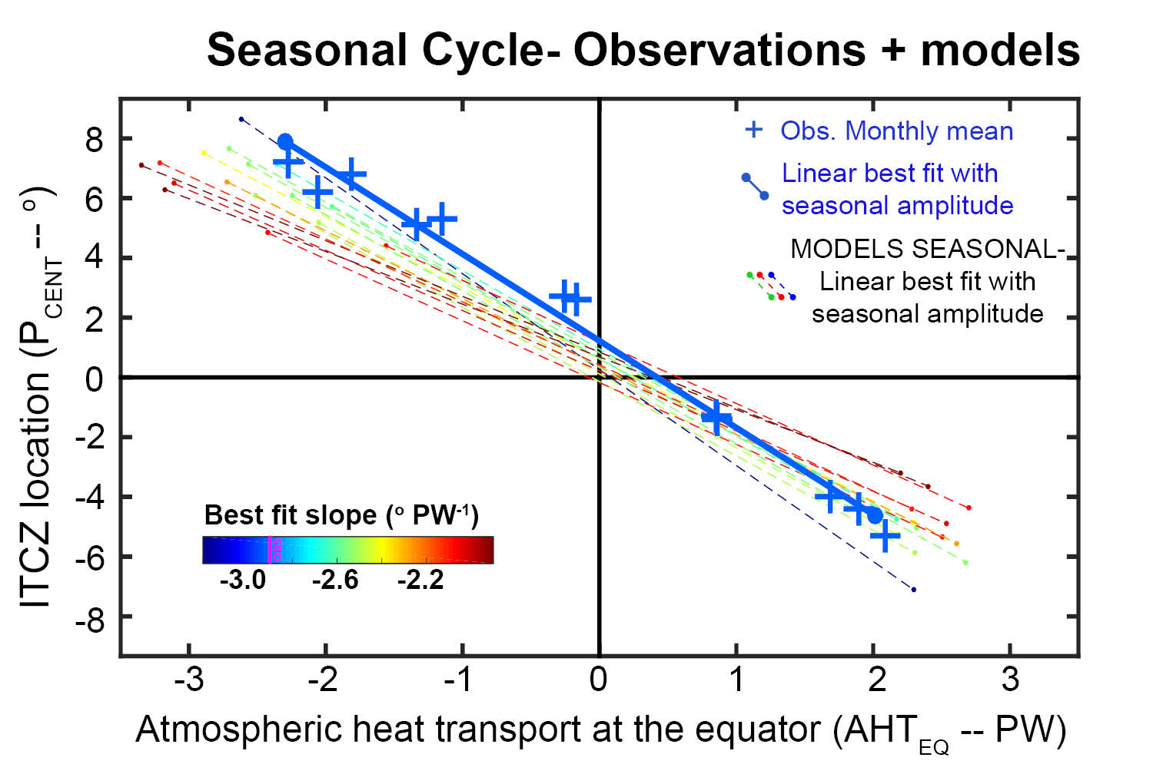
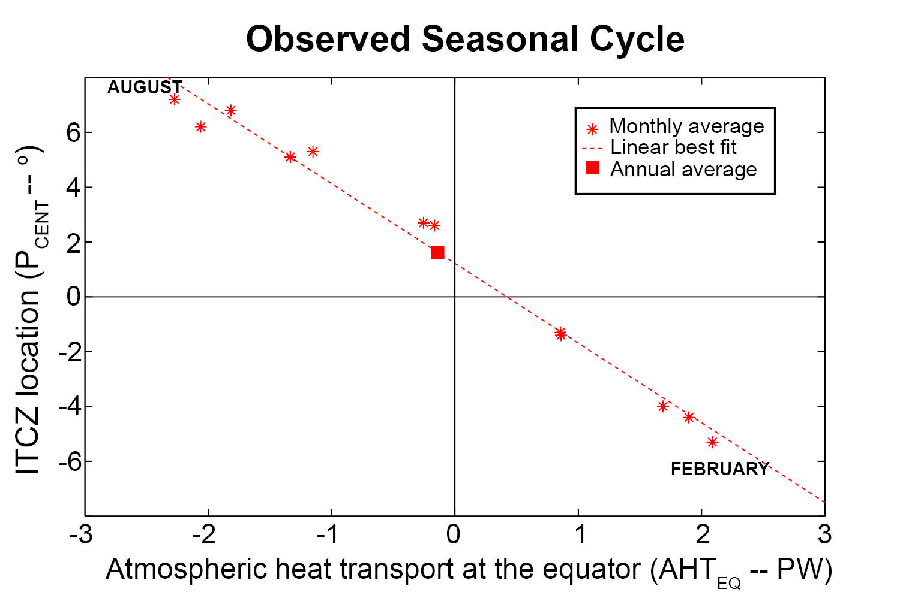
Seasonal cycle of AHT_{EQ} and ITCZ location
For each month, the ITCZ is defined as the precipitation centroid – P_{CENT}, the latitude where there is equal precipitation to the North and South (to 20º)
Heat transport from reanalysis
Slope is -2.7 +/-0.6 degree latitude per PW

Slide 13
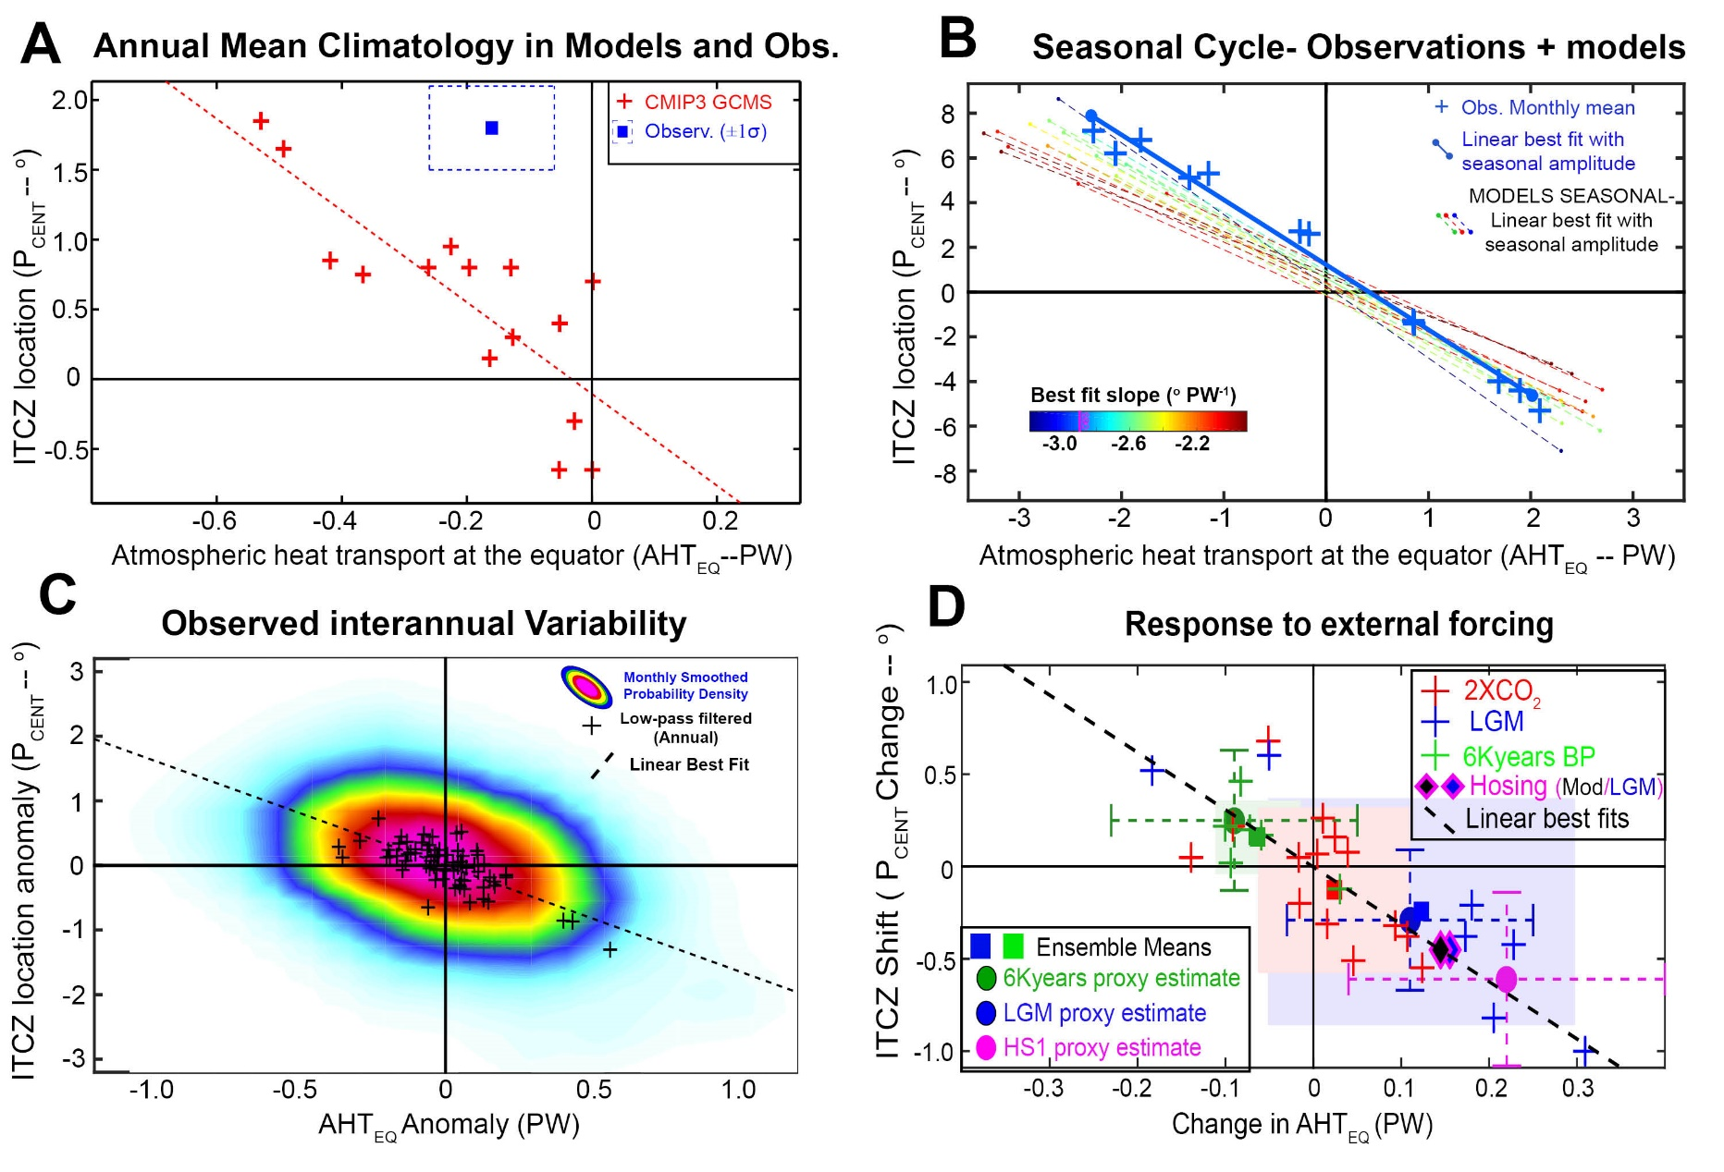
The order 3º latitude ITCZ shift per PW of inter-hemispheric energy transport is found to apply to:
Inter-model spread in climatological ITCZ position
Seasonal cycle in observations and models
Inter-annual (unforced) variability in observations and models
Annual mean response to external forcing (anthropogenic, paleo, idealized)

Slide 14
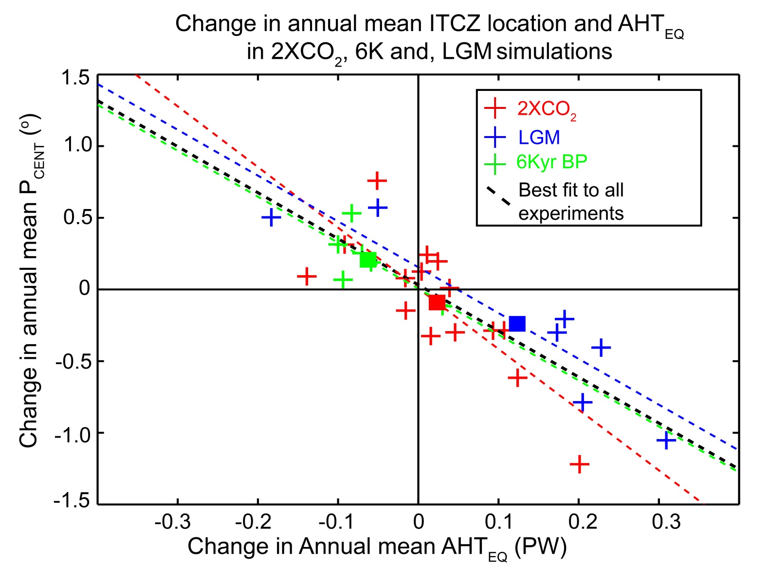
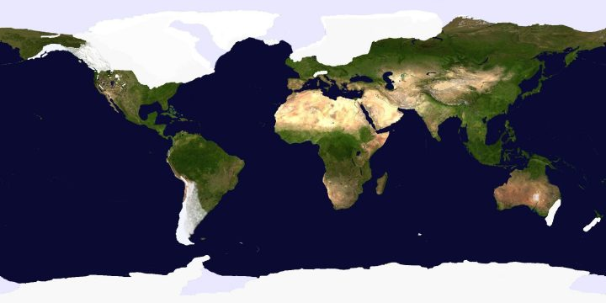
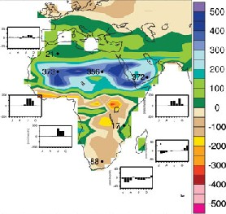
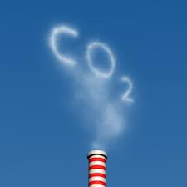
Last Glacial Maximum (LGM)
Credit: Robert Johnson
Mid Holocene (6Kyear BP)
Martini and Chesworth
CO₂ Doubling
Ensemble mean of each experiment
Slope of -3.2 degrees latitude per PW

Slide 15
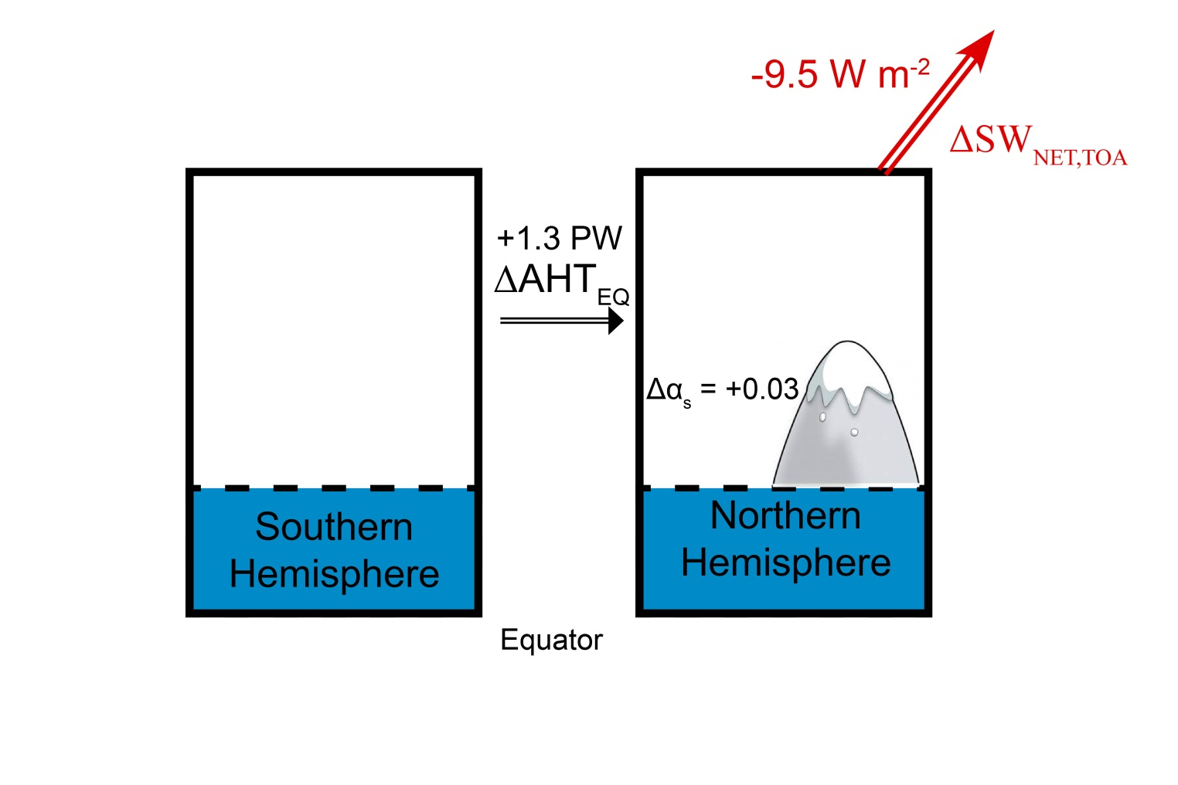
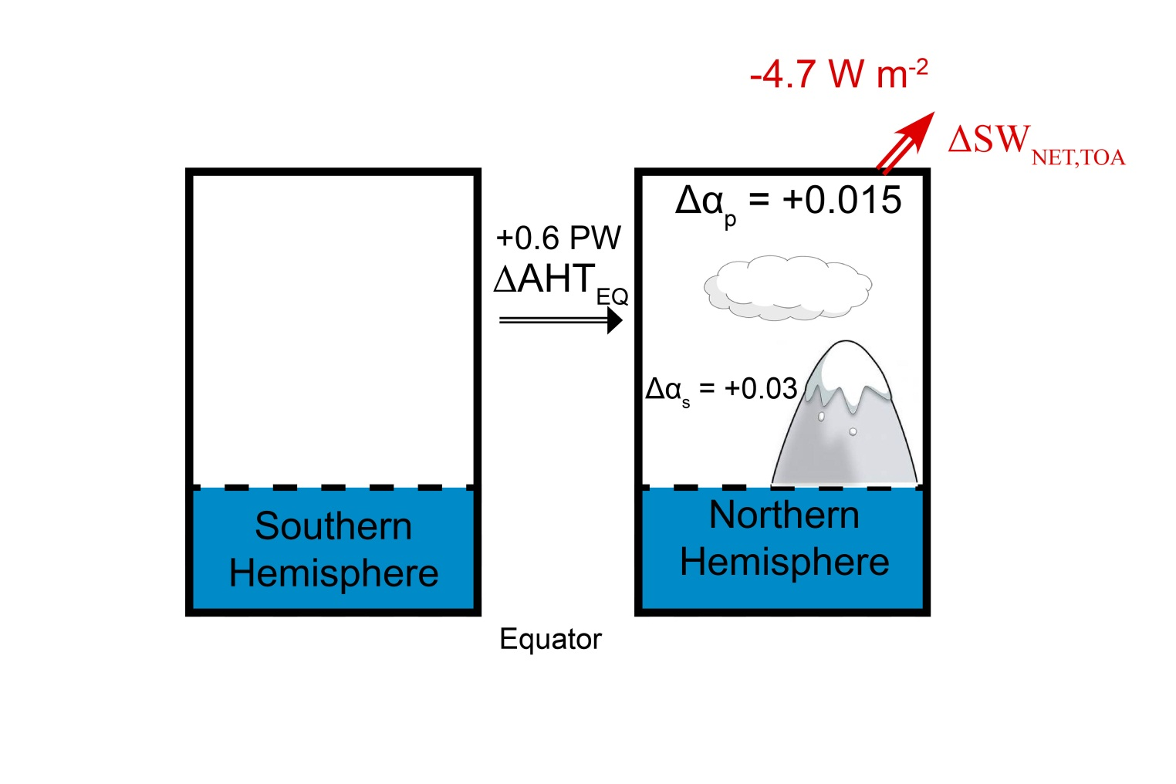



LGM Energetics
AHT_{EQ} change
By processes included :
Surface albedo only:
1.3 PW
Atmospheric SW opacity:
0.6 PW
SW cloud feedback :
0.43 PW
Planck (OLR) Feedback :
0.11 PW
OHT change:
0.12 PW

Slide 16
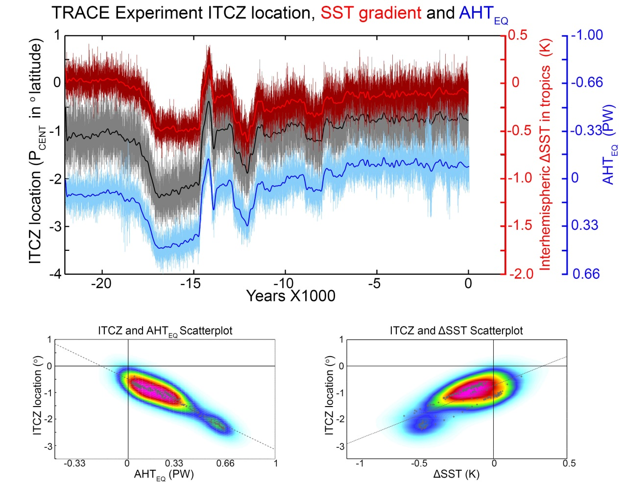
Transient climate simulation of the last 21,000 years in CCSM3 – TRACE (Feng He)
Forcings:
Solar (orbital)
Greenhouse gases
Prescribed Ice sheets (time varying – ICE 5G)
Freshwater forcing (Heinrich 1, Bølling-Allerød and Younger Dryas)
HS1
LGM
BA

Slide 17
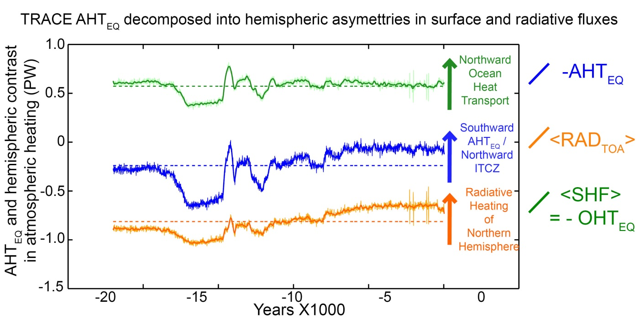
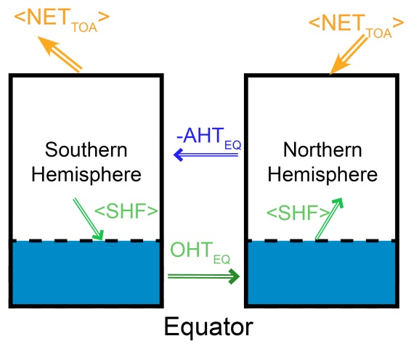
Cause of AHT_{EQ} changes from the glacial to present day– TRACE simulation
Radiative forcing of ice sheets drives trend from LGM to modern
Changes in ocean circulation strength drive more rapid transitions
Mean state OHTEQ in the Atlantic meridional Circulation is ≈ 0.6 PW
Complete AMOC shutdown gives
0.6 PW* 3º /PW
≈ 2º Southward ITCZ shift

Slide 18
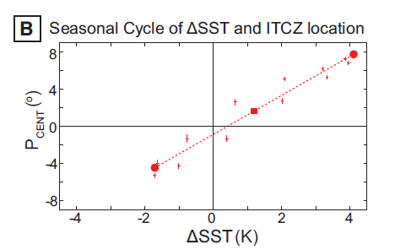
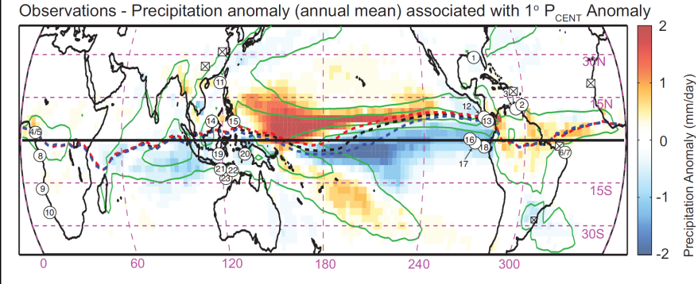
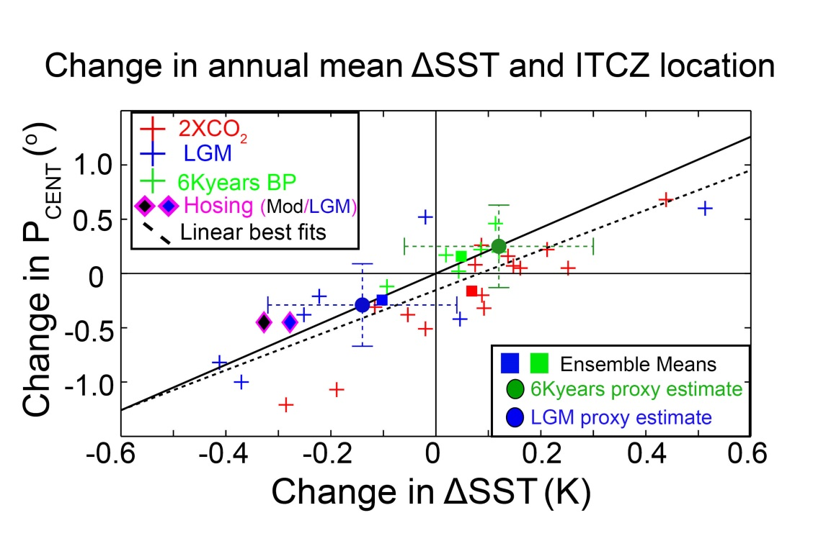
Use SST gradient to reconstruct ITCZ location and AHT_{EQ}
2º latitude ITCZ shift per 1K
Marine Sediment Core SST proxies
The magnitude of SST gradients and implied ITCZ shifts deduced from the paleo records are consistent with the changes
in model simulations
In the LGM and mid-Holocene
McGee, Donohoe, Marshall and Ferreira, EPSL (2013)

Slide 19
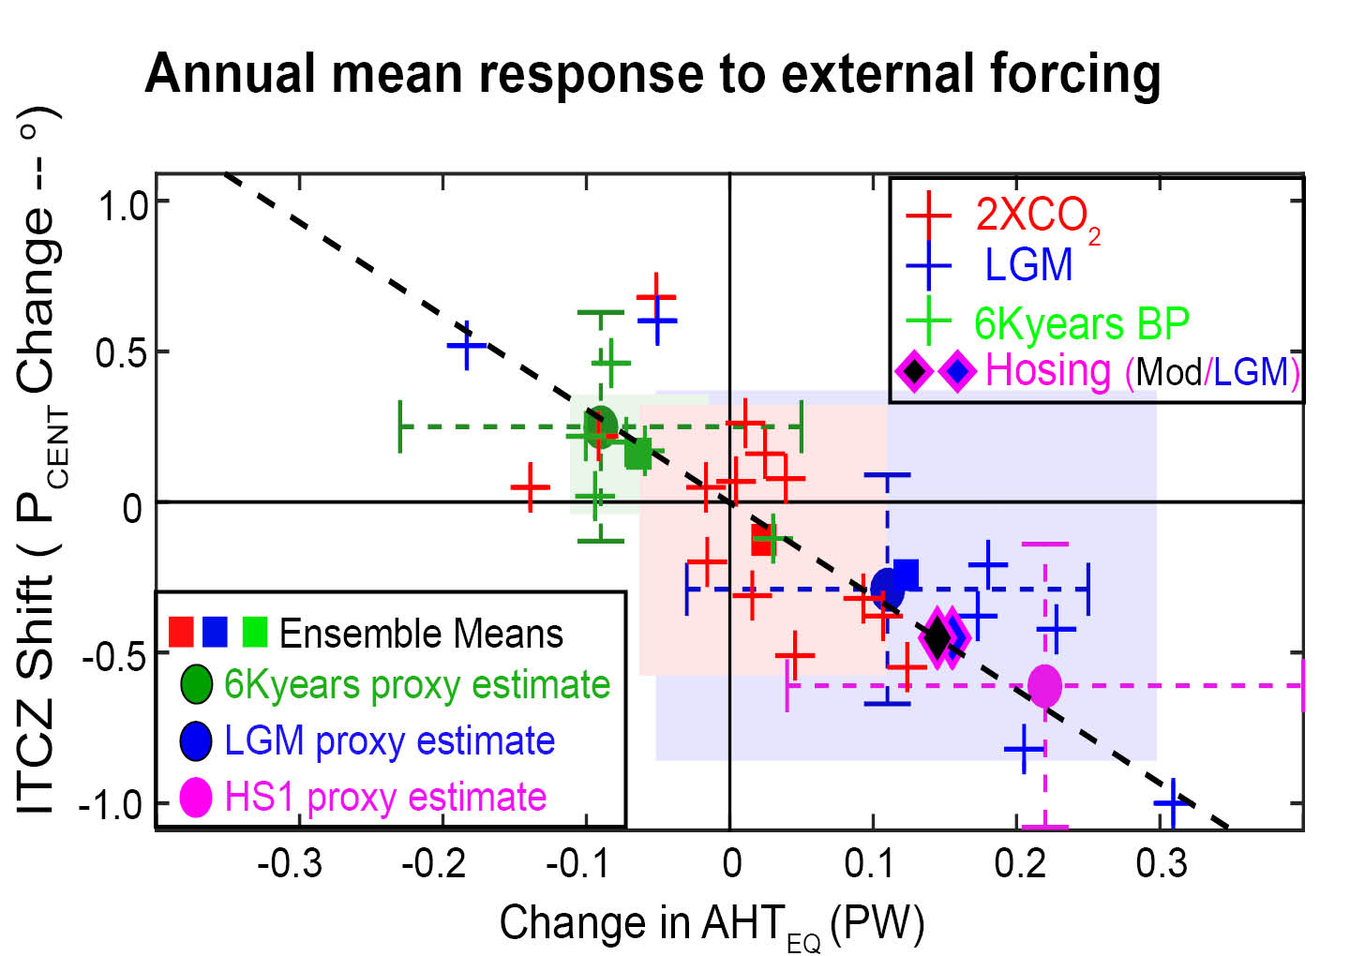
Energetic constraints, model simulations and paleoproxy records all suggest that ITCZ shifts are small (< 1⁰ latitude)

Slide 20
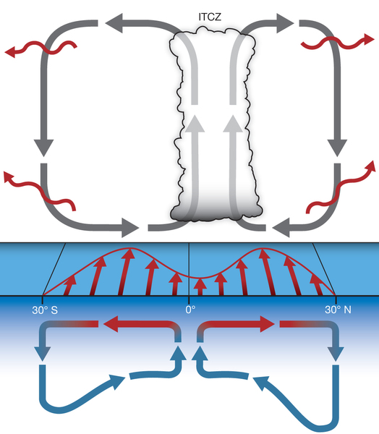
CLAIM: Ocean coupling makes the ITCZ less sensitive to external forcing (Brian Green, MIT)
IDEA: Mass transport (Ekman drift) of the surface atmosphere and oceanare equal in magnitude and in the opposite direction since they RESPOND TO THE SAME WIND STRESS
→the wind driven oceanic overturning circulation is in the same sense as the Hadley cell and comparable in magnitude
→ Ocean and atmosphere both transport energy in the same direction in the deep tropics
→ This will be true in the perturbation sense
Atmosphere
Surface
Winds
Ocean
(wind driven)
Schneider et al. 2014

Slide 21
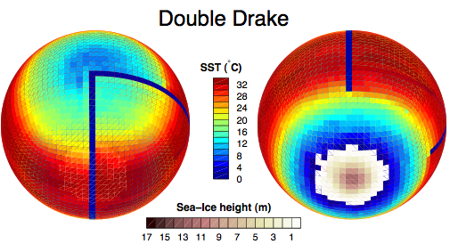
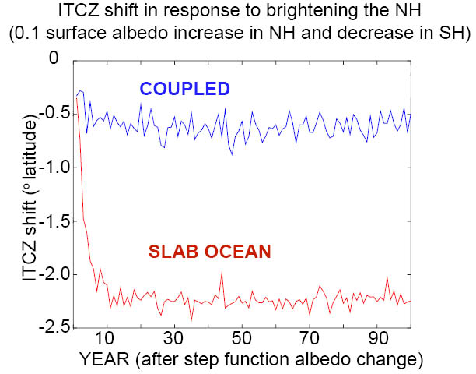
CLAIM: Ocean coupling makes the ITCZ less sensitive to external forcing (Brian Green, MIT)
SETUP:
MIT aquaplanet GCM in “Double Drake” configuration
Dargan’s gray radiation
Step function surface albedo change –
Brighten NH, Darken SH
In response to hemispheric contrast in surface albedo change:
ITCZ shifts 3.7 times farther in a slab ocean (uncoupled) setting as compared to the coupled setting
Consistent with idea that ocean and atmosphere work together to move energy across the equator

Slide 22
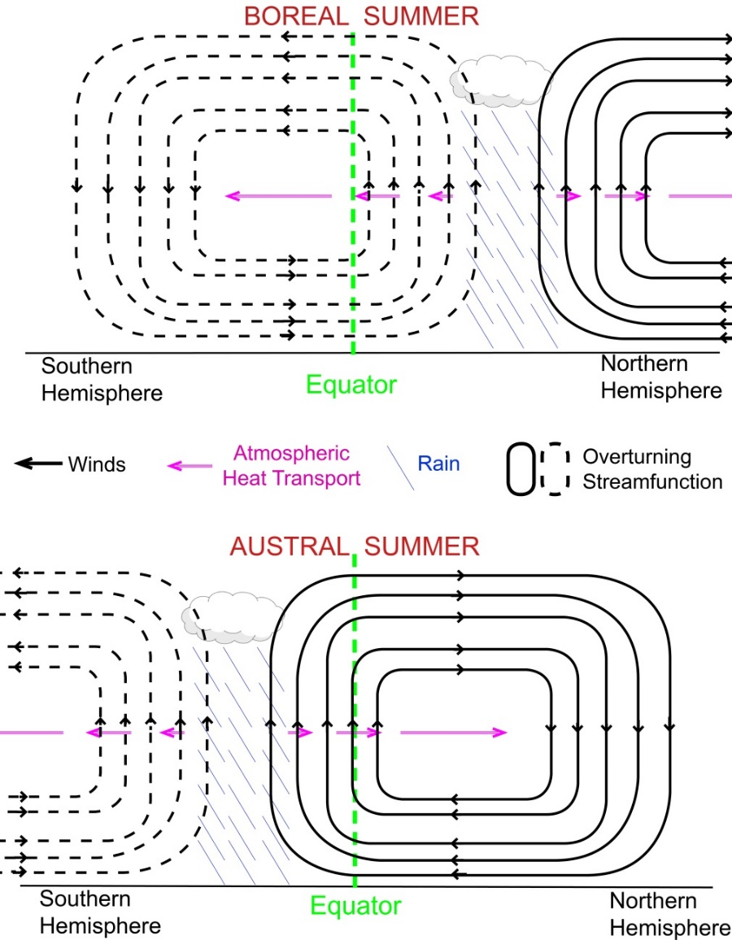
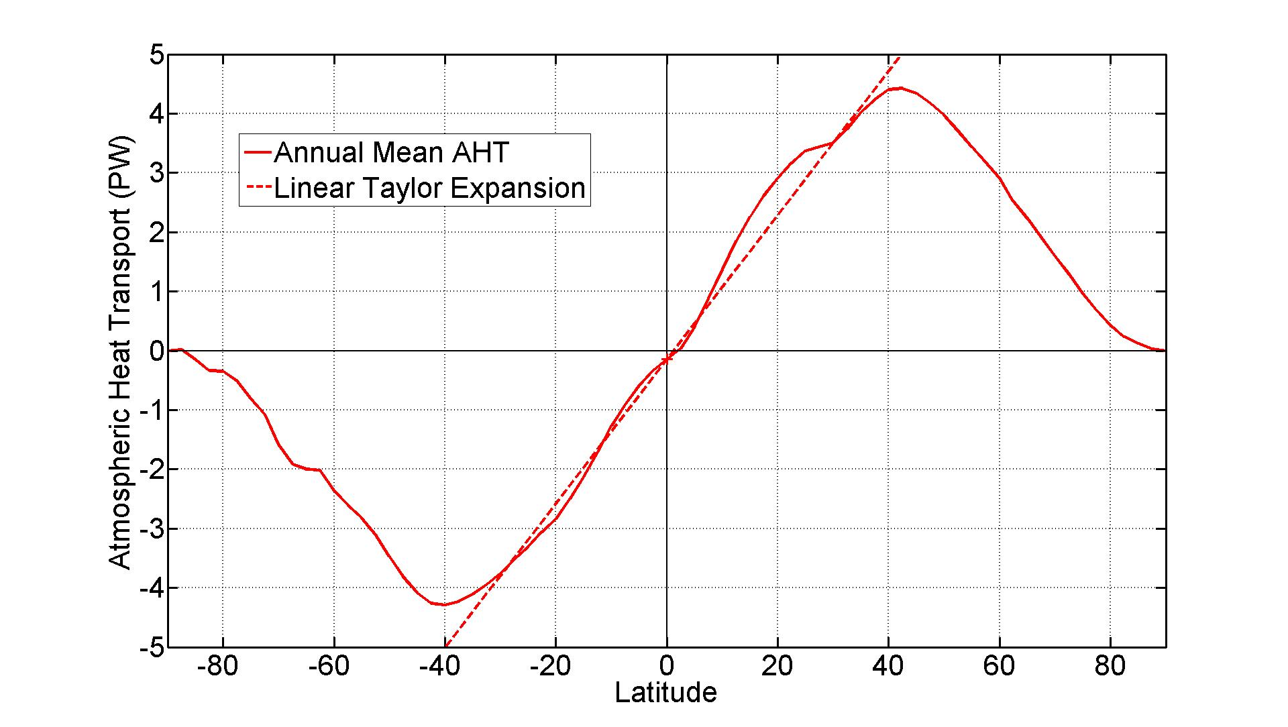
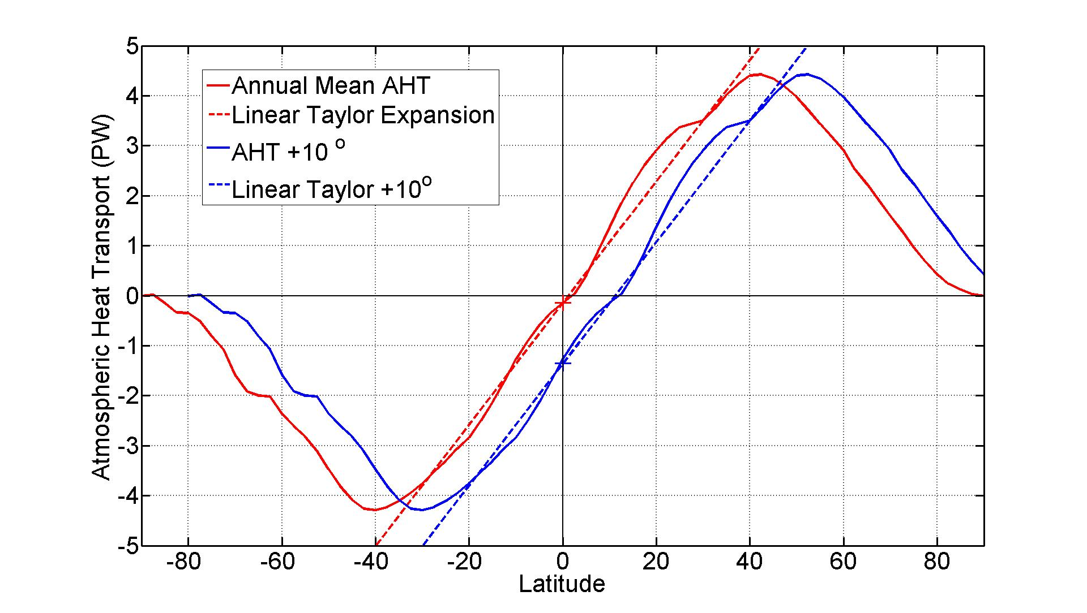
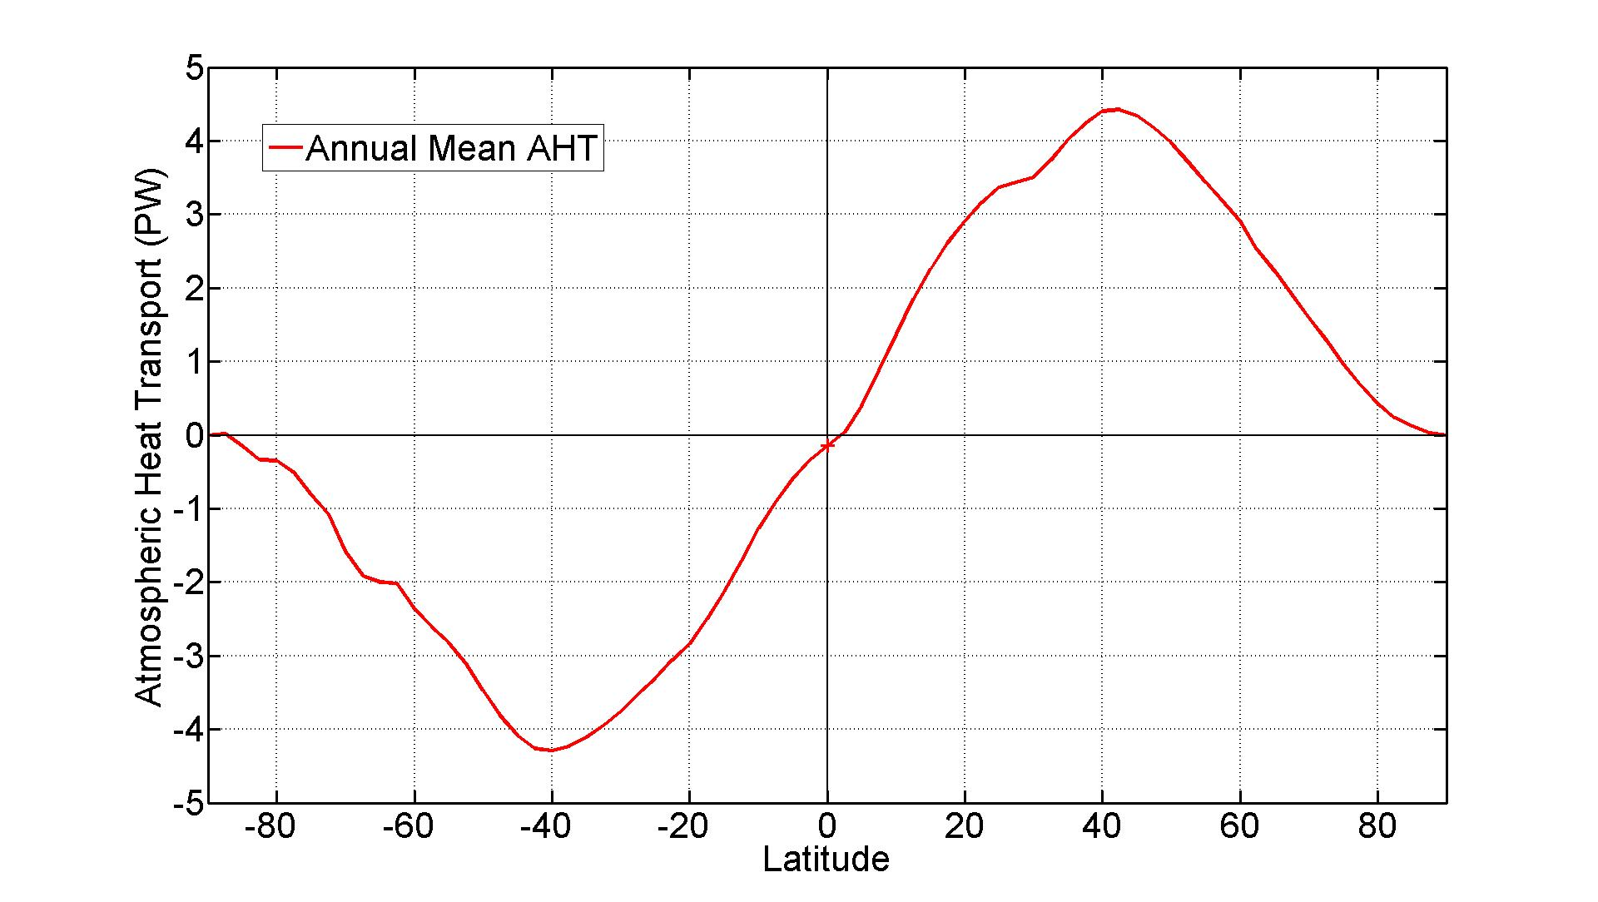
What sets the relationship between ITCZ location and AHT_{EQ}?
=
( )⁻¹
10º
PW
If the Hadley cell and ITCZ were
meridionally translated (together)
d (ITCZ)
=
d (AHT)
d (AHT_{EQ})
d (latitude)
Annual Mean Atmospheric Heat Transport

Slide 23
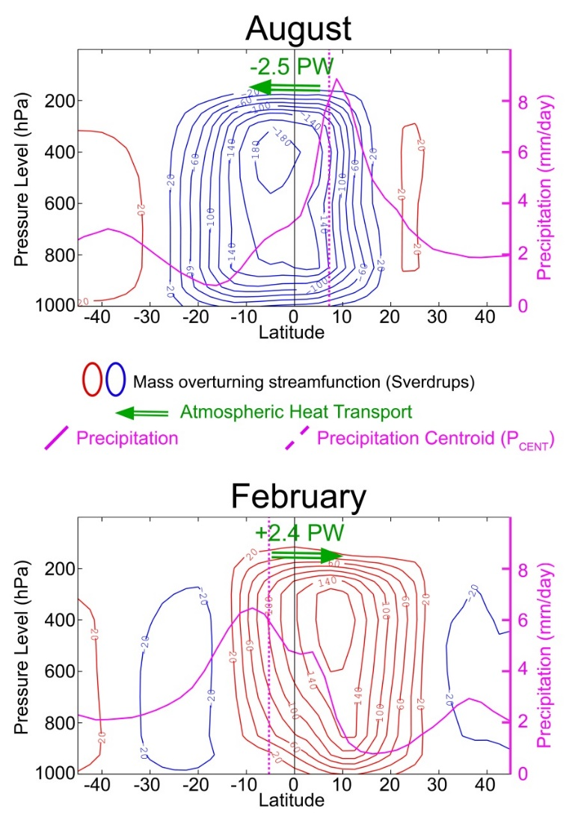
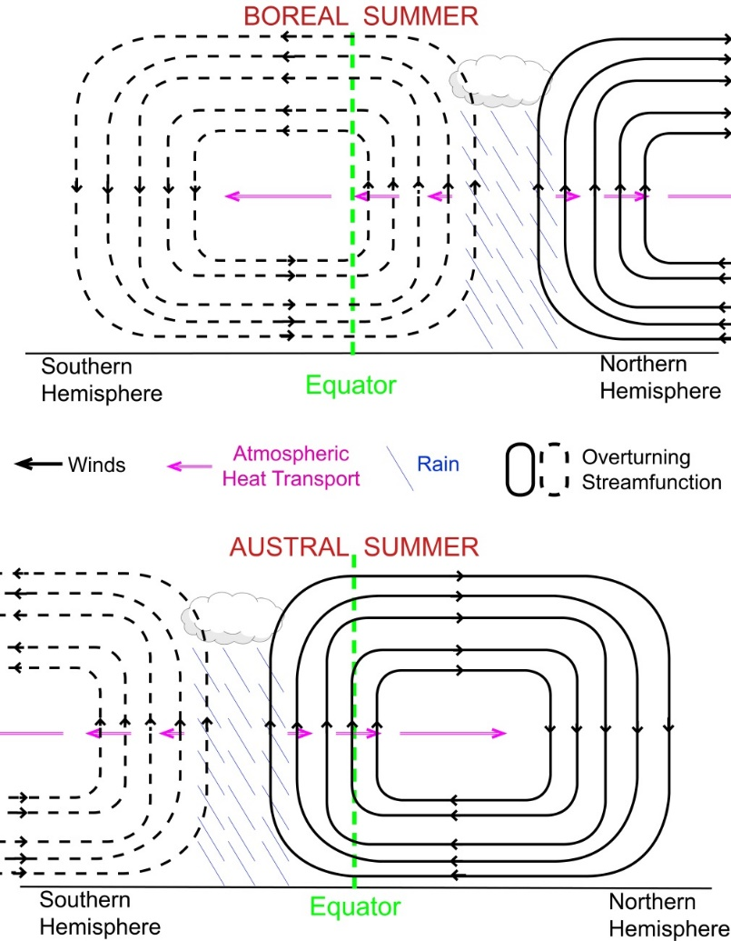
Idealized seasonal cycle
Pure translation
Reality: Intensification of winter cell
Linearization about annual mean doesn’t work because:
ITCZ moves less than the Hadley cell (Energy flux equator)
Winter cell intensifies as Hadley cell moves off the equator
Net result; ITCZ moves less and AHT_{EQ} changes more than expected from translation
<
10º
PW
d (ITCZ)
d (AHT_{EQ})

Slide 24
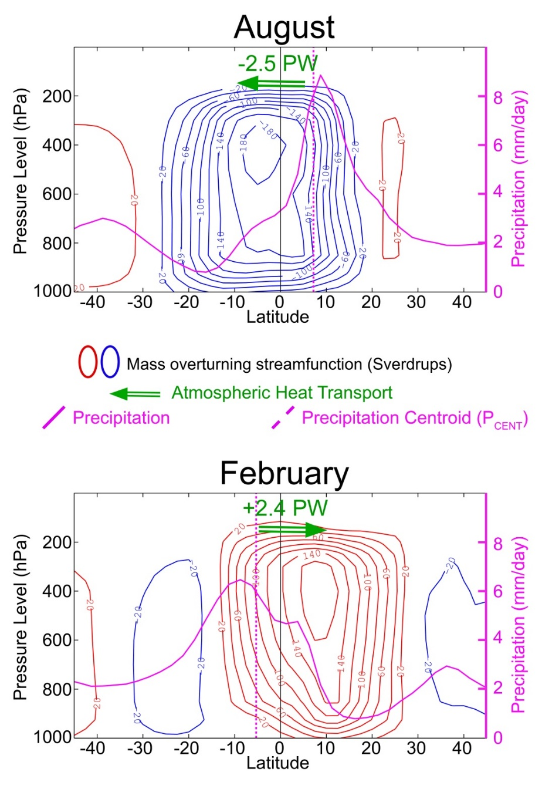
The ITCZ moves less than the Hadley Cell (energy flux equator)

Slide 25
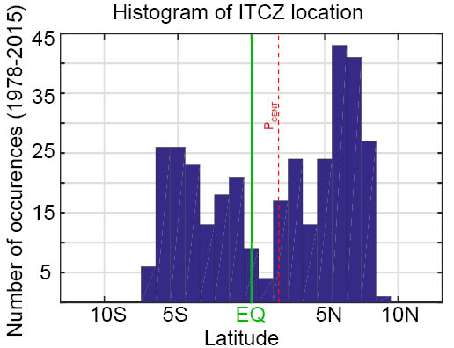
Summary so far:
ITCZ is relatively insensitive to external forcing (3⁰ /PW)
→ITCZ can’t move much even with substantial forcing
(i.e. Ice sheets, AMOC shutdown)
Pure translation of annual mean ITCZ and Hadley cell imply a much larger ITCZ sensitivity to external forcing (10⁰ /PW)
Important reasons why the seasonal cycle does not follow the above scaling: winter Hadley cell intensifies and ITCZ is located within the Hadley cell
Why do long term shifts in the ITCZ conform to the seasonal relationship (3⁰ /PW) ?

Slide 26
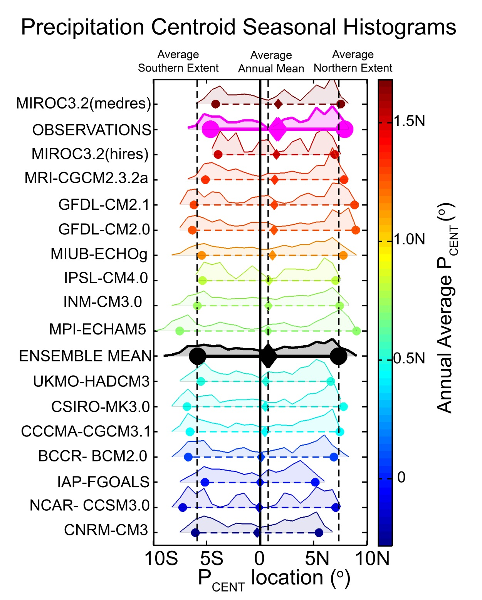
Bi-modality of ITCZ and the meaning of the annual mean ITCZ location
The annual average is seldom realized
Seasonal extremes set the annual average

Slide 27
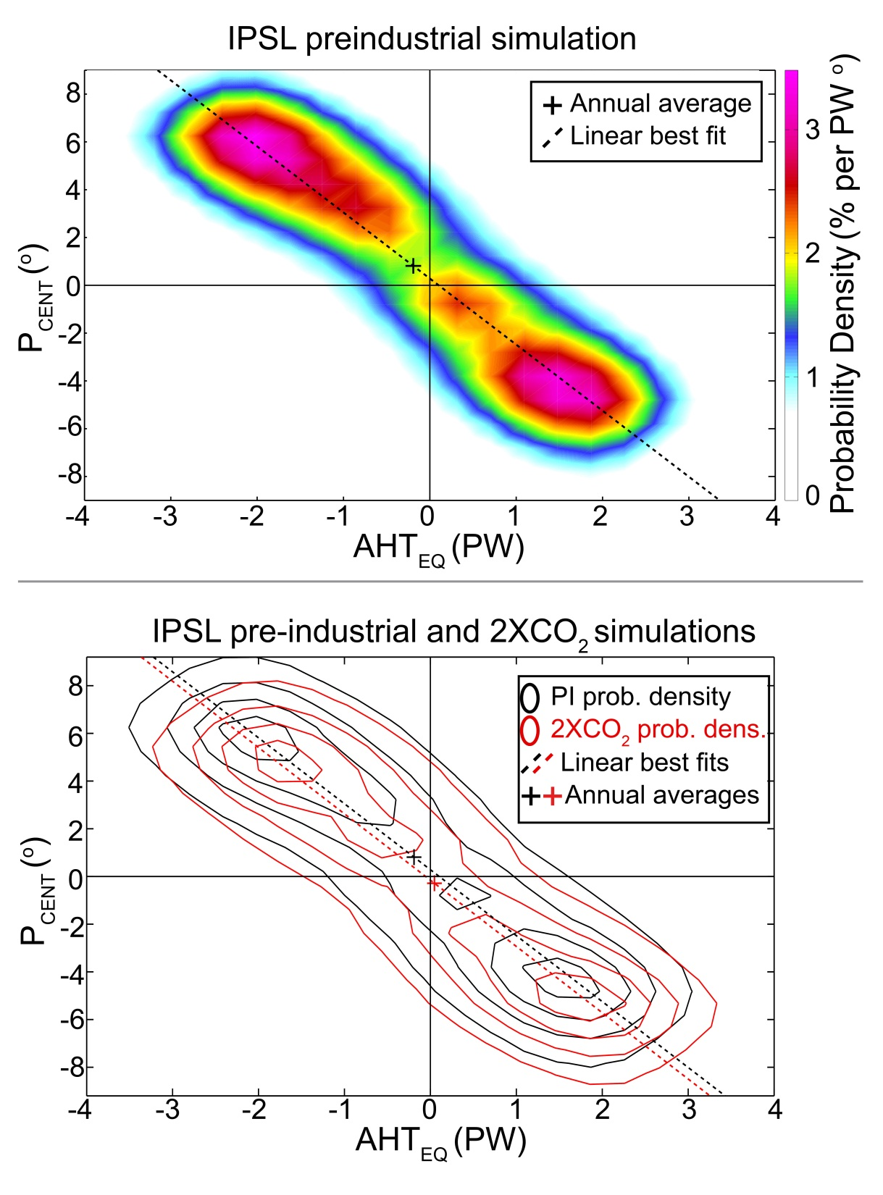
Why is the seasonal relationship between ITCZ location and AHT_{EQ} realized in the (annual mean) perturbation experiments?
The annual mean is the statistical average between alternating extremes and therefore must shift along the line connecting the extremes

Slide 28
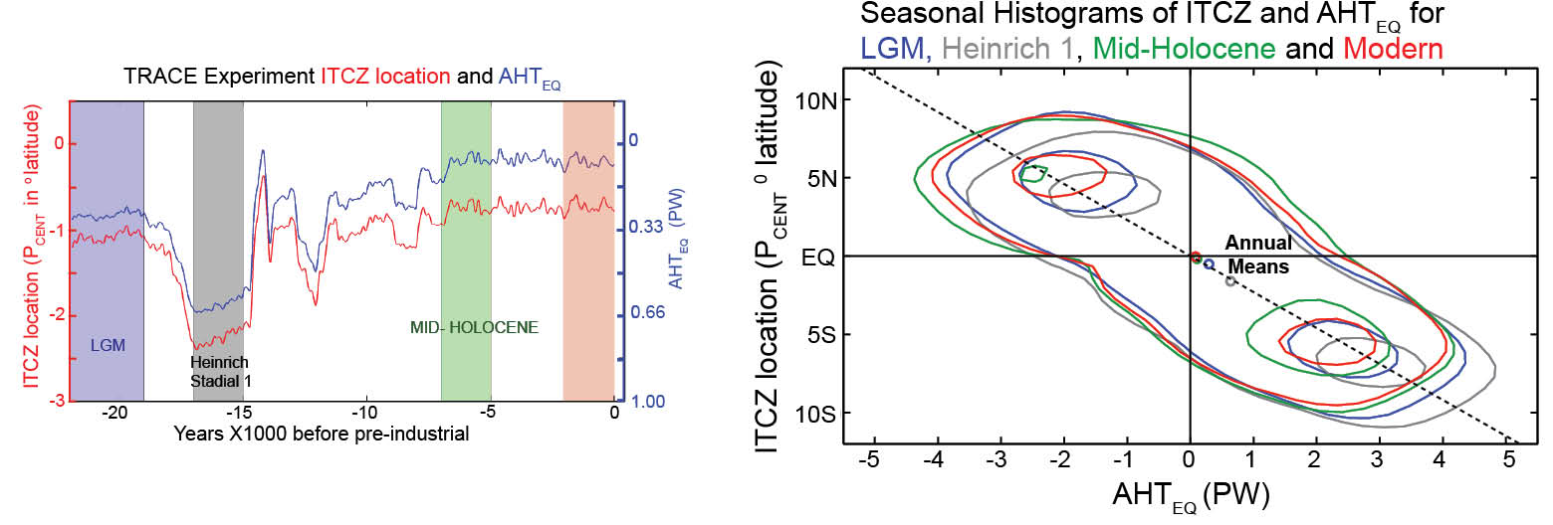
Annual mean ITCZ shifts are a consequence of changes (position or duration) during the extreme seasons

Slide 29
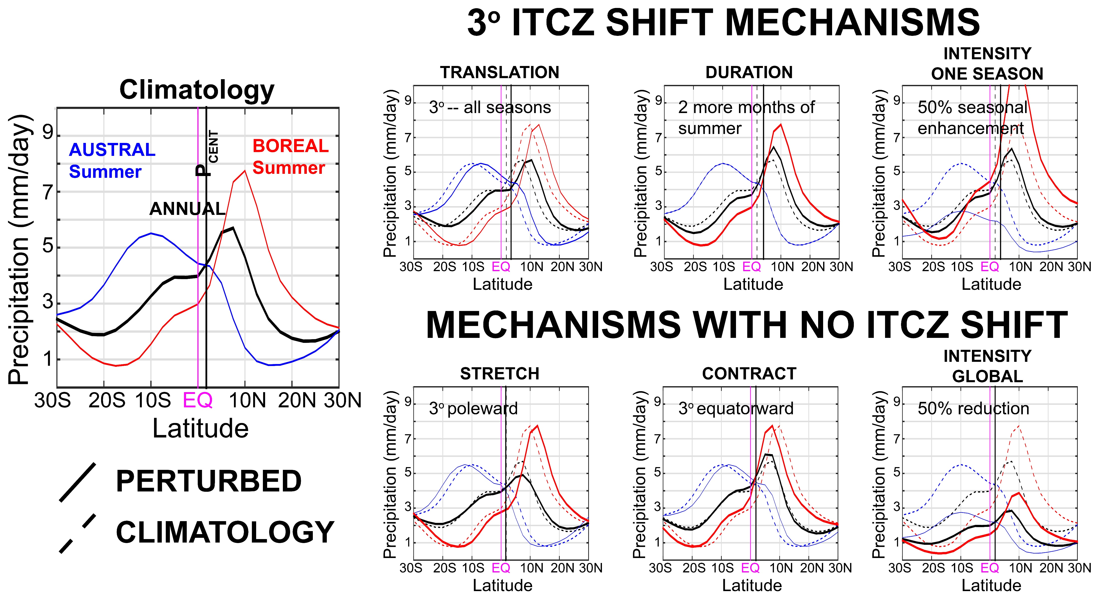
Why does the seasonal cycle constrain annual mean ITC Z shifts – start with precip.

Slide 30
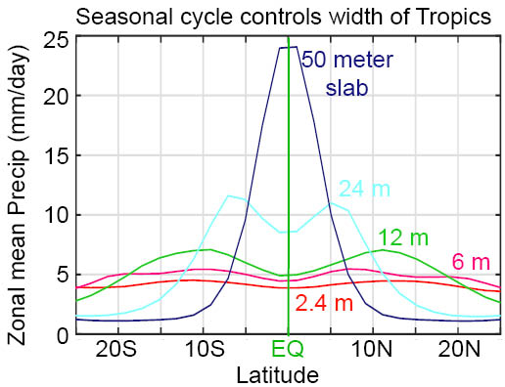
Role of seasonal cycle in stretching out the annual mean precipitation
GFDL aquaplanet with seasonal insolation coupled to slab ocean (Dargan)
Change depth of slab (50m to 2.4 m --globally uniform)
Amplitude of seasonal ITCZ migration off the equator controls the width of the tropics!

Slide 31
How useful is the concept of ITCZ shift?
Assumption:
Changes in tropical precipitation are dominated by meridional shifts in the climatological annual mean precipitation
How much (%) of the tropical precipitation shift is explained by a meridional translation of the climatological precipitation?

Slide 32
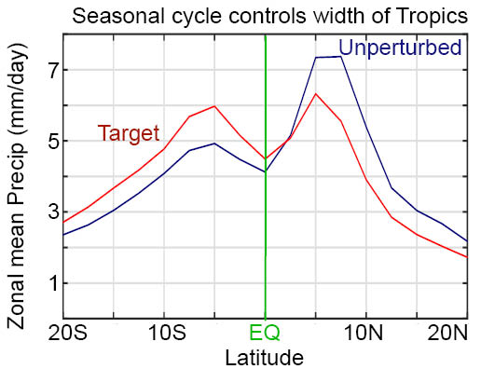
An example : hosing run that shows a 3⁰ P_{CENT} shift

Slide 33
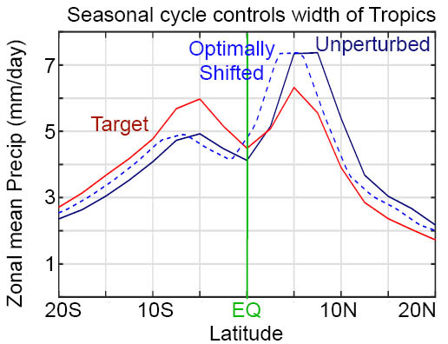
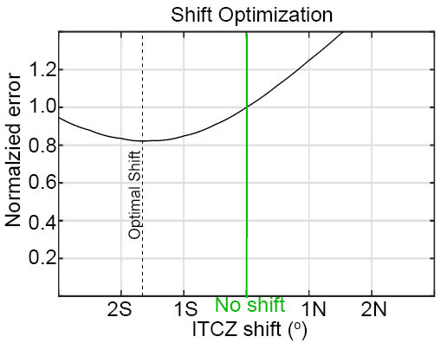
An example : hosing run that shows a 3⁰ P_{CENT} shift

Slide 34

Consider all experiments we can get our hands on
Last Glacial Maximum (LGM)
Freshwater Hosing
Credit: Robert Johnson
Mid Holocene (6Kyear BP)
4XCO₂

Slide 35
How useful is the concept of ITCZ shift?
(Atwood, Battisti, Liu, In Prep.)
Consider three modes of tropical precipitation P(lat):
SHIFT: meridional translation of climatological precip.
→add a constant to latitude – P(lat-S)
CONTRACTION: symetric meridional contraction of climatological precip.
→ Scalar multiplication of latitude – P(lat/C)
INTENSIFICATION: intensification of climatological precip.
with no change in structure
→ Scalar multiplication of precipitation – I*P(lat)
Optimize three modes SIMULTANEOUSLY

Slide 36
P_{CENT} shift versus optimal shift
If anything, P_{CENT} overestimates the ITCZ shift

Slide 37
Fraction of zonal mean changes explained

Slide 38
Fraction of local precipitation changes explained by shift/contraction/intensification modes of tropical precipitation

Slide 39
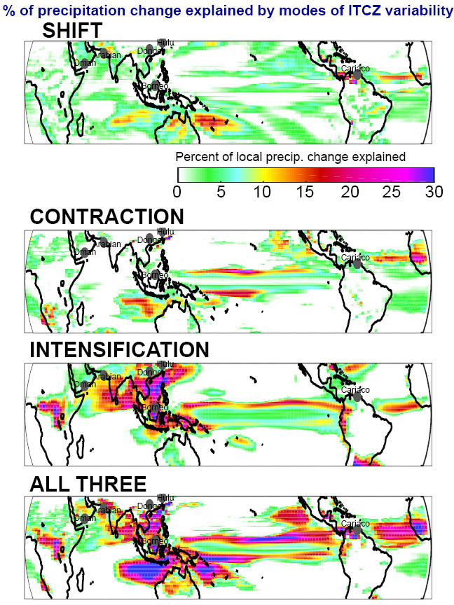
Fraction of local precipitation changes explained by shift/contraction/intensification

Slide 40
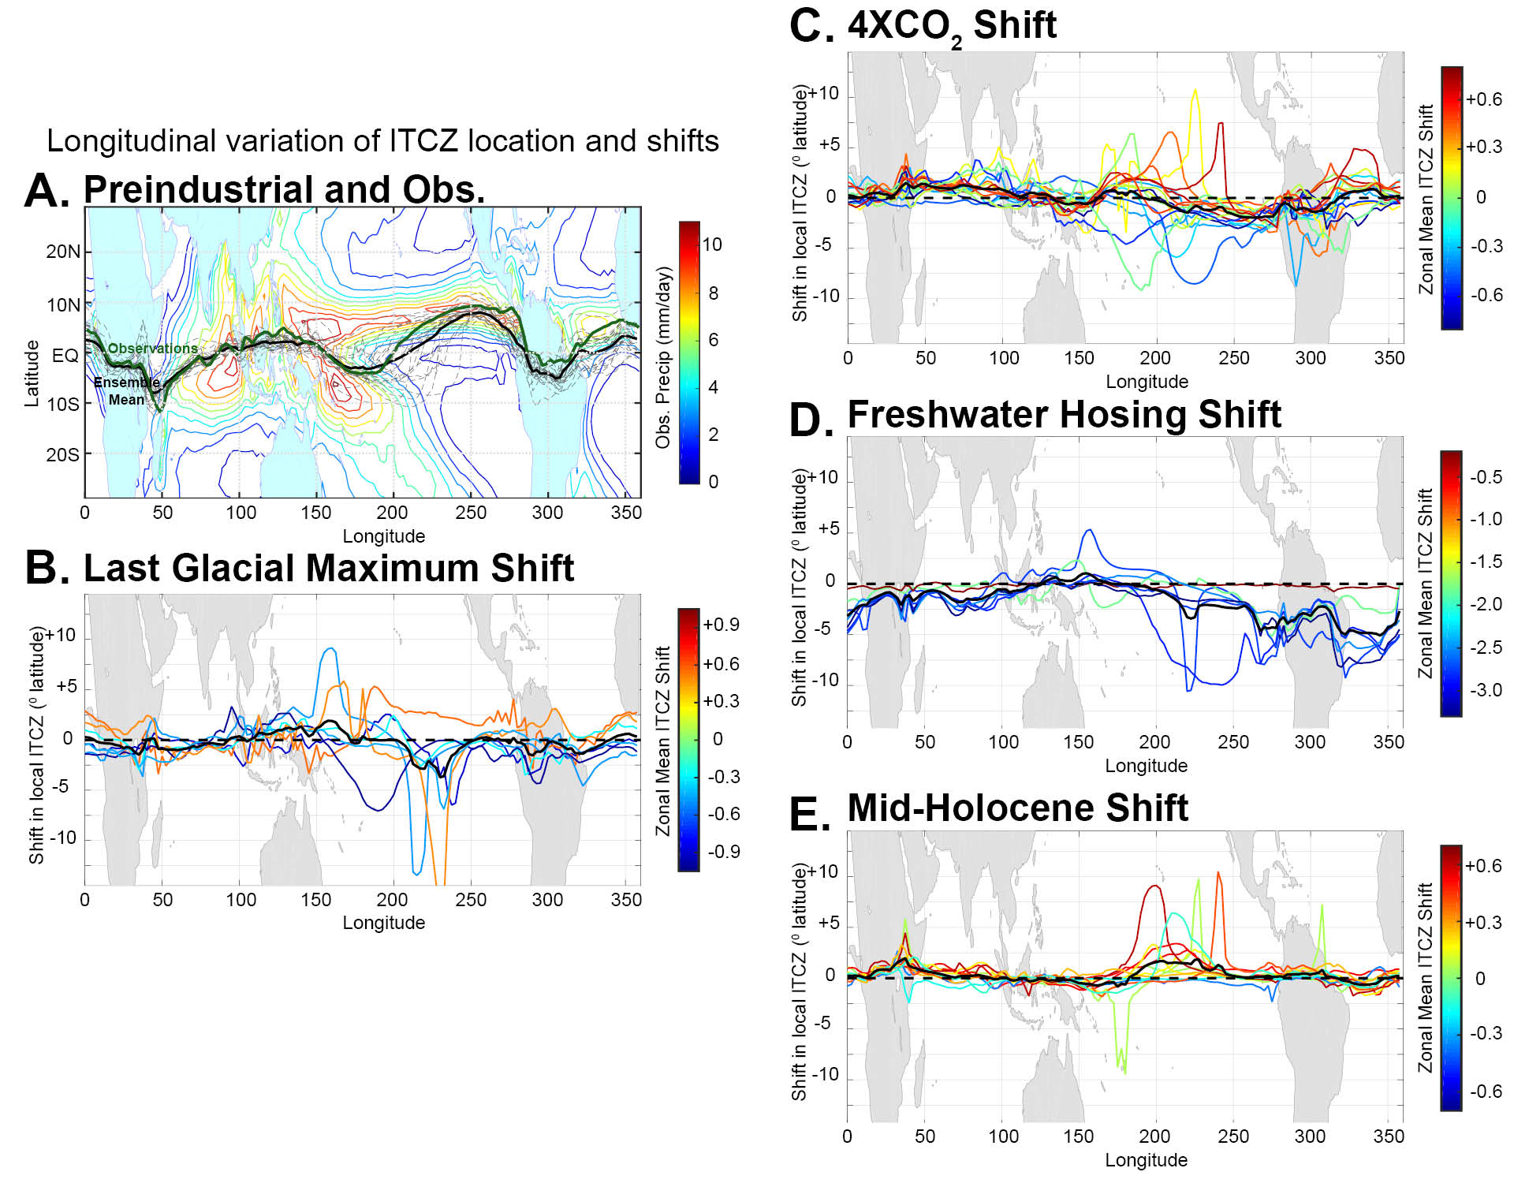

Slide 41

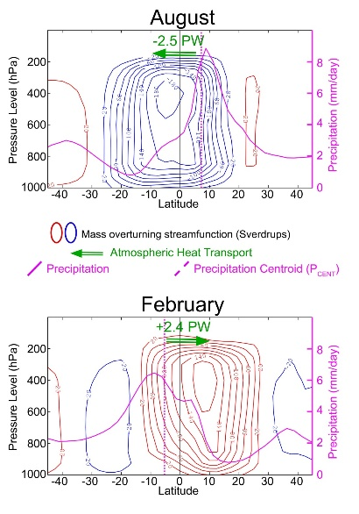
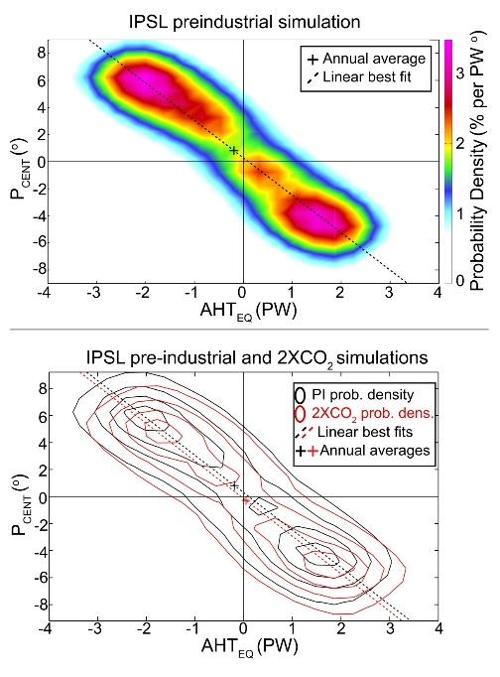
Conclusions
ITCZ is insensitive to external forcing -- 3º latitude shift per PW of hemispheric contrast in atmospheric heating
Seasonal relationship between ITCZ and inter-hemispheric energy transport relies on the amplitude asymmetry between winter and summer Hadley cells → not captured in an annual mean setting
Annual mean is the small residual of seasonal cycle
of bi-modal ITCZ location
Reflects (maybe subtle) changes in the intensity
and duration of seasonal ITCZ
ITCZ shifts explain a small fraction of Tropical
precipitation changes under external forcing
Zonally (and seasonally) inhomogenous
changes overwhelm zonally homogenous changes

Slide 42
4XCO₂ Tropical Contraction

