Slide 1

Global Scale Energy Fluxes: Comparison of Observational Estimates and Model Simulations
Aaron Donohoe -- MIT
David Battisti -- UW
CERES Science Team Meeting
4/23/2014

Slide 2
Global mean energy balance
The Earth receives energy from the sun (and reflects back some portion of it)
To come into energy balance (equilibrium) the Earth must emit the same amount of energy it receives
Reflected
Emitted
Incident
Solar
Incident – Reflected = Emitted
Earth
S(1-α_{P}) = σT_{e}⁴

Slide 3
Equator-to-pole contrast
The tropics receive more solar radiation than the high latitudes (extratropics)
To come to equilibrium, the tropics must either emit excess radiation or transport energy to the extratropics
Incident
Reflected
Emitted
Net
Tropics
Extratropics

Slide 4
Seasonal Cycle
Seasonal variations in solar insolation are of order 1 in the extratropics
How much energy goes into the atmosphere versus the ocean to drive seasonal variations in temperature and circulation?
Summer
Winter
Heating
Cooling
Solar
Atmos.-Ocean
Exchange
Emitted
Heat Transport
Absorbed
Transmitted
Energy gain
Energy loss

Slide 5
Outline
What determines the Earth’s planetary albedo? (How much solar radiation gets reflected)
Earth
2. What determines the meridional heat transport in the climate system?
Tropics
Extratropics
3. How do seasonal variations in solar insolation lead to atmospheric heating?

Slide 6
1 : What determines the Earth’s planetary albedo? (solar radiation reflected at top of atmosphere)
Reflected by Atmosphere
Solar Incident
Reflected by Surface
Atmosphere
Earth’s Surface

Slide 7
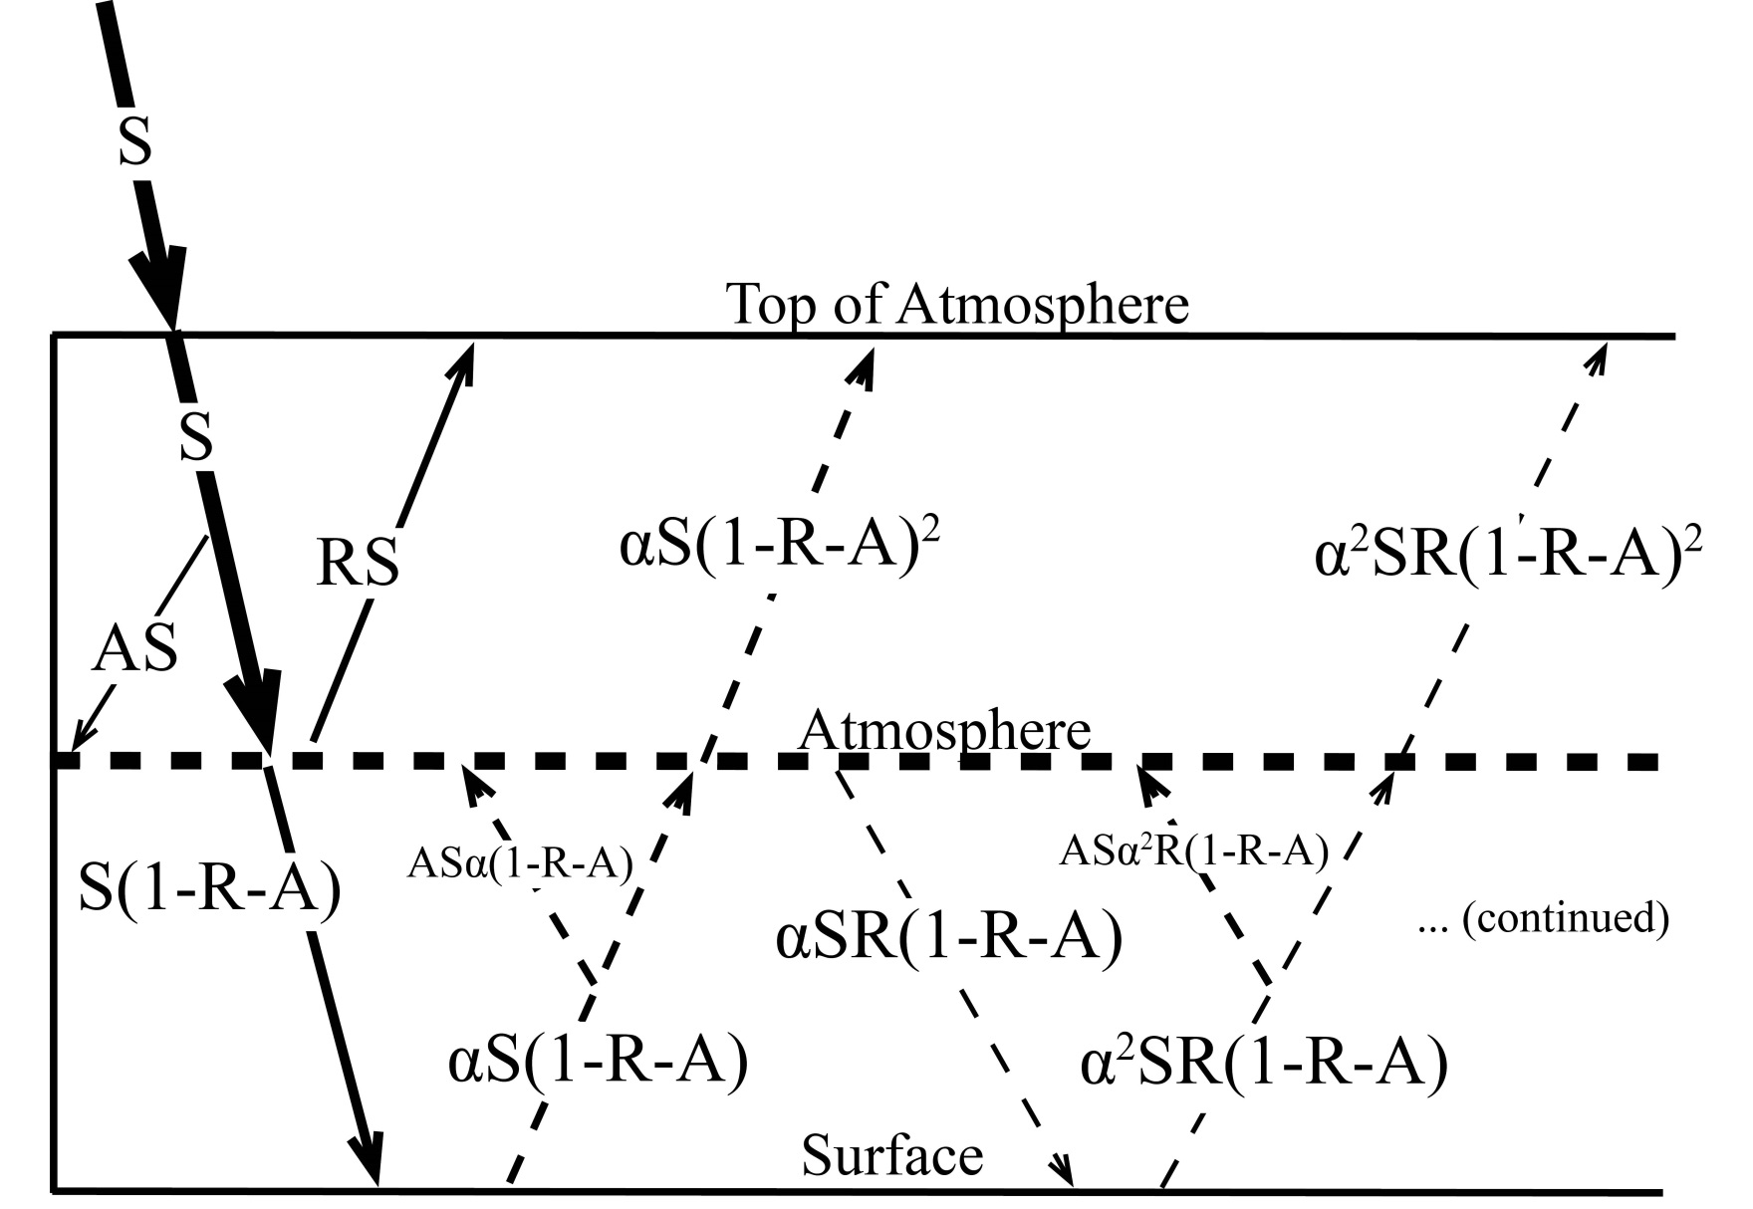
Simplified (isotropic) shortwave radiation model
Atmospheric
Contribution
To planetary
Albedo
Surface
Contribution
To planetary
Albedo
S = incident
R = cloud
reflection
A = absorption
α = surface
albedo
(UNKNOWNS)

Slide 8
Partitioning of planetary albedo into atmospheric and surface components
Reflected by Atmosphere
α_{P} = α_{P,ATMOS} + α_{P,SURF}
Reflected by Surface
α_{P,ATMOS} = R
Solar Incident
α_{P,SURF} = α(1-R-A)²
(1-αR)
Atmosphere
Earth’s Surface

Slide 9
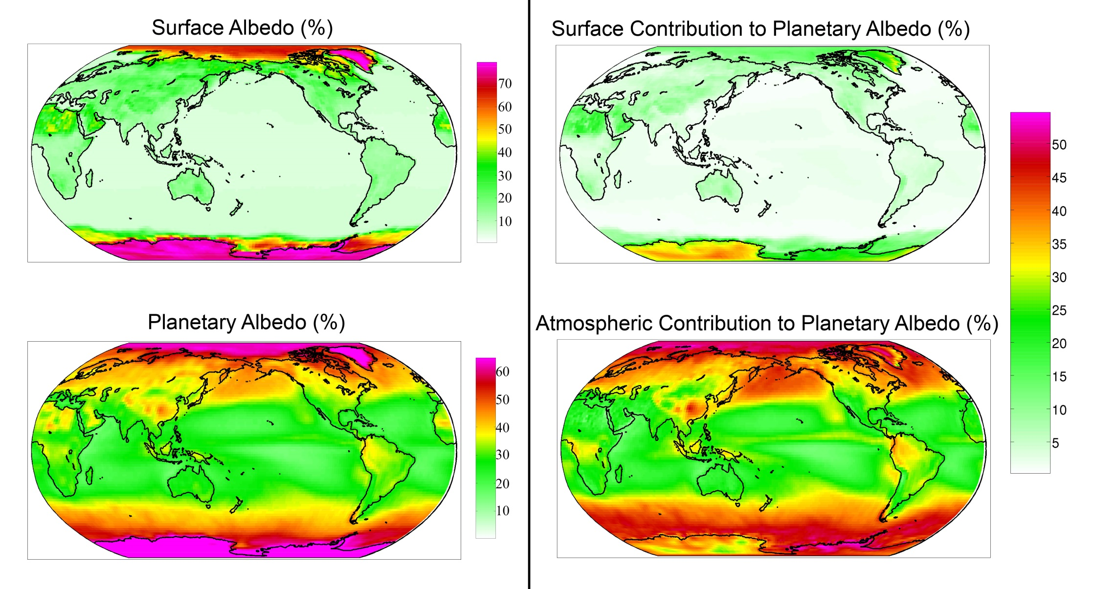
Observed (CERES) surface and atmospheric contribution to planetary albedo

Slide 10
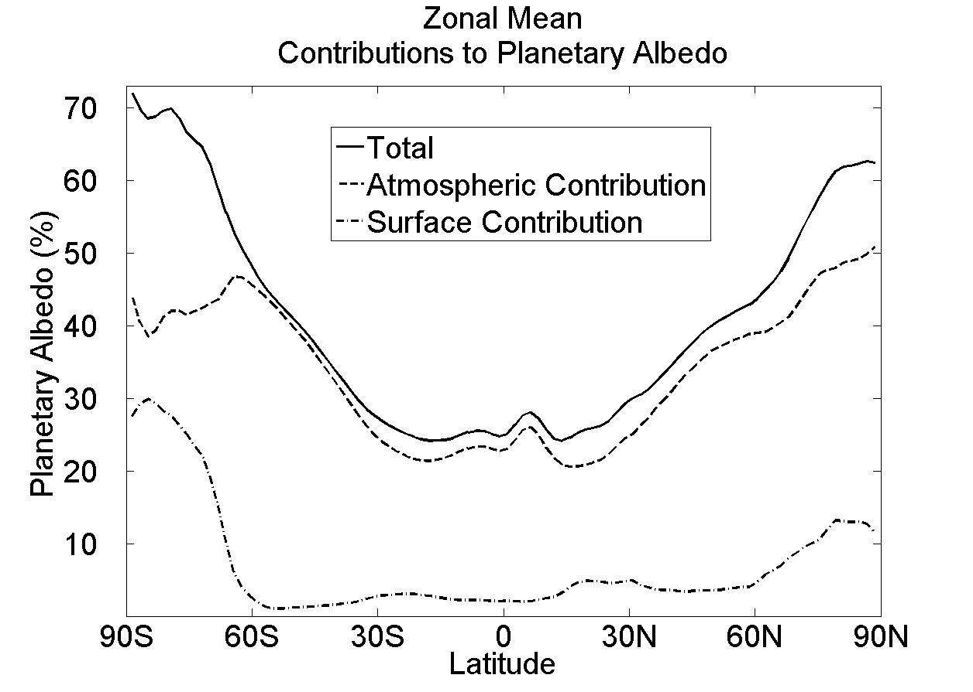
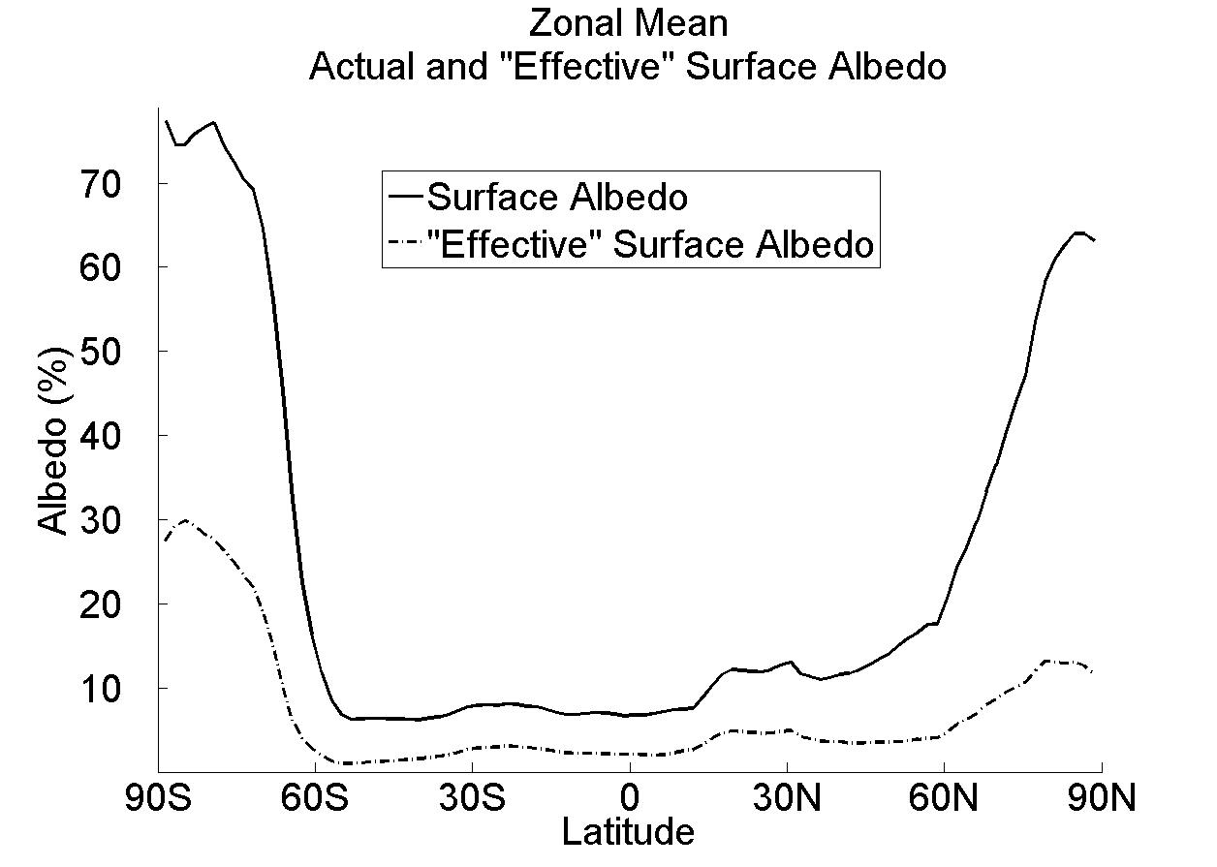
Observed Surface and atmospheric contribution to planetary albedo
Surface albedo and surface contribution to planetary albedo (α and α_{P,SURF})
α (surface albedo)
α_{P,SURF} = α(1-R-A)²
α_{P,SURF}
(1-αR)

Slide 11
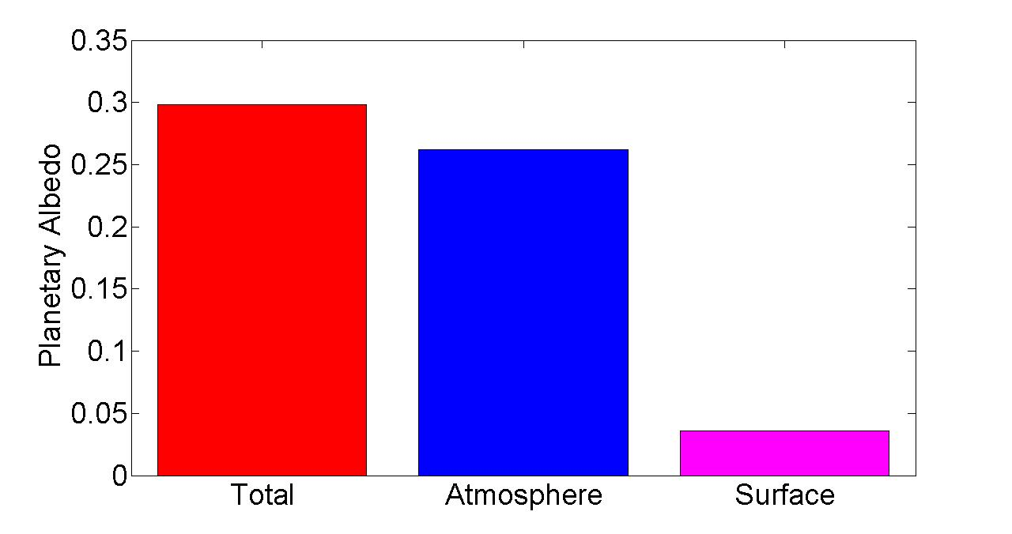
Observed Global Mean Planetary Albedo and it atmospheric/surface Partitioning
Notes:
0.298 = 0.262 + 0.036
100% = 88% + 12%

Slide 12
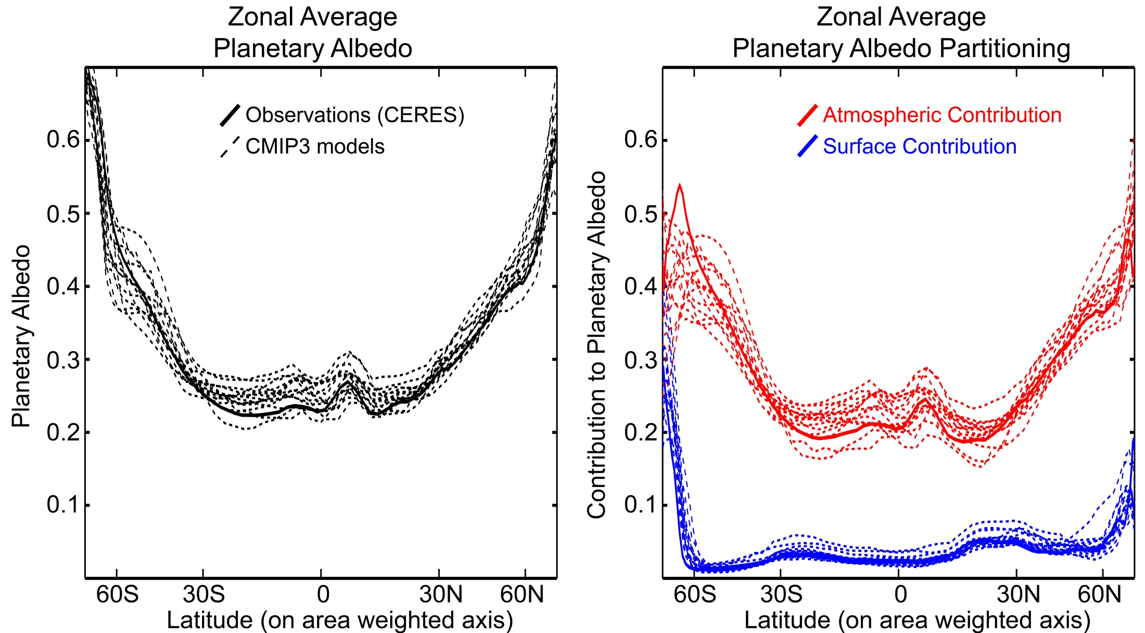
Planetary Albedo Partitioning:
Comparison of models (CMIP3 pre-industrial) and observations (CERES)

Slide 13
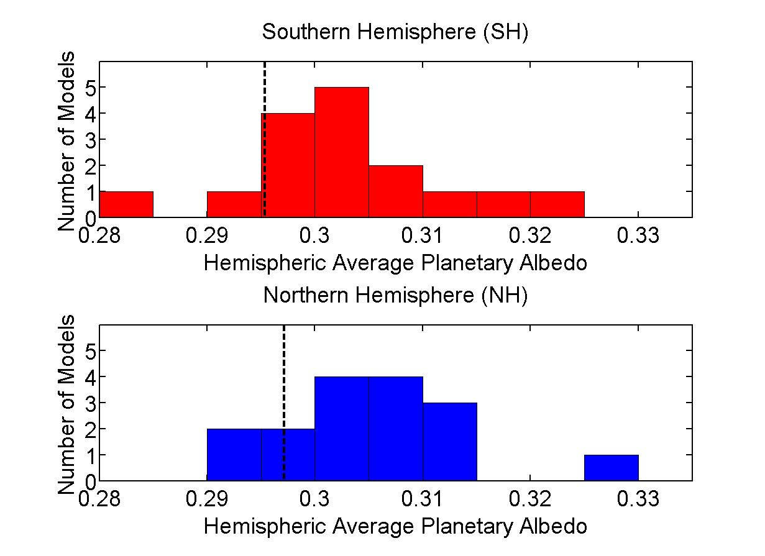
Histogram of hemispheric average planetary albedo
10 W m⁻²
Observations
(CERES)
Notes:
2 sigma = 0.016

Slide 14
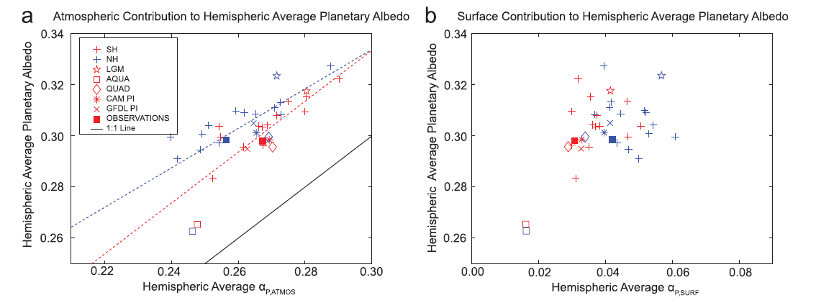
Hemispheric average planetary albedo partitioning in climate models
Inter-model spread in Hemispheric average planetary albedo is a consequence of differences in cloud reflection
Surface albedo makes a much smaller contribution to basic state albedo, model bias and inter-model spread

Slide 15
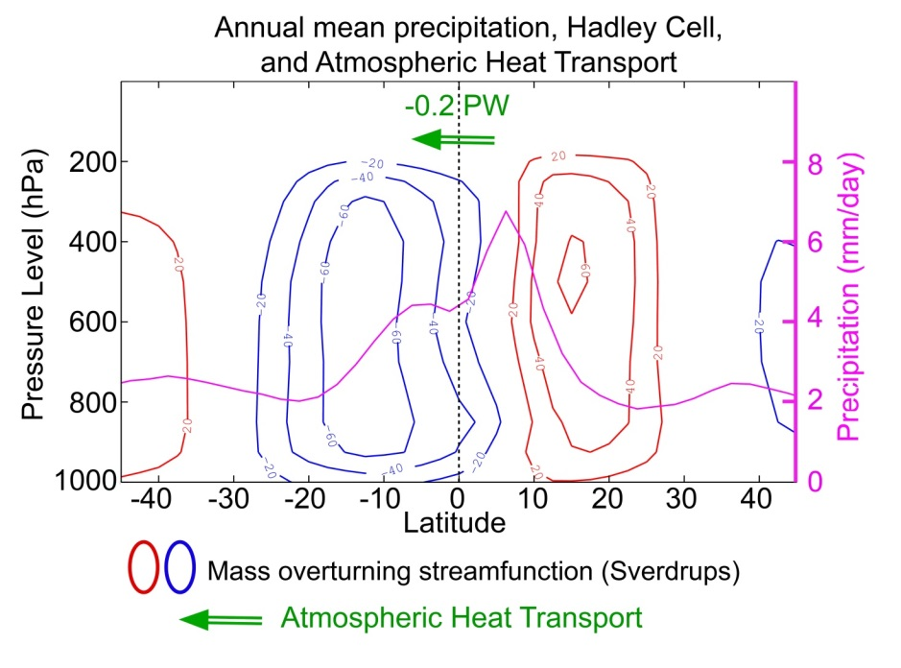
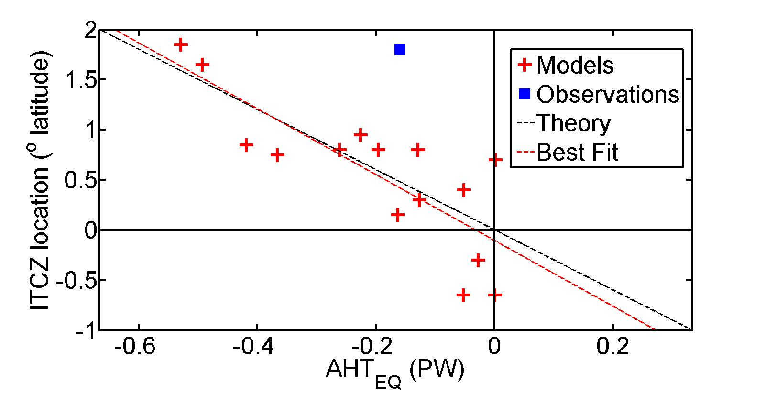
Inter-hemispheric energy transport and the location of tropical precipitation
ITCZ location and atmospheric heat transport across the equator (AHT_{EQ})are both a consequence of the Hadley cell location
-> The atmosphere moves energy away from the ITCZ
The inter-model spread in
AHT_{EQ} and ITCZ location are strongly correlated

Slide 16
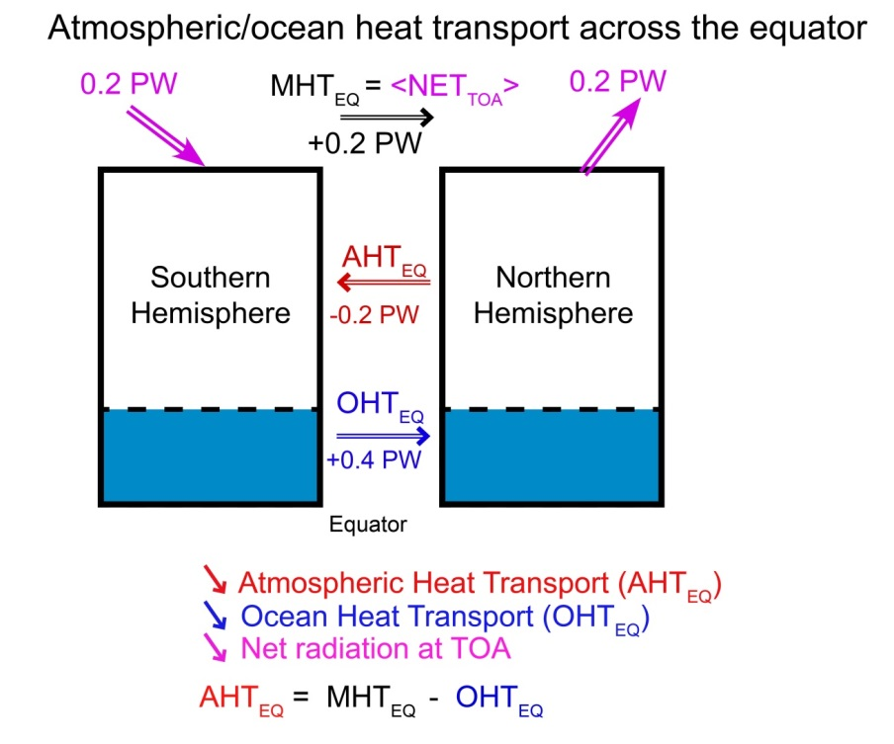
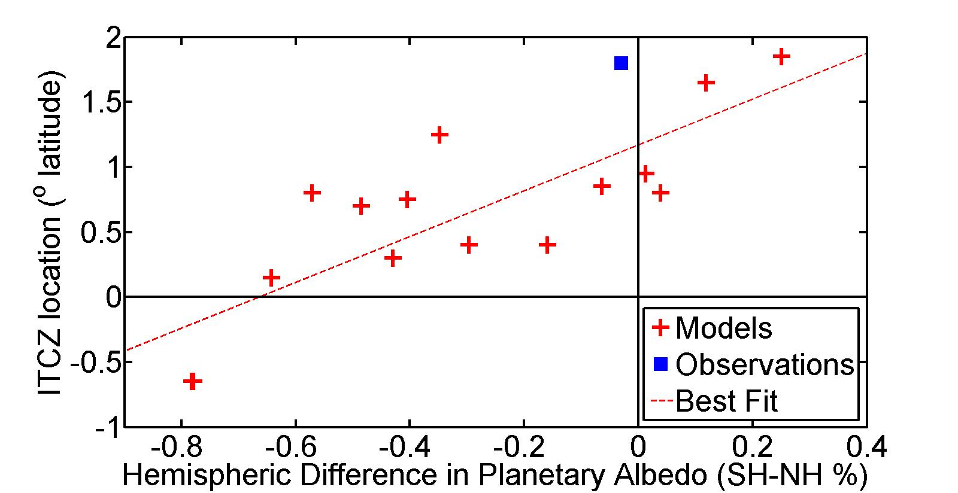
Hemispheric contrast of radiation and ITCZ location
ITCZ lives in the hemisphere where the atmosphere is heated more strongly
-> In observations, the radiative input to each hemisphere is nearly equal and ITCZ is North of the equator because of Northward ocean heat transport
Model biases is planetary albedo lead to ITCZ biases
-> SH absorbs too much shortwave and ITCZ is too far south
Heating of SH

Slide 17
2 : What determines meridional heat transport?
Incident
Reflected
Emitted
Net
Tropics
Extratropics

Slide 18
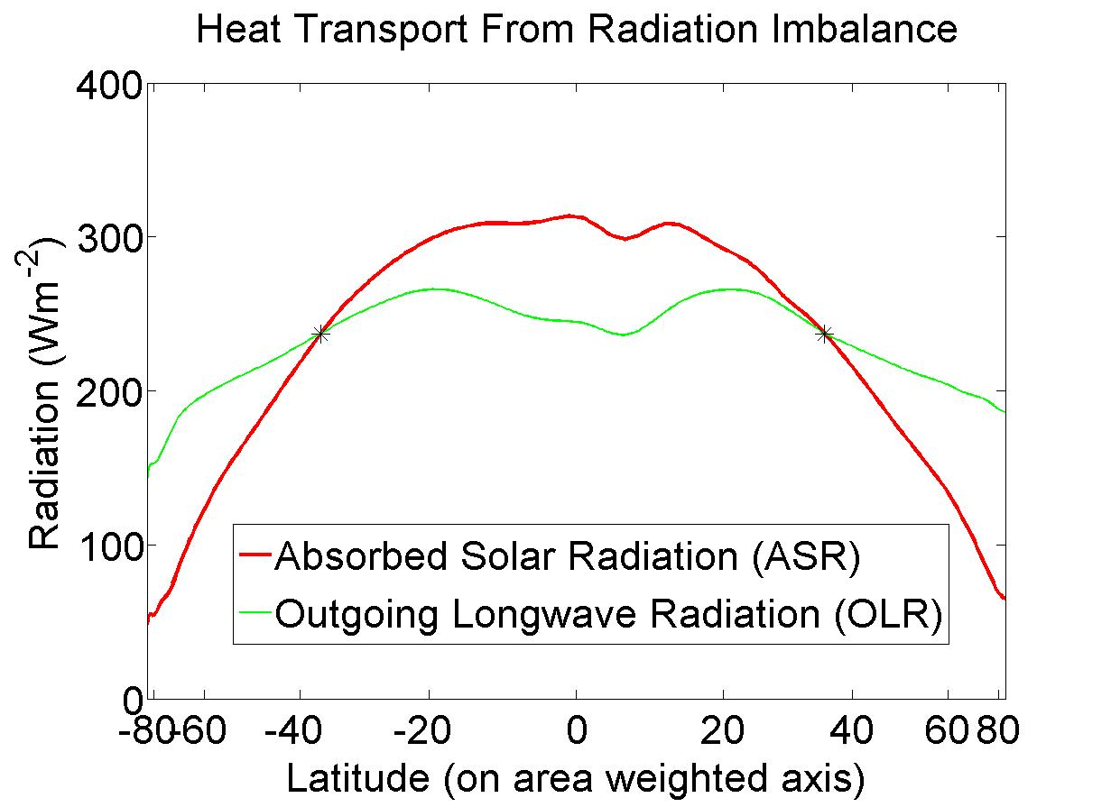
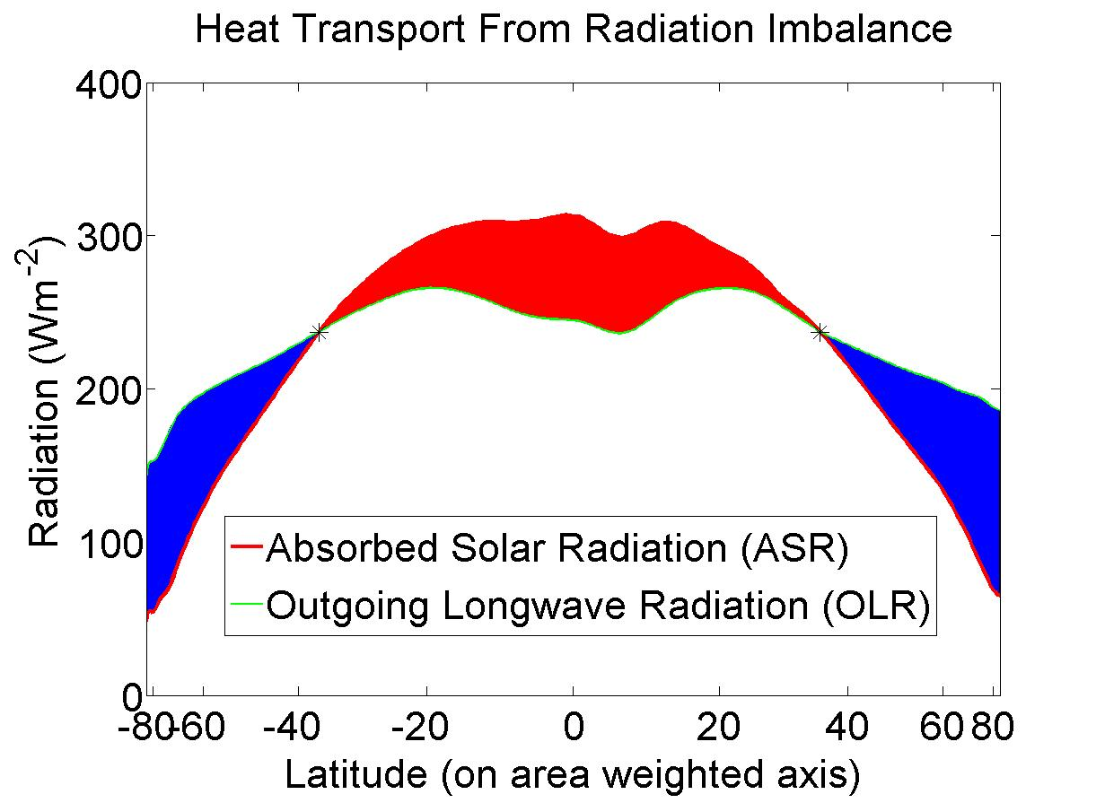
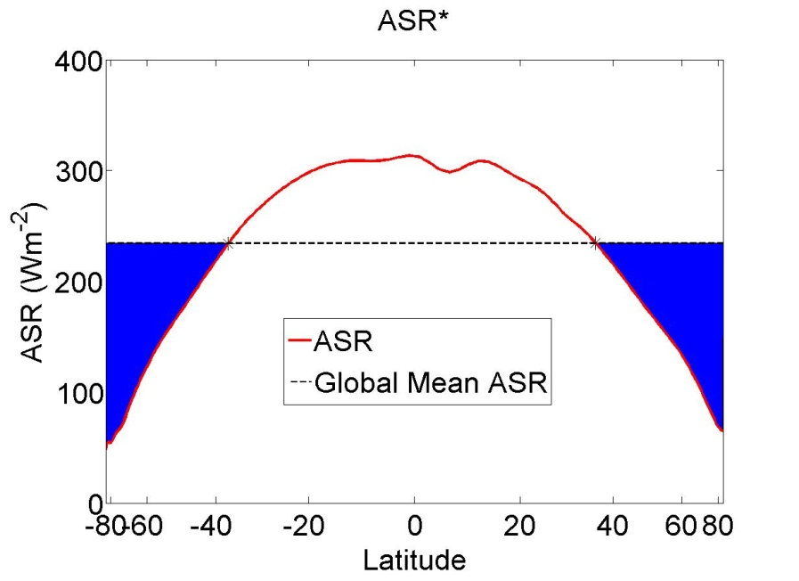
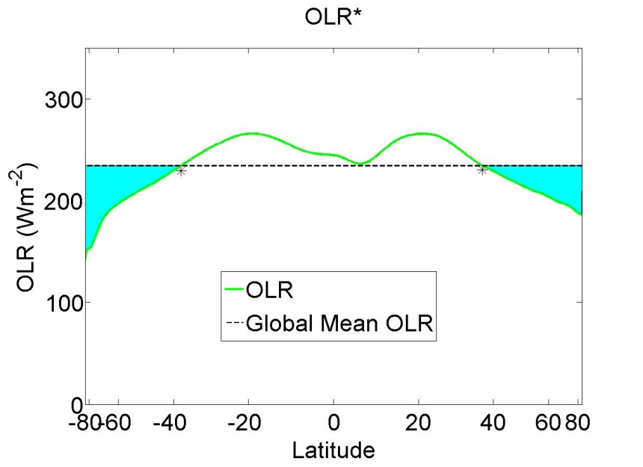
Understanding heat transport
5.8 PW
ASR*
OLR*
8.2 PW
2.4 PW
-
Heat
Transport
=
Notes:
NH = 8.2 - 2.4 = 5.8
SH = 9.0 – 3.2 = 5.8

Slide 19
ASR*, OLR*, MHT, and the tropical/extratropical energy budget
OLR*
ASR*
2.4 PW
8.2 PW
MHT =
ASR* - OLR*
MHT
Tropics
5.8 PW
To extratropics
All arrows are relative to the global average

Slide 20
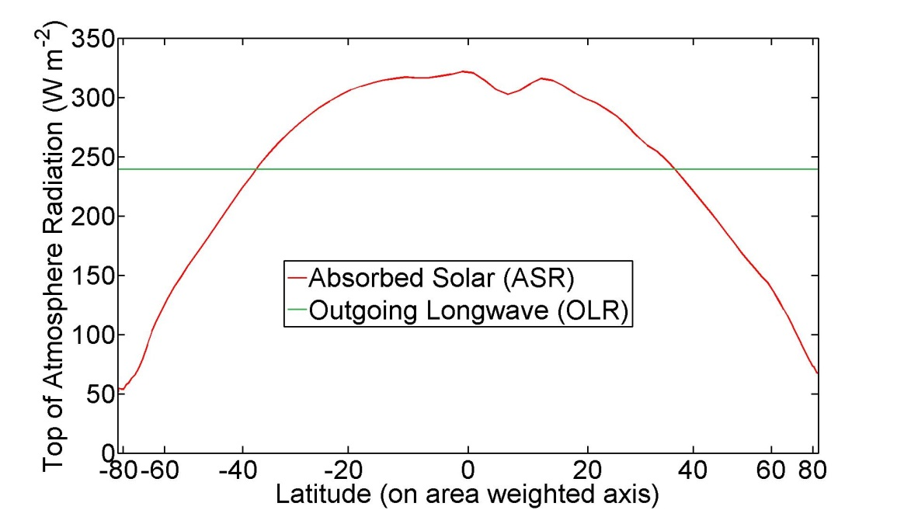
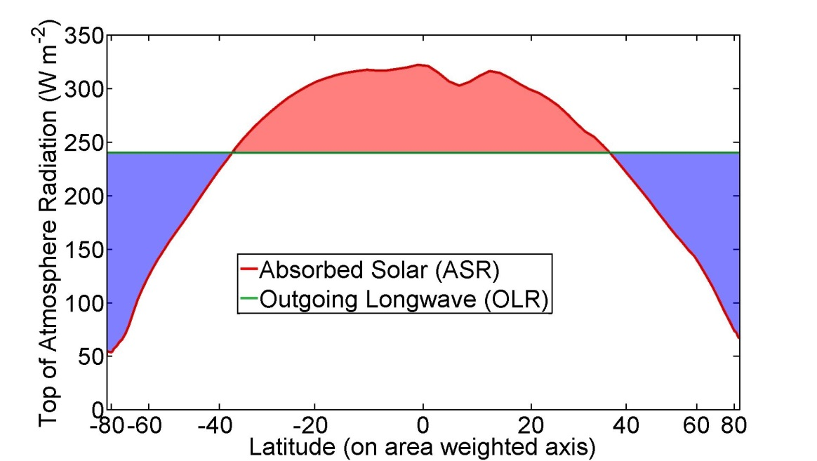
ASR*, OLR*, MHT
Dynamic Limit
MHT = ASR*
OLR* = 0
ASR*
9.0 PW
8.2 PW
8.2 PW
MHT
Tropics
8.2 PW
To extratropics
All arrows are relative to the global average

Slide 21
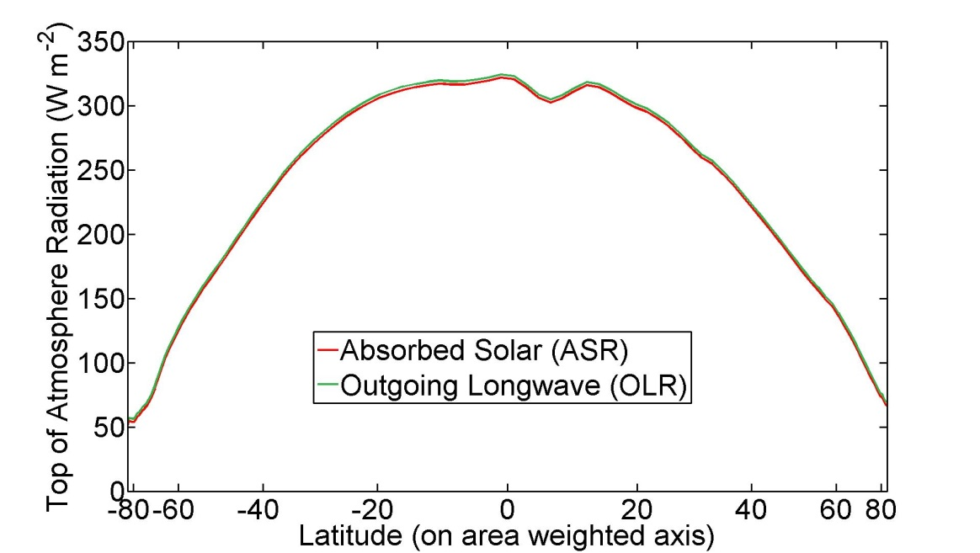
ASR*, OLR*, MHT
Radiative Limit
MHT = 0 ,
ASR* = OLR*
ASR*
8.2 PW
OLR*
8.2 PW
MHT
Tropics
0 PW
To extratropics
All arrows are relative to the global average

Slide 22
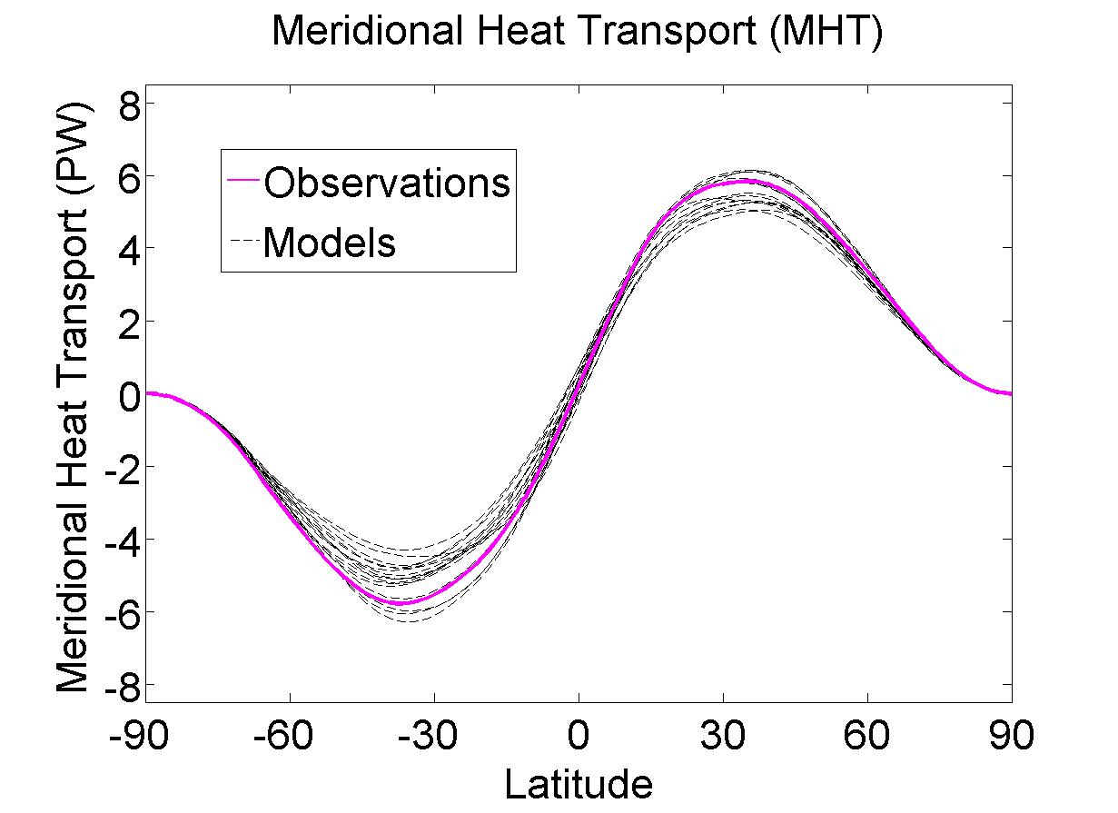
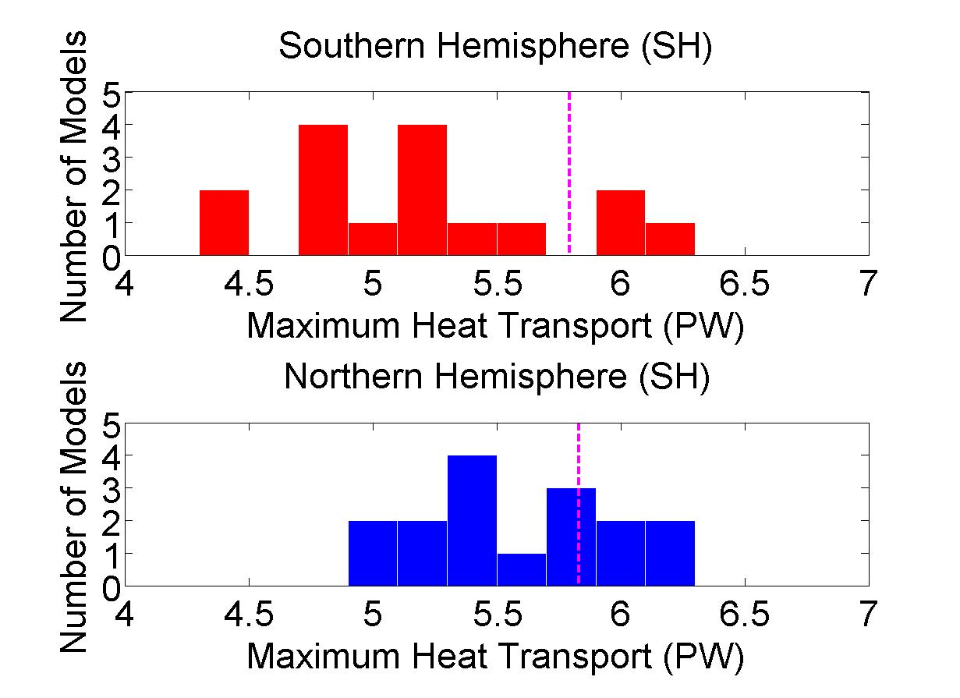
Heat Transport In Climate Models
(CMIP3)
Peak Heat Transport Histograms
Observations
Notes:
Spread – 2 sigma SH = 1.1 PW NH = 0.8 PW

Slide 23
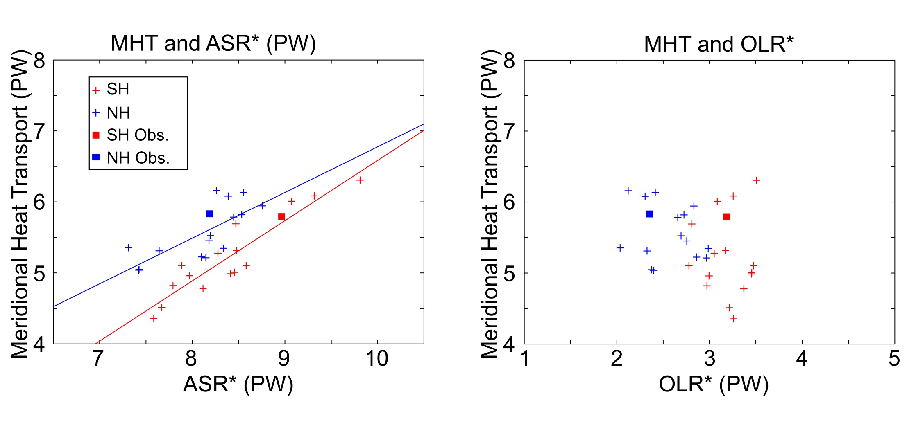
Model heat transport spread in terms of OLR* and ASR*
Notes:
ASR and MHT R^2 (slope) /// NH = 0.57 (0.64) , SH = 0.85 (0.85)
OLR* is insignificant

Slide 24
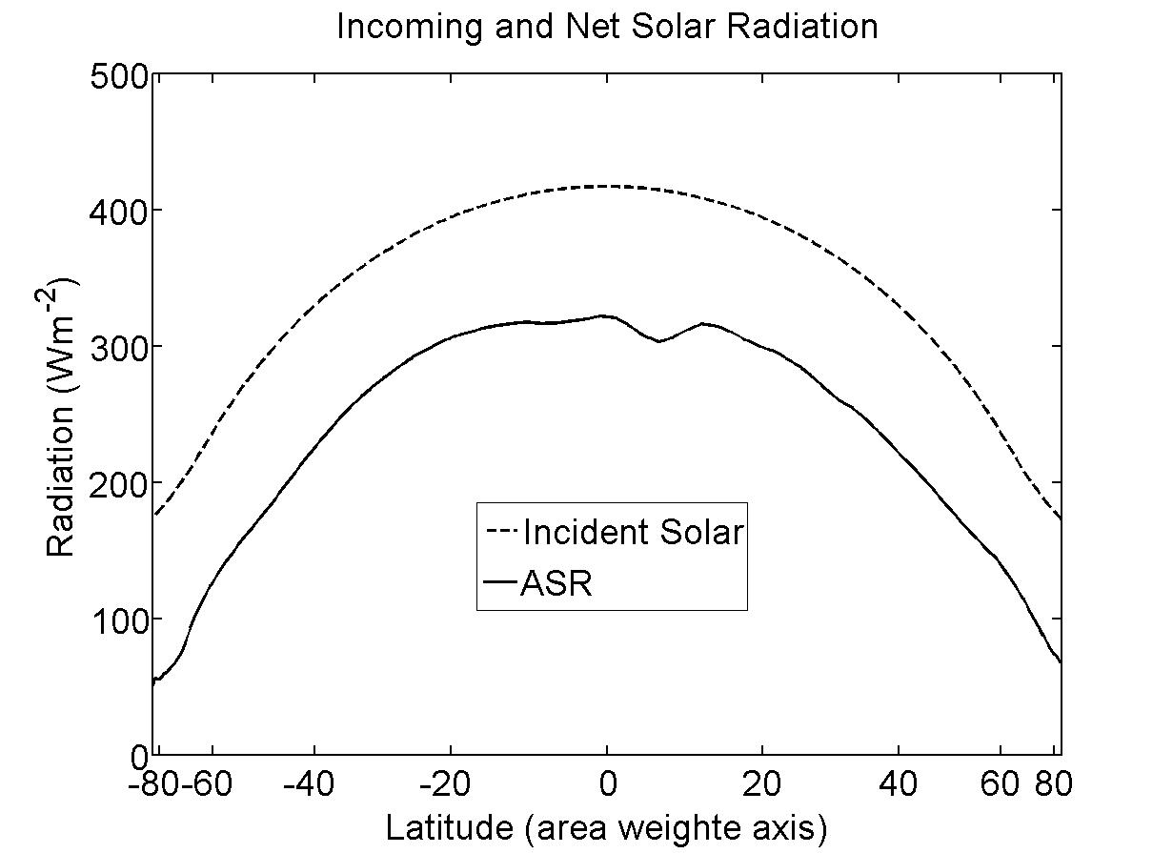
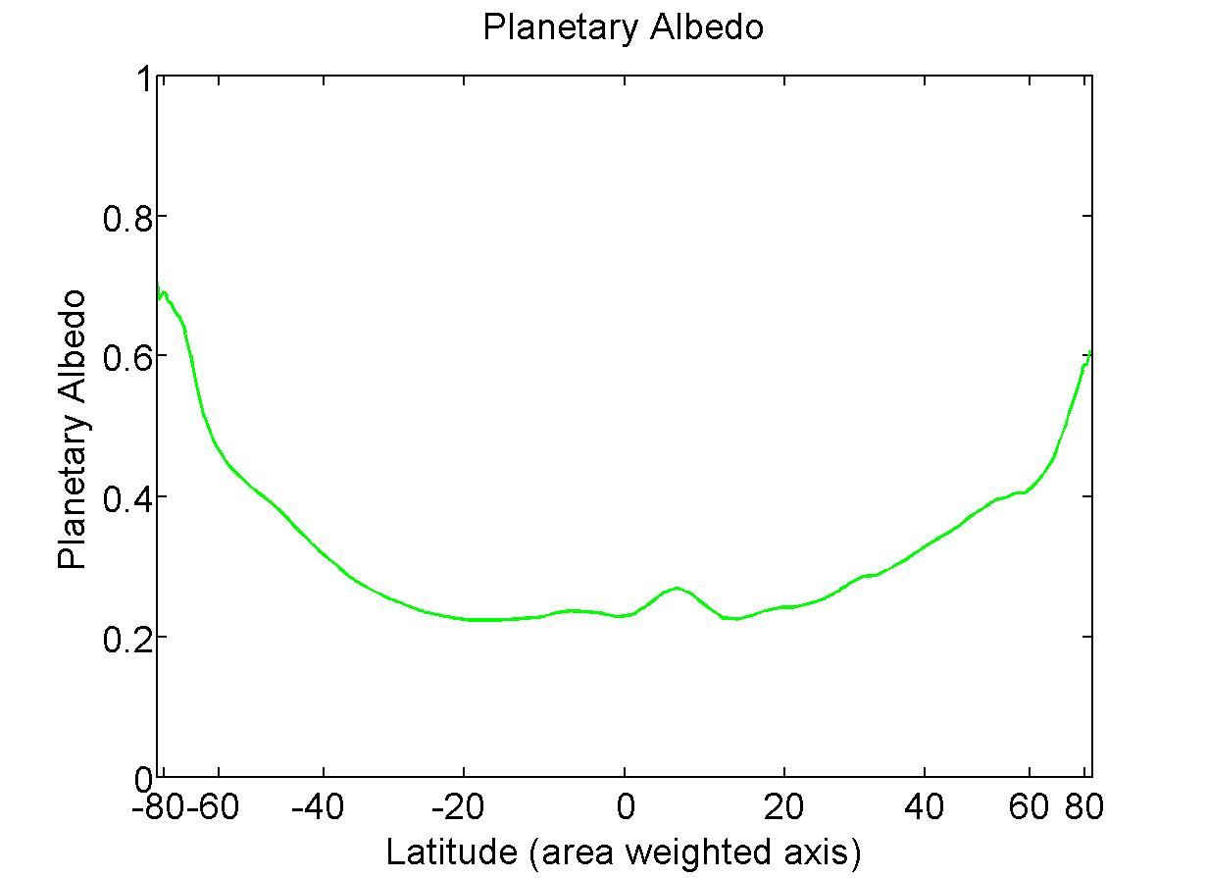
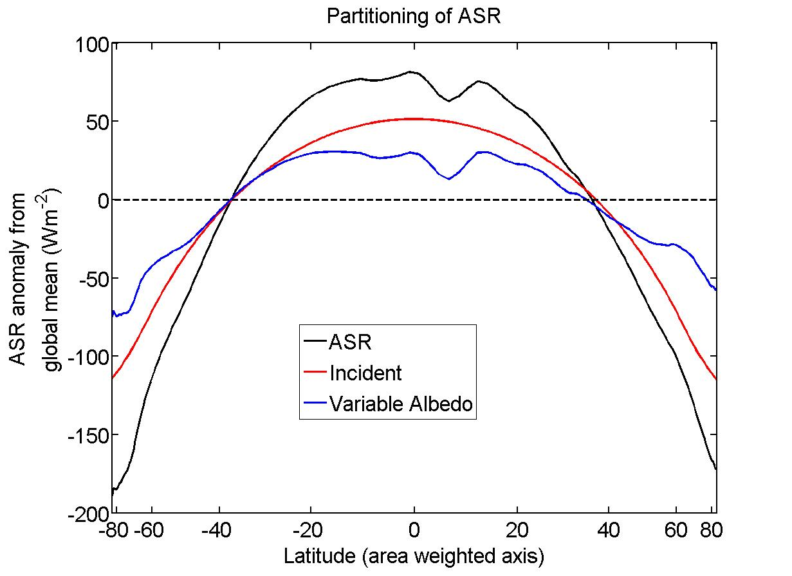
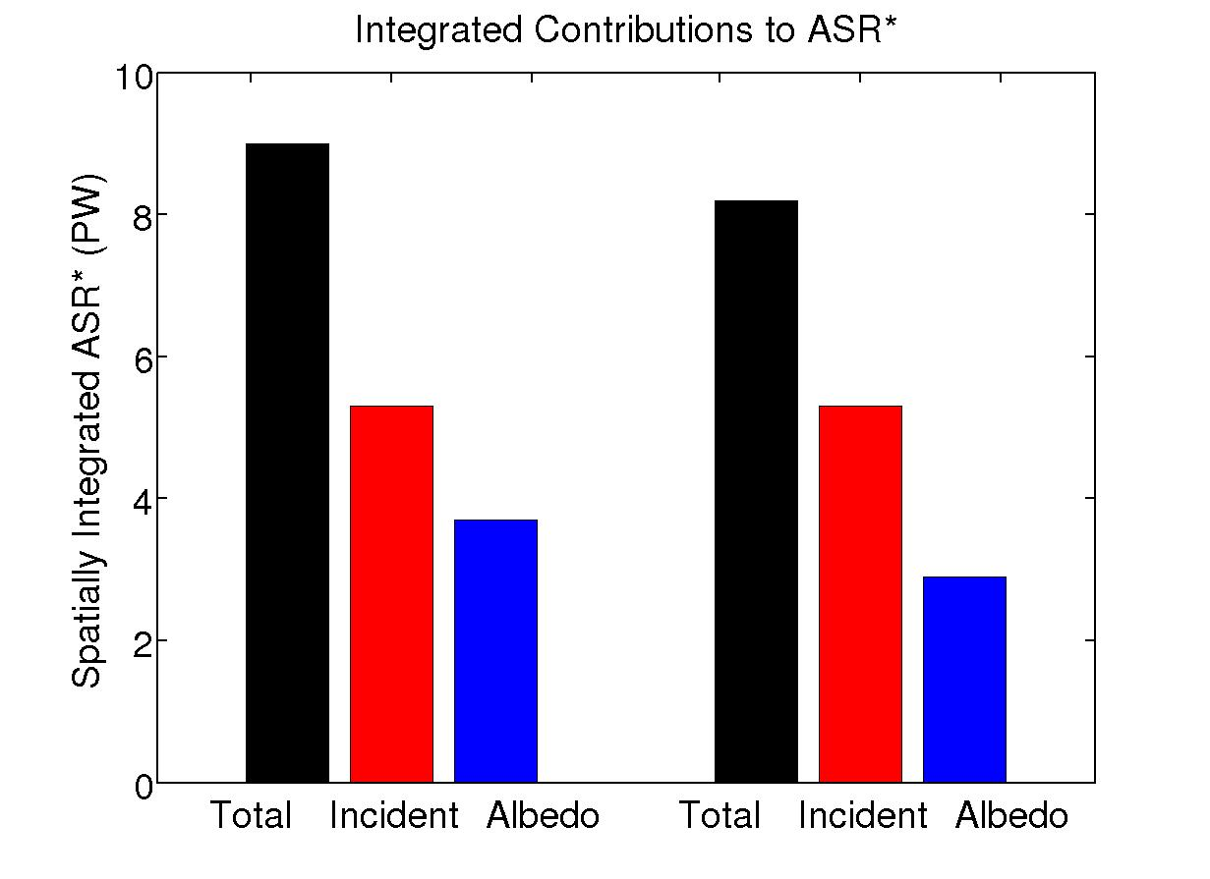
Understanding ASR*
SH
NH
Notes:
ASR = incident + albedo
NH // 8.2 = 5.3 + 2.9
SH \\\ 9.0 = 5.3 + 3.7

Slide 25
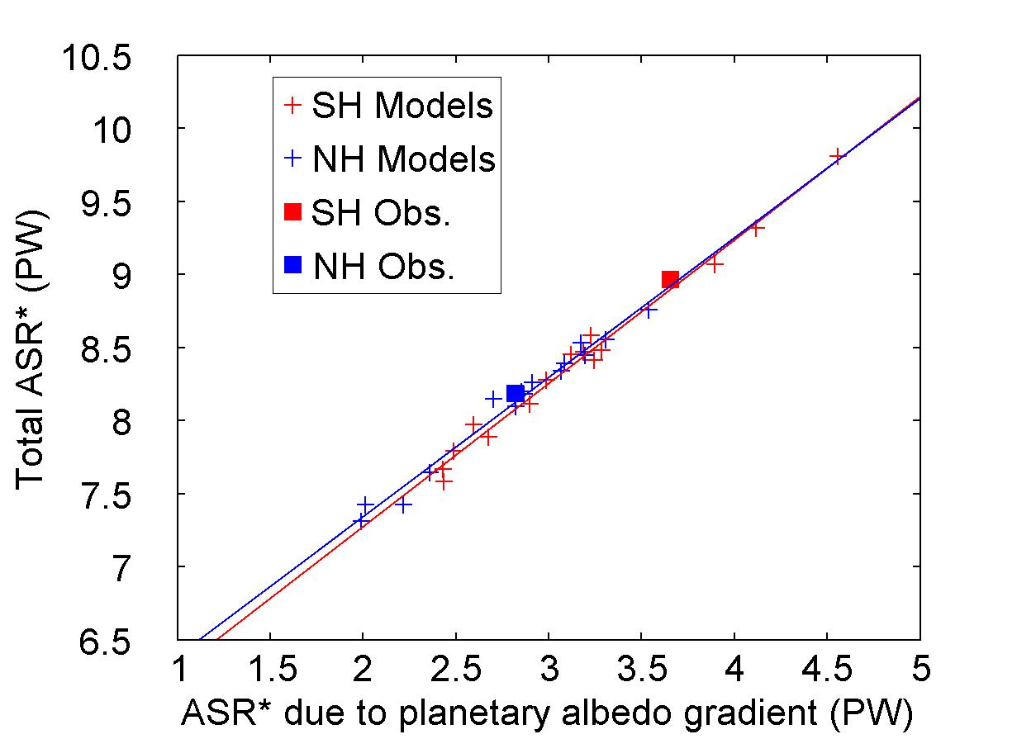
ASR* and planetary albedo
Notes:
ASR* and albedo spread correlated with R^2 0.99
Same correlations as before

Slide 26
What determines the equator-to-pole contrast of planetary albedo?
Reflected by Atmosphere
Solar Incident
Reflected by Surface
Atmosphere
Earth’s Surface

Slide 27
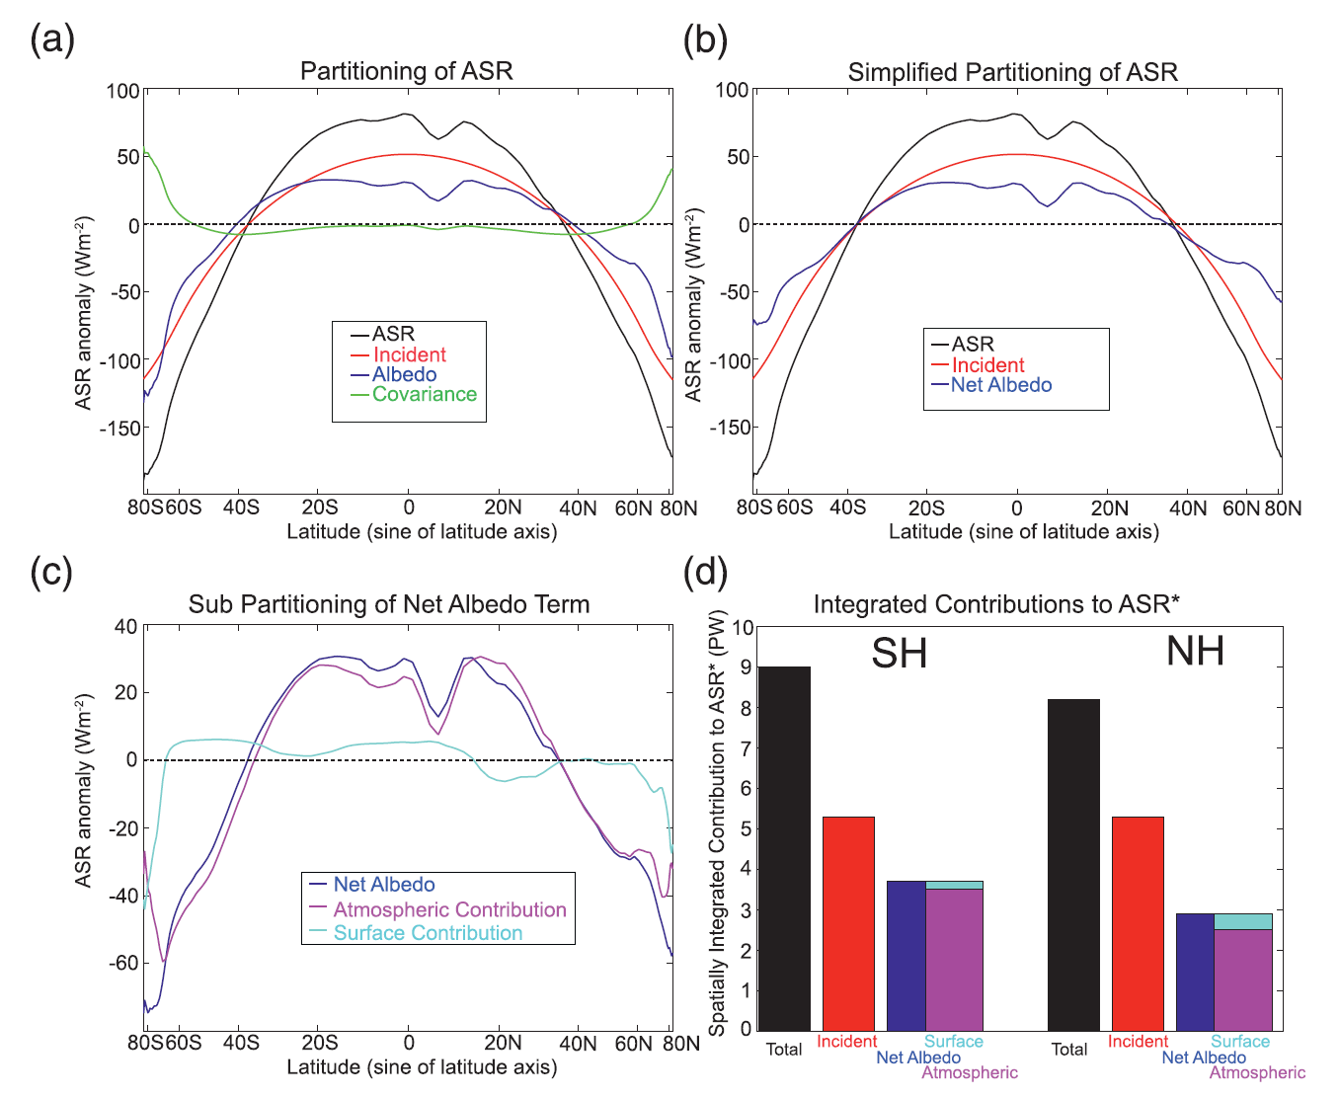
Surface and atmospheric contributions to the equator-to-pole contrast in absorbed shortwave radiation

Slide 28
Planetary Albedo Partitioning

Slide 29
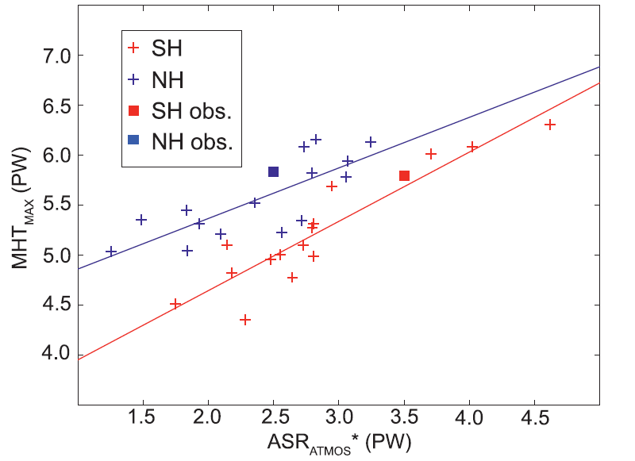
Atmospheric and Surface reflection contribution to ASR*
Cloud Reflection
Equator to pole contrast of absorbed shortwave
Poleward Energy Transport
Poleward Energy Transport
MHT spread
Equator to pole contrast in clouds
Notes:
R^2 NH \\\ 0.63 SH \\\\ 0.84

Slide 30
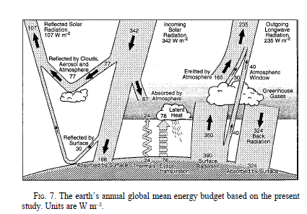
How is the atmosphere heated in the annual average?
3. The seasonal cycle of atmospheric heating and temperature
30% reflected
20% absorbed atmosphere
50% transmitted
To surface
50% net flux
From surface
To atmosphere
Kiehl and Trenberth 1997

Slide 31
Annual mean heating summary
30% reflected
20% absorbed atmosphere
atmosphere
50% transmitted
To surface
50% net flux from surface
to atmosphere
surface
Surface energy balance (absorbed solar flux = upward flux to the atmosphere) requires that the ratio of heating from direct absorption to surface energy fluxes is
approximately:
atmospheric absorption (SW) /atmospheric transmissivity(SW)
=> direct absorption accounts for 30% of atmospheric heating

Slide 32
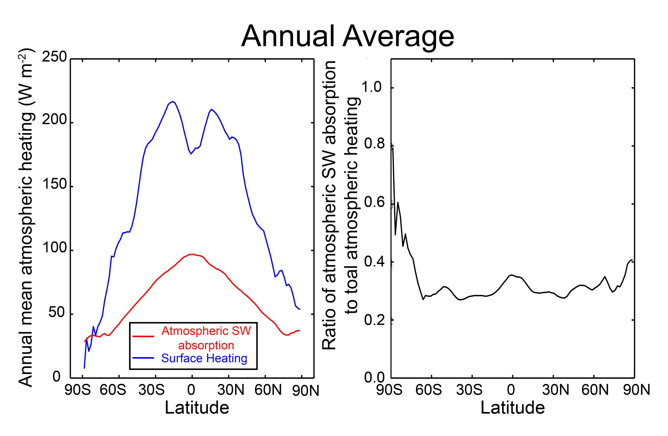
Spatial structure of atmospheric heating
Spatial structure of atmospheric heating
Annual Average

Slide 33
Limiting models of seasonal atmospheric heating
SW flux
Turbulent + LW
Surface flux
Heated from above
Heated from below
SW absorbing
atmosphere
SW transparent
atmosphere
DEEP
OCEAN
Shallow ocean

Slide 34
Atmospheric energy budget
Conventional
This study
Net SW
TOA
OLR
Atmospheric SW absorption (SWABS)
OLR
Heat Transport
Divergence
Net energy flux
Through surface
Heat Transport
Divergence
SW transparent
atmosphere
Surface heat
Flux (SHF)
Storage
Storage
Surface
Surface
Net energy flux through surface =
Solar + turbulent + LW
SHF = turbulent + LW
=> Energy exchange between surface and atmosphere

Slide 35
Atmospheric energy budget
Atmospheric energy budget -- Observations
Storage
Heat Transport Divergence
Radiative Fluxes from CERES
Dynamic fluxes and storage are calculated from ERA-40 reanalysis
Atmos. Surface exchange (SHF) as RESIDUAL

Slide 36
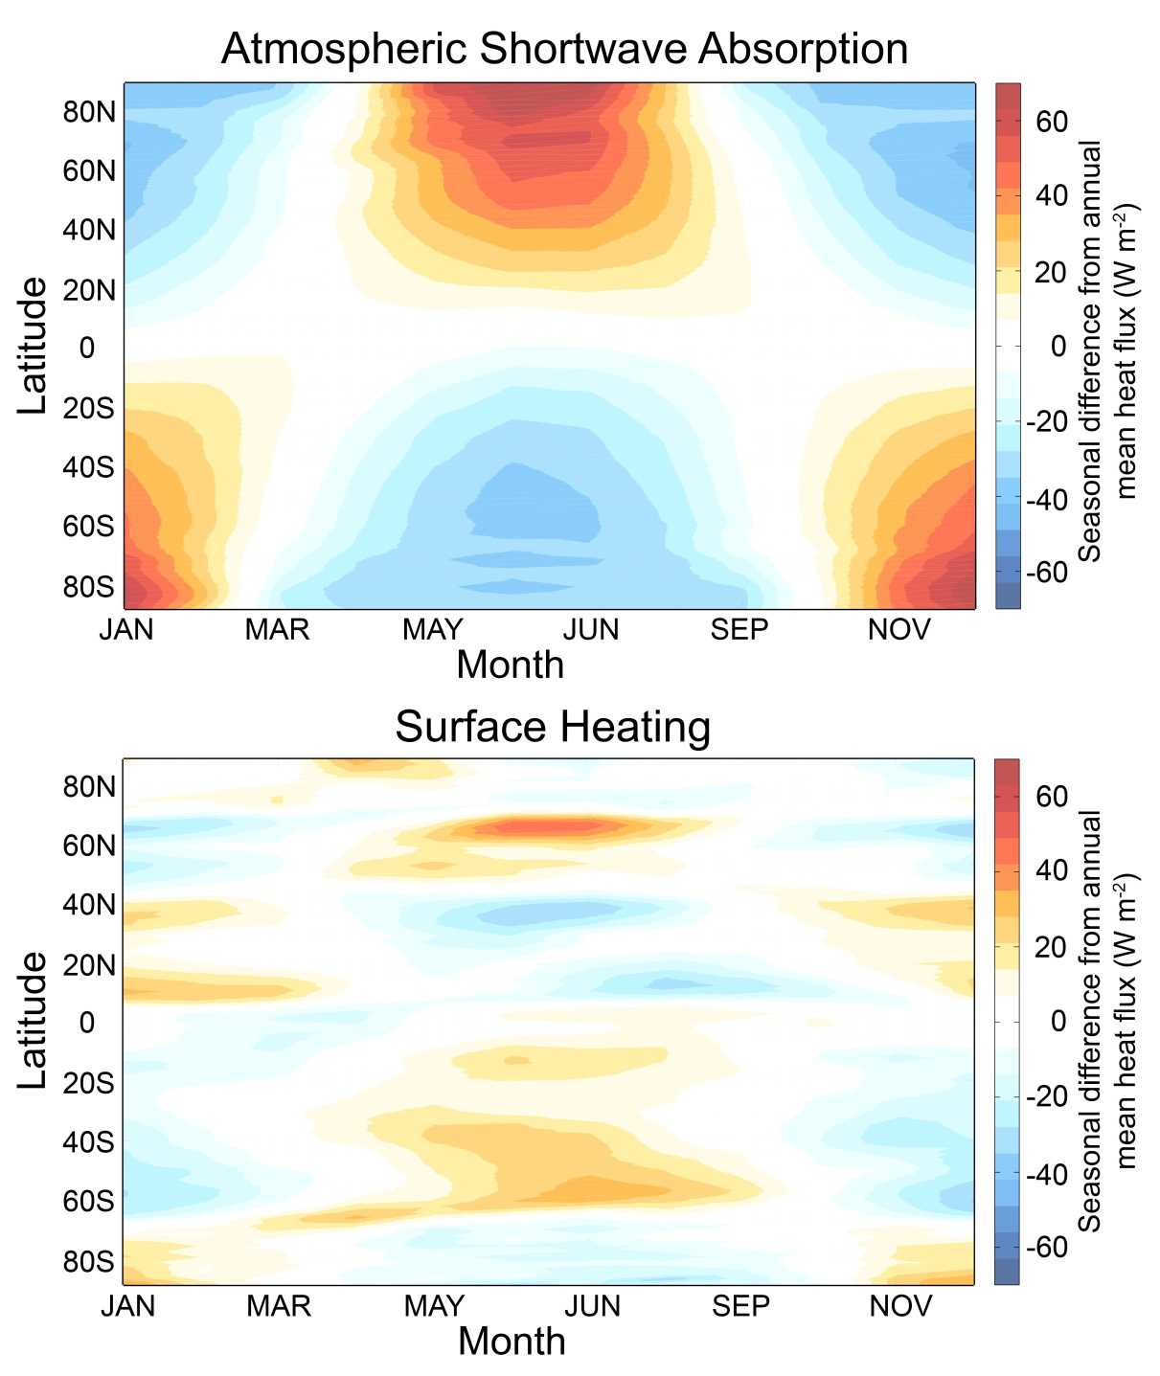
Seasonal Atmospheric Heating
ANNUAL MEAN IS
REMOVED

Slide 37
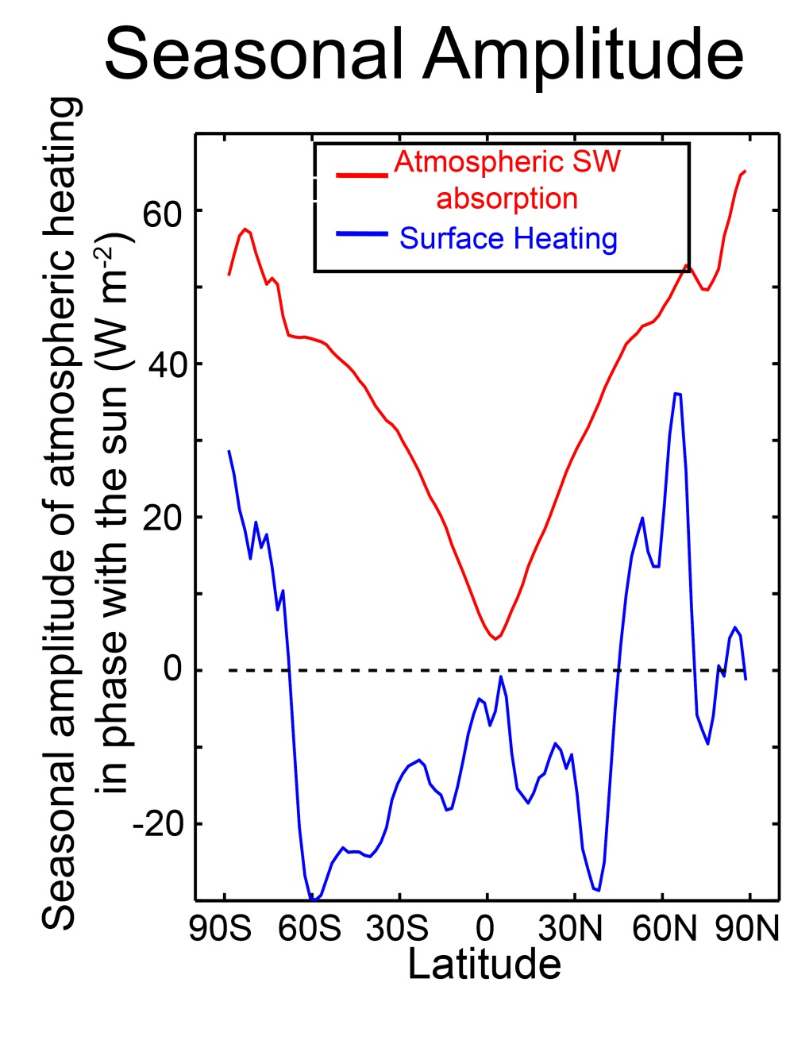
Seasonal Amplitude of heating
Annual Mean
Define seasonal amplitude as:
Amplitude of annual harmonic
In phase with the insolation
Takes into account magnitude
and phase
Positive amplifies seasonal cycle
Negative reduces seasonal cycle

Slide 38

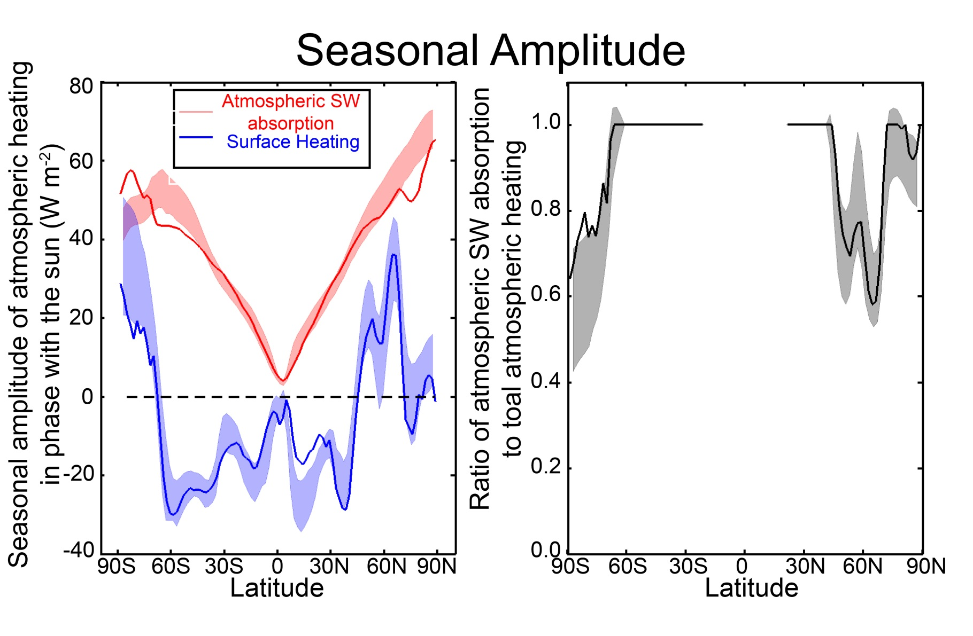
The seasonal heating of the atmosphere in climate models
Seasonal Amplitude
In phase with sun
Surface fluxes and shortwave absorption are calculated directly from model output
Atmospheric heat transport as a residual
=> Solid lines = observations
=> Shading is ±1σ about CMIP3 ensemble mean

Slide 39
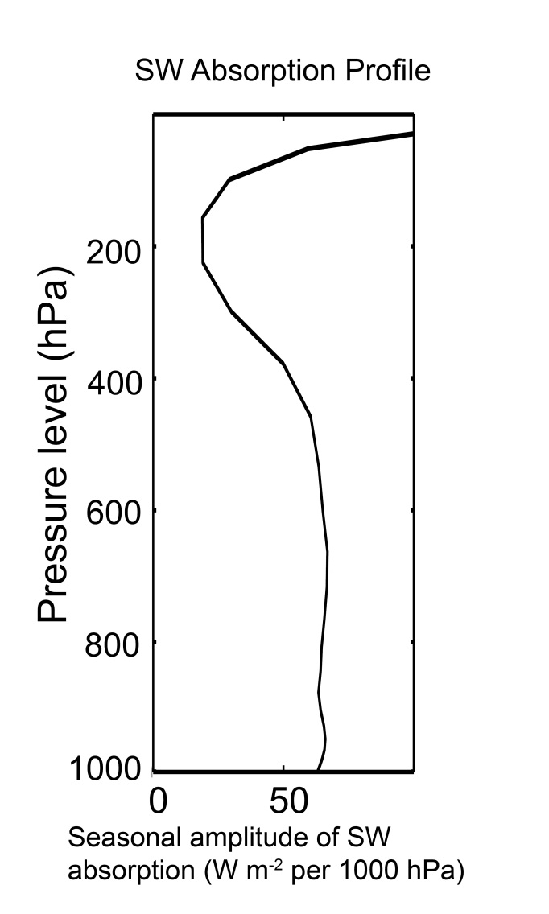
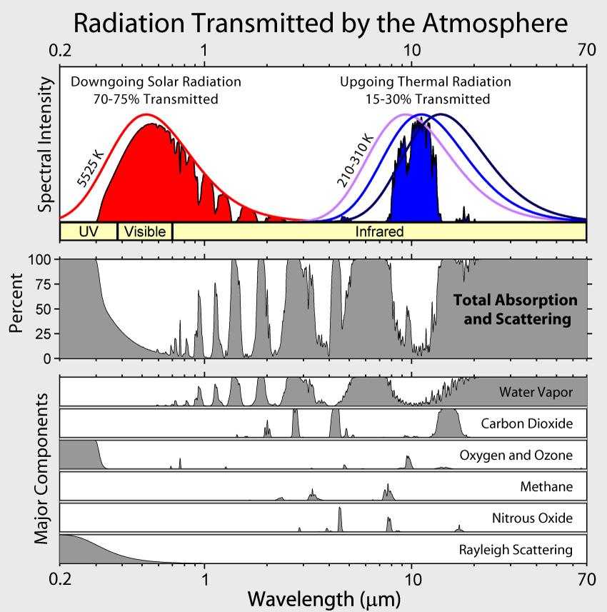
Define a seasonal amplitude
Vertical structure of SW absorption
GFDL Model
Seasonal amplitude
In the extratropics
Ozone
Water
Vapor

Slide 40
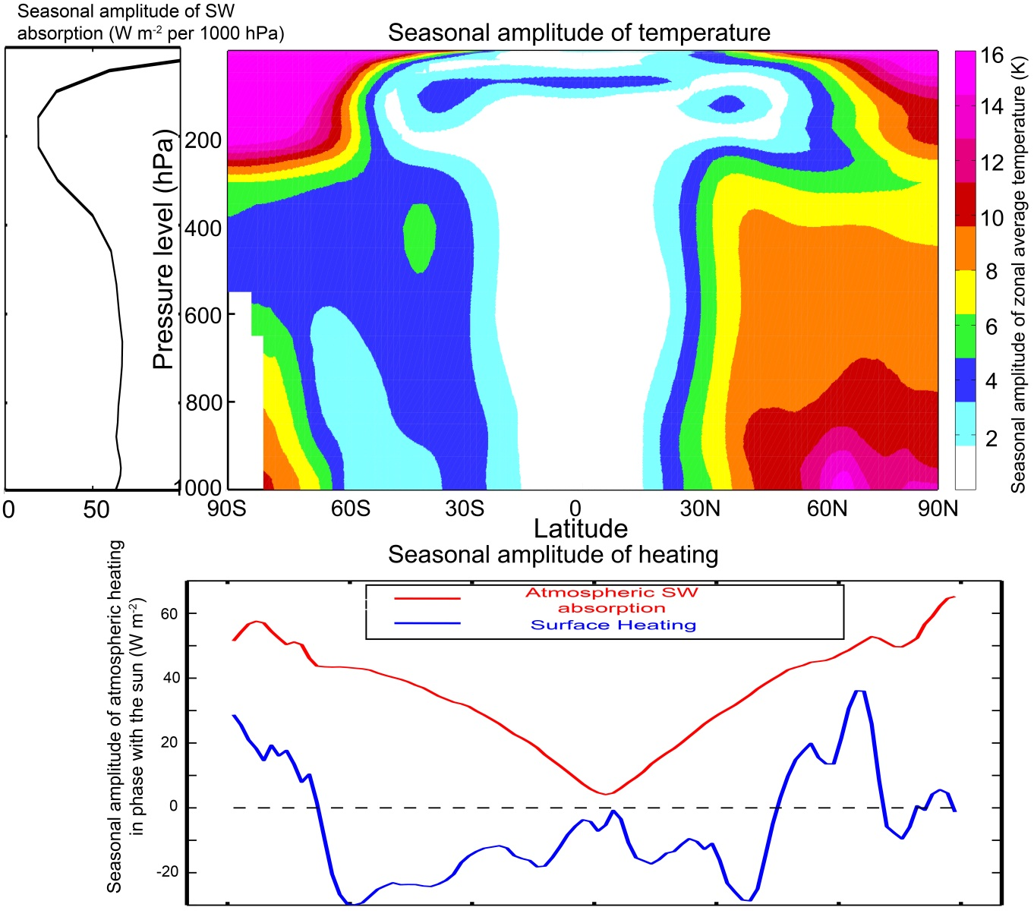
Structure of seasonal amplitude in temperature
Seasonal cycle is surface amplified where the surface heat fluxes contribute to seasonal heating (over land)

Slide 41
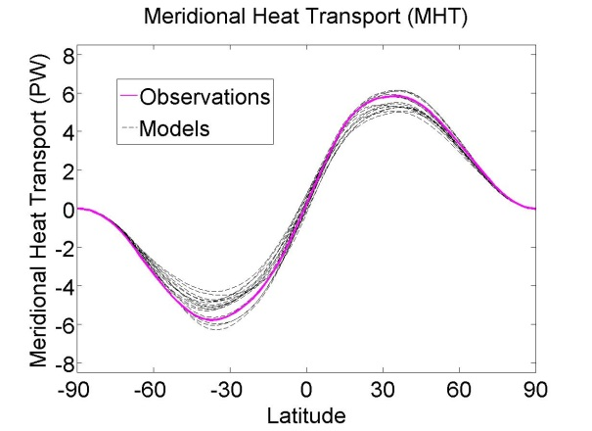

Conclusions
Reflected by Atmosphere
Global mean planetary albedo is primarily (88%) due to atmospheric reflection and only secondarily (12%) due to surface reflection
-> Climatology and model spread
-> Hemispheric contrast in planetary albedo sets ITCZ location
Solar Incident
Reflected by Surface
Atmosphere
2. Poleward energy transport varies by 20% in climate models and is a consequence of simulated clouds
3. The seasonal heating of the atmosphere is due to shortwave heating of the atmosphere and is opposed by surface fluxes (contrast to annual mean)

Slide 42
Extras

Slide 43
CO₂ doubling expectations
Summer schematic
Surface flux
SWABS
Moistening and melting
Mores seasonal energy input directly into the atmosphere (SWABS)
Less seasonal energy input at the surface (SHF)
Sea ice
Open ocean

Slide 44
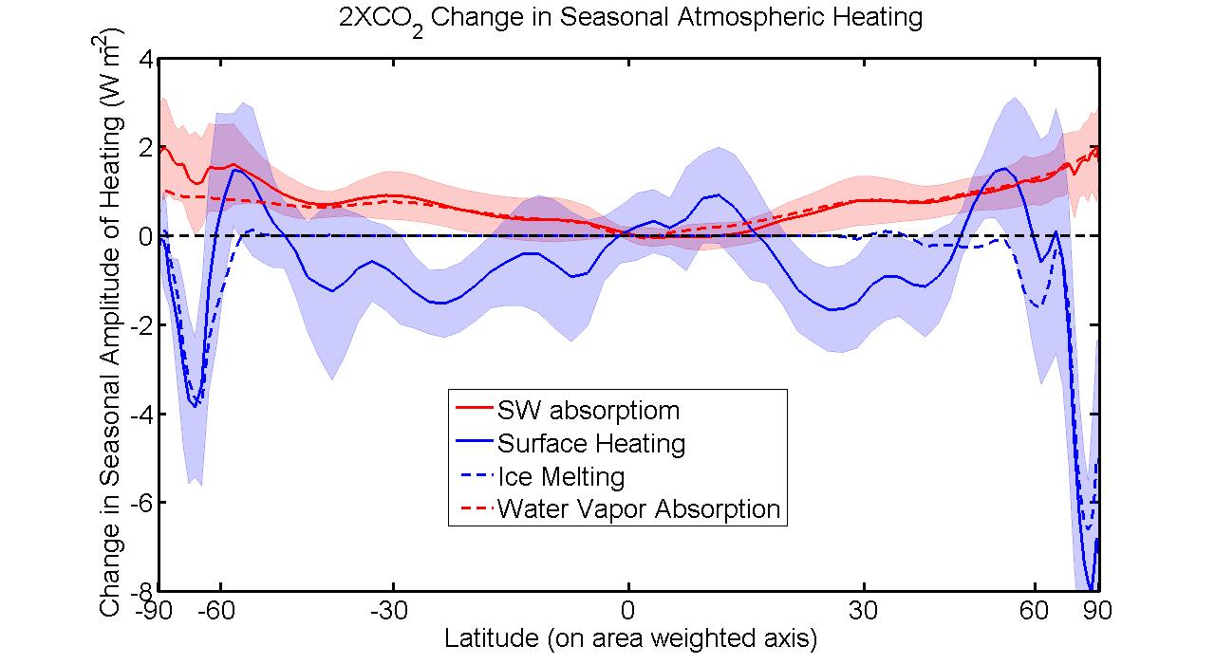

Slide 45
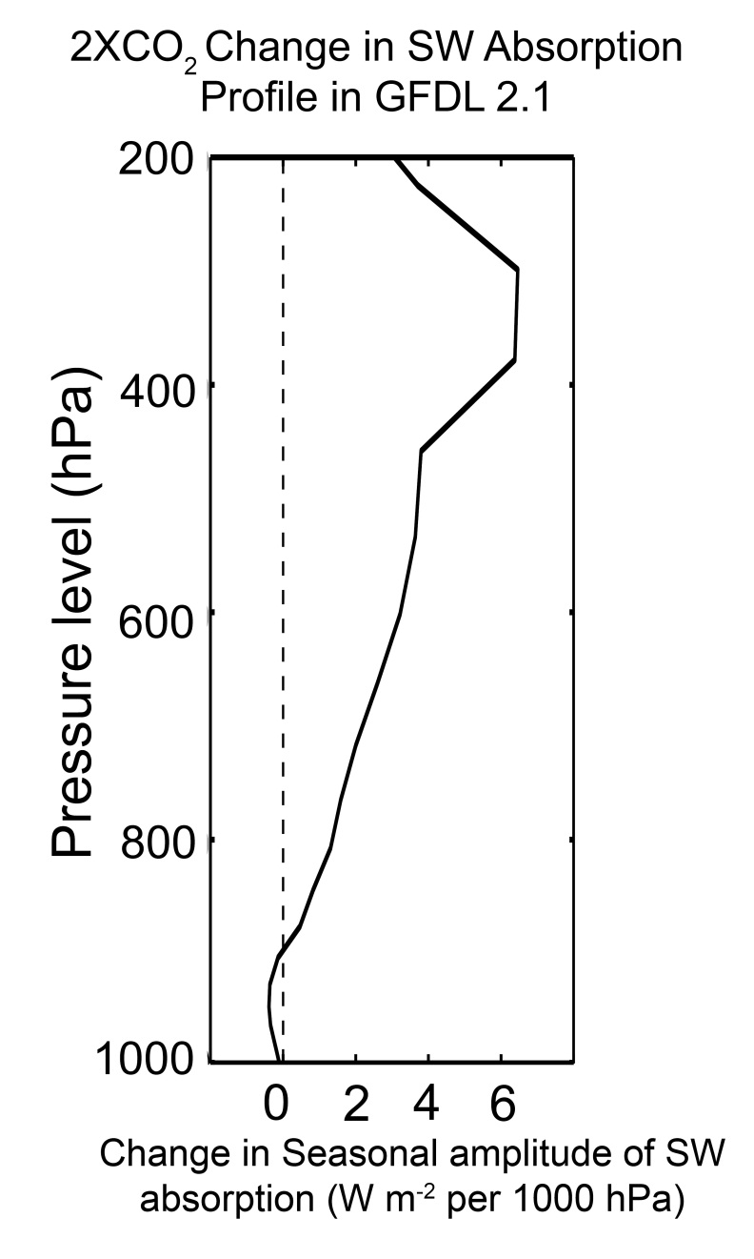
Water Vapor as a SW Absorber
(Figure: Robert Rhode
Global Warming Art Project)

Slide 46
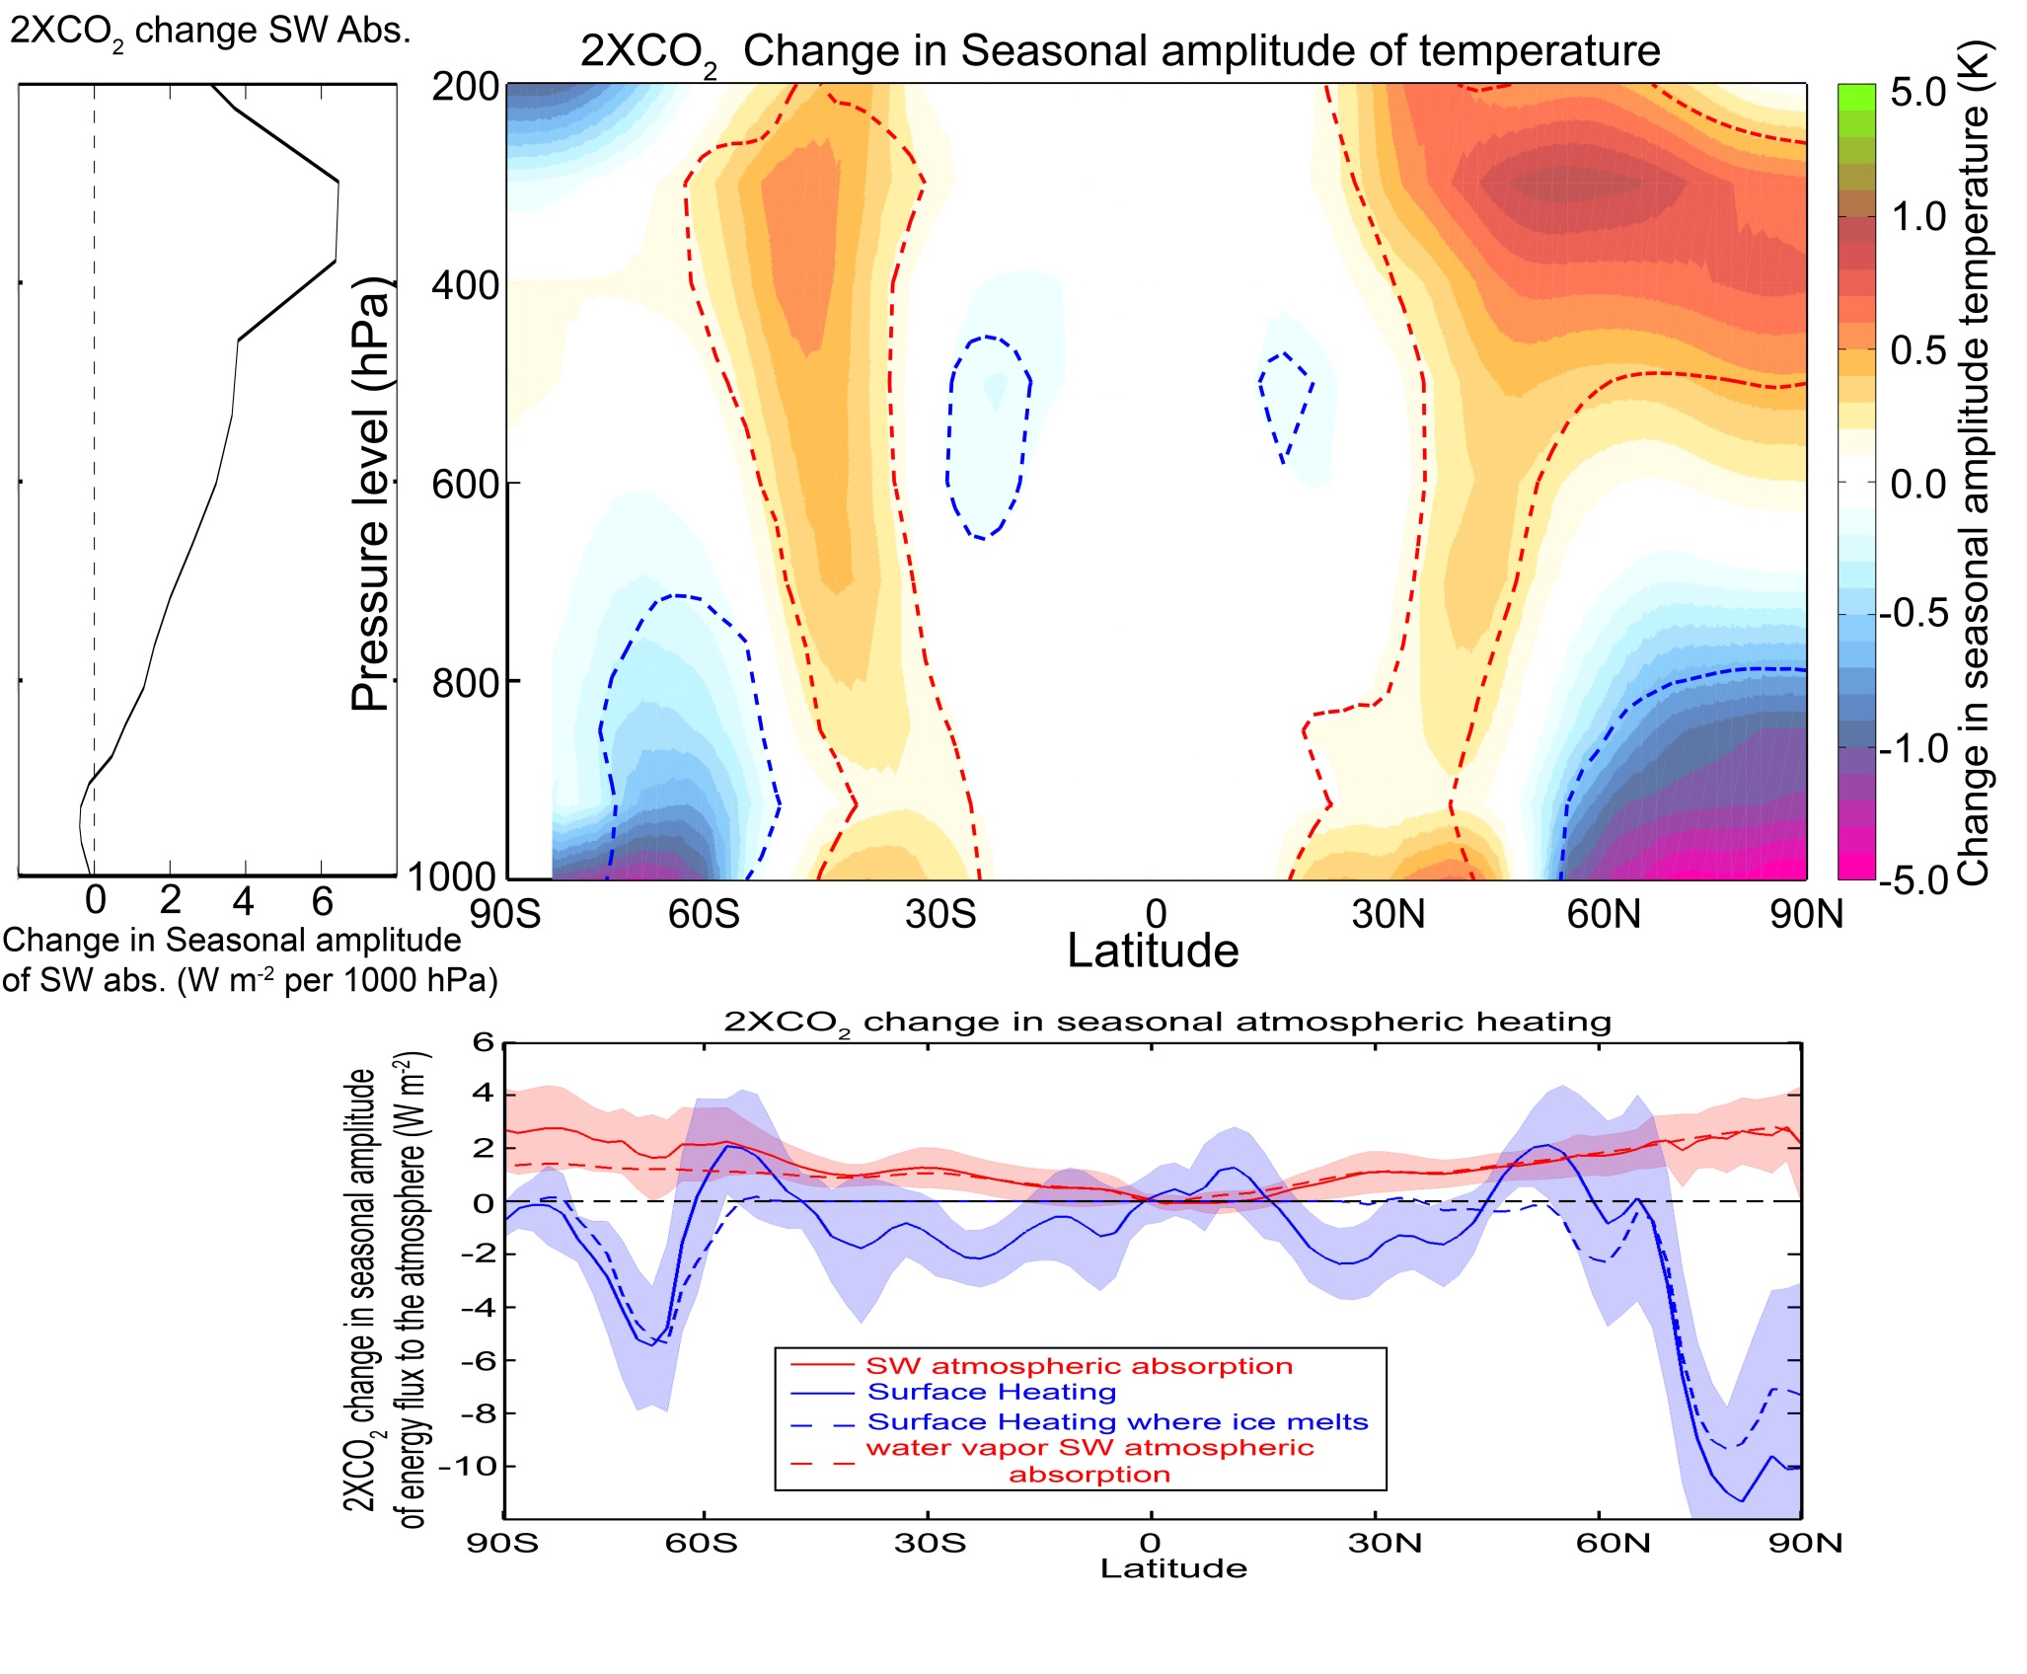
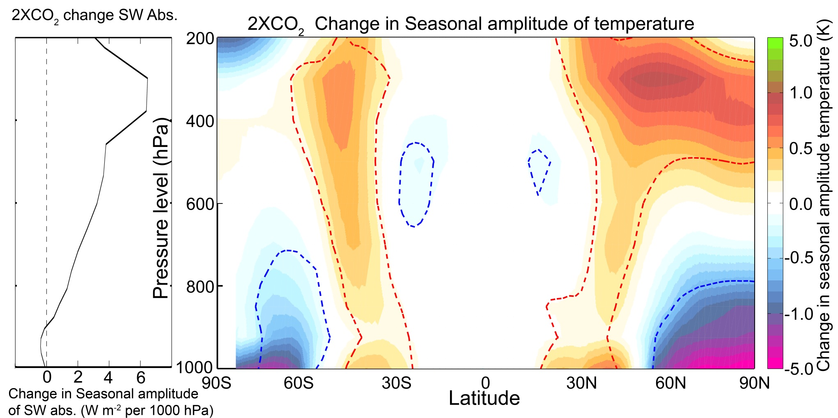
Reflects the combined contributions of:
Melting sea ice
=> reduced seasonal cycle of temperature at the surface
2. Increased SWABS due to atmospheric moistening
=> enhanced seasonal cycle of temperature aloft

Slide 47
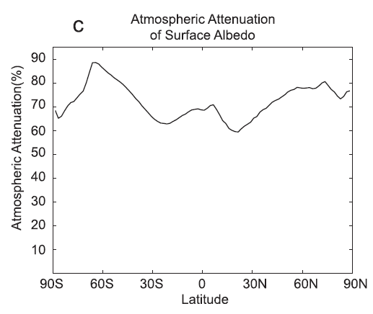
Meridional structure of atmospheric attenuation

Slide 48
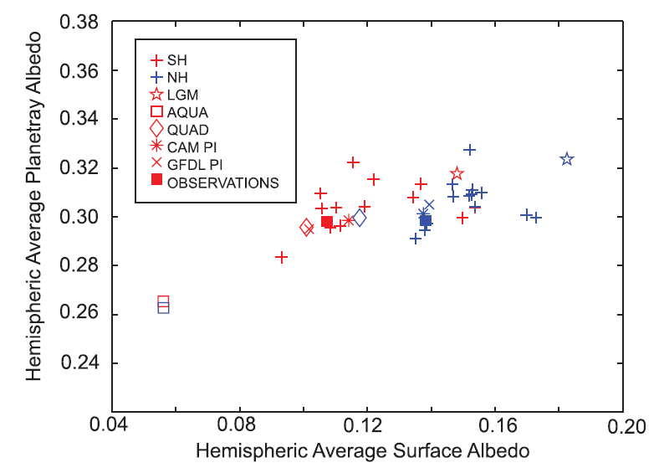
Planetary Albedo and Surface Albedo

Slide 49
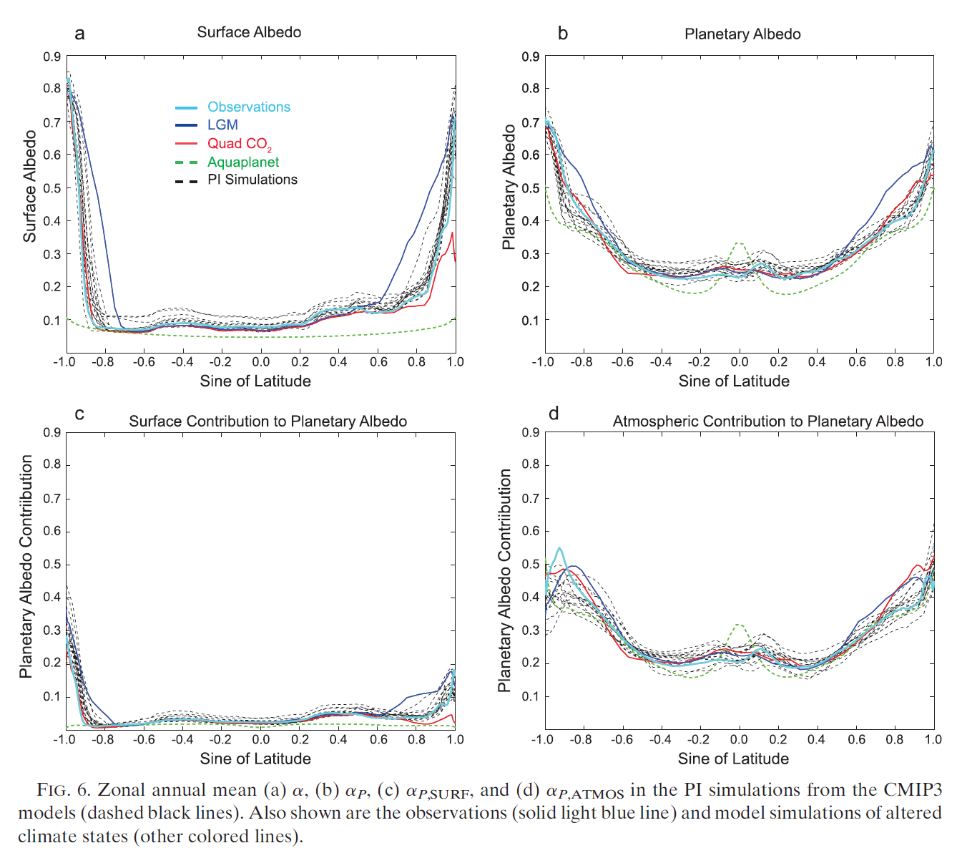
Meridional profile of albedo in all simiulations

Slide 50
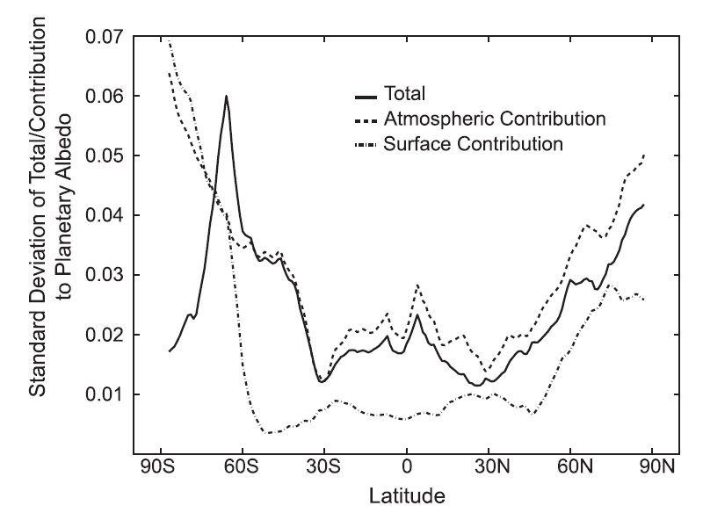
Inter-model spread in albedo by region

Slide 51
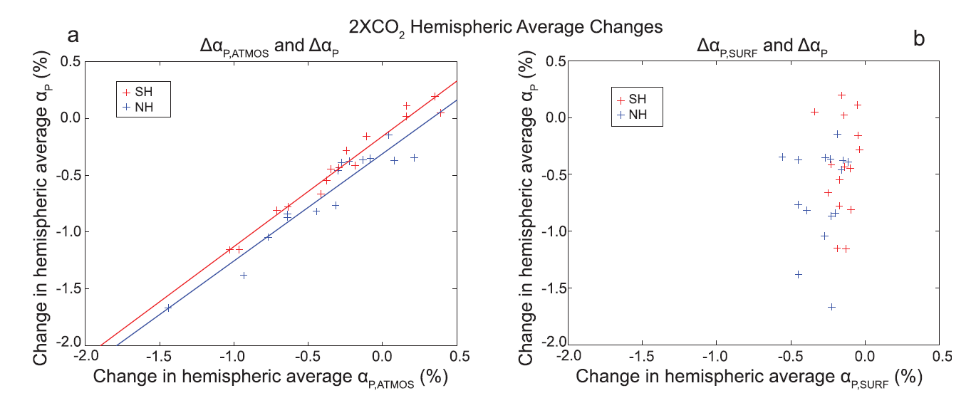
2XCO₂ Planetary Albedo

Slide 52
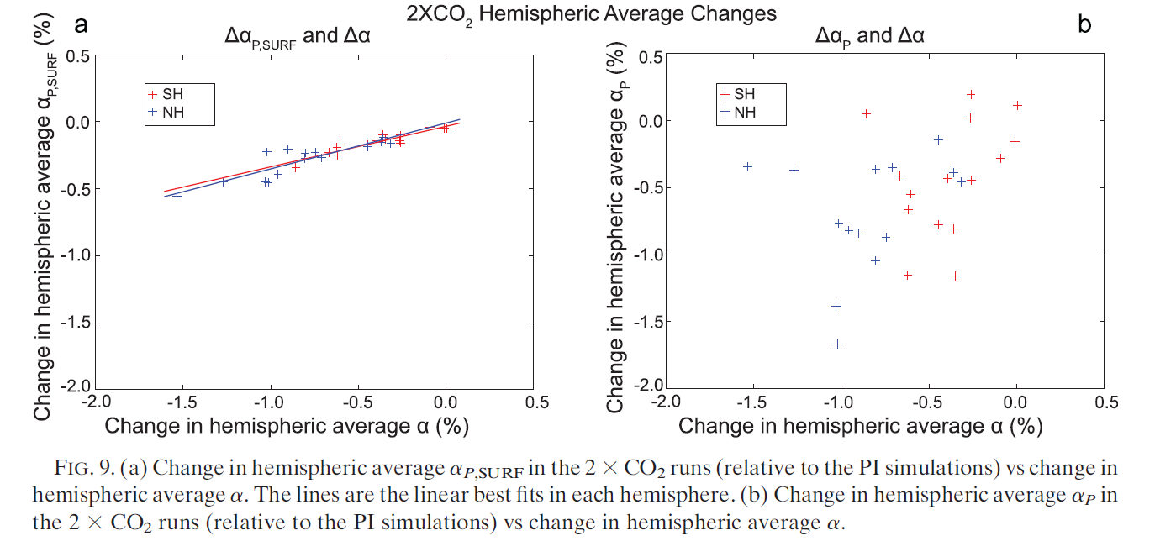
2XCO₂ Planetary Albedo

Slide 53
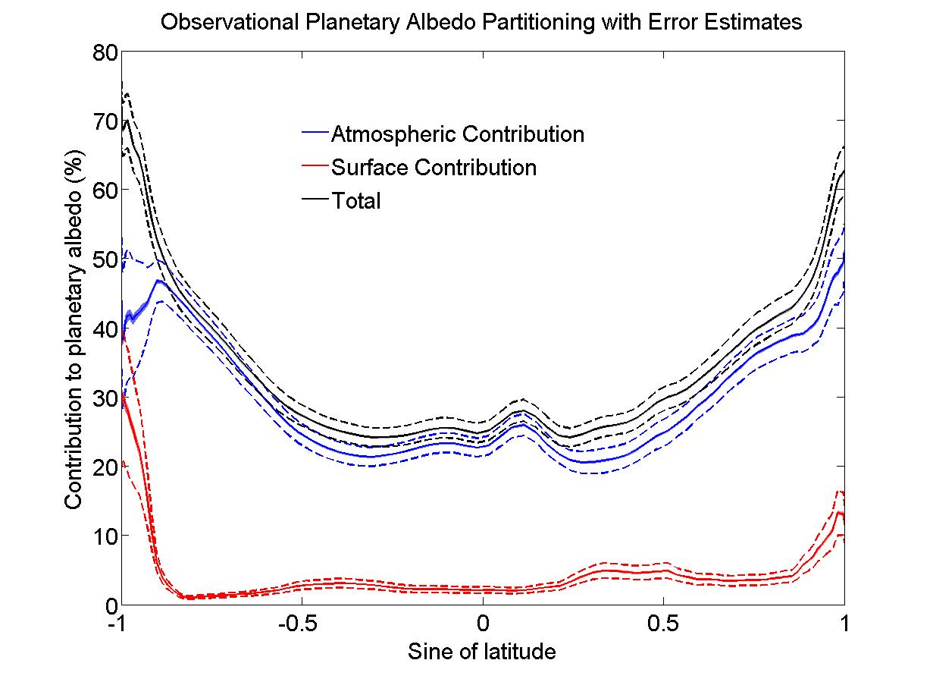
Carl’s Question: Planetary Albedo Partitioning Error Bars

Slide 54
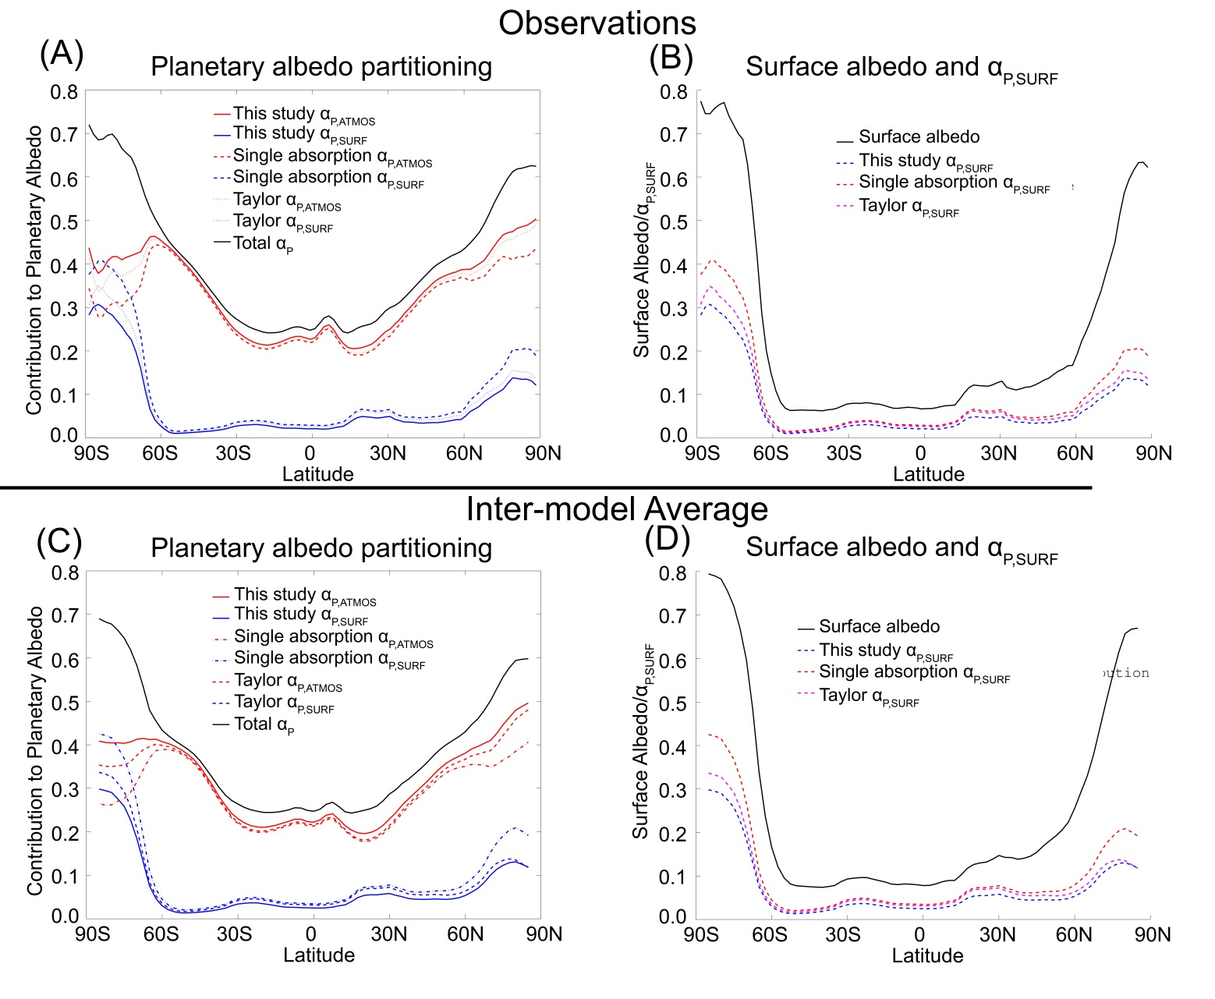
Planetary Albedo Partition: Sensitivity to shortwave absorption assumptions

Slide 55
What determines OLR*?
Why don’t differences in ASR* and OLR* compensate for each other?
Longwave Cloud Forcing
LWCF = OLR_{CLEAR} - OLR
(Kiehl, 1994)

Slide 56


Contributions to ASR* spread

Slide 57

Hemispheric Contrast Of TOA Radiation
NH reflects more SW radiation in the subtropical deserts. SH reflects more SW in the extratropics due to clouds in the Southern Ocean
The NH is warmer (more OLR), especially in the polar latitudes
Planetary albedo is partitioned into cloud and surface contributions via the method of Donohoe and Battisti (2011)

Slide 58
Define a seasonal amplitude
Vertical structure of SW absorption
GFDL Model
Seasonal amplitude
In the extratropics
Chou Lee (1996)
Water vapor absorption
In the summer
50
100
150
Heating Rate (W m⁻² )

