Slide 1
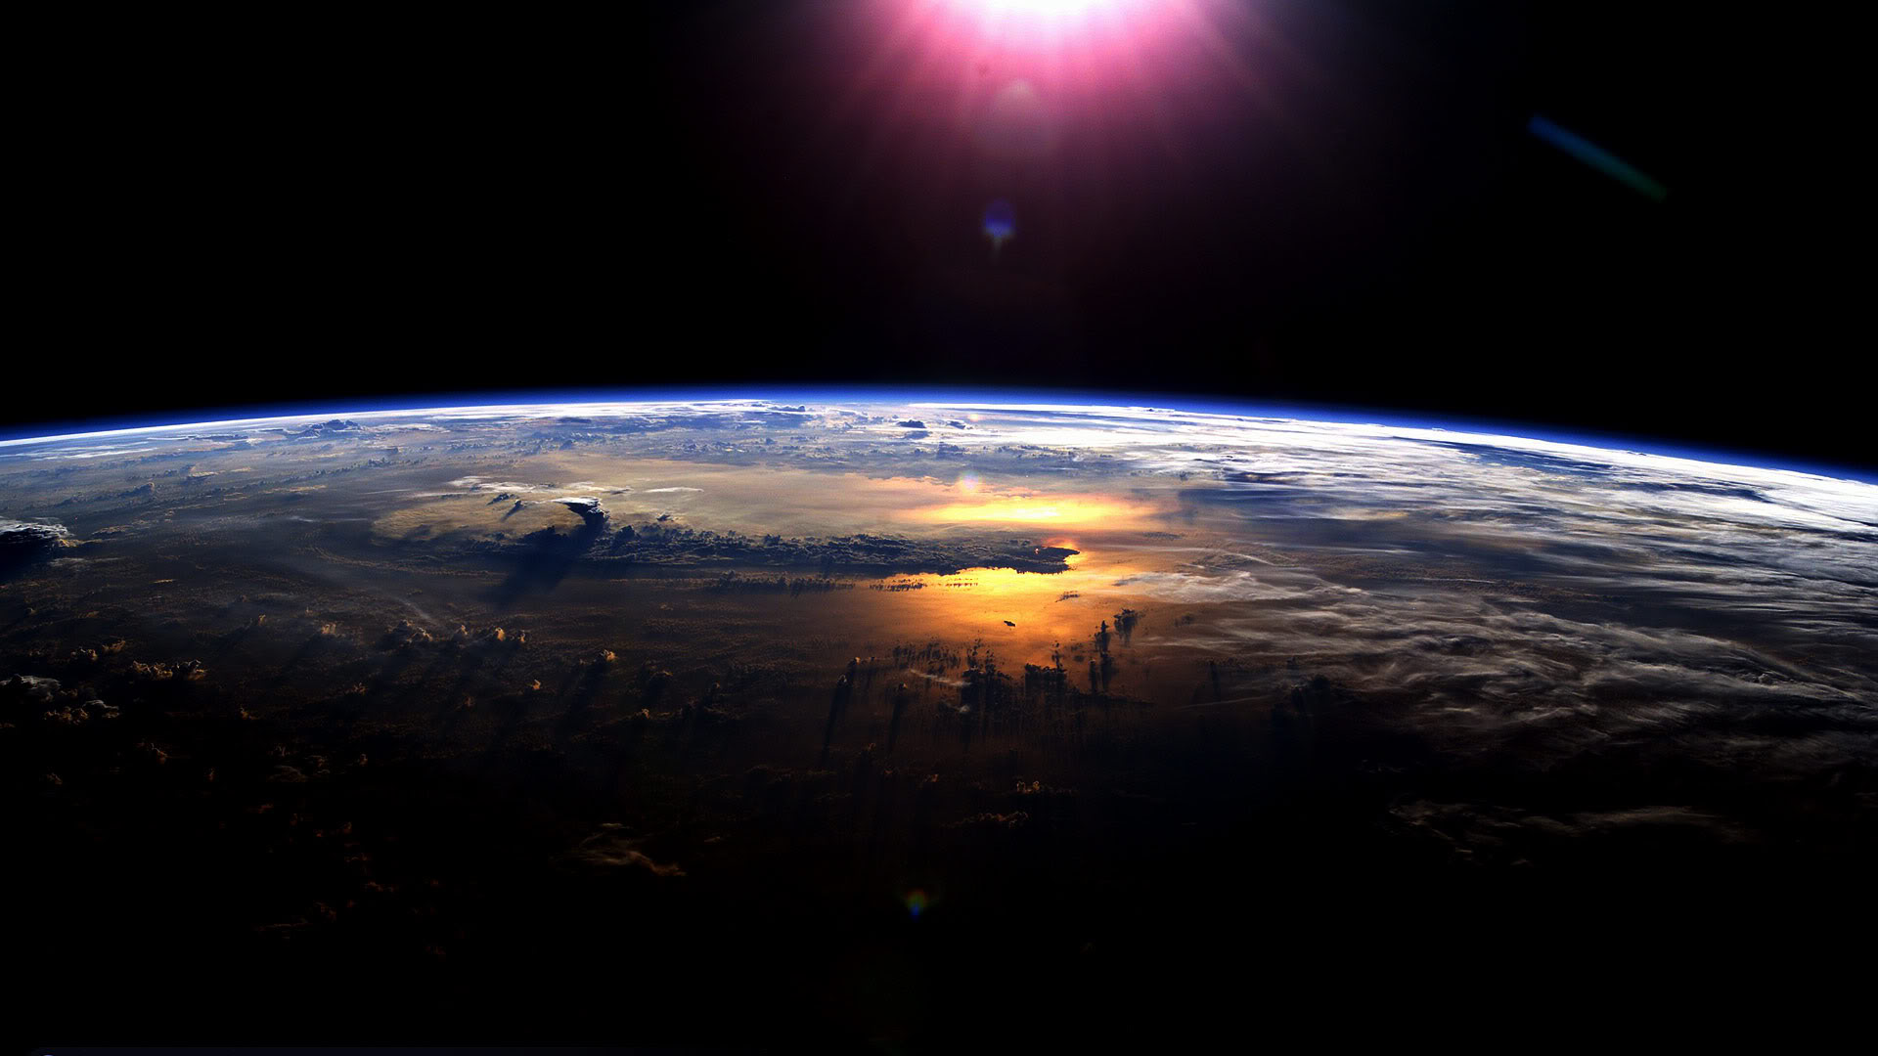
The absorption of solar radiation in the climate system
Aaron Donohoe
Applied Physics Lab – University of Washington

Slide 2
How much solar radiation is absorbed and reflected by the climate system
Reflected by Atmosphere
Solar Incident
Reflected by Surface
Atmosphere
Surface
Earth’s Surface

Slide 3
Global mean energy balance
The Earth receives energy from the sun (and reflects back some portion of it)
To come into energy balance (equilibrium) the Earth must emit the same amount of energy it receives
Reflected
Emitted
Incident
Solar
Incident – Reflected = Emitted
Earth
Absorbed Solar Radiation (ASR)
Emitted radiation= OLR ∝ T_{e}

Slide 4
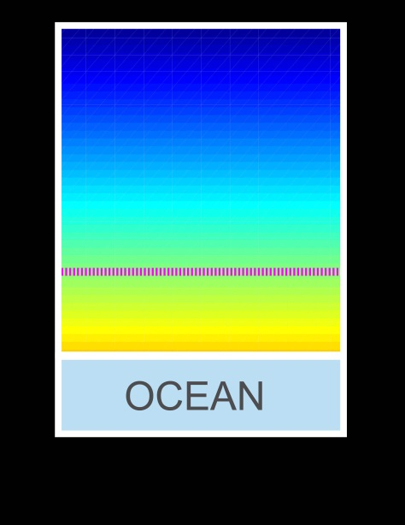
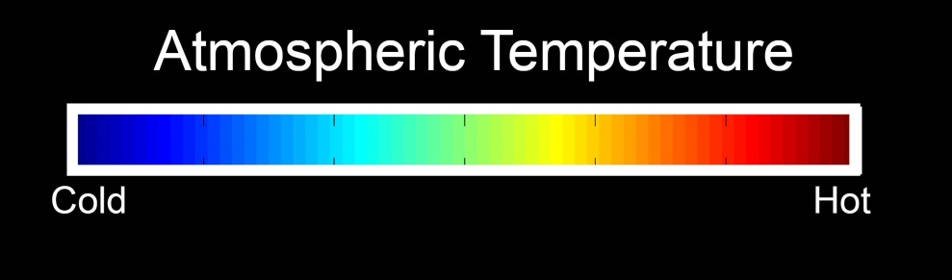
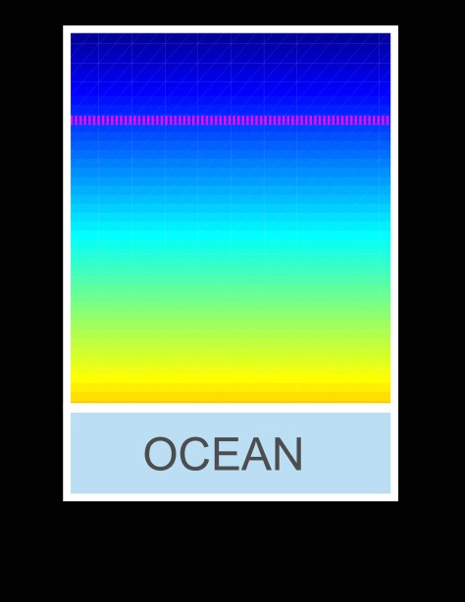
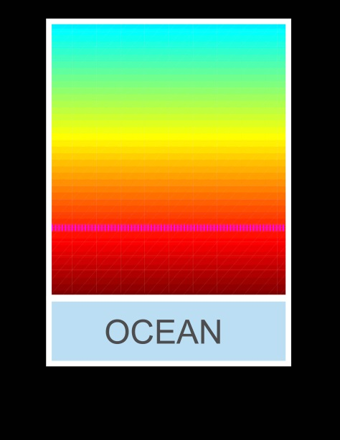

Energy imbalance and temperature change
Unperturbed
ASR = OLR
Atmospheric Emission Level
Solar Perturbation
Greenhouse Perturbation
ASR = OLR
ASR > OLR
CO₂
CO₂
ASR = OLR
ASR > OLR

Slide 5
Equator-to-pole contrast
The tropics receive more solar radiation than the high latitudes (extratropics)
To come to equilibrium, the tropics must either emit excess radiation or transport energy to the extratropics
Incident
Reflected
Emitted
Net
Tropics
Extratropics

Slide 6
Seasonal Cycle
Seasonal variations in solar insolation are of order 1 in the extratropics
How much energy goes into the atmosphere versus the ocean to drive seasonal variations in temperature and circulation?
ExtratropicsSummer
Heating
Solar
Atmos.-Ocean
Exchange
Emitted
Heat Transport
Absorbed
Transmitted
Energy gain

Slide 7


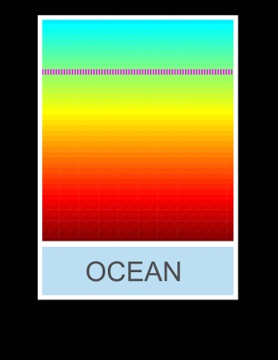
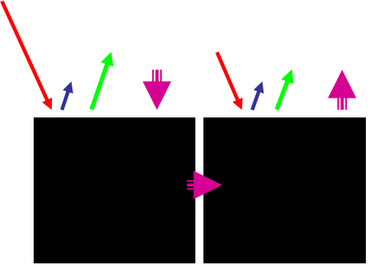
Outline
Reflected by Atmosphere
What determines how much solar radiation is absorbed in the climate system?
Solar Incident
Reflected by Surface
Atmosphere
2. How does the absorption of solar radiation change in a warmer world?
Shortwave and longwave contributions to global warming
Unperturbed
Solar forced
Greenhouse
3. What determines the meridional heat transport in the climate system?
Tropics
Extratropics
4. How do seasonal variations in solar insolation lead to atmospheric heating?

Slide 8
1 : What determines the Earth’s planetary albedo? (solar radiation reflected at top of atmosphere)
Reflected by Atmosphere
Solar Incident
Reflected by Surface
Atmosphere
Earth’s Surface

Slide 9
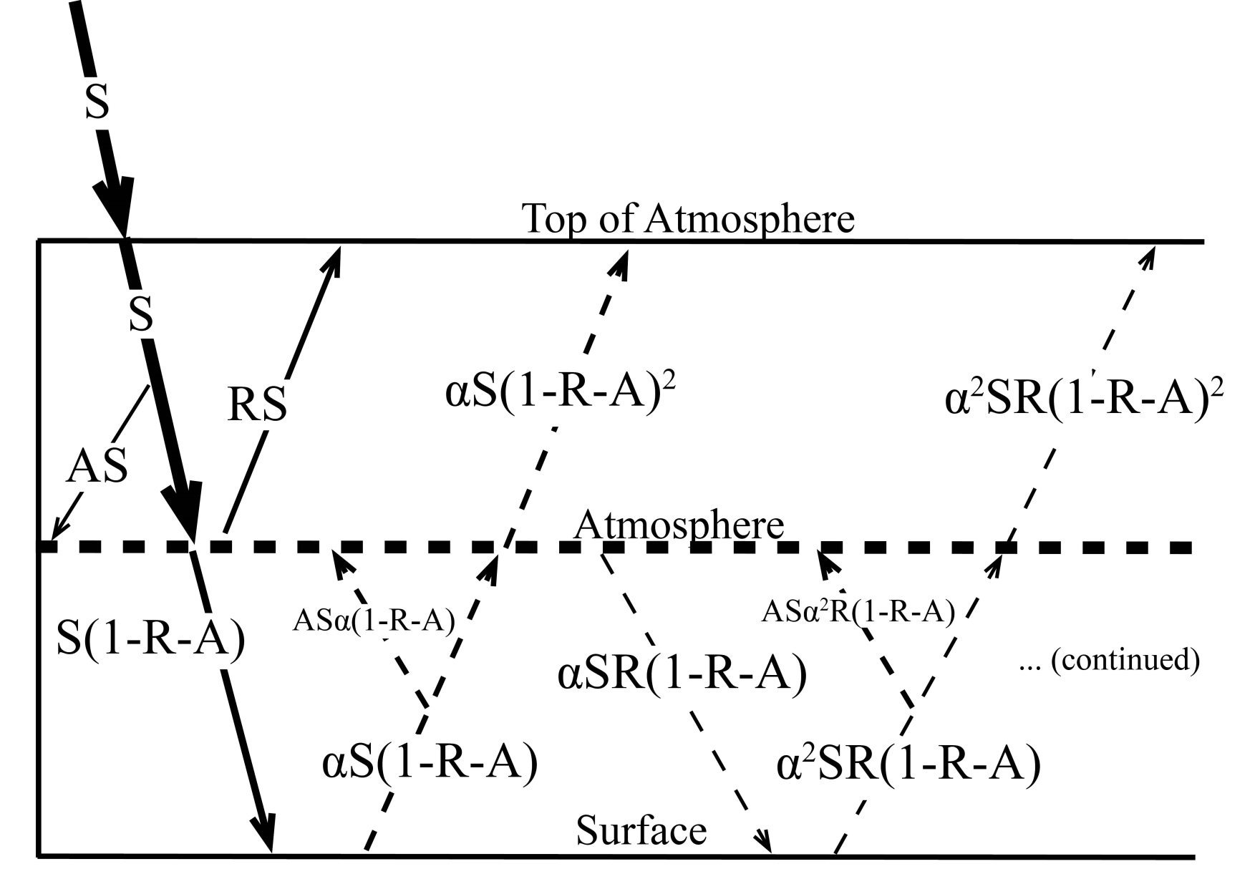
Simplified (isotropic) shortwave radiation model
Atmospheric
Contribution
To planetary
Albedo
Surface
Contribution
To planetary
Albedo
S = incident
R = cloud
reflection
A = absorption
α = surface
albedo
(UNKNOWNS)

Slide 10
Partitioning of planetary albedo into atmospheric and surface components
Reflected by Atmosphere
α_{P} = α_{P,ATMOS} + α_{P,SURF}
Reflected by Surface
α_{P,ATMOS} = R
Solar Incident
α_{P,SURF} = α(1-R-A)²
(1-αR)
Atmosphere
Earth’s Surface

Slide 11
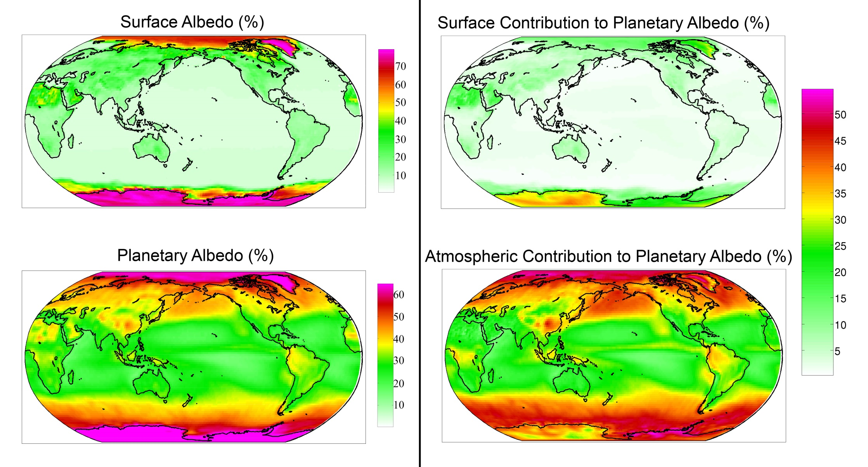
Observed (CERES) surface and atmospheric contribution to planetary albedo

Slide 12
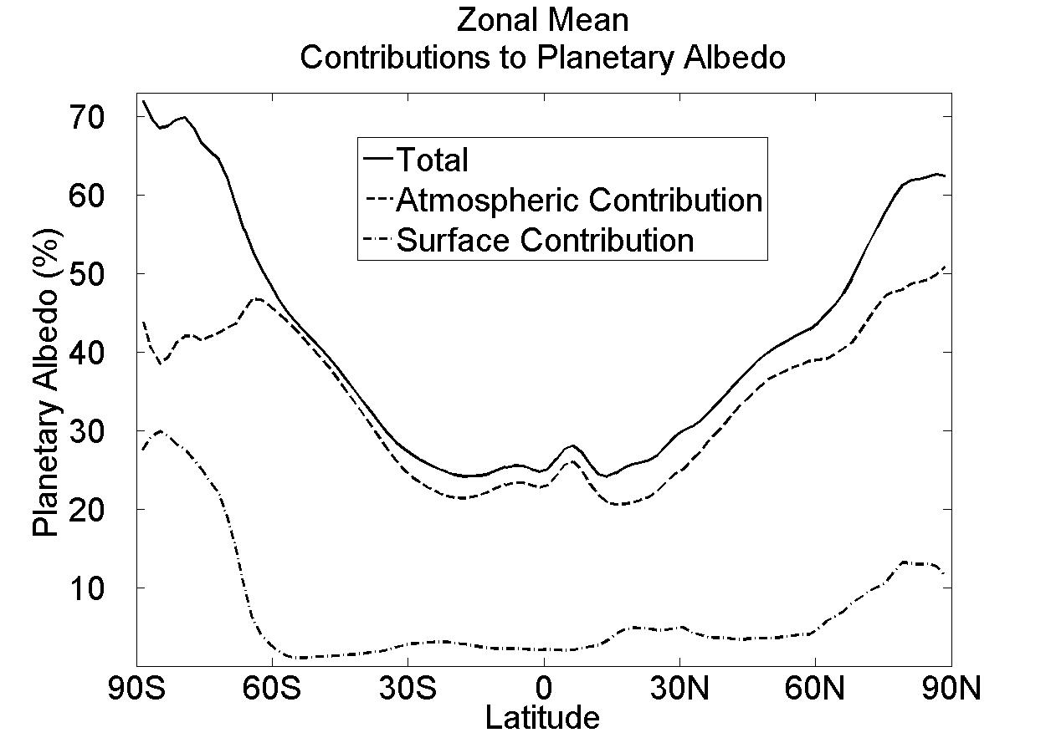
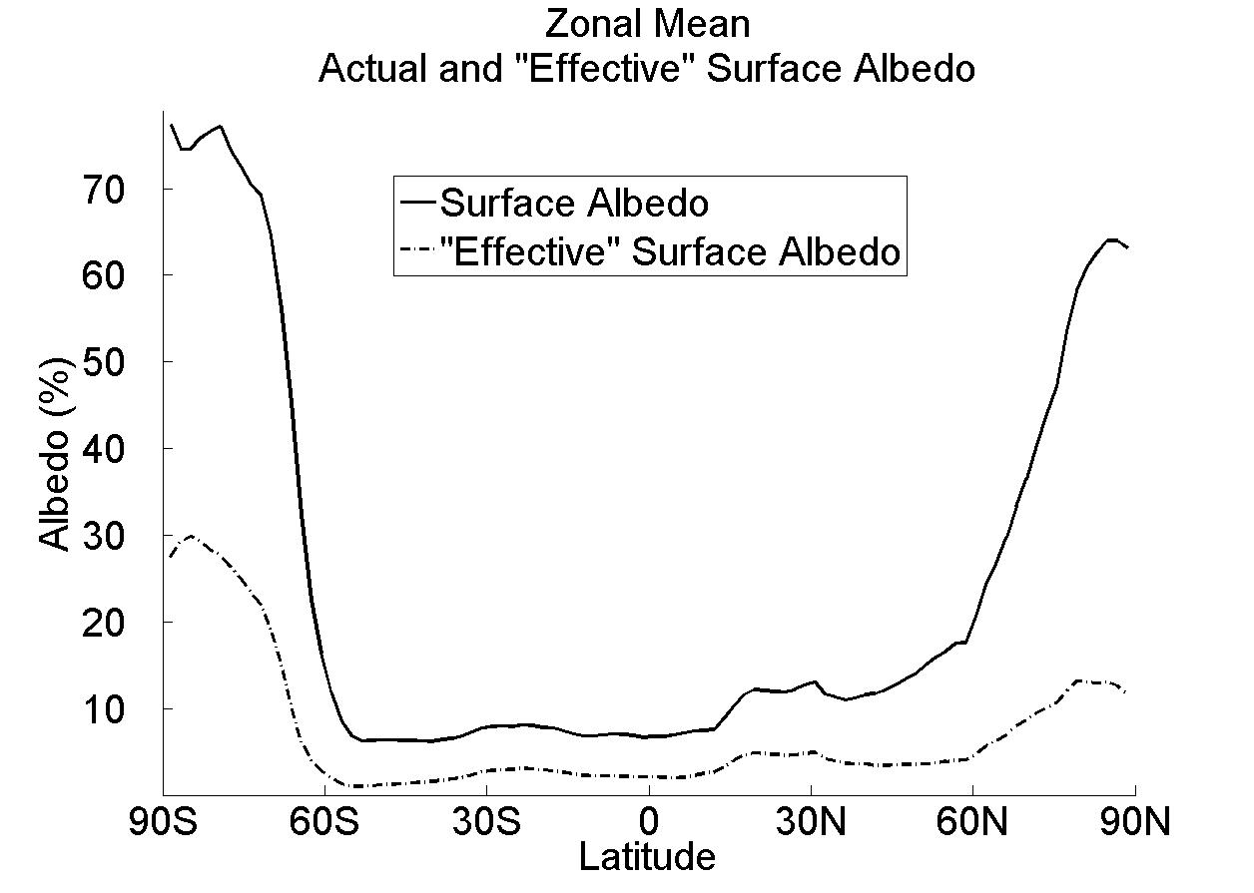
Observed Surface and atmospheric contribution to planetary albedo
Surface albedo and surface contribution to planetary albedo (α and α_{P,SURF})
α (surface albedo)
α_{P,SURF} = α(1-R-A)²
α_{P,SURF}
(1-αR)

Slide 13
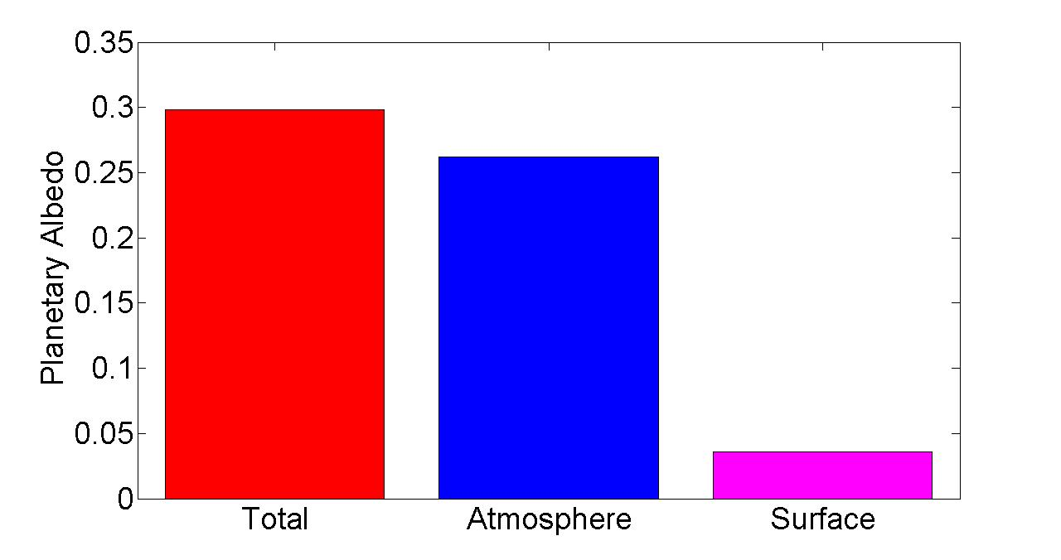
Observed Global Mean Planetary Albedo and it atmospheric/surface Partitioning
Notes:
0.298 = 0.262 + 0.036
100% = 88% + 12%

Slide 14
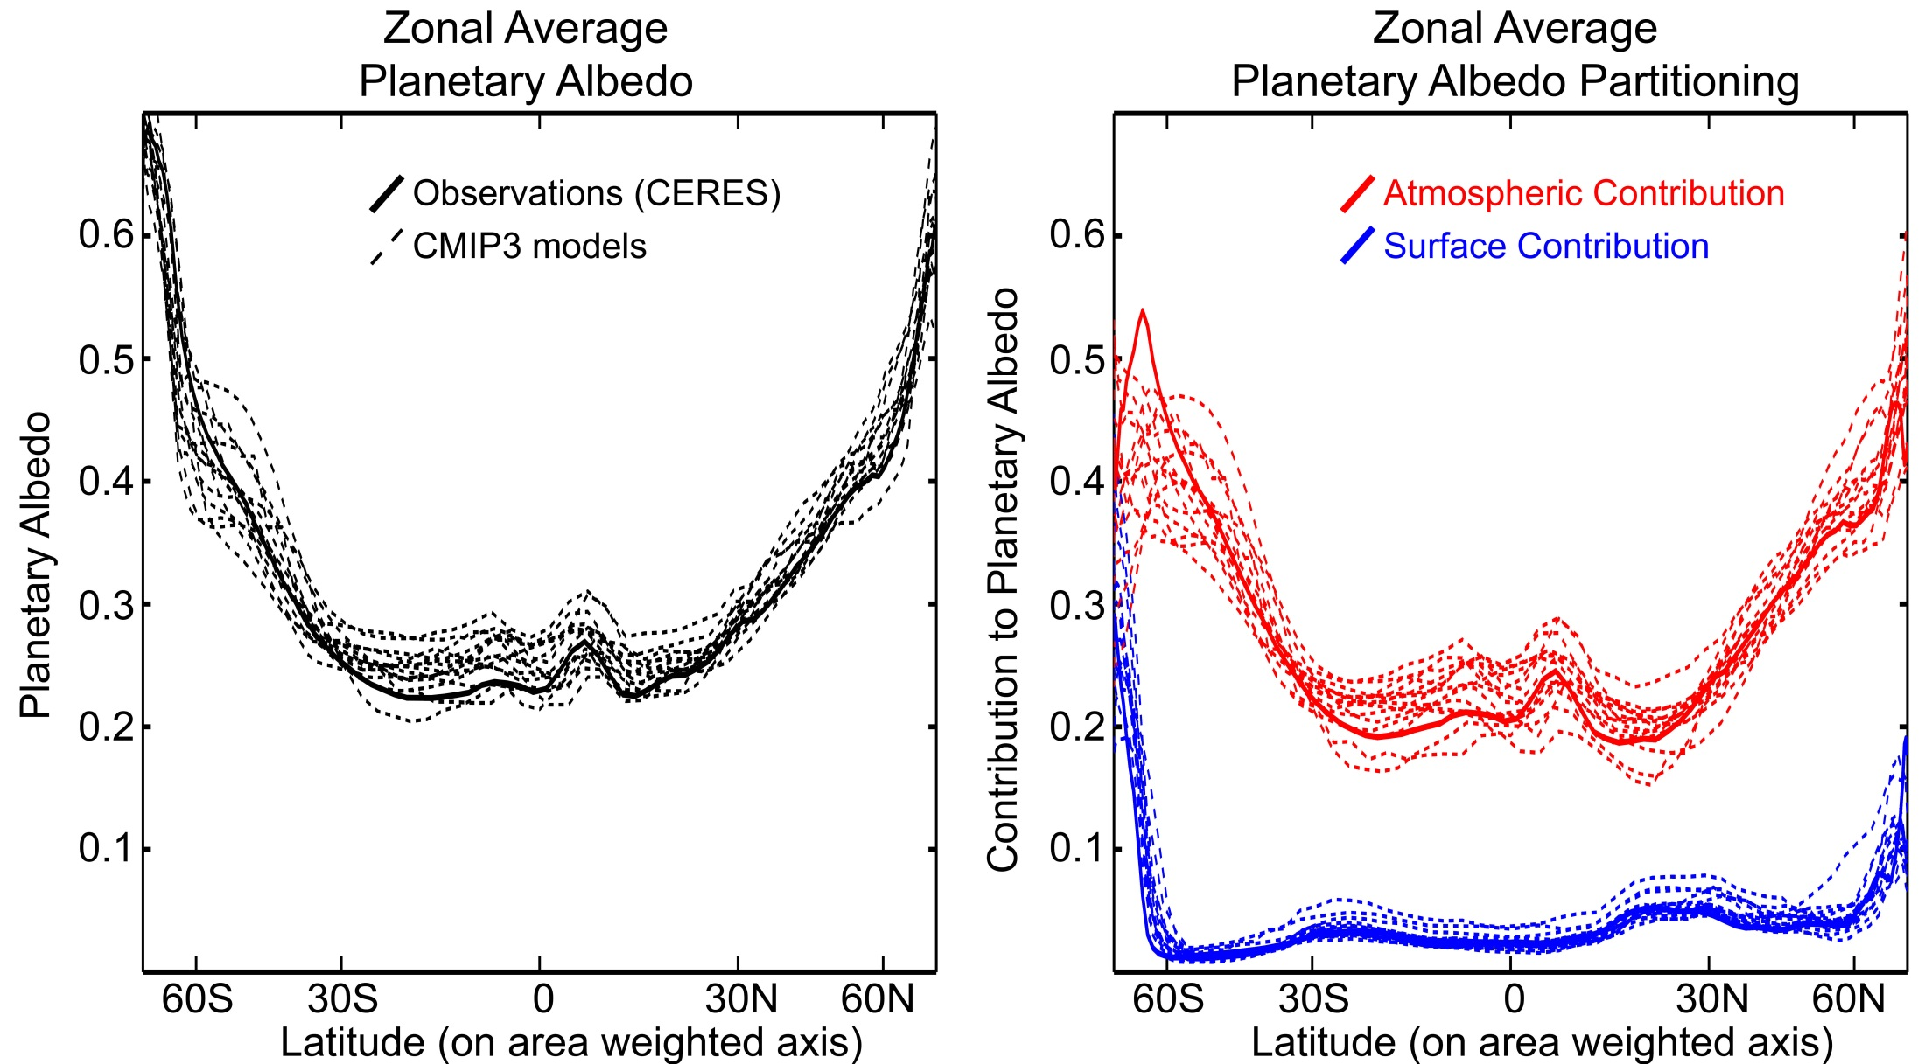
Planetary Albedo Partitioning:
Comparison of models (CMIP3 pre-industrial) and observations (CERES)

Slide 15
Shortwave and longwave contributions to global warming
Unperturbed
ASR = OLR
Atmospheric Emission Level
Solar Perturbation
Greenhouse Perturbation
ASR = OLR
ASR > OLR
CO₂
CO₂
ASR = OLR
ASR > OLR

Slide 16
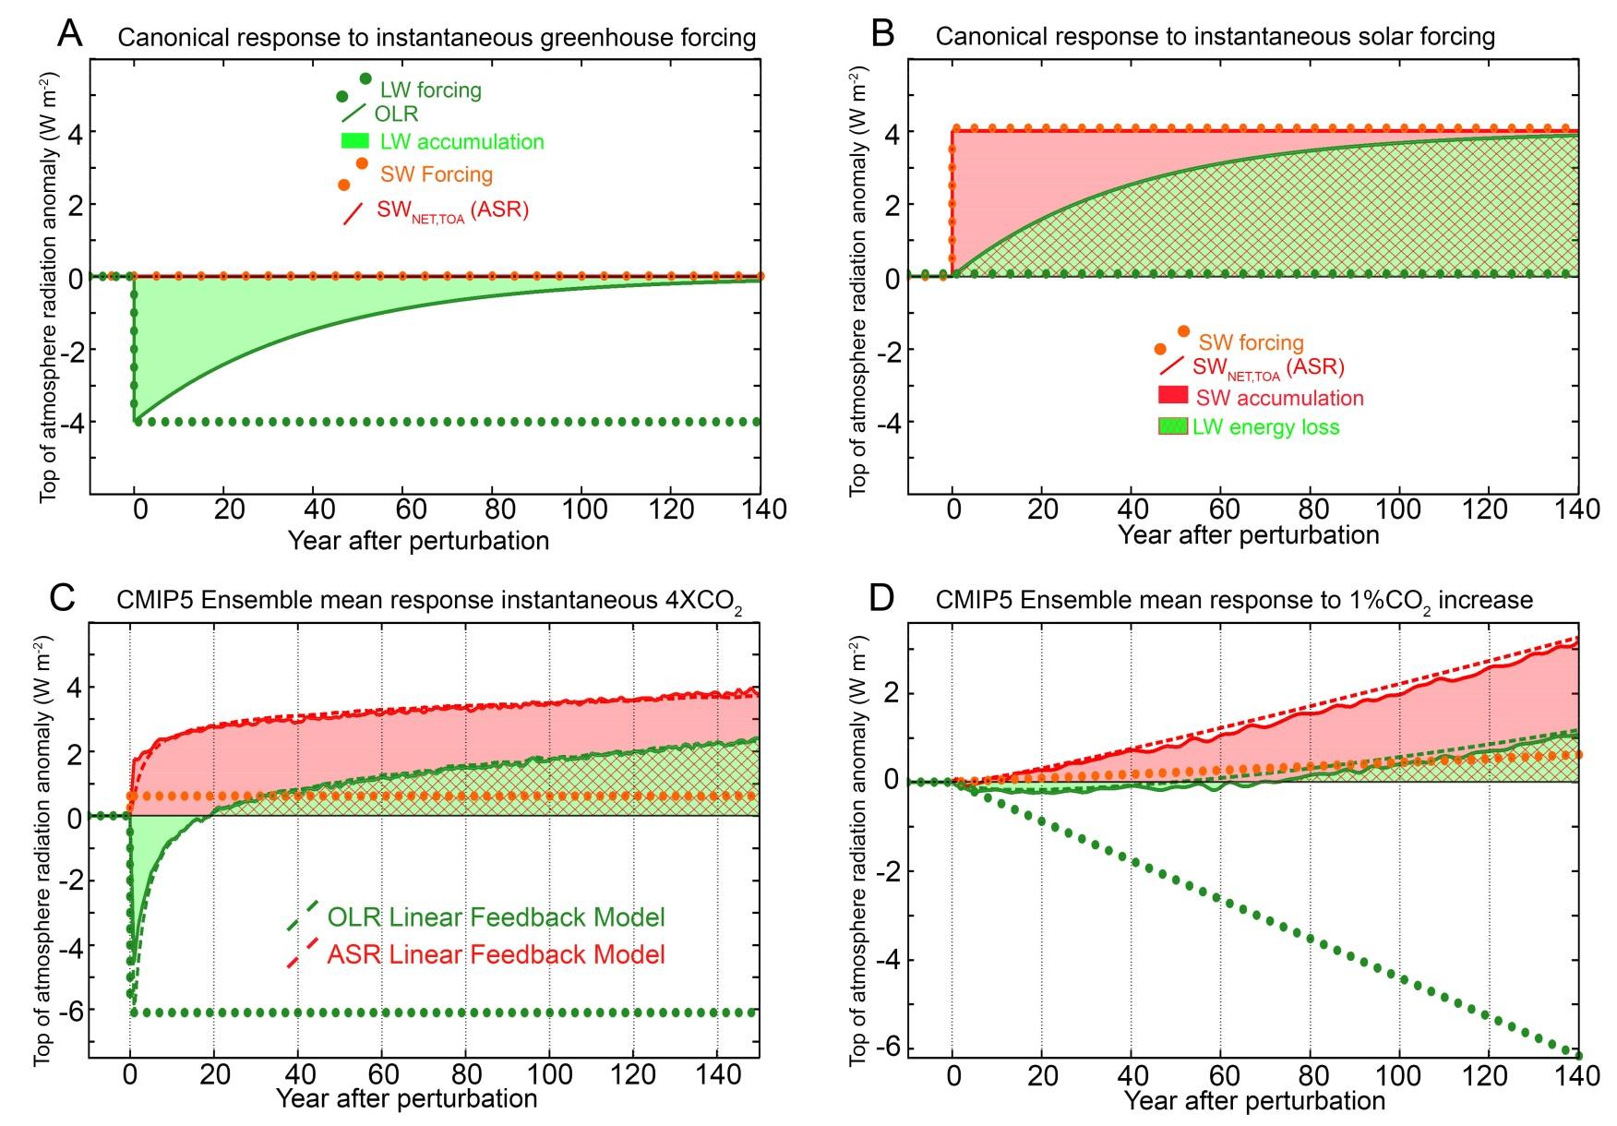
Top of Atmosphere Radiative response to greenhouse and shortwave forcing
OLR returns to unperturbed value in 20 years

Slide 17
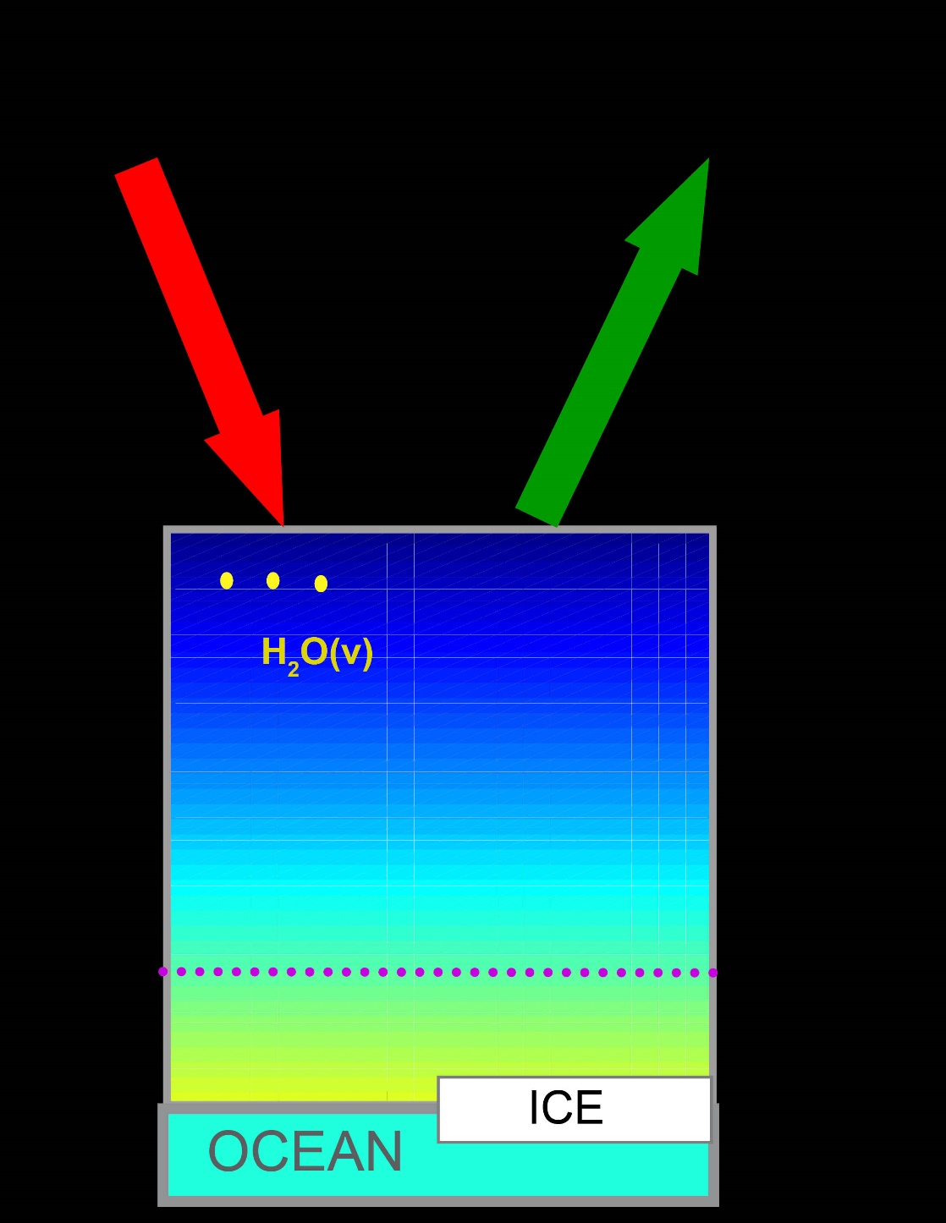
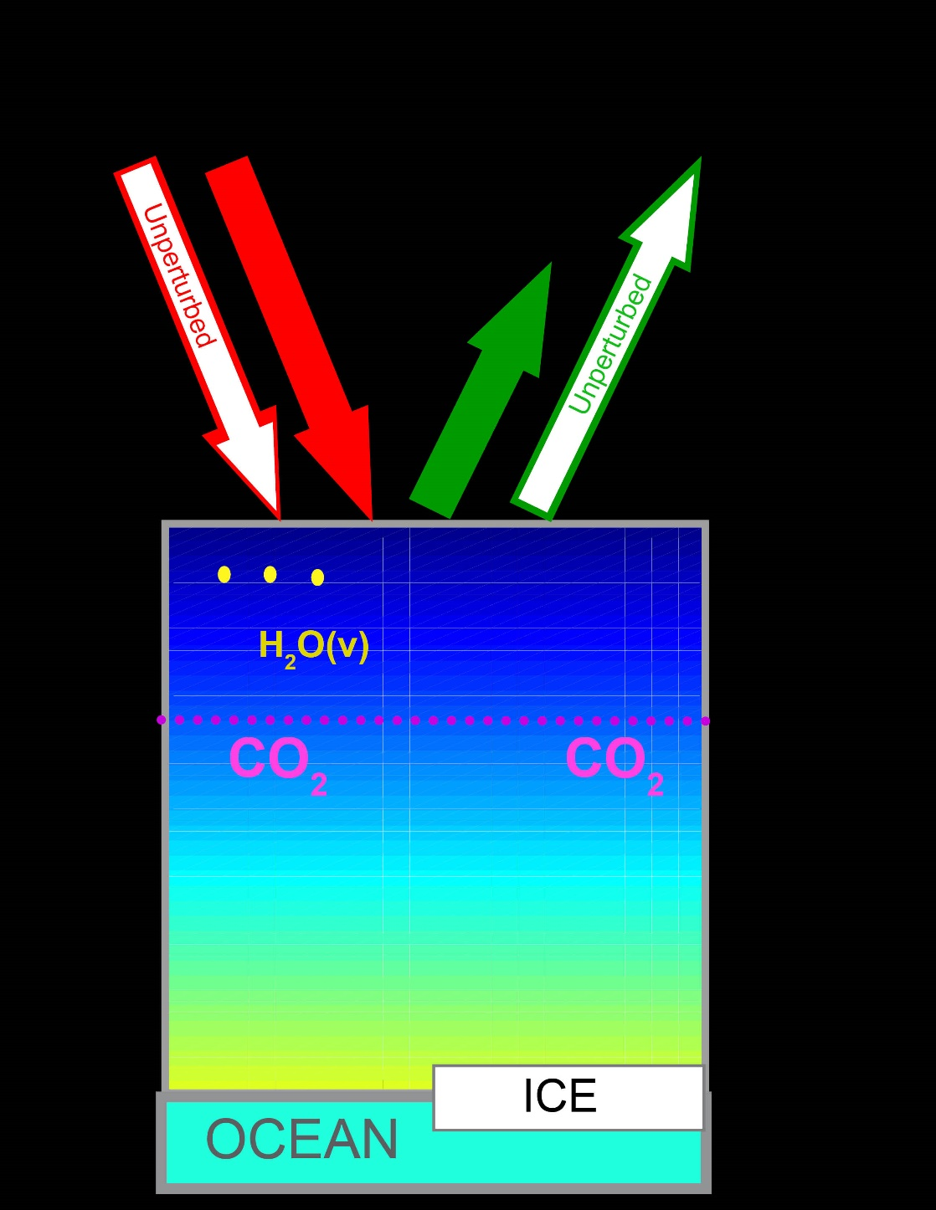
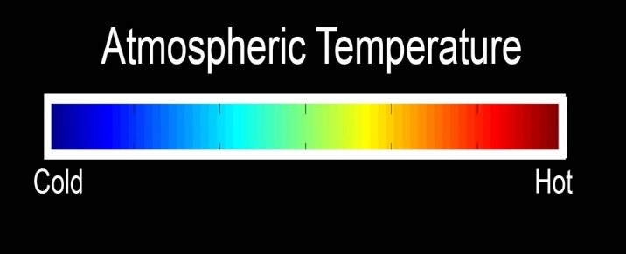
Proposed solution – Positive SW feedback
ASR > OLR
Absorbed Solar
Radiation
Outgoing Longwave
Radiation
ADD CO₂
Unperturbed
Atmospheric Emission Level

Slide 18
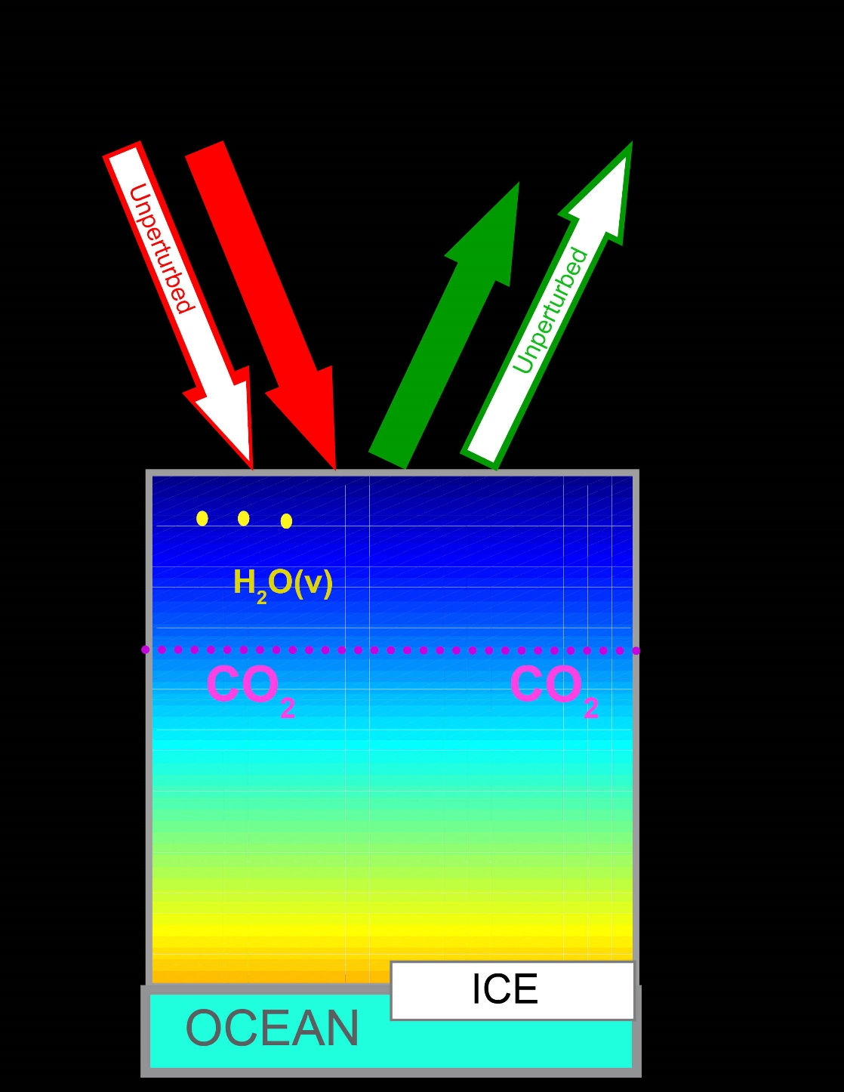
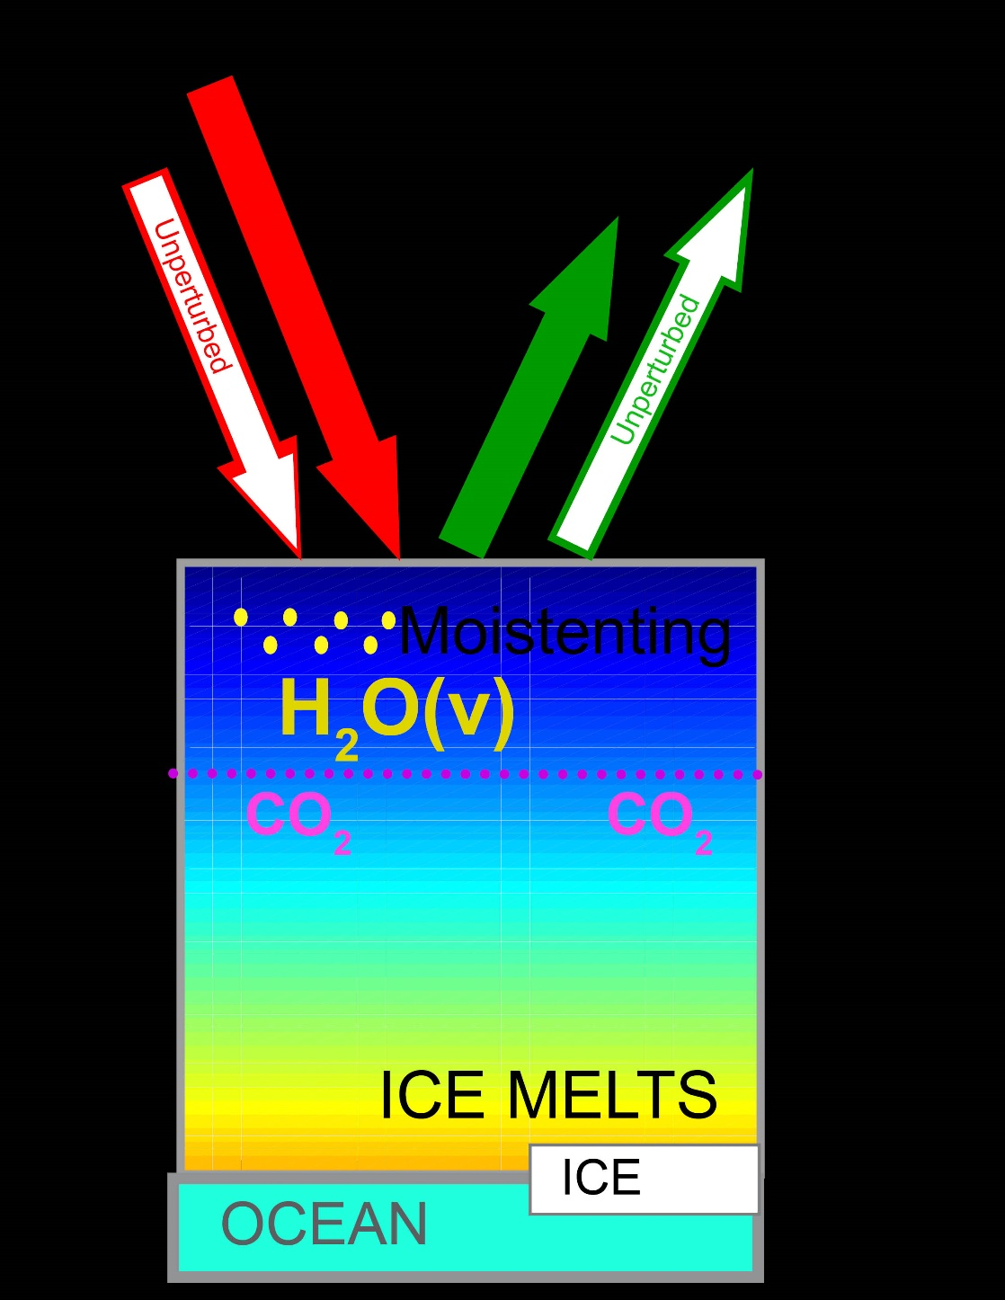
Proposed solution – Positive SW feedback
OLR Increases
ASR Increases
Absorbed Solar
Radiation
Outgoing Longwave
Radiation
+ Feedback
CO₂ + Warming
Atmospheric Emission Level
WARMING

Slide 19
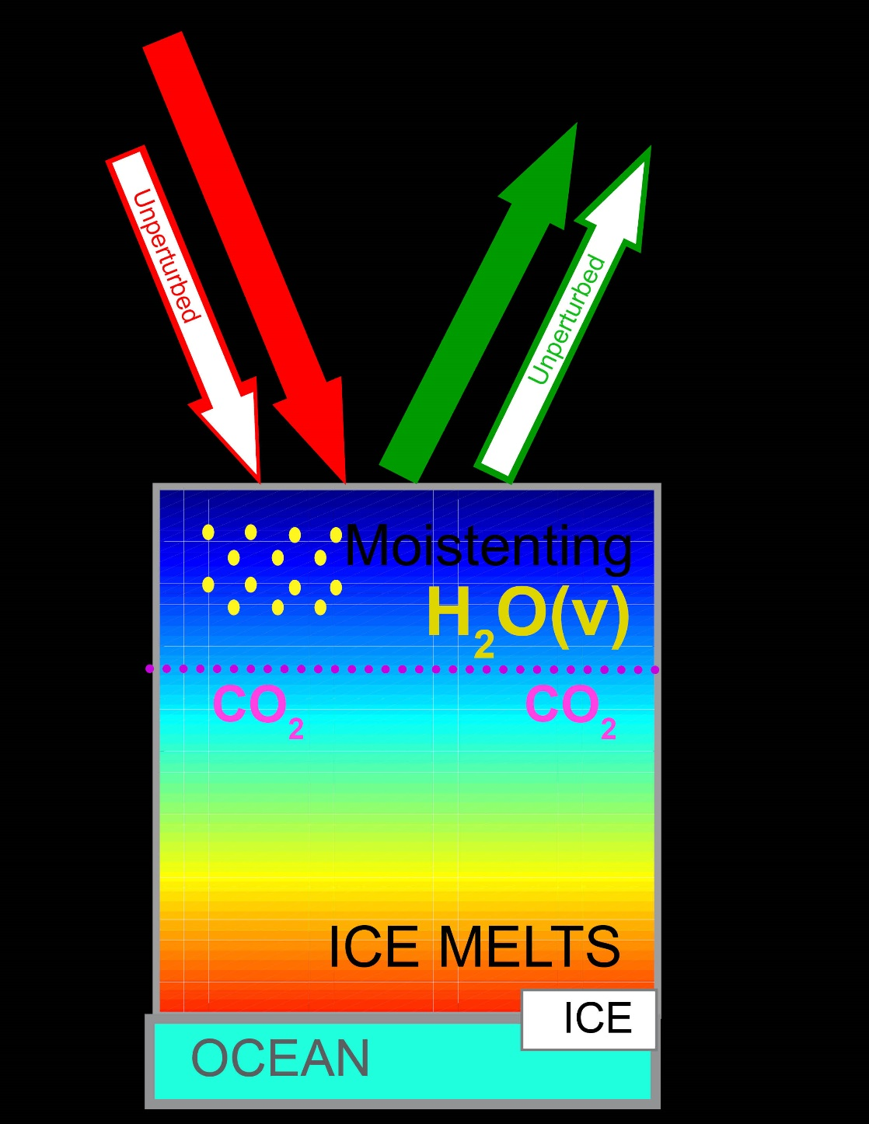
Proposed solution – Positive SW feedback
Absorbed Solar
Radiation
Outgoing Longwave
Radiation
OLR = Unperturbed
Energy still accumulating
Atmospheric Emission Level
WARMING

Slide 20
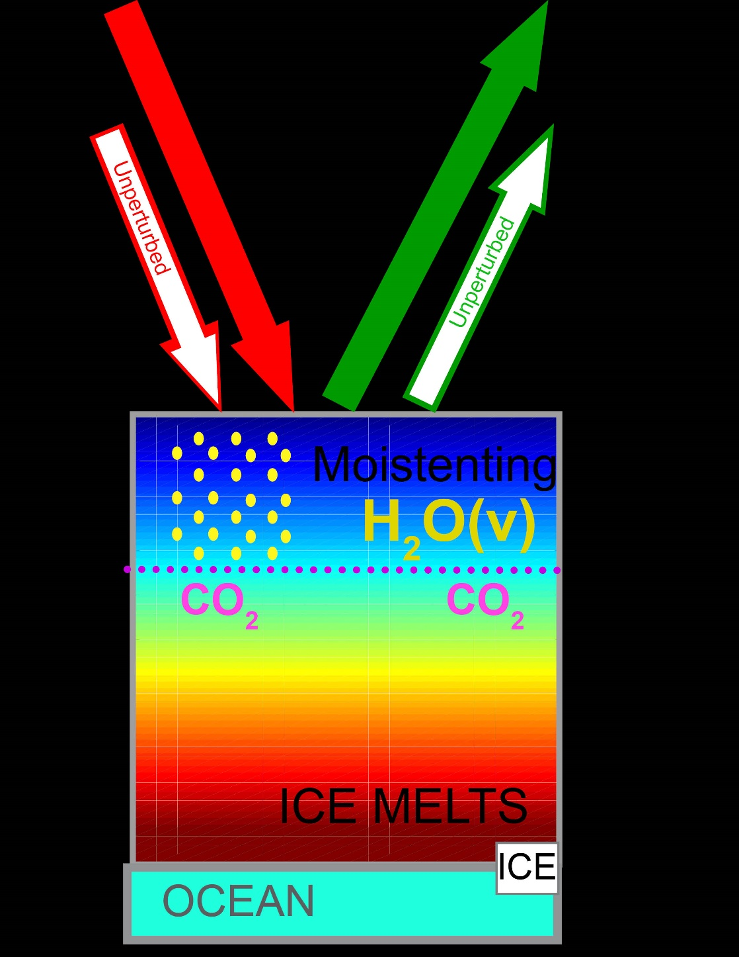
Proposed solution – Positive SW feedback
Absorbed Solar
Radiation
Outgoing Longwave
Radiation
New Equilibrium
OLR = ASR
BOTH INCRESED
Atmospheric Emission Level
WARMING

Slide 21
How to reconcile this – response to greenhouse forcing with a shortwave feedback
LW feedback only
LW and SW feedback
Greenhouse forcing F_{LW}= 4 W m⁻²
F_{LW}= 4 W m⁻²
λ_{SW} ΔT
= 4 W m⁻²
λ_{LW} ΔT
= 8 W m⁻²
-λ_{LW} ΔT
= 4 W m⁻²
ΔOLR=
-F_{LW} + -λ_{LW} ΔT = ΔASR
ΔOLR
= 0
ΔT= 2K
ΔT= 4K
Forcing = response
Forcing = response
F_{LW} = -(λ_{LW} +λ_{SW} ) ΔT
F_{LW} = -λ_{LW} ΔT
if λ_{SW} = +1 W m ⁻² K ⁻¹
if λ_{LW} = -2 W m ⁻² K ⁻¹
ΔT = F_{LW} /-λ_{LW} = 2 K
ΔT = F_{LW} /-(λ_{LW} + λ_{SW} ) = 4 K

Slide 22
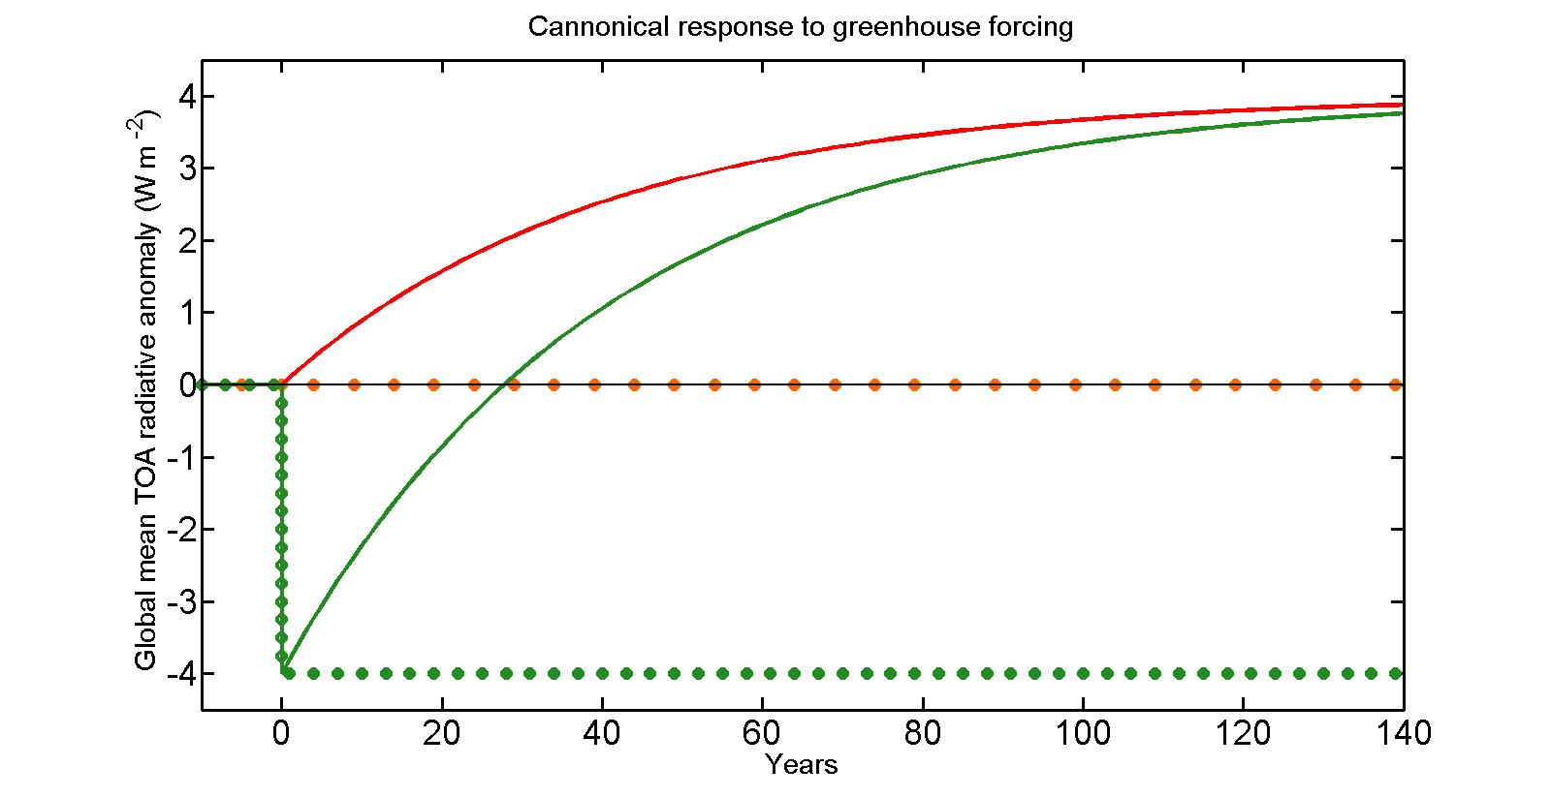
Time evolution of OLR response to greenhouse forcing with SW feedback
OLR must go from –FLW at time 0 to FLW in the equilibrium response
OLR returns to unperturbed value when half of the equilibrium temperature change occurs
ASR
OLR
F_{LW}
The energy imbalance equation:
$$C\frac{dT_{S}}{dt}=F+λT_{S}$$
T_{S}$\left(t\right)= \frac{−F}{\text{λ}} \left(1−e^{\frac{tλ}{C}} \right)=T_{eq} (1−e^{−\frac{t}{τ}} )$
Has the solution:
With the characteristic timescale (τ)
τ= $\frac{−C}{λ}$ = $\frac{−C}{λ_{SW}+λ_{LW}}$ = 30 years (for 150 meter deep ocean)

Slide 23
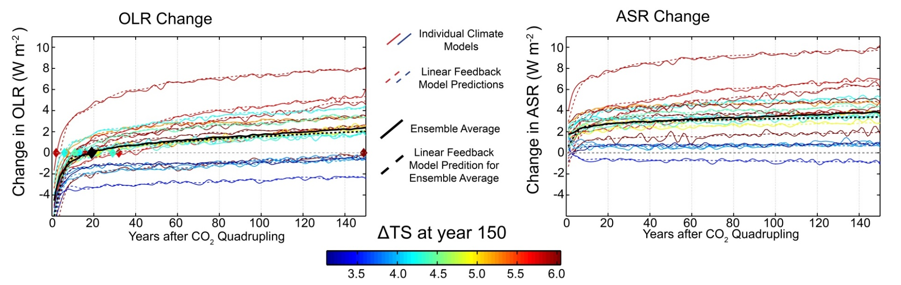
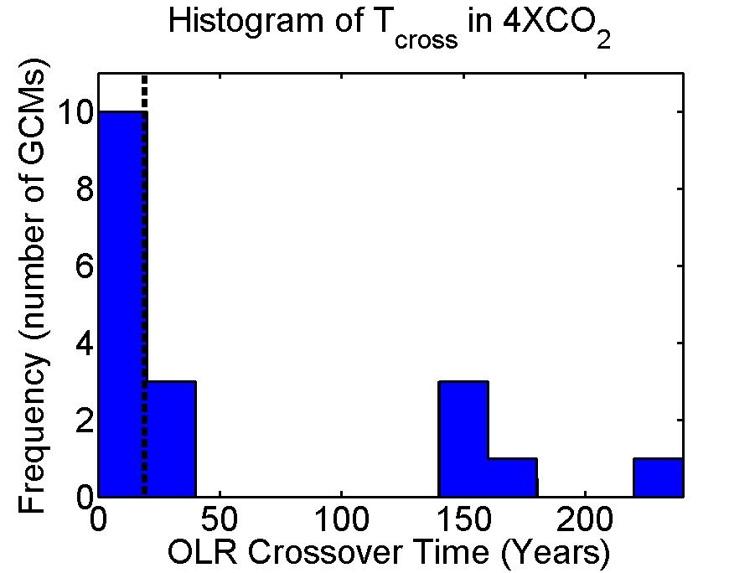
Inter-model spread in TOA response
The TOA response to greenhouse forcing differs a lot between GCMs
OLR returns to unperturbed values (Τ_{CROSS}) within 5 years for some GCMs and not at all for others (bi-modal)
On average, Τ_{CROSS} = 19 years
Ensemble mean

Slide 24

Linear Feedback model
Top of atmosphere (TOA) radiation
Forcing
Feedbacks
Energy Change
C = heat capacity of climate system. Time dependent – meters of ocean
T_{S} = Global mean surface temperature change
F_{SW} and F_{LW} are the SW and LW radiative forcing (including fast cloud response to radiative forcing – W m⁻²)
λ_{LW} and λ_{SW} are the LW and SW feedback parameters. W m⁻² K⁻¹
Given above parameters and T_{S} , we can predict the TOA response
Notes:
7.5 meters per W m^-2 year

Slide 25
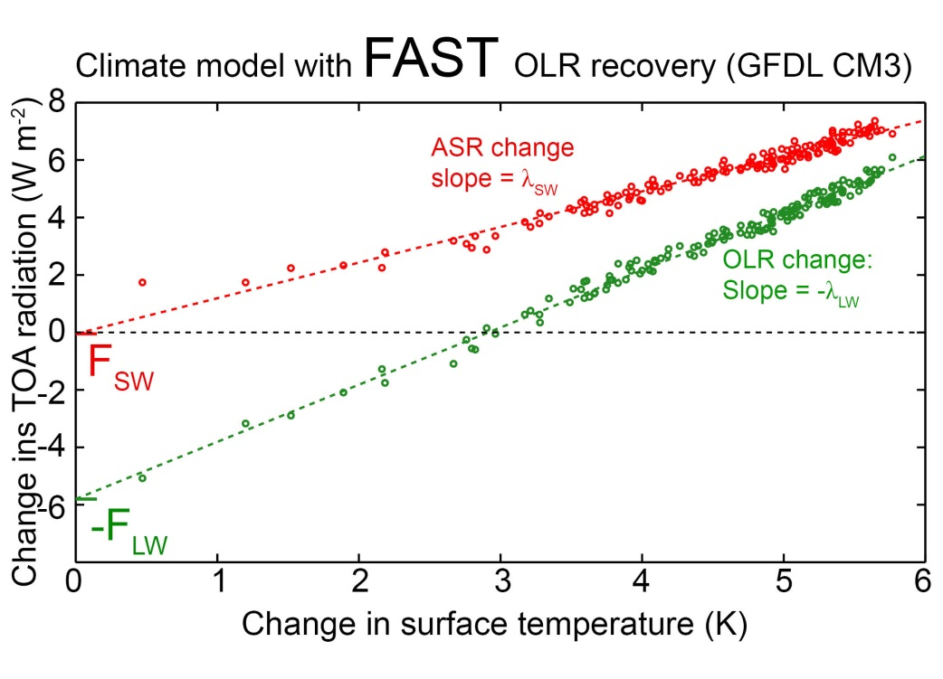
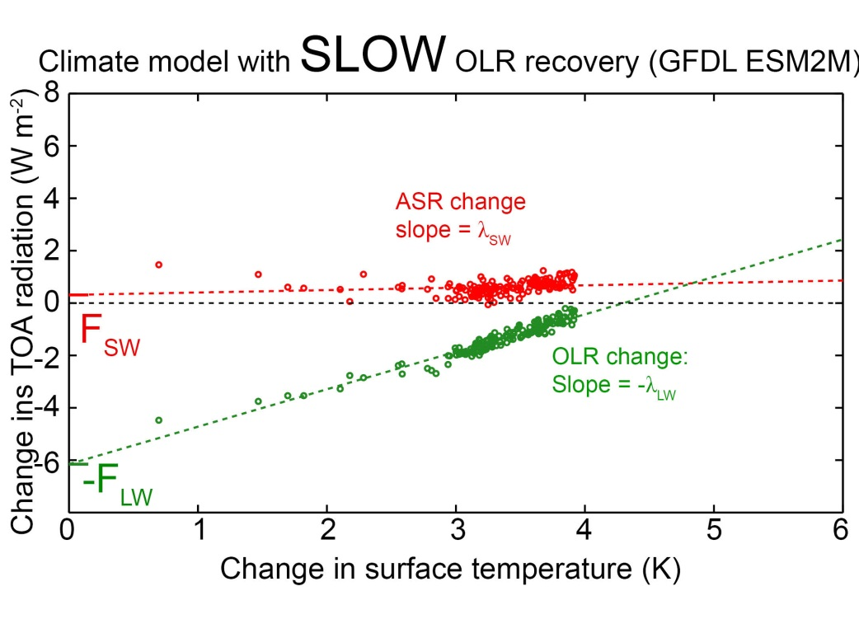
Backing out Forcing and feedbacks from instantaneous 4XCO2 increase runs
CNRM model
Feedbacks parameters (λ_{LW} and λ_{SW}) are the slope of –OLR and ASR vs. T_{S} (W m⁻² K⁻¹)
Forcing (F_{SW} and F_{LW}) is the intercept (W m⁻² ) . Includes rapid cloud response to CO₂ (Gregory and Webb)

Slide 26
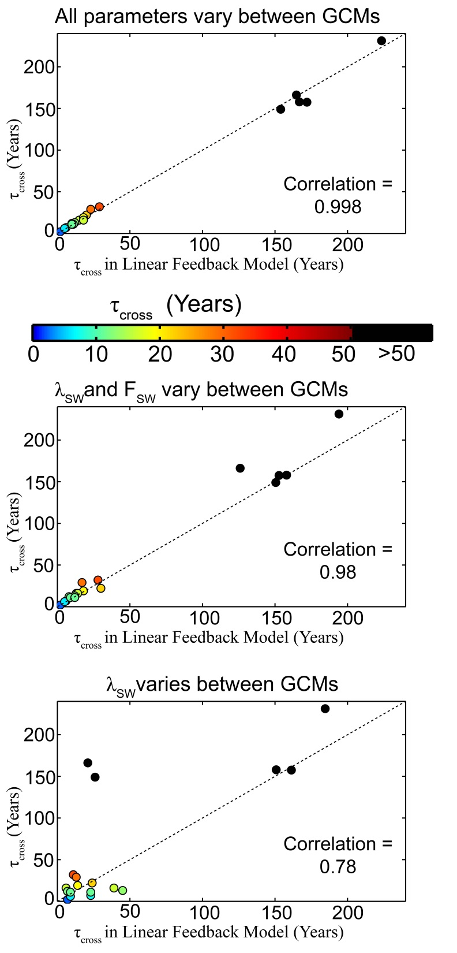
Linear Feedback model works
The TOA response in each model (and ensemble average) – solid lines– is well replicated by the linear feedback model
What parameters (forcing, feedbacks, heat capacity) set the mean radiative response and its variations across models?

Slide 27
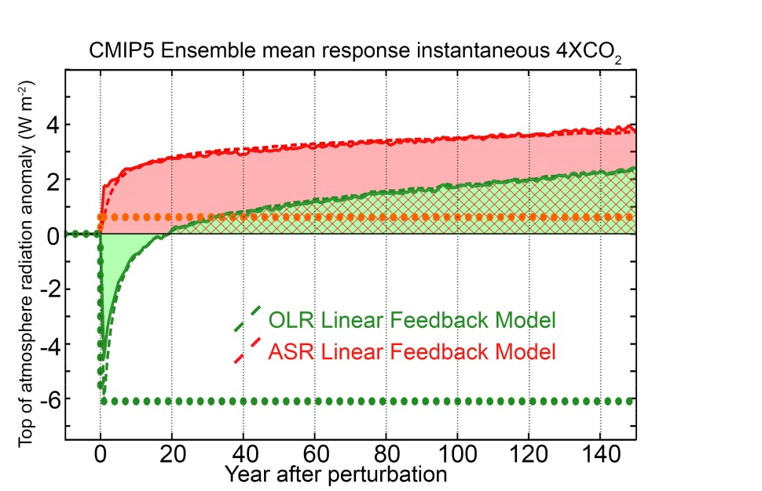
Ensemble average OLR recovery timescale
Ensemble average forcing and feedbacks
OLR at equilibrium
λ_{LW} = -1.7 W m⁻² K⁻¹
λ_{SW} = +0.6 W m⁻² K⁻¹
F_{LW} = + 6.1 W m⁻²
OLR at time = 0
equilibrium temperature change
T_{EQ}$=\frac{−F}{\text{λ}\text{LW} \text{+ }\text{λ}\text{S}\text{W}} =6K$
ASR in new equilibrium = T_{EQ} λ_{SW} = 4 W m⁻²
To come to equilibrium, OLR must go from - F_{LW} = - 6.1 W m⁻² to T_{EQ} λ_{LW} = +4 W m⁻²
OLR must change by 10 W m⁻² to come to equilibrium
→ OLR crosses zero about 60% of the way the equilibrium

Slide 28
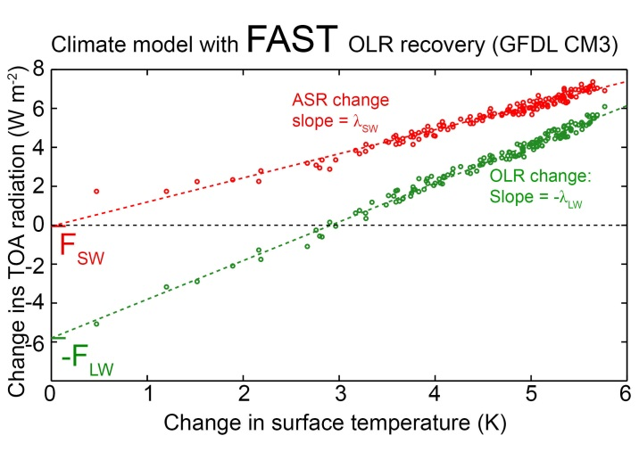

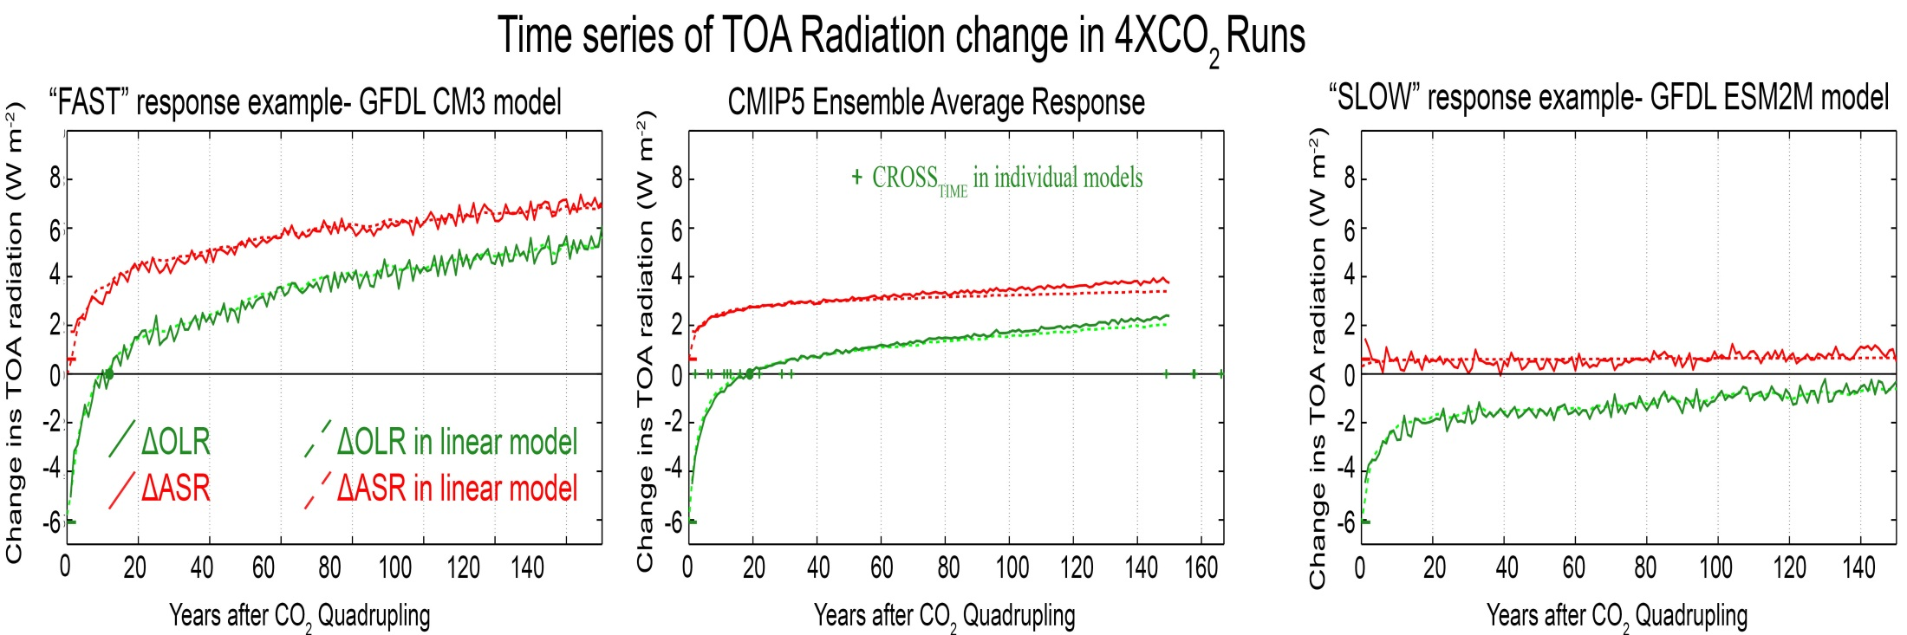
Climate model differences in OLR response time
CNRM model

Slide 29
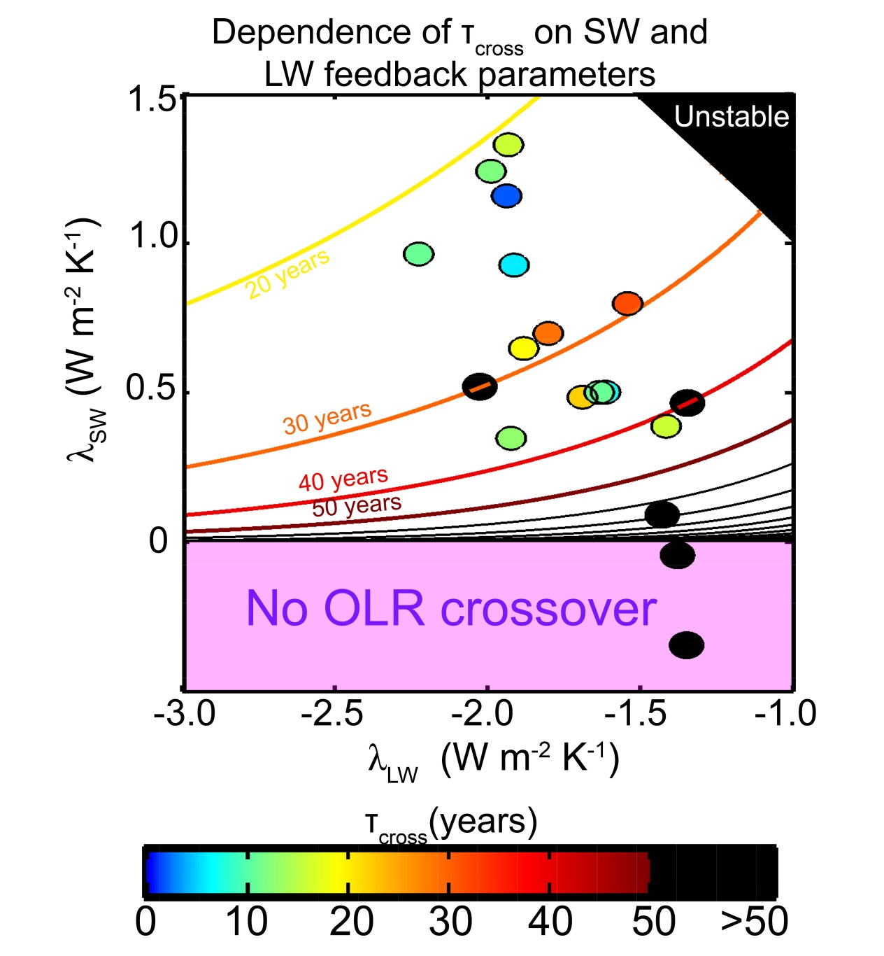
Sensitivity of τ_{CROSS} to feedback parameters
If F_{SW} = 0 (simplification):
τ_{CROSS} = τ ln(-λ _{LW} / λ _{SW} )
Ensemble Average
τ_{cross} is determined by the OLR value demanded in the new equilibrium
Set by relative magnitudes of λ _{LW}
and λ _{SW}
HAS STEEP GRADIENTS IN VICINITY OF λ_{SW}=0

Slide 30
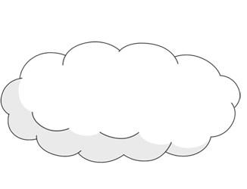
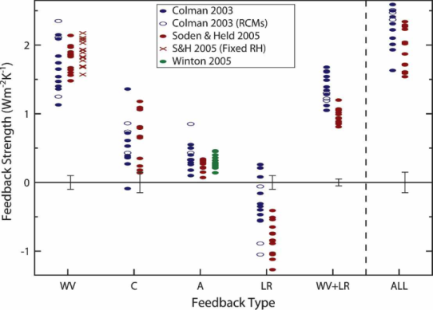
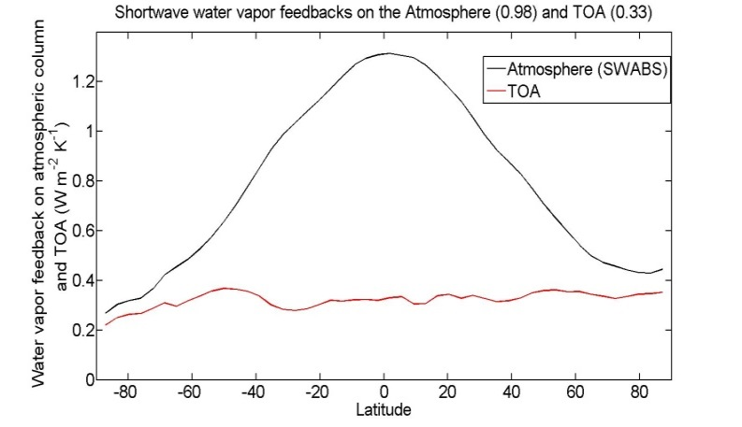
Cause of SW positive feedbacks:
incident
Reflected
cloud
absorbed
H₂0
(vapor)
Reflected
surface
transmitted
ice
ocean
Surface albedo feedback =
+0.26 ±0.08 W m⁻²K⁻¹
Bony et al. (2006)
SW Water vapor feedback
= +0.3±0.1 W m⁻²K⁻¹

Slide 31
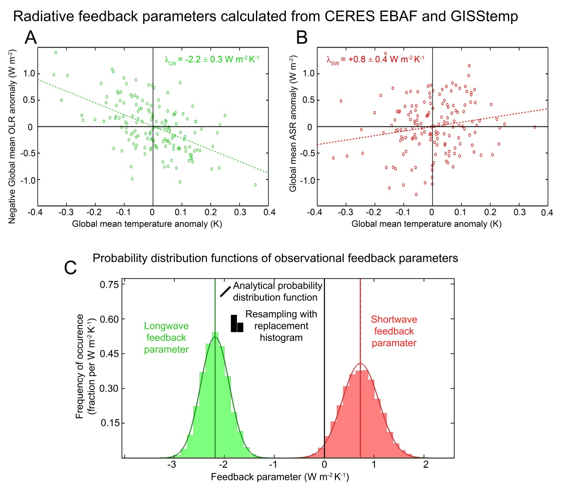
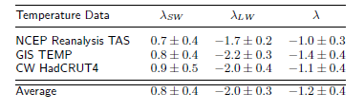
Observations of the co-variability of global mean surface temperature and ASR/OLR give statistically significant estimates of λ_{SW} and λ_{LW}
λ_{SW} = 0.8 ± 0.4 W m⁻² K⁻¹
λ_{LW} = -2.0 ± 0.3 W m⁻² K⁻¹

Slide 32
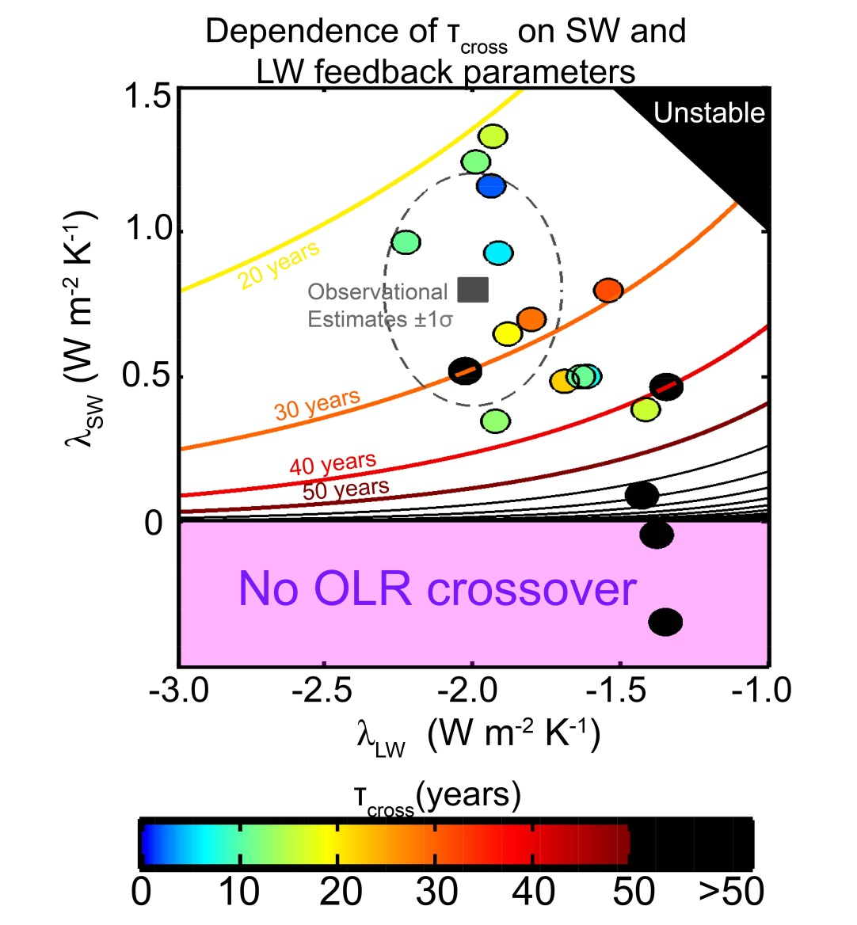
Implications for OLR recovery timescale
Observational constraints suggest that τ_{cross} is of order decades IN RESPONSE TO LW FORCING ONLY
Assumes an (CMIP5 ensemble average) radiative relaxation timescale (τ) of 27 years
τ_{CROSS} = τ ln(-λ _{LW} / λ _{SW} )

Slide 33
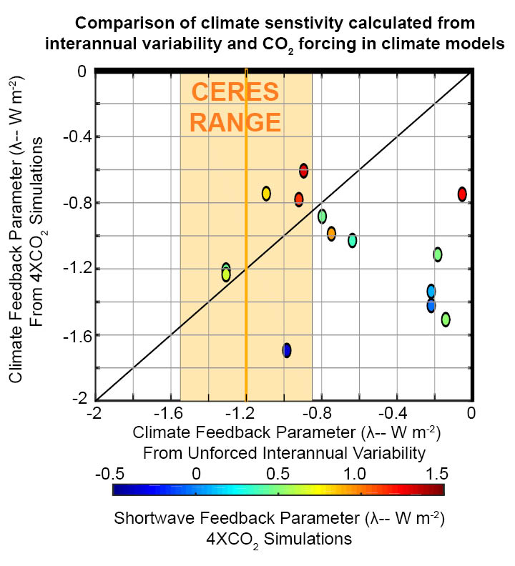
Can we get climate feedbacks from interannual variability of CERES (and surface temperature)?

Slide 34
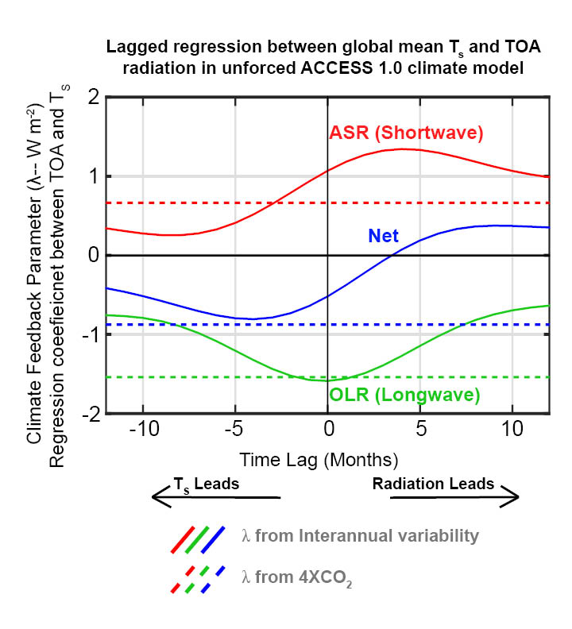
Radiation causes surface temperature anomalies as well as responds to it– potential to confuse the non-feedback forcing with the feedback.

Slide 35


Conclusions
CO2 initiates global warming by decreasing OLR but the TOA energy imbalance is dominated by increased absorbed solar radiation in most climate models – associated with surface albedo and SW water vapor feedbacks
CERES data also suggest a positive shortwave feedback → global warming will most likely result in enhanced ASR and we should not expect to see reduced OLR from the forcing
Can interannual variability in CERES tell us anything about climate feedbacks?

Slide 36
3 : What determines meridional heat transport?
Incident
Reflected
Emitted
Net
Tropics
Extratropics

Slide 37




Understanding heat transport
5.8 PW
ASR*
OLR*
8.2 PW
2.4 PW
-
Heat
Transport
=
Notes:
NH = 8.2 - 2.4 = 5.8
SH = 9.0 – 3.2 = 5.8

Slide 38
ASR*, OLR*, MHT, and the tropical/extratropical energy budget
OLR*
ASR*
2.4 PW
8.2 PW
MHT =
ASR* - OLR*
MHT
Tropics
5.8 PW
To extratropics
All arrows are relative to the global average

Slide 39
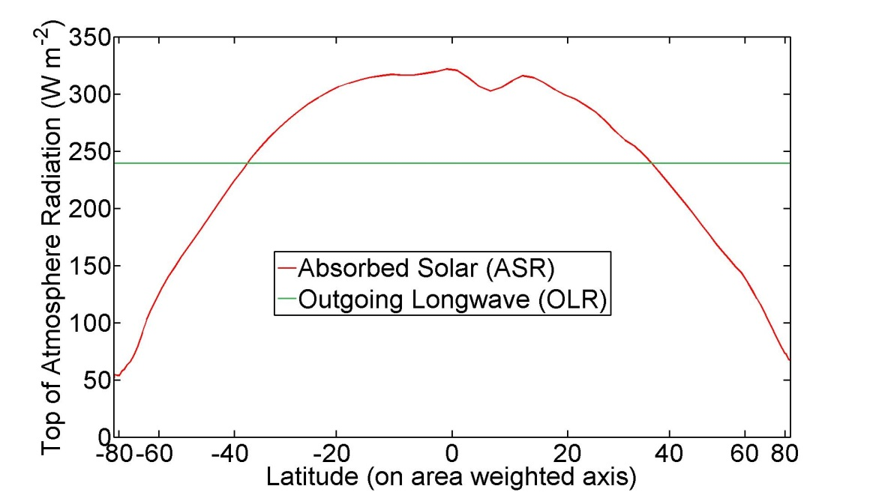

ASR*, OLR*, MHT
Dynamic Limit
MHT = ASR*
OLR* = 0
ASR*
9.0 PW
8.2 PW
8.2 PW
MHT
Tropics
8.2 PW
To extratropics
All arrows are relative to the global average

Slide 40
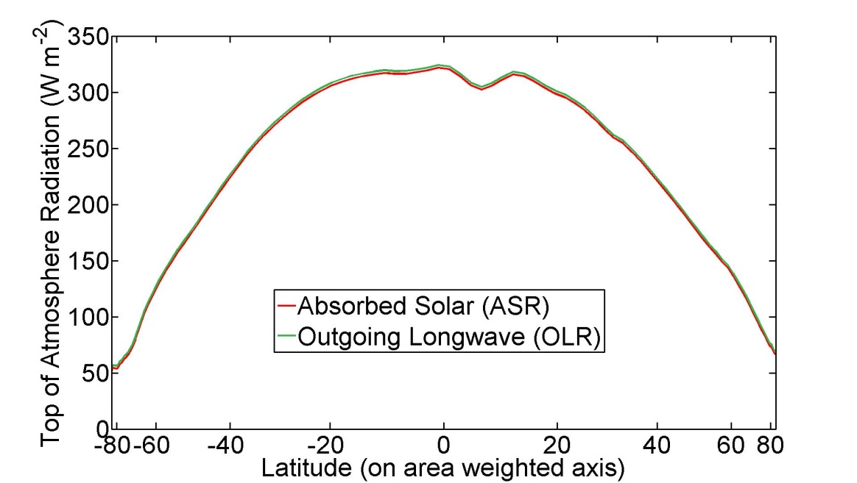
ASR*, OLR*, MHT
Radiative Limit
MHT = 0 ,
ASR* = OLR*
ASR*
8.2 PW
OLR*
8.2 PW
MHT
Tropics
0 PW
To extratropics
All arrows are relative to the global average

Slide 41
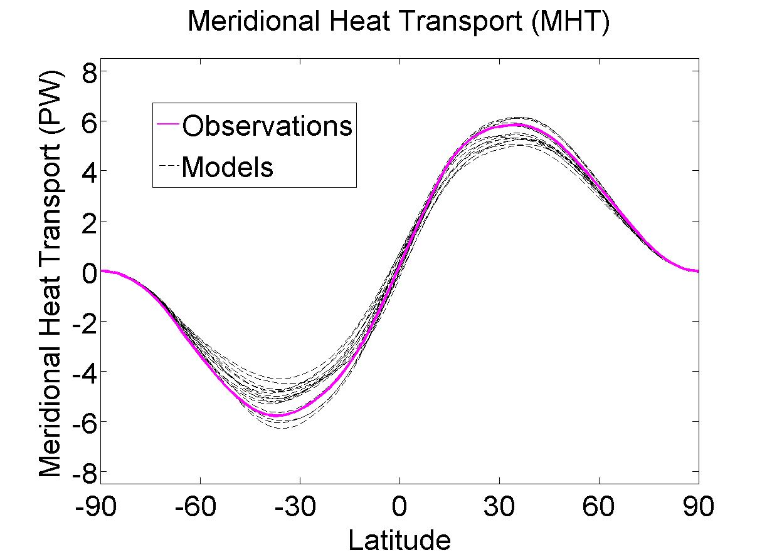
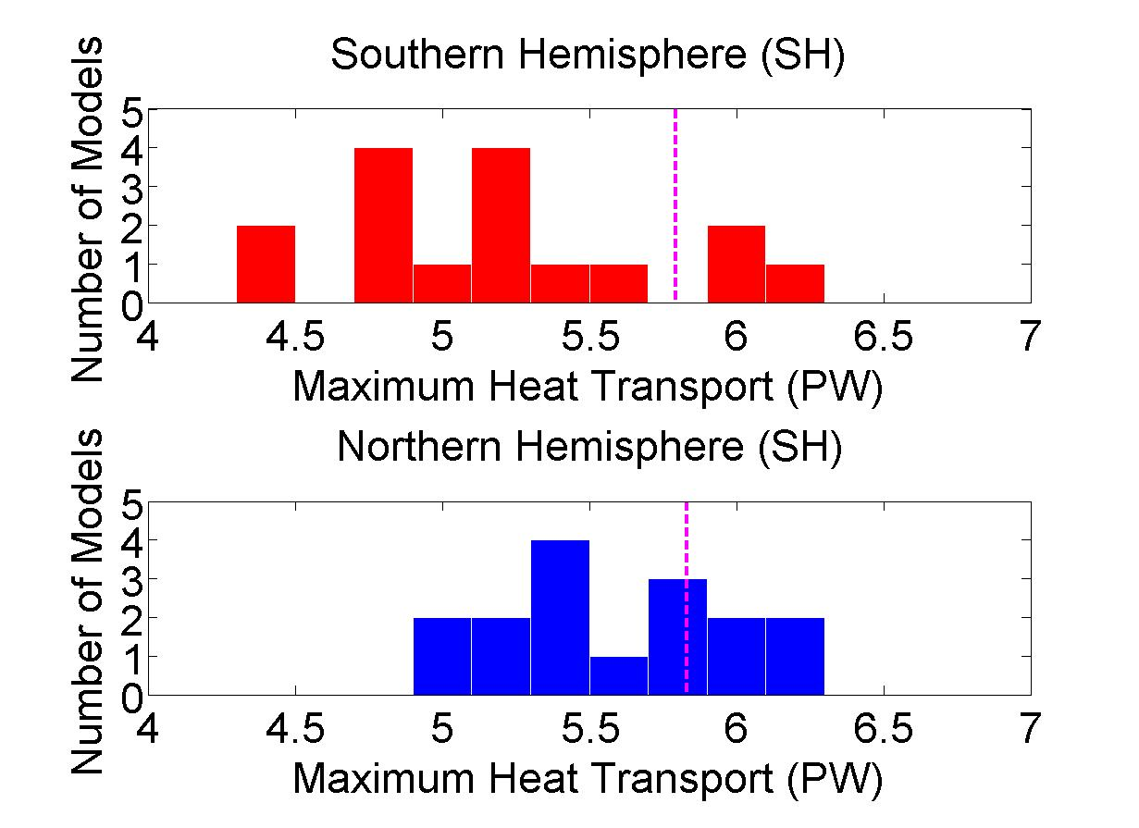
Heat Transport In Climate Models
(CMIP3)
Peak Heat Transport Histograms
Observations
Notes:
Spread – 2 sigma SH = 1.1 PW NH = 0.8 PW

Slide 42
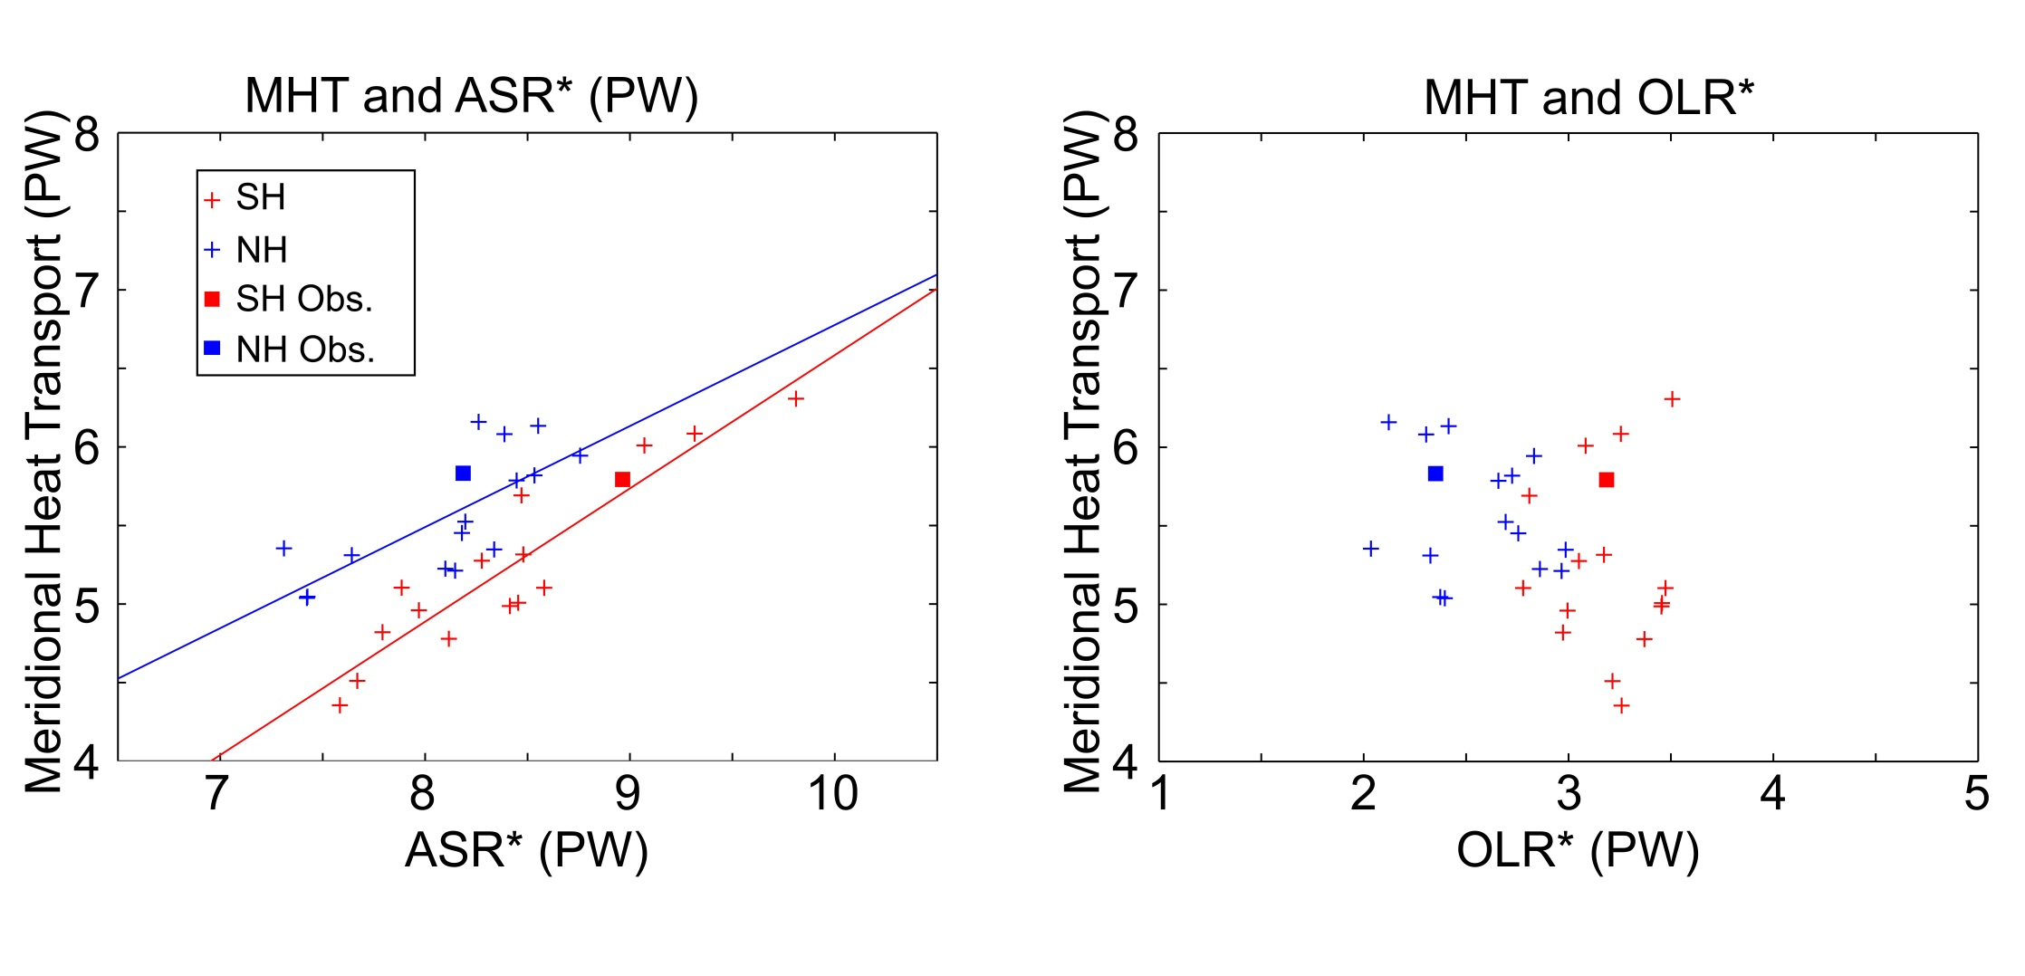
Model heat transport spread in terms of OLR* and ASR*
Notes:
ASR and MHT R^2 (slope) /// NH = 0.57 (0.64) , SH = 0.85 (0.85)
OLR* is insignificant

Slide 43
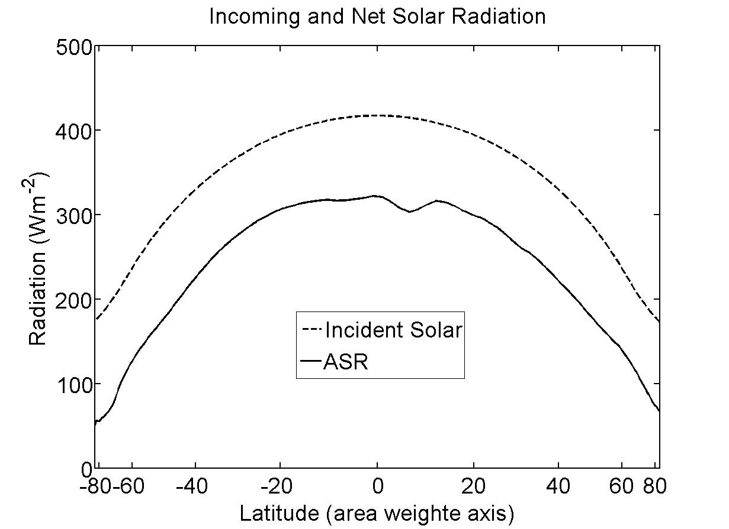
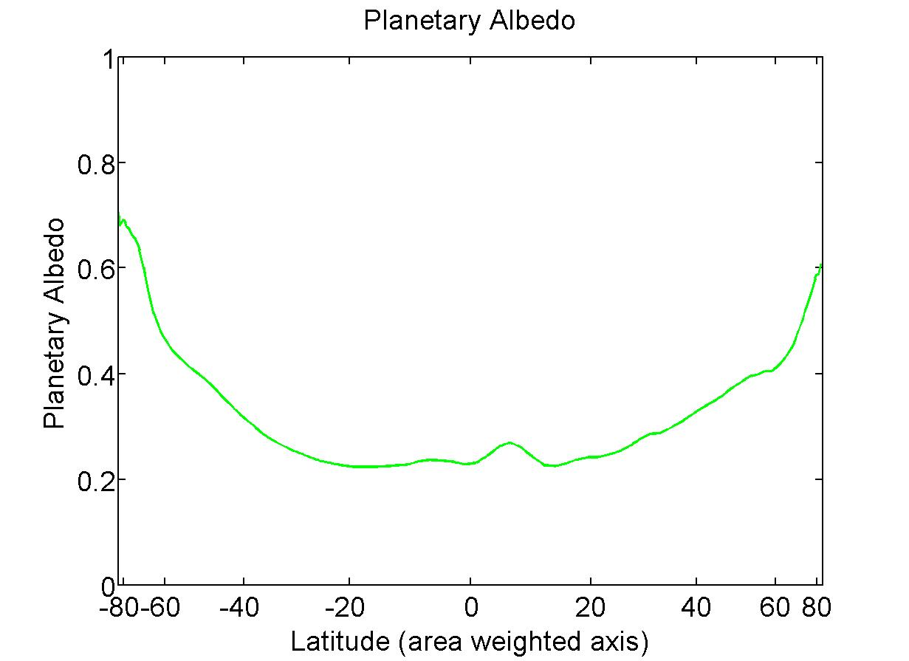
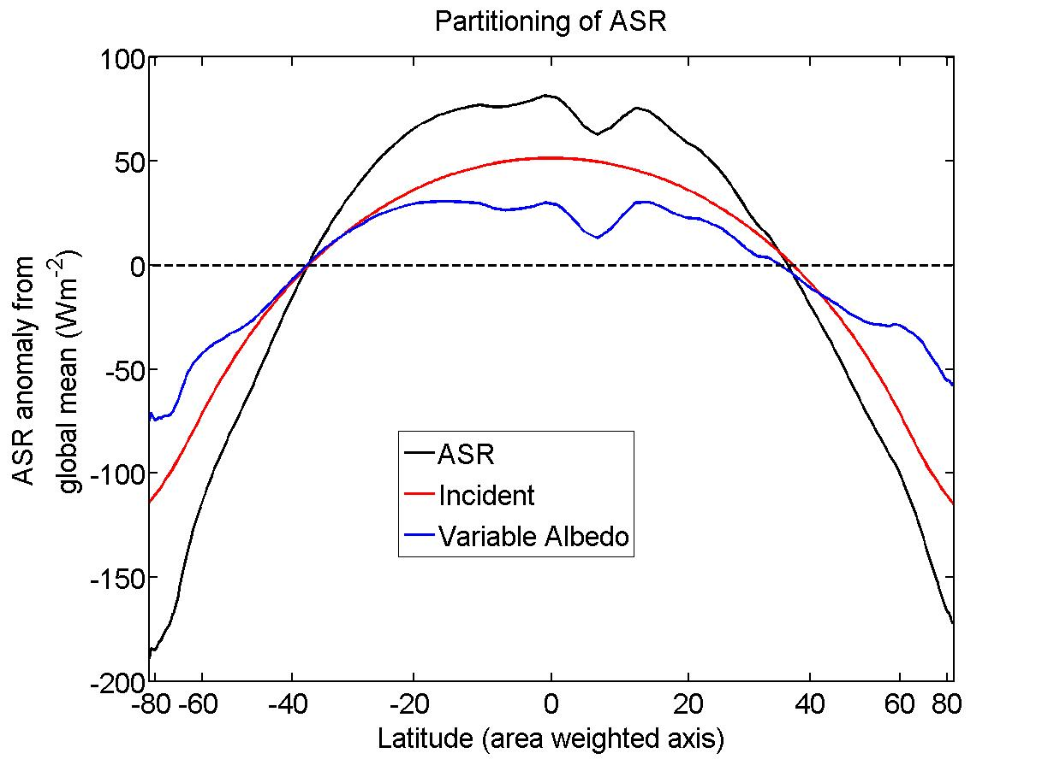
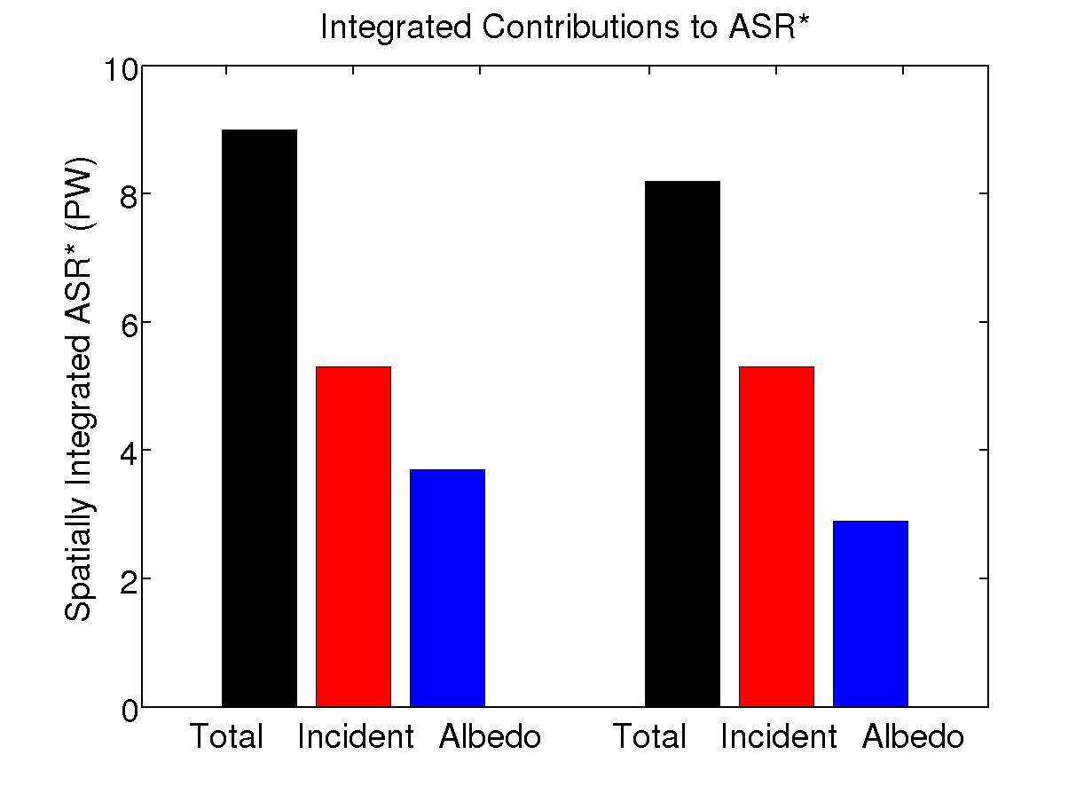
Understanding ASR*
SH
NH
Notes:
ASR = incident + albedo
NH // 8.2 = 5.3 + 2.9
SH \\\ 9.0 = 5.3 + 3.7

Slide 44
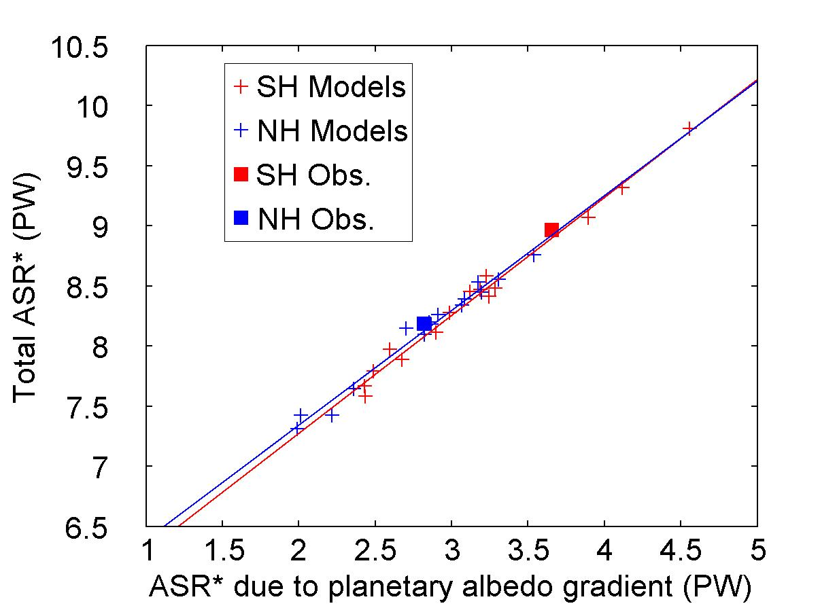
ASR* and planetary albedo
Notes:
ASR* and albedo spread correlated with R^2 0.99
Same correlations as before

Slide 45
What determines the equator-to-pole contrast of planetary albedo?
Reflected by Atmosphere
Solar Incident
Reflected by Surface
Atmosphere
Earth’s Surface

Slide 46
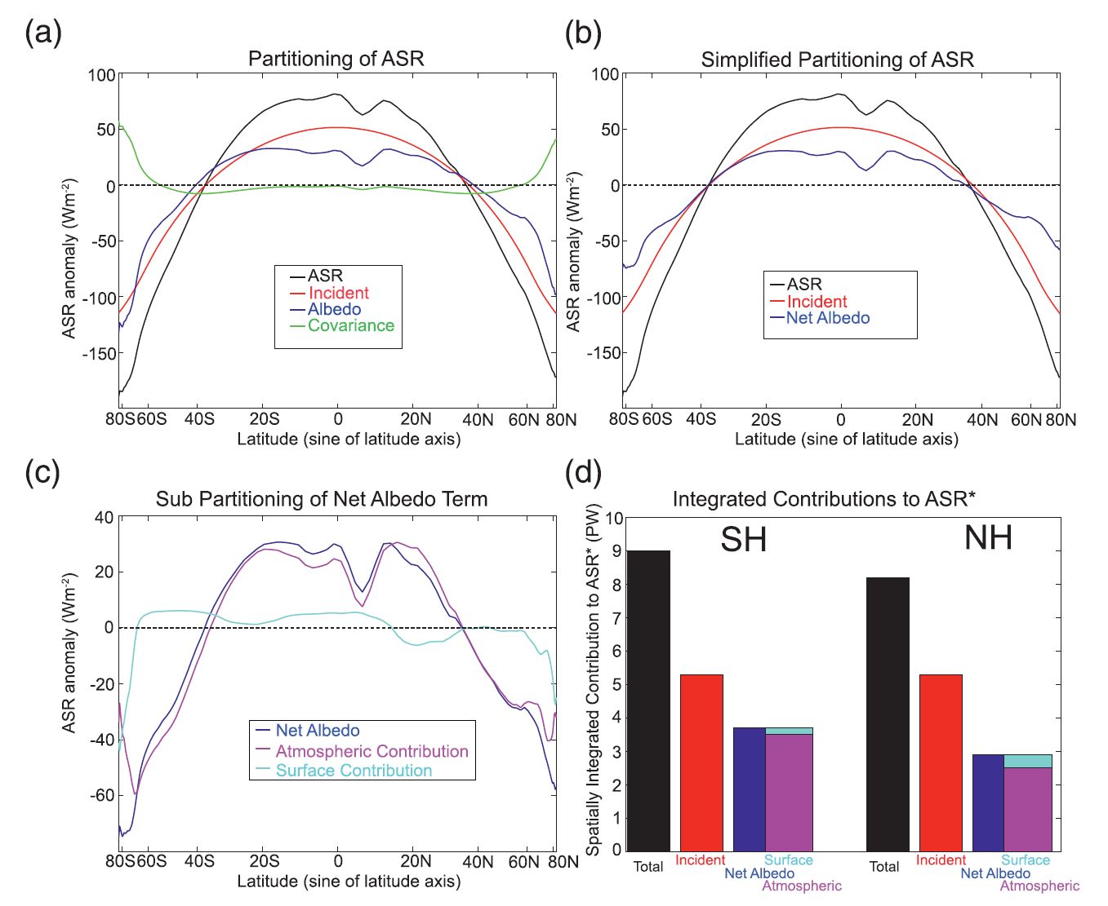
Surface and atmospheric contributions to the equator-to-pole contrast in absorbed shortwave radiation

Slide 47
Planetary Albedo Partitioning

Slide 48

Atmospheric and Surface reflection contribution to ASR*
Cloud Reflection
Equator to pole contrast of absorbed shortwave
Poleward Energy Transport
Poleward Energy Transport
MHT spread
Equator to pole contrast in clouds
Notes:
R^2 NH \\\ 0.63 SH \\\\ 0.84

Slide 49

How is the atmosphere heated in the annual average?
4. The seasonal cycle of atmospheric heating and temperature
30% reflected
20% absorbed atmosphere
50% transmitted
To surface
50% net flux
From surface
To atmosphere
Kiehl and Trenberth 1997

Slide 50
Annual mean heating summary
30% reflected
20% absorbed atmosphere
atmosphere
50% transmitted
To surface
50% net flux from surface
to atmosphere
surface
Surface energy balance requires that the ratio of heating from direct absorption to surface energy fluxes is approximately:
atmospheric absorption (SW) /atmospheric transmissivity(SW)
=> direct absorption accounts for 30% of atmospheric heating

Slide 51

Spatial structure of atmospheric heating
Spatial structure of atmospheric heating
Annual Average

Slide 52
Limiting models of seasonal atmospheric heating
SW flux
Turbulent + LW
Surface flux
Heated from above
Heated from below
SW absorbing
atmosphere
SW transparent
atmosphere
DEEP
OCEAN
Shallow ocean

Slide 53
Atmospheric energy budget
Conventional
This study
Net SW
TOA
OLR
Atmospheric SW absorption (SWABS)
OLR
Heat Transport
Divergence
Net energy flux
Through surface
Heat Transport
Divergence
SW transparent
atmosphere
Surface heat
Flux (SHF)
Storage
Storage
Surface
Surface
Net energy flux through surface =
Solar + turbulent + LW
SHF = turbulent + LW
=> Energy exchange between surface and atmosphere

Slide 54
Atmospheric energy budget
Atmospheric energy budget -- Observations
Storage
Heat Transport Divergence
Radiative Fluxes from CERES
Dynamic fluxes and storage are calculated from ERA-40 reanalysis
Atmos. Surface exchange (SHF) as RESIDUAL

Slide 55

Seasonal Atmospheric Heating
ANNUAL MEAN IS
REMOVED

Slide 56

Seasonal Amplitude of heating
Annual Mean
Define seasonal amplitude as:
Amplitude of annual harmonic
In phase with the insolation
Takes into account magnitude
and phase
Positive amplifies seasonal cycle
Negative reduces seasonal cycle

Slide 57


The seasonal heating of the atmosphere in climate models
Seasonal Amplitude
In phase with sun
Surface fluxes and shortwave absorption are calculated directly from model output
Atmospheric heat transport as a residual
=> Solid lines = observations
=> Shading is ±1σ about CMIP3 ensemble mean

Slide 58


Define a seasonal amplitude
Vertical structure of SW absorption
GFDL Model
Seasonal amplitude
In the extratropics
Ozone
Water
Vapor

Slide 59

Structure of seasonal amplitude in temperature
Seasonal cycle is surface amplified where the surface heat fluxes contribute to seasonal heating (over land)

Slide 60


Conclusions
Reflected by Atmosphere
Global mean planetary albedo is primarily (88%) due to atmospheric reflection and only secondarily (12%) due to surface reflection
-> Climatology and model spread
Solar Incident
Reflected by Surface
Atmosphere
2. Radiative response to increasing CO₂ is set in motion by decrease in OLR but energy accumulation is due to enhanced ASR. This result is a consequence of two robust positive SW feedbacks:
-Surface albedo feedback
-Water vapor absorption of
3. The seasonal heating of the atmosphere is due to shortwave heating of the atmosphere and is opposed by surface fluxes (contrast to annual mean)

Slide 61
Extras

Slide 62

Histogram of hemispheric average planetary albedo
10 W m⁻²
Observations
(CERES)
Notes:
2 sigma = 0.016

Slide 63

Hemispheric average planetary albedo partitioning in climate models
Inter-model spread in Hemispheric average planetary albedo is a consequence of differences in cloud reflection
Surface albedo makes a much smaller contribution to basic state albedo, model bias and inter-model spread

Slide 64


Inter-hemispheric energy transport and the location of tropical precipitation
ITCZ location and atmospheric heat transport across the equator (AHT_{EQ})are both a consequence of the Hadley cell location
-> The atmosphere moves energy away from the ITCZ
The inter-model spread in
AHT_{EQ} and ITCZ location are strongly correlated

Slide 65


Hemispheric contrast of radiation and ITCZ location
ITCZ lives in the hemisphere where the atmosphere is heated more strongly
-> In observations, the radiative input to each hemisphere is nearly equal and ITCZ is North of the equator because of Northward ocean heat transport
Model biases is planetary albedo lead to ITCZ biases
-> SH absorbs too much shortwave and ITCZ is too far south
Heating of SH

Slide 66

Arctic Planetary Albedo
→Atmosphere contributes more to climatology
→ Surface and atmosphere make comparable contributions to interannual variability

Slide 67


Slide 68

Are the radiative feedbacks that operate on inter-annual timescales equivalent to equilibrium feedbacks?
SW
LW
NET

Slide 69

Water Vapor as a SW Absorber
(Figure: Robert Rhode
Global Warming Art Project)

Slide 70


Heat capacity: 4XCO₂
Heat capacity increases with time as energy penetrates into the ocean
In first couple decades, energy is within the first couple 100 m of ocean and system e-folds to radiative equilibrium in about a decade

Slide 71
Equator-to-pole contrast
The tropics receive more solar radiation than the high latitudes (extratropics)
To come to equilibrium, the tropics must either emit excess radiation or transport energy to the extratropics
Incident
Reflected
Emitted
Net
Tropics
Extratropics

Slide 72
Understanding heat transport
5.8 PW
ASR*
OLR*
8.2 PW
2.4 PW
-
Heat
Transport
=
Notes:
NH = 8.2 - 2.4 = 5.8
SH = 9.0 – 3.2 = 5.8

Slide 73
ASR*, OLR*, MHT, and the tropical/extratropical energy budget
OLR*
ASR*
2.4 PW
8.2 PW
MHT =
ASR* - OLR*
MHT
Tropics
5.8 PW
To extratropics
All arrows are relative to the global average

Slide 74
ASR*, OLR*, MHT
Dynamic Limit
MHT = ASR*
OLR* = 0
ASR*
9.0 PW
8.2 PW
8.2 PW
MHT
Tropics
8.2 PW
To extratropics
All arrows are relative to the global average

Slide 75
ASR*, OLR*, MHT
Radiative Limit
MHT = 0 ,
ASR* = OLR*
ASR*
8.2 PW
OLR*
8.2 PW
MHT
Tropics
0 PW
To extratropics
All arrows are relative to the global average

Slide 76
Heat Transport In Climate Models
(CMIP3)
Peak Heat Transport Histograms
Observations
Notes:
Spread – 2 sigma SH = 1.1 PW NH = 0.8 PW

Slide 77
Model heat transport spread in terms of OLR* and ASR*
Notes:
ASR and MHT R^2 (slope) /// NH = 0.57 (0.64) , SH = 0.85 (0.85)
OLR* is insignificant

Slide 78
Understanding ASR*
SH
NH
Notes:
ASR = incident + albedo
NH // 8.2 = 5.3 + 2.9
SH \\\ 9.0 = 5.3 + 3.7

Slide 79
ASR* and planetary albedo
Notes:
ASR* and albedo spread correlated with R^2 0.99
Same correlations as before

Slide 80
What determines the equator-to-pole contrast of planetary albedo?
Reflected by Atmosphere
Solar Incident
Reflected by Surface
Atmosphere
Earth’s Surface

Slide 81
Surface and atmospheric contributions to the equator-to-pole contrast in absorbed shortwave radiation

Slide 82
Planetary Albedo Partitioning

Slide 83
Atmospheric and Surface reflection contribution to ASR*
Cloud Reflection
Equator to pole contrast of absorbed shortwave
Poleward Energy Transport
Poleward Energy Transport
MHT spread
Equator to pole contrast in clouds
Notes:
R^2 NH \\\ 0.63 SH \\\\ 0.84

Slide 84
Define a seasonal amplitude
Vertical structure of SW absorption
GFDL Model
Seasonal amplitude
In the extratropics
Chou Lee (1996)
Water vapor absorption
In the summer
50
100
150
Heating Rate (W m⁻² )

Slide 85
CO₂ doubling expectations
Summer schematic
Surface flux
SWABS
Moistening and melting
Mores seasonal energy input directly into the atmosphere (SWABS)
Less seasonal energy input at the surface (SHF)
Sea ice
Open ocean

Slide 86


Slide 87
Water Vapor as a SW Absorber
(Figure: Robert Rhode
Global Warming Art Project)

Slide 88


Reflects the combined contributions of:
Melting sea ice
=> reduced seasonal cycle of temperature at the surface
2. Increased SWABS due to atmospheric moistening
=> enhanced seasonal cycle of temperature aloft

Slide 89

Meridional structure of atmospheric attenuation

Slide 90

Planetary Albedo and Surface Albedo

Slide 91

Meridional profile of albedo in all simiulations

Slide 92

Inter-model spread in albedo by region

Slide 93

2XCO₂ Planetary Albedo

Slide 94

2XCO₂ Planetary Albedo

Slide 95

Planetary Albedo Partitioning Error Bars

Slide 96

Planetary Albedo Partition: Sensitivity to shortwave absorption assumptions

Slide 97
What determines OLR*?
Why don’t differences in ASR* and OLR* compensate for each other?
Longwave Cloud Forcing
LWCF = OLR_{CLEAR} - OLR
(Kiehl, 1994)

Slide 98
Heat capacity: 4XCO₂
Heat capacity increases with time as energy penetrates into the ocean
In first couple decades, energy is within the first couple 100 m of ocean and system e-folds to radiative equilibrium in about a decade

Slide 99




How fast does the system approach equilibrium?
Ensemble average forcing and feedbacks
C = 250 m (30 W m⁻²year K⁻¹)
the ensemble average for first
century after forcing
λ_{LW} = -1.7 W m⁻² K⁻¹
λ_{SW} = +0.6 W m⁻² K⁻¹
The energy imbalance equation:
$$C\frac{dT_{S}}{dt}=F+λT_{S}$$
Has the solution:
T_{S}$\left(t\right)= \frac{−F}{\text{λ}} \left(1−e^{\frac{tλ}{C}} \right)=T_{eq} (1−e^{−\frac{t}{τ}} )$
Key point:
OLR returns to unperturbed value in of order the radiative relaxation timescale of the system → decades
With the characteristic timescale (τ)
τ= $\frac{−C}{λ}$ = $\frac{−C}{λ_{SW}+λ_{LW}}$
= $\frac{30 W m^{−2} {year K}^{−1 }}{1.1 W m^{−2}K^{−1}}$ = 27 years

Slide 100
What parameter controls inter-GCM spread in TOA response?
Using all GCM specific parameters gets the inter-model spread in τ_{cross}
Varying just λ_{SW} and F_{SW} between GCMS captures inter-model spread in τ_{cross}
λ_{LW} , F_{LW} and heat capacity differences between GCMs less important for determining the radiative response
Varying just λ_{SW} gives bi-modal distribution of τ_{cross} with exception of two models (F_{SW} plays a role here)

Slide 101







τ_{cross} dependence on feedback parameters
Ensemble average forcing and feedbacks
λ_{LW} = -1.7 W m⁻² K⁻¹
λ_{SW} = +0.6 W m⁻² K⁻¹
F_{LW} = + 6.1 W m⁻²
equilibrium temperature change
T_{EQ}$=\frac{−F}{\text{λ}\text{LW}\text{+}\text{λ}\text{SW}} =6K$
T_{EQ}$=GFEED \frac{−F}{\text{λ}\text{LW}} =1.6 ∗3.7K$
Feedback gain: Amplification of response due to $\text{λ}\text{SW}$
G_{FEED}$=\frac{1}{\text{1+}\text{λ}\text{SW}\text{/}\text{λ}\text{LW}} =1.6$
T_{S}$=GFEED \frac{−F}{\text{λ}\text{LW}} (1−e^{−\frac{t}{τ}} )$
OLR$=F_{LW}(−1+GFEED−GFEEDe^{−\frac{t}{τ}} )$
initial
transition
final
OLR =0 at τ=τ_{cross}
How far from equilibrium OLR =0
$$\text{τ}\text{cross}=−τ \ln\left(1−\frac{1}{GFEED}\right)$$

Slide 102
How fast does the system approach equilibrium?
Ensemble average forcing and feedbacks
C = 250 m (30 W m⁻²year K⁻¹)
the ensemble average for first
century after forcing
λ_{LW} = -1.7 W m⁻² K⁻¹
λ_{SW} = +0.6 W m⁻² K⁻¹
The energy imbalance equation:
$$C\frac{dT_{S}}{dt}=F+λT_{S}$$
Key point:
OLR returns to unperturbed value in of order the radiative relaxation timescale of the system → decades
Has the solution:
T_{S}$\left(t\right)= \frac{−F}{\text{λ}} \left(1−e^{\frac{tλ}{C}} \right)=T_{eq} (1−e^{−\frac{t}{τ}} )$
With the characteristic timescale (τ)
τ= $\frac{−C}{λ}$ = $\frac{−C}{λ_{SW}+λ_{LW}}$
= $\frac{30 W m^{−2} {year K}^{−1 }}{1.1 W m^{−2}K^{−1}}$ = 27 years

Slide 103
What parameter controls inter-GCM spread in TOA response?
Using all GCM specific parameters gets the inter-model spread in τ_{cross}
Varying just λ_{SW} and F_{SW} between GCMS captures inter-model spread in τ_{cross}
λ_{LW} , F_{LW} and heat capacity differences between GCMs less important for determining the radiative response
Varying just λ_{SW} gives bi-modal distribution of τ_{cross} with exception of two models (F_{SW} plays a role here)

Slide 104
τ_{cross} dependence on feedback parameters
Ensemble average forcing and feedbacks
λ_{LW} = -1.7 W m⁻² K⁻¹
λ_{SW} = +0.6 W m⁻² K⁻¹
F_{LW} = + 6.1 W m⁻²
equilibrium temperature change
T_{EQ}$=\frac{−F}{\text{λ}\text{LW}\text{+}\text{λ}\text{SW}} =6K$
T_{EQ}$=GFEED \frac{−F}{\text{λ}\text{LW}} =1.6 ∗3.7K$
Feedback gain: Amplification of response due to $\text{λ}\text{SW}$
G_{FEED}$=\frac{1}{\text{1+}\text{λ}\text{SW}\text{/}\text{λ}\text{LW}} =1.6$
T_{S}$=GFEED \frac{−F}{\text{λ}\text{LW}} (1−e^{−\frac{t}{τ}} )$
OLR$=F_{LW}(−1+GFEED−GFEEDe^{−\frac{t}{τ}} )$
initial
transition
final
OLR =0 at τ=τ_{cross}
How far from equilibrium OLR =0
$$\text{τ}\text{cross}=−τ \ln\left(1−\frac{1}{GFEED}\right)$$

Slide 105

Sensitivity of τ_{CROSS} to feedback parameters
If F_{SW} = 0 (simplification):
τ_{CROSS} = $−τ \ln\left(1−\frac{1}{GFEED}\right)$
= τ ln(-λ _{LW} / λ _{SW} )
Ensemble Average
τ_{cross} is determined by the OLR value demanded in the new equilibrium
Set by relative magnitudes of λ _{LW}
and λ _{SW}
HAS STEEP GRADIENTS IN VICINITY OF λ_{SW}=0

Slide 106
What parameter controls inter-GCM spread in TOA response?
While the relative magnitudes of λ_{SW} and λ_{LW} explain the vast majority of the spread in τ_{cross} there are several model outliers
A more complete analysis includes inter-model differences in F_{SW}
→ F_{SW} includes both direct radiative forcing by CO2 (small) and the rapid response of clouds to the forcing

Slide 107





From before, if F_{SW} =0 then::
If F_{SW} ≠ 0 then::
$$\text{τ}\text{cross}=−τ \ln\left(1−\frac{1}{GFEED}\right)$$
$$\text{τ}\text{cross}=−τ \ln\left(1−\frac{1}{GFORCEGFEED}\right)$$
G_{FEED}$=\frac{1}{\text{1+}\text{λ}\text{LW}\text{/}\text{λ}\text{SW}}$
G_{FORCE}$=1+\frac{F_{SW}}{\text{F}\text{LW}}$
Forcing Gain = 2
Feedback Gain = 2
If |λ_{SW}| = ½ |λ_{LW}| → T_{EQ} is doubled
The OLR change to get to equilibrium is:
(2*F_{LW}/ |λ_{LW}|) * |λ_{LW}| = 2F_{LW}
OLR = 0 occurs half way to equilibrium
T_{CROSS} = T ln(2)
If F_{LW} = F_{SW} → T_{EQ} is doubled and OLR asymptotes to +F_{LW}
OLR = 0 occurs half way to equilibrium
T_{CROSS} = T ln(2)

Slide 108

SW and LW Feedbacks and Forcing: 4XCO₂
Feedbacks
LW
SW
Ensemble Average
Forcing
LW feedback is negative (stabilizing) and has small inter-GCM spread
SW feedback is mostly positive and has large inter-GCM spread
Forcing is mostly in LW (greenhouse)
SW forcing has a significant inter-GCM spread

Slide 109


Sensitivity of τ_{CROSS} to feedback parameters
$$\text{τ}\text{cross}=−τ \ln\left(1−\frac{1}{GFORCEGFEED}\right)$$
Positive SW forcing and feedbacks favor a short OLR recovery timescale with a symetric dependence on the “gain” factors
Explains the majority (R= 0.88) of inter- model spread
Assumes a time and model invariant heat capacity (250m ocean depth equivalent)

Slide 110
Are the radiative feedbacks that operate on inter-annual timescales equivalent to equilibrium feedbacks?
SW
LW
NET

Slide 111


LW Feedback parameter from observations
Surface temperature explains a small fraction of OLR’ variance (R=0.52)
Error bars on regression coefficient (1σ) are small, why?
Weak 1 month auto-correlation in OLR’ – r_{OLR} (1month) = 0.3 → lots of DOF (N*= 113)
Unexplained amplitude
$$σ_{λ_{LW}}=\frac{σ_{OLR}\sqrt{1−{{r^{2}}_{OLR,TS}^{}}_{\begin{aligned} \\ \end{aligned}}^{}}}{σ_{T_{S}}\sqrt{N^{∗}}}$$
Independent
realizations
Even if none of the OLR’ variance was explained, the regression slope is still significant
→ Given the number of realizations, you would seldom realize such a large regression coefficient in a random sample – in the absence of a genuine relationship between T_{S} and OLR

Slide 112


SW Feedback parameter from observations
Very weak correlation (r=0.16)
Almost no memory in ASR’ – r_{OLR} (1month) = 0.1 – mean we have lots of DOF (N*= 143)
$$σ_{λ_{SW}}=\frac{σ_{ASR}\sqrt{1−{{r^{2}}_{ASR,TS}^{}}_{\begin{aligned} \\ \end{aligned}}^{}}}{σ_{T_{S}}\sqrt{N^{∗}}}$$
The significance of the regression slope is not a consequence of the variance explained but, rather, the non-zero of the slope despite the number of realizations
→ The feedback has emerged from the non-feedback radiative processes in the record

Slide 113

Hemispheric Contrast Of TOA Radiation
NH reflects more SW radiation in the subtropical deserts. SH reflects more SW in the extratropics due to clouds in the Southern Ocean
The NH is warmer (more OLR), especially in the polar latitudes
Planetary albedo is partitioned into cloud and surface contributions via the method of Donohoe and Battisti (2011)

